Slide 1



ROAL: RecOnfigurable self-repairing and Adaptive high-speed Links for HEP
a MIUR SIR 2014 grant
R. Giordano^{a,b}, A.Aloisio^{a,b},
V. Izzo^{b} V, S. Perrella^{a,b}
a) Università degli Studi di Napoli ‘Federico II’, Dipartimento di Fisica, via Cintia, 80126, Napoli.
b) INFN, Sezione di Napoli, via Cintia, 80126, Napoli.

Slide 2
Outline
The ROAL project
SRAM-based FPGAs and radiation
Key ideas, tools and methods
High-speed self-repairing serial links
Radiation testing
  at facilities
  in situ tests at HEP experiments

Slide 3




The ROAL Project
Approved and funded by MIUR (June 2015) within the Scientific Independence of Young Researchers (SIR) program
Reconfigurable and self-repairing high-speed serial Links for TDAQ systems of Nuclear and Sub-nuclear Physics experiments
Based on Commercial off-the-shelf components
3 years, started Sept. 23 2015
Supported by University of Naples and INFN Sezione di Napoli
Activities in Belle2 and ATLAS experiments

Slide 4
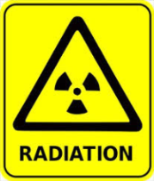
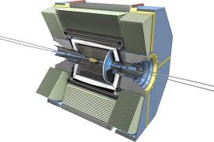
High-Speed Serial Links
3-5 Gbps
1000-10000
fibers
Other PADs)
Other PADs)
On-detector
Electronics
Read-out
Electronics
100-200 m
Particle Detector
Links for Trigger and Data Acquisition (TDAQ) systems of
  High-Energy Physics experiments, very harsh radiation environments
  but also other radiation environments (particle accelerators control, avionics, space, nuclear power plants & waste monitoring)
Based on off-the-shelf components: technology-independent Links, for a longer life cycle
Notes:
La ricerca si inquadra nel contesto dei sistemi di acquisizione dati per esperimenti di Fisica delle Alte Energie. In questi esperimenti abbiamo

Slide 5
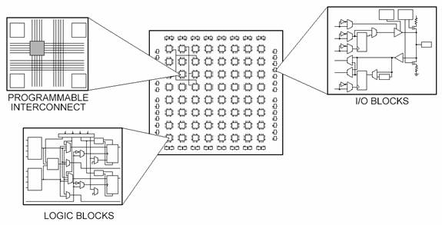
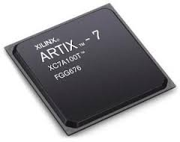
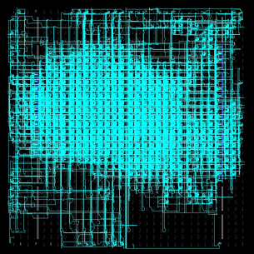

Field Programmable Gate Arrays
Regular array of (re)configurable logic blocks and interconnect
Functionality defined by configuration memory, it is the DNA of the implemented circuit
Powerful, very widely adopted in industrial and scientific applications (HEP, Nuclear physics and so on…)
configuration
10⁸⁻⁹ bits
010010101010100100001101010101010000001000000000000000000000000000…
0000000000000100101010101001000011010101010100000010000000000000000000000000000000000000…
0001001010101010010000
11010101010100000010000000000000000000000000
Implemented
design
configuration memory
Notes:
(mostly) regular array of programmable logic blocks (FF, LUTs) and interconnect
Lower performance than ASICs, lower resources density, less freedom but
(Re)configurable to realize desired function
for low # of devices Implementation much cheaper than ASIC (just buy the device and program it)
Simpler design flow
Very widely adopted in scientific applications (HEP, Nuclear physics and so on…)
But rarely on-detector due radiation issues
Configuration bits control resources, modifying one of them alters the implemented circuit

Slide 6
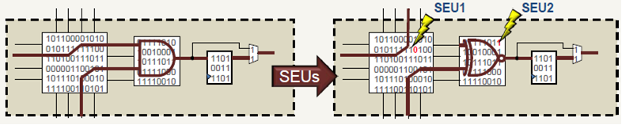
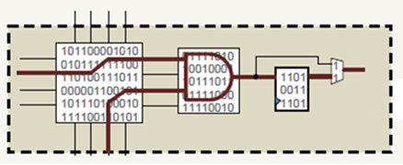


SRAM-based FPGAs and Radiation
SRAM-based FPGAs are the most power powerful and the most used but
  Radiation might induce single event upsets (SEUs) in the configuration => alteration of functionality
Radiation mitigation possible by scrubbing configuration memory
  Error correcting codes: add redundant configuration bits, correct 0.1% errors
  External radiation hardened memory
Notes:
A bit-flip in the configuration memory can change design functionality, until device is reconfigured
Radiation mitigation possible on (at least) two levels
Logical => Triple Modular Redundancy (lower the failure probability of each module, requires scrubbing)
Layout => Placement and routing hardening (reduce sensitive bits, avoid MCUs generating DCEs)
We aim at measuring the direct effect of TMR & placement hardening on our link architecture => several version of the link firmware (w and w/out TMR, with different placement hardening schemes)

Slide 7
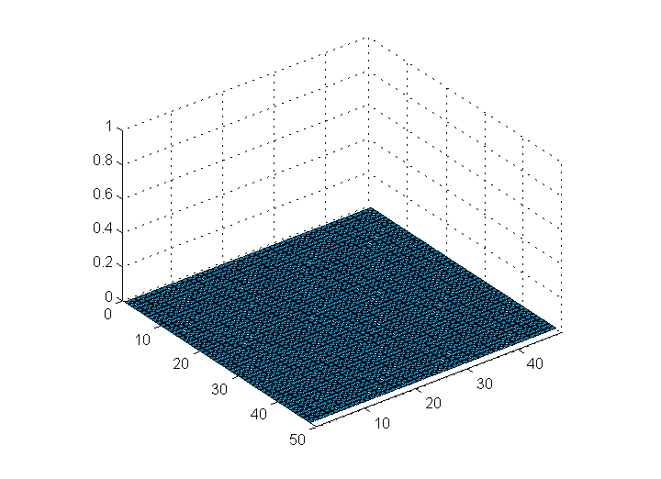
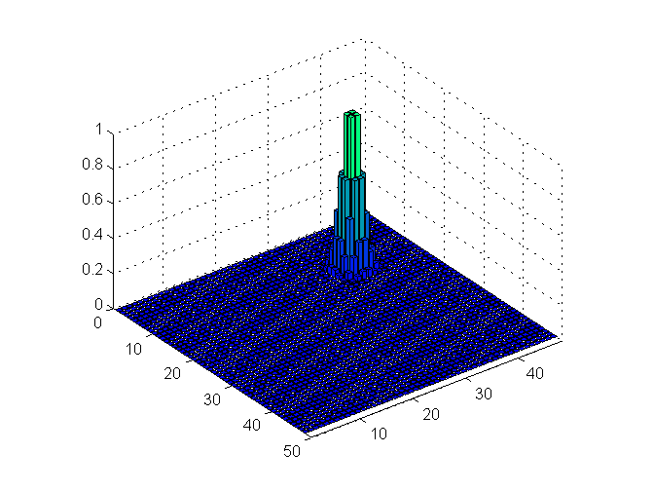
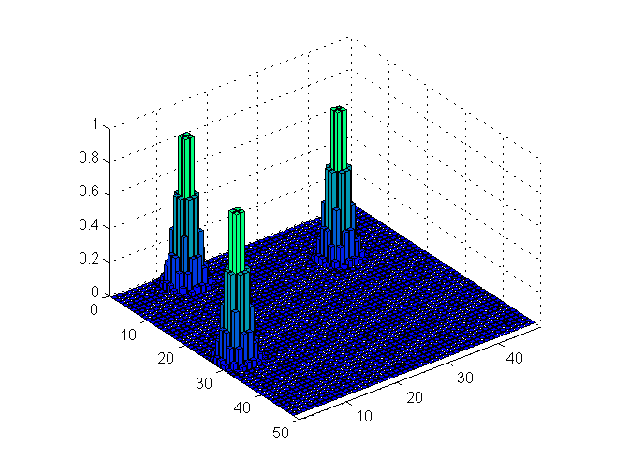
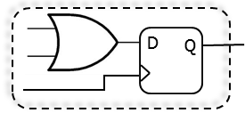

ROAL Key Ideas (1)
Assigned circuit
There is no such thing as a free lunch
Generation of replicas
Emtpy device,
unconfigured bits
Conf. Frame [A.U.]
Finding compatible
memory spots
is challenging
Need for novel software tools to implement it
Memory Row
Memory Column

Slide 8
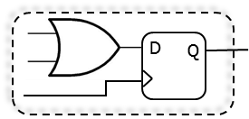
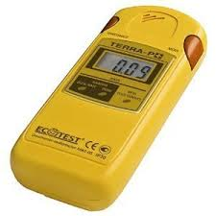


ROAL Key Ideas (2)
FPGAs normally considered «just» digital logic devices, with disadvantages wrt radiation
In the ROAL approach, they are at the same time
  storage resources
  dosimeters
  robust SEU-tolerant, self-correcting (up to 100%) devices
  of course also a logic device
100%
Main goal: high-speed self-repairing links
Notes:
Sfruttiamo la riconfigurabilita’

Slide 9



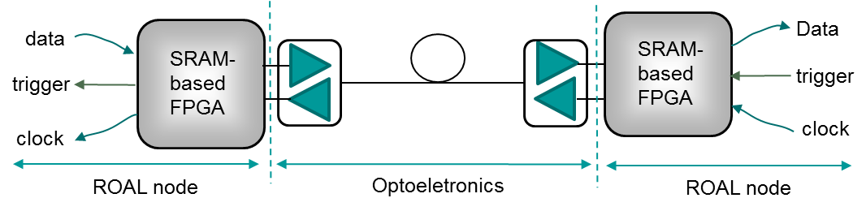
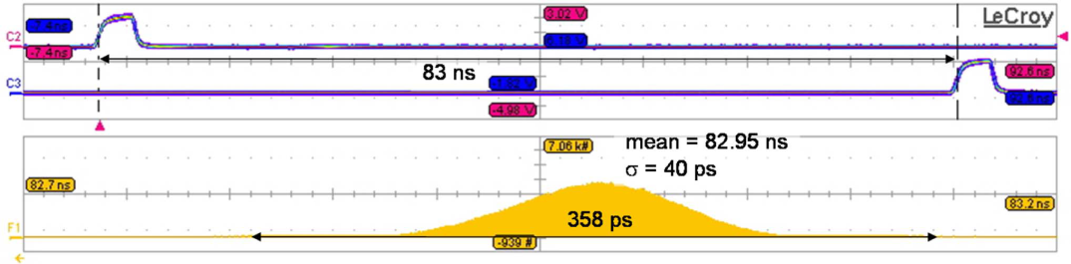
High-speed Self-Repairing and Adaptive Links
5-13 Gbps
Transmission protected by
Adaptive Forward Error Correction
3. Deterministic latency
2. Very low jitter
Goal: <1 ns latency variation
Eye Diagram @ 5 Gbps
at the receiver,
Goal:
clock rms jitter < 20ps
4. Technology independence

Slide 10


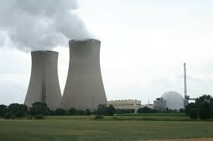
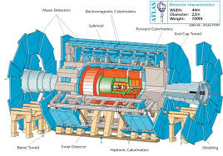

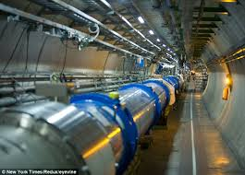
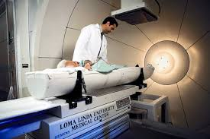
Potential Applications
Space
Avionics
Nuclear Sites:
Research and Power Plants
High Energy Physics
& Nuclear Physics
Nuclear waste monitoring
Homeland security
Particle Accelerators
Proton Therapy
Notes:
Telecomunnication, do not forget CPRI
Synchronization IEEE1588

Slide 11
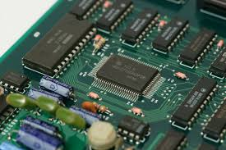


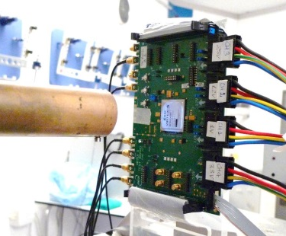

Tools and Methods
  Hardware design
    Self-repair controller
    High-speed link prototype w/ deterministic timing
  Software development
    redundancy generator;
    tools for soft-error injection and bench testing
    data analysis for bench and irradiation testing
  SEE Irradiation testing
    protons, neutrons
  Direct test in HEP experiments
  Open Hardware Approach
    Useful for science but also for industry

Slide 12
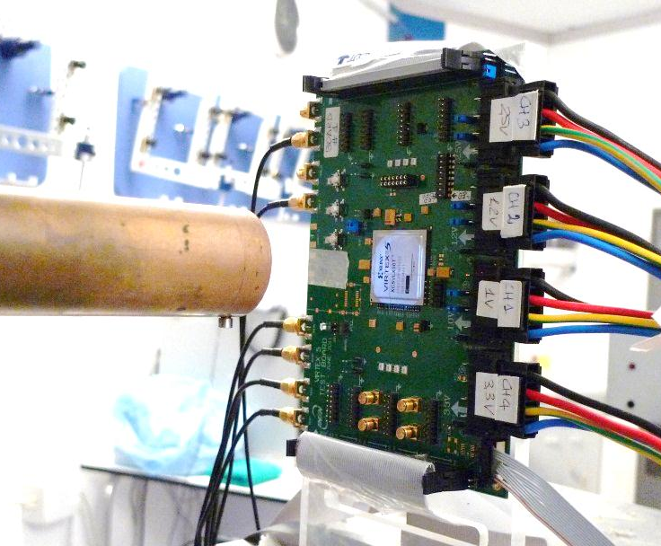
Beam Testing
Testing at INFN Laboratori Nazionali del Sud (Catania, Italy), 62-MeV protons
Provides part of the beam tests needed by ROAL
  effectiveness of self-repair method
  possible impact of radiation over the link performance
  measure the mean time to recovery (MTTR) after SEU-induced failures of the link
Custom
DUT board
Beam
collimator
First test scheduled in
Oct. 2016

Slide 13

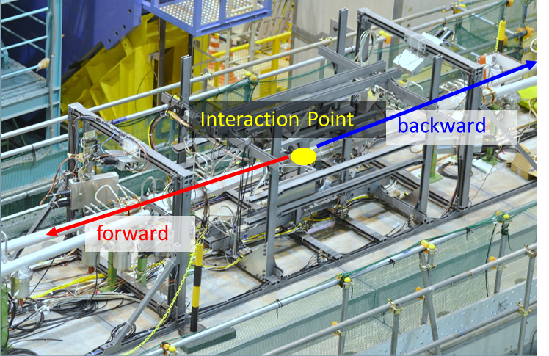
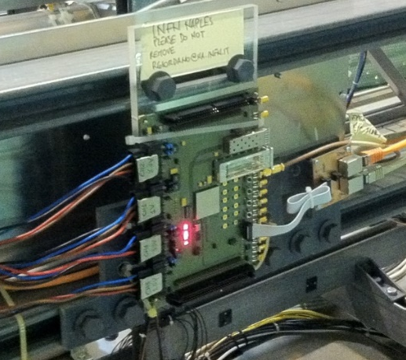


ROAL@Belle2
BEAST
frame
Installed a FPGA-based board at SuperKEKB e+e- collider interaction region, KEK (Tsukuba, Japan) (L= 8 ×10³⁵ cm⁻² s⁻¹, LER 4GeV, HER 7 GeV)
X
Hosted by the BEAST2 experiment for studying machine backgrounds prior to Belle2 roll in (see C. La Licata talk)
Board installed behind He3 tube => neutron rates
Reading back configuration errors
Activity supported w/ JENNIFER secondments

Slide 14
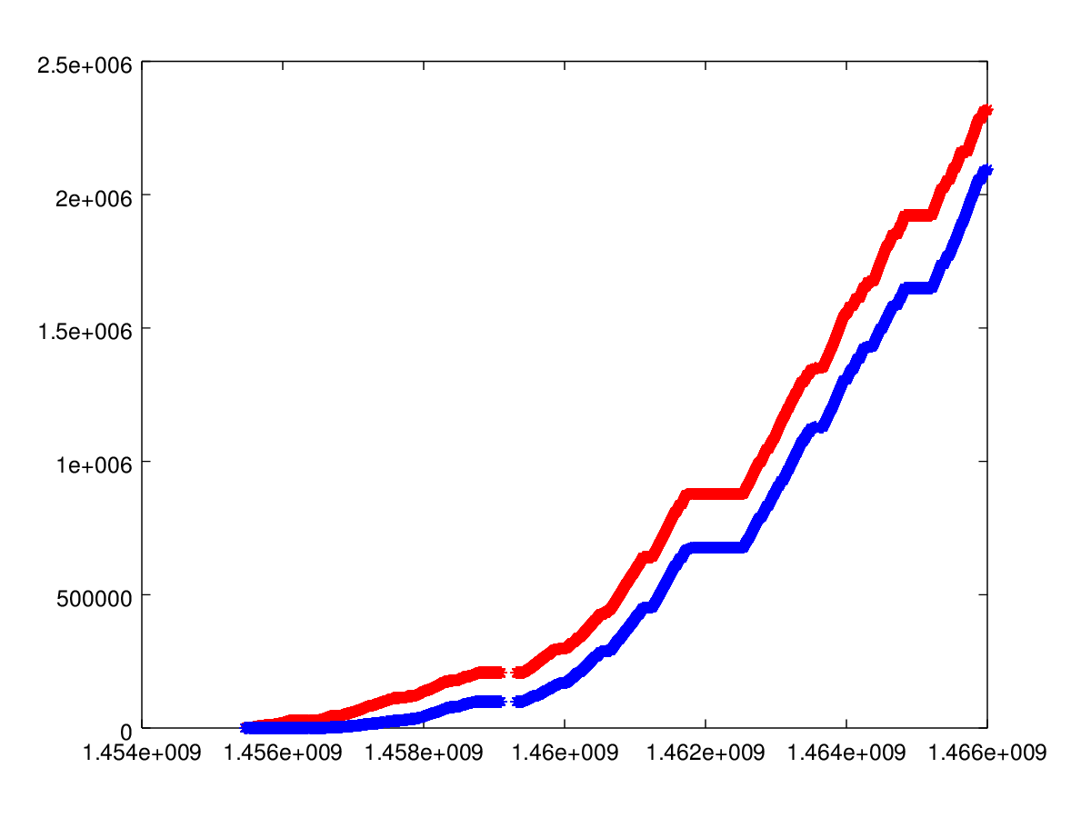
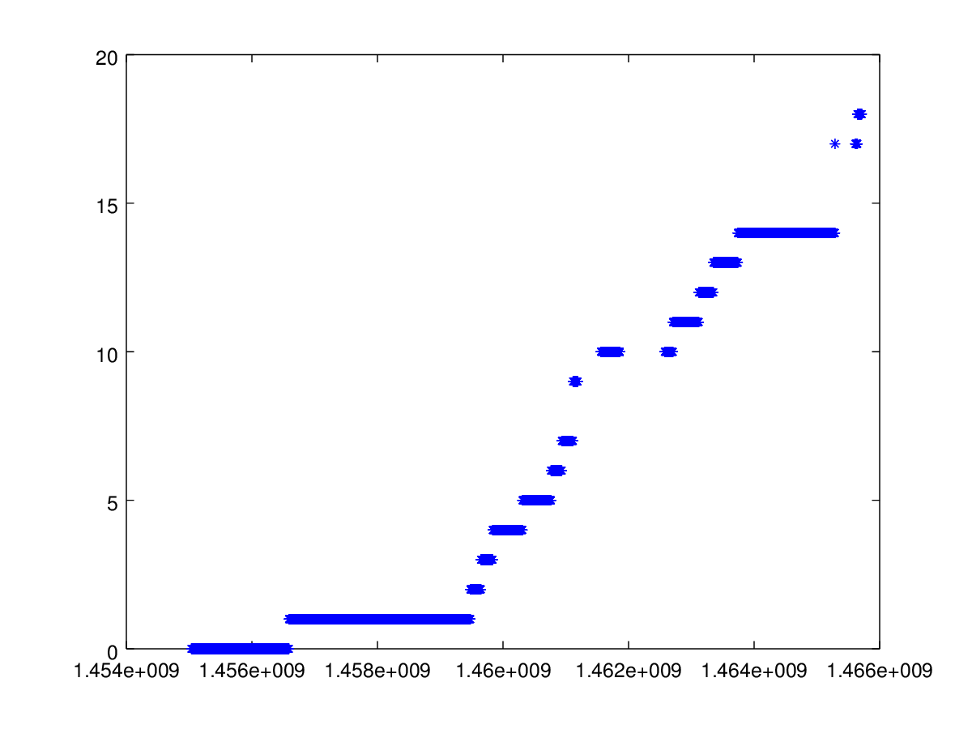
Preliminary Results
During SuperKEKB operation from Feb. 14th to June 11th, 18 configuration errors detected out of 91.5∙10⁶ configuration bits
Integrated beam currents nearly 2.5∙10⁶ C (in 118 days)
Average rate 0.15 SEUs/day (or 1 SEU every 6.7 days)
Negligible variation in currents absorbed by FPGA (< 1mA, i.e. no TID effects)
FPGA is still fully functional, no permanent damage
However currents will increase and beams will be focused, so it would be interesting to continue data taking when that will happen
HER
Integrated Beam Currents (C)
LER
Time (s)
FPGA
# of config errors
Time (s)

Slide 15
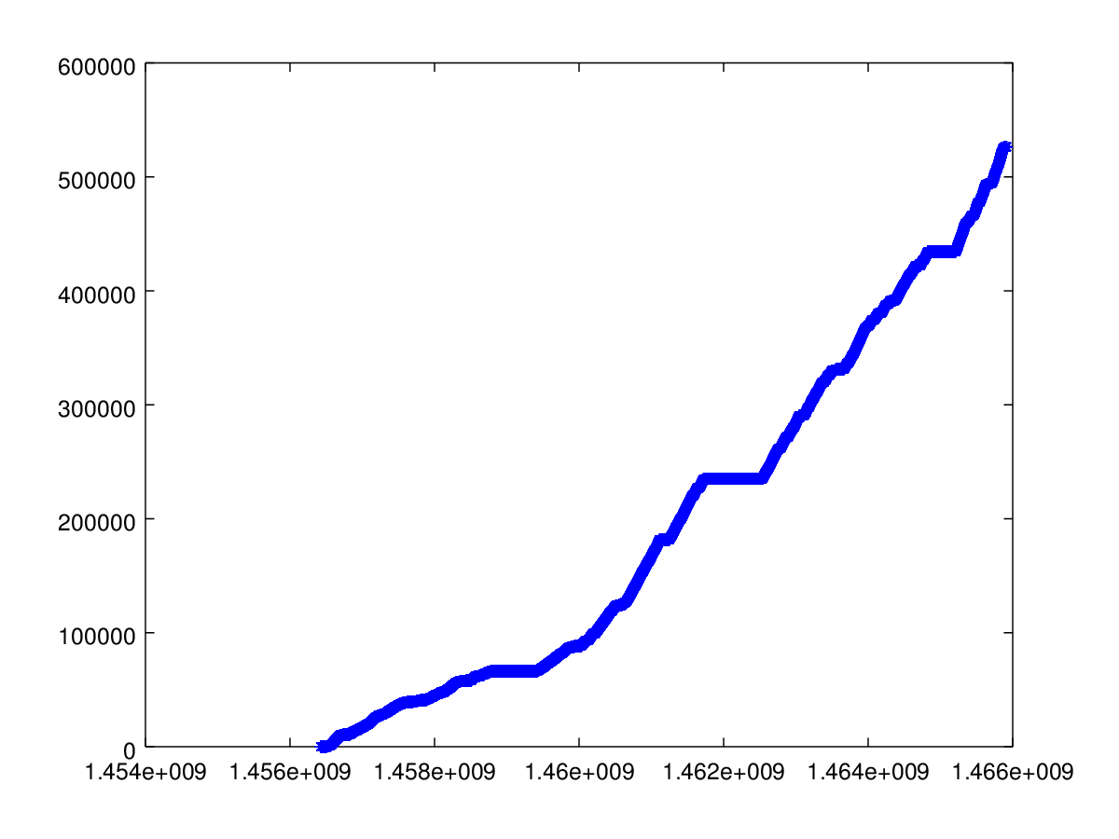
Preliminary Results (2)
SEUs vs He3 Tube Rates
He3 Tube integrated rate follows beam integrated current very well
So does FPGA error count
He3 Tube at φ=0°
Integrated rate (A.U.)
Time (s)
FPGA
# of config errors
Time (s)

Slide 16
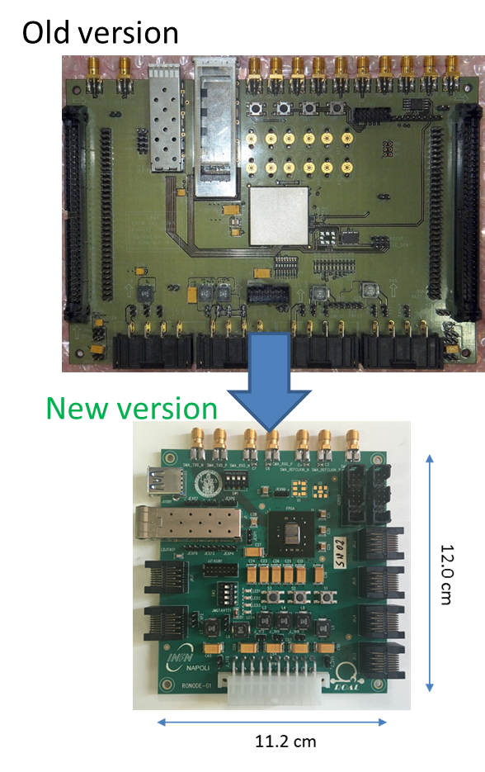
Custom Test Board
New FPGA test board ready
  ROAL link node (RoNode)
Based on Xilinx Kintex-7 70T and passives (no active components other than FPGA)
5 power domains (Core, aux, MGTs, IO 2V5, IO 3V3)
4-wire scheme on power supply for sensing voltages at the load
RJ45 connectors for passive long-haul connection over CAT7 cables (JTAG, RS232 and parallel configuration)
8 units produced
  2 successfully tested
  6 to be tested
JTAG
UART
Power

Slide 17
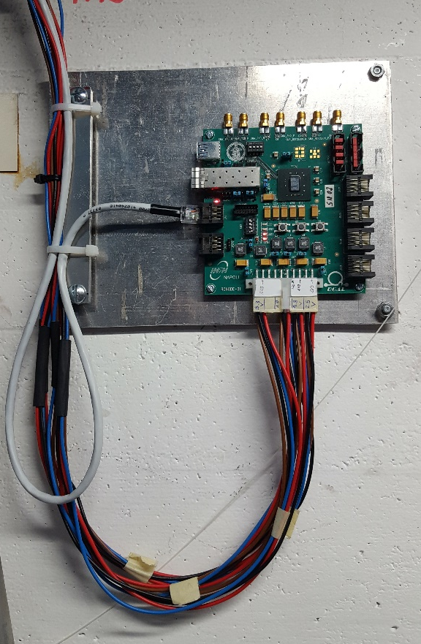
ROAL@ATLAS
Installation in ATLAS cavern completed during last technical stop (Sept. 12 to 16 2016)
Installation of read out eletronics ongoing
  To be completed before the end of the year
100m-long cables from counting room to board
  Passive JTAG readout challenging at this distance

Slide 18
Conclusions
ROAL aims at developing self-repairing and adaptive high-speed serial links based on programmable COTS for TDAQ systems
Possible applications also outside HEP
Novel configuration correction method for SRAM-based FPGAs
Testing at irradiation facilities and at HEP experiments
ROAL has bee funded by MIUR in the framework of the 2014 SIR program (grant no. RBSI14JOUV)

Slide 19
Back-up Slides

Slide 20
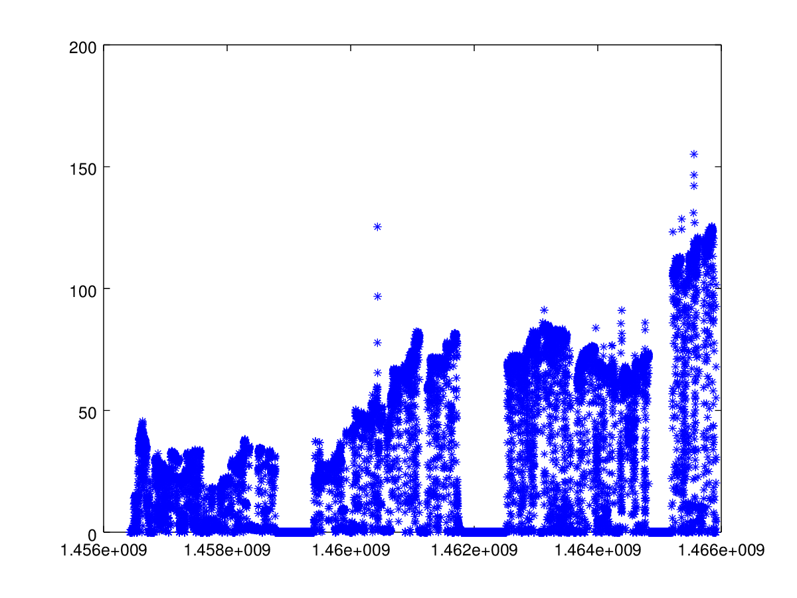
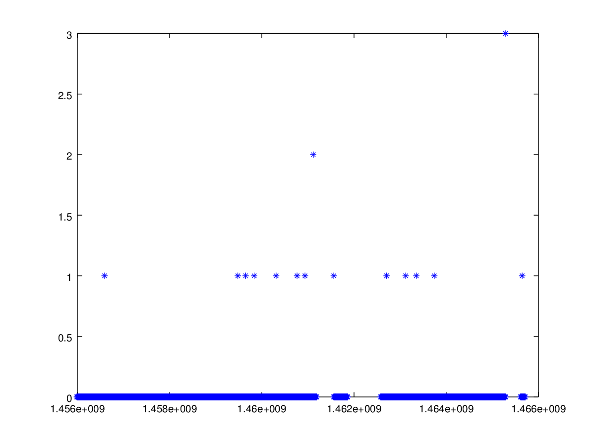
SEUs vs He3 Tube Rates
He3 Tube at φ=0°
He3 Tube at φ=0°
Rate (A.U.)
Integrated rate (A.U.)
Time (s)
Time (s)
FPGA
# of config errors
Time (s)
Time (s)

Slide 21
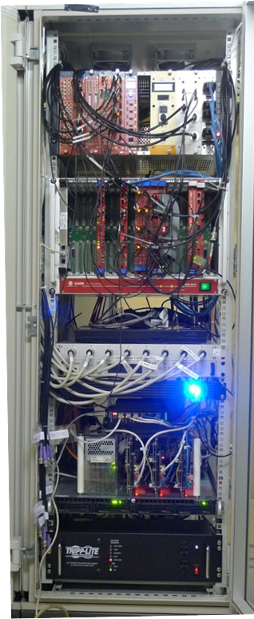
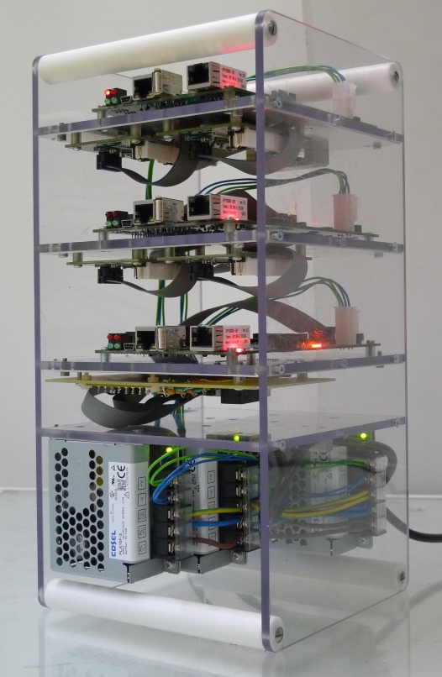
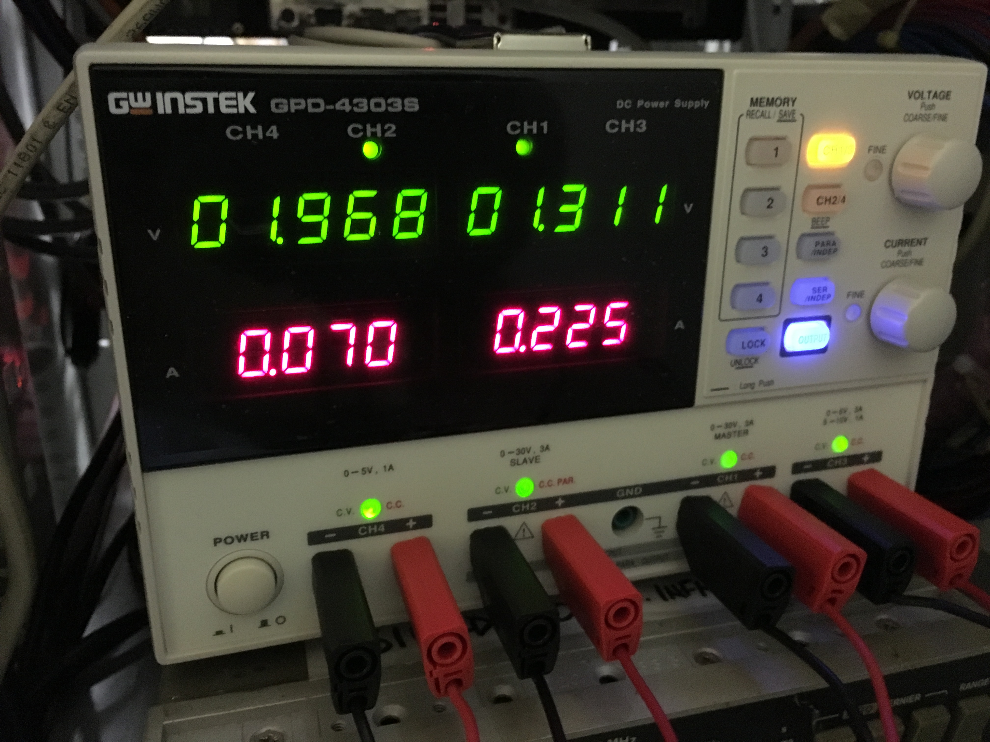
In the DAQ Room
uSOP+ADC(LTC2499) sense remote voltage
Logging of FPGA configuration errors, voltage and current drawn has been running during BEAST phase one
4-channel Power supply and clock generator on the back of the crate
One of the BEAST Racks
uSOP for
FPGA readout
uSOP minicrate
Power &
JTAG
cables
from IP
FPGA Power supply

Slide 22
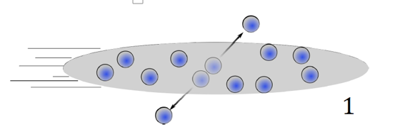
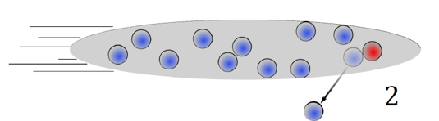
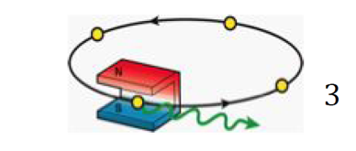
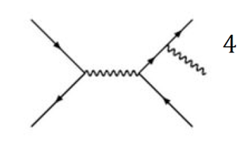
SuperKEKB Beam Backgrounds
Among the technical challenges at Belle2, there are beam backgrounds
In Belle/KEKB, unexpected backgrounds burnt a hole in the beam pipe and damaged inner detectors
Especially dangerous at SuperKEKB:
  Obscure physics processes
  Fake interesting physics signals
  Rejecting fake signals also lowers efficiency
  Temporary damage or faults in electronics, total ionizing dose, single event effects (SEEs)
This is where BEASTII comes in...
Touschek scattering
Beam-gas scattering
Synchroton radiation
Radiative Bhabbha

Slide 23
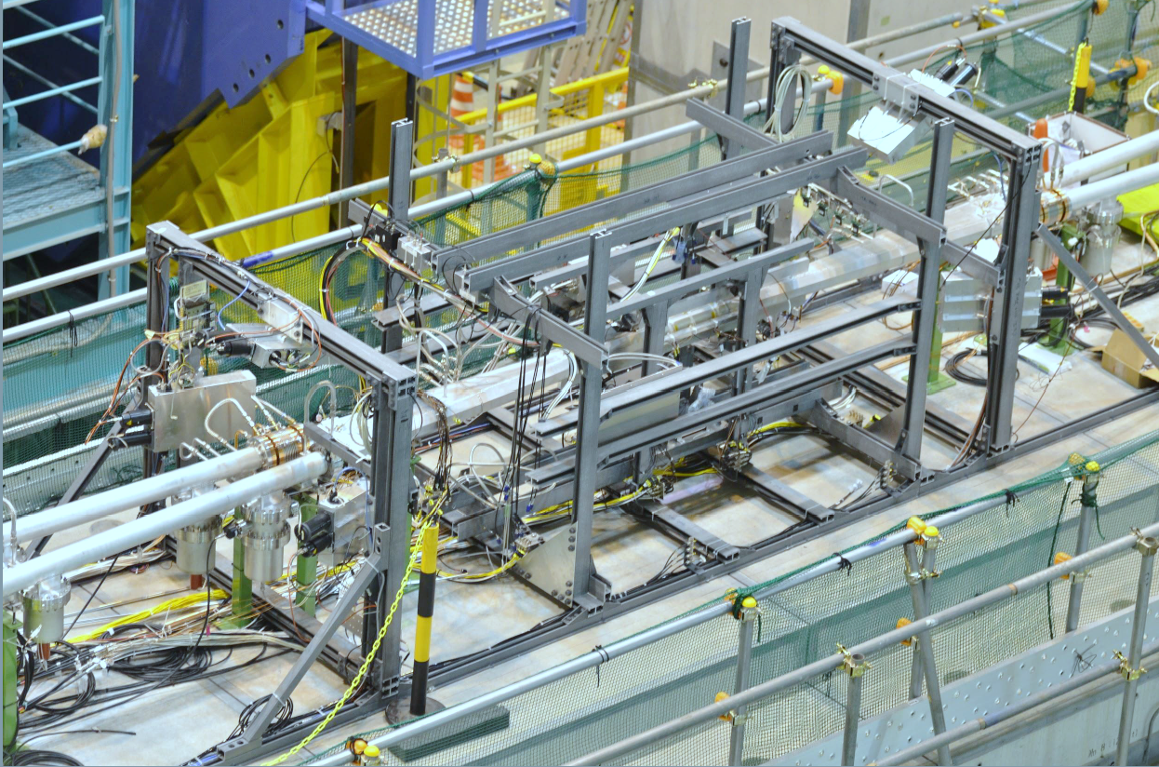
BEAST II Goals
Instrument SuperKEKB before Belle II is rolled in
Measure beam backgrounds where BelleII will operate to:
  Tune simulations in
  Ensure radiation level is safe for detectors
  Identify and shield background “hot spots”
  Test systems that measure radiation levels for feedback to SuperKEKB
Interaction Point
backward
forward
BEASTII fiberglass frame
supporting background detectors
(PIN diodes, TPCs, Diamonds, He3 tubes,
BGO, Calorimeter crystals)

Slide 24
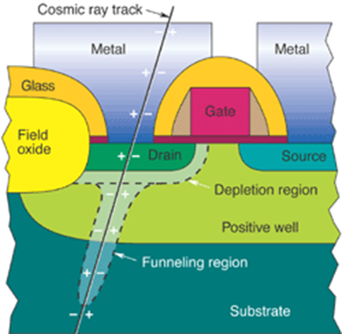
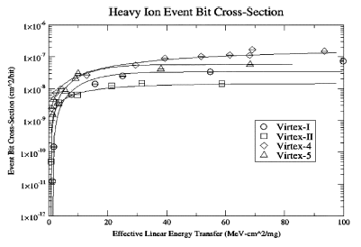
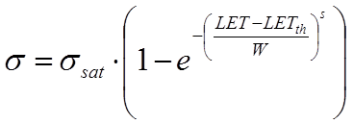
Single Event Upsets (SEUs)
Iozing particle travelling through the device might release charge in depletion regions of junctions
This might change the state of transistors: ON->OFF or OFF->ON
Heavy Ions are used to determine LET threshold for SEEs in devices
  Weibull function fit, determines LET_{th}, W and σ
  For latest generation FPGAs ~ LET_{th} = 0.1-1 MeV cm²/mg
MBUs > 10% for
LET>20 MeV·cm²/mg

Slide 25
Configuration Memory Error Results
Accumulation of bit-flips into configuration memory, FPGA working like a «dosimeter»
Cross section for p @ 62MeV
  Our measurement
      σ = 3,5⋅10⁻¹⁴ cm²/bit
  From literature
      σ = 6.4⋅10⁻¹⁴ cm²/bit
# of Config Errors
Irradiation
Stopped @
71 Gy (Si)
Time (s)
Experienced a few SEFIs, a SEU causes failure of read-back circuitry
Configuration is correct but is read-back incorrectly
1 SEU generates many (thousands) apparent configuration errors
SEFI causes ‘jump’
of config errors
# of Config Errors
9225
errors
Time (s)

Slide 26
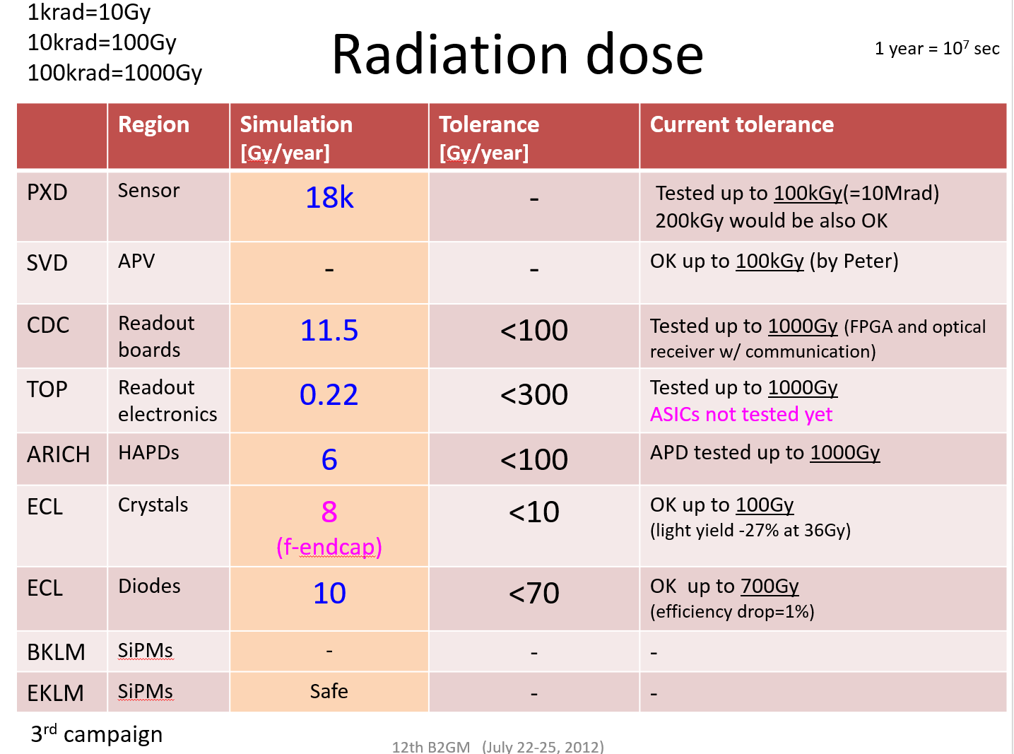
From. Hiroyuki NAKAYAMA (KEK) Talk at 12th B2GM

Slide 27
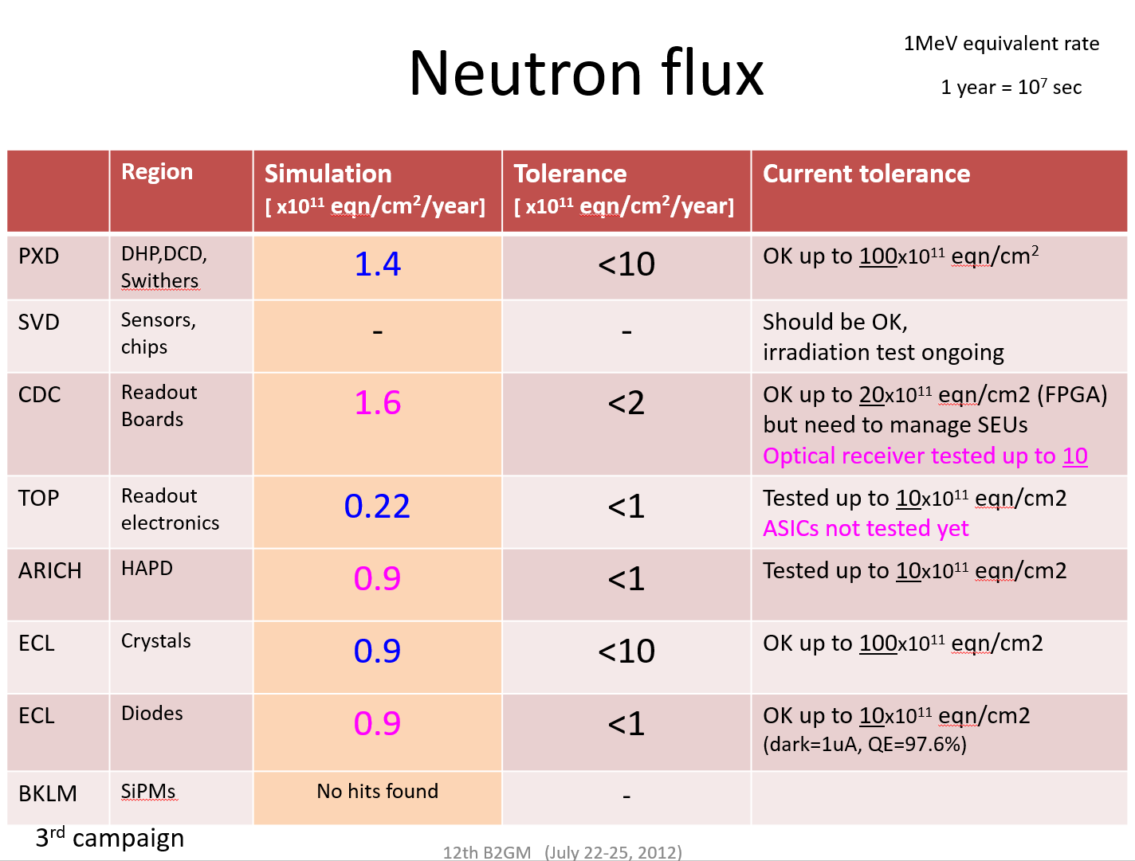
From. Hiroyuki NAKAYAMA (KEK) Talk at 12th B2GM

Slide 28
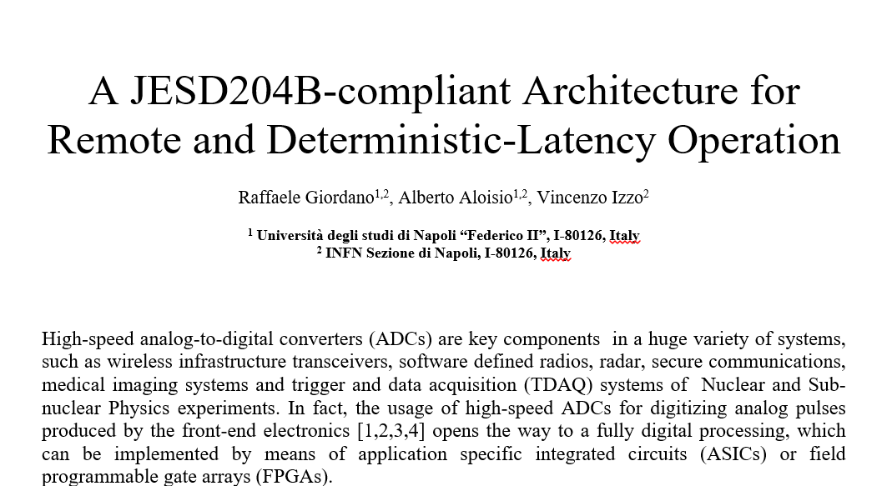
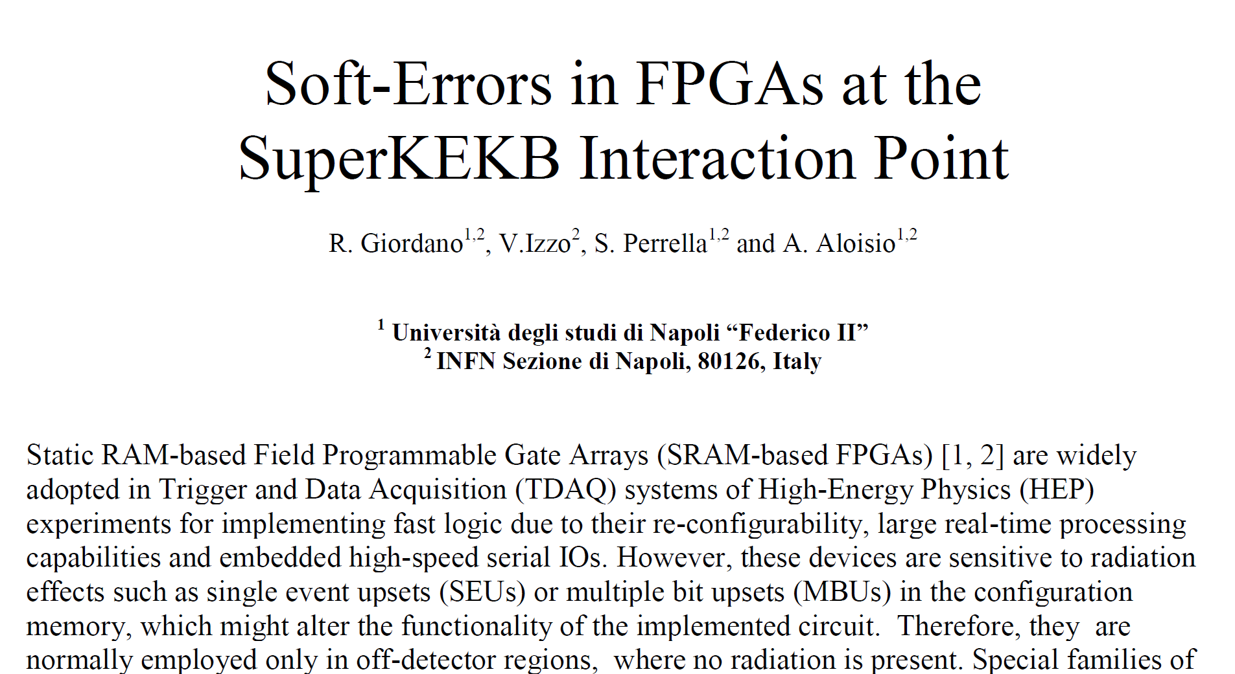
Publication Outcome
Papers
  R. Giordano et. al., “Layout and Radiation Tolerance Issues in High-Speed Links,” IEEE Trans. On Nucl. Sci., Vol. 62, no. 6, Dec. 2015
  R. Giordano et. al., “A JESD204B-compliant Architecture for Remote and Deterministic-Latency Operation,” submitted to IEEE TNS Jul. 2016
Conference Contributions
  Talk at IEEE RT2016, (Padova Italy, Jun. 5th-10th)
    R. Giordano et. al., “A JESD204B-compliant Architecture for Remote and Deterministic-Latency Operation”
  Mini-oral and poster at IEEE NSS 2016 (Strasbourg, France, Oct. 29th – Nov. 6th)
    R. Giordano et. al., “Soft-Errors in FPGAs at the SuperKEKB Interaction Point”

