Slide 1


Fast Luminosity Monitoring
Cécile Rimbault, LAL-IN2P3/CNRS
JENNIFER Mid-Term Review
23 September 2016 , Queen Mary Univ., London
EU grant n.644294

Slide 2
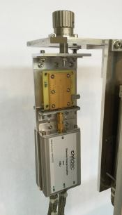
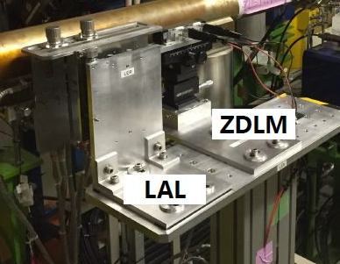
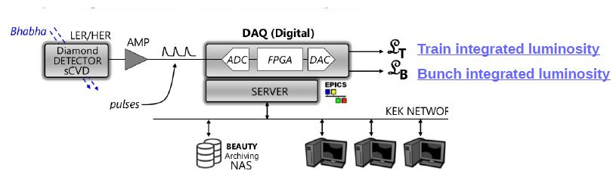

Fast Luminosity Monitoring
Goal: Realization of a fast lumi monitor based on radiative Bhabha scattering at low angle measurement with diamond sensors for SuperKEKB luminosity feedback and backgrounds study (BEAST).
  Aimed precision: δL/L ~ 10 ⁻² to 10⁻³ in 1 to 10ms
  Fast signal : Lumi monitoring for each bunch crossing: 2500 bunches/train, collisions every 4 ns
Setup: 2 sets of 2 ~5x5 mm² diamond sensors
coupled to fast charge amplifiers,
positioned outside of the beam pipe
Collaboration with ZDLM group @ KEK
(Cerenkov detector + scintillator)
Locations :
- In High Energy Electron Ring : 30m downstream the Interaction Point for Bhabha photon detection
- In Low Energy Positron Ring : 11.9m from IP for Bhabha scattered positron detection
DAQ : ADC+FPGA+DAC
synchronised to SuperKEKB RF

Slide 3
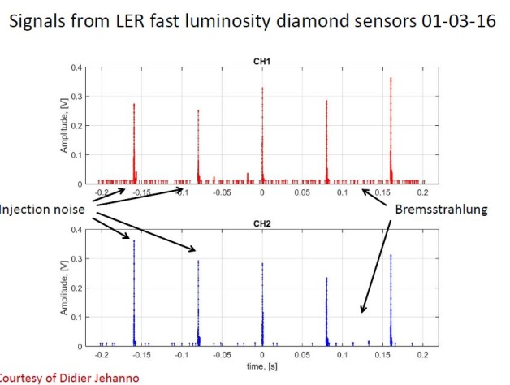
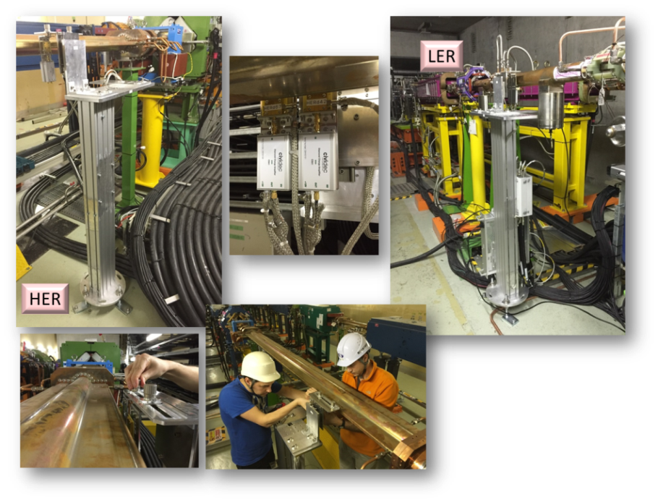
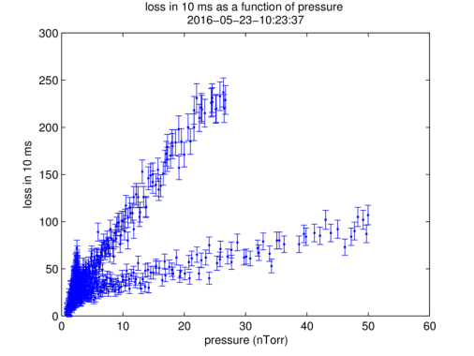
Fast Luminosity Monitoring: Highlights and status
Automn 2015: Installation of LAL made pillars and sCVD diamond sensors on SuperKEKB Rings
February 2016: Installation of LAL Rack in Electronic Hut
02/2016➔06/2016: Phase 1 of SuperKEKB commissioning
  Single beam background measurements (bremsstrahlung + Touschek) with sCVD in HER & LER with oscillo
  Developments of scripts and GUI for real time data taking and processing/post processing analysis
  Tests and improvement of LAL Diamond sensors
  LER background analysis / comparison with simulations
EU grant n.644294

Slide 4
Fast Luminosity Monitoring - Schedule for next years
07/2016-10/2017:
- Finalization LER background phase1 data analysis
- DAQ for the phase II of SuperKEKB commissioning (11/2017):
2 choices are studied, choice will be fixed at end of fall 2016
- HER phase 1 data analysis.
- R&D Diamond sensors miniaturized packaging @ LAL
- adaptation of existing pillar in LER for phase-II (to fit with vacuum chamber modification)
11/2017-03/2018: tests during phase II of SuperKEKB commissioning
- Bhabha acquisition and first luminosity measurement tests
- Single beam background characterization
- Integration CVD DAQ to the SuperKEKB feedback system
- optimization of choice for final sensors (500um/140um sCVD) and ampli (Charge/current) (TIL/BIL)
10/2018: Phase III = first Belle-II runs
- Operating fast lumi monitoring system for SuperKEKB feedback
- New single beam and beam-beam background characterization
- Non linear phenomena measurements occurring with small beam size beam-beam interaction
EU grant n.644294

Slide 5
Fast Luminosity Monitoring : Secondments
Number of asked secondments: 15
Used secondments: 11
Dima El Kechen – PhD student : +5 months
- June 2015: background simulation tool learning and improvement (Work with KEK researcher who made the code )
- Feb-june 2016: Phase 1 data acquisition with diamond sensors
Participation to SuperKEKB commissioning: Great opportunity to be formed on machine tuning
Collaboration with BEAST-II group on background study and analysis
Didier Jehanno – elec. Eng., DAQ : +5 months
Luminosity monitor installation (cables+pillars+Rack in Ehut), readout synchronisation, phase1 data acquisition, development of scripts and GUI for data taking and processing…
Viacheslav Kubytskyi – Post-doc: 1 month
Diamond sensors installation and tests, development of scripts and GUI for data taking and processing, LAL made diamond sensor tests…
Started secondments: 3
Yann Peinaud – mech. eng.
Philip Bambade- researcher
Cécile Rimbault-researcher
EU grant n.644294

Slide 6
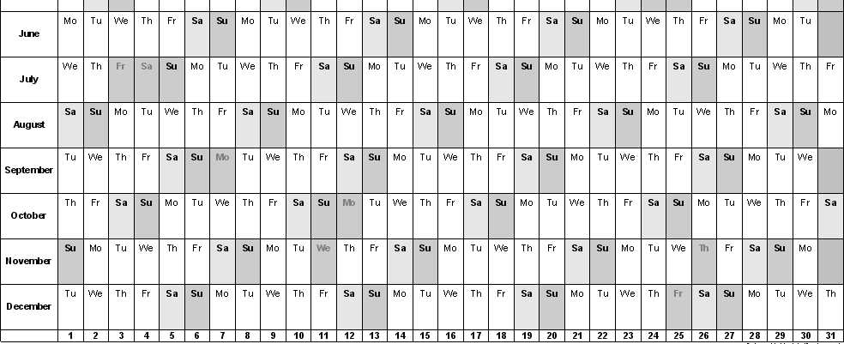
Fast Luminosity Monitoring : Secondments declaration 2015
Dima El Kechen – PhD student
Didier Jehanno – elec. Eng., DAQ
Viacheslav Kubytskyi – Post-doc
Yann Peinaud – mech. eng.
Philip Bambade- researcher
Cécile Rimbault-researcher
2015
EU grant n.644294

Slide 7
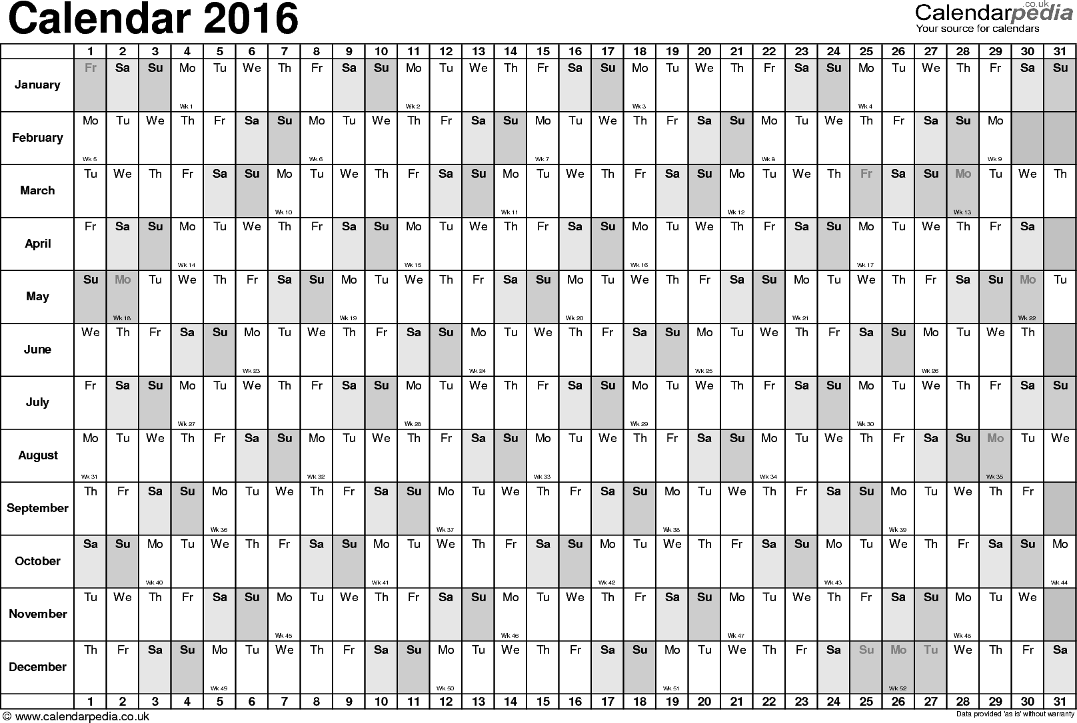
Fast Luminosity Monitoring : Secondments declaration 2016
Dima El Kechen – PhD student
Didier Jehanno – elec. Eng., DAQ
Viacheslav Kubytskyi – Post-doc
Yann Peinaud – mech. eng.
Philip Bambade- researcher
Cécile Rimbault-researcher
2016
EU grant n.644294

