Slide 1
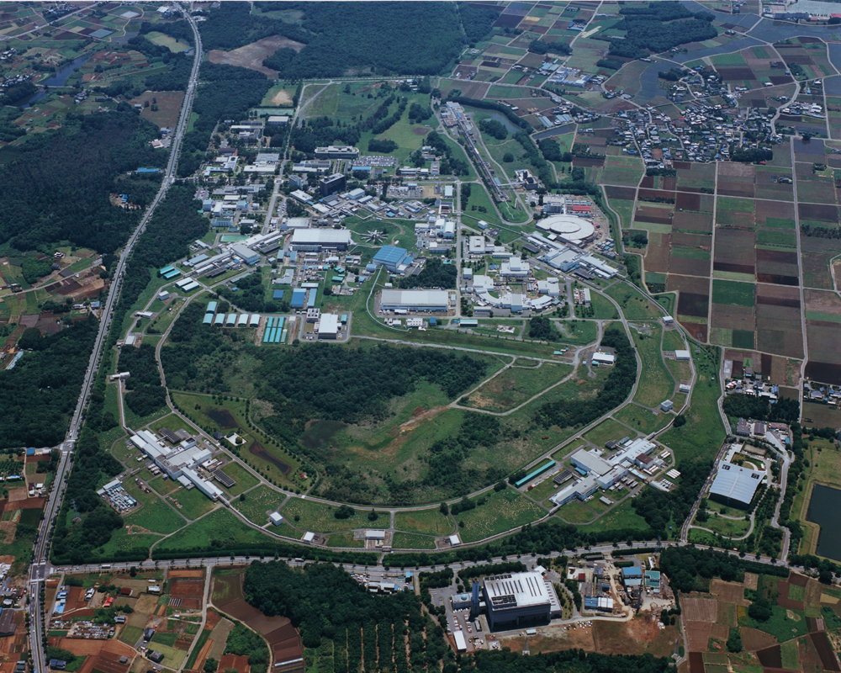
Report on WP2 Activities
Outline:
SuperKEB & Belle II
- how to reach 40x more luminosity
- upgrade of the Belle detector to cope with 40x more luminosity
Jennifer WP2: tasks and deliverables
WP 2.1. Forward electromagnetic calorimeter (Claudia Cecchi)
WP 2.2. Tracking
WP 2.3. Particle ID (Rok Pestotnik.)
WP 2.4. Luminosity monitors (Cecile Rimbaud)
WP2: CDC, PXD, SVD: status & deliverables
Conclusions

Slide 2
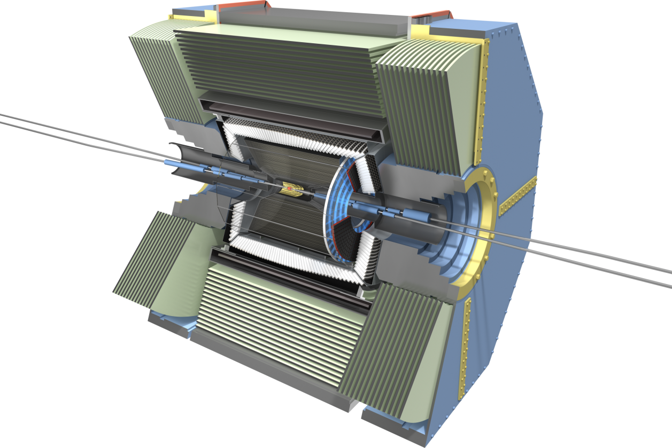

Flavour Physics
Belle II experiment at SuperKEKB
Tsukuba, Japan
Upgrade of KEKB, 40x luminosity: 8 x 10³⁵ cm⁻²s⁻¹
First beam: February 2016
First Physics: End of 2018
Nano Beams: 10µm x 60nm
Increase beam current (x2)
Reduce asymmetry (boost)
KEB:
βγ = 0.42 (8 GeV, 3.5 GeV)
SuperKEKB:
βγ = 0.28 (7 GeV, 4 GeV)
Belle II Collaboration: 100 Institutions, ~600 physicists
Major upgrade of Belle
Groups supported by Jennifer make important contributions to
The Belle II upgrade

Slide 3
Requirements for the Belle II detector
Critical issues at L= 8 x 10³⁵/cm²/sec
4 Higher background ( ×10-20)
4 Higher event rate ( ×10)
4 Special features required
radiation damage and occupancy
fake hits and pile-up noise in the EM Calorimeter
- higher rate trigger, DAQ and computing
- γβ reduced by a factor of 2: compensated by improved vertexing
Result: significant upgrade

Slide 4

Belle II
7.4 m
CsI(Tl) EM calorimeter:
pure CsI
for end-caps
2 layers PXD (DEPFET),
4 layers DSSD
8.0 m
Time-of-Propagation counter
(barrel),
prox. focusing Aerogel RICH
(forward)
Central Drift Chamber:
smaller cell size,
long lever arm

Slide 5
WP2 Tasks and Deliverables
WP2 - Belle-II detector construction and test [Months: 1-48]
Task 2.1: Forward Electromagnetic Calorimeter [INFN, KEK] (C. Cecchi)
Task 2.2: Tracking detectors [DESY, HEPHY, INFN, METU, IFJ, UKP, KEK]
Task 2.3: Particle Identification [INFN, JSI, KEK] (C. Rimbault)
Task 2.4: Luminosity monitor [CNRS, KEK] (R. Pestotnik)
Number Deliverable Lead beneficiary Due Date New
D2.1 FW ECL TDR 1 INFN (10) Jan 2016 (24) March 2017
D2.2 Commissioning Report FW ECL INFN (48) Mar 2019
D2.3 CDC commissioning METU (14) May 2016 (26) May 2017
D2.4 PXD White-book 2 DESY (20) Nov 2016
D2.5 SVD+PXD full commissioning DESY (30) Sep 2017 (49) Sep 2018
D2.6 TOP commissioning INFN (36) Mar 2018
D2.7 ARICH JSI (26) May 2017
D2.8 Diamond sensor CNRS (36) Mar 2018
WP2: 227 months of secondments (~20 FTE)

Slide 6
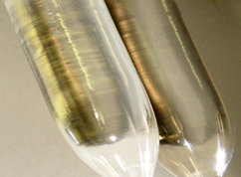
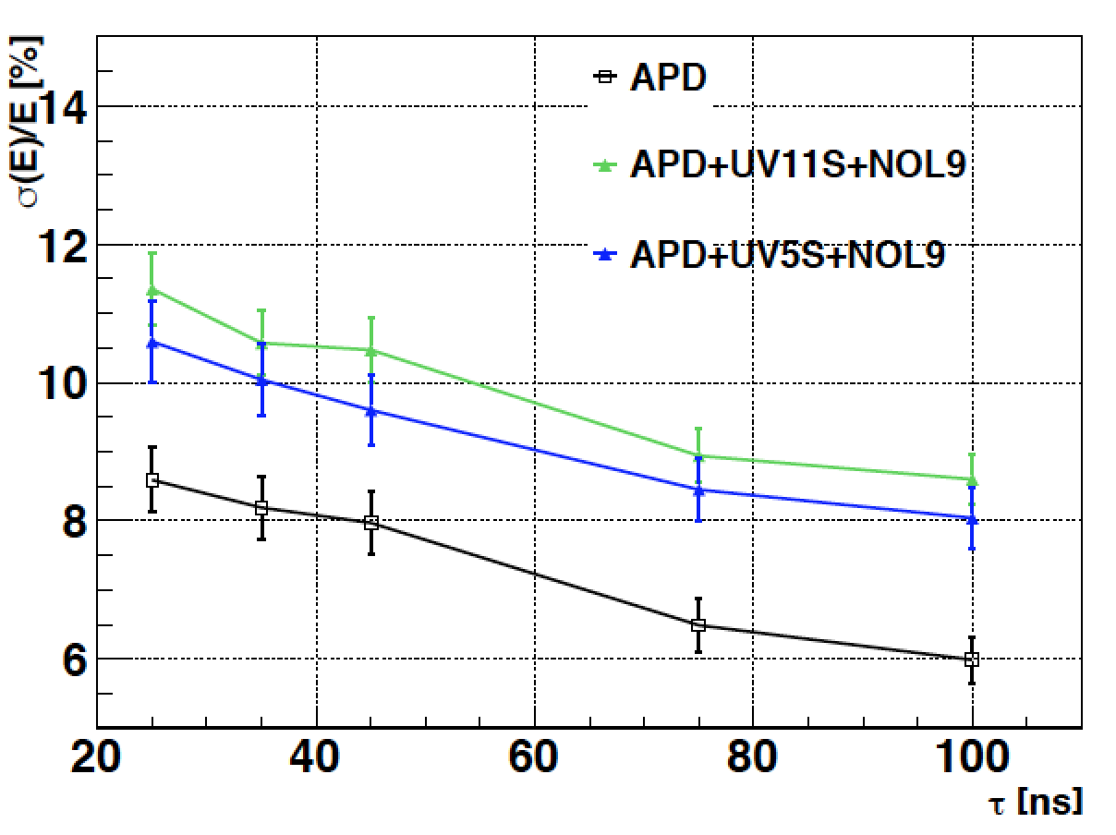
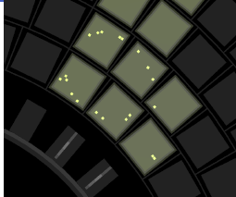
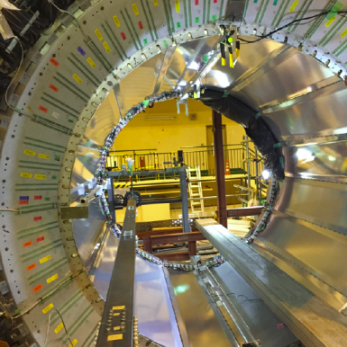
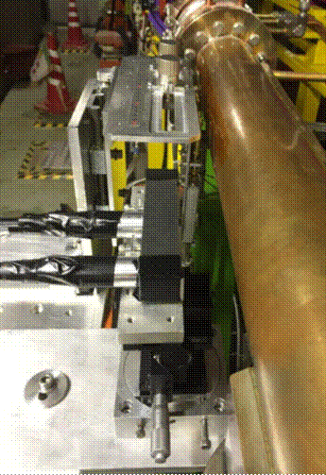
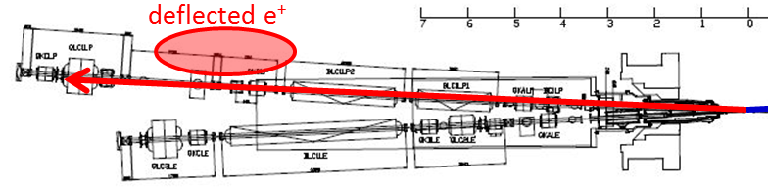
WP2 Subtasks
2.1
Forward Electromagnetic Calorimeter
Use pure CsI with fast emission (30ns) to avoid pickup
Use filter to eliminate slow component and wavelength shifter to match to APD
2.3
Particle
Identification
ARICH (Aerogel Ring Imaging Cherenkov) and TOP (Time of propagation) for K/π separation based on detection of Cherenkov light
2.4
Luminosity Monitor
Using 5x5 mm² diamond sensors the SuperKEKB luminosity will be measured with 10⁻² to 10⁻³ precision (radiative Bhabha scattering)

Slide 7
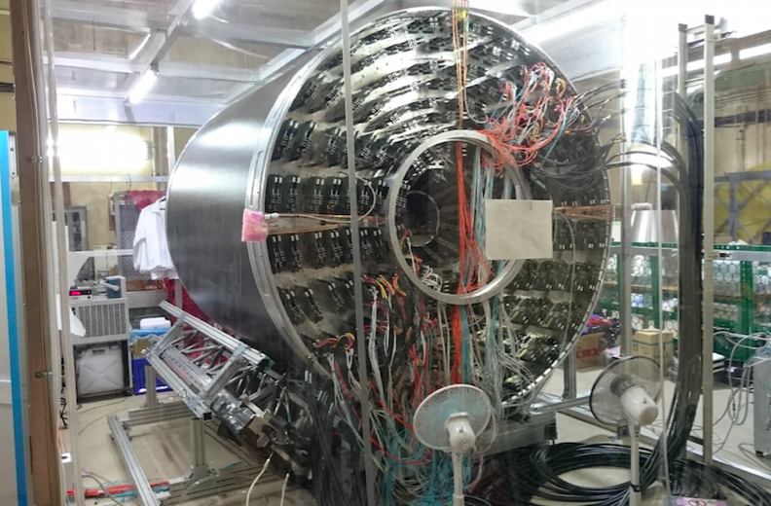
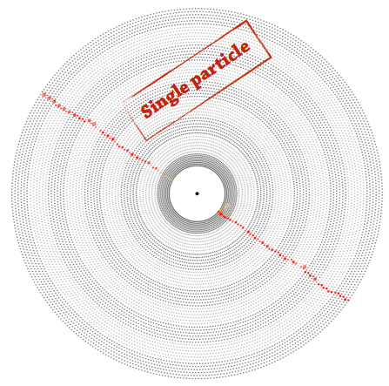
WP2 Tracking Detectors: CDC
The new drift chamber has a smaller cell size (1-20mm => 6-9 mm, 51456 wires)
Completed and partially tested with cosmic rays
Installation in Belle II in October 2016
First tests with magnetic filed in spring 2017 (consequently D2.3 delayed from month 14 to month ~26
End of 2017 first real data with superKEKB (phase II)
Jennifer particpant: METU (Ankara):
6 months of secondments starting spring 2017
6 months of secondments starting summer 2018

Slide 8
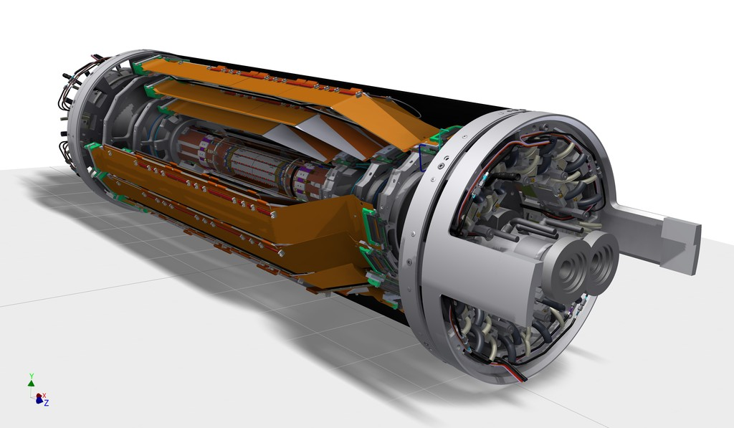
WP2 Tracking Detectors: Silicon
(SVD & PXD: VXD)
Outer CF shell
End flange
PXD+SVD
σ [µm]
100
Belle
End rings
50
30μm
SVD Ladders
20
Belle II
15μm
PXD
Beam pipe
0
0.4
0.8
1.2
1.6
2.0
pβsin(θ) [GeV/c]
SVD: 4 layer Si strip detector (DSSD)
(R = 3.8, 8.0, 11.5, 14.0 cm)
Significant improvement in z-vertex resolution
PXD: 2 layer Si pixel detector (DEPFET technology)
(R = 1.4, 2.2 cm)
+ enviromental and radiation monitor & interlock

Slide 9
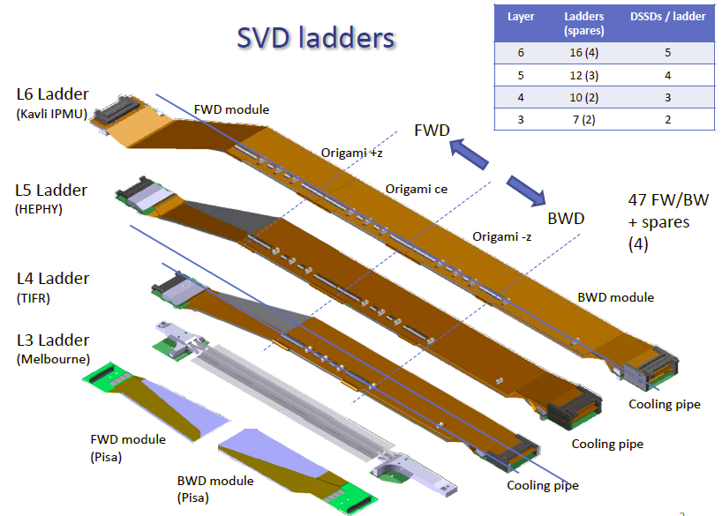
Silicon Vertex Detector (SVD)
Ladder production is ongoing
FWD: 100% (Pisa)
BWD: 85% (PISA)
L3: 5/9 (Melbourne)
L4: 3/12 (TIFR)
L5: 4/15 (HEPHY)
L6: 3/20 (IPMU)
Ladder production completed:
November 2017
Beam Test at DESY in April 2016
Sector Test at superKEKB
(Beast II): end of 2017
Integration with PXD (=> VXD)
End of 2017
Installation of completed VXD
Spring 2018

Slide 10
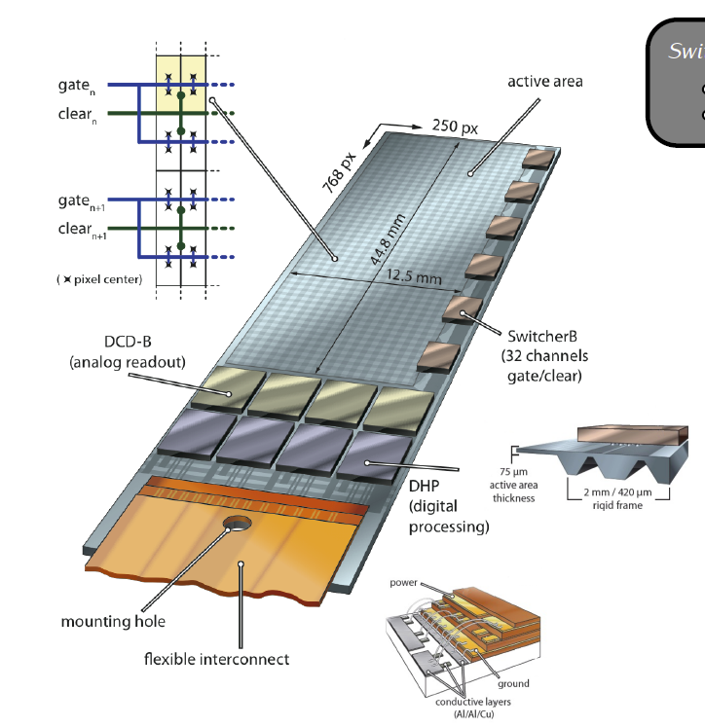
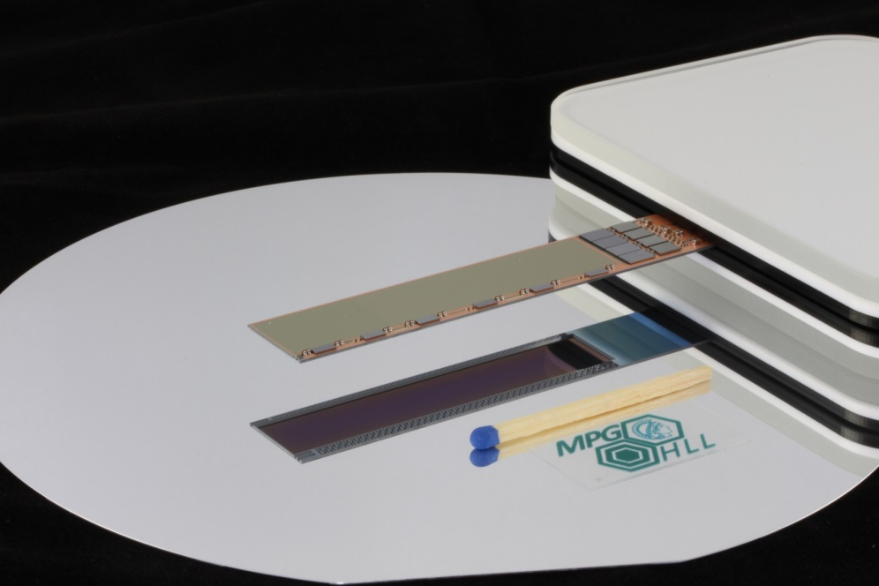
Pixel Detector (PXD)
DEPFET technology (MPP/HLL) Each pixel is a p-channel FET on a completely depleted bulk
Low capacitance, internal amplification: => low noise
Sensitive area thinned to 75 µm with a rigid support frame (all silicon module)
Low material to reduce multiple scattering (0.21% X₀)
Sensors in production (enough sensors already produced for complete PXD
Module assembly: Spring 2017
Integration with SVD at KEK: End of 2017
Installation in Belle II: Spring 2018

Slide 11
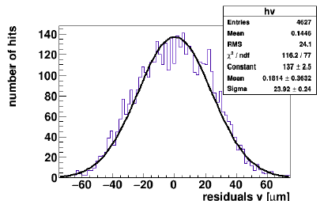
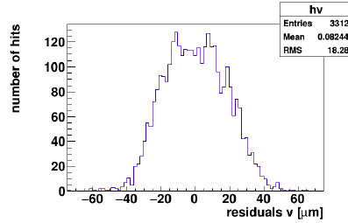
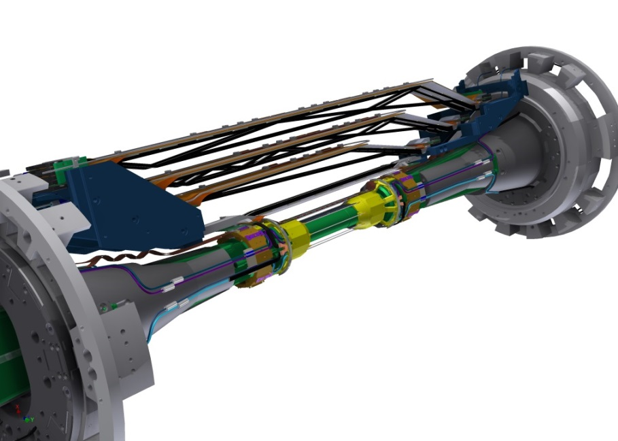
VXD Tests
SVD
PXD
Beam Test
Common beam test, DESY, April 2016
2 PXD layers
4 SVD layers
Beast II (background detector)
SVD sector & special radiation sensors
Beam conditioning to start collisions
Background measurements and mitigation
Belle II commissioning with partial VXD sensors
Optimization of interlock system
Installation of
2 PXD & 4 SVD layers
(& other specific sensors for background determination)
Beast II: May – December 2017
Subtask 2.2.1: First data with 1 VXD (4 SVD+ 2 PXD) Sector

Slide 12
Task 2.2 Deliverables
Some delays in superKEKB /Belle II schedule
Task 2.2 Tracking Detectors
Full CDC commissioning: (14) May 2016 (26) May 2017
Cosmic ray test of CDC modules in the Belle II area (6) Sep 2015 (14) May 2016 ok
Installation of CDC chambers in Belle II (10) Feb 2106 (19) Oct 2016
CDC cosmic ray test inside Belle II, with and without magnetic field (12) Mar 2916 (26) May 2017
PXD Whitebook, “PXD technology, procedure and operation” (20) Nov 2016 ok
Full integration and commissioning of SVD+PXD inside Belle II detector: (30) Sep 2017 (45) Dec 2018
First data with 1 VXD (4 SVD+ 2 PXD) Sector (14) May 2016 (32) Dec 2017
First cosmic data with SVD+PXD (16) Jul 2016 (33) Dec 2017
First beam data with SVD+PXD and all other Belle II sub-detectors (20) Nov 2016 (45) Dec 2018
A 4-layer DSSD Vertex Detector integrated in the Belle II tracking system (24) Mar 2017 (49) Sep 2018
Environmental monitoring for SVD and Belle II radiation protection system (24) Mar 2017 ?
Institutes in WP 2.2:
HEPHY (Austria), INFN (Italy), METU (Turkey), IFJ (Poland), UKP (Czech), DESY [DESY, Uni Bonn, Uni Giessen, Uni Heidelberg, MPP] (Germany)
135 months of secondments for WP 2.2, 31 months already used

Slide 13
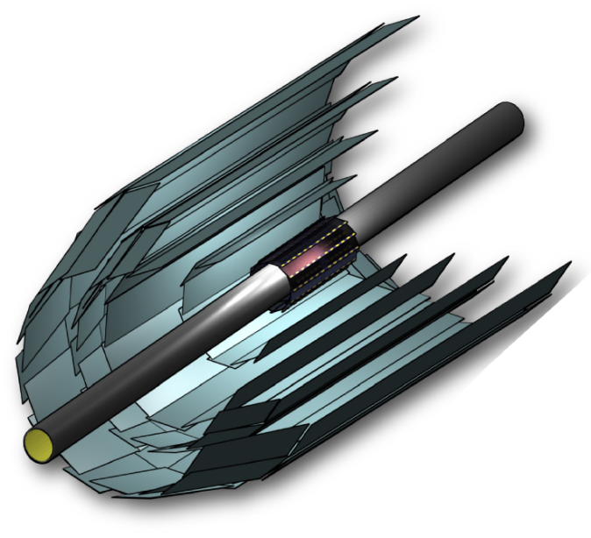

Conclusions
Belle II will be a key player in flavour physics and CP violation
Very challenging upgrade program of the detector
Jennifer supports essential parts of the detector upgrade program
227 months of secondments (20 FTE !)
Due to the latest schedule changes of superKEKB/Belle II some adaptations of the Jennifer deliverables (dates) are needed (mostly tracking detectors) => nevertheless the program will be completed within the Jennifer time scale (March 2019)
Jennifer secondments are essential to
Provide on-site presence for installations and tests.
Enable close collaboration with scientists from the host institute (KEK).
Transfer knowledge of technical infrastructure at host lab to technicians and engineers.
69 months of secondments already used for WP2 (~30%)

Slide 14
Backup

Slide 15
Detailed Secondments
WP subdetector months total/months
WP 2.1 forward ECL 5
WP 2.2 SVD/PXD 31
WP 2.3 PID ARICH 16
TOP 4
22
WP 2.4 Lumi Monitor 11
WP2 69
Secondments used so far (73 / 227)
More if secondments which have been started but not yet completed are included

