Slide 1
Geography
TOP
Groups (INFN+University)
Torino
Padova
Trieste
TIFPA
Pisa
Perugia
Laboratori Nazionali di Frascati
Roma 3
Enea Casaccia/Roma 1
Napoli
SVD
ECL
COMP
http://goo.gl/ZjVJO

Slide 2
Gli afferenti @RomaTre (2016)
P. Branchini 0.5
A. Baroncelli 0.3
E. Bernieri 0.5
A. Budano 0.5
M. Ciuchini 0.2
E. Graziani 0.5
A. Passeri 0.5
S. Bussino 0.3
Totale: 3.3
Very strong support and interest from Electronic (D. Tagnani, F. Budano)

Slide 3
Introduction
Beast experiment
News from Belle2 (KLM)

Slide 4
Introduction
In 2014-2016 we have focused on the possibility to take
Part to the EMC forward upgrade. Moreover in 2015-2016 we have
Also taken part to the beast phase 1 experiment to measure
radiation back ground in the experiment.
The R&D on the Forward Calorimeter is over.
Several papers concerning test beam are being written.
RM3 developped the front-end electronics in this framework and
the daq system.
Collaboration will take a decision on what to do as soon as we’have final
results from beast

Slide 5
Beast phase 1:
Crystal box contains: Lyso, CsI CsI (Tl) equipped to monitor T and H
Idea: To measure irradiation spectra and rate and correlate it with machine optical function.

Slide 6
Beam blow up evidence in LER:

Slide 7
HER Touscheck study:

Slide 8
Touscheck study

Slide 9
LER Collimation Study

Slide 11
Injection study

Slide 12
New scheme of daq adopted (and made it work)

Slide 19
Why KLM
Semileptonic decays are fundamental for B physics.
KLM detector detects and tiggers on muons.
By the end of 2015 beginning 2016 it was clear KLM fe would not
have been ready by the end of 2017.
The spokesman asked us (LNF and RM3) if we could take care
of this problem.
We analyzed the problem and acted.

Slide 20
INFN KLM system review, board production
KLM system overview
KLM board production in Italy
results

Slide 21

The Sytem
Front-end Board
INFN
LNF-RM3
13 RPC Front-End boards connect to a Data Concentrator in the barrel
2 Scintillator Motherboards connect to a Data Concentrator in the barrel
7 Scintillator Motherboards connect to a Data Concentrator in the end-cap
The Data Concentrator connects to the detector interface (HSLB, UT3, FTSW)

Slide 22
Data Concentrator Board

Slide 23
Data Concentrator Functions

Slide 24
RPC front-end functions

Slide 25
Custom backplane

Slide 26
RPC Signals

Slide 27
RPC front end board

Slide 28
Test results
2 board were perfect
1 board has a broken multiplexer a broken diode and
transformer badly soldered.
This board has been reworked and it’s working now.

Slide 29
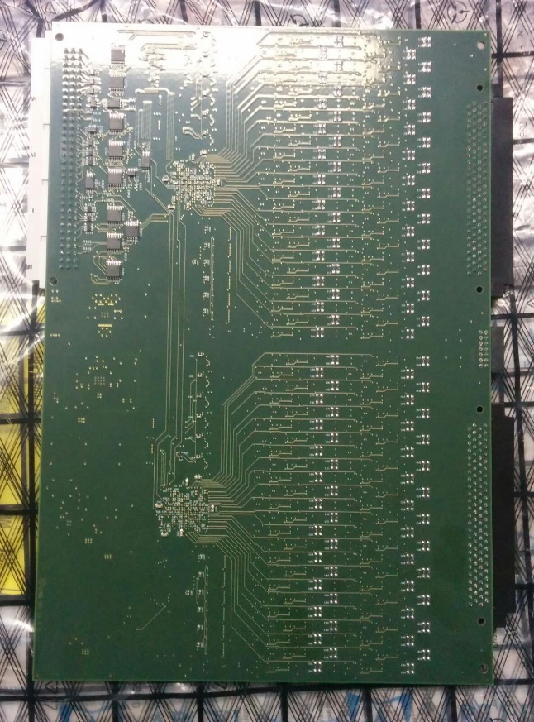
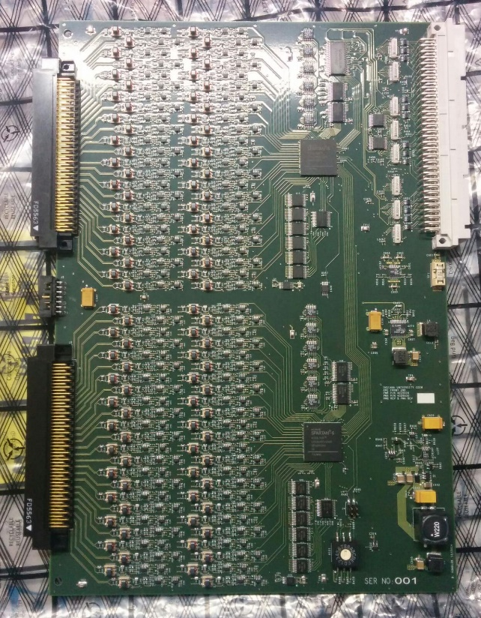
Board:

Slide 30
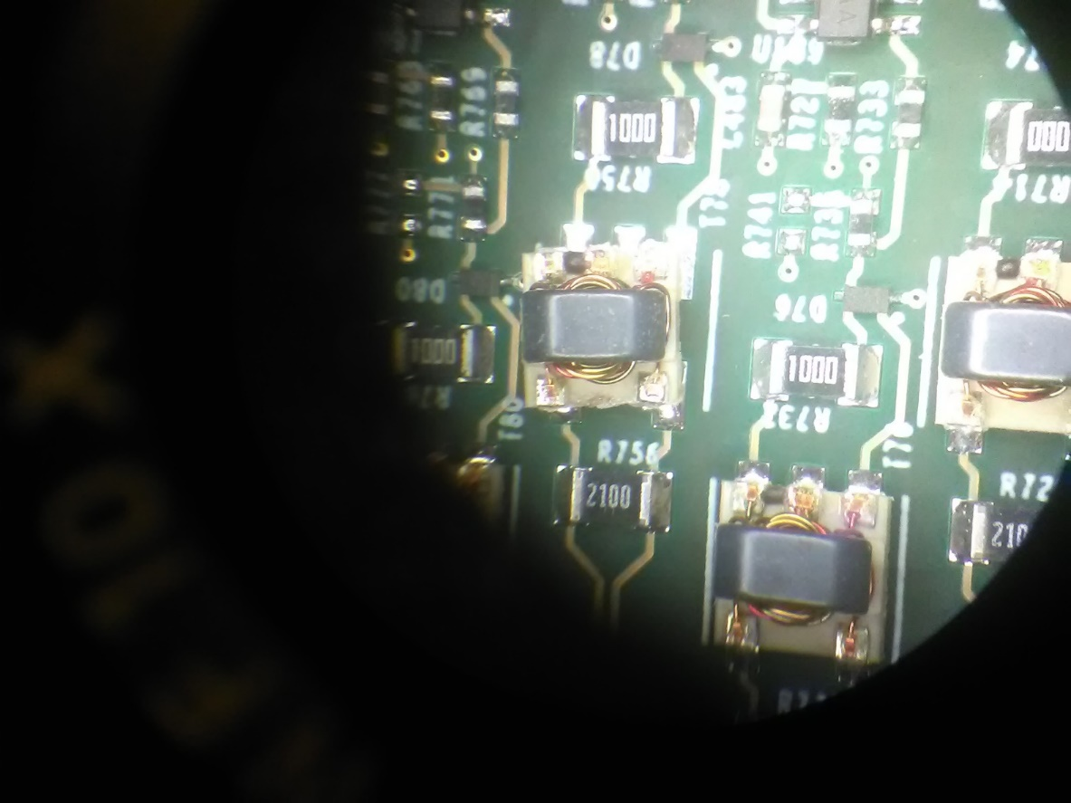
What was visible @microscope
A rotation occurred when it was
soldered

Slide 31
Quotation
The 3 boards produced worked fine from the start now we are running a bid to assign the production.

Slide 32
Next STEP on KLM
We are building a setup facility@LNF. (We need space)
We want to get the production done by the end of march 2017.
We want to test all the board in our facility by 30 th june 2017.
In this case installation will occur by end of october 2017.

Slide 33
Backup slides

Slide 34
Beast results (vacum scrubbing):

Slide 39
Indiana test setup description
External pulser with variable amplitude connects to Z and Phi connectors
to pulse every channel while data is analyzed with COPPER readout.
Threshold and built-in pulser are manipulated with and data is analyzed
with COPPER readout .
Configure FPGAs with Data Concentrator.
It is a complicated setup and needs a lot of hw

Slide 40
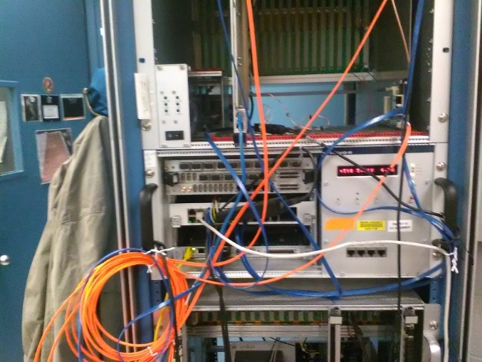
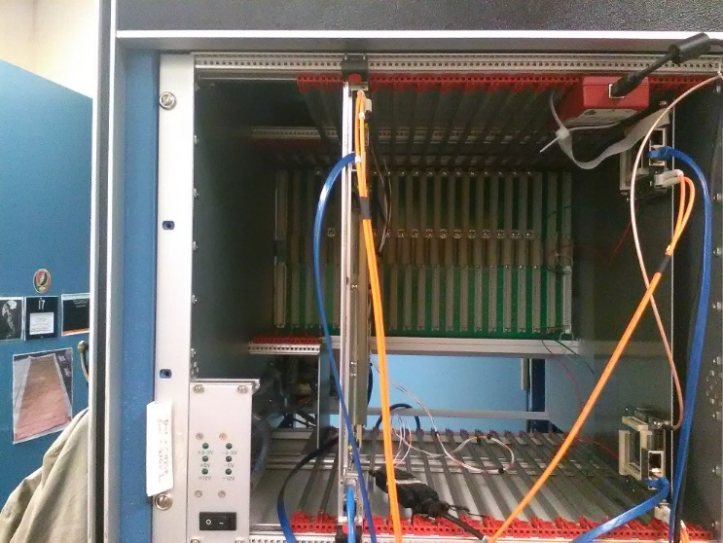
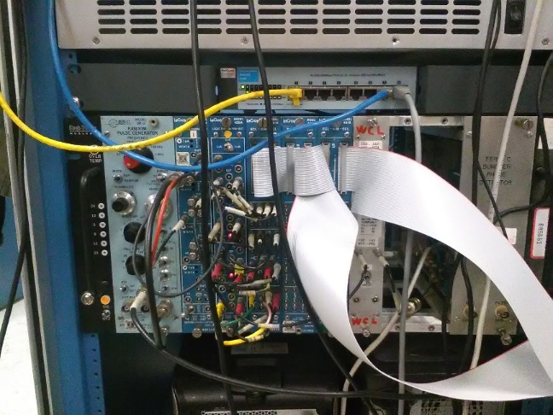
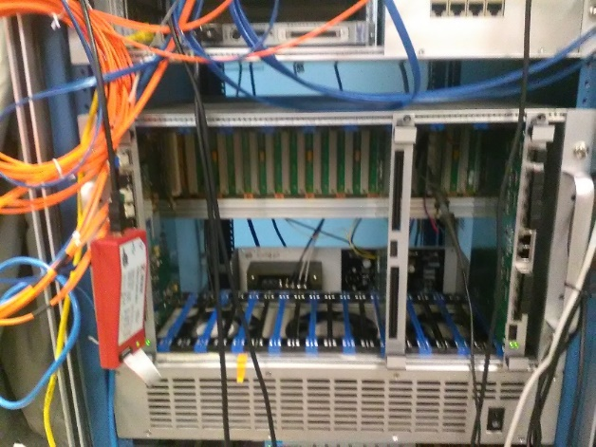
Hw needed for standard test setup
Home made Pulser
(1 board at the time!!
very slow)
Copper link and pocket daq
2 optical concentrator (one is needed to
Teminate the bus) MANDATORY!

Slide 41

What we have:
To setup the very same test bed they
have in Indiana we should order 2 VME 64X
crate (lots of time and money)

Slide 42
A different strategy:
Use ChipScope VIO to assert built-in test pulser channel, monitor associated channel with ChipScope ILA
Use ChipScope VIO to program threshold with low threshold, monitor associated channels with ChipScope ILA
Configure FPGA with Data Concentrator
Benefit: what we have is enough.

Slide 43
And…
We developped this strategy when we were in Indiana (thanks Brandon) and
made it work….
Moreover we discovered that:
We could have been much faster if we could pulse the system
one crate at the time (13 boards)….
Therefore we are designing a pulse system we can use in Italy and Japan
To drive the RPC single crate and make debugging much faster.

Slide 44
Proposed strategy:
Test analog part at the firm level using a scope and the proper hw
we are developping.
Test the digital part using chipscope at the crate level in italy.
Test the board with the pulser in Italy and send everything pulser
Included in Japan.
Cosmic test in Japan on KLM

Slide 45
Situazione 2016
La commissione 1 ha appena approvato 210 keuro di finanziamento
per lo svolgimento delle gare per l’acquisto di FE boards per il KLM.
Queste gare dovrebbero avere luogo entro il corrente anno.
Per il prossimo anno si prevedono attivita’ di test ed installazione

Slide 46
Richieste 2017
Missioni estere per metabolismo 23 keuro
Missioni estere per installazione 27 keuro
Missioni per contatti 2 keuro
Consumo metabolismo 5 keuro
Inventariabile 12 keuro

Slide 47
Architettura proposta
Architettura di validazione del sistema EMC in avanti
Il sistema costituisce la dorsale DAQ per tutti i test svolti in italia durante la costruzione
E’ contemporaneamente uno studio di fattibilità di funzioni di SLOW control con capacita’ di DAQ e TRIGGER integrate.
In questo quadro RM3 seguirebbe lo sviluppo del pre-amp e scheda di gestione del very front-end (PTD power threshold digital). Il PTD e’ interfacciato con elettronica di Napoli.
uSOP
Pre-Amps
PTD

Slide 48
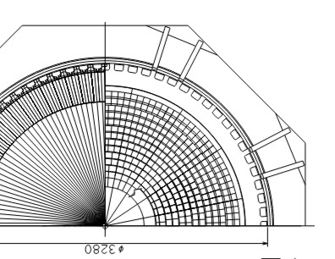

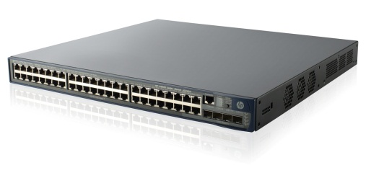
Gerarchia di Aggregazione
<# | Crystal | LA APD | Preamp | PTD | uSOP
# | 72 | 144 | 144 | 5 | 1
mod | - | 2x Crystal | 1x LAAPD | 1x 32 Pre | 1x 5 PTD
costo | - | - | 65€/chan | 2k€/board | 4k€/board
totale | - | - | 10k€ | 10k€ | 4k€
uSOP
PTD
PTD
PTD
32 LA-APD
PTD
PTD
 | Forward
 | # | costo
spicchi | 16 | -
Crystal | ~1150 | -
LA-APD | ~1150 | -
PreAmp | ~2300 | 160 k€
PTD | 80 | 160 k€
uSOP | 16 | 64 k€
Totale | - | 384 k€
To Belle2 Network D

Slide 49
Costi di Sviluppo 2013-2015
 | NRE costs (k€)
 | 2013 | 2014 | 2015
Napoli | 12.5 k€ | 42 k€ | ?
Roma3 | 12 k€ | 22 k€ | 22 k€
I costi di sviluppo devono considerarsi in aggiunta ai costi di produzione

Slide 50
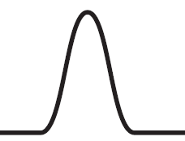
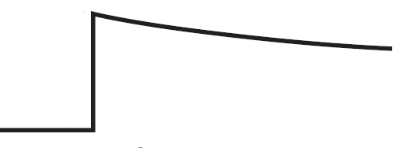
EMC energy, slow and Trigger path
Energy accurate measurement, trigger and slow control path
Shaper
Range (0,1)
Pre-amp
X N_{cryst}
Slow control
and monitor
Trigger Fast Path
Analog
Σ
n
Pulse
Encoder
LVDS

Slide 51
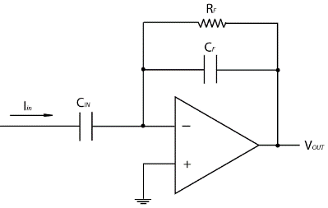
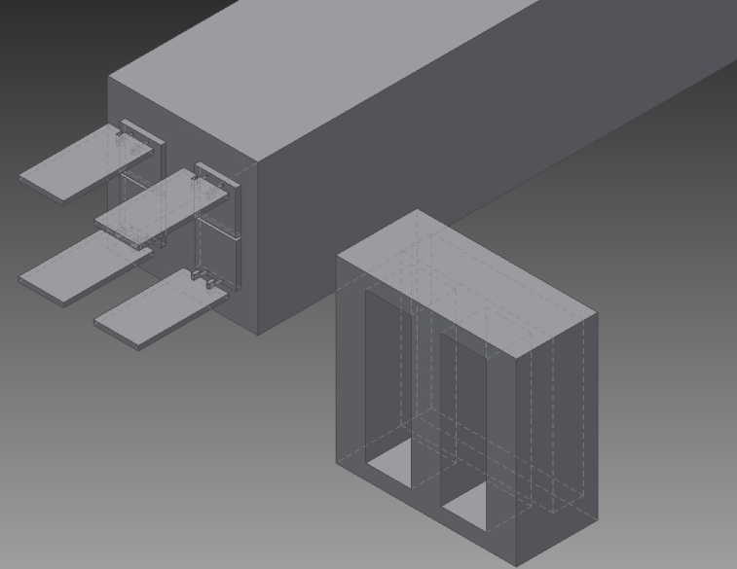
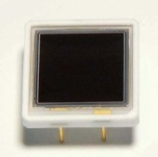




Front end undoped CsI EMC BELLE 2
$I^{2}C$ DAC SET Voltage
Power Regulator $V_{APD}=250V to$ 500V
$I^{2}C$ADC READ Voltage
Q output
$I^{2}C$ ADC READ Current APD
PTD con input da SLOW
Ultra LowNoise Charge Preamplifier
Front& cards
Pre-Amp
G ̴ 1,4V/pC N < 0.6 MeV
Risoluzione@100MeV 4% and 1.6% @ 8 GeV
Range E = µ ( ̴168MeV) to 8 GeV
𝑄resolution = 2%/(𝑒)^{1/4}
Dinamica massima = ? V (da decidere)
Dissipazione massima = ? mW da vedere potrebbe non essere un problema
Alimentazione singola = +6V
Dimensioni = 15 x 30 mm
Regolatore Alta Tensione
Regolazione = 250V a 500V
Lettura e scrittura regolazione alta tensione = 16bit tramite protocollo I2C
Stabilità regolazione alta tensione = 0.1‰
Range temperatura = 0 a 60°C.
2 or 4 LAAPS Si APD S8664-1010 and Front& cards
Lavoro fatto ed in corso di implementazione nella matrice di CsI che stiamo costruendo

Slide 52
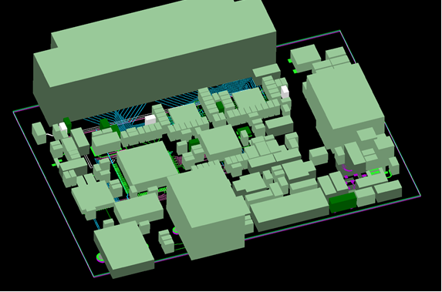


PTD CSI EMC BELLE 2
………..
Single channel control units
Ognuna controlla il singolo
Pre-amp.
…………..
From/to pre-amp
SLOW control interface
Set & Read Voltage single LAAPD (I2C protocol) la banda passante richiesta e’ qualche Mb/s.
Ethernet control
USB control
HV primary
HV generator 600V
Funzioni di DAQ
Processa signal
Somma signali for cristallo
Ecc..
PTD : paramteri di slow control
HV primaria
Soglie
Monitor in tensione
Monitor in corrente
Temperatura
Digitalizzazione
Lettura adc
uSOP (Na)
FMC
Lavoro fatto ed in corso di implementazione nella matrice di CsI che stiamo costruendo

Slide 53
Tool Chain
File System
(P)NFS
Web Server
GUI
Web Services
Load Balancing
Run Control
Graphic Display
Network profiling
Controls
Trig
DAQ
uSOP: Service Oriented
Platform based on uP
ARM
Cortex A8
LINUX
FMC
RAM
FLASH
USB
Ethernet
ZYNQ 7000
SPI
I2C
Parallel Digital
Timing
FPGA
KINTEX 7
uSOP
Aggregation switch
PC Server
Photodetector
APD
FrontEnd
PTD
Power
Threshold
Pre-Amp
Digital ReadOut
Detetector, PreAmp, PTD

Slide 54
Lavoro svolto a RM3
1
2
Start up system for the test beam
3
Single ended to differential converter
Front End
4
Conclusions and future development
Notes:
Questa è un'altra opzione per creare una diapositiva introduttiva.

Slide 55
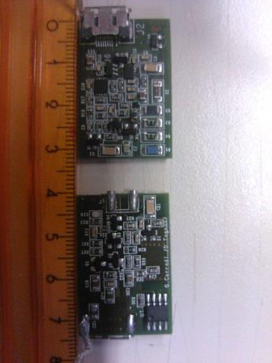
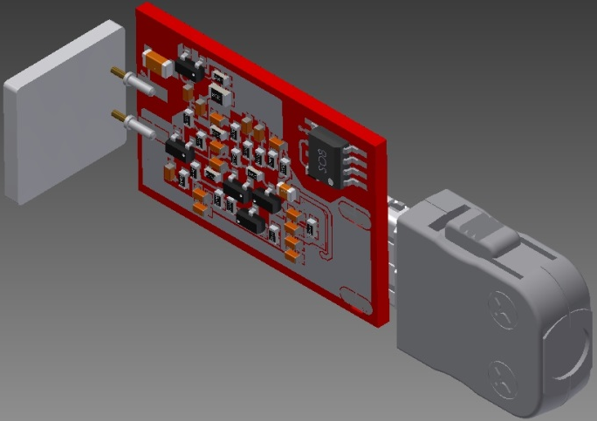
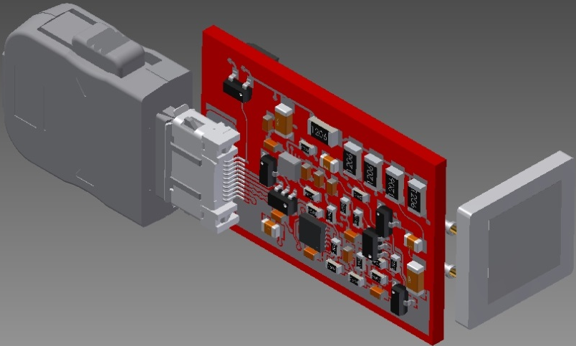
Front End.
TOP side.
Detector linear voltage regulator
Charge pre-amp and detector
Voltage regulator.
BOTTOM side.
Charge pre-amp.
Notes:
Aggiungere le diapositive necessarie per ogni sezione di argomento, incluse diapositive con tabelle, grafici e immagini.
Vedere la sezione successiva per un esempio di tabelle, grafici, immagini e video.

Slide 56
Front End. Charge pre-amp
Pulse test IN
C
C
KATODE
Signal OUT
K
Charge – Preamplifier
Custom discrete amplifier at BJT transistor.
Gain = 1.4V/pC
Power dissipation = 16mW
Single power = 6V to GND
Dynamic Range 2.2V 50R
Tau IN = 40ns
Protection
TIMING CsI PURE:
40ns
40ns
Signal IN
420ns
Signal OUT

Slide 57
Cosmic ray test stand 1.
VIEW
Electronics System
Finger UP
TOP VIEW
Pb
5cm
CsI Pure
Finger UP
Finger DOWN
Logic NIM
SCOPE
Finger UP
Pb
CsI Pure
Trigger Finger UP & Finger DOWN

Slide 58
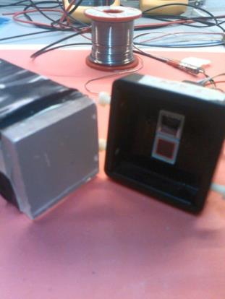
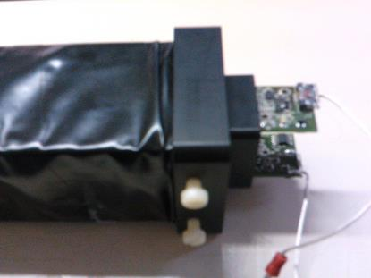
Front End. APD SET-UP.
Double APD Large Area read-out(S8664-1010).
Mechanical support for APDs.
Front end, mounted on APD.

Slide 59
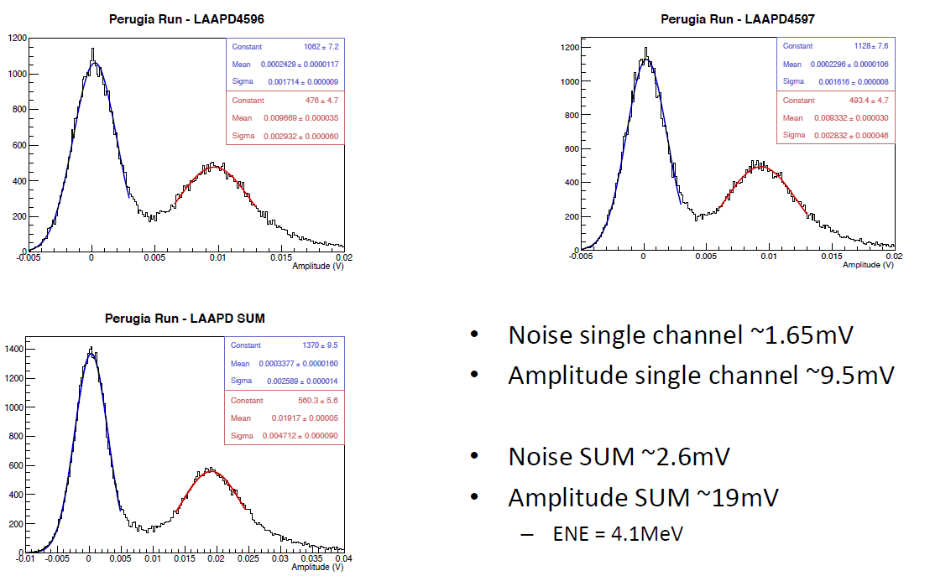
Front End. LAAPD Performance.
Standard analysis by Perugia.
Alessandro Rossi.

Slide 60
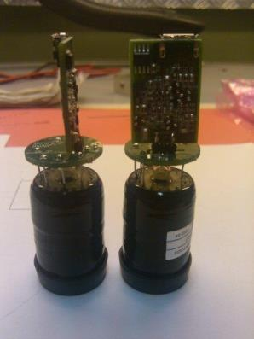
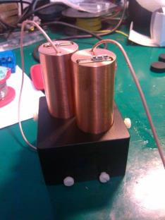
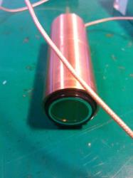
Front End. PP 1inch SET-UP.
PP 1inch double rea-out (HAMAMATSU 1’’ UV PENTODE).
Mechanical support for 2 PP,voltage divider and front end electronics.

Slide 61
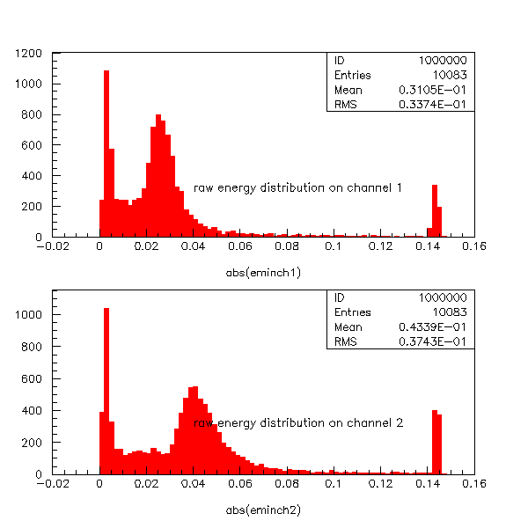
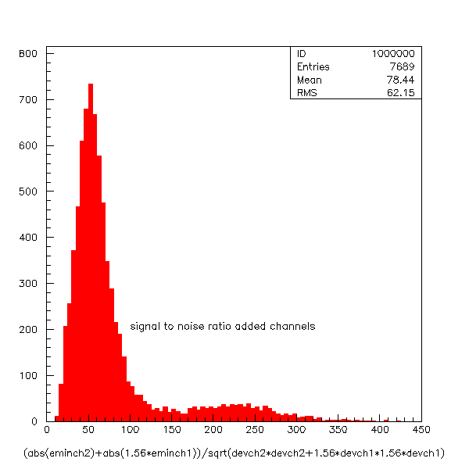
Front End. 2PP 1inch Performance.
Signal/noise on ch1 = 49.
  Assuming a that muon delivers 30 MeV noise level is about 650 KeV
Signal to noise ratio on ch2 = 76
  Assuming a that muon delivers 30 MeV noise level is about 400 KeV
Signal/noise on
ch1+ch2 = 78.
  Assuming a that muon delivers 30 MeV noise level is about 400 KeV

Slide 62
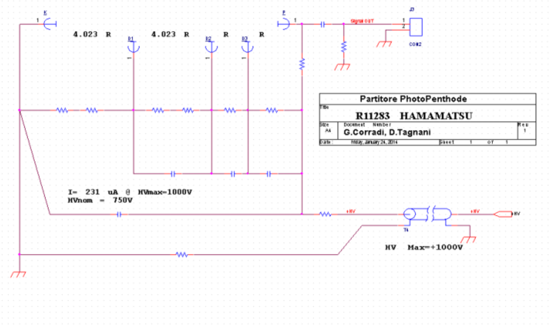
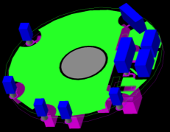
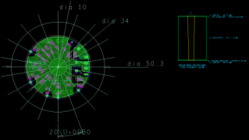
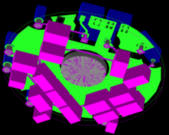
PP 1inch e 2inch voltage divider.
LV PW
Pre Charge Amplifier
HV PW

Slide 63
In view of the next test beam
A test beam has been scheduled for next October.
We need:
  To sets and read back several parameters:
  HVs for each single channel.
  temperature for each channel.
  The uSOP platform (see Alberto Aloisio’s talk) will not be ready by then therefore we have developped a temporary solution.

Slide 64
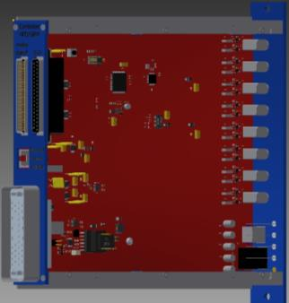
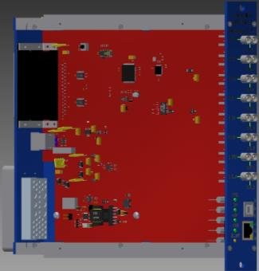
HV APD control system.
16 Analog Signal Output
Rear Panel NIM1U
Front Panel NIM1U
16 Analog Signal Input
16 line I2C.
Slow Control Front end
1-Ware protocol for external sensor:
- Temperature.
- Humidity.
ON BOARD:
CPU (LPC1768FBD100)
HV for 16CH Front End
LV for 16CH Front End
High Voltage Generator.
Frequency: 250kHz.
Stability: 0,1%
Selectable Voltage:
- 50V
- 100V
- 600V
USB & Ethernet Connection

Slide 65
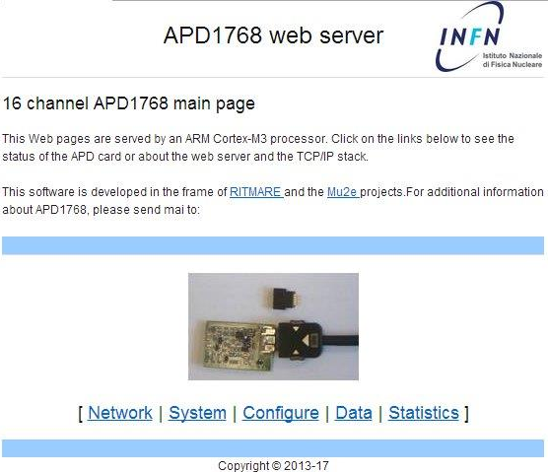
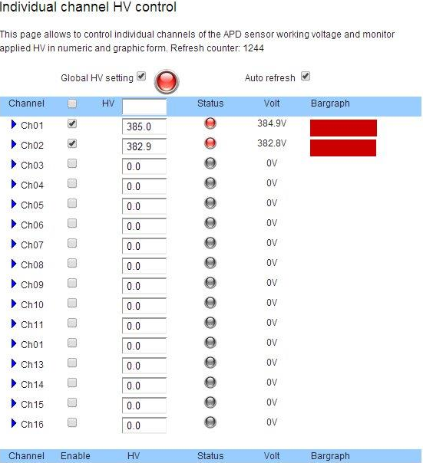
Front End control system for APDs.
Web panel.
  sets and reads back
  single channels HVs.
  Single channel temperature reading

Slide 66
Attivita’ 2015
Pre-amp in carica con uscita differenziale e basati su JFET (vogliamo migliorare il rapporto
segnale fondo).
Sviluppo di una scheda di controllo per l’amplificatore e per l’HV che tenga conto delle
specifiche dell’esperimento piu’ restrittive di
quelle sulla base delle quali sono state sviluppate
le attuali distribuzioni di HV standard.

Slide 67
Richieste Consumo EMC FE 2015
15 Keuro di consumo per produrre una catena di studio del EMC basata sui nuovi pre-amplificatori e Controller HV che seguono le specifiche dell’esperimento.
4 Montaggi radiografie saldature etc..
3 Connettori, componenti…

Slide 68
Richieste Missioni 2015
Metabolismo: 1 m.u./FTE + 1.5ke/FTE *4 FTE=30
Assemblaggio modulo a KEK (1 m.u.) 5.5 keuro
Contatti tra gruppi italiani 4 keuro
Refurbishment ECL 12 keuro
2 sw e physics meeting 8.5 keuro

Slide 69
Inventariabile
Impulsatore 10 keuro

