Slide 1
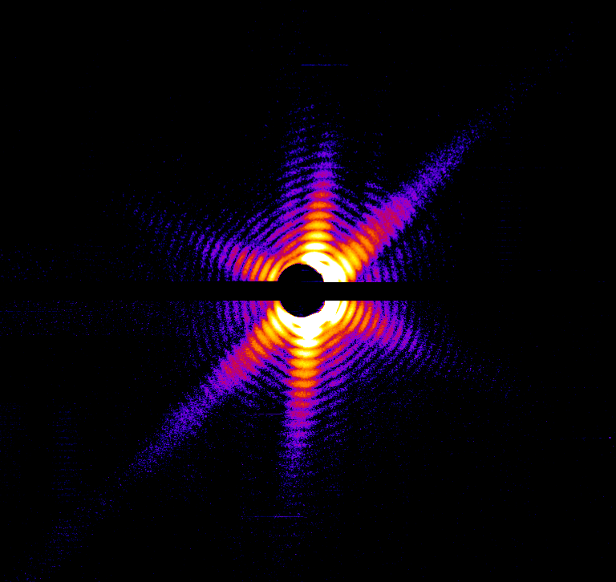

Lothar Strüder and
Gerhard Lutz
December – 5, 2016
Pavia
Integrated Front End Electronics for High Resolution Silicon Detectors
JFETs in a CMOS process
In Memoriam: Pier Franco Manfredi
and

Slide 2
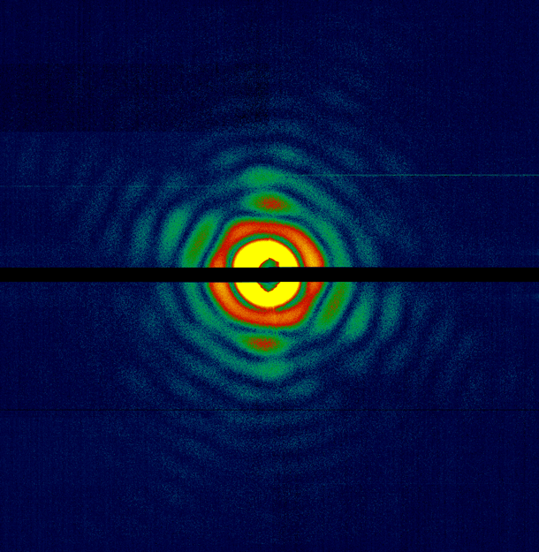
Outline
Parallel Readout of JCCDs (pnCCDs)
JFETs in the CAMEX ASIC
Science driven implementation
The ongoing succes of XMM-Newton
More satellite missions to come
X-ray FELs need it as well
Synchrotrons love it
pn CCDs in STEMs
X-ray color camera
Adaptive Optics
. . . . . and many more
The future of JFETs in radiation detection

Slide 3
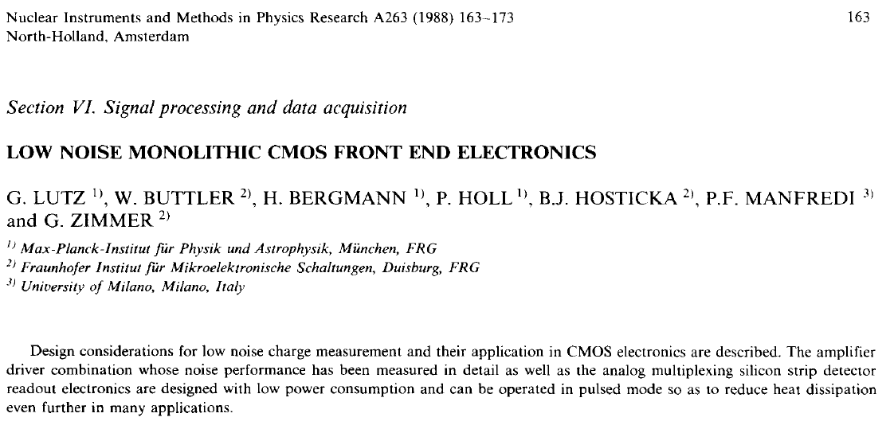
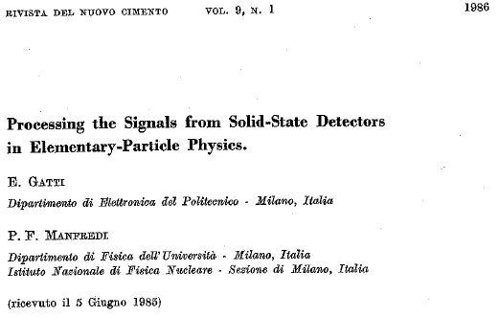
Presented @ the 3rd Pisa meeting in 1986
Lothar Strüder
and

Slide 4
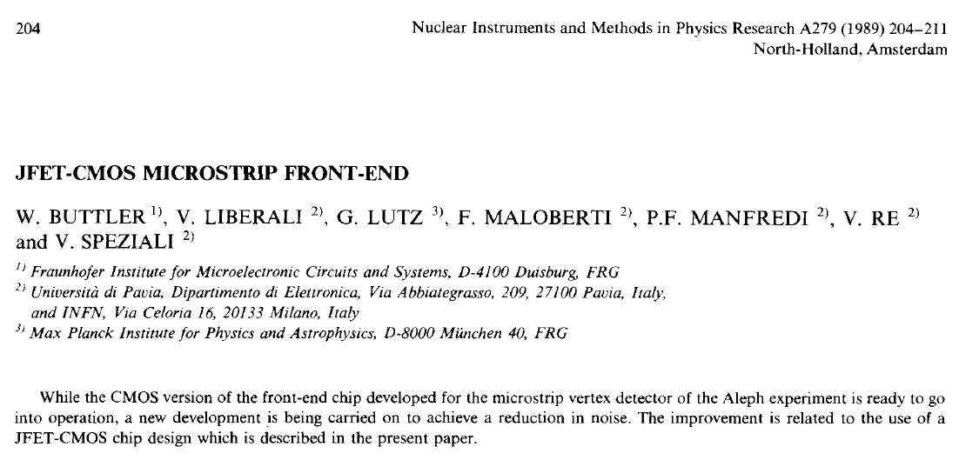
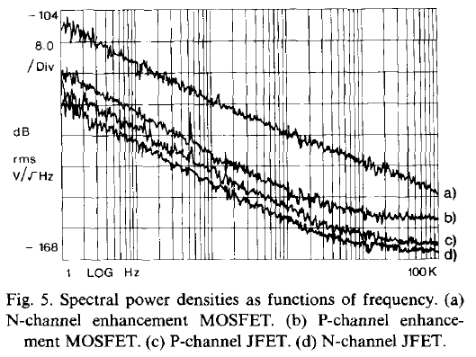
Lothar Strüder
and

Slide 5
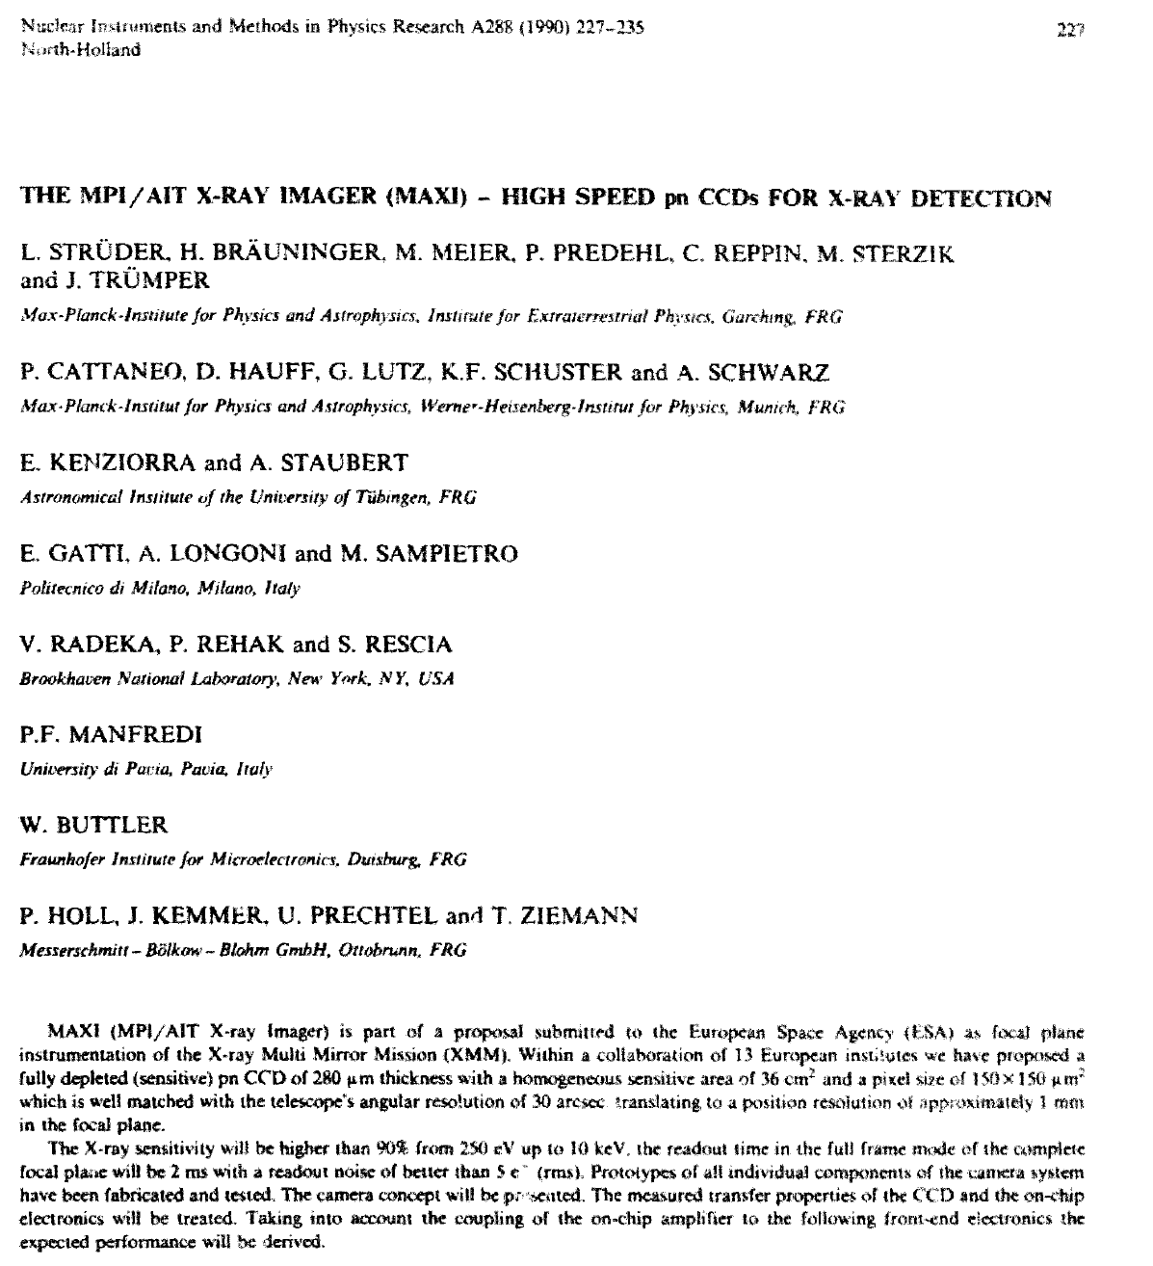

Slide 6
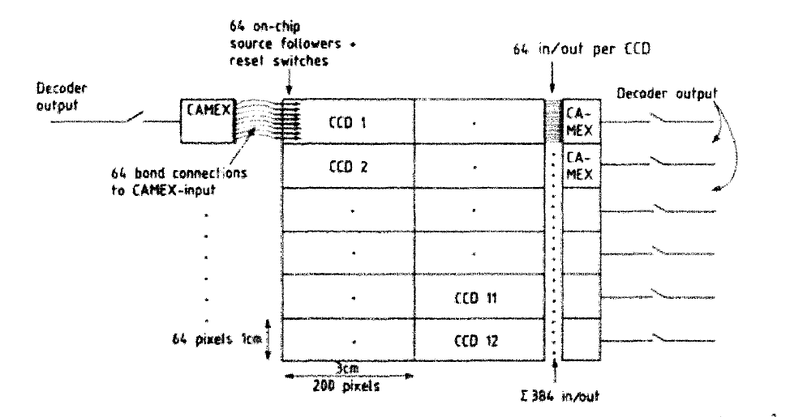
Very first publication about the column parallel
readout of CCDs: The MPI/AIT X-ray imager
(MAXI) – high speed pnCCDs for X-ray detection
L. Strüder et al., NIM A(288) 1990, p 227-235

Slide 7
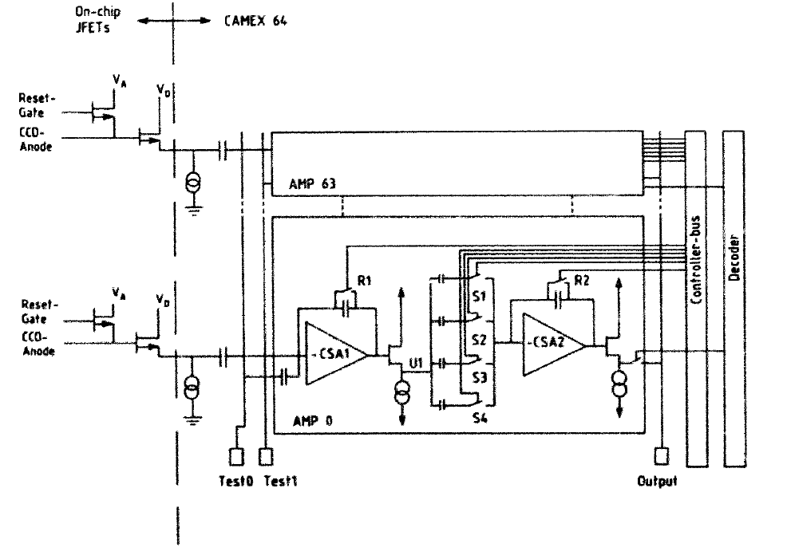
Schematic building blocks of the first CAMEX for the pnCCD readout
From: The MPI/AIT X-ray imager
(MAXI) – high speed pnCCDs for X-ray detection
L. Strüder et al., NIM A(288) 1990, p 227-235

Slide 9
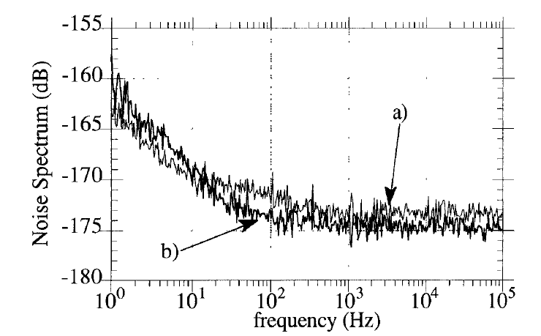
Lothar Strüder
and

Slide 10
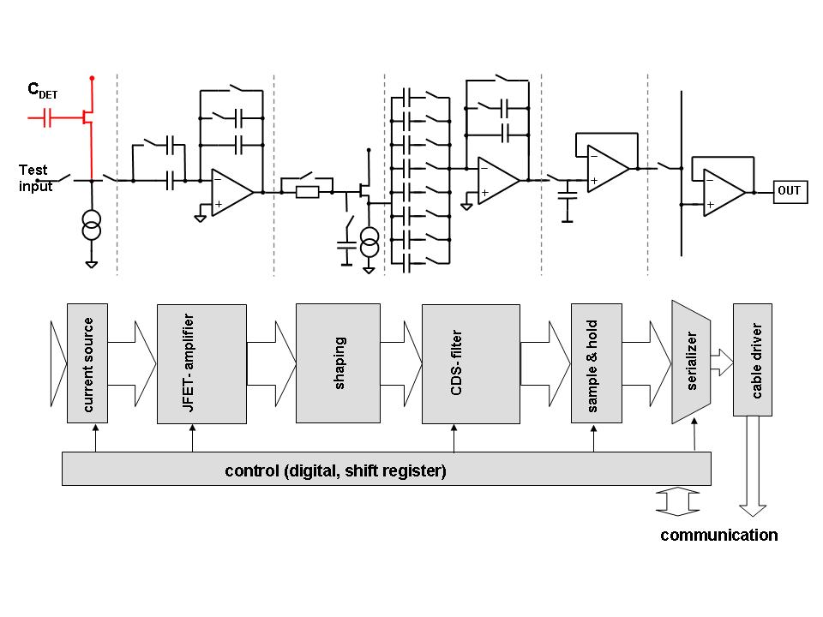
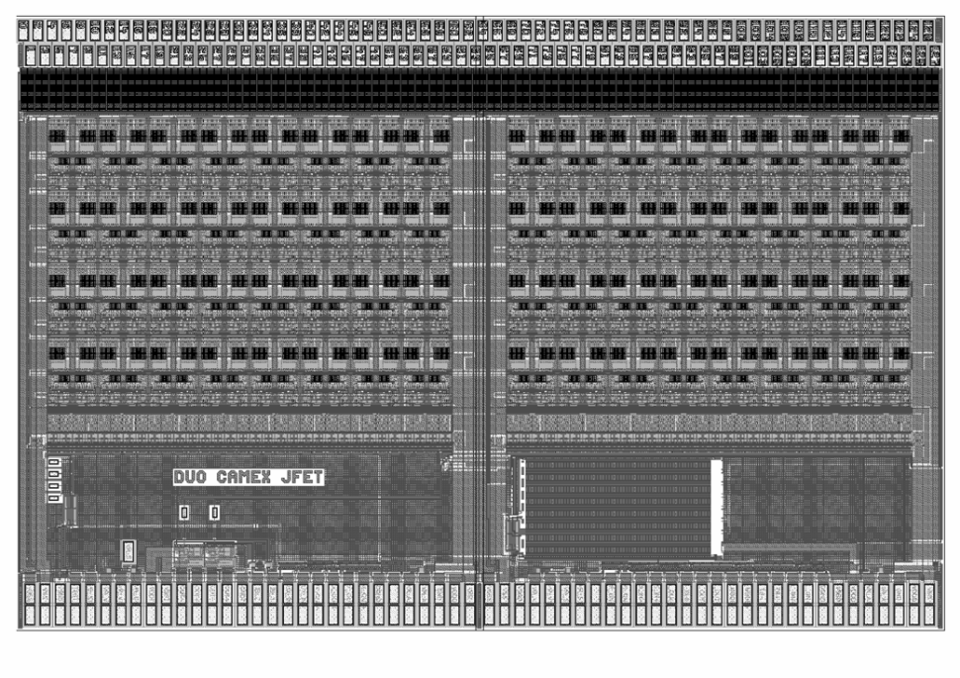
CAMEX analog signal processor
CAMEX ASIC (CMOS Analog Multiplexing): tailor-made for eROSITA CCD
JFET-CMOS process, 5 V, 0.8 µm
128 readout channels filtered in parallel
1 or 2 analog output nodes (selectable)
8-fold correlated double sampling
internal shift register sequencer
gain & bandwidth of the ASIC can be changed
by digital programing
  (16 gain settings, 8 bandwidth settings)

Slide 11
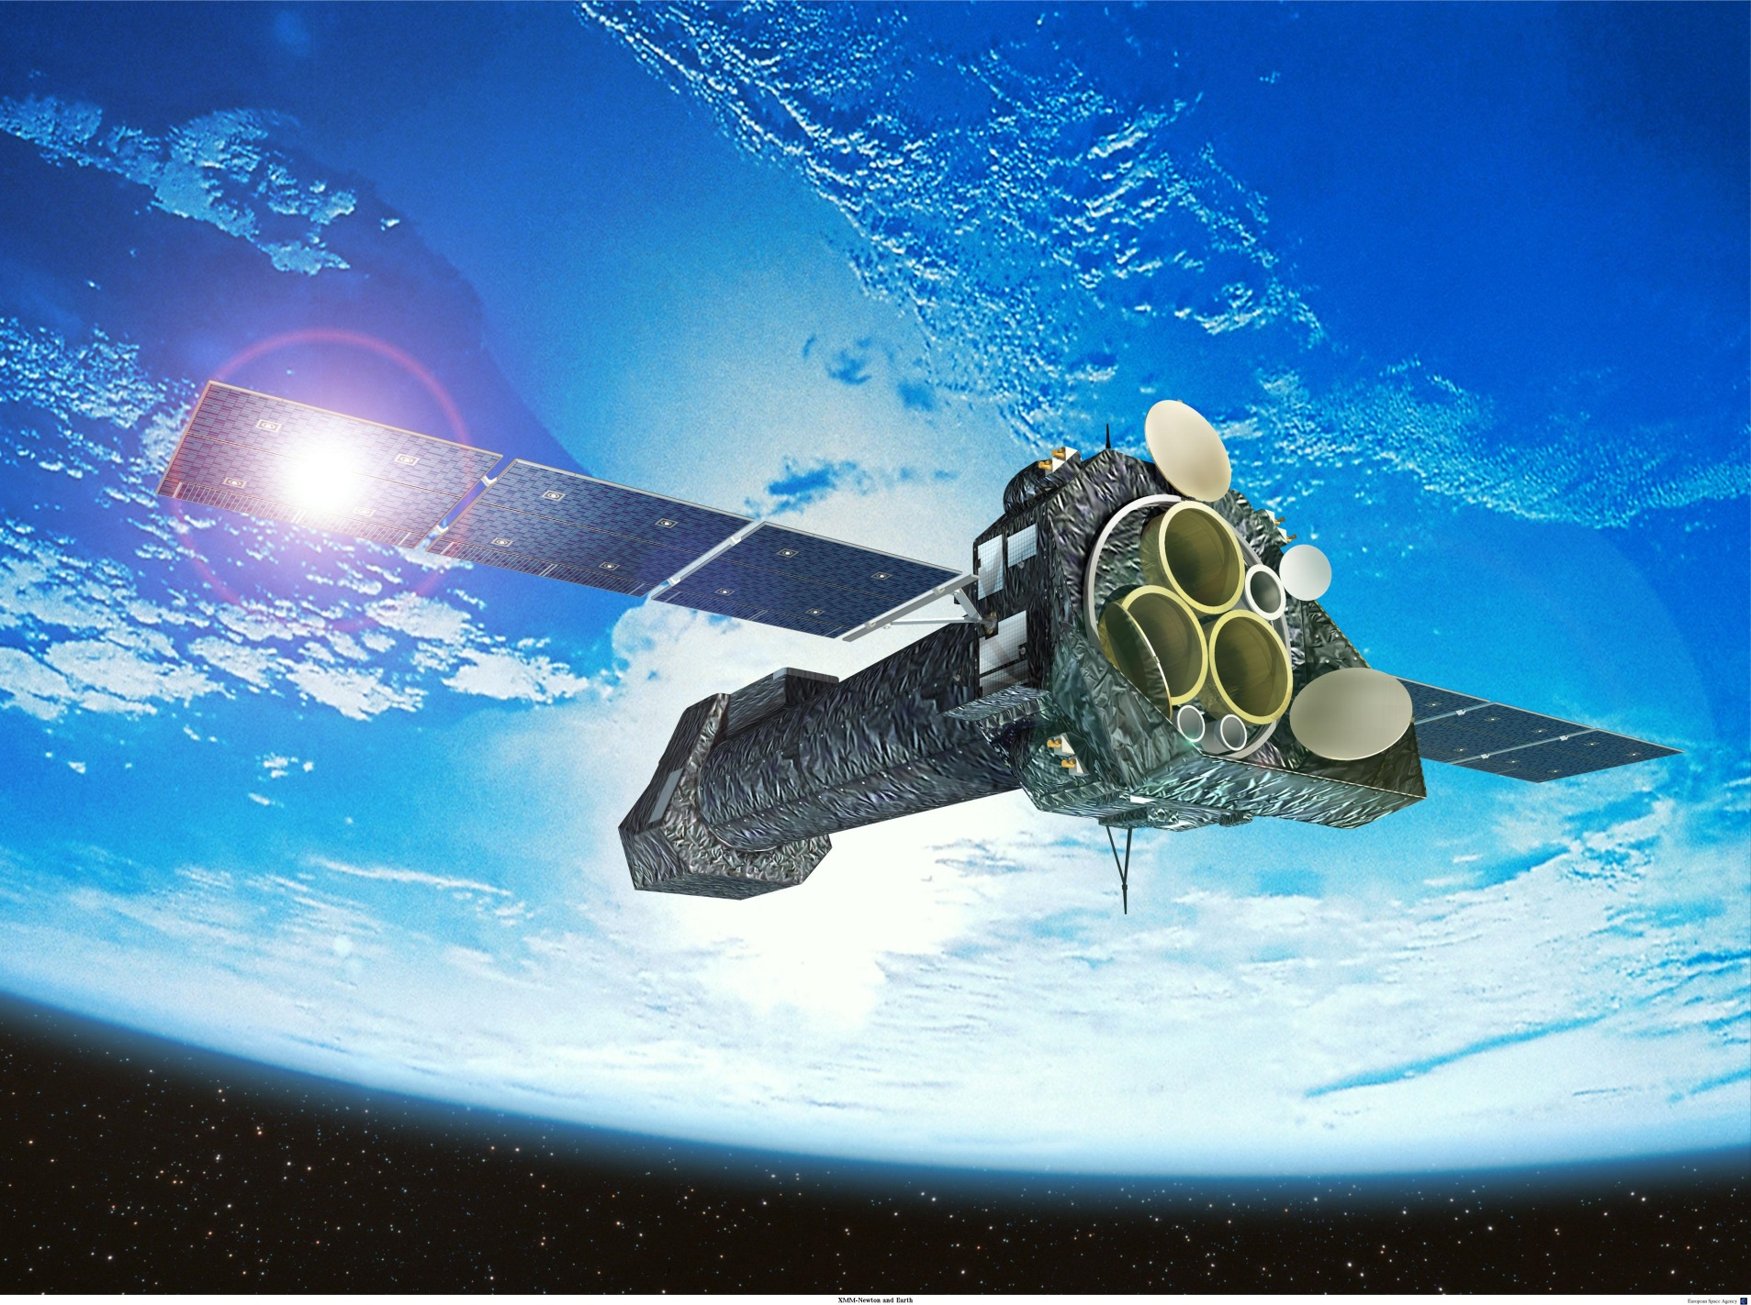
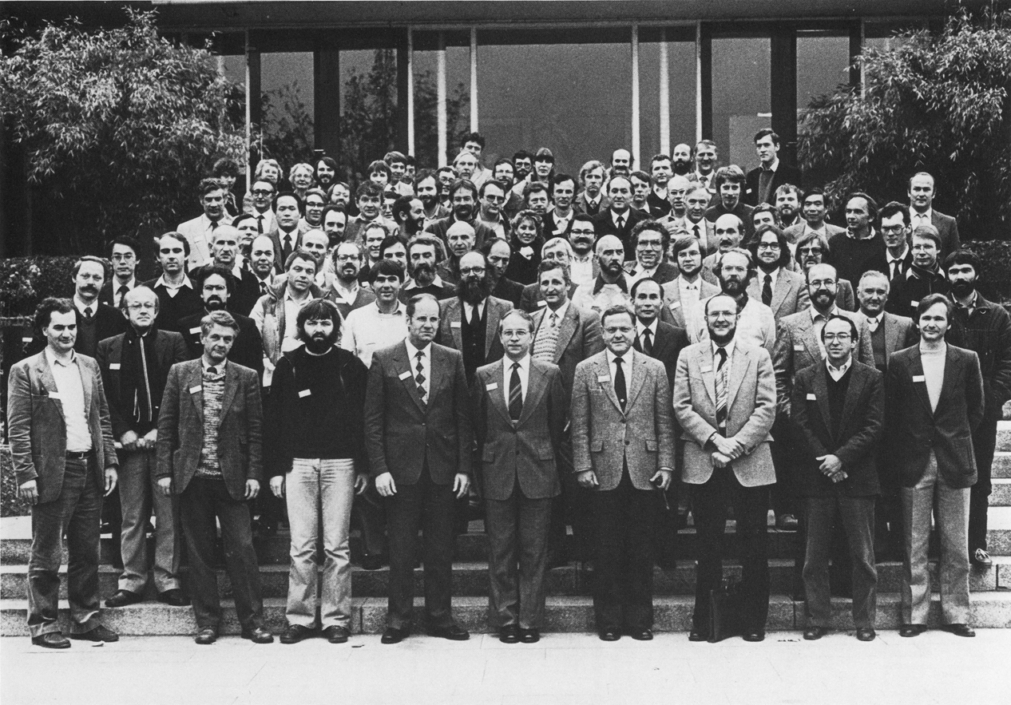
3rd European Symposium on semiconductor detectors, MPI for Physics, Munich 1983
Lothar Strüder
and

Slide 12
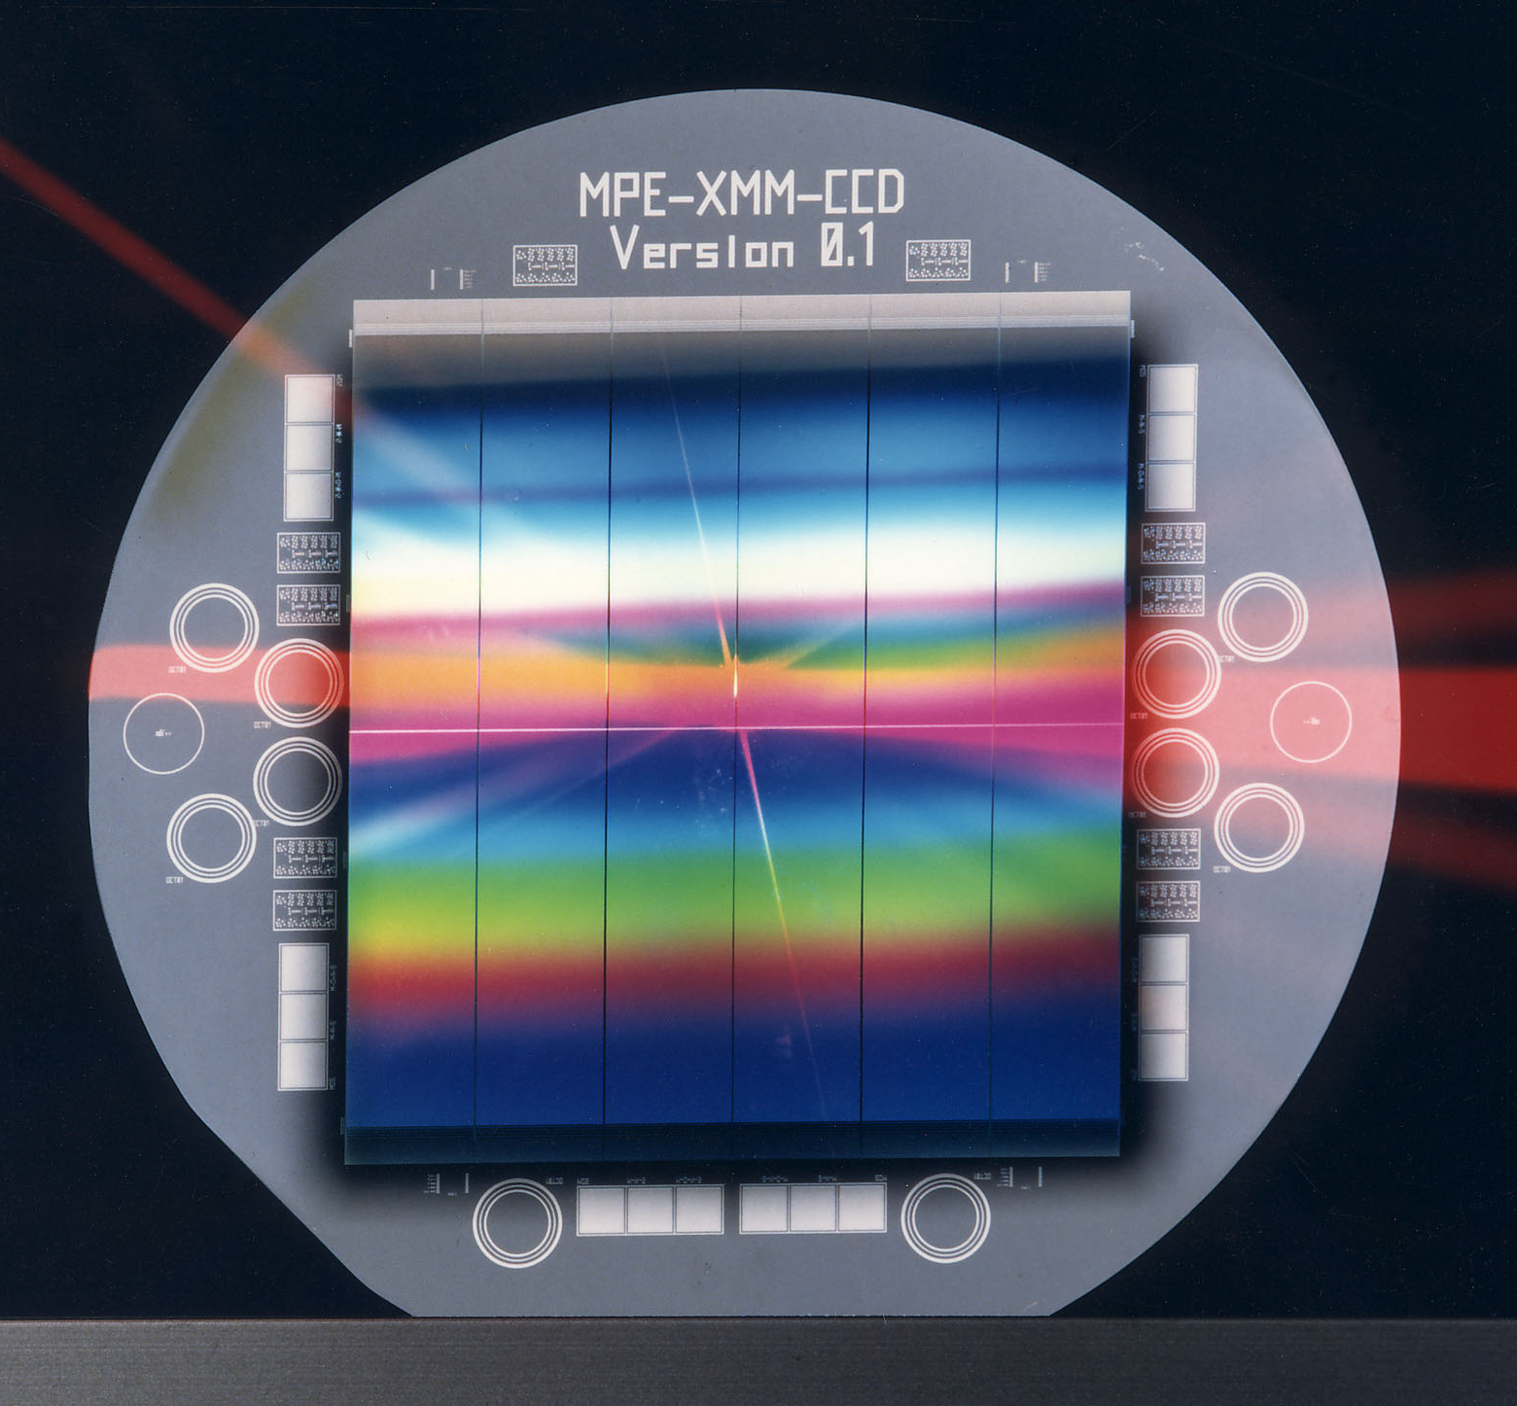
XMM EPIC pnCCD
Device
  Monolithic array
  of 12 pnCCDs
  200 x 64 pixels each
  pixel size
  150 x 150 μm²
  6 x 6 cm² area
  4“ wafer
  280 μm thick
  Common entrance
  window
Performance
  5 e- ENC
  Readout time
  4.5 ms
  Integration time
  100 ms
  Energy resolution
  150 eV FWHM @ 5.9 keV

Slide 13
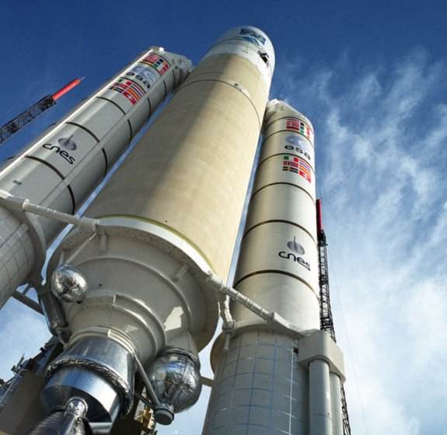
XMM – Newton was launched on
Dec. 10 1999
from Kourou
after 14 years of preparation.
Major contributions for
EPIC:
Germany
UK
ESA
France
Italy
Apogee: 120.000 km
Perigee: 7.000 km
48 hour orbit
40 hours of observation
8 hours of radiation belt
start @ max. of solar cycle

Slide 14


Slide 15
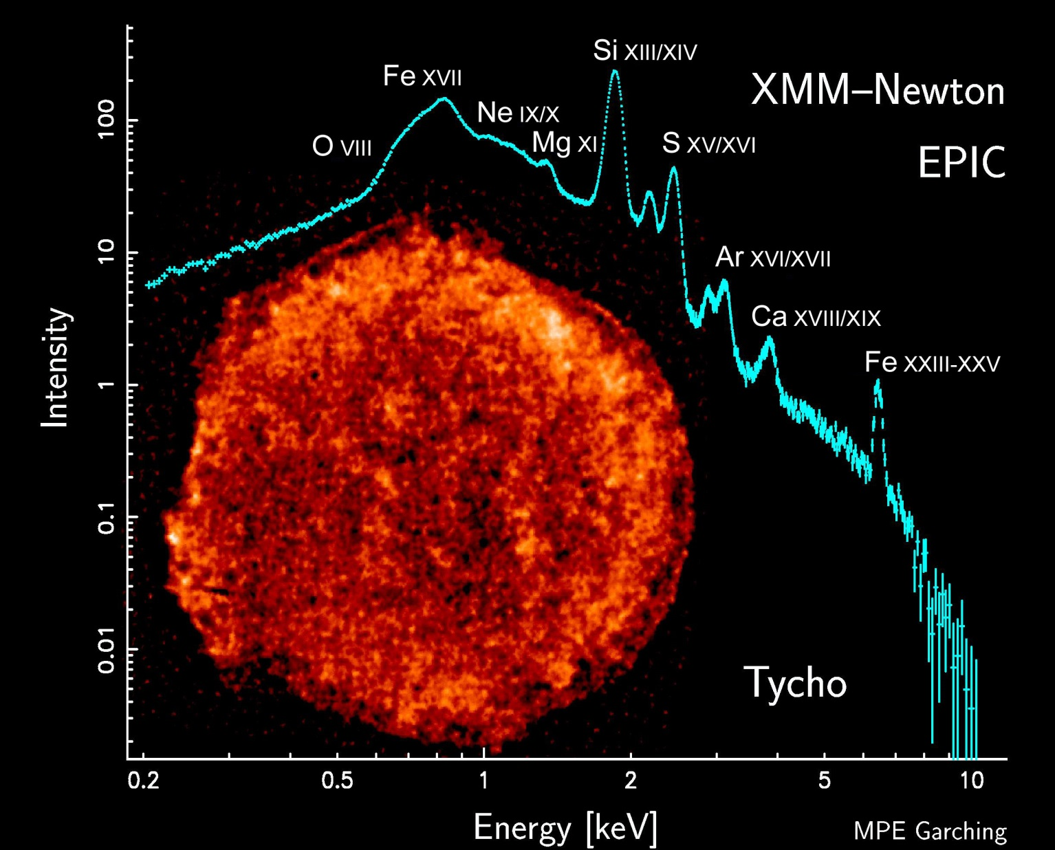
Lothar Strüder
and

Slide 16
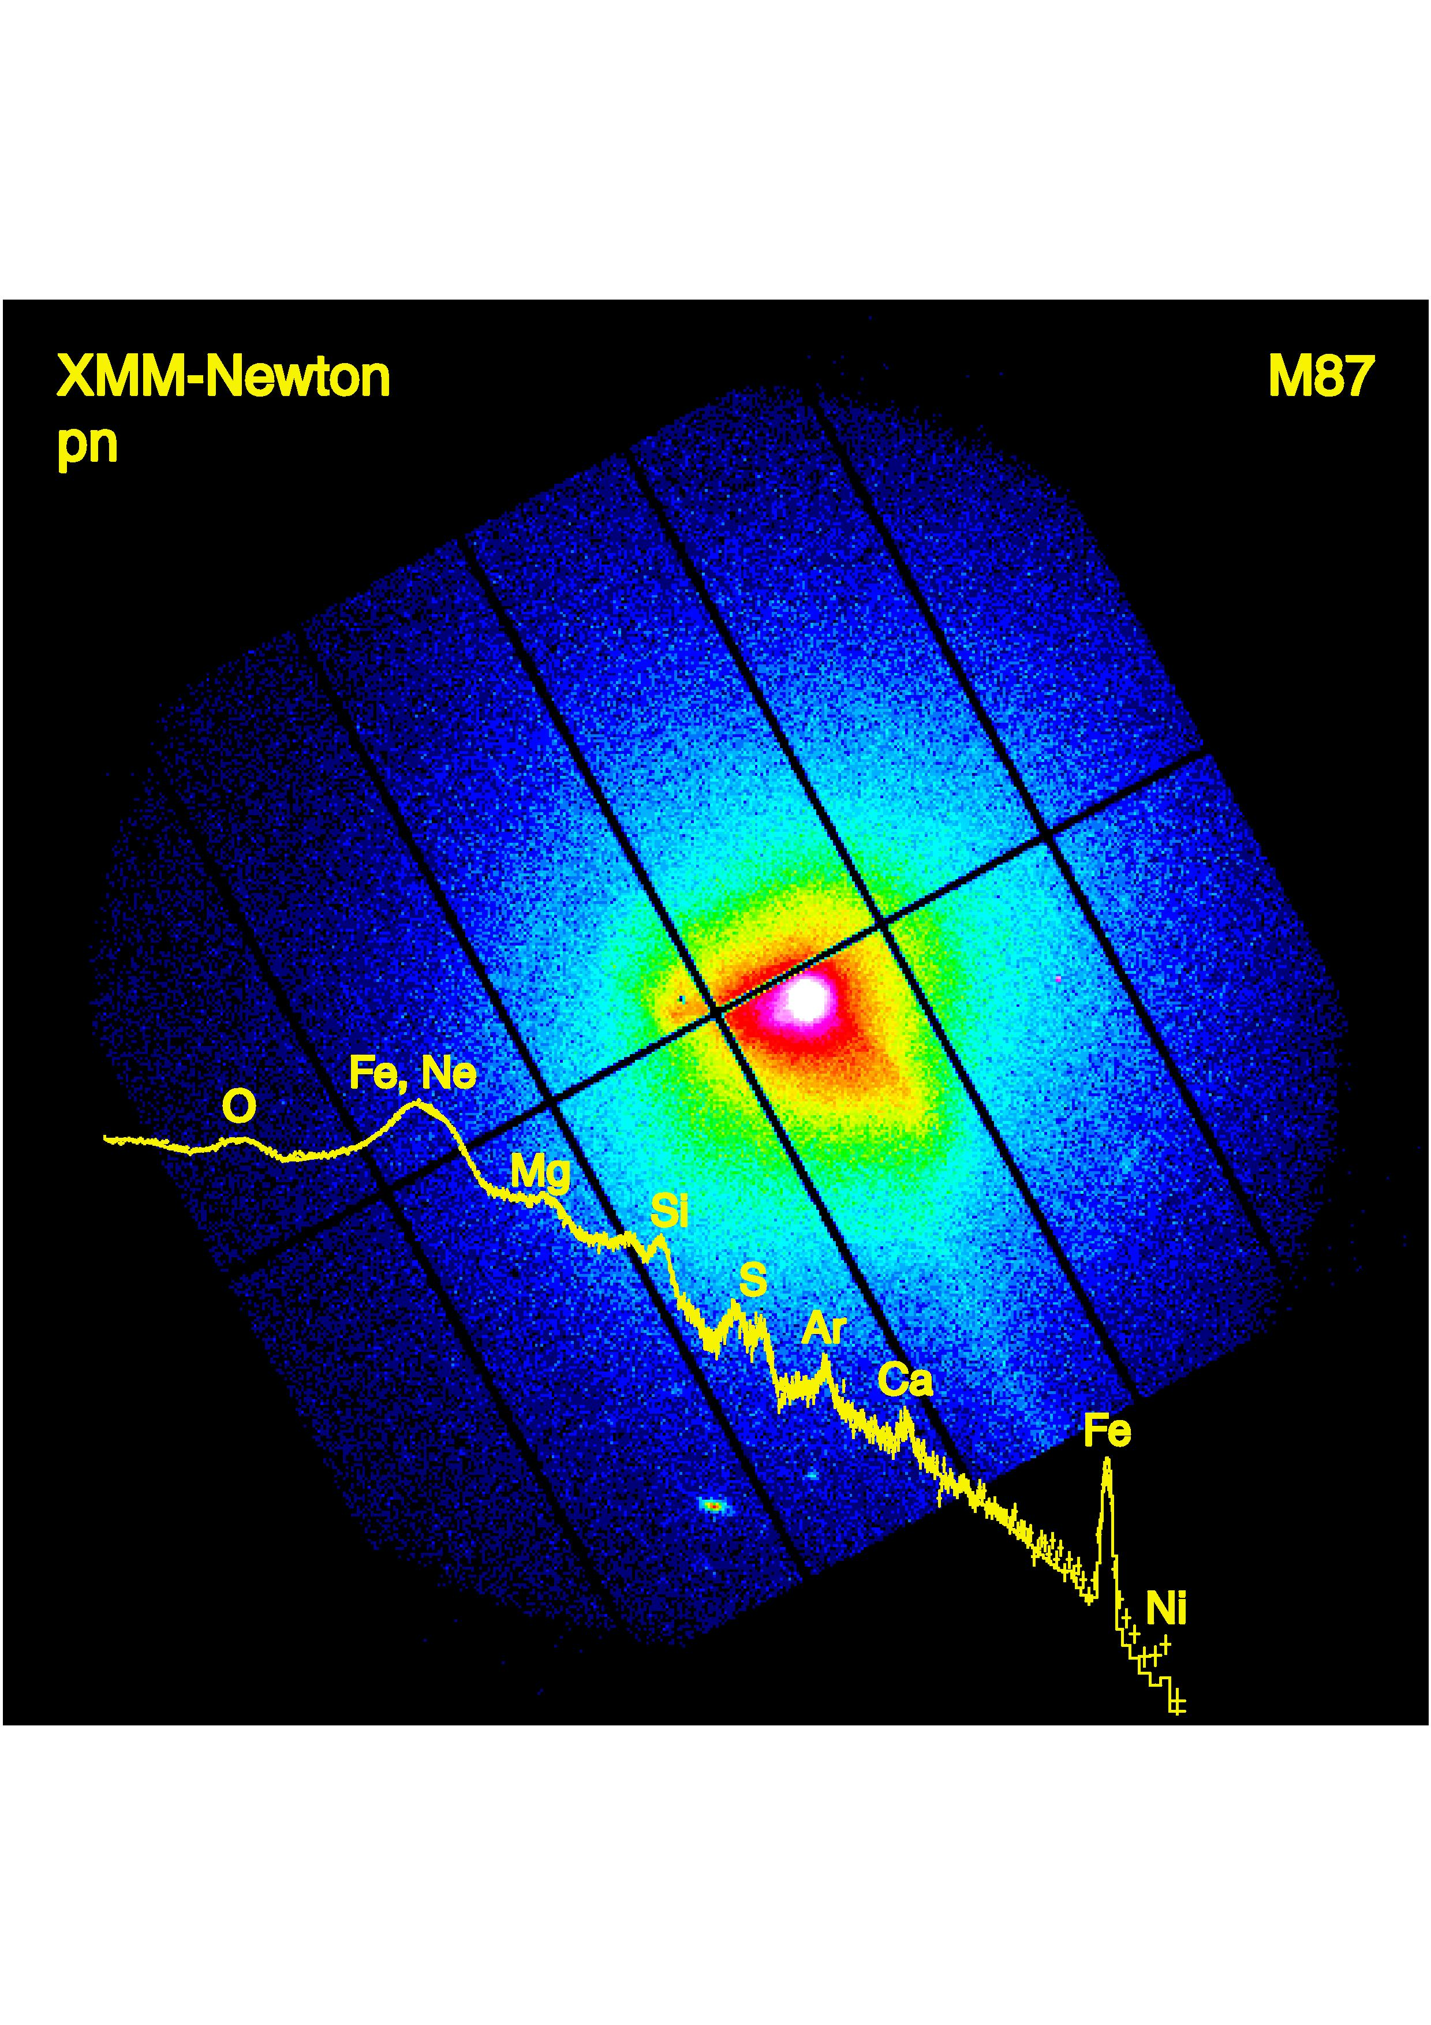
Chemical Elements in the Virgo Cluster of galaxies
Böhringer et al.
16

Slide 17
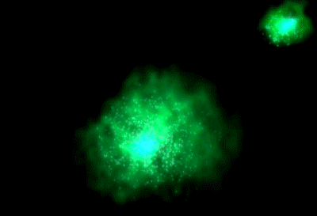

Slide 19
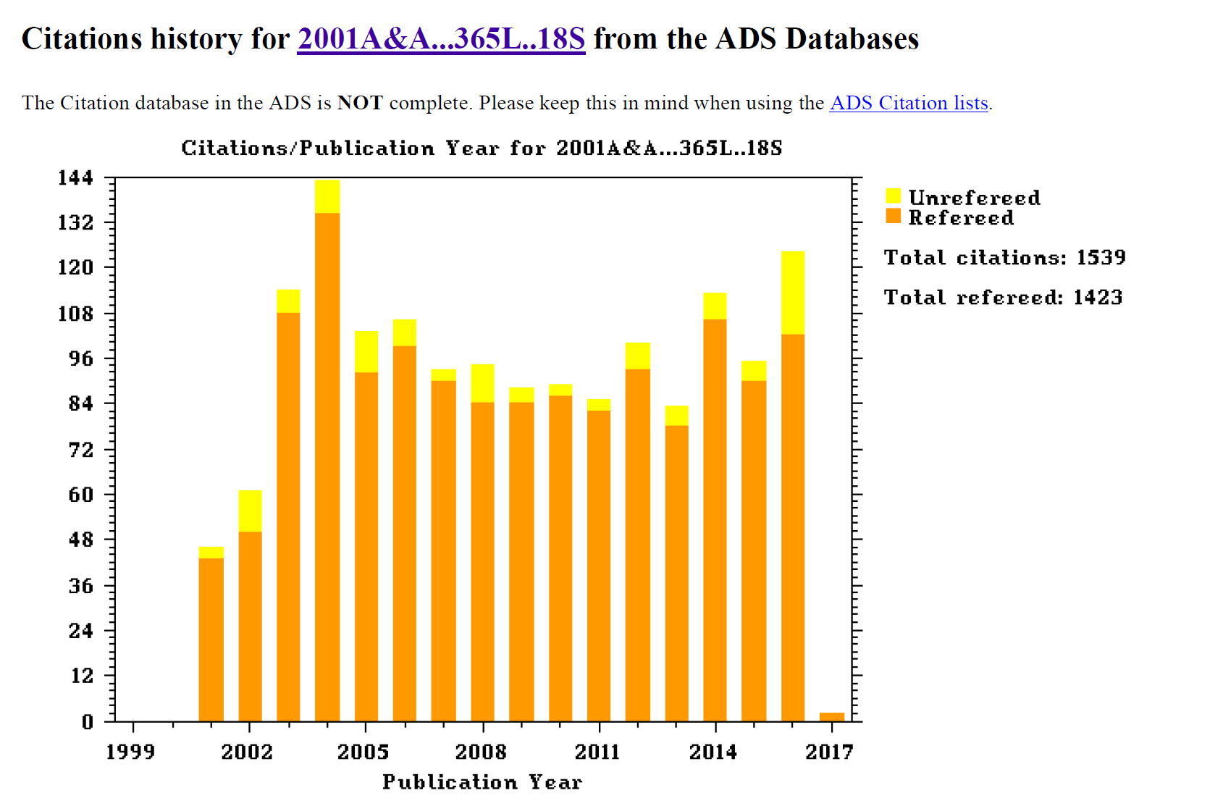
The scientific harvest of the pnCCD camera development
The European Photon Imaging Camera
on XMM-Newton: The pn-CCD camera
Plus 380 more citations in
technical journals

Slide 20
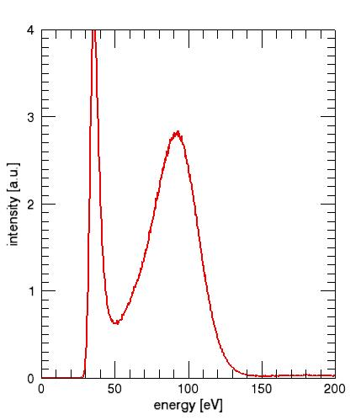
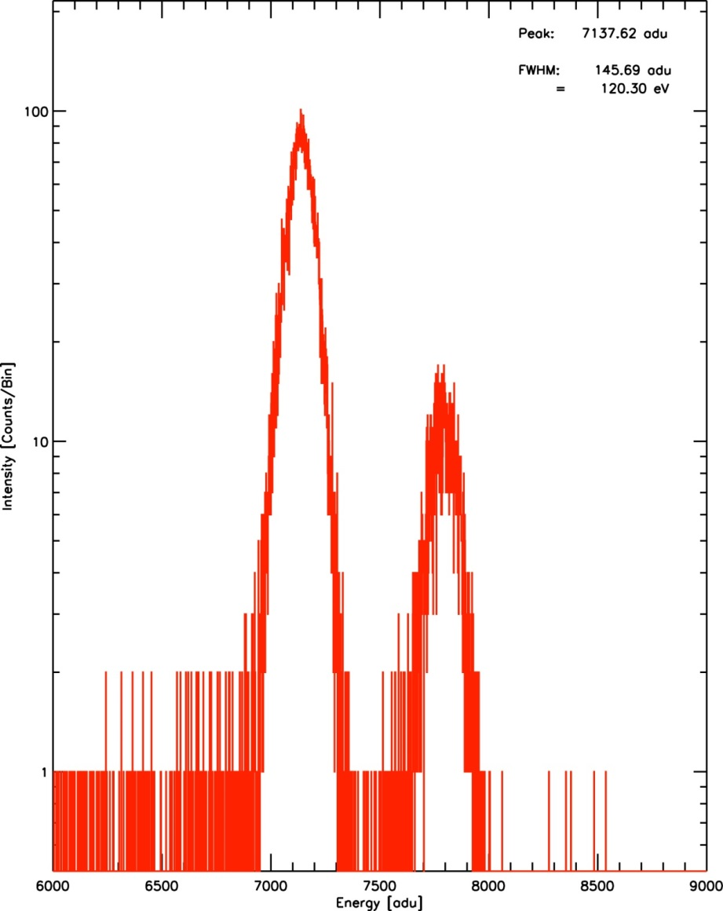
E = 90 eV
➩ 25 ± 1.7 e-h pairs
ENC = 2.5 e⁻ (rms)
∆E = 120.30 eV
t
r
i
g
g
e
r
t
h
r
e
s
h
o
l
d
30 eV
FWHM: 38.9 eV

Slide 21
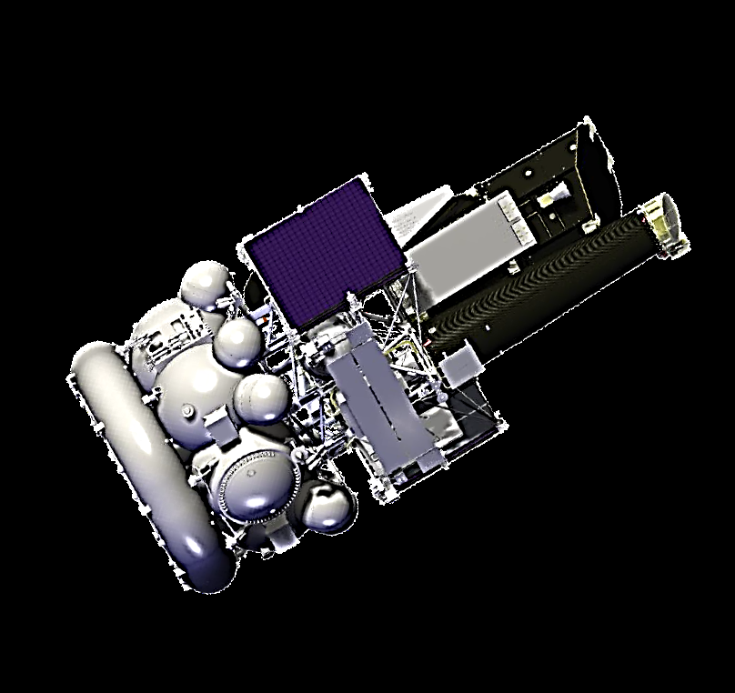
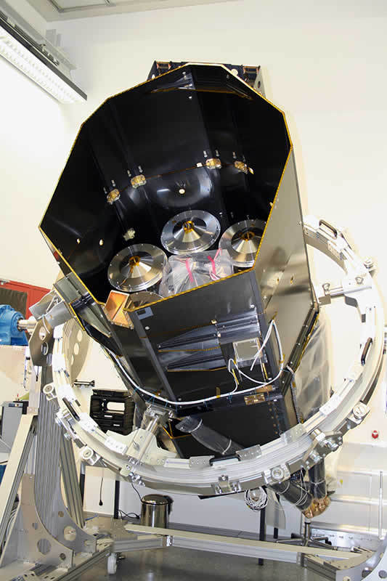
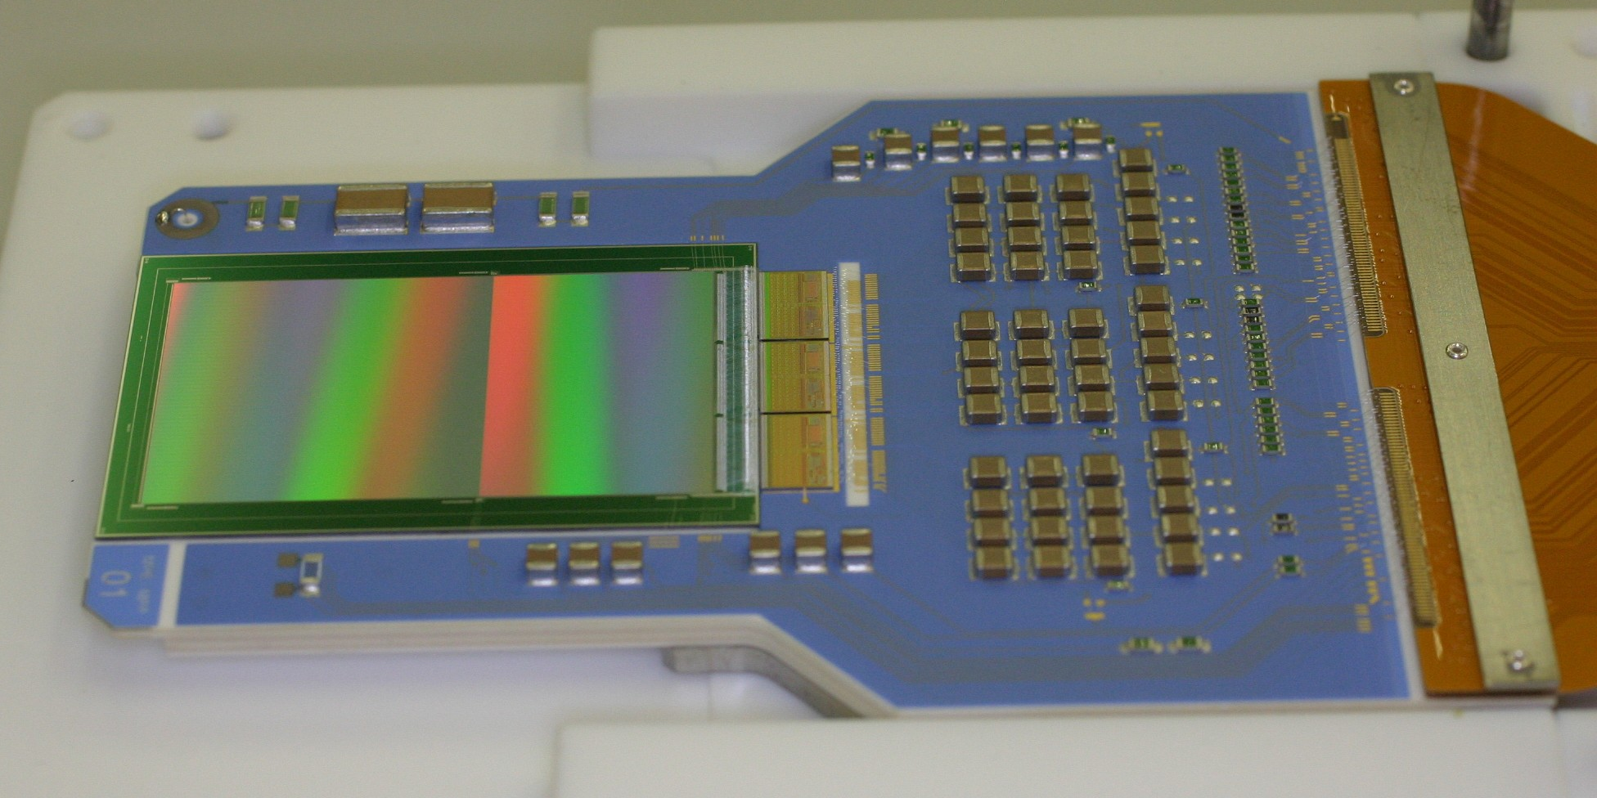
Erosita, svom
e R O S I T A
Launch in 2018
from Baikonour

Slide 22
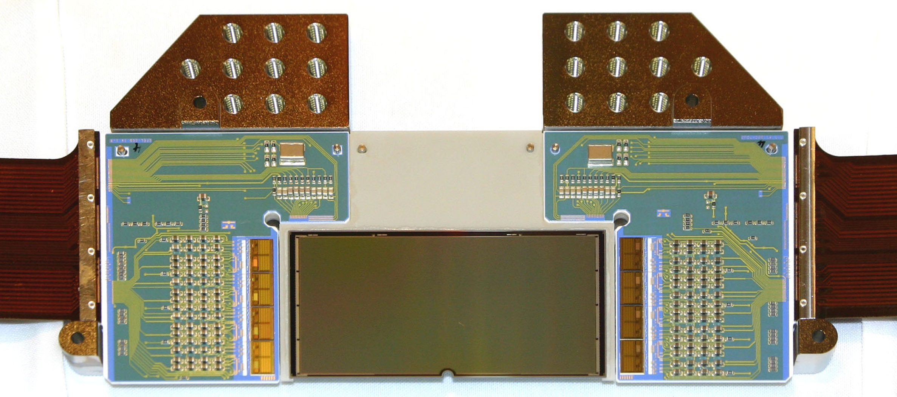
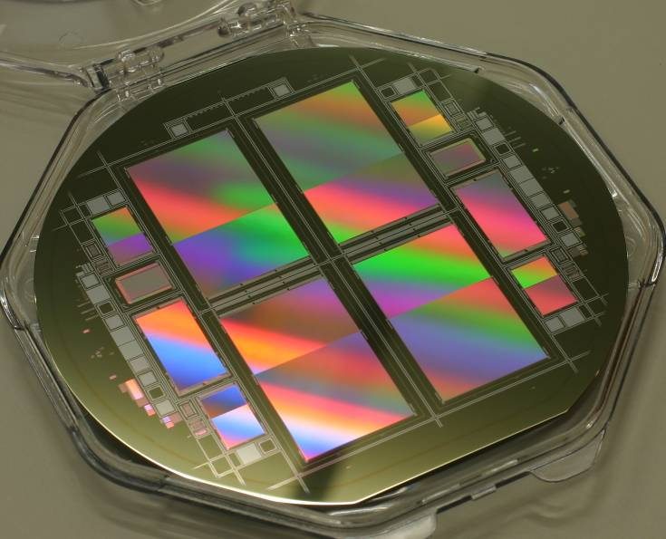
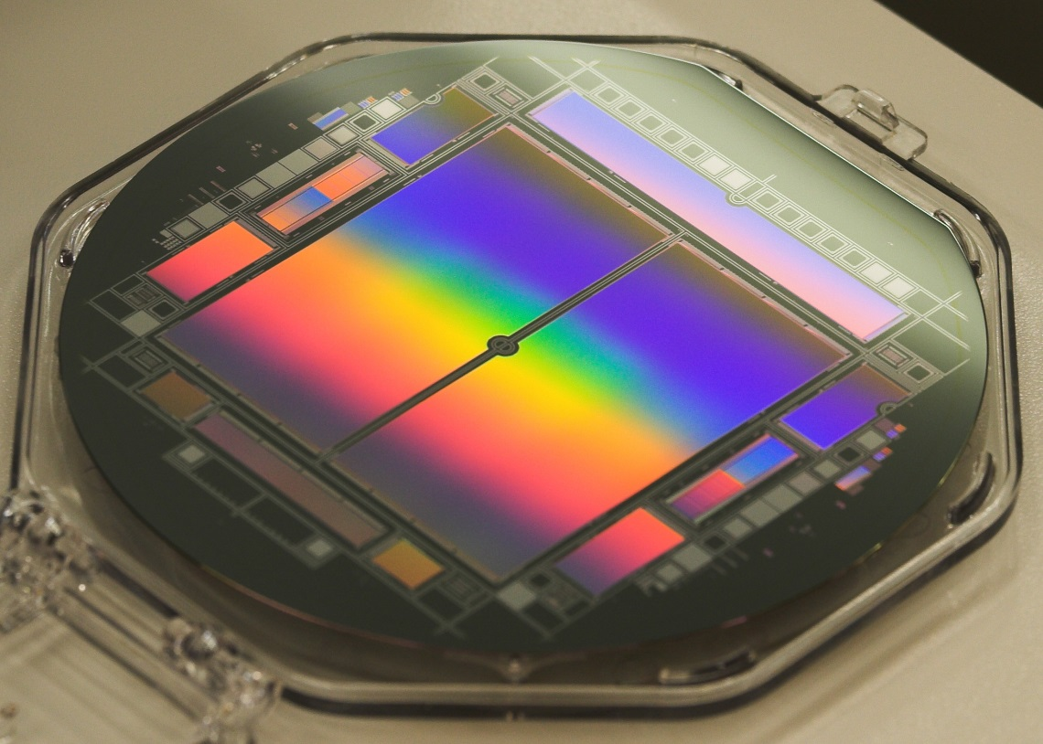
More projects with pnCCDs
Seven 2 x 384 x 384 pnCCDs on board of the e ROSITA Mission (2018)
Wave Front Sensors @ LBT in Arizona (2014)
Two 1024 x 1024 systems for LCLS, SCSS and XFEL in 2009, 2048 x 2048 formats in 2017
2 D X-ray detectors for X-ray generation with
Attosecond IR lasers (2018)
22

Slide 23
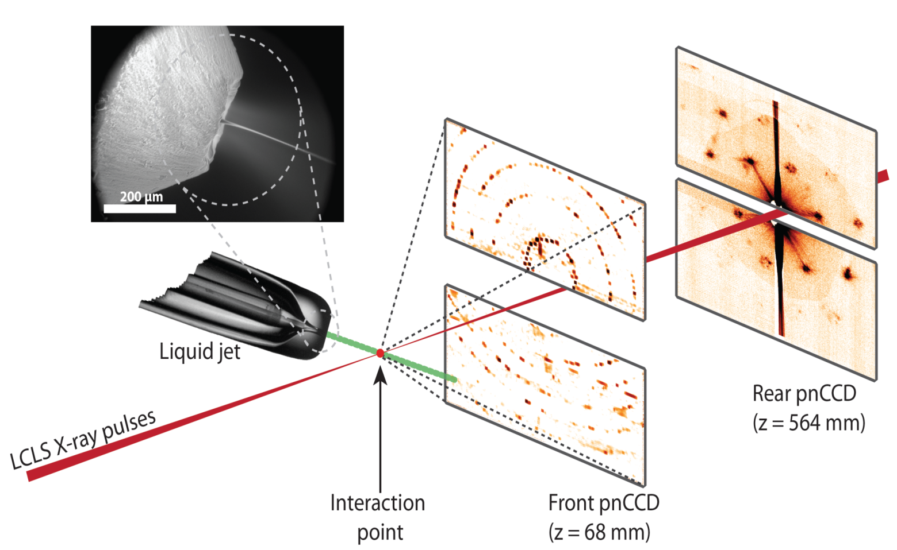
Imaging of X-rays at LCLS
Henry Chapman et al., Nature 470, 73–77 (03 February 2011)
PS1: Membrane protein photosystem I, typical size: 100 nm to 1 µm
water jet

Slide 24
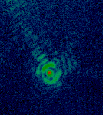
nature 470, 73–77 (03 February 2011)

Slide 25
Tomas Ekeberg et al., nature, DOI: 10.1038/sdata.2016.60

Slide 26
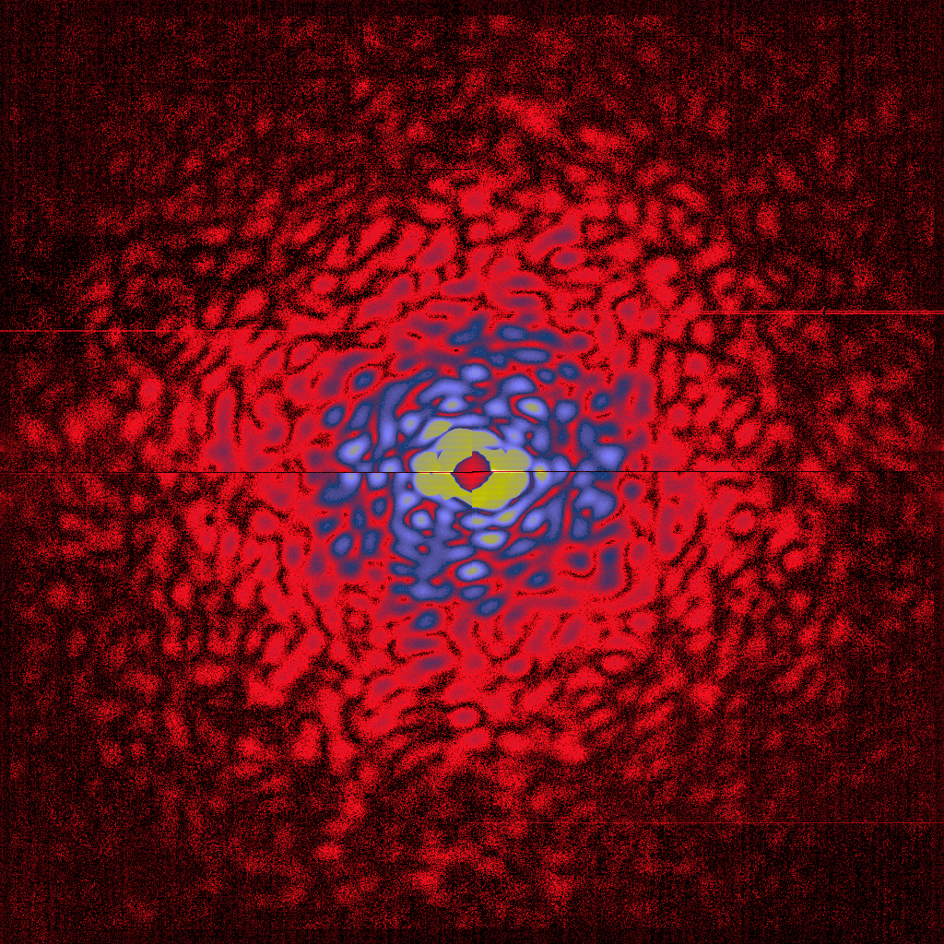
R. Koopmann et al., Nature Methods 9(3), 259 -262, 2012,
In vivo crystallization and serial femtosecond crystallography
of cathepsin B from the protozoan parasite Trypanosoma brucei
26

Slide 27
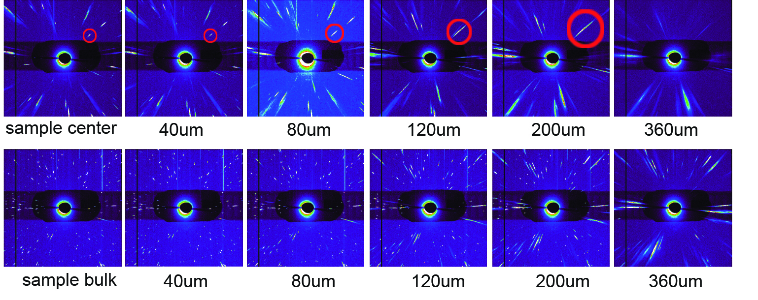
In situ analysis of polycrystalline metals at the Synchrotron at ESRF and BESSY
Position 1
Position 2
1
2
A. Abboud, et al., Rev. Sci. Instrum. 85, 113901 (2014)
S. Send, et al., J. Appl. Cryst. (2016). 49, 222–233

Slide 28
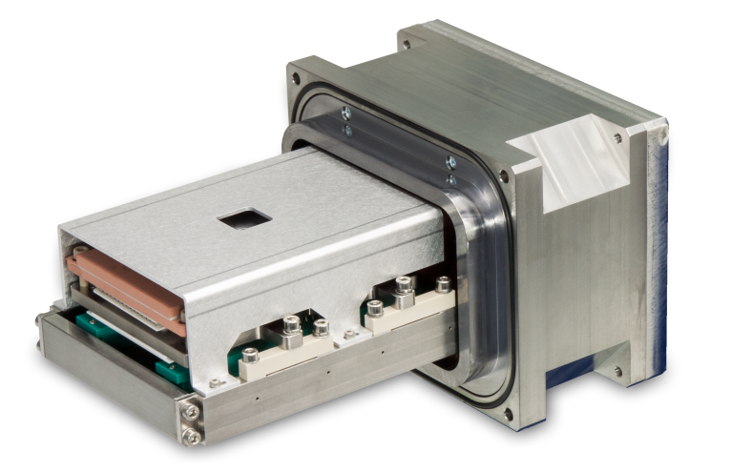
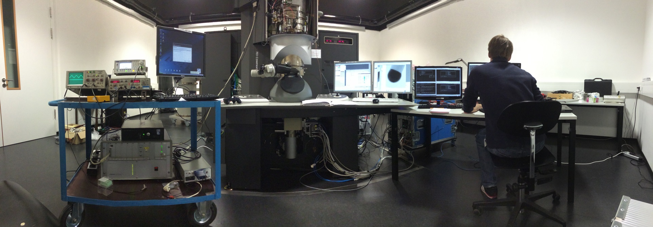
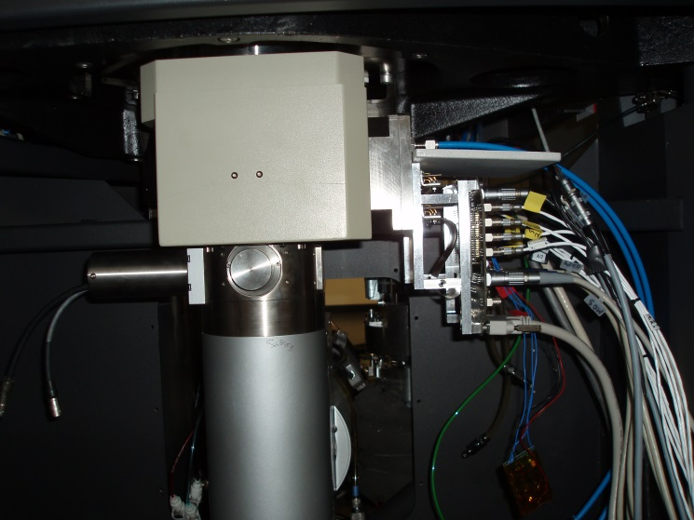
pnCCD as a (S)TEM Camera

Slide 29
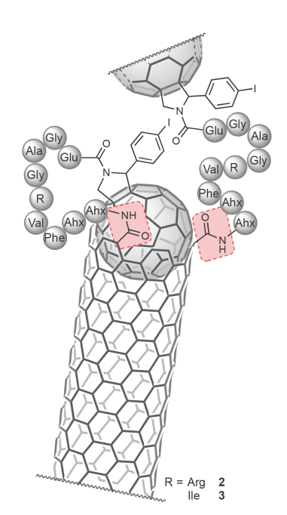
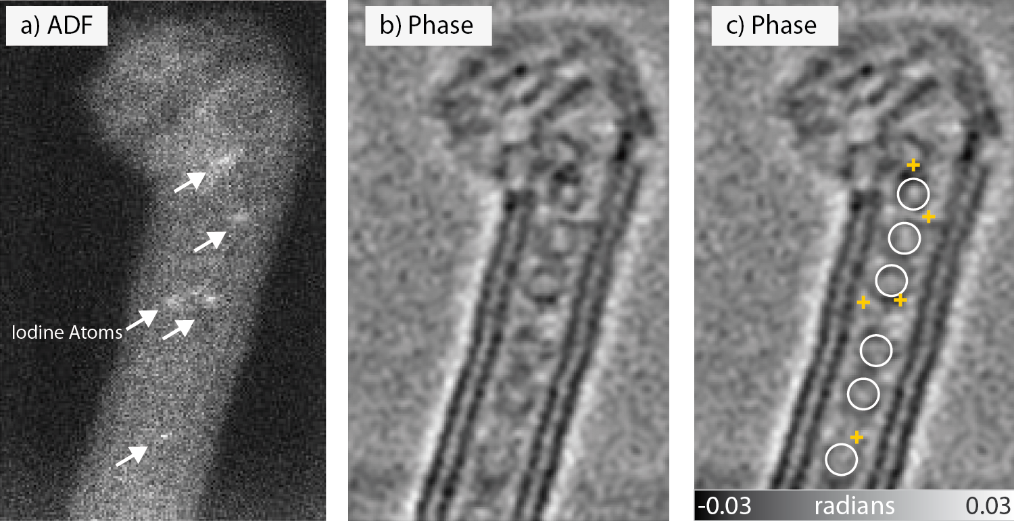
Ptychography Results in a STEM
Carbon nanotube with fullerenes inside
H. Yang, … H. Ryll, et. al., ‘Simultaneous atomic-resolution electron ptychography and Z-contrast imaging of light and heavy elements in complex nanostructures’. nature Communications 7, 2016

Slide 30

Interference Pattern @ 300 keV
30

Slide 31
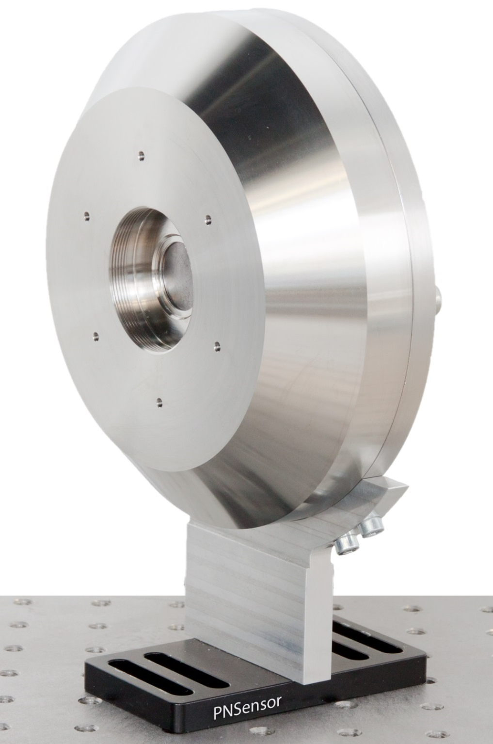
Color x-ray camera
pnCCD
48 µm pixel size
264 x 528 pixel
450 µm fully sensitive Si
1.200 frames per second
(4.800 with binning)
3 electrons (rms) readout noise
∆E_{6keV} ≤ 150 eV (FWHM)
∆E_{0,5keV} ≤ 65 eV (FWHM)
up to 1 x 10⁶ counts per second
4224 x 8448 resolution points
Energy range: 0.1 keV to 50 keV

Slide 32
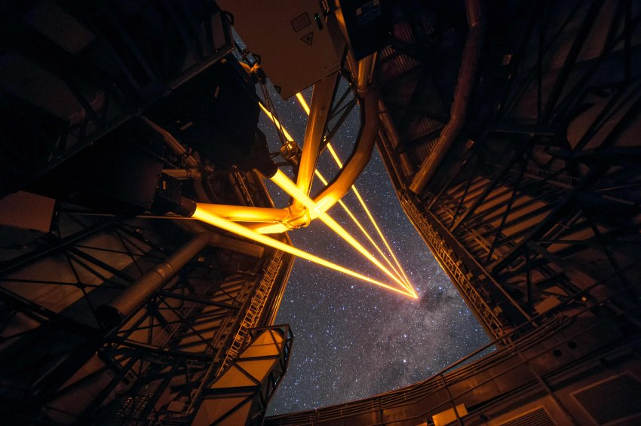
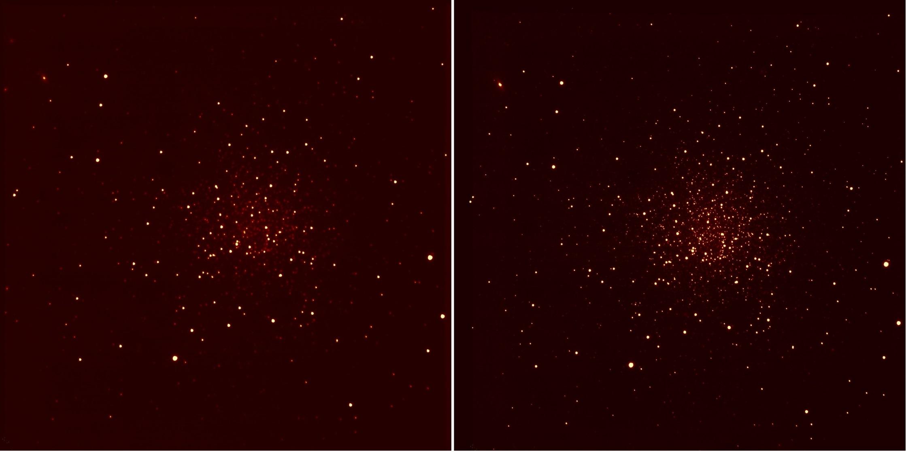
Wave-front sensor in adaptive optics systems
LBT in Arizona installed in 2014
Without AO
With AO
O. Xivry et al., doi.org/10.13009/AO4ELT2/2011.032

Slide 33
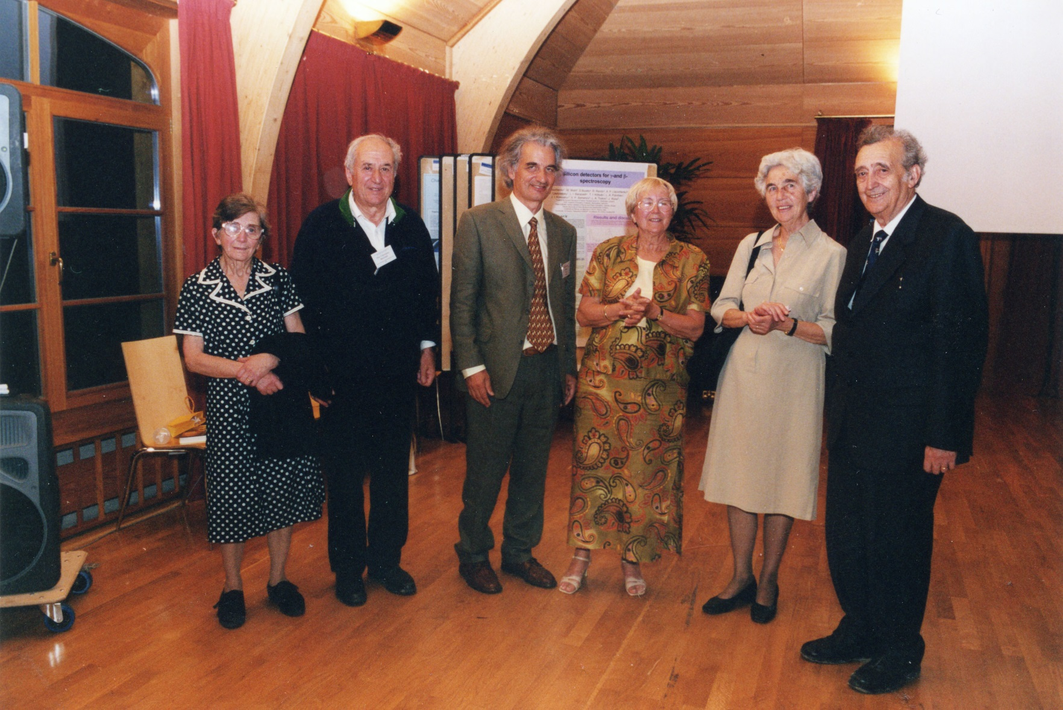
1998 in Schloss Elmau
and

Slide 34

2009 in Wildbad Kreuth

Slide 35
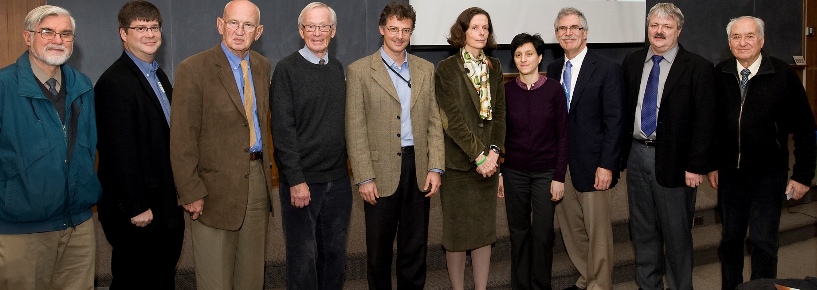
2010 at BNL

Slide 36
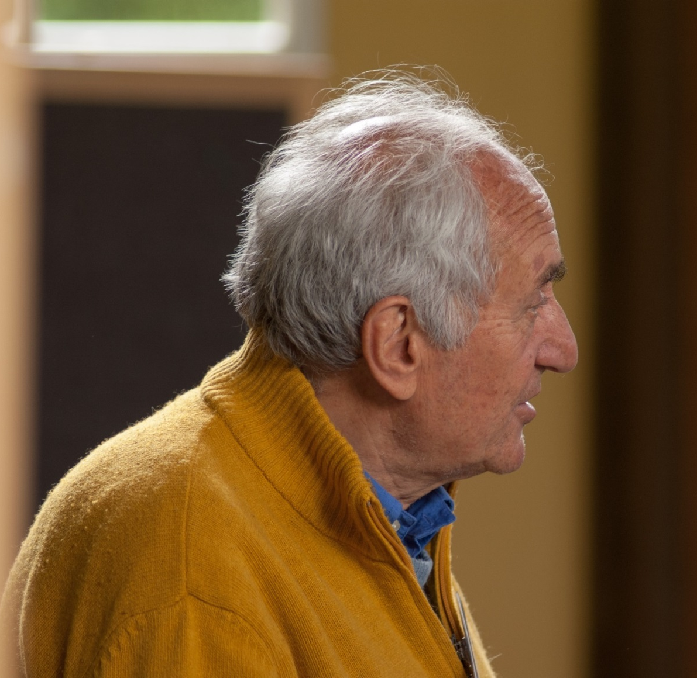
Pier Franco Manfredi has left deep traces in Munich
ASIC development with Gerhard Lutz over more than ten years
Noise Analysis for the CMX type mixed signal ASICs
Development of a CMOS compatible JFETs
Applications in many different fields were stimulated by his work

