Slide 1

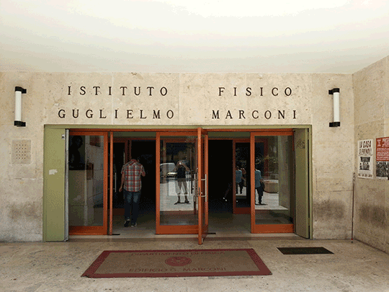



K_{L} → π⁰νν Beyond Grossman-Nir Bound
30 Sept 2016, Seminar @ Sapienza – Uni. di Roma

Slide 2
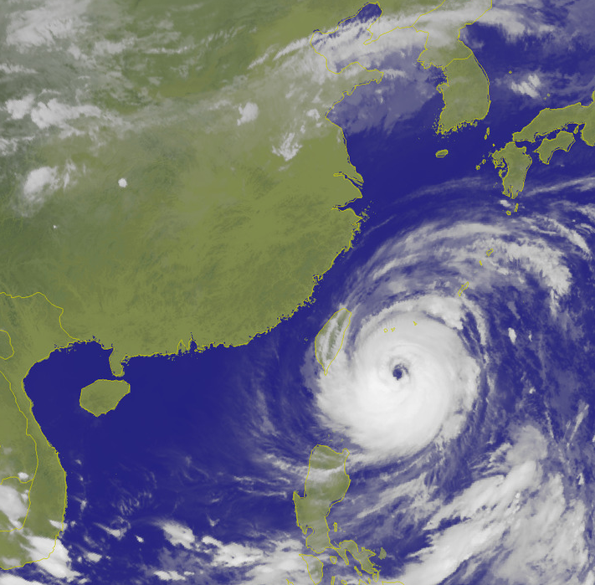
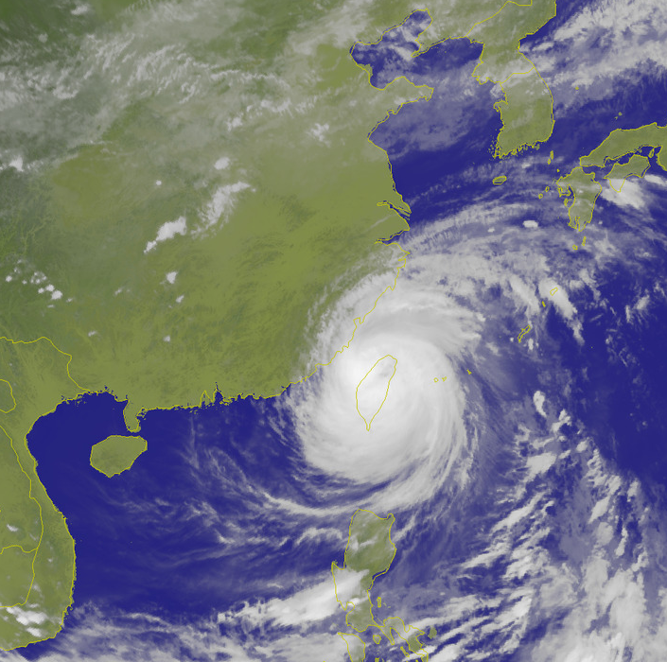
Apologies for date change !
Thanks to Roberto for Much Effort !!
0:00, 27.9 (Taipei Time)
15:00, 27.9 (Taipei Time)
Taiwan
MEGI
My flight to Hong Kong got Cancelled
(→ Zurich → Rome)

Slide 3
K_{L} → π⁰νν Beyond Grossman-Nir Bound
Outline
Intro: Kaon, as old as Particle Physics
… KOTO’s public neglect, Until Now!
Blinding [K⁺ → π⁺] π⁰: Blessed are the Blind
— K_{L} → π⁰ + Nothing above “GN Bound”? —
III. A Motivated Model (existence proof)
Gauged L_{μ} – L_{τ} related to muon g – 2 + ...
What Then? ― an Illustration of Impact
“Exotic” Rare K & B Decays
V. Conclusion
CMS → Kaon
Fuyoto, WSH, Kohda, 1412.4397 (PRL’15)
and 1512.09026 (PRD’16)

Slide 4
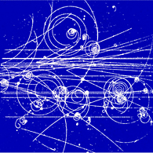

69+
I. Intro: Kaon, as old as Particle Physics
V particles from cosmic
g – 2 = α/π at one loop
But still NP Frontier:
K⁺ → π⁺νν vs K_{L} → π⁰ νν
@ CERN
@ J-PARC

Slide 5
KOTO SP at FPCP2016, Caltech
p. 26
Relative Mute @ ICHEP
p. 14

Slide 6
… KOTO’s public neglect, Until Now!
p. 26
1609.03637
One Event, 0.34 ± 0.16 BG expected
slightly worse vs E391a
slightly better limit

Slide 7




Grossman-Nir Bound
Grossman and Nir, PLB 398, 163 (1997)
The following model-independent (solid) relation holds
due to isospin symmetry
Using E949 90% CL upper limit,
(“GN bound”)
Much better than E391a 90% CL upper limit
~ 0.5 x KOTO w/ 100h data
Folklore: KOTO will start to probe New Physics only
after the GN bound is reached

Slide 8
Now …
?
Shaken It Off !
mostly
KOTO @ 100 hrs (2013), paper finally ...
“Blind man blessed by senses.”
Grossman-Nir Limit
@ J-PARC

Slide 9
II. Blinding [K⁺ → π⁺] π⁰: Blessed are the Blind
Or: Stupid is as stupid does.

Slide 10
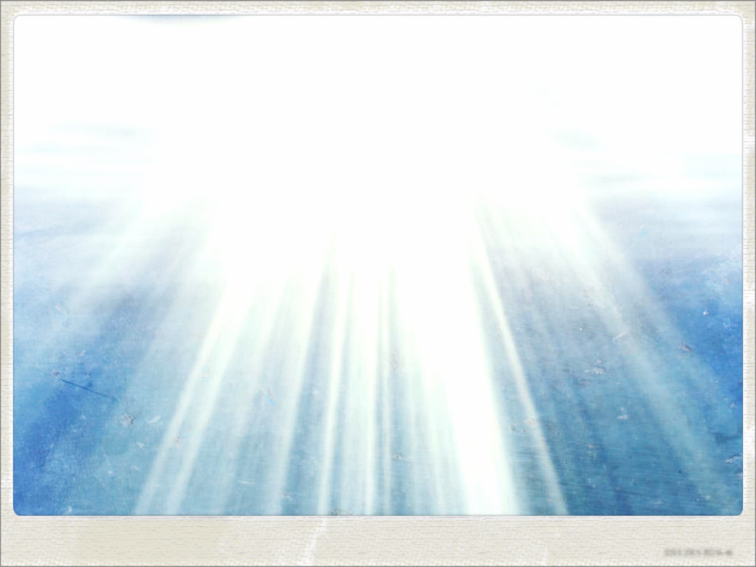

The Blinding K⁺ → π⁺π⁰
I (We) have (all) stared
at this gazillion times,
and became numb.
blinding spot

Slide 11
The Blinding K⁺ → π⁺π⁰
Window basically Same
as E787/949 @ BNL
@ CERN
Kinematic exclusion:
21%
5.6%
1.8%
Kinematic Control:
use K⁺ and π⁺ momenta
to block out blinding zone
See Neither
See Not

Slide 12

The Blinding K⁺ → π⁺π⁰
Not a great limit
stable
1/200 weaker than K⁺ → π⁺νν bound
blinding spot
$$X_{}^{0}$$
X

Slide 13


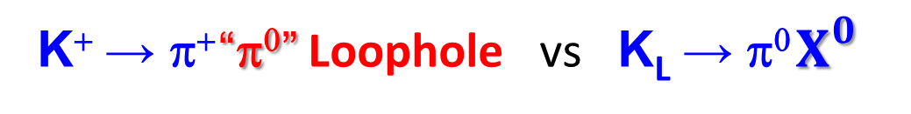
K⁺ → π⁺ “π⁰” Loophole vs K_{L} → π⁰ $X_{}^{0}$
Window basically Same
as E787/949 @ BNL
The KOTO Expt at J-PARC
can discover above
the Grossman-Nir Bound !
K_{L} → π⁰ X⁰
@ CERN
Kinematic exclusion:
“Blessed are the Blind.”
A Surprise ! “Trivial”
K_{L} → π⁰ νν
“Nothing to Nothing” (just γγ)
― Veto Everything !
But: Cannot Veto WILPs.
(Weakly Int. Light Particle)
See Neither
See Not
$$X_{}^{0}$$
$$X_{}^{0}$$
Fuyoto, WSH, Kohda, PRL’15

Slide 14
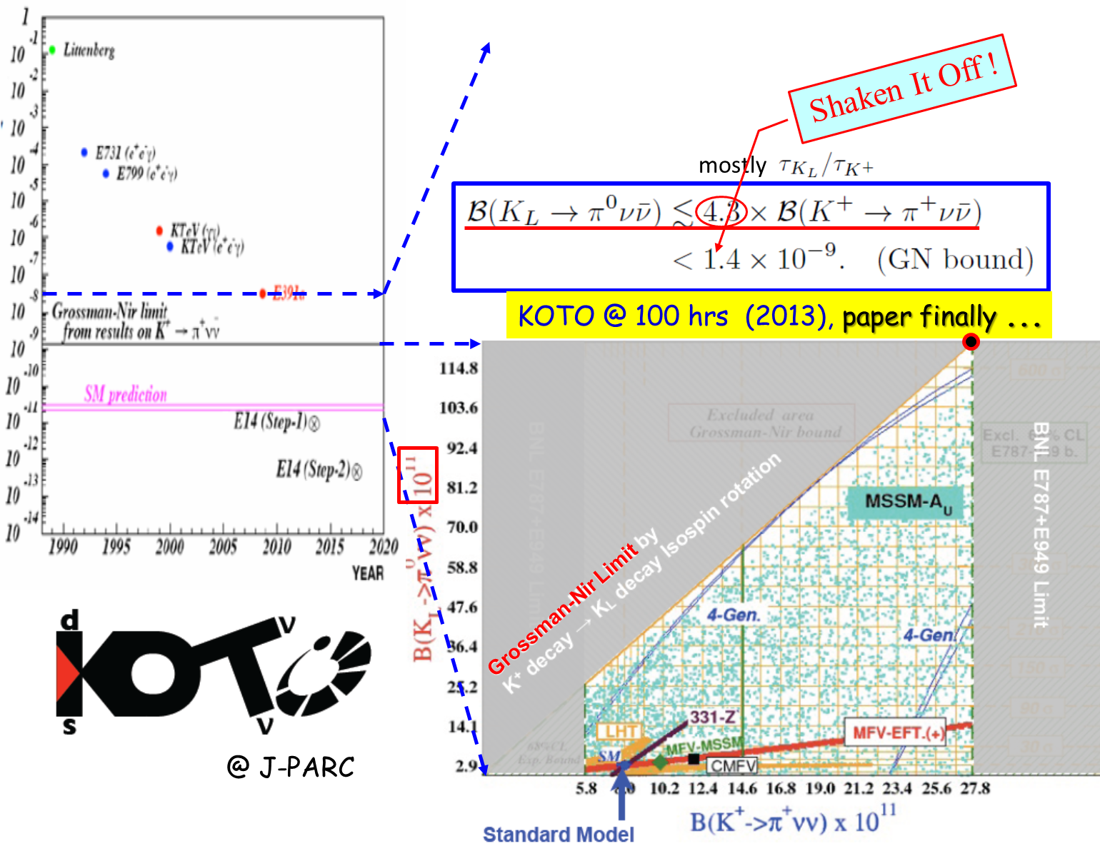
Discovery Starting “Now” !
The KOTO Expt at J-PARC
can discover above
the Grossman-Nir Bound !
K_{L} → π⁰ X⁰
discovery

Slide 15
— K_{L} → π⁰ + Nothing above “GN Bound” ? —
What you learned in “school” not quite right
Seeing the possibility was inadvertent
It all started from CMS & TopCNC Pheno …
A Story of CMS-related work leading to Kaon physics … ☺

Slide 16
III. A Motivated Model (existence proof)
gauged L_{μ} – L_{τ} related to muon g – 2
+ ...

Slide 17


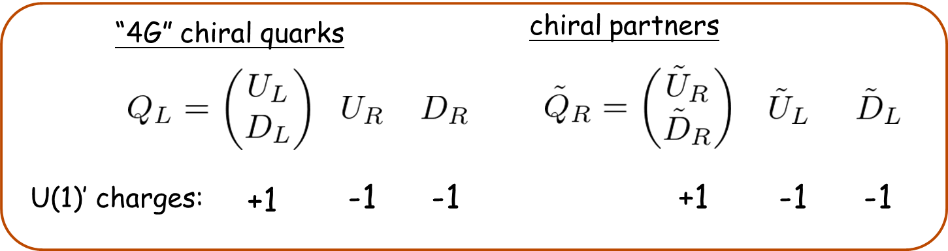
Gauged L_{μ} - L_{τ} model
Altmannshofer, Gori, Pospelov and Yavin, PRD89, 095033 (2014)
• U(1)′: gauging L_{m} - L_{t} (m-number minus t-number)
→ anomaly free within SM particle content
• U(1)′ breaking:
- SM singlet
- U(1)′ charge +1
- Z′ mass:
- L_{m} - L_{t} current:
- Link to Quarks? Introduce New Vector-like Quarks
X.G. He et al., PRD1991
g.i. mass, plus
Yuk. Mixing w/
SM Quarks

Slide 18
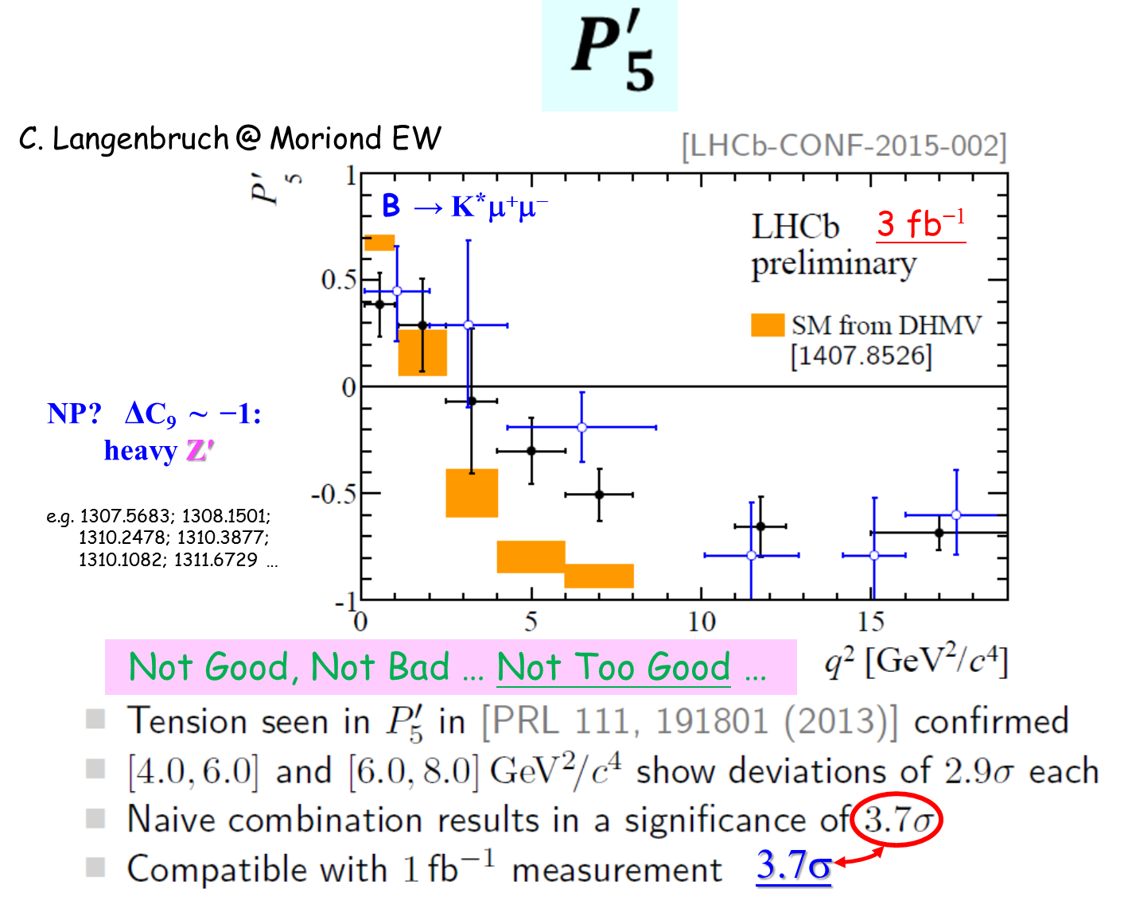
[3.4σ published]

Slide 19
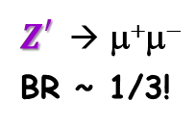
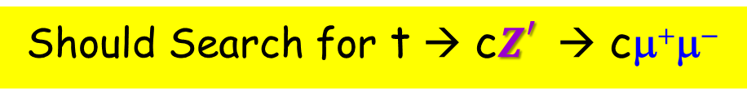
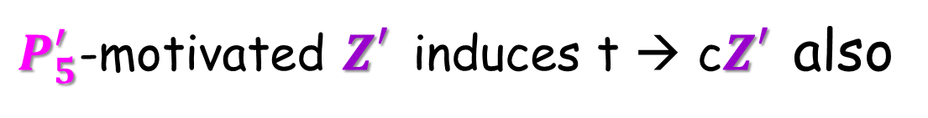
$P_{5}^{′}$-motivated $Z_{}^{′}$induces t → c$Z_{}^{′}$also
B → K*μ⁺μ⁻
Our Original Interest
flow of U(1)′ charge
Q, D, U: vector-like quarks with Z′ charge
“unconstrained”
Should Search for t → c$Z_{}^{′}$→ cμ⁺μ⁻
$Z_{}^{′}$→ μ⁺μ⁻
BR ~ 1/3!
“gauged L_{μ} – L_{τ}”

Slide 20
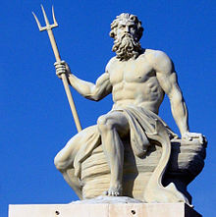
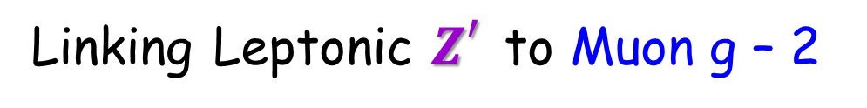


Linking Leptonic $Z_{}^{′}$to Muon g – 2
gauged L_{μ} – L_{τ}
1406.2332
Cannot Affect $P_{5}^{′}$
Altmannshofer, Gori, Pospelov, Yavin [PRD → PRL]
“Neutrino Trident Production”
Quite Weakly
Coupled
“LBNE”
but not DM
Muon g – 2 related $Z_{}^{′}$≲ 400 MeV < m_{K} ?
New Physics from Light Particle !?

Slide 21
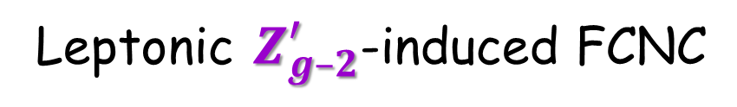

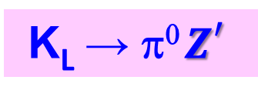
Leptonic $Z_{g–2}^{′}$-induced FCNC
gauged L_{μ} – L_{τ}
flow of U(1)′ charge
Tune away by Z₂
Q, D, U : vector-like quarks with Z′ charge
〈ϕ〉 : generates Z′ mass
SM-assisted loop
s → dZ′; b → sZ′
Fuyoto, WSH, Kohda, PRL’15
K_{L} → π⁰ $Z_{}^{′}$
Muon g – 2 related $Z_{}^{′}$≲ 400 MeV < m_{K} !
New Physics from Light Particle !?

Slide 22
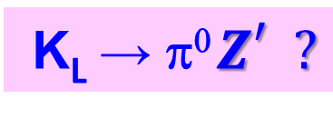

…
A Little Some Work
π (K^{(*)})
K (B)
$Z_{}^{′}$≲ 400 MeV < m_{K}
Aim: allowed t → cZ′ rate
But,
K_{L} → π⁰ $Z_{}^{′}?$
...

Slide 23


K⁺ → π⁺ “π⁰” Loophole vs K_{L} → π⁰ $X_{}^{0}$
Window basically Same
as E787/949 @ BNL
The KOTO Expt at J-PARC
can discover above
the Grossman-Nir Bound !
K_{L} → π⁰$Z_{}^{′}$
@ CERN
Kinematic exclusion:
“Blessed are the Blind.”
A Surprise ! “Trivial”
K_{L} → π⁰ νν
“Nothing to Nothing” (just γγ)
― Veto Everything !
But: Cannot Veto WILPs.
(Weakly Int. Light Particle)
See Neither
See Not
$$Z_{}^{′}$$
$$Z_{}^{′}$$
Fuyoto, WSH, Kohda, PRL’15

Slide 24

IV. What Then? ― an Illustration of Impact
Circumstantial Hints/Possibilities in Rare B & K Decays
$$Z_{}^{′}< 2mμ: νν only$$
$$Z_{}^{′}> 2mμ: νν/μμ$$

Slide 25
BaBar: mild hint in B⁺ → K⁺νν
N.B. B(B → Kπ⁰) << B(K → ππ⁰)
BaBar’13 (471M BB(bar))
BaBar hint fully covers down to GN Bound !
Belle needs to follow up with
the Binned m_{mis} analysis.
(→ Belle II)
10 m_{mis} bins
driven by lowest bin
Fuyoto, WSH, Kohda, PRL’15

Slide 26
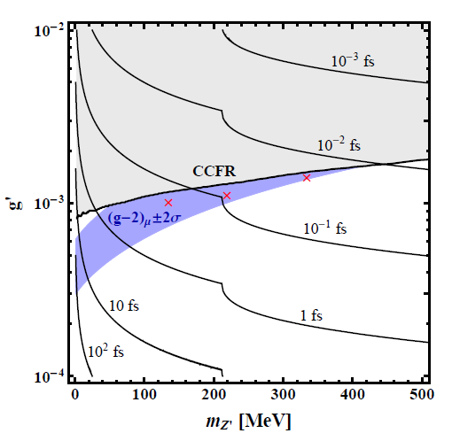



Comment: Light “g-2” Z’ decay is
prompt, even when highly boosted.
Fuyoto, WSH, Kohda, PRD’16

Slide 27
LHCb 1508.04094 [PRL’15 supplementary]

Slide 28
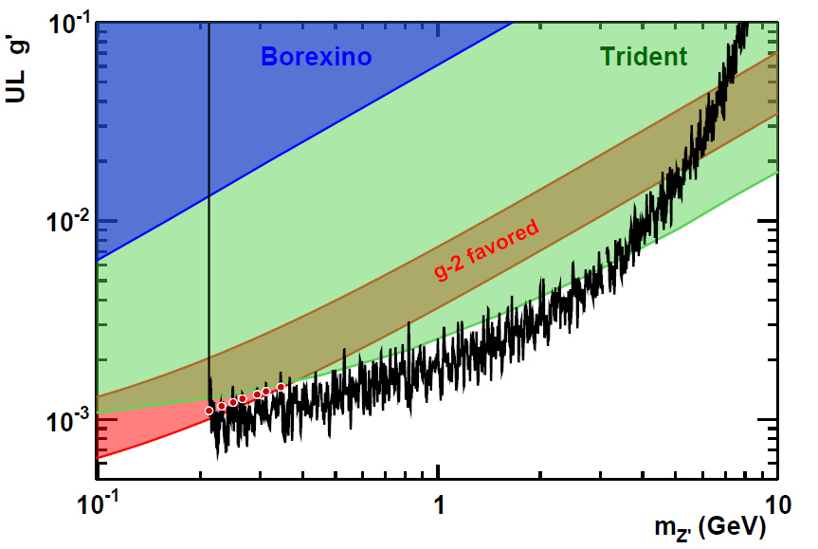
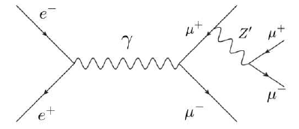
1606.03501
“Pockets” exist, but paper came after our PRD,
so, will not incorporate in discussion.
exclude all but a sliver …
above dimuon threshold

Slide 29

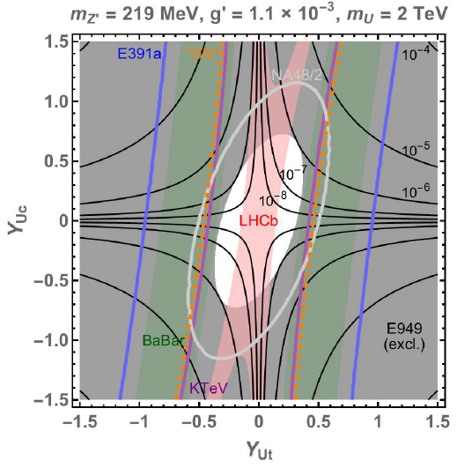




$$Z_{}^{′}> 2mμ: νν/μμ$$
The 2nd Window: “pocket” physics
Allowed
334 MeV $Z_{}^{′}$ [LHCb tolerant]
219 MeV $Z_{}^{′}$ [LHCb stringent]
Fuyoto, WSH, Kohda, PRD’16

Slide 30




The Light $Z_{g–2}^{′}$ Landscape (illustration)
Perhaps 100 TeV SPPC/FCChh Needed .... Or not? [50% μμ]
Contour in backdrop is t → c$Z_{g–2}^{′}$
334 MeV $Z_{}^{′}$
135 MeV $Z_{}^{′}$
Opportunity
Y_{Uc} & Y_{Ut} reasonable in strength
Fuyoto, WSH, Kohda, PRL’15
and PRD’16

Slide 31
Now …
Discovery Zone
(2015 Data!)
Shaken It Off !
mostly
KOTO @ 100 hrs (2013), paper finally ...
NA62
“Blind man blessed by senses.”
Zone Open
Grossman-Nir Limit
@ J-PARC

Slide 32
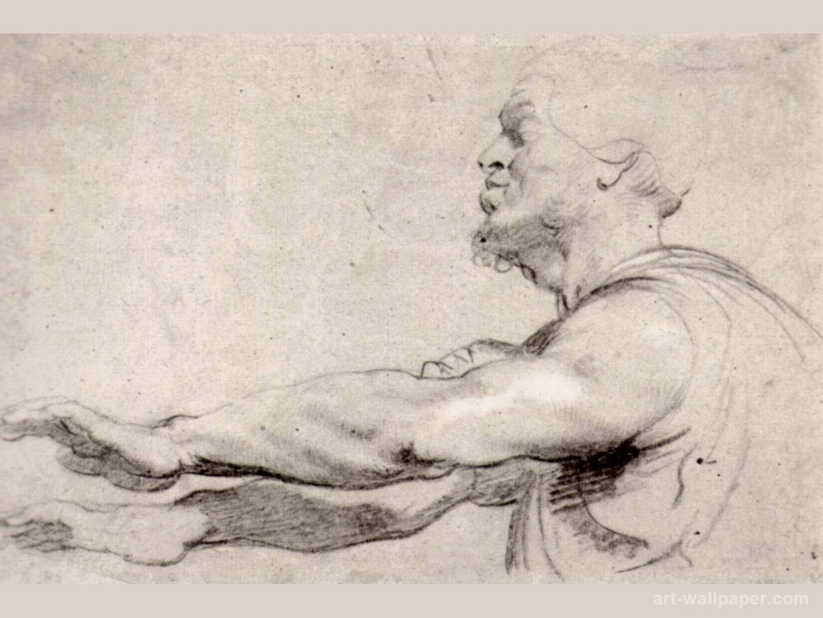
V. Conclusion
• K_{L} → π⁰ + nothing: can occur above “Grossman-Nir Bound” ➔ KOTO !
If See Early Event(s), Try Hard to Kill ... But Not Overkill.
• If above GN Bound, then likely “π⁰” mass object .
• When KOTO reaches below current “GN Bound”, concept still effective.
➔ KOTO/NA62/Belle(II) (/LHCb) all in game.
(that slips thru NA62)
Analyze, KOTO, Analyze !

Slide 33
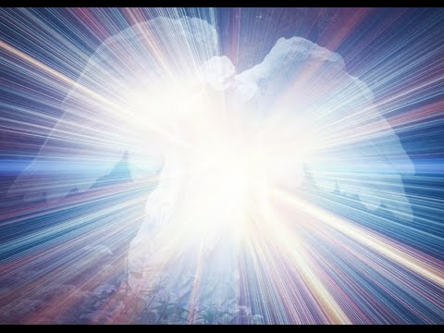
“Blessed are the Blind,
for they shall see the Heavens open.”
Analyze, KOTO, Analyze !
and, ... Dark Connections?

Slide 35
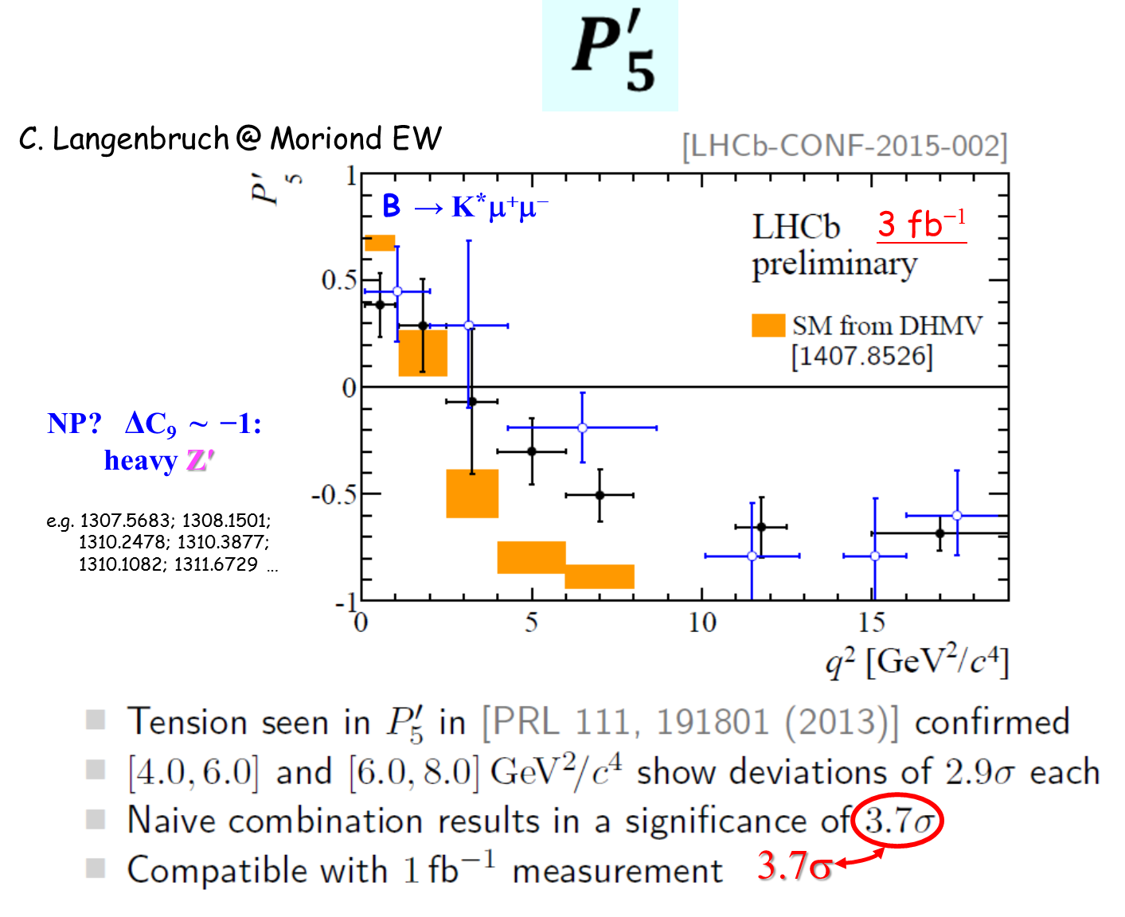
Ex: Tolk yesterday;
Th: Turstall this morning
Not Good, Not Bad … Not Too Good …
3.4 σ

Slide 36
Pick up t → cZ' topic at LHCP2014
difference between muon- and tau-lepton number
X.G. He et al., PRD1991
1403.1269
I ask from back of room: “How to Search?”.
Came the reply: “μμ or ττ” mode.

Slide 37

$$Z_{}^{′}> 2mμ: νν/μμ$$
The 2nd Window
285 MeV
OUTDATED BY LHCb DB
260
300
Range of “excess”
“excess” in 1st bin
Can be refined by NA62
Piccini talk this morning
Fuyoto, WSH, Kohda, PRL’15

Slide 38
The Blinding K⁺ → π⁺π⁰
I (We) have (all) stared
at this gazillion times,
and became numb.
blinding spot

