Slide 1
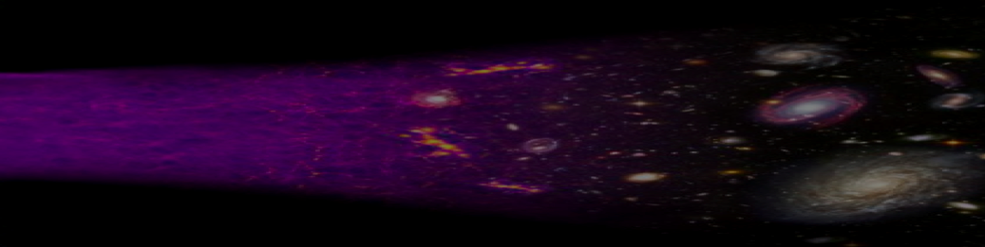
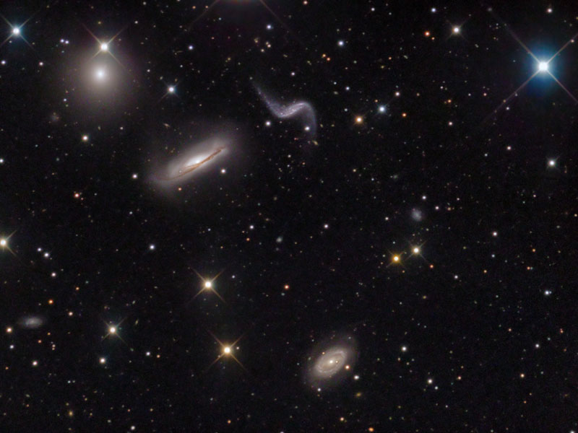

Raul Jimenez
ICREA & ICCUB
BARCELONA
Beyond precision cosmology, some examples
Notes:
Mention ERC large grant there will be positions associated with it
Mention ICC and maria de Maeztu distinction excellence center.

Slide 2
First decade or so of 2000: Precision cosmology
(WMAP, Boomerang, Acbar, …SDSS, 2dF, Supernovae etc..)
ΛCDM: The standard cosmological model
Just 6 numbers…..
describe the Universe composition and evolution
Homogenous background
Perturbations
Notes:
The first decade of the years 2000 saw the establishment of precision cosmology:
Thanks to a massive observational effort...
Like the establishment of the standard model for particle physics in the 70. cosmology has s standard model .
A standard cosmological model just 6 numbers describe as fas as we can tell the composition and evolution of the universe…
Oh well observations of thereof
this is not the end of the game because in this model there are things we do not understand (deeply disturbing..)

Slide 3
Context and overview
Cosmology over the past 20 years has made the transition to precision cosmology
Cosmology has now a standard model. The standard cosmological model only needs few parameters to describe origin composition and evolution of the Universe
Big difference between modeling and understanding
Implies Challenges and opportunities
Comology is special: we can’t make experiments, only observations. We have to use the entire Universe as a detector: the detector is given, we can’t tinker with it.
Notes:
so we have observed as much as possible of it…
Avalache of data: CMB planck the information content of the primary temperature anisotropies has been saturated i.e no extra –statistical-infornmation... LSS larve volume surveyed
we observe and we therfore observed as much as possible of it
add slide of sdss

Slide 4
Can now do precision tests of fundamental physics with cosmological data
Notes:
what does this massive, high precison amount of data mean???
Take the base model and extend it, considering one thing at the time
Neutrino masses**, properties of dark energy, properties of dark matter…
Once you have a standard model (like particle physics in the 70). Once you have a standard model
precision tests have confirmed the standard model of particle physics and searched for distinctive signatures of the natural extension of the standard model: supersymmetry.
This is what we have been doing also in cosmology (some 30-40 years later…)

Slide 5
Wonderful agreement of new data with the ΛCDM model
* With some notable exceptions which are still up for discussion.
Notes:
Planck+ the biggest 3D maps of galaxies in the Universe….
First order answer. If you want a second order answer or a one loop answer… I am happy to discuss it during the questions...

Slide 6
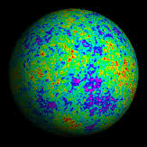
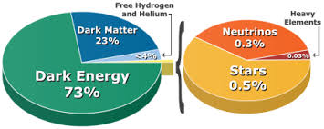
Is this the whole story?
What is the 96% of the Universe?
What set out the primordial perturbations?
The model is “preposterous”, how can it be correct?
Challenges and opportunities

Slide 7
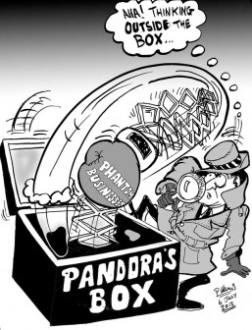
STILL….
The model IS incomplete… Neutrinos have mass
The model is unsatisfactory
The cosmological constant problem
Inflation is more than n_{s}
Neff
Curvature
Neutrino mass
w
This drives a massive experimental effort

Slide 8
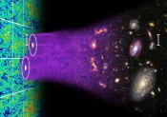
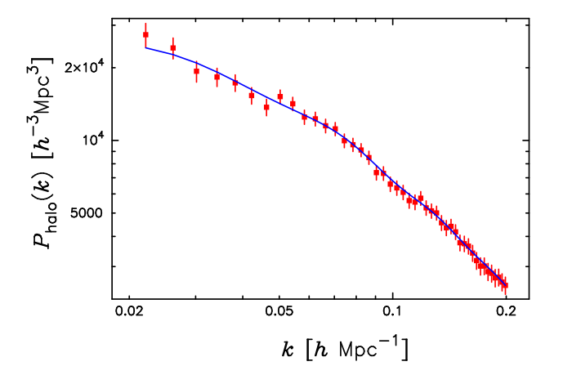
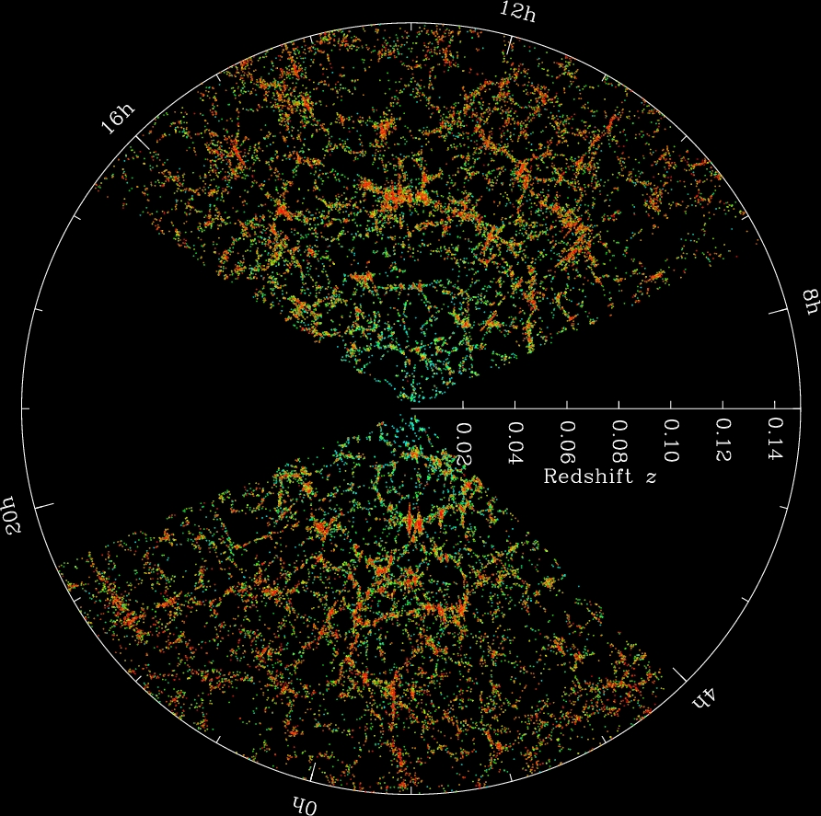
CMB temperature information content has been saturated
The near future IS large-scale structure
SDSS LRG galaxies power spectrum (Reid et al. 2010)
13 billion years of gravitational evolution
Notes:
3D information , across cosmic ages of cosmic gravitational evolution

Slide 9
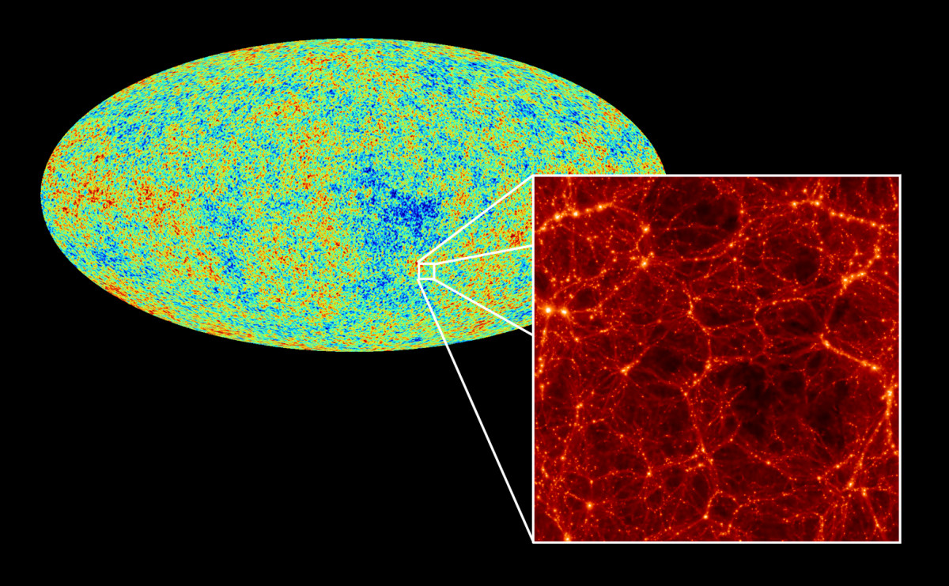
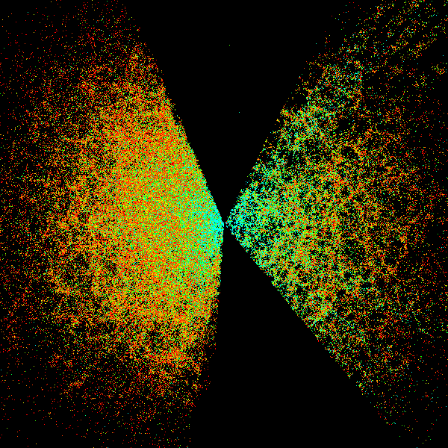
NEXT: Explore low(er)-redshift Universe
Notes:
Rich info not just clustering if you have to break degeneracies! Meaning you could be measuring something completely else and still constrain nu properties!!!

Slide 10
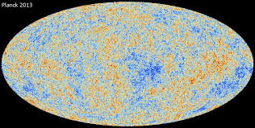
WHY SHOULD YOU CARE?
Forthcoming new avalanche of data enables
PRECISION tests beyond the standard model
Neutrinos contribute at least to ~0.5% of the total matter density
Use the entire Universe as “detector”!

Slide 11
In its infancy…
The question is: It is possible to be less model dependent? At what price?
here’s some exploratory examples
The trouble with Ho; Bernal, Verde, Riess, 2016, JCAP
The length of the local standard ruler; Verde, Bernal, Heavens, Jimenez 2017, MNRAS
Early cosmology Constrained; Verde, Bellini et al. 2017, JCAP
Strong Evidence for the Normal Neutrino Hierarchy; Fergus Simpson et al. 2017, JCAP
Dark Energy from the Motions of Neutrinos; Fergus Simpson et al. 2017, PRL
Notes:
Something that I have started to explore with my group over the past ~2 yrs or so

Slide 12
In a nutshell
The LCDM paradigm describes well all observations. However, there is a tension between the local value of H0 and the one derived from the CMB that is significant.
This tension can be alleviated if there is extra radiation on the form of Neff = 0.4; HOWEVER, this solution is disfavoured by Planck high-l polarization.
(Cosmology) Model independent measurements of the expansion history indicate it is consistent with LCDM. The problem is the anchors: either low or at the CMB.
There is already strong evidence that the Normal neutrino hierrachy is the prefered one (odds 50:1).
Neutrinos could play a role at freesing scalar fields and thus explain the Dark Energy

Slide 13
The trouble with H₀
JL Bernal, Verde, A Riess, JACP 2016
Direct measurement: 73.24 ± 1.74 km/s/Mpc (Riess et al 2016; verified with GAIA parallaxes)
Planck (ΛCDM): 67.8± 0.9(66.9±0.6) km/s/Mpc
Formally 3.4 σ, maybe we should pay attention
Possibly worst with Planck low l polarization re-analysis

Slide 14
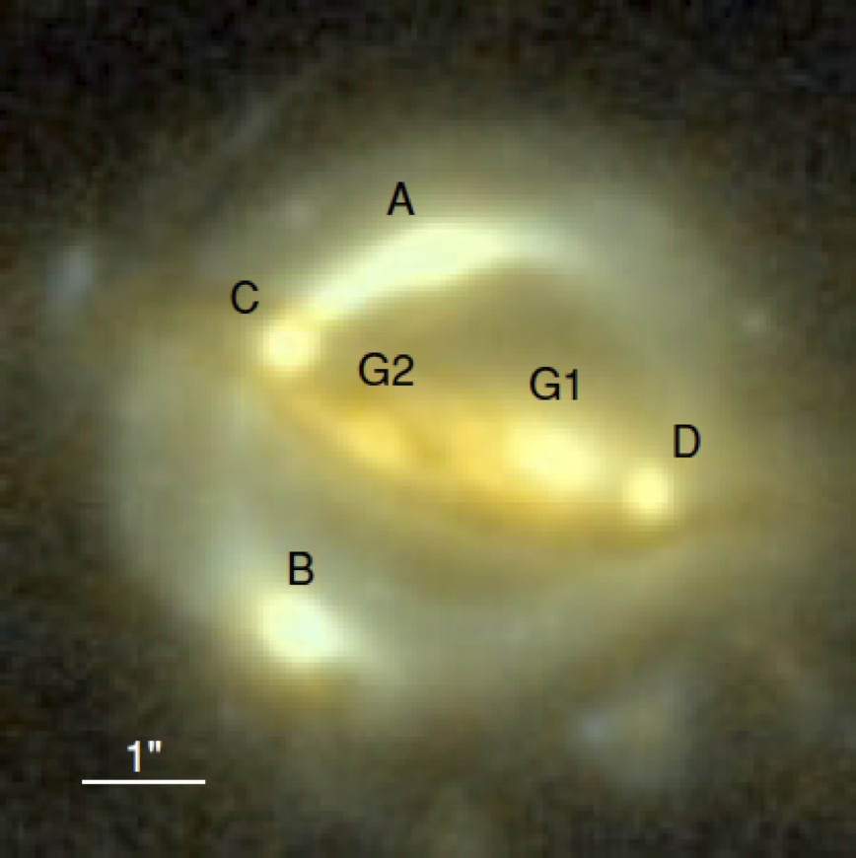
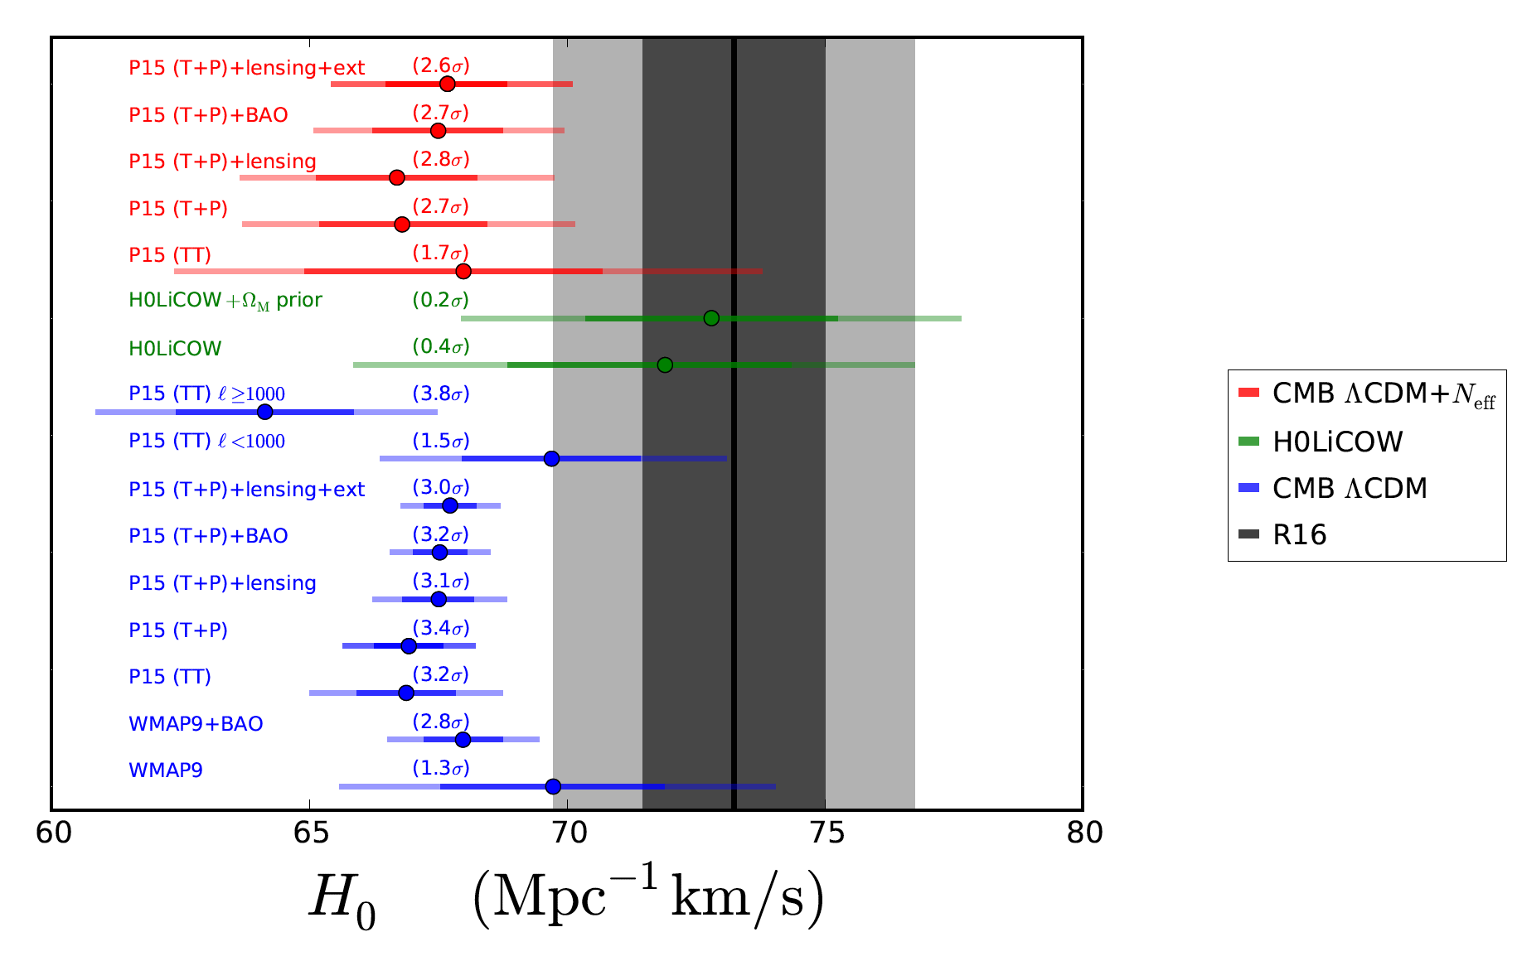
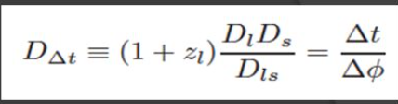
The landscape
The trouble with H₀
Notes:
Direct vs model dependent measurements! We should take notice!

Slide 15
Three avenues
Without invoking systematics (beside those declared by the authors themselves)
Allow early cosmology to deviate from ΛCDM (unaltered late-time cosmology)
Give freedom to late cosmology (unaltered early time physics*)
Model-independent
The trouble with H₀

Slide 16
Data
CMB: Planck TT, lowP, TEEE*, Lensing (even l>1000 or l<1000 for TT)#
BAO: compilation 6dF, SDSS MGS, LOWZ, CMASS, WiggleZ
SNe: JLA compilation
Riess 2016 H₀ measurement
# Addison et al. 2016, response of Planck team (Planck 2016)
* Planck high l polarization “ok for LCDM not ok beyond LCDM”
The trouble with H₀

Slide 17
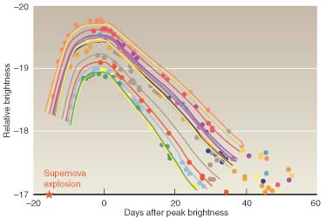
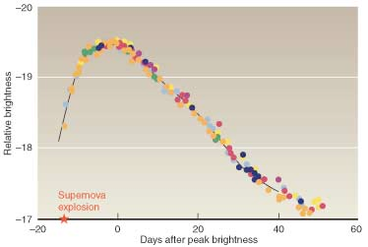
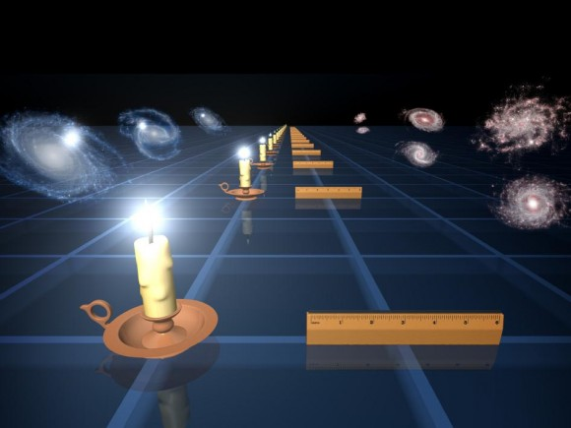
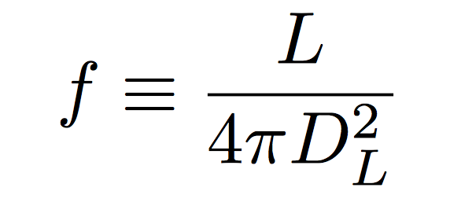
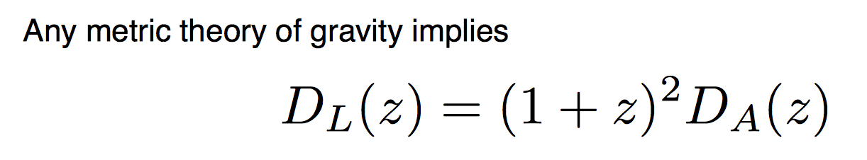
SNe : standard candles
DA: function of
geomerty and
integral of 1/H
Since L is poorly known this is “uncalibrated”,
usually calibrated using measurements of H0

Slide 18
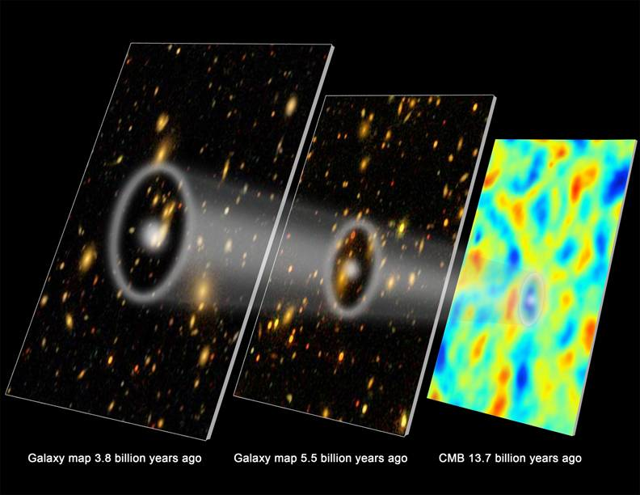
Baryon acoustic oscillations (BAO)
Standard ruler
Physics: sound waves in early Universe propagate until radiation and matter decouple
Imprints a scale - standard ruler
Key Observable.
Useful for:
  geometry of Universe (Dark Energy equation of state, or modifications to GR)
  early Universe physics (well known) sets it)
CMB and early universe physics in LCDM constrain the standard ruler length to 0.2%
Notes:
Explain BAO
Mention Nikhil P.

Slide 19
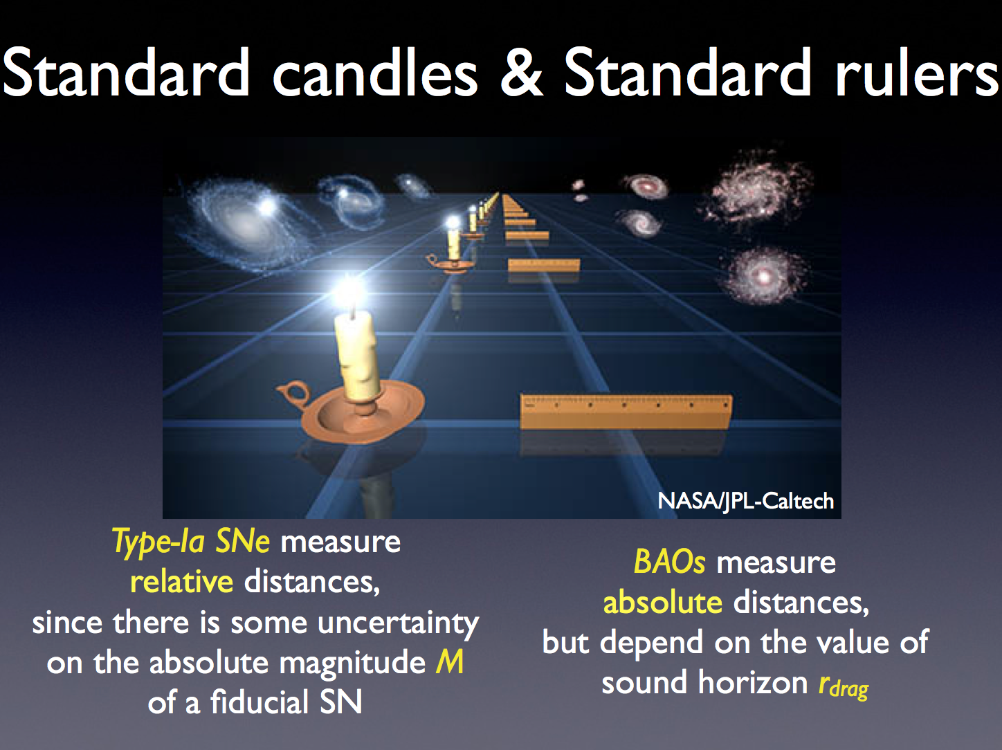
large
Cuesta et al (2015)

Slide 20
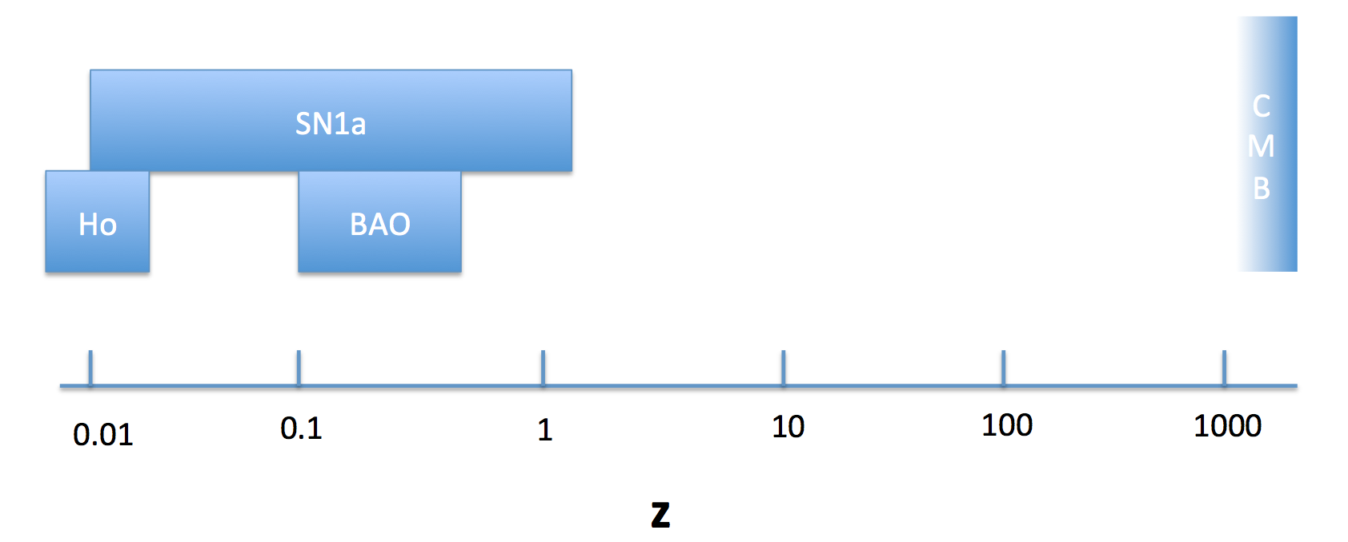
At glance: direct and inverse distance ladder
Clocks
H0: Direct measurement: 73.24 ± 1.74 km/s/Mpc (Riess et al 2016)
Low z anchor
rd,
high z anchor
Cuesta et al 2014, Bernal et al 2016
Notes:
Something we also pioneered at the ICC

Slide 21
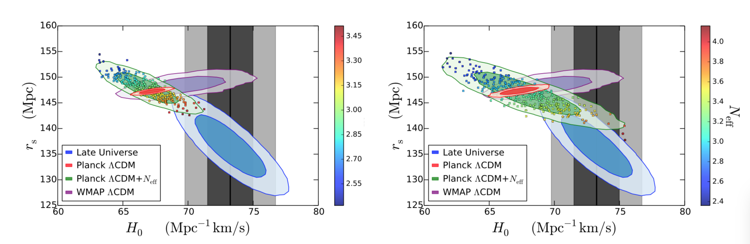
Why so much interest in Neff…
With high l polarization
w/o high l polarization
ΔNeff ~0.4 fixes everything but is disfavored by high l Planck polarization
The trouble with H₀

Slide 22

Changing late-time cosmology
Spline reconstruction of the expansion history
H(z) with 4 (5 with SNe) knots.
Direct and inverse cosmic distance ladder (Cuesta et al 2015)
r_{s}
The trouble with H₀

Slide 23
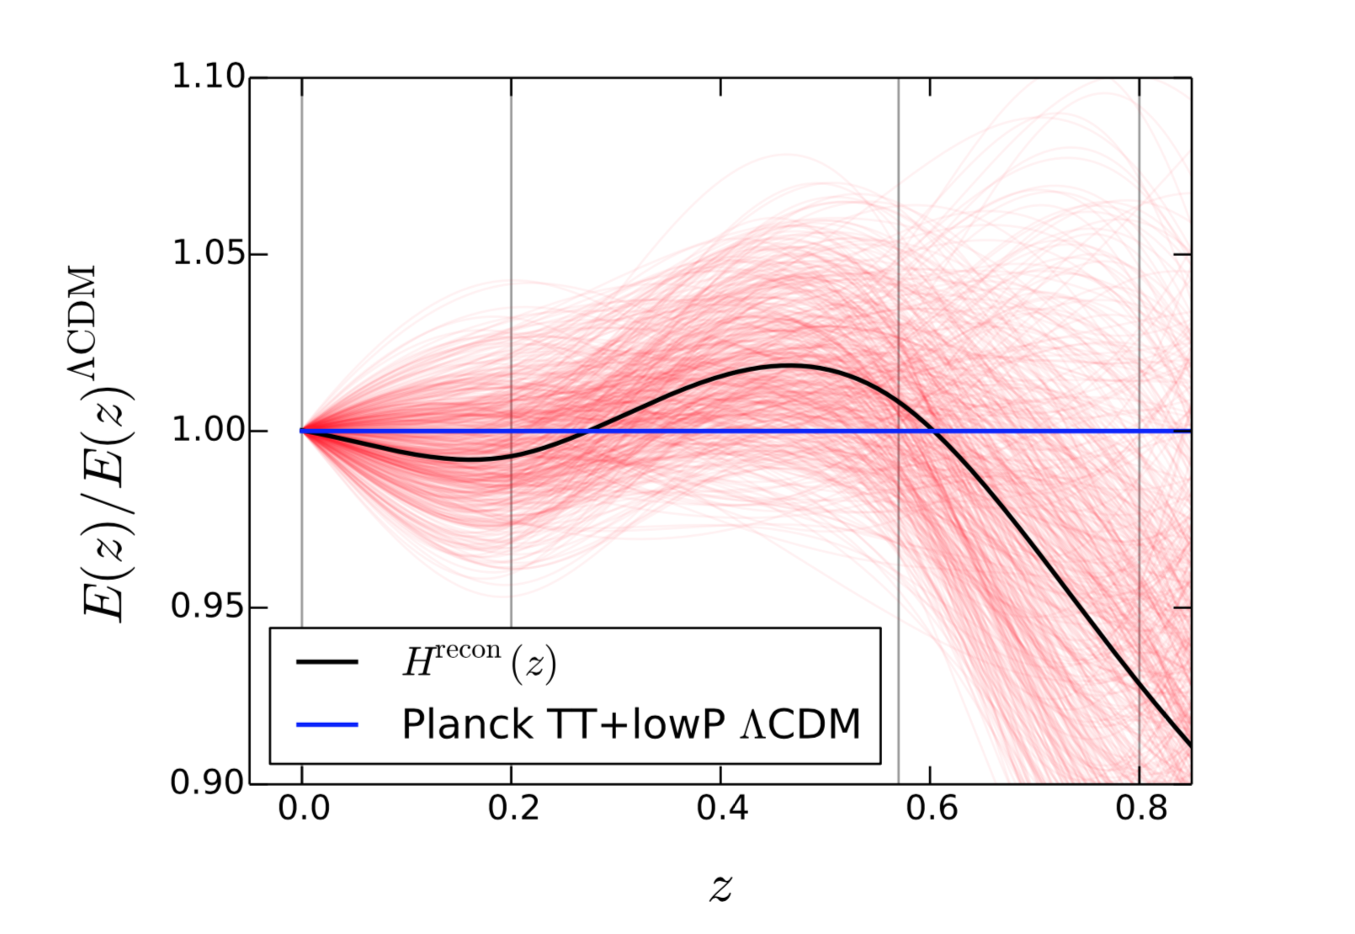
The SHAPE of expansion history is well constrained
The issue is with the normalization
The trouble with H₀

Slide 24
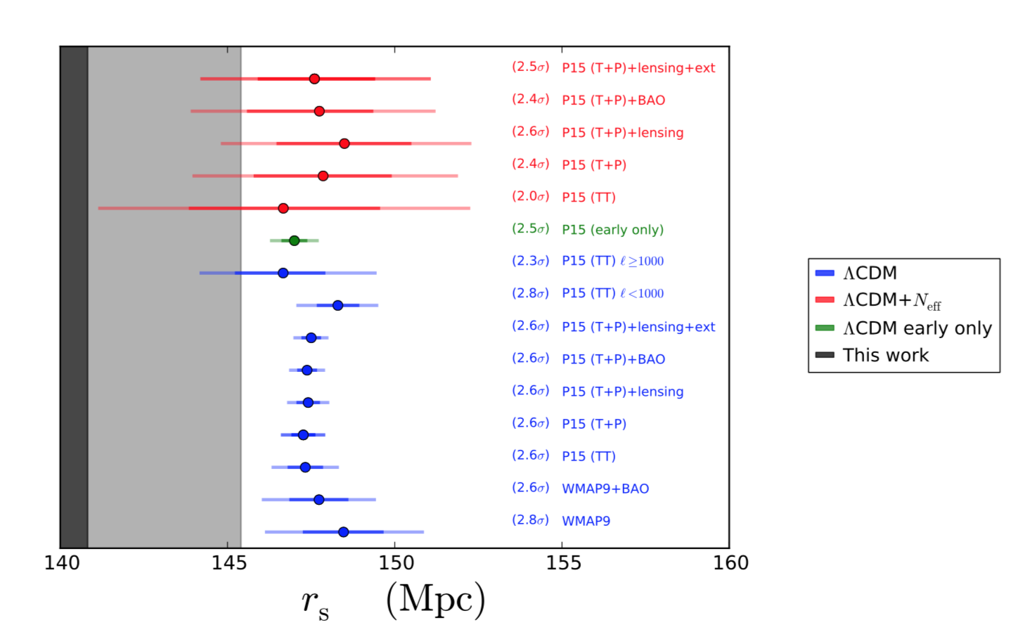
The H₀ problem as a r_{s} problem
The trouble with H₀

Slide 25
In a nutshell
The H0 problem is an anchor problem (either at z=0 or at z=1100), which cannot be solved by tweaking (or bending) the expansion history
It can be solved by changing rs (thus early time physics) but polarization data impose some tight limits.
Notes:
Of course you can take the side of G. Efstathiou or Mukhanov and just say that Riess is wrong and H0 is actually 68. a posteriori just because I say so.

Slide 26
The low redshift standard ruler
Verde, Bernal et al 2016
rs
Clocks
The low redshift standar ruler
Notes:
Independent of many model and physics assumptions!

Slide 27
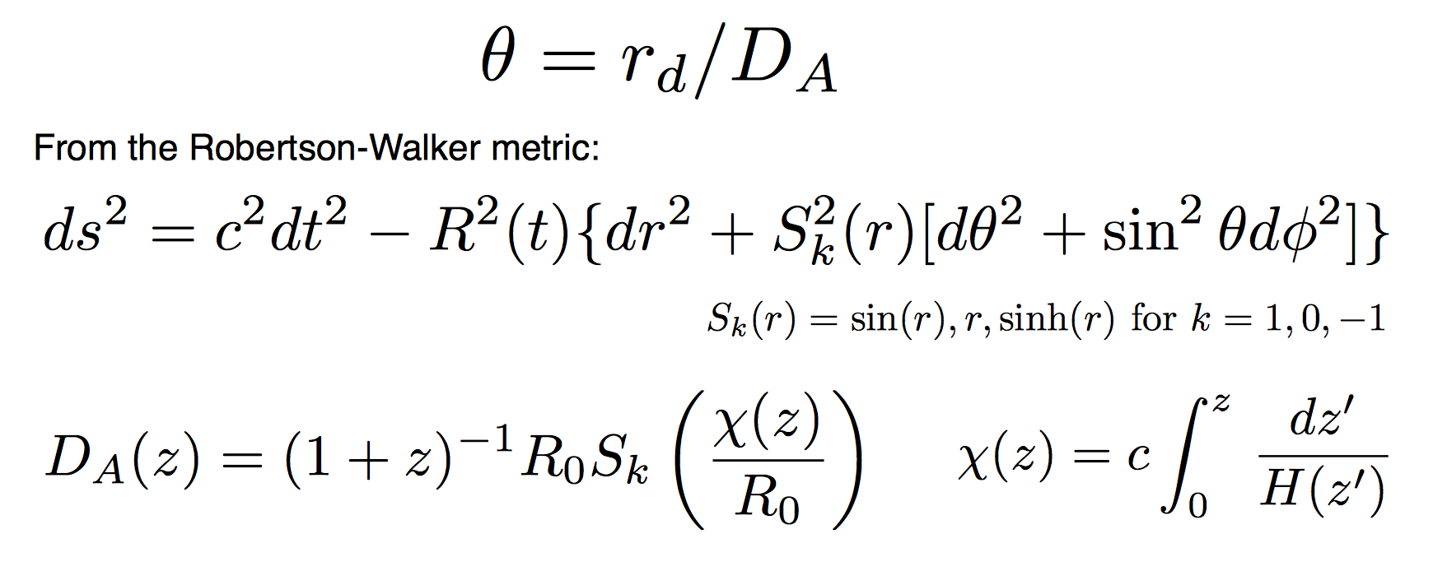
How long is the standard ruler?
And the existence of a standard ruler, of course (standard candles etc..)

Slide 28
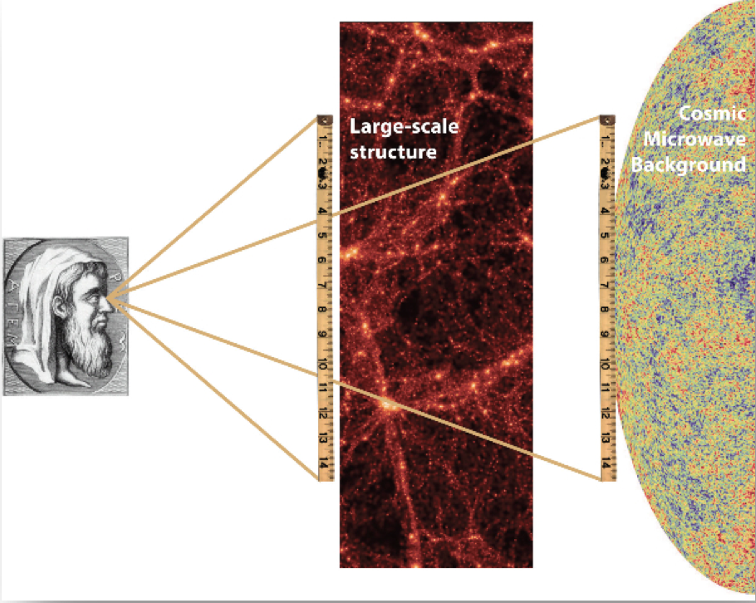
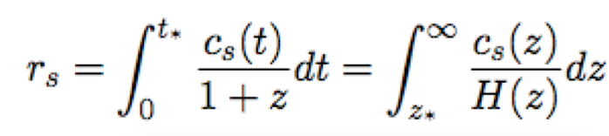
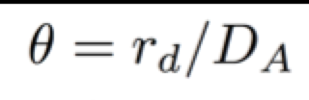
How long is the standard ruler?
Normally model-dependent
“Only” measure angles
The geometry can be measured with a standard ruler
whose length is not necessarily important
Can we measure how long it is in a model independent way?
(so we can use it to test models)
A. Heavens, R. Jimenez, Verde , PRL 2014, arXiv:1409.6217
PS similar philosophy of Sutherland 2012 MNRAS (but in a model dependent way)

Slide 29
Basic model parameters and assumptions
Assume only:
Cosmological Principle
(Homogeneity, Isotropy)
A metric theory of gravity
Smooth expansion history
Equation of state (of dark energy etc) is not assumed
Independent of Cosmological Model
Late-time data , z<1.3(1.8) tells us the length of the standard ruler.
Physics of the early Universe sets it
The low redshift standar ruler

Slide 30
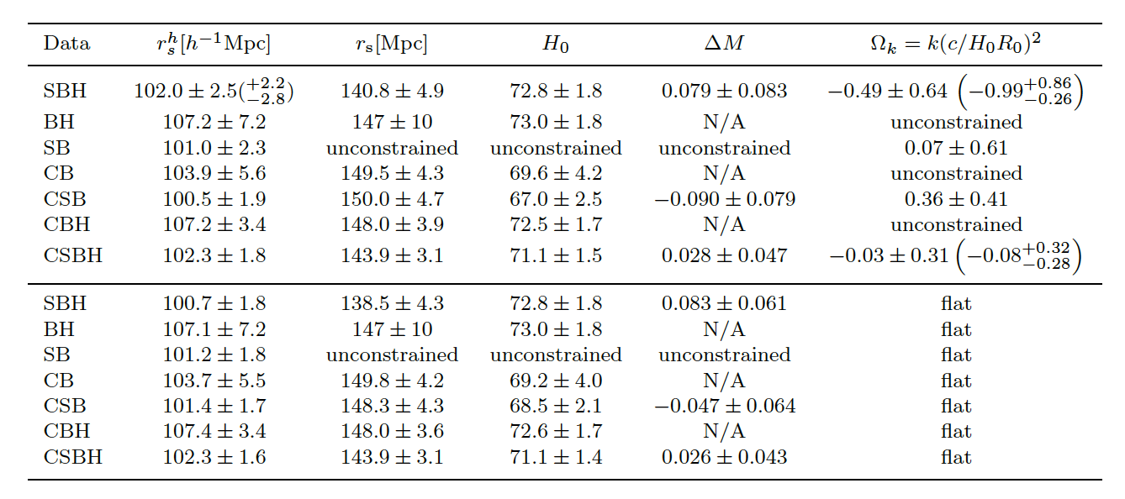
Results
2% measure
Planck, LCDM: 147.27 ± 0.31 Mpc
The low redshift standar ruler
Notes:
But look at the case with Neff!!!

Slide 31
In a nutshell
It is possible to measure the standard ruler from low redshift observations
in a model-independent way without making any assumptions about
gravity, GR, dark energy, or early time physics etc.
Value so measured is in agreement with CMB-LCDM except for SBH combination
The error-bars are still an order of magnitude larger than that of CMB-inferred value in LCDM
The error bars are however (slightly) smaller that CMB-inferred ones for NeffLCDM model.
Can be used to constrain Neff
Error on rs dominated by error on H0

Slide 32
In summary
The ``Ho trouble”: It is a mis-match of anchors no evidence for strange expansion history.
Can shift Ho or r_{s}. (keep this in mind if looking for new physics)
ΔNeff~0.4 would do (if no Planck polarization)
Can measure the standard ruler length in a model-independent way
More better data are coming in

Slide 33
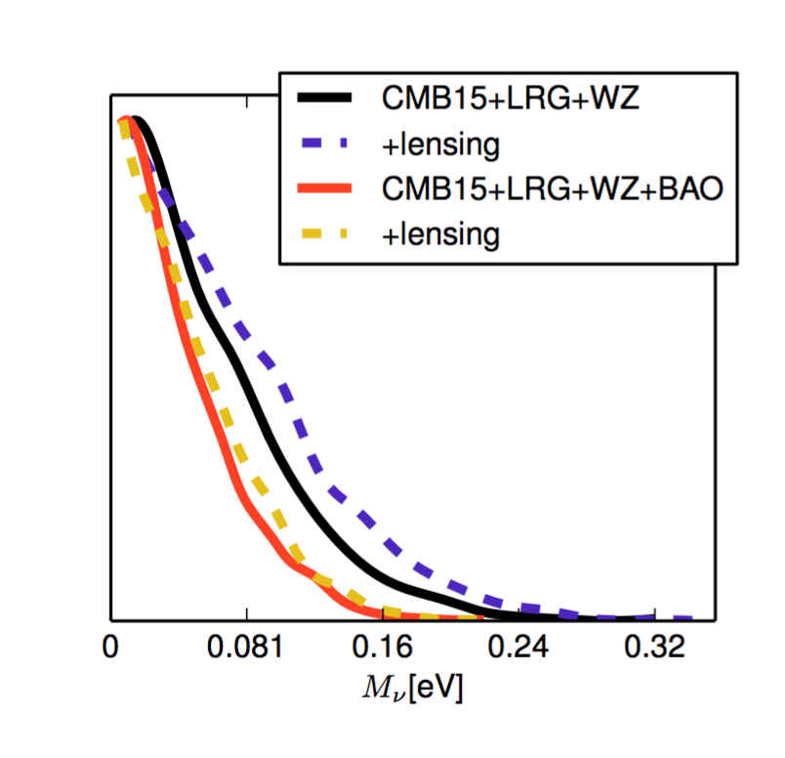
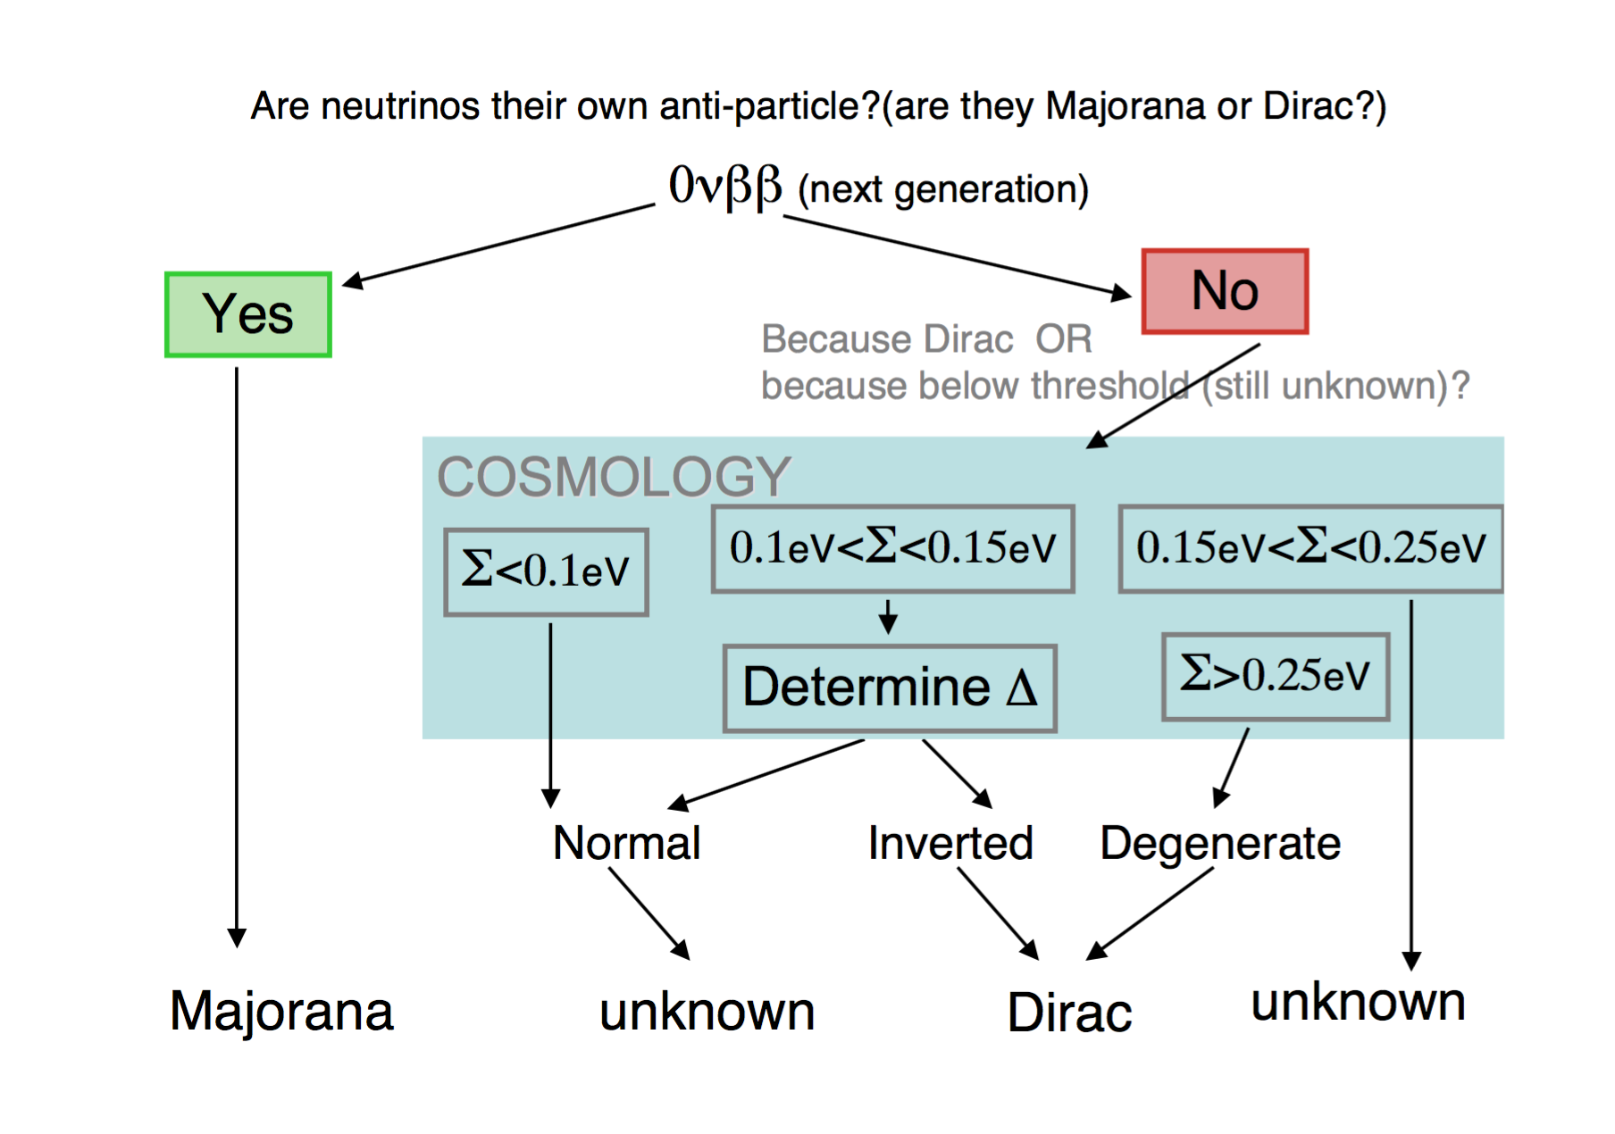
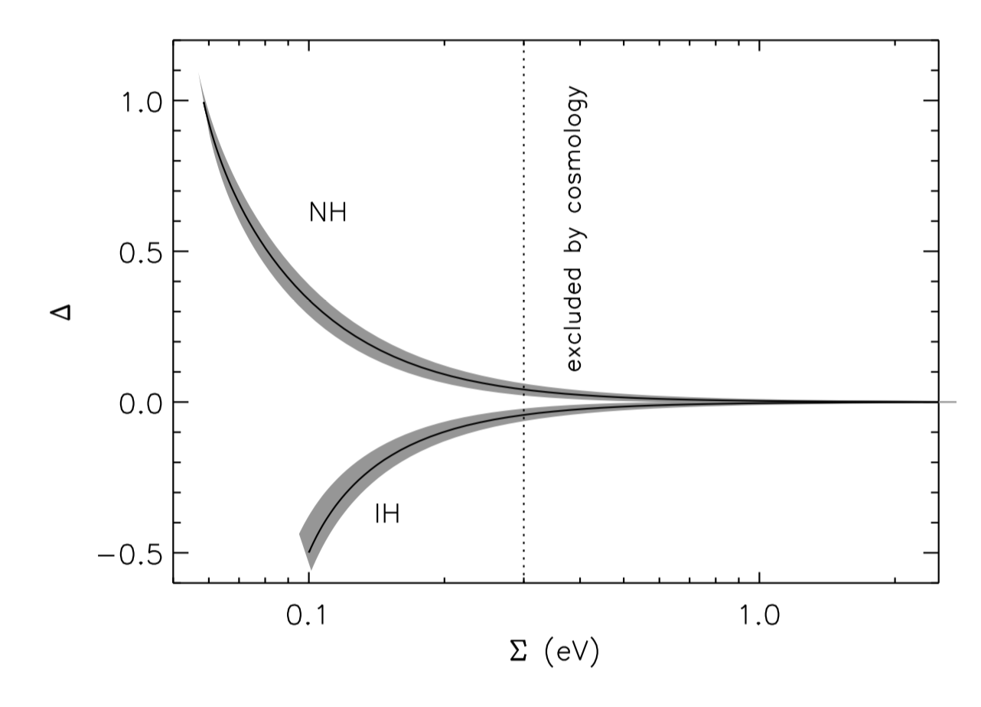
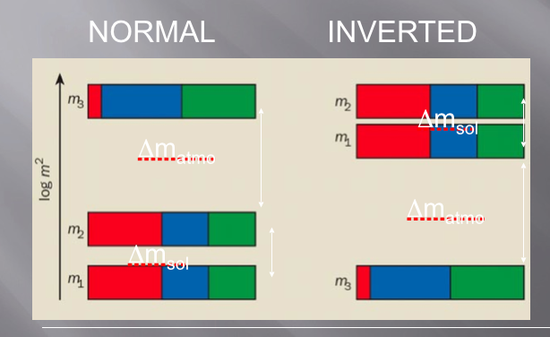
Neutrino masses ( < 0.11eV @ 95% CL)
Cosmology Faces Neutrino Physics
95%
Great potential for discovery
RJ et al. 2010, JCAP

Slide 34
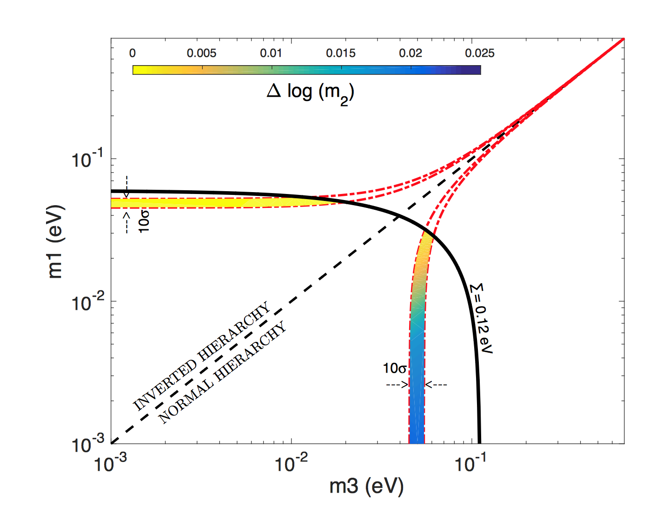
Strong (Bayesian) Evidence for the Normal Neutrino Hierarchy
In particular we argue that if we are dealing with the three neutrino masses, which in the absence of data —even oscillation data—, could range over many orders of magnitude, then an uninformative Jeffreys’ prior should be used. For those not familiar with this prior it is a uniform prior in log which in this case is the log of each of the three masses. This point is shown clearly in Clarke & Barron 1994
Simpson, RJ et al. 1703.03425
Of course, in the absence of any data, such prior does not favor one hierarchy over the other. But also a uniform prior in the masses themselves would not favour one ordering over the other. Now we add in the oscillations data keeping our uninformative prior on the three masses. Since one mass splitting is much smaller than the other, this fact by itself makes the odds for the normal ordering higher than those for the inverted one, about 30:1, where this ratio does not depend on the limits imposed on the minimum mass. When cosmological bounds on the sum of the masses are imposed the odds for the normal ordering increase rapidly.

Slide 35
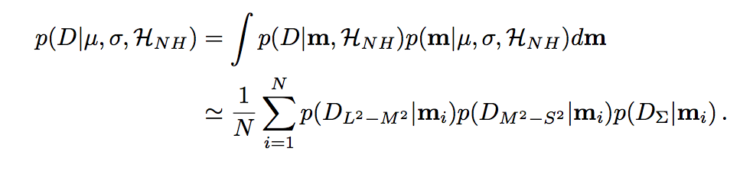
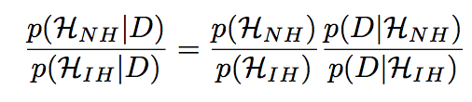
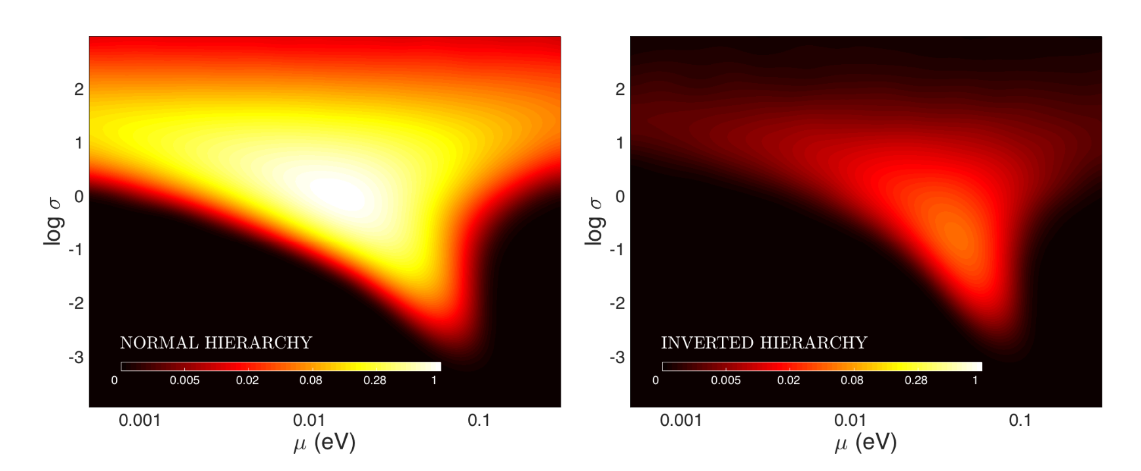
Use an Hyperprior, that is a family of priors that get marginalized over. In this case we take a Gaussian prior in log mass, with mean and width as variables to be marginalized over. You can of course look at it in details in the paper, but even marginalizing over an hyperprior, normal ordering has still much better odds than the inverted one. Add the cosmological bounds and the odds can grow up to 40:1, 50:1 or even 90:1 depending on which datasets you are willing to consider. In other words if you are a betting person, bet on the normal ordering.

Slide 36
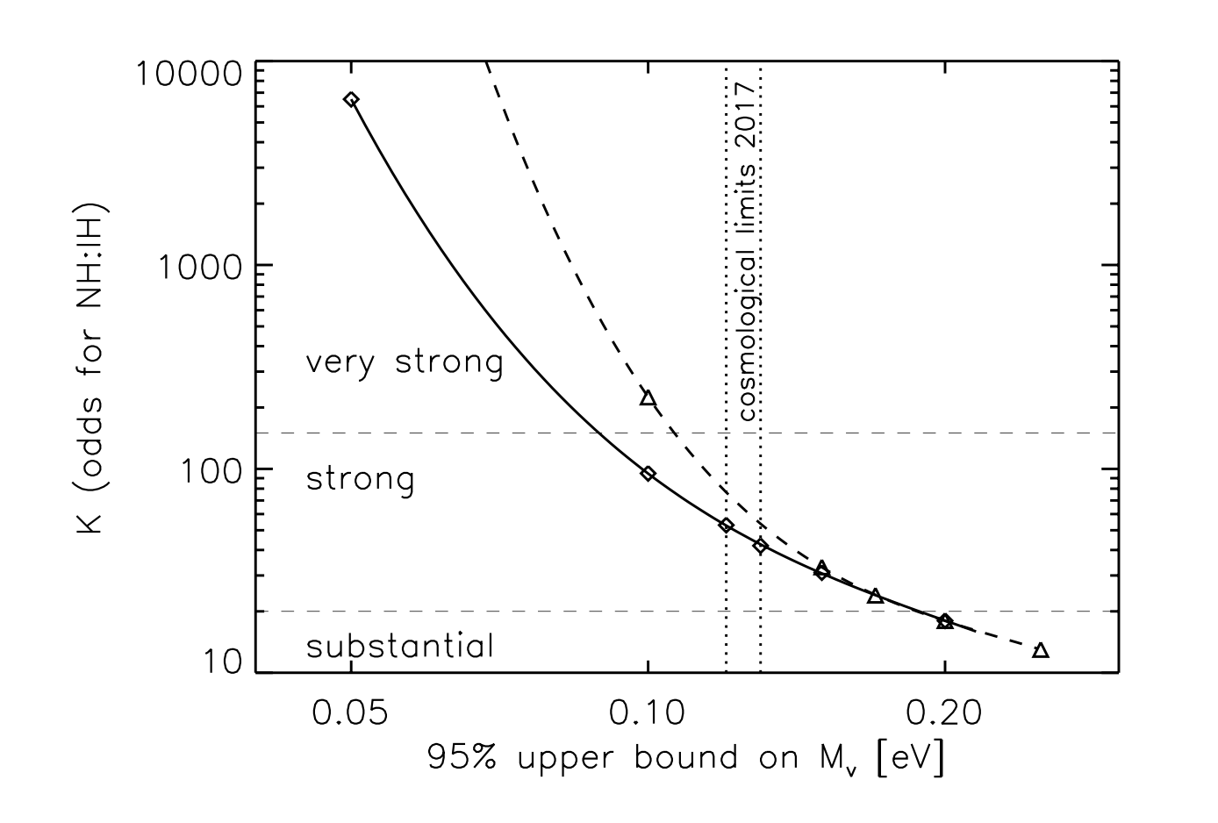
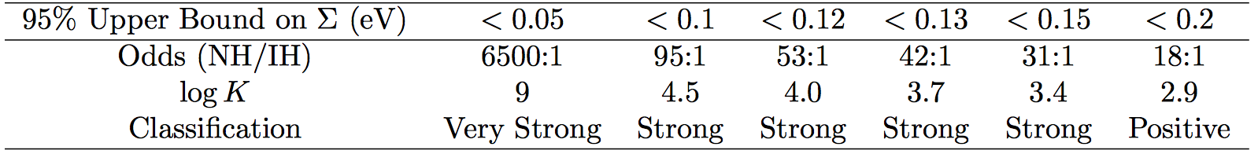
Strong Evidence for the Normal Neutrino Hierarchy
Simpson, RJ et al. 2017 1703.03425
H0
Odds with current data (both cosmology and oscillations) are already 50:1 for the normal hierarchy
Similar conclusions to a later frequentist analysis by Capozzi et al. 2017 1703.04471
Same ODDS

Slide 37
Final conclusions
All Cosmology observations are consistent with a minimal LCDM model. However, the tension between the local and CMB universe (H0) is starting to be significant.
This can be reconciled by extra radiation Neff~0.5. However, this solution is disfavoured by Planck high-l polarization (on this, jury still out there).
There is strong evidence that the ordering of neutrinos is normal from (mostly) oscillation data and (less from cosmology).
Neutrino motions could be a route to freeze scalar fields and thus be an option to explain dark energy.

Slide 38

Dark energy from the motion of neutrinos
arXiv:1607.02515.
Fergus Simpson, Carlos Penya Garay, Raul Jimenez, Licia Verde
Or Forbes re-interpretation: Could Dark Energy Be Caused By Frozen Neutrinos?

Slide 39
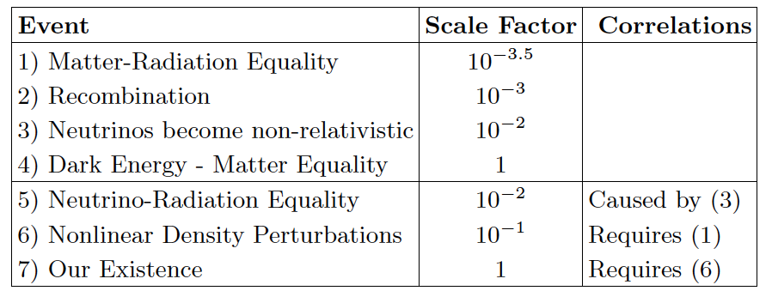
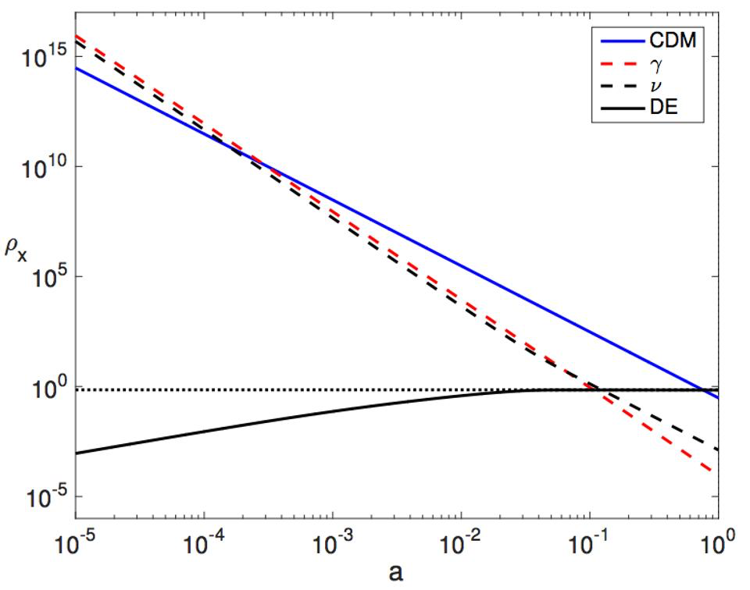
“Why now?” problem
minimum of three distinct events are required in order for the four fuids to reverse their
positions in the density hierarchy (since reordering N objects requires N- 1 moves)
Notes:
There are 4 independent events: could there be unknown correlations which may reduce this number?

Slide 40
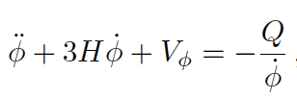

What energy exchange can facilitate dark energy?
a generic scalar field couples to the neutrinos we have in our Universe, that fine-tuning goes away, and that scalar field will “automatically” begin behaving as a cosmological constant (Forbes)
derivative coupling at the particle level, between neutrinos and a scalar field.
For the field to reverse its direction must go to zero. Before this happens,
Notes:
neutrinos act as the second fuid is in part motivated by the approximate equivalence of
the neutrino mass and the energy scale of dark energy(i.e. \rho_lambda^1/4) Neutrinos mass varying models have problems with perturbations
)

Slide 41
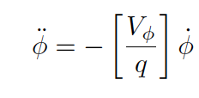
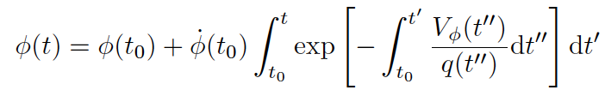
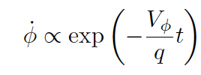
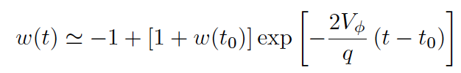
Then…
So
φ Is monotonic. The kinetic term is damped. If varies slowly:
Equation of state parameter for the field:
Notes:
If q is positive, the field can become frozen as it climbs uphill, and this state
can be maintained with a vanishingly small injection of
energy. Conversely if q is negative, this leads to the extraction
of kinetic energy from the scalar.

Slide 42
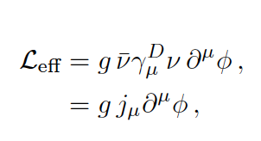
Available energy sources?
Masses, why not the kinetic energies?
At MR equality DM velocity perturbations → ~
Neutrinos loose kinetic energy
due to a drag force with a field
Neutrino K.E. density exceeds until a~0.1
This is when v’s become non relativistic and bulk
motions can form.
Derivative coupling (generic for Nambu-Goldstone bosons)
M Majorana mass
Notes:
This satisfies supernova cooling, solar neutrino, kaon decay and double-beta
decay bounds.
In this proposal, the scalar is truly massless, but carries lepton number charge (majoron). This
scheme suggests the existence of heavy isosinglet neutrinos in the mass range of several hundred MeV, with
signicant mixing to the electron neutrino [27]. These heavy neutrinos could manifest themselves in the decays
(including neutrinoless double beta decay)

Slide 43


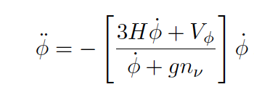
So for each neutrino
For the dark energy
nv number of neutrinos per unit volume
Energy of the field goes into neutrinos K.E.
when
We go back to
Perturbations are stable
No lower bound on g
No mention if the potential shape, could be anything…
Notes:
attractive features of a derivative coupling
is that makes no explicit contribution to the efefctive
potential. does not contribute to the mass
of \phi.
Sub h perturbations remain stable
Stability of perturbations: no DE perturbations

Slide 44
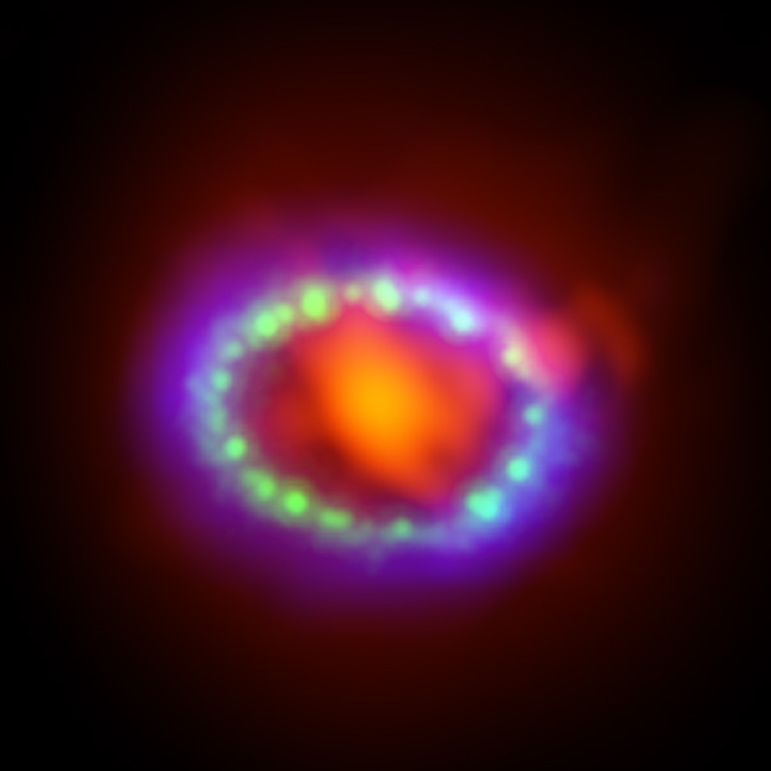

Observational consequences
SN 1987A excludes the range
4x10⁻⁷<g<2x10⁻⁵
(Choi & Santamaria 1990)
Current Lack of Neutrinoless Double
Beta Decay suggests:
g<0.013
(arXiv:1205.6372)

Slide 45
summary
A derivatively coupled scalar can:
Avoid fine tuning of dark energy scale
Create w=-1 using any V(𝜙)
!

