Slide 1
High quality beam driven acceleration up to 1GeV @Eu_SPARC
2016-07-12

Slide 2
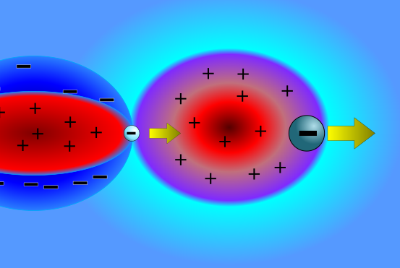
New concept: surfing bubble
The driver generates a linear field
The field generated by the witness is non linear
The witness can be injected in the zone of maximum field
Simple matching
The injection is performed on the crest of linear field
The focusing is guaranteed by a beam loading effect
Minimum energy spread
Maximum gradient
Increased witness stability

Slide 3
Simulation parameters
Plasma density $n_{0}=2∙{10}^{16}$
Driver:
Energy $γ=500$
Charge $Q=200pC$
Length $σ_{z}=\frac{1}{k_{p}}$
$α=0.5$
Emittance $ε_{n}=10 mm mrad$
Witness:
Energy $γ=500$
Charge $Q=15pC$
Length $σ_{z}=3μm$
Spot size $σ_{r}=\sqrt[4]{\frac{1}{γ}}\sqrt{\frac{2ε_{n}}{k_{p}}}$
Emittance $ε_{n}=0.3 mm mrad$
Injection distance $Δz=0.42, 0.45λ_{p}$

Slide 4
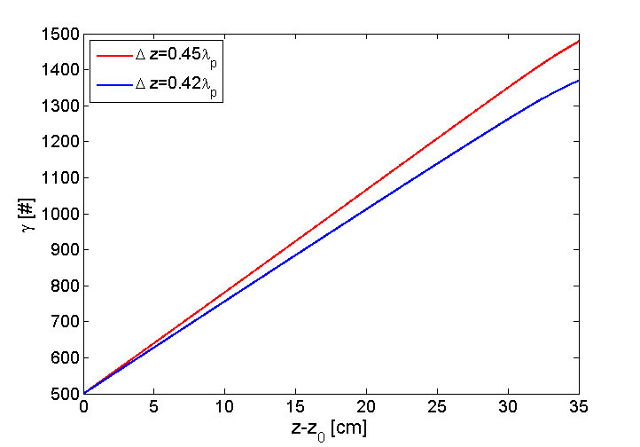
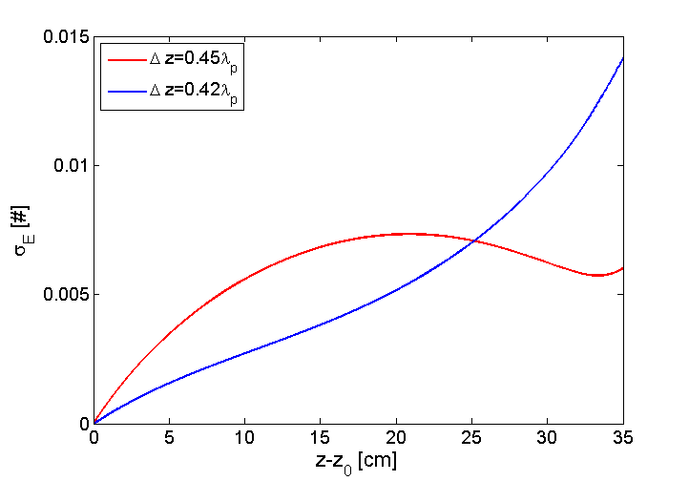
Energy and energy spread
Effective accelerating gradient >1.4GV/m

Slide 5
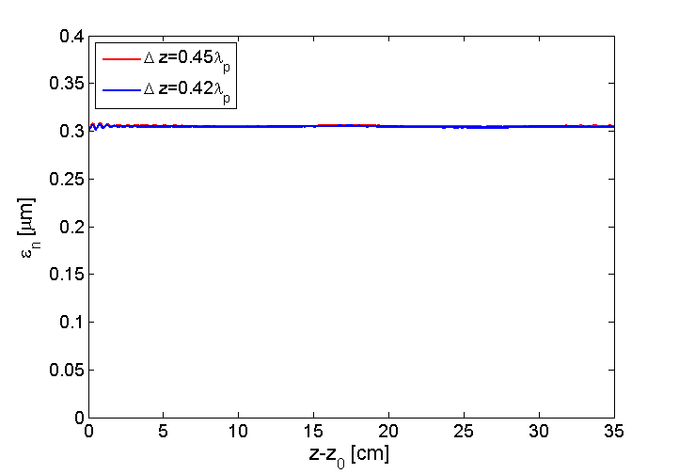
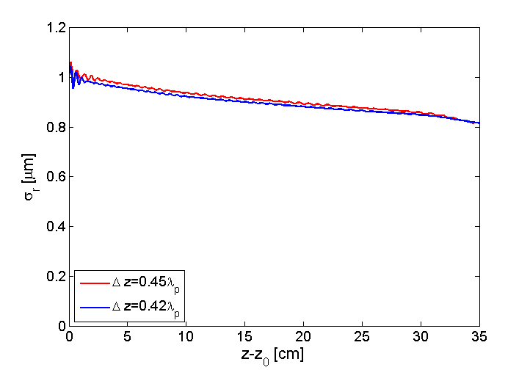
Envelope and emittance
Almost perfectly matched

Slide 6
Density

Slide 7
Phase Spaces

Slide 8
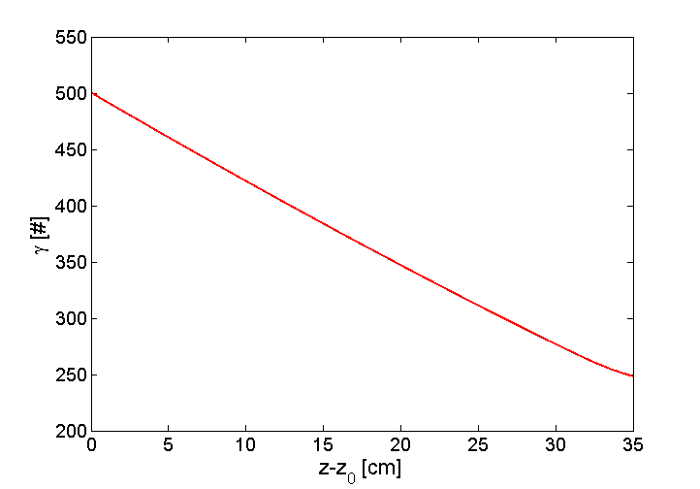
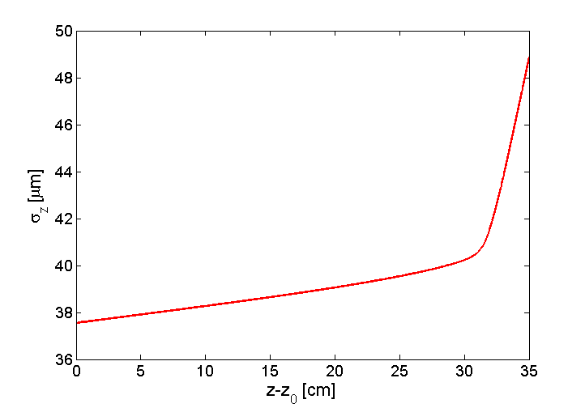
Efficiency and limits

Slide 9
Scheme limited by driver depletion

Slide 10
Conclusions
The surfing bubble scheme seems to be a valid alternative for the production of high quality accelerated beams
The scheme can be easily used also for LWFA with external injection
1 KA current high quality plasma wakefield acceleration is possible
1 GV/m high quality plasma wakefield acceleration is possible
Limit in this configuration for up to 750 MeV, can be improved easily to 1 GeV
There is the necessity of a technological improvement in order to achieve to short beam lengths required for low energy spread acceleration

Slide 11
Thanks for the attention

Slide 12
Minimization of energy spread in linear field
$$σ_{E}=1−\cos\left(k_{p}σ_{z}\right)+\tan{φ}\sin\left(k_{p}σ_{z}\right)$$
$$σ_{E}=\frac{{k_{p}}^{7/5}σ_{r_{w}}^{2}}{4/5σ_{d_{w}}^{3/5}}$$
10
The minimum energy spread occurs by injecting a very short bunch ($k_{p}σ_{z}≈0$) injected on crest ($φ=0$) with a minimal spot size ($k_{p}σ_{r}≈0$)
For such a bunch, we require a focusing field and a matching

Slide 13
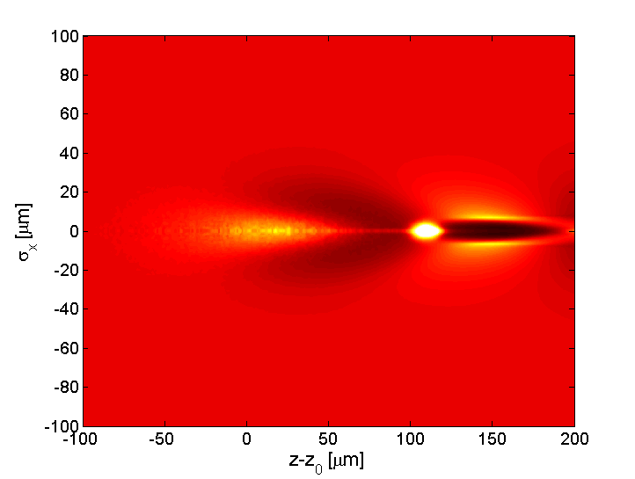
The longitudinal field crest region
[Lu, W., et al. "Limits of linear plasma wakefield theory for electron or positron beams." Physics of Plasmas (1994-present) 12.6 (2005): 063101.]
Very far behind the driver ($ξ≪−σ_{z}$)
In the crest region the plasma is locally neutral
$$n_{1}=−\frac{ε_{0}k_{p}^{2}}{e}n_{0}Z\left(ξ\right)n_{b⊥}$$
$$n_{1}=n_{0}$$
$$E_{z}\left(ξ,0\right)=\sqrt{π}α\left(\frac{c^{2}m_{e}}{e}\right)k_{p}^{2}σ_{z}e^{−\frac{k_{p}^{2}σ_{z}^{2}}{2}}R\left(0\right)\cos{k_{p}ξ}$$
$$Z\left(ξ\right)=\sqrt{π}α\left(\frac{c^{2}m_{e}}{e}\right)k_{p}σ_{z}e^{−\frac{k_{p}^{2}σ_{z}^{2}}{2}}\sin{k_{p}ξ}$$
$$B_{θ}\left(ξ,r\right)≈0$$
$$E_{r}\left(ξ,r\right)=\sqrt{π}α\left(\frac{c^{2}m_{e}}{e}\right)k_{p}σ_{z}e^{−\frac{k_{p}^{2}σ_{z}^{2}}{2}}R\left(r\right)\sin{k_{p}ξ}$$
For the transverse matching at first order, the injection of witness on crest is equivalent to the injection inside neutral plasma

Slide 14
Matching conditions for short, narrow and ultra dense bunch
Cylindrical ion column
Half density ion column
One of the hypotesis to calculate the matching of driver was that the bubble is completely formed in the very head of the bunch
$$σ_{r}=\sqrt[4]{\frac{2}{γ}}\sqrt{\frac{ε_{n}}{k_{p}}}$$
$$σ_{r}=\sqrt[4]{\frac{1}{γ}}\sqrt{\frac{2ε_{n}}{k_{p}}}$$
$$E_{r}=\frac{en_{0}}{2ε_{0}}$$
$$E_{r}=\frac{en_{0}}{4ε_{0}}$$
New hypotesis
Short and narrow ($k_{p}σ_{z},k_{p}σ_{r}≪1)$
Ultra dense $(α≫1)$
Ultra relativistic ($β≈1)$
The local electron plasma density 𝒏_𝟏 is:
Almost constant inside bunch
0 behind the bunch
Equal to $n_{0}$ before the bunch
The matching conditions of witness are completely independent from driver
We conclude that in the region inside the bunch, the local plasma density $n_{1}=n_{0}/2$

