Slide 1
EuPRAXIA working package report
WP3 and WP4

Slide 2
WP3 and WP4
WP3 is on High Gradient Laser Plasma Accelerating Structure – WP Leaders B. Cros (CNRS) and Z. Nujmudin (Imperial College)
WP4 is on Laser Design and Optimization – WP Leaders L.Gizzi (CNR Pisa) and F. Mathieu (CNRS)
Are strictly connected.
Our current activities with the FLAME laser are strongly related to both the WPs.

Slide 3
WP3 - High Gradient Laser Plasma Accelerating Structure

Slide 4
WP3 - High Gradient Laser Plasma Accelerating Structure
Task 3.1: Define regime of operation
Task 3.2: Design plasma structure
Plasma creation, laser confinement, injection techniques…
Task 3.3: Design plasma chamber and environment
Vacuum, activation…
Task 3.4: Diagnostics
Laser focusing, alignment, control, laser beam dumping…
Task 3.5: Staging plasma structures
Laser-plasma coupling (plasma mirrors), synchronization, overlap at the plasma entrance…

Slide 5
WP3 - High Gradient Laser Plasma Accelerating Structure
Is it all plasma based accelerator?
If yes: how to design the plasma injector? e- beam quality required?
If no: what are in input e- beam parameters?
Electron beam properties and plasma parameters needs to be matched.
The regime of work need to be defined (linear, quasi linear…)
Diagnostic strongly depends on the plasma parameters.
Rep rate important for vacuum issues.

Slide 6
WP3 - High Gradient Laser Plasma Accelerating Structure

Slide 7
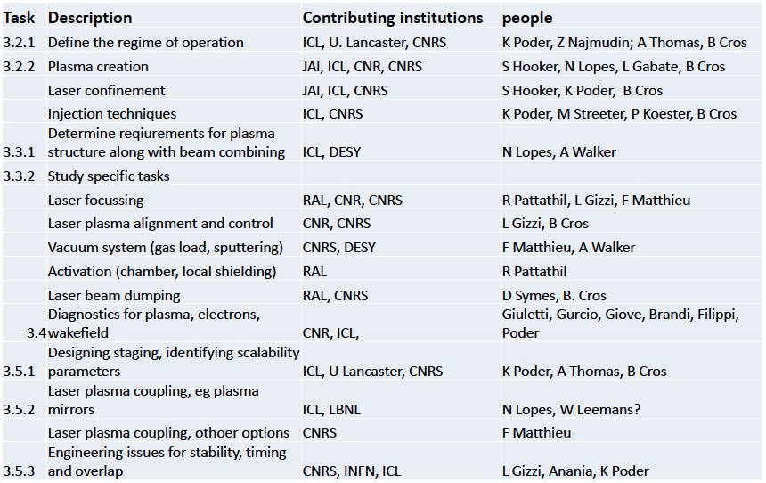
WP3 - High Gradient Laser Plasma Accelerating Structure

Slide 8
WP3 - High Gradient Laser Plasma Accelerating Structure
Why this two tasks?
Mainly are the issue we will have already faced for THOMSON and that we will have to solve for EXIN (synchronization, spatial overlap and so on).
Diagnostic as well is an expertise that we are growing both for LWFA at FLAME and for COMB. Mainly it’s plasma diagnostic at different plasma density.

Slide 9
WP4 – Laser Design and Optimization

Slide 10
WP4 - Laser Design and Optimization
Task 4.1: Management and system engineering
Task 4.2: Laser design study
Task 4.2.1: Benchmarking
Task 4.2.2: Front-end
Task 4.2.3: Power amplification section
Task 4.2.4: Stretching, compression and Transport
Task 4.2.2: Diagnostics
Task 4.3: Transverse functions, alignment and control, active stabilization, synchronization
Task 4.4: Laser control system

Slide 11
WP4 - Laser Design and Optimization
How many lasers to guarantee 24/7 operation?
Is high rep rate the way to have more stability?
How many photon beams are needed (mains and probes)?
Do we have to use the some laser for the photocathode? Are requirements comparable?
100³ solution: 100 J, 100 fs, 100 Hz. Is it technologically feasible.
Stabilization of the beam might be thought to be done from oscillator.
Is Ti:Sa a feasible solution or other material for the pumping part need to be taken into account?

Slide 12
WP4 - Laser Design and Optimization
Task 4.1: Management and system engineering
Task 4.2: Laser design study
Task 4.2.1: Benchmarking
Task 4.2.2: Front-end
Task 4.2.3: Power amplification section
Task 4.2.4: Stretching, compression and Transport
Task 4.2.2: Diagnostics
Task 4.3: Transverse functions, alignment and control, active stabilization, synchronization
Task 4.4: Laser control system

Slide 13
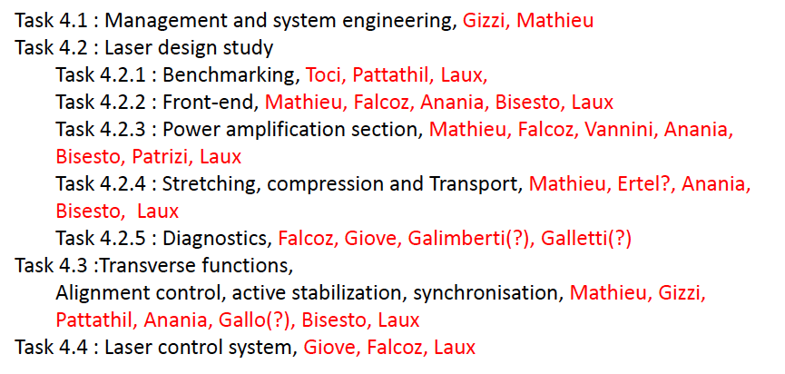
WP4 - Laser Design and Optimization

Slide 14
WP4 - Laser Design and Optimization
Why this tasks?
FLAME update will be necessary for EuSPARC and we can definitely gain from the study of the laser.
Also, during these years, we have been working intensively on the laser side in order to have the best performances and high stability and reproducibility.
The task on synchronization is strongly related to that of WP3.

Slide 15
WP3 and WP4 tasks – what we are doing already
We are already working on all the tasks where we have proposed ourselves:
Laser optimization and stabilization
Plasma accelerators studies
Diagnostics

Slide 16
In the mean time at FLAME…
Laser optimization and stabilization
Focal spot diffraction limited, with 60% energy in the 1/e² diameter.
Mainly compressor optimization and controlled transport.
Higher stability achieved with temperature control (from clean room down to the bunker) and by tubing all the laser transport section in order to avoid turbulence.

Slide 17
In the mean time at FLAME…
Plasma accelerators studies
Using only 2J of energy and 2 mm gas-jet, 350 MeV electron bunches with mrad divergence, high charge, “small” energy spread have been produced. The corresponding integrated accelerating field is of about 200 GV/m.
350 MeV
100 MeV
50 MeV

Slide 18
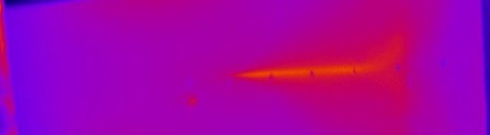
In the mean time at FLAME…
Source optimization and parametric study of the laser and plasma parameters is undergoing.
So for example by scanning the plasma density, electron energy has been varied from 50 MeV, to 175 MeV and up to 300 MeV.
Also by tuning plasma density, energy spread has been reduced from 100% to 20%.
174 MeV
57 MeV
236 MeV
81 MeV

Slide 19
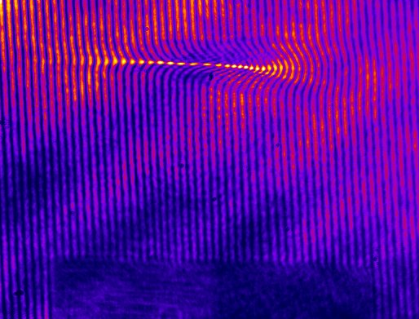
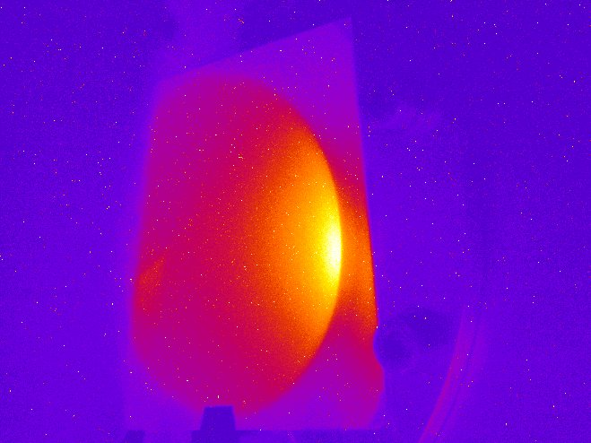
In the mean time at FLAME…
Diagnostics
MacZender interferometer to measure the plasma density.
OTR to measure the electron beam emittance.
Betatron radiation to measure beam quality inside the plasma bubble.

Slide 20
Thank you

