Slide 1
WP Compton Sources
C. Vaccarezza

Slide 2
Outline
The WP:
A. Bacci, I. Drebot, A. Giribono, V. Petrillo, L. Serafini, C. Vaccarezza
Scientific case
The ELI-NP expertize
1 GeV Compton source first results

Slide 3
Gamma-ray Compton Sources
Thanks to the extremely advanced characteristics:
energy, tunability, mono-chromaticity, collimation, brilliance, time rapidity, polarizability etc.
the new generation of Compton Sources will play a critical role for advanced applications in many fields: Nuclear resonance fluorescence, Nuclear photonics with (γ-p) (γ-n) reactions, New medical isotopes production, Material studies, Radioactive waste management and isotope identification, High brilliance Neutron sources ecc. ecc.
ELI-NP, the Nuclear Physics Pillar of ELI
is building an advanced Compton Source (Gamma Beam System) aiming at making a substantial step forward in γ-ray beam performances

Slide 4
In detail:
With a 2.3 eV laser beam and:
75-740 MeV Linac 2-19.5 MeV 𝜸 beam:
GDR (Giant Dipole Resonance)
1.1 GeV Linac 45 MeV 𝜸 beam:
2nd harm. GDR effects (never observed up to now)
1.35 GeV Linac 60 MeV 𝜸 beam:
Polarized Positron Source
by ICS polarized photons (P. Musumeci& L. Serafini provate comm., Omori NIM A 500,232, 2003)

Slide 5
ELI-NP GBS
European Collaboration:
Italy: INFN,Un. Sapienza
France: IN2P3, Un. Paris Sud
UK: ASTeC/STFC
From building delivery:
3.5 MeV 𝜸 beam : 1.5 years
19.5 MeV 𝜸 beam: 3-4 years

Slide 6
EuroGammaS Organisational Breakdown Structure (OBS) Hierarchical management structure, communication routes and reporting links
Governing Board
Institute Partner Members
Industrial Partner Members
Project Coordinator, Machine Leader, Q&C Manager
IFIN-HH
Project Coordinator
Luigi Palumbo
Project Office
Technical TEAM
Finance Manager
(Sabrina Argentati)
Q&C Manager
(Antonio Napolitano)
Machine Leader
(Alessandro Variola) INFN
Scientific Coordinator
(Luca Serafini)
Legal Advisors
(Nicolas Castoldi, Fabio MIccoli)
Deputy (Optics)
(Fabian Zomer) CNRS
Deputy (Linac)
(David Alesini) INFN
Training Manager
(tba)
Safety Coordinator
(Sandro Vescovi)
Deputy (Integration)
(Antonio Falone) INFN
Work Packages
WP 01a
Accelerator Physics
(Cristina Vaccarezza)
INFN Frascati
WP 01b
Source
Physics
(Vittoria Petrillo)
INFN Milan
WP 02
Optics
(Kevin Cassou)
CNRS
WP 03
Accelerating Structures
(David Alesini)
INFN Frascati
WP 04a
High Power RF & Distribution
(Roberto Boni)
INFN Frascati
WP 04b
LLRF & syncrhonisation
(Alessandro Gallo)
INFN Frascati
WP 05
STFC Modules, Magnets & Vacuum
(Neil Bliss)
STFC Daresbury
WP 06
INFN Modules
(Sandro Tomassini)
INFN Frascati
WP 07
Diagnostics
(Andrea Mostacci)
INFN Frascati
WP 02A
Lasers
(Franck Falcoz)
Amplitude
WP 02B
Interaction chambers
(Herve Rocipon)
Alsyom
WP 08
Control System
(Giampiero
Di Pirro)
INFN Frascati
WP 09
Gamma Systems
(M. Gambaccini)
INFN Ferrara
WP 10
Radioprotection
(Adolfo Esposito)
INFN Frascati
WP 11a
CAD/3D integration layout
(V. Pettinacci) INFN
WP 11c
Electrical Power
(Ruggero Ricci) INFN
WP 11d
Cooling & Air
(Ugo Rotundo)
INFN

Slide 7
New generation γ-source: High Phase Space density electron beams vs Lasers
Energy [MeV] | 0.2 – 19.5
Spectral Density [ph/s∙eV] | 0.8 – 4∙10⁴
Bandwidth rms [%] | ≤ 0.5
# photons/pulse within FWHM bdw. | ≤ 2.6∙10⁵
# photons/s within FWHM bdw. | ≤ 8.3∙10⁸
Source rms size [μm] | 10 – 30
Source rms divergence [μrad] | 25 – 200
Peak brilliance [N_{ph}/s∙mm²∙mrad²∙0.1%] | 10²⁰ – 10²³
Radiation pulse length rms [ps] | 0.7 – 1.5
Linear polarization [%] | > 99
Macro repetition rate [Hz] | 100
# pulses per macropulse | 32
Pulse–to–pulse separation [ns] | 16
Polarization axis wiggling [deg] | < 1
Synchronization to an external clock [ps] | ≤ 0.5
Source position transverse jitter [μm] | < 5
Energy jitter pulse–to–pulse [%] | < 0.2
# photons jitter pulse–to–pulse [%] | ≤ 3
ELI-NP
Source
Specifications

Slide 8
GBS scheme: r.t. RF linac vs pulsed laser
Electron beam parameter at IP
Energy (MeV) | 80-720
Bunch charge (pC) | 25-400
Bunch length (µm) | 100-400
ε_{n}__{x,y} (mm-mrad) | 0.2-0.6
Bunch Energy spread (%) | 0.04-0.1
Focal spot size (µm) | > 15
# bunches in the train | ≤32
Bunch separation (nsec) | 16
energy variation along the train | 0.1 %
Energy jitter shot-to-shot | 0.1 %
Emittance dilution due to beam breakup | < 10%
Time arrival jitter (psec) | < 0.5
Pointing jitter (μm) | 1
Yb:Yag Collision Laser | LE Interaction | HE Interaction
Pulse energy (J) | 0.2 | 2x0.2
Wavelength (eV) | 2.3,515 | 2.3,515
FWHM pulse length (ps) | 3.5 | 3.5
Repetition Rate (Hz) | 100 | 100
M² | ≤1.2 | ≤1.2
Focal spot size w₀ (µm) | > 28 | > 28
Bandwidth (rms) | 0.1 % | 0.1 %
Pointing Stability (µrad) | 1 | 1
Sinchronization to an ext. clock | < 1 psec | < 1 psec
Pulse energy stability | 1 % | 1 %

Slide 9
Based on the electron-photon collider approach:
The rate of emitted photons is given by:
$$N_{γ}=Lσ_{T}$$
where:
leading to:
Laser
$$L={N_{L}N_{e}}/{2π\left({σ_{x}}_{}^{2}+{{w_{0}}_{}^{2}}/4\right)}$$
e⁻
$$N_{γ}\left[\sec^{−1}\right]=4.1×{10}^{8}\frac{U_{L}\left[J\right]Q\left[pC\right]f_{RF}n_{RF}}{hν_{L}\left[eV\right]\left({σ_{x}}_{}^{2}\left[μm\right]+\frac{1}{4}{w_{0}}_{}^{2}\left[μm\right]\right)\sqrt{1+{\left(\frac{cσ_{t}δ}{4σ_{x}}\right)}^{2}}}$$

Slide 10
Within the desired bandwidth:
$$\frac{Δν_{γ}}{ν_{γ}}≅\sqrt{{\left(γθ\right)}^{4}+4{\left(\frac{∆γ}{γ}\right)}^{2}+{\left(\frac{ε_{n}}{σ_{x}}\right)}^{4}+{\left(\frac{∆ν_{L}}{ν_{L}}\right)}^{2}+{\left(\frac{M^{2}λ_{L}}{{2πw}_{0}}\right)}^{4}+{\left(\frac{{{a_{0p}}^{2}}/3}{{{1+a_{0p}}^{2}}/2}\right)}^{2}}$$
collimation
system
e⁻ beam
Laser system
Courtesy of L. Serafini

Slide 11
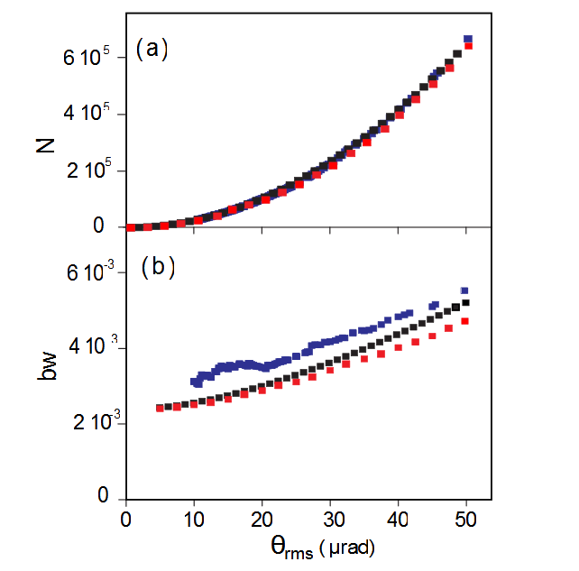
Analytical model vs. classical/quantum simulation
V. Petrillo
Number of
photons
CAIN (quantum
MonteCarlo)
Run by I.Chaichovska
and A. Variola
TSST (classical)
Developed by
P. Tomassini
bandwidth
Comp_Cross (quantum
semianalytical)
Developed by V.Petrillo

Slide 12
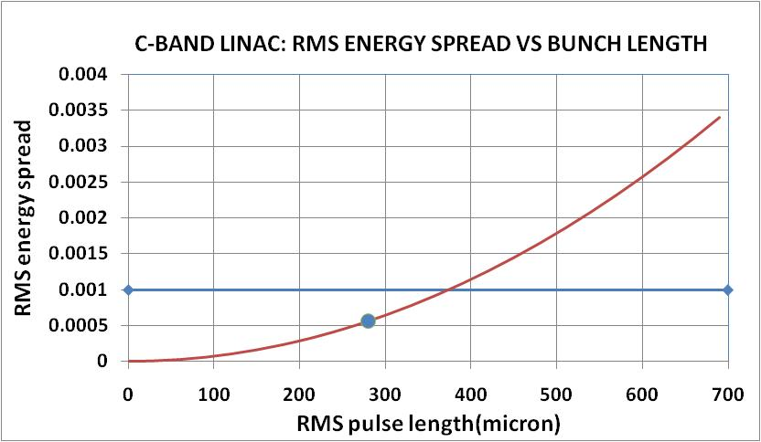
The hybrid scheme for the Linac:
Velocity bunching operation
Long bunch at cathode for high phase space density :
Q/ε_{n}² >10³ pC/(µrad)²
Short exit bunch (280 µm) for low energy spread (~0.05%)
Moderate risk (state of art RF gun, reduced multibunch operation problems respect to higher frequencies, low compression factor<3)
Economic
Compact (the use of the C-band booster meets the requirements on the available space)

Slide 13
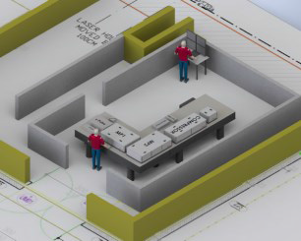
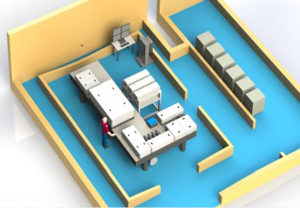
Gamma Beam System – Layout
Master clock synchronization @ < 0.5 ps
e– beam
dump
Interaction Point
High Energy
e– beam
dump
Interaction Point
Low Energy
Photogun
multibunch
beam
coll&diag
beam
coll&diag
e– beam
dump
Racks
Room
Control
Room
Racks
Room
Interaction Laser
High Energy
e– RF LINAC
High Energy
720 MeV
Interaction Laser
Low Energy
e– RF LINAC
Low Energy
300 MeV
Photo–drive Laser
e– source
Courtesy of A. Variola

Slide 14
Accelerator Bay 1 – Layout
laser beam
circulator M9
300 MeV
beam dump
low energy interaction point
switching dipole
magnet
C–band
structures
S–band
structures
Photogun

Slide 15
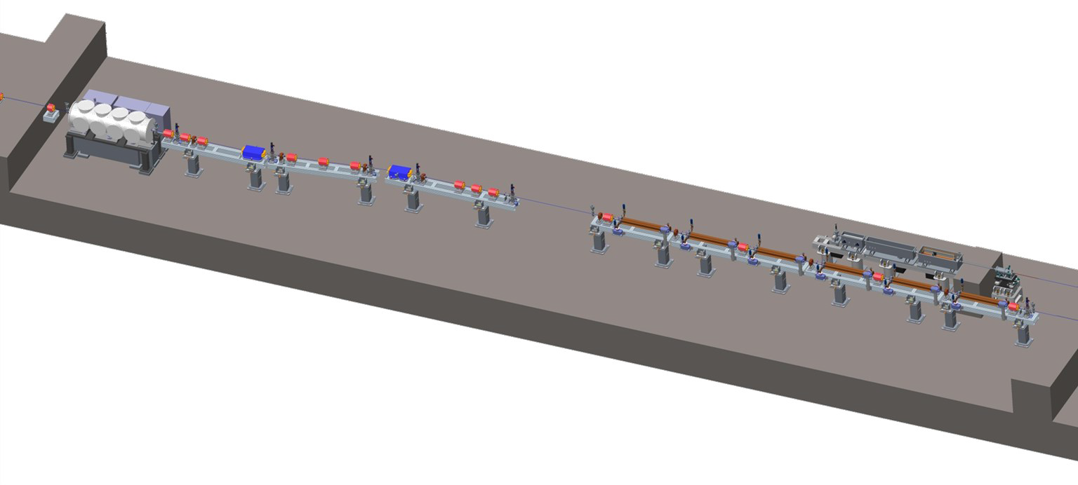
Accelerator Bay 2 – Layout
laser beam
circulator M26
high energy interaction point
switching dipole
magnet
C–band
structures
low energy gamma beam diagnostics
low energy collimator

Slide 16
Simulated gamma beams for different energies
Energy [MeV] | 2.00 | 3.45 | 9.87 | 19.5
# photons/pulse within FWHM bdw. | < 1.2∙10⁵ | < 1.1∙10⁵ | < 2.6∙10⁵ | < 2.5∙10⁵
# photons/s within FWHM bdw. | < 4.0∙10⁸ | < 3.7∙10⁸ | < 8.3∙10⁸ | < 8.1∙10⁸
Source rms size [mm] | 12 | 11 | 11 | 10
Source rms divergence [mrad] | ≤ 140 | ≤ 100 | ≤ 50 | ≤ 40
Radiation pulse length rms [ps] | 0.92 | 0.91 | 0.95 | 0.90

Slide 17
The IP Laser ricirculator

Slide 18
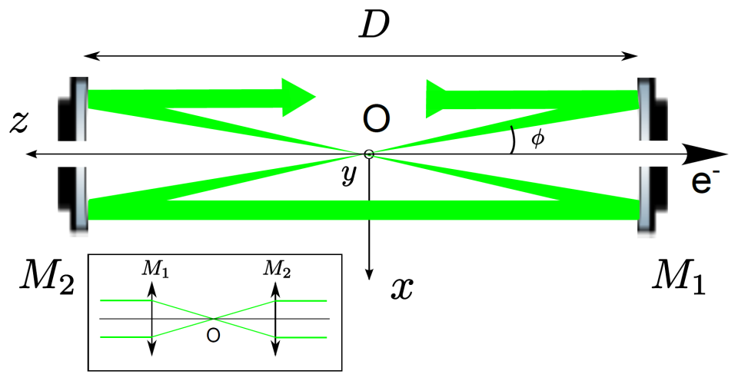
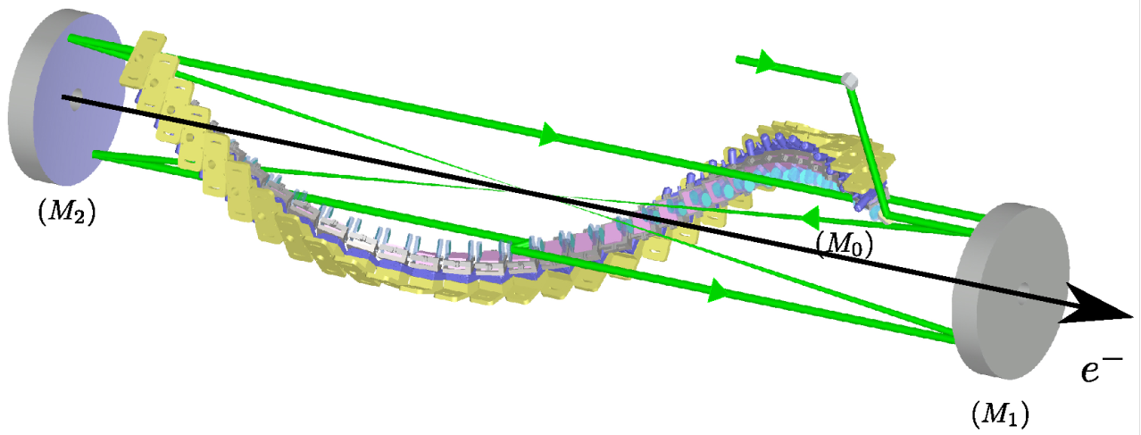
Optical system: laser beam circulator (LBC) for J-class psec laser pulses focused down to μm spot sizes
Electron beam is transparent to the laser (only 10⁹ photons are back-scattered at each collision out of the 10¹⁸ carried by the laser pulse)
Circulator principle
PARAMETERS = OPTIMIZED ON THE GAMMA-RAY FLUX
2 high-grade quality parabolic mirrors
Aberration free
Mirror-pair system (MPS) per pass
Synchronization
Optical plan switching
Constant incident angle = small bandwidth
Laser power = state of the art
Angle of incidence (φ = 7.54°)
Waist size (ω₀ = 28.3μm)
Number of passes = 32 passes
30 cm
2.4 m
F. Zomer K. Cassou

Slide 19
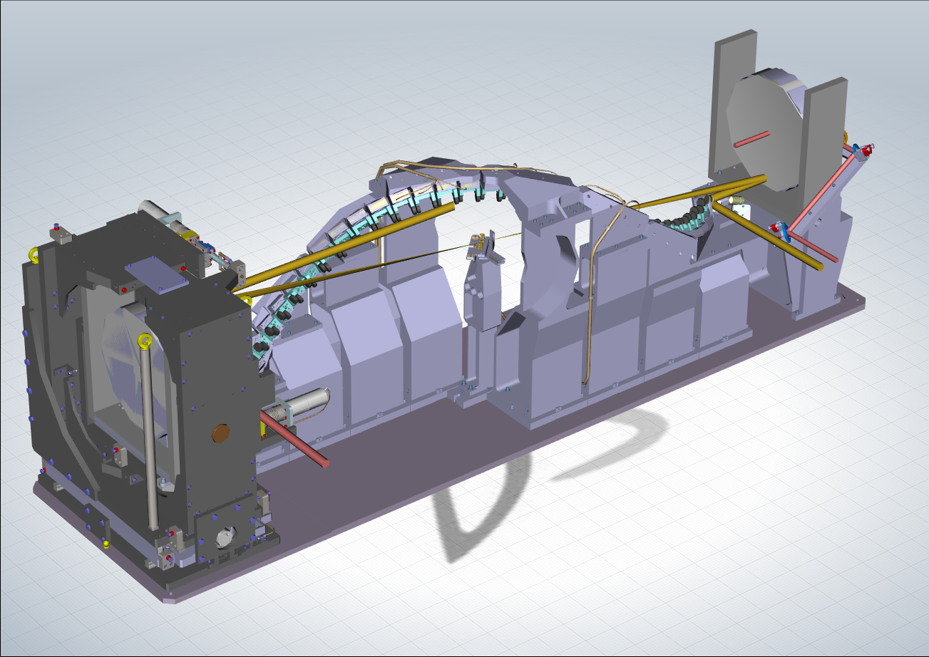
Laser pulse round-trip is about 16 nsec. A fresh electron bunch must be transported and focused at the IP every 16 nsec, for 32 round trips (total of 480 nsec -> need long flat RF pulse)
γ-ray beam time structure: micro-pulses carrying about 10⁵ photons within the bandwidth (0.3%-0.5%) with 0.8 psec pulse duration, in trains of 32 micro-pulses, repeating at 100 Hz (10 msec train-to-train separation)

Slide 20
Technical solution: the dragon shape circulator

Slide 21
1 GeV e⁻ beam for EUSPARC (6 more C-band sections)

Slide 22
Input and IP beam

Slide 23
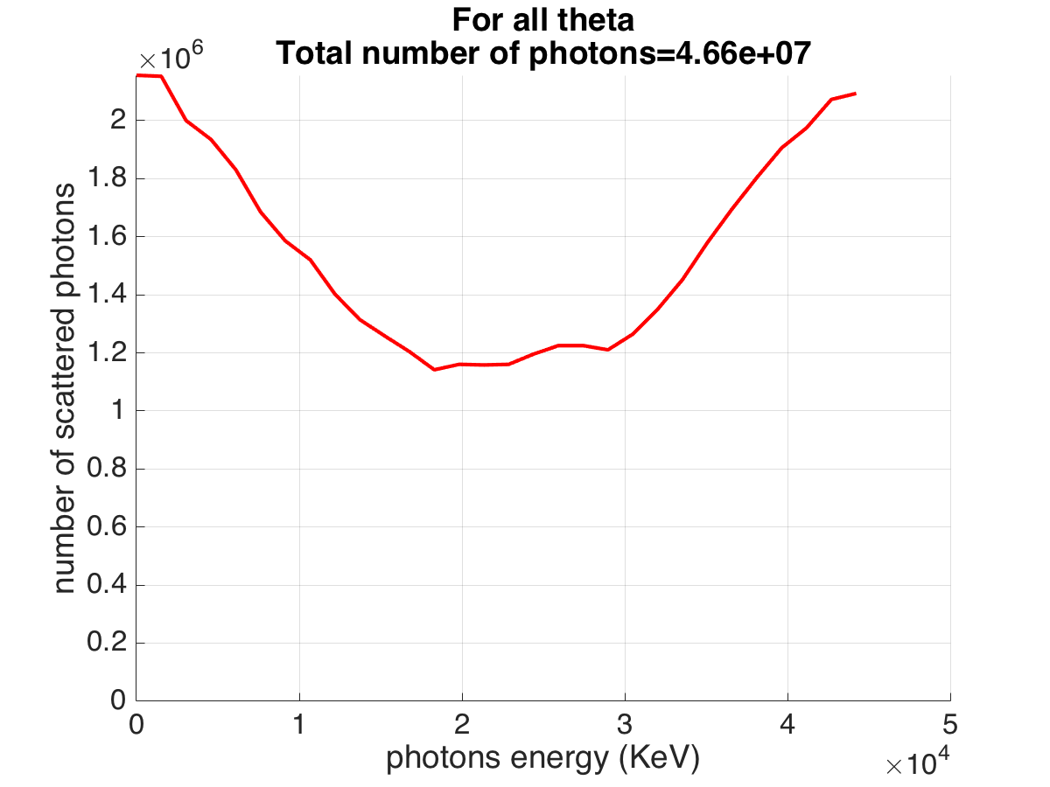
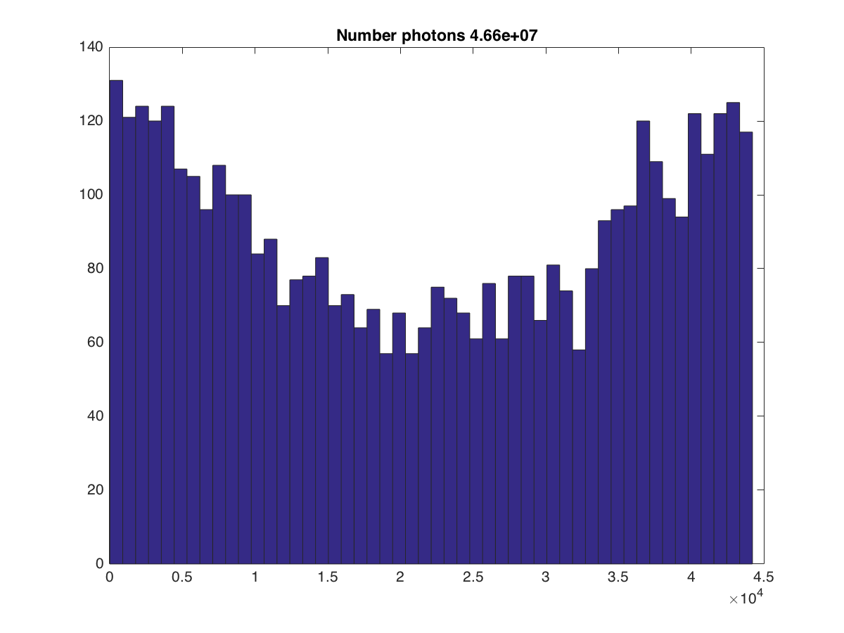
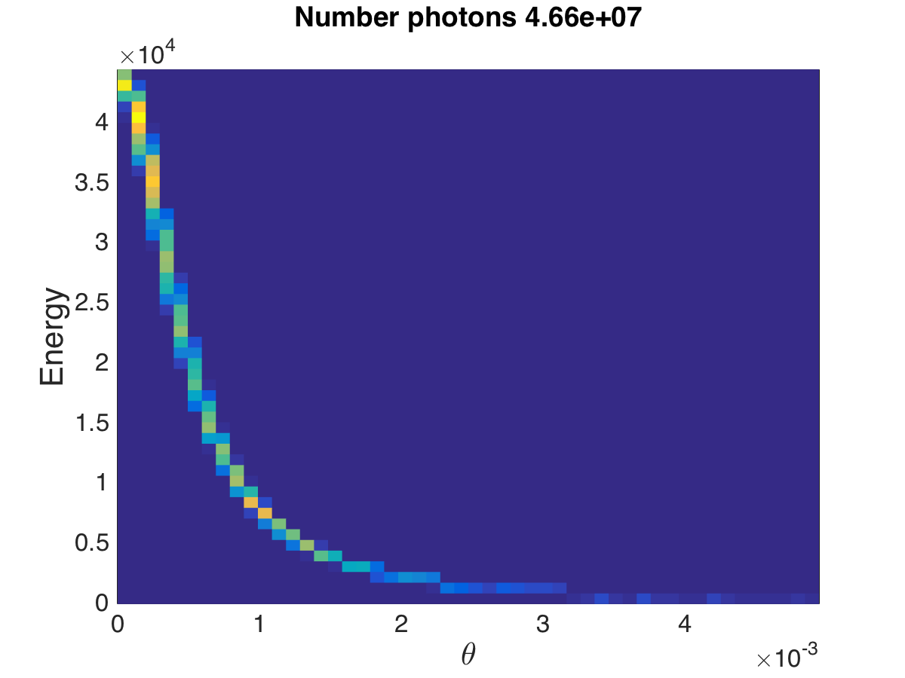
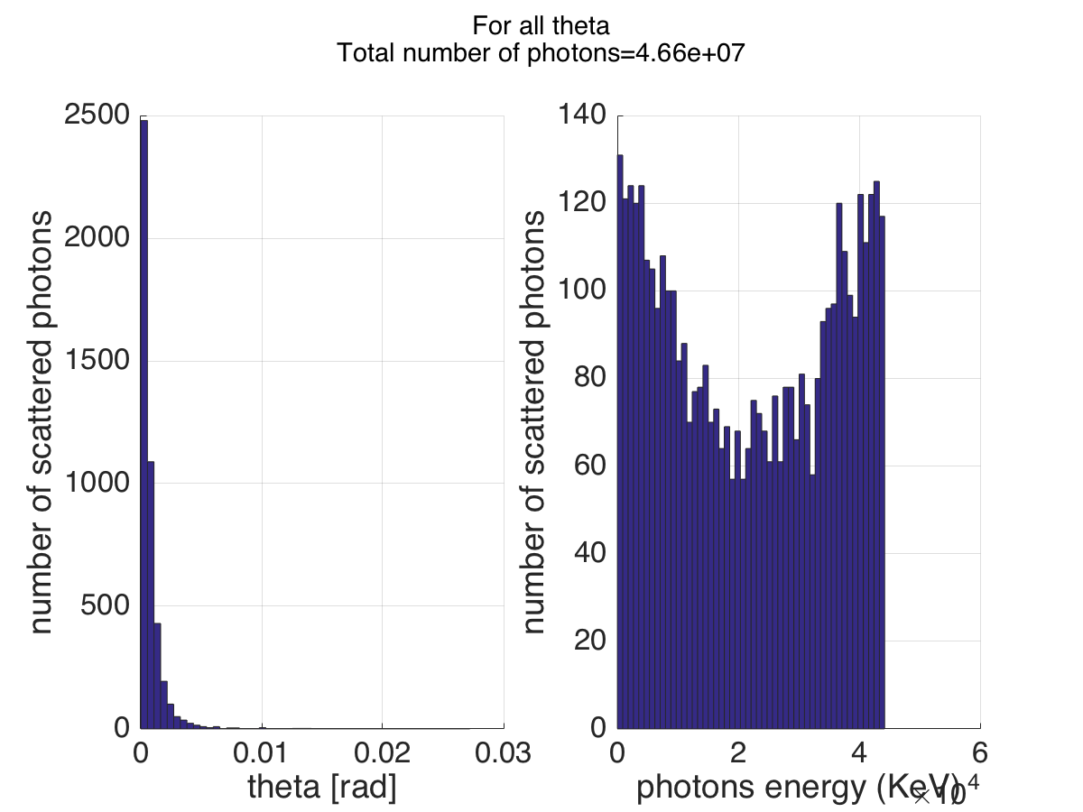
Preliminary 𝛄-results
Charge of the electron 250 pC
laser
sigz=0.000278 um,
laserwl=515.*nm,
pulseE=0.4 J,
sigLr=14.*micron,
w0=2*sigLr,
rayl=Pi*w0^2/laserwl,
sigt=1.5*psec,
angle=0,

Slide 24
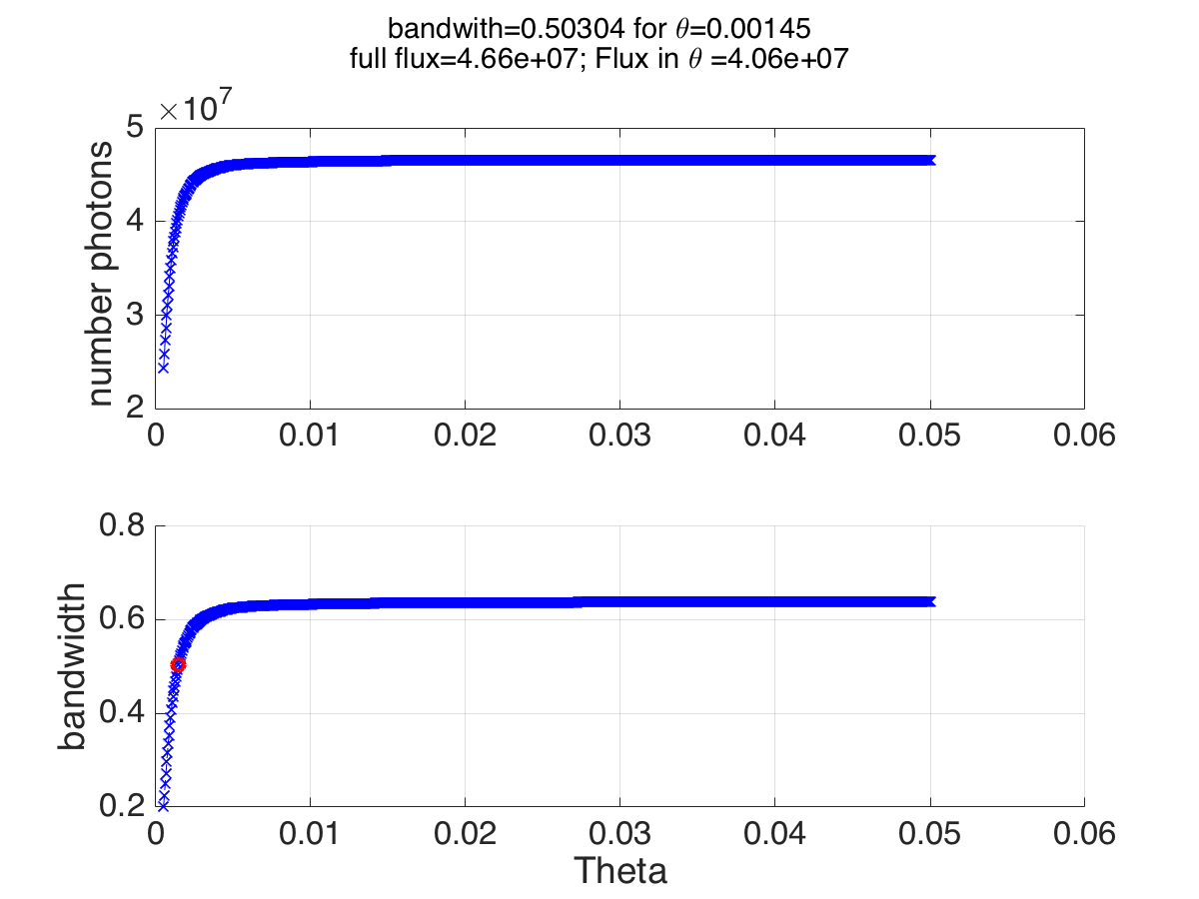
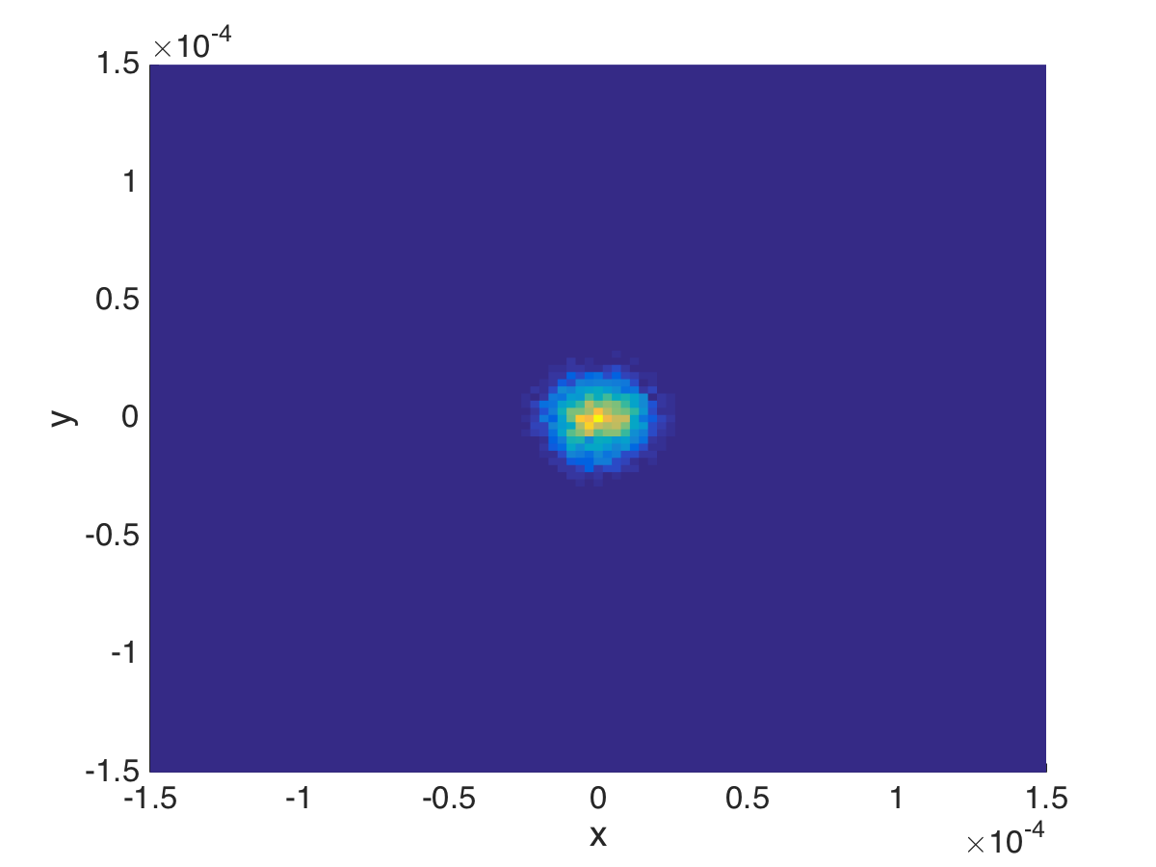
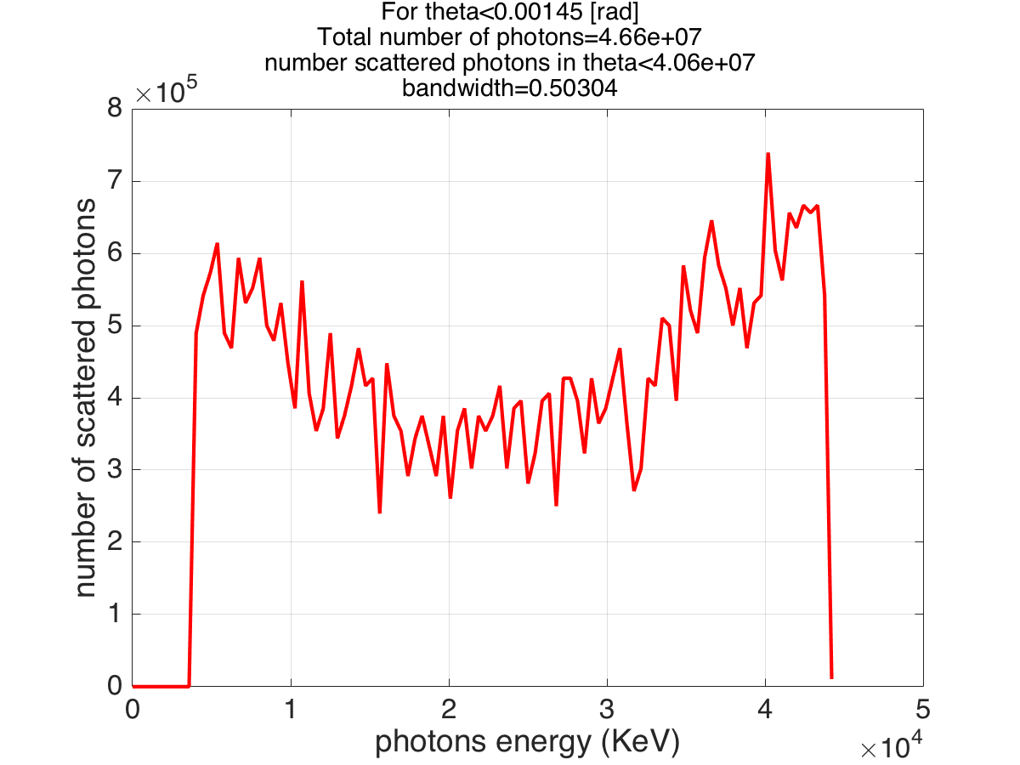
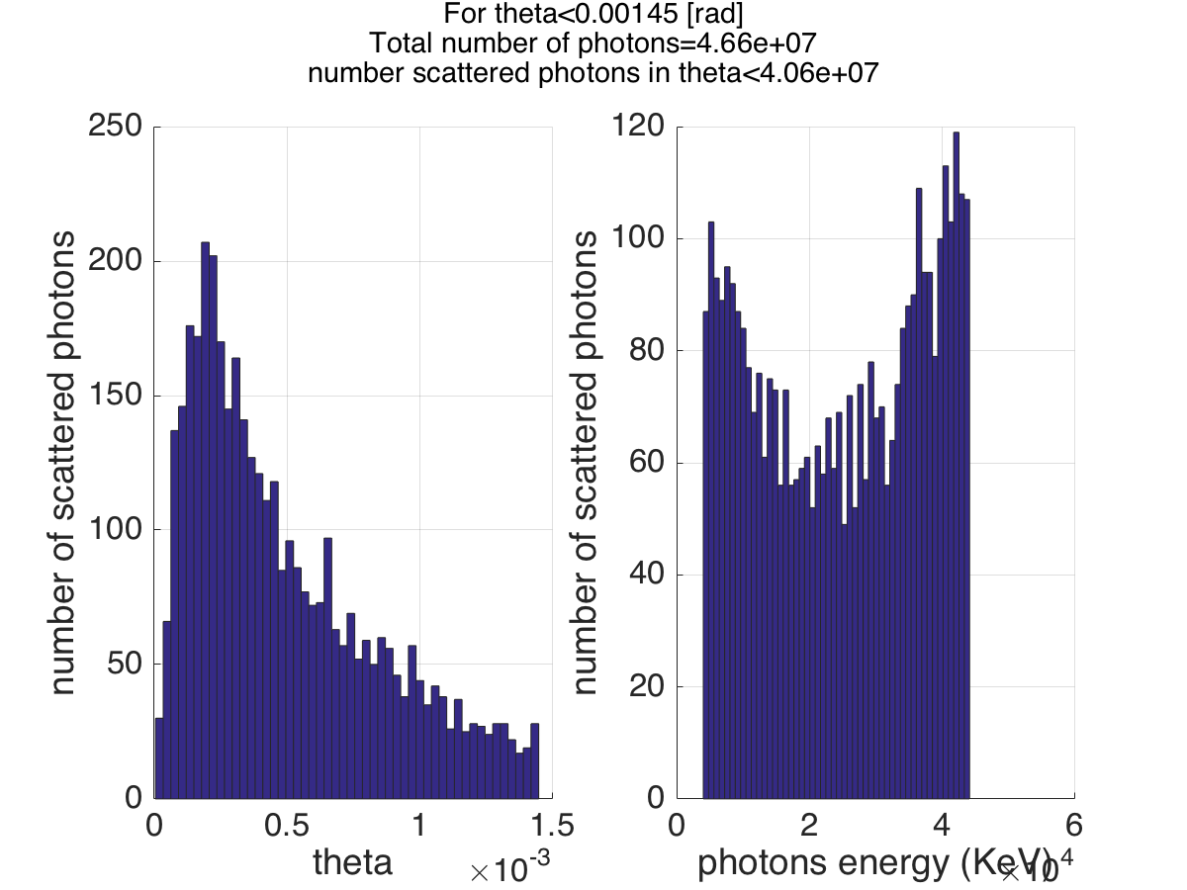
bandwith analysis

Slide 25
Bandwidth analysis
Collimated case
Sigma_x=14 um
Sigma_x=20 um

