Slide 1
Stato e richieste degli esperimenti di Linea Scientifica 3
Rosario Turrisi
9 luglio 2015

Slide 2
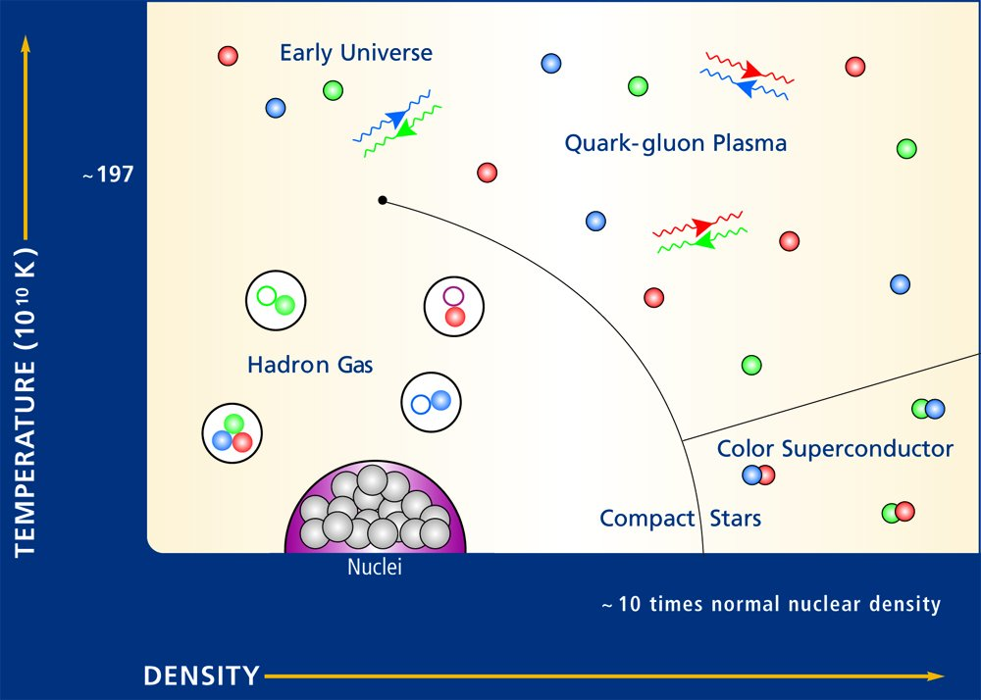
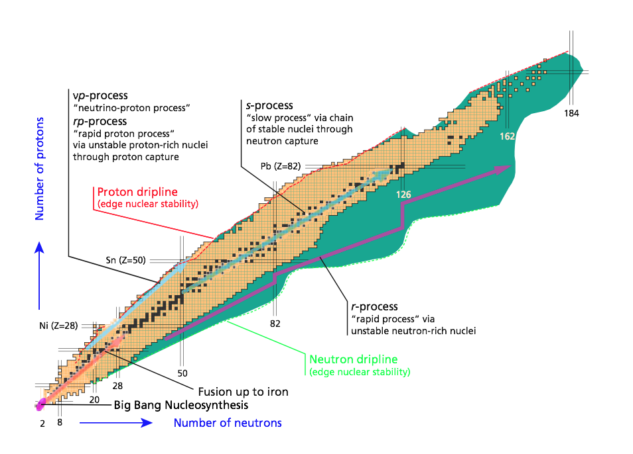
Gruppo3-Pd in una slide (2010-15)
Rappresentate le 4 linee della CSN3,
dall’evoluzione delle stelle a quella dei quark!
1 Quarks and hadron dynamics
~135
~175 MeV
JLAB12
2 Phase transitions of nuclear and hadronic matter
ALICE
3 Nuclear structure and reaction dynamics
NUCL-EX
PRISMA-FIDES
EXOTIC
GAMMA
4 Nuclear astrophysics and interdisciplinary researches
AEGIS
LUNA3
Personale ricercatore:
14 dipendenti+19 associati + 5 borsisti (PhD/adr)
Totale=38 pp/31.77 FTE (inizio 2015)
2 progetti premiali (LUNA3)
FIRB (M. Mazzocco)
ERC Consolidator grant (P. Giubilato)
Dati degli ultimi 4 anni
Articoli: >250 Lauree: 8 PhD: 10 PostDoc: 13 Premi: 1 (Villi)

Slide 3

JLAB12
1 Quarks and hadron dynamics

Slide 4
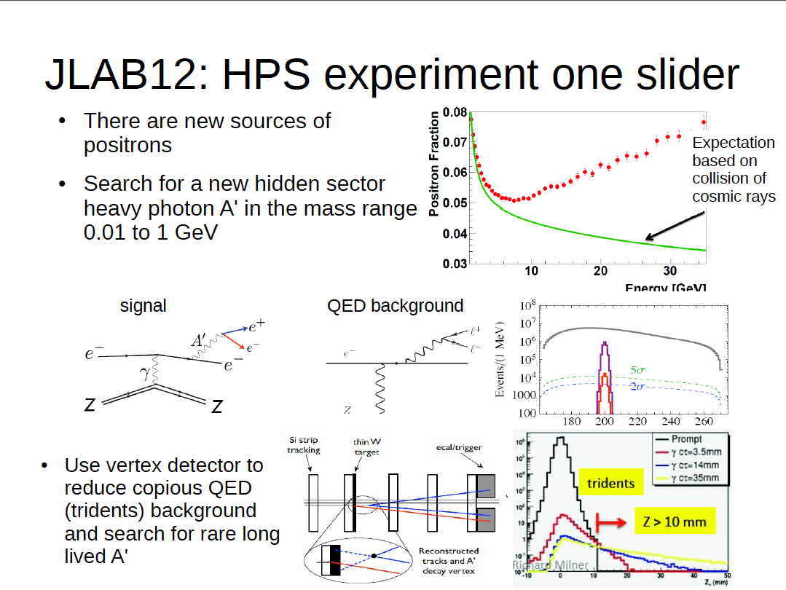
by G. Simi
1 Quarks and hadron dynamics

Slide 5
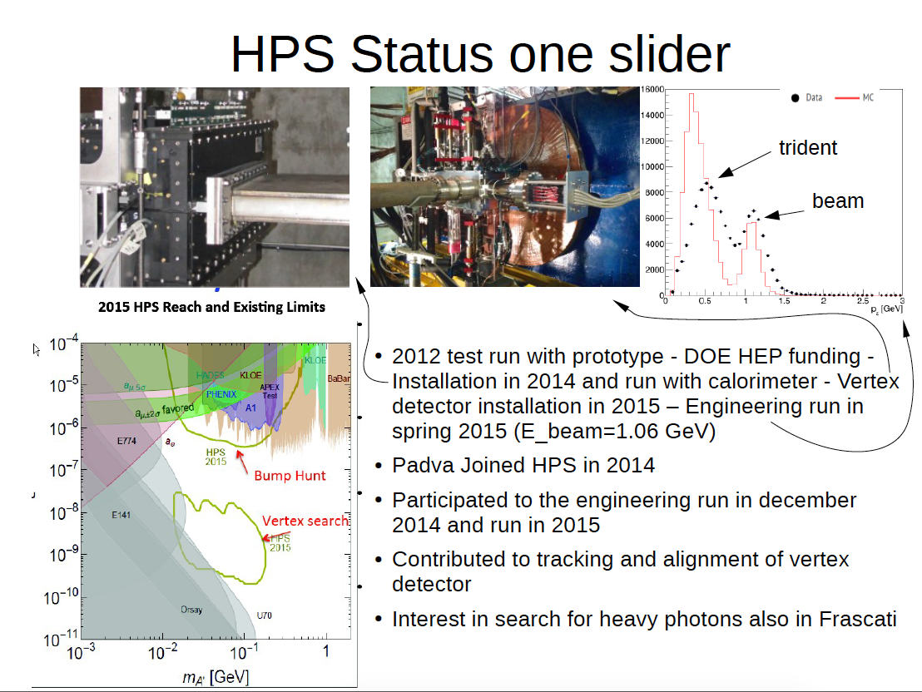
by G. Simi
1 Quarks and hadron dynamics
Padova

Slide 6
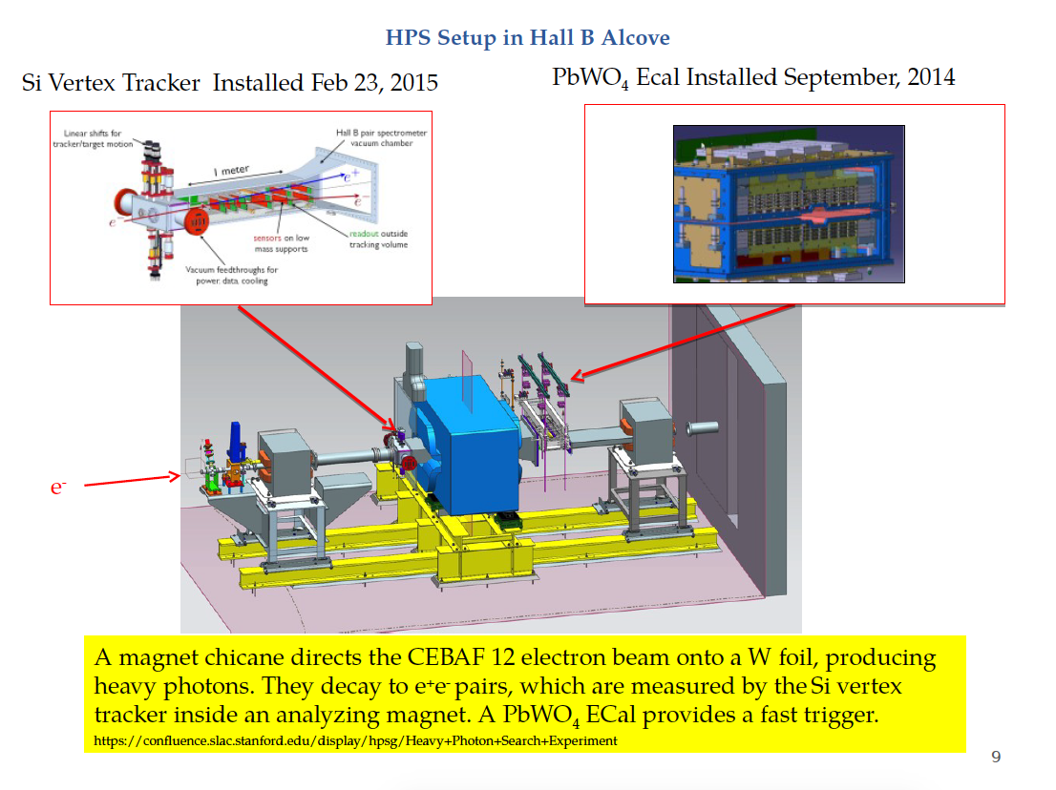
by G. Simi
1 Quarks and hadron dynamics

Slide 7
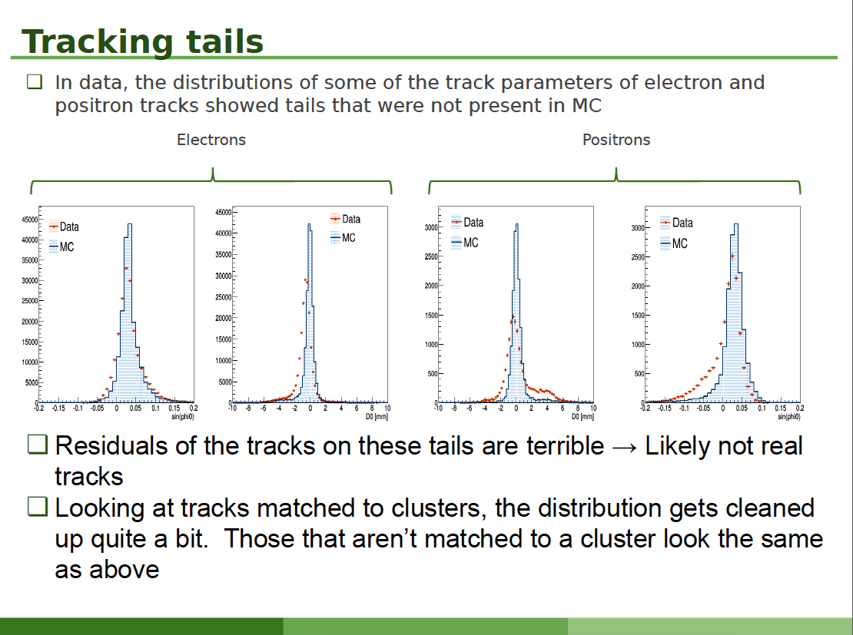
by G. Simi
1 Quarks and hadron dynamics

Slide 8
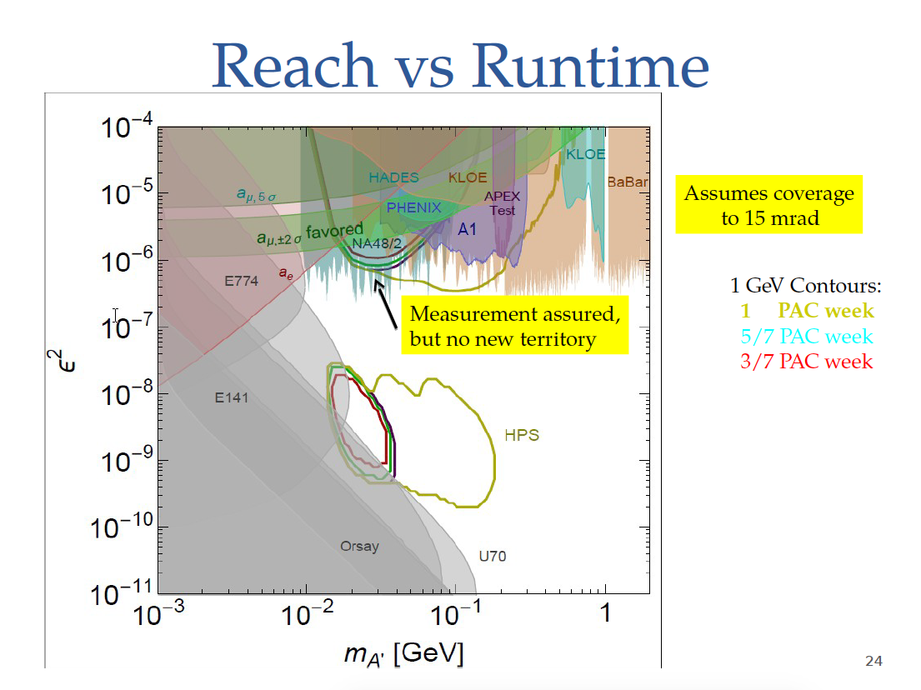
by G. Simi
1 Quarks and hadron dynamics

Slide 9
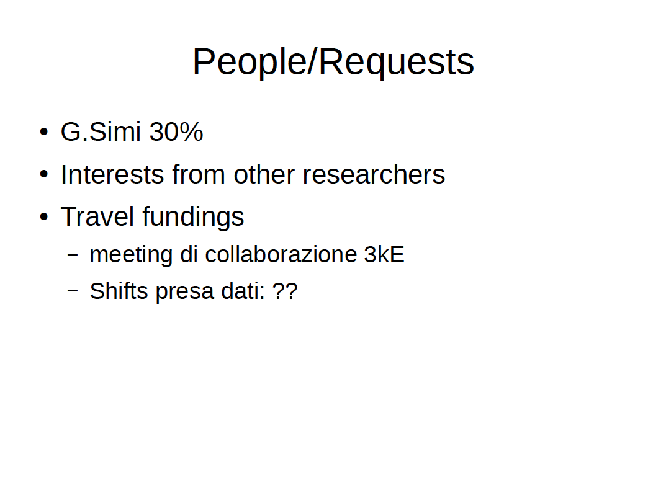
by G. Simi
1 Quarks and hadron dynamics

Slide 10
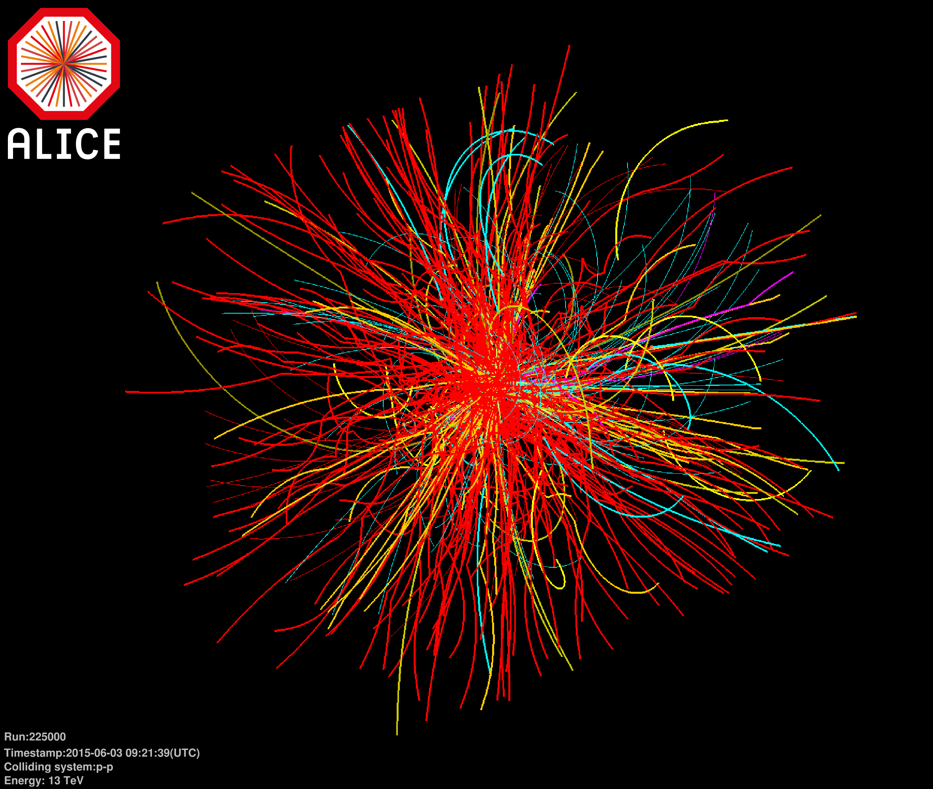
ALICE
2 Phase transitions of nuclear and hadronic matter
pp 13 TeV

Slide 11
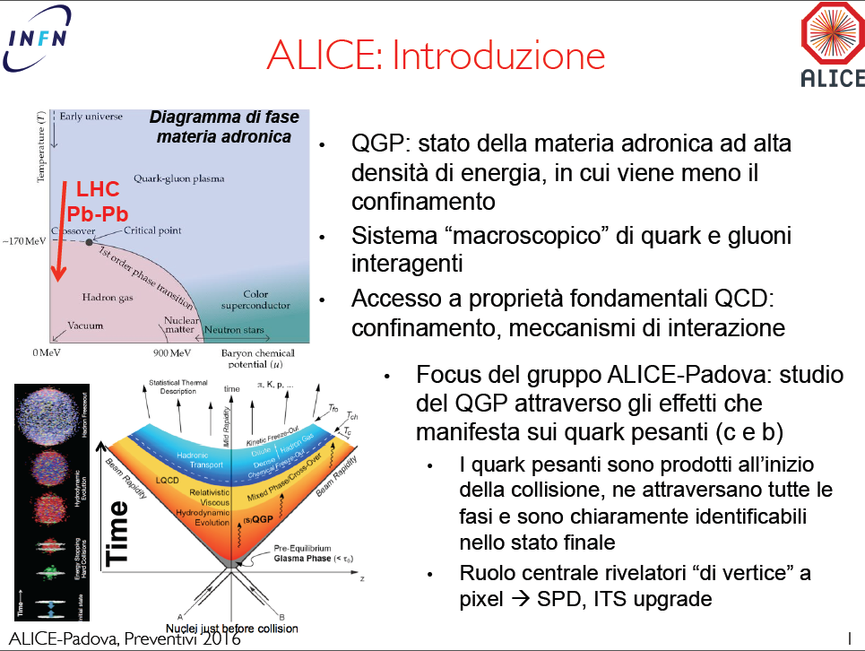
ALICE
by A. Dainese
2 Phase transitions of nuclear and hadronic matter

Slide 12
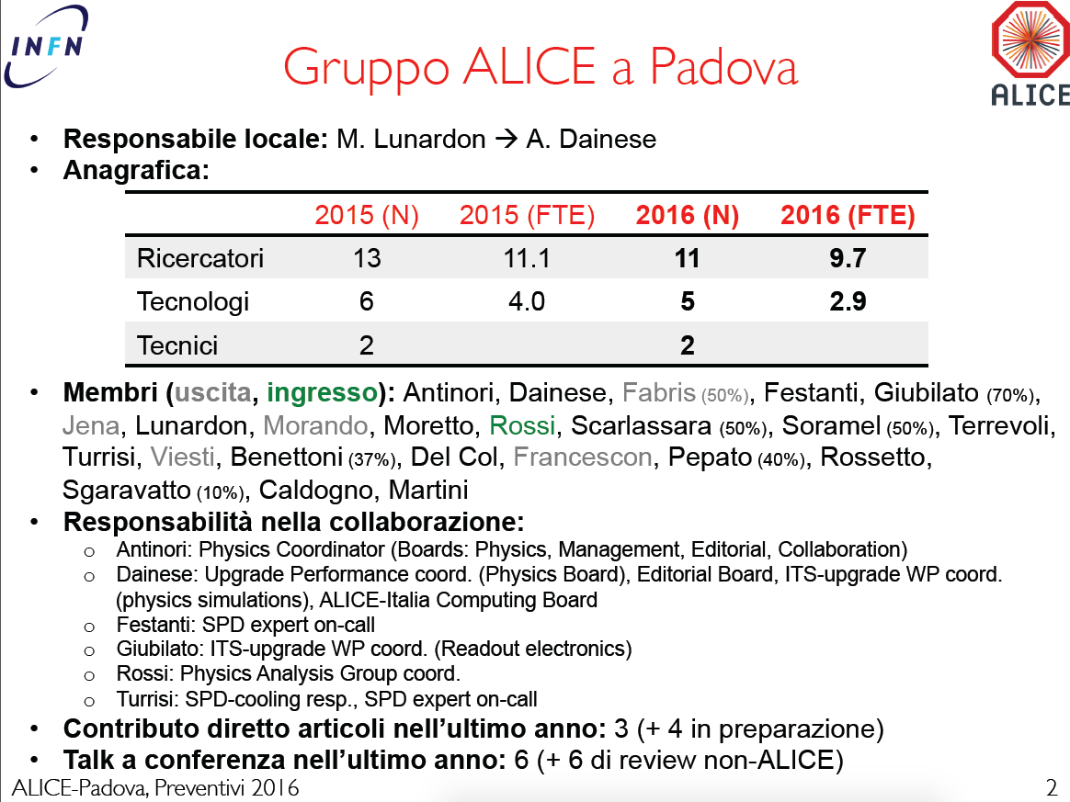
by A. Dainese
2 Phase transitions of nuclear and hadronic matter

Slide 13
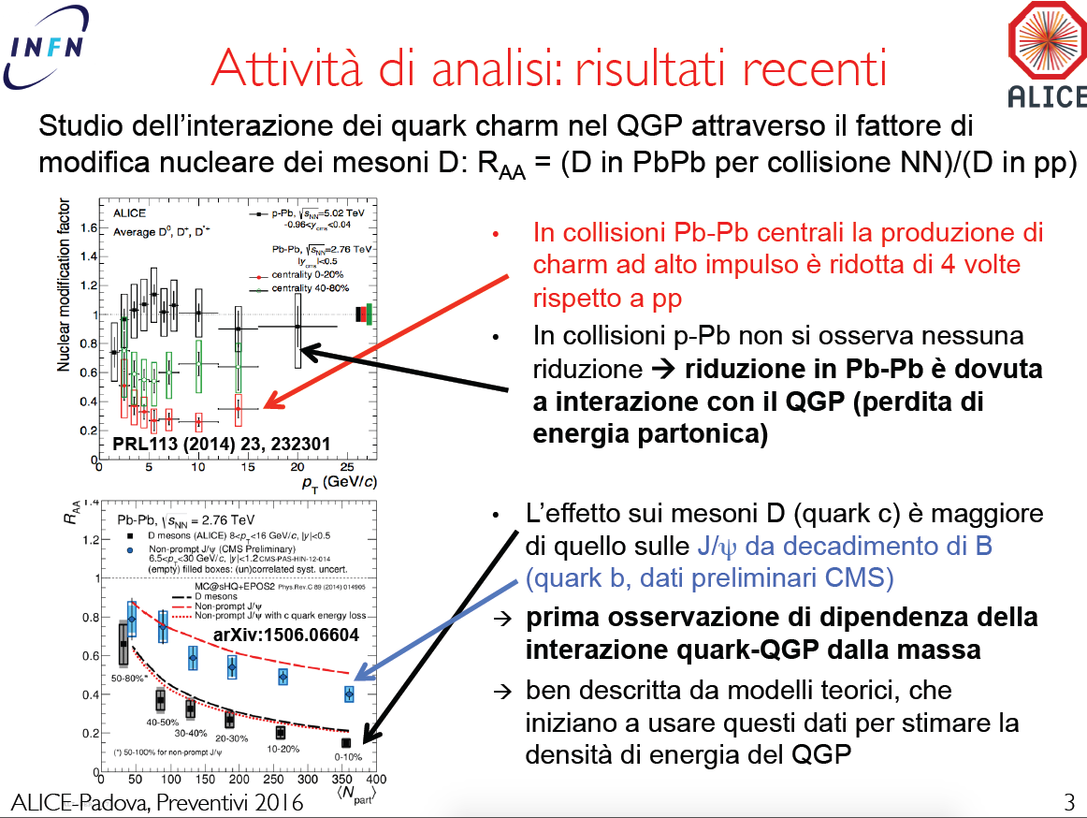
by A. Dainese
2 Phase transitions of nuclear and hadronic matter

Slide 14
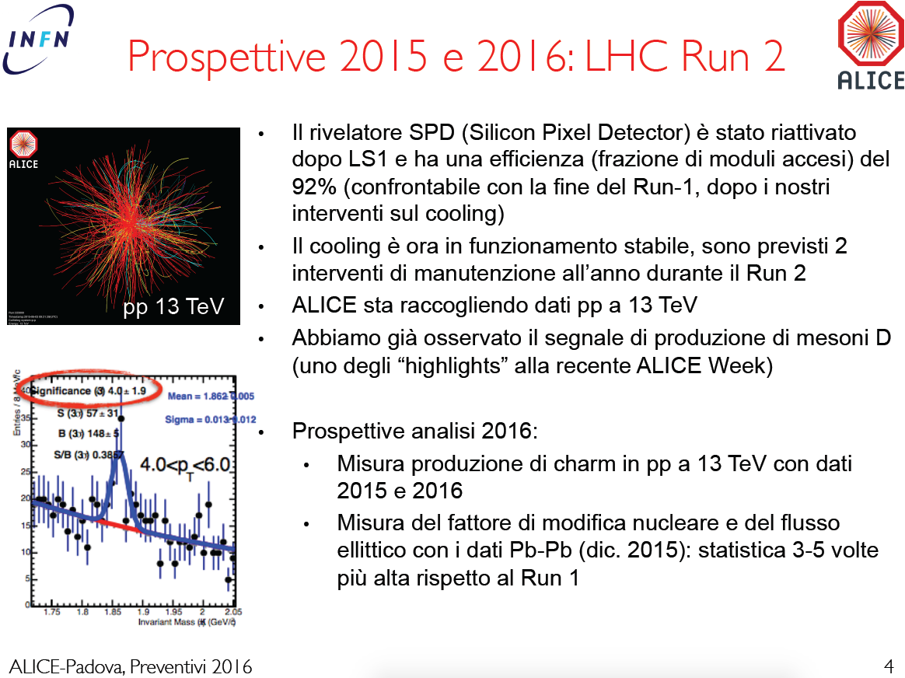
by A. Dainese
2 Phase transitions of nuclear and hadronic matter

Slide 15
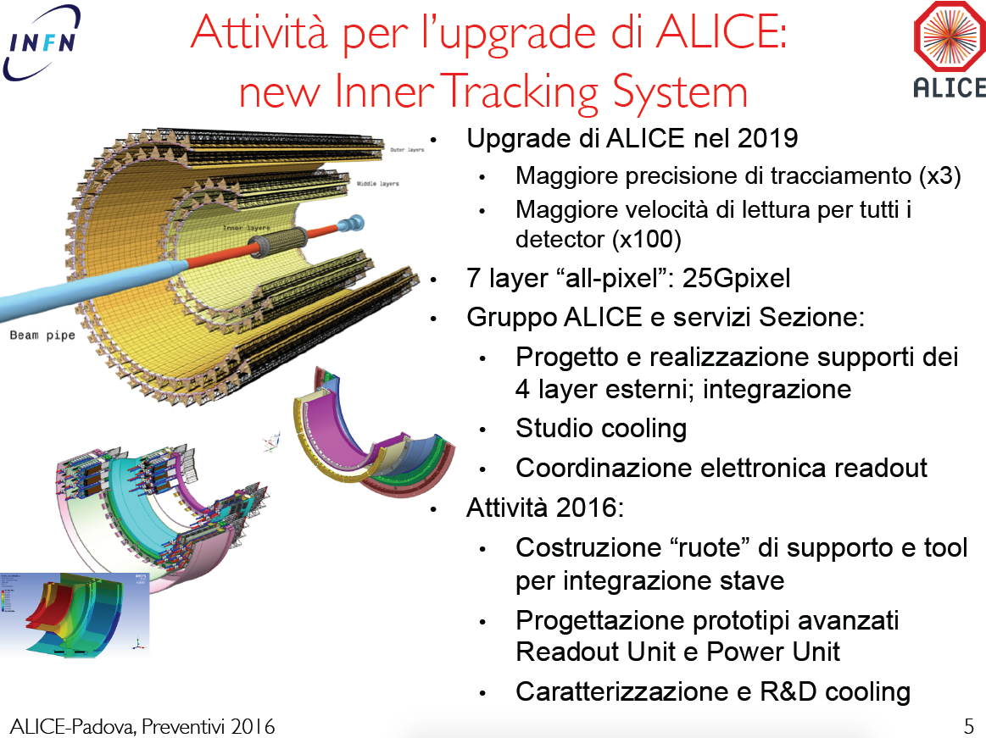
by A. Dainese
2 Phase transitions of nuclear and hadronic matter

Slide 16
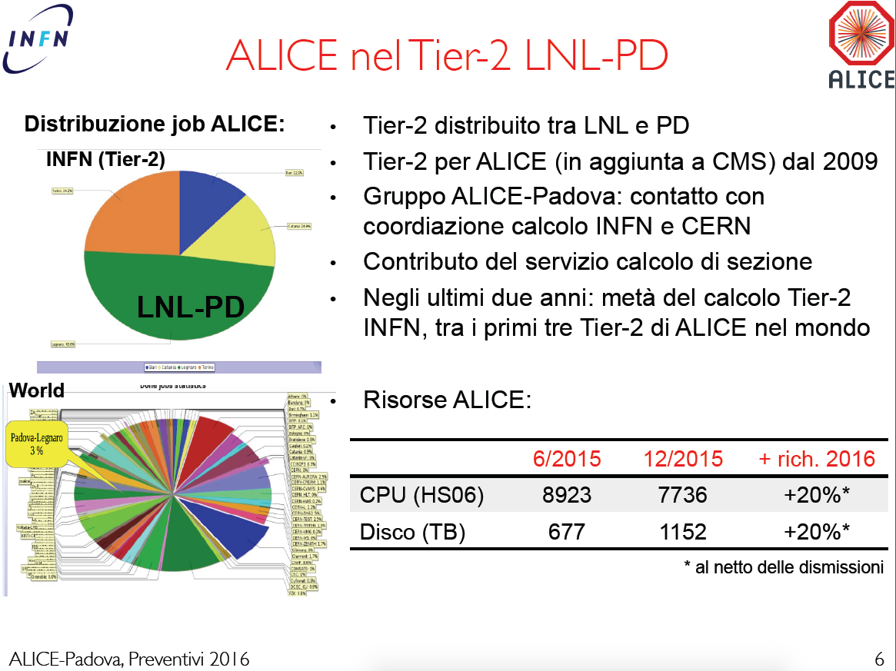
by A. Dainese
2 Phase transitions of nuclear and hadronic matter

Slide 17
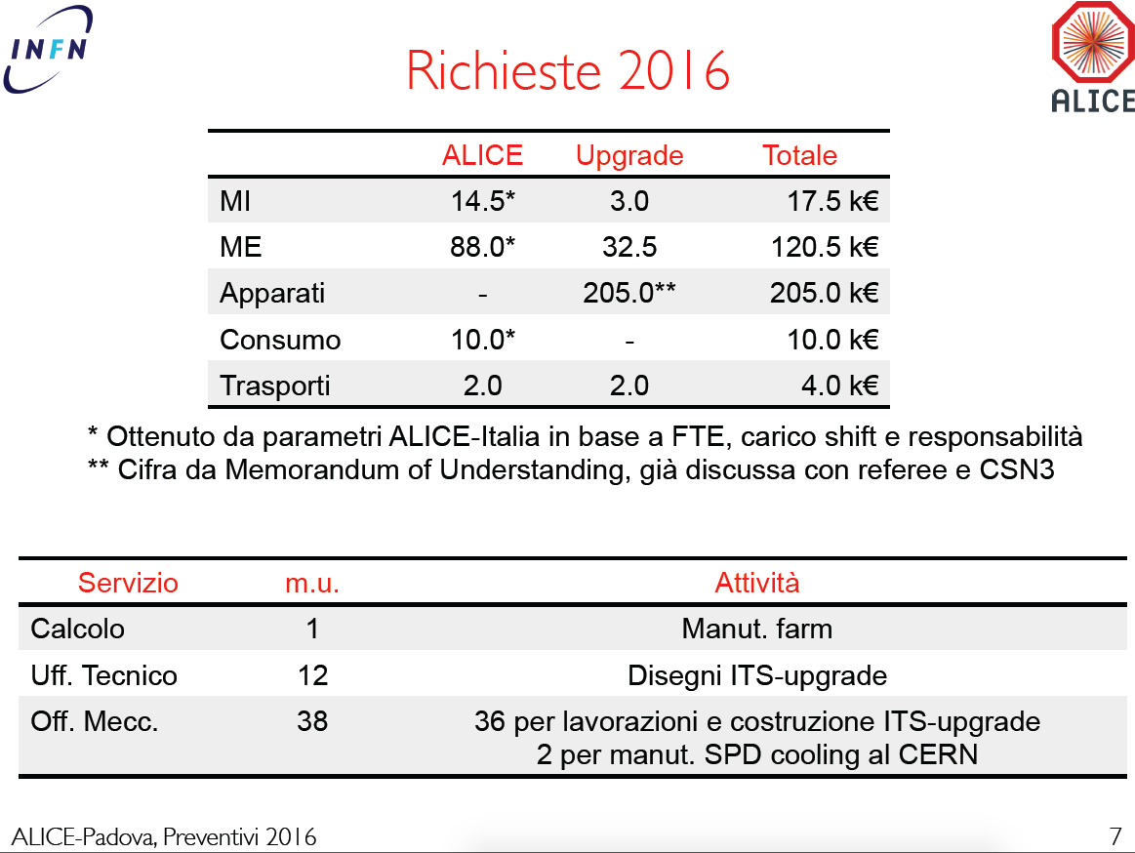
by A. Dainese
2 Phase transitions of nuclear and hadronic matter

Slide 18

Oltre la valle di stabilità…
Shell structure in nuclei
Structure of doubly magic nuclei
Changes in the (effective) interactions
N=Z
Shape coexistence
Transfermium nuclei
Proton drip line and N=Z nuclei
Spectroscopy beyond the drip line
Proton-neutron pairing
Isospin symmetry
r process
Nuclear shapes
Exotic shapes and isomers
Coexistence and transitions
¹⁰⁰Sn
⁴⁸Ni
Neutron-rich heavy nuclei (N/Z → 2)
Large neutron skins (r_{ν}-r_{π}→ 1fm)
New coherent excitation modes
Shell quenching
^{132+x}Sn
protons→
⁷⁸Ni
…and the quest for the superheavy island!
Nuclei at the neutron drip line (Z→25)
Very large proton-neutron asymmetries
Resonant excitation modes
Neutron Decay
neutrons→
Notes:
The r-process is a nucleosynthesis process that occurs in core-collapse supernovae (see also supernova nucleosynthesis) and is responsible for the creation of approximately half of the neutron-rich atomic nuclei heavier than iron.
‘’r’’ sta per RAPID NEUTRON CAPTURE

Slide 19
NUCL-EX
3 Nuclear structure and reaction dynamics

Slide 20
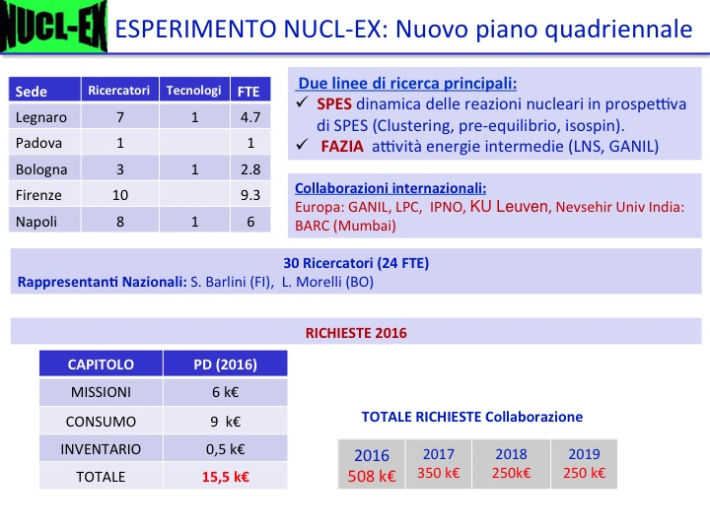
by D. Fabris
3 Nuclear structure and reaction dynamics

Slide 21
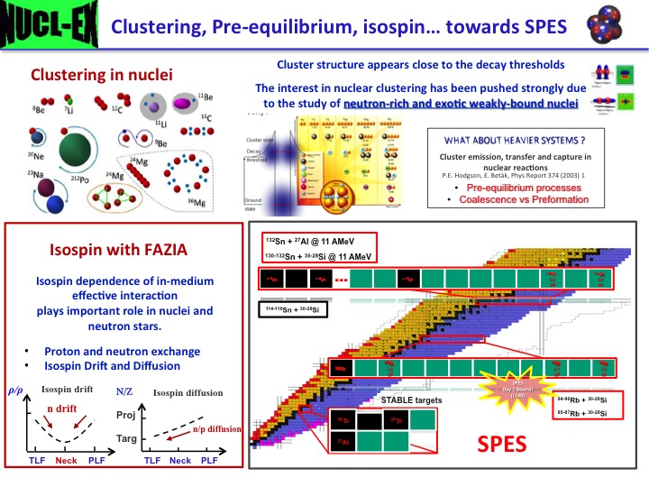
by D. Fabris
3 Nuclear structure and reaction dynamics

Slide 22
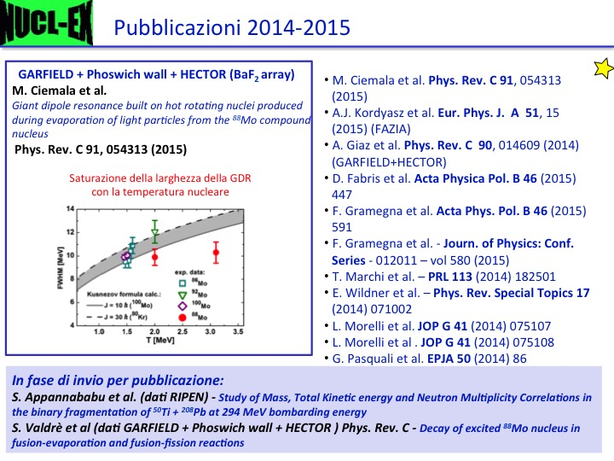
by D. Fabris
3 Nuclear structure and reaction dynamics

Slide 23
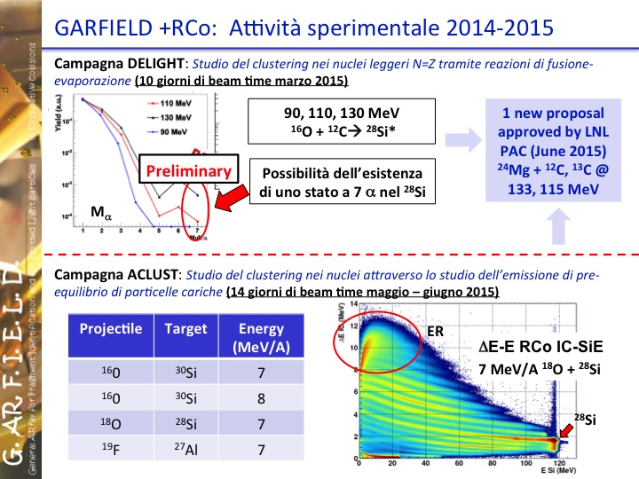
by D. Fabris
3 Nuclear structure and reaction dynamics

Slide 24
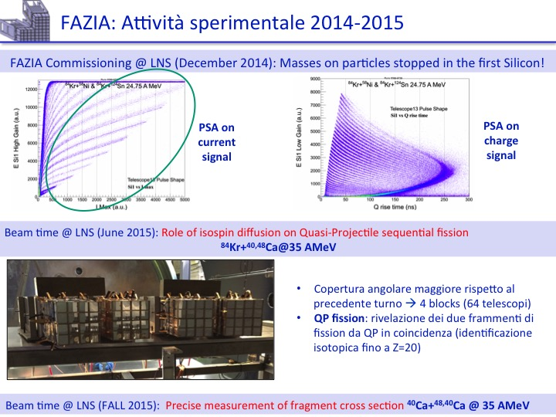
by D. Fabris
3 Nuclear structure and reaction dynamics

Slide 25
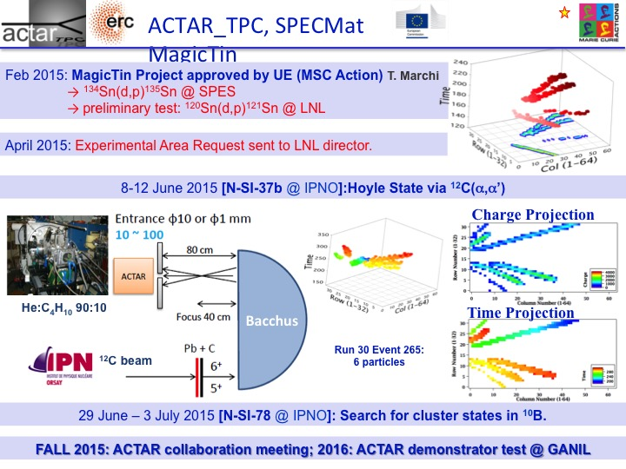
by D. Fabris
3 Nuclear structure and reaction dynamics

Slide 26
PRISMA-FIDES
3 Nuclear structure and reaction dynamics

Slide 27
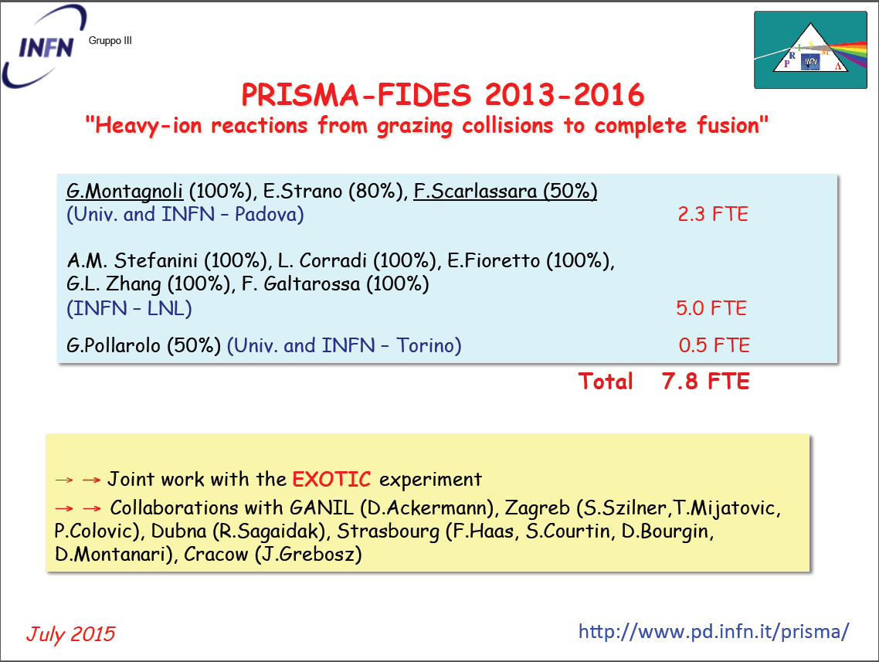
by G. Montagnoli
3 Nuclear structure and reaction dynamics
20%
1.8

Slide 28
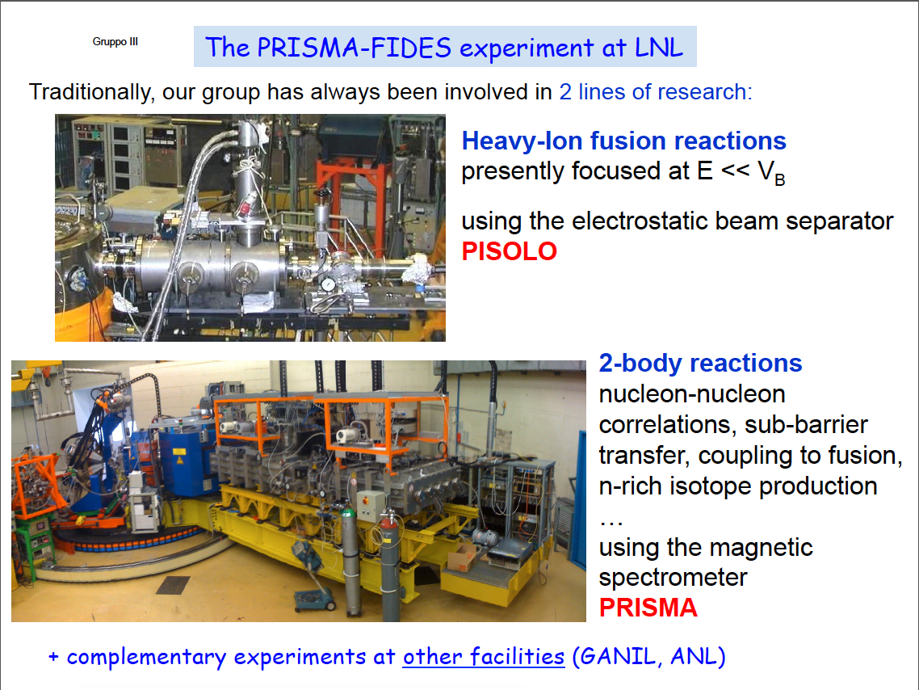
by G. Montagnoli
3 Nuclear structure and reaction dynamics

Slide 29
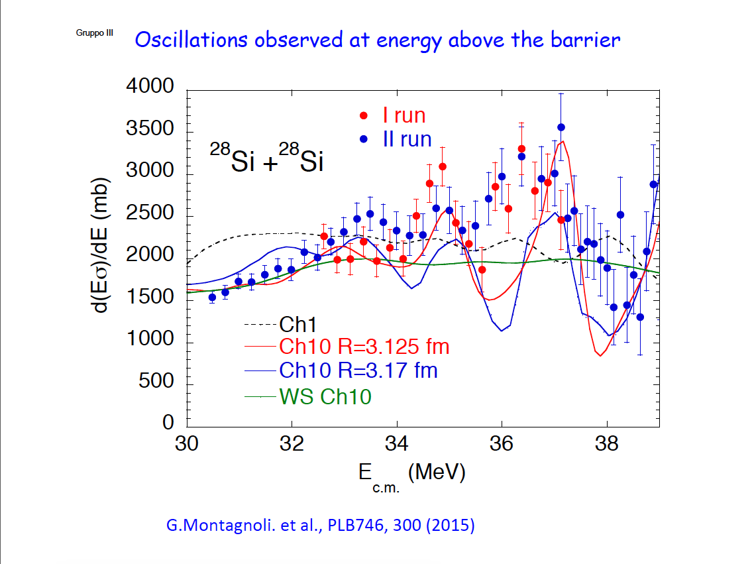
by G. Montagnoli
3 Nuclear structure and reaction dynamics

Slide 30
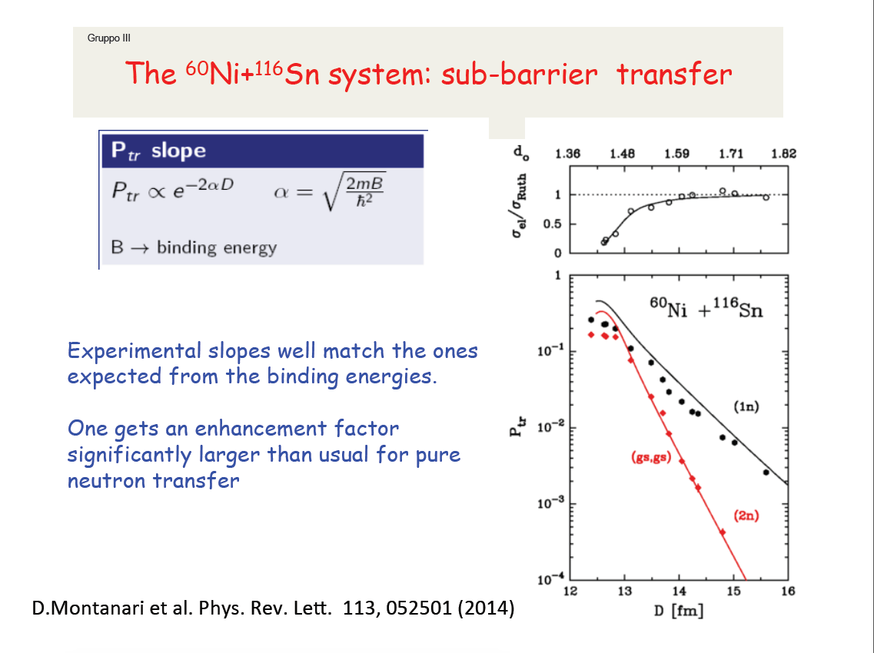
by G. Montagnoli
3 Nuclear structure and reaction dynamics
Notes:
P2=EFxP1^2 EF=5.5 comprensibile solo introducendo effetti di struttura, possibile in questo caso perché transizioni ground-ground

Slide 31
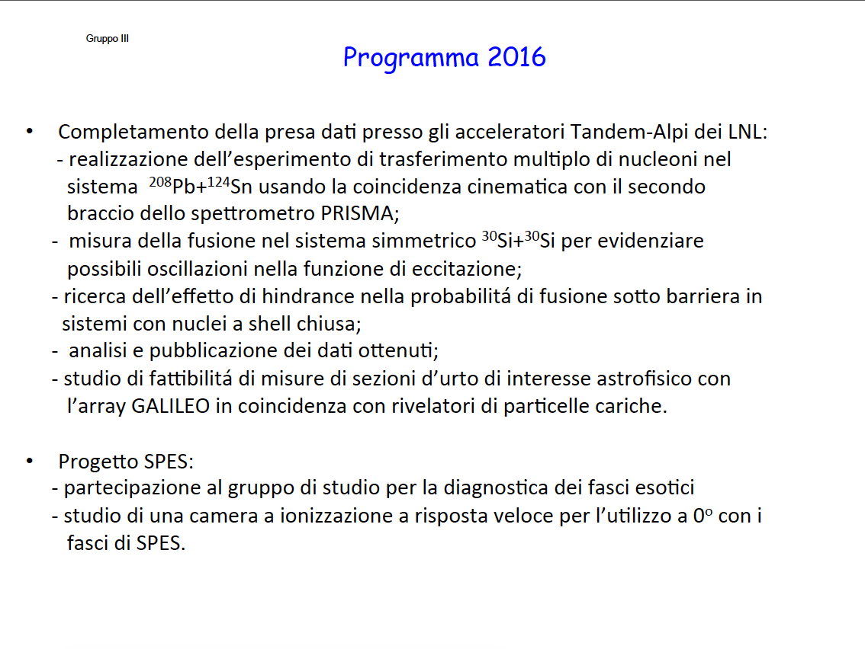
by G. Montagnoli
3 Nuclear structure and reaction dynamics

Slide 32
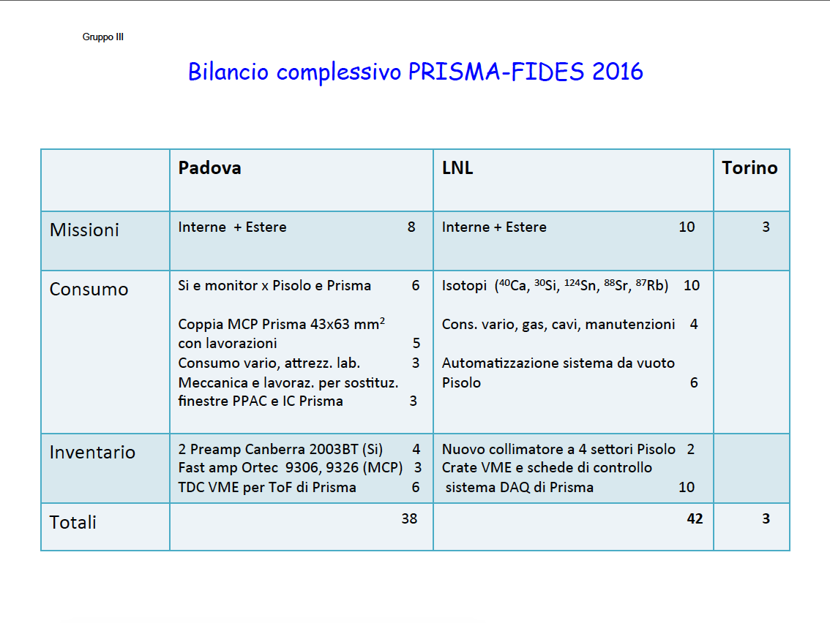
by G. Montagnoli
3 Nuclear structure and reaction dynamics

Slide 33
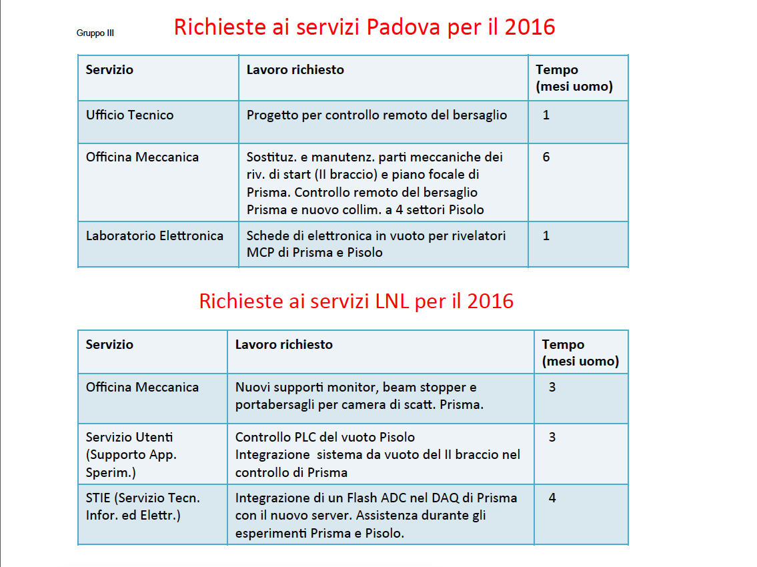
by G. Montagnoli
3 Nuclear structure and reaction dynamics

Slide 34
EXOTIC
3 Nuclear structure and reaction dynamics

Slide 35
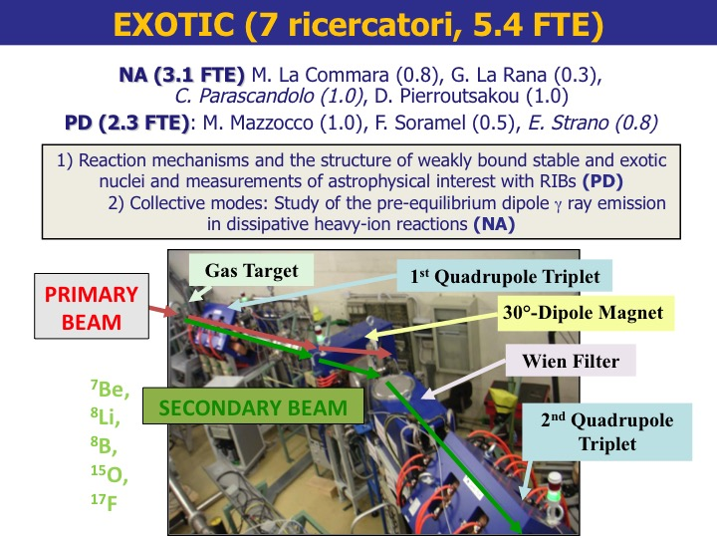
by M. Mazzocco
3 Nuclear structure and reaction dynamics

Slide 36
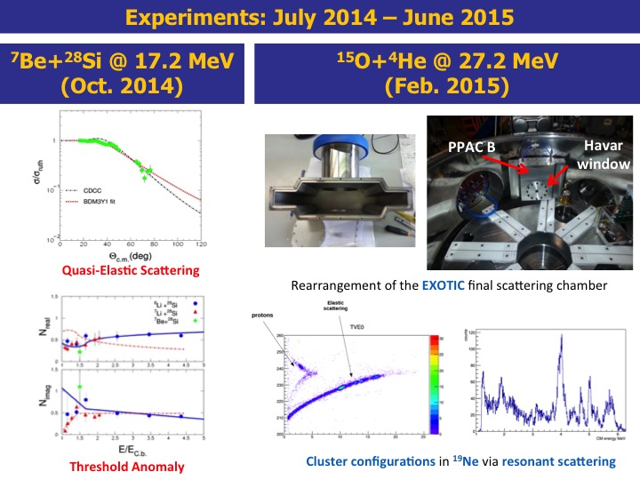
by M. Mazzocco
3 Nuclear structure and reaction dynamics

Slide 37
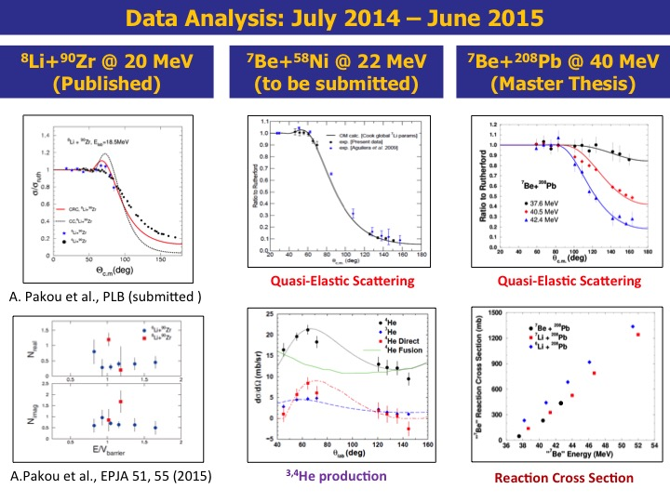
by M. Mazzocco
3 Nuclear structure and reaction dynamics

Slide 38
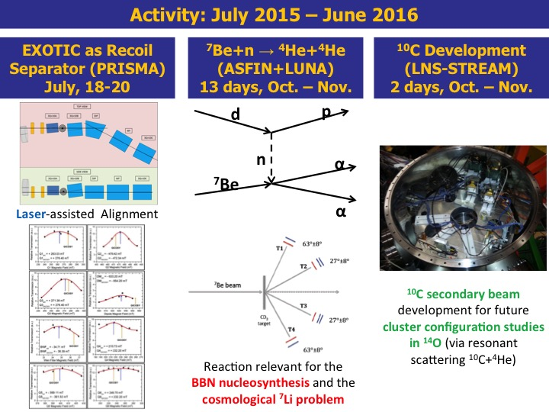
by M. Mazzocco
3 Nuclear structure and reaction dynamics

Slide 39
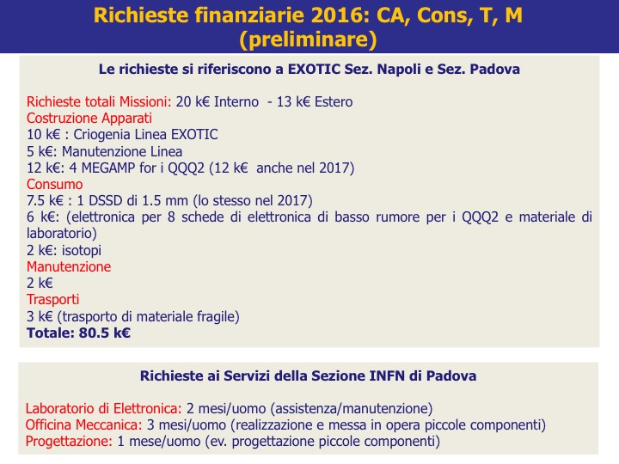
by M. Mazzocco
3 Nuclear structure and reaction dynamics

Slide 40
GAMMA
3 Nuclear structure and reaction dynamics

Slide 41
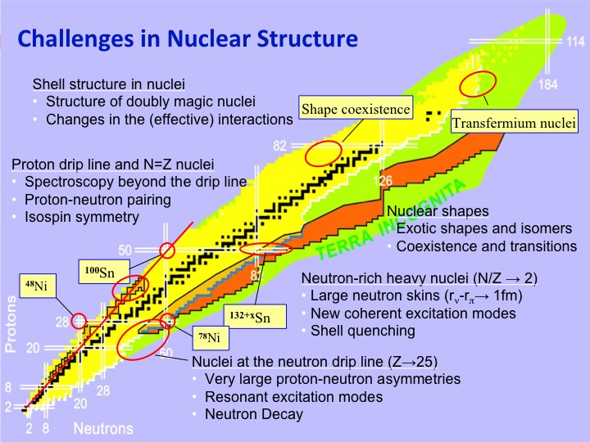
by R. Menegazzo
3 Nuclear structure and reaction dynamics

Slide 42
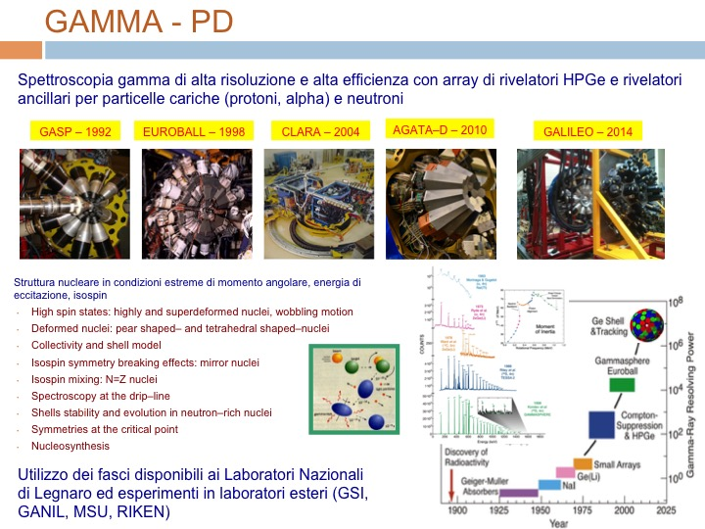
by R. Menegazzo
3 Nuclear structure and reaction dynamics

Slide 43
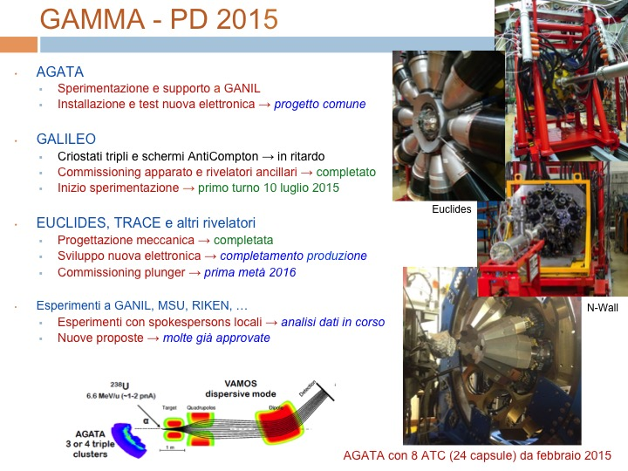
by R. Menegazzo
3 Nuclear structure and reaction dynamics

Slide 44
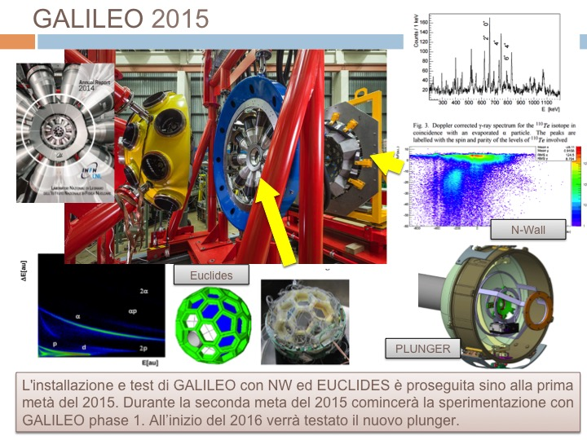
by R. Menegazzo
3 Nuclear structure and reaction dynamics

Slide 45
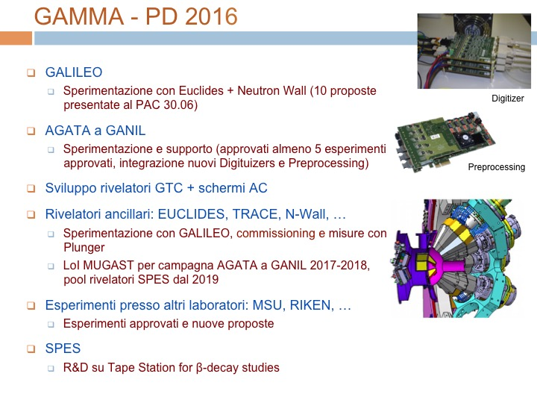
by R. Menegazzo
3 Nuclear structure and reaction dynamics

Slide 46
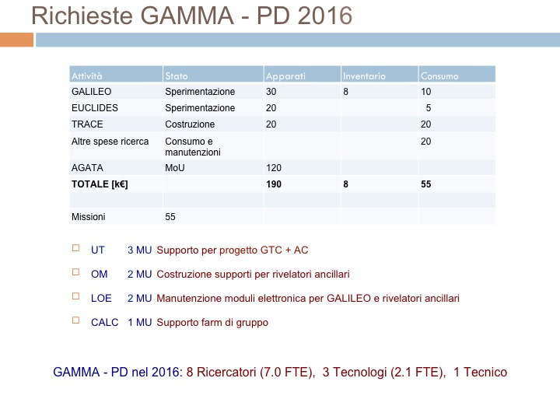
by R. Menegazzo
3 Nuclear structure and reaction dynamics

Slide 47
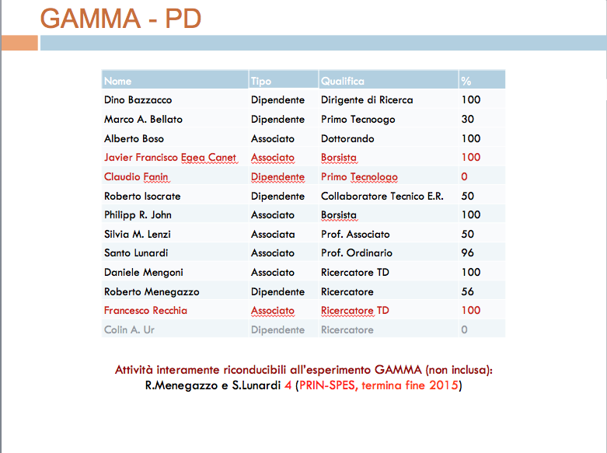
by R. Menegazzo
3 Nuclear structure and reaction dynamics

Slide 48
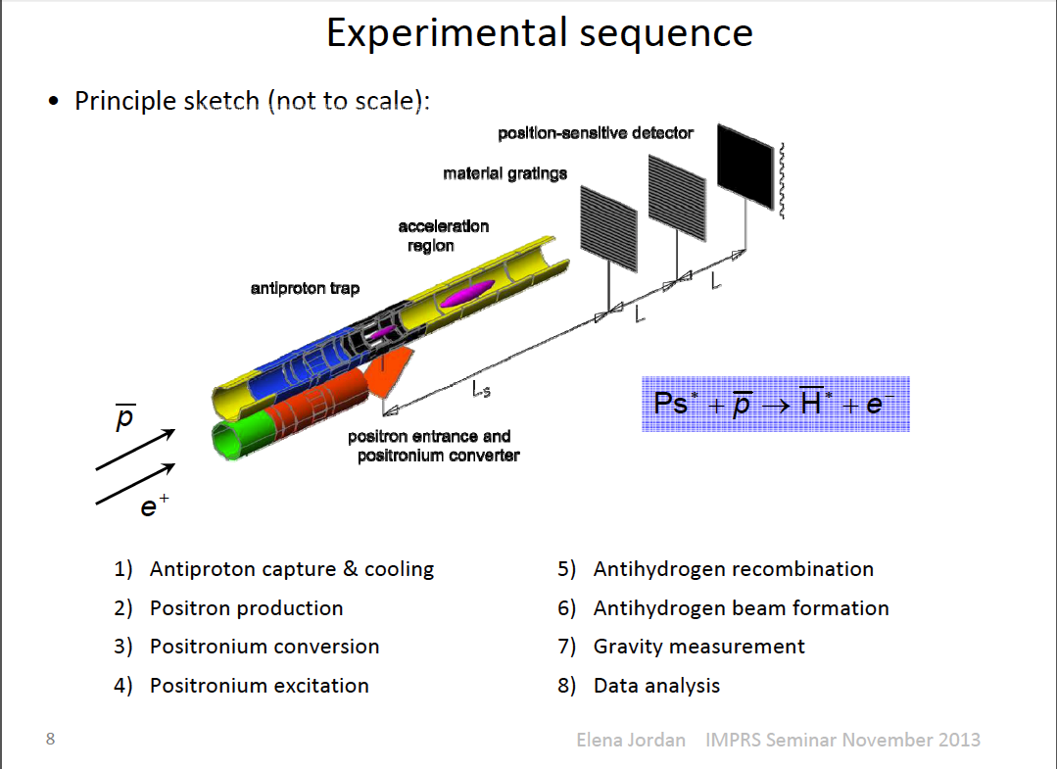
AEGIS
4 Nuclear astrophysics and interdisciplinary researches
Antimatter Experiment: Gravity, Interferometry, Spectroscopy
Positronium Spectrscopy!

Slide 49
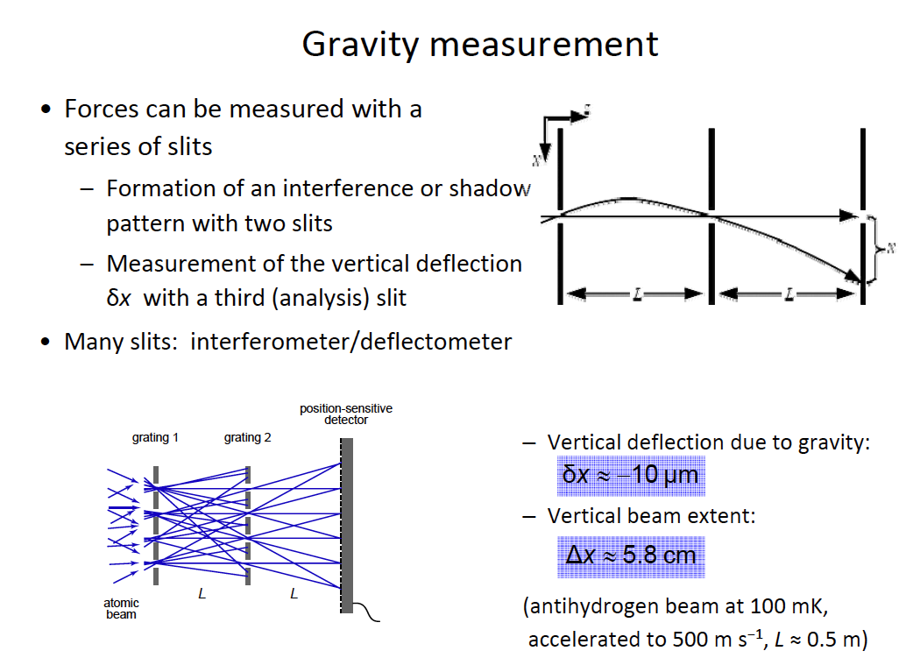
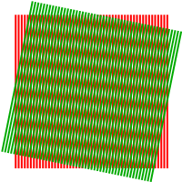
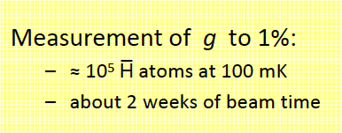
by G. Nebbia
4 Nuclear astrophysics and interdisciplinary researches

Slide 50
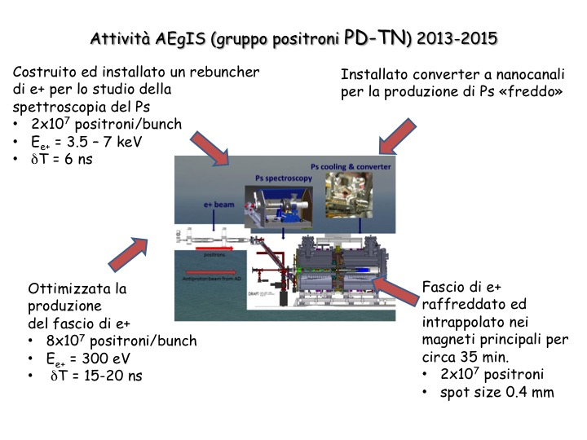
by G. Nebbia
4 Nuclear astrophysics and interdisciplinary researches

Slide 51
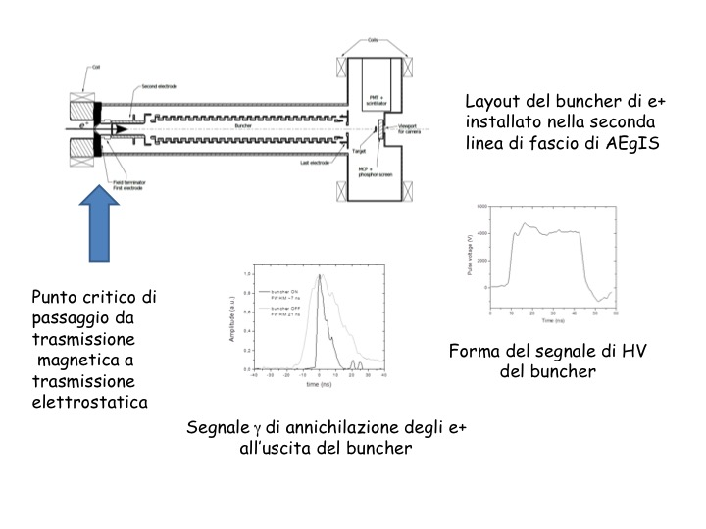
by G. Nebbia
4 Nuclear astrophysics and interdisciplinary researches

Slide 52
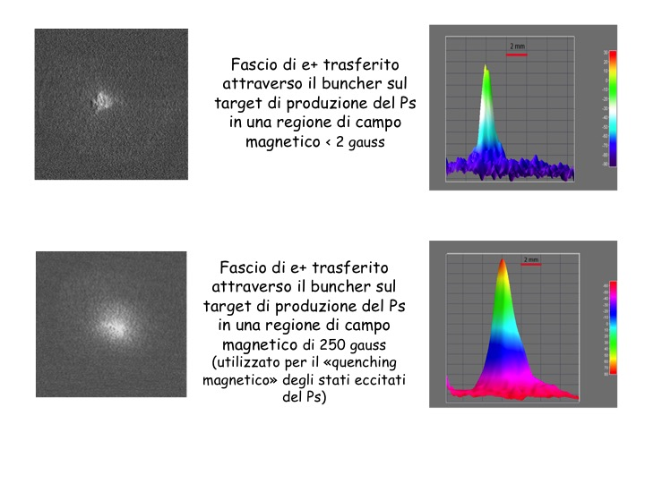
by G. Nebbia
4 Nuclear astrophysics and interdisciplinary researches

Slide 53
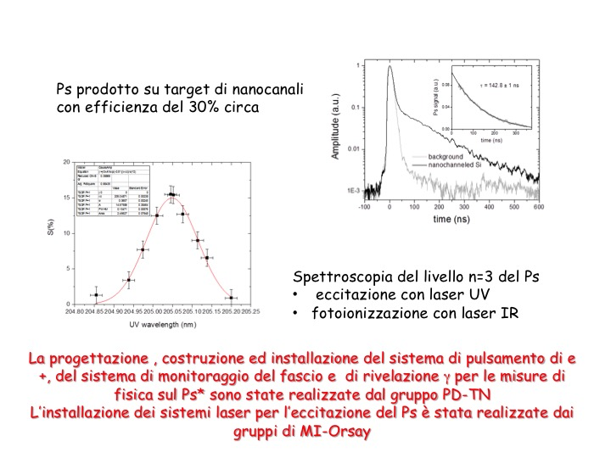
by G. Nebbia
4 Nuclear astrophysics and interdisciplinary researches

Slide 54
LUNA3
4 Nuclear astrophysics and interdisciplinary researches

Slide 55
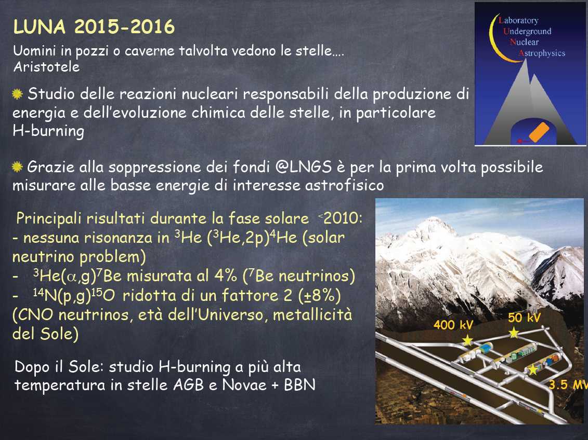
by C. Broggini
4 Nuclear astrophysics and interdisciplinary researches

Slide 56

by C. Broggini
4 Nuclear astrophysics and interdisciplinary researches

Slide 57

by C. Broggini
4 Nuclear astrophysics and interdisciplinary researches

Slide 58

by C. Broggini
4 Nuclear astrophysics and interdisciplinary researches

Slide 59

by C. Broggini
4 Nuclear astrophysics and interdisciplinary researches
Richieste Servizi:
OM 2 MU
Progettazione 2 MU
OE 1 MU

Slide 60


