Slide 1
CMS: stato e futuro
Sommario:
Dal Run I: altri Risultati di Fisica
Partenza Run II
Responsabilità Padovane
Stato Attività LS1 e seguenti
Studi per “ Fase 2” (HL-LHC) : nuova sigla
Burocrazia (richieste serv., preventivi ecc.)
<number>
Notes:
<number>

Slide 2
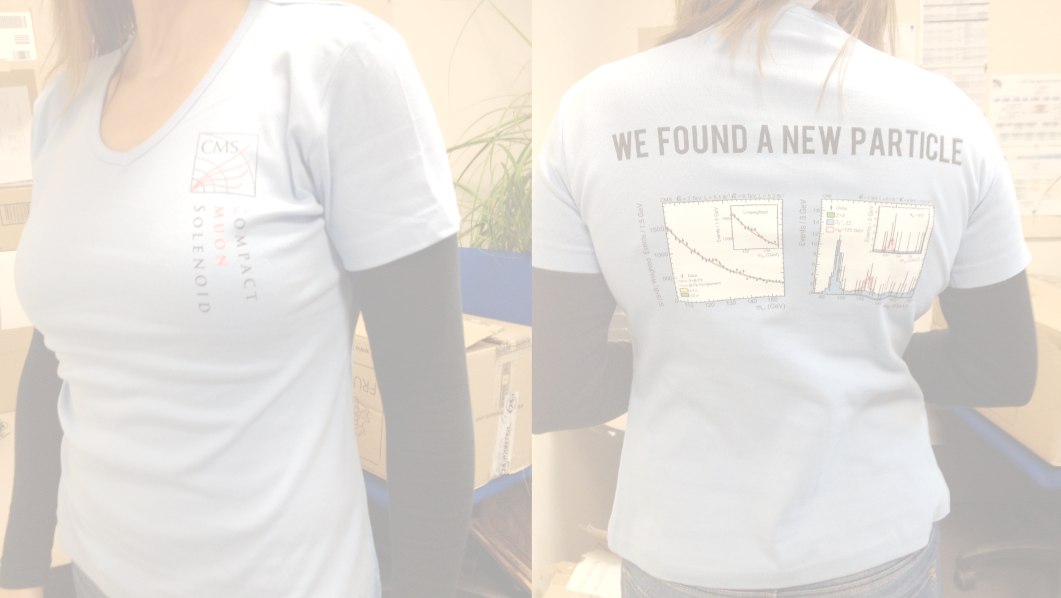
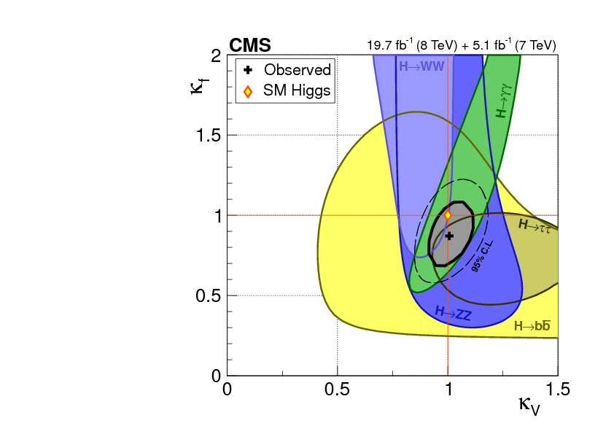
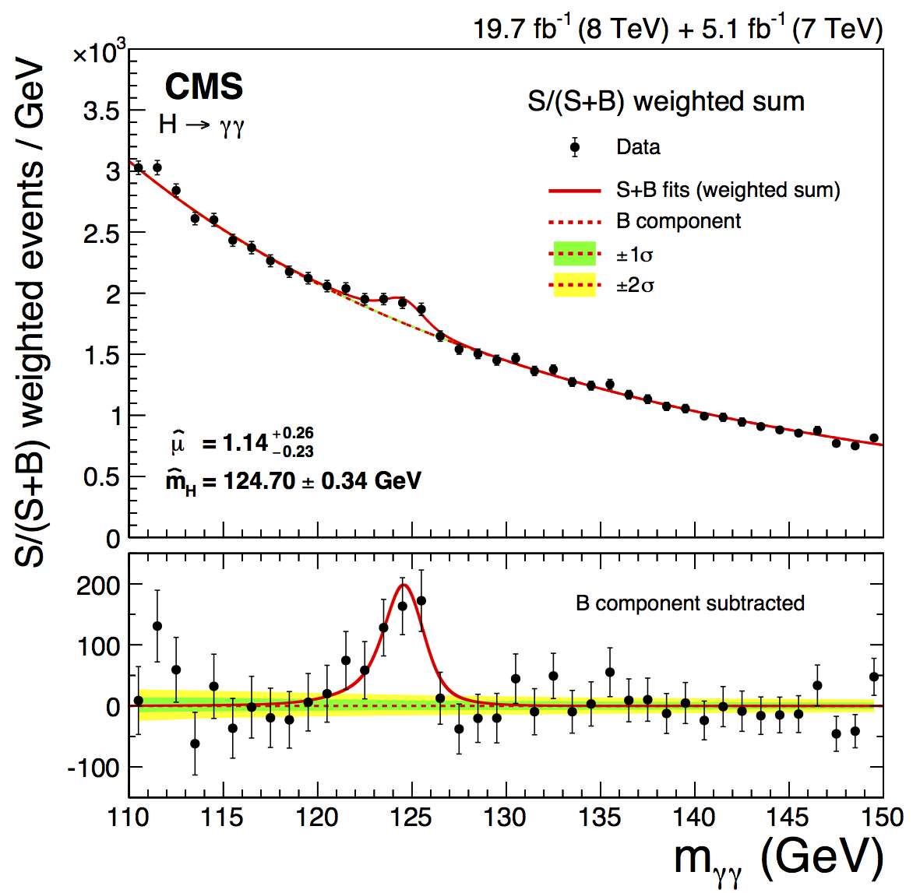
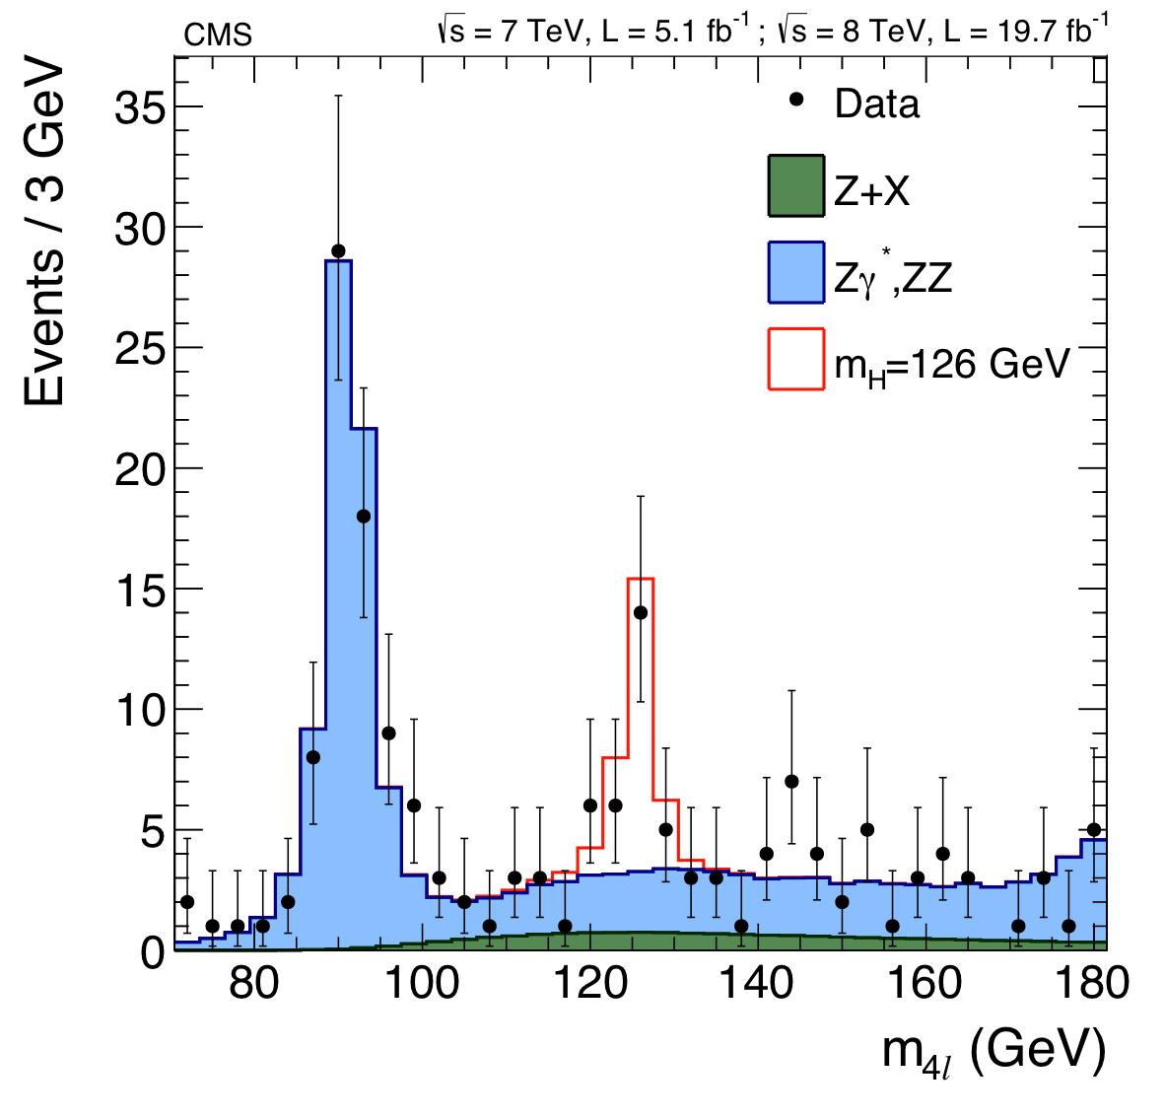
Run I: tanti risultati
Higgs (con un Nobel di mezzo…)
H→γγ
H→ZZ*→4l
Contributo padovano al rivelatore …
<number>
Notes:
<number>

Slide 3
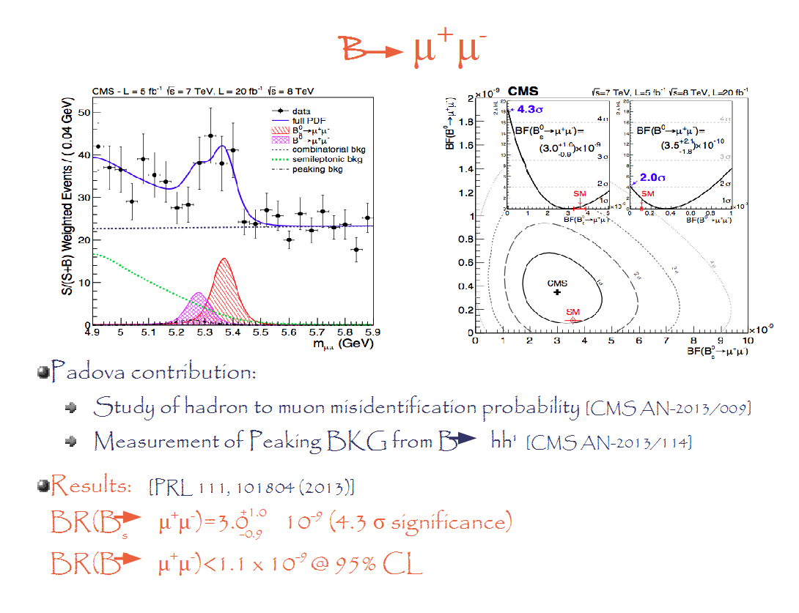
Run I:tanti risultati
Higgs e non solo (con un Nobel di mezzo…)
H→γγ
H→ZZ*→4l
Contributo padovano al rivelatore …
… e
all’analisi
NATURE OnLine 14474
<number>
Notes:
<number>

Slide 4
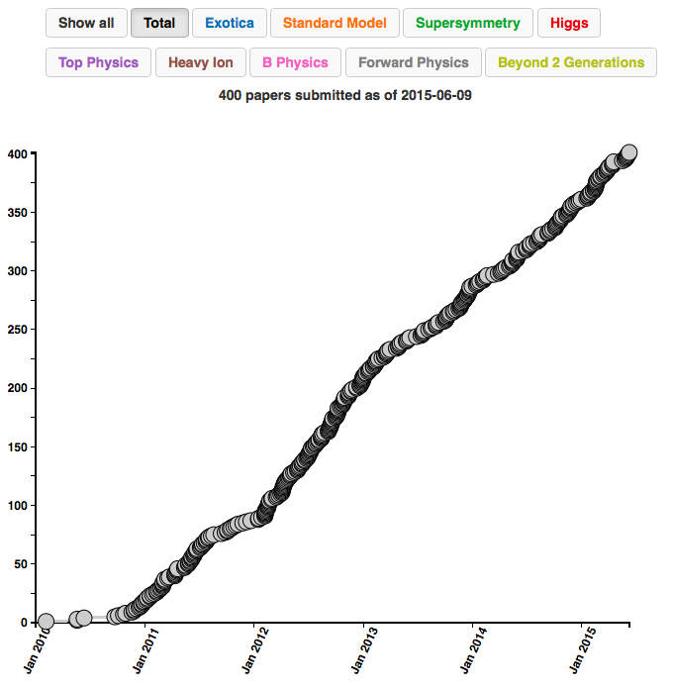
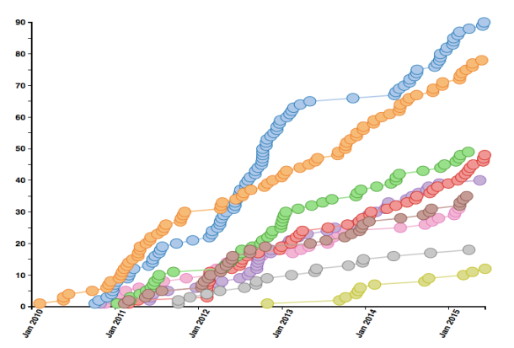
Tanti risultati di Fisica
>400 pubblicazioni basate su dati;
Higgs discovery paper: 4411 citazioni (16-6-2015)
73 pubblicazioni con 100 o più citazioni
Stanno arrivando i primi lavori a 13 TeV!!
Contributo padovano ad ampio spettro:
Higgs MS e BSM
B-Physics
Dark Matter
… e altra nuova Fisica BSM
<number>
Notes:
<number>

Slide 5
Misure “padovane” recenti
Pubbliche :
SEE-SAW tipo III
SUSY A->Zh
In evoluzione:
B-Physics
  Fasi CP in B_{s} → J/ψ φ
  Asimmetrie in B⁰ → Κ∗μμ
Standard Model
  h->hh
Dark Matter
  bbX
  ttX
NP in stati finali leptonici:
  Z' → μμ
  multileptoni
<number>
Notes:
<number>

Slide 6
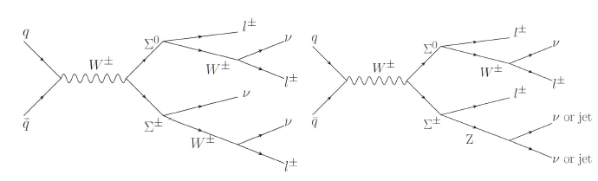
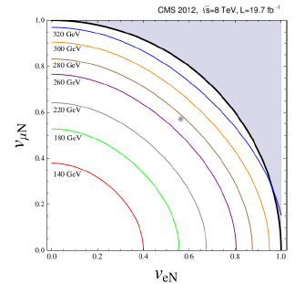
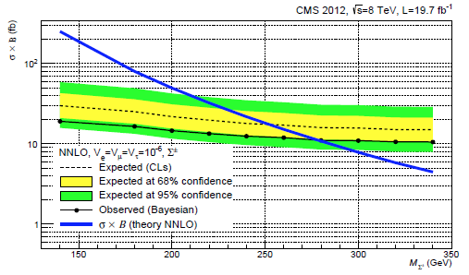
Ricerca seesaw tipo III a 8 TeV
PAS EXO-14-001
Ricerca dei fermioni pesanti mediatori del meccanismo Seesaw di tipo III
( tipo I singoletto fermionico, tipo II triplrtto scalare, tipo III tripletto fermionico)
Stati finali con tre leptoni, energia trasversa mancante e veto su massa invariante Z
DATI: intera statistica collisioni protone-protone a 8 TeV (19.7 /fb) raccolti nel 2012
FONDI: dibosoni e tribosoni (WZ, ZZ, WWW), leptoni non prompt e fake
Nessun eccesso rispetto al fondo atteso
Limite mixing democratico
M(Σ±) > 278 GeV
Precedente limite
M(Σ⁺) > 179 GeV
mixing democrarico
Interpretazione dei limite per mixing generico
Notes:
<number>

Slide 7
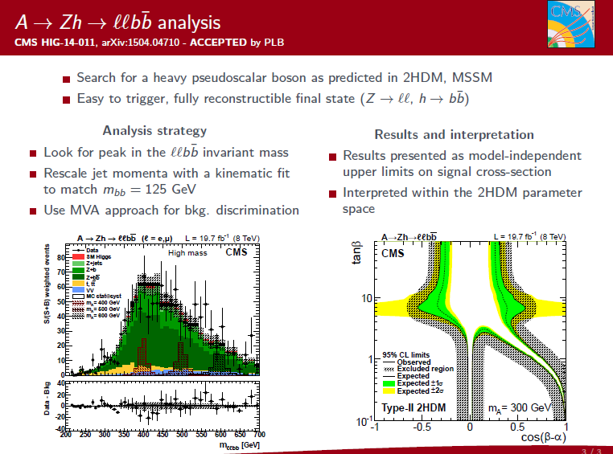

Slide 8
ACCEPTED ON 07/07/2015

Slide 9
Misure “padovane” recenti
Pubbliche :
SEE-SAW tipo III
SUSY A->Zh
In evoluzione:
B-Physics
  Fasi CP in B_{s} → J/ψ φ
  Asimmetrie in B⁰ → Κ∗μμ
Standard Model
  h->hh
Dark Matter
  bbχχ
  tt χχ
NP in stati finali leptonici:
  Z' → μμ
  multileptoni
<number>
Notes:
<number>

Slide 10
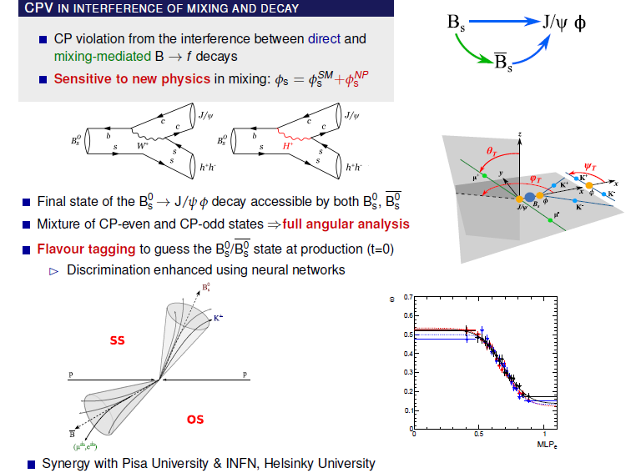
<number>
J.Pazzini, F.Simonetto, M.Margoni

Slide 11
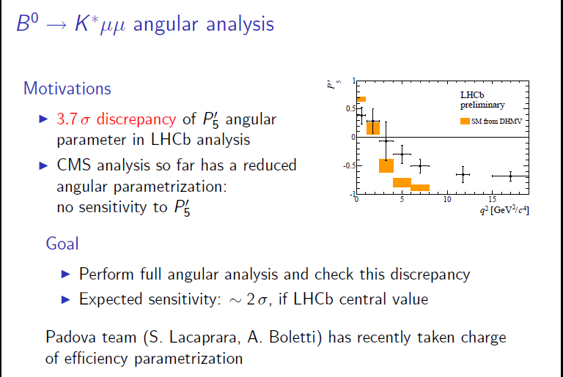
<number>

Slide 12
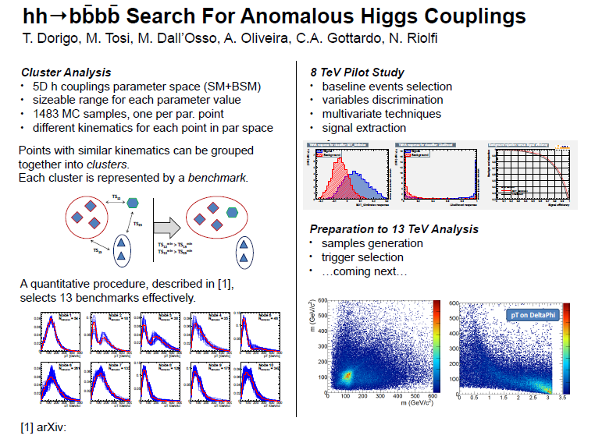
arXiv…
<number>

Slide 13
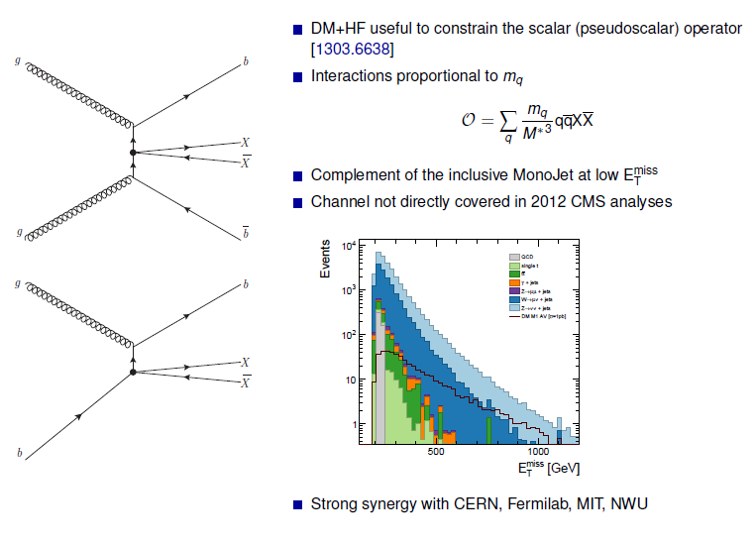
DM χχbb
J.Pazzini, M.Zanetti, A.Zucchetta
<number>

Slide 14



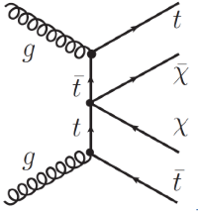
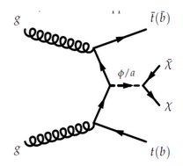
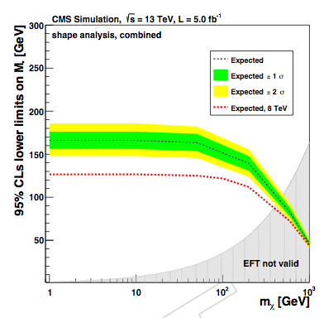
Dark Matter searches in tt events
search for DM candidates in tt events
Spin-0 interactions are most compelling for tt+DM
Run-2 results interpret w/ both EFT (already used in Run-1)
and simplified models
  benchmark models from ATLAS-CMS DM Forum (arxiv)
    minimal set of MC points to cover kinematic regimes
3 channels in Run-2
di-leptonic
semi-leptonic
all-hadronic
in different kinematical regime of the 2 tops in the event
“low p_{T}”
boosted (new)
preliminary studies (based on 8TeV data and 13TeV MC)
show improvements w.r.t. Run-1 results already w/ few fb⁻¹
2 independent analysis strategy
cut-and-count
shape
patrizia azzi, mia tosi
EFT
simplified models
CMS private
Physics Analysis Summary already started ! (B2G-15-005)
<number>

Slide 15
<number>

Slide 16
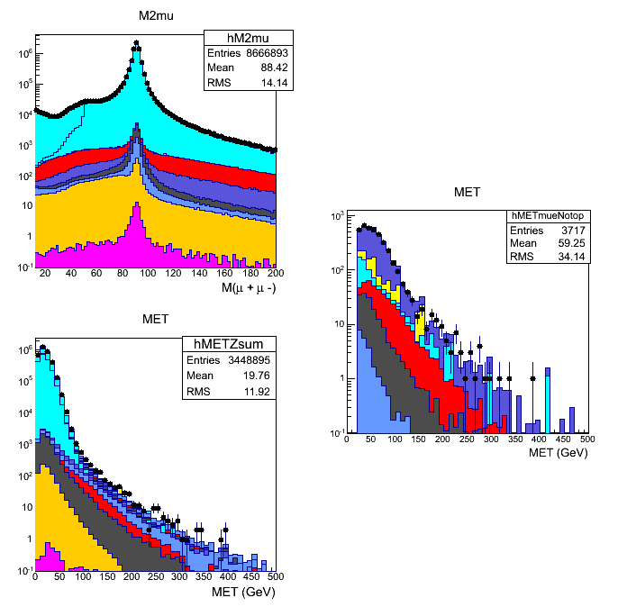
Multi-lepton (OS vs SS) + MET searches
Topology from many possible BSM signatures
interesting rare SM processes (important to keep under control…)
Examples of data control regions:
inclusive Z→μμ
sample
Opposite sign μ−e sample
(WW enriched sample)
b-tag veto
Legenda:
Drell-Yan
tt -> 2μ X
WZ
WW
ZZ
W γ*
Z Z/γ*
ttW,ttZ,ttH
p_{T}^{Z}>40 GeV
& b-tag veto
ZZ→μμνν
enriched
sample
U. Gasparini
<number>

Slide 17
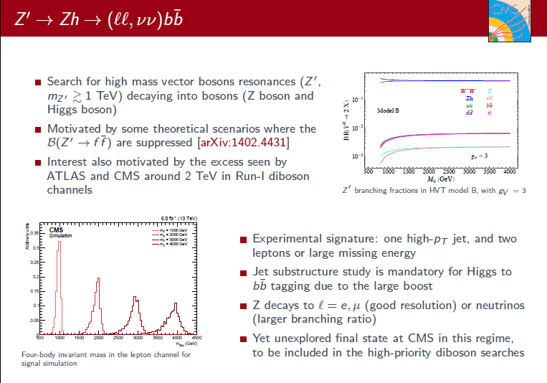
Naturale estensione di A→ Zh
<number>

Slide 18
Partenza Run II
<number>
Notes:
<number>

Slide 19
LHC news
LHC has restarted after the successful scrubbing run to prepare for 50 ns running on Sunday
They are now in a two weeks run to ramp up the intensity at 50 ns before the Technical Stop and the scrubbing period to prepare 25 ns running
So far so good … it is clear that there is still a lot to do : the scrubbing to prepare 25 ns is based on the doublet (bunches separated by 5 ns) scheme and so far they have managed to inject one Doublet…
<number>

Slide 20
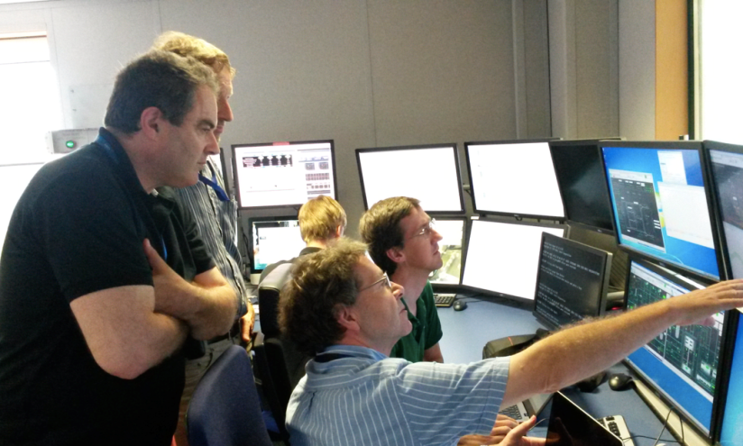
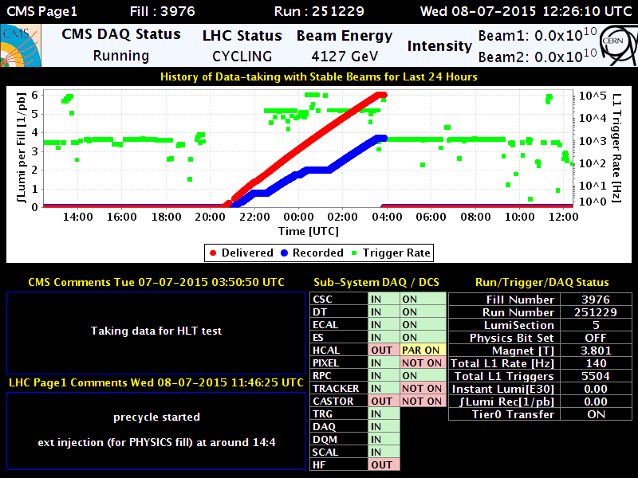
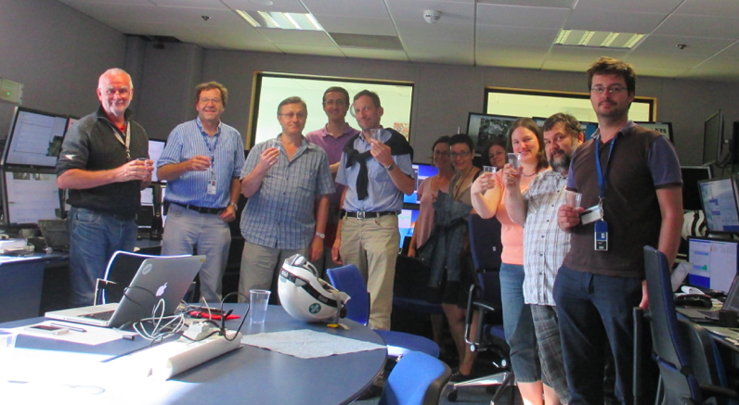
CMS news
The magnet is at 3.8 Tesla since Monday late afternoon!!
<number>

Slide 21
Attività & responsabilità 2015
Commissioning/controllo rivelatore DT :
- local trigger sync., time calibrations,
on-line / off-line DataQualityMonitoring
Sviluppi / maintenance DT DAQ / DCS
Physics Performance, data certification
DT & Tracker offline Databases
TK techn. coordination
Tier2 operations, data management
Nuovo trigger DT: slice test 2015
simulazioni per upgrade/HL-LHC
- Convenership di fisica
Roberto Carlin Trigger Coordinator
Patrizia Azzi Convener PAG. B2G
Sandro Ventura DT-DAQ resp
Marco Bellato DT-DCS resp
Fabio Montecassiano DT electr. coord.
Mario Galanti BPH PAG. subconv.
Martino Margoni BPH PAG subconv.
Tommaso Dorigo chair Stat. Comm.
Nicola Bacchetta TK techn.coord.
Mia Tosi TK HLT resp.
Marina Passaseo HLT FOG coord.
Fabrizio Gasparini Muon IB chair
<number>
Notes:
7/8/15
<number>

Slide 22
Attività & responsabilità 2016
Sviluppi / maintenance DT DAQ / DCS
Physics Performance, data certification
DT & Tracker offline Databases
TK techn. coordination
Tier2 operations, data management
Nuovo trigger DT istallazione completa
simulazioni per upgrade/HL-LHC
R&D Fase 2
Sandro Ventura DT-DAQ resp
Anna Meneguzzo DQM ch Performance
Marco Bellato Ph2 minicrate perspective
Fabio Montecassiano DT electr.coord
Pieluigi Zotto Phase 2 tracker liason
Tommaso Dorigo Stat.Comm.
Mia Tosi TK HLT resp.
Marina Passaseo HLT FOG coord.
Nicola Bacchetta TK techn.coord.
<number>
Notes:
7/8/15
<number>

Slide 23
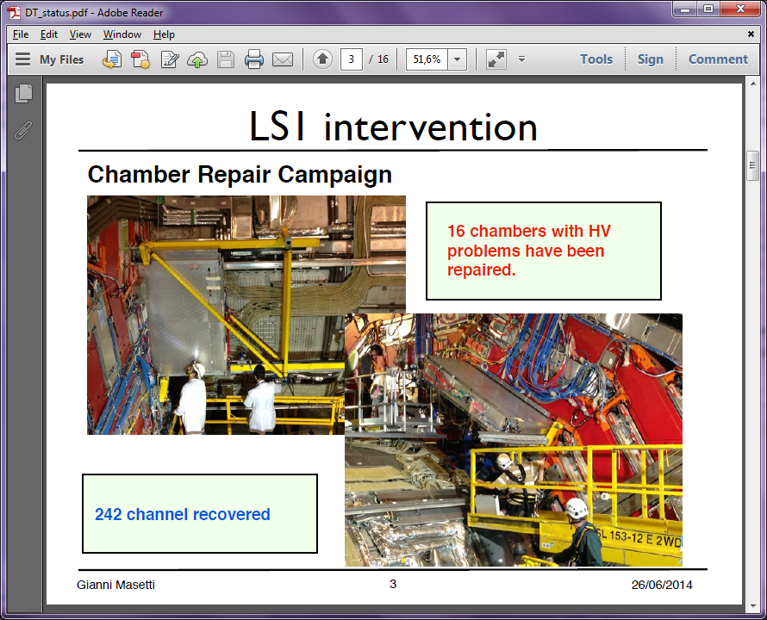
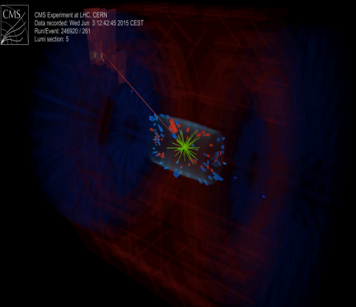
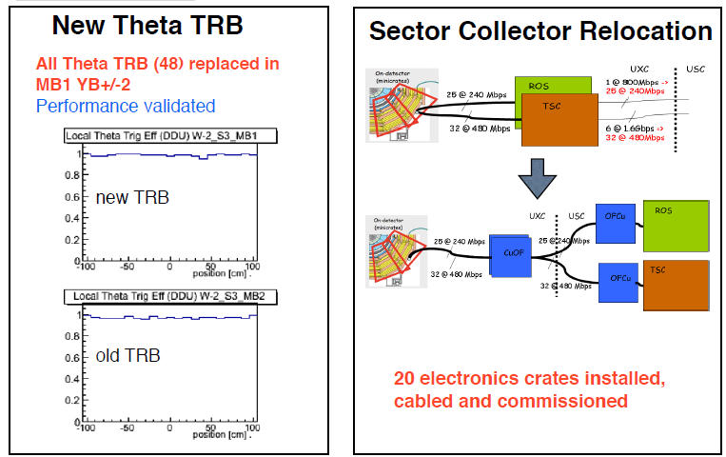
Attività per ripartire a 13 TeV
camere a μ
^{Padova:}
Riparazione camere a μ
Tracciatore
Riconfigurazione Trigger
13 TeV
> 99% canali funzionanti
CMS DN -2015/011
<number>
Notes:
<number>

Slide 24
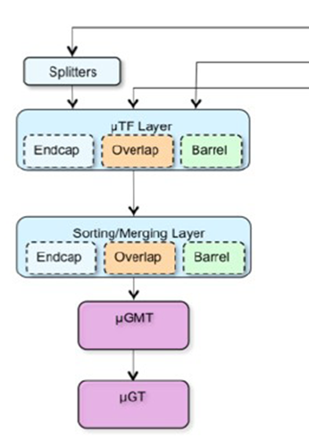
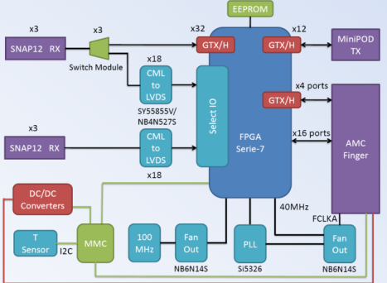
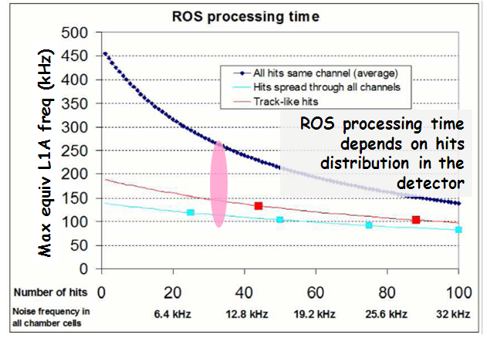
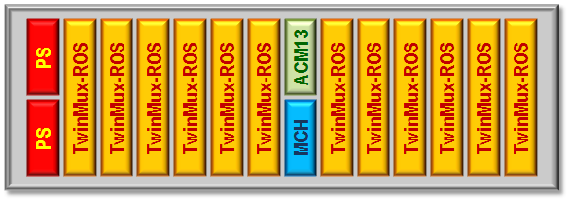
Drift Tubes Phase 1 Upgrades
LS1
Nominal lumi
8 TeV
LS2
Phase 1
Phase 2
3000 fb-1
2012 | 2013 | 2014 | 2015 | 2016 | 2017 | 2018 | 2019 | 2020 | 2021 | 2022 | 2023
Twin Mux
2 x lumi
8 TeV
New ROS
Luminosity increase will compromise processing speed of the Read-Out-Server boards
uTCA design based in Twin Mux hardware
Memento:
Multiplexing layer to forward full chamber trigger info to the Track Finder layer with high speed links (allow new form factors)
Aim to allow merging information from other subdetectors (RPC, HO, etc)
DT collaboration July 24th, 2013
Notes:
7/8/15
<number>

Slide 25
Per dettagli: presentazioni 2013 e 2014
Schedule:
2015 – validation on a slice
2016 – full deployment
AMP
<number>
0 100
t (ns)
Notes:
7/8/15
<number>

Slide 26
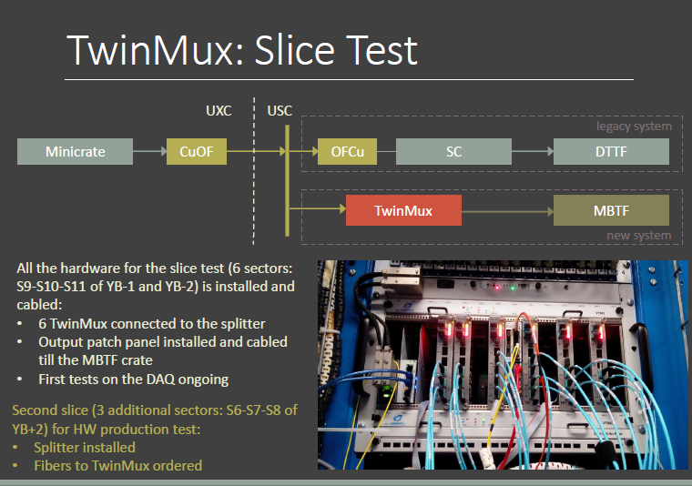
Test del nuovo sistema appena si prenderanno i nuovi dati
Vecchio
DT Track Finder
Nuovo
Muon Barrel Track Finder
<number>

Slide 27
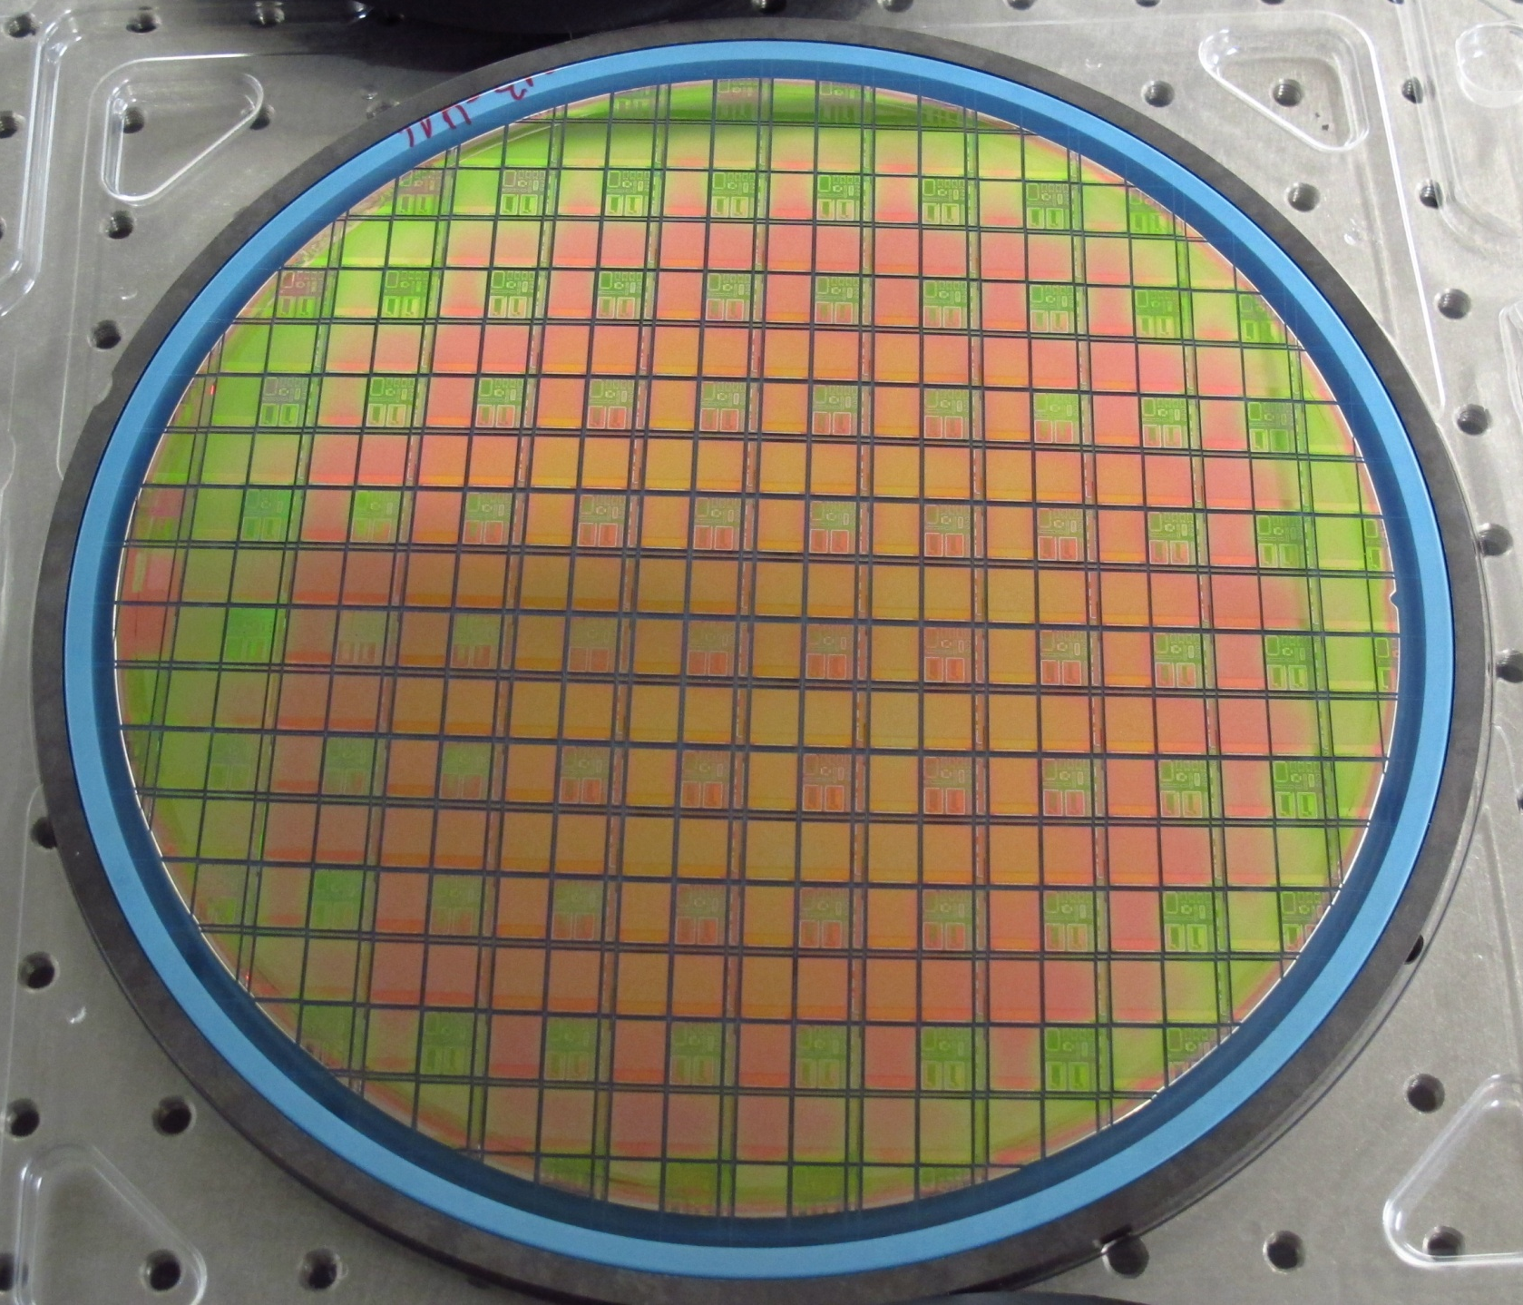
Section of Padova
Dario Bisello,
Nicola Bacchetta,
Devis Pantano,
Martino Dall’Osso
HW Upgrade
Pixel Upgrade Phase 1
-
State of the art
Notes:
<number>

Slide 28


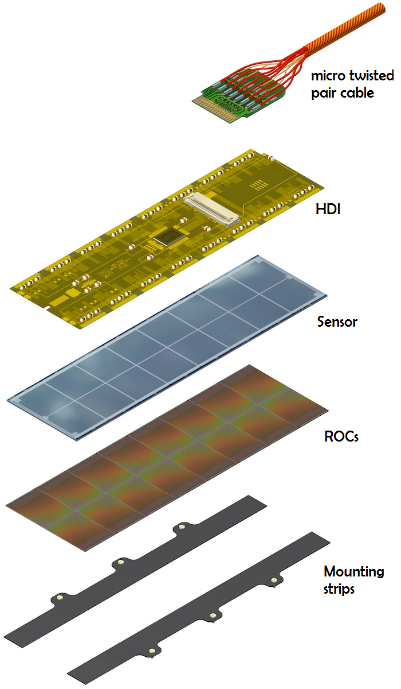
Pixel Upgrade Phase 1
reminder
TBM
HDI:
Tested
in Catania
FULL MODULE:
Assembled in Bari
Tested in Perugia
SENSOR:
Tested
in Pisa
BARE MODULE:
Assembled at IZM
Tested in Pisa
ROC:
Tested
in Padova
Our Target: ROC wafers test after post-processing (metal and bumps deposition, thermal process, thinning, dicing).
<number>
Notes:
<number>

Slide 29
Pixel Phase 1 Upgrade – Status of the art
Section: Padova
GENERAL
        Pixel Phase 1 Workshop done a two weeks ago.
        Technical Coordination review last June 16th.
        Each centers started smoothly the production.
        Parts procurement -> almost fine. New TBM arrived this month
INFN CONSORTIUM
        Problem with bump bonding process (by IZM) solved -> larger bumps (38um).
        4 Grade A modules produced.
        Green light for final production obtained last week.
        1 month to fill production chain. Full regime expected within September.
INFN PADOVA
        New filter for the clean room arrived. Support structure is under production.
        Waiting for the first wafers from IZM -> probably end of July. (Several delays from IZM did not help in planning our task).
        Martino and Nicola back to Padova next week to finalize the setup.
<number>
Notes:
Foto nuovo chuck – nuova probestation
<number>

Slide 30
Pixel Phase 1 Upgrade – Time schedule
Section: Padova
GENERAL
        Installation is still scheduled for EYETS2016-17 (~50 working days).
        BPIX modules production ‘must’ end within Feb’16.
INFN CONSORTIUM
        Production schedule is still a draft -> waiting from final feedback from IZM.
        Throughput = 4 final modules per days.
        Deadline -> total n° modules within Feb ‘16.
INFN PADOVA
        Effectively 2 weeks per month starting from end August/September.
        Total expected: 3 months.
        Tests should end within 2015.
<number>
Notes:
Foto nuovo chuck – nuova probestation
<number>

Slide 31
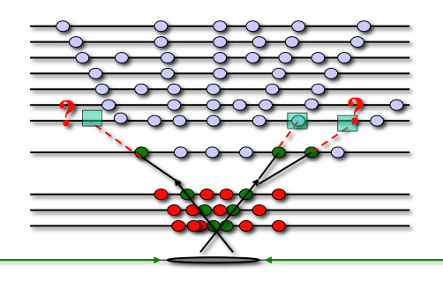
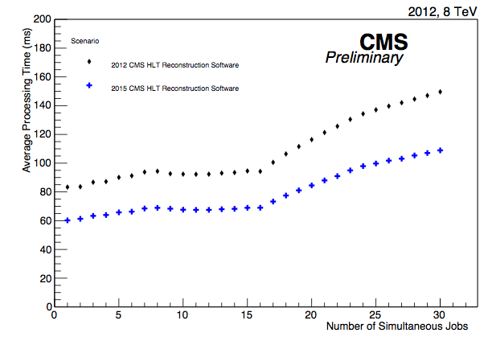
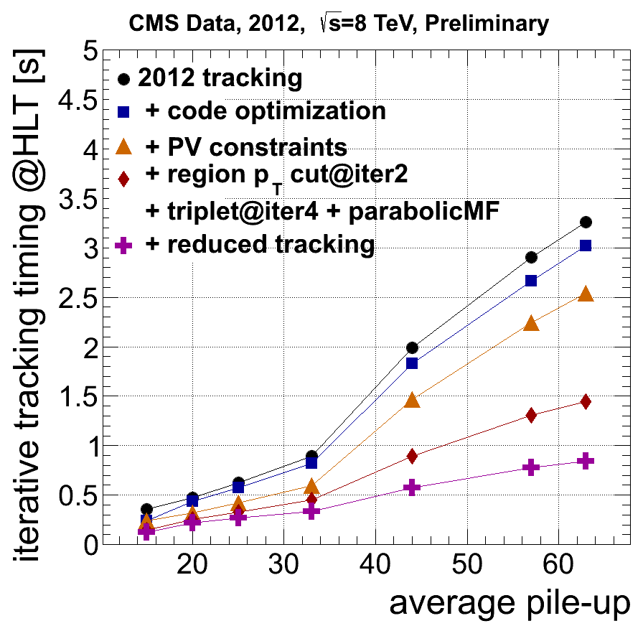
Tracking improvements@HLT for Run-2
HLT uses regional tracking of strip and pixel hits
in an iterative approach (ad hoc configuration)
tracking is the most time consuming step in the event reconstruction, but it is also one of the main ingredients for precise measurements …
the CPU processing time has been reduced, effects from pile-up has been mitigated gain: factor ~4 @ <PU> ~40
mia tosi
limit
<number>

Slide 32


R&D Ph2
A differenza dello scorso anno …..
per il 2016 sono previste 3 attività con piccole richieste finanziarie:
Studi per nuova elettronica minicrates
Studi di nuovi algoritmi di trigger
3) TEST longevità CAMERE sotto irraggiamento: DT alla GIF++
<number>

Slide 33
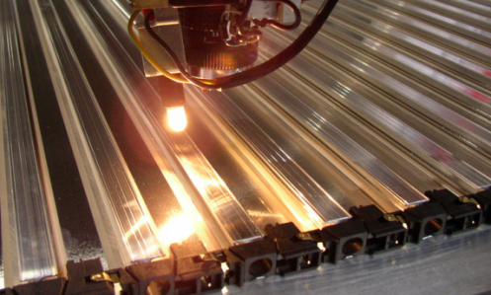
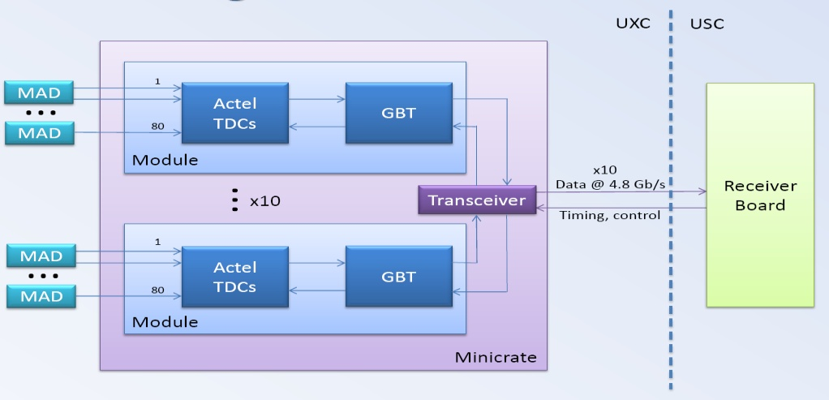
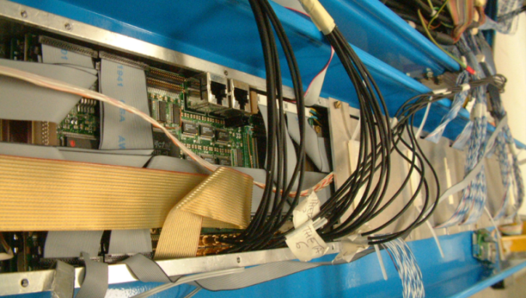
Drift Tubes Phase 2 Upgrades
LS1
Nominal lumi
8 TeV
Phase 1
Phase 2
LS2
2012 | 2013 | 2014 | 2015 | 2016 | 2017 | 2018 | 2019 | 2020 | 2021 | 2022 | 2023
3000 fb-1
No indications of aging effects, neither in previous tests
Plan to take preventive actions (HV, gas, etc)
Perform simulations of the impact of chamber aging (efficiency loss, noise, etc)
Pile-up effects also reevaluated in complex regions
Non ufficiale: spostamento di LS2 e LS3
New Minicrates
Radiation and aging is a concern.
R&D in new design: time digitization and direct data forwarding (fundamental architectural differences)
Based in FPGA + GBT system. 2-3 optical links/Minic.
Simple, robust and low power
Readout event matching an trigger primitive generator in USC (slightly better performance possible)
Chamber longevity studies
Ricordo:
Cavern
Counting
room
DT collaboration July 24th, 2013

Slide 34
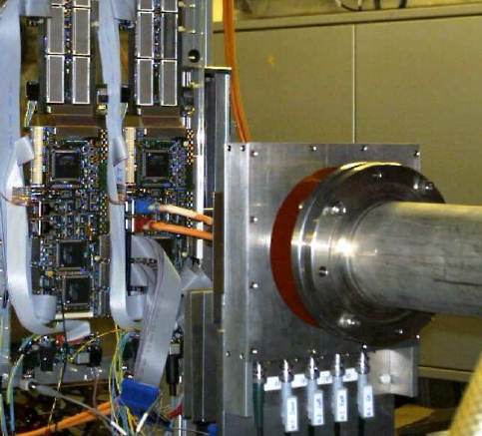
DT Phase 2 Upgrade
Radiation
- Radiation tests performed at the PSI in 2003
- Two components were particularly weak to the total dose received:
  UART device, responsible of the backup communication link of the Minicrate broke (irradiated to 100 Gy)
  Altera MAX7000 CPLD EPM7128S died (irradiated to 100 Gy).
- Failure in these parts compromise the operation of the full chamber.
CPLD results confirmed by independent tests by Rice Universitity and University of California (actually they got lower limit than us... 7.6 Gy!)
M.Matveev et al. “Software Evaluation and Irradiation Test of the SBS Technologies Model 620 PCI-to-VME Bus Adapter.” Published in Proceedings of the 9th Workshop on Electronics for LHC Experiments. Pp. 389-391. Amsterdam, the Netherlands, 29 September - 3 October 2003. CERN 2003-006. CERN-LHCC-2003-055. LHCC-G-061. 10 November 2003.
Altera EPM7064S and EPM7192S PLD died at 7.66 Gy under a 63 MeV proton beam at the Crocker Nuclear Laboratory at the University of California, Davis (UCD)
C. F. Bedoya
DT Upgrade – May 14th, 2015
<number>

Slide 35
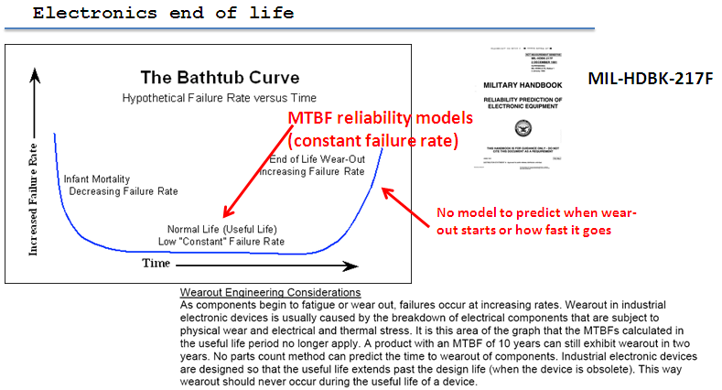
DT Phase 2 Upgrade
Aging
-ASICs date back to 1996 - 2000.
-Final board productions < 2003.
-The system will be 25 years old, operating intensively since production through validation, commissioning and running
-How long will they last?
In backup more info about failure rate projection
2010
2011
2012
LS1
C. F. Bedoya
DT Upgrade – May 14th, 2015
<number>

Slide 36
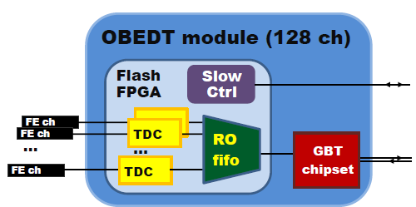
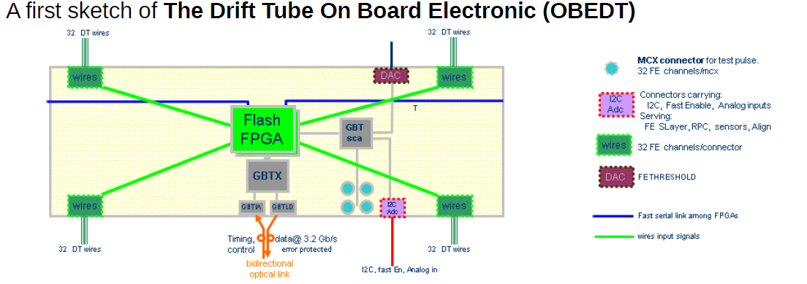
CMS DT: new MC electronics
The DT phase2 upgrade foresee the full substitution of the DT on-boards electronic system because of obsolescence, difficulties and high cost to maintain it.
In 2016 the PD group will develop the 1st prototype of the new DT on-board electronics (OBEDT board), which will pair each one of the 175K of the DT's wires, with a radiation tolerant ~1 ns TDC, capable of assign a digital time stamp for each hit. The readout and slow control will be based on the GBT chipset and Versatile optical link from CERN.
Richieste
5 Ke # PCB development
5 Ke # PCB prototype production
2 Ke/board # FPGA + components
3 Ke/board # Assembly
15 Ke for the 1st board prototype
Notes:
<number>

Slide 37
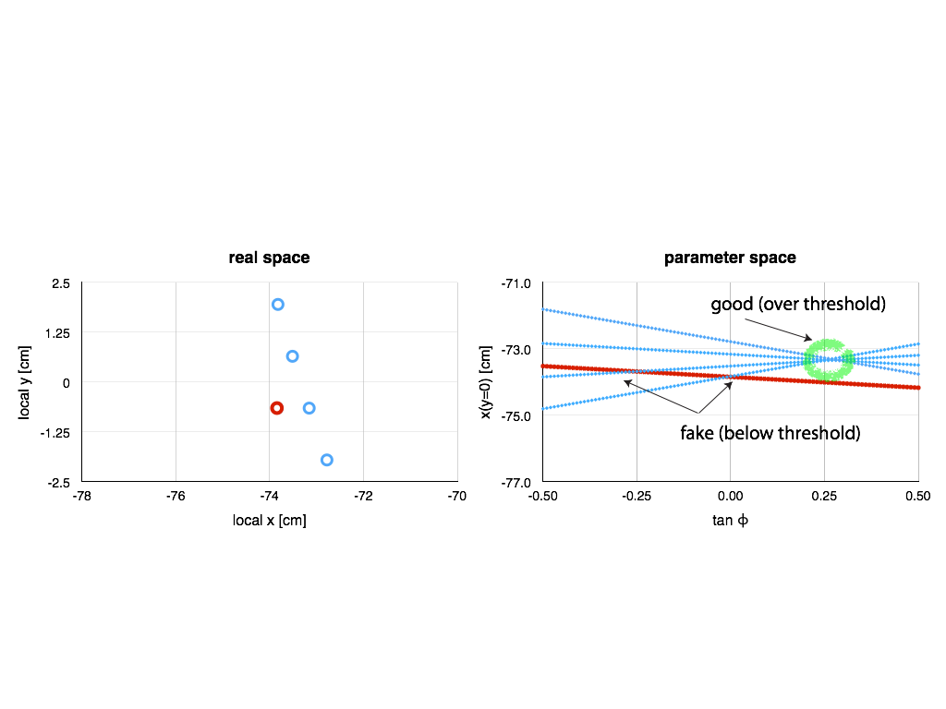
Upgrade of Trigger Algorithm
Minicrates needs to be redone because of ageing and foreseen tighter requirements on trigger bandwidth.
High speed asynchronous transfer of all TDC data to UXC is planned.
The current trigger primitive generation algorithm is based on synchronous processing and cannot be used straightforwardly, but needs a very demanding over-structure to re-synchronize data.
Since few months a different
approach based on Hough
Transform is under study.
The Hough transform is a tool
determining track parameters
by accumulation in bins of the
scanned parameter space.
It is a versatile, multi-threshold, naturally noise-insensitive algorithm.
Preliminary results show that it can replace the current algorithm with roughly the same efficiency and position and direction resolutions (completely new approach to HT developed: planning a paper on the method).
Similar approaches are being tried in the forthcoming tracking trigger.
Deployment of a algorithm in a demonstrator to evaluate needed resources is planned by 2nd half of 2016
Requires the highest size state-of-the-art FPGA ASIC development board (e.g. Virtex Ultrascale +). Cost around 15 keuro
F. Montecassiano
N. Pozzobon
P. Zotto
NB: vedi sopra per eventuale pubblicazione

Slide 38
Burocrazia
Proposta di afferenza
Richieste Servizi in sezione
Preventivi
<number>
Notes:
<number>

Slide 39
R&D Ph2
Afferenze (%):
POZZOBON Nicola | 80
ZOTTO Pierluigi | 80
ToT | 1,6
BELLATO Marco | 50
GONELLA Franco | 30
MONTECASSIANO Fabio | 20
VENTURA Sandro | 20
 | 1,1
Totale R&D | 2,8
<number>

Slide 40
Personale gruppo CMS 2016
DT, Phys:
Tracker:
AZZI Patrizia | 100
BENATO Lisa | 100
BOLETTI Alessio | 100
CARLIN Roberto | 100
CHECCHIA Paolo | 95
DOSSELLI Umberto | 80
GASPARINI Fabrizio | 0
GASPARINI Ugo | 100
LACAPRARA Stefano | 70
MARGONI Martino | 90
MAZZUCATO Mirco | 10
MENEGUZZO Anna T. | 100
PAZZINI Jacopo | 100
POZZOBON Nicola | 20
RONCHESE Paolo | 100
SIMONETTO Franco | 90
TORASSA Ezio | 60
TOSI Mia | 100
ZANETTI Marco | 100
ZUCCHETTA Alberto | 100
ZUMERLE Gianni | 100
Totale | 17,15
BACCHETTA Nicola | 100
BISELLO Dario | 70
Dell'OSSO Martino | 100
DORIGO Tommaso | 100
GERARDIN S | 30
Paccagnella Alessandro | 30
SILVESTRIN Luca | 0
Totale | 4,3
Tecnologi
BENETTONI Massimo | 30
FANZAGO Federica | 80
GAO G. | 0
GONELLA Franco | 40
MICHELOTTO Michele | 20
MONTECASSIANO Fabio | 20
PASSASEO Marina | 100
PEGORARO Matteo | 60
SGARAVATTO | 70
VENTURA Sandro | 50
VOGRIG Daniele | 0
NEVIANI Andrea | 0
Totale | 4,7
Gran Totale 31,15 26,25+2,7 R&DPh2
+2,2 CHIPIX65 ( era 28,5)
<number>
Notes:
7/8/15
<number>

Slide 41
Richieste servizi 2016
Tracker:
Manutenzione macchina radiogena/linea SIRAD 2 m/u LE
DT:
Lab. Elettronica:
2 m.u. supporto mC
3 m.u. mantenimento camere a LNL,
riparazione e test schede cms,
sistemazione spares a LNL.
1 m.u. installazione trigger
Off. Mecc. . 1 m.u. attrezzi/supporti per test irraggiamento
Uff.Tecn.
R&DPh2:
Lab. Elettronica:
8 m.u. per sviluppo scheda TDC
2 m.u. test irraggiamento GIF++
Off. Mecc.
Uff.Tecn.
Serv. Calcolo : 24 m.u. Supporto cluster locale CMS, supporto CMS center,
maintenance/operations/sviluppi T2 Pd-Legnaro
<number>
Notes:
7/8/15
<number>

Slide 42
Richieste finanziarie 2016
Missioni
Metabolismo Totale 31,2(FTE)*(3,8+1) 149
Responsabilità (16 mu) 61
Installazione e commissioning Trigger( 5mu) 19
ESP/EPR (dipende da autori: 29*1.5 mu) 165
Test irraggiamento GIF++ (2 mu) 8
Totale: 98 m.u. 402 k€
2015: chiesti 436
Ass. 184.5+10
Consumo
    Metabolismi auto CERN 55
    Camera pulita 3
Totale: 58 k€
2015: chiesti 67,5
Ass.
45,5
NB 2015: CA per trigger: 274
Gran Totale CMS : 460 k€
<number>
<number>
Notes:
7/8/15
<number>

Slide 43
Richieste finanziarie 2016
R&D Fase2
Consumo
    Realizzazione prima scheda prototipo 15
    Scheda per studi trigger 15
Totale: 30 k€
Gran Totale (CMS+R&D Fase 2): 490 k€
<number>
<number>
Notes:
7/8/15
<number>

Slide 44
backup
<number>

Slide 45
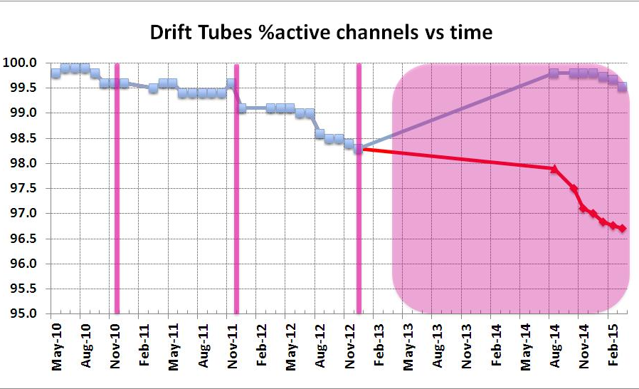
Past DT Failure rate vs Time
A 0.5% has been lost after all reparations due to power cycles at the end of LS1
Blue: Present. Includes reparations.
2010
2011
2012
LS1
Red: Situation with no reparations in LS1.
Shutdowns in pink
Difficult maintenance: 40% of the Minicrates had to be accessed during LS1 and we only had 3% of the system dead
C. F. Bedoya
DT Upgrade – May 14th, 2015
<number>

Slide 46
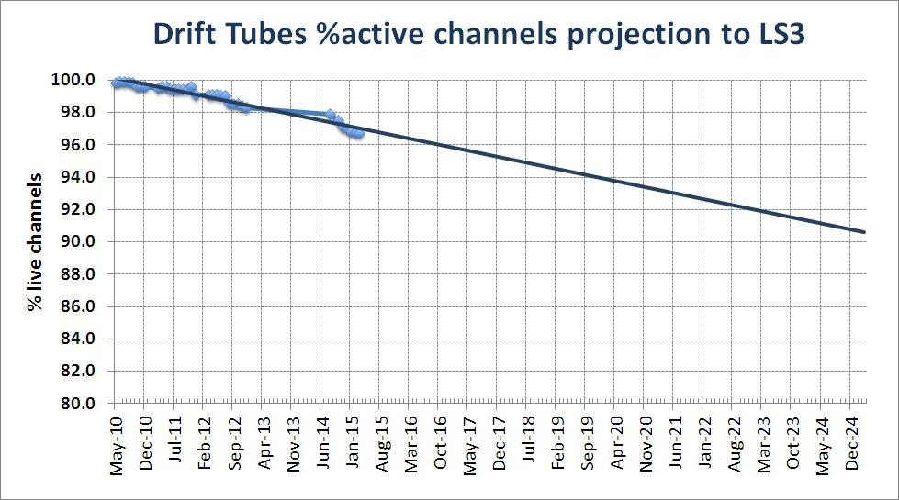
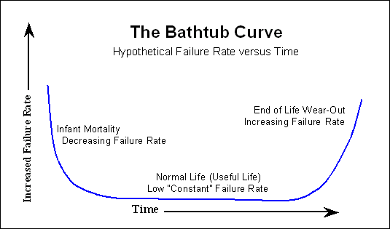
DT Failure rate projection
Constant Failure rate
during normal life
10% loss at the start of 2025 if linear trend remains and no repairs
C. F. Bedoya
DT Upgrade – May 14th, 2015
<number>

Slide 47
Richieste servizi 2015
Tracker:
Preparazione e test ROC 4 m/u LE
Manutenzione macchina radiogena/linea SIRAD 2 m/u LE
Supporti meccanici per test ed irraggiamenti 1 m/u OM
DT:
Lab. Elettronica:
1 m.u. manutenzione e supporto manutenzione al CERN
commissioning slow control CuOF-OFCu
1 m.u. Commissioning TRB
1 m.u. test irreggiamento nuovo mC
5 m.u. manutenzione camere durante LS1 al CERN
manutenzione a LNL preparazione manutenzione al CERN,
studi di “longevità” a LNL.
Off. Mecc. 1 m.u. attrezzi/supporti per test irraggiamento
Uff.Tecn. 1 m.u disegno attrezzi/supporti DT TRB test irraggiamento
Serv. Calcolo : 24 m.u. Supporto cluster locale CMS, supporto CMS center,
maintenance/operations/sviluppi T2 Pd-Legnaro
<number>
Notes:
7/8/15
<number>

