Slide 1
Stato e richieste degli esperimenti di Linea Scientifica 3
Rosario Turrisi
9 luglio 2015

Slide 2
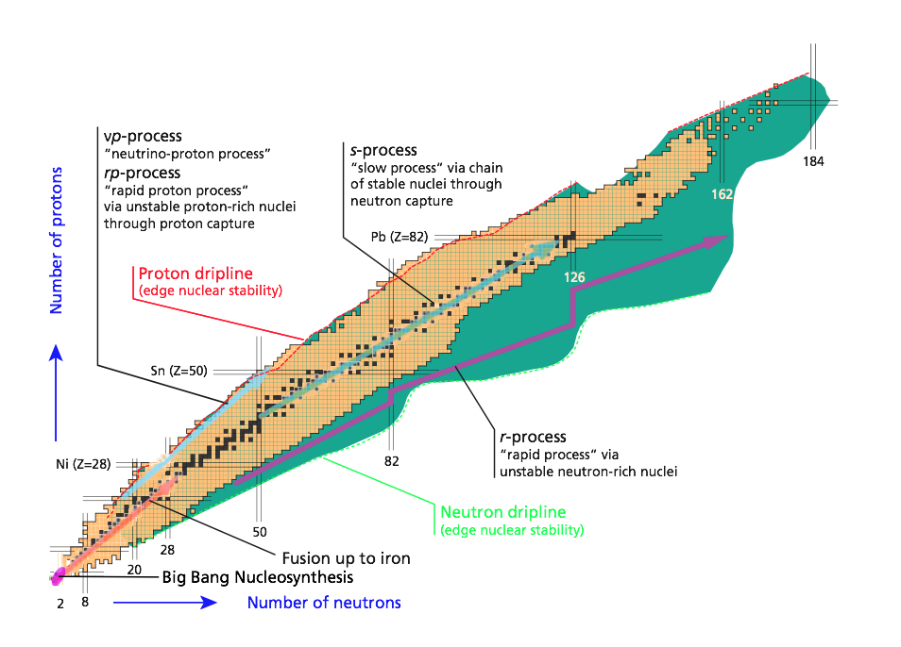
Gruppo3-Pd in una slide (2010-15)
Rappresentate le 4 linee della CSN3,
dall’evoluzione delle stelle a quella dei quark!
1 Quarks and hadron dynamics
~135
~175 MeV
JLAB12
2 Phase transitions of nuclear and hadronic matter
ALICE
3 Nuclear structure and reaction dynamics
NUCL-EX
PRISMA-FIDES
EXOTIC
GAMMA
4 Nuclear astrophysics and interdisciplinary researches
AEGIS
LUNA3
Personale ricercatore:
14 dipendenti+19 associati + 5 borsisti (PhD/adr)
Totale=38 pp/31.77 FTE (inizio 2015)
2 progetti premiali (LUNA3)
FIRB (M. Mazzocco)
ERC Consolidator grant (P. Giubilato)
Dati degli ultimi 4 anni
Articoli: >250 Lauree: 8 PhD: 10 PostDoc: 13 Premi: 1 (Villi)

Slide 3
JLAB12
1 Quarks and hadron dynamics

Slide 4
by G. Simi
1 Quarks and hadron dynamics

Slide 5
by G. Simi
1 Quarks and hadron dynamics
Padova

Slide 6
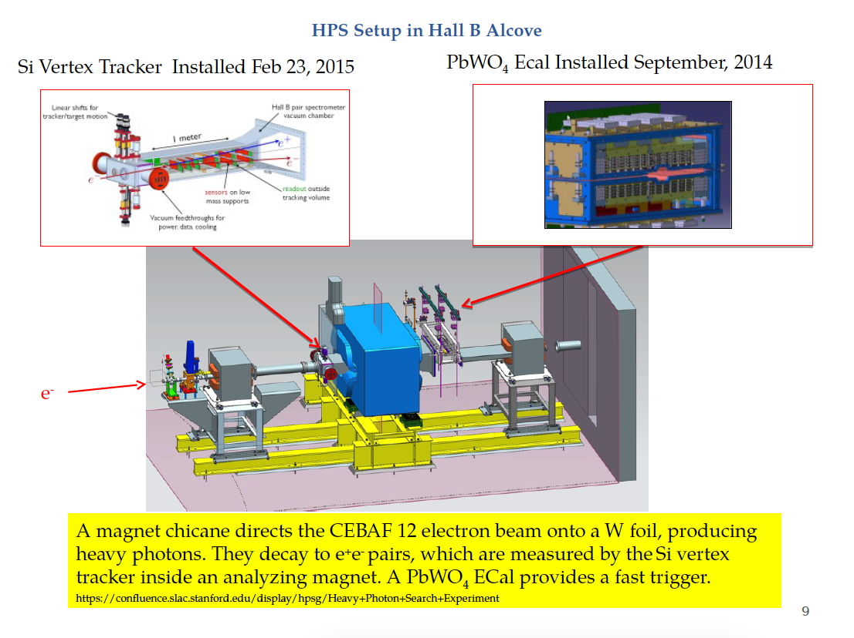
by G. Simi
1 Quarks and hadron dynamics

Slide 7
by G. Simi
1 Quarks and hadron dynamics

Slide 8
by G. Simi
1 Quarks and hadron dynamics

Slide 9
by G. Simi
1 Quarks and hadron dynamics

Slide 10
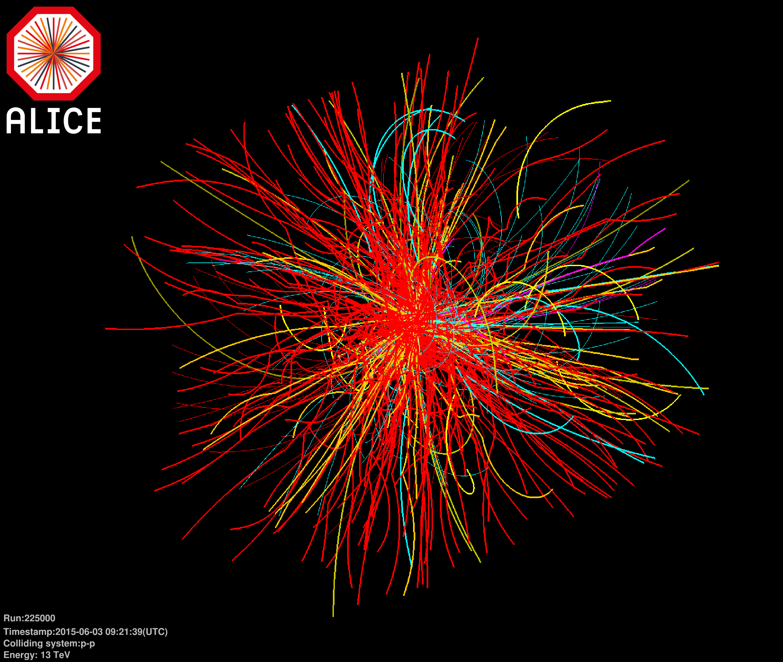
ALICE
2 Phase transitions of nuclear and hadronic matter
pp 13 TeV

Slide 11
ALICE
by A. Dainese
2 Phase transitions of nuclear and hadronic matter

Slide 12
by A. Dainese
2 Phase transitions of nuclear and hadronic matter

Slide 13
by A. Dainese
2 Phase transitions of nuclear and hadronic matter

Slide 14
by A. Dainese
2 Phase transitions of nuclear and hadronic matter

Slide 15
by A. Dainese
2 Phase transitions of nuclear and hadronic matter

Slide 16
by A. Dainese
2 Phase transitions of nuclear and hadronic matter

Slide 17
by A. Dainese
2 Phase transitions of nuclear and hadronic matter

Slide 18
Oltre la valle di stabilità…
Shell structure in nuclei
Structure of doubly magic nuclei
Changes in the (effective) interactions
N=Z
Shape coexistence
Transfermium nuclei
Proton drip line and N=Z nuclei
Spectroscopy beyond the drip line
Proton-neutron pairing
Isospin symmetry
r process
Nuclear shapes
Exotic shapes and isomers
Coexistence and transitions
¹⁰⁰Sn
⁴⁸Ni
Neutron-rich heavy nuclei (N/Z → 2)
Large neutron skins (r_{ν}-r_{π}→ 1fm)
New coherent excitation modes
Shell quenching
^{132+x}Sn
protons→
⁷⁸Ni
…and the quest for the superheavy island!
Nuclei at the neutron drip line (Z→25)
Very large proton-neutron asymmetries
Resonant excitation modes
Neutron Decay
neutrons→
Notes:
The r-process is a nucleosynthesis process that occurs in core-collapse supernovae (see also supernova nucleosynthesis) and is responsible for the creation of approximately half of the neutron-rich atomic nuclei heavier than iron.
‘’r’’ sta per RAPID NEUTRON CAPTURE

Slide 19
NUCL-EX
3 Nuclear structure and reaction dynamics

Slide 20
by D. Fabris
3 Nuclear structure and reaction dynamics

Slide 21
by D. Fabris
3 Nuclear structure and reaction dynamics

Slide 22
by D. Fabris
3 Nuclear structure and reaction dynamics

Slide 23
by D. Fabris
3 Nuclear structure and reaction dynamics

Slide 24
by D. Fabris
3 Nuclear structure and reaction dynamics

Slide 25
by D. Fabris
3 Nuclear structure and reaction dynamics

Slide 26
PRISMA-FIDES
3 Nuclear structure and reaction dynamics

Slide 27
by G. Montagnoli
3 Nuclear structure and reaction dynamics
20%
1.8

Slide 28
by G. Montagnoli
3 Nuclear structure and reaction dynamics

Slide 29
by G. Montagnoli
3 Nuclear structure and reaction dynamics

Slide 30
by G. Montagnoli
3 Nuclear structure and reaction dynamics
Notes:
P2=EFxP1^2 EF=5.5 comprensibile solo introducendo effetti di struttura, possibile in questo caso perché transizioni ground-ground

Slide 31
by G. Montagnoli
3 Nuclear structure and reaction dynamics

Slide 32
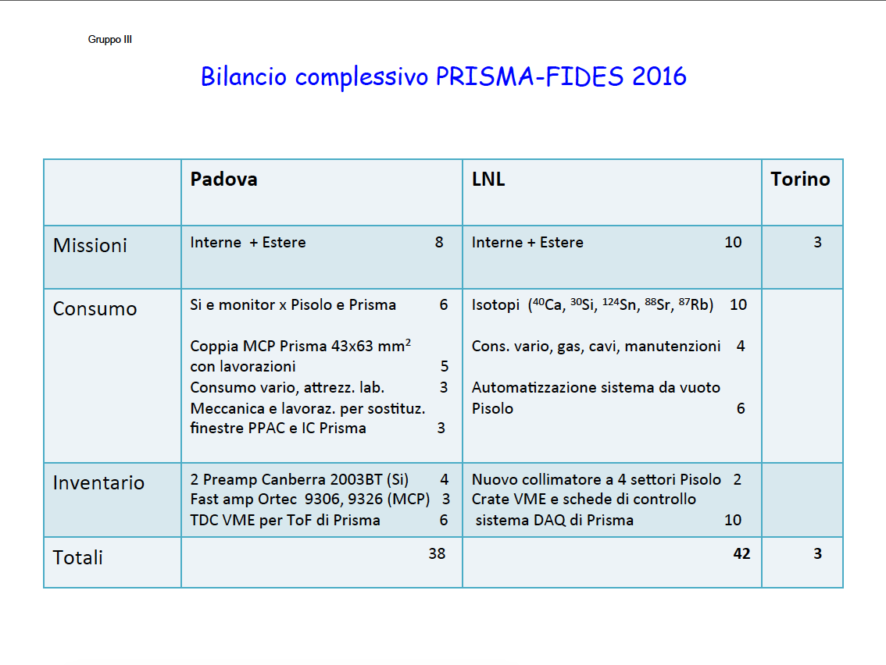
by G. Montagnoli
3 Nuclear structure and reaction dynamics

Slide 33
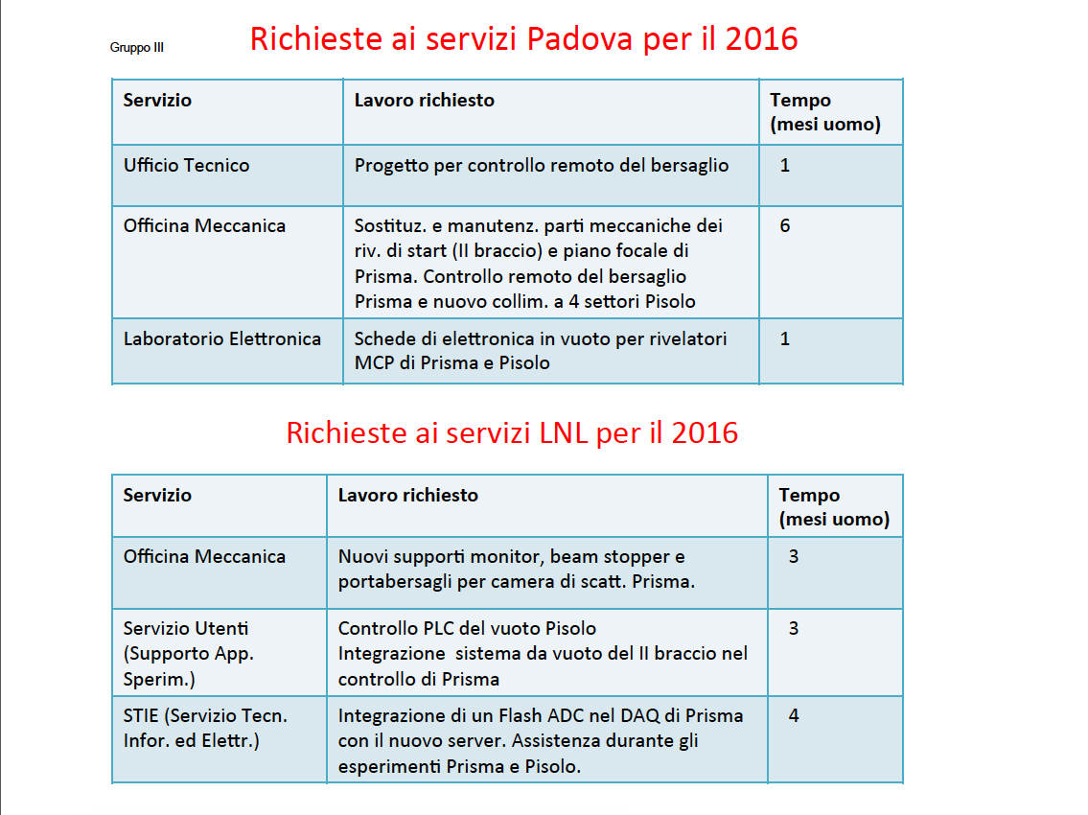
by G. Montagnoli
3 Nuclear structure and reaction dynamics

Slide 34
EXOTIC
3 Nuclear structure and reaction dynamics

Slide 35
by M. Mazzocco
3 Nuclear structure and reaction dynamics

Slide 36
by M. Mazzocco
3 Nuclear structure and reaction dynamics

Slide 37
by M. Mazzocco
3 Nuclear structure and reaction dynamics

Slide 38
by M. Mazzocco
3 Nuclear structure and reaction dynamics

Slide 39
by M. Mazzocco
3 Nuclear structure and reaction dynamics

Slide 40
GAMMA
3 Nuclear structure and reaction dynamics

Slide 41
by R. Menegazzo
3 Nuclear structure and reaction dynamics

Slide 42
by R. Menegazzo
3 Nuclear structure and reaction dynamics

Slide 43
by R. Menegazzo
3 Nuclear structure and reaction dynamics

Slide 44
by R. Menegazzo
3 Nuclear structure and reaction dynamics

Slide 45
by R. Menegazzo
3 Nuclear structure and reaction dynamics

Slide 46
by R. Menegazzo
3 Nuclear structure and reaction dynamics

Slide 47
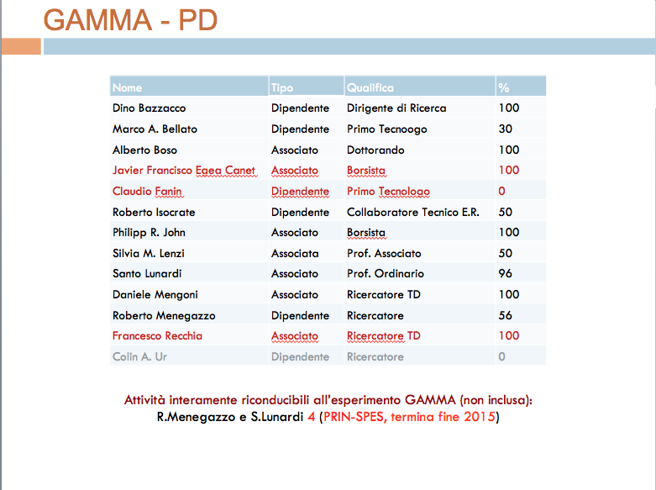
by R. Menegazzo
3 Nuclear structure and reaction dynamics

Slide 48
AEGIS
4 Nuclear astrophysics and interdisciplinary researches
Antimatter Experiment: Gravity, Interferometry, Spectroscopy
Positronium Spectrscopy!

Slide 49
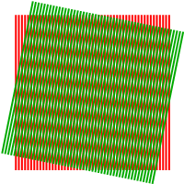
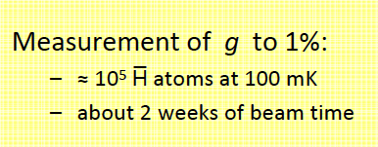
by G. Nebbia
4 Nuclear astrophysics and interdisciplinary researches

Slide 50
by G. Nebbia
4 Nuclear astrophysics and interdisciplinary researches

Slide 51
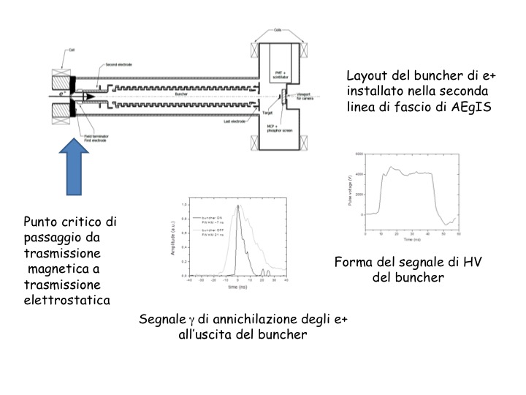
by G. Nebbia
4 Nuclear astrophysics and interdisciplinary researches

Slide 52
by G. Nebbia
4 Nuclear astrophysics and interdisciplinary researches

Slide 53
by G. Nebbia
4 Nuclear astrophysics and interdisciplinary researches

Slide 54
LUNA3
4 Nuclear astrophysics and interdisciplinary researches

Slide 55
by C. Broggini
4 Nuclear astrophysics and interdisciplinary researches

Slide 56
by C. Broggini
4 Nuclear astrophysics and interdisciplinary researches

Slide 57
by C. Broggini
4 Nuclear astrophysics and interdisciplinary researches

Slide 58
by C. Broggini
4 Nuclear astrophysics and interdisciplinary researches

Slide 59
by C. Broggini
4 Nuclear astrophysics and interdisciplinary researches
Richieste Servizi:
OM 2 MU
Progettazione 2 MU
OE 1 MU

