Slide 1
AA
The Cosmological Lithium Problem and the
Measurement of the ⁷Be(n,alpha) Reaction at n_TOF-CERN.
Agatino Musumarra and Massimo Barbagallo
for the n_TOF@CERN Collaboration
DFA-University of Catania, INFN-Laboratori Nazionali del Sud
INFN-Bari

Slide 2
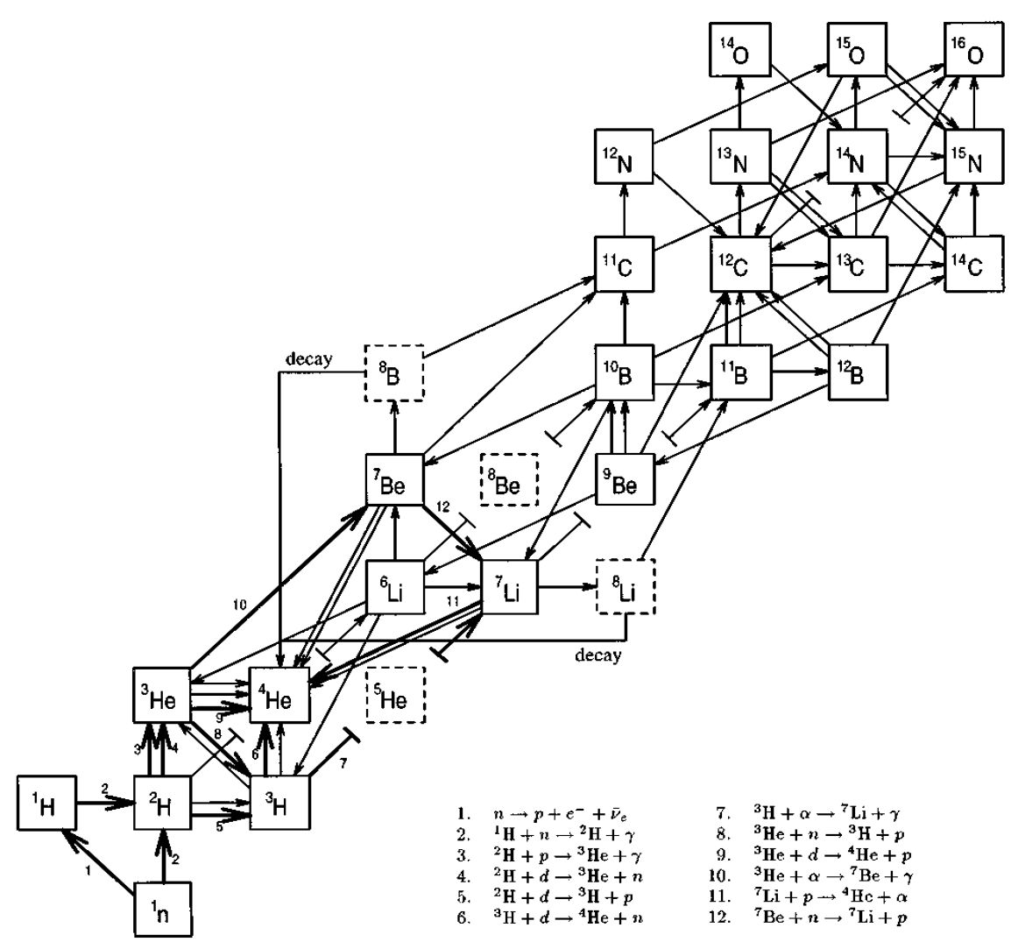
Bing Bang Nucleosynthesis
Bing Bang Nucleosynthesis (BBN), together with Hubble expansion and Cosmic Microwave Background Radiation is one of the cornerstones for Bing Bang Theory.
BBN gives the sequence of nuclear reactions leading to the synthesis of light elements up to Na* in the early stage of Universe (0.01-1000 sec)
At his first formulation, it depended on 3 parameters:
-the baryon-to-photon ratio η,
-the number of species of neutrino ν,
-the lifetime of neutron τ.
Nowadays BBN is a parameter free theory**, being the cross-sections of reactions involved the only input to the theory.
bottleneck A=8
* A.Coc et al., The Astrophysical Journal, 744:158 (2012)
**D.N. Schramm and T.S Turner, Rev. Mod. Phys 70 (1998) 303

Slide 3
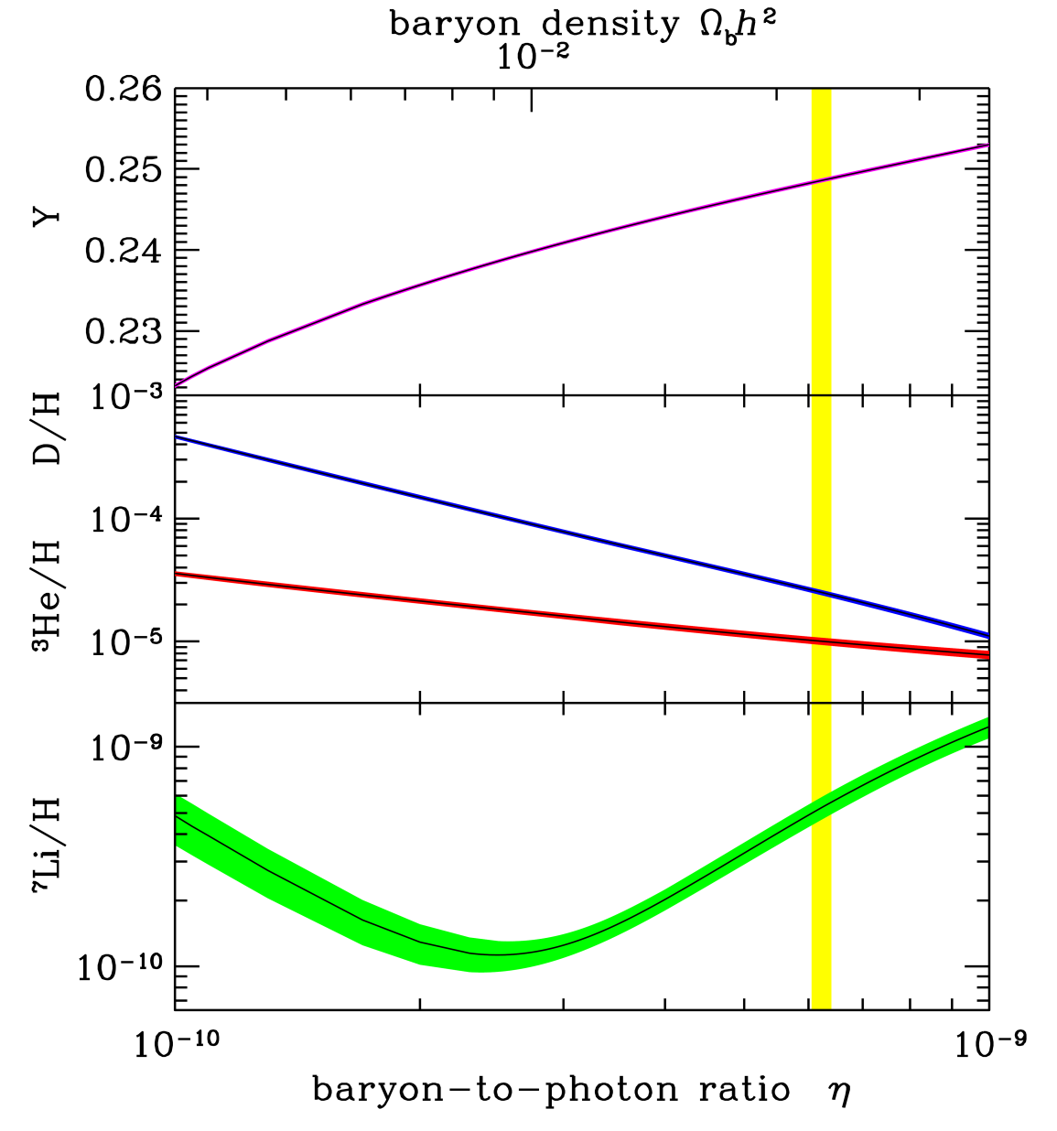
The Cosmological Lithium Problem
BBN successfully predicts the abundances of primordial elements such as ⁴He, D and ³He.
⁴He mass ratio
A serious discrepancy (factor 2-4) between the predicted abundance of ⁷Li and the value inferred by measurements (Spite et al, many others.)
Cosmological Lithium Problem (CLiP)
WMAP
* R.H.Cyburt et al., Journal of Cosmology and Astroparticle Physics 11 (2008) 012
** A.Coc et al., The Astrophysical Journal, 744:158 (2012)

Slide 4
Solution to CLiP?
Approximately 95% of primordial ⁷Li is produced from the Electron Capture decay of ⁷Be (T_{1/2}=53.2 d ?).
A higher destruction rate of ⁷Be can solve or at least partially explain the CLiP.
⁷Be is destroyed via (n,p) (~97%) and (n,α) (~2.5%) reactions
n + ⁷Be p + ⁷Li Q= 1.644 MeV
n + ⁷Be α + α Q= 19 MeV
150 mb @ 25 meV (Bassi 1963)

Slide 5
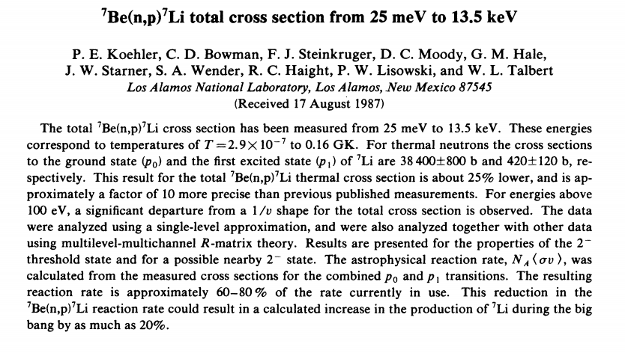
Phys. Rev. C 37(1988) 917
Il Nuovo Cimento
XXVIII (1963)1049

Slide 6
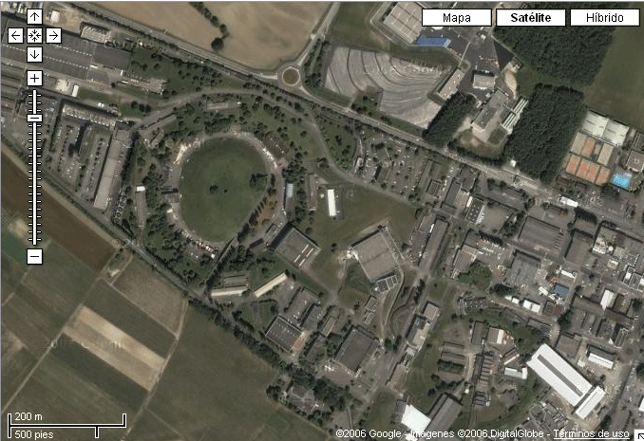
The n_TOF facility at CERN
185 m flight path
n_TOF is a spallation neutron source based on 20 GeV/c protons from the CERN PS hitting a Pb block (~360 neutrons per proton).
Experimental Area I at 185 m
Experimental Area II at 20 m
Booster
1.4 GeV
PS 20 GeV
Linac
50 MeV

Slide 7
n_TOF program on ⁷Be(n,cp)

Slide 8
⁷Be available at PSI-Zurich !
Thanks to E. Maugeri, S. Heinitz, D. Schumann (PSI Villigen)

Slide 9
Experimental setup (INFN-LNS)
Those who made it possible: - L. Cosentino, P. Finocchiaro, A. Pappalardo (INFN-LNS)
- M. Barbagallo, N. Colonna (INFN-Bari)

Slide 10
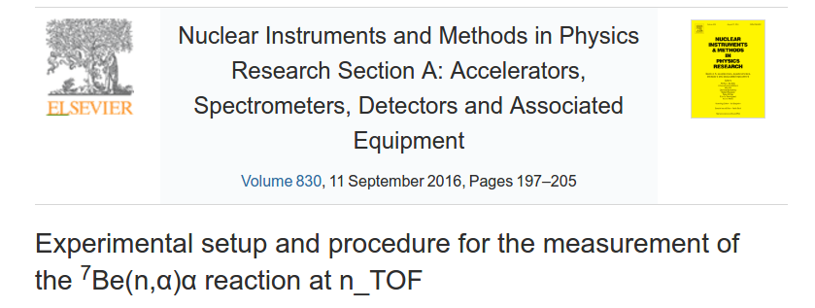
For further informations...
Corresponding author:
P. Finocchiaro (INFN-LNS)

Slide 11
⁷Be(n,alpha) data analysis

Slide 12
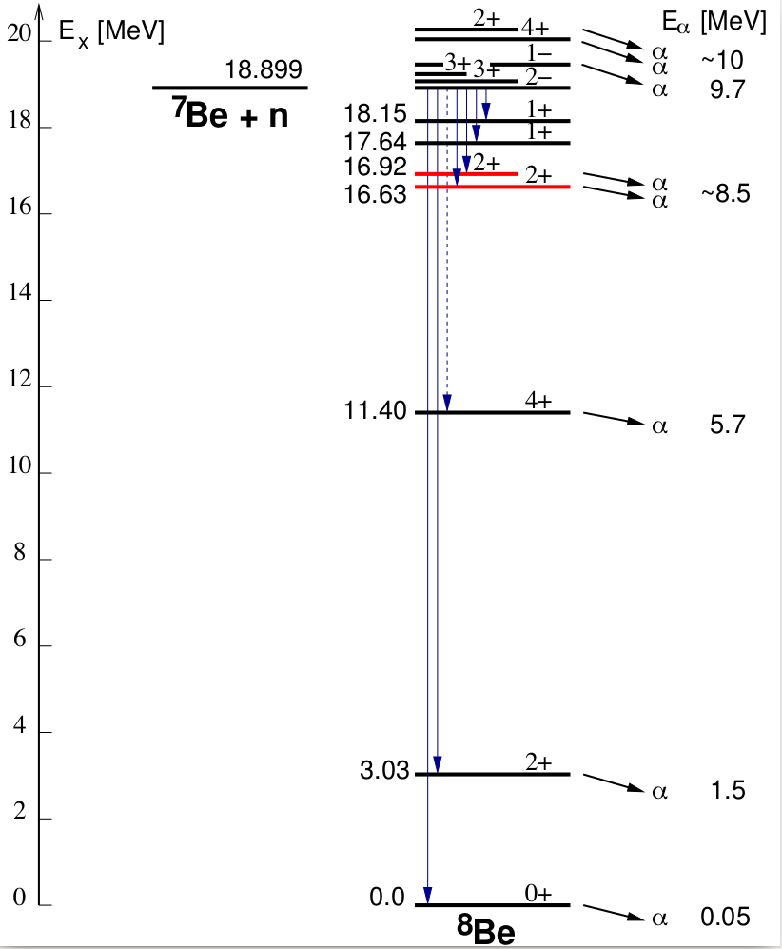
⁸Be level scheme and decay channels
By A. Mengoni
Article submitted to PRL
Possible 2α channels
not observed due to
exp n-energy cutoff
Observed γ-2α channels
Suppressed γ−2α channel
(not observed)
Predicted γ-2α channel
not observed due to exp.
apparatus energy threshold

Slide 13
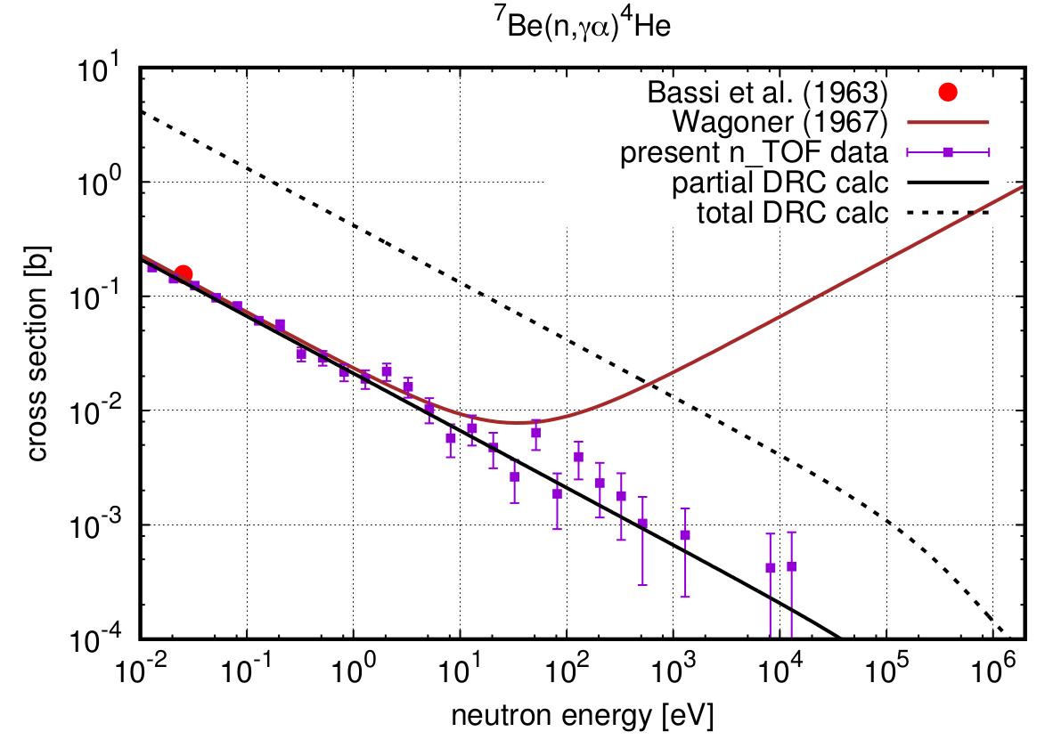
Impact on Cosmological Lithium Problem
Missing Direct Radiative Capture contribution
No p-wave evidence
Article submitted to PRL

Slide 14
Conclusions and outlook

Slide 15
⁷Be(n,p) cross-section measurement
Data analysis is in progress
20 MBq
1 GBq

Slide 16
⁷Be(n,p) cross-section measurement

