Slide 1



The ⁸Be anomaly and the fifth force
A.J. Krasznahorkay
Inst. for Nucl. Res., Hung. Acad. of Sci. (MTA-Atomki)

Slide 2

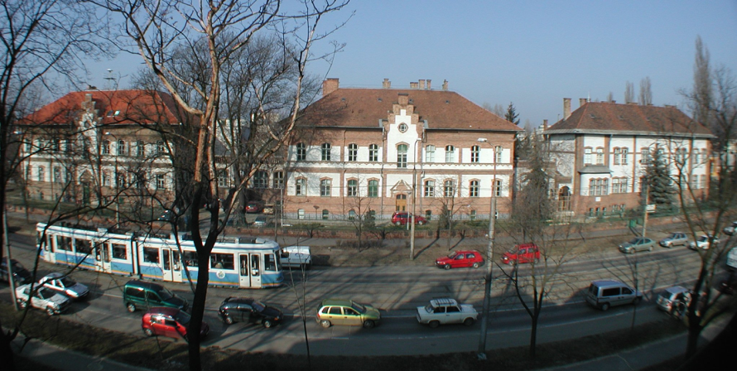
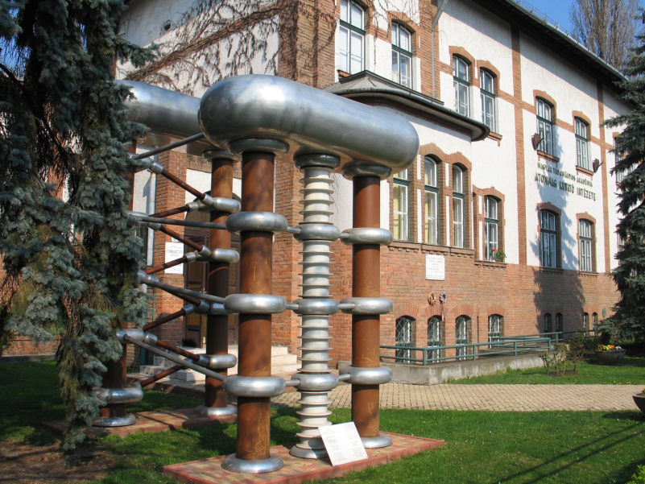
ATOMKI, Debrecen
The „Institute for Nuclear Research” in the downtown of Debrecen!
4 main divisions:
  Nuclear Physics Division
  Atomic Physics Division
  Applied Physics Division
  Accelerator Centre
  Size: 100 scientists, 100 other staff
www.atomki.mta.hu/en/

Slide 3
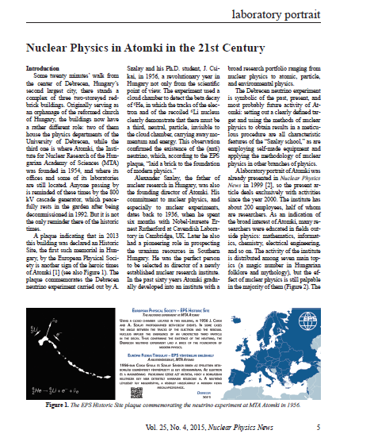
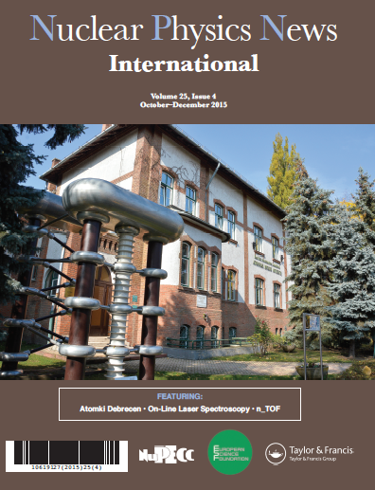
http://www.nupecc.org/npn/npn254.pdf

Slide 4
The Atomki anomaly → signals for a new 17 MeV boson → gauge boson of a new fundamental force of nature
Protophobic Fifth-Force Interpretation of the Observed Anomaly in Be8 Nuclear Transitions, Jonathan L. Feng, Bartosz Fornal, Iftah Galon, Susan Gardner, Jordan Smolinsky, Tim M. P. Tait, and Philip Tanedo, Phys. Rev. Lett. 117, 071803 – Published 11 August 2016

Slide 5
Dark photons and the g-2 anomaly
Branching ratio
Lifetime

Slide 6
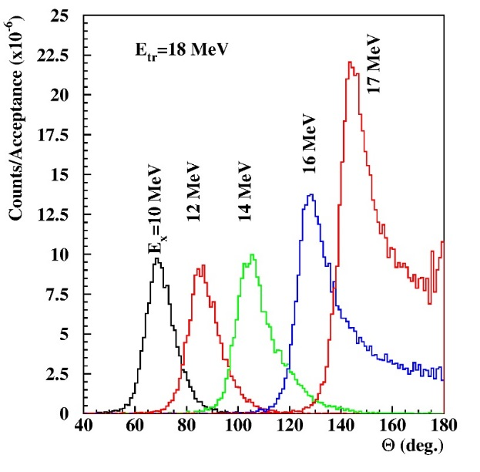
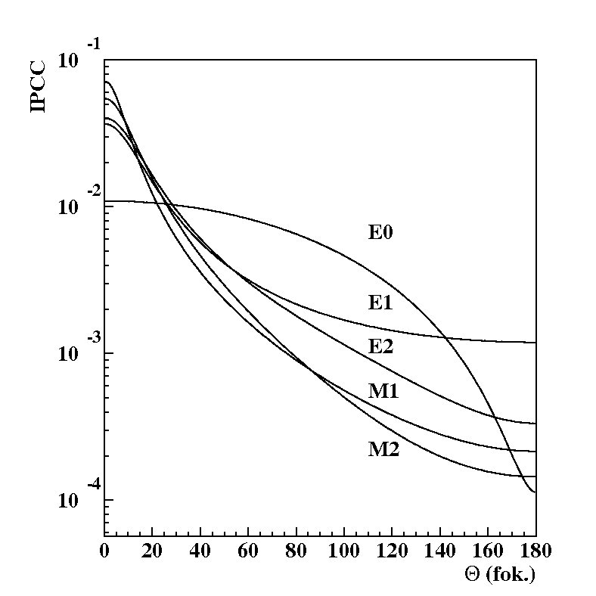
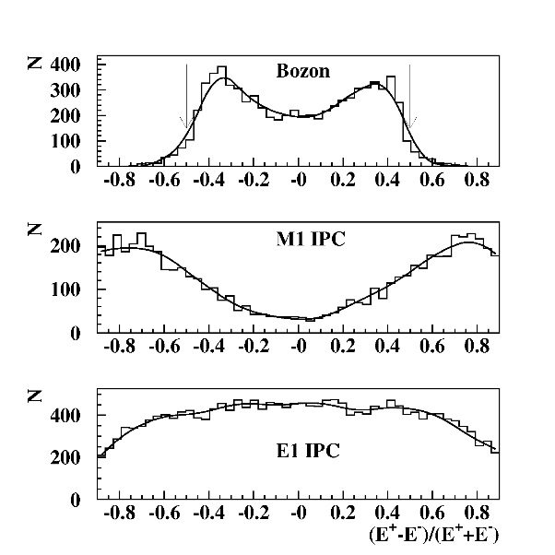
Search for the e⁺-e⁻ decay of the dark photon in nuclear transitions
The atomic nucleus is a femto-laboratory including all of the interactions in Nature. A real discovery machine like LHC, but at low energy.
e⁺-e⁻ internal pair creation
J^{π}
i
e⁺
J^{π}
e–
f
M.E. Rose Phys. Rev. 76 (1949) 678
E.K. Warburton Phys. Rev. B133 (1964) 1368.
P. Schlüter, G. Soff, W. Greiner, Phys. Rep. 75 (1981) 327.

Slide 7
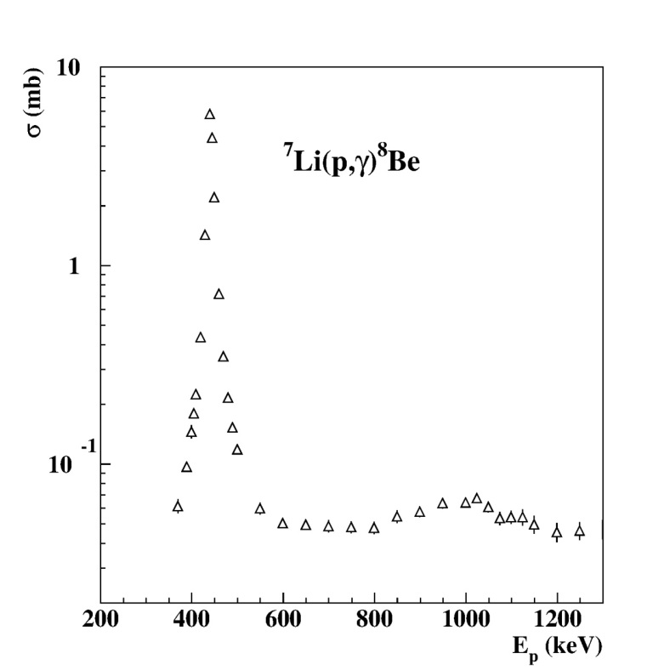
Study the ⁸Be M1 transitions
Excitation with the
⁷Li(p,γ)⁸Be reaction
18.2
1⁺
Ep= 1030 keV
17.6
1⁺
⁷Li, p3/2⁻ + p
Ep= 441 keV
3.0
2⁺
0
0⁺
⁸Be

Slide 8
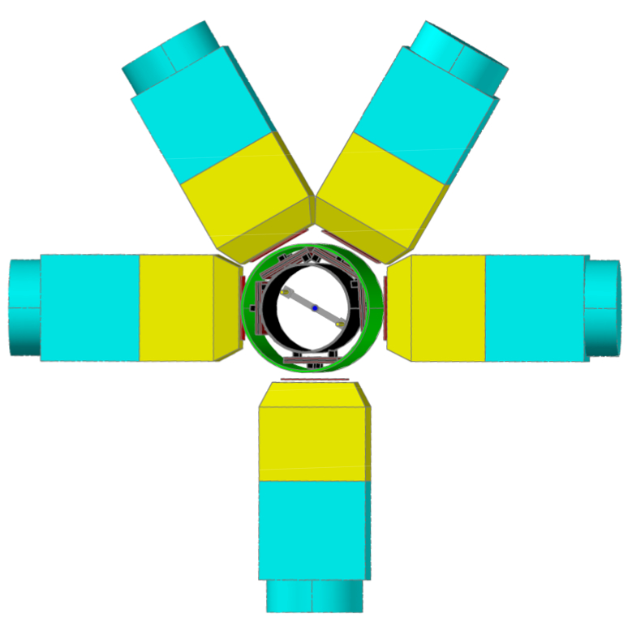
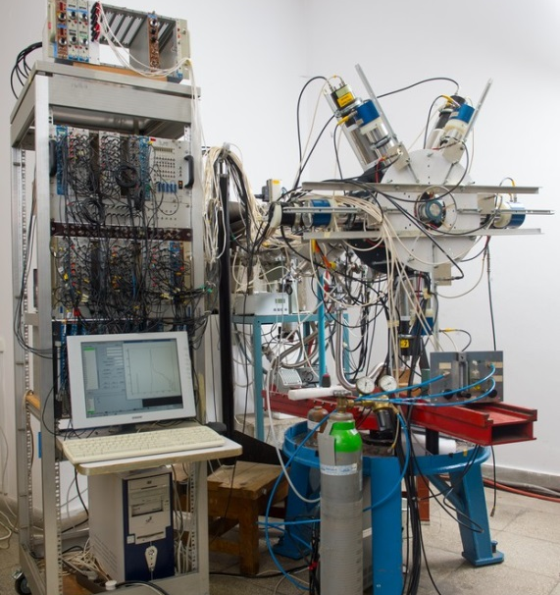
Geometrical arrangement of the scintillator telescopes (NIM, A808 (2016) 21)

Slide 9
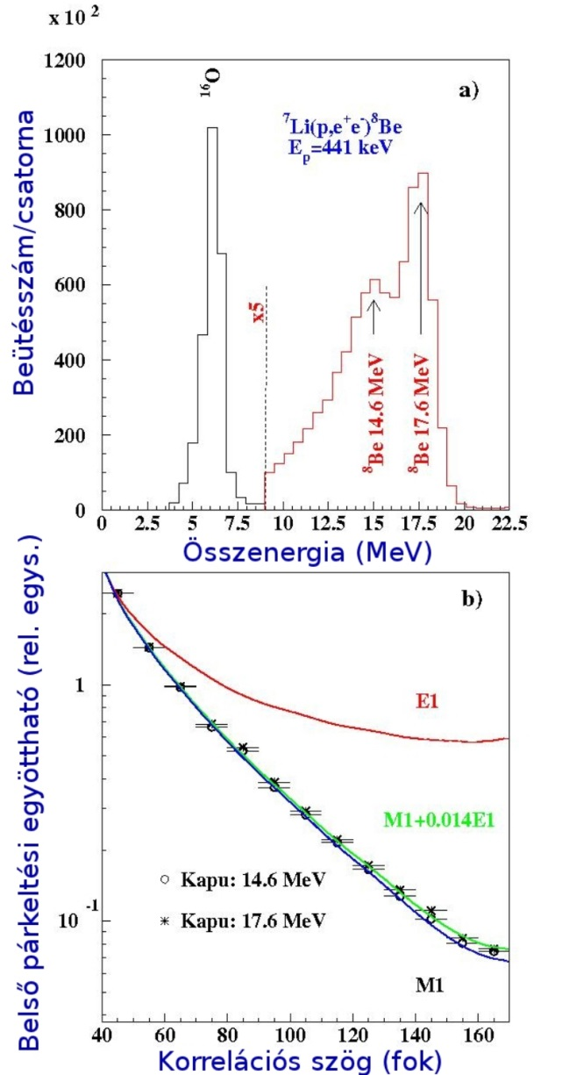
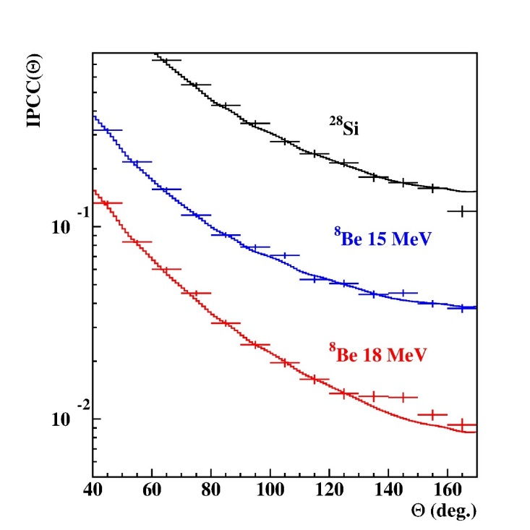
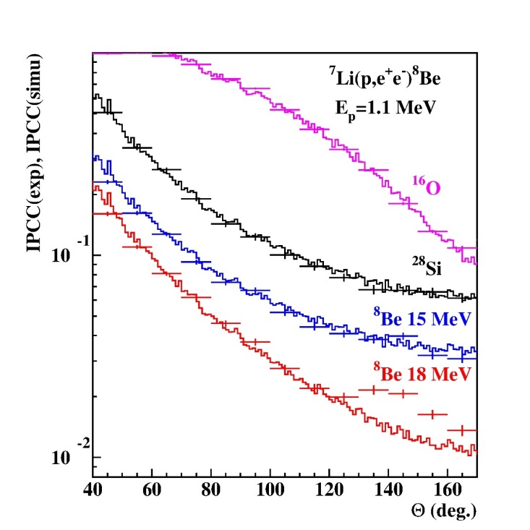
Results e⁺ - e⁻ sum energy spectra and angular correlations
Ep=1.04 MeV Ep=1.10 MeV
Deviation from IPC
Can it be some artificial effect caused by γ-rays?
→ No, since we observed it at Ep= 1.1 MeV but not at 0.441 MeV.
Can it be some nuclear physics effect?
Let’s investigate that at different bombarding energies!

Slide 10
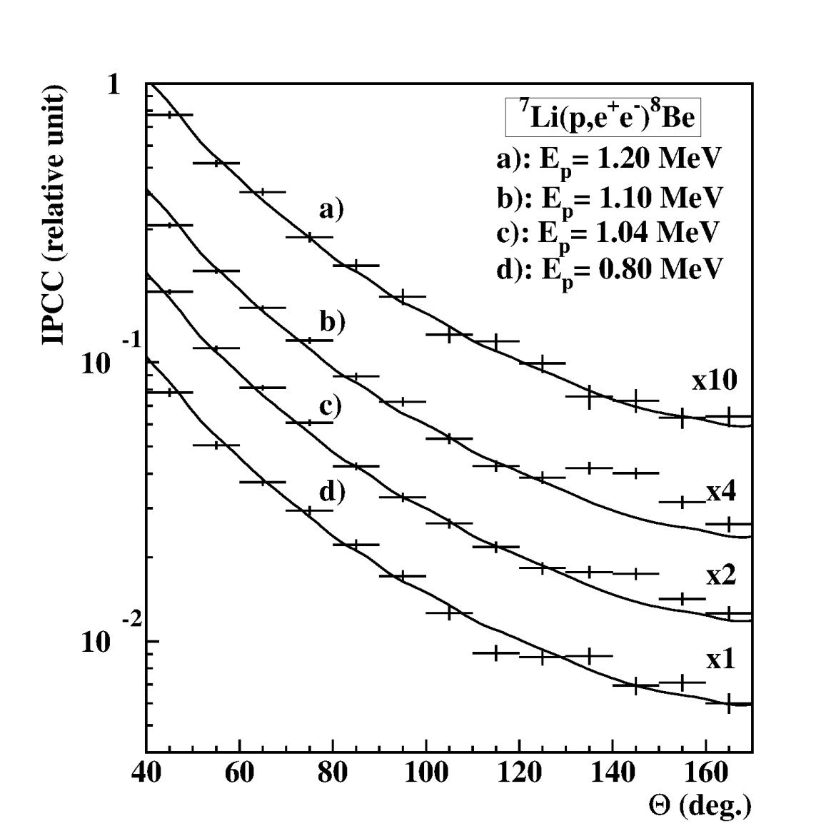
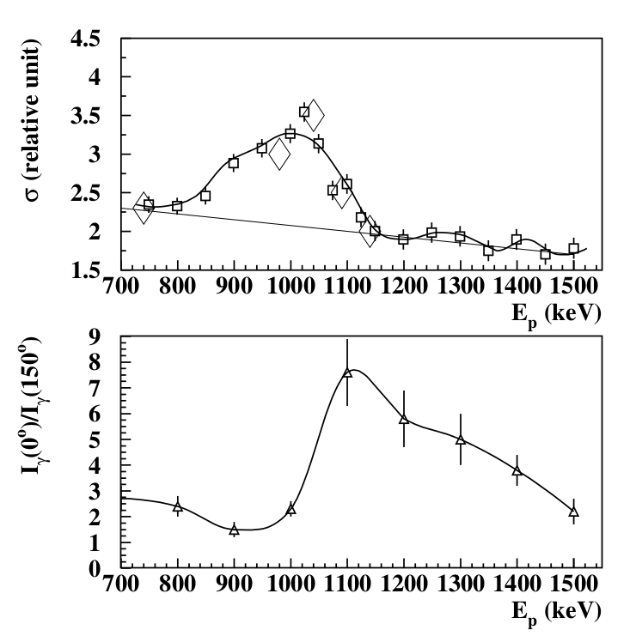
Can it be some kind of interference effect between transitions with different multipolarities?
Most probably not. In case of any interference the peak should behave differently.

Slide 11

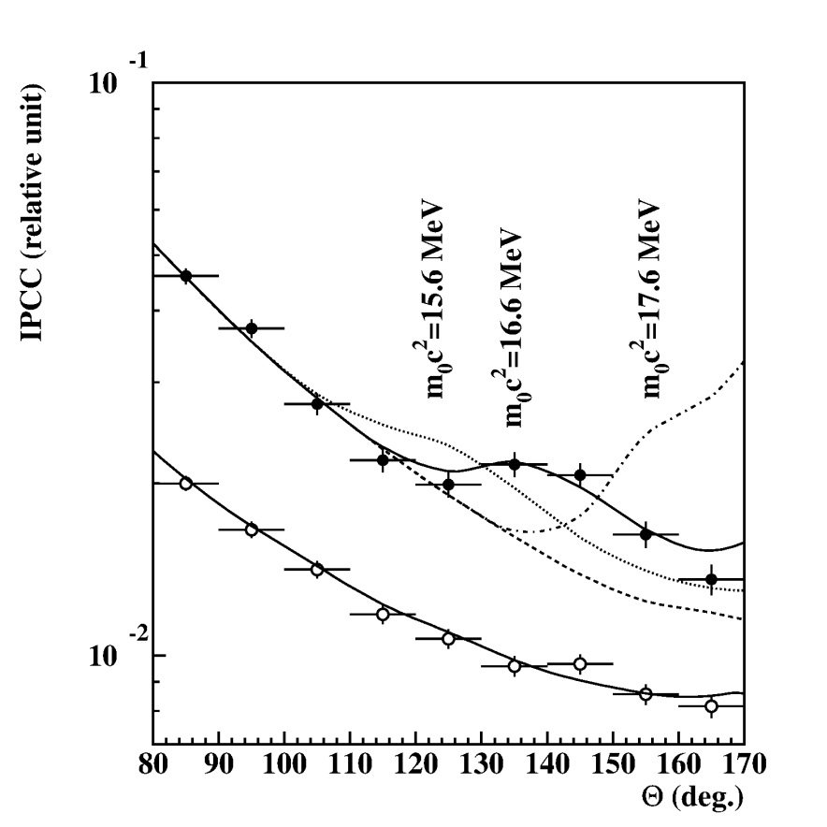
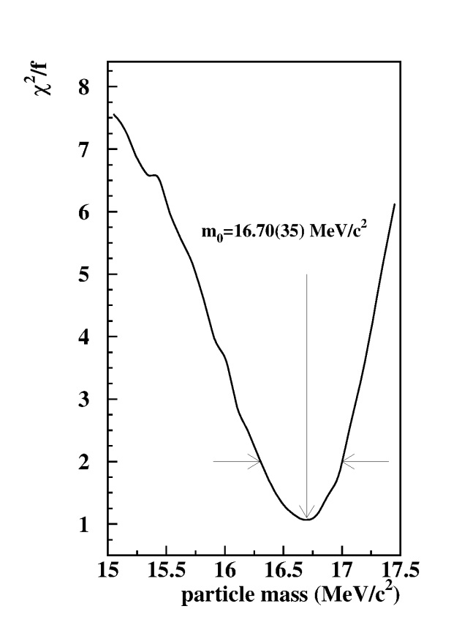
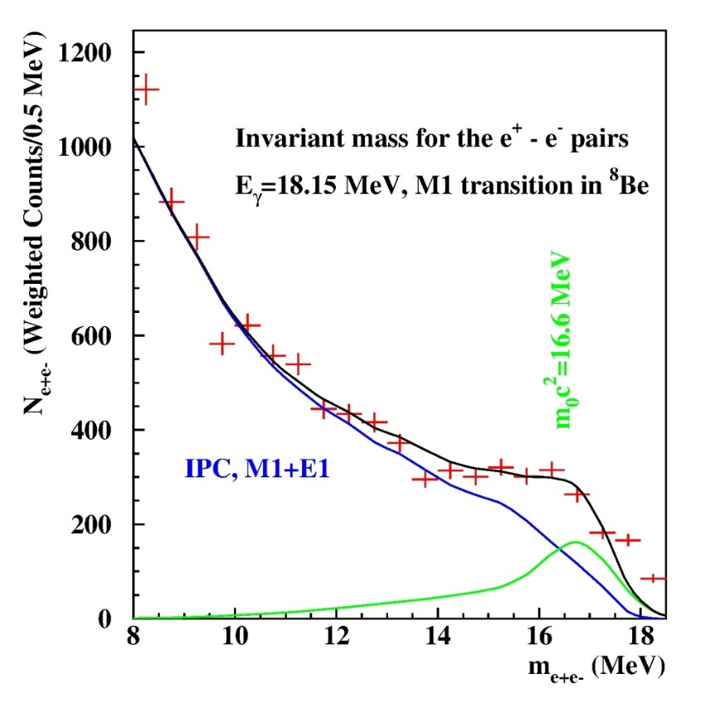
How can we understand the peak like deviation? Fitting the angular correlations
Experimental angular e⁺e⁻ pair correlations measured in the ⁷Li(p,e⁺e⁻) reaction at Ep=1.10 MeV with -0.5< y <0.5 (closed circles) and |y|>0.5 (open circles). The results of simulations of boson decay pairs added to those of IPC pairs are shown for different boson masses.
Determination of the mass of the new particle by the Χ2/f method
Invariant mass distribution plot for the electron-positron pairs

Slide 12
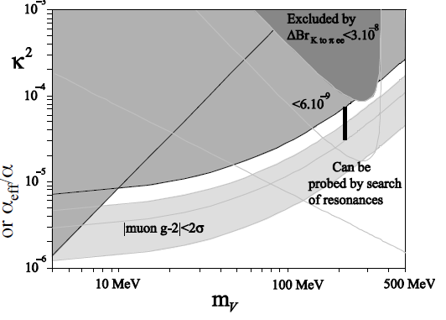
The coupling constant
Search for a dark photon in the π⁰→e⁺e⁻ γ decay, NA48/2 Collaboration, Phys. Lett. B 746, 178 (2015).

Slide 13
Introduction of the protophobic fifth force
(J. Feng et al.PRL 117, 071803, (2016))

Slide 14
What are the properties of the interaction?
Branching ratio:
Lifetime:
Pion decay:
Prophobic particle

Slide 15
Conclusions
The observed deviation between the experimental and theoretical angular correlations is significant and can be described by assuming the creation and subsequent decay of a boson with mass m₀c² =16.70±0.35(stat)±0.5(sys) MeV.
The branching ratio of the e⁺e⁻ decay of such a boson to the γ decay of the 18.15 MeV level of ⁸Be is found to be 5.8 × 10⁻⁶ for the best fit.
The lifetime of the boson with the observed coupling strength is expected to be in the order of 10⁻¹⁴ s. This gives a flight distance of about 30 μm in the present experiment, and would imply a very sharp resonance (Γ~ 0.07 eV) in the future e⁺e⁻ scattering experiments.

Slide 16
To be continued …
More telescopes, even bigger efficiency
Si detectors for tracking the particles
Constraining the mass of the particle
Can we see anything in the 17.6 MeV transition?
Constraining the lifetime of the particle
Can we see particle creation in E1 transitions (¹¹B(p,γ)¹²C) ? Parity conservation?

Slide 17
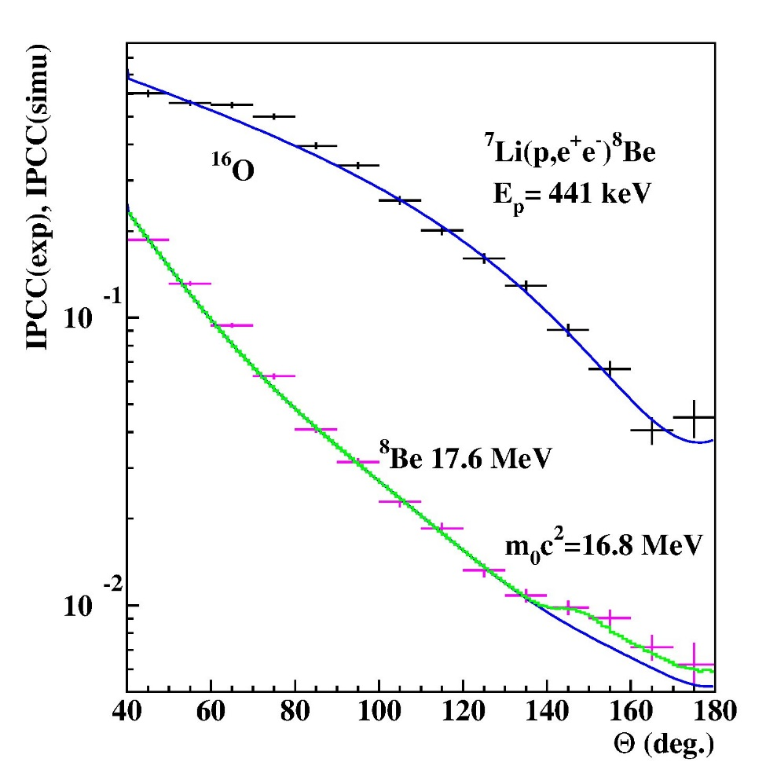
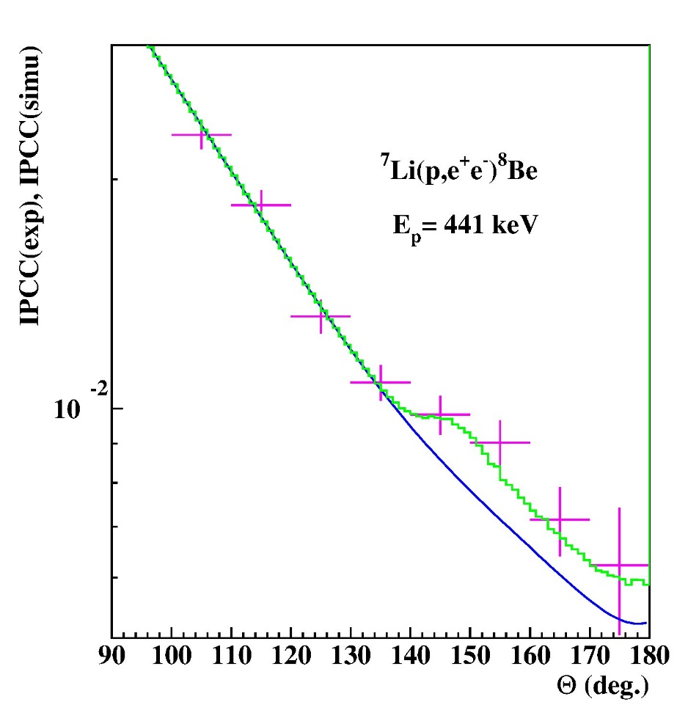
New results for the 17.6 MeV transition
→The prediction of Feng et al. Is correct.

Slide 18
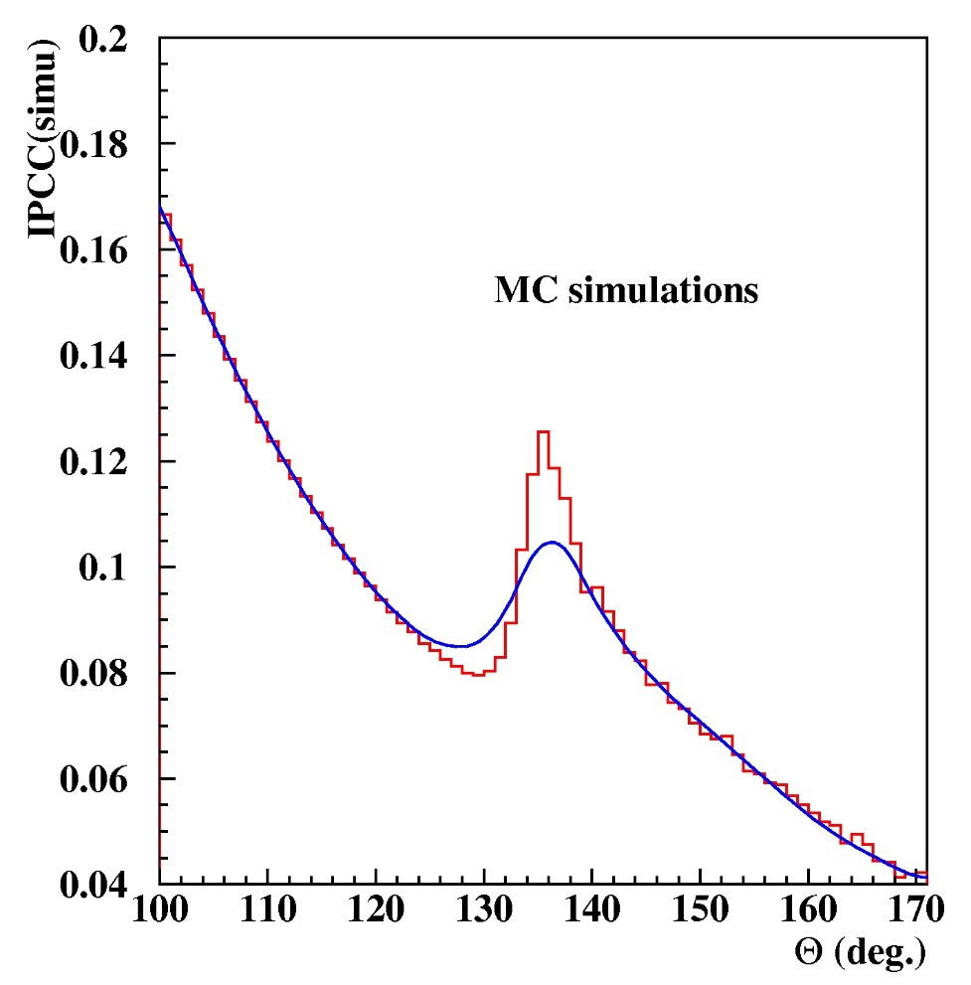
The effect of multiple scattering on the beam pipe
→ We are going to put the DSSD detectors into vacuum to avoid the multiple scattering

Slide 19
Evidence of a ‘Fifth Force’ Faces Scrutiny
Quanta magazine: By Natalie Wolchover
June 7, 2016
“The new claim now is [a] boson with a mass of 16.7 MeV,” “But they don’t say anything about what went wrong in their previous claims and why we should not take those claims seriously.” (Oscar Naviliat-Cuncic MSU)
Vitéz A. Cs. et al.: Anomalous internal pair creation in ⁸Be as a signature of the decay of a new particle, Acta Physica Polonica B 39 (2008) 483-487 (Presented at the XXX Mazurian Lakes Conference on Physics, Piaski, Poland, September 2–9, 2007).
Krasznahorkay A. J. et al.: Searching for a light neutral axial-vector boson in isoscalar nuclear transitions, Dark Forces at Accelerators. DARK 2012. Frascati (Rome), Italy, Laboratory Nazionali di Frascati, INFN, 16-19 Oct., 2012. Proceedings (Frascati Physics Series 56) (2013) 86-97.

Slide 20
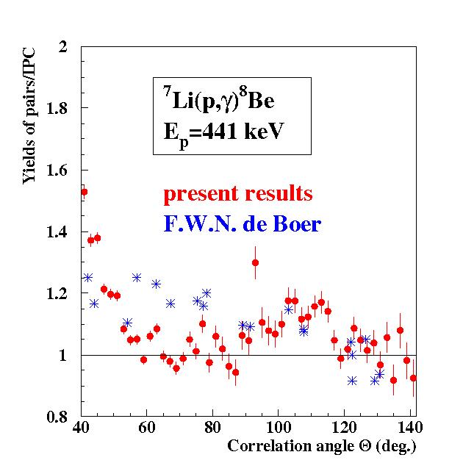
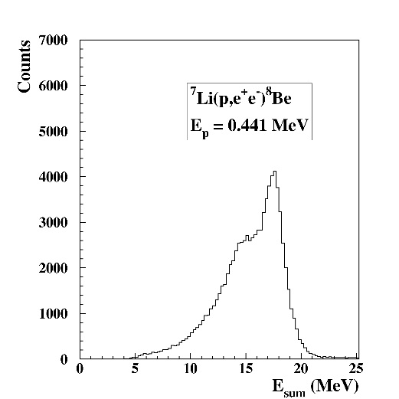
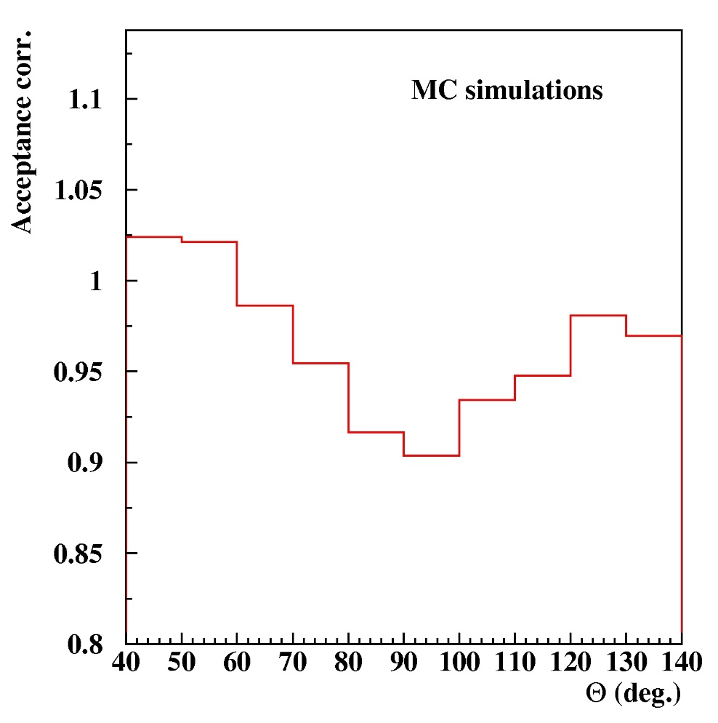
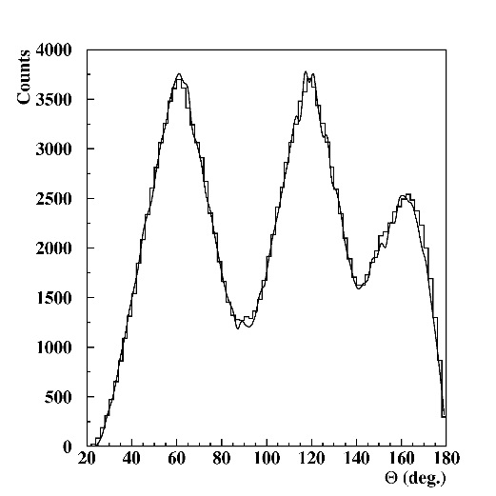
What did we observe in 2008?
Vitéz et al., Acta Physica Polonica B 39 (2008) 483
The effect disappeared.

Slide 21
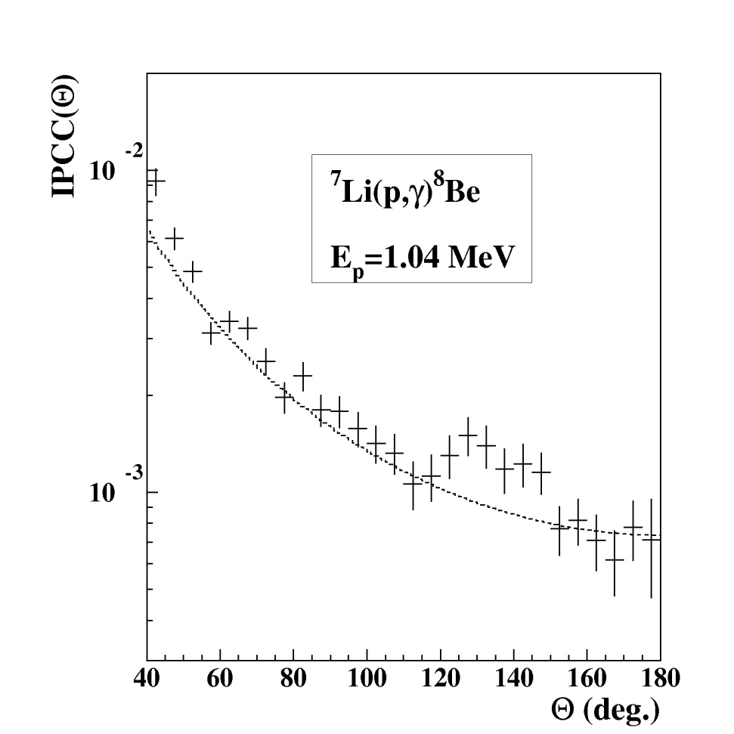
Problems with the interpretation in 2012
Frascati (2012)
Present results (PRL, 2016)

Slide 22
Thank you very much for your attention

