Slide 1
NEUROGICAL MODEL in IMAGE PROCESSING
Data compression based on a neurological model

Slide 2
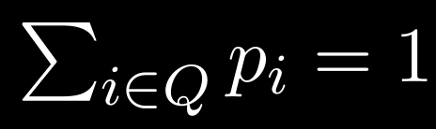
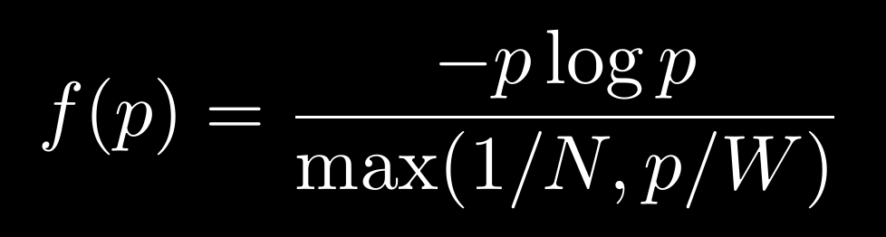
Modello Del Viva
p_{i} = probability of a portion of te input to correspond to a pattern i
= set of all possible patterns
N = pattern bank dimension
W = acceptance bandwith
space cost
bandwidth cost

Slide 3
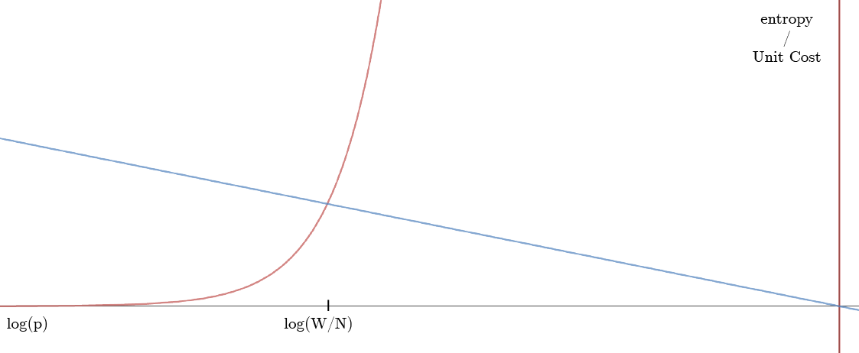
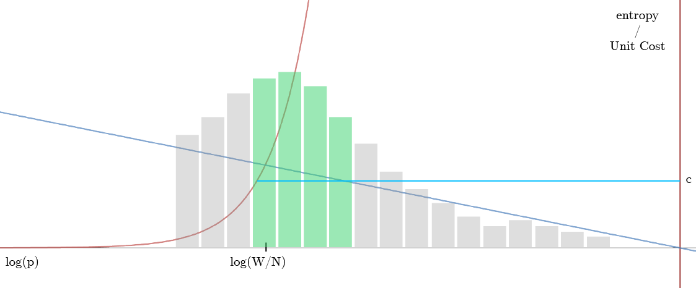
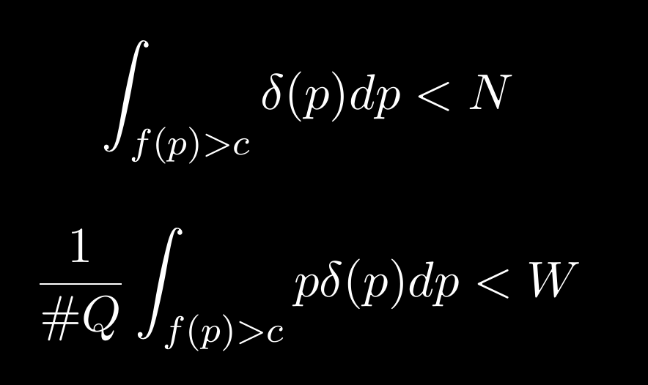
Del Viva Model
The “cut” value c indicates the “window” of selection
from the frequency density histogram only meaningful patterns according to constrains A and B are accepted.
A
B

Slide 4
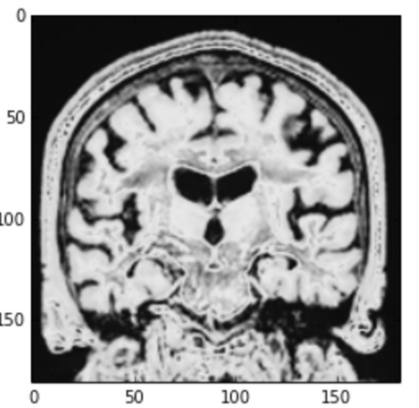
Application on MRI
Script run on a selected slice/plane of the MRI voxel space.
Apply threshold values to downsample the image.
Samples patterns.
Create pattern bank by applying constrain to maximize entropy (M Del viva).
Rebuild the image using the pattern bank.

Slide 5
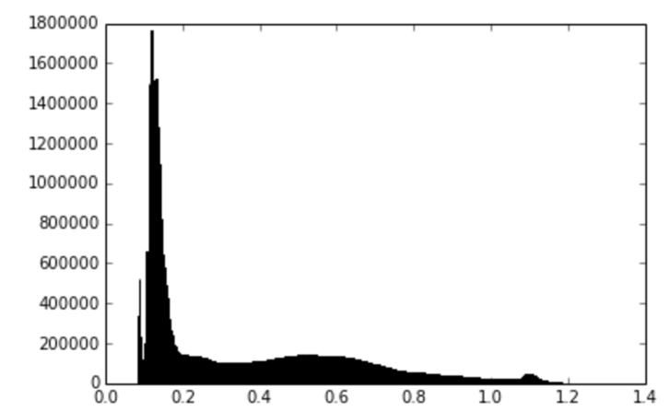
Threshold values
Threshold values are choosen in correspondence of local maxima along the grey levels histogram (left image).
Such maxima are thought to correspond to different tissue consistencies.
#
voxels
dark -> bright
Grey values histogram sampled from 8 patients dataset (AD,CTRL,CONV).

Slide 6
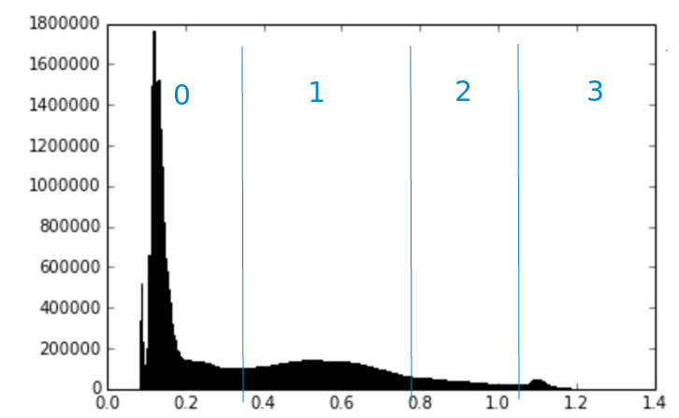
Threshold values
Once values are found we’ll obtain a hard segmentation (no overlaps) which can be expressed as a downsampled image (next slide).
PROBLEM: agree and develop a method for threshold identification (investigating EM GMM)
#
voxels
dark -> bright
Grey values histogram sampled from 8 patients dataset (AD,CTRL,CONV).

Slide 7
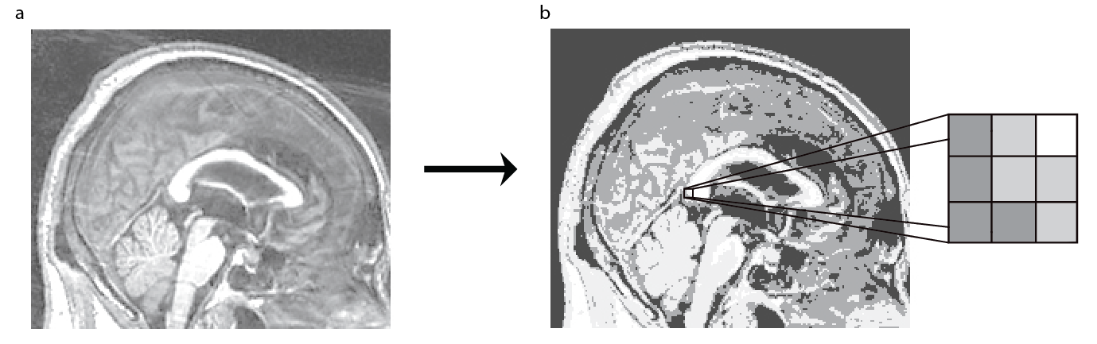
Apply threshold
Segmented image with hard clusters results in a “downsampled” version of the original, on the right a sample patch.

Slide 8
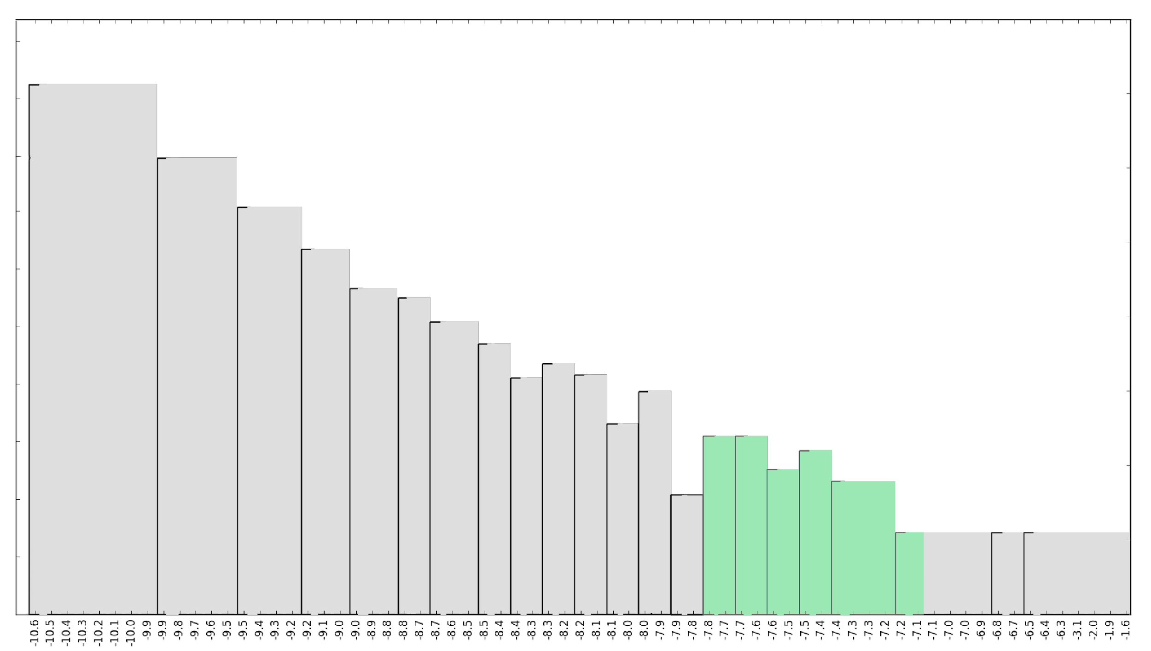
Patterns density
W = 0.1 e N = 180*
  5% of total
Max in log(W/N)≅-7.5
# pattern
parameters are choosen arbitrarely, depends on the application and on the processing unit.
notice: M Del Viva method is solved iteritatively.
log (p)

Slide 9
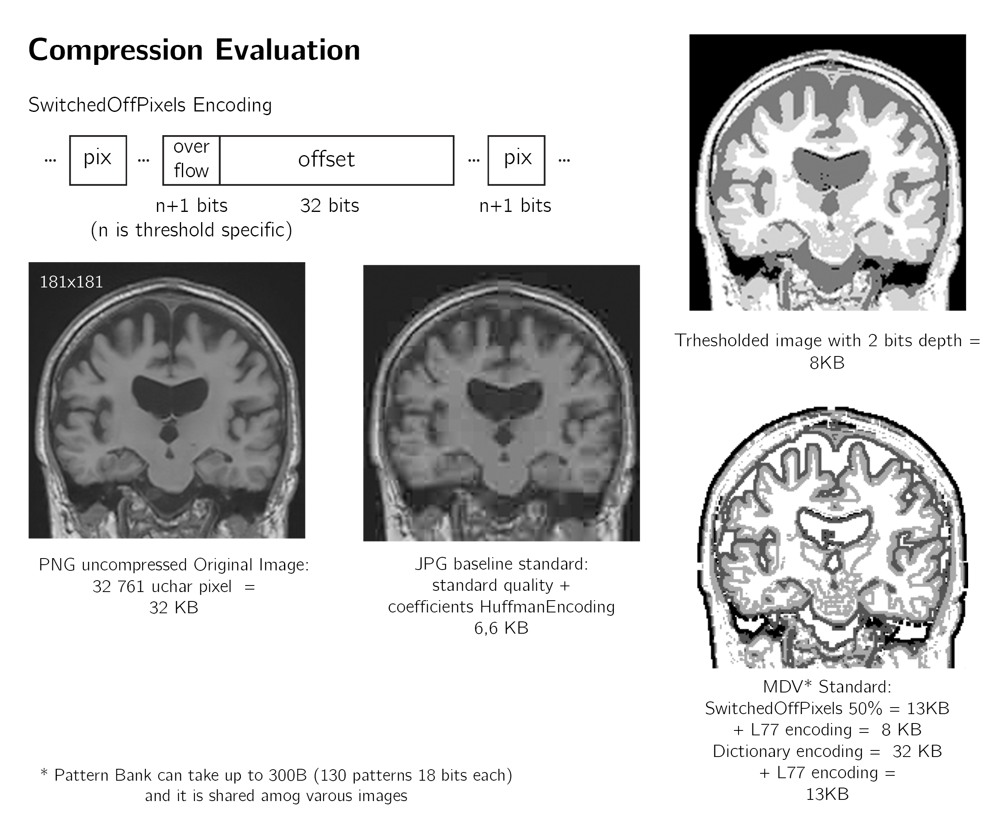
Comp ratio
In some cases images inflates depending on the encoding
comp ratio is content dependent

Slide 10
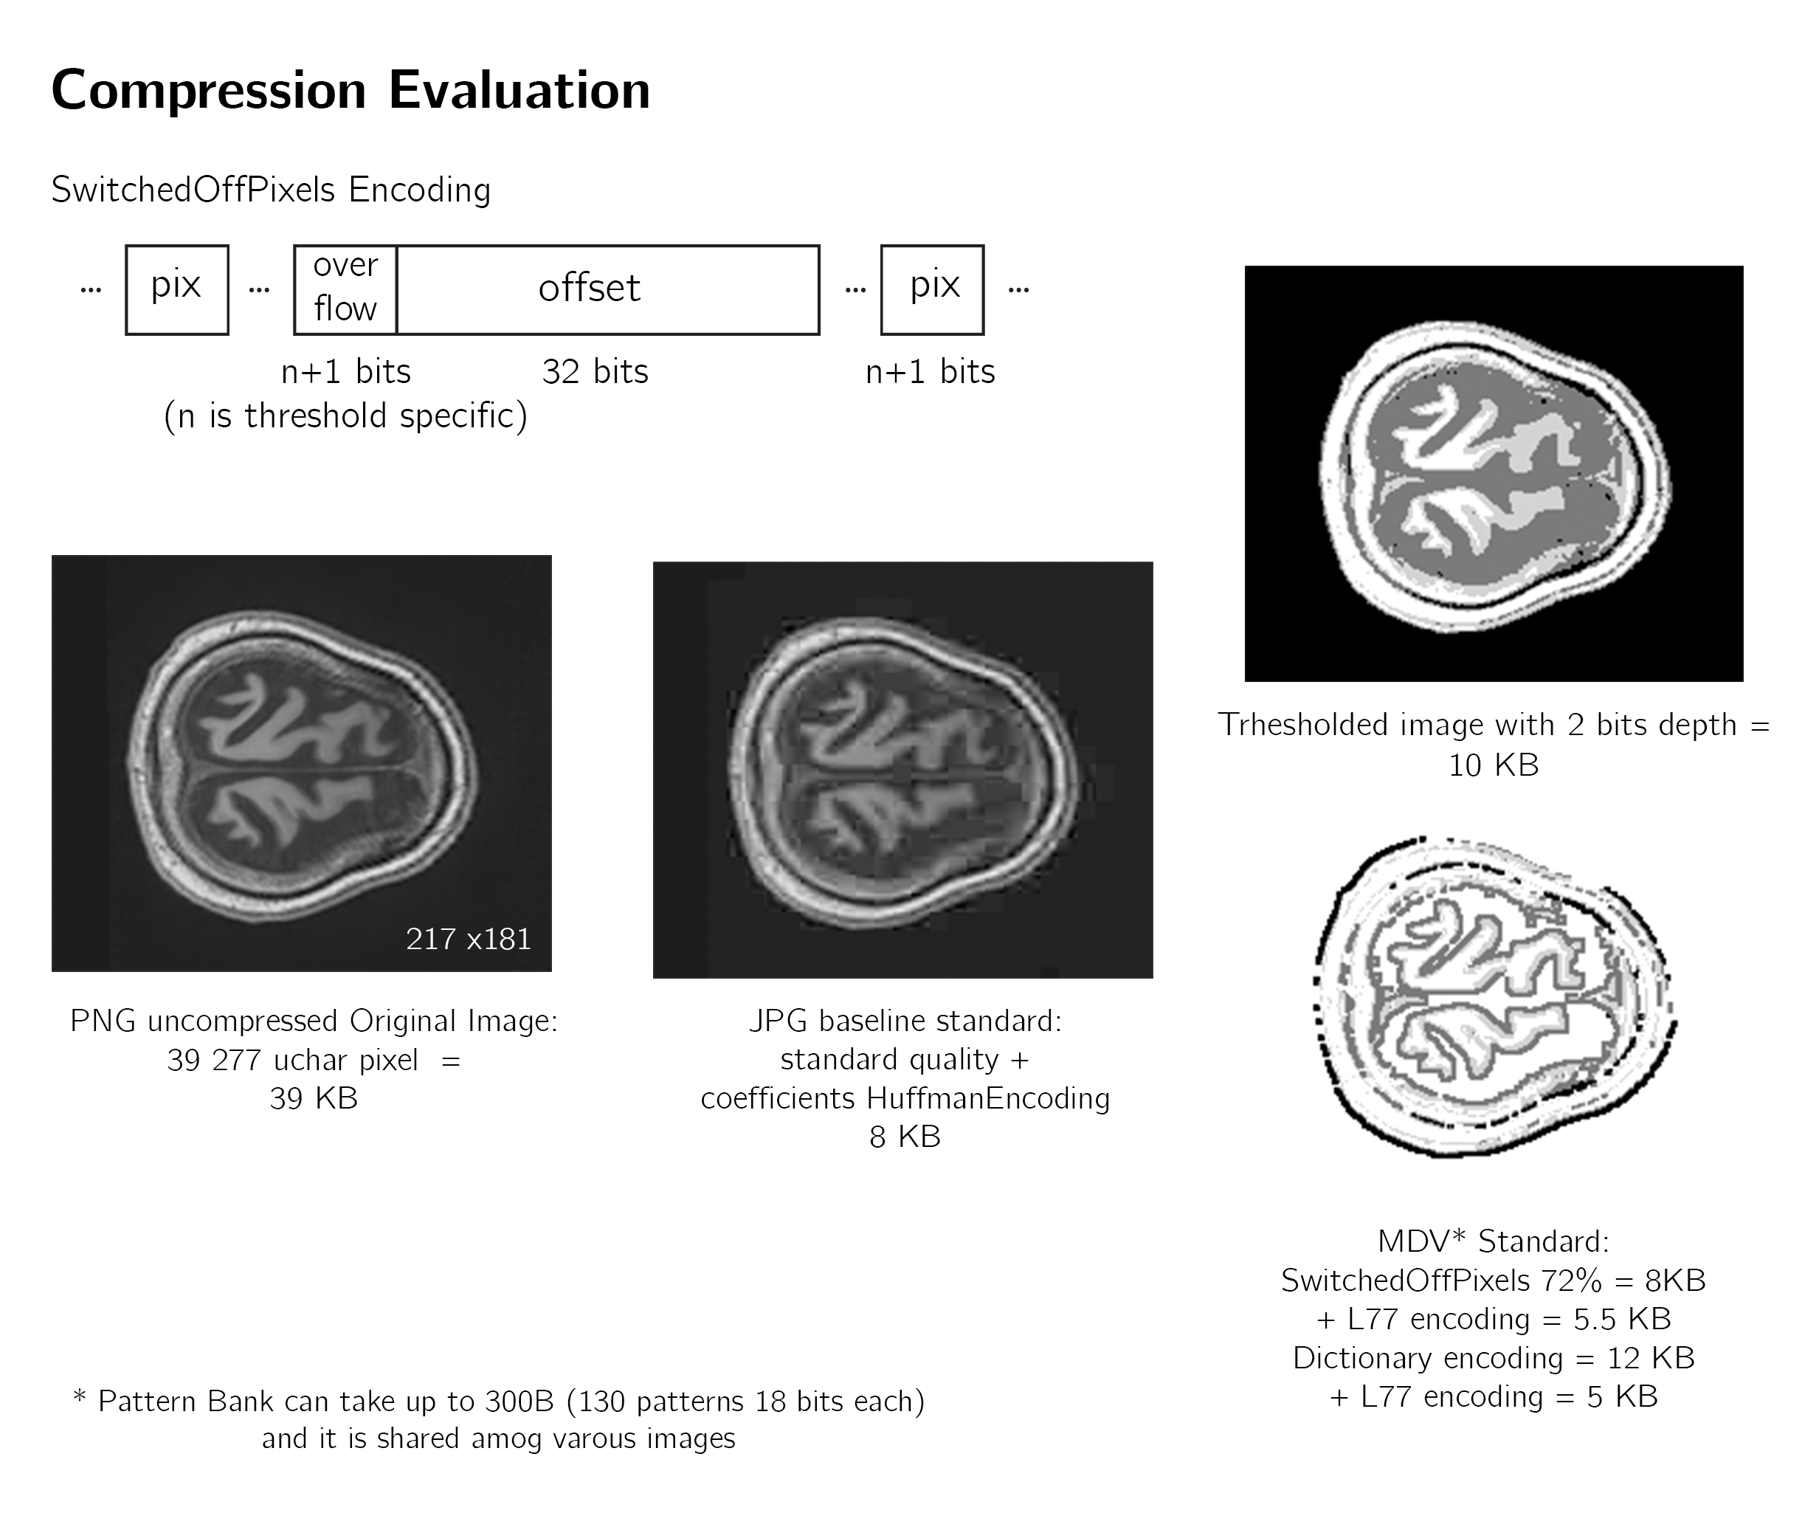
Comp ratio
In some cases images inflates depending on the encoding
comp ratio is content dependent

Slide 11
Hence
MRI 3D images are sparse and most of the data stored is non brain tissue.
Comp ration is highly dependent on content, therefore non brain tissue is not preserved by compression.
Quality: the loss depends on the application, if the features saved by compression are still informative for a particular task (diagnosis) loss can be accepted.
Goal*: find a particular task in which conserved data with a significant comp ratio is still informative.
*in my honest opinion

Slide 12
3D
sampled data size
3x3x3 patterns 2 bits per pixel = 54 bits per pattern
numeber of patter sampled: 1082242
total size of pattern sampled: 7133 Kbytes

Slide 13
Next
Python
Implement 3D sampling ✓
Implement 3D pattern selection (inherited from 2D) ✓
proposal: Find a ML method that can use compressed data as input
C++
proposal: Use standard nifty library
Implement 3D sampling
Implement 3D pattern selection
proposal: Create a standard output format (uniform with Hardware)
Performance test AM vs CPU to confirm a priori non Von Neuman complexity analysis

