Slide 1
Emulsion Cloud Chamber
for the FOOT experiment
Gruppo di Napoli
A. Aleksandrov, G. De Lellis, A. Di Crescenzo, M. Fioranelli,
A. Iacomino, A. Lauria, J. Lotti, M.C. Montesi, V. Tioukov
1. Detector structure and construction
2. Set up for the measurement
3. Calibration run

Slide 2
1. Detector structure
The ECC is made of three sections:
Section 1: alternated layers of emulsions and target (C/CH₂)
vertex detector
tracking of all charged particles produced
Section 2: made of emulsion films only
charge identification for low Z fragments (H, He, Li)
Section 3: alternated layers of emulsions and lead
Momentum measurement by range
Section 1
vertexing
Section 2
Charge identification
Section 3
momentum
Beam
300 μm
1 mm
1 mm
Emulsion layer
C or CH₂ layer
Pb layer

Slide 3
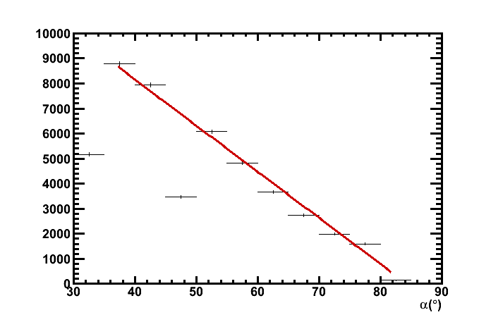
1. Section 1: vertex detector
Alternate target layers of C or CH₂ (1 mm) and emulsion (300 μm)
Vertex detector and particle tracking
Chamber thickness defined by the interaction length → obtain a sufficiently high number of interactions
20% of Carbon ions interacting in 3 cm Lexan
Total length ∼ 30 cells = 39mm
Beam
∗
C or CH₂
C or CH₂
C or CH₂
300 μm
1 mm

Slide 4
1. Section 2: structure charge analyzer
Charge identification for low Z fragments (H, He, Li)
Emulsion were differently treated after the exposure and before the chemical treatment according to their position in the elementary cell (0, 1, 2)
R0:
Not refreshed
Developed soon after the exposure
Sensitive to m.i.p.
R1:
Appropriate refreshing for protons
Insensitive to m.i.p.
Sensitive to protons
R2:
Appropriate refreshing for He
Sensitive to He
elementary cell
R0
R1
R2
m.i.p.
∗
Incident particles
from vertex
p
He

Slide 5
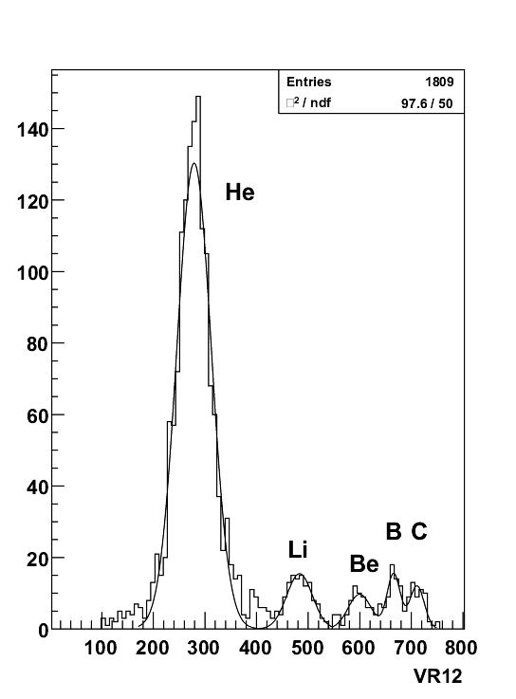
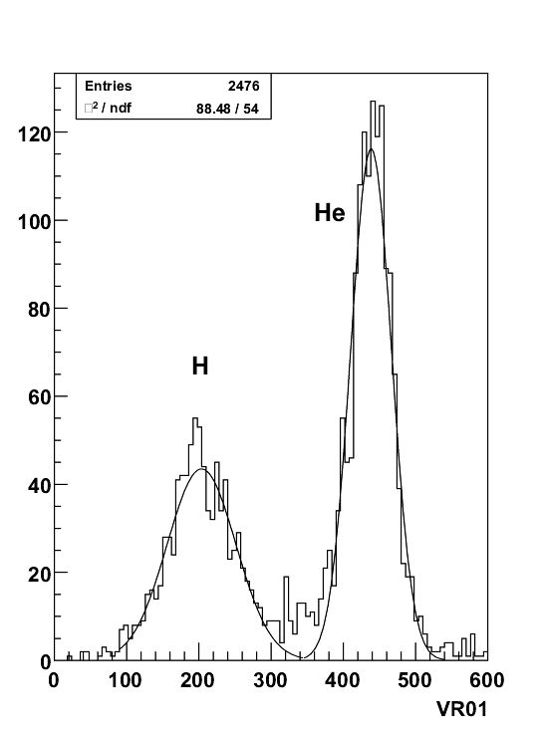
1. Section 2: how many elementary cells for charge separation?
The standard deviation for the separation of pair of nuclei, as function of number of elementary cells, is reported in the table.
1 cell = 0.9 mm length. A 3σ He-Li separation with 9 cells (8.1 mm)
Cells | 3 | 9 | 13 | 20
H-He | 3.3 | 4.5 | 6.5
He-Li | 2.6 | 3.9 | 4.3 | 5.0
Li-Be | 1.7 | 2.7 | 3.1 | 3.5

Slide 6
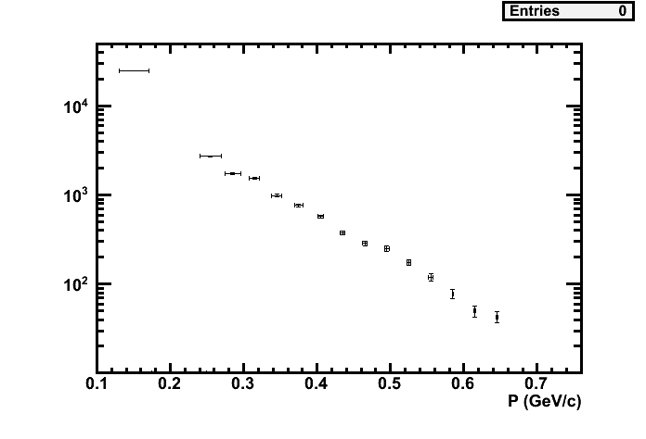
1. Section 3: momentum measurement
Emulsion films interleaved with 1mm thick lead plates
Lead plates from ∼10 to ∼50 according to the incident beam energy
Pb
Pb
Pb
Pb
Pb
300 μm
1 mm
Emulsion layer
Lead layer

Slide 7
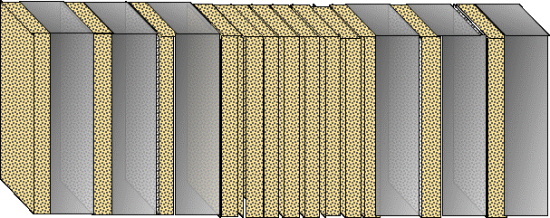
2. Set up for the measurement
To monitor the incident beam:
spatial distribution with ~ 1mm resolution: drift chamber
Scintillator counter for flux monitor
Depending on the rates, ECC may be moved by a motorised 2D stage
Counter
Beam
monitor
Emulsion
spectrometer
C/O beam
∗
motorised
stage

Slide 8
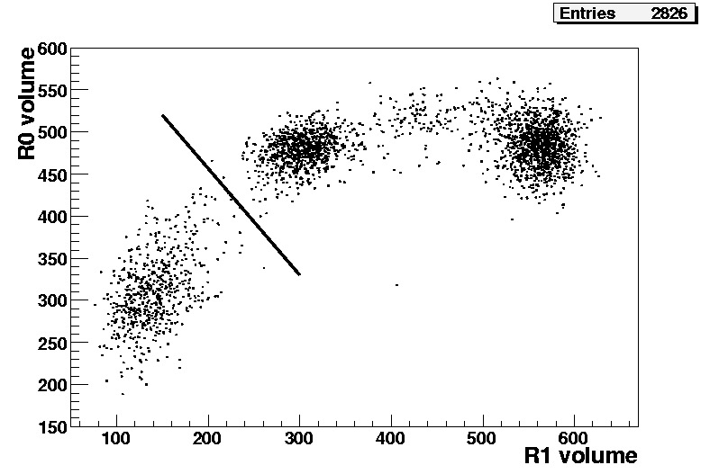
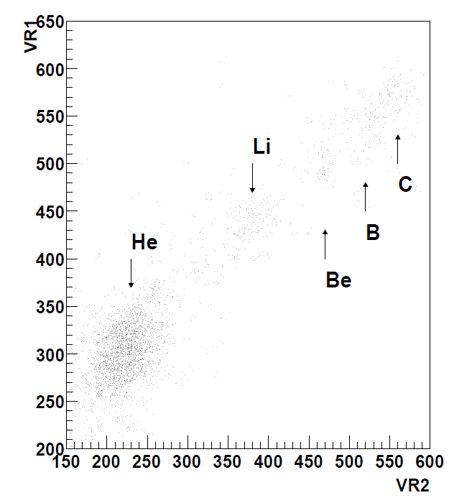
3. Calibration (+Physics?) run
Exposure of ECC made of ∼30 emulsions in order to measure the sensitivity to p, alpha and cosmic rays
we need:
proton source
Ideally He/Li
He
H
Journal of Instrumentation 2 (2007) P06004
Counter
Beam
monitor
Emulsion
p, C beam

Slide 9
back up slides

Slide 10
3. Detector construction: material
4. Detector construction: material
 | ECC (C or CH₂) |  |  | TOT
 | Section 1 (em+C) | Section 2 (em) | Section 3 (em+Pb)
Emulsion films | 30 | 30 | 20-50 | 80-110
C or CH₂ layers | 30 | 0 | 0 | 30
Pb plates | 0 | 0 | 20-50 | 20-50
At least 2 ECC (C or CH₂) for each energy exposure

