Slide 1
DAQ ACQUISITION FOR THE dE/dX DETECTOR
FOOT DAQ meeting Matteo Morrocchi Bologna 12 / 07 / 2016

Slide 2
STRUCTURE AND REQUIREMENTS
20 + 20 plastic scintillator bars arranged in two orthogonal layers.
double side SiPM read-out
80 channels read-out in coincidence each-others and with the start counter
Time resolution of 70 ps (standard deviation)
High energy resolution
Data rate of few kHz/chn
synchronization with the start counter and with the other detector of the system
FOOT DAQ meeting Matteo Morrocchi Bologna 12 / 07 / 2016

Slide 3
ADVANTAGES OF DIGITIZED SIGNALS
Data rate is not high and digitized waveform can be stored or processed on-line on PC or on FPGA
Time resolution can be improved interpolating the rising edge of the waveform
Pile-up can be recognized and efficiently rejected or processed with dedicated algorithms
Energy resolution can be obtained simply integrating the signal
Thresholds for the optimal time resolution and integration time for the best energy resolution has not to be tuned with calibrations because it will be mainly a software post processing elaboration.
FOOT DAQ meeting Matteo Morrocchi Bologna 12 / 07 / 2016

Slide 4
DISADVANTAGES OF DIGITIZED SIGNALS
A high data bandwidth has to be sustained
A huge amount of data need to be post-processed
A very fine time sampling is needed
Cost can be higher than integrator and discriminators
…
FOOT DAQ meeting Matteo Morrocchi Bologna 12 / 07 / 2016

Slide 5
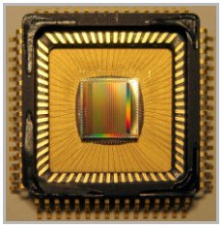
FAST DIGITIZER
DRS 4
Main features*
-SCA (switched capacitors array)
-Single 2.5 V power supply
-Sampling speed 700 MSPS to 5 GSPS
-8+1 channels with 1024 storage cells each
-Cascading of channels or chips allows deeper sampling depth
-Differential inputs with 950 MHz bandwidth
-Differential outputs for direct ADC interfacing
-Transparent mode for integrated triggering
-Readout time: 30 ns * number of samples
-Multiplexed or parallel analog outputs
-Low integral nonlinearity: 0.5x10-3 at 1 V range
-High SNR: 69 dB after offset correction
-Low Noise: 0.35 mV after offset correction
Developed in the MEG collaboration and used in the Fast-Digitizer CAEN modules
*https://www.psi.ch/drs/DocumentationEN/DRS4_rev09.pdf
FOOT DAQ meeting Matteo Morrocchi Bologna 12 / 07 / 2016

Slide 6
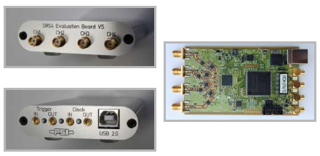
FAST DIGITIZER
DRS 4
4 – Channels evaluation board is available for a preliminary evaluation of the performance
Developed in the MEG collaboration and used in the Fast-Digitizer CAEN modules
https://www.psi.ch/drs/drs-chip
*https://www.psi.ch/drs/DocumentationEN/DRS4_rev09.pdf
FOOT DAQ meeting Matteo Morrocchi Bologna 12 / 07 / 2016

Slide 7
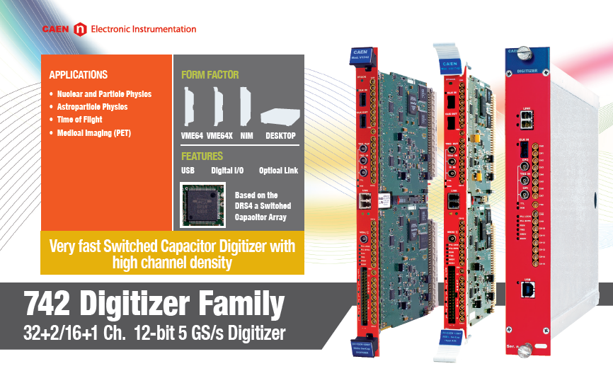
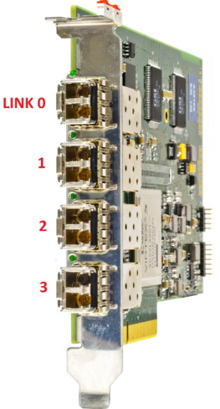
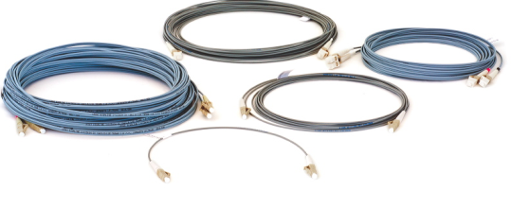
COMMERCIAL SOLUTION
- 12-bit @ 5 GS/s, 1024 samples per event
- 5, 2.5, 1 GS/s software selectable sampling frequencies
- Analog inputs on MCX coaxial connectors
- VME64/VME64X (32 ch.), NIM (16 ch.) and Desktop (16 ch.) modules
- Special analog inputs (2 ch. for VME; 1 ch. for NIM/Desktop)
- 1 Vpp input dynamic range with programmable DC offset adj.
- VME64/VME64X, USB and Optical Link communication interfaces
- Multi-board synchronization features
- 16 programmable LVDS I/Os
- Daisy chain capability
FOOT DAQ meeting Matteo Morrocchi Bologna 12 / 07 / 2016

Slide 8
COMMERCIAL SOLUTION
Is a trigger source? | Yes/No Trigger latency of 250 ns
Can be triggered? | Yes
Event Volume? | -
Acquisition Rate? | -
Dead Time? | 180 us dead time for A/D conversion
Pile-Up? | Two wfs are digitized
# Channel? | 32 for each module Synchronization in up to 8 modules (256 channels)
Infos? | 1024 samples @ 5 Gs/s 12 bit resolution
FOOT DAQ meeting Matteo Morrocchi Bologna 12 / 07 / 2016

Slide 9
COMMERCIAL SOLUTION
Questions:
Absolute time stamp
Maximum data bandwidth
Trigger scheme
Interactions with others detectors
Cost
…
FOOT DAQ meeting Matteo Morrocchi Bologna 12 / 07 / 2016

Slide 10
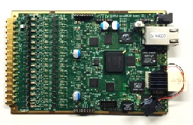
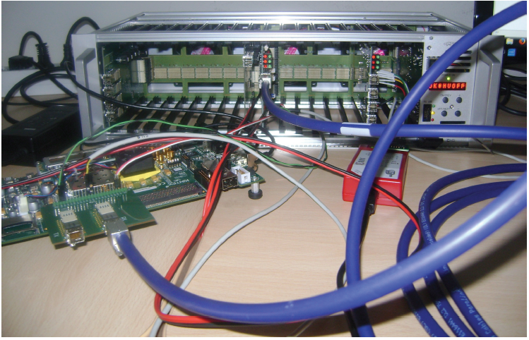
The MEG-II solution
From 16 to >10.000 channels
Use of 5 Gs/s waveform digitizer
SiPMs power supply and configurable amplification circuit on board
Clock distribution board for sincronization of several crates
Data read out with 1Gb serial links and Gb ethernet to storage
up to 1 KHz of DAQ rate
Event selection on FPGA
Francesconi et al., A new generation of integrated trigger and read out system for the MEG II experiment
Galli et al. A new genera)on of integrated trigger and read out system for the MEG II experiment, MOCAST, Thessaloniki 13-05-2016
FOOT DAQ meeting Matteo Morrocchi Bologna 12 / 07 / 2016

