Slide 1
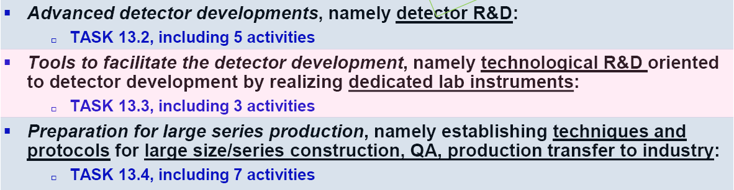
WP13 Scientific Aspects
2 Technologies: the future of GAS Detectors
  RPC
  MPGD
Sub-tasks grouped in 3 major sectors

Slide 2
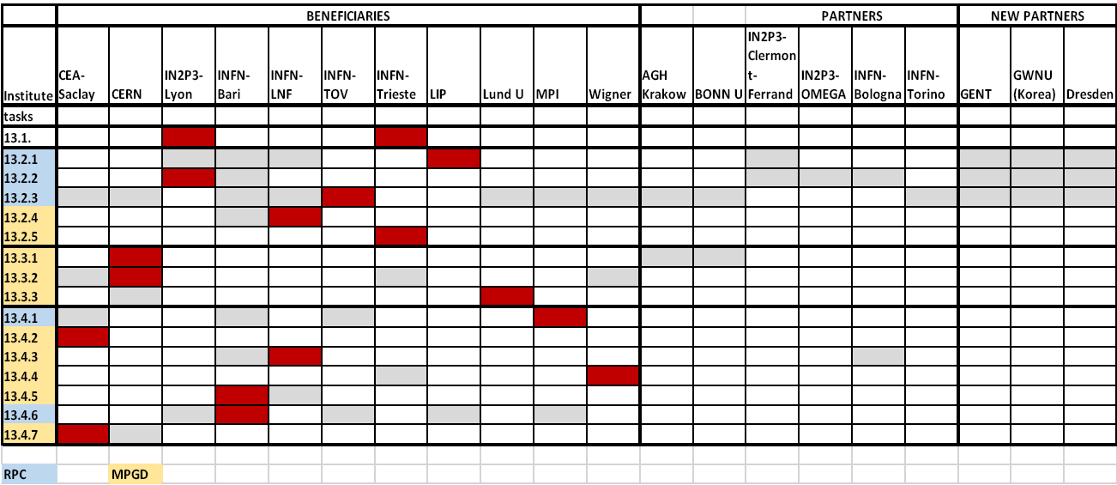
Institutions & Activities

Slide 3
WP13
Innovative gas detectors
Sub-Task 13.4.5
“Design of an automatic system to ensure the electrical integrity of electrode patterns by pulse reflection method”
Task 13.4.6
“Preparation for large series production for construction of MPGDs implemented for future physics experiments”

Slide 4
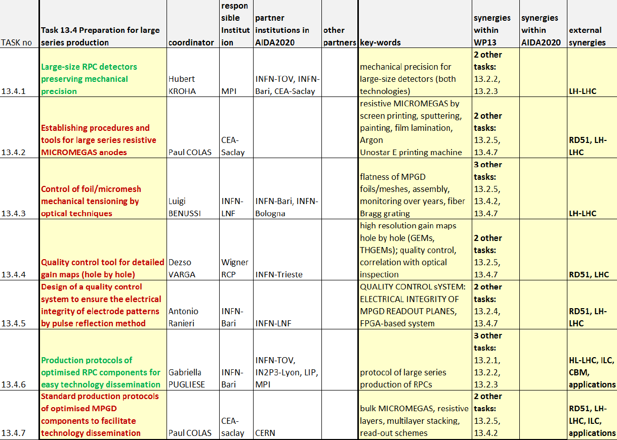
Tasks responsibilities

Slide 5
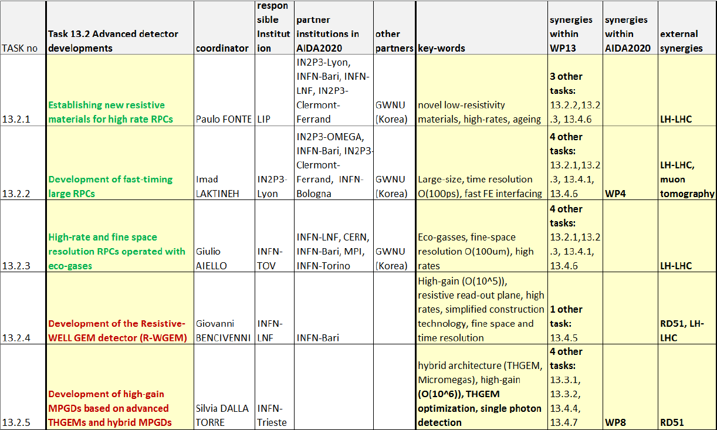
Tasks commitments

Slide 6
Task 13.4.5
Design of an automatic system to ensure the electrical integrity of electrode patterns by pulse reflection method
Attività suddivisa in due sub-tasks:
Partecipazione al disegno e alla progettazione di:
  Prototipo camera a GEM con tecnologia u-Rwell e relativo foglio di readout (sinergia con GE2/1 per CMS R&D Phase 2)
  Studio di tecniche di deposito DLC su kapton e disegno foglio di readout relativo
Final Goal:
  Realizzazione di un Test Bench per il test di integrità elettrica su grande scala
  Test finale su foglio di readout anodico per GEM detector BESIII e CMS_Phase2

Slide 7
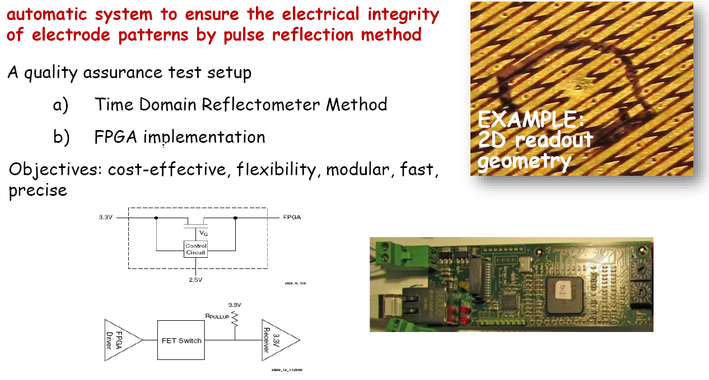
Task 13.4.5
QA: electrical integrity of electrode patterns

Slide 8
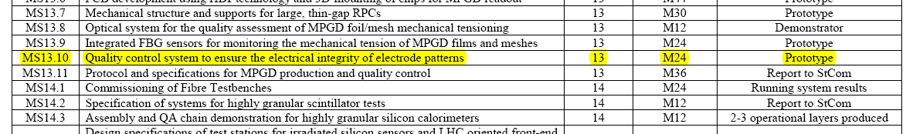
Milestones & Deliverables
MS13.10 - Quality control system to ensure the electrical integrity of readout electrode for MPGDs (prototype of a Time Domain Reflectometer: M24) (verification on floor-D48)
Asap anodic foils will be delivered a few tests will be performed and results will be reported as soon as hardware will be ready
Simulation of TDR test bench to be done (2’nd half 2016)
  we will try to insert more than one TDC inside the FPGA (firmware) to overcome the temperature instability

Slide 9
Task 13.4.6
Technological activity
Production protocols of optimized RPC components for easy technology dissemination:
  Standardized production of each components
    Electrode: the Bakelite and glass (or others) production should be standardized keeping high level of quality and with technical specification satisfying the specifications (see value resistivity).
  Detector construction simplification:
    New coating → Bari – Roma
    Spacers gluing → Bari – Roma
    Improved Gas distribution → LYON
    Microstrip → LIP
  Develop of engineering design and protocols suitable for standards large-scale production → LYON - Munich

Slide 10
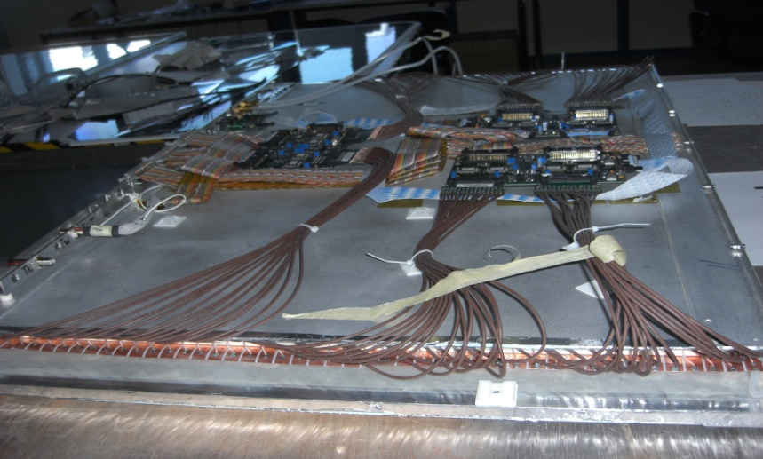
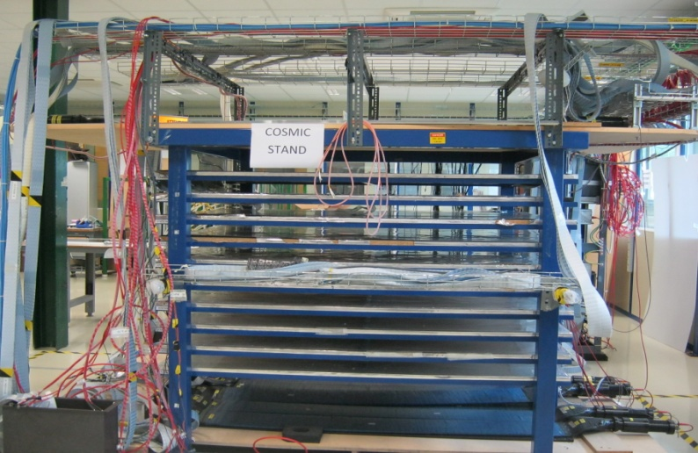
Preparation for large RPC series production
Construction of large size RPC using different kind of electrodes : HPL, Glass
Large Bakelite RPC chamber with thinner electrodes and gas gap than those currently used in CMS
Large Glass RPC built from small pieces of low resistivity glass
Definition and developing of common tools for QC & QA procedures are under preparation at CERN. This is crucial to guarantee uniformity on each detectors components

Slide 11
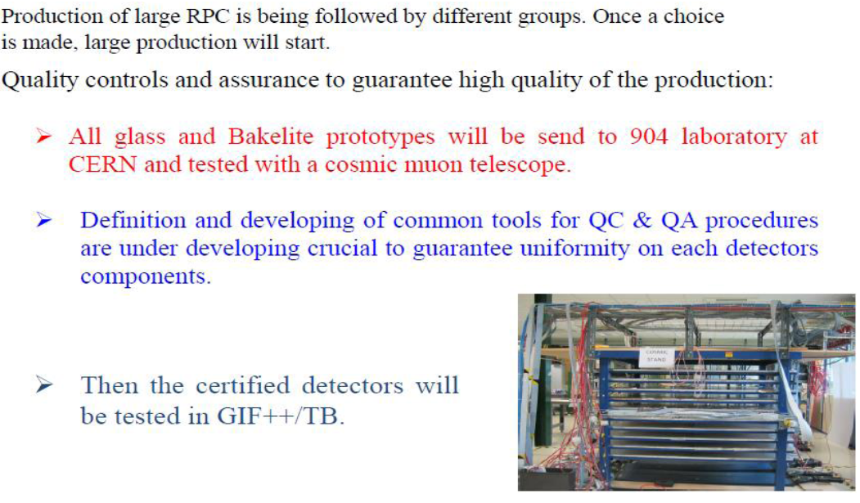
Task 13.4.6
Large scale production and QC
DELIVERABLES:

Slide 12
Personale partecipante
  A. Colaleo 5%
  A. Ranieri 5% → 10% (solo se serve)
  Assegno di ricerca cofinanziato (concorso in attesa di ratifica da parte della G.E. INFN)
  LNF rendiconta l’attività RPC
  Assegno di ricerca bandito (Bando nr. 18195)

