Slide 1
stato di TOTEM & richieste 2017
F. Cafagna, E. Radicioni

Slide 2
outline
Running scenarios
Strategy for special effort on CT-PPS
Exceptional integration effort
  RP status and insertion tests
  DAQ and Trigger integration w/CMS
  Totem Si-strips readout and reconstruction in CMS DAQ and Offline
  New diamond detectors
  Clock distribution system
  DQM and Offline integration in CMSSW

Slide 3
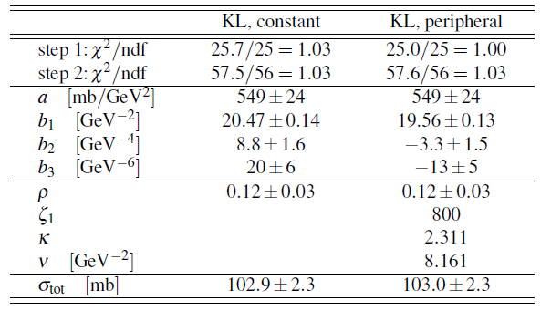
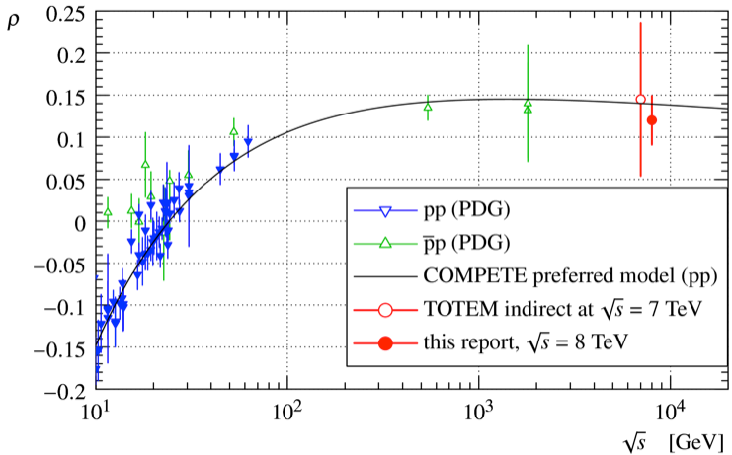
Coulomb Nuclear interference: ρ
First LHC determination from Coulomb-hadronic interference at √s=8TeV: ρ = 0.12±0.03.
Cross-section measurements compatible with lumi-independent one.

Slide 4
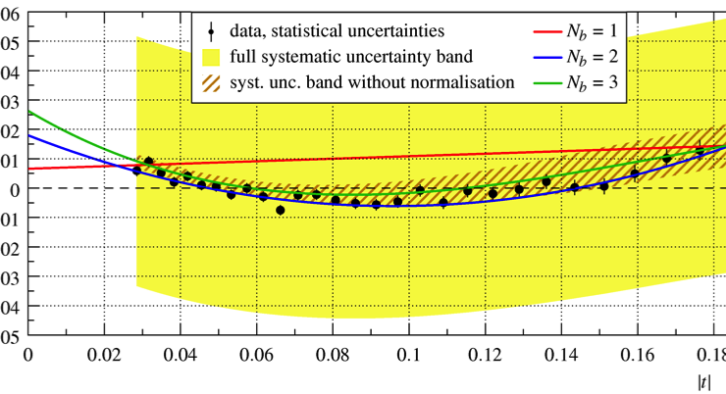
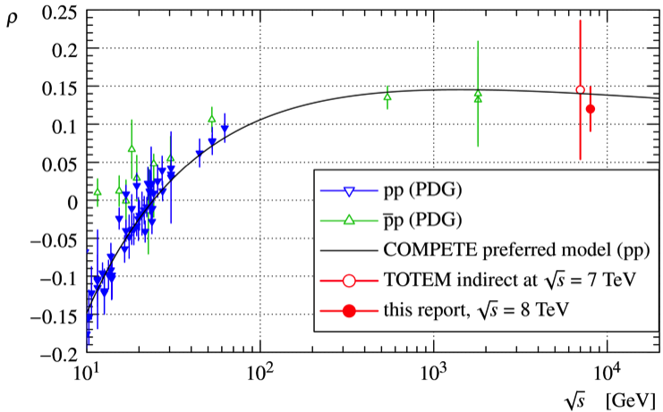
running scenario: high beta
β* = 2500m
Measure elastic scattering in Nuclear-Coulomb interference region at 13TeV
Check at higher energy what measured at 8 TeV:
  Non exponential behavior at low |t|
  ρ values at higher energy.

Slide 5

running scenario: CT-PPS
Anticipate running operations in 2016
  γγ candidate at 750 GeV could be produced exclusively and seen in CT-PPS
    Fichet, von Gersdorff, Royon (arXiv:1601.01712, arXiv:1512.05751)
    Csaki, Hubisz, Terning (arXiv:1512.05776, arXiv:1601.00638)
    Harland-Lang, Khoze, Ryskin (arXiv:1601.07187)
CT-PPS physics can start one year earlier than foreseen.
  Exclusive DiJet physics
  Anomalous quartic couplings measurement.

Slide 6
CT-PPS strategy 2016
2 Tracking horizontal Roman Pots (210 near and far) qualified for Low β and High intensity operation.
Use current Totem Si Strip detectors in 2016 before the new 3D pixel are ready (2017). Estimation of correct working over 10 fb⁻¹ per telescope.
2 Telescope groups are available to get up to 20 fb⁻¹ of integrated luminosity before loosing tracking efficiency
1 Timing cylindrical horizontal Roman Pot qualified for Low β and High intensity operation.
Since no β*=90m medium luminosity run is foreseen in 2016, we decided to install 2 diamonds detector packages, developed for the vertical Roman Pots, in the cylindrical one during TS1.
In addition to TOF, they give some proton tagging with enough ξ resolution when Si strip loose efficiency

Slide 7
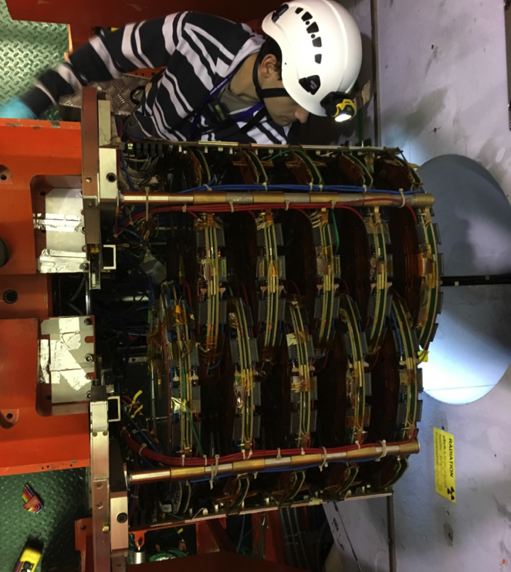
T1, T2 status
T2
  Control loop fixed on the faulty quarter
  Water leak fixed
  The detector is fully recovered.
T1
  The detector has been removed from
  CMS and safely stored on surface.
  Not needed for the 2016 running
  Scenario: save it from radiation damage

Slide 8
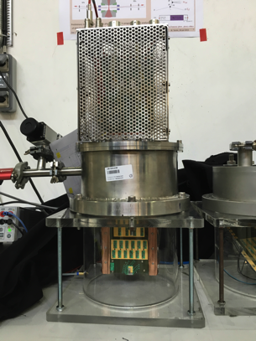
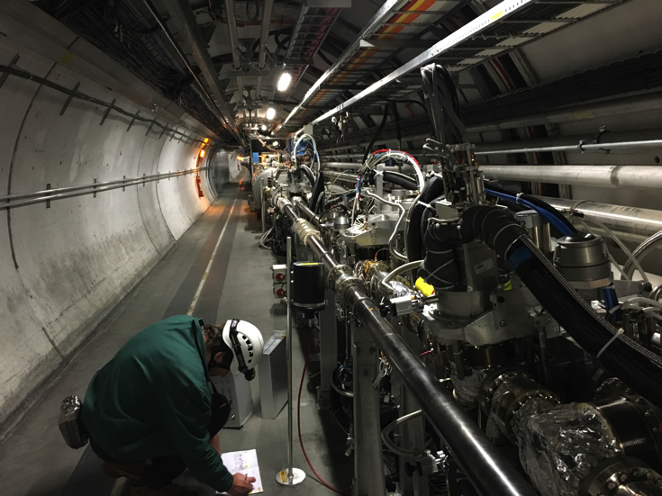
RP status
Removed 220 Near Vertical detectors to prepare the installation of diamonds later in TS2
Electrical trigger of the Vertical Pots connected to the new 210 Far (tilted) pots
Electrical trigger of the 220 Horizontal moved to 210 Horizontal for low β running.
The two 210 Horizontal are qualified for low β beams insertion together
Cylindrical RP for timing ready to receive diamond detectors in TS1

Slide 9
RP Insertions 2016
Programme for insertions in intensity ramp-up
Agreed settings:
15 σ + 0.5 mm until TS1, then removal of 0.5 mm margin if demonstrated to be possible
Insertion in which fills?
2nd fill of each intensity step, then – if successful – subsequent insertions possible
Insertion at what time in the fill?
2 hours after declaration of Stable Beams
→ after progressive ramp-up, insertions now allowed during all runs
Tests of removal of the 0.5 mm margin:
- in addition to orbit stability observations
- End-of-fill tests before TS1:
√
√
√
√
√
3 – 12 – 49 – 313 – 601 – 889 – 1177 – 1753 – 2300 – 2800

Slide 10
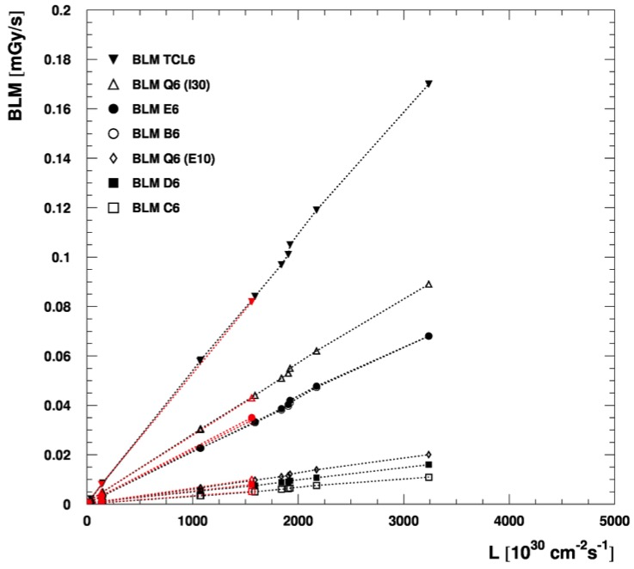
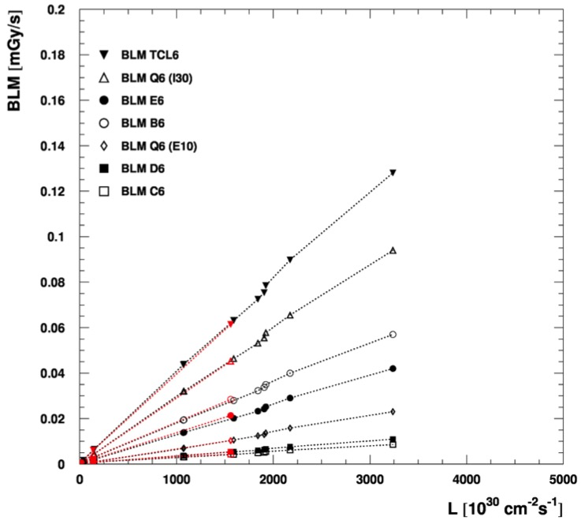
BLM Response 2016 with and without Margin
(15 σ + 0.5 mm and 15 σ)
Sector 5-6
Sector 4-5
15 σ
15 σ + 0.5 mm
15 σ
15 σ + 0.5 mm
So far: very little effect from removing the 0.5 mm margin !
Notes:
10

Slide 11
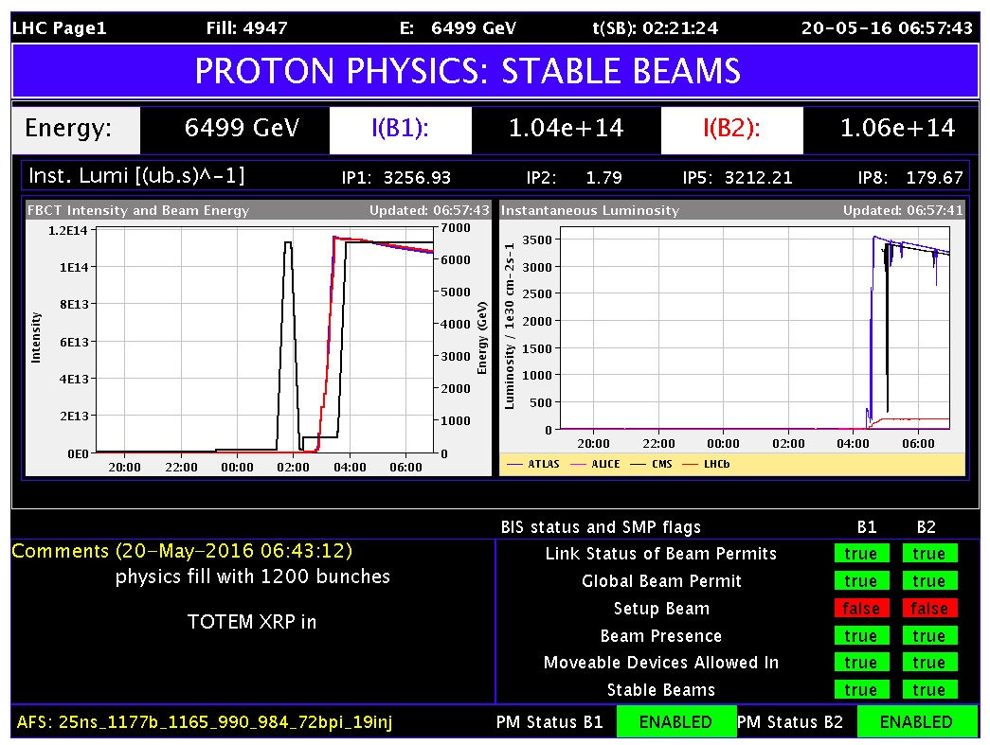

Slide 12
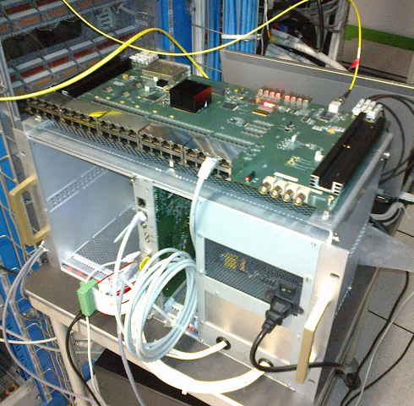
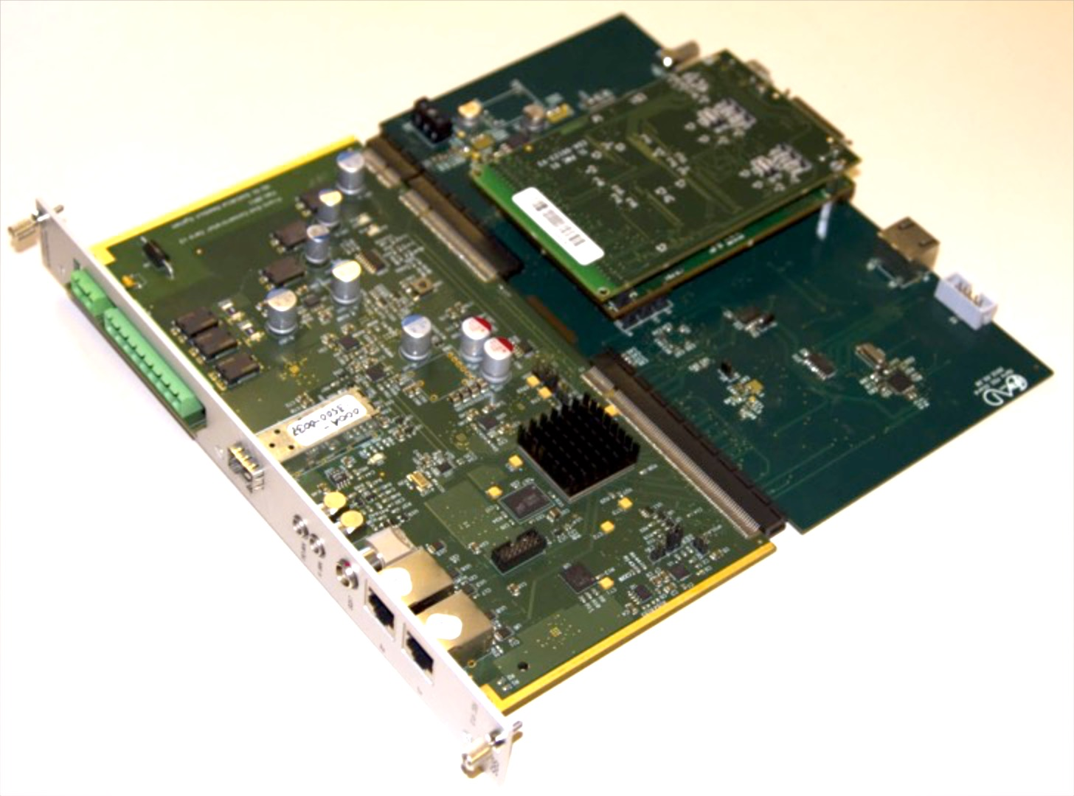
TOTEM readout back-end
SRS-FEC: interface to stand-alone DAQ
Data concentrator board with interface to TCDS system
(timing trigger and fast-command)
OptoRX & S-LINK 64 to CMS DAQ
Designed and implemented to be CMS compliant at both HW and FW level
Trigger Throttling System interface to CMS

Slide 13
DAQ and TCDS integration
The TOTEM DAQ has been designed to be compliant with the CMS one. The integration of the two systems required:
Hardware
  All OptoRx cards upgraded with larger FPGA flash
  5 OptoRx installed and connected to Front-end Readout Links (FRL) and Fast Merging Module (FMM)
  2 TCDS (2 iCI + 2 PI) partitions installed with fibers pulled from S1 <-> S2
Software
  Level 1 Function Manager implemented
  Configurator of readout back-end (OptoRx)
  Configurator of TDCS system
  MiniDAQ/Global run configuration
Firmware
  SLink interface (OptoRX -> FRL)
  Compatibility to CMS Trigger Throttling System (TTS)
  Compatibility to TCDS ReSync fast command when Out-Of-Synch

Slide 14


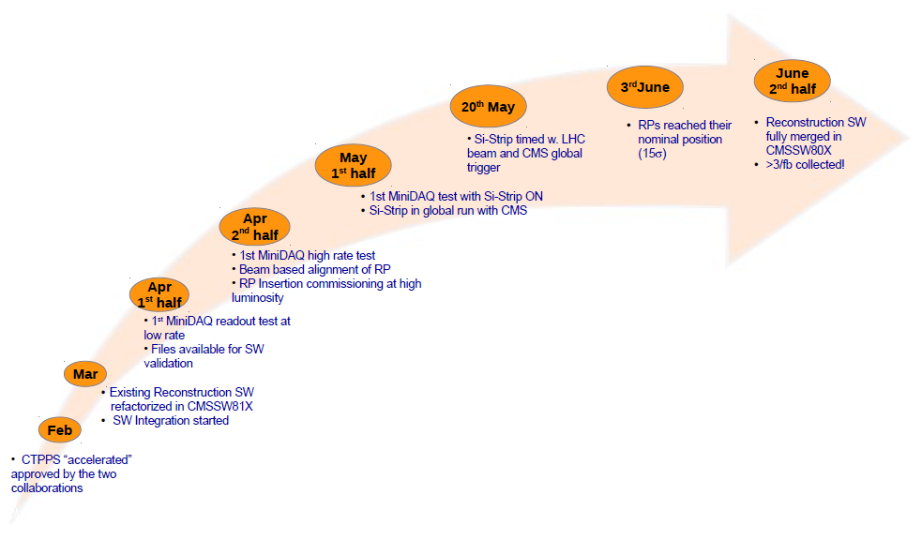
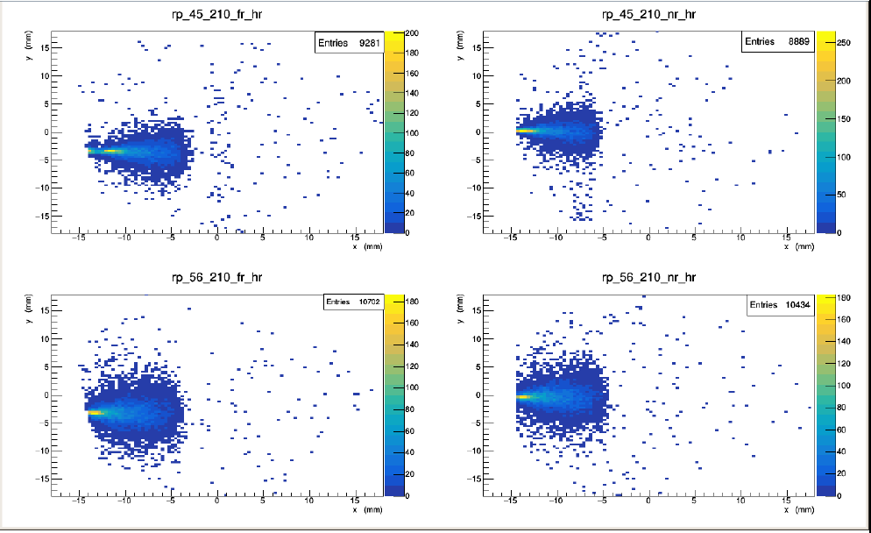
The Si-Strip integration

Slide 15
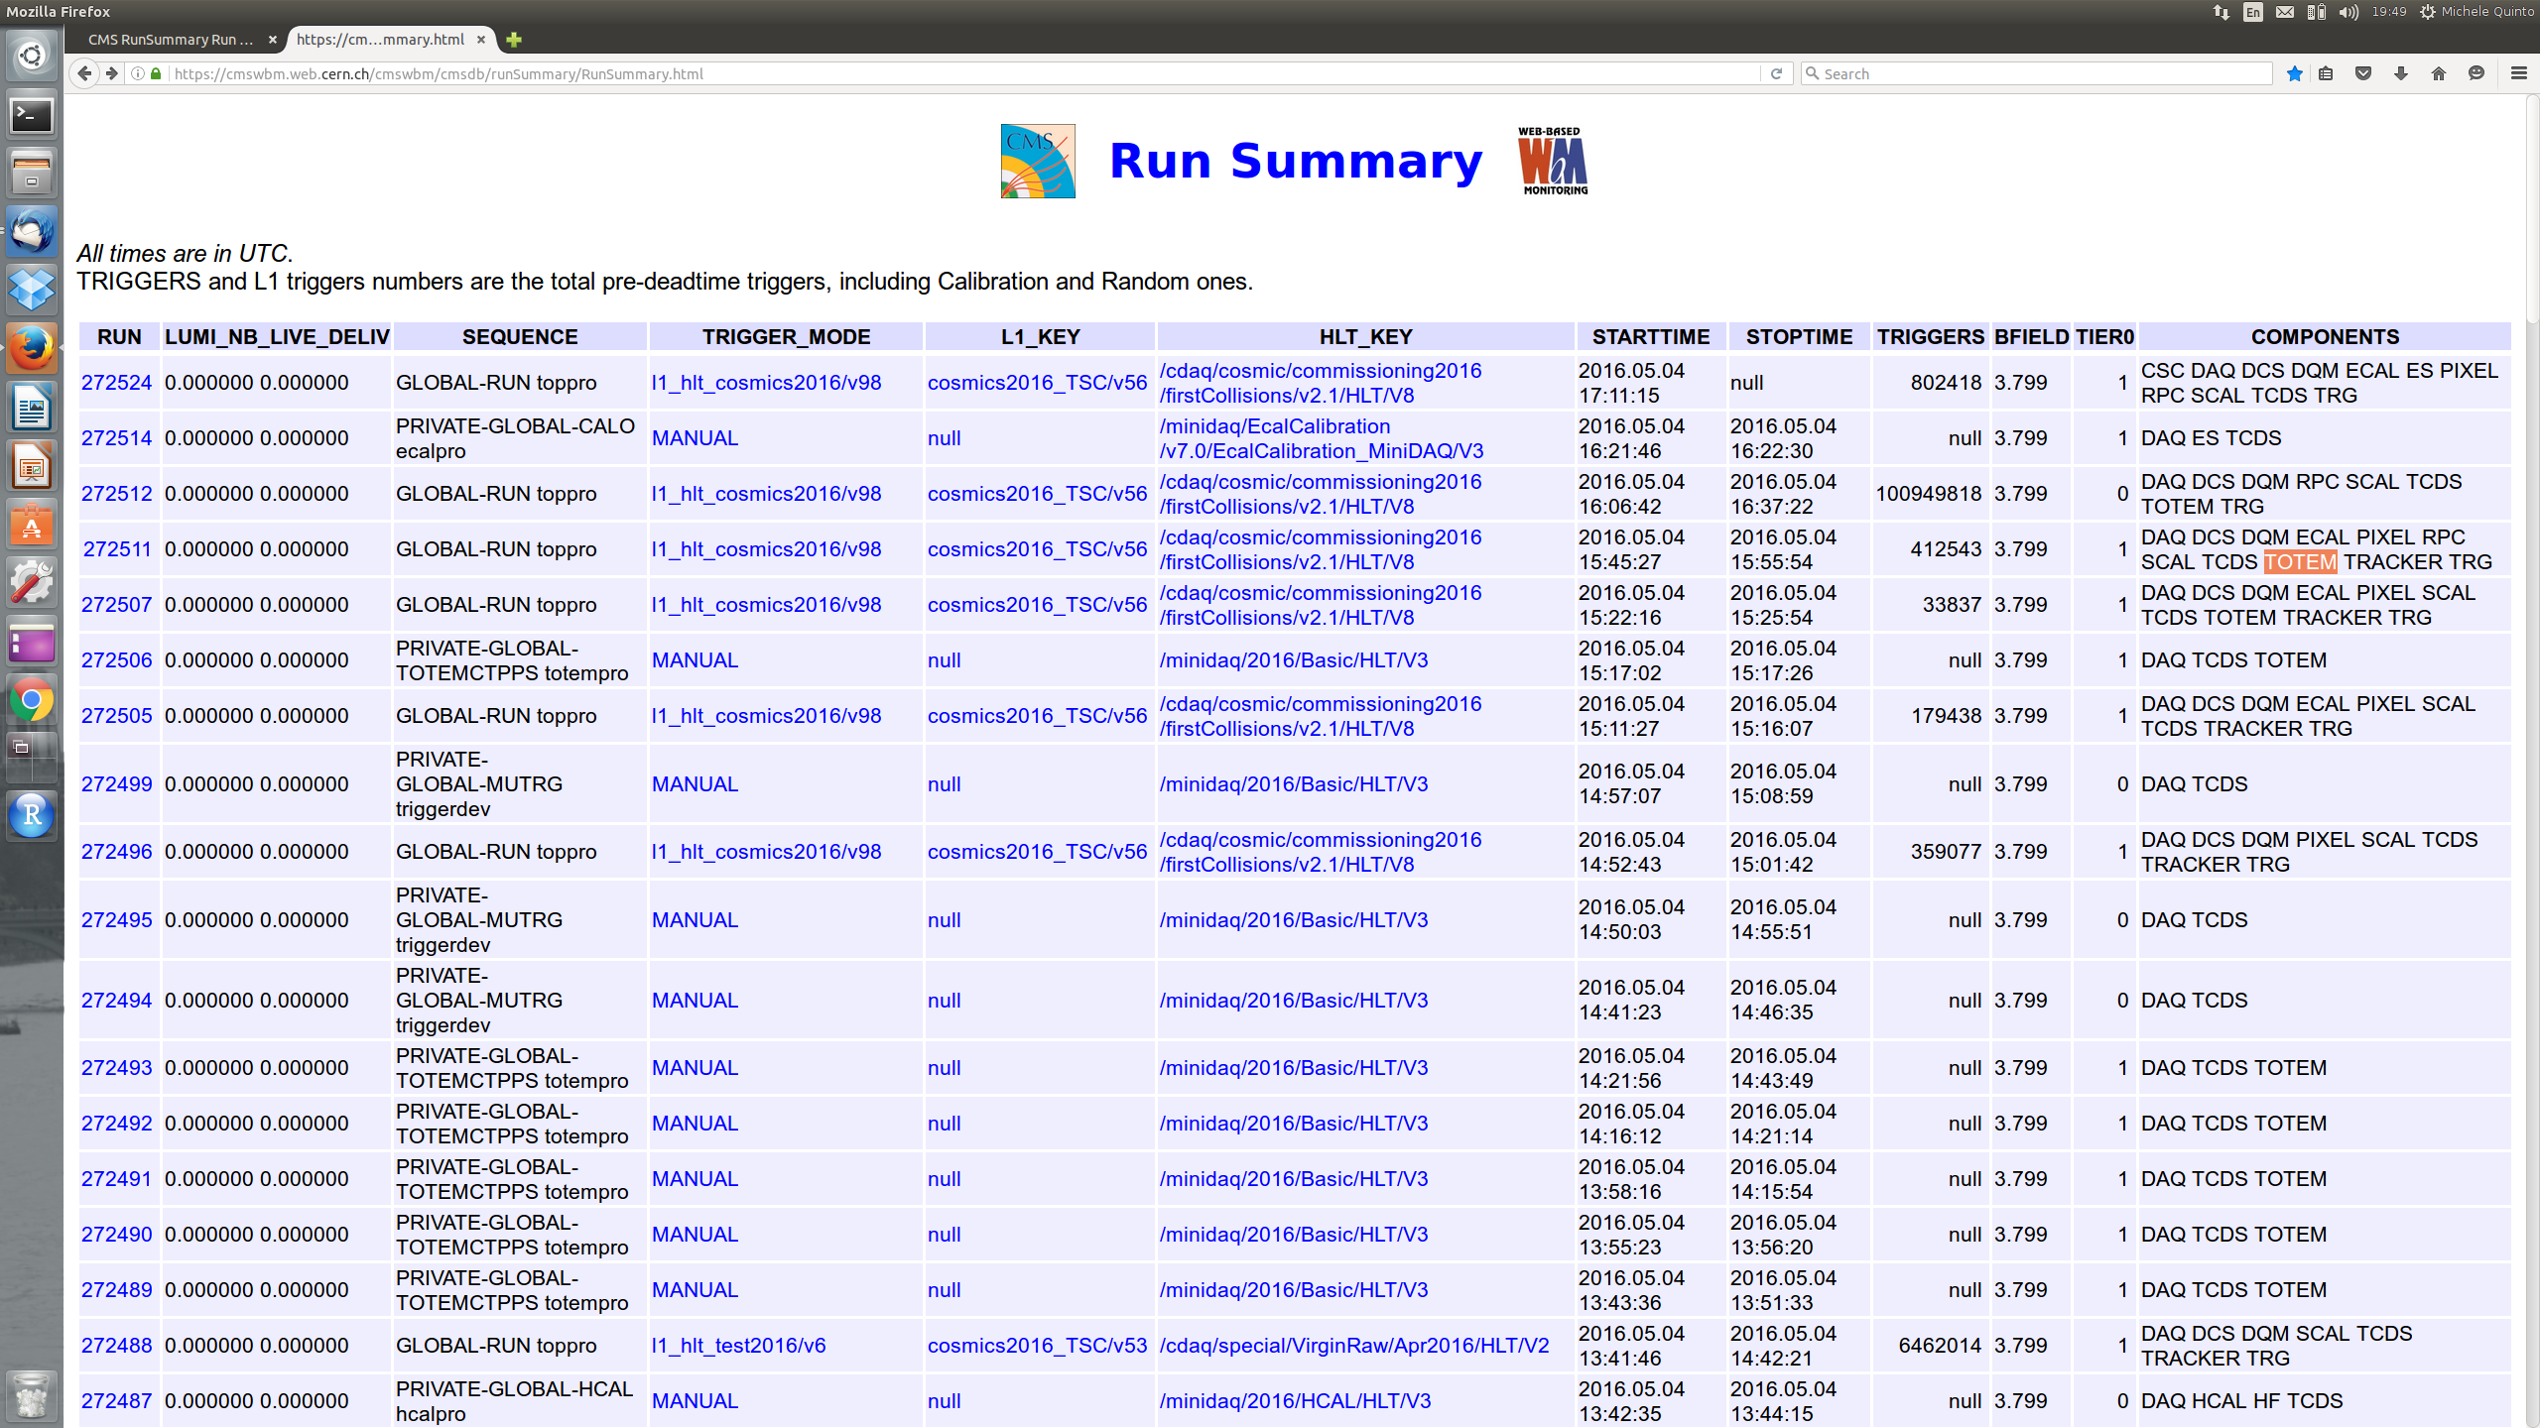
First global run of SiStrips in CMS DAQ
Diamond detectors will follow the same path front-end → TOTEM Opto-RX → CMS FRL

Slide 16
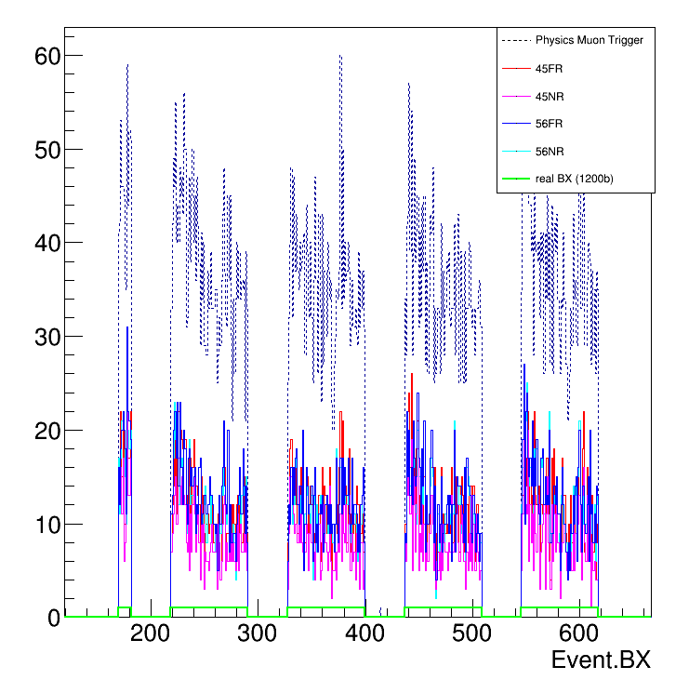
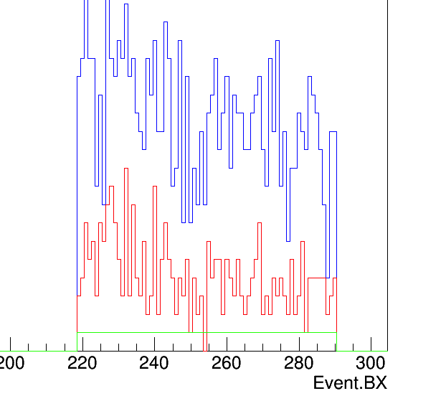
Global run of SiStrips, latency adjusted
Long run with 1200 bx is already good for physics

Slide 17


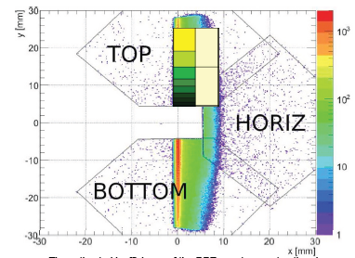
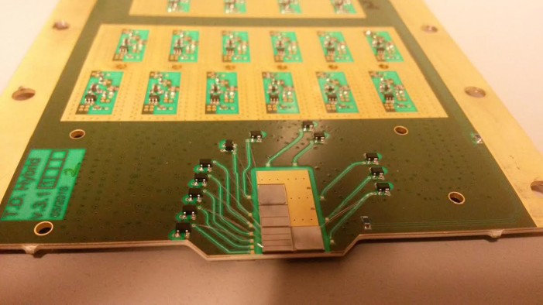
The TOTEM timing TDR
Timing detectors in the relocated vertical RPs:
  Limited space available -> Solid
  State Detectors: Diamond
  Time resolution & performances: 50 ps per pot (~100ps per detector), reduce PU by a factor 4 (50% ->~ 12%).
  One test RP with 4 diamonds planes , with final front end and digitization (SAMPIC) electronics was installed in the LHC during the TS3 (2015).

Slide 18
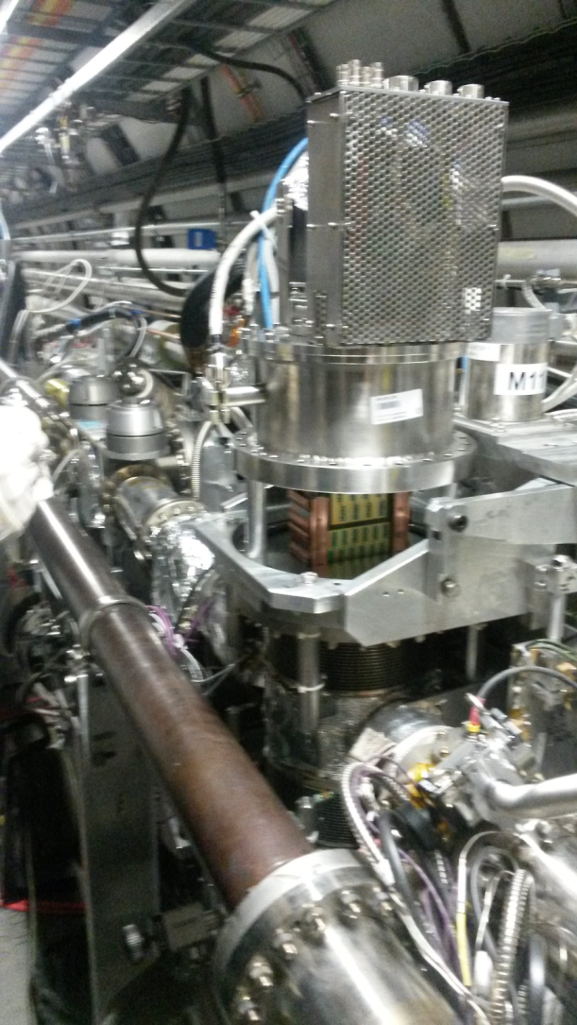
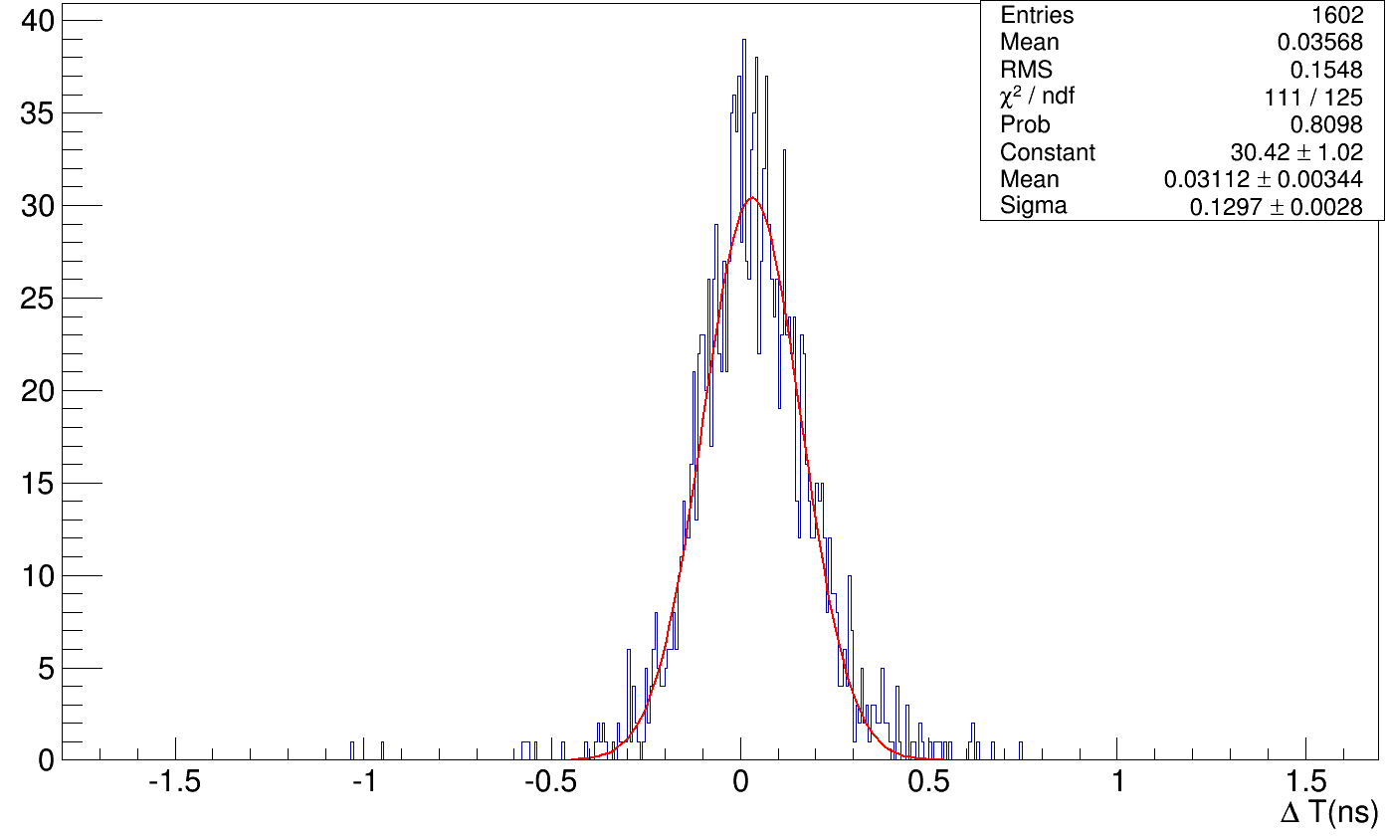
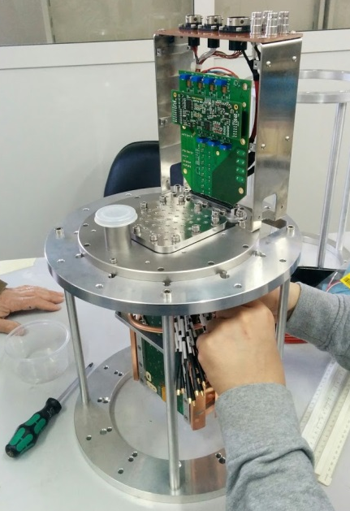
The TOTEM timing TDR
From CT-PPS TDR
LHC optics β*=0.6m (2014)
σ=91ps

Slide 19
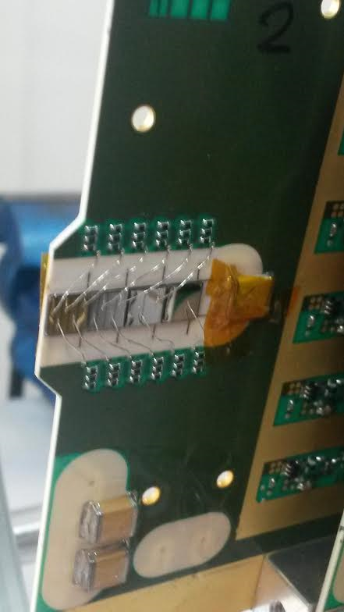
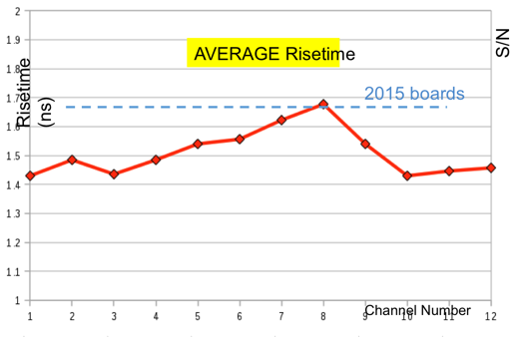
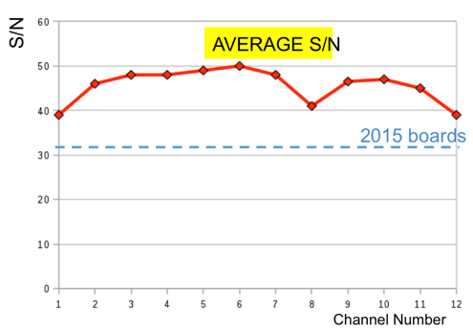
diamond detectors
One of the 8 detector planes
with diamond bonded (larger 150 μm
diameter Al wire) and coated
Specs equivalent or better than R&D samples
Compatible with resolution <= 100ps per plane
T/P stability verified OK for the first detector package (including overpressure test and T_{min} down to -25 C). Second package to follow
Detector package integration is OK, initial noise hiccups solved
Final test with front/end electronics next week
Installed during TS1

Slide 20
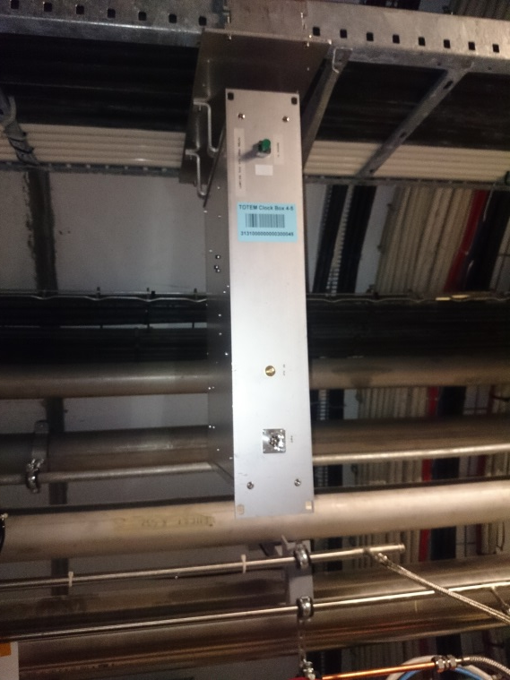
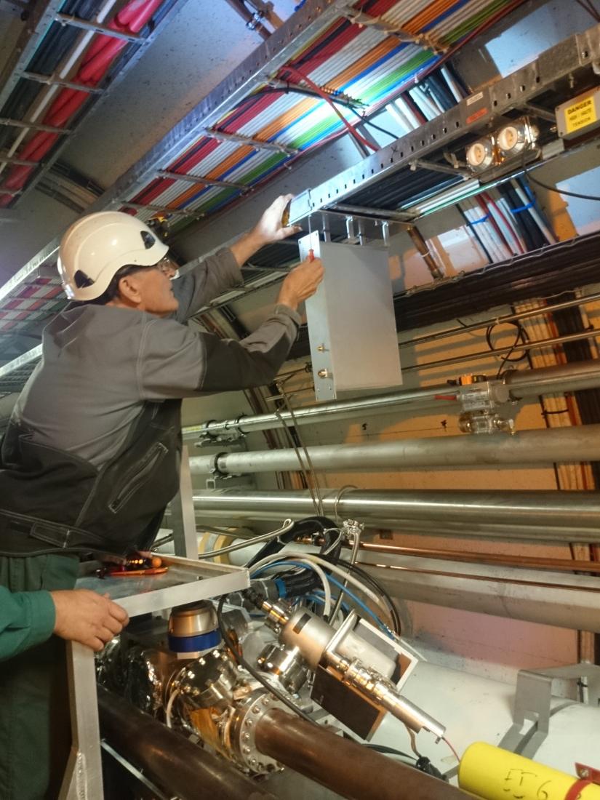
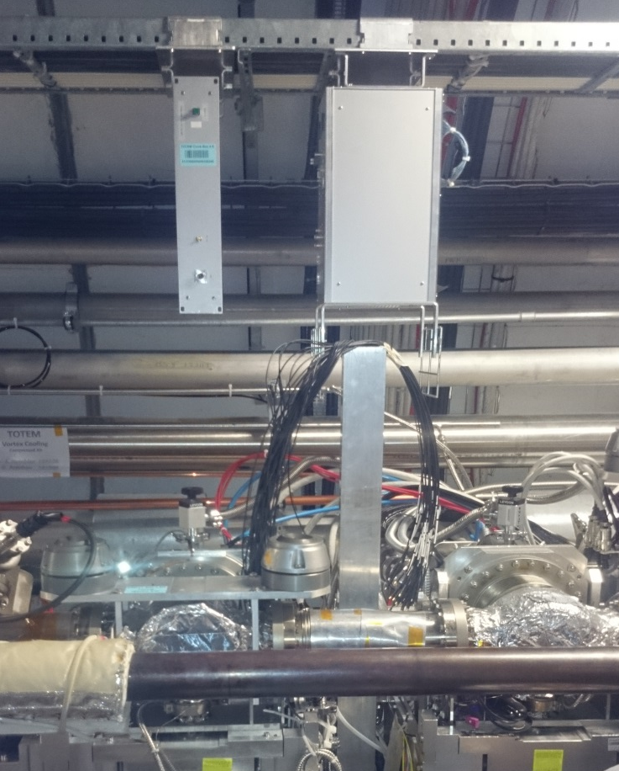
TOTEM Clock Distribution
Sector 4-5
Sector 5-6

Slide 21
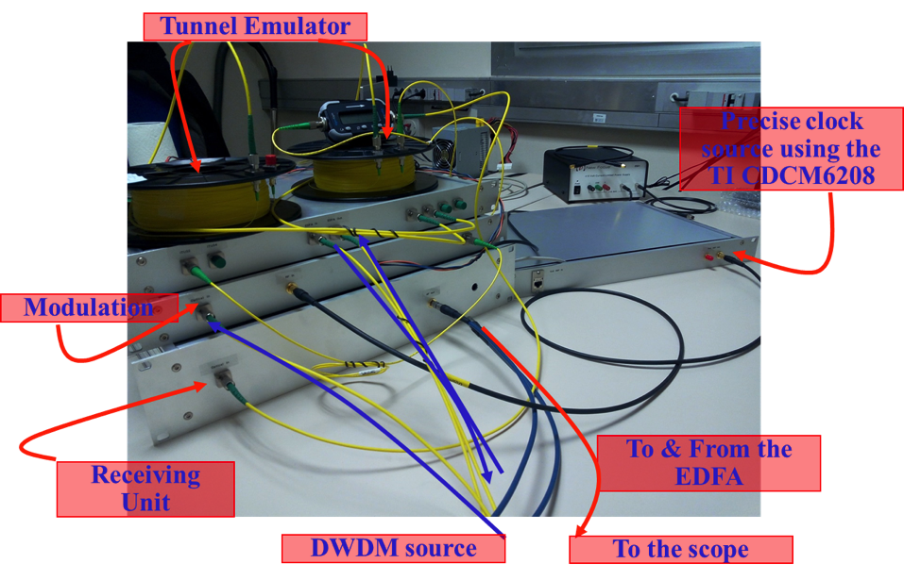
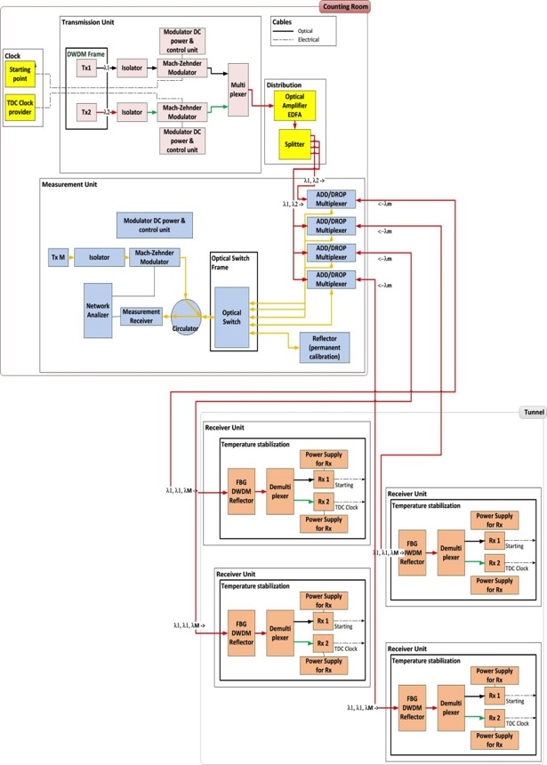
Clock distribution system ready for installation in TS1
Transmission & Measurement units
All components set up in the laboratory for characterization and stability checks. Working and ready to be installed
Installed receiving units in the tunnel during TS1.
Receiving units, to be installed in the tunnel

Slide 22
Offline and DQM
All code (unpacking, clustering, reco, …) migrated to CMSSW8X
Code refactory to comply to CMS SW standards
Integration/backporting in CMSSW81X
Already working SiStrip DQM
  Diamond detectors to follow
Integration of SiStrips
  reconstruction OK
  working on simulation
In parallel, working on simulation and Database for all detectors, including:
  Diamonds
  Quartic
  pixels

Slide 23
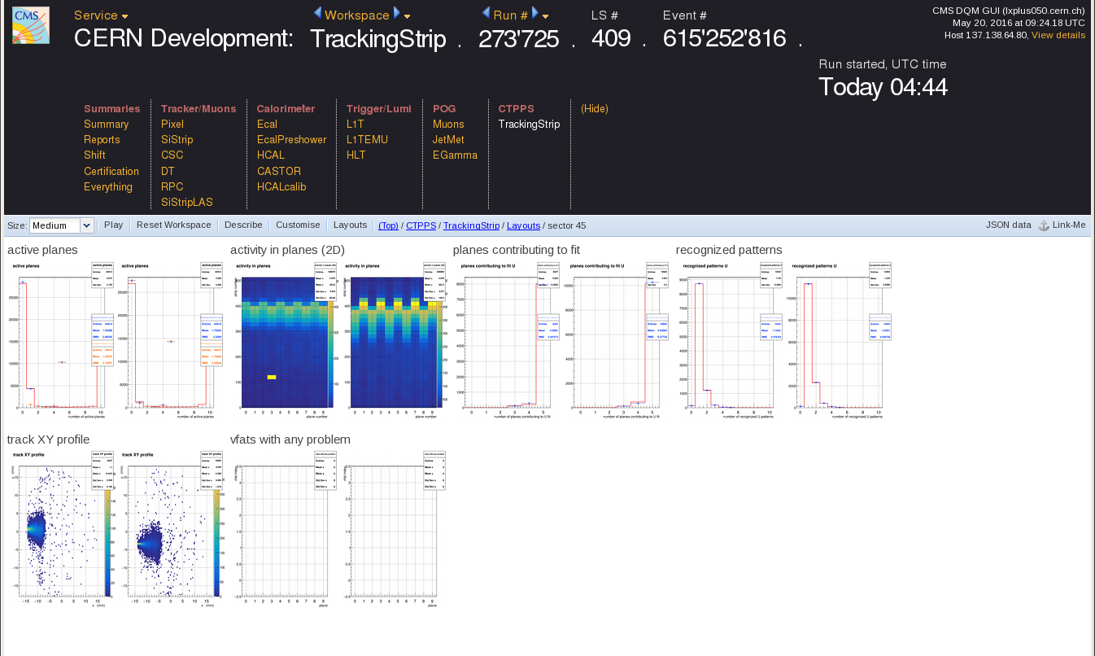
DQM in CMS system

Slide 24
responsabilità del gruppo
  Responsabilità DAQ/online (Francesco)
  chairman Editorial Board (Gabriella)
  Timing di precisione (Francesco)
  Resource coordinator & Management Board (Emilio)
  Coordinatore Nazionale

Slide 25
composizione del gruppo
Ricercatori
V. Berardi | 40
F. Cafagna | 50
M.G. Catanesi | 40
E. Radicioni | 60
Tecnologi
A. d'Orazio | 40
F. De Leonardi | 50
V. Passaro | 50
Totale FTE: 3.3
commenti
la fase di studio e progetto del sistema di clock è terminata, una parte del gruppo di ingegneria rimane per seguire operations e maintenance
il gruppo perde due postdoc (Michele e Nicola) – sebbene rimangano nell’esperimento.

Slide 26
richieste 2016
richieste di servizi invariate rispetto allo scorso anno (includono RD51):
  1 mu camera pulita
  1 mu elettronica
  1 mu officina meccanica
  1 mu progettazione meccanica
Le richieste saranno minori di quelle del 2016
  ~20k, circa la metà dell’anno scorso
  la fase principale di costruzione del sistema di TOF è finita.
M&O 2017 secondo RRB 2016, saranno definiti come al solito a ottobre 2016.

Slide 27
conclusions
Inter-operation of TOTEM systems with CMS has been demonstrated
Silicon Strips detectors are now routinely included in the CMS global runs
Tight schedule on several fronts for “accelerated” CT-PPS
  up to now all deadlines have been met
  next: TS1 installations
The achievements of the last few months would not have been possible without help from
  CMS DAQ group and Offline Coordinators
  for the operations in IP5, the CMS Run Coordinators

