Slide 1
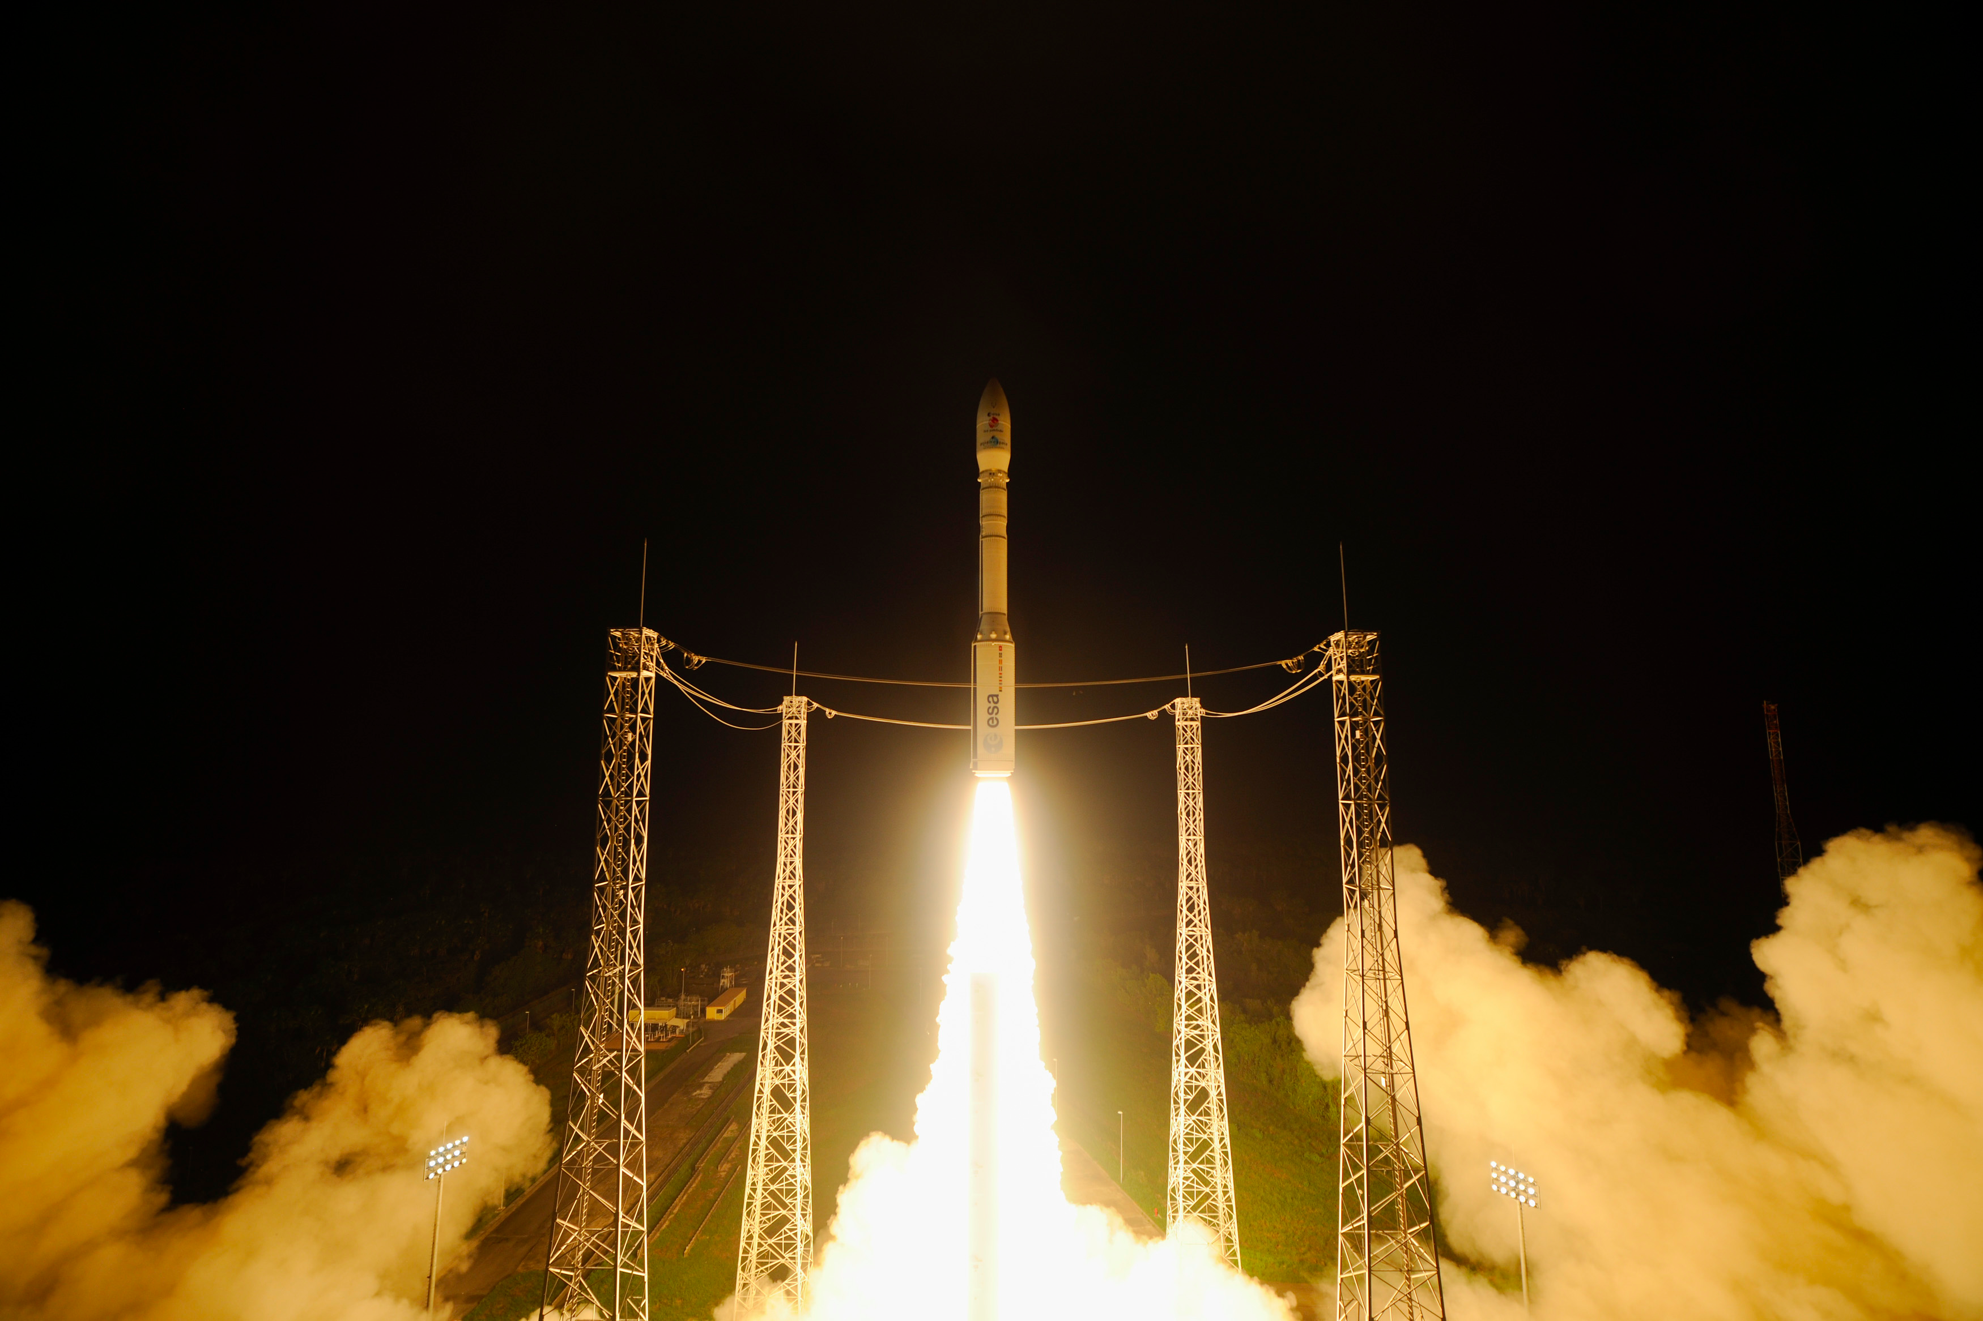
LISA Pathfinder launch & results
December 3rd 2015 5.04 GMT+1
Catia Grimani
University of Urbino “Carlo Bo” – INFN Florence

Slide 2
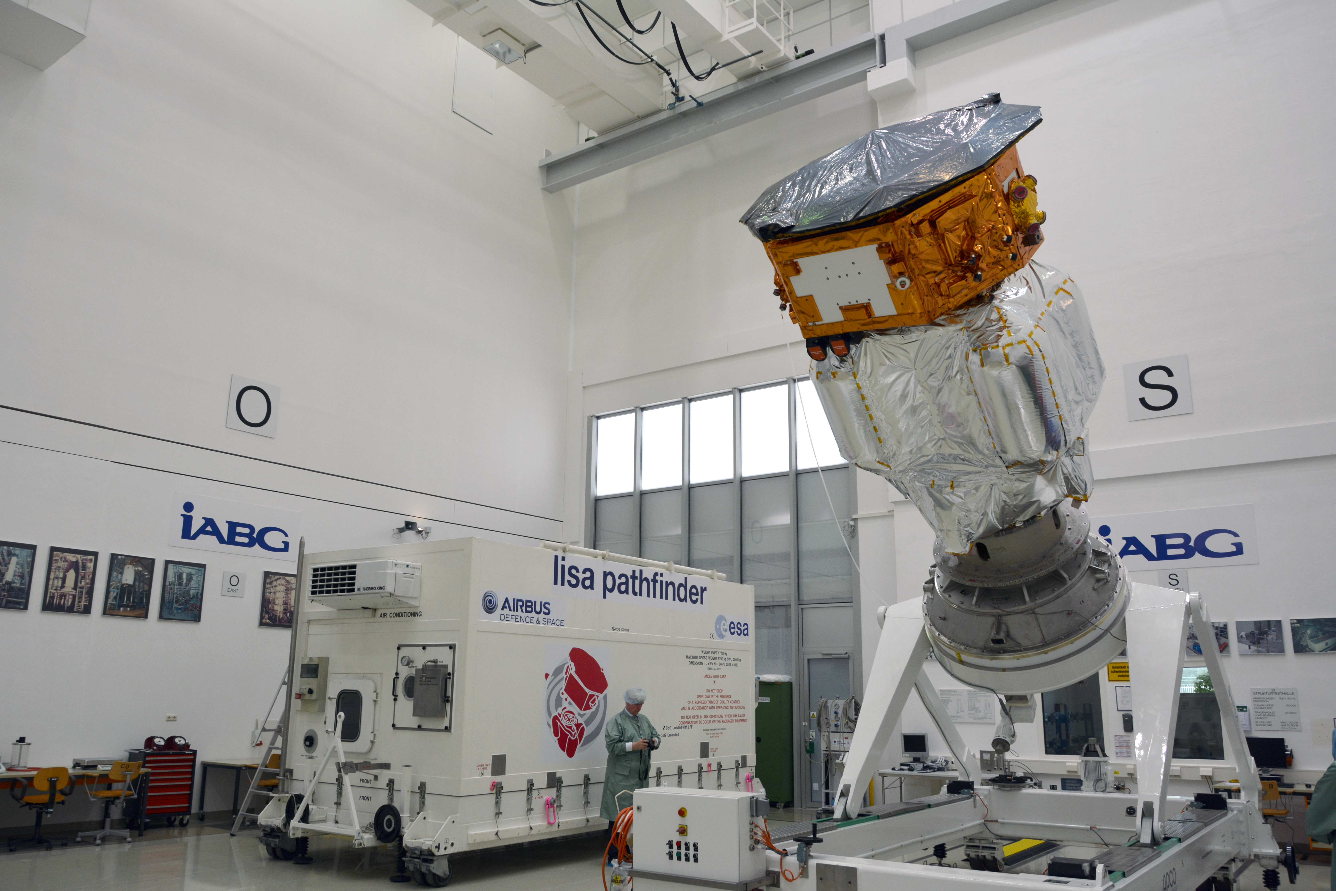
LISA Pathfinder spacecraft
ESA mission for technology testing of LISA the first interferometer for gravitational waves in space
The aim of this experiment is to study residual acceleration noise between two truly free falling test masses in space (masses released in February)

Slide 3
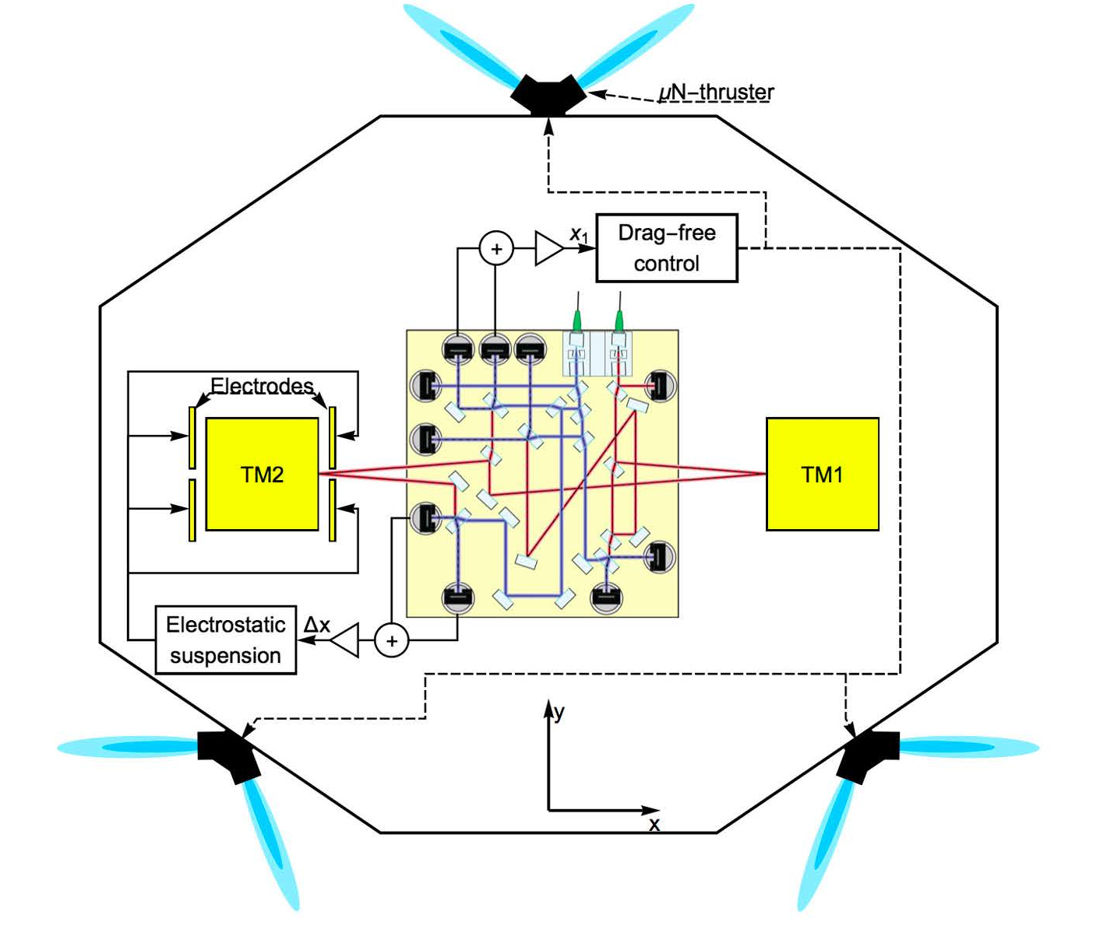
LISA Pathfinder apparatus scheme

Slide 4
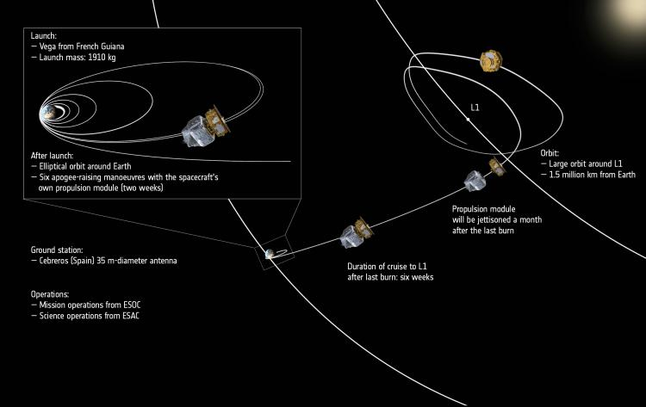
LISA-PF Orbit
Science operation mode: March 1st

Slide 5
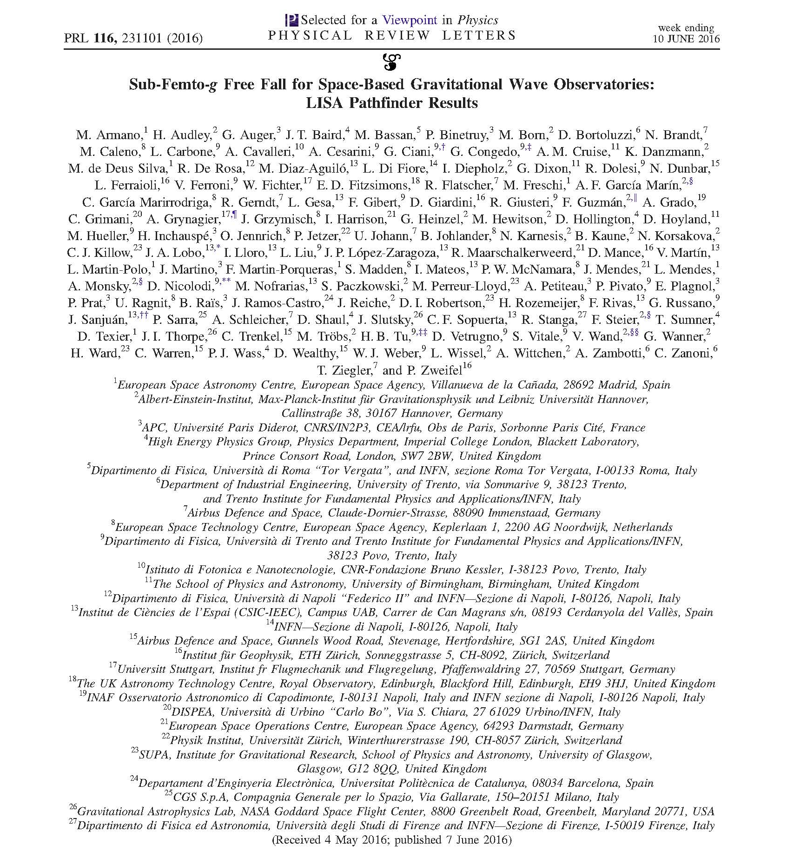

Slide 6
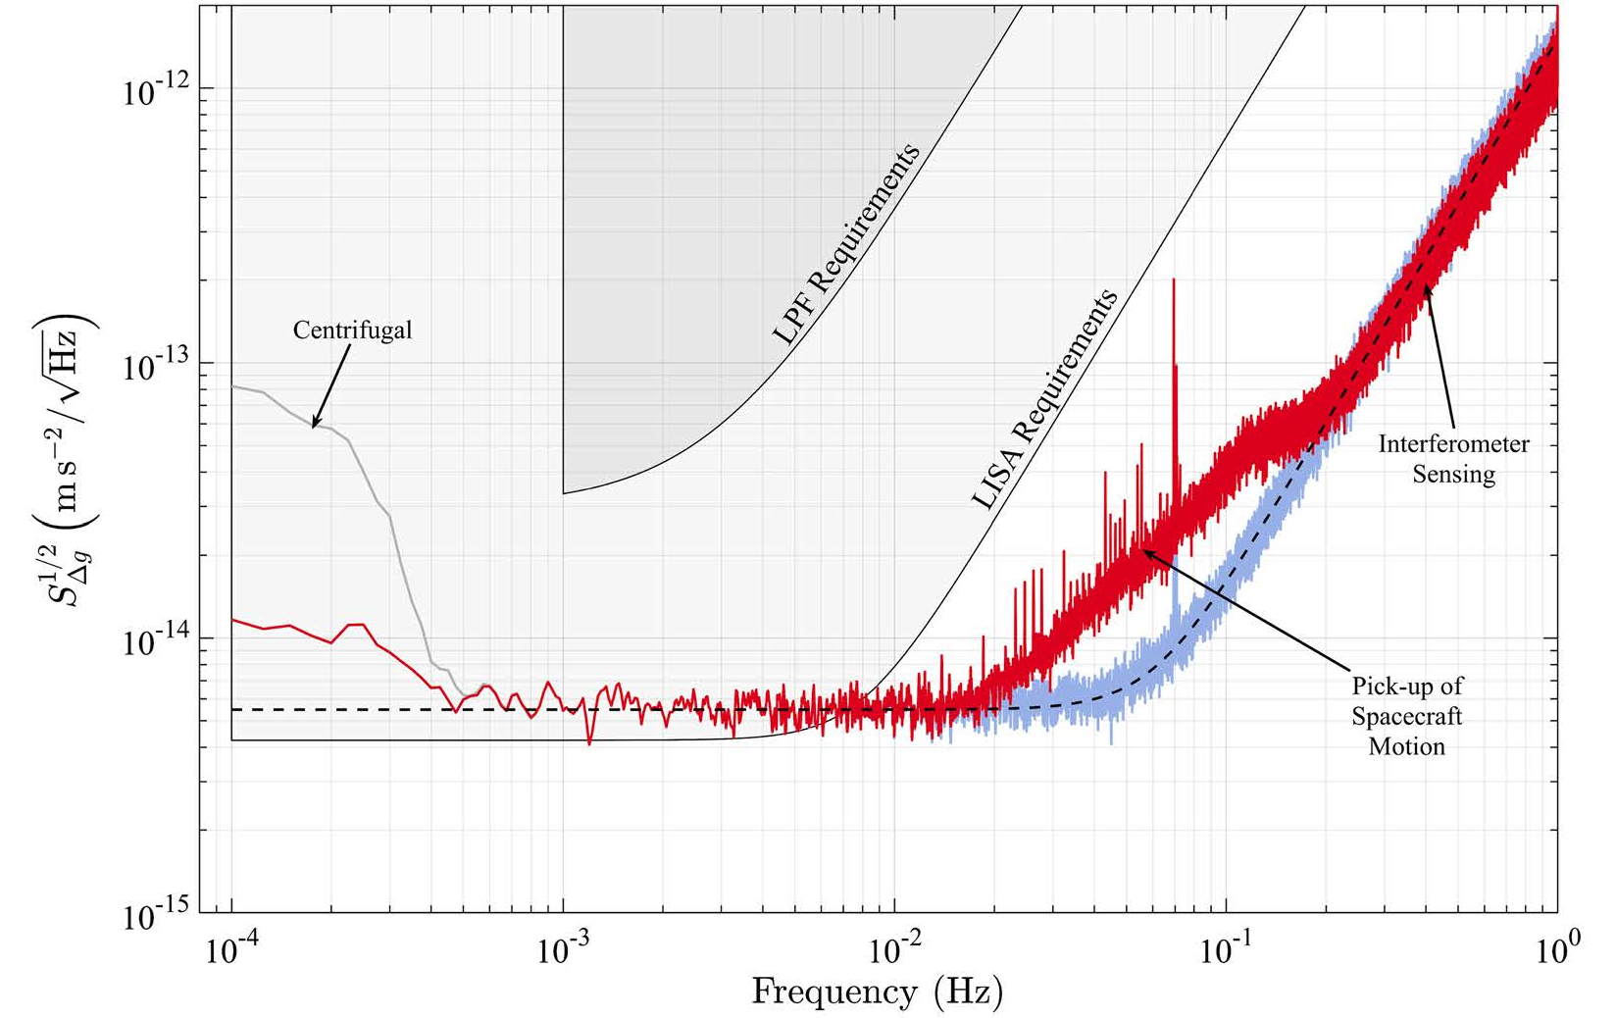
LISA-PF ASD
<0.1- 0.5 mHz 12 fm s⁻² Hz^{-1/2}
0.7-20 mHz 5.2+/-0.01 fm s⁻² Hz^{-1/2}
> 60 mHz (34.8+/-0.3) fm Hz^{-1/2}

Slide 7
LISA performance whith the LISA-PF acceleration noise
Black hole merging with total mass 10⁶ solar masses at redshift z=3 with S/N ratio of 5000 (several % of LISA expected performance)
Heavy black hole merger with 10⁷ solar masses total mass at redshift z=3 with
S/N ratio of 1400 (2000 expected with LISA).
EMRIs and coalescing compact binaries will
present S/N ratio similar to LISA.

Slide 8
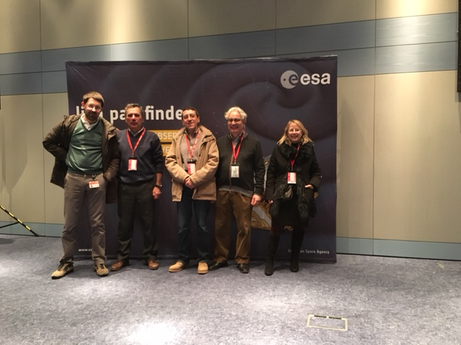
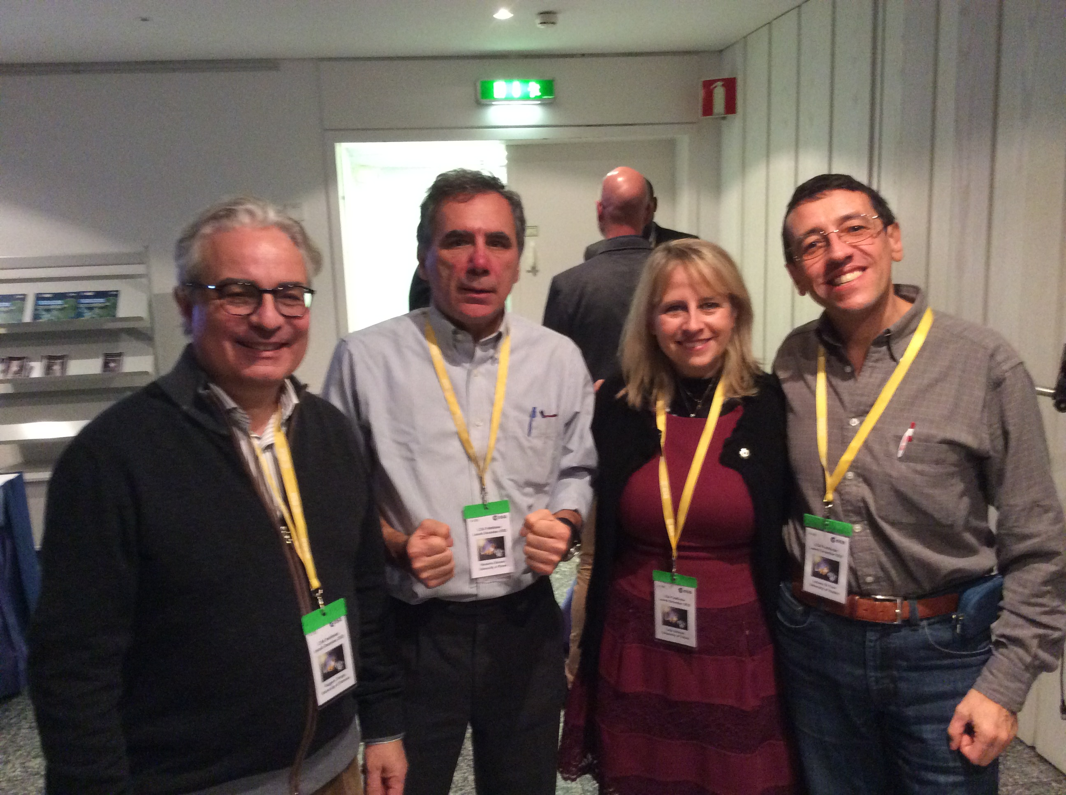
LISA-PF in Florence since 2003
Catia Grimani
Ruggero Stanga
Noemi Finetti
Daniele Telloni (INAF - solar wind)
Monica Laurenza (INAF - SEPs)
G. Bagni, M. Barone, L. Marconi &
M. Fabi (Urbino)
2 main activities
Two-degree-of-freedom pendulum
Florence - Rome - Naples
(II) Test-mass charging
Perugia for 4 years

Slide 9
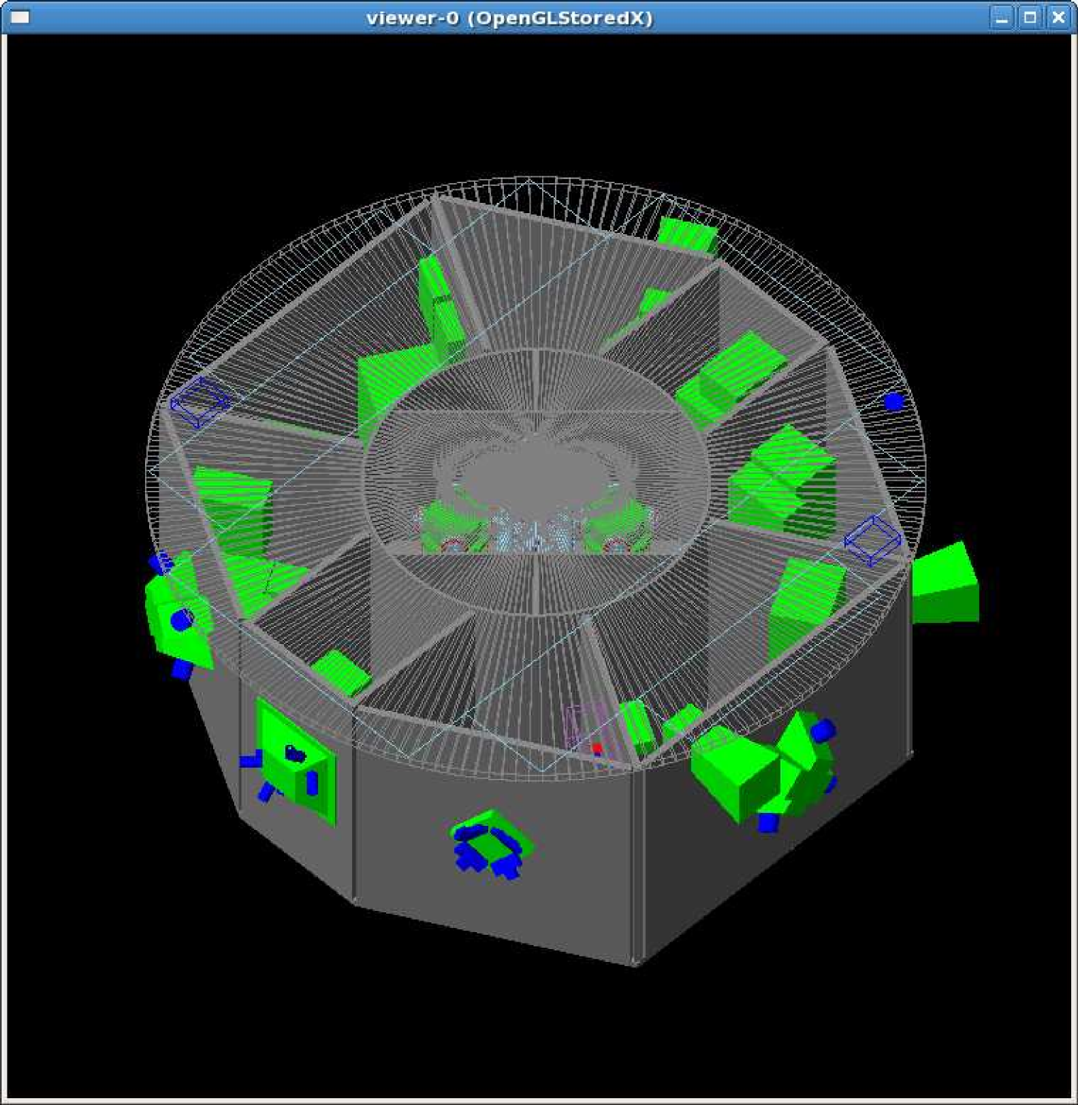
Test-mass charging study with Fluka
FLUKA MC
Simulation
Wass et al., CQG, 22, 2005, S311-S317
CG et al., CQG, 32, 2015, 035001

Slide 10
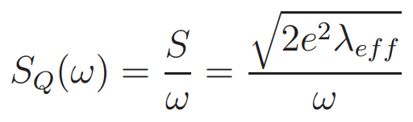

Test-mass charging
Net and effective charging estimated with the
Fluka MC Program
Ferrari et al., 2005-10 (Geneva:CERN)
Battistoni et al.,
AIP Conf. Proc. 896,
Albrow and R. Raja, 31-49
2x10⁶ events
in each run
In order to
limit the
uncertainty on
λ _{eff} <2%
Where: j is the amplitude of the charge released by each event and λ _{j} is
rate of occurrence of that event.
Catia Grimani

Slide 11
LISA acceleration noise spectral density
Required acceleration noise limit
for random charge:
9.4·10⁻¹⁶ (m s⁻² Hz^{-1/2})
[total: 3·10⁻¹⁵]
(10⁻⁴ ÷ 10⁻¹ Hz)
TO BE UPDATED FOR LISA-PF

Slide 12
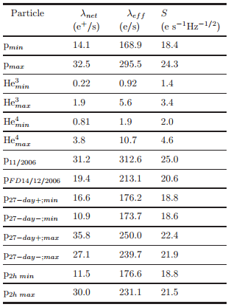
LISA-PF test-mass charging
@solar minimum
GEANT4:
24.9 e s⁻¹ Hz^{-1/2}
Wass et al., 2005
FLUKA:
25.0 e s⁻¹ Hz^{-1/2}
(p_{max,},He_{max})
18.6 e s⁻¹ Hz^{-1/2}
(p_{min,},He_{min})
Real data
(13 may 2016):
TM1: 24.5 e/s
TM2: 27 e/s
CG et al. CQG, 2015

Slide 13
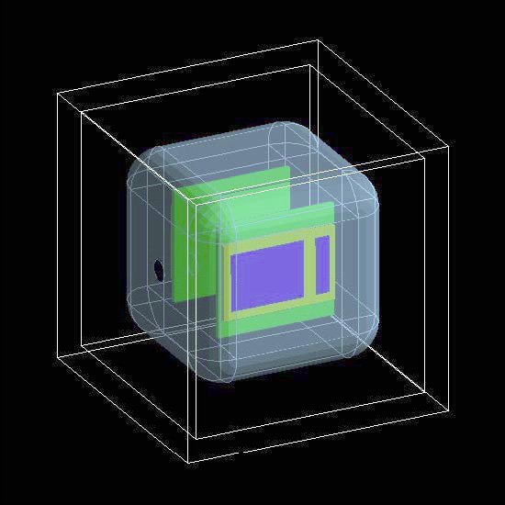
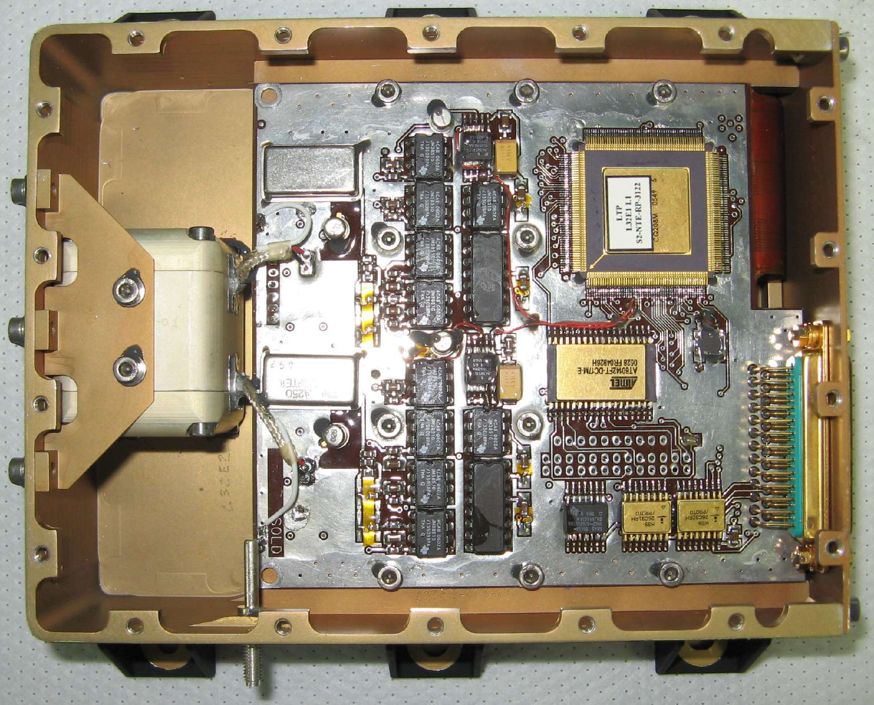
LISA-PF TEST masses and radiation monitors
2 silicon wafers
of 1.4 x 1.05 cm² area
placed 2 cm apart.

Slide 14
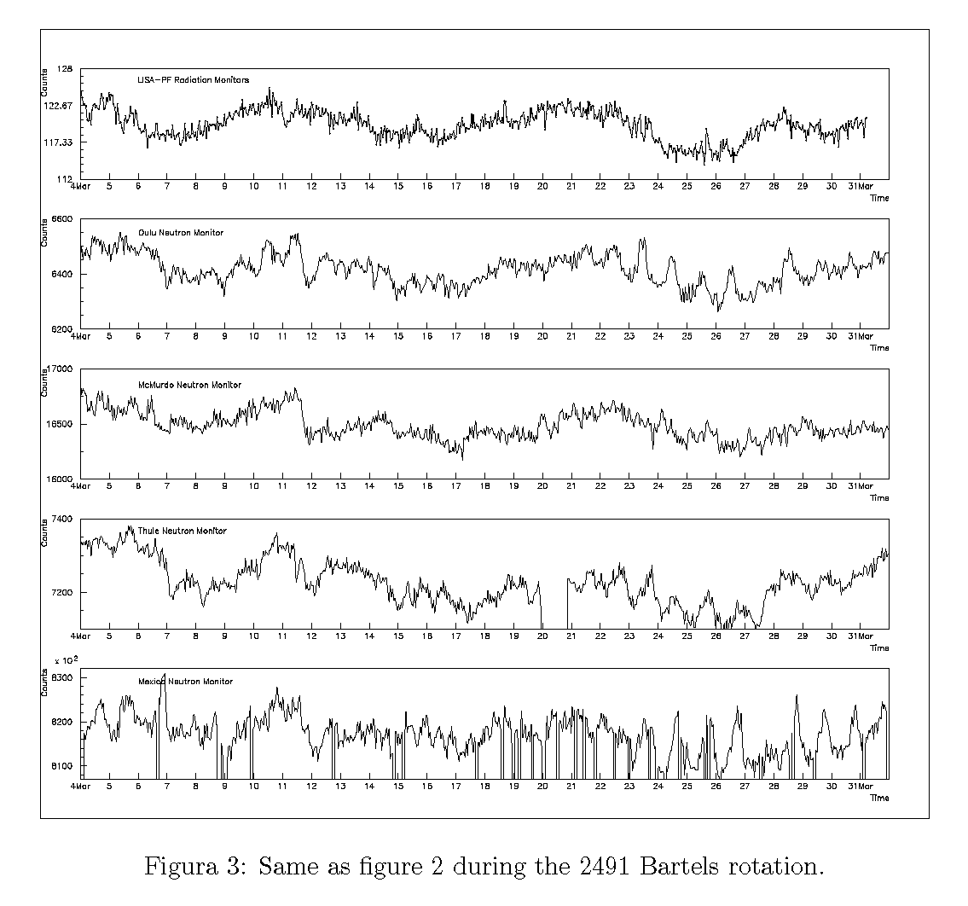
LISA-PF Radiation Monitor data 4 March – 31 March 2016
LISA-PF radiation monitor
data
Oulu neutron monitors
McMurdo neutron
monitors
Thule neutron monitors
Mexico neutron monitors

Slide 15
About gravitational wave detection
In November 2013 ESA selected
the Gravitational Universe as one of its
corner-stone science themes.
LISA to be selected as the third large
mission after JUICE (L. 2022), ATHENA
(L. 2028) initially scheduled for launch in
2034 will go probably by 2029.
On February 11th 2016 the discovery of gravitational waves was announced by the LIGO/Virgo collaboration.

Slide 16
LISA-PF mission extension
The mission duration, originally set to 6 months, was extended on June 21st to May 31st 2017

Slide 17
Future activity
RADIATION MONITOR DATA ANALYSIS
TEST-MASS CHARGING IN LISA

Slide 18
FTE 2017
Catia Grimani 100%
Ruggero Stanga 0%
Noemi Finetti 50%
Monica Laurenza 20%
Daniele Telloni 40%
FTE: 2.1
Recent publications:
Grimani C. et al., CQG, 32, 035001 (14 pp), 2015
Grimani C. et al., J. Phys. Conf. Ser., 610, 012025 (5 pp), 2015
Grimani C. et al., MG14 Proc. Electron test-mass charging aboard the future space interferometers. Published online March 2016
Robot.icra.it:8080/store/l165.pdf
Armano M. et al., Ph. Rev. Lett., 116, 231101, 2016

Slide 19
BACKUP SLIDES

Slide 20
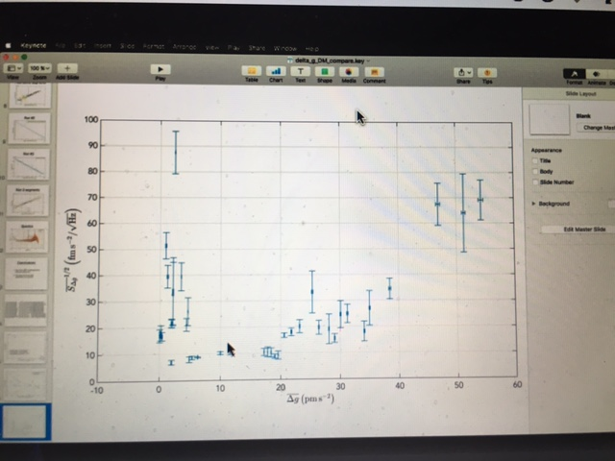

Slide 21
Noise and charge in URLA DOY 134
BY P. WASS – NOT for public USE

Slide 22
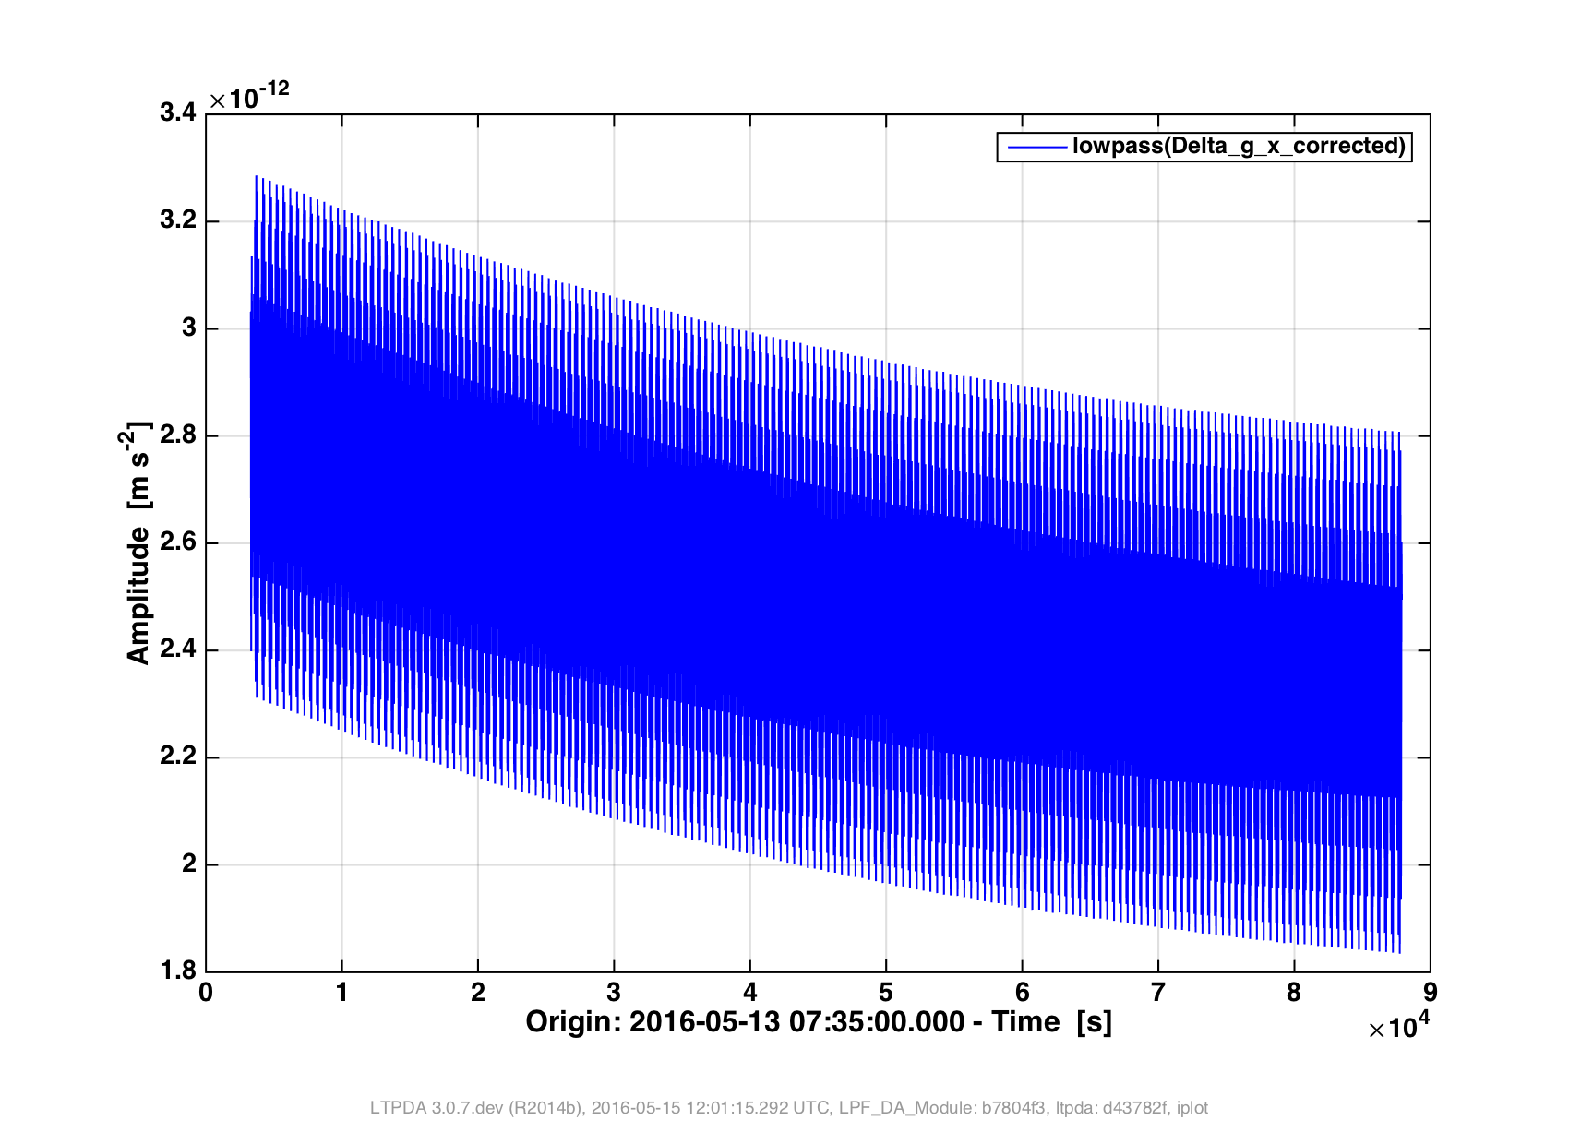

Slide 23
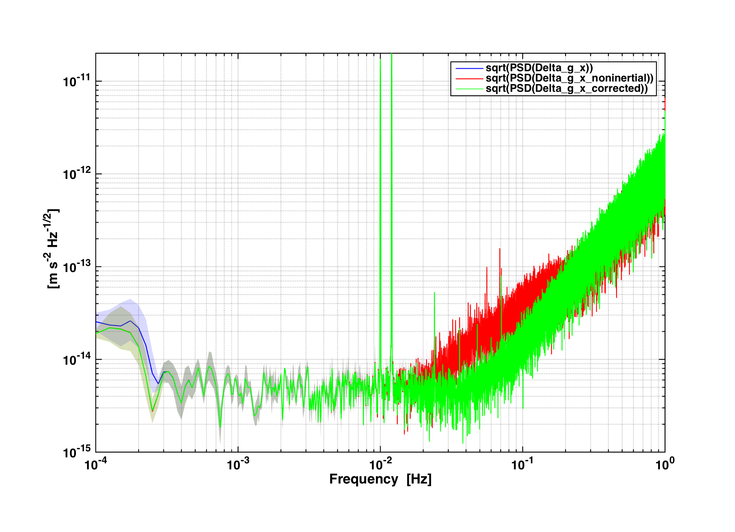

Slide 25
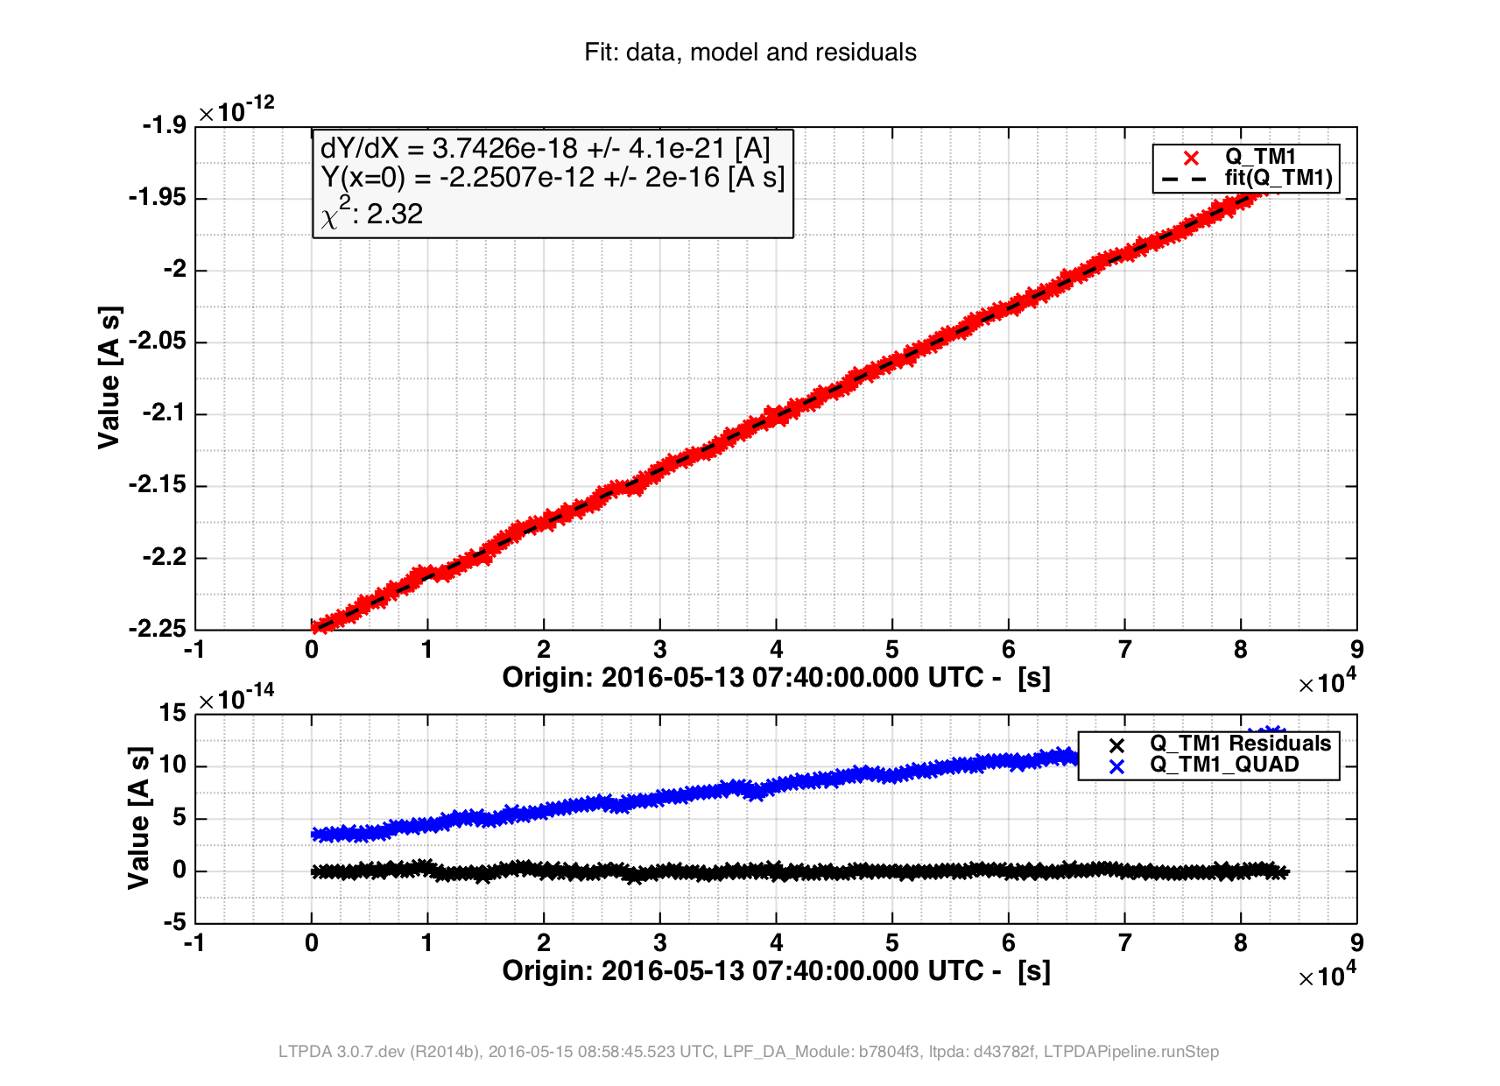
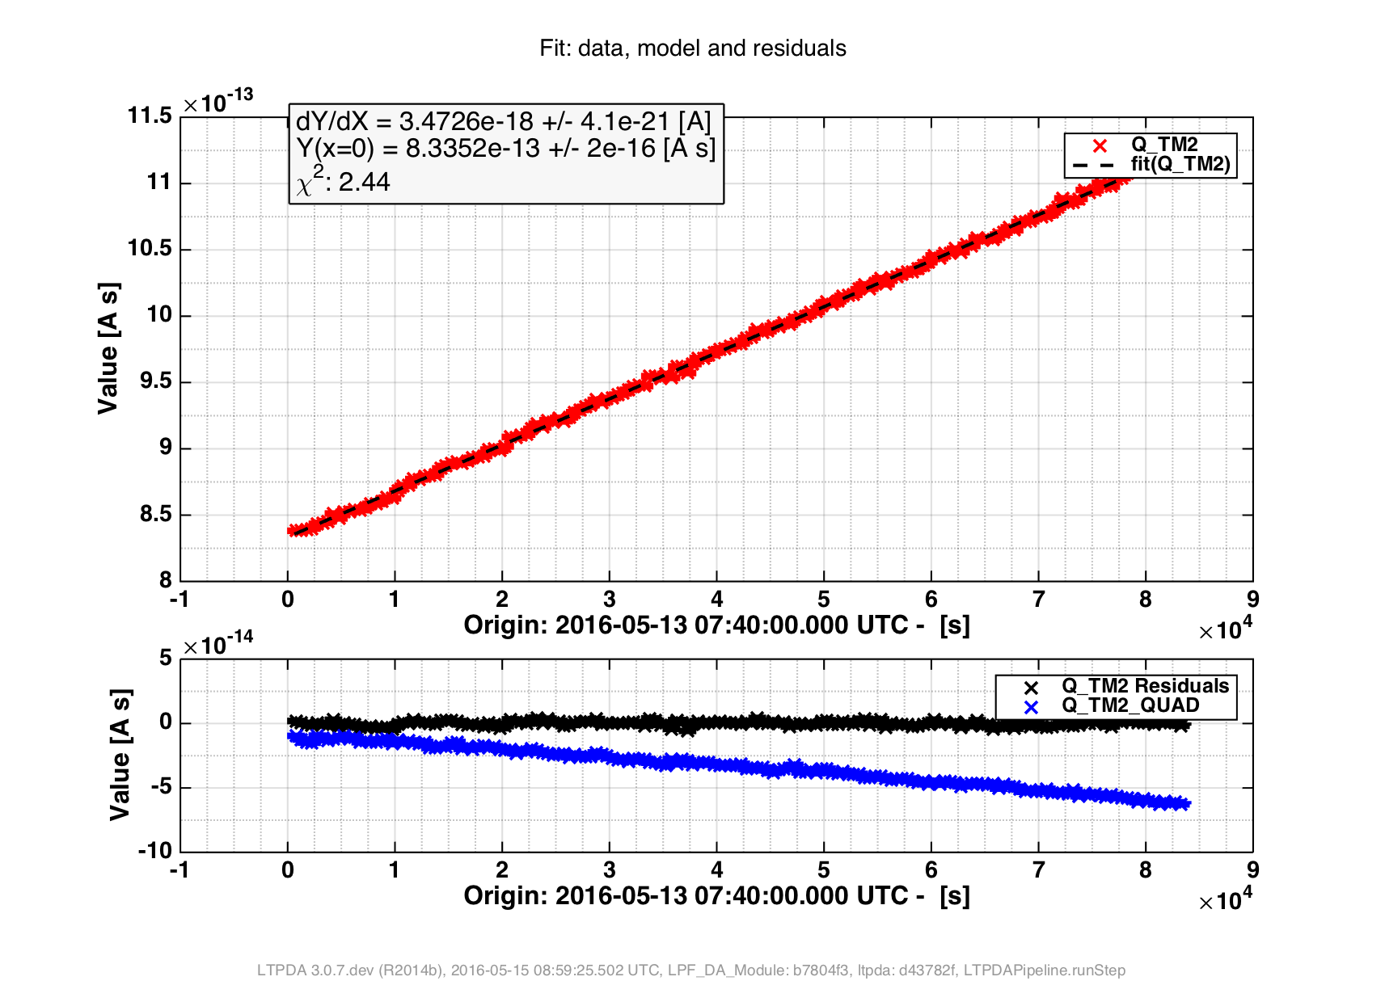
TM1 23.3 ± <0.1 e/s TM2 21.7±<0.1e/s
cf 24.5±0.2e/s cf 27.5±0.2e/s

Slide 26
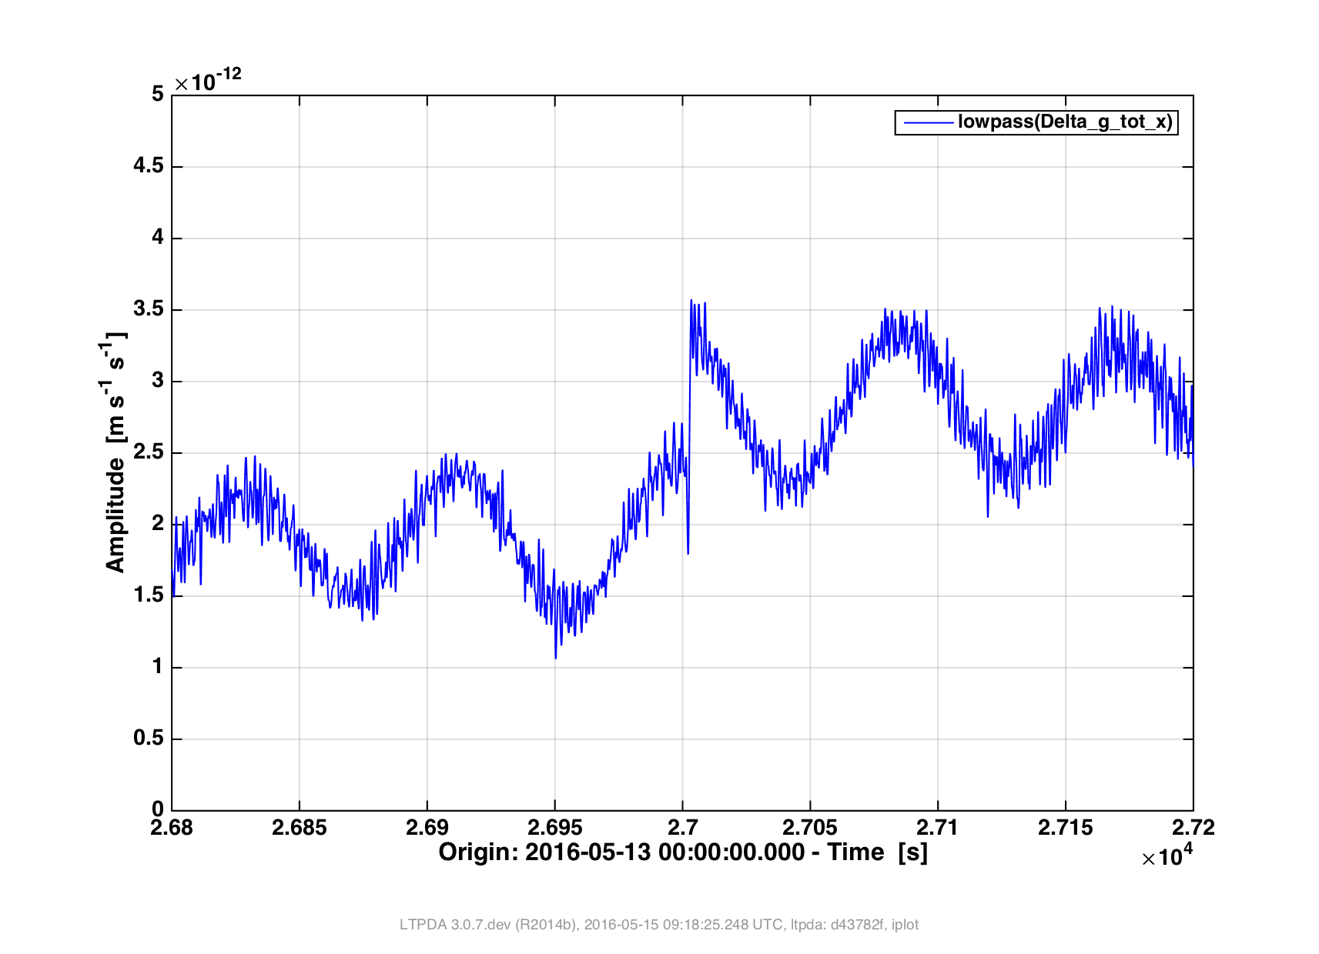
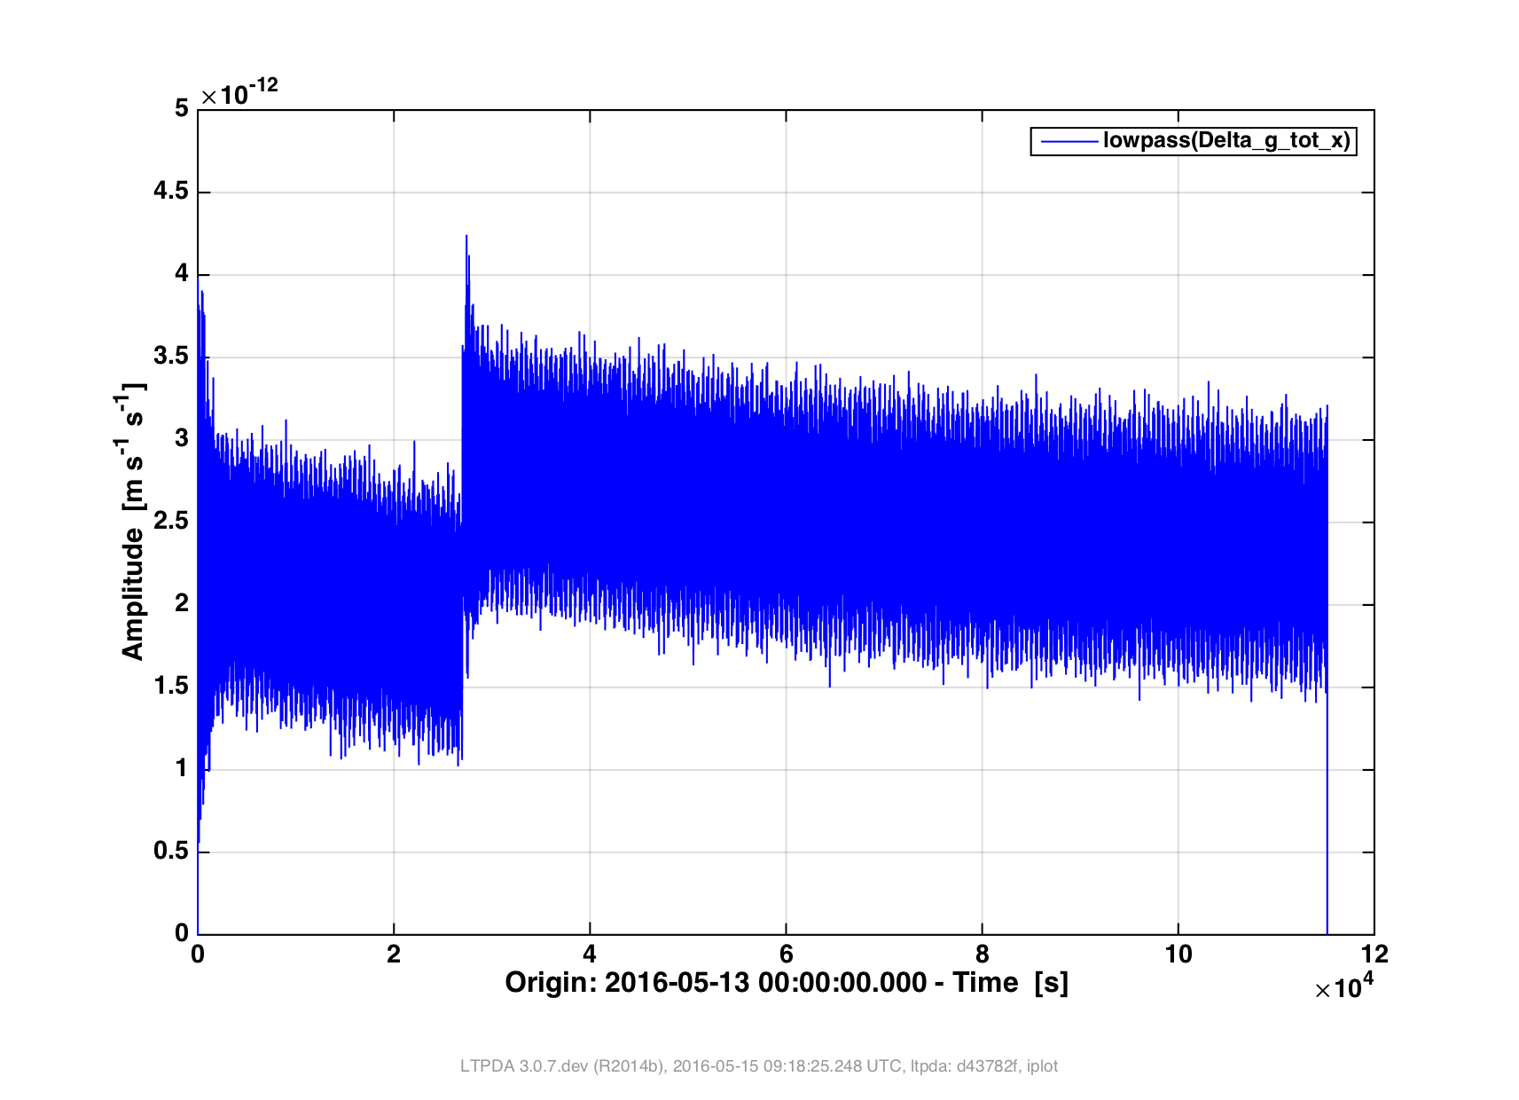

Slide 27
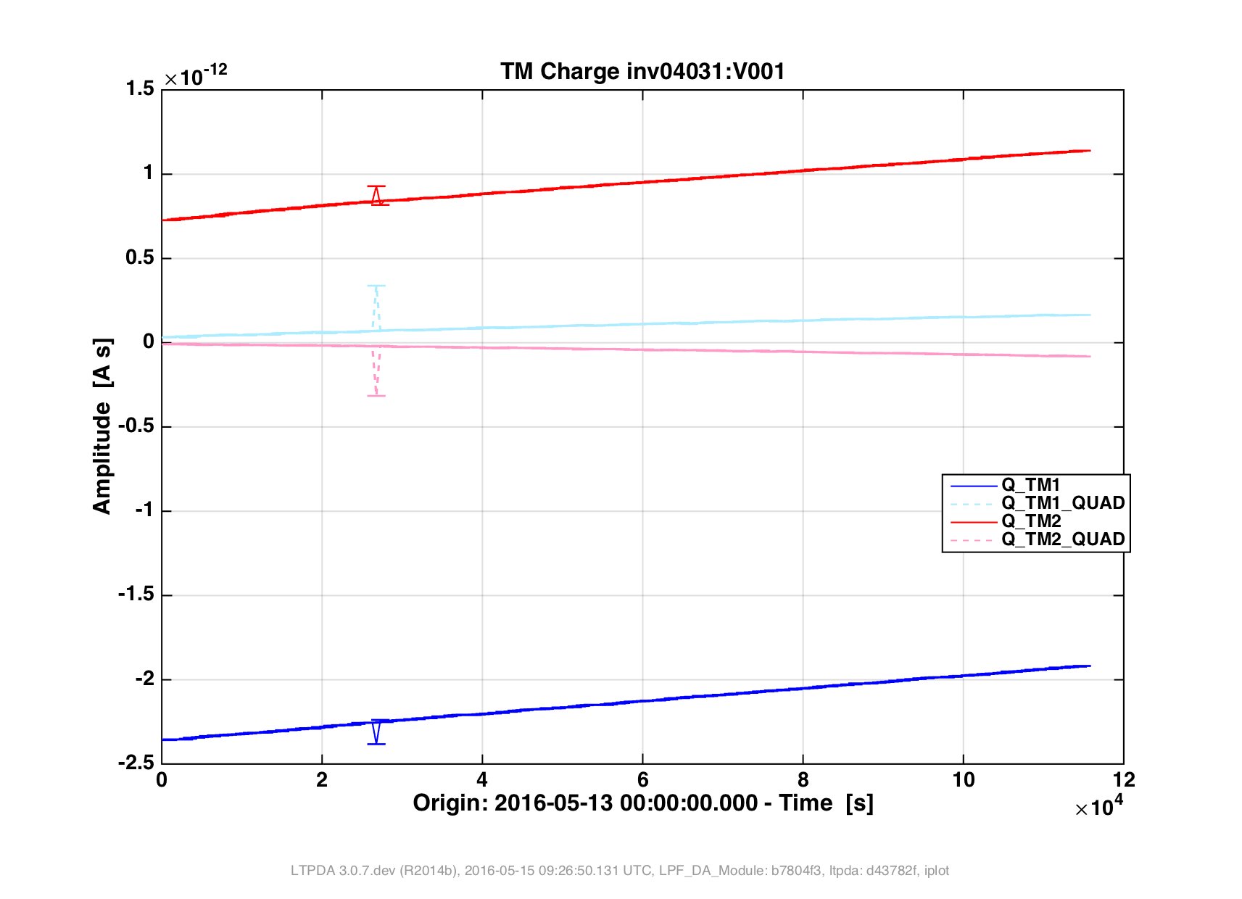

Slide 28
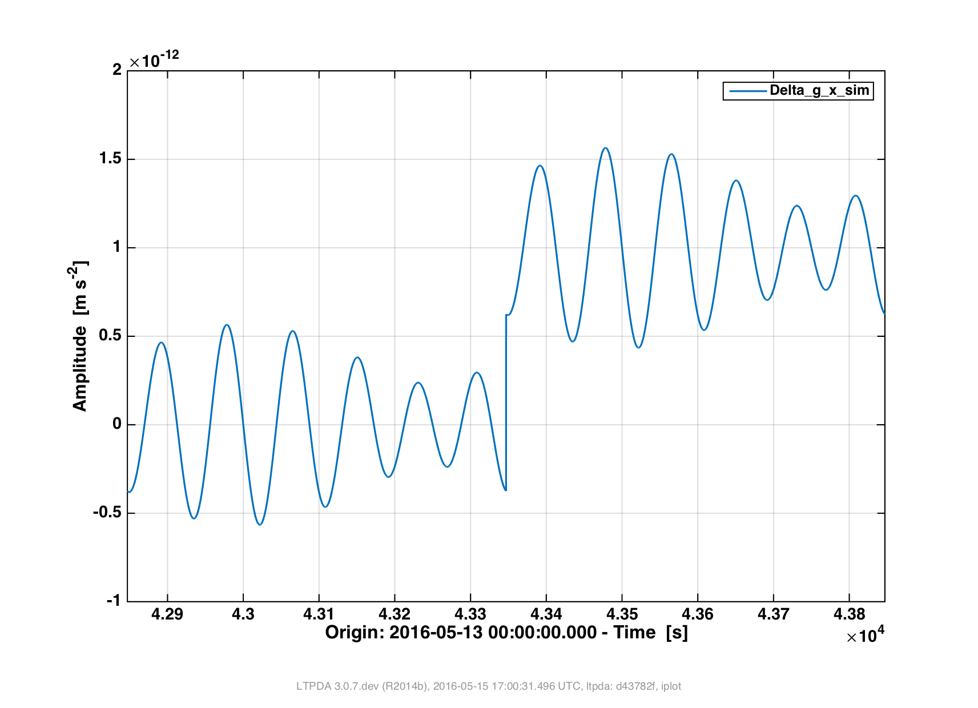
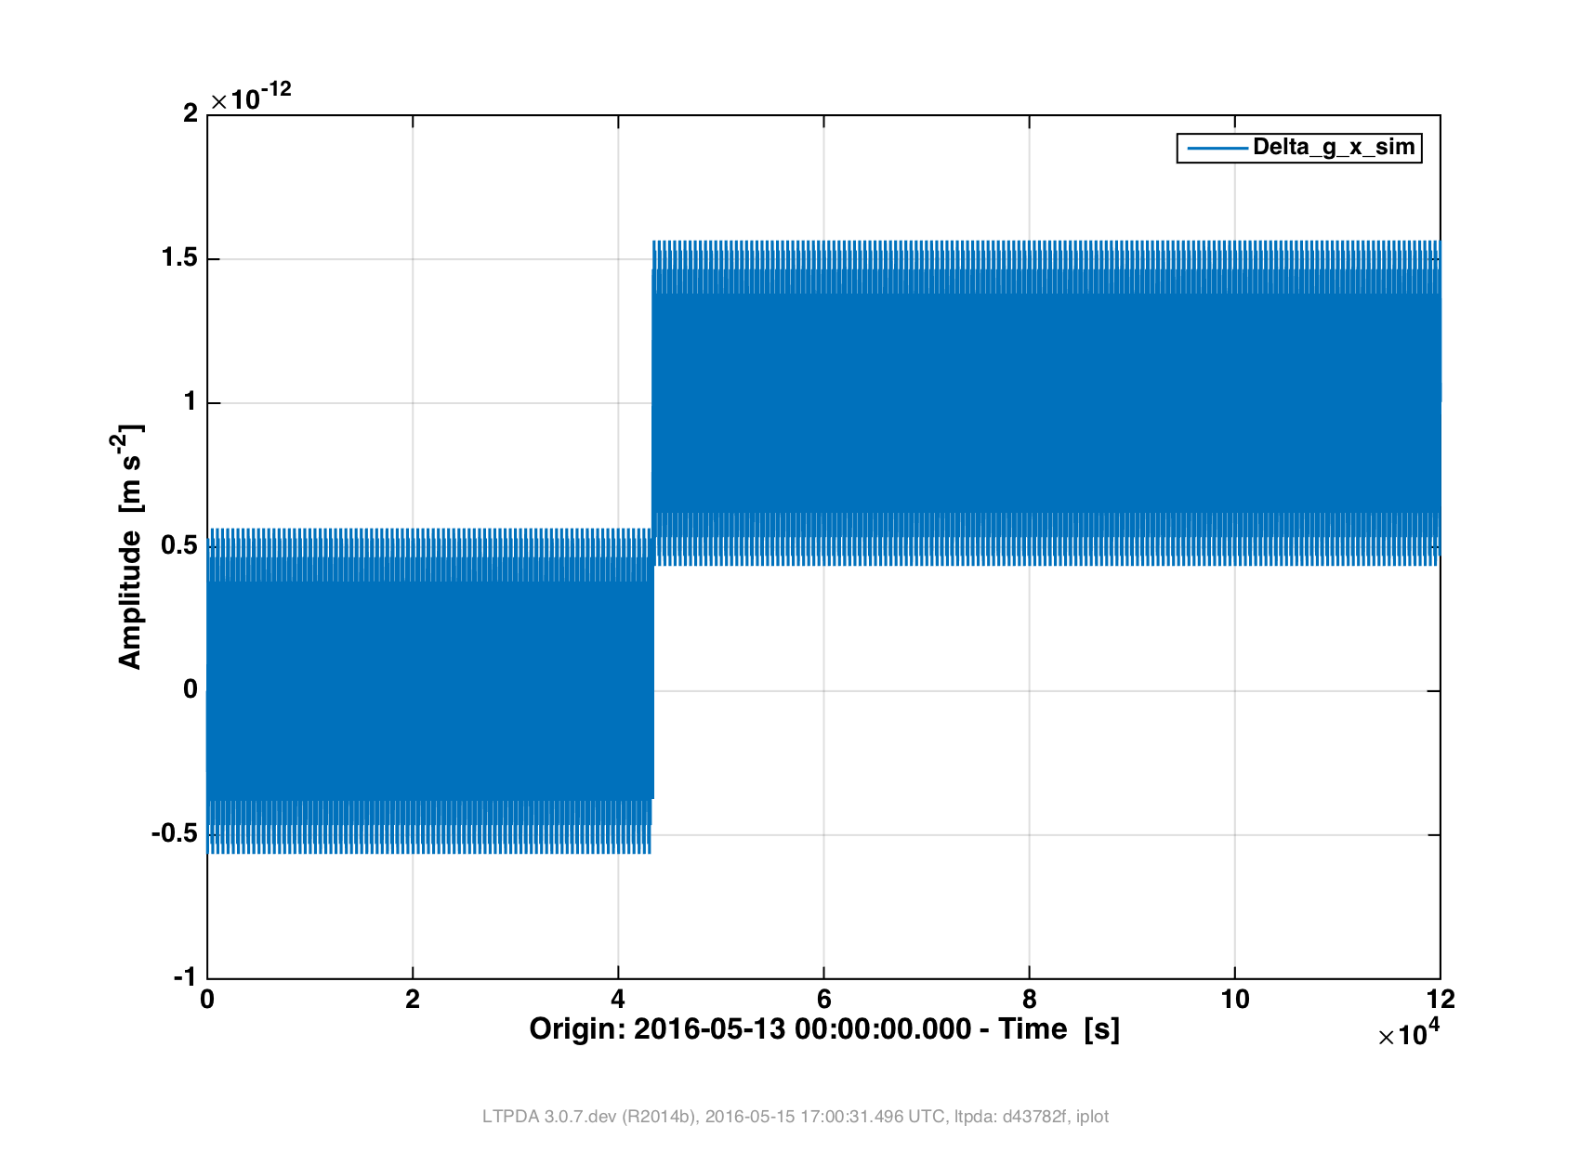

Slide 29
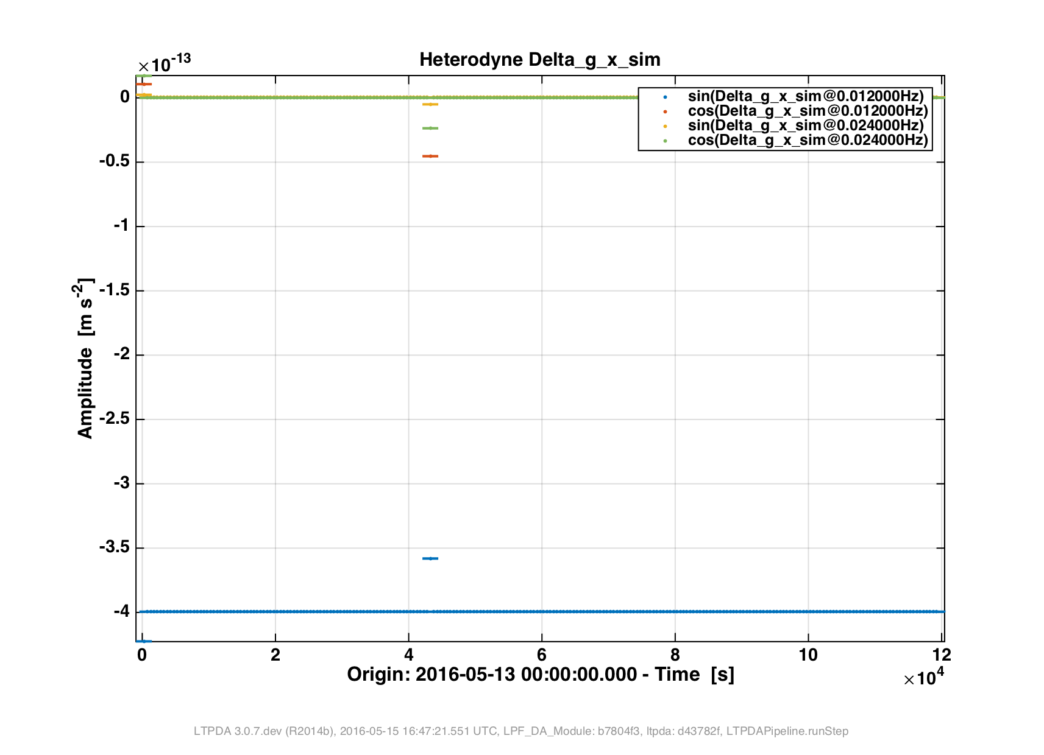

Slide 30
