Slide 1
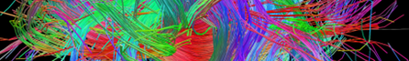
Medical Image Processing
Alessandra Retico
Istituto Nazionale di Fisica Nucleare - Sezione di Pisa
alessandra.retico@pi.infn.it
Image Processing Meeting (FTK-IAPP)
Pisa, July 5, 2016

Slide 2
Outline
Diagnostic Imaging
Medical Image Processing:
Visualization
Segmentation of anatomical/functional/pathological structures
Quantification
➔Identification of Biomarkers

Slide 3
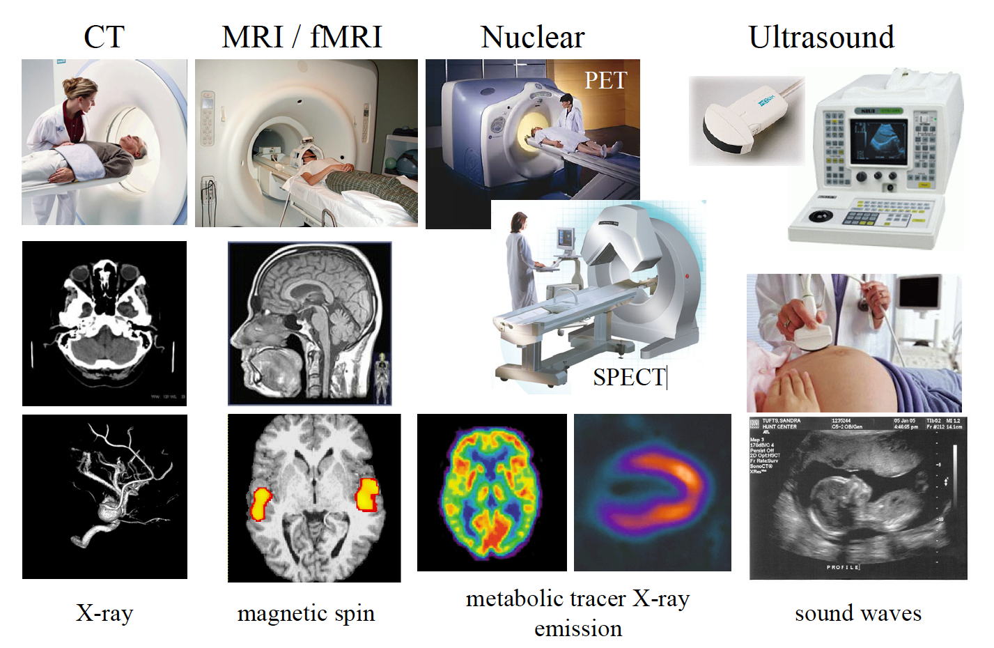
Diagnostic imaging modalities

Slide 4
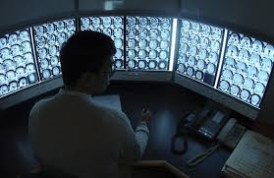
Image processing and machine learning
Post-processing of raw data:
Visualization
Quantification:
Image segmentation
Volumetric assessment of regions of interest (ROIs), lesions, etc.
Follow up of pathological conditions:
Grow rate of lesions; assessment of treatment efficiency
Fusing information:
Inter/intra-modality acquisitions (deformations, registration algorithms)
The aim is to assist clinicians in their tasks, not to replace them.

Slide 5
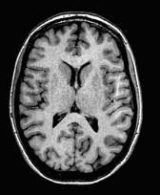
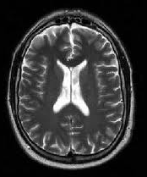
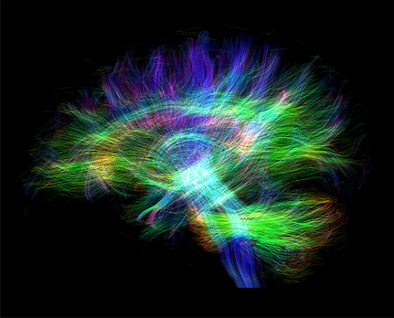
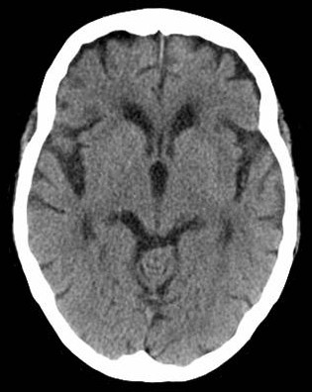
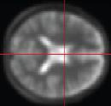
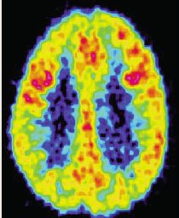
Measuring structure and function of the brain
Non-invasive methods
Structure
Structural Magnetic Resonance imaging
MRI
Diffusion Tensor Imaging
DTI
Function
Functional Magnetic Resonance Imaging
fMRI
Computed Tomography
CT
Positron Emission Tomography
PET
Ionizing
radiation
Ionizing
radiation

Slide 6
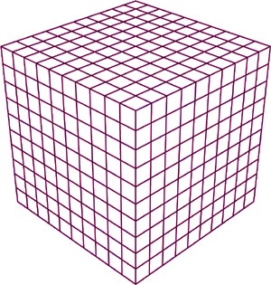
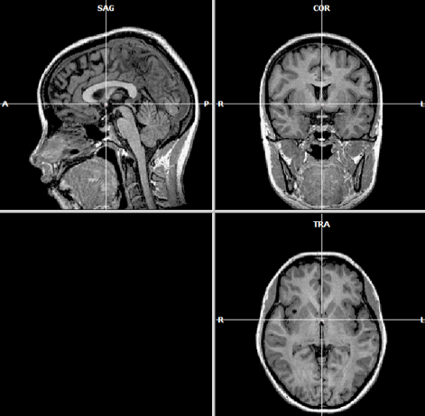
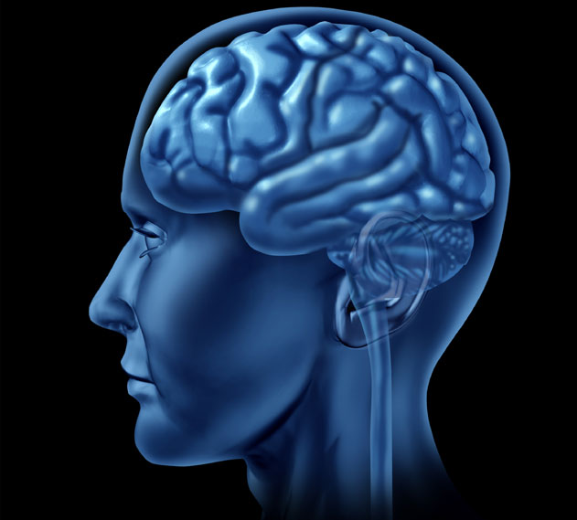
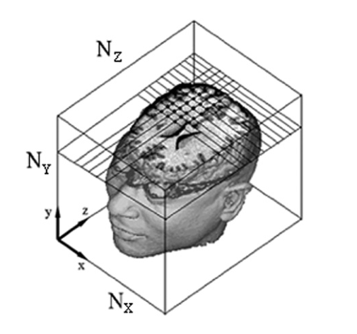
Structural MRI (sMRI) T₁-w images
Sagittal
Coronal
Axial or transaxial
3D array of data:
The voxel is the “volume element”
“High resolution” MRI T₁-w images: v_{x} × v_{y} × v_{z} ≈ 1 × 1 × 1 mm³
e.g. N_{x} x N_{y} x N_{z} = 256 x 256 x 128
16 bit 16 MB

Slide 7
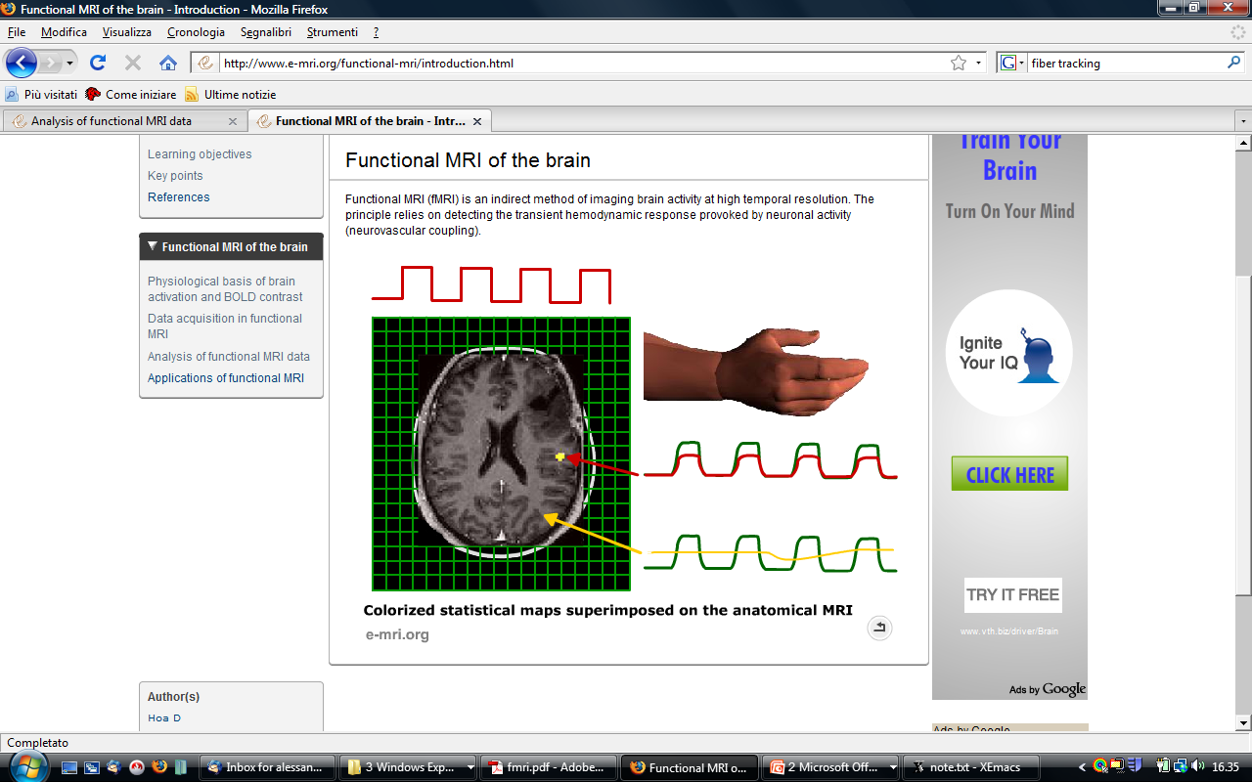
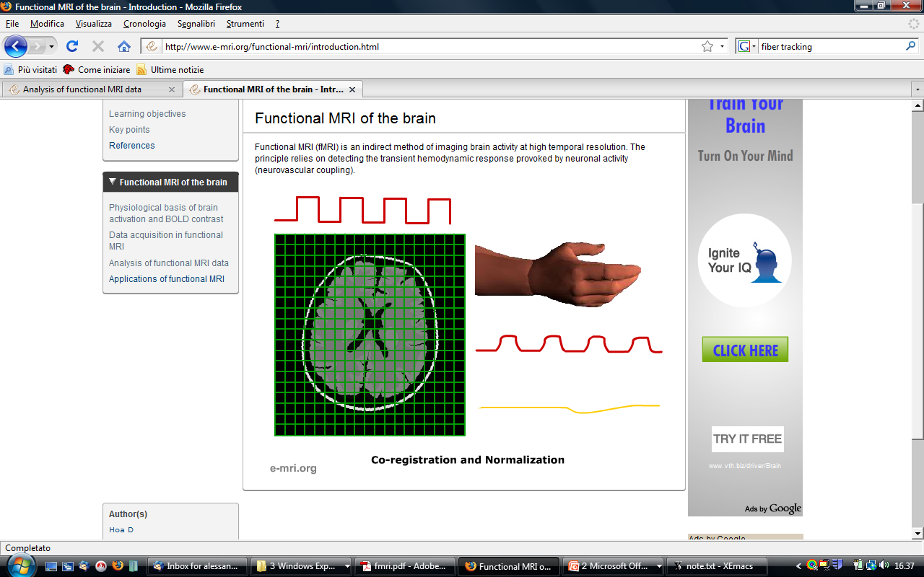
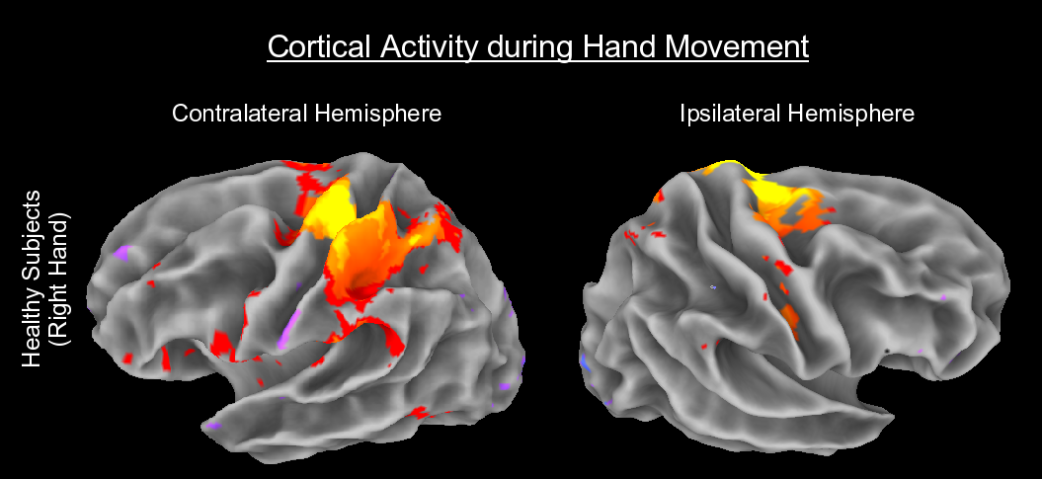
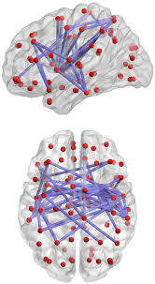
Functional MRI (fMRI)
BOLD Response: blood-oxygen-level-dependent (BOLD) contrast
1 volume per second (3x3x3mm³), for 4-5 min:~ 320 MB
Stimuli (visual, auditory, tactile, …) are presented during the scan
Analysis of data time series to look for up-and-down signals that match the stimulus time series
Functional connectivity
Resting state rs-fMRI: study of temporal correlations between spatially remote neurophysiological events

Slide 8
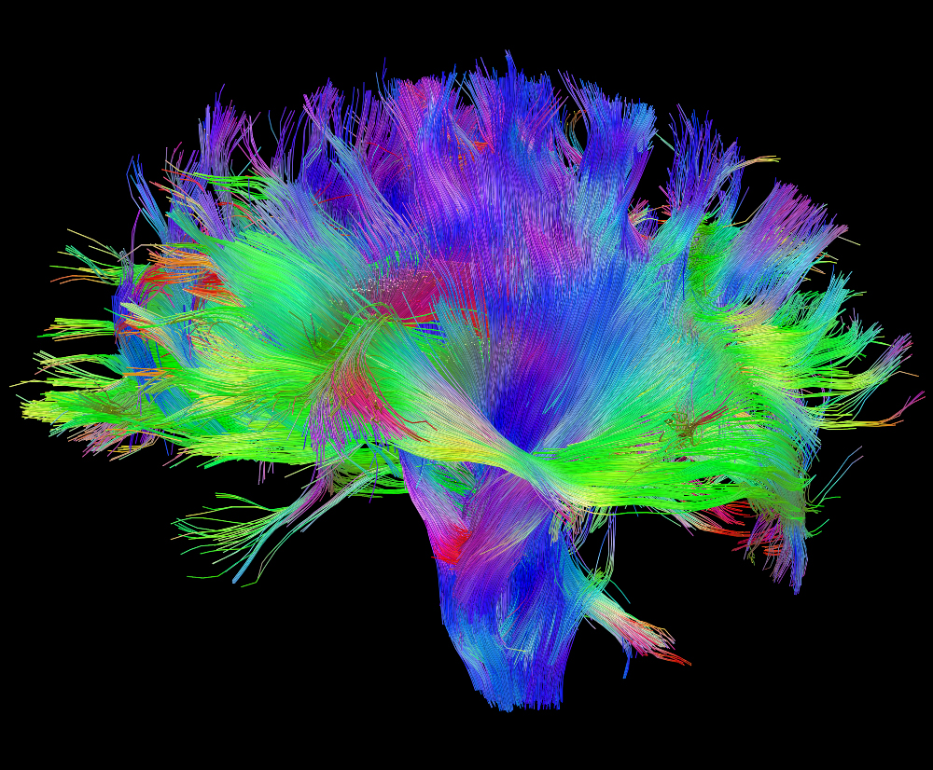
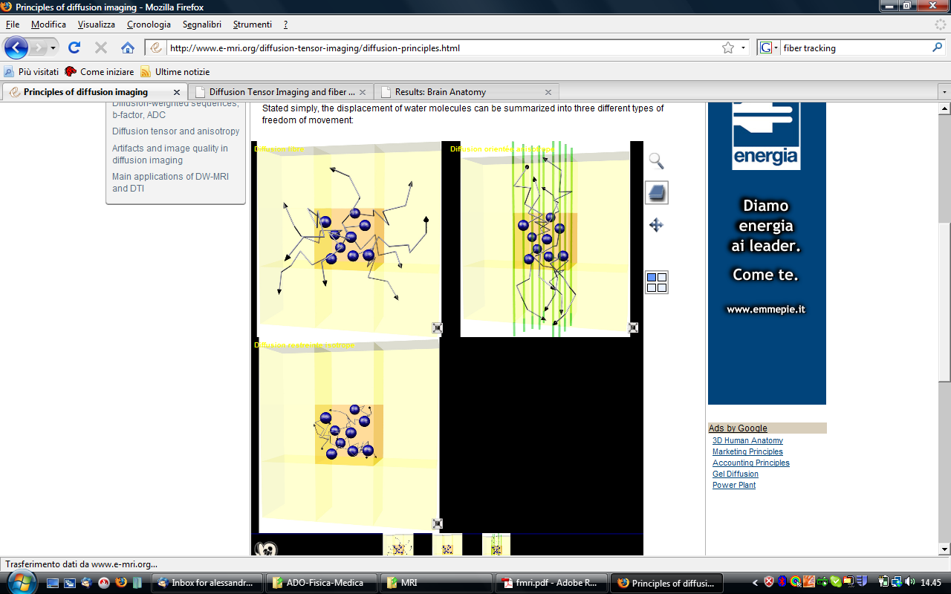
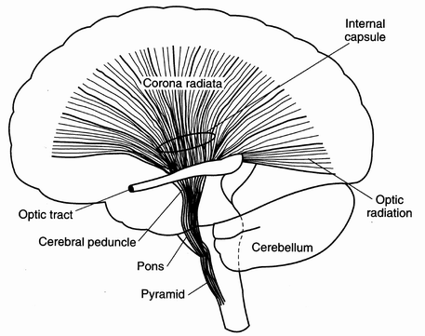
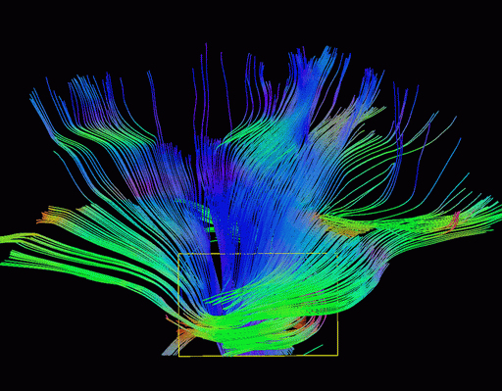
Diffusion weighted imaging
Water molecules diffuse around during the imaging readout window
Diffusive movement of water in brain is not isotropic
In white matter (WM) diffusion along axonal fiber orientation is faster
Imaging can be made sensitive to this diffusive motion
Isotropic diffusion
Anisotropic diffusion
Structural connectivity: Fiber tractography
The orientation of axon fibers is reconstructed in vivo

Slide 9
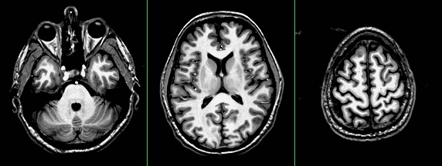
T₁-weighted brain images
Axial slices of a human head with spatial resolution of 1 mm³
Grey Matter (GM)
White Matter (WM)
Cerebrospinal fluid (CSF)
Grey Matter (GM) cortex can by followed and cortical thickness can be evaluated to investigate GM involvement in pathological conditions.

Slide 10
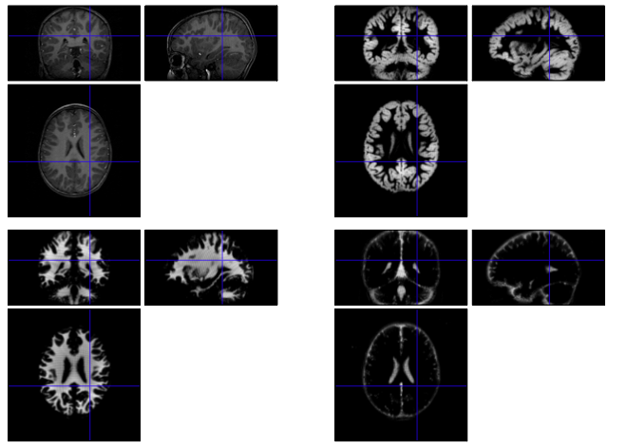
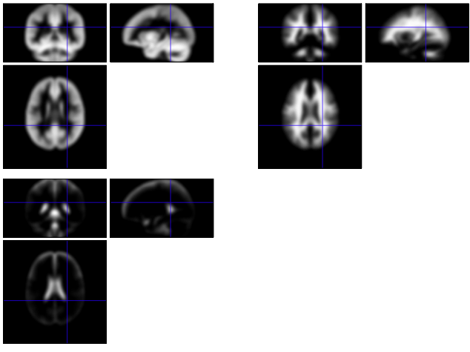



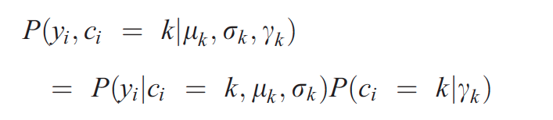
Segmentation of brain components
Grey matter
White matter
Cerebrospinal fluid
Mixture of Gaussian Model (MOG)
Tissue probability maps (TPMs) in SPM8
Tissue segmentation in SPM8
In a simple MOG, the probability of obtaining a voxel with intensity y_{i} given that it belongs to the k^{th} cluster, i.e. Gaussian (c_{i} = k), and that the k^{th} Gaussian is parameterized by μ_{k} and σ_{k}² is:
The prior probability of any voxel, irrespective of its intensity, belonging to the k^{th} is:
Using Bayes rule, the joint probability of cluster k and intensity y_{i} is:
www.fil.ion.ucl.ac.uk/spm/
Sum over K clusters, accounting for each voxel and maximize with respect to the unknowns (μ, σ)

Slide 11
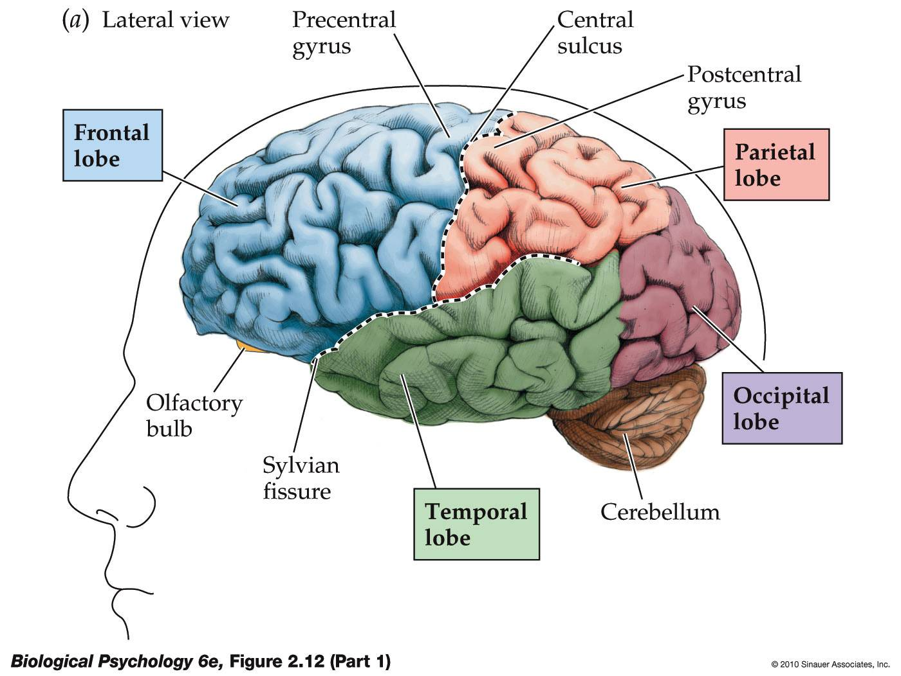
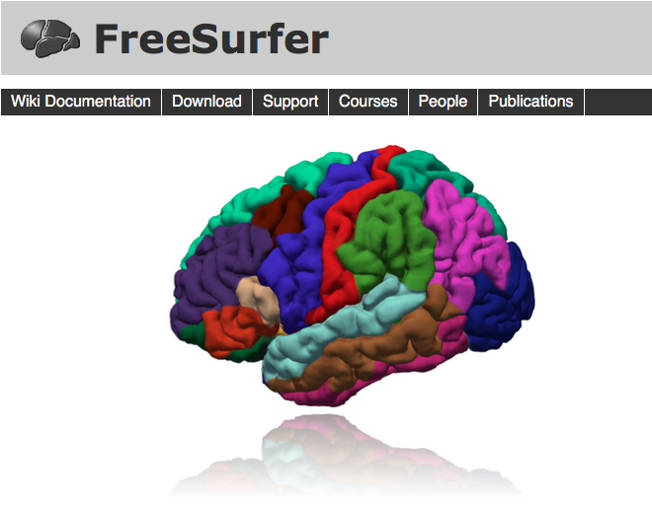
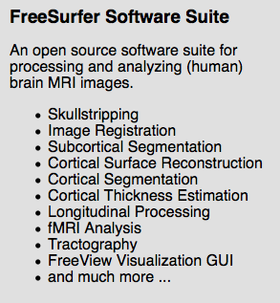


Brain parcellation
http://freesurfer.net/
http://www.loni.usc.edu/
Notes:
FRONTAL LOBE
Concerned with reasoning, planning, parts of speech and movement (motor cortex), emotions, and problem-solving.
PARIETAL LOBE
Concerned with perception of stimuli such as touch, pressure, temperature and pain.
TEMPORAL LOBE
Concerned with perception and recognition of auditory stimuli (hearing) and memory (hippocampus).
OCCIPITAL LOBE
Concerned with many aspects of vision.

Slide 12
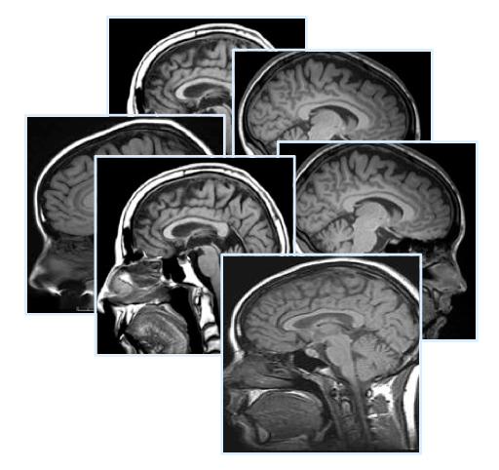
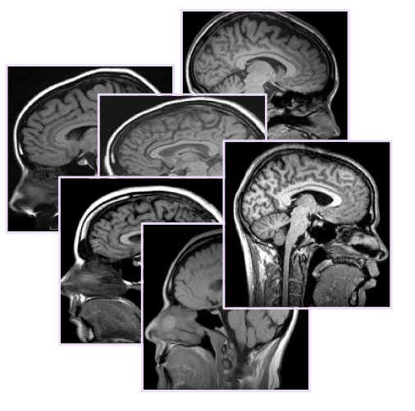
Group comparison (voxel/regional level)
Comparison between groups
Group 1
Group 2
Voxel-wise statistical analysis
Multivariate techniques, machine learning,
predictive models.
Patients (group 1) vs. Controls (group 2):
Pathology specific brain alterations
Longitudinal studies (same group after a time delay)
Effect of aging
Effect of treatments

Slide 13


The Alzheimer’s Disease Neuroimaging Initiative (ADNI)
http://adni.loni.ucla.edu/
> thousands of cases: baseline, follow up; AD, MCI, Controls; MRI, PET
~ 800 cases with genetic data

Slide 14

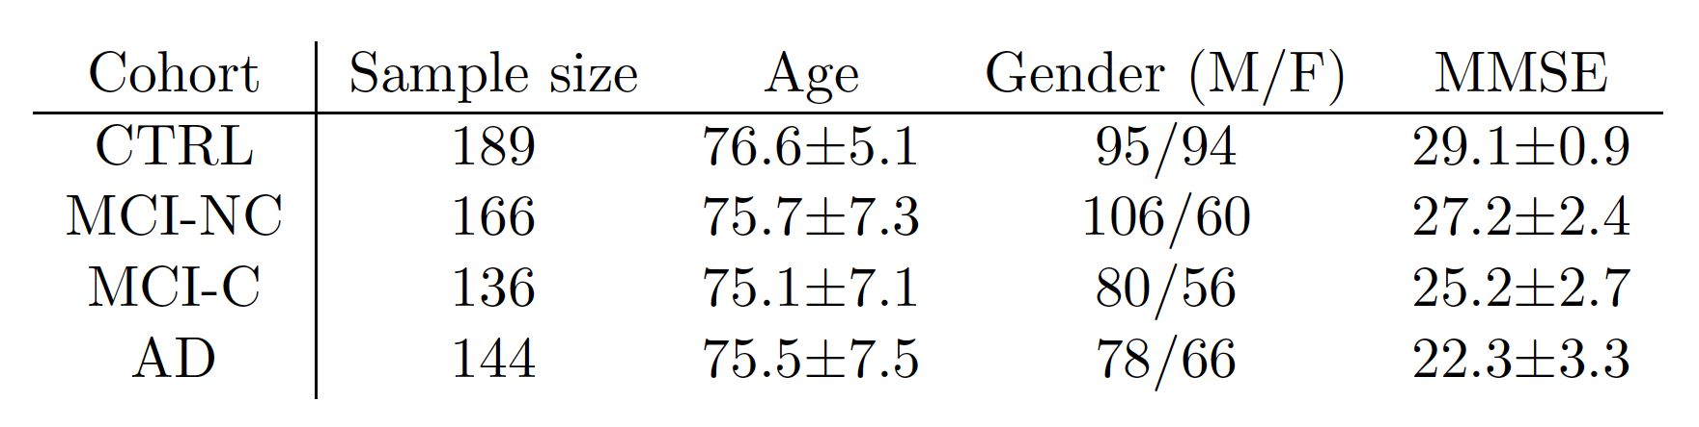
Dataset available in this study
The Alzheimer’s Disease Neuroimaging Initiative (ADNI)
http://adni.loni.ucla.edu/
The mission of the ADNI is to define the progression of Alzheimer’s Disease. A major goal of the ADNI study has been to collect and validate data such as MRI and PET images, cerebral spinal fluid, and blood biomarkers as predictors of the disease. Data from Alzheimer’s Disease patients, Mild Cognitive Impairment subjects, and elderly controls are available to download.
Dataset used in this study:
Train & test: 144 AD + 189 age-matched Controls (CTRL)
Trial on 302 MCI subjects: 136 converters (MCI-C) + 166 non converters (MCI-NC)
TOT 635
This dataset was selected with the requirement of having at least 2-year information in addition to the baseline scan:
the AD/CTRL subjects were confirmed to be healthy controls/AD at the follow-up assessment;
MCI-C subjects converted to AD in a time-frame of 2 years from the baseline scan.

Slide 15
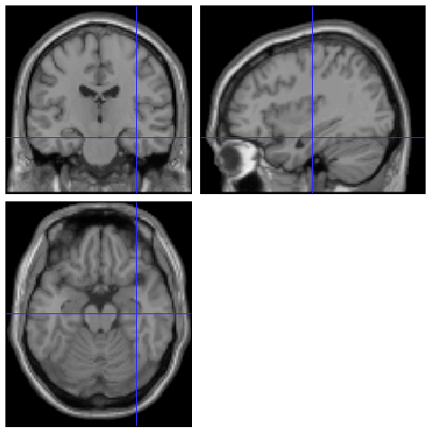
Example of MTL atrophy visibility on MRI structural data
AD
CTRL
Healthy younger subject

Slide 16
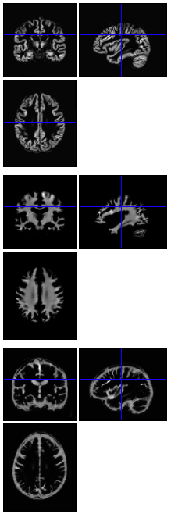
Voxel-Based Morphometry (VBM) analysis with SPM8
The VBM whole-brain analysis provides statistical parametric maps (SPM) of regions where GM significantly differs among groups of subjects
VBM preprocessing:
SPM tissue segmentation of GM, WM and CSF
DARTEL registration and study specific template
Alignment to MNI space
VBM analysis (voxel-wise t-test) to identify the regions where AD and CTRL differ (Gaussian smoothing with s=3mm; i>0.1; covariates: Age, Gender and TIV)
The amount of GM in AD is significantly lower than in CTRL, especially in the Temporal and Limbic Lobes
GM
WM
A mask is derived from the SPM map
Gaussian smoothing with s=3 mm;
Covariates: Age, Gender and TIV
CSF

Slide 17
VBM results: Structural abnormalities in AD subjects vs. Controls
Regions where GM in AD < than GM in Controls are displayed: significant SPM blobs are overlaid to a representative T1-w image
(s=3 mm, covariates: age, gender and TIV)

Slide 18
Limitation of the VBM approach
VBM allows localizing brain regions where GM (WM) significantly differs among groups of subjects.
VBM limitations:
VBM allows for comparisons between groups of subjects, not for single subject analysis.
The inference on new cases is not possible.

Slide 19
Why using machine-learning techniques?
Some tasks cannot be defined well, except by examples.
Relationships and correlations can be hidden within large amounts of data.
Machine Learning/Data Mining may be able to find these relationships.
The amount of knowledge available about certain tasks might be too large for explicit encoding by humans (e.g., medical diagnostic).
Learning from examples
Vocabulary:
Training set: a subset of items, with known classification
Training: allowing the algorithm to set weights and “learn” how to classify your data, using the training set
This produces classifier, i.e. a quantitative mapping from features to class.
Classification: using these training-set weights to classify data of previously unknown category
Notes:
Some tasks cannot be defined well, except by examples (e.g., recognizing people).
Training a decision-making system
Defining a criterion for success [What is the error that needs to be minimized?]
Choose an algorithm capable of finding weights of a linear function that minimize that error [e.g. the Least Mean Square (LMS) training rule].

Slide 20
Pattern classification in MRI data of Alzheimer’s disease
Automatic classification of subjects into the Alzheimer’s Disease (AD) and the Healthy Control (HC) categories
The predictive value of structural MRI can be investigated to:
classify newly acquired subjects;
infer on the outcome of Mild Cognitive Impairment (MCI) subjects.
A. Retico - INFN Pisa

Slide 21
Support Vector Machine (SVM) classification
AD subjects
Healthy Controls
Training on known cases
SVM OUTPUT
AD subject
Healthy Control
Trained SVM
Prediction on MCI outcome
New subject

Slide 22
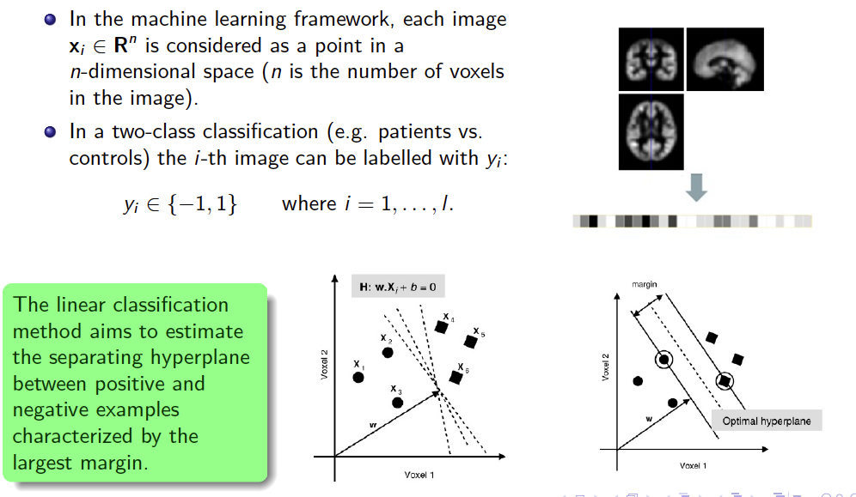
Support Vector Machine (SVM) classification
VBM preprocessed data:
segmented, normalized, modulated and smoothed GM for each subject
Binary classification
Notes:
Only distinguishes
between two different
classes (+1/-1)

Slide 23
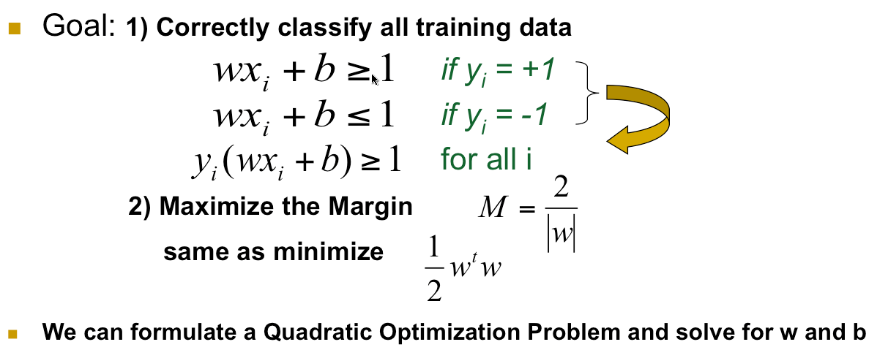
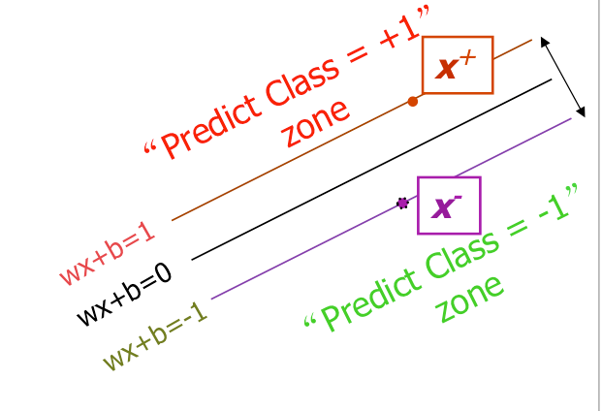
Support Vector Machines (SVM)
-
Quadratic optimization problems are a well-known class of mathematical programming problems, and many (rather intricate) algorithms exist for solving them.
The solution involves constructing a dual problem where a Lagrange multiplier α_{i} is associated with every constraint in the primary problem.
Find w and b such that
Φ(w) = ½ w^{t}w is minimized;
and for all {(x_{i} ,y_{i})}: y_{i} (w^{T}x_{i} + b) ≥ 1

Slide 24
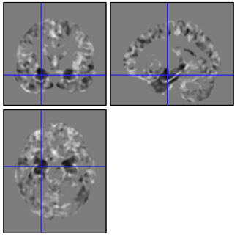
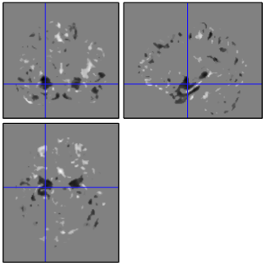
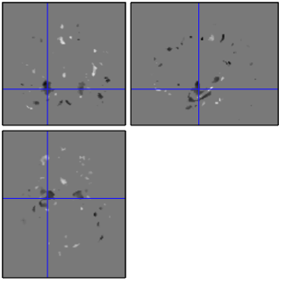
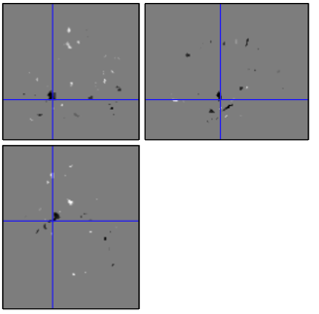
SVM Recursive Feature Elimination (SVM-RFE)
Features/voxels are iteratively removed from the data set with the aim of retaining only those voxels that carry discriminative information
The weight magnitude |w_{i}| is used as ranking criterion:
features/voxels with low |w_{i}| are removed from the dataset,
features/voxels with high |w_{i}| are retained.
A new SVM is trained at each iteration.
The SVM classification performance (AUC) is evaluated at each iteration (i.e. as a function of the number of retained GM voxels)
3 10⁵ voxels
[Guyon et al, Mach Learn (2002)]
8 10⁴ voxels
2 10⁴ voxels
6 10³ voxels
The SVM-RFE discrimination maps can be compared to the VBM maps.
Notes:
Features/voxels with low |w_{i}| are removed from the dataset, while retaining those encoding the discriminative information (high |w_{i}|).
We are interested both in reducing the large number of voxels to classify and in the visual information contained in the discrimination maps

Slide 25
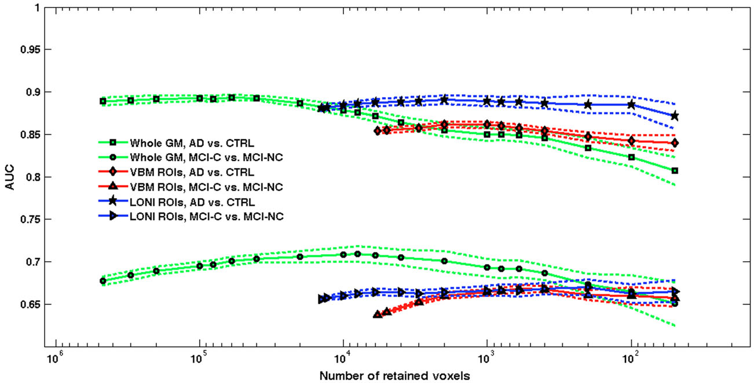
Local vs. global approach
6000 voxels
AUC=(87.1±0.6)%
AUC=(70.7±0.9)%
The average values obtained over 10 repetitions of 20f-CV are shown; the bands around the average curves correspond to two standard deviations.
A. Retico et al., J Neuroimaging (2015)

Slide 26
Advantages of SVM analysis
In contrast to VBM, SVM is a multivariate approach thus automatically takes into account interregional correlations.
Identification of patterns of brain alterations
In addition SVM offers a predictive value
Once the decision function is learned from the training data (AD vs. CTRL) it can be used to predict the class membership of new test examples (MCI prediction of conversion).

Slide 27
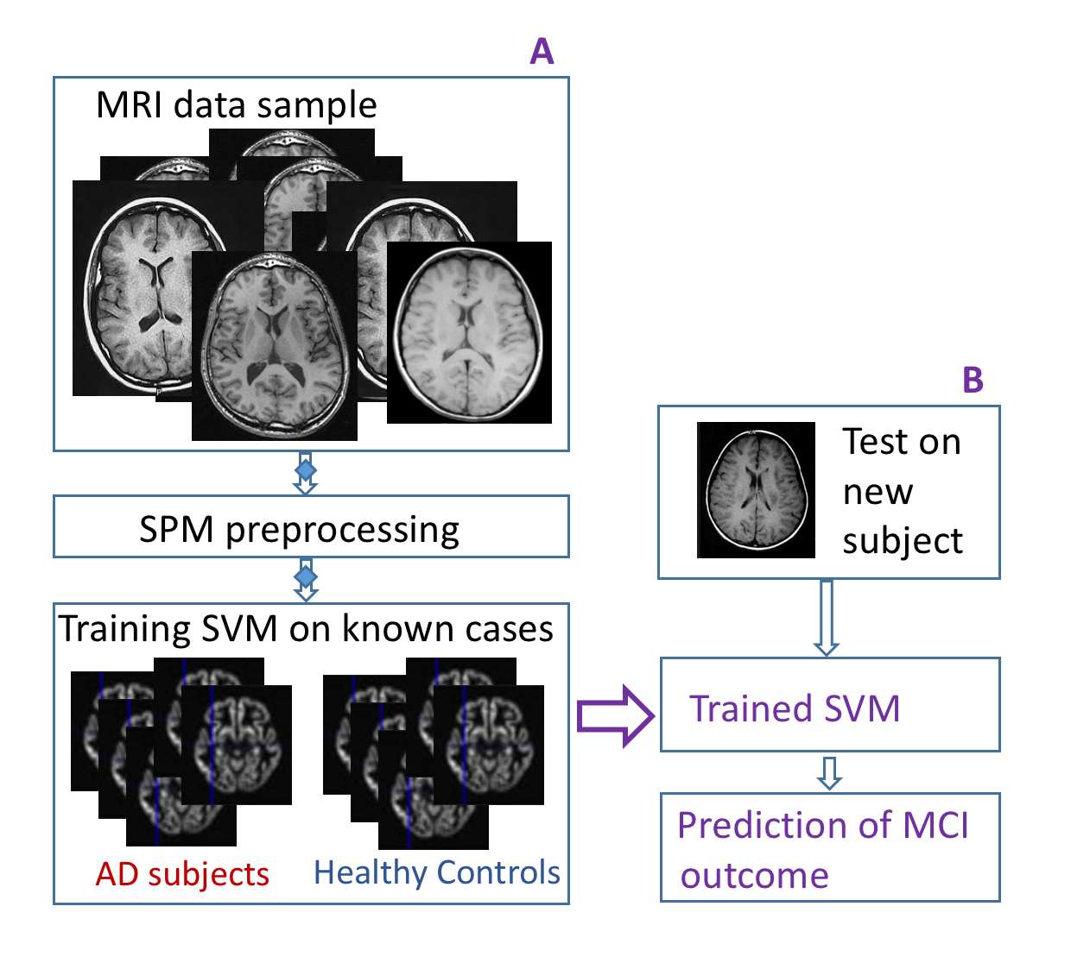
Where this pipeline can be improved?

Slide 28
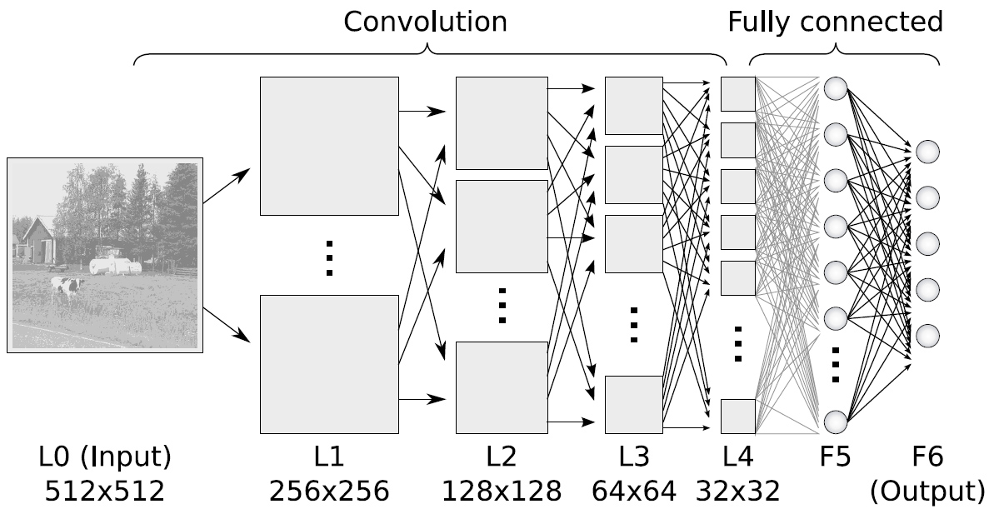
Deep learning
An algorithm to make ANN learn in multiple levels of representation, corresponding to different levels of abstraction.
Convolutional neural networks (CNNs) represent mid-level and high-level abstractions obtained from raw data.
Neural networks with 6-9 hidden layers

Slide 29
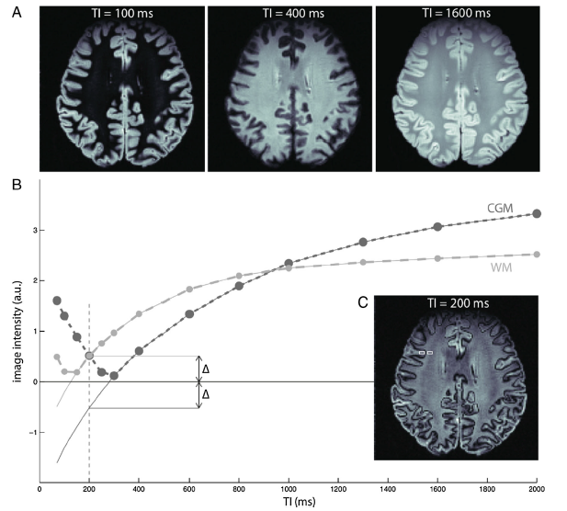
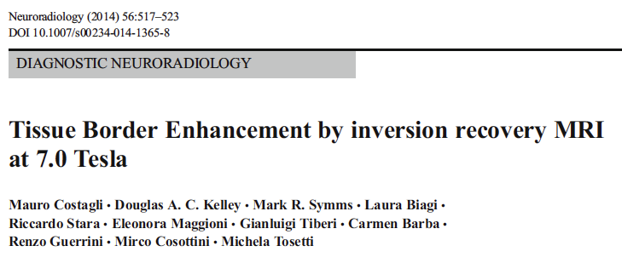
The tissue border enhancement (TBE) sequence
TBE acquisition technique provides images with enhanced visualization of borders between two tissues of interest without any post-processing.
TBE is an Inversion Recovery sequence (FSE-IR) with appropriate TI
Accurate assessment of the GM-WM interface is important in the classification of cortical malformations
M_{WM}
M_{CGM}

Slide 30
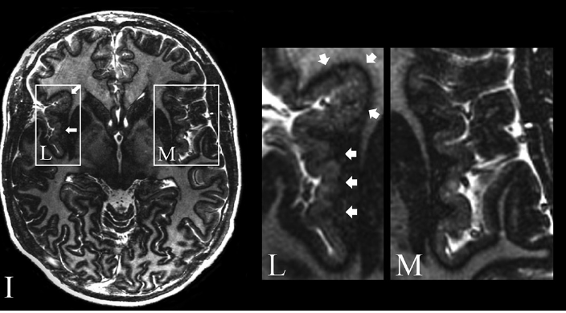
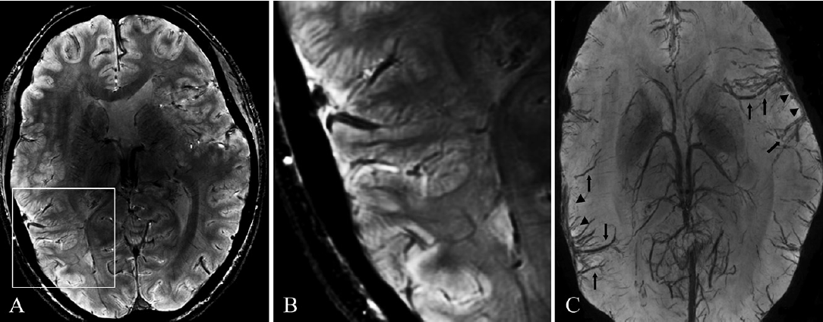
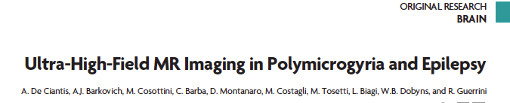
7T MRI in Polymicrogyria
De Ciantis et al,. AJNR (2015)
TBE imaging depicted a hypointense line corresponding to GM-WM interface, improving detection of the polymicrogyric cortex
Potential relevant implications for diagnosis, genetic studies, and surgical treatment of associated epilepsy.
TBE
SWAN
SWAN minIP

