Slide 1
Image Processing Meeting 05/07/2016
Cognitive Image Processing
Calliope-Louisa Sotiropoulou

Slide 2


Cognitive Image Processing:
Algorithm
Build small arrays of pixels (3x3 for static images or 3x3x3 for movies – 3rd dimension for time) that are AM patterns (M. Del. Viva, G. Punzi)
B/W 2⁹=512 patterns: 101-010-100, ……. , 111-011-001
4 gray level 2¹⁸= 256 Kpatterns: 00,00,01-00,01,00-11,00,10 …..
B/W + time 2²⁷= 128 Mpatterns: 111,000,000 - 000,111,000 - 000,000,000
Training: Calculate the frequency of each pattern in the sample images/frames
Compute Probability Density Histograms (PDHs) for different training image sets
Select the relevant patterns to be put in the AM bank
Running stage: Send the patterns to the AM chip to be filtered

Slide 3
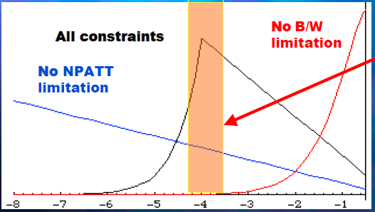
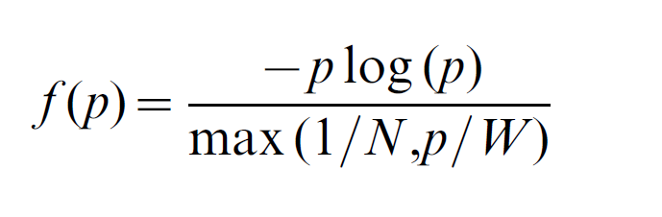
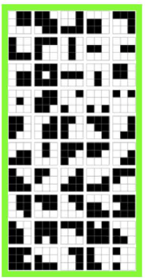

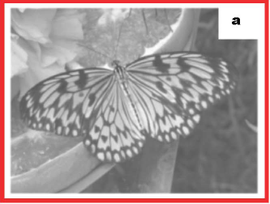
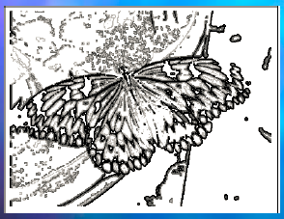
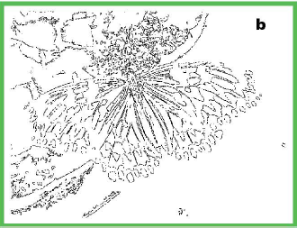
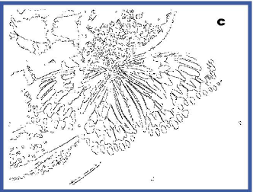
FTK for Image Filtering
Choice of relative patterns: Choose the pattern set that maximizes entropy H under real constraints
Patterns that are efficient carriers of information
given the bandwidth (W) & memory limits (N)
Accepting only
these 50 patterns
4 grey level:
2¹⁸ patterns
Stored N=2000
= 1/64 of 1 chip
= 50 mW
Accepting only
these 16 patterns
9.8%
5.5%

Slide 4
Cognitive Image Processing:
Current Status
We use the Kintex Ultrascale KCU105 Evaluation board
Communication via Ethernet and IP bus
An image is loaded through the IP bus in an internal memory
The identifying patterns module scans the internal memory and send the identified patterns to the accumulators

Slide 5
Cognitive Image Processing:
Current Status
After the accumulation process is finished the probability is calculated for each pattern (using a DSP slice divider)
The probability is used as an address to a 16k positions LUT to calculate the entropy
The entropy is used as an address to a 16k LUT to find the entropy bin

Slide 6
Cognitive Image Processing:
Entropy Calculation
We divide the x axis (log(p) axis) into equal intervals called pSS or bins (probability Super Strips – same principle as FTK). The value will be generic and can be a user defined value (using log(p) for defining pSS facilitates defining the intervals because the log function will complicate the transformation to pSS defined for p).
In order to order the patterns what is required from the Sim framework is a LUT that given a log(p) value in the input (in fixed point arithmetic value) will return an index in the output, the pSS index value

Slide 7
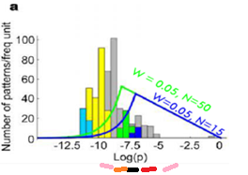
Cognitive Image Processing:
Entropy Calculation
We need to choose the patterns below the area of maximum entropy
log(pi) in the black area will have an index 0, log(pi) in the red area 1, in the orange area 2, pink area 3 etc. Areas with approximate entropy values will have the same pSS index.
The pSS index will serve as a Pointer to a Data Organizer structure. In each index the of the Data Organizer the number of patterns that belong to this index will be stored with an address that will point to another memory (probably external to the device) where these patterns will be retrieved from.

Slide 8
Cognitive Image Processing:
Entropy Calculation
What we have now as a first step to achieve pattern selection quickly is the following:
  We use the bin number as an address to an internal memory (1k words)
  We choose to write only the bins (pSS) with values from 0→ 1024
  For each selected bin we writhe to the bin address the pattern and we use a preselected bit to set it as an “active pattern”
  After the entropy calculation process is finished we read the N first written words from the memory (where N is the number of selected patterns)
  In the future this structure will be substituted by a Data Organizer like module

Slide 9
Cognitive Image Processing:
Pattern Selection Process

