Slide 1


GAMMA: Struttura nucleare con spettroscopia γ
SPES
NUCLEI ESOTICI LONTANO DALLA VALLE DI STABILITA’
LIMITI dell’ESISTENZA del SISTEMA NUCLEARE
ATTIVITA’ 2015-2016
GAMMA
FTE: 46.5 (18.1 Milano)
Persone: 64 (23 Milano)
6 Sezioni: FI,LNL,MI,NA,PD,PG
CONSUNTIVI 2015
80 pubblicazioni
91 Talks (51 Milano)
12 Tesi (9 Milano)

Slide 2
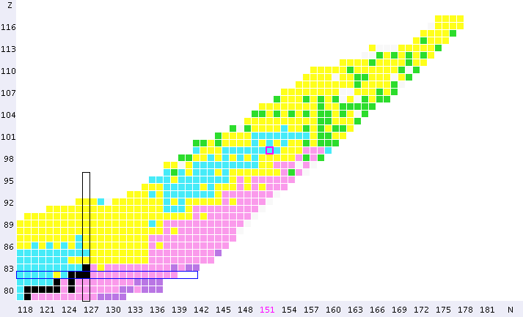
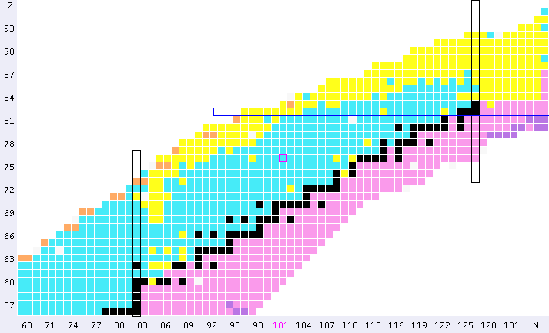
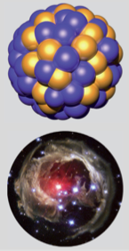
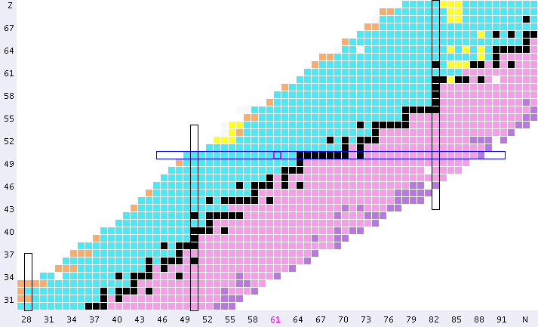
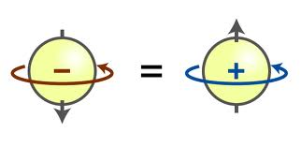
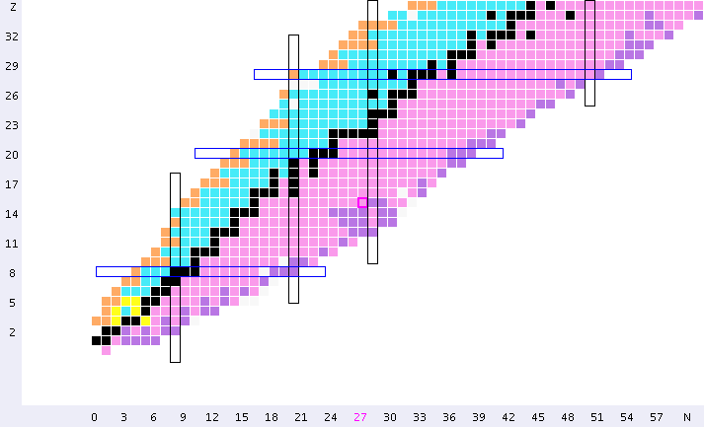
Challenges in MODERN NUCLEAR PHYSICS
Quest for a UNIFIED DESCRIPTION of ALL Nuclei
248 Stable
~3000 discovered
82
BASIC SCIENCE
126
Many Body Finite Quantum System
Proton number Z
n
p
Symmetry
Principle
50
82
28
50
> 6000 expected
20
8
28
2
20
Neutron number N
2
8
Notes:
UNIFIED DESCRIPTION of More than 6000 nuclei expected to exist in the universe, STARTING from the same common basis which is the symmetry principle of the nuclear force

Slide 3
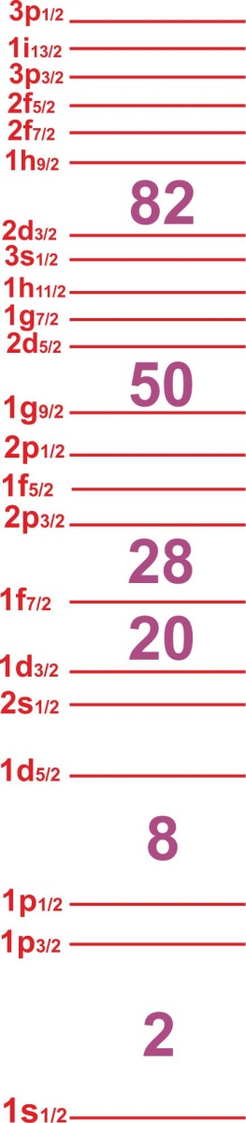
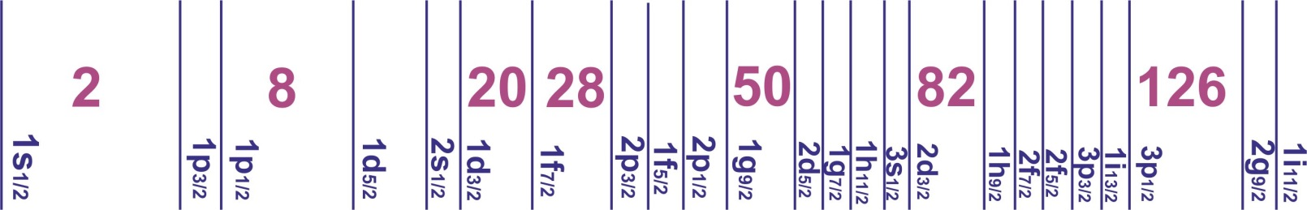
Challenges in MODERN NUCLEAR PHYSICS
Quest for a UNIFIED DESCRIPTION of ALL Nuclei
82
²⁰⁸Pb
BASIC SCIENCE
126
Many Body Finite Quantum System
Proton number Z
¹⁰⁰Sn
¹³²Sn
Symmetry
Principle
50
82
SHELL STRUCTURE
(Magic Numbers)
28
⁷⁸Ni
50
20
⁴⁸Ca
8
¹⁶O
28
2
20
Neutron number N
2
8

Slide 4
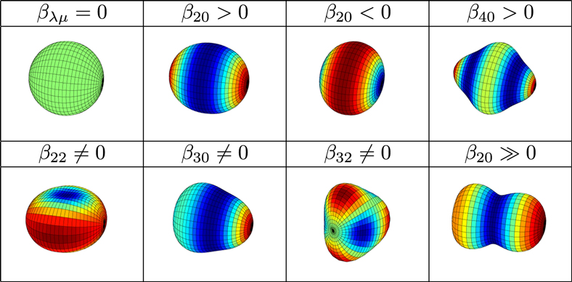
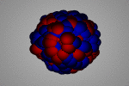
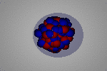
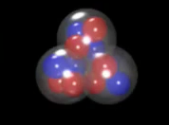
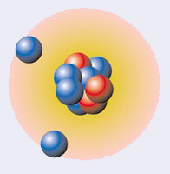
Challenges in MODERN NUCLEAR PHYSICS
Quest for a UNIFIED DESCRIPTION of ALL Nuclei
²²⁴Ra
Stable
octupole
GIANT DIPOLE
pygmy DIPOLE
N SKIN OSCILLATION
82
BASIC SCIENCE
Collective Excitations:
RESONANCES
126
Many Body Finite Quantum System
Proton number Z
Symmetry
Principle
50
82
SHELL STRUCTURE
(Magic Numbers)
28
Shape Evolution
50
SHAPES
20
EXCITATIONS
8
28
¹²c
2
20
Neutron number N
2
8
Clusters
¹¹Li
Halos
Notes:
COLLECTIVE EXCITATIONS

Slide 5
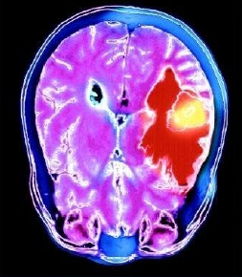
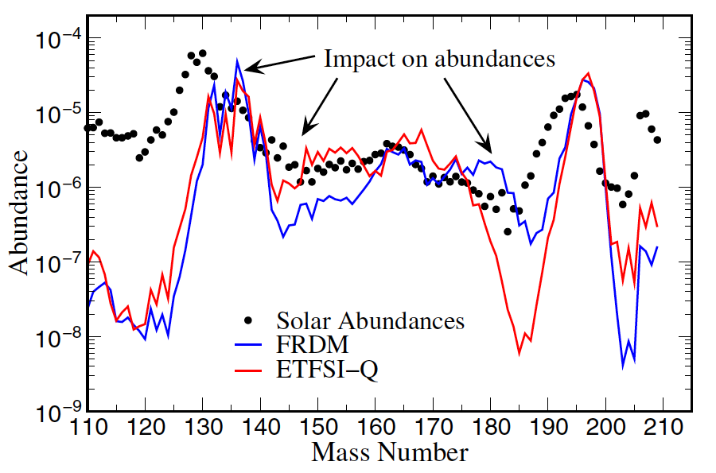
Challenges in MODERN NUCLEAR PHYSICS
Quest for a UNIFIED DESCRIPTION of ALL Nuclei
C
INTERDISCIPLINARITY
Astrophysics
Nucleosynthesis
C
BASIC SCIENCE
82
Applications
Radioisotopes,
Reactors, …
126
Many Body Finite Quantum System
Proton number Z
Symmetry
Principle
50
r-process path
82
SHELL STRUCTURE
(Magic Numbers)
28
50
SHAPES
20
Impact on abundances
Element
ABUNDANCES
EXCITATIONS
8
28
2
20
Neutron number N
r- process location
2
8
β-decay : τ_{β SPH} ~ 10 x τ_{β DEF}
n emission : P_{nSPH} ~ 0.5 x P_{nDEF}

Slide 6

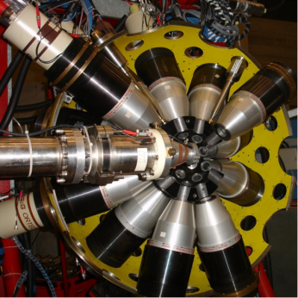
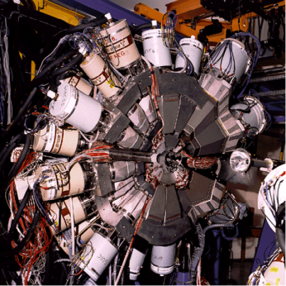
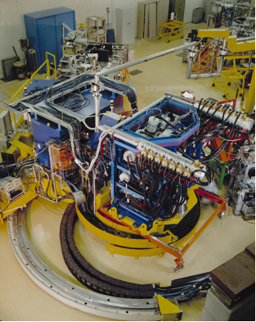
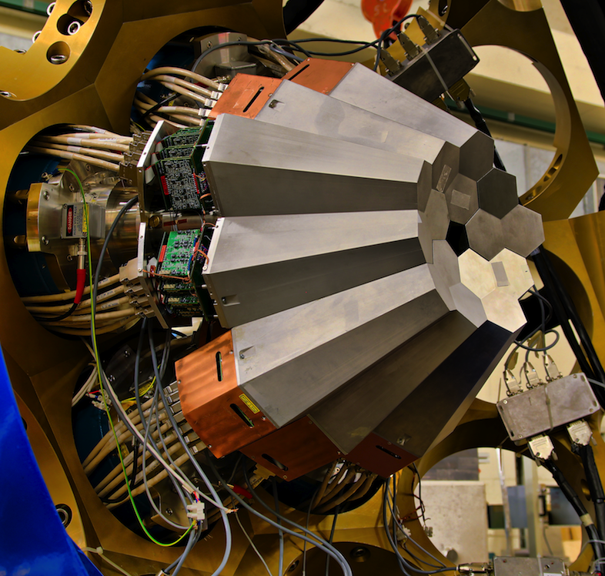
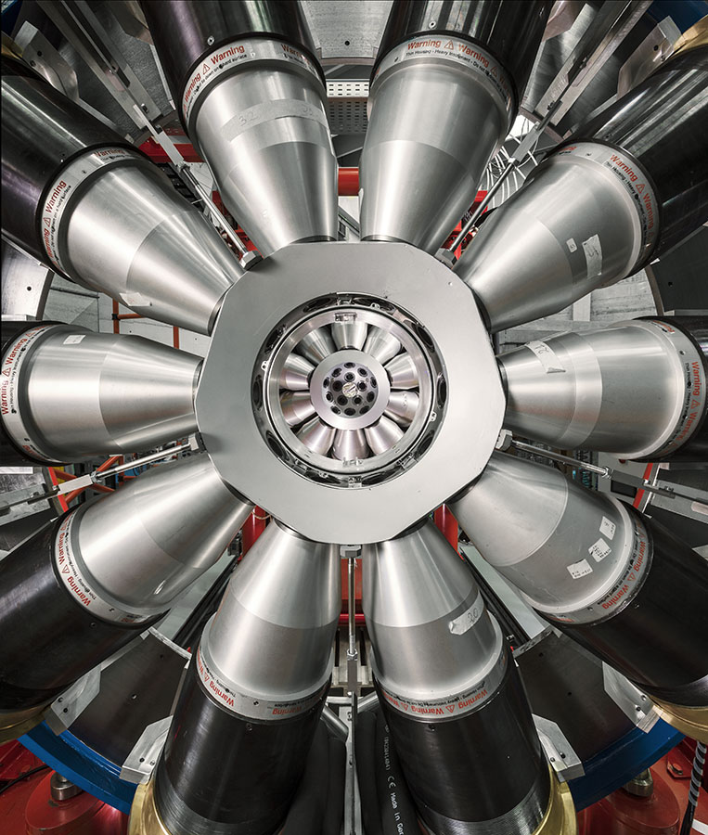
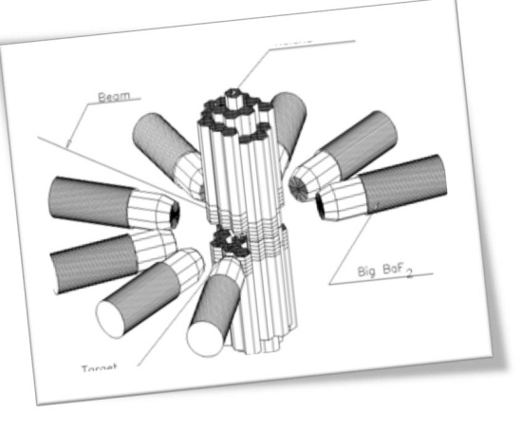
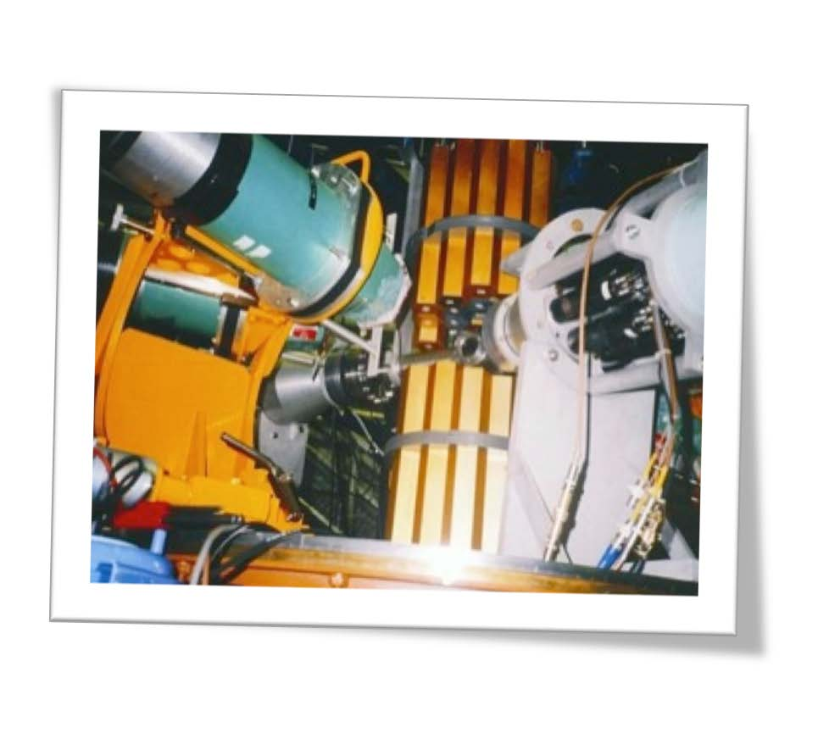
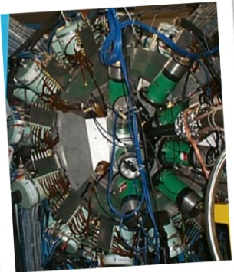
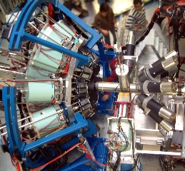
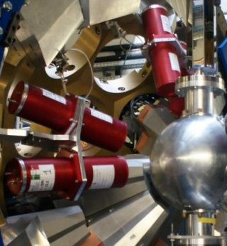
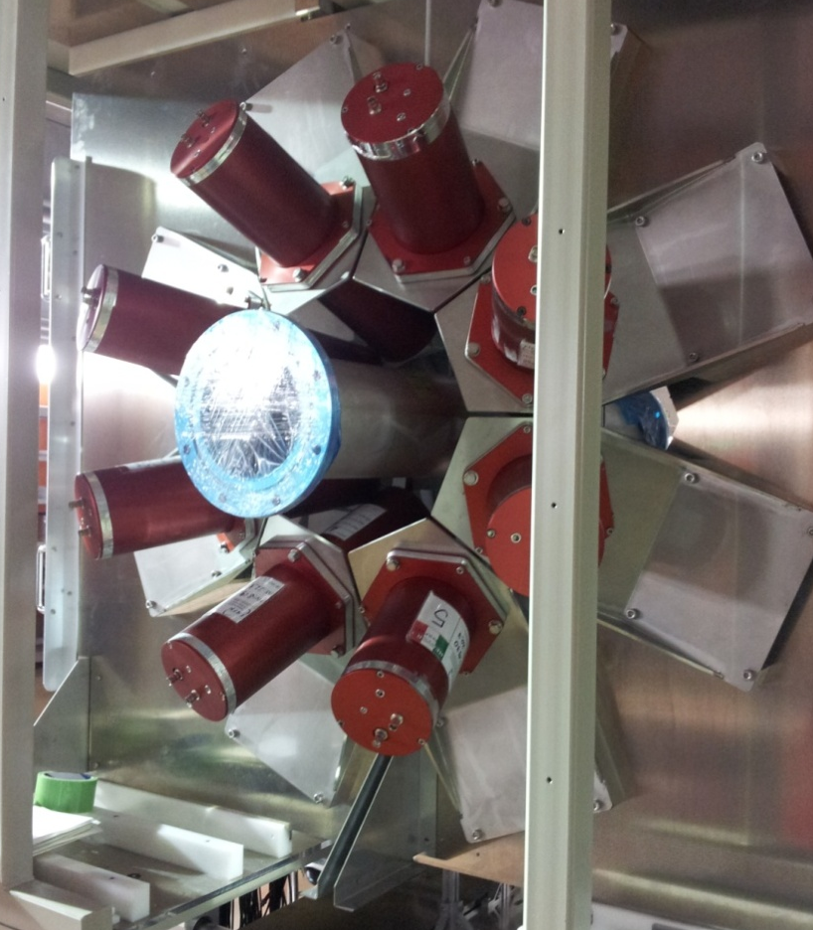
Spettroscopia GAMMA allo stato dell’arte
Spettroscopia γ di alta risoluzione e alta efficienza
Rivelatori HPGe per raggi gamma ai LNL
GASP
1992 - 2012
EUROBALL
1997 - 1998
CLARA
2004 - 2008
AGATA
2009 - 2011
GALILEO
2014 - ...
AGATA
2019 - …
MIPAD 1988 - 1992
Spettroscopia γ di alta energia – RESPONSABILITA’ di MILANO
Rivelatori scintillatori per raggi gamma (BaF₂, LaBr₃, ...)
HECTOR
1980' @ NBI
HECTOR
1990' @ LNL
HECTOR
2000' @ IRES
HECTOR
2000' @ GSI
HECTOR+
2010' @ GSI
HECTOR+
2014' @ RIKEN
Ricerca e Sviluppo
Rivelatori HPGe, scintillatori e nuovi materiali, elettronica dedicata …

Slide 7
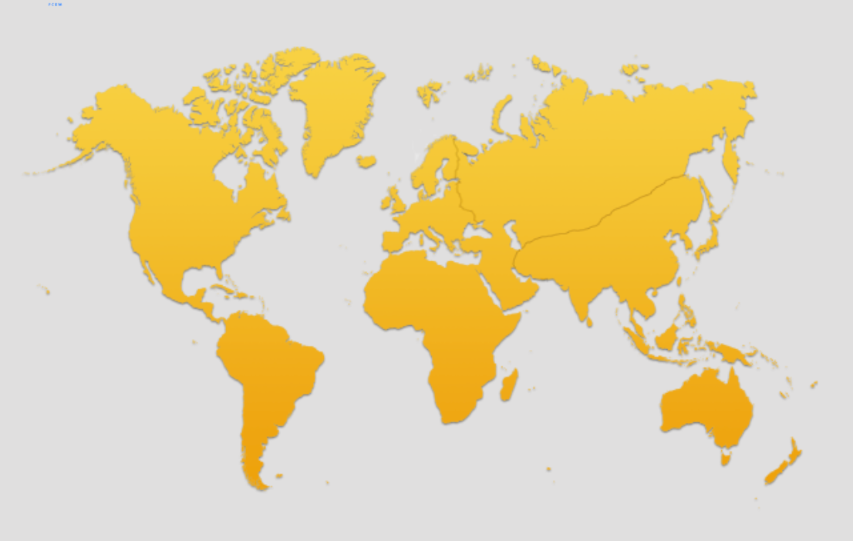
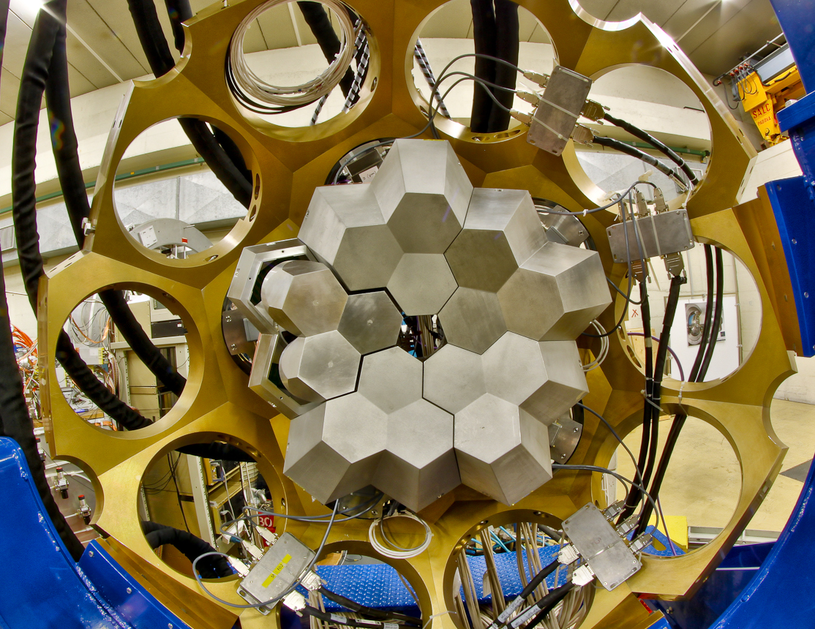
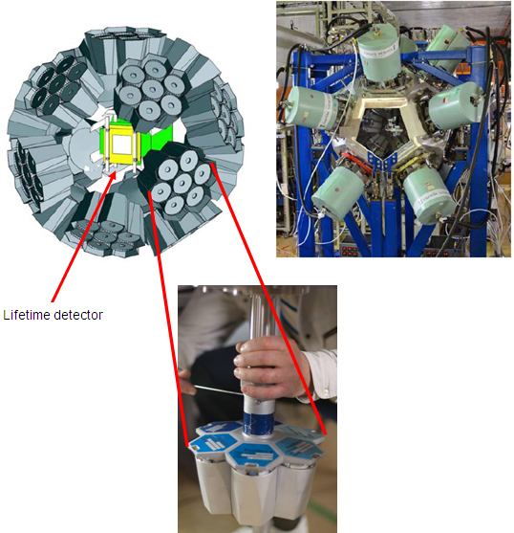
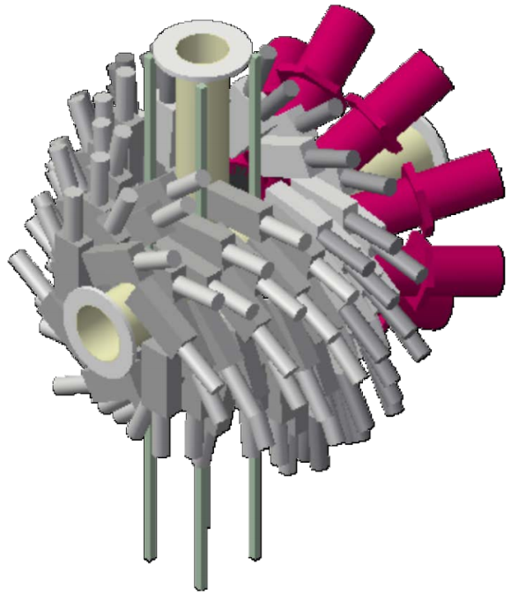


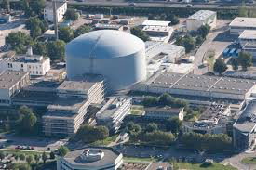

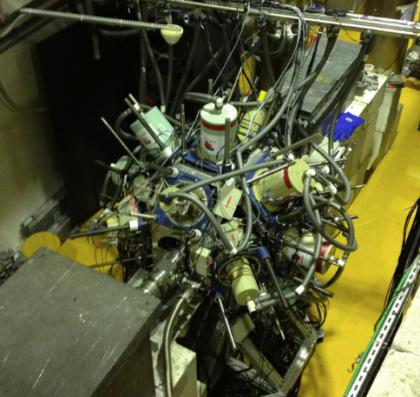

CAMPAGNE SPERIMENTALI COMPLEMENTARI
FASCI (stabili, instabili, neutroni), APPARATI, …
DUBNA
Oslo
JYFL
Warsaw
GANIL
GSI
Orsay
Legnaro
ISOLDE
CERN
OSAKA
ILL
RIKEN
Bucharest
EXILL
LNS
GALILEO Array at LNL
Working horse for

Slide 8
GAMMA
13 Esperimenti Realizzati nel 2014 – 2016
(6 con spokepersons di Milano)
>= 17 Esperimenti da Svolgere nel 2016 – 2018
(>= 6 con spokepersons di Milano)

Slide 9
  HIGHLIGHTS and STATUS
      AGATA (LNL, GSI, GANIL)
      RIKEN, OSAKA
      ILL (reattore, Grenoble)
      ISOLDE-CERN
      LNL: Apparato GALILEO
      R & D HPGe e Scintillatori
→

Slide 10
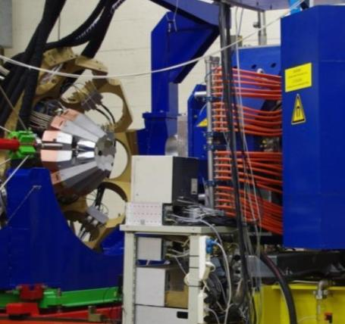
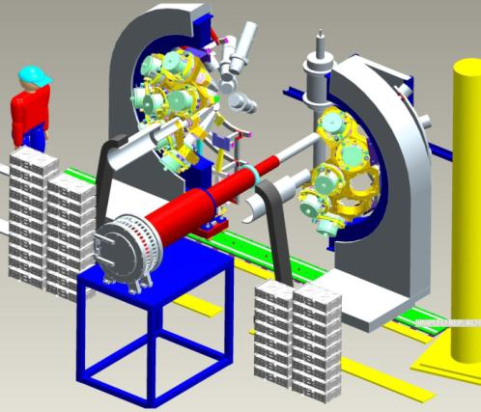
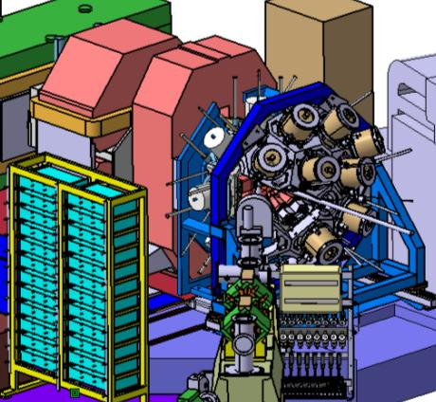
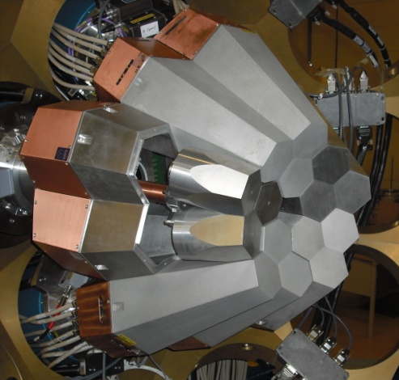
The AGATA Evolution Towards 1π
LNL
2009
9 crystals
Eff. ~3.5%
LNL: 2010-2011
15 crystals
Total Eff. ~6%
GSI: 2012-2014
22 crystals
Total Eff.~10%
GANIL: 2015-2019
up to 45 crystals Total Eff. ~22%
AGATA + PRISMA
“backward”
STABLE
BEAMS
20 experiments
AGATA + Hector⁺ + FRS
“forward”
RELATIVISTIC
EXOTIC BEAMS
7 experiments
AGATA+VAMOS+ …
“backward”
EXOTIC (ISOL)
& STABLE BEAMS
6 experiments in 2015
AGATA “Demonstrator”
→ From 2020 at LNL at SPES (ISOL Beams)

Slide 11
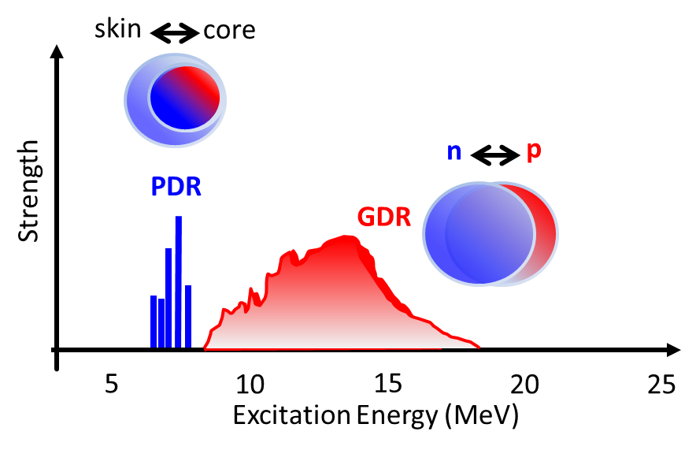
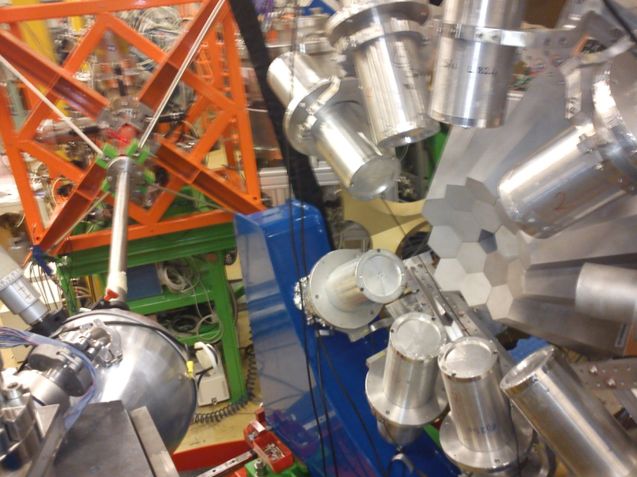
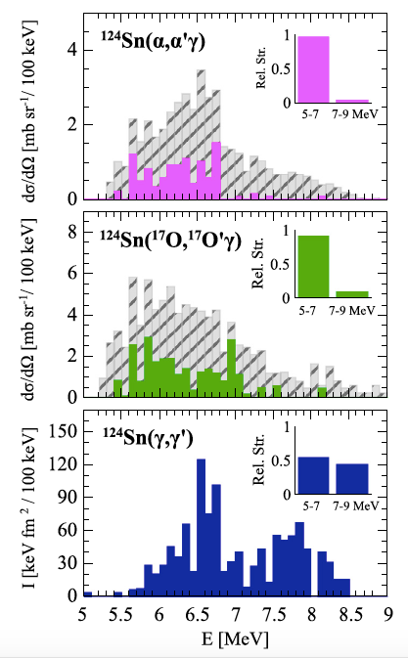
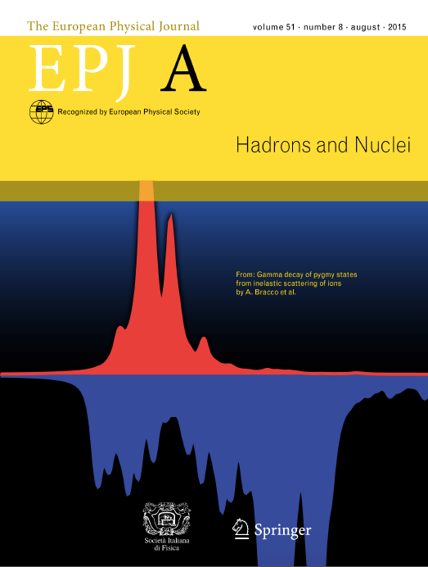
AGATA@LNL Highlights
n
PYGMY
DIPOLE response
LaBr₃
S_{n}
Few %
GIANT
(α,α’)
KVI
Pygmy
Resonance in
STABLE nuclei
5< E <7 MeV
E1 Isoscalar
n skin
oscillation
Review paper
COVER PAGE
A.Bracco, F. Crespi, E. Lanza
(¹⁷O,¹⁷O’)
AGATA-LNL
Inelastic
scattering
Milano proposals
Data Fully Analyzed
And Published
(γ,γ’)
Darmstadt
²⁰⁸Pb: F.C.L. Crespi, A. Bracco et al., PRL113 (2014) 012501
¹²⁴Sn: L. Pellegri, A. Bracco et al., PLB738 (2014)519,
L. Pellegri, A. Bracco et al., PRC92, 014330 (2015)
⁹⁰Zr: F.C.L. Crespi et al, PRC 91 (2015) 024323
MICROSCOPIC NATURE of PYGMY:
ISOSCALAR E1 Strength in ²⁰⁸Pb, ¹²⁴Sn, ⁹⁰Zr
¹⁴⁰Ce: M. Krzysiek et al, PRC 93 (2016) 044330
⁸⁰Zr: S. Ceruti et al, PRL115 (2016) 222502 – GDR Isospin Mixing
Important for ASTROPHYSICS:
Nucleosynthesis, Neutron Stars

Slide 12
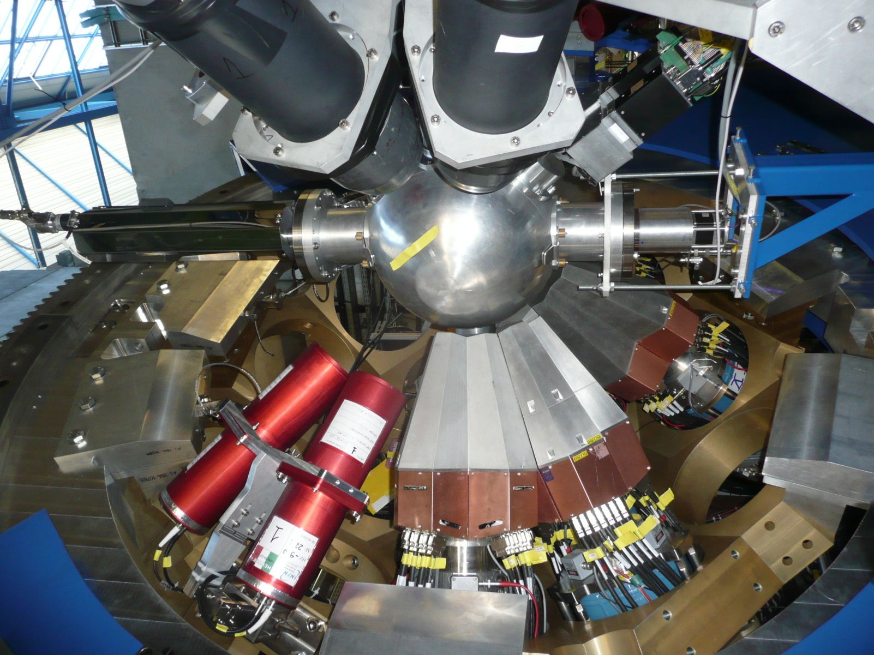
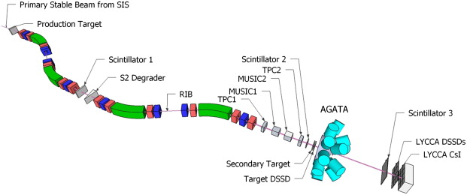
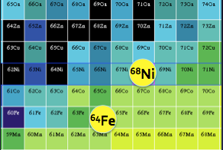
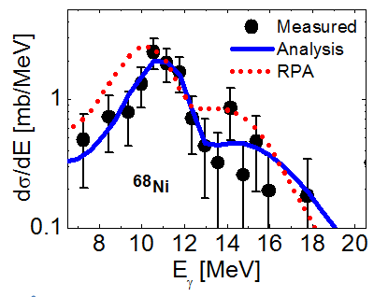
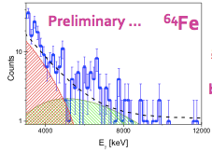
AGATA@GSI Highlights
2012-2014
INCOMING
identification
Ion SELECTION
OUTGOING
Identification
LYCCA
Koeln-Lund
LaBr₃
AGATA+LaBr3
@ GSI
FRagment Separator
Relativistic Coulomb Excitation
Pygmy Resonances in EXOTIC Nuclei
MILANO proposal
O.Wieland, et al. …
2005: FIRST Case
(2005: EUROBALL Clusters + BaF2)
⁶⁸Ni
O.Wieland, A. Bracco et al., PRL 102, 092502 (2009)

Slide 13

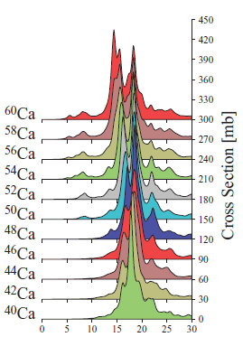
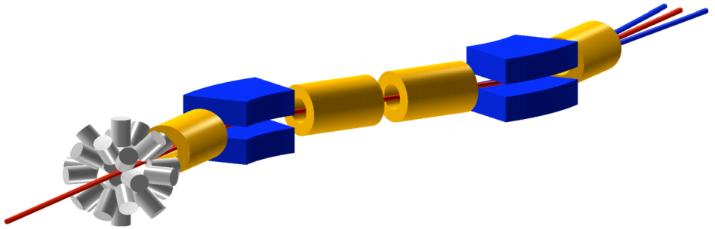
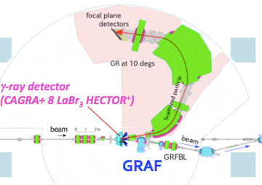
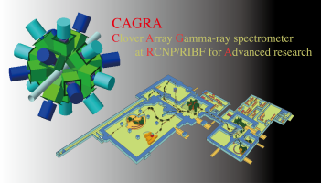
Pygmy Resonances in EXOTIC/STABLE Nuclei
GAMMA Campaign in Japan
@RIKEN:
The most Intense RIB Facility …
@OSAKA:
Fine structure of Pygmy
⁷⁰Zn , ⁷⁶Ge, ⁸⁶Kr, ²³⁸U
250-350 MeV/A
up to 100 pnA
^{90,94}Zr(α,α’γ) 140 MeV
^{90,94}Zr(p,p’γ) reactions
31 days approved
A.Bracco, F. Crespi, …
June-October 2016
2017…
Pygmy Evolution
In n-Rich Nuclei
Ca
MILANO LaBr₃
ε=1-2%@ 10 MeV
16 Clovers, 6% eff
Analysis
DALI₂ -NaI
ε=4%@ 10 MeV
The most Exotic Nuclei:
^{20,22,24}O, ^{50,52}Ca, ⁷⁰Ni, ^{128,132}Sn
O. Wieland et al., …
Grand RAiden Forward beam line

Slide 14
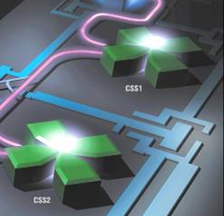




AGATA@GANIL (2014-2019)
Magnetic Spectrometer
VAMOS
dispersive mode
beam
AGATA
Commissioning December 2014
10 Experiments in 2015-2016
1st campaign AGATA (2015-2017)
VAMOS (Vacuum mode)
+ plunger; + FATIMA; + PARIS
Future campaigns (2018-2019):
NEDA/NWALL and DIAMANT,
VAMOS gas-filled mode
Coulex with the upgraded SPIRAL 1
PSA hits for 24 crystals

Slide 15

AGATA@GANIL
2 Esperimenti approvati con spokesperson Milano
In 2017:
Lifetime measurements of excited states
in neutron-rich C and O isotopes:
a stringent test of the three body forces with the AGATA+PARIS+VAMOS setup
(S. Leoni,B. Fornal, M. Ciemala)
Necessità di accoppiare
scintillatori di grosso volume
(LaBr3 e PARIS array) ad AGATA:
- Integrazione DAQ (S. Brambilla)
- Richieste di meccanica per 2017
in sezione a Milano
Housing
Shielding from magnetic field
In 2018:
Gamma decay from near-threshold states in 14C: a probe of clusterization phenomena
in open quantum systems
(B. Fornal, S. Leoni, M. Ciemala)

Slide 16
  HIGHLIGHTS and STATUS
      AGATA (LNL, GSI, GANIL)
      RIKEN, OSAKA
      ILL (reattore, Grenoble)
      ISOLDE-CERN
      LNL: Apparato GALILEO
      R & D HPGe e Scintillatori
→

Slide 17


The γ-spectroscopy campaign @ ILL-Reactor (Grenoble)
2012-2013: 100 days, 95% DATA taking
EXILL
10 EXOGAM Clovers
+
6 Ge GASP
6% efficiency
World brightest
continuum
neutron source.
In pile
Φ_{n} = 5×10¹⁴ n cm⁻² s⁻¹
First time a large HPGE array
(up to 52 crystals)
is installed around an
Highly collimated n-guide

Slide 18




HIGHLIGHTS from EXILL Campaign
²¹⁰Bi: ²⁰⁸Pb + 1 π + 1 ν
133
Neutron-induced
FISSION
n + ²³⁵U
n + ²⁴¹Pu
Neutron-capture
²⁰⁹Bi(n,γ)
Full low spin
spectroscopy
¹³³Sb:
¹³²Sn + 1 π
Complex excitations, couplings with phonons,
NEW MODEL developed
G. Bocchi, S. Leoni, F. Fornal,G. Colò, … in print in PLB
Milano/
Krakow

Slide 19



²⁰⁹Bi(n,γ)²¹⁰Bi – ILL Grenoble
EXILL
Capture Level
Complete
Low Spin
Spectroscopy
of ²¹⁰Bi
4605.2(1) keV
4-,5-
One-to-One
Comparison
with SHELL Model
considering
²⁰⁸Pb + 1𝜋 + 1𝜈
frozen
CORE
VALENCE
Particles
64 primary transitions (40 new)
70 excited states (33 new)
Angular Correlations
Multipolarities of γ-decay
Spin (Parity) of States
N.Cieplicka, B. Fornal, S. Leoni, PRC93, 054302 (2016)
N. Cieplicka, , S. Leoni, B. Fornal et al., in print in PRC
Notes:
In questa figura si puo sottolineare i stati, che non sono descritti da shell model – lo faccio stasera

Slide 20



Da Autunno 2015: HIE-ISOLDE (> 4-5 MeV/A)
MINIBALL+T-REX
New exp at HIE-ISOLDE in 2017
On ¹³³Sb
(complementary to EXILL results
Spokepersons Milano)
4 MeV/A – HIE-ISOLDE
Same Reaction Mechanism
at CARIBU to reach ^{105,106}Nb
on stand by (too low beam intensity)
New reaction mechanism - CLUSTER TRANSFER -
with RIB’s to populate neutron-rich nuclei
at medium-high energy and spin
Pilot Experiment @ REX-ISOLDE
^{A}X + ⁷Li → (^{A}X + t) + α
→ (^{A}X + α) + t
S. Bottoni, PhD-Thesis, Milano
Weakly Bound Target
B.E.(α-t) = 2.5 MeV
Cluster Structure
PRC92(2015)024322
Future Applications
at SPES (2 LOIs)
4 MeV/A – HIE-ISOLDE

Slide 21



β-decay Studies @ ISOLDE (CERN)
G. Benzoni et al., …
New Decay Station
July
2014
Studies of ¹⁵⁰⁻¹⁵²Ba via by β-decay ¹⁵⁰⁻¹⁵²Cs
High intensity ¹⁵⁰⁻¹⁵²Cs beams are unique to ISOLDE
ISOLDE Decay Station in phase1 configuration
4 HPGe + LEP + 4 FAST-TIMING detectors LaBr₃
Measurements of halflives of decay and P_{n}
Information on low-lying levels (OCTUPOLES) in ¹⁵⁰⁻¹⁵²Ba
Recovery in 2016
Important Activity
for Development of
decay-station for SPES
Additional activity on β-decay at RIKEN (G. Benzoni et al., …)

Slide 22


Richieste di meccanica 2017 –TAPE Station
* Realizzazione della camera di alloggiamento del nastro per b-decay Tape Station
* Progettazione camera di scattering per b-decay Tape Station @SPES
* Progettazione e realizzazione di una stazione per
avvolgimento del nastro
RICHIESTA 6-8 mesi Progettazione
4 mesi realizzazione

Slide 23
  HIGHLIGHTS and STATUS
      AGATA (LNL, GSI, GANIL)
      RIKEN, OSAKA
      ILL (reattore, Grenoble)
      ISOLDE-CERN
      LNL: Apparato GALILEO
      R & D HPGe e Scintillatori
→

Slide 24


GALILEO
Sistema ad alta efficienza e versatilità
30 GASP HPGe (80%) @ 22.5 cm
5 5 5 5 5 5
29º 51º 59º 121º 129º 151º
30 EB cluster capsules (60%)
(10 EB clusters) @ 24 cm, 90º
4.5%
ε_{ph} ~ 8%
P/T ~ 50%
4%
using AGATA R&D
preamplifiers, digital sampling, preprocessing, DAQ
→ high count rates
(30–50 kHz/det)
using EXISTING DETECTORS
GASP detectors
EB cluster detectors capsules
→ high photopeak efficiency
at LNL
Tandem, ALPI - PIAVE
SPES – ISOL Beams

Slide 25



Integrazione dei rivelatori ancillari
  Ancillary detectors
  INTERNI (reaction chamber)
    EUCLIDES (GAMMAPOOL)
    PLUNGER (Kholn/LNL)
    TRACE (Padova)
    SPIDER (Firenze)
    DANTE (LNL)
  ESTERNI
    n–Wall (GAMMAPOOL)
    LaBr₃ (Milano)
    RFD (IFJ PAN Krakow)
    NEDA (LNL)
  Mechanical integration
    reaction chamber
    support and cabling
    holding structure
    mounting on the rails
  DAQ integration
    AGATA-like solution
    VME + AGAVA (IFJ PAN - INFN Mi)
GALILEO + RFD
n–Wall

Slide 26



OFFICINA SEDE - Attivita’ principale nel 2017:
Multi-target system per GALILEO (LNL)
Progettazione e realizzazione di un sistema di sostituzione remoto del target di Galileo
Progettazione terminata
Realizzazione di un dummy per verifica della movimentazione terminata
Realizzazione delle componenti da vuoto in corso e successiva verifica del funzionamente sotto vuoto
C. Gesmundo, …

Slide 27



GALILEO - Inizio attività nel 2015
2014-2015: 3 Turni di Commissioning
da Luglio 2015: Campagna Sperimentale
2 Esperimenti svolti con spokesperson di Milano
Giugno 2016 – 2 weeks
S. Ceruti, A. Mentana, F. Camera, et al., …
Misura della simmetria di isospin
attraverso il decadimento γ della GDR
Follow up di esperimento AGATA@LNL
GALILEO + EUCLIDES
+ NWALL + 10 LaBr₃
S. Ceruti et al, PRL115 (2016) 222502

Slide 28



Luglio 2016 – 2 days
S. Leoni, B. Fornal, et al., …
Testing the performances of the TRACE detector
for identification of A 10 mass ions
at low kinetic energy, by PSA analysis
In view of a new Physics program GALILEO/AGATA:
γ-decay from unbound states in
Light systems…
Different Configurations
Individual pads
2 pads
4 pads
TWO ACQ – SYSTEMS
Analog (Brambilla, Boiano)
Digital
GALILEO + TRACE +
NWALL + 10 LaBr₃
Supporto
Stampante 3D
(F. Tomasi,
INFN sezione)
13 MeV
C
B
Be
α
Li
SVILUPPO – costruzione di un array TRACE (Meccanica ed elettronica, INFN sezione)

Slide 29
GALILEO – NEXT Major Steps
Implementazione dei 10 TRIPLI CLUSTERS (ex-EUROBALL Detectors):
Criostati
Anti-Compton SHIELDS
Implementazione Array 10 Scintillatory LaBr3 a 90°
(4 rivelatori – mancanti, 6 già in possesso)
Array Rivelatori a Si segmentati – pixel: TRACE
Studio geometria, …
elettronica, …
Implementazione in GALILEO

Slide 30
  HIGHLIGHTS and STATUS
      AGATA (LNL, GSI, GANIL)
      RIKEN, OSAKA
      ILL (reattore, Grenoble)
      ISOLDE-CERN
      LNL: Apparato GALILEO
      R & D HPGe e Scintillatori
→

Slide 31
  GAMMA - R & D
Elettronica e DAQ (AGATA/GALILEO e Ancillari)
Preamplifiatori e Digitalizzatori per AGATA/GALILEO (A. Pullia)
Preamplificatori integrati per Si segmentati TRACE (A. Pullia, S. Capra)
Preamplificatori Analogici (C. Boiano)
Elettronica e DAQ per scintillatori LaBr3/PARIS (S. Brambilla,S. Riboldi, C. Boiano)
Scintillatori e Nuovi Materiali
(F.Camera, A. Giaz, N. Blasi, B. Million, …)
Misure di Performances LaBr3 con p
Misure di nuovi materiali CLYC, GYGAG, …
Sensitività posizionale con LaBr3 di grossi volume
Studio funzione di risposta
γ Monocromatici
Giugno 2016
LaBr:Ce 3.5”X8”
New SUBARU - SPring-8 (Giappone)

Slide 32
Grazie per l’attenzione

Slide 33


AGATA Steering Committee Italian Members: A. Bracco, G. De Angelis
AGATA Collaboration Council Italian Members: S. Lenzi, B. Million, A. Nannini, D. Napoli
AGATA MANAGEMENT BOARD and TEAMS
E. Farnea
Status June 2016

Slide 34


The Gamma Tracking Array Concept
HARDWARE
SOFTWARE

Slide 35


Primo turno di misura - luglio 2015
GALILEO + EUCLIDES + NWALL (analysis on going)
25 HPGe (4 Rings) – 3.6% eff
High spin structure of ⁸⁴Br (N=49) - situated next to major Shell closure (N=50)
⁸²Se (250 MeV) + ⁷Li (1 mg/cm²) → ⁸⁴Br + 1n + 1α
γ-nα
γγ-nα coincidences
Angular correlations
⁸⁴Br
γγ-matrix
Online Spectra
Analysis on-going

Slide 36
Attività di R&D con scintillatori
R&D su nuovi Scintillatori (i.e. SrI₂, GYGAG, CLYC, Ce:Br₃, LaBr₃:Ce)
  Misurate le performance di CeBr₃ (2”x3” e 3”x3”), GYGAG, SrI₂ e CLYC
    Risoluzione energetica e linearità da 0.5 a 9 MeV
    Pulse lineshape vs Posizione di interazione con una sorgente g collimata di 661 keV
  Misura a BCC (Cracovia) del quenching indotto da Protoni in LaBr₃:Ce
  Due misure con neutroni monocromatici su CLYC-6 e CLYC-7 (Enea Frascati e LNL)
  Misura dell’efficienza per neutroni veloci del CLYC-6 e CLYC-7 al LASA (Mi)
  Nucl. Instr. and Meth. A 778 (2015) 20–25
  sottomessi nel 2015 un articolo sui nuovi scintillatori
  sottomesso nel 2015 un articolo sulle proprietà dei CLYC-6 e CLYC-7
  In preparazione un articolo sulle misure con il CLYC
Imaging Gamma con scintillatori a grande volume, spettroscopici e continui (3”x3” LaBr₃:Ce)
  Misure di sensitività posizionale con sorgente collimata e LaBr₃:Ce 3”x3”
  Nucl. Instr. and Meth. A 772, (2015), 103
  In preparazione un articolo misure con nuovo PMT finanziato nel 2015

Slide 37




Misura con il CLYC - En = 3.3 MeV
Doppler Broadening correction in 3x3 LaBr₃:Ce
Energy resolution:
Fixed source ~ 50 keV
Source v/c=0.5 ~ 250 keV
Doppler corrected ~ 100 keV
Risoluzione energetica al variare della posizione di collimazione
Linearità (residui) nel SrI₂

Slide 38

Pygmy Resonances in STABLE NUCLEI
Study of ISOSCALAR part of PDR
^{90,94}Zr(α,α’γ) 140 MeV and ^{90,94}Zr(p,p’γ) reactions
31 days approved, A.Bracco, F. Crespi, … 2016-2017
OSAKA: GRAF (Grand RAiden Forward beam line)
16 Clovers, 6% eff
γ-ray detector
(CAGRA+ 8 LaBr₃ HECTOR⁺)
US-JAPAN Project
GRAF

Slide 39

First time a large HPGe array (52 Ge crystals)
installed around a highly collimated cold-neutron beam
SETUP 1
SETUP 2
γ – spectroscopy
lifetime measurement
10 EXOGAM – Clovers + 6 Ge GASP
6% efficiency
8 EXOGAM – Clovers + 16 LaBr3
FATIMA ARRAY
LaBr3
LaBr3
LaBr3
LaBr3
Autumn
2012
Spring
2013
15 (n,γ) and cold-neutron induced fission on ²³⁵U and ²⁴¹Pu
ACQUISITION SYSTEM
fully digital approach, TRIGGERLESS
>10 kHz/crystal, >600 kHz total, 10 ns clock
Unique opportunity for γ-coincidences over several μs time window

Slide 40


Test experiment in June 27-30, RCNP Osaka
Beam Time: from 9pm June 27 to 1 pm June 30
Beam: alpha 130 MeV
Mode: GrandRaiden at 4.7 deg with the GRAF beam line
Gamma Detectors: 1 clover at 45°, 2 LaBr:Ce 3.5”X8” at 45°,135°
Purposes:
• background condition test with alpha 130 MeV and different targets
• background test for LaBr3 detectors (+1 cm lead shield)
• neutron flux and background spectrum in clover, esp. at 45 deg
• rate test for resistive feedback type clover (US clover)
• DAQ/analyzer system test
• elastic scattering stopper & background reduction at 4.7 deg

Slide 41





GAMMA@RIKEN: The most Intense RIB Facility …
Pygmy Evolution
In n-Rich Nuclei
Ca
⁷⁰Zn
⁷⁶Ge
⁸⁶Kr
²³⁸U
250-350 MeV/A
up to 100 pnA
MILANO LaBr₃
ε=1-2%@ 10 MeV
Analysis
DALI₂ -NaI
ε=4%@ 10 MeV
Beam
Gamma Arrays
Particle id. plot
EURICA ARRAY
Big Rips
Ni
12 EUROBALL Clusters
(Eff 15% at 662keV)
18 LaBr3 array
(for FAST TIMING)
WAS3ABi
(Wide-range Active
Silicon Strip Stopper Array)
Co
Fe
Mn
New
Isotopes
… The most
Exotic Nuclei
⁷⁰Fe
At Final FOCAL PLANE of Big Rips
β decay and γ spectroscopy

Slide 42

Pygmy Resonances in EXOTIC NUCLEI
Relativistic Coulomb Excitation
@RIKEN-BigRips
2014:
^{70,72}Ni (260 MeV, 10⁴-10³ pps) + ²⁰⁸Pb
BaF2 Array DALI2+ 8 LaBr₃
Pygmy in ¹³²Sn and O – isotopes
(T. Aumann, Baba)
3 Succesfull Experiments
New Proposasl on ⁷²Ni and ^{52,54}Ca in 2016-2017
Dali2+LaBr
BaF2
GSI
Evolution of
PDR strength
in Ni isotopes
Milano LaBr3
ε=1-2%@ 10 MeV
Beam
Analysis
DALI2 -NaI
ε=4%@ 10 MeV
Big Rips
Gamma ray
detection
RIKEN

Slide 43
Misura della simmetria di isospin attraverso il decadimento γ della GDR
L’interazione Coulombiana rompe la simmetria di isopin
Ad alta energia di eccitazione la simmetria di isopin viene dinamicamente ristabilita
La rottura della simmetria di isospin è importante per il decadimento b, per le proprieta dell’isobaric analog state (IAS) e per il termine Vud della matrice CKM
Misura della simmetria di isopin nello ⁸⁰Zr
  analizzata all’interno di una tesi di dottorato e pubblicata su PRL a fine 2015
Simmetria di isopin nello ⁶⁰Zn
  Misura svolta a Legnaro usando GALILIEO + 10 LaBr₃:Ce + EUCLIDES + NEUTRON WALL
Satula et al., PRL 106(, 132502 (2011)
A.Corsi et al. PRC 84, 041304(R) (2011)
S.Ceruti et al., PRL 115, 222502 (2015)
I. S. Towner, J. C. Hardy, and M. Harvey, Nucl. Phys. A284, 269 (1977).
N. Auerbach, Phys. Rev. C 79, 035502 (2009).
S.Ceruti et al., PRL 115, 222502 (2015)

