Slide 1
Preventivi INFN 2017 anagrafiche e richieste
Sezione di Roma Tor Vergata
Sigle di CSN1
A cura di P. Camarri
Coordinatore Locale CSN1

Slide 2
L’esperimento ATLAS a LHC
(Resp. Loc.: A. Di Ciaccio)
Studio di collisioni pp al Large Hadron Collider del CERN (energia c.m. 7 -> 8 -> … -> 14 TeV)
Obiettivi principali:
  verifica dell’esistenza del bosone di Higgs previsto dal Modello Standard
  ricerca di fenomeni “beyond the Standard Model” (particelle supersimmetriche, deviazioni rispetto alle previsioni del MS, ecc.)

Slide 3
Premessa
La sezione di Roma 2 (Tor Vergata) è presente nella collaborazione ATLAS fin dal 1992.
Fin da allora il gruppo ATLAS di Roma 2 si è occupato della messa a punto delle camere a elettrodi resistivi piani (RPC) per il sistema di trigger muonico di livello 1, e del monitoraggio e controllo di questo subdetector
Novembre 2009 – febbraio 2013: Run 1(7-8 TeV)
Febbraio 2013 – Dicembre 2014: Long Shutdown 1 (LS1)
Aprile 2015 – Dicembre 2015: run di fisica @ 13 TeV
Dicembre 2015 – Maggio 2016: stop per upgrade
Maggio 2016: inizio nuovo run di fisica @ 10³⁴ cm⁻² s⁻¹

Slide 4
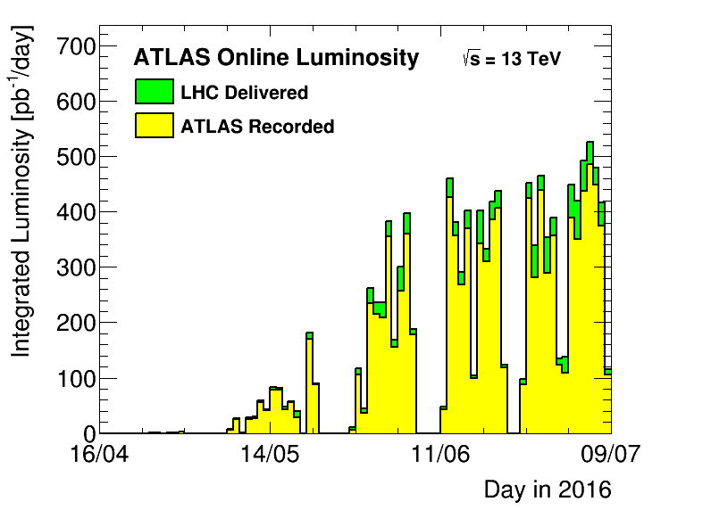
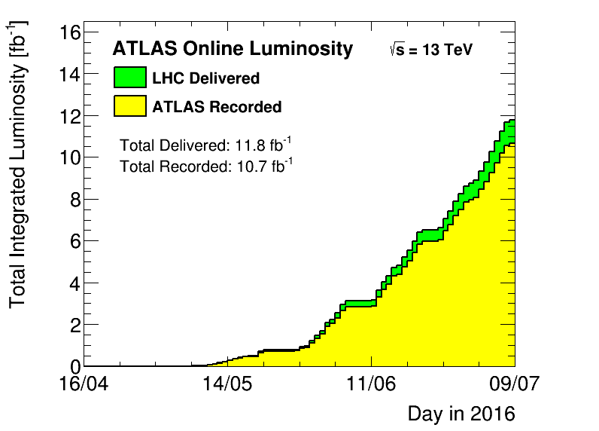
ATLAS data taking
  Data-taking at these luminosities has not been “easy”
    Pixel readout difficulties (two readout systems)
    Magnet instabilities (especially toroid)
    Other issues (TGC...)
  Difficulties overpassed with lot of work
  Collisions expected to continue through late July (MD1)
2016 DT efficiency
to date: 90.5%
μ = 23.2
10.7 fb⁻¹ !!

Slide 5
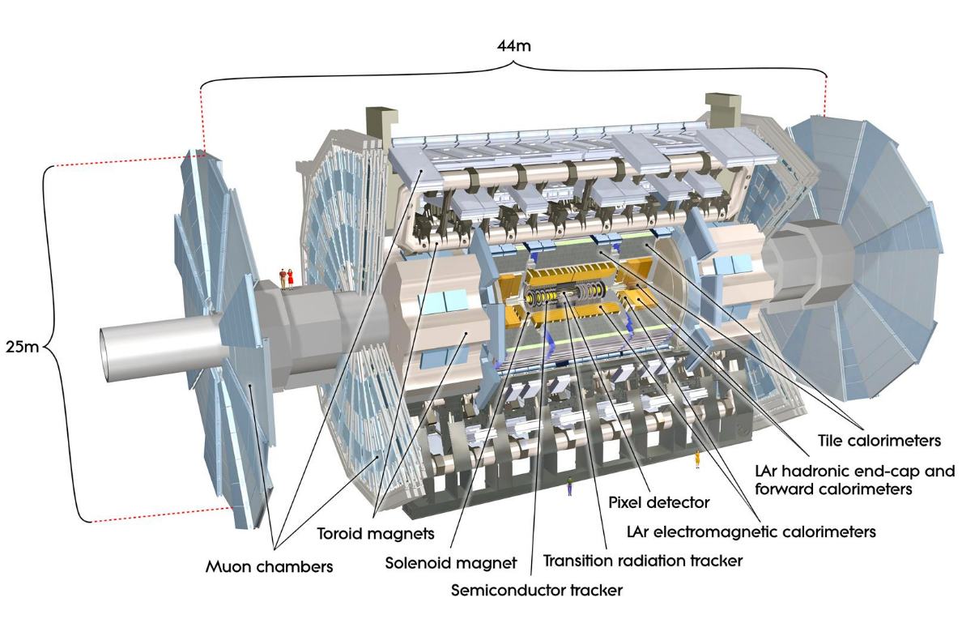
Detector upgrades for Run 2
Insertable B-Layer (IBL), 4th silicon pixel detector layer
  2 cm x 2 cm FE-I4 Pixel Chip, 130 nm CMOS process
  Innermost Pixel detector layer at R=3.3 cm from the beam
  Improves b-tagging performance
Trigger:
New Topological L1 trigger,
new central trigger processor,
restructuring of high-level trigger,
new Fast TracK Trigger (FTK)
Software improvements to:
simulation
reconstruction,
analysis software
Overall detector consolidation
  • Muon chambers completion (|η|=1.1-1.3) and repairs
  • improved readout of various systems, (L1 rate up to 100 kHz)
  • repair of pixel modules and calorimeter electronics
  • new pixel services, new luminosity detectors, new MBTS detector

Slide 6
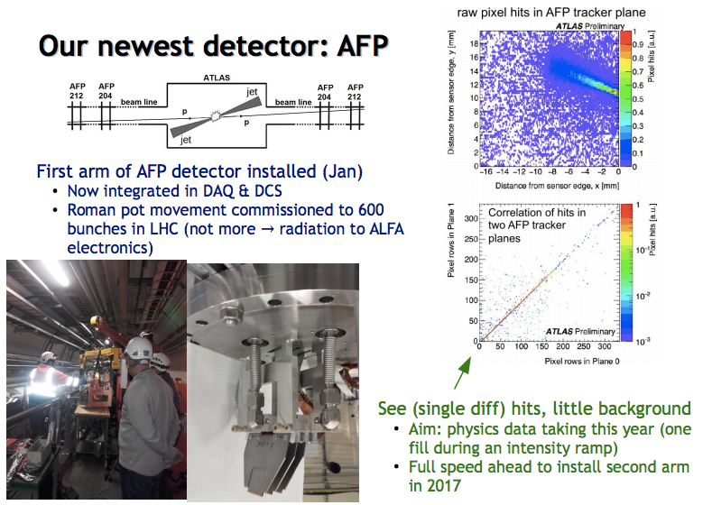
AFP

Slide 7
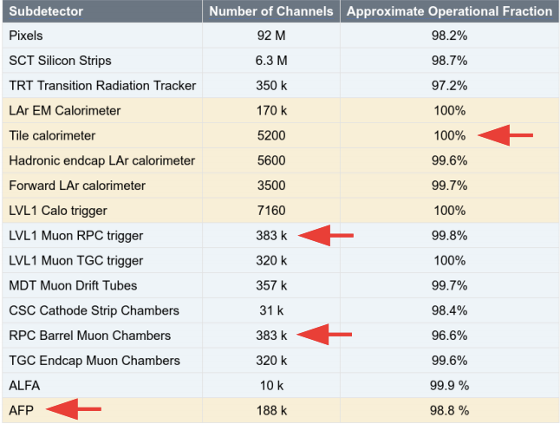
Data Quality
Detector operational
fractions similar to 2015
After YETS Tile reached 100%
For RPCs, S12 & S14 added
AFP new
2016 DQ
efficiency to
date: 96.3%
Data quality team working hard to update good run lists (GRLs) quickly
  So far 6.3 fb-1 analysed
  DQ efficiency (all good) 96.3% (87.9% if toroid-on)

Slide 8
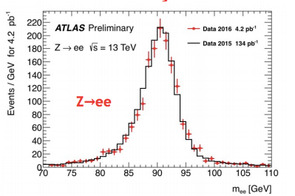
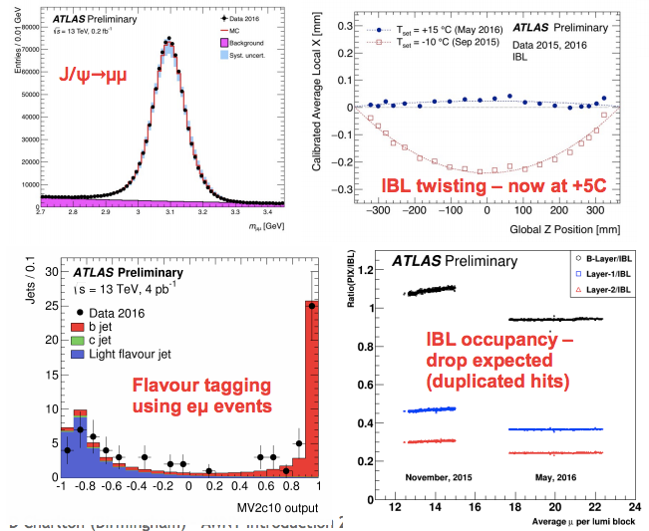
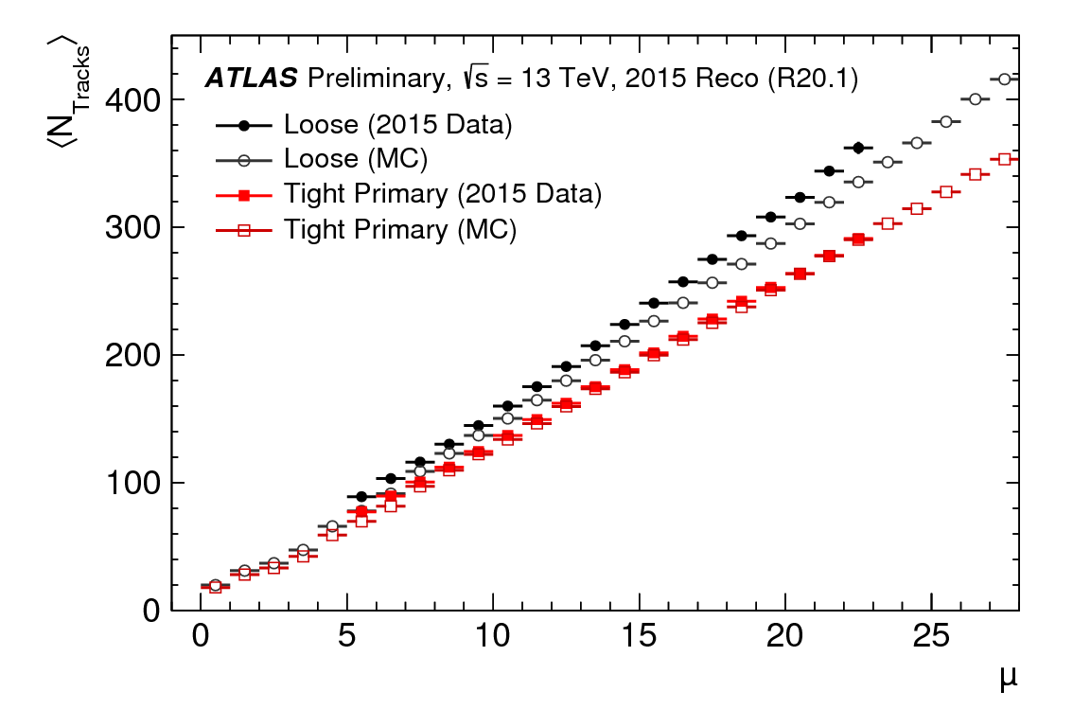
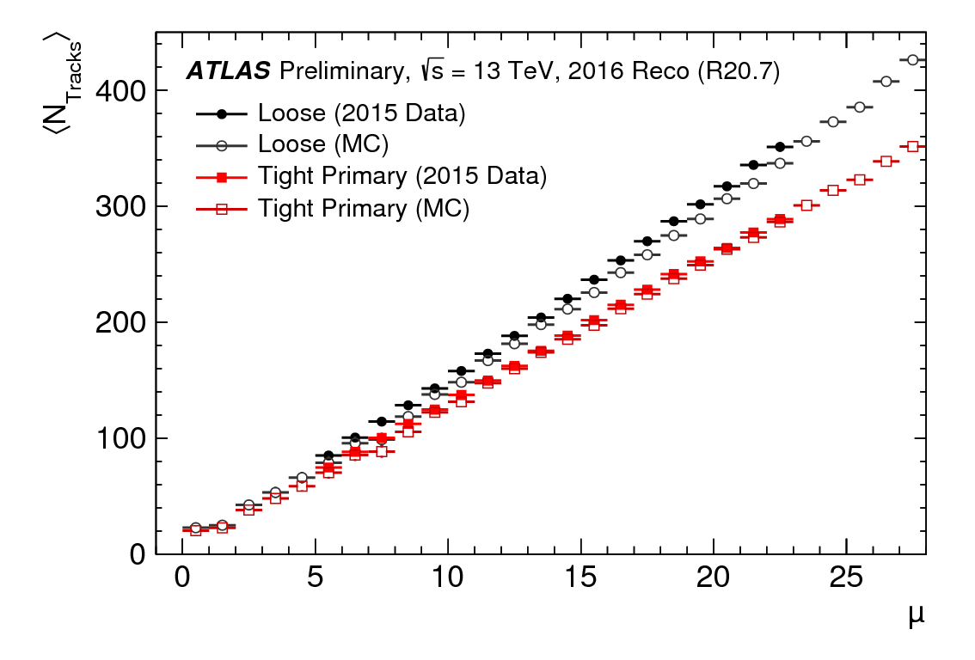
Performance
Very fast work from detector performances and detector groups to understand 2016 data
Notes:
Number of tracks vs pile-up, for Loose (black) and Tight Primary track selection (red). Filled points are the 2015 data, open points Monte Carlo simulation. Data and MC events have been reconstructed with the 2015 reconstruction software (R20.1). The statistical uncertainty on the mean number of tracks is considered, but are too small to be seen. The displayed μ range for data, in contrast to simulation, is limited by the available μ values in the data sample.

Slide 9
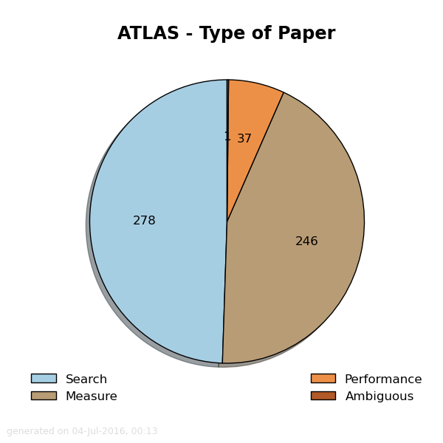
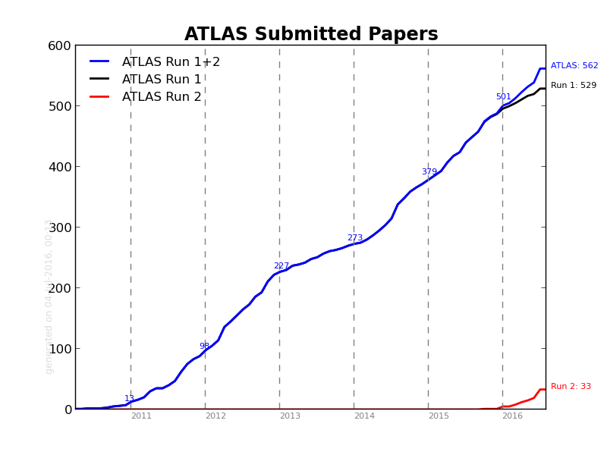
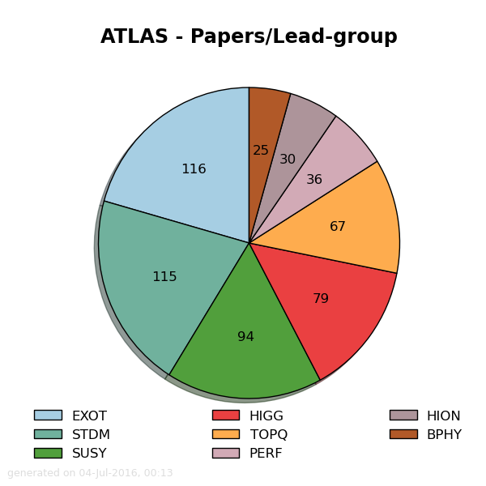
Papers
562 papers
529 papers
33 papers
562 paper submitted:
  33 from Run 2
  529 from Run 1
44 papers almost ready
  24 from Run 2
  20 from Run 1
Notes:
At present, wide and deep searches and measurements are crucial as we
map out the 13 TeV physics landscape
As we go deep into Run-2, paper rate (& conference rushes) will need to
slow – because we need effort for operations, and especially upgrades

Slide 10
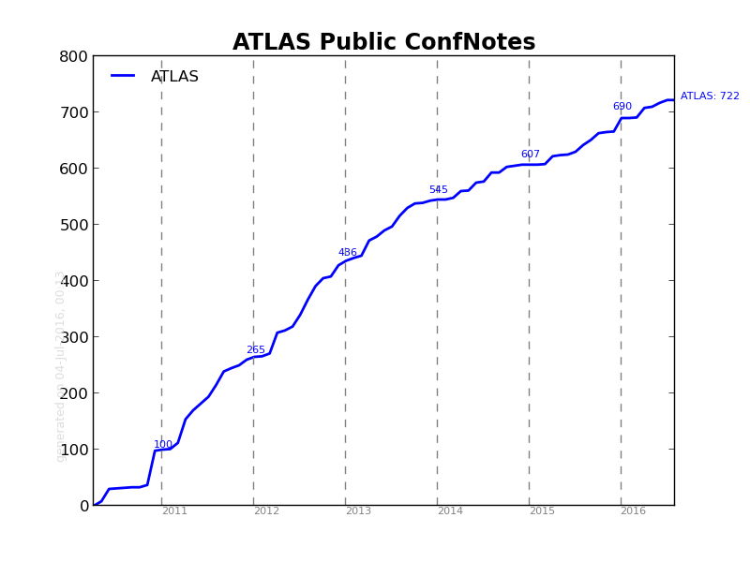
Papers
562 paper submitted:
  33 from Run 1
  529 from Run 2
44 papers almost ready
  24 from Run 2
  20 from Run 1
Notes:
At present, wide and deep searches and measurements are crucial as we
map out the 13 TeV physics landscape
As we go deep into Run-2, paper rate (& conference rushes) will need to
slow – because we need effort for operations, and especially upgrades

Slide 11
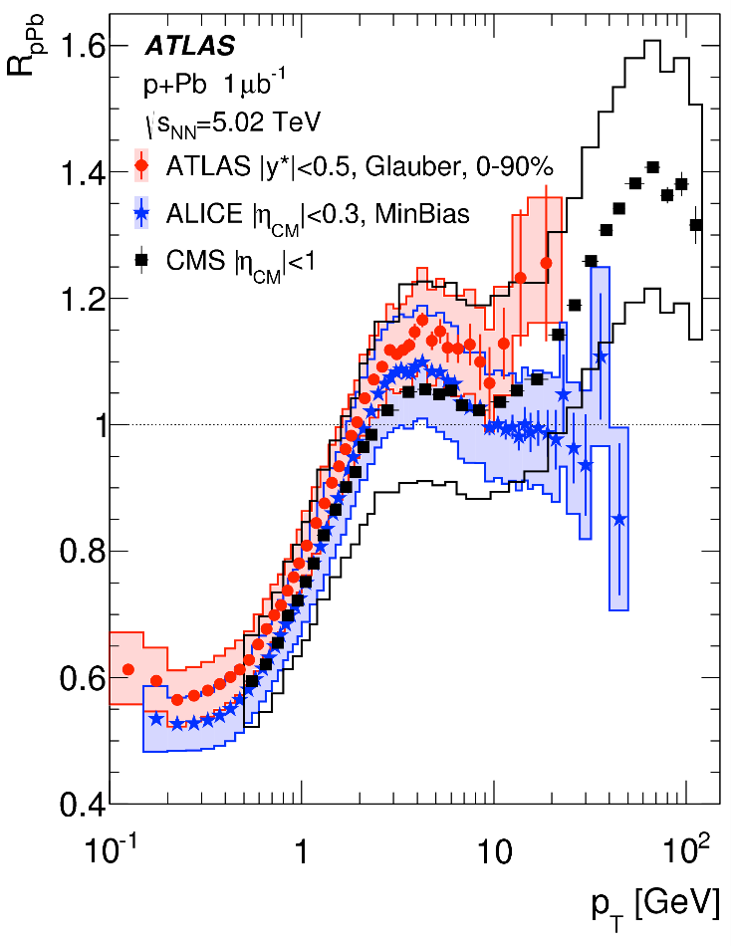
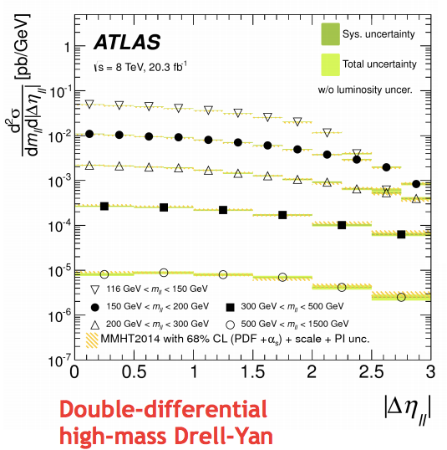
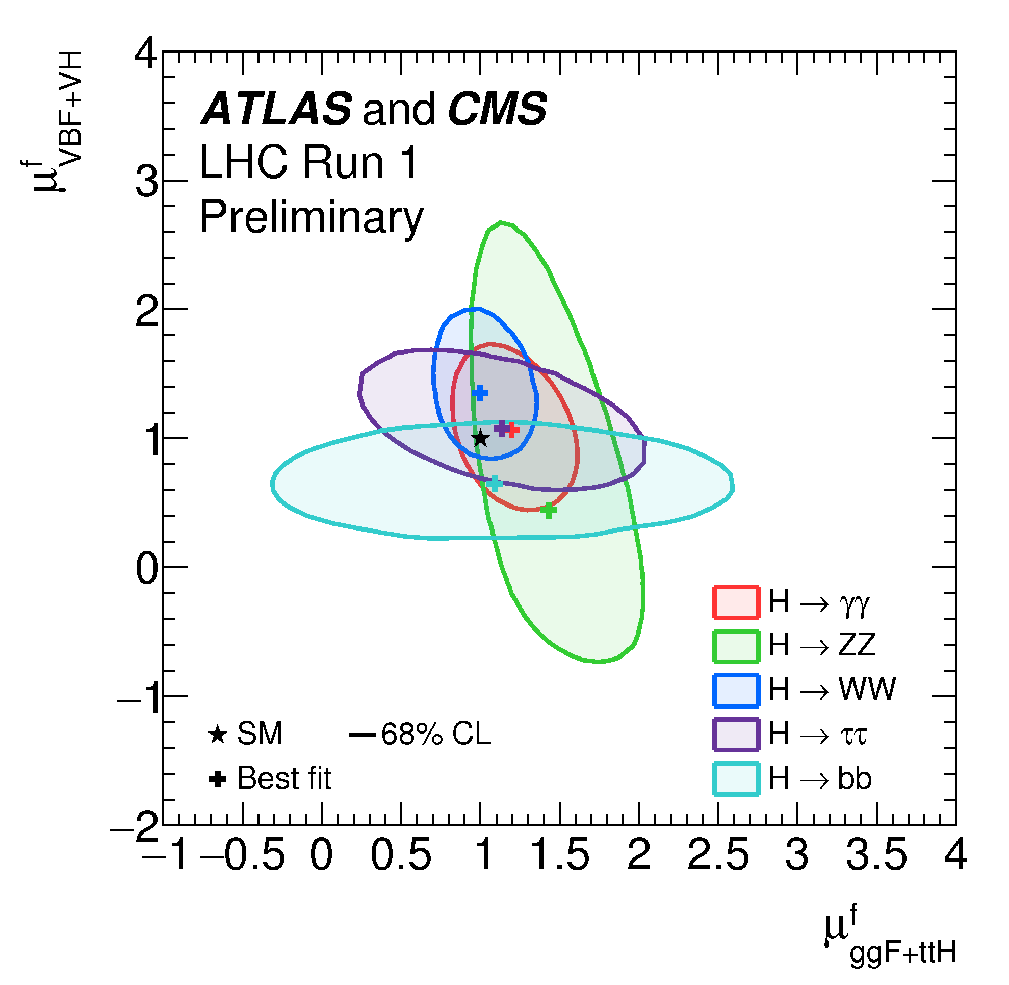
Run-1 precision measurements
Run-1 ATLAS+CMS Higgs coupling paper submitted on 7th June
Many other precision measurements ready or converging
ATLAS+ CMS
H combo
R_{ppb}
Notes:
Double differential
===============
measurement of the double-differential cross section for the Drell-Yan Z/γ∗→ℓ+ℓ− and photon-induced γγ→ℓ+ℓ− processes where ℓ is an electron or muon. The measurement is performed for invariant masses of the lepton pairs, mℓℓ, between 116 GeV and 1500 GeV, using a sample of 20.3 fb−1 of pp collisions data at centre-of-mass energy of s√ = 8 TeV collected by the ATLAS detector at the LHC in 2012. The data are presented double differentially in invariant mass and absolute dilepton rapidity as well as in invariant mass and absolute pseudorapidity separation of the lepton pair.
Hion
====
RpPb values as a function of pT in the 0-90% centrality interval averaged over |y*|<0.5, are compared to the minimum-bias (0-100%) results from a different pseudorapidity range in the centre-of-mass system: ALICE for |ηCM|<0.3 [26] and CMS for |ηCM|<1 [29]. The ⟨TPb⟩ value for the ATLAS centrality correction is calculated with the Glauber model. The total systematic uncertainties, which include the uncertainty in ⟨TPb⟩, are indicated by lines of the same colour. Strict quantitative agreement is not expected as each measurement uses different rapidity intervals for the centrality determination and apply different event selection criteria to reject diffractive collision
The combined double-differential cross sections as a function of invariant mass mℓℓ and absolute dilepton rapidity |yℓℓ| (left panel) and as a function of mℓℓ and absolute dilepton pseudorapidity separation |Δ ηℓℓ| (right panel) at the Born-level within the fiducial region with statistical, systematic and total uncertainties, excluding the 1.9% uncertainty on the luminosity. Data are compared to combined NNLO pQCD and NLO EW calculations using the MMHT2014 PDF, where the uncertainty band displays the combined 68% confidence level (CL) PDF and α S variation, the renormalisation and factorisation scale uncertainties and the PI uncertainty.
H combo
=======
Likelihood contours in the (μggF+ttHf, μVBF+VHf) plane for the combination of ATLAS and CMS, shown for the five decay channels, H→ ZZ, H→ WW, H→γγ, H→ττ, and H→ bb. The results are shown as 68% CL contours, together with the best-fit values to the data and the SM expectation. Figure 28 in Appendix C shows both the 68% and 95% contours for the results of these fits.

Slide 12
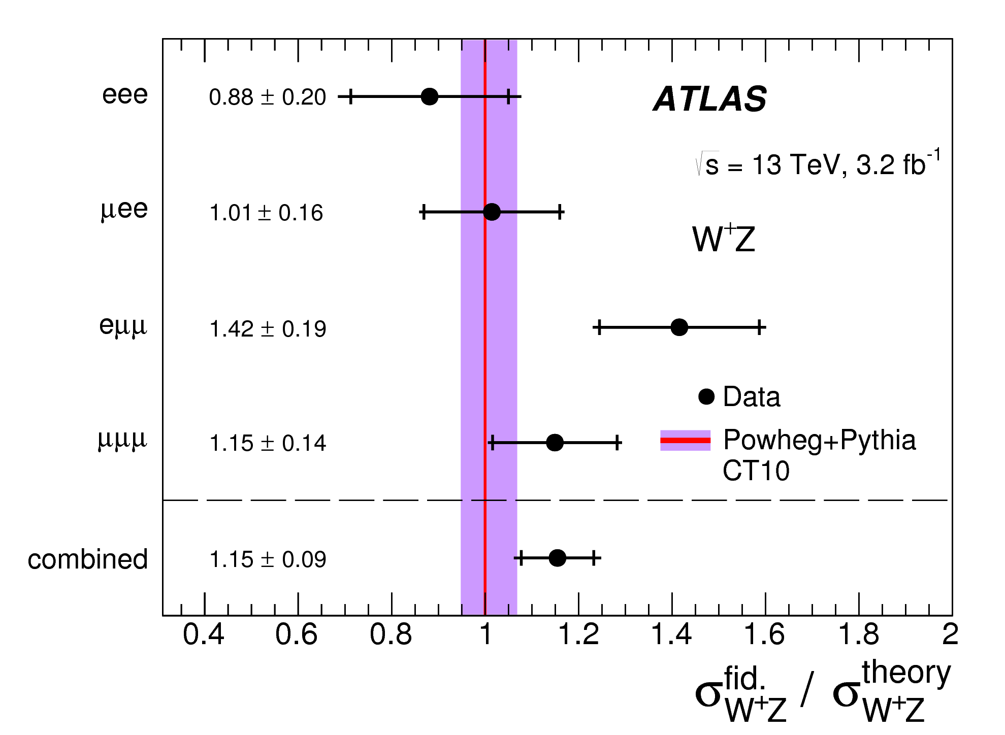
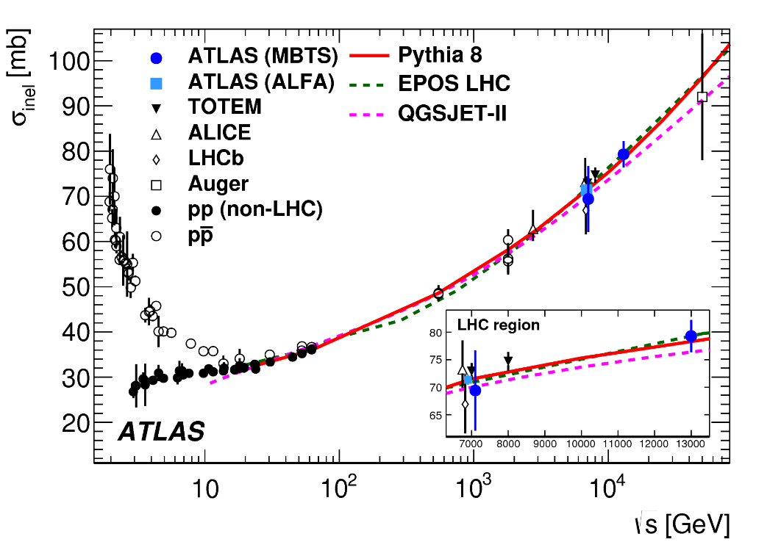
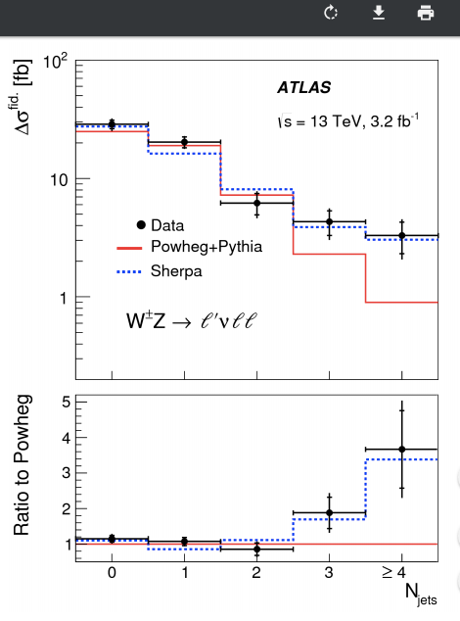
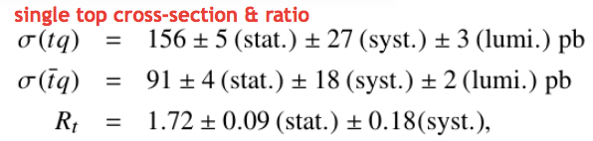
Run-2 measurements
W/Z in 3 l
Many results finalised
8 papers submitted, 4 more in circulation
Ridge, MB, inelastic xs, W, Z & dibosons,
tt → eµX, single-top, ttV, FB mult corrs…
pp inelastic
cross section
Notes:
W/z in 3 leptons
=============
Ratio between the measured W+Z integrated cross sections in the fiducial phase space and the NLO SM prediction from Powheg+Pythia in each of the four channels and for their combination. The inner and outer error bars on the data points represent the statistical and total uncertainties, respectively. The shaded violet band represents the uncertainty associated to the SM prediction.
Pp inelastic cross section
===================
measurement of the inelastic proton-proton cross section using 60 μb−1 of pp collisions at a center-of-mass energy s√ of 13 TeV with the ATLAS detector at the LHC. Inelastic interactions are selected using highly efficient plastic scintillators in the forward region of the detector.
The measurement agrees with a range of theoretical predictions. When extrapolated to the full phase space, the result is consistent with an inelastic cross section increasing with center-of-mass energy, as observed at lower energies.
The inelastic proton-proton cross section versus √s. Measurements from other hadron collider experiments [6,10,8,14,15] and the Pierre Auger experiment [16] are also shown. Some of the LHC data points have been slightly shifted in the horizontal position for display purposes. The data are compared to the PYTHIA8, Epos LHC and QGSJet-II MC generator predictions. The uncertainty in the ATLAS ALFA measurement is smaller than the size of the marker.

Slide 13
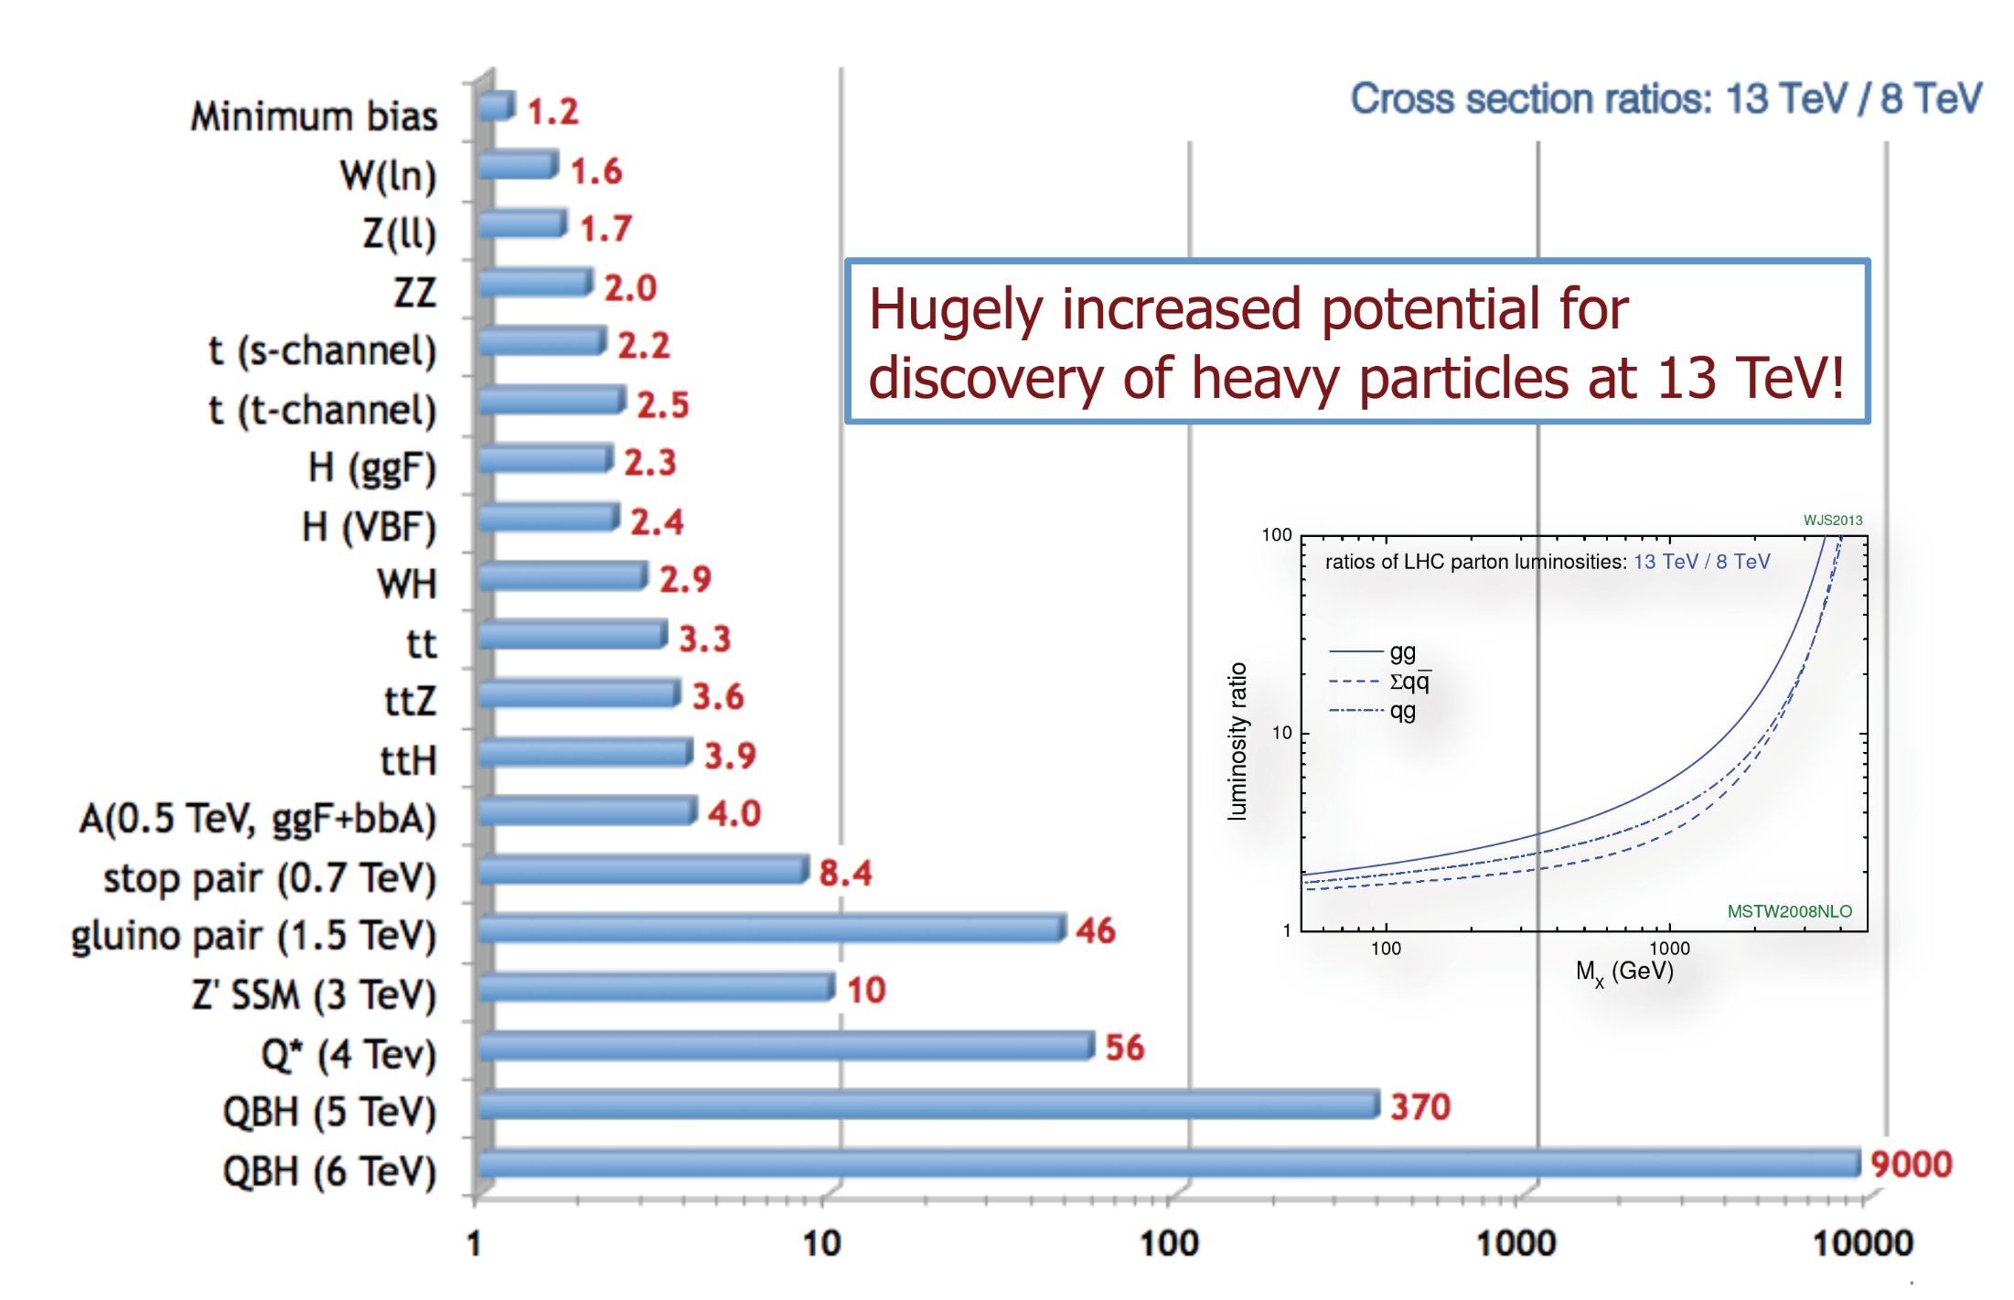
Physics Potential for Run 2
A factor 10 to 50 higher
luminosity for 2< Mx< 3 TeV

Slide 14
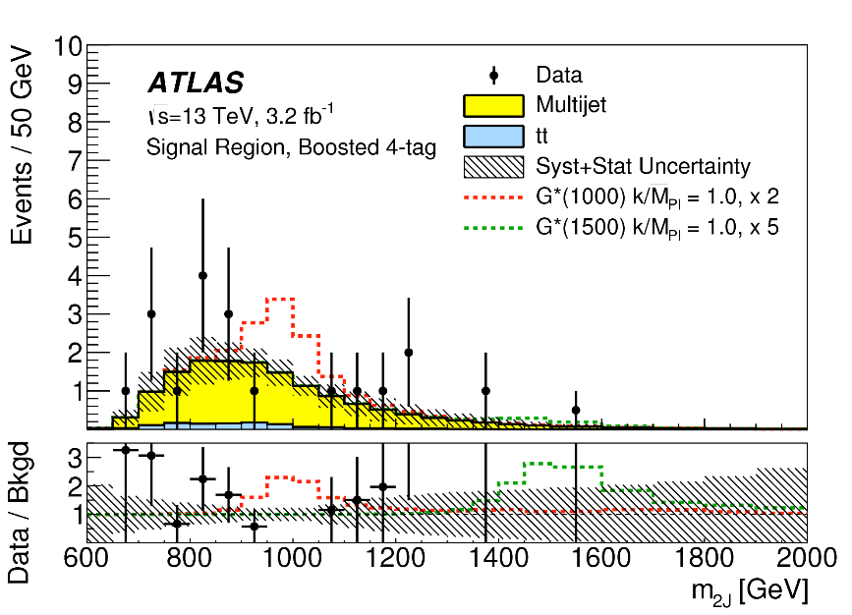
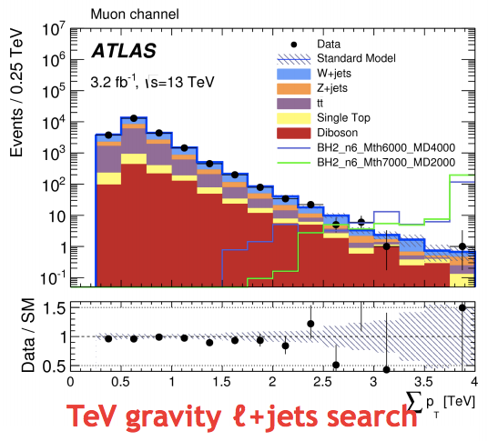
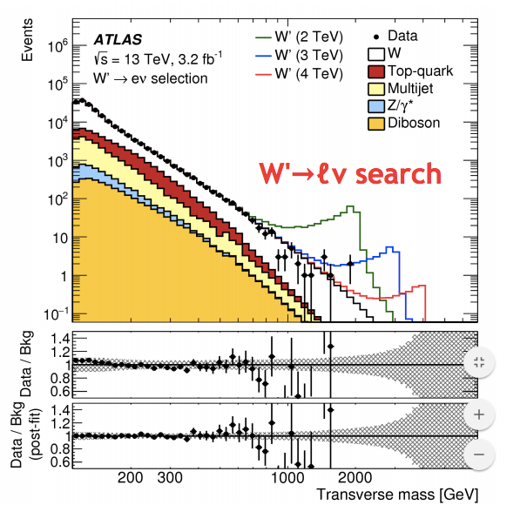
Searches at 13 TeV
Deep and extensive studies of 2015 data
  21 papers submitted, 8 more drafts
  2/signoff stage
A few recent results shown here
Analyses now turned to 2016 data...
HH -> bbbb
Notes:
HH-> bbbb
=========
A search for Higgs-boson pair production in the bb¯bb¯ final state is carried out with 3.2 fb−1 of proton--proton collision data collected at s√=13 TeV with the ATLAS detector. The data are consistent with the estimated background and are used to set upper limits on the production cross section of Higgs-boson pairs times branching ratio to bb¯bb¯ for both nonresonant and resonant production. In the case of resonant production of Kaluza--Klein gravitons within the Randall--Sundrum model, upper limits in the 24 to 91 fb range are obtained for masses between 600 and 3000 GeV, at the 95% confidence level. The production cross section times branching ratio for nonresonant Higgs-boson pairs is also constrained to be less than 1.22 pb, at the 95% confidence level.
Dijet mass distribution in the hh signal region for data (points) and background estimate (histograms) in the boosted analysis for events in the (left) 3-tag and (right) 4-tag categories. The expected signal distributions for G*_{KK} masses of 1.0, 1.5 and 1.8 TeV are also shown. The uncertainty band includes both the statistical and systematic uncertainties in the background estimate.
TEV graviity
=========
A search for evidence for physics beyond the Standard Model in final states with at least one high transverse momentum charged lepton (electron or muon), and two additional high transverse momentum leptons or jets, is performed using 3.2 fb−1 of proton-proton collisions recorded by the ATLAS detector at the Large Hadron Collider in 2015 at s√ = 13 TeV. No excess of events beyond Standard Model expectations is observed. Exclusion limits are set for black hole models with two to six extra dimensions.
The ∑ p_{T} distribution in the muon channel for 3.2/fb. The selection is identical to that of the signal regions but for the omission of any requirements on ∑ p_{T}. The data are shown as points with error bars; all expected backgrounds are shown as stacked coloured histograms, with the total background uncertainty shown as a shaded band. Two representative signal distributions for rotating black holes with n = 6 are overlaid to illustrate the signal properties. The lower panels show the ratio of the data to the expected background. The t-tbar, W+jets and Z+jets backgrounds are normalised by the factors 0.95, 0.81 and 1.01 as obtained from the background likelihood fit. The single top and diboson background normalisations are taken from the simulation. The multijet background is obtained using a data-driven method. Additionally, the likelihood fit may constrain nuisance parameters for certain systematic uncertainties, altering the normalisation and shape of some of the distributions.
pn

Slide 15
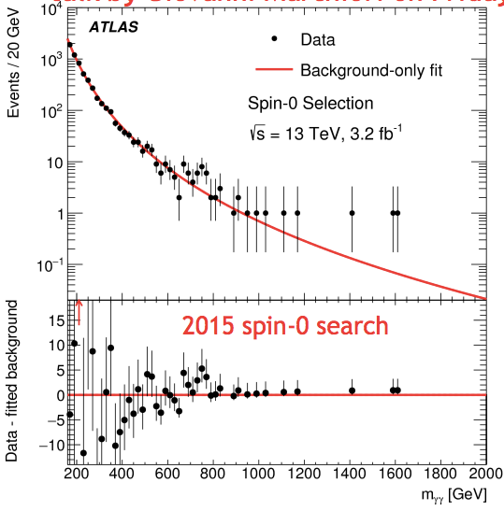
γγ resonance
Paper on 2015 data submitted on same day as CMS (different journals)
Spin-2 and spin-0 selections
Comparisons with 8 TeV
Bottom line: global significances of 2.1σ, 3.9σ local significance at ~750 GeV in both spin-2 and spin-0 analyses
Team now looking at 2016 data
More data added as they are processed and GRLs updated
Plan remains to present results externally at ICHEP

Slide 16
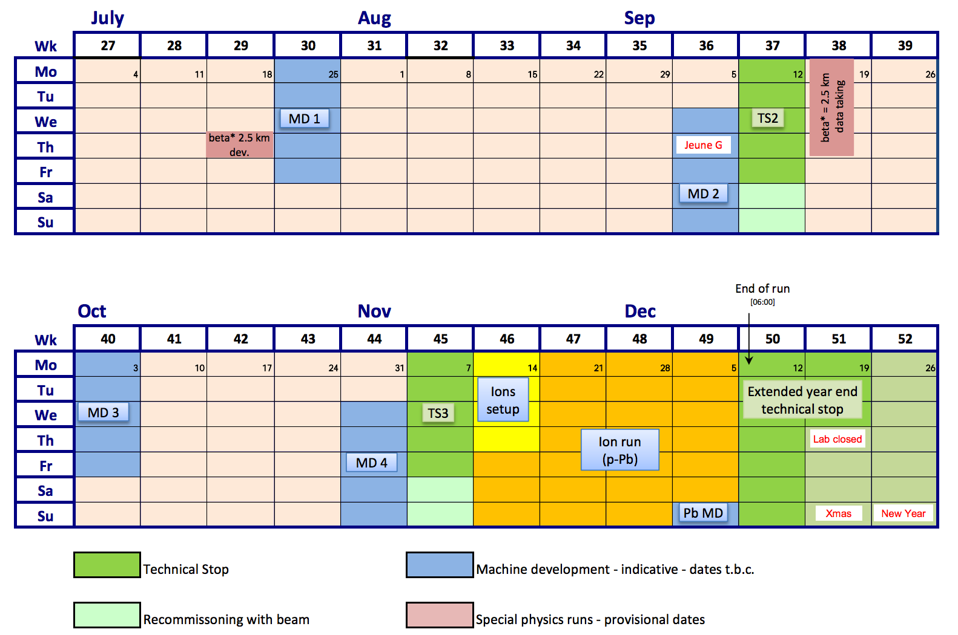
LHC Schedule: 2nd Half of 2016
LHC Schedule
2016 v1.7
(second half)

Slide 17
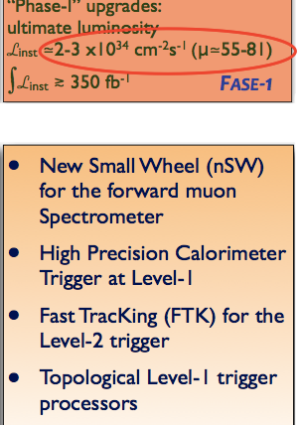

ATLAS Upgrade Phase 1
4 TDRs presented and approved by LHCC in 2013
Now entering in the production phase
NSW
FTK
LAr
TDAQ
BIS-7/8 (2020-…): 16 new muon stations (MDT/RPCs) in the inner part of MS close to the two New Small Wheel (BO, NA, RM 1,RM 2)
To suppress the muons fake rate in 1 < |η| < 1.3
Approved at the March 2015 ATLAS CB
Notes:
BIS7-8: Sj 20 keuro (BO) al successo dei test con I nuovi volumi di gas per rd-fase 2
i gap sono di 1mm invece che 2mm , nuova elettronica di FE (c’e’ meno carica prodotta) anche questa sotto test

Slide 18
Phase-1 status
Phase-I projects continue to progress well
Fast Tracker FTK
Integration well under way
Delay at production level with some boards (LAMB/AMB
Now aiming for μ=40 barrel system to deliver tracks by end of 2016
New Small Wheel
sTGC PRR passed for 4/5 production sites
MM readout board order placed
NSW readout config for 1MHz rate
Readout chips submitted for production, except ROC
Lar
Difficulties with ADC fixed
Serialiser chip still a concern, back-ups critical path
Back-end board (LATOME) passed FDR
LNF, MI, PV, PI
Italian contribution:
Input Mezzanine with Artix7,AM06 chip AMB/LAMB, Infrastructure & cooling
Online software
CS, LE, LNF, NA, PV, RM1, RM3
Italian contribution:
32 MM SM1 chambers
  Logic Pad Units for sTGCs trigger
MI
  Italian contribution:
  produce the baseplane of one of the 5 types foreseen
  Design, test and integrate the powering part of the new trigger board

Slide 19
Phase-1 status
Phase-I projects continue to progress well
BIS7/8
italian contribution:
gas gap construction
front end electronics (chip production)
TDAQ
Assembled gFEX & eFEX tested to 11.2 Gbps link speed
jFEX prototype testing soon
Progress on new MUCTPI + endcap sector logic
BO, RM1, RM2
MI, NA, PV, PI, RM1, RM2
Italian contribution:
Design and Test of the MuCTPI Interface boards and firmware
Hardware and firmware design and test for the PAD Trigger board
Dataflow
FTK

Slide 20
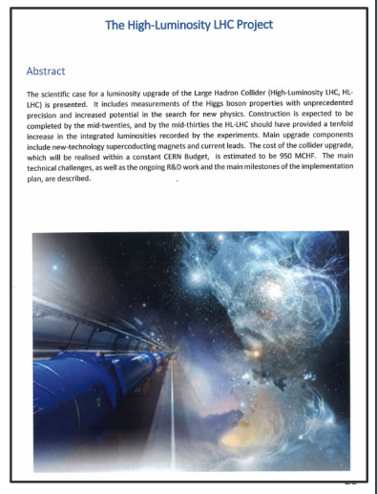
HL-LHC approved!
CERN Council three weeks ago
approved the HL-LHC project
Approval is for the accelerator upgrade
  Cost estimate 950 MCHF
  Pileup 140 as standard, with a maximum up to 200
  Does not cover the injector
upgrade (LIU) which is
already well under way
Does not cover the experiment upgrades, which have their separate approval process

Slide 21
Attività del gruppo ATLAS a Roma Tor Vergata
Ricerca di fisica «oltre il Modello Standard»
Fisica del quark top
Manutenzione degli RPC di ATLAS in vista del Run 2 e nei TS del run
Installazione di flussimetri di massa sulle linee di gas degli RPC

Slide 22
Attività in vista della “Fase 2”
(HL-LHC, dal 2022)
Sviluppo di RPC con migliore “rate capability”:
  Realizzazione di elettrodi di lettura di spessore 0.5-0.8 mm e resistività
  Studio di nuove miscele di gas con componenti “eco”
  Sviluppo di nuova elettronica di lettura basata su transistor BJT in tecnologia SiGe

Slide 23
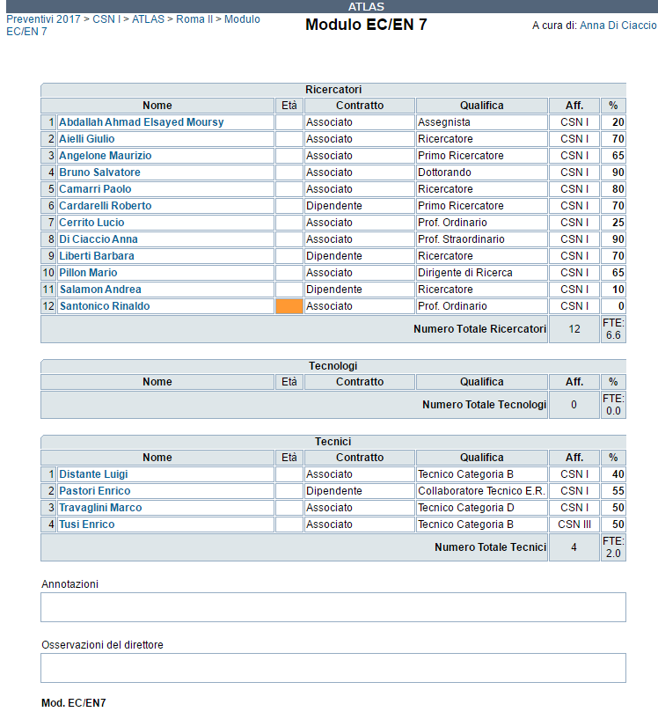
ATLAS Roma Tor Vergata - Anagrafica 2017

Slide 24
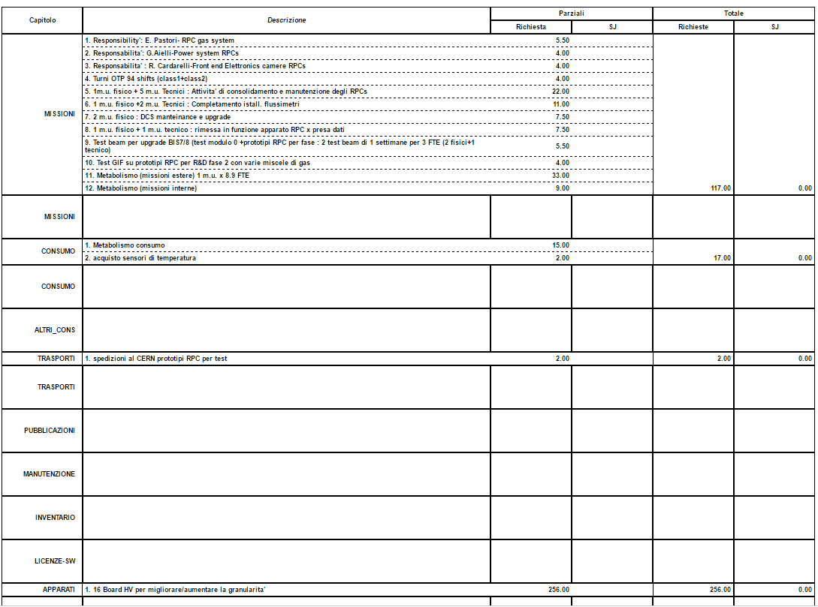
ATLAS Roma Tor Vergata - Richieste 2017

Slide 25
R&D per LHC Fase 2
L’INFN ha deciso nel 2014 di inserire in un’unica sigla (denominata RD_FASE2) le assegnazioni alla voce Apparati relative all’attività R&D di Fase 2 degli esperimenti ATLAS, CMS e ALICE. Queste assegnazioni non comprendono le missioni, che restano a carico delle sigle di esperimento.
Nel 2017 la sigla RD_FASE2 a Roma Tor Vergata avrà più di 2 FTE

Slide 26
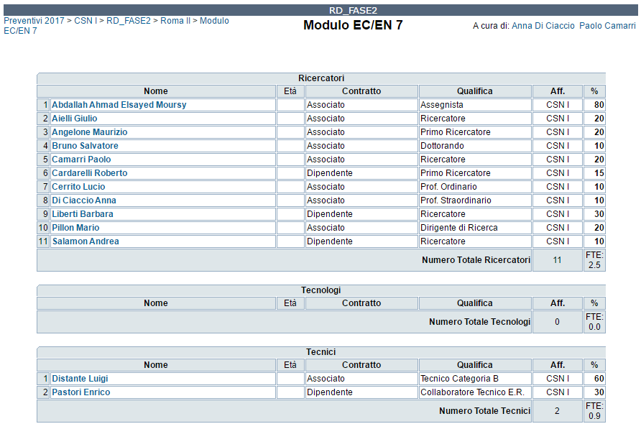
RD_FASE2 Roma Tor Vergata
(Resp. Loc. A. Di Ciaccio, P. Camarri)
Anagrafica 2017

Slide 27
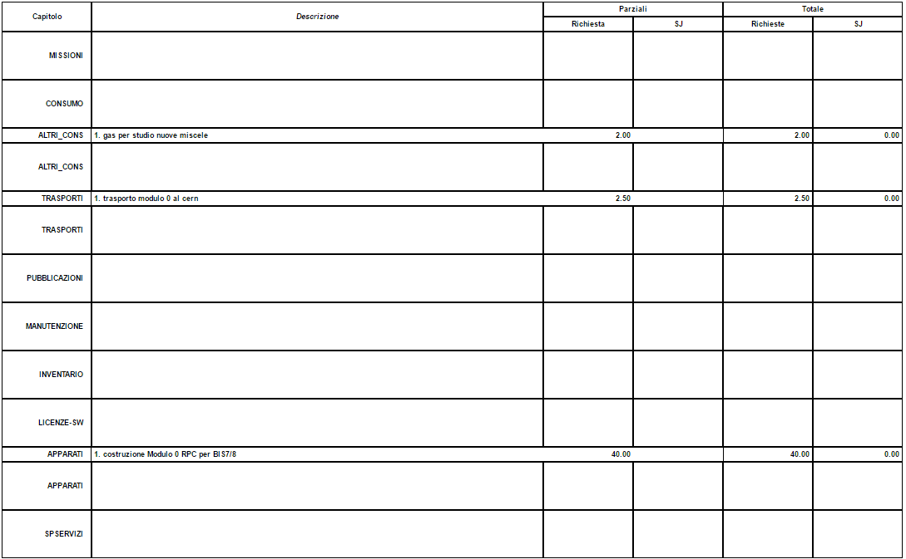
RD_FASE2 Roma Tor Vergata- Richieste 2017

Slide 28

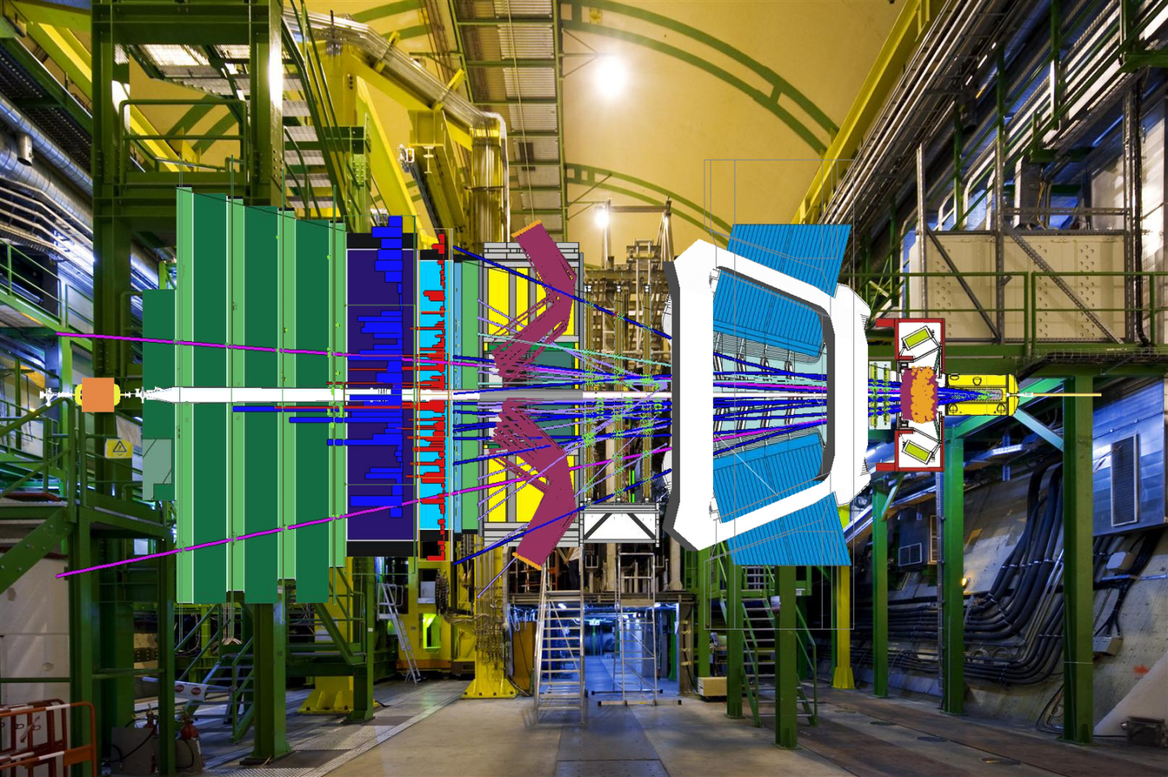
L’esperimento LHCb a LHC (Resp. Loc.: E. Santovetti)
L’esperimento LHCb è un complesso rivelatore di particelle (con uno spettrometro) in grado di rivelare le interazioni fondamentali scaturite dall’interazione protone-protone all’acceleratore LHC.
Scopo dell’esperimento è la verifica del modello standard delle interazioni fondamentali, attraverso molte misure nel settore della fisica del flavour (violazione della simmetria CP, decadimenti rari etc…).
Il rivelatore LHCb si trova in una sala sotterranea 90 m sottoterra
Rivelatore di muoni
Magnete dipolare
Calorimetri
Regione d’interazione
e rivelatore di vertice
In evidenza un evento ricostruito
Rivelatori RICH

Slide 29
Il gruppo LHCb e le sue attività
L’esperimento LHCb si occupa della fisica del flavour ad LHC. In particolare fa misure di violazione di CP e di decadimenti rari dei quark pesanti b e c.
Ha partecipato alla realizzazione del rivelatore di muoni dell’esperimento e attualmente è coinvolto nelle seguenti attività:
Manutenzione dell’attuale sistema e turni di presa dati sull’esperimento;
Progetto di “upgrade” per la presa dati ad alta luminosità (2018): attività nel sistema di acquisizione del rivelatore di muoni;
  Progettazione e implementazione del firmware di readout delle schede di acquisizione del rivelatore di muoni;
  Attività software (e hardware) nel sistema di controllo
Attività di analisi dei dati raccolti (3 fb⁻¹);
  Analisi e misura dei decadimenti dei mesoni B (compresi B_{s} e B_{c})
  Spettroscopia adronica nei decadimenti dei mesoni B e osservazione di nuove risonanze
  Misure di violazione di CP nei mesoni B
  Misure di polarizzazione

Slide 30
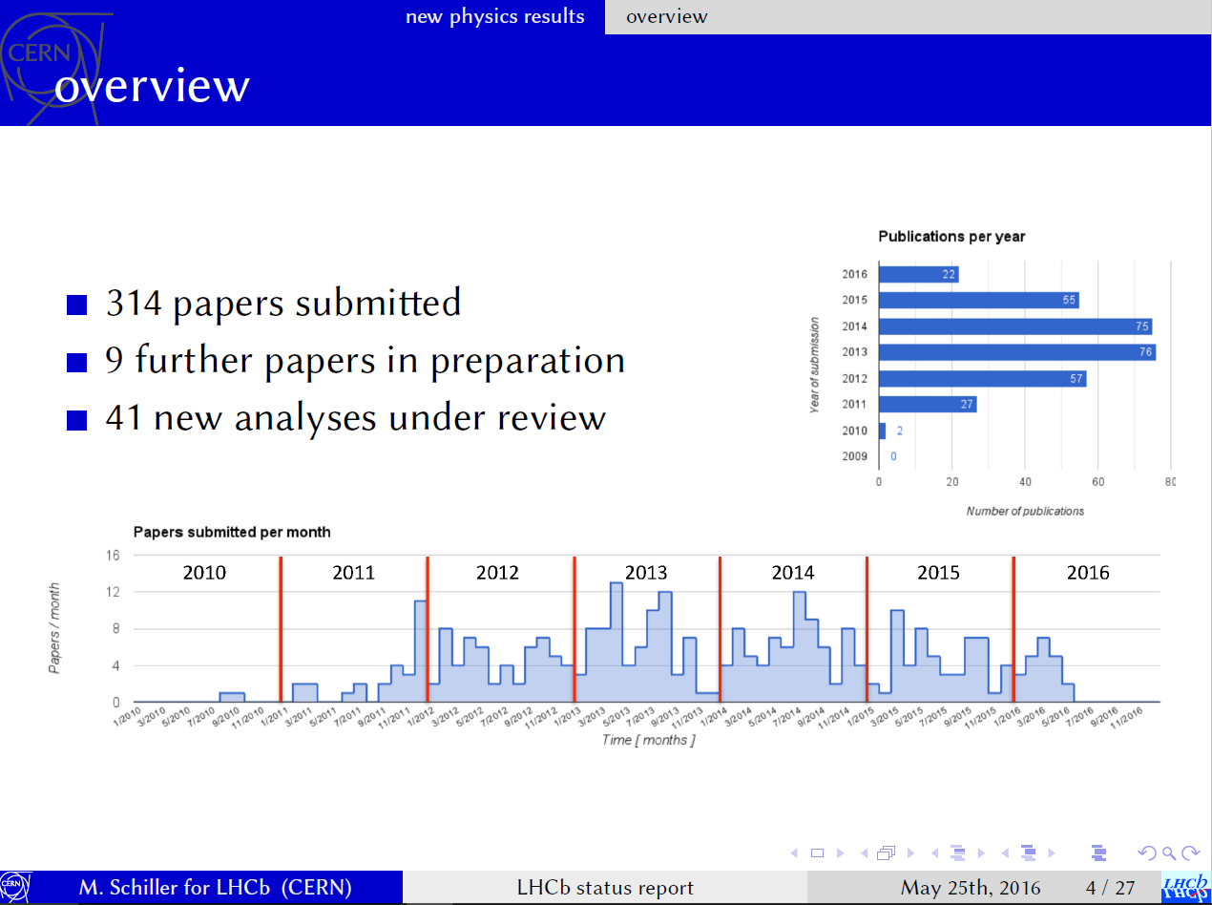

Slide 31
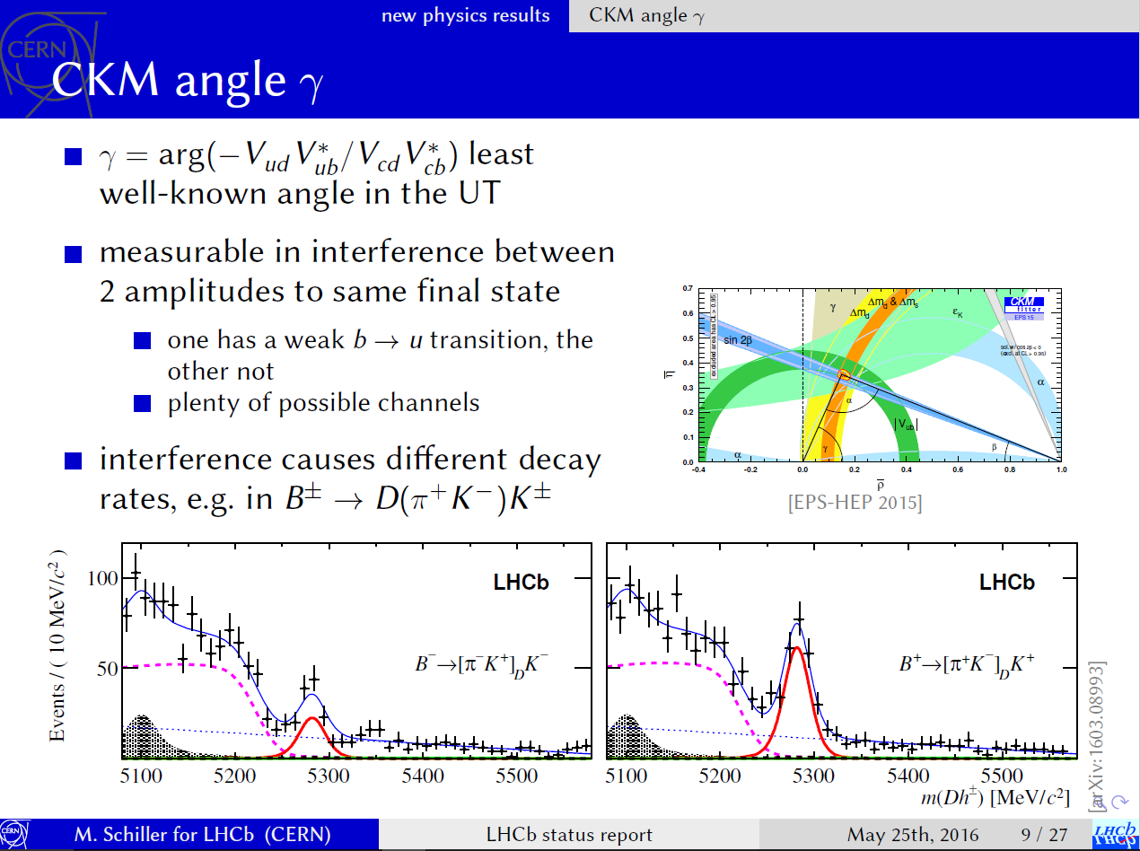

Slide 32
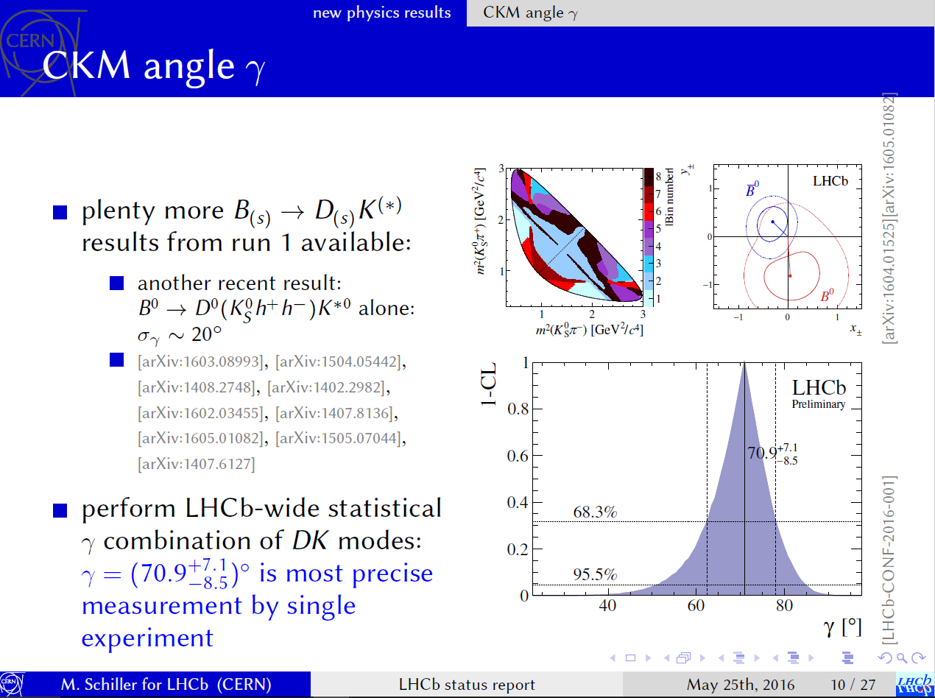

Slide 33
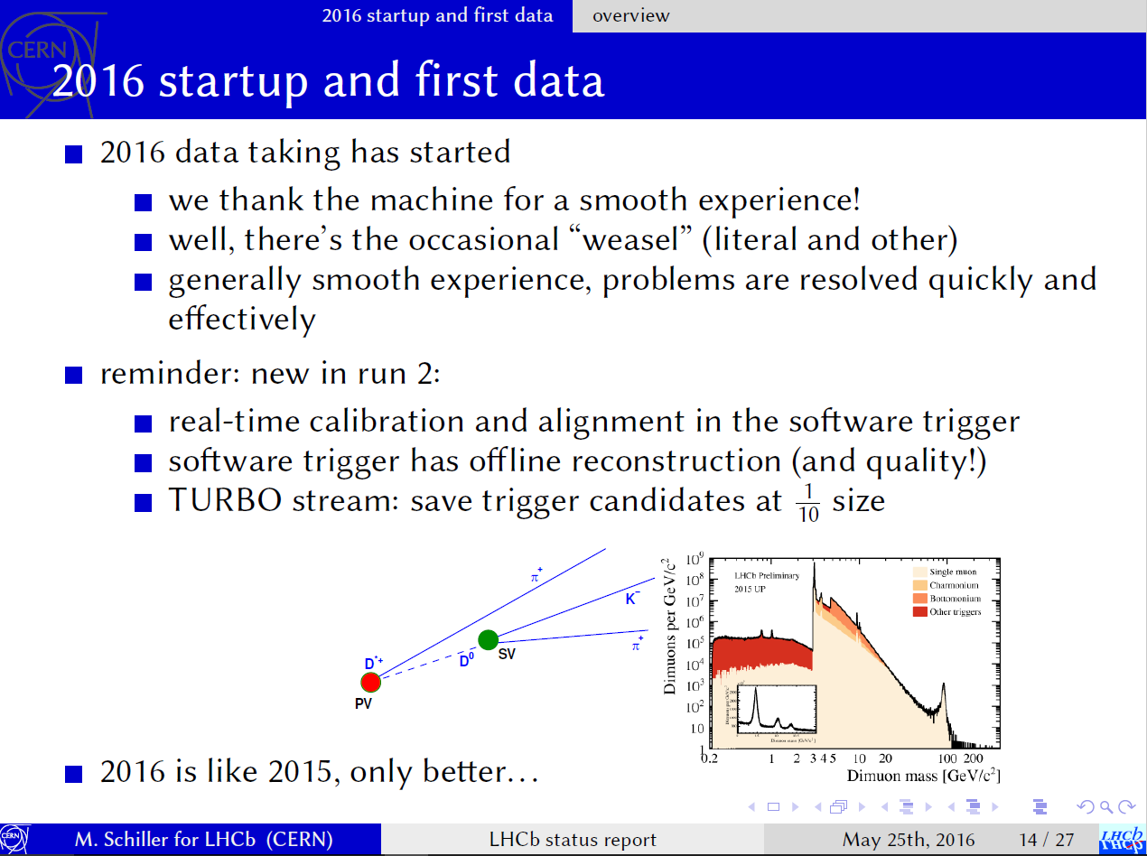

Slide 34
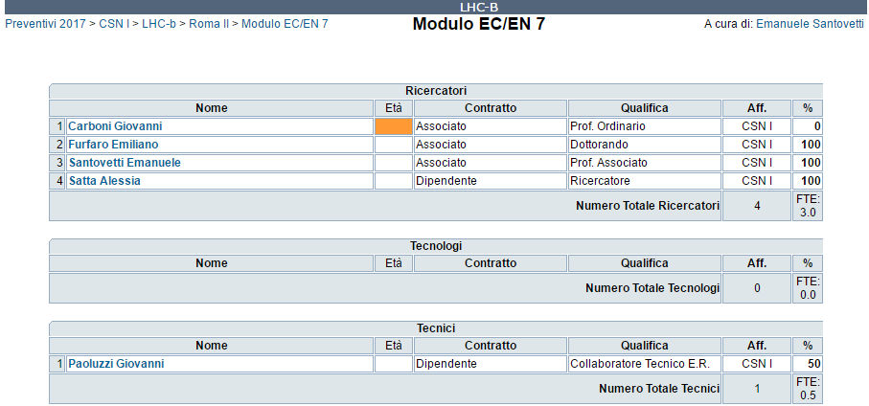
LHC-b Roma Tor Vergata - Anagrafica 2017

Slide 35
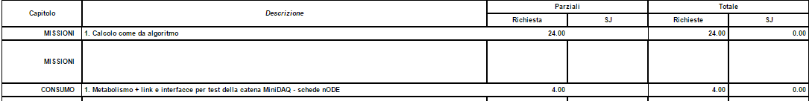
LHC-b Roma Tor Vergata - Richieste 2017

Slide 36
L’esperimento GMINUS2
(Resp. Loc.: D. Moricciani)
Misura del momento magnetico anomalo del muone con statistica senza precedenti (goal: precisione di 140 parti per miliardo, a fronte di un’incertezza teorica di 400 parti per miliardo secondo il Modello Standard)
Possibilità di trovare indizi di nuova fisica

Slide 37
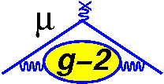
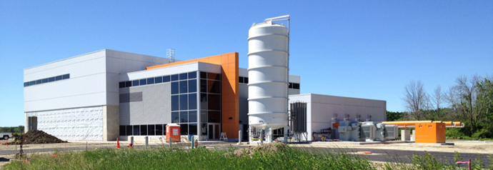
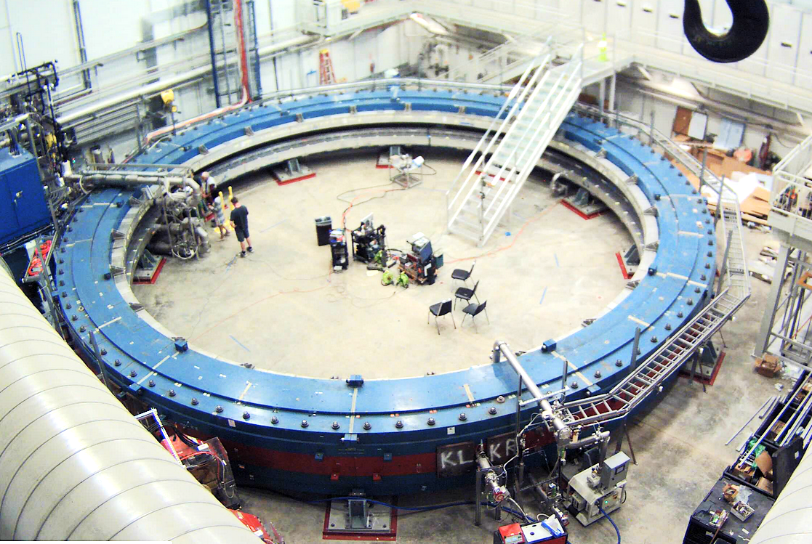
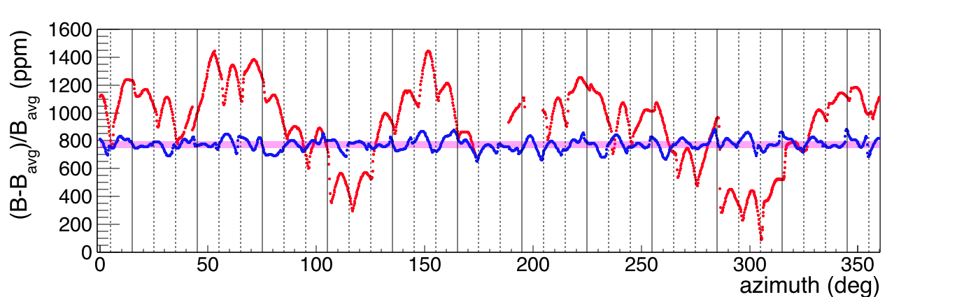
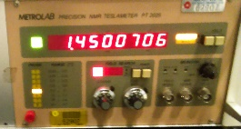
Stato dell’esperimento g-2
Muon g-2
The magnet was switched on September 2015! Shimming is going on…
Magnetic field uniformity
Oct 2015
→ June 2016
→Goal
~1400
ppm
I=5300 A B= 1.45 T

Slide 38
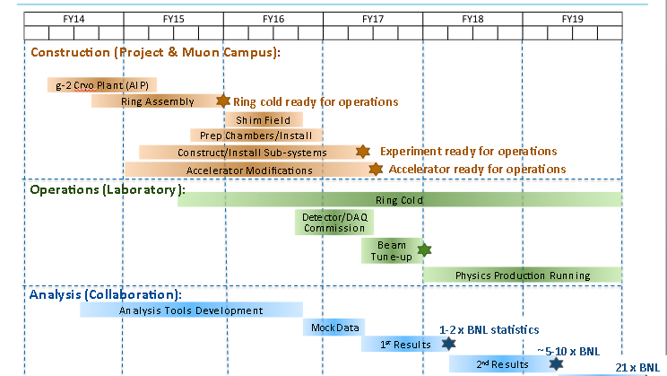
Timeline
Now
In 1 Year (first muons!)
Muon g-2
2016: installation and commissioning
2017: start of data taking

Slide 39
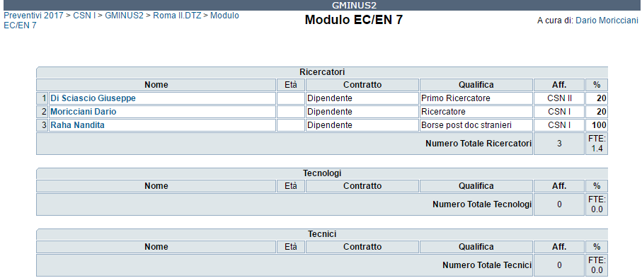
GMINUS2 Roma Tor Vergata - Anagrafica 2017

Slide 40
GMINUS2 Roma Tor Vergata - Richieste 2017
FTE < 2 -> Assegnazioni sotto Dot1
Missioni 24 kEuro
Consumo 10 kEuro
Apparati 10 kEuro (osc. FNAL)

Slide 41


NA62
(Resp. Loc.: A. Salamon)
R. Ammendola, V. Bonaiuto, L. Federici,
G. Paoluzzi, A. Salamon, G. Salina, F. Sargeni

Slide 42
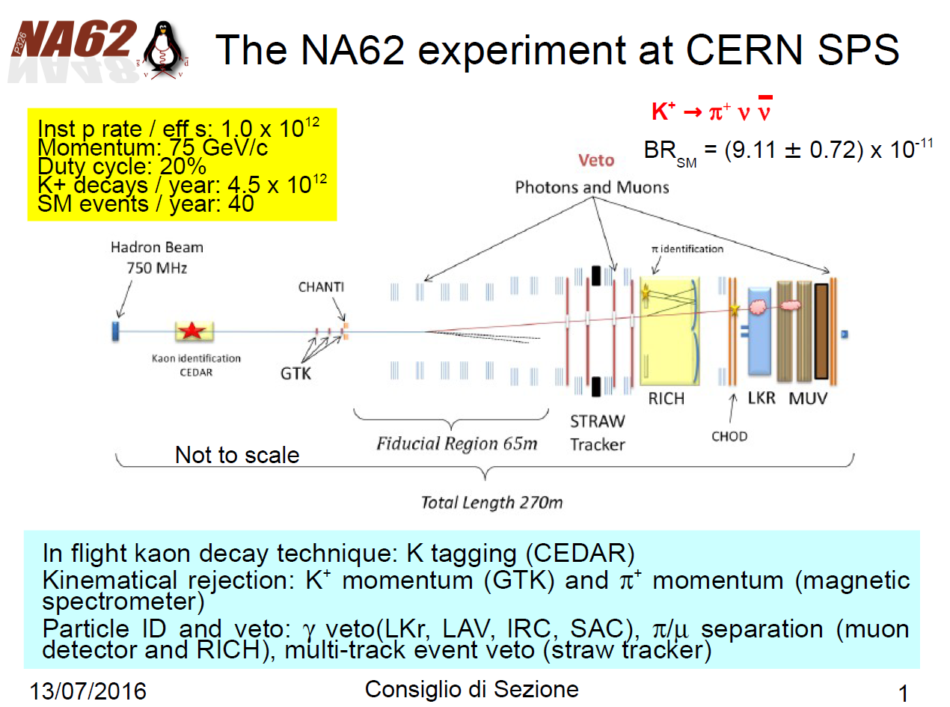

Slide 43
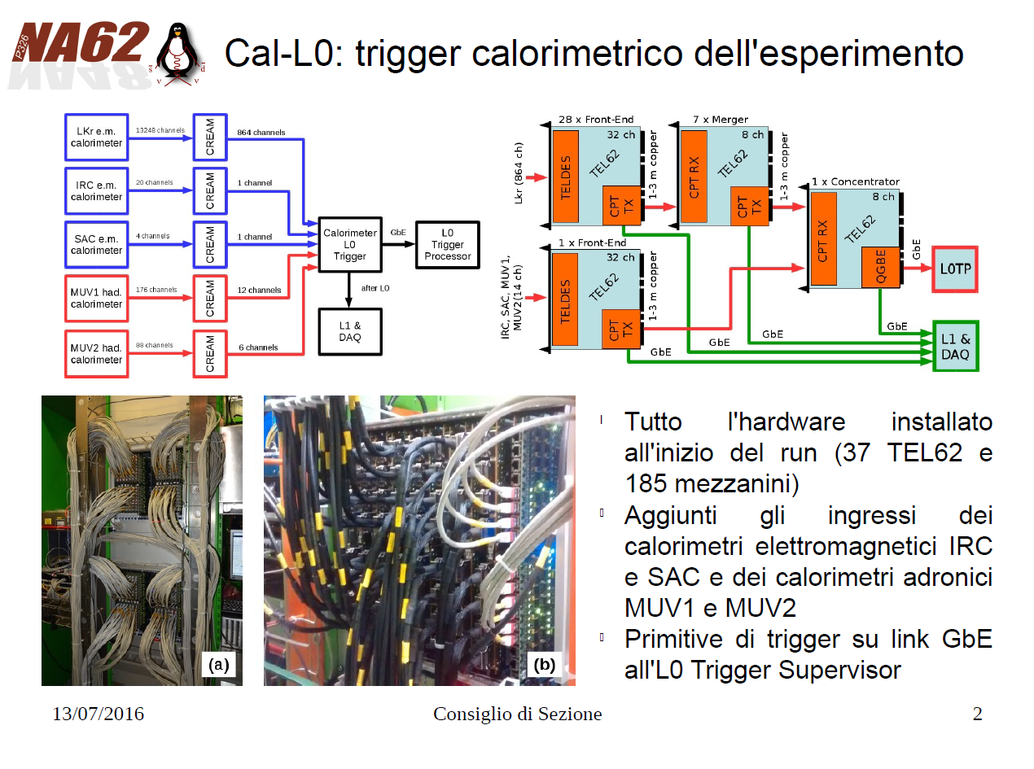

Slide 44
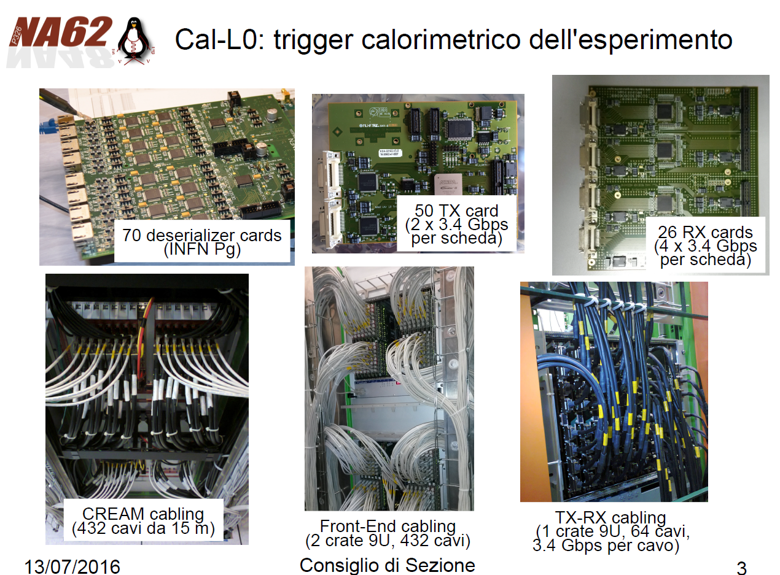

Slide 45
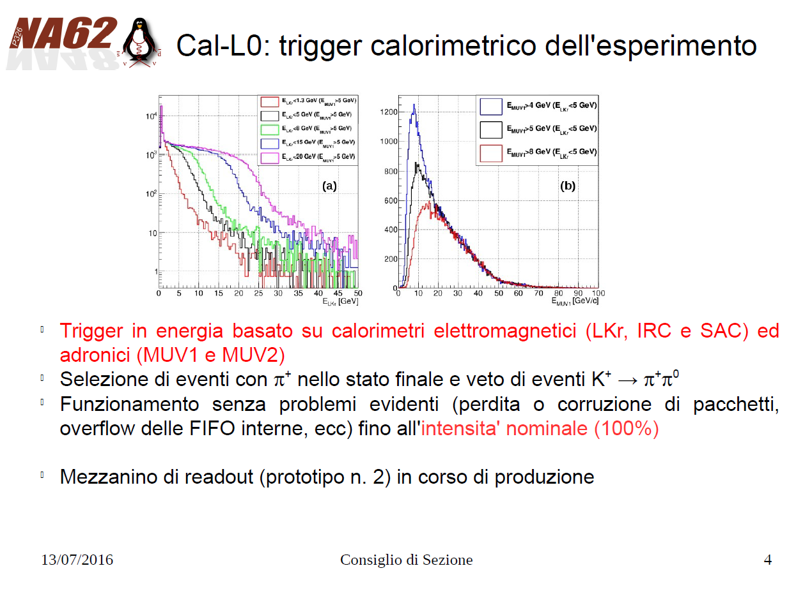

Slide 46


Slide 47

NA62 Roma Tor Vergata - Anagrafica 2017

Slide 48

NA62 Roma Tor Vergata - Richieste 2017

Slide 49

KLOE-2 Roma Tor Vergata – Anagrafica 2017
Quello che intendiamo misurare

Slide 50
KLOE-2 Roma Tor Vergata – Richieste 2017
Missioni 10 kEuro
Consumo 7 kEuro (metab.)
Apparati 6 kEuro

Slide 51
Attività 2014→…
Nel 2013 : DAΦNE fermo per installare i nuovi rivelatori in KLOE : IT-QCAL-CCALT (Abbiamo modificato la meccanica e l’assemblaggio dell’elettronica dei HET)
A partire dal 2014 : Test di DAΦNE con i nuovi rivelatori è previsto un run di presa dati della durata di tre anni.
Pubblicazione dal 2011 ad oggi :
PLB 702,(2011),324
PLB 706,(2012),251
EPJC 72,(2012),1917
PLB 718,(2012),910
JHEP 01,(2013),119
PLB 720,(2013),111
PLB 720,(2013),336
PLB 723,(2013),54
NIM A739,(2014),75
PLB 730,(2014),89
hep-ph 1404.7772 Submitted to PLB
hep-ph 1407.2028 Submitted to PLB

Slide 52
Attività 2014→…

Slide 53
Preventivi Roma Tor Vergata 2017 in sintesi
FTE (Ricercatori + Tecnologi) = 17.4
Richieste per fondi DOT1 (algoritmo):
  Missioni 9.0 kEuro
  Consumo 8.5 kEuro
  Inventario 16.5 kEuro
Preventivi 2016: 15.9 FTE

Slide 54


