Slide 1
Basic science and storytelling:
The experience of an Italian biomedical charity
Annamaria Zaccheddu
Erice International School of Science Journalism

Slide 2
A big challenge for communicators
The narration of basic science is a big challenge, regardless of the specific topic (physics, climatology, biomedicine, etc.)
At the same time, any organization is obliged to include fundamental science in its communication strategy
What does this mean for a biomedical charity as Fondazione Telethon?

Slide 3
Who we are

Slide 4
Our mission
Notes:
Fondazione Telethon finances the finest scientific research into finding a cure for rare genetic diseases. Because of their rarity, these diseases are traditionally neglected by major public and private investments.
Telethon was created in order to turn this situation around: for Telethon, the life of every patient matters, and it is necessary to do all we can so that no-one is excluded from the possibility of treatment and the hope of finding a cure, however rare their condition is.
The ultimate objective is to make the treatments developed thanks to the research financed by Telethon truly accessible to all those who need them.

Slide 5
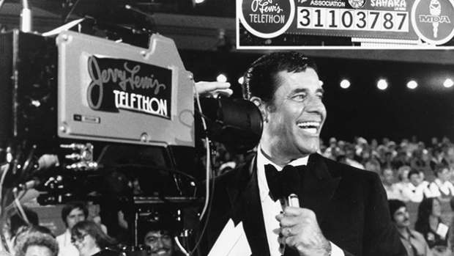
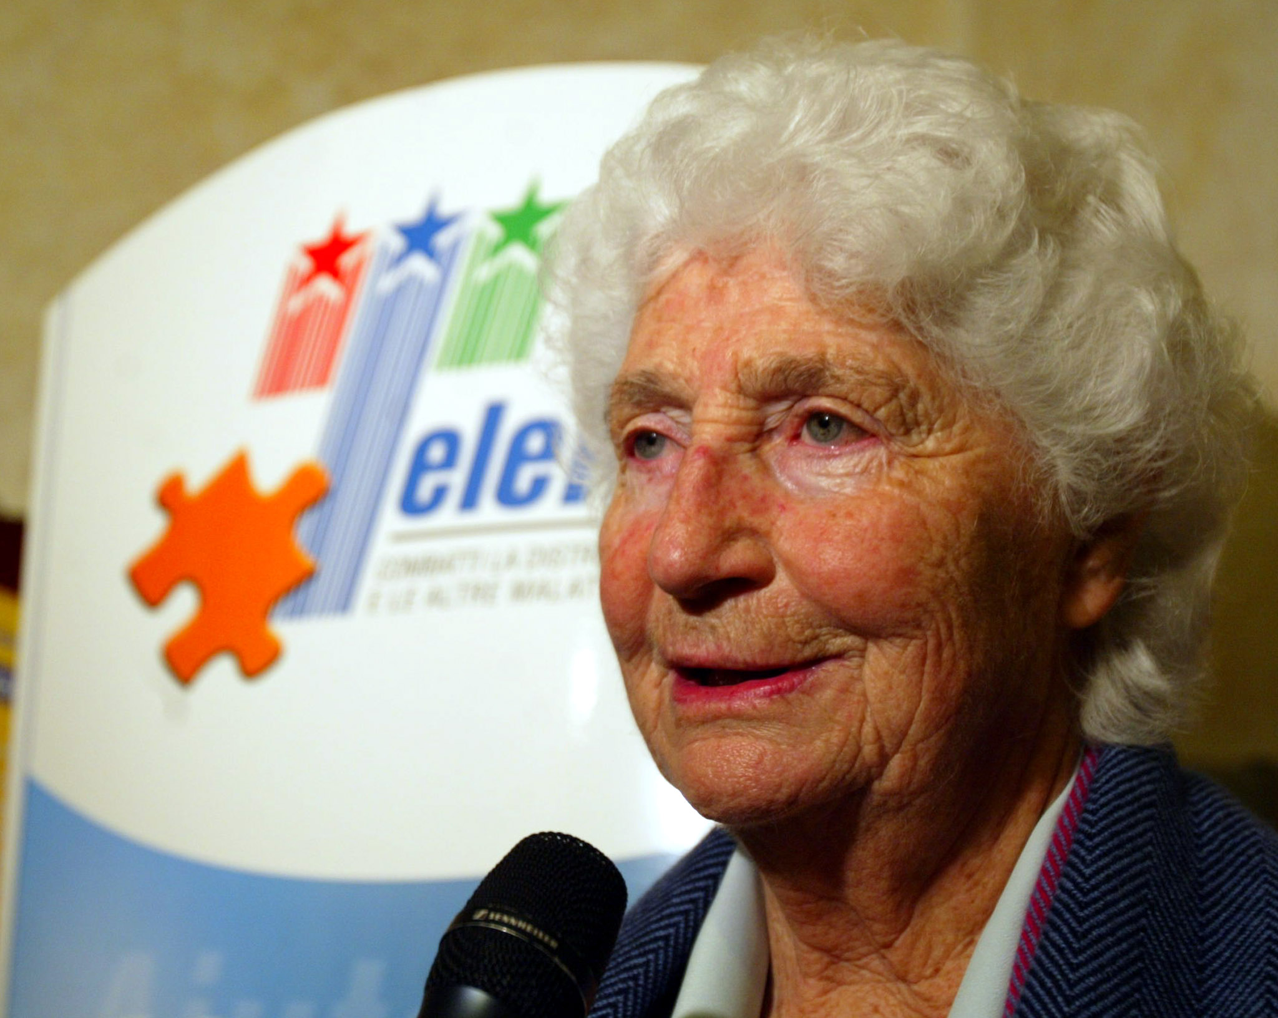
Our story
USA, 1966: the comic actor Jerry Lewis launches Telethon, a television marathon to raise money for the Muscular Distrophy Association (MDA)
Italy, 1990: a group of parents with children suffering from muscular dystrophy appeal to the Foreign Affair Minister Susanna Agnelli to create Telethon also in Italy. The show is a big success and two years later the founders decide to extend the Telethon mission to all rare genetic diseases.
Notes:
FT was created thanks to the long-sighted approach of a group of stakeholders who saw scientific research as the only real opportunity to fight genetic diseases and win.
(hence the name telethon, television marathon)

Slide 6
Rare diseases are not – as fact – so rare
In Europe A disease is defined as rare when it affects less than 1 in 2000. There are more than 6000 RDs.
On the whole, RDs may affect 30 million EU citizens.
70% of RDs become manifest within the first 5 years of an individual’s life.
80% of RDs are of genetic origin, and are often chronic and life-threatening.
For most of these diseases there is still no cure and many of them are still undiagnosed.
Fondazione Telethon exists for these people
Notes:
One rare disease may affect only a handful of patients in the EU, and another touch as many as 245,000.

Slide 7
How we operate

Slide 8
Telethon, number and facts*
OVER 451M€
invested
75%
spent in programs
We support only top, internationally competitive projects, through highly selective peer review conducted by a prestigious international Committee
ONLY THE BEST BASIC AND CLINICAL RESEARCH
475 genetic diseases studied
10,222
scientific papers
2,570
Research Grants
1,556
Funded scientists
20+
Therapeutic strategies
at the clinical or
pre-clinical stage
* Last update 30/06/2015

Slide 9
A big success of Telethon research
Strimvelis, the first ex-vivo stem cell gene therapy to treat patients with a rare immunodeficiency (ADA-SCID) has just been approved by the European Commission.
It has been developed by the scientists of the San Raffaele-Telethon Institute of Gene Therapy in collaboration with GlaxoSmithKline
Notes:
A child born with ADA-SCID does not have a healthy, fully-functioning immune system and as a consequence, is unable to fight off everyday infections. Strimvelis (autologous CD34+ cells transduced to express ADA) is the first corrective gene therapy for children to be awarded regulatory approval anywhere in the world. It is indicated for the treatment of patients with ADA-SCID for whom no suitable human leukocyte antigen (HLA)-matched related stem cell donor is available

Slide 10
Next steps for the future
Thanks to the strategic alliance with industries, the gene therapy developed by Telethon scientists could be applied to other genetic diseases:
Disease | Type of disease | State of the art
Metachromatic leucodystrophy | Metabolic disorder (CNS, both central and peripheral) | Clinical trial started in 2010 (20 pts treated)
Wiskott-Aldrich Syndrome | Immunodeficiency | Clinical trial started in 2010 (8 pts treated)
Beta thalassemia | Blood disorder | Clinical trial started in 2015 (3 pts treated)
Muchopolysaccharidosis type 1 | Metabolic disorder (bone, CNS) | Clinical trial starting within 2016
Muchopolysaccharidosis type 6 | Metabolic disorder (bone, heart, eye) | Clinical trial starting within 2016
Notes:
Moreover Telethon scientists are working also on other diseases, such as haemophilia

Slide 11
Basic vs. clinical research

Slide 12
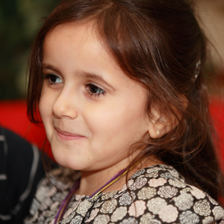
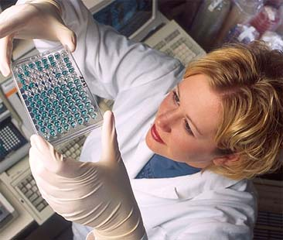
Different communication approaches
_
+
CLINICAL RESEARCH
Concrete results
Expression of the mission (the cure)
Emotional involvement
Stimulating fundraising
“You invested more than 450 million euros in research and saved only 20 children?”
“Why don’t you study my disease too?”
Industries involvement
Expression of the mission (many diseases)
Contribution to the dissemination of scientific culture
Difficult to explain
Intermediate results (how and when?)
Animal models
False expectations within patients community
BASIC RESEARCH

Slide 13
The Telethon «research ladder»
Over the years, our funding has taken us closer to patients, moving away from basic research towards pre-clinical and clinical research

Slide 14
Basic science, an essential issue
An organization aiming at the cure of rare genetic diseases can’t afford to ignore basic research
There are many reasons why an organization as FT has to continue support basic science and communication strategy has to take it into consideration too
Let’s see three «good stories» we chose to communicate basic research.

Slide 15
1. Basic science is a powerful source of good ideas

Slide 16
Liviana’s gift (2012)

Slide 17
The same story, another perspective
Giovanni is one of the children successfully treated with gene therapy: the first results of the clinical trial has been described in Science in 2013 and received huge media coverage
However, this moving story – one of the main successes of Telethon research – can also be told from another perspective:
That of a scientist with a «crazy» idea

Slide 18
HIV, a killer to cure
The story is that of Luigi Naldini, an Italian scientist with a revolutionary idea: the possibility to use HIV to transfer correct versions of genes
The first reaction of the scientific community to Naldini’s “revolutionary” paper (Science, 1995) has been: «Wonderful science but… you are not going to apply it to humans, are you?»
More than 20 years later now lentiviral vectors are routinely used and in the meantime allowed Telethon scientists to treat at least 3 severe genetic diseases
So, are we sure that patients’ perspectives are the only ones we can effectively use to communicate basic science?

Slide 19
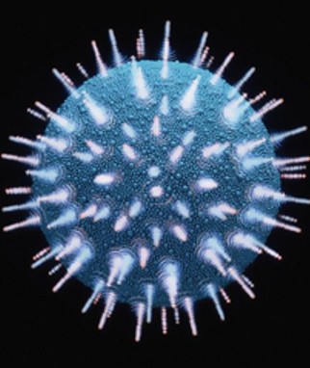
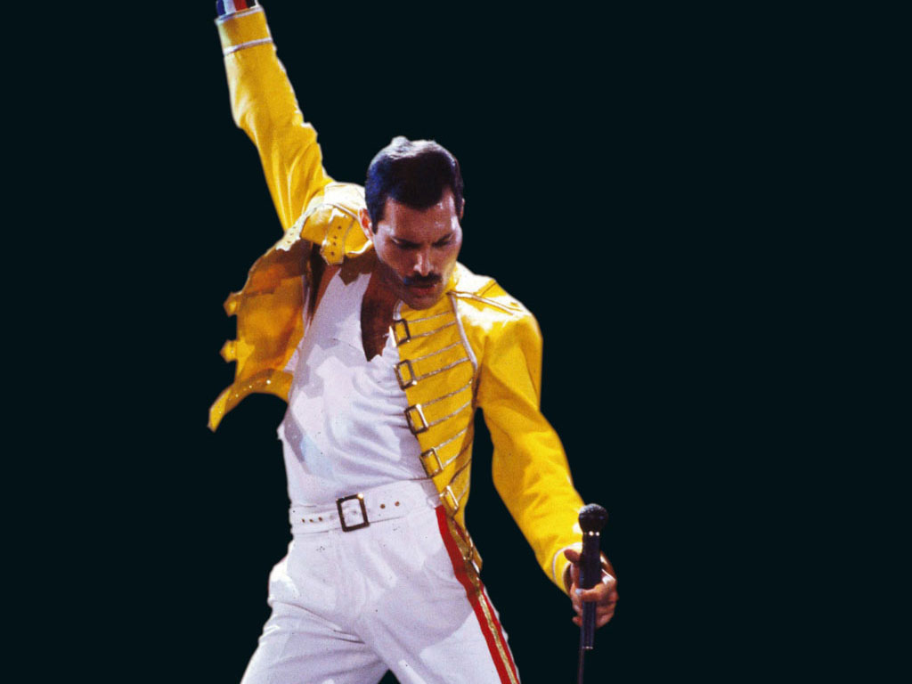
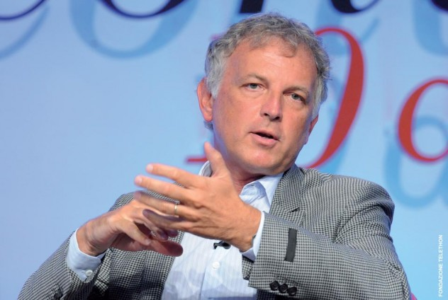
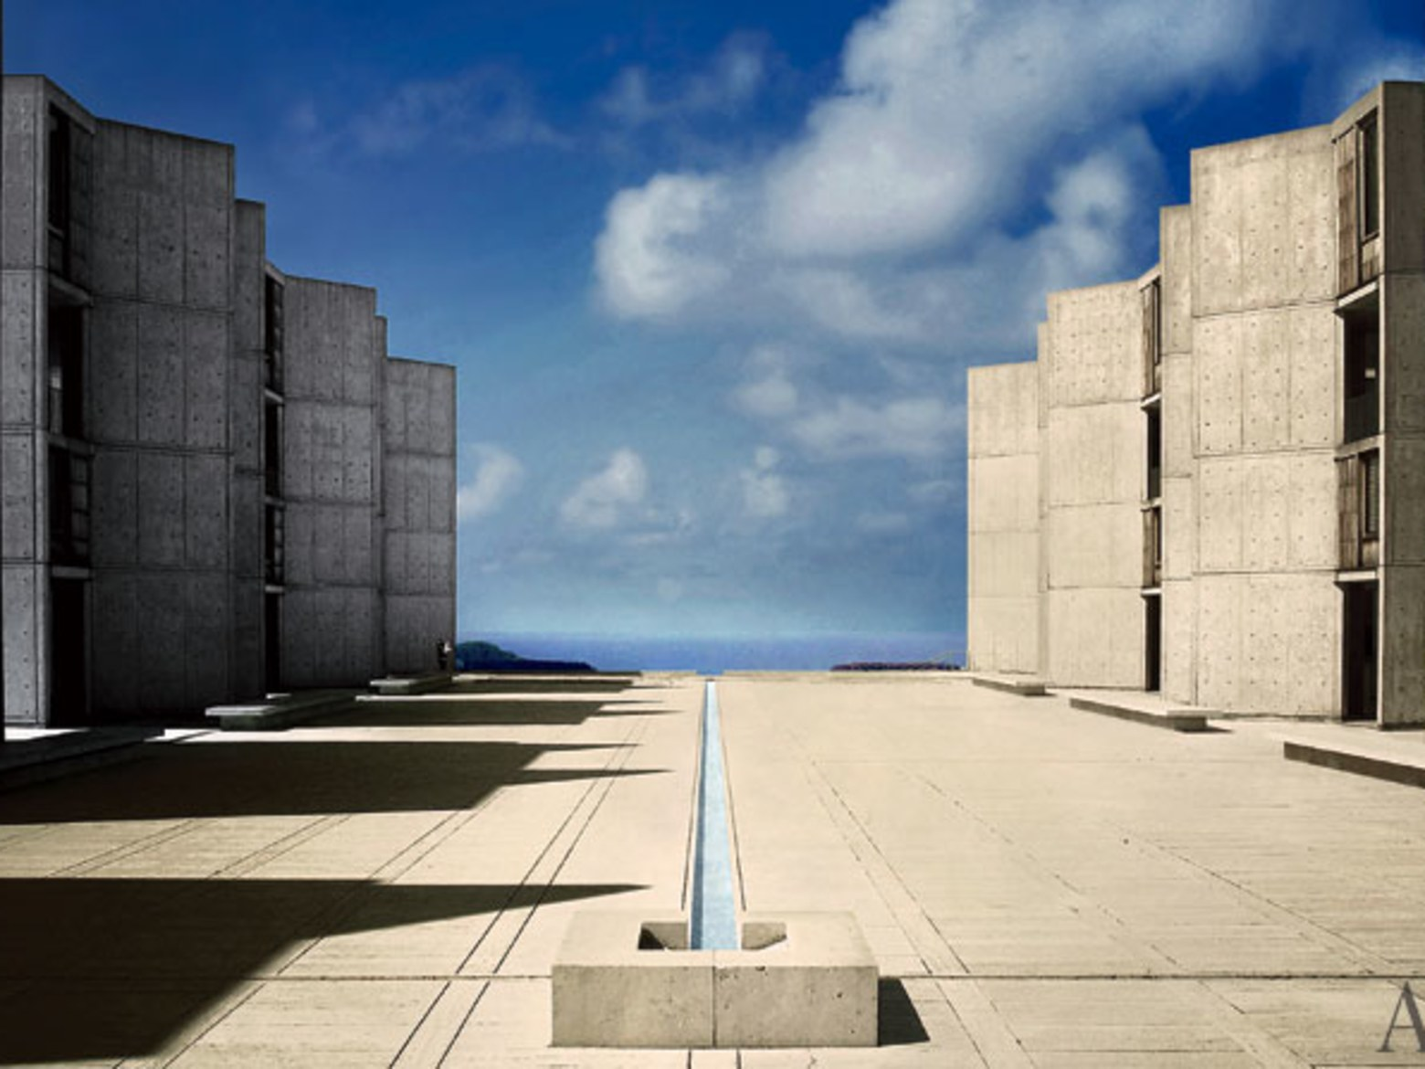
A new storytelling
… capable of killing millions of people, also
very famous and rich
A dreadful and mysterious virus…
An Italian scientist «borrowed» by USA…
… working in the institute founded by a virus fighter, Jonas Salk

Slide 20
2. Basic science is a strong ally of clinical research

Slide 21
Research is not a one-way road
Basic science is very helpful also to clinical research, because it provides information about whether therapies work or don’t, and why so.
Even in the presence of outstanding clinical results we shouldn’t ignore their correlated basic studies
Although more difficult to tell, these stories make people understand better what translational research is (and why it takes so much time to achieve results)

Slide 22
An important source of knowledge
Starting in 2010, 8 children with a rare immunodeficiency have been successfully treated thanks to gene therapy
Meanwhile, in the lab, Telethon scientists studied the «long-term destiny» of the engineered hematopoietic stem cells
This study provided useful information not only about this specific rare disease, but also about hematopoietic stem cell transplantation (a very common treatment for other diseases, including leukemia and other blood cancers)
Although more difficult to communicate, these collateral results deserve to be known by the lay public

Slide 23
3. Basic science can be extremely surprising

Slide 24
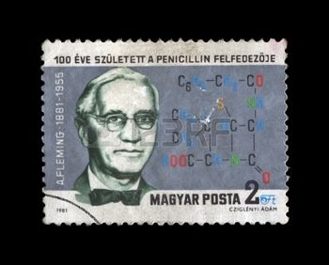
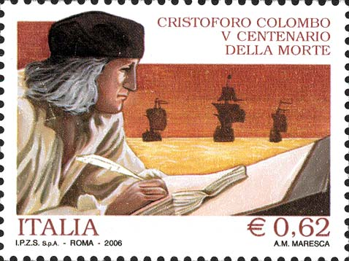
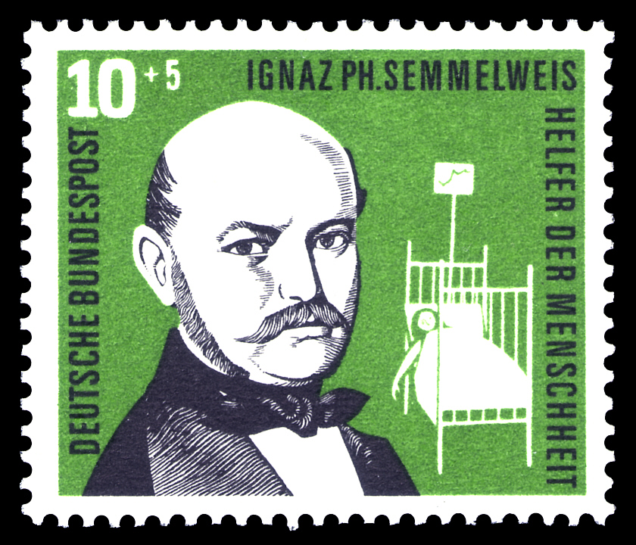
Unexpected results
A core message to be transmitted to donors, stakeholders and the public in general is that supporting basic science means investing in unexpected opportunities
Narrating these «unexpected results» could make basic science more fascinating to the lay public

Slide 25
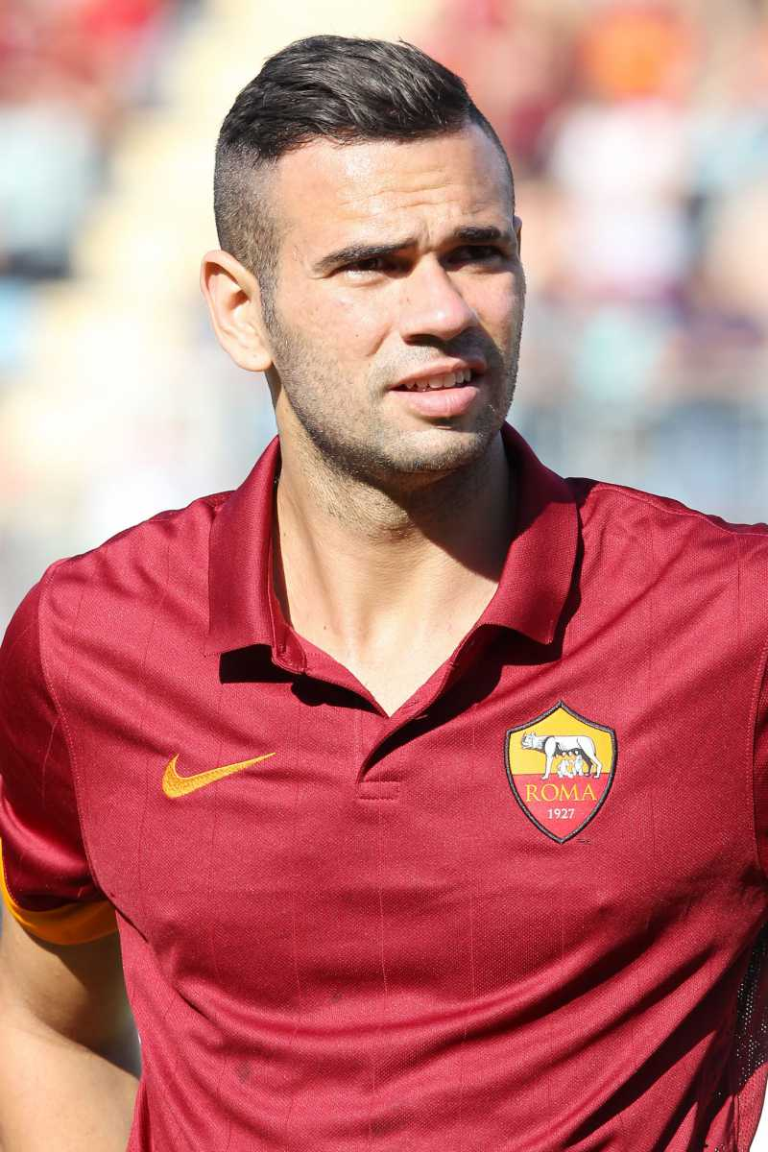
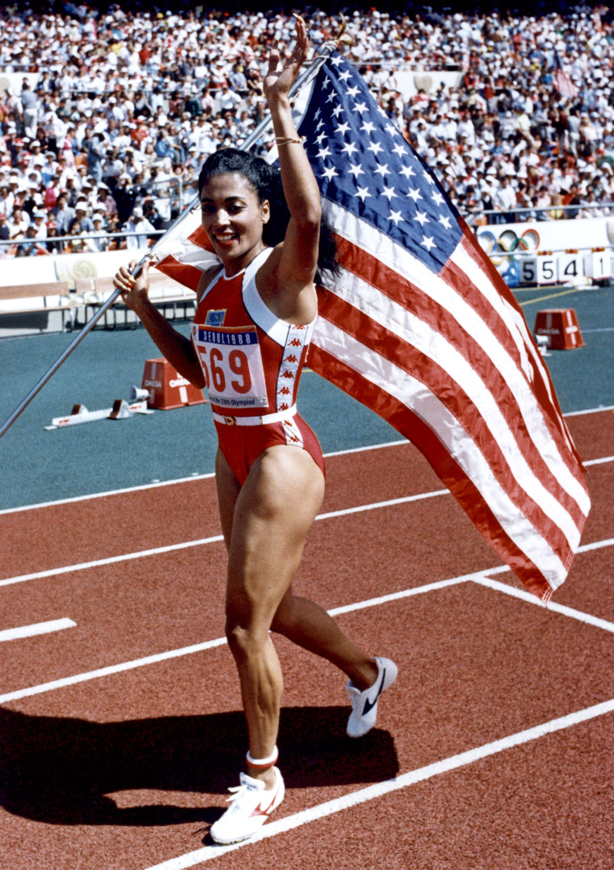
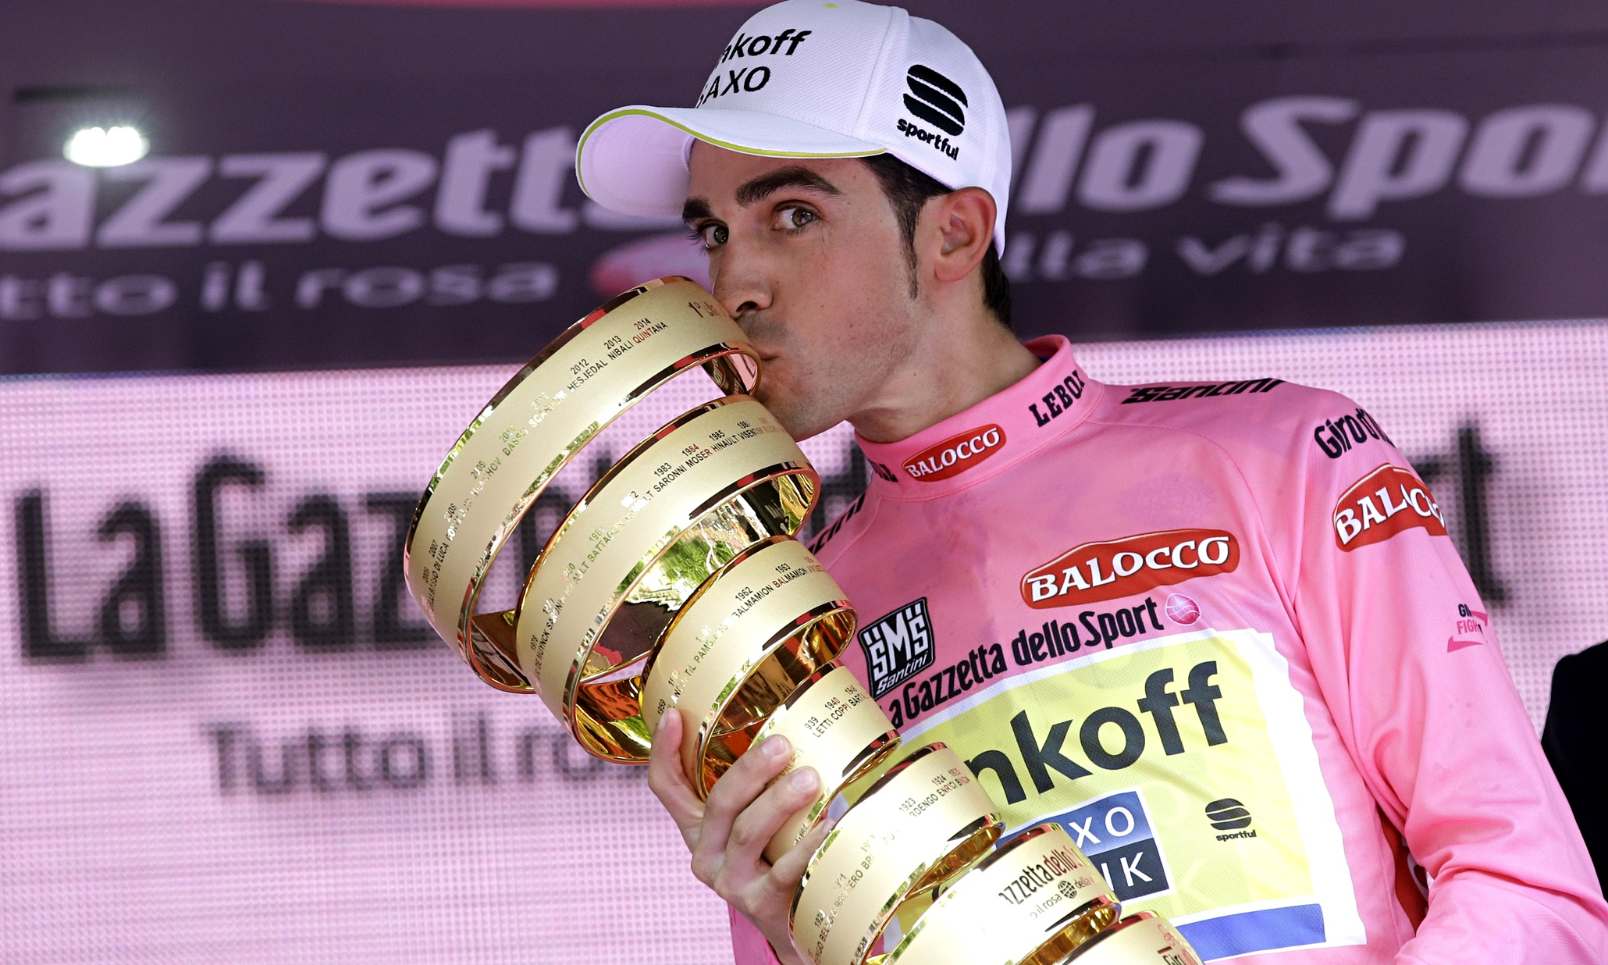
From cancer to a very rare disease
A group of Telethon-funded scientists discovered that an old anticancer drug could be effective against a rare genetic disease – cavernous hemangioma – characterized by severe and unpredictable cerebral hemorrhages.
The drug, capable of arresting the production of new blood vessels, showed effectiveness in both the disease models.
Leandro Castan
Florence Griffith
Alberto Contador

Slide 26
The take home message
Communicating the results of clinical research can be relatively easier, because we can rely upon “success stories,” that show the effectiveness of new treatments. Nonetheless, for an organization like FT is crucial to talk about the possibilities offered by basic science too.
We must show our main stakeholders (patients and donors) that thanks to their money we are supporting basic science with great potential.
At the same time we have to clarify that research can be complex, expensive and time-consuming, and sometimes does not lead to immediate results: dead-end roads are part of the whole process.

Slide 27
Never forget the power of words

Slide 28
Thank you! azaccheddu@telethon.it (+39) 06 44015402 www.telethon.it

