Slide 1
Circular Lepton Colliders
S. Guiducci, INFN-LNF
PhD course on accelerators
LNF, Frascati, 14 June 2016

Slide 2
Outline
Basics concepts of circular colliders:
  luminosity
  tune shifts
Main design criteria and challenges of the high luminosity and high energy colliders including:
  different collision schemes
  luminosity optimization
  beam lifetimes
  examples of colliders achievements and design choices for future colliders

Slide 3
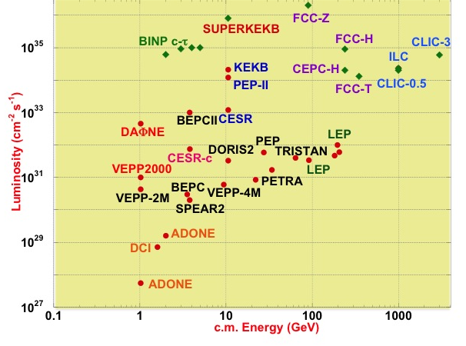
World e⁺e⁻ colliders luminosity
Factories
Future colliders
B-Factories
Φ-Factories
Future Colliders
Notes:
Aggiorna con FCC e CEPC

Slide 4
World e⁺e⁻ colliders luminosity plot
Two regions:
  High luminosity frontier
    Factories, high precision physics measurements
  High energy frontier
    Discovery measurements
    Before Higgs
      LEP2 latest circular collider
      Next is a linear collider ILC or CLIC
    After LHC Higgs discovery at E = 126 GeV
      Two proposals for a “Higgs Factory” circular collider: FCCee (CERN, Geneva) and CEPC (IHEP, Beijing)

Slide 5
Energy loss/turn
e⁺e⁻ Colliders
 | E (GeV) | ρ (m) | L (m) | T₀ (μs) | U₀ (dip)* (MeV)
ADONE | 1.5 | 5 | 105 | 0.35 | 0.09
DAΦNE | 0.51 | 1.4 | 98 | 0.31 | 0.004
PEP-II LER | 3.1 | 30.5 | 2200 | 13.6 | 0.27
PEP-II HER | 9 | 165 | 2200 | 13.6 | 3.52
LEP | 100 | 3100 | 27000 | 89 | 2855
FCCee | 120 | 10400 | 100000 | 333 | 1765
dip = radiation from dipoles, excluding contribution of wigglers

Slide 6
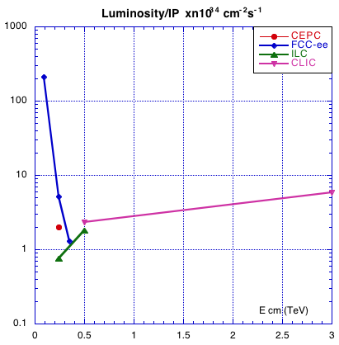
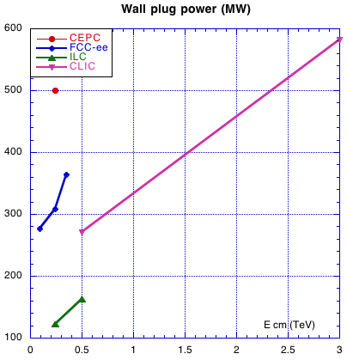
Linear vs. Circular
Circular Colliders Luminosity rapidly decreases on energy for a constant beam power
To reach higher energies Linear Colliders are needed

Slide 7
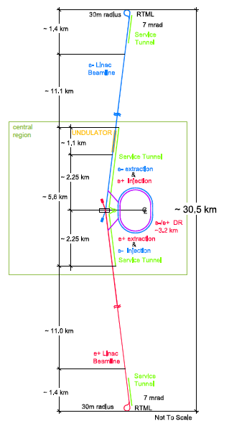



ILC Linear Collider
Two linacs made of ~ 7300 SC nine-cell cavities
Two damping rings to reduce the beam emittances to very low values
An interaction region to squeeze the beam sizes to ultra-low values
Total length 30.5 km
A 1.3 GHz superconducting nine-cell niobium cavity like the ones used for the X-FEL under commissioning at DESY, Germany
ILC Technical Design Report 2013
https://www.linearcollider.org/ILC/Publications/Technical-Design-Report

Slide 8
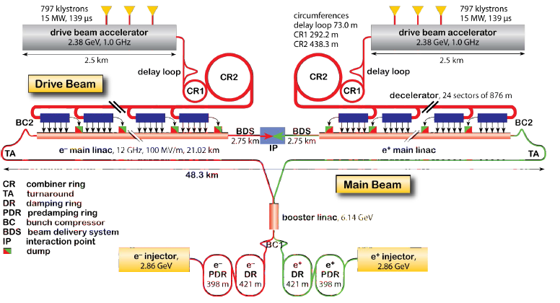
CLIC Layout at 3 TeV
Luminosity
5.9x10³⁴ @ 3 TeV
CLIC Linacs are based on 12 GHz normal conducting cavities with a gradient of 100 MV/m
The klystron powering is replaced by the generation of a second ‘Drive Beam’ and its compression and reconversion into RF power

Slide 9
Luminosity
The Luminosity L is a measure of the probability of particle encounters per unit area per second in a collision process
Given the cross section of a physics process σ_{phys} the counting rate of a physics event is
R [s⁻¹] = σ_{phys} [cm⁻²] L [cm⁻²s⁻¹]
Notes:
Definizione cross section?

Slide 10
Luminosity
For head-on collisions, bunched beams of opposite charge, Gaussian charge distributions, L can be written as:
f_{coll} = n_{b}f₀ = collision frequency
n_{b}= number of bunches, f₀=revolution frequency
N⁺, N⁻ number of particles/bunch
σ*_{x}, σ*_{y} transverse beam sizes at Interaction Point (IP)
4πσ*_{x} σ*_{y} area of colliding beams
To get high luminosity:
  Increase the collision frequency
  Increase the bunch density

Slide 11
Luminosity
For head-on collisions, bunched beams of opposite charge, Gaussian charge distributions, L can be written as:
f_{coll} = n_{b}f₀ = collision frequency
n_{b}= number of bunches, f₀=revolution frequency
N⁺, N⁻ number of particles/bunch
σ*_{x}, σ*_{y} transverse beam sizes at Interaction Point (IP)
4πσ*_{x} σ*_{y} area of colliding beams
To get high luminosity:
  Increase the collision frequency
  Increase the bunch density ➔ but
Beam-beam effects pose a limitation on the maximum achievable bunch density

Slide 12
Beam-beam effects
Beam-beam effects pose a limitation on the maximum achievable bunch density
Particles in a bunch are strongly affected by the nonlinear field of the counter rotating bunches
Increasing the bunch density produces beam blow-up and particle losses
A measure of the strength of the beam-beam interaction is given by the linear beam-beam tune shift ξ_{x}, ξ_{y}
It exists an empirical upper bound on ξ_{x}, ξ_{y}

Slide 13
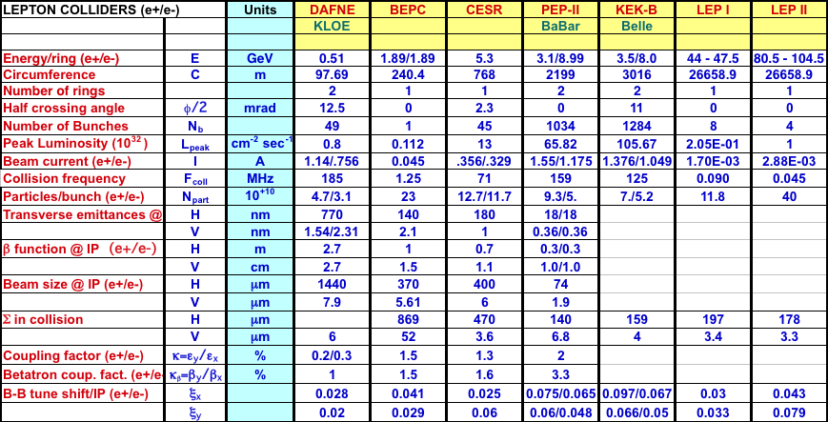
Achieved beam-beam tune shifts
From ICFA Lepton Colliders Database v8 2005 (M. Biagini)
KEKB has achieved ξ_{x} = 0.127/0.122, ξ_{y} = 0.129/0.090 and L = 210.8 10³² cm⁻²/s

Slide 14
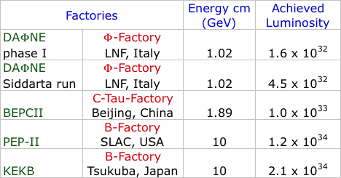
Achieved peak luminosities
The previous table is not up to date but is useful since it lists many useful parameters
Here are the updated numbers for the peak luminosities
Notes:
Aggiungi le energie?

Slide 15
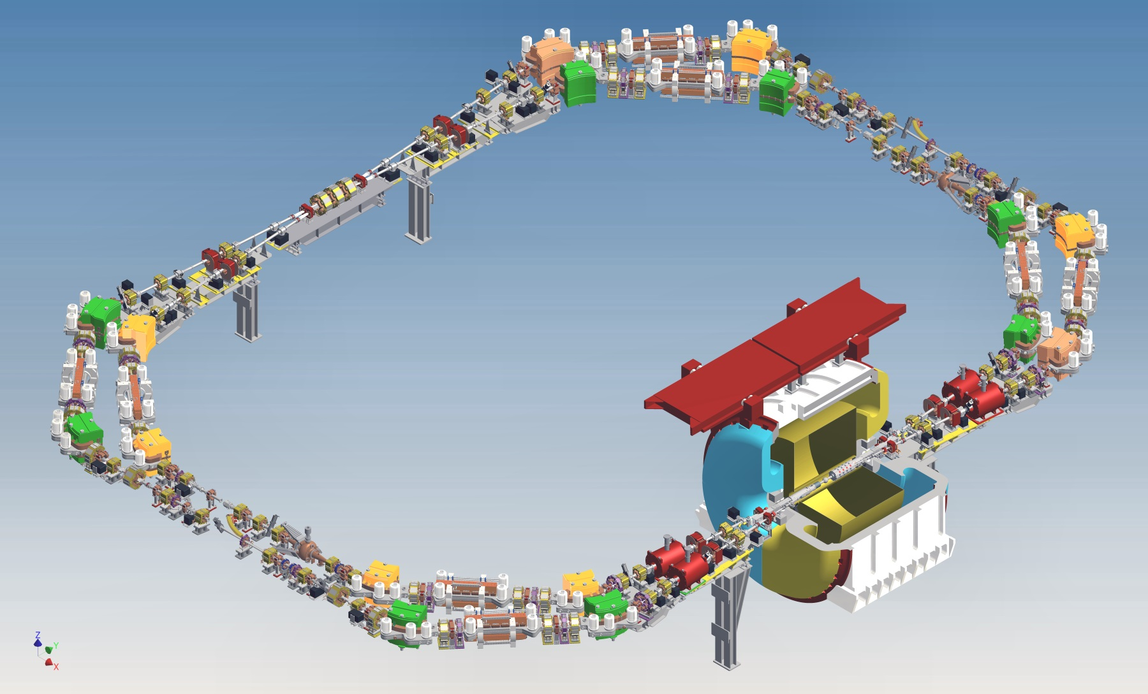

DAΦNE Φ-Factory
E_{CM} = 1020 MeV
Circumference = 97 m
Crab-Waist collision scheme implemented for the first time
Max Luminosity achieved at DAΦNE 4 10³² cm⁻²s⁻¹ is by far the highest achieved at this energy

Slide 16
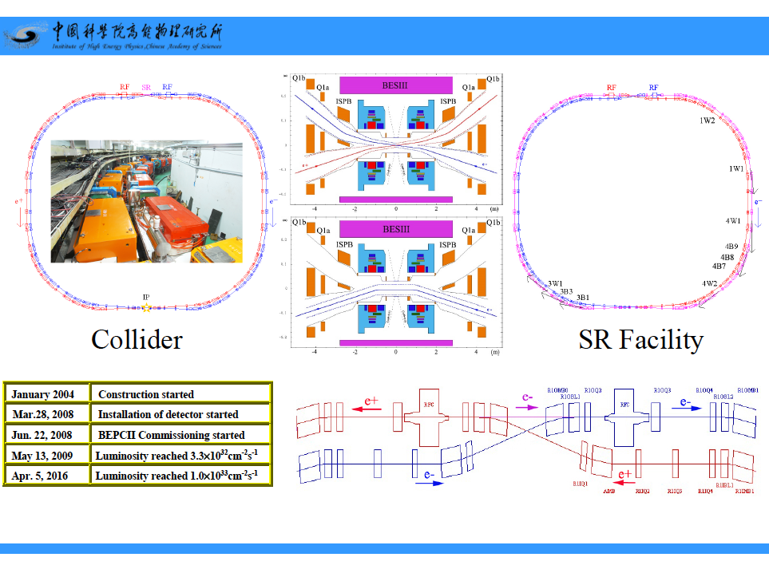
BEPCII C-Tau-Factory, Beijing, China
Energy = 1.89 GeV
Circumference = 237.5 m

Slide 17
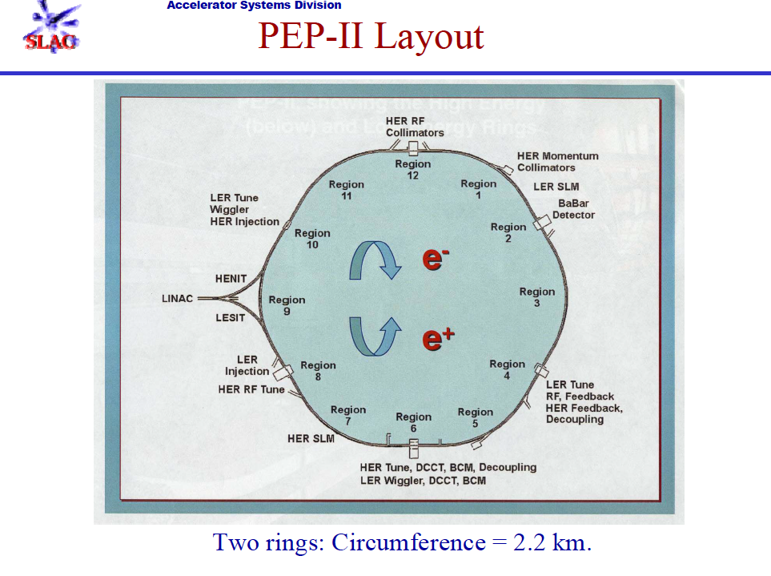
1998 – 2008
Energy cm = 10 GeV
LER = 3.1 GeV
HER = 9 GeV

Slide 18
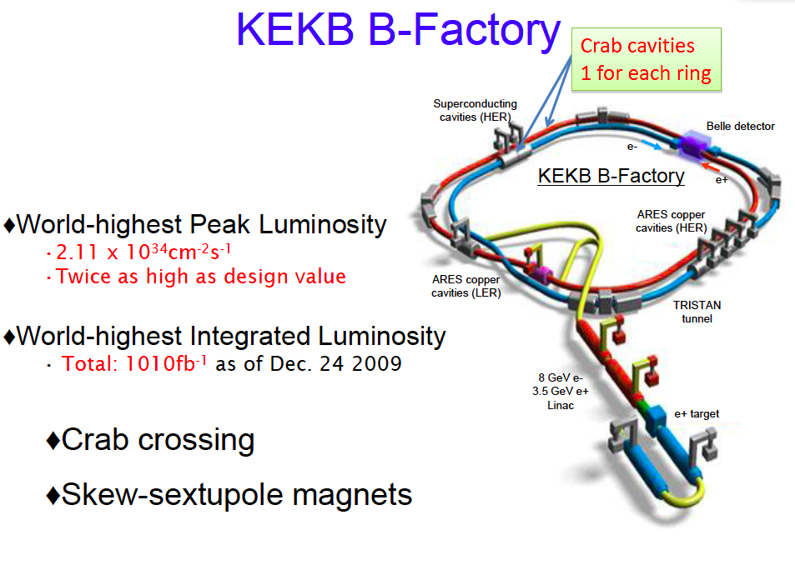
1999 - 2010
Energy cm = 10 GeV
LER = 3.5 GeV
HER = 8 GeV
Circumference = 3 km

Slide 19
Beam-beam tune shift – Bassetti - Erskine formula
The electric field of a gaussian bunch with N particles seen by a test particle in collision can be expressed in terms of the complex error function:
For relativistic particles the electric and magnetic field are equal
These expressions of the fields can be used in simulation programs to evaluate the beam-beam effects with realistic beam distributions
The beam-beam interaction at large amplitudes is highly nonlinear
For small amplitude particles it is characterized by a quadrupole-like force with focal length:
The beam-beam tune shift is the first order approximation to the betatron tune change given by: ξ_{x,y} = β*_{x,y} K_{x,y} /(4π)
M. Bassetti, G. A. Erskine CERN-ISR-TH/80-06
Notes:
Ci vorrebbe un plot del campo elettrico

Slide 20
Beam-beam tune shift
The beam-beam tune shift is given by:
Inserting in the luminosity formula we get
For flat beams and

Slide 21
Beam-beam tune shift
Assume both tune shifts equal to the limit value i.e. κ_{b}=κ
At the b-b limit to further increase luminosity we can:
Increase the current and the emittance keeping the tune shift constant
  Current is limited by the RF power available, vacuum system limits and beam instabilities
  Emittance is limited by vacuum chamber aperture and dynamic aperture
Reduce β_{y} with challenges on the IR design and dynamic aperture
Minimum β_{y} is limited by the hourglass effect

Slide 22
Hourglass effect: why short bunches?
In the drift near the IP:
β_{y}(s) = β_{y}* + s²/β_{y}*
To squeeze the vertical beam size, and increase Luminosity, β_{y}* at IP must be decreased
This is efficient only if at the same time the bunch length is shortened to σ_{z} ≈ β_{y} otherwise particles in the head and tail of the bunches will collide at a larger β_{y}
0,1
β_{y}*
1 mm
0,08
5 mm
0,06
0,04
2 cm
0,02
s (m)
0
-0,02
-0,01
0
0,01
0,02
Bunch length

Slide 23
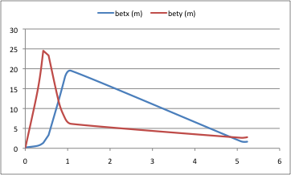
Low β_{y} insertion
L* is the length of the drift between the IP and the first QD quadrupole focusing in the vertical plane
β(s) = β* + s²/β* ⇒ β_{max} ≈ L*²/β*
DAΦNE
L*=0.3 m β*= 6 mm β_{max} ≈ 15 m
QD quadrupole
gradient = 26 T/m length = 0.25 m
SuperB
L*=0.52 m β*= 0.21 mm β_{max} ≈ 1700 m
QD quadrupole
gradient = 100 T/m length = 0.3 m
DAΦNE - Siddharta IR
Permanent Magnet
Superconducting

Slide 24
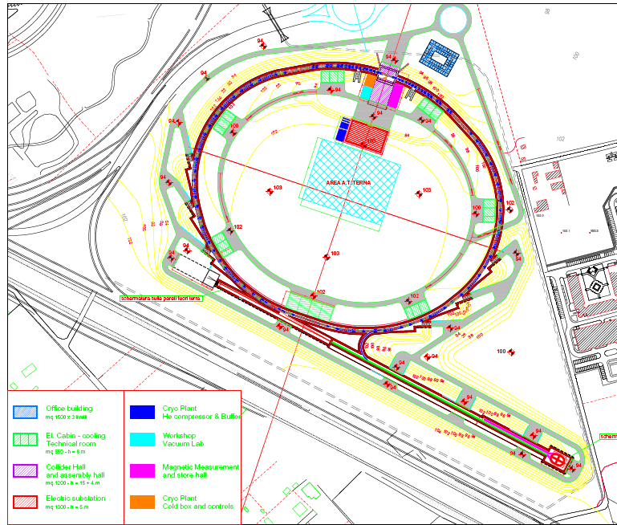
SuperB Layout @ Tor Vergata University
SuperB was a proposal to build a ultra high luminosity B-Factory in the Tor Vergata University campus
The proposal was not accepted for cost reasons
The design aimed at a ultra high luminosity: 10³⁶ cm⁻²s⁻¹
A CDR was published in 2010:
SuperB Progress Report – Accelerators, arcXiv:1009.6178 [physics.acc-ph], http://arxiv.org/abs/1009.6178
IP
LER Spin Rotators
3 ID cells
3 ID cells
Injection & RF section
Linac complex

Slide 25
SuperB - Proposal
SuperB is an asymmetric lepton collider aiming at a luminosity of 10³⁶ cm⁻² s⁻¹ at the center of mass energy 10.6 GeV
The target luminosity is ~ two orders of magnitude larger than that achieved by PEP-II (SLAC, USA) and KEKB (KEK, Japan)
The leptons are stored in two rings (e⁺@6.7 GeV, e⁻@4.2 GeV)
Circumference is 1.2 km
Interaction region design is based on “crab waist scheme”

Slide 26
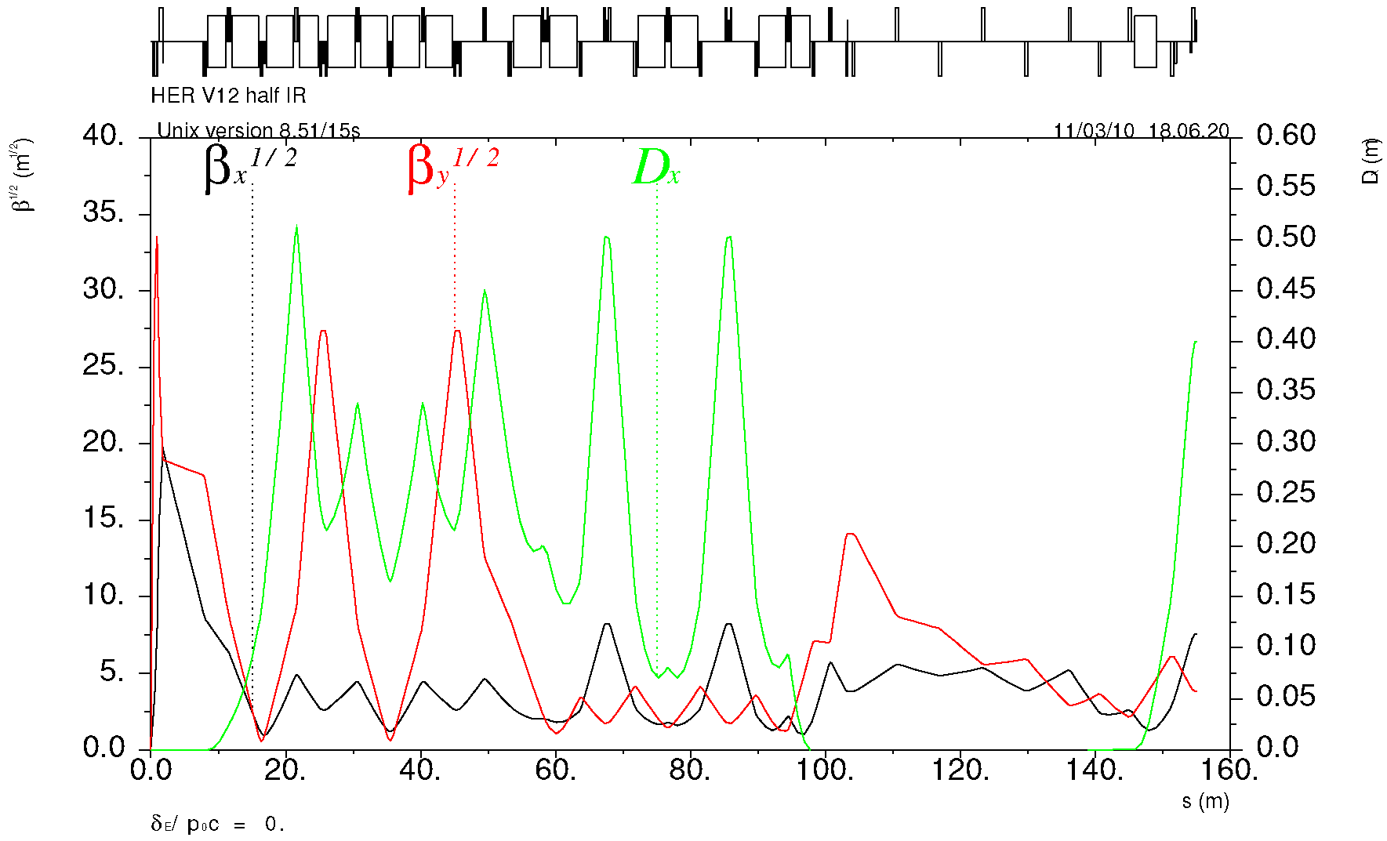
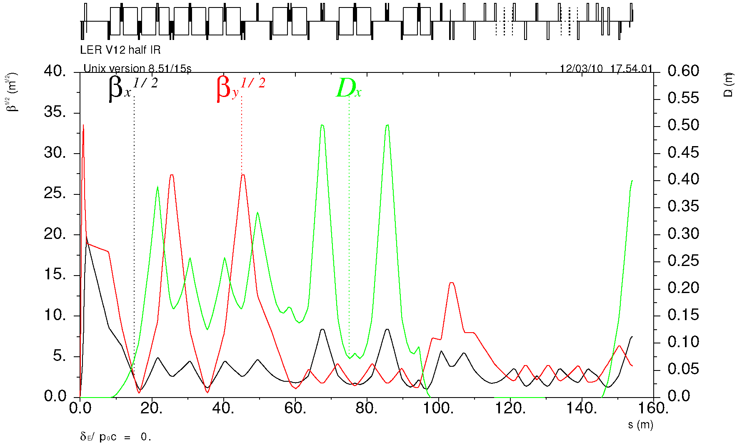
SuperB Final Focus sections
“Spin rotator” optics is replaced with a simpler matching section
IP
β* = 26 / 0.25 mm
Y-sext
Crab
Match
X-sext
HER
Matching section is shorter than HER to provide space for SR optics
IP
Y-sext
β* = 32 / 0.21 mm
LER
Crab
Match &
Spin Rotator
X-sext
P. Raimondi
L. Malisheva

Slide 27
Different collision schemes
Single ring, few bunches, few IPs, head-on collisions (1st generation 1966 - 1999 : Aco, VEPPII, Adone, Spear, Petra, PEP, LEP, BEPC)
Exotic schemes (DCI (4 beams), Doris (first attempt with a vertical crossing angle), VEPP2000 (round beams), CESR (pretzel orbit))
Double rings, multibunch, 1 IP, crossing angle
  Small Piwinski angle (Factories since 1999: PEPII, KEKB, DAΦNE, BEPCII)
  Large Piwinski angle and low emittance w/o crab waist (present and future colliders since 2009: DAΦNE upgrade, SuperB proposal, SuperKEKB, BINP τ/charm proposal, FCCee)
Notes:
Aggiungo gli anni, tipo 1st generation, 2nd and 3rd?

Slide 28
Single ring - head-on collision
The number of IPs is 2n_{b,} twice the number of bunches
Beam-beam sets a limit on the maximum tune shift in the ring: more IPs ⇒ less luminosity per IP
Therefore the number of bunches is small, ~1÷8, and the collision frequency is of the order of the revolution frequency
Below beam-beam limit luminosity is proportional to the square of the particles per bunch N²/β_{y}
Above beam-beam limit, luminosity increases linearly with N/β_{y}
Due to hourglass effect σ_{z} ≈ β_{y}
Bunch peak current is pushed to the maximum

Slide 29
Single ring - head-on collision
At low energy main limitations are
  single bunch instabilities due to the interaction of the bunch e.m. fields with the vacuum chamber (HOM heating, bunch lenghtening, …)
  Large beam emittances requiring large magnetic apertures and large dynamic apertures
At high energy main limitations come from
  RF power available and issues related to high synchrotron radiation power
  HOM heating and stability issues related to high bunch charge and short bunches

Slide 30
Double rings – crossing angle
The bunches are stored in 2 separate rings crossing at 1 IP with a crossing angle
They travel in the same vacuum chamber in a short region near the IP
In this region the bunches see each other with an offset at a number of parasitic points, at distances from the IP equal to half the bunch distance
The tune shift due to the parasitic crossings is inversely proportional to the square of the bunch separation

Slide 31
Double rings – crossing angle
Luminosity is proportional to the number of bunches L ∝ n_{b}
Below bb limit L ∝ N²
Above bb limit L ∝ N
Therefore it is convenient to increase number of bunches instead of the particles per bunch N, i.e. increase the average current I = en_{b}N/T₀ at constant bunch peak current I_{peak} = eN/√(2πσ_{l}) decreasing the impact of single bunch instabilities
The limit on maximum n_{b} is the tune shift due to the parasitic crossings
The limit to the maximum ring current is again RF power, and issues related to high synchrotron radiation
At Factories very large currents have been stored with collision frequencies of the order 100 ÷ 350 MHz

Slide 32
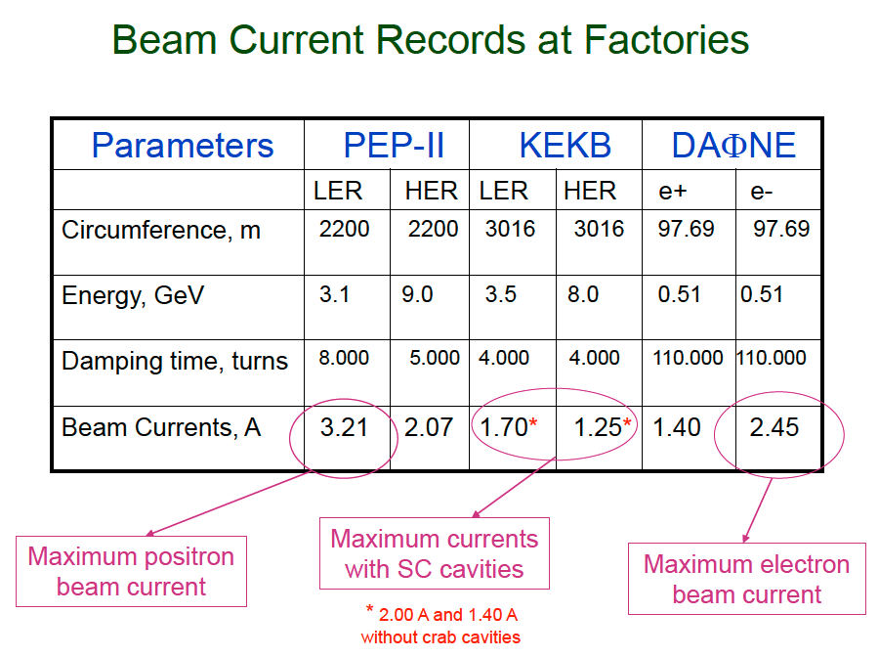
M. Zobov, IPAC10

Slide 33
Crossing angle and Piwinski angle
Crossing angle induces a coupling between the synchrotron and betatron motion since the kick experienced by a particle depends on its longitudinal position
θ/2
σ_{x}
σ_{z}
Small Piwinski angle to reduce strength of synchro-betatron resonances
Since generally σ_{x}<< σ_{z} small Piwinski angle implies small crossing angle θ <<1

Slide 34
Luminosity strategy with double rings
Small beta function at the IP β_{y}*
Higher number of particles per bunch N
More colliding bunches n_{b}
Large beam emittance ε_{x}
Higher tune shift parameters ξ_{x,y}
Crossing angle θ
- Small Piwinski angle Φ = σ_{z}tg(θ/2)/σ_{x} < 1
small crossing angle θ < σ_{x}/σ_{z}
To avoid parasitic crossings
To reduce strength of synchro-betatron resonances

Slide 35
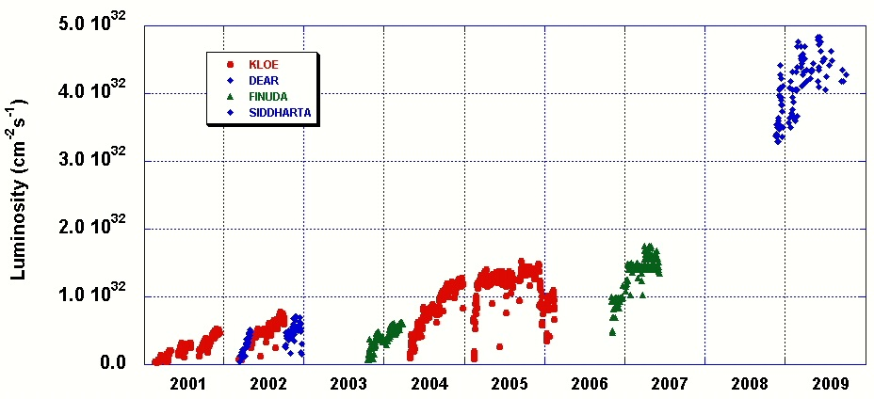
Large Piwinski Angle & Crab Waist scheme
To break B-Factories record in peak luminosity a new collision scheme is needed
The «Large Piwinski Angle» and «crab-waist sextupoles» (LPA&CW) option was first developed by Pantaleo Raimondi and tested at DAΦNE (LNF)
Large crossing angle and very small beam sizes:
  collision area is shorter
  IP β functions can be smaller Φ_{Piwinski} = tg(θ)σ_{z}/σ_{x}
  less parasitic crossings
Design Goal
NEW COLLISION SCHEME

Slide 36
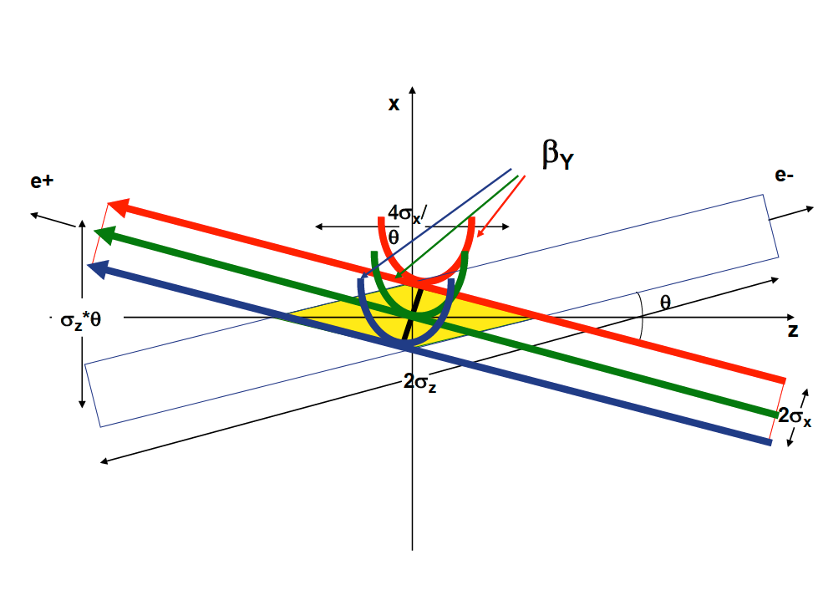
Crab sextupoles off
Crab waist is realized with a sextupole in phase with the IP in x and at π/2 in y

Slide 37
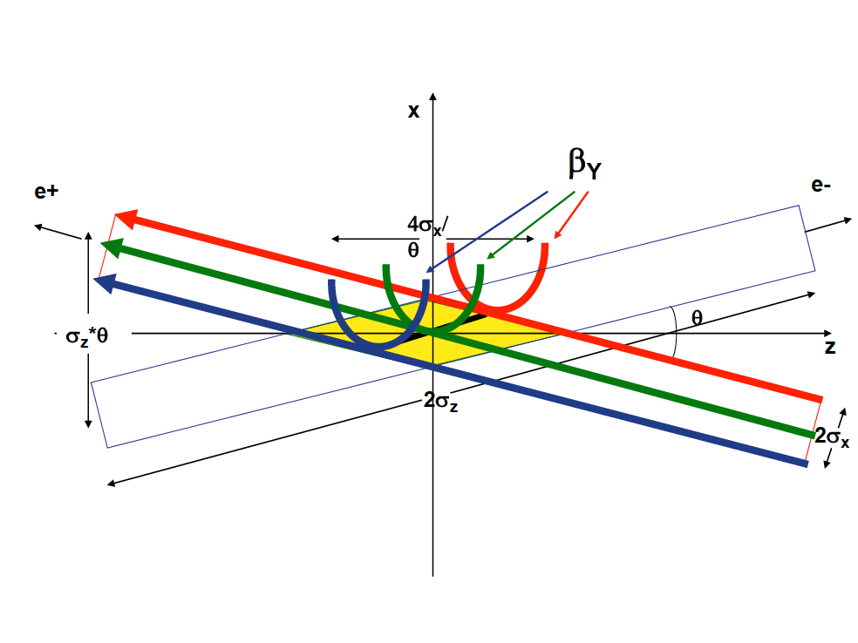
Crab sextupoles on
Crab waist is realized with a sextupole in phase with the IP in x and at π/2 in y

Slide 38
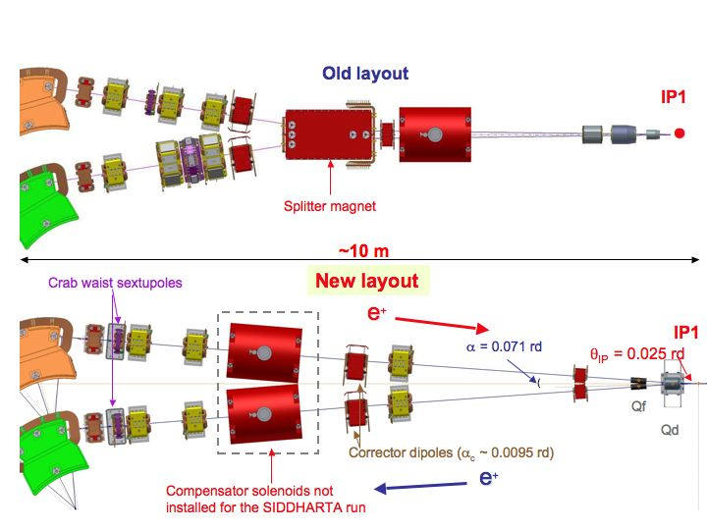
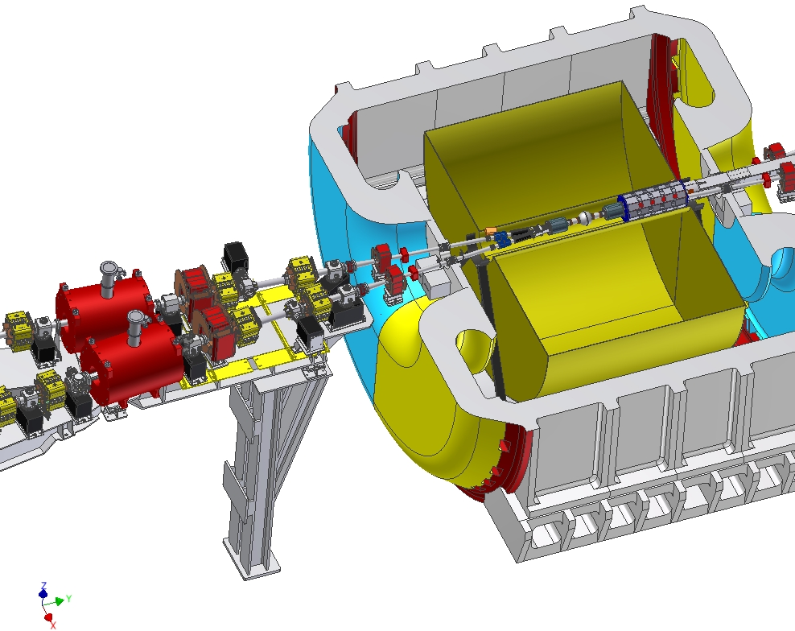
New DAΦNE Experimental Interaction Region
KLOE IR
P. Raimondi, April 22-2010

Slide 39
DAFNE with SiDDARTA experiment
Crab on/off Specific Luminosity
vs Current Product
Lifetime limit
Crab on/off Luminosity
vs Current Product
P. Raimondi, Fermilab, April 22-2010

Slide 40
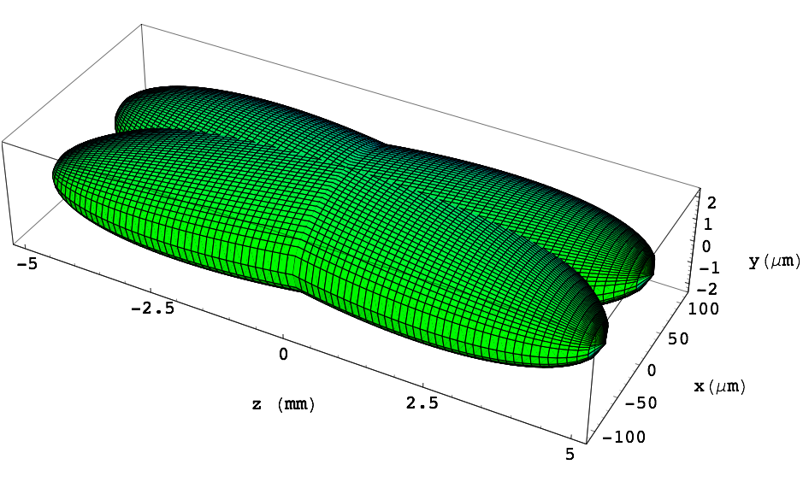
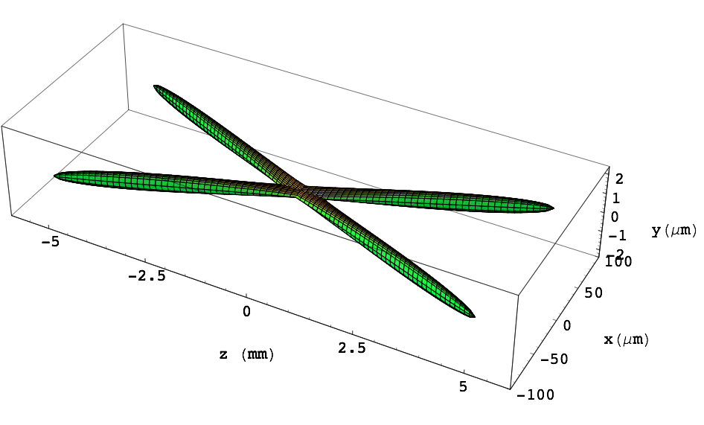

IP beam distributions for KEKB
SuperB beams are focused in the y-plane 100 times more than in the present factories, thanks to:
- small emittances
- small beta functions
larger crossing angle
Tune shifts and longitudinal overlap are greatly reduced
y(mm)
x(mm)
z(mm)
IP beam distributions for SuperB
 | KEKB | SuperB
I (A) | 1.7 | 2.
β_{y}* (mm) | 6 | 0.22/0.39
β_{x}* (mm) | 300 | 22/39
σ_{y}* (μm) | 3 | 0.039
σ_{x}* (μm) | 80 | 10/6
σ_{z} (mm) | 6 | 5
L (cm⁻²s⁻¹) | 1.7x10³⁴ | 1.x10³⁶
y(mm)
x(mm)
z(mm)
P. Raimondi, Fermilab, April 22-2010

Slide 41
Example of x-y resonance suppression
D.Shatilov’s (BINP), ICFA08 Workshop
Much higher luminosity!
Typical case (KEKB, DAFNE):
1. low Piwinski angle Φ < 1
2. β_{y} comparable with s_{z}
Crab Waist On:
1. large Piwinski angle Φ >> 1
2. β_{y} comparable with s_{x}/q

Slide 42
Crossing angle schemes
Requirements
Challenges
Small Piwinski angle:
  High current, very short bunches
LPA&CW :
  Low emittance, very small β_{y}
Small Piwinski angle:
  Wall plug power, RF and vacuum systems, vacuum chamber heating, instabilities
LPA&CW:
  IR design, Dynamic aperture, short beam lifetime, continuous injection

Slide 43
Future Colliders
SuperKEKB (KEKB, Japan) B-Factory aiming at ultra high luminosity 8 x 10³⁵, is an upgrade of KEKB based on large Piwinski angle and very low β_{y}*, no crab-sextupoles. Phase I commissioning is under completion now.
CEPC (IHEP, China) Circular Electron Positron Collider proposal of a Higgs Factory circular collider with ~ 50 km circumference and cm energy 240 GeV
FCC-ee (CERN) Future Circular Collider proposal of a 100 km circumference electron positron collider with a cm energy range from 90 to 350 GeV. A proton proton collider in the same tunnel is also foreseen

Slide 44
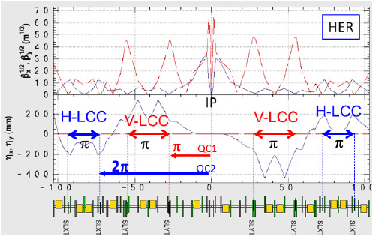
SuperKEKB IR design
Final Focus optics with local chromaticity correction

Slide 45
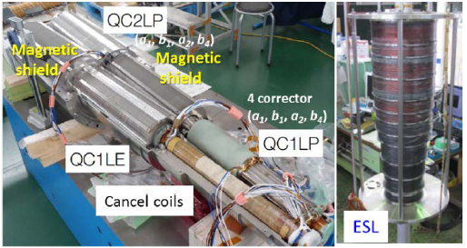
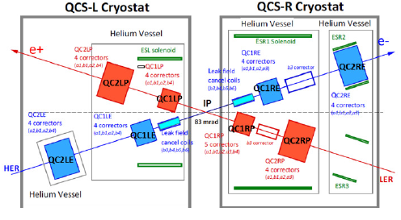
SuperKEKB IR design
IR superconducting magnets
Layout of Final Focus superconducting magnets

Slide 46
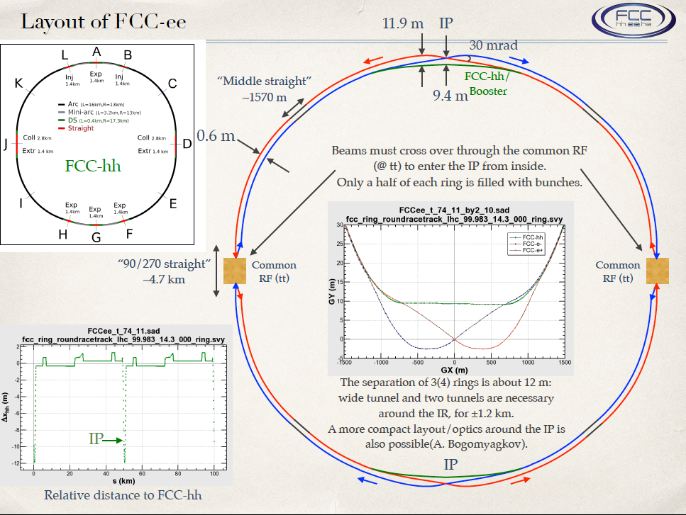

Slide 47
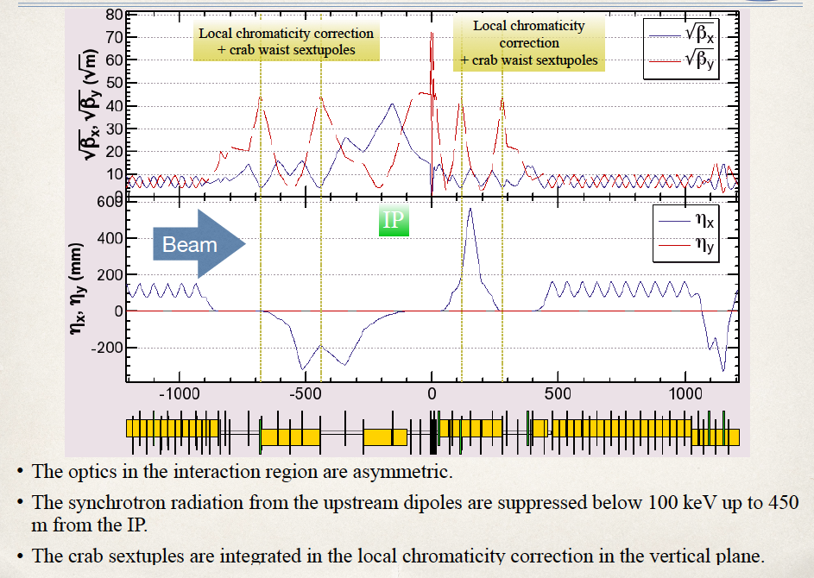
FCC-ee: IR optics design for all working points achieving baseline performance
Dynamic aperture & momentum acceptance requirements fulfilled at all WPs
28
K. Oide
Notes:
New slide from Katsunobu on converged optics, final focus and ring optics
Sufficient dynamic aperture and momentum
Injection details missing

Slide 48

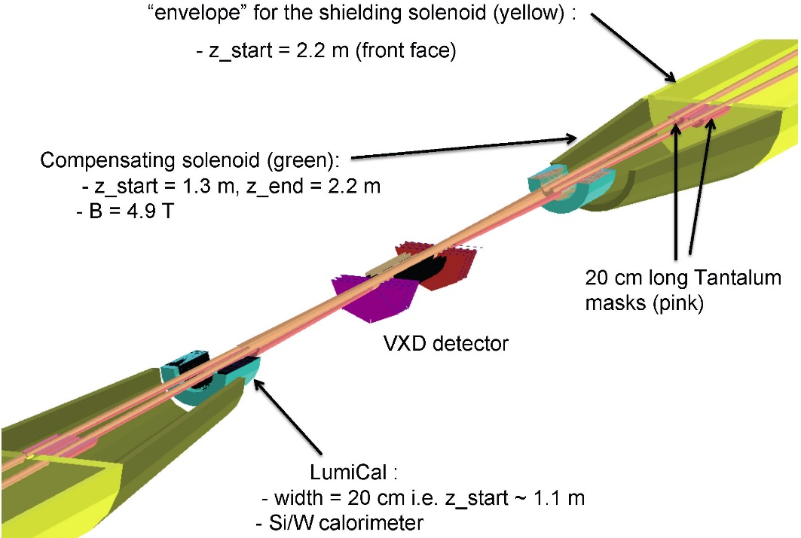
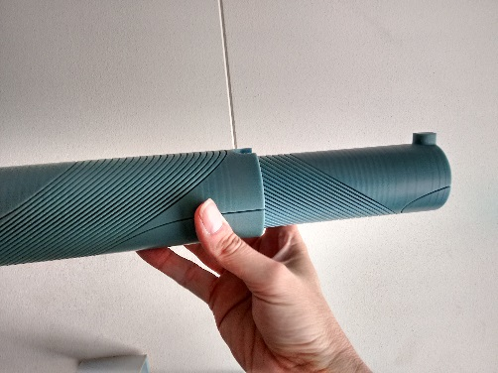
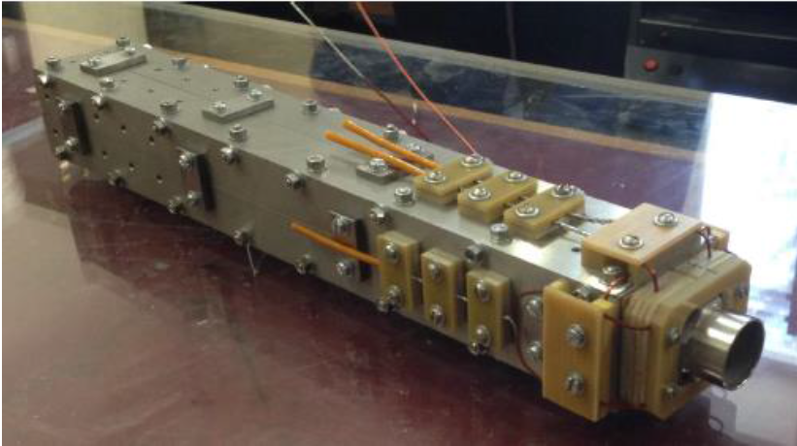
FCC-ee MDI optimisation
MDI work started with optimization of
l*, IR quadrupole design
compensation & shielding solenoid
SR masking and chamber layout
CERN model of
CCT IR quadrupole
BINP prototype IR quadr.
2 cm aperture, 100 T/m
Notes:
New slide on MDI optimisation, L*, solenoid compensation, lumi monitoring, etc.
Slide from Mike Sullivan talk, synchrotron radiation IR, masking?
Possibly one slide on magnet design of Attilio?

Slide 49
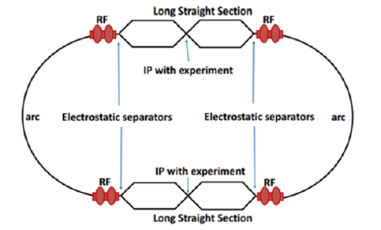
CEPC – Layout of partial double ring scheme
Circumference 54 km
Energy 80 – 120 GeV

Slide 50
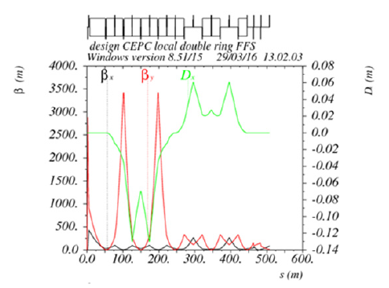
CEPC – Final Focus optics with “crab-waist”
betax = 0.25 m
betay= 1.36 mm
L* = 1.5m
strength of first quadrupole = 200T/m
Crossing angle = 30 mrad

Slide 51
Integrated luminosity
The main goal of a high energy physics detector is to collect a large number of events during an experimental run of a few years
The measure of the machine performance is not peak luminosity but the luminosity integrated over time: day, month, year
To increase integrated luminosity
  Increase L_{average}/L_{peak}
    Beam lifetime, luminosity lifetime, continuos injection
  Increase machine availability
    Maintenance, spares

Slide 52
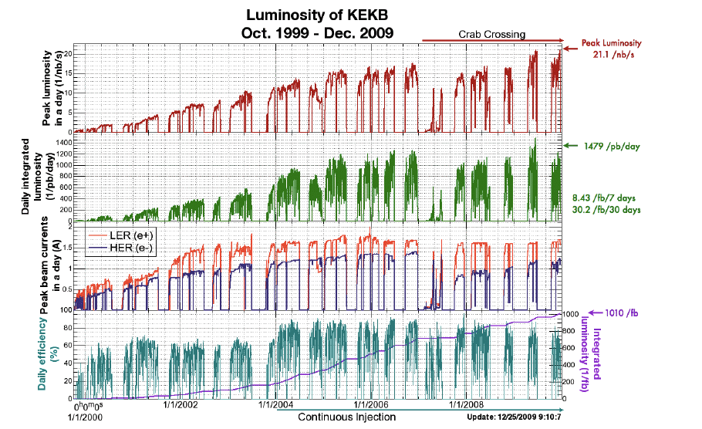
KEKB history: peak and integrated luminosity
Y. Funakoshi, IPAC10

Slide 53
Beam lifetime
Processes that lead to particle losses:
  Single beam
    Quantum lifetime (particles in the tail of the distribution are lost)
    Touschek scattering of particles within the bunch
    Gas scattering on gas molecules
  Colliding beams
    Radiative Bhabha e⁺e⁻ → e⁺e⁻γ
    Beamsstrahlung

Slide 54
Beamstrahlung
Emission of synchrotron radiation due to the electromagnetic field of the opposite beam
Particles emitting a photon with an energy larger than the ring acceptance ηE₀ get lost
  Lifetime limitation
  Detector background
  Important at high energies: Higgs Factories
To increase beam lifetime it is necessary to increase the ring energy acceptance
V. I. Telnov, “Restriction on the energy and luminosity of e⁺e⁻ storage rings due to beamstrahlung” arXiv:1203.6563
D. Schulte et al., Beam-Beam Simulations with GUINEA-PIG, ICAP98, Monterey, CA, USA(1998), CERN/PS 99-014 (LP)

Slide 55
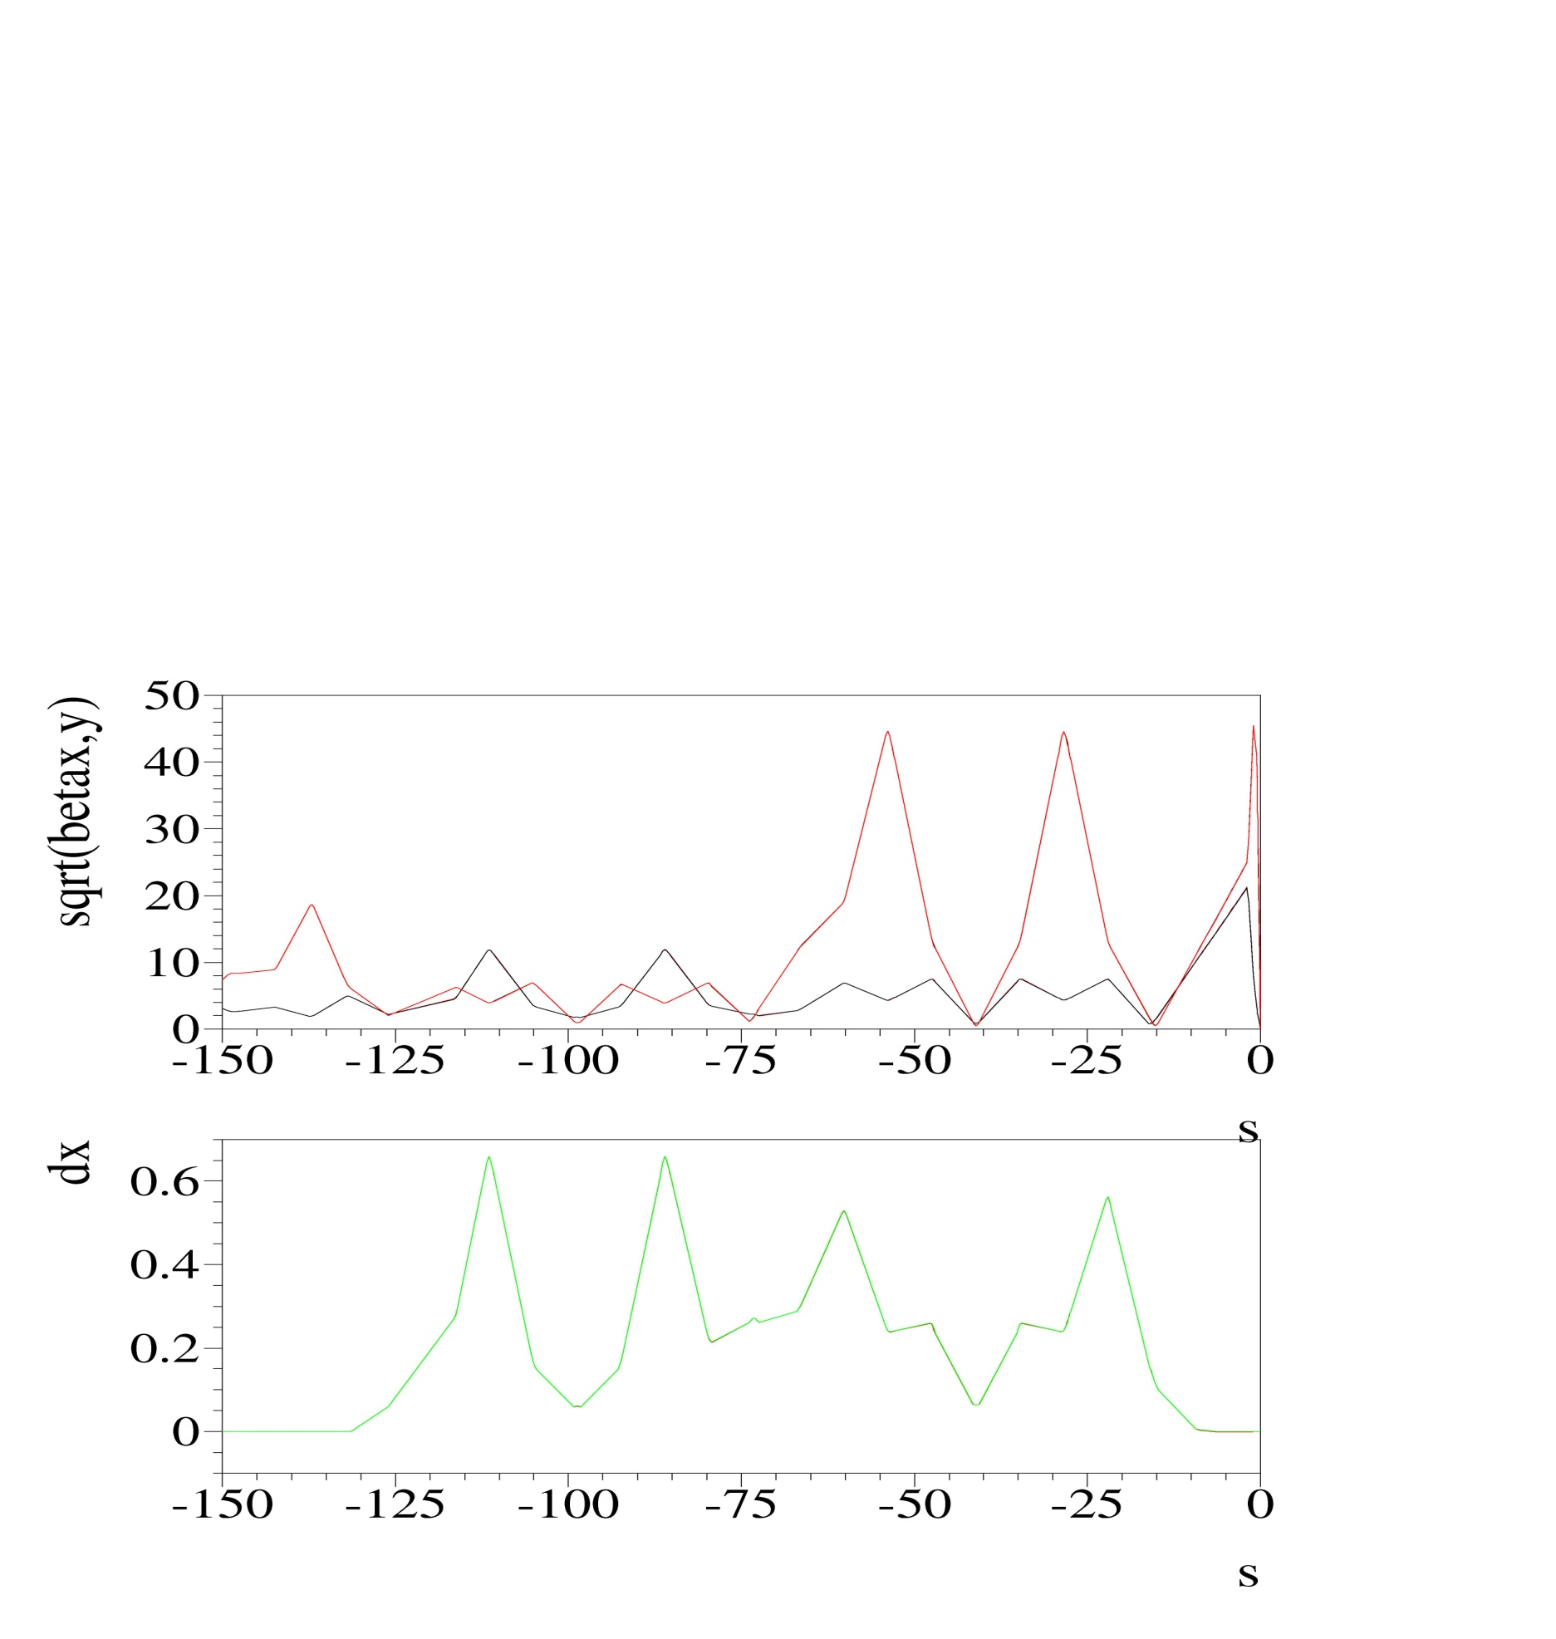
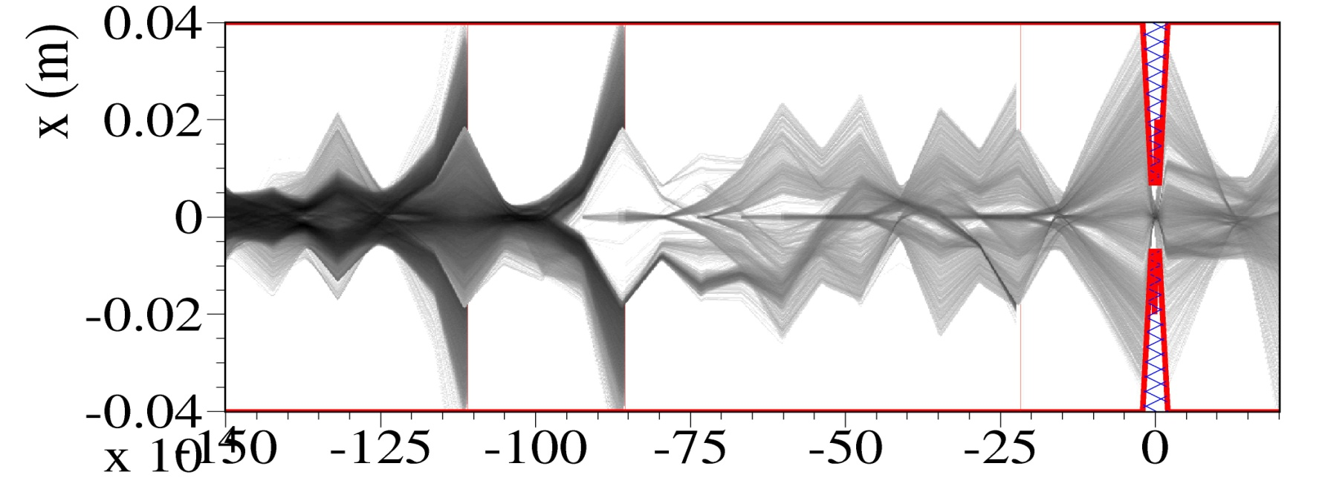
SuperB beam lifetime estimation
Dominated by luminosity itself- all other contributions are much smaller but for the Touschek effect in the LER.
Dynamic aperture and momentum acceptance are crucial for the Touschek lifetime
dedicated Monte Carlo simulation (for all the effects contributing to particle losses) necessary for:
  lifetime evaluation
  careful study of backgrounds, horizontal/vertical collimation system design and shieldings
Lifetime (seconds) | HER | LER
Radiative Bhabha | 290* / 280⁺ | 380* / 420⁺
Touschek | 1320 | 420
Coulomb Beam-gas | 3040 | 1420
Bremsstrahlung | 72 hrs | 77 hrs
√β_{x,} √β_{y}
0
Position H Collim.
D_{x}
Position H Collim.
Position secondary H Collim.
with collimators inserted and IBS included
(momentum acceptance calculated with tracking)
* 1% momentum acceptance assumed
⁺ momentum acceptance calculated with tracking
Touschek trajectories
IP
Total Lifetime | 220 s (3.7 min) | 180 s (3.0 min)
-150
M. Boscolo

Slide 56
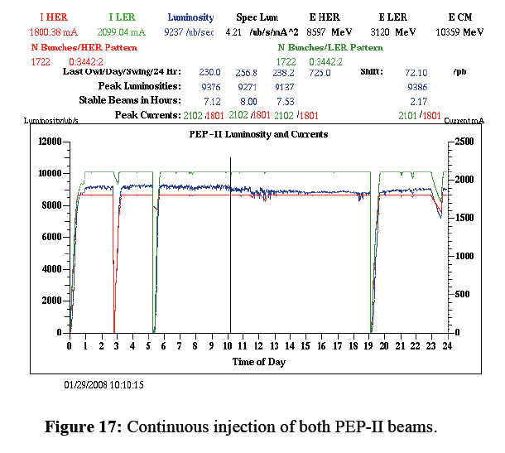
Continuous injection
To keep the luminosity nearly constant continuous injection at high repetition rate is needed
PEP-II (SLAC) had the most powerful injector!

Slide 57
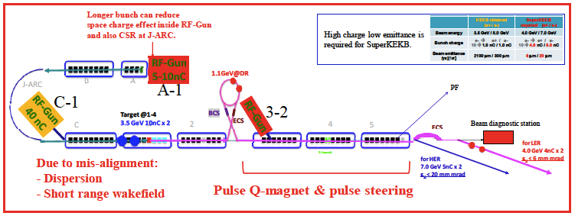
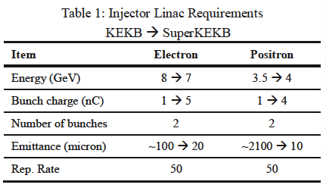
SuperKEKB Injection system layout
M.Yoshida, T. Higo IPAC12

Slide 58
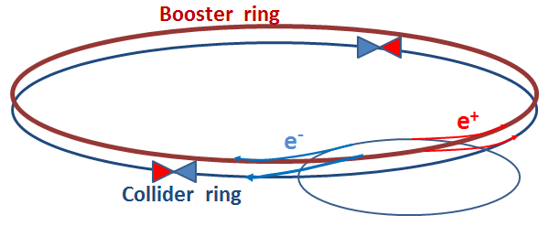
FCCee injector complex
Injector complex is comprised by:
  e+/e- LINAC (up to ~10GeV)
  Pre-Booster Damping Ring - PBDR (from ~10 to ~20GeV)
  Booster ring (from ~20 to full FCCee energy)
  Proposal for extra ring with wigglers for rapid radiative polarization (@ ~1-2 GeV)
PBDR (SPS)
e+/e- LINAC
Y.Papaphilippou - FCCee week 2016

Slide 59
Design challenges of future colliders
Interaction Region design with ultralow by*, large crossing angle and detector solenoids poses many technical and optics design issues:
  high gradient SC quads in a restricted space
  control of background rates
  sensitivity to magnets alignment errors and control of vibrations at IP
  coupling & chromaticity correction in the IR
  dynamic aperture with crab sextupoles
Beam lifetime reduction due to the luminosity increase (baba scattering and bremstrahlung) makes necessary continuous injection with high efficiency and high injection rate
Very high energy requires very large infrastructures (tunnels 50 – 100 km long), high power consumption, high costs. A very cost and energy effective design is needed

Slide 60
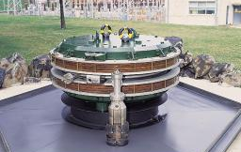
Acknowledgements
In this lesson is described the work of many accelerator physicists since AdA http://w3.lnf.infn.it/ada-anello-di-accumulazione/. I tried to give the references but it’s impossible to reference all
A useful source of information on circular colliders is the ICFA BD Newsletter 48 http://www-bd.fnal.gov/icfabd/Newsletter48.pdf
Very interesting and updated material on the new “Higgs Factories” can be found at the “FCC week 2016”, 11-15 April 2016, Rome, Italy https://indico.cern.ch/event/438866/overview
Other data and references can be found in the proceedings of the IPAC (and PAC, EPAC, APAC) conferences http://www.jacow.org/index.php?n=Main.Proceedings&sel=IPAC
Thanks to all the contributors and in particular to my colleagues Marica Biagini, Mikhail Zobov and Manuela Boscolo who borrowed me their slides and to Mario Bassetti who introduced me in the field

Slide 61
Thanks to all
This presentation is based on the work of many physicists over many years and on fruitful discussions with many colleagues
Sorry for not mentioning everybody in the slides or in the references

Slide 62
Super B-Factories main parameters
Parameter | SuperB |  | SuperKEKB
 | HER (e⁺) | LER (e⁻) | HER (e⁻) | LER (e⁺)
Luminosity (cm⁻²s⁻¹) | 10³⁶ |  | 8x10³⁵
C (m) | 1200 |  | 3016
E (GeV) | 6.7 | 4.18 | 7.007 | 4
Crossing angle (mrad) | 60 |  | 83
Piwinski angle | 20.8 | 16.9 | 19.3 | 24.6
I (mA) | 1900 | 2440 | 2600 | 3600
ε_{x/y} (nm/pm) (with IBS) | 2/5 | 2.5/6.2 | 4.6/11.5 | 3.2/8.6
IP s_{x/y} (mm/nm) | 7.2/36 | 8.9/36 | 10.7/62 | 10.1/48
σ_{l} (mm) | 5 | 5 | 5 | 6
N. bunches | 978 |  | 2500
Part/bunch (x10¹⁰) | 5.1 | 6.6 | 6.5 | 9.04
σ_{E}/E (x10⁻⁴) | 6.4 | 7.3 | 6.5 | 8.14
bb tune shift (x/y) | 0.0026/0.107 | 0.004/0.107 | 0.0012/0.081 | 0.0028/0.088
Beam losses (MeV) | 2.1 | 0.86 | 2.4 | 1.9
Total beam lifetime (s) | 254 | 269 | 332 | 346
Polarization (%) | 0 | 80 | 0 | 0
RF (MHz) | 476 |  | 508.9
M. E. Biagini IPAC12

