Slide 1
SINGLE PARTICLE
LONGITUDINAL DYNAMICS
Alessandro Gallo and David Alesini
INFN-LNF
INTRODUCTION
LONGITUDINAL DYNAMICS IN LINAC
LONGITUDINAL DYNAMICS IN SYNCROTRONS AND STORAGE RINGS

Slide 2
1) INTRODUCTION
Fundamental relations of the relativistic dynamics

Slide 3
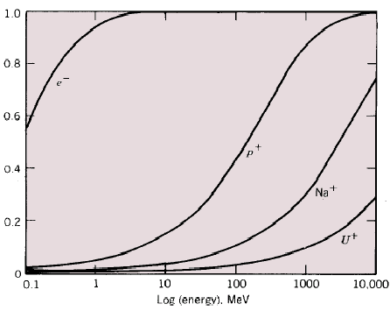
Fundamental relations of the relativistic dynamics
To change the energy of a charged particle a longitudinal E-field component is necessary:
Lorentz force
To bend a particle trajectory the B-field is preferably used, being a factor “v” more efficient (v = particle velocity – see Lorentz force) of the E-field:
Bending radius
In most existing accelerators leptons are fully relativistic particles (W_{k}>>W₀, with the exception of the very first acceleration phase) while protons and ions are weakly relativistic particles (W_{k}<W₀, with the exception of large high energy colliders - such as Tevatron, LHC, …- ).

Slide 4
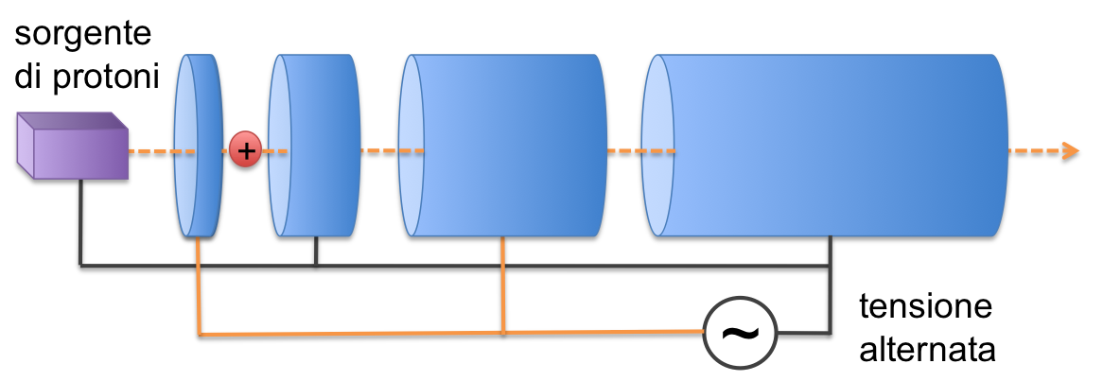
1) LONGITUDINAL DYNAMICS IN LINACs
Proton
source
AC
voltage
A Linac consits in a linear sequence of accelerating structures;
They can be Drift Tubes, SW cavities, TW structures, or a combination of them;
Whatever the accelerating structures are, the particles gain energy and velocity while travelling through each of them, and need to arrive at right time to the next one to get the proper kick and continue the acceleration process;
Particles and accelerating fields need to be synchronized. If they are not, the acceleration process will result to be perturbed. The longitudinal dynamics describes the particle motion in the longitudinal phase space, whose coordinates are the particle time (or RF phase) error and energy deviation.

Slide 5
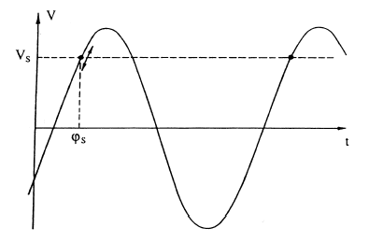
LONGITUDINAL DYNAMICS IN LINACs – non relativistic particles
2.1 Synchronous Particle and phase stability
average accelerating
gradient
Energy gain of a particle moving along the axis of a standing wave RF cavity:
Let’s consider a LINAC designed to provide an energy kick qV_{k} any time that a particle travels along the axis of a SW cavity:
V_{RF}
V_{k}
φ_{s}
A particle which is injected in the Linac with the design phase φ_{s} and proper initial energy will get the design energy kick and will arrive perfectly in time at the following gaps. We define φ_{s} as the synchronous phase and the particle as the synchronous particle.
It’s easy to demonstrate that if φ_{s}≤ 0 a generic particle with phase and energy values close to the synchronous particle ones is accelerated in similar way with small energy and phase oscillations around the synchronous values.
In fact, since the synchronous phase preceeds the peak, any particle crossing the gap before the synchronous particle will get a smaller energy kick, will gain less velocity and its time of flight to next gap will be longer, compensating the initial error.
Any particle arriving late at the gap with respect to the synchronous particle will get a larger energy kick, will gain more velocity and will arrive to next gap with a smaller error.
The choice φ_{s}<0 provides longitudinal focusing of the beam (phase stability principle for linear accelerators). The opposite choice leads to longitudinal instability.
Relying on particle velocity variations, longitudinal focusing does not work for fully relativistic beams. In this case acceleration “on crest” is more convenient.

Slide 6
Phase-energy equations
In order to study the longitudinal dynamics in a LINAC, the following variables are used, which describe particle position and energy with respect to the synchronous particle:
Let’s also define:
Average accelarting gradient, as seen by the generic particle and by the synchronous particle in a portion of the trajectory of length ΔL:
Energy gain per unit length of a generic particle and of a synchronous particle:
From previous expressions one gets:

Slide 7
Synchrotron oscillations in the longitudinal phase space
The longitudinal motion is governed by a non-linear system of two coupled differential equations:
In case of small oscillations around the synchronous particle (ϕ << 1 rad) and neglecting the particle energy and speed variation along the LINAC (adiabaticity), we get:
The condition to have stable longitudinal oscillations and acceleration at the same time is:
harmonic oscillator equation
The trajectory of a a generic particle in the longitudinal phase space is an ellipse.
The maximum energy deviation is reached at ϕ = 0 while the maximum phase excursion corresponds to w=0.
It is easy to show that:
w
ϕ
Numerical
example:
Protons (W₀ = 938 MeV) @ 100 MeV; E₀ = 2,5 MV/m; φ_{s} = -30°; f_{RF} = 600 MHz; L_{linac}= 40 m

Slide 8
Bunch length and energy spread along a LINAC
According to Liouville’s theorem, under the action of conservative forces, the ellipse area in phase space is constant.
The amplitude of the synchrotron oscillations remains rigorously constant only at constant energy (which is not the case in accelerators!), while in case of slow acceleration (low gradients) the oscillation amplitudes will smoothly change to satisfy the Liouville’s theorem. In fact:
The result is that during acceleration the bunch gets shorter and its relative energy spread is reduced.
ADIABATIC DAMPING

Slide 9
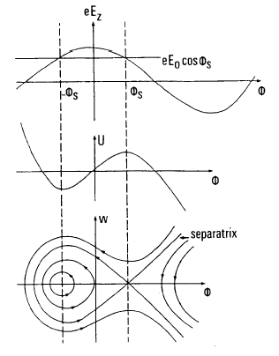
Large oscillations
To study the longitudinal dynamics at large oscillations, we have to consider the non linear system of differential equations without approximations. By neglecting particle energy and speed variations along the LINAC we obtain:
The restoring force F can not be considered purely elastic anymore and may by derived from a potential function according to the usual definition:
With few simple passages we obtain an “energy conservation”–like law:
At large oscillations:
the phase space trajectories are not ellipses anymore;
the oscillations are stable within a region bounded by a special curve called separatrix. The maximum phase excursion is equal to 2φ_{s} ;
the region inside the separatrix is called RF bucket. The dimensions of the bucket shrinks to zero if φ_{s}=0.
points outside the buckets belong to unstable trajectories.

Slide 10
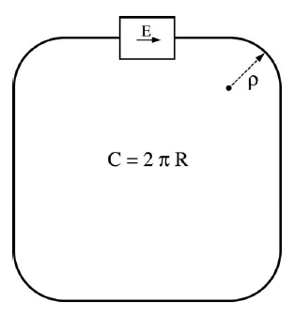
2) LONGITUDINAL DYNAMICS IN SYNCROTRONS
Synchrotrons are circular accelerators. Particles are bended by dipolar magnets, while acceleration is provided by standing wave RF cavities.
Differently from LINACs, in synchrotrons the particles run over closed orbits so that they are accelerated by the RF cavities in a very large number of turns.
Since the beam energy and momentum increase turn by turn, the bending magnetic field has to be increased proportionally to the momentum, in order to keep invariant the bending radii and the orbit. The revolution frequency also increases with energy, which requires variation of the RF frequency to maintain the synchronization between beam and accelerating field.
Accelerator Length
Synchronous particle and phase
The synchronous particle is the particle that undergoes the ideal acceleration process, gaining a constant amount of energy ΔW per turn remaining all the time on the design orbit. While running the n^{th} turn, the synchronous particle has to have the proper energy to perfectly satisfy the following condition:
dipole bending radius, invariant during the whole acceleration process
dipole magnetic field at turn # n
The particle velocity increases turn by turn during acceleration (and tends asyntotically to the speed of light at high energies), and so it does the revolution frequency (F_{rev}). As a consequence the frequency of the RF system (f_{RF}) must change to be synchronous with the beam motion.
Synchronization between acce-lerating field and synchronous particle requires:
harmonic number
Corresponds to the number of time-separated synchronous particles that can be accelerated in the synchrotron
Energy gain of the synchronous particle due to the n^{th} passage in the RF cavity
synchronous phase
(invariant)

Slide 11
B and f_{RF} variations during acceleration
Turn-by-turn energy increase:
B-field increase to keep the synchronous particle on a constant orbit
B
B_{in}
t
B has to grow linearly with time
Turn-by-turn energy increase:
F_{rev} variation
f_{RF}
hc/L
f_{RF} has to be continouosly changed to keep synchronized the accelerating field and the synchronous particle passages
t
f_{RF} asyntotically tends to hc/L as B becomes much larger than m₀c/qρ , i.e. when the particle becomes ultra-relativistic and v→c

Slide 12
Injection
Exercise : let’s design a synchrotron!
Particle | Protons
Rest energy | W₀ = 938 MeV
Injection energy | Win = 10 MeV γ_{in} ≈ 1.01 β_{in} ≈ 0.14
Extraction energy | W_{out} = 400 MeV γ_{out} ≈ 1.43 β_{out} ≈ 0.71
B field @ extraction | B_{max} = 1.0 T
Bending radius | ρ ≈ 3.2 m
B field @ inction | B_{in} = 0.14 T
Total length | L= 40 m (2πρ + 4d)
RF kick Voltage | V·cos(φ_{s}) ≈ 1 kV
Magnetic field slope | dB/dt = 7.81 T/s
Energy ramp duration | T_{ramp} ≈ 110 ms
Number of turns | N_{turna} ≈ 390000
Revolution frequency | f_{rev} ≈ 1.7 MHz in ≈ 5.0 MHz out
RF frequency | f_{RF} = f_{rev} (h=1)
Bending
radius ρ
RF
Bending
Magnets
Diagnostics
?
Extraction
?
?
?
?

Slide 13
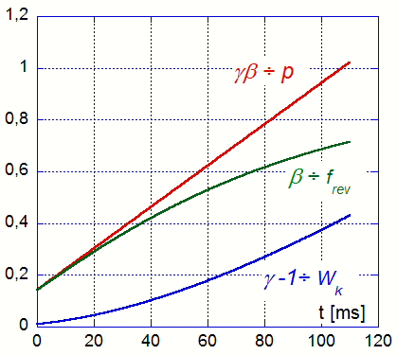
Exercise : let’s design a synchrotron!
Injection
Particle | Protons
Rest energy | W₀ = 938 MeV
Injection energy | Win = 10 MeV γ_{in} ≈ 1.01 β_{in} ≈ 0.14
Extraction energy | W_{out} = 400 MeV γ_{out} ≈ 1.43 β_{out} ≈ 0.71
B field @ extraction | B_{max} = 1.0 T
Bending radius | ρ ≈ 3.2 m
B field @ inction | B_{in} = 0.14 T
Total length | L= 40 m (2πρ + 4d)
RF kick Voltage | V·cos(φ_{s}) ≈ 1 kV
Magnetic field slope | dB/dt = 7.81 T/s
Energy ramp duration | T_{ramp} ≈ 110 ms
Number of turns | N_{turna} ≈ 390000
Revolution frequency | f_{rev} ≈ 1.7 MHz in ≈ 5.0 MHz out
RF frequency | f_{RF} = f_{rev} (h=1)
Bending
radius ρ
RF
Bending
Magnets
Diagnostics
Extraction

Slide 14
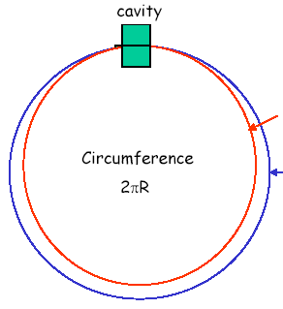
“Momentum compaction” and transition energy
The relative orbit length variation for a given relative particle momentum variation in a circular, transversely focused accelerator is property of ring magnetic guide called “momentum compaction” factor α :
while the relative revolution frequency variation for a given relative particle momentum variation is called “slippage factor” η :
Transition energy is defined as:
Momentum compation factors are usually positive (α>0) in circular accelerators, so that below transition energy particle revolution frequency increases with energy (the velocity increase dominates the orbit length increase). On the contrary, beyond transition energy revolution frequency decreases while energy increases (since v≅c and orbit length variation dominates in this case).

Slide 15
Non-synchronous particles: phase-energy equations
Deviations of revolution frequency, phase , energy, etc., respect to the synchronous particle:
For a non-synchronous particle we may define the following quantities to measure the deviation respect to the synchronous particle at the n^{th} turn:
Turn-by-turn evolution of energy and phase of non-synchronous particle is described by the following equations:

Slide 16
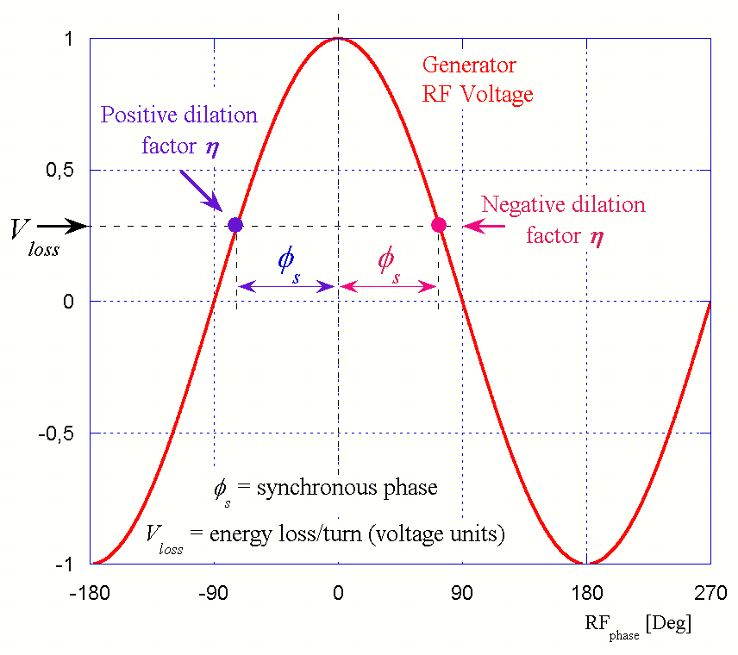


Synchrotron oscillations
If we consider small oscillations around the synchronous phase and slow variations of P_{s}, F_{rev_s} and η, we easily obtain the equation of an harmonic oscillator whose frequency f_{s} is called again synchrotron frequency.
To get stable oscillations the following condition have to be fulfilled:
$$η>0$$
$$η<0$$
If during acceleration the transition energy is crossed, the RF cavity phase has to be rapidly changed in order to preserve the beam longitudinal stability.

Slide 17
Synchrotron oscillations
w
Similarly to the already shown result for the longitudinal dynamics of LINACs, particles oscillate around the synchronous one with the frequency f_{s} and the trajectories of their motion in the longitudinal phase space are ellipses.
However, differently from the LINAC case, the synchrotron frequency shows a rather complex scaling law with energy:
ϕ
Adiabatic damping
Previous results concerning small oscillations are rigorously valid under the assumption of very slow beam energy W_{s} variation with time compared to those of the variable w and ϕ. Again, a more correct result obtained applying the Liouville’s theorem reveals that the amplitude of energy and phase oscillations changes during the acceleration process. In particular, since oscillation amplitudes of both phase and relative energy deviation of the particles are reduced during the acceleration, this effect is called adiabatic damping.

Slide 18
Adiabatic damping
w/W_{s}
Energy ramp stop
ϕ
Energy ramp
start
Please note:
accordingly with these expressions it may appear that near transition energy the phase oscillation amplitude goes to zero while that of the energy spread goes to infinity. This is not actually the case since in this particular regime linear approximations are not valid anymore. A more rigorous approach shows that the oscillations can be made stable also in this case.

Slide 19
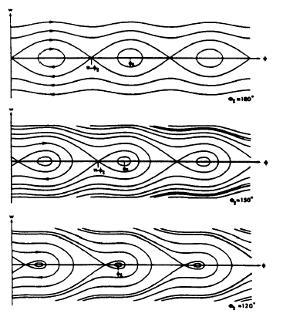
Large oscillations and energy acceptance
As already discussed in the LINAC case, at large oscillations the non-linearity in the phase – energy differential equations can not be neglected, and the particle trajectories in the longitudinal phase space are deformed (not ellipses anymore). A potential U for the non linear restoring force can be introduced again, just as in the LINAC case, and a separatrix line divides the stable and unstable regions in the longitudinal phase space (RF bucket). In particular the RF acceptance is defined as one half of the bucket total height and is given by:
and being the synchronous phase identified by the relation:
2 x RF acceptance
the RF acceptance can be also expressed as:
that for large values of the overvoltage factor is reduced to:

Slide 20
Lepton rings
Rings for light particles (electrons) present two peculiar aspects that deeply impact the longitudinal dynamics:
particle are ultra-relativistic at relatively low energies already (>10 MeV) and their speed is almost constant and equal to c all over the acceleration process;
while traveling through bending dipole magnets the beam emits radiation in a wide spectrum range (synchrotron radiation).
The RF system is much simpler since frequency change is not necessary.
The power emitted in the form of synchrotron radiation is given by:
emission is completely negligible for heavy particle up to very high energies. On the contrary, it is a very important effect in electron rings.
This phenomenon cause a turn-by-turn beam energy loss which has to be compensated by the RF system.
The emission strongly depends on the particle energy, which produces a damping effect on the synchrotron oscillation amplitude.
On the other hand the synchrotron radiation emission is a stochastic quantum process which drives the longitudinal oscillations acting as a noise excitation term.
Radiation damping and quantum excitation are two counteracting processes that lead to an equilibrium state characterized by a particle distribution in the longitudinal phase space.
The energy radiated in a single turn is given by:
A particle with an energy deviation w with respect to the synchronous particle energy W_{s} will radiate more, with a radiated energy excess u_{rad} given by:

Slide 21
Equilibrium distributions in lepton rings
The linearized differential equation of the particle longitudinal motion for a storage ring of constant energy has the following form:
Quantum excitation term
Damping term:
responsible of the exponential decay of the oscillations amplitude (radiation damping) with a damping time:
In light particle (such as electrons) synchrotrons the equilibrium final distribution is given by the two contributions of the radiation damping ,which reduces the oscillation amplitude (of both phase and energy deviation), and of the quantum emission noise which sthoastically excites the oscillations. The equilibrium distributions fully depend on these processes while the memory of the particle initial condition is completely lost in few damping times.
It may be demonstrated that the final equilibrium distribution of the bunch particles in the longitudinal phase space is a bi-dimensional gaussian:
w
depends on radiation process, may be calculated from the ring linear optics functions
ϕ
The 2 standard deviations are related by:

Slide 22
SPARE
SLIDES

Slide 23

Light particle capture by TW sections (no synchrotron motion) (1/2)
Is this the case of electrons whose velocity is always close to speed of light c even at low energies. Accelerating structures are designed to provide an accelerating field synchronous with particles moving at v=c. One possible choice is to use traveling wave structures with phase velocity equal to c.
From previous formulae it is clear that there is no motion in the longitudinal phase space for ultrarelativistic particles (γ>>1), that typically get to the LINAC end before executing a single complete synchrotron oscillation.
It is interesting to analyze the conditions that allow to inject and capture an electron beam produced by a cathode directly in a TW structure with phase velocity equal to c, or equivalently in a SW structure designed to accelerate ultrarelativistic particles.
E₀
c
In this case particles enter the structure with velocity v<c and, at least initially, they are not synchronous with the accelerating field.
z

Slide 24
Light particle capture by TW sections (no synchrotron motion) (2/2)
Let’s consider the phase φ between field and particle, i.e. the phase of the wave computed at the position z occupied by the particle at the instant t. After an elementary time increment dt the phase variation dφ can be computed according to:
negative if z > 0,
i.e. particle ahead the wavefront
From Newton’s 2nd law we have:
Let’s introduce the variable α defined by:
From previous
equations:
integral:
By integrating the equation between t₀ and t, that means between β=β₀ e β =1 one gets:
Since this quantity can never exceed the value of 2, we got a condition which sets a minimum value of the accelerating field below which no particle can be captured:
c
v=c
v<c

Slide 25
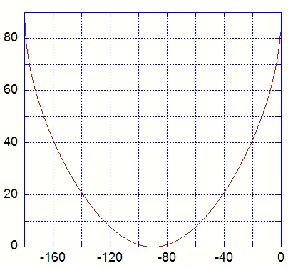

Numbers!
e- beam, W₀ = 510 keV
W_{in} = 100 keV, (kinetic energy) -> γ ≈ 1.2; β ≈ 0.55
f_{RF}= 2856 MHz -> λ_{RF}≈ 10.5 cm
E_{0min} = ?
How is the capture if E₀ =2 E_{0min} ?
E₀ = 16.4 MV/m

Slide 26
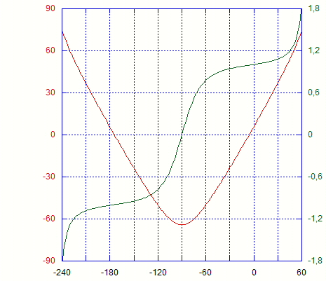
RF Compression
The curve of the capture phase vs the injection phase contains an important information. The derivative of the plot indicates – to the 1st order – how a bunch injected at a certain phase will be shortened or elongated after being captured.
Ex: SPARC
W_{in}≈ 5 MeV, γ_{in} ≈ 10.8, β_{in} ≈ .996
E_{acc} ≈ 15 MV/m => E_{acc} / E_{min} ≈ 20
Compression is always maximum for bunches injected at –90° (at the accelerating field zero crossing);
Bunches injected at > -90° are less compressed (and accelerated more);
Bunches injected at < -90° are overcompressed, which means that head and tail are reversed after capture;
This model describes single particles, i.e. does not take into account space charge which might be relevant in high compression regimes.

Slide 27
2.7 pre-buncher
Once the capture condition is fulfilled the fundamental equation:
sets the ranges of the injection phases φ₀ actually accepted. Clearly, there will always be a range of values around φ₀ =π /2 corresponding to sin φ ≥ 1. Particles whose injection phases are within this range cannot be captured and are lost.
In order to increase the capture efficiency of a traveling wave section, pre-bunchers are often used. They are standing wave cavities aimed at pre-forming particle bunches gathering particles continuously emitted by a source.
Bunching is obtained by modulating the energy (and therefore the velocity) of a continuous beam using the longitudinal E-field of a SW cavity. After a certain drift space the velocity modulation is converted in a density (and charge) modulation. A TW accelerating stucture (capture section) is placed at an optimal distance from the pre-buncher, to capture a large fraction of the charge and accelerate it till relativistic energies. The density modulation deplates the regions corresponding to injection phase values incompatible with the capture process. The amount of charge lost is drastically reduced, while the capture section provide also further beam bunching.
L
drift length
Thermionic
Buncher
Capture section
Gun
(SW Cavity)
(SW or TW)
Continuous
beam
Continuous beam
velocity modulation
Bunched
Bunched and captured
beam
beam
I
I
I
t
T
RF
t
T
RF
t

Slide 28
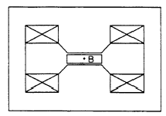
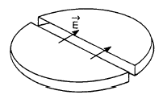
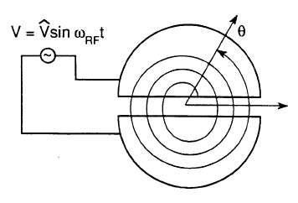
4) LONGITUDINAL DYNAMICS IN CYCLOTRONS
Synchronization between particles and accelerating field
In cyclotrons the acceleration is provided by an alternate electric field between two or more electrodes immersed in a uniform dipolar magnetic field.
The particle gains energy at each passage in the gap between the 2 electrodes.
The bending radius of the beam trajectory changes turn-by-turn with the particle momentum and is given by:
Spiral trajectory
The synchronization between accelerating field and particles is preserved provided that the following condition is fulfilled:
Standard cyclotrons have constant f_{RF} so that synchronization is guaranteed only in non relativistic particle case (m=m₀=constant)

Slide 29
Phase and energy evolution with time
In the ideal case the phase of the RF should increase of exactly 2π in one turn. The phase advance error is given by (if h=1):
Concerning the energy we got:
(remember that every turn the beam passes twice across the accelerating gap):
These equations allows studying the energy and phase evolution in time of a particle of given initial conditions.

Slide 30
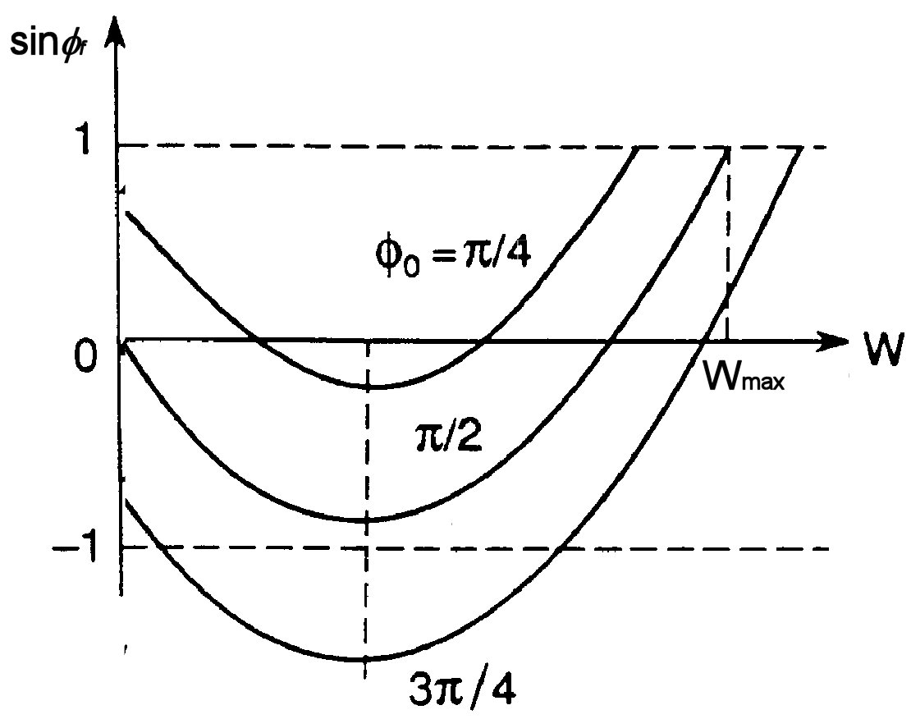
Phase-energy diagram
By elaborating the previous equations we obtain:
Initial phase
Rest energy
By integrating both sides of the equations between initial and final instants:
Starting from this expression it is possible to plot sinφ_{f} as a function of the final kinetic energy for different initial phase values. The plots make sense only in the [1,-1] interval of the vertical coordinate. The maximum energy is obtained for a specific optimal phase that depends on the accelerator parameters and on the characteristics of the particle.
Unless the B-field and/or the electrode shape are properly profiled to correct the revolution frequency dependence on the particle energy, it can be easily shown that the maximum kinetic energy of the accelerated particle is limited to:

Slide 31
References:
All the particle accelerator physics @ CERN Accelerator School Proceedings
http://cdsweb.cern.ch/search.py?sc=1&p=CERN+Accelerator+School&f=&cc=CERN+Yellow+Reports
In particular, longitudinal dynamics @
http://cdsweb.cern.ch/record/235242/files/CERN-94-01-V1.pdf
Joel Le Duff, “Dynamics and acceleration in linear structures”, p. 253
Joel Le Duff, “Longitudinal beam dynamics in circular accelerators”, p. 289
All abour RF, cavities, power sources , … @
CERN Accelerator School: RF for Accelerators - Ebeltoft, Denmark, 8 - 17 Jun 2010
http://arxiv.org/html/1201.4648v2
Storage rings
http://www.slac.stanford.edu/cgi-wrap/getdoc/slac-r-121.pdf
Matthew Sands, “The physics of electron storage rings. An introduction”

