Slide 1
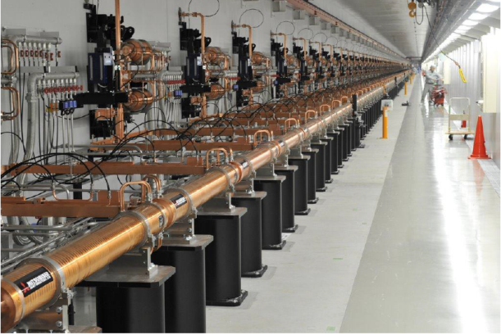
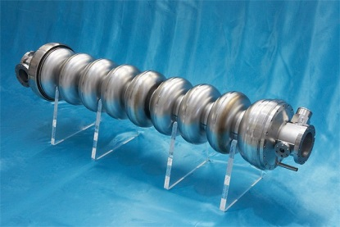
Linear Accelerator
Principles and Technology
David Alesini
(INFN-LNF, Frascati, Rome, Italy)
PhD students seminar, LNF, 13 June 2016

Slide 2
ACKNOWLEDGEMENTS
Several pictures, schemes, images and plots have been taken from papers and presentations reported at the end of the presentation.
I would like to acknowledge all the following authors:
A. Gallo, Hans Weise, Sergey Belomestnykh, Dinh Nguyen, John Lewellen, Leanne Duffy, Gianluigi Ciovati, Jean Delayen, S. Di Mitri, R. Carter, G. Bisoffi, B. Aune, J. Sekutowicz, H. Safa, D. Proch, H. Padamsee, R. Parodi, E. Jensen, Paolo Michelato, Terry Garvey, Yujong Kim, S. Saitiniyazi, M. Mayierjiang, M. Titberidze, T. Andrews, C. Eckman, Roger M. Jones, T. Inagaki, T. Shintake, F. Löhl, J. Alex, H. Blumer, M. Bopp, H. Braun, A. Citterio, U. Ellenberger, H. Fitze, H. Joehri, T. Kleeb, L. Paly, J.Y. Raguin, L. Schulz, R. Zennaro, C. Zumbach. Detlef Reschke, David Dowell, K. Smolenski, I. Bazarov, B. Dunham, H. Li, Y. Li, X. Liu, D. Ouzounov, C. Sinclair

Slide 3
LINAC: BASIC DEFINITION AND MAIN COMPONENTS
A LINAC (linear accelerator) is a system that allows to accelerate charged particles through a linear trajectory by electromagnetic fields.
RF control system
RF Power sources
Accelerating structures (cavities)
Magnets
Diagnostics systems
Vacuum pumps and gauges
Cryostat (superconducting linac)
Particle source
Accelerated beam
Magnet power supplies
Vacuum pumps power supplies
Cooling and cryogenics
Diagnostic acquisition system

Slide 4
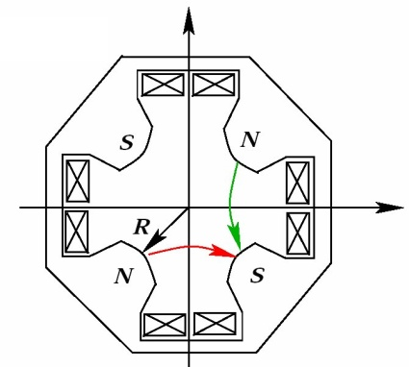
LORENTZ FORCE: ACCELERATION
Particles are accelerated through electric field and are focalized through magnetic field.
The basic equation that describe the acceleration process is the Lorentz Force.
ACCELERATION
BENDING AND FOCUSSING
Longitudinal Dynamics
Transverse Dynamics
Electric field
Beam

Slide 5
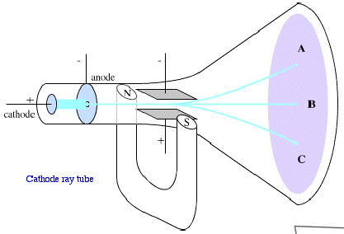
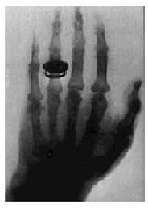

ACCELERATION
The first historical particle accelerator was built by the Nobel prize Wilhelm Conrad Röntgen (1900). It consisted in a vacuum tube containing a cathode connected to the negative pole of a DC voltage generator. Electrons emitted by the heated cathode were accelerated while flowing to another electrode connected to the positive generator pole (anode). Collisions between energetic electrons and anode produced X-rays.
The energy gained by the electrons travelling from cathode to anode is equal to their charge multiplied the electrostatic potential difference between the two electrodes.
Cathode
Anode
Electric field
+
Voltage V
PRINCIPLE
The DC voltage of a generator is used to accelerate particles
The energy gain ∆W=q∆V is proportional to the DC voltage ∆V which is limited by unavoidable breakdown phenomena!
Particle energies are tipically expressed in electron-volt [eV], equal to the energy gained by 1 electron accelerated through an electrostatic potential of 1 volt:
1 eV=1.6x10⁻¹⁹ J

Slide 6
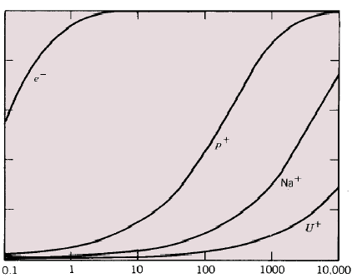
PARTICLE VELOCITY vs ENERGY
Velocity of light (c)
Leptons (light particles) are pratically fully relativistic in any existing dedicated accelerators (W_{k}>>W₀, with the exception of the very first acceleration stage) while protons and ions are typically weakly relativistic (W_{k}<W₀ – but not always, see high energy hadron colliders such as the LHC).
For leptons the accelerating process occours at constant particle velocity (v ≈ c), while protons and ions velocity may change a lot during acceleration. This implies major important differences in the technical characteristics of the dedicated accelerating structures.
Light particles
Particle velocity
Heavy particles
Velocity variations are negligible at energies well above the particle rest energy!
Energy [MeV]

Slide 7
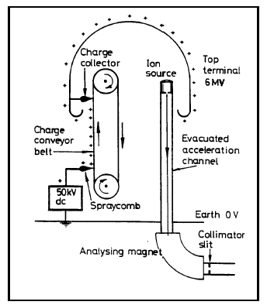
ELECTROSTATIC ACCELERATORS
To increase the achievable maximum energy Van de Graaff invented an electrostatic generator based on a dielectric belt transporting positive charges to an isolated electrode hosting an ion source. The positive ions generated in a large positive potential were accelerated toward ground by the static electric field.
DC voltage as large as 15 MV can be obtained (E ~ 15MeV). The main limit in the achievable voltage is the breakdown
APPLICATIONS
Still ~ 350 Van De Graaff are in operation worldwide, typically at V<25MV, I<100mA. They are used for:
Material analysis:
such as Semiconductors structure analysis,
X-ray production, …;
Material modification:
ion implantation for semiconductors

Slide 8
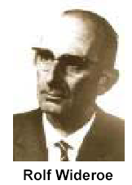
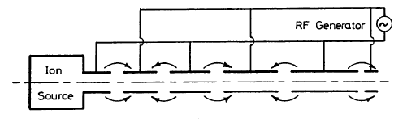
RF Acceleration : the Wideröe “Drift Tube LINAC” (DTL)
Basic idea: the particles produced by a filament are accelerated by the electric field in the gap between electrodes connected alternatively to the poles of an AC generator.
If the length of the tubes increases with the particle velocity during the acceleration such that the time of flight is kept constant and equal to half of the RF period , the particles are subject to a synchronous accelerating voltage and experience an energy gain of ∆W=q∆V at each gap crossing.
In principle a single AC voltage can be used to indefinitely accelerate a beam, avoiding the breakdown limitation affecting the electrostatic accelerators.
The original idea of Ising (1924) was implemented by Wideroe (1927) who applied a sine-wave voltage to a sequence of drift tubes. The particles do not experience any force while travelling inside the tubes (equipotential regions) and are accelerated across the gaps. This kind of structure is called Drift Tube LINAC (DTL).
Please notice that this technique requires
bunched beams
i.e. in order to be synchronous with the external AC field, particles have to be gathered in non-uniform temporal structures

Slide 9
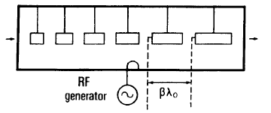
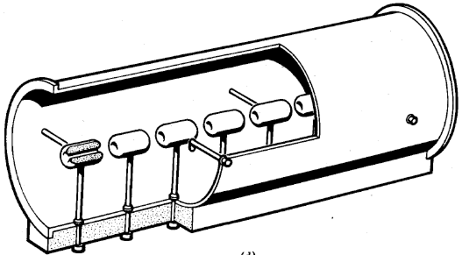
RF ACCELERATION: CAVITIES
From the idea to apply, instead of a static electric field, an oscillating field with appropriate frequency such that the phase change of π during the time of flight between two successive gap is progressively passed to the concept of acceleration with radiofrequency fields.
The accelerating structure becomes a resonant cavity (closed metal structure) in which the energy in the form of RF electromagnetic fields is accumulated
Alvarez's structure is based on this concept and is widely used in the acceleration of protons and low to medium energy ions. It can be described as a special DTL in which the electrodes are part of a resonant macrostructure.

Slide 10
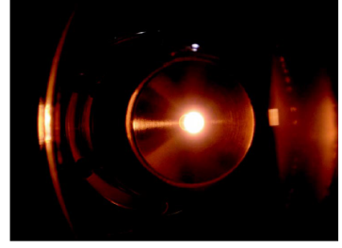
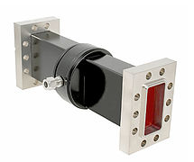
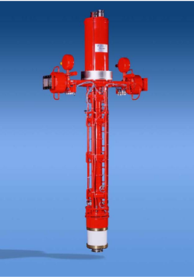
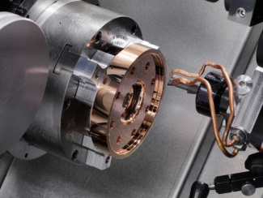
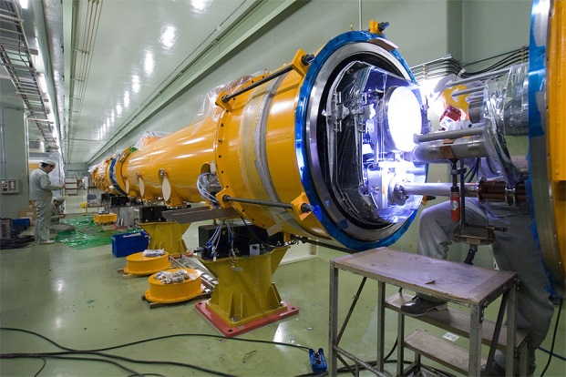
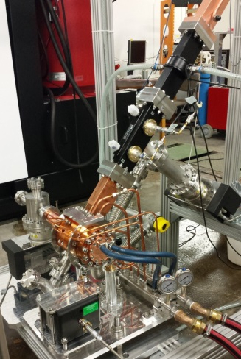
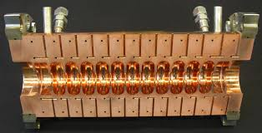
ELECTRON LINACs
Waveguide components
Electron sources
NC Accelerating structures
Fabrication techniques
RF sources
SC Accelerating structures
Cryostat for SC structures
Power distribution
Tuning, RF measurements

Slide 11

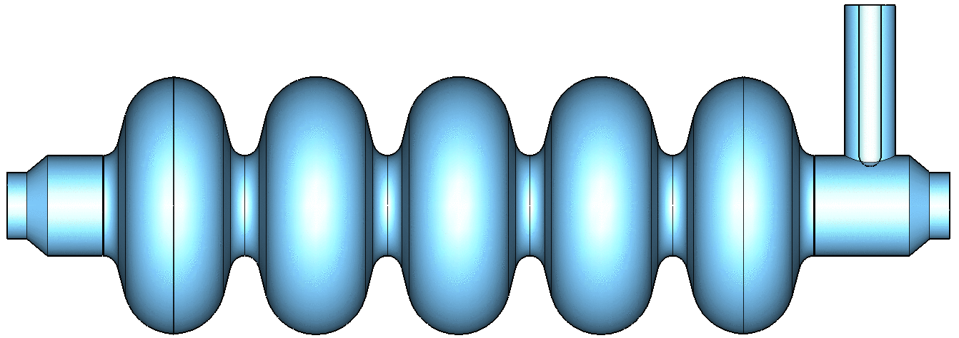
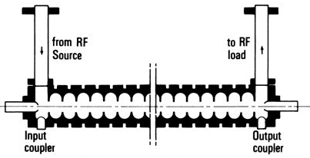
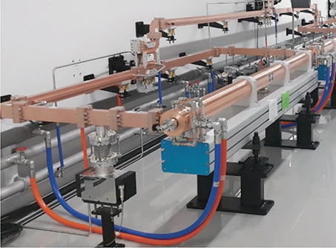
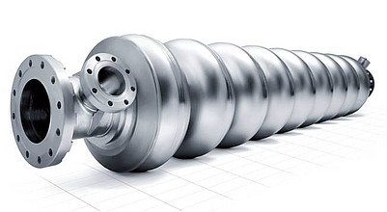
ACCELERATING CAVITIES
P _{RF in}
E_{z}
Direction of propagation
To accelerate charged particles, the RF wave must have an electric field along the direction of propagation of the particle. There are basically two possibilities:
1-Using standing wave (SW) TM010-like modes in a resonant cavity (or multiple resonant cavities) in which the beam is synchronous with the resonating field;
2-Using a travelling wave (TW) disk loaded structure operating on the TM01-like mode in which the RF wave is co-propagating with the beam with a phase velocity equal to the beam velocity (c for e⁻).
z
P _{RF in}
P _{RF out}
E_{z}
P _{RF TW}
z
⇒The structures are powered by RF generators (typically klystrons).
⇒The cavities (and the related LINAC technology) can be of different material:
copper for normal conducting (NC, typically TW) cavities;
Niobium for superconducting cavities (SC, typically SW);
⇒We can choose between NC or the SC technology depending on the required performances in term of:
accelerating gradient (MV/m);
RF pulse length (how many bunches we can contemporary accelerate);
Duty cycle: pulsed operation (i.e. 10-100 Hz) or continuous wave (CW) operation;
Average beam current.

Slide 12
SW CAVITIES

Slide 13
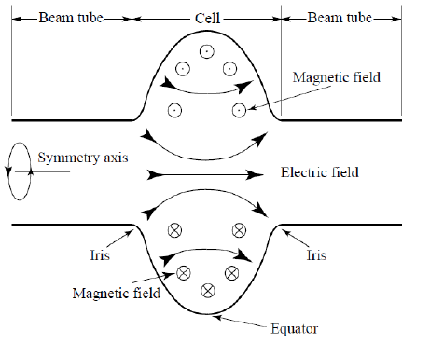
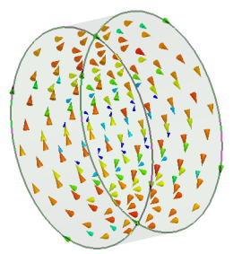
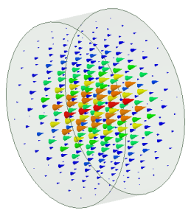
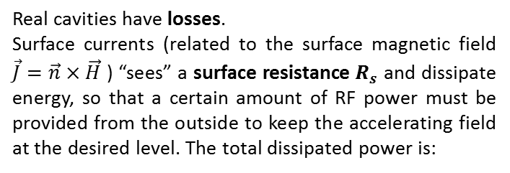

SW CAVITIES PARAMETERS: V_{acc}, P_{diss}, W
To compare different technologies is necessary to define some parameter that characterize each accelerating structure.
E_{z}
ACCELERATING VOLTAGE
We suppose that the cavities are powered at a constant frequency f_{RF}. The maximum energy gain of a particle crossing the cavity at a velocity v (∼c for electrons) is obtained integrating the time-varying accelerating field sampled by the charge along the trajectory:
z
B
E
MODE TM₀₁₀
DISSIPATED POWER
Real cavities have losses.
Surface currents (related to the surface magnetic field $\vec{J}=\vec{n}×\vec{H}$ ) “sees” a surface resistance $R_{s}$ and dissipate energy, so that a certain amount of RF power must be provided from the outside to keep the accelerating field at the desired level. The total dissipated power is:
STORED ENERGY
The total energy stored in the cavity:
  NC cavity (Cu $R_{s}≈3 \text{mΩ}$ at 1 GHz)
  SC cavity (Nb $at 2 \text{K}$ $R_{s}≈10 \text{nΩ}$ at 1 GHz)

Slide 14
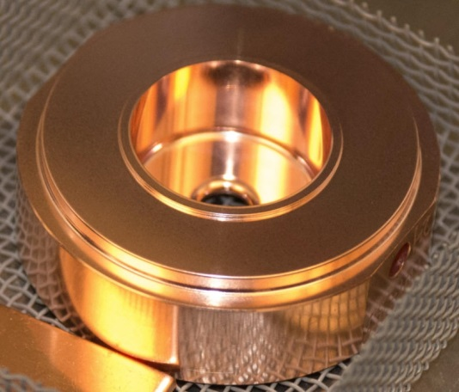
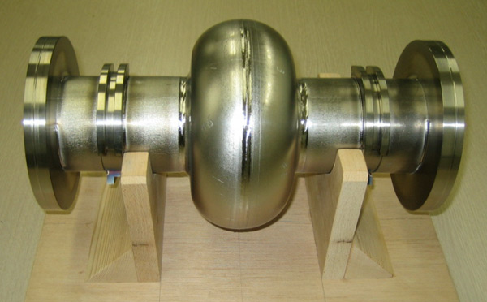
SW CAVITIES PARAMETERS: R, Q, R/Q
ACCELERATING VOLTAGE (V_{acc})
DISSIPATED POWER (P_{diss})
STORED ENERGY (W)
SHUNT IMPEDANCE
QUALITY FACTOR
The shunt impedance is the parameter that qualifies the efficiency of an accelerating mode. The highest is its value, the larger is the obtainable accelerating voltage for a given power. Traditionally, it is the quantity to optimize in order to maximize the accelerating field for a given dissipated power:
  NC cavity Q∼10⁴
  SC cavity Q∼10¹⁰
R/Q
  NC cavity R∼1MΩ
  SC cavity R∼1TΩ
The R/Q is a pure geometric qualification factor. It does not depend on the cavity wall conductivity. R/Q of a single cell is of the order of 100.

Slide 15
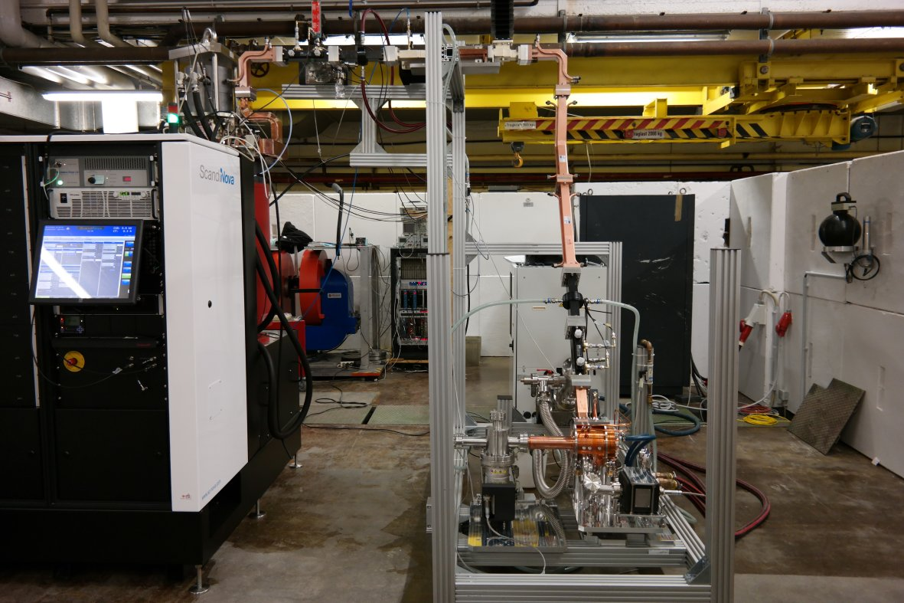
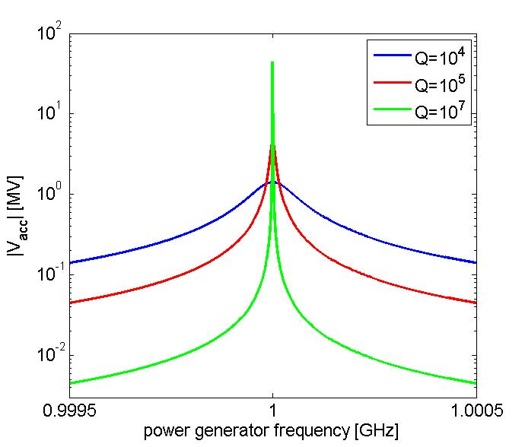
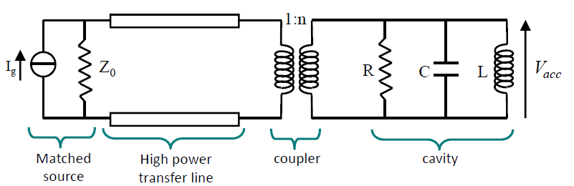
SW CAVITIES : EQUIVALENT CIRCUIT AND BANDWIDTH
The previous quantities plays crucial roles in the evaluation of the cavity performances. Let us consider the case of a cavity powered by a source (klystron) at a constant frequency in CW and at a fixed power (P_{in}).
P_{in}=1 MW
R/Q=100
β=1 (no reflections, P_{diss}=P_{in})
f_{res}=1 GHz
The reachable V_{acc} for a given power is proportional to √Q
Frequency domain
BANDWIDTH
Modulator and klystron
waveguide
cavity
P_{in}

Slide 16
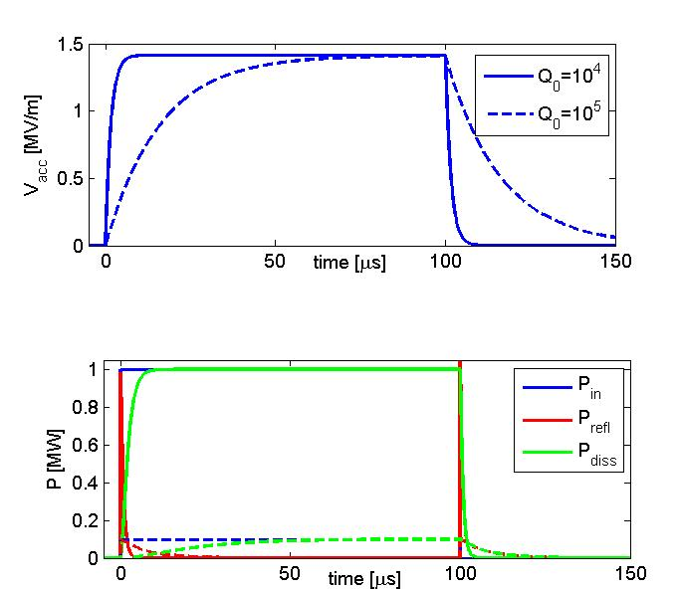
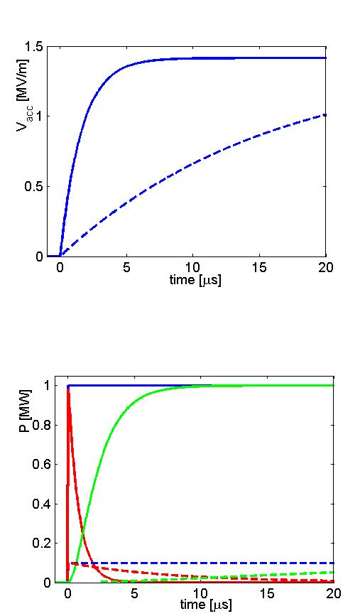
SW CAVITIES : FILLING TIME AND DISSIPATED POWER
Let us now consider the case of a cavity powered by a source (klystron) in pulsed mode at a frequency f_{RF}=f_{res}. Let as calculate the power we need from the klystron (and the dissipated one) to obtain a given accelerating voltage
Time domain
[MV]
One needs several filling times to completely fill the cavity
FILLING TIME
P_{diss} ∝1/Q
The reachable V_{acc} for a given power is proportional to √Q but, on the other hand, the filling time is ∝Q
P_{refl} to the generator (it that has to be protected!)

Slide 17
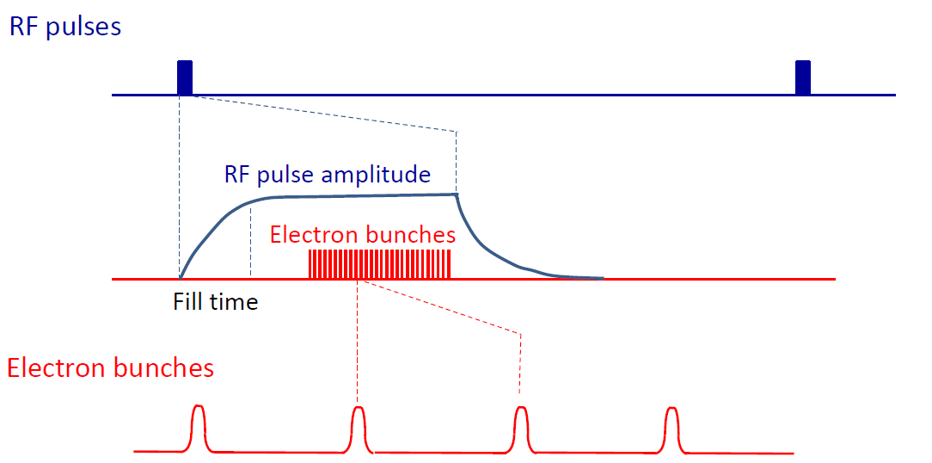
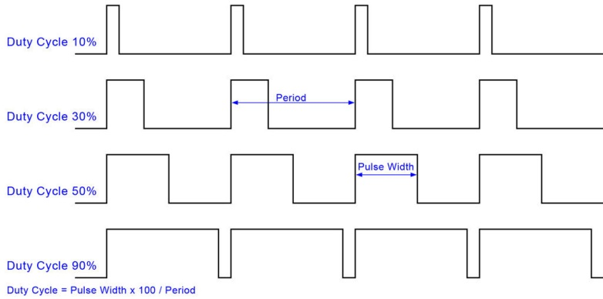
SW CAVITIES : RF STRUCTURE AND BEAM STRUCTURE
The “beam structure” in a LINAC (or ERL) is directly related to the “RF structure”. There are basically two possible type of operations:
CW (continuous wave) ⇒ allow, in principle, to operate with a continuous beam
PULSED OPARATION ⇒ there are RF pulses at a certain repetition rate (Duty Cycle (DC)=pulsed width/period)
RF power
RF pulses
t
Amplitude
10³-10⁸ RF periods
Bunch spacing
t
Because of the very low power dissipation and low RF power required to achieve a certain V_{acc}, the SC structures allow operation at very high Duty Cycle (DC) up to a CW operation.

Slide 18
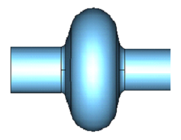
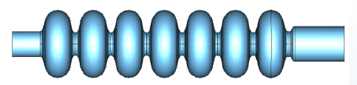
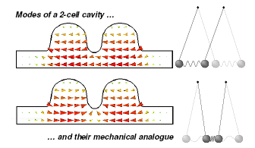

MULTI-CELL SW CAVITIES
P_{in}
P_{in}
R
.
In a multi-cell structure there is one RF input coupler. As a consequence the total number of RF sources is reduced, with a simplification of the layout and reduction of the costs;
The shunt impedance is n time the impedance of a single cavity
They are more complicated to fabricate than single cell cavities;
The fields of adjacent cells couple through the cell irises and/or through properly designed coupling slots.
The N-cell structure behaves like a system composed by N coupled oscillators with N coupled RF modes. The modes are characterized by a cell-to-cell phase advance given by:
nR
E_{z}
z
The most efficient mode (and generally used) is the π mode.
Field amplitude variation from cell to cell should be small for maximum acceleration efficiency⇒ necessity of tuning
It is possible to demonstrate that over a certain number of cavities (>10) the overlap between adjacent modes can be a problem from the tunability and operational point of view.

Slide 19
TW CAVITIES

Slide 20
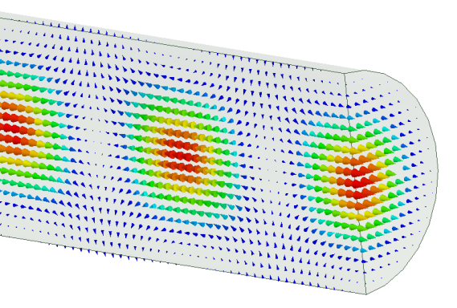
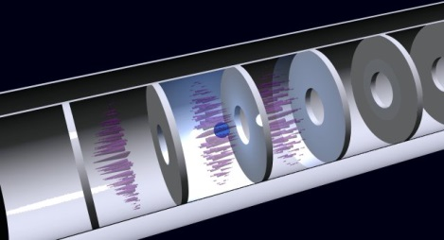
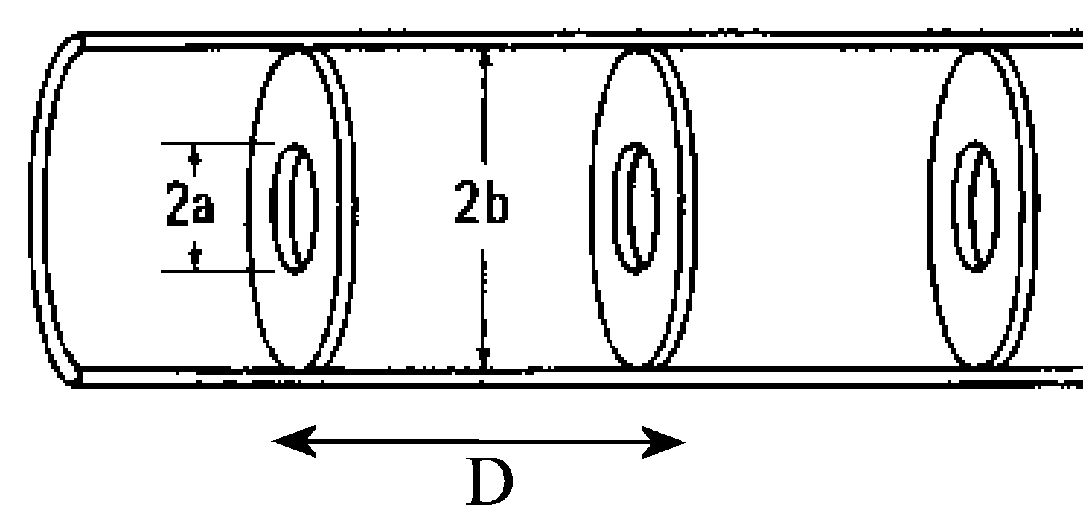
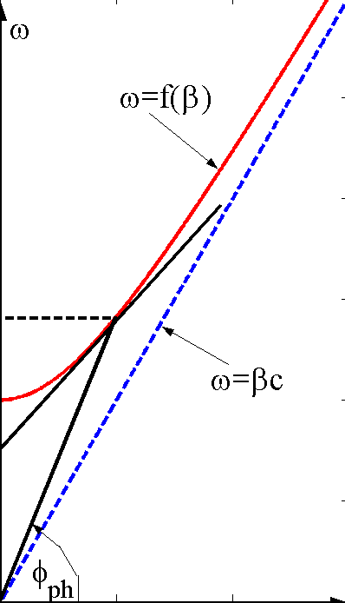
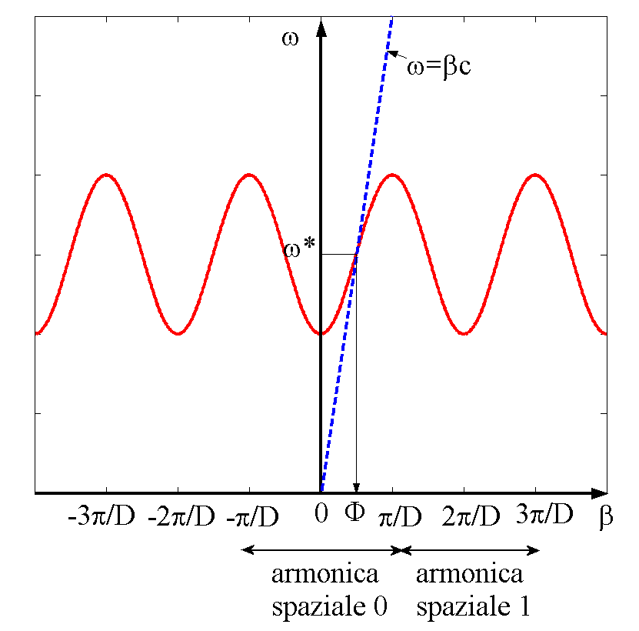
TW CAVITIES: BASICS
In TW structures an e.m. wave with E_{z}≠0 travel together with the beam in a special guide in which the phase velocity of the wave matches the particle velocity (v). In this case the beam absorbs energy from the wave and it is continuously accelerated.
CIRCULAR WAVEGUIDE
IRIS LOADED STRUCTURE
ω
ω
In order to slow-down the wave phase velocity, iris-loaded periodic structure are used. The field in this kind of structures is that of a special wave travelling within a spatial periodic profile. The structure can be designed to have the phase velocity equal to the speed of the particles. This allows acceleration over large distances.
ω
By solving the wave equation it turns out that an e.m. wave propagating in a constant cross section waveguide will never be synchronous with a particle beam since the phase velocity is always larger than the speed of light c. The first propagating mode with E_{z}≠0 is the TM₀₁ mode
ω_{RF}
ω_{RF}
_{β}
_{β}
_{β*}
_{β*}
_{2π/D}
Periodic in z of period D
MODE TM₀₁
MODE TM₀₁-like

Slide 21
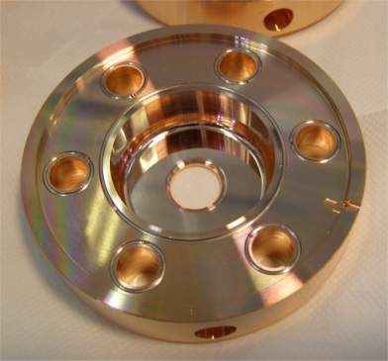
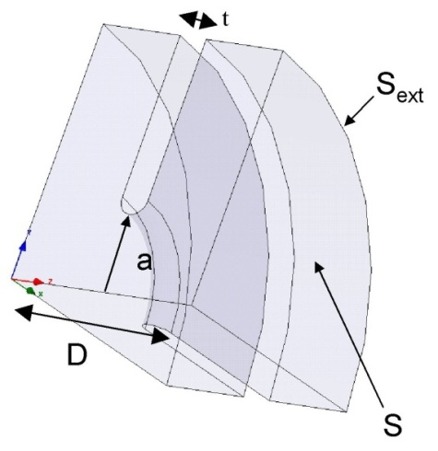
TW CAVITIES PARAMETERS: r, α, v_{g}
Similarly to the SW cavities it is possible to define some figure of merit of the TW structures
Shunt impedance per unit length. Similarly to SW structures the higher is r, the higher the available accelerating field for a given RF power.
Field attenuation constant: because of the wall dissipation, the RF power flux and the accelerating field decrease along the structure.
Group velocity: the velocity of the energy flow in the structure (∼1-2% of c).
Working mode: defined as the phase advance of the fundamental harmonic over a period D. For several reasons the most common mode is the 2π/3

Slide 22
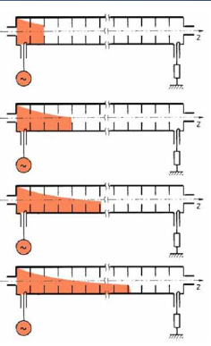
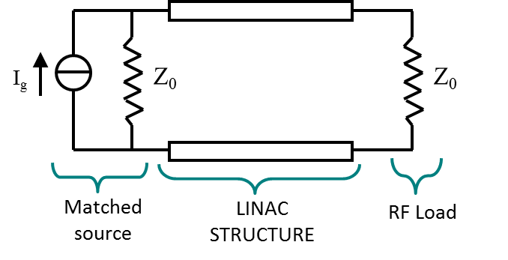
TW CAVITIES: EQUIVALENT CIRCUIT AND τ_{F}
In a TW structure, the RF power enters into the cavity through an input coupler, flows (travels) through the cavity in the same direction as the beam and an output coupler at the end of the structure is connected to a matched power load.
If there is no beam, the input power reduced by the cavity losses goes to the power load where it is dissipated.
In the presence of a large beam current, however, a fraction of the TW power is transferred to the beam.
In a purely periodic structure, made by a sequence of identical cells (also called “constant impedance structure”), α does not depend on z and both the RF power flux and the intensity of the accelerating field decay exponentially along the structure :
The filling time is the time necessary to propagate the RF wave-front from the input to the end of the section of length L is:
High group velocities allow reducing the duration of the RF pulse powering the structure. However since:
Low group velocity is preferable to increase the effective accelerating field for a given power flowing in the structure.
Differently from SW cavities after one filling time the cavity is completely full of energy
L

Slide 23
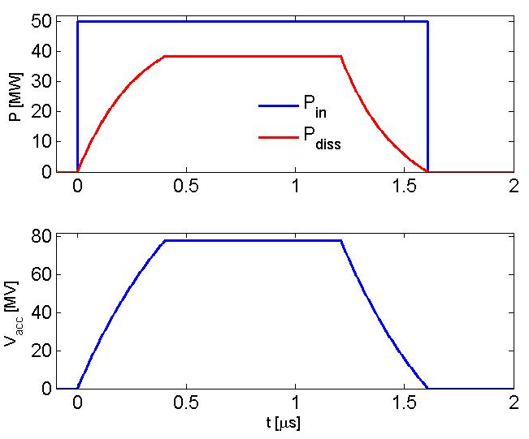
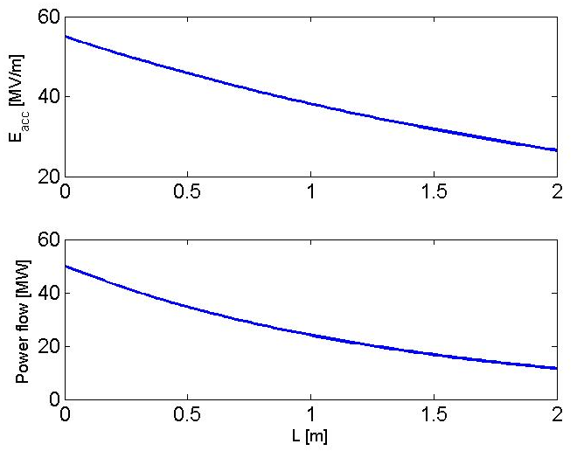
TW CAVITIES: PERFORMANCES
Just as an example we can consider a C-band (5.712 GHz) accelerating cavity of 2 m long made in copper.
r=82 [MΩ/m]
α=0.36 [1/m]
v_{g}/c=1.7%
τ_{F}=400 ns (very short if compared to SW!)
Field attenuation due to the copper dissipations
τ_{F}
Input power
Output power (dissipated into the RF load): it is not convenient to have very long RF structures because their efficiency decreases over a certain length (2-3 m depending on the operating frequency).
RF STRUCTURE AND BEAM STRUCTURE
TW structures have very short filling time (<1μs) and allow operation in pulsed mode with high peak power (tens of MW per structure) and relatively high accelerating field (>50-100 MV/m), with short RF pulses (1 μs) and low repetition rate (10-100 Hz) and low DC (10⁻³-10⁻² %) in single or few bunches

Slide 24
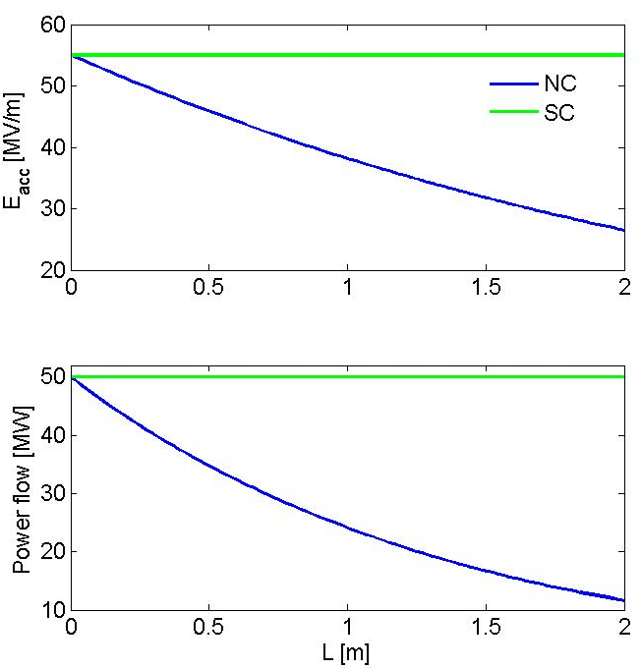

TW CAVITIES: PERFORMANCES (2/2)
If we compare the performances of this copper structure with the same cavity made on a superconducting material it is quite easy to understand that it is not convenient to use TW SC structures:
⇒we do not gain in term of E_{acc} as we do for SW structures and as a consequence we do not gain in term of V_{acc}⇒ direct consequence of the TW mechanism (no field build up effects!)
⇒for a short structure all power is dissipated into the RF load
⇒It is, in principle possible to gain with TW SC if we increase the length of the structure and, as a consequence, the RF pulse length but we have problems of available power sources (high power/long RF pulses) and cavity construction
r=82 [MΩ/m]⇒[TΩ/m]
α=0.36 [1/m]⇒∼0
v_{g}/c=1.7%
τ_{F}=400 ns

Slide 25


TW CAVITIES: CONSTANT GRADIENT STRUCTURES
It is possible to demonstrate that, in order to keep the accelerating field constant along the structure, the iris apertures have to decrease along the structure in such a way that the field attenuation is compensated by the increase of the stored energy (with consequent decrease of the group velocity).
In general the constant gradient structures are more efficient than constant impedance ones, because of the more uniform distribution of the RF power along them.

Slide 26


MATERIALS

Slide 27


NORMAL CONDUCTING (NC) MATERIAL: COPPER
conductor
E₀
σ
R_{s} vs RF FREQUENCY
The microwave surface resistance of a normal metals is expressed by:
z
Skin depth: penetration of the EM field ans surface currents inside the metal
δ
For copper: σ=5.7x10⁸ S/m⇒R_{s}(@1 GHz)≅3mΩ, δ<1 μm
R_{s} AT LOW TEMPERATURE ANOMALUS SKIN EFFECT
At low temperature and at high frequency, NC material there is a mechanism called “anomalous skin effect” that increases the conductivity with respect to the DC case. For copper, as example, at microwave frequencies and cryogenic temperatures, one can see that, although the DC conductivity increases by a factor 100, the anomalous skin effect allows only a decrease of a factor 6 in the surface resistance. This shows that it is definitely not convenient to cool an NC metal to cryogenic temperatures.
COPPER
The most widely used NC metal for RF structures is OFHC copper (Oxigen free high conductivity) for several reasons:
Easy to machine (good achievable roughness at the few nm level)
Easy to braze/weld
Easy to find at relatively low cost
Very good electrical (and thermal) conductivity
Low SEY (multipacting fenomena)
Good performances at high accelerating gradient

Slide 28




SUPERCONDUCTING (SC) MATERIAL: NIOBIUM (Nb)
⇒The SC was discovered in 1911.
⇒ For SC elements at T<T_{c} in DC regime the resistance is 0.
⇒ In AC (RF) regime the surface resistance of a SC is always larger than 0 (even if very small if compared to NC element).
⇒For frequencies below 10 GHz (and T<T_{c}/2) the experimental data are well described by the empirical relation:
exponential decrease with temperature (high frequency cavity >1 GHz have to be cooled to reduce the dissipation)
Depends on the material
Square dependence with frequency
Two fluid model or BCS resistance R_{BCS}
Residual resistance (typically 5-20 nΩ) this term dominate the low frequency (10-150 MHz) resonators. Caused by: magnetic flux trapped in at cooldown, surface contaminations, defects,…
NIOBIUM
The most common material for SC cavities is Nb because:
Nb has a relatively high transition temperature (Tc=9.25 K).
SC can be destroyed by magnetic field grater than a critical field H_{c} ⇒ Pure Nb has a relatively high critical magnetic field Hc=170-180 mT.
It is chemically inert
It can be machined and deep-drawn
It is available as bulk and sheet material in any size, fabricated by forging and rolling
Large grain sizes (often favoured) obtained by e-beam melting Instead of bulk or sheet, it can also be coated (e.g. by sputtering) on Cu
Other advantages: thermal stability, material cost, possible optimisation of R_{s}

Slide 29


PARAMETERS SCALING WITH FREQUENCY
We can analyze how all parameters (r, Q) scale with frequency and what are the advantages or disadvantages in accelerate with low or high frequencies cavities.
linear dimensions f-1
frequency f
parameter | NC | SC
R_{s} | ∝ f^{1/2} | ∝ f²
Q | ∝ f^{-1/2} | ∝ f⁻²
r | ∝ f^{1/2} | ∝ f⁻¹
r/Q | ∝ f
w// | ∝ f²
w┴ | ∝ f³
⇒r/Q increases at high frequency
⇒for NC structures also r increases and this push to adopt higher frequencies
⇒for SC structures the power losses increases with f² and, as a consequence, r scales with 1/f this push to adopt lower frequencies
⇒On the other hand at very high frequencies (>10 GHz) power sources are less available
⇒Beam interaction (wakefield) became more critical at high frequency
⇒Cavity fabrication at very high frequency requires higher precision but, on the other hand, at low frequencies one needs more material and larger machines
⇒short bunches are easier with higher f
Wakefield intensity: related to BD issues
For FEL and ERL basically:
SW SC: 500 MHz-1500 MHz
TW NC: 3 GHz-6 GHz
SW NC: 0.5 GHz-3 GHz
Compromise
between several requirements

Slide 30

LINAC TECHNOLOGY:
NC TW CAVITIES

Slide 31






NC TW STRUCTURES: ACCELERATING CELLS
⇒Copper structures with many cells (hundred), and input coupler, and an output coupler connected to an RF load;
⇒The structures operate typically:
with short RF pulses (∼0.5-2μ) in single bunch (or few bunches)
at high peak power (∼50 MW)
at high accelerating field (20-40 MV/m)
on the 2π/3 mode
in pulsed mode at a low rep. rate (10-100 Hz) and low DC
in S or C band (3 GHz, 6 GHz)
⇒the TW cells are optimized to have high shunt impedance, low filling time and the most important role is played by the iris dimensions.
⇒Cooling pipes are inserted or brazed around the cells to guarantee the temperature stability of the structures avoiding detuning of the structure under high power feeding .

Slide 32






NC TW STRUCTURES: COUPLERS
The structures are fed by waveguides. The coupler, realized by a slot in the waveguide, matches the TE₁₀ mode of the waveguide with the traveling wave mode (TM₀₁-like).
J-type couplers or integrated splitters allow compensating the dipole kick in the coupling cells.
Input coupler
Output coupler
TW cells
Rounded shapes in the couplers (low magnetic filed) allows to reduce the pulsed heating.
Race track profiles allow to compensate the quadrupole distortions of the field in the coupling cells

Slide 33








NC TW STRUCTURES: FABRICATION
The cells and couplers are fabricated with milling machines and lathes starting from OFHC forged or laminated copper with precisions that can be of the order of few um and surface roughness <50 nm.
The cells are then piled up and brazed together in vacuum or hydrogen furnace using different alloys at different temperatures (700-1000 C) and/or in different steps.

Slide 34





NC TW STRUCTURES: TUNING
To compensate deformations and imperfections that can also occur during the brazing process, tuning is often necessary. The standard method is to measure the field inside by a perturbation technique (Steele method) and to “tune” the phase advance per cell to the correct value by deforming the outer volume of the cells with deformation tuners.
Deformation of the volume
tuner
Metallic or dielectric bead
NA

Slide 35






NC TW STRUCTURES: RF WAVEGUIDE NETWORK AND POWER SOURCES
TW structures require high peak power pulsed sources. To this purpose klystron+RF compression systems (SLED) are usually adopted
Courtesy T. Inagaki et al.

Slide 36

LINAC TECHNOLOGY:
SC SW CAVITIES

Slide 37



SC SW STRUCTURES: ACCELERATING CELLS
Typically the SC SW structures are:
⇒ Single and multi cell structures (up to ∼10)
⇒ Operating on the π mode
⇒ The irises have an elliptical shape to:
minimize E_{surf}/E_{acc} (and then the electrons field emission)
minimize B_{surf}/E_{acc} (break-down of superconductivity for Nb is 170-190 mT)
suppress multipacting
increase the machinability and cleanability
Also for this type of cavities the iris radius play a fundamental role in the design of the structures
For TESLA cavities and then theoretically the maximum achievable E_{acc} is about 40-45 MV/m

Slide 38



SC SW STRUCTURES: POWER COUPLERS
Coaxial-type electric couplers have the widest applications, because magnetic coupling with waveguides or loops can create hot spots in the cavities with additional design complications
RF input
Q_{EXT} tunability. For many accelerators it is necessary to tune the coupling changing the penetration of the antenna in the pipe.
Vacuum barriers (windows). They prevent contamination of the SC structure. Obviously these barrier are necessary also in normal conducting accelerators but the demand on the quality of the vacuum and reliability of the windows are less stringent. The failure of a window in superconducting accelerator can necessitate very costly and lengthy in repart. They are made, in general, in Al₂O₃. Ceramic material have a SEY that stimulates the multipacting activity. Ti-coating can reduce this phenomena.
Thermal barrier: The RF power must be fed into the cold superconducting cavity and in the coupler we cross the boundary between the room temperature and the low-temperature environment

Slide 39




SC SW STRUCTURES: HOM DAMPERS
SC cavities can be used to accelerate train of bunches. As bunch traverses a cavity, it deposits electromagnetic energy on Higher order modes (HOM) described in terms of long range wakefields. Subsequent bunches (or the same bunch in several turns like in ERLs) may be affected by these fields causing instabilities and additional heating of accelerator components.
Several approaches are used:
Loop couplers (several per cavity for different modes/orientations)
Waveguide dampers
Beam pipe absorbers (ferrite or ceramic)

Slide 40








SC SW STRUCTURES: FABRICATION
Nb is available as bulk and sheet material in any size, fabricated by forging and rolling. High Purity Nb is made by electron beam melting under good vacuum.
The most common fabrication techniques for the cavities are to deep draw or spin half-cells.
Alternative techniques are: hydroforming, spinning an entire cavity out of single sheet or tube and Nb sputtering
After forming the parts are electron beam welded together
CAVITY TREATMENT
The cavity treatment after the welding is quite complicated and require several steps between:
buffered chemical polishing (BCP), electropolishing and etching to remove surface damaged layers of the order of 100 μm
rinsed with ultraclean water also at highpressure (100 bar)
Thermal treatments up to >1000 C to diffuse H₂ out of the material increasing the Nb purity (RRR)
high-temperature treatment with Ti getter (post-purification)
RF tuning

Slide 41




SC SW STRUCTURES: CRYOMODULE
The cavity is immersed in a liquid helium bath, which is pumped to remove helium vapor boil-off as well as to reduce the bath temperature.
An RF input coupler and other penetrations create “spurious” sources of heat losses.
Proper design methods must be used (material choice, heat intercepts, etc.)
The cold portions of the cryomodule need to be extremely well insulated, which is best accomplished by a vacuum vessel surrounding the helium vessel and all ancillary cold components
European XFEL

Slide 42





REAL PERFORMANCES OF SC CAVITIES: Q vs Eacc (1/2)
Usually the performances of SC cavities are analyzed by plotting dependence of their quality factor on the accelerating field.
There are several mechanisms responsible for additional losses under high power.
The measured surface resistivity is larger than predicted by BCS theory. Causes are:
magnetic flux trapped in at cool down
dielectric surface contaminations (chemical residues, dust,…)
NC defects and inclusions
surface imperfections
hydrogen precipitates
Multipacting=multiple impact electron amplification (MP) is a resonant process, when a large number of electrons build up under influence of RF field (input couplers, cavities, etc.). It needs two conditions:
electron synchronization with RF field
electron multiplication via secondary electron emission (SEY).
MP was an early limitation of SRF cavities’ performance.
It was overcome by adopting spherical/elliptical cell shapes.
In severe cases MP may cause quench and limit the cavity field.
Also the RF conditioning can reduce the MP

Slide 43





REAL PERFORMANCES OF SC CAVITIES: Q vs Eacc (2/2)
Thermal breakdown occurs when the heat generated at the hot spot is larger than that can be transferred to the helium bath causing T>T_{c} and, as a consequence, “quench” of the superconducting state
Exponential increase of losses due to acceleration of Field Emitted electrons. Associated with production of X-rays and dark current.
The main cause of FE is particulate contamination.
FE can be prevented by proper surface preparation and contamination control.
It is possible to reduce using High-power Pulsed Processing (HPP) and/or Helium processing.

Slide 44



SC SW STRUCTURES: RF FEEDING SYSTEM
The requirements on the stability of the accelerating field in a superconducting acceleration structure are comparable to those in a normal-conducting cavity. However, the nature and magnitude of the perturbations to be controlled are rather different. Superconducting cavities possess a very narrow bandwidth and are therefore highly susceptible to mechanical perturbations. Significant phase and amplitude errors are induced by the resulting frequency variations. Perturbations can be excited by mechanical vibrations (microphonics), changes in helium pressure and level, or Lorentz forces. Slow changes in frequency, on the time scale of minutes or longer, are corrected by a frequency tuner, while faster changes are counteracted by an amplitude and phase modulation of the incident rf power.

Slide 45
ELECTRON SOURCES

Slide 46





NC SW STRUCTURES: RF PHOTO-GUNS
RF guns are used in the first stage of electron beam generation in FEL and acceleration.
Multi cell: typically 2-3 cells
SW π mode cavities
operate in the range of 60-120 MV/m cathode peak accelerating field with up to 10 MW input power.
Typically in L-band- S-band (1-3 GHz) at 10-100 Hz.
Single or multi bunch (L-band)
Different type of cathodes (copper,…)
cathode
The electrons are emitted on the cathode through a laser that hit the surface. They are then accelerated trough the electric field that has a longitudinal component on axis TM₀₁₀.

Slide 47





RF PHOTO-GUNS: EXAMPLES
PITZ L-band Gun
Frequency = 1,300 MHz
Gradient = up to 60 MV/m
Exit energy = 6.5 MeV
Rep. rate 10 Hz
Cs₂Te photocathode
RF pulse length ∼1 ms
800 bunches per macropulse
Normalized rms emittance
1 nC 0.70 mm⋅mrad
0.1 nC 0.21 mm⋅mrad
LCLS I
Frequency = 2,856 MHz
Gradient = 120 MV/m
Exit energy = 6 MeV
Copper photocathode
RF pulse length ∼2 μs
Bunch repetition rate = 120 Hz
Norm. rms emittance
0.4 mm⋅mrad at 250 pC

Slide 48

RF PHOTO-GUNS: RF WAVEGUIDE DISTRIBUTION
DC1
Ceramic window
KLY+
MOD
Isolator/
circulator
DC2
Ion pump
protect the klystron from reflected power. SW structures always reflect power (during RF transients)
Gun probe
Isolate the vacuum of the waveguides from that of the gun

Slide 49



DC PHOTO-GUNS
DC photoguns can be used as electron sources for high average current accelerator (CW, ERL). In this case the cathode of GaAs(Cs) is used in a DC system. Average currents up to 100 mA can be achieved.
Cornell DC gun
Gradient = 5 – 10 MV/m
Gun exit energy = 0.35 MeV
GaAs and K₂CsSb photocathodes
Bunch repetition rate = 1300 MHz
Norm. rms emittance = 0.5/0.3 μm at 80 pC
Average current = 65 mA (at 50 pC)
The Cornell Photoemission Gun.

Slide 50

POWER SOURCES AND POWER DISTRIBUTION

Slide 51






RF SOURCES
Klystron
Intensity modulation of DC beam by cavity
Output cavity
Both ppulsed and CW
Typical 0.3-30 GHz
High power >50 MW´s
High gain (>40dB)
Inductive Output Tube (IOT)
Intensity modulation of DC beam by control grid
Typical up to 2 GHz
Higher efficiency than klystron
Moderate power (<100 kW)
Combines power of many transistors
Soft failure mode (single module failure does not cause failure of the amplifier, just reduction of the output power)
Typical up to 2 GHz
Efficiency is approaching and even exceeding that of vacuum tubes
Moderate high power
Solid state amplifier

Slide 52





WAVEGUIDE RF COMPONENTS
Isolators/circulators
The circulator is a passive non-reciprocal device with 3 or more ports, and protect (isolate) the RF power sources from microwave power reflected back from a non-ideal loads. This is possible due to unique magnetic properties of ferrites that, when properly magnetized, introduce different phase shift for electromagnetic waves traveling in opposite directions.
High power RF loads
Ceramic windows
Directional couplers
Waveguide bend
Waveguide pumping port

Slide 53


EXAMPLES

Slide 54








EXAMPLE: SWISSFEL LINAC (PSI)

Slide 55






EXAMPLES: JAPANESE XFEL (SPRING-8)
Thermionic gun
The most remarkable feature of the injector is employing a thermoionic gun (500 keV CeB6 single crystal). RF beam manipulations with multi-stage RF cavities are the necessary to not degrade the initial emittance.
Damped C-band cavities

Slide 56









EXAMPLES: EUROPEAN XFEL
Frequency = 1.3 GHz
Gradient = up to 60 MV/m
Exit energy = 6.5 MeV
Cs₂Te photocathode

Slide 57


NEW TECHNOLOGIES

Slide 58



New Technology based on clamping for High Gradient RF Photogun
⇒The new SPARC GUN and the ELI-NP one have been realized without brazing using a novel process developed at LNF-INFN involving the use of special vacuum/RF gaskets.
⇒The guns have been tested at high power and with beam
⇒The results demonstrate the use of this novel technique for a high brightness photoinjectors and can be extended to more genral RF structures
⇒The new technique could be applied to other RF structures (S-Band, X band,…) and more high power tests (in X band as example) would be very useful to understand the criticalities and the limits of this new technology.
D. Alesini et al., PRST-AB 18, 092001 (2015)
F. Cardelli et al., proceedings IPAC16, MOPMW005.

Slide 59





Damped/High Gradient/High Repetition Rate C-Band Accelerating Structures for the ELI-NP LINAC
The linac energy booster of the European ELI-NP proposal foresees the use of 12, 1.8 m long, travelling wave C-Band structures.
Because of the multi-bunch operation, the structures integrate a very effective dipole HOM damping system to avoid beam break-up (BBU).
An optimization of the electromagnetic and mechanical design has been done to simplify the fabrication and to reduce their cost.
The high power test on the first full scale structure shown the feasibility of the 33 MV/m, 100 Hz, long RF pulse operation
D. Alesini et al., WEPFI013, Proceedings of IPAC2013, p. 2726
D. Alesini et al., THPRI042, Proceedings of IPAC2014, p. 3856
D. Alesini et al., MOPMW004 Proceedings of IPAC2016

Slide 60
REFERENCES
Hans Weise, DESY, The Electron Accelerator of the European XFEL, presentation at the European XFEL User Meeting 2011, Hamburg, Germany
Sergey Belomestnykh, Brookhaven National Laboratory, Principles of RF superconductivity, Presentation at the USPAS school, Durham, NC, 2013
Dinh Nguyen, John Lewellen and Leanne Duffy, Los Alamos National Laboratory, RF Linac for High-Gain FEL, USPAS School, 2014
Gianluigi Ciovati, Thomas Jefferson National Accelerator Facility, presentations at the USPAS School, 2015.
Jean Delayen, Thomas Jefferson National Accelerator Facility, presentations at the USPAS school, 2015
S. Di Mitri, RF Technology, USPAS school 2015
R. Carter, Review of RF power sources for particle accelerators, CAS School on Radiofrequency engineering, CERN-2005-003, 2005 and RF power generation, CAS School on RF for accelerators, Ebeltoft, Denmark, 2010, CERN–2011–007
G. Bisoffi, Superconducting Cavities, CAS School on Radiofrequency engineering, SeeimCERN-2005-003, 2005
B. Aune et al., Superconducting TESLA cavities, PRST-AB, VOLUME 3, 092001 (2000)
J. Sekutowicz, Desy, Superconducting Linear Accelerator for the European XFEL, International Workshop on X-ray Diagnostics and Scientific Application of the European XFELRyn, Poland, 14-17 February 2010 and Superconducting Cavities, CAS on RF for Accelerators, Ebeltoft, Denmark, 8-18 June, 2010.
H. Safa, Surface effects in SCRF cavity, CAS School on Superconductivuty and Cryogenics for accelerators and detectors, CERN-2004-008
D. Proch, RF cavity fabrication, CAS School on Superconductivuty and Cryogenics for accelerators and detectors, CERN-2004-008

Slide 61
H. Padamsee, Designing superconducting cavities for accelerators, CAS School on Superconductivuty and Cryogenics for accelerators and detectors, CERN-2004-008 and Design Topics for Superconducting RF Cavities and Ancillaries, CAS School on Superconductivity for Accelerators, Erice 2013, CERN–2014–005
R. Parodi, Couplers and HOM dampers, CAS School on Superconductivuty and Cryogenics for accelerators and detectors, CERN-2004-008
E. Jensen, CERN, Cavity basics, CAS School on RF for accelerators, Ebeltoft, Denmark, 2010, CERN–2011–007 and RF Principles and TM Mode Cavity, SRF 2015, Whistler, 2015
Paolo Michelato, INFN Milano – LASA, Cavity Processing: EP/BCP, heat treatments, baking and clean room techniques, SRF13 Tutorials, September 2013.
Terry Garvey, The SwissFEL Linac, Presentation at the John Adams Institute, Oxford University, 8th May, 2014.
Yujong Kim†, S. Saitiniyazi, M. Mayierjiang, M. Titberidze, T. Andrews, and C. Eckman, Performance Comparison of S-band, C-band, and X-band RF Linac based XFELs, ICFA FLS2012 Workshop, Newport News, USA
Roger M. Jones, Wakefield suppression in high gradient linacs for lepton linear colliders, PRST-AB, 12, 104801 (2009)
T. Inagaki#, K. Shirasawa, T. Sakurai, C. Kondo, T. Ohshima, Y. Otake, and T. Shintake, OPERATION STATUS OF C-BAND HIGH-GRADIENT ACCELERATOR FOR XFEL/SPRING-8 (SACLA), Proceedings of IPAC2011, San Sebastián, Spain.
K. Togawa,* T. Shintake, T. Inagaki, K. Onoe,† and T. Tanaka, CeB6 electron gun for low-emittance injector, PRST-AB 10, 020703 (2007)
T. Inagaki,* C. Kondo, H. Maesaka, T. Ohshima, Y. Otake, T. Sakurai, K. Shirasawa,† and T. Shintake, High-gradient C-band linac for a compact x-ray free-electron laser facility, PRST-AB 17, 080702 (2014)
F. Löhl, J. Alex, H. Blumer, M. Bopp, H. Braun, A. Citterio, U. Ellenberger, H. Fitze, H. Joehri, T. Kleeb, L. Paly, J.-Y. Raguin,
L. Schulz, R. Zennaro, C. Zumbach, Status of the SwissFEL C-band Linac, FEL 2014 Conference, August 25-29, 2014, Basel, Switzerland
David Dowell, USPAS school, High Brightness Electron Injectors for Light Sources, 2010
K. Smolenski, I. Bazarov, B. Dunham, H. Li, Y. Li, X. Liu, D. Ouzounov, C. Sinclair, Design and Performance of the Cornell ERL DC Photoemission Gun, AIP Conf. Proc. 1149, 1077 (2009);

