Slide 1
PET reconstruction software test
Giovanni Pirrone
INSIDE meeting, 14/06/2016, Roma

Slide 2
MLEM algorithm: iterative method for Tomographic Image Reconstruction
Why iterative?
Can handle complex acquisition geometries
Do not need complete projection data
Can account for the type of measurement statistics
Can model both the geometry and the physics of the acquisition system
From continuous to discrete
The image is discretised: f_{j=1,…,N} with N as the number of voxels/pixels
The data is discretised: p_{i=1,…,M} with M as the number of measured projection
The imaging system is modeled vie the system matrix A Є R^{M X N} . System matrix entry expresses the contribution of image pixel j to detector bin i.

Slide 3
Basic concepts: how to recover the image
Imaging process is expressed as linear system of equations
$$Af=p$$
$f=A^{−1}p$ but A might not be invertible! i.e. not square or bad conditioned
More practical approach: search for the solution f iteratively by guessing f and improving it iteratively using only A and A^{T}:
$$f^{k+1}=f^{k}∙\left(correction term\right)$$
Where k is the iteration number, and the system matrix A is used in the «correction term»

Slide 4
Basic concepts: how to recover the image
For k=1 start
with a guess
Image (f^{k})
Project
A
‘artificial’ projection data
Measurement data (p)
Compute next
image (k=k+1)
compare
Correction data
Backproject
A^{T}
Correction data
Divide by the sensitivity
Loop notation
Operator notation
$$f_{j}^{k∗1}=\frac{f_{j}^{k}}{\sum_{i=1}^{M}{a_{ij}}}\sum_{i=1}^{M}{a_{ij}\frac{p_{i}}{\sum_{l=1}^{N}{a_{il}f_{l}^{k}}}}$$
$$f^{k+1}=\frac{1}{\left\|A\right\|}{\vec{f}}^{k}∙A^{T}\frac{\vec{p}}{A{\vec{f}}^{k}}$$

Slide 5
INSIDE 5x2 System matrix
System matrix informations
Head-to-Head distance (mm): 500
FOV dimension (in voxels): 140,70,165
FOV spacing (mm): 1.6
Crystals size (mm²): 3 x 3
Crystals pitch (mm): 3.2
Detector size (mm): 51.2
Detector pitch (mm): 54.5
Model size (Mb): 458
PET 1
Reference system
Y
Z
X
PET 2

Slide 6
Sensitivity image
Sensitivity evaluation
Lines Of Response (LORs) backprojection into the Field Of View (FOV)
For each image voxel a value is assigned. This value is given by LORs that are crossing the voxel
If the voxel is crossed by j LORs, the value for that voxel is computed by a weighted sum of j terms
The weights W_{j} are given by the lines length within the voxel
LOR₂
$$W_{2}> W_{1}$$
LOR₁

Slide 7
Sensitivity image
Y
Y
Z
X
X
Sensitivity image orthogonal views (central slices)
Z

Slide 8
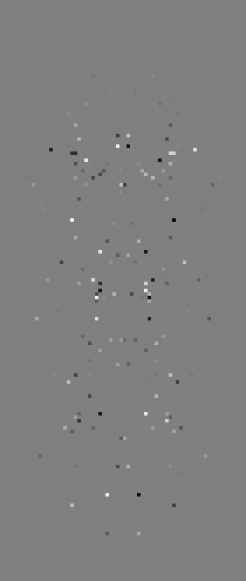
Sensitivity image: symmetry
Z
Horizontal flip
No visible pattern.
Image values ~ 10⁻⁹ ÷ 10⁻¹⁰.
Y
Z
Vertical flip
No visible pattern.
Image values ~ 10⁻⁹ ÷ 10⁻¹⁰.
Y

Slide 9
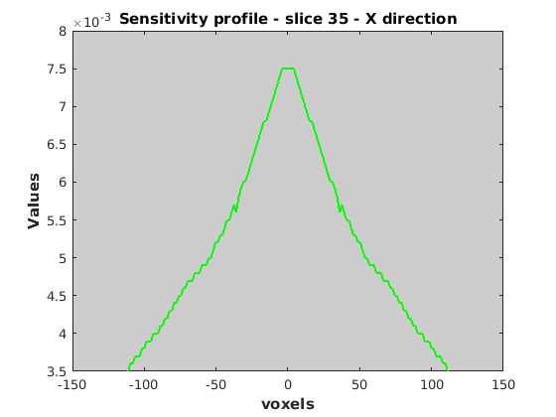
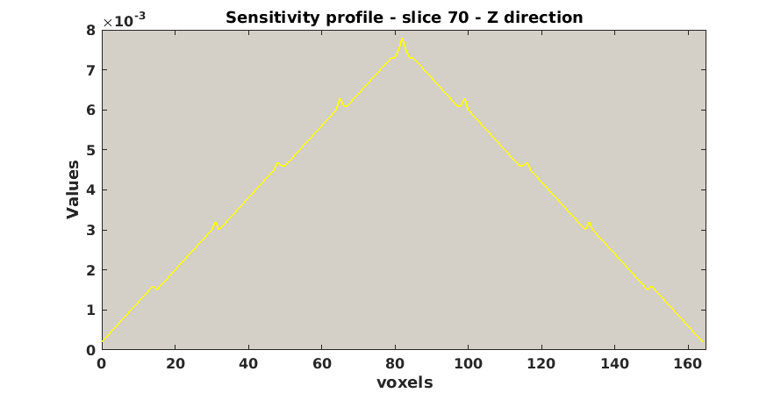
Sensitivity profiles
Y
Z

Slide 10
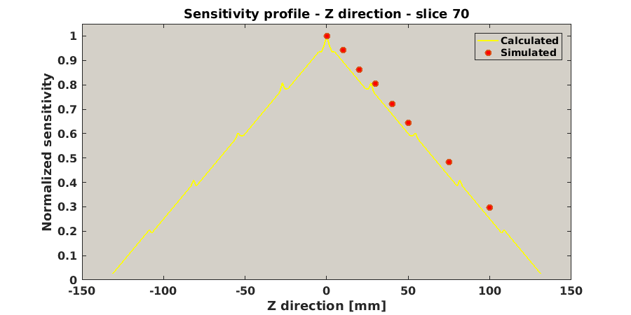
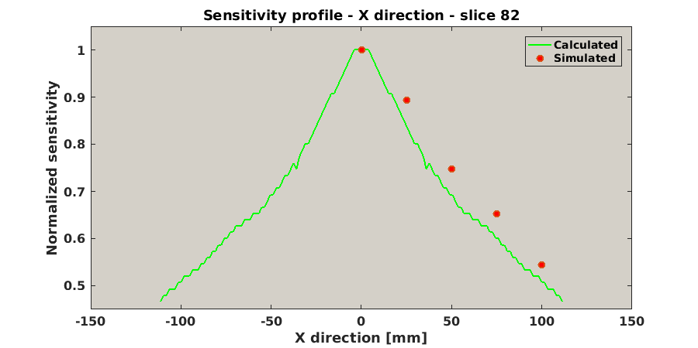
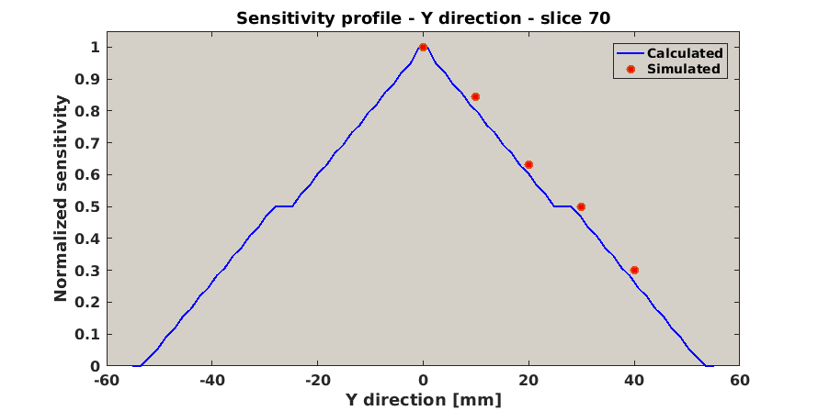
Sensitivity: computed VS simulated
Gate simulations
F-18 point source (cube of 500 μm) within a PMMA phantom (cube of 10 mm side)
Activity: 100 μCi (3700000 Bq)
Simulation time: 120 s
The source was positioned in different points of the FOV along the x, y and z directions

Slide 11
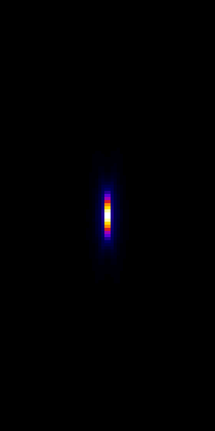
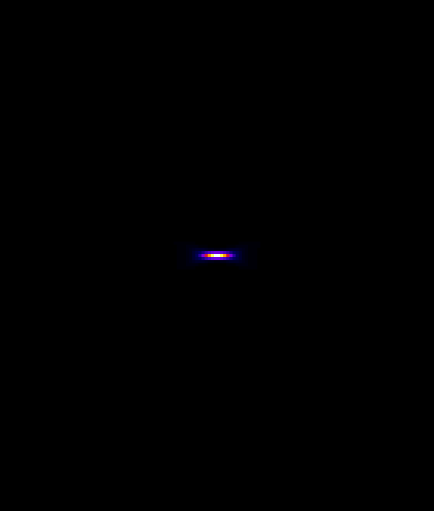
Point source reconstruction
Gate simulations
A ROI was selected for each slice along all the orthogonal planes and the arrays of the average counts values were calculated
Profile plot and gaussian fit were performed to determine the reconstructed position as a function of the nominal position
Z
Z
X
Y
X
Y

Slide 12
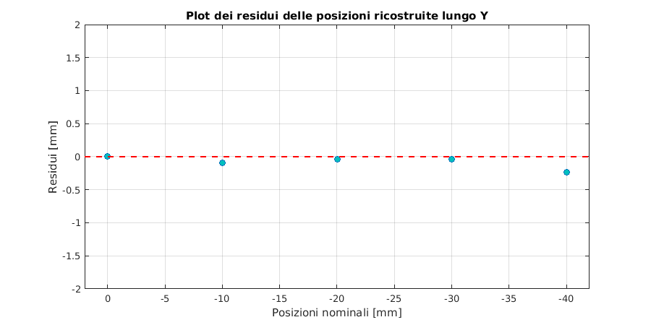
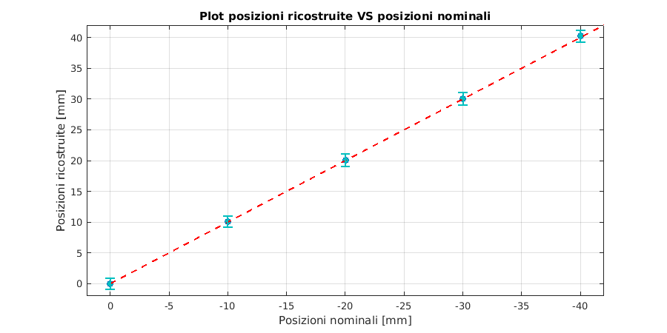
Point source reconstruction Profiles along Y (plane YZ)
Gate simulations
F-18 point source (cube of 500 μm) within a PMMA phantom (cube of 10 mm side)
Activity: 100 μCi (3700000 Bq)
Simulation time: 120 s
Source positions: 0, 10, 20, 30, 40 mm along the Y direction (with the coordinates X and Z equal to 0)
The std of the profiles gaussian fit goes from 0.9 mm to 1.3 mm for the positions y=0 mm and y=40 mm respectively
Same behaviour along the Z direction

Slide 13
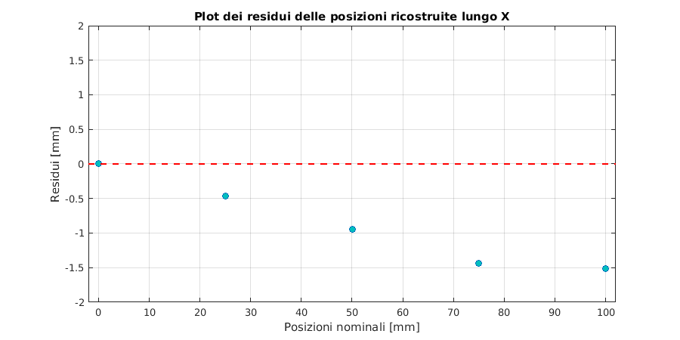
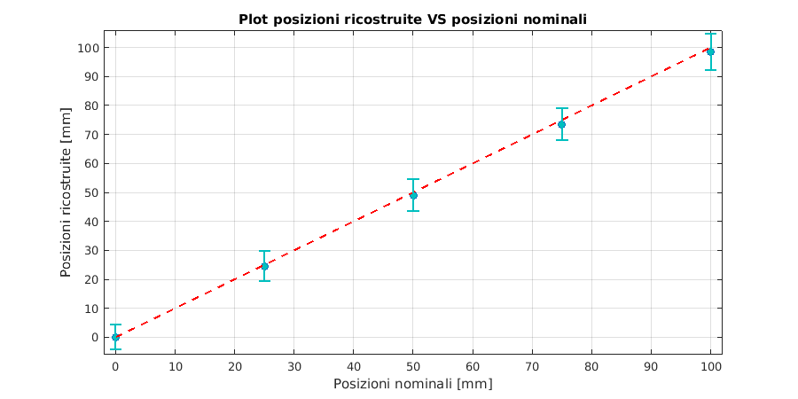
Point source reconstruction Profiles along X (plane XY)
Gate simulations
F-18 point source (cube of 500 μm) within a PMMA phantom (cube of 10 mm side)
Activity: 100 μCi (3700000 Bq)
Simulation time: 120 s
Source positions: 0, 25, 50, 75, 100 mm along the Y direction (with the coordinates X and Z equal to 0)
The std of the profiles gaussian fit goes from 4.3 mm to 6.2 mm for the positions x=0 mm and x=100 mm respectively.
Worst results (but satisfying) on the position reconstruction

Slide 14
Limits of our system…

Slide 15
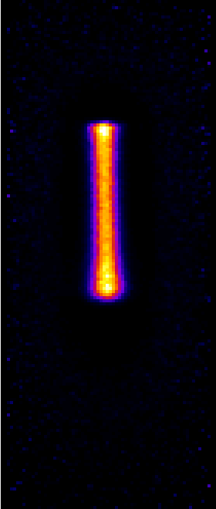
CNAO data reconstruction Single spot, 124 MeV (111 mm in H₂O), high statistic
X
Y
Z
Y

Slide 16
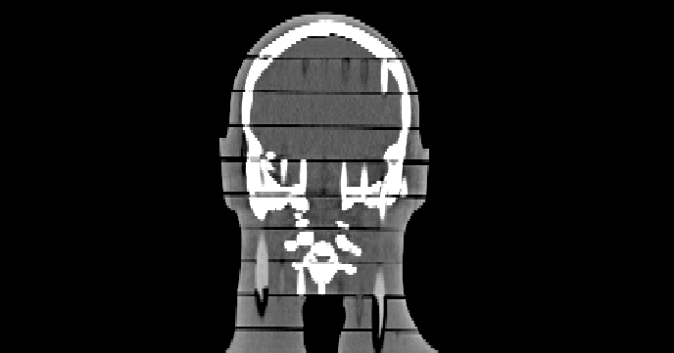
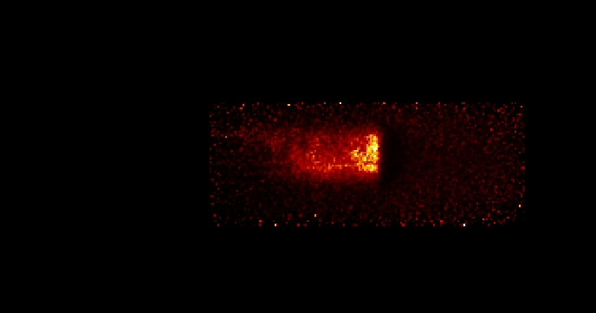
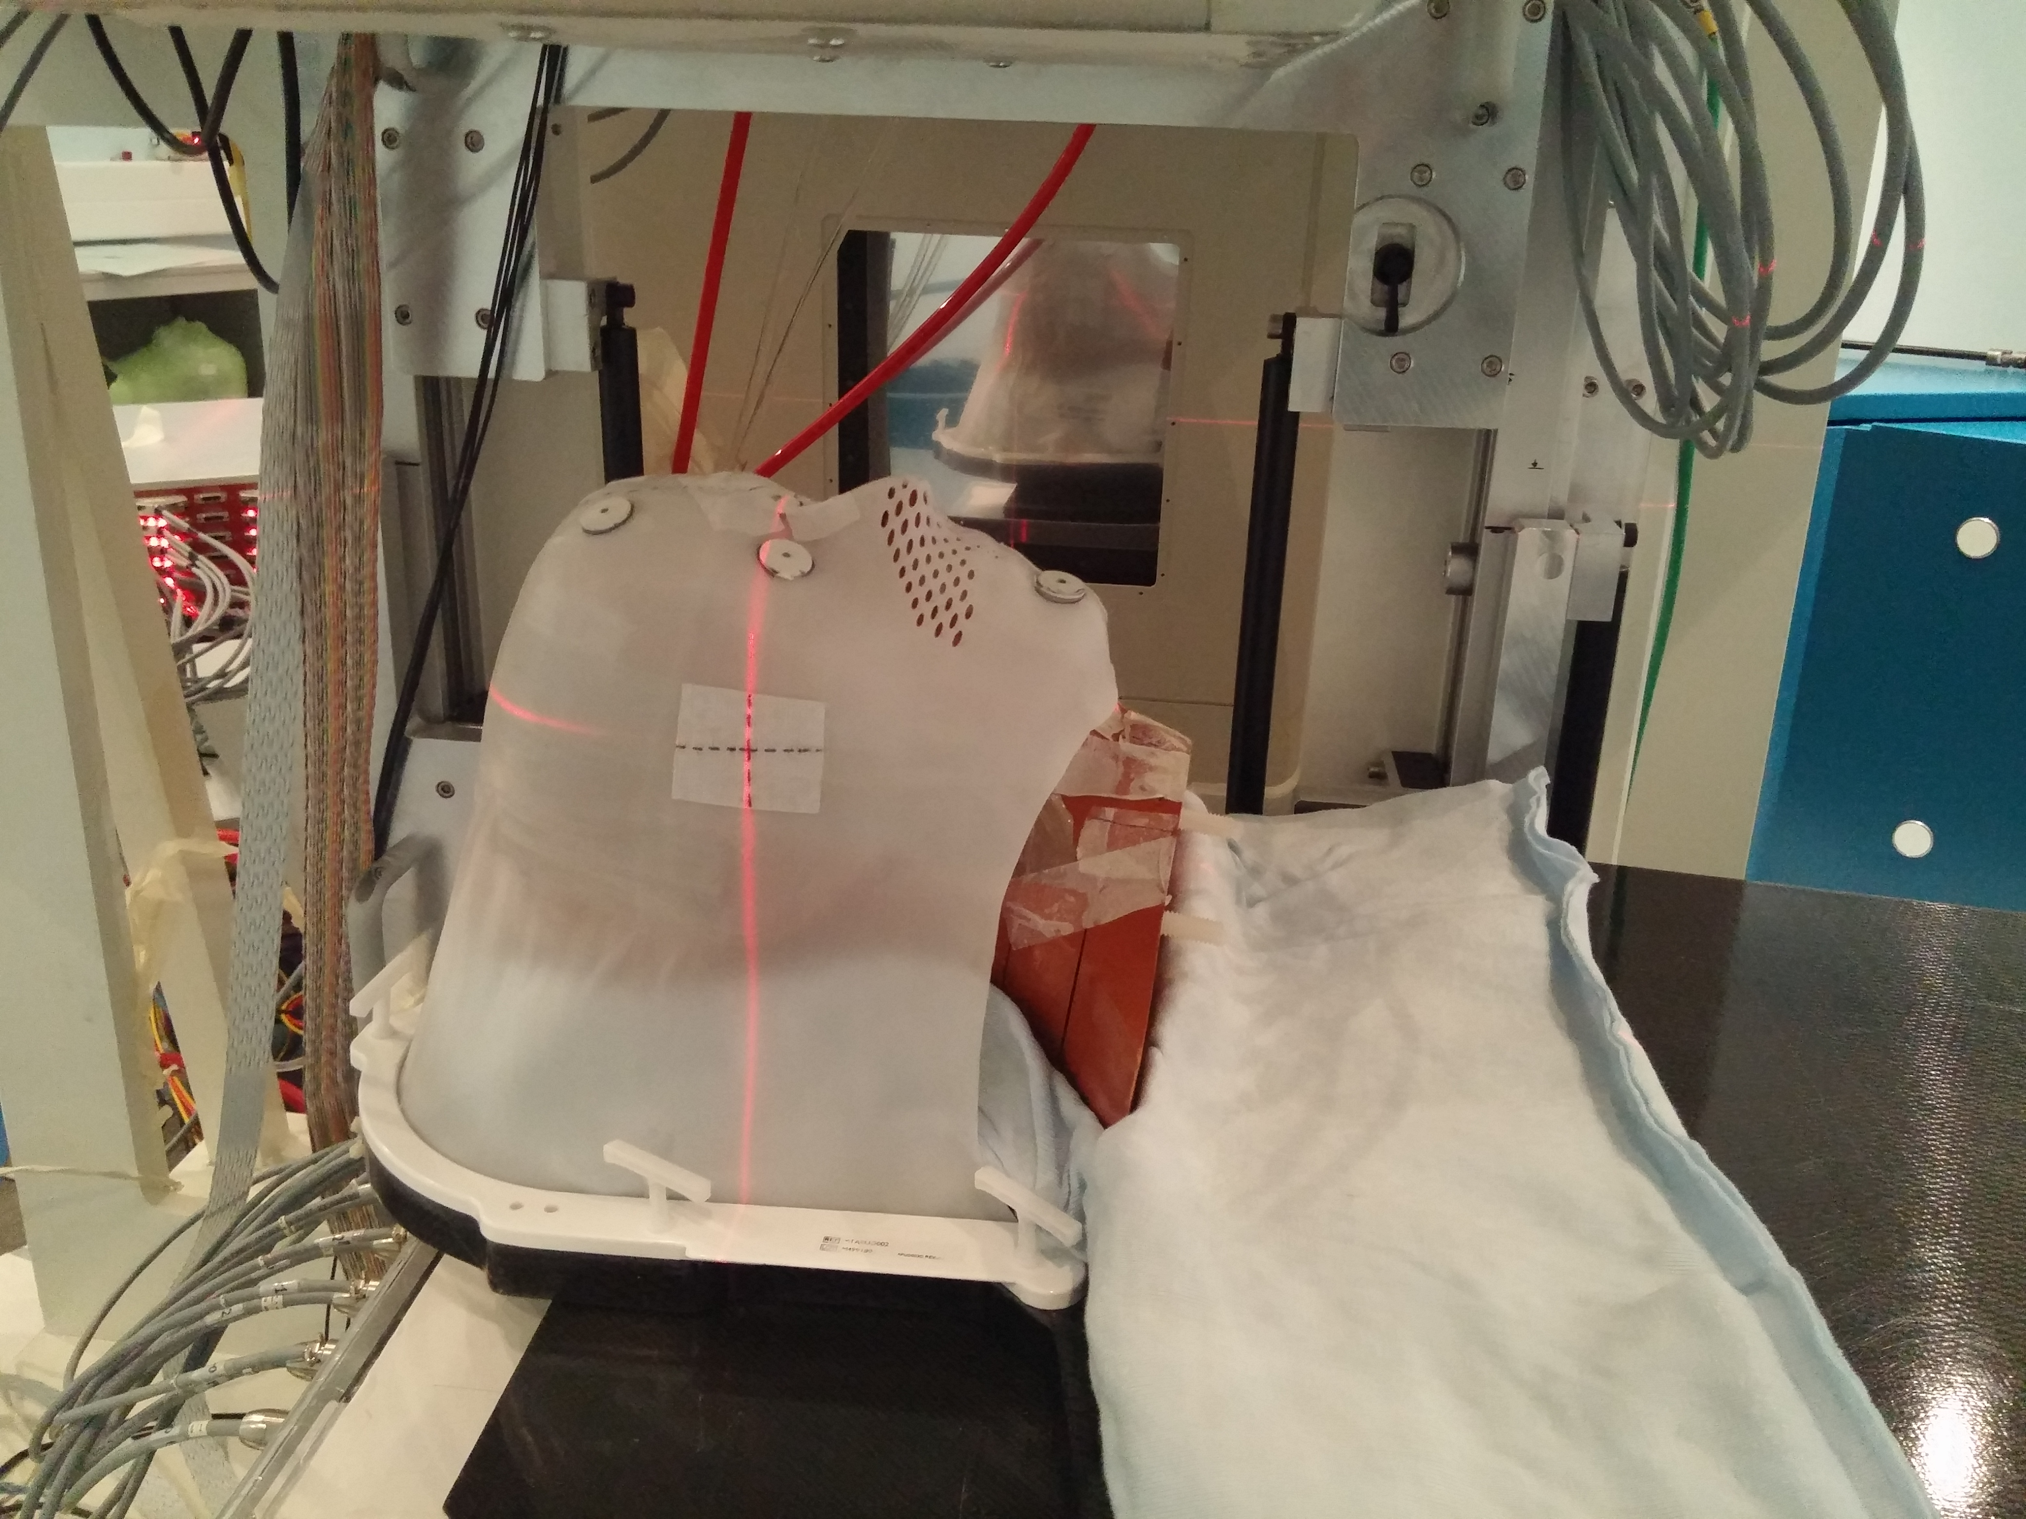
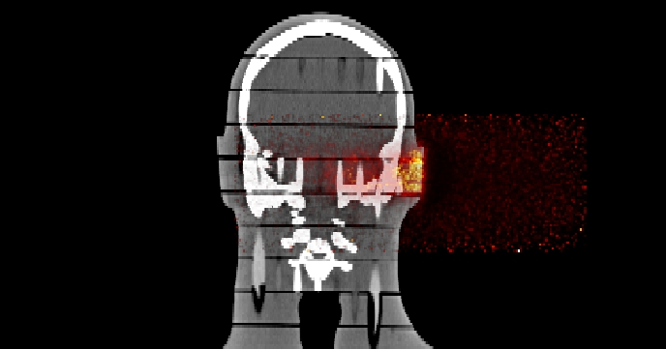
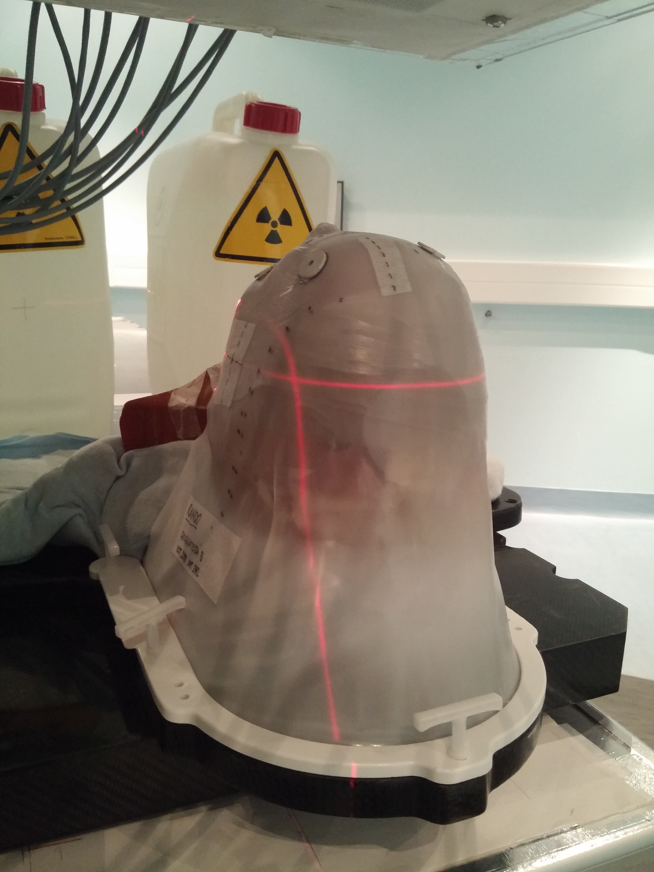
PET-CT image fusion
Treatment plan information
Radiation type | Proton
Target prescription dose | 55.8 Gy
Number of fraction planned | 31
Fraction dose | 1.8 Gy
Number of beam | 2 (B1, B2)
Measurements information
Beam | B1
Dose delivered | 0.9 Gy
Nominal beam energy range | 73.93 ÷ 134.12 MeV
Rando CT
PET image
fusion

