Slide 1
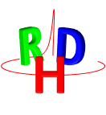


Dose Profiler simulation update
@
G. Battistoni, D. Iuso, S. Muraro, R. Sartorelli,
A. Schiavi, V. Patera, C. Voena
Milano, June 14° 2016

Slide 2
Reminder from January’s meeting:
Key question: how to make use of emission profile detected in a complex geometry
in other words: how to take into account different shapes and materials

Slide 3
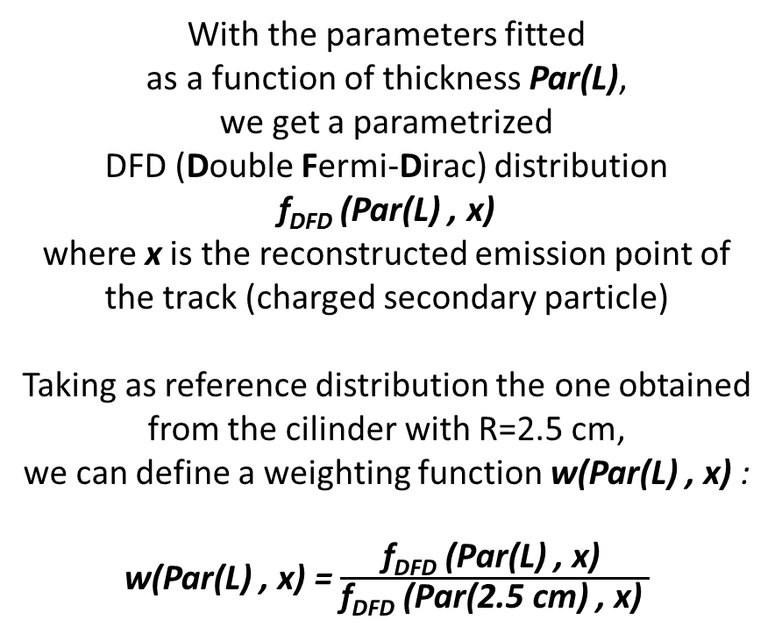
With the parameters fitted
as a function of thickness Par(L),
we get a parametrized
DFD (Double Fermi-Dirac) distribution
f_{DFD} (Par(L) , x)
where x is the reconstructed emission point of the track (charged secondary particle)
Taking as reference distribution the one obtained from the cilinder with R=2.5 cm,
we can define a weighting function w(Par(L) , x) :
w(Par(L) , x) = $\frac{\text{f}\text{DFD}\text{ (}\text{Par}\text{(}\text{L}\text{) , }\text{x}\text{) }}{\text{f}\text{DFD}\text{ (}\text{Par}\text{(2.5 }\text{cm}\text{) , }\text{x}\text{) }}$
Target
x
BEAM
L
Dose Profiler
We get the thichness L of crossed material from the geometry (patient CT) and reconstructed track informations (emission point and direction).
Known the thickness L and the reconstructed emission point x on the beam axis, we associate a weighting value 1/w(Par(L) , x) which converts the emission profile to the reference one (cilinder R = 2.5 cm)

Slide 4
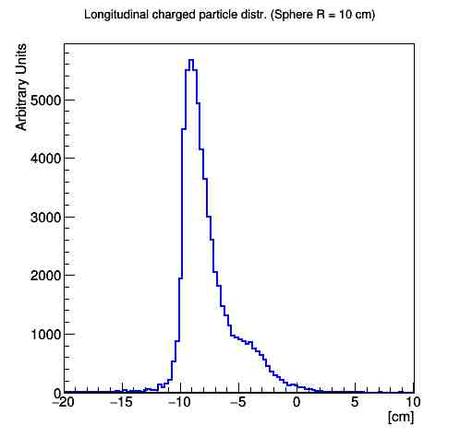
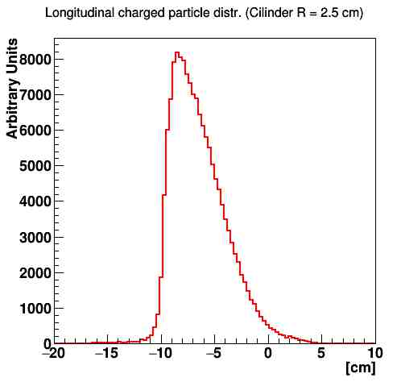
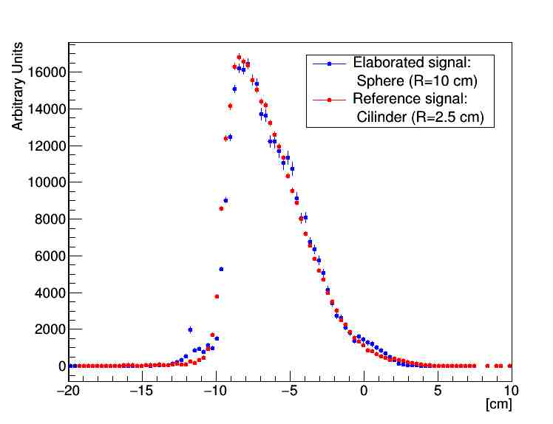
x
Reconstructed emission profile
Reference emission profile
PMMA Cyl
R=2.5 cm
BEAM
L
X
X
Dose Profiler
Result of the application of the weighting function

Slide 5
New developments
So far the correction was valid a-priori just to correct for different thickness and density. What if elemental composition changes?
Our generator was developed only for PMMA, how to make it general? (In partcular how to apply it to Water?)

Slide 6
Two different Corrections:
Thickness correction
For materials different from PMMA, to take into account for different densities ρ_{mat} and different material chemical composition, the thickness l is multiplied
by the factor
where Z is the atomic number and A is the mass number of the compound material.

Slide 7
The new test case

Slide 9
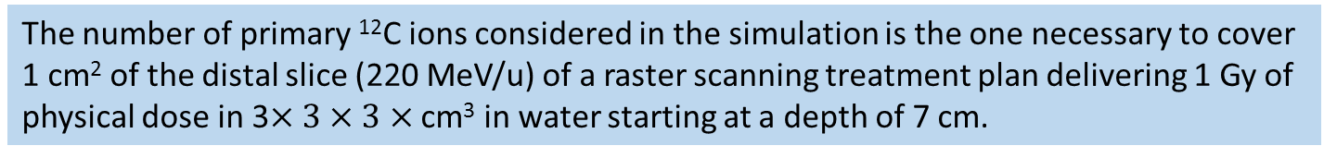
Complete correction applied
The number of primary ¹²C ions considered in the simulation is the one necessary to cover 1 cm² of the distal slice (220 MeV/u) of a raster scanning treatment plan delivering 1 Gy of physical dose in 3$×3×3×$ cm³ in water starting at a depth of 7 cm.

Slide 10
Improvement of generator
The first version was built starting from the emission profile of measured protons as emerging from R = 2.5 cm of PMMA: with the help of MC and taking into account the functional form described above, an extension to R~0 is now available
Making use of the already discussed dependences on density and elemental composition we are now able to adapt the distributions as a function of x and E in PMMA to any material or to any non-homegeneous situation

Slide 11
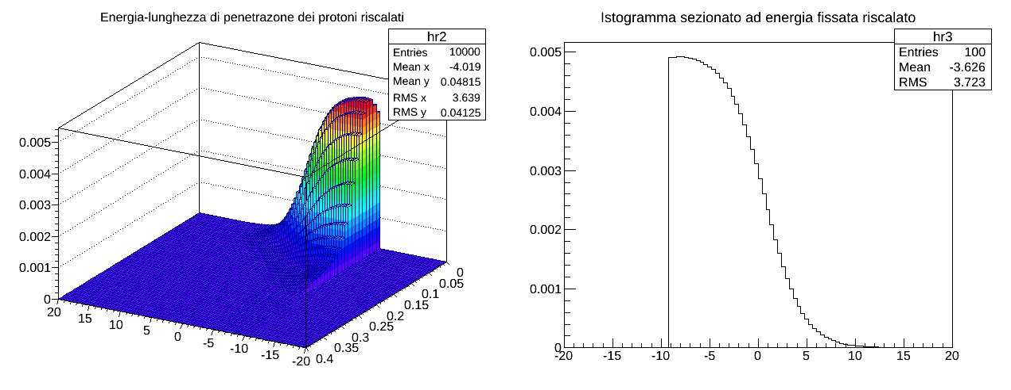
New fast generator starting in WATER
originating from the beam axes (R=0)
x (cm)
Energy
x (cm)

Slide 12
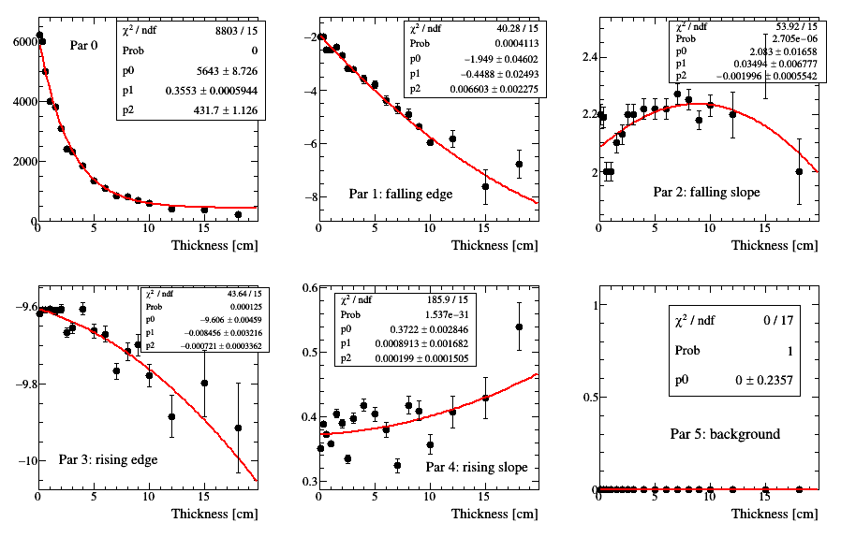
Evolution of 5 parameters of f(x)
for different material thickness
Example:from 0.1 cm to 18 cm in water

Slide 13
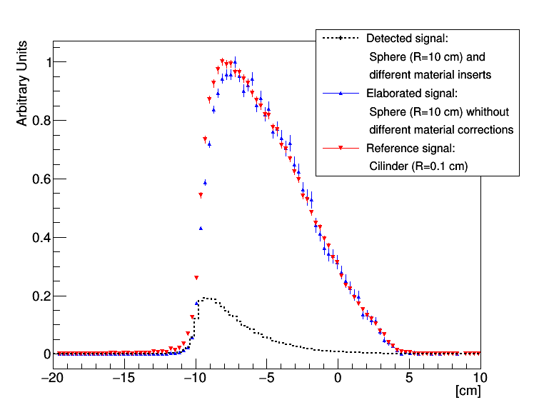
Reconstruction of the emission shape at beam level starting from the detected shape emerging from a homogeneous WATER sphere

Slide 14
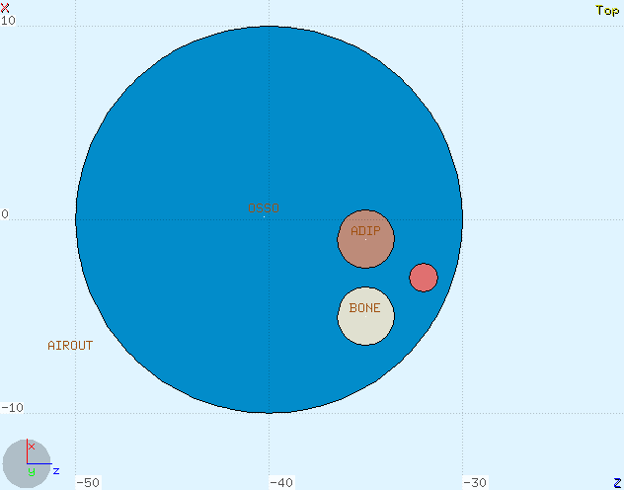
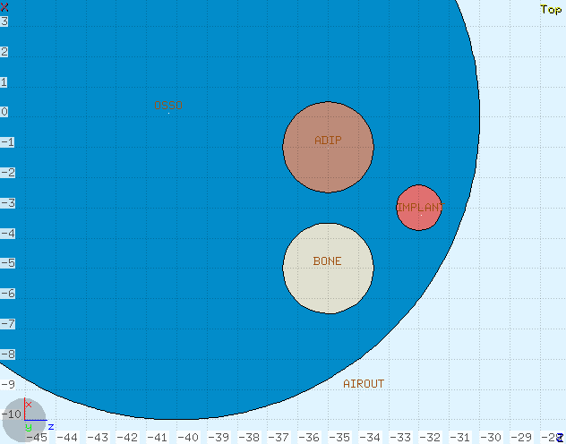
New test case
AIR
WATER
ADIPOSE TISSUE
BEAM
BONE
METALLIC IMPLANT

Slide 15

Reconstruction of the emission shape at beam level starting from the detected shape emerging from a WATER sphere with different material inserts

Slide 16
Towards the use in clinical practice: use of fast MC
We developed a plugin for FRED (a fast-MC simulation software for ray tracing, RDH-WP11) to reconstruct the fragmentation pattern of the beam in a real patient case and take into account in real time of all corrections needed in a non-homegenous case in order to reconstruct the actual range of primary beam
Input:
CT of the patient, the relative detector position and the on-line info about position and direction of primary beam.
Secondary particles’ position, energy and velocity direction supplied by the tracker + calorimeter
FRED backtracks every particle until it reach the «minimum approach position» with respect to primay beam. Once it is done, FRED «interprets» the data to find the actual range.

Slide 17
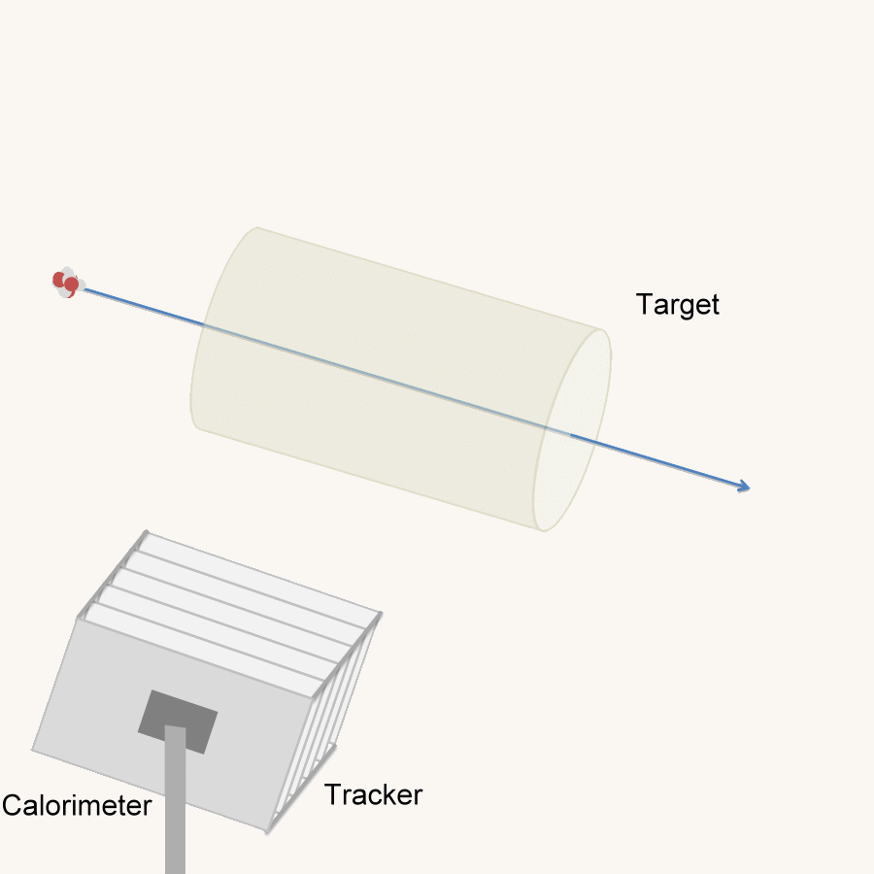

Slide 18
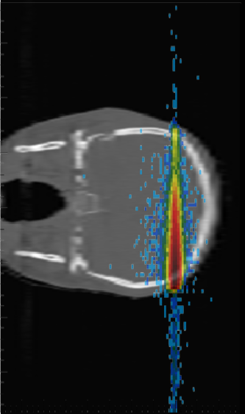
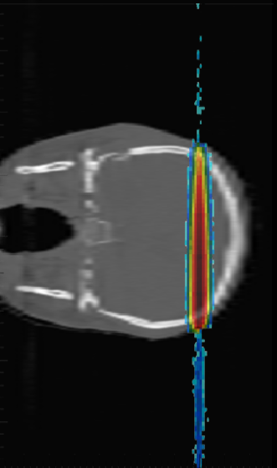
Emission Profile of Reconstructed secondary particles
Emitted secondary particles as resulting from FRED backtracking
C220 MeV beam on a real CT (head)
[XZ view]

Slide 19
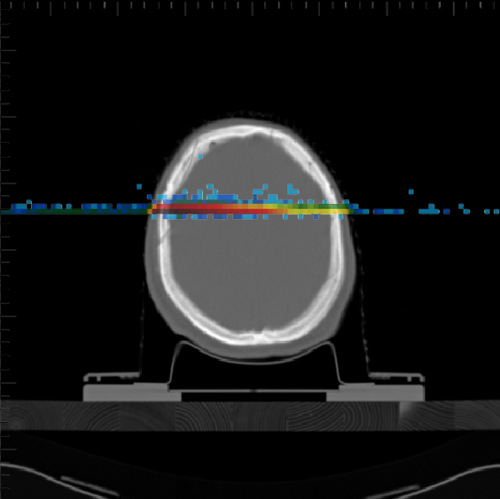
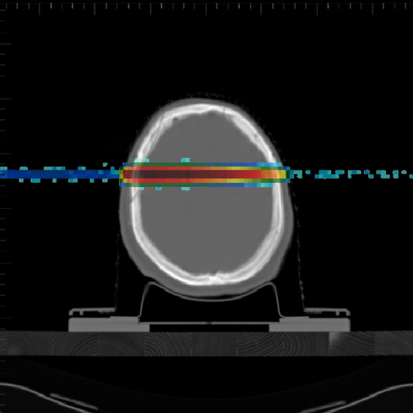
Emission Profile of Reconstructed secondary particles
Emitted secondary particles as resulting from FRED backtracking
C220 MeV beam on a real CT (head)
[XY view]

Slide 20
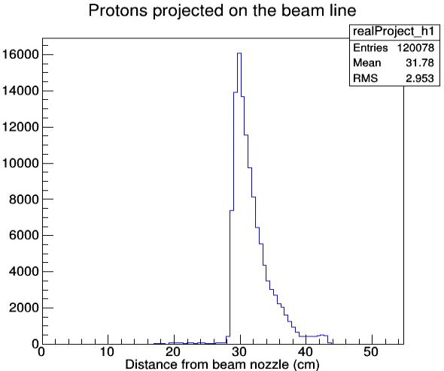
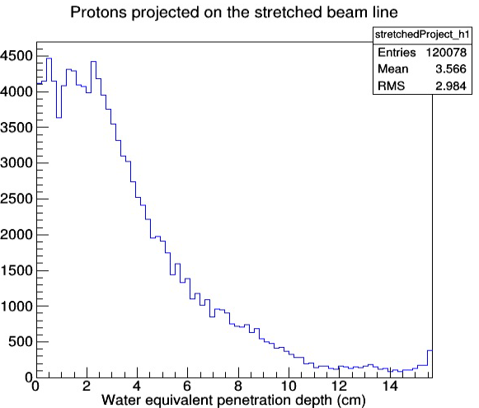
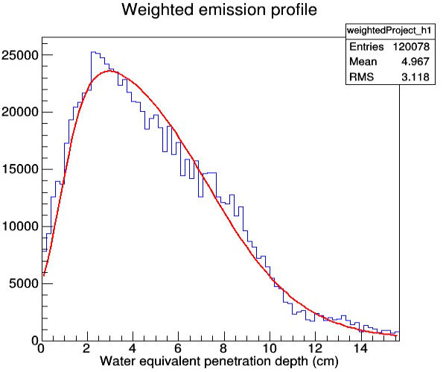
The same weighting technique introduced at January’s meeing is used:
To translate the «penetration depth» in «water equivalent penetration depth»
To consider how many secondary particles may be trapped in the target
The red line is the reference emission profile for which we know the BP position (= range)
C220 MeV beam on a real CT (head)
[beam line projection]

Slide 21
Other topics
Dose Profiler presented in February at the 14th Vienna Conference on Instrumentation (S. Muraro). Proceedings available on-line
Paper on Dose Profiler ~ready for submission to Physica Medica

