Slide 1
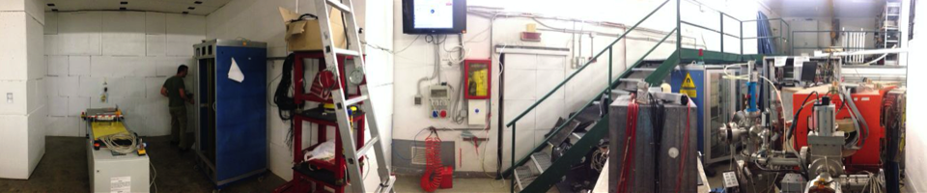
Beam test facility (BTF)
Paolo Valente*, Bruno Buonomo, Luca Foggetta, Claudio Di Giulio
*INFN Roma
LINAC technical staff
Maurizio Belli, Riccardo Ceccarelli, Alberto Cecchinelli, Renato Clementi, Graziano Piermarini, Serena Strabioli, Luis Antonio Rossi, Raffaele Zarlenga
BTF support team
Francesca Casarin, Maria Rita Ferrazza, Manuela Giabbai

Slide 2
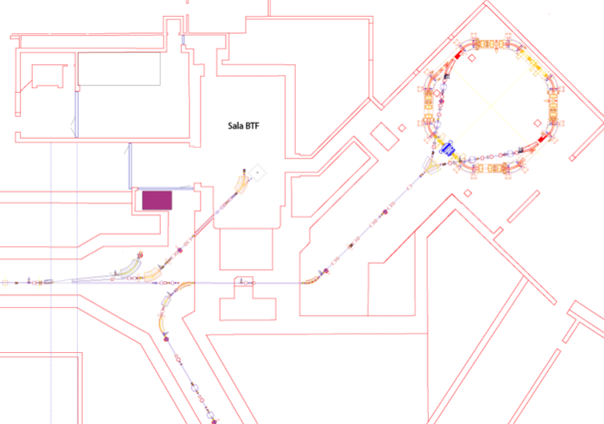
BTF & DAΦNE
Power supplies
BTF
Control room
BTF
Damping
Ring
Transfer line
LINAC
The complex:
Started mid ’90
Commissioning of KLOE 1999
Collisions at the Φ (1020 MeV/c²)
Beam-test facility (2004)
Synchrotron radiation lines
Transfer line
Main rings
Notes:
La BTF nel complesso DAFNE e’ situata alla fine del LINAC. Questo permette di estrarre fasci di elettroni e positroni prima dell’iniezione nel ring attraverso una linea di trasferimento dedicata.

Slide 3
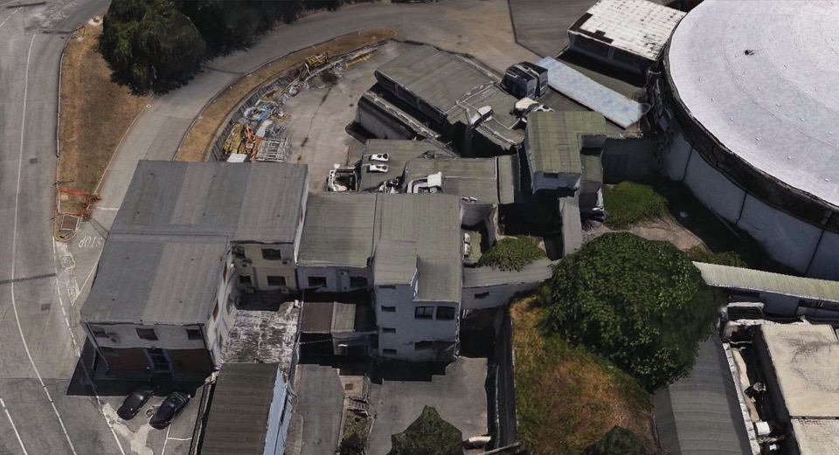

Slide 4
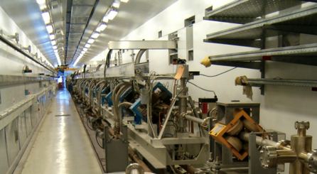
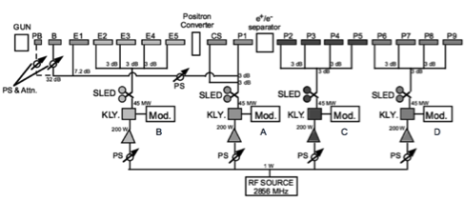
DAΦNE LINAC
 | Progetto | Prestazioni
Energia Finale fascio e- | 800 MeV | 510 MeV
Energia Finale fascio e+ | 550 MeV | 510 MeV
Radio Frequenza | 2856 MHz
Energia Conversione e+ | 250 MeV | 220 MeV
Freq. ripetizione impulso | 1 to 50 Hz | 1 to 50 Hz
Lunghezza impulso | 10 ns | 1.4 to 40 ns
Corrente del gun | 8 A | 8 A
Dimensioni del fascio sul convertitore e+ | 1 mm | 1 mm
Emittanza Normalizzata (mm mrad) | 1 (e-) 10 (e+) | < 1.5
RMS Energia | 0.5% (e-) 1.0% (e+) | 0.5% (e-) 1.0% (e+)
Corrente elettronica sul converitore e+ | 5 A | 5.2 A
Massima corrente per e- | >150 mA | 500 mA
Massima corrente per e+ | 36 mA | 85 mA
Efficienza di trasporto dalla conversione alla fine del LINAC | 90% | 90%
Strutture acceleranti | SLAC-type, CG, 2π/3
Sorgenti and amplificazione Radio Frequenza | 4 x 45 MWp SLED-ed klystrons TH2128C
TITAN Beta (Ca,USA) 1995
S-band, 60 m long, 3,05 m long SLAC-type, TW, CG, 2/3π sections
High current thermo-ionic gun, four RF stations, 45 MWp klystrons (Thales) with SLED compression.
Strong consolidation and upgrade activity started in 2012
10 ns pulses delivered to collider
Notes:
Il LINAC di DAFNE è un acceleratore lineare costruito dalla TITAN Beta (Ca,USA) ed installato alla fine del 1995.
L’ acceleratore lineare e’ lungo ~60 m ed e’ in banda S-band.
E’ composto di un gun termoionico, quattro klystrons da 45 MW con l’amplificazione fornita dagli SLED, e da 15 guide d’onda di tipo 2/3π di tipo SLAC con sezioni acceleranti lunghe 3 m.
L’energia finale raggiungibile dagli elettroni e’ 800 MeV dai positroni 550 MeV la duranta dell’impulso microbunchato va da 1.4 a 40 ns.

Slide 5
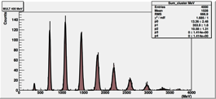
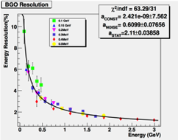
The Beam-Test Facility (BTF)
Starting from 10¹⁰(10⁹) electrons (positrons) from the linac, it operates mainly in two different intensity regimes:
  High intensity primary beam driven to the experimental hall, between 250 MeV and E_{max}, tuned with collimators
  Single particle/bunch (Poisson distribution) between few tens of MeV and E_{max}, created intercepting the beam with a variable depth copper target, selecting the energy and collimating.
Intermediate intensity (<10⁵ particles/bunch) is possible
Primary beam fixed to E=510 MeV and Δt=10 ns during operations of DAFNE collider (“parasitic” operation)
Wider range can be covered (higher energy, longer pulses, etc.) in dedicated operation (no injections)

Slide 6
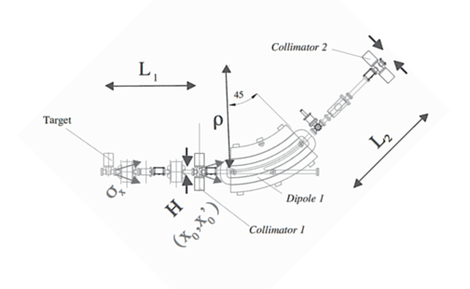
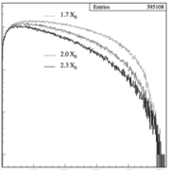



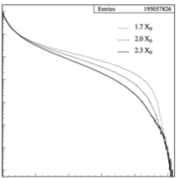

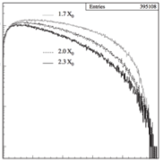
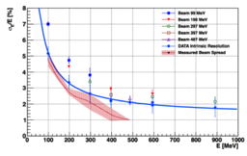

Copper target≈2x₀, collimation and magnetic momentum selection
10⁻⁵
10⁻⁶
Target
10⁻⁷
10⁻⁸
0
0.2
0.4
0.6
0.8
1 (E₀)
10⁻¹
Energy resolution:
10⁻³
10⁻⁵
10⁻⁵
Out of target
10⁻⁶
Energy spread (LYSO)
10⁻⁷
10⁻⁷
< 4 mrad
0
0.2
0.4
0.6
0.8
1 (E₀)
10⁻⁸
0
0.2
0.4
0.6
0.8
1 (E₀)
Maximum input divergence:
d≈0.25 mm
D=60 mm

Slide 7
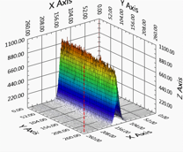
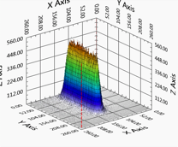
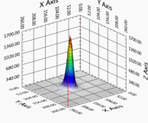
Low intensity tuning
Tuning the number of particles can be achieved:
Without changing the momentum resolution:
  Modulating the LINAC current [not possible in ‘parasitic mode’, rough] (transport optics or modulators power/phase, etc.)
  Collimating the beam before the target, using the up-stream vertical slits [large range]
  Choosing one of the three target depths [step change, very reproducible]
  Collimating the beam after the dipole, using the down-stream vertical slits [fine, small range]
Also changing the momentum resolution:
  Closing/Opening the horizontal collimators [both upstream and downstream]

Slide 8
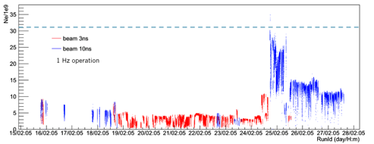
“High” intensity
Primary beam focused, scrapered and transported to the BTF hall
Radio-protection limit: 3.125 ×10¹⁰ particle/s
Photo-production of neutrons on dedicated target

Slide 9
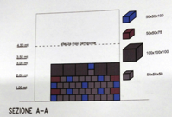
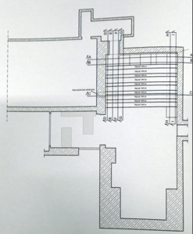
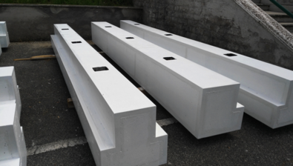
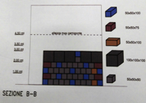
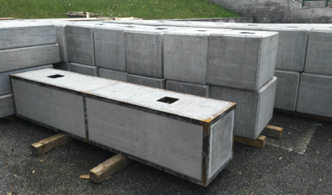
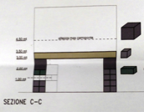
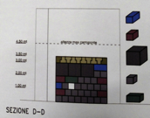
Improved shielding in BTF hall
Dismantling of existing shielding blocks on Jul. 13th
Complete refurbishing of the experimental hall (ducts, cabling, electricity, safety systems…)
Sep. 7th: start new block-house installation

Slide 10
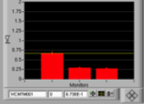
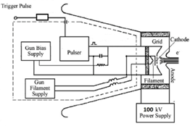
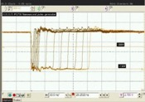
High intensity/high energy electrons
ICT readout (e⁺ injection)
Typical charge to damping ring with 10 ns pulses at 50 Hz:
  1 to 2 nC/pulse for e⁻
  0.7-0.8 nC/pulse for e⁺
But…
  Much higher charge is driven onto the converter during positron production
  Indeed up to 8 A (12 A) can be drawn from the gun cathode
Extracted charge can be increased:
At constant current (no saturation), by simply increasing the pulse duration to the gun
Increasing the pulse height of applied voltage
Decreasing the stopping voltage applied to grid
300 to 750 V
0.5 to 40 ns

Slide 11
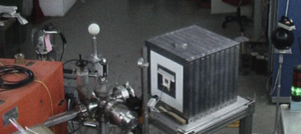
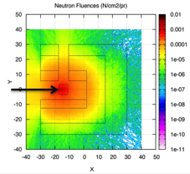
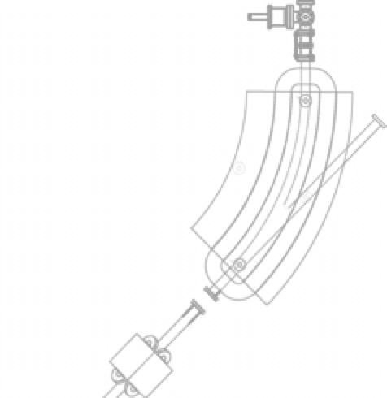
n@BTF
Viene fatto collidere con un bersaglio di Tungsteno.
Gli elettroni di alta energia producono uno spettro continuo di fotoni per bremsstrhalung. Questi possono generare neutroni attraverso reazioni foto-nucleari se la loro energia è almeno uguale all’energia di legame dei neutroni nel bersaglio.
Il numero di neutroni dipende dalla potenza rilasciata nel bersaglio:
  P = rate×energia =[N×f]×E
    N = numero di particelle per bunch (1×10¹⁰)
    f = frequenza (1-49 Hz)
    E = Energia dle fascio (510-800 MeV)
  Potenza massima: 40 W a 510 MeV
Swanson: 10¹¹n per W, 8.8×10⁸ n/cm²/s

Slide 12
Neutron electro-production
Tungsten target
At full linac power: 10¹³ e/s
  to be compared e.g. with nELBE, N=6·10¹⁵ e/s
Swanson estimate
  9.3·10¹⁰ Z^{(0.73±0.05)} n/s kW⁻¹
  2.15 ·10¹² n/s kW⁻¹ for Tungsten
Optimizing the target configuration can (slightly) improve the yield:
  n@BTF optimized target: 2.75 ·10¹² n/s kW⁻¹
  0.218 n/pr (over 4π and all spectrum)
In our case the main limitation will always be the intensity delivered onto the target
Evaporation peak + fast neutrons shoulder

Slide 13
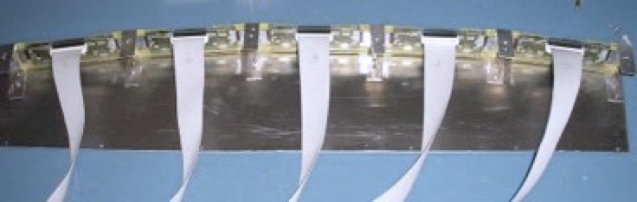
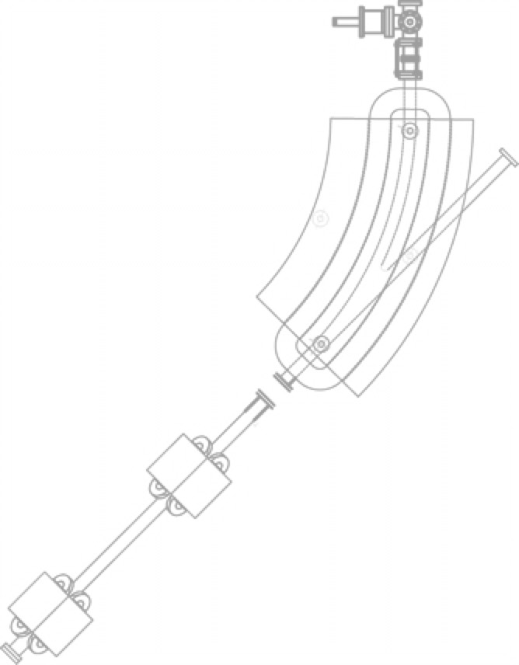
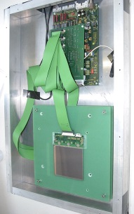
Tagged photons
Progettato e costruito in collaborazione con il team del satellite AGILE il cui scopo era la calibrazione del payload tracciatore+calorimetro.
γ
I fotoni sono “taggati” in energia utilizzando il dipolo le cui pareti interne sono ricoperte da 10 moduli Si micro-strip.
A seconda della perdita di energia nella produzione di fotoni, gli elettroni urtano una striscia diversa una volta impostato il valore di corrente di dipolo.
La correlazione tra la posizione dell’elettrone sulla camera di silicio e la posizione di impatto all’interno delle strip nel magnete permettono la “taggatura” dei fotoni.
E
silicon detectors
silicon tagging
target
dipole magnet
Incoming electron
Be window

Slide 14
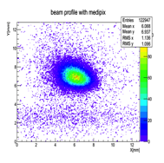
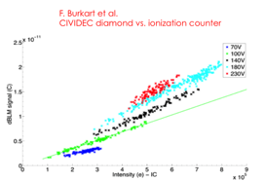
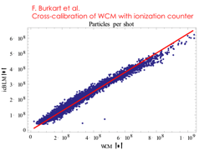

Beam parameters
Different ranges of beam parameters can be achieved in the different modes: dedicated running or parasitic operation / with or without attenuating target
Parameter | Parasitic mode |  | Dedicated mode
 | With target | Without target | With target | Without target
Particle species | e⁺ or e⁻ Selectable by user | e⁺ or e⁻ Depending on DAFNE mode | e⁺ or e⁻ Selectable by user
Energy (MeV) | 25–500 | 510 | 25–700 (e⁻) 25–500 (e⁺) | 250–730 (e⁻) 250–530 (e⁺)
Energy spread | 1% at 500 MeV | 0.5% | 0.5%
Repetition rate (Hz) | Variable between 10 and 49 Depending on DAFNE mode |  | 1–49 Selectable by user
Pulse duration (ns) | 10 |  | 1.5–40 Selectable by user
Intensity (particles/bunch) | 1–10⁵ | 10⁷–1.5 10¹⁰ | 1–10⁵ | 10³–3 10¹⁰
Maximum average flux | 3.125 10¹⁰ particles/s
Spot size (mm) | 1–25 (y) × 1–55 (x)
Divergence (mrad) | 1–2
With target
Without target

Slide 15
Strong points
Efficiency
  Al netto del down-time del linac e del tempo morto dovuto allo switch del linac tra modalità elettroni e modalità positroni, l’efficienza complessiva è >90%
  Naturalmente durante le iniezioni, il numero di bunch disponibili scende da 49 al secondo a 49 – n dove n è il numero di bunch ineiettati
Flexibility
  I parametri fondamentali del fascio sono modificabili in range piuttosto ampi, ma soprattutto in modo veloce e riproducibile
  Lo spot è molto riproducibile e il fuoco può essere facilmente modificato
User-friendly diagnostics
  In questi anni la diagnostica del fascio è stata continuamente migliorata, sia dal punto di vista delle prestazioni, sia da quello della facilità d’uso
  In particolare i rivelatori di tipo MediPix/FitPix permettono di aggiustare lo spot del fascio in tempo reale e garantiscono una misura molto accurata delle dimensioni e posizione del fascio

Slide 16
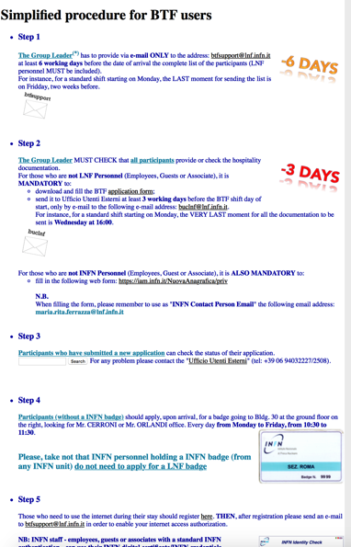
Access & Schedule
Two calls/year typically in november and may, for planning a long period before summer and one short after Aug. shutdown
Strongly epending on DAFNE operations
Operators 24/7, of course, but also technical services
Strong support from Administration for heavy load (150-200 users/year)

Slide 17
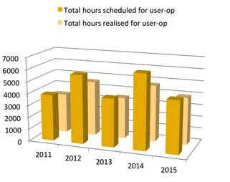
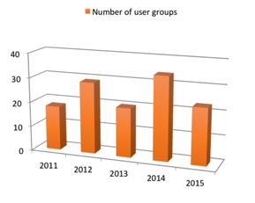
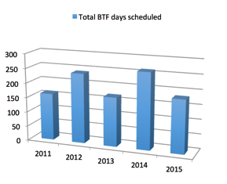
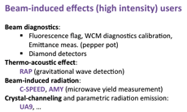
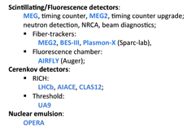
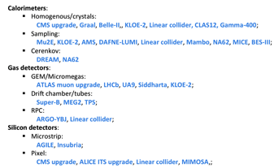
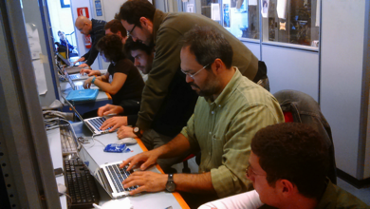
Users statistics
90% detector testing and calibration
10% high intensity
Average 150% of requested/available time

Slide 18
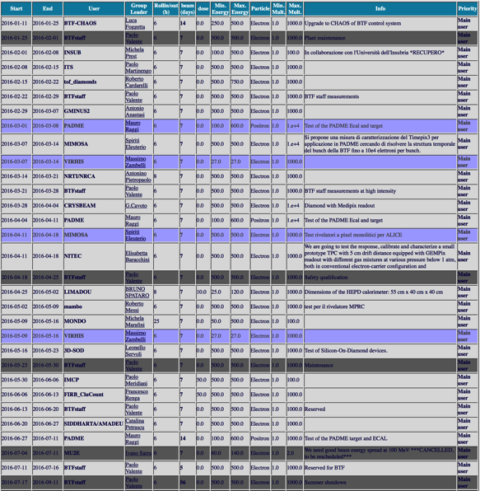

BTF 2016
Jan
Feb
Not approved
Cancelled/Maintenance
Mar
January-July:
2 development shifts
1 safety qualification +
1 maintenance weeks
1 CHAOS-BTF joint shift
18 users slots/22 requested
138 users (with repetitions…)
Apr
May
Jun
Jul

Slide 19
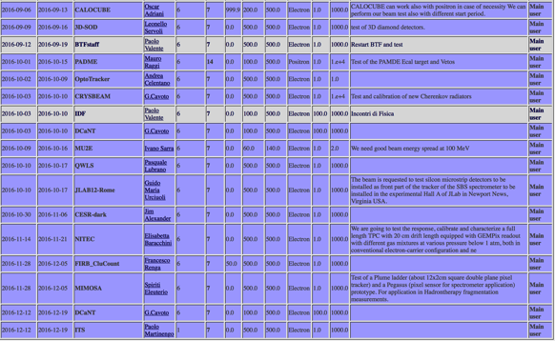
Schedule
2 pre-booked shifts (startup, teacher’s week)
1 safety qualification week
1 development shift
16 weeks new requests
Considering already booked or not available weeks, we will accept not more than 8 out of 20 new requests for the last part of the year
Projected overall 2016: 38 requests/26 available
[But we are not even at the end of May]
Inline with usual 150% request level

Slide 20


Future
1991
2016
arXiv:1603.05651 [physics.acc-ph]

Slide 21
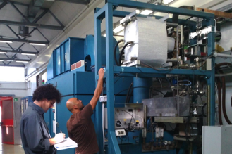
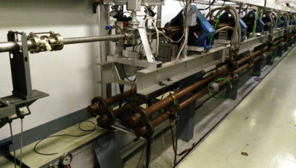
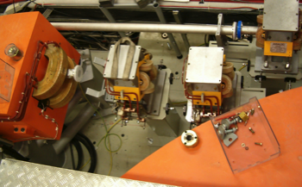
WP1: LINAC modulators consolidation
WP2: Increase energy to 1 GeV
WP3: second BTF beam-line

Slide 22
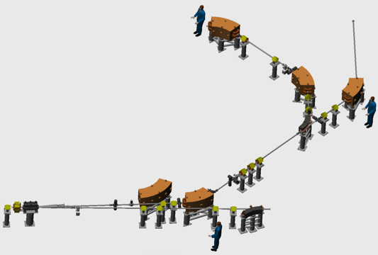


BTF line doubling
10¹³ positrons on target
PADME experiment approved for searching dark photon/ALPs and other light dark matter mediators using positron annihilations on target at the BTF line: needs a couple of years at full rate running
Recently included in ASI/ESA facilities for electron irradiation
DHSTB04
BTF new beam-lines:
Existing elements
New elements
DHSTB03
DHSTB02
QUATB08-09
QUATB06-07
QUATB05
QUATB01-03
QUATB04
QUATB101-102
DHPTB102
DHSTS01
DHSTB01
DHPTB101
DHPTS01

Slide 23
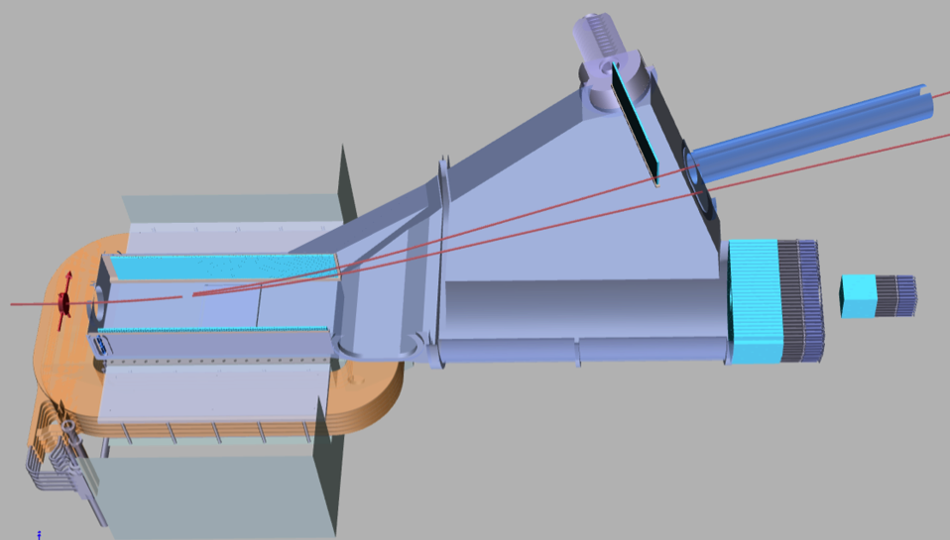
PADME detector
High Energy Positron veto
1 cm scintillators with SiPM readout
Dipole 0.55 Tm
Calorimeter
BGO crystals 20×20x220 mm³
Diamond target
50-100 μm
Positron veto
1 cm scintillators with SiPM readout
Positron beam
Small Angle Calorimeter
Electron veto
1 cm scintillators with SiPM readout

Slide 24



PADME experiment status
CSN I full approval for 1,350 kEuro for 2016-2018
Magnet from CERN (OK, being measured now)
600 BGO crystals from former L3 experiment
Calorimeter construction starting in summer 2016
Thin diamond, full Carbon, large area active target developed in Lecce
Scintillating bars positron veto being developed in Bulgaria
Interest from Hungarian group
Collaboration with Cornell starting this summer

Slide 25


PADME main backgrounds
Signal e⁺e⁻->γA’
BG SM annih. e⁺e⁻->γγ(γ)
BG SM Brems.: e⁺N->e⁺Nγ
M_{miss}=M_{A’}
1 lost e⁺
P⁴_{γ},t
1 lost γ
γ
γ
γ
γ
P⁴_{e+},t
e⁺
e⁺
e⁺

Slide 26


PADME-invisible decay sensitivity
Based on 2.5x10¹⁰ fully GEANT4 simulated 550MeV e+ on target events
  Number of BG events is extrapolated to 1x10¹³ electrons on target
  Using N(A’γ)=s(N_{BG})
  δ enhancement factor δ(M_{A’}) = σ(Α’γ)/σ(γγ) with ε=1
PADME 2 years of data taking at 50% efficiency with bunch length of 40 ns
10¹³ EOT = 6000 e⁺/bunch × 3.1⋅10⁷s ⋅ 49 Hz
PADME can explore in a model-independent way the favourite by (g-2)_{μ} band up to M²_{A’} = 2m_{e}E_{e+}
E_{e+}=550 MeV: M_{A’} < 23.7 MeV/c²
E_{e+}=1 GeV: M_{A’} < 32 MeV/c²
  New estimate with optimized detector layout public by the summer!

Slide 27







Slide 28

BTF upgrade(s): pulse width extension
New pulser for the LINAC gun ordered at end of 2015. Delivery due in these days
Adds to 1.5 – 40 ns (0.5 ns steps) the capability of producing 50-1000 ns pulses (50 ns steps)
Fully compatible with existing hardware and only minor modifications to software
Installation during summer shutdown, tests at restart of the LINAC in September
Crucial for PADME! Luminosity increases linearly with pulse duration, since it increases the number of positrons in the beam while keeping the pile-up probability in the detector constant
Indication that time and phase differences among the four modulators produces a good accelerating field in the 200 ns range already in the presente configuration, without any modification to the RF system.
10 ns pulse

Slide 29


LINAC energy upgrade
LINAC energy upgrade:
add 4 accelerating sections
+ 1 klystron/modulator

Slide 30





Thank you
pALPIDE chip for ALICE ITS upgrade
Cherenkov quartz detector for
crystal channeling
LIMADOU: China-INFN γ satellite
… and many others
Negative ion TPC

Slide 31




BTF layout
Target
Pulsed dipole 3°
LINAC spectrometer
BTF line
Pulsed dipole 6°
BTF dipole
To/from damping ring
3-way beam pipe
Target

Slide 32


Beam spot
Beam spot at the exit of the vacuum pipe suffers from
  Beam divergence ≈1 mrad
  Multiple scattering on the Beryllium window
    0.5 mm thickness/352.8 mm = 1.4 10⁻³ X₀
    ≈1 mrad at 500 MeV
Best spot: 0.6×0.5 mm² (at 450 MeV)
Imaged by Medipix (FITpix) detector
  Si pixel, 55 μm pitch, 15×15 mm² area
Beam spot centroid stability at the level of 200 μm

Slide 33






Irradiation: beam spot
The “natural” beam spot in the transverse plane has a Gaussian shape
Generally, aiming at a “pencil” beam at low multiplicity
50 MeV electrons: 3.2×3.4 mm² (σ)
1 10³/pulse
Irradiation requirement is the opposite: uniform intensity on a ≈cm² area (±10%)
450 MeV electrons: 540×480 μm² (σ)
FitPIX detector:
2.25 cm² area
50 MeV electrons: 9.3×6.1 mm² (σ)
3.5 10³/pulse
50 MeV electrons: 8.6×3.5 mm² (σ)
6 10³/pulse

Slide 34

Irradiation: dosimetry
Planned acquisitions:
Diamond detector:
  It gives flux measurement without relying on calorimetry with no saturation effects
Faraday cup:
  The “standard” charge absolute reference measurement
F. Burkart et al.
CIVIDEC diamond detector
With target
Without target

Slide 35







A possible beam-dump
DR pumps hall
A new thin vacuum chamber for DHPTT01 with double exit
  Exactly the same design of existing DHPTT02
A straight beam-line to the inside of the cavity hosting the dump target (to be optimized, designed, cooled, etc.)
Possibly, use DR pumps hall for dump experiments
Additional shielding all around the area, to be carefully calculated

Slide 36

A possible beam-dump
DR pumps hall

Slide 37
Projects
BTF additional line
  Approved AIDA-2020, Task 15.4.1
Refurbished photon tagging
  Approved AIDA-2020, Task 15.4.2
SATELLES
  Proposed: large overlap with additional line project
Long linac pulse
  From 40 to about 150 ns
  Above 150 ns up to 500 ns
Thin BTF target
  High energy positron production for PADME
Micro-divergence beam
Electron irradiation facility
Energy upgrade of the linac
  Submitted to INFN
  Includes matching funds for BTF additional line
  Includes consolidation of linac modulators power supplies
Dump for high-intensity
  BDX, PADME
  Neutron/pion/muon production

Slide 38


DAΦNE timing
25 or 50 Hz repetition rate
Last bunch every second always to spectrometer line
Accumulator
BTF line
Spectrometer
Main rings
LINAC = LINAC shots are delivered at 25(50) pulses/s and dumped at the end of TL
LINAC+BTF = LINAC shots are delivered with a selectable duty cycle to BTF: 1 to 24(49) pulses/s. Remaining pulses are dumped at the end of the TL
GLOBAL = LINAC shots are delivered with a variable duty cycle to BTF according to injection parameter in ACCUMULATOR
  NO INJECTION = SELECTABLE from 1 to 24(49) pulse per second
  INJECTION = the injection needs are DAΦNE Control Room controlled. Typically injection pulses are at 2Hz, taking from 1 up to 7 LINAC bunches per sequence. BTF delivers 22 down to 10 bunches per second

