Slide 1
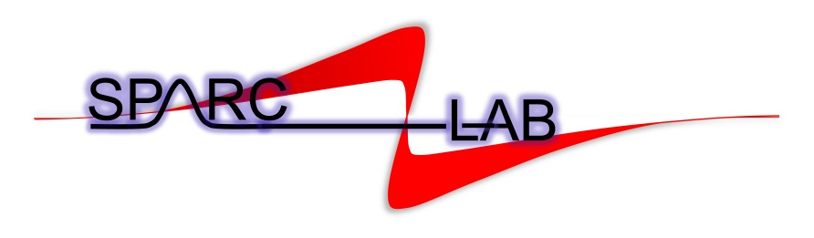


SPARC_LAB activities
Maria Pia Anania*
On behalf of the SPARC_LAB collaboration
* maria.pia.anania@lnf.infn.it

Slide 2
Outline
SPARC_LAB facility
Particle wakefield acceleration experiment
FLAME @ SPARC_LAB
Experiments and recent results with the FLAME laser
FLAME coupled with the SPARC linac
Experiments and recent results with FLAME + SPARC
Summary

Slide 3
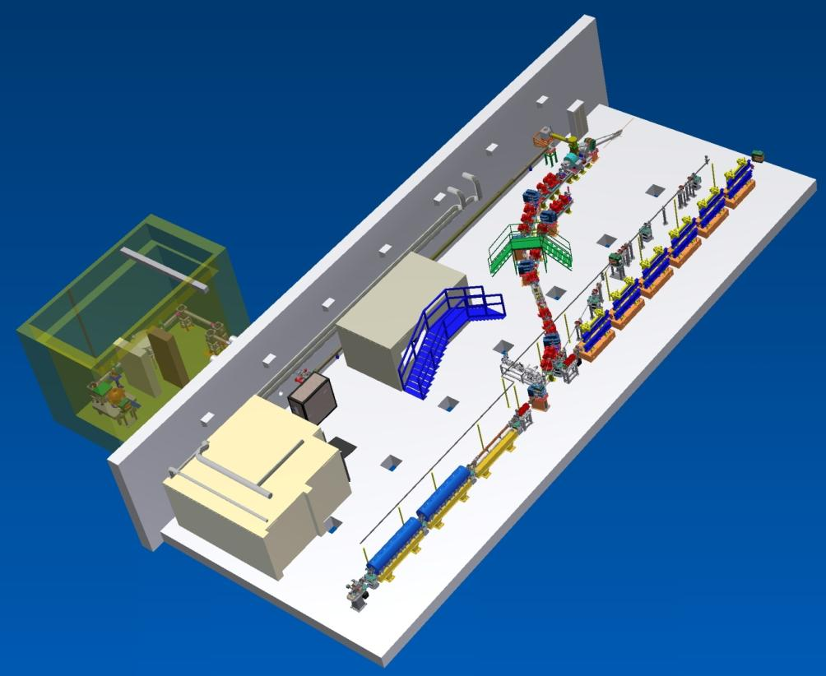
SPARC_LAB layout
SPARC_LAB is a multi-disciplinary test facility composed by a high brightness LINAC and a high power laser.
Laser filaments
Thomson beam-line
Ion acceleration
FLAME LASER
Self injection
EOS
External injection
FEL
THz
Particle wakefield acceleration
Layout @ October 2015

Slide 4
Particle wakefield acceleration

Slide 5
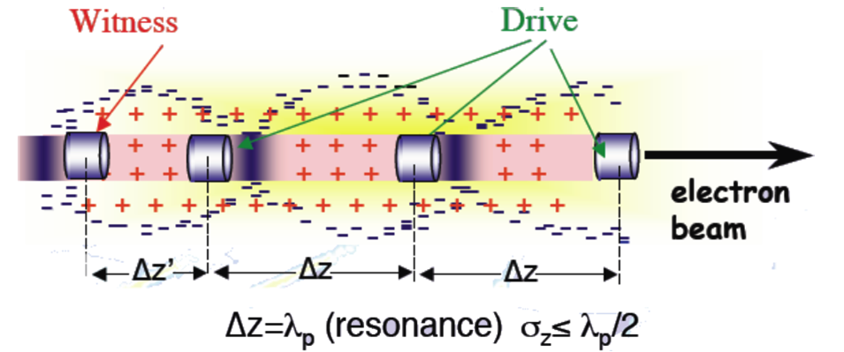
Particle wakefield acceleration
Preformed plasma will be used (discharge in hydrogen gas).
The driver bunches are injected in the preformed plasma and resonantly excite the wakefield.
The witness bunch is sent on the crest of the wakefield to be post-accelerated.
GOAL: high brightness bunches!
Difficulties: maintain ultra high vacuum to avoid accelerating cavity breakdown, produce low density plasmas (10¹⁵ – 10¹⁷ cm⁻³) to match bubble size with electron bunch length.

Slide 6
Particle wakefield acceleration
Steps followed to be ready to have a plasma accelerator on a linac.
From the plasma point of view:
Design of the vacuum chamber to maintain UHV;
Design the plasma accelerator to have the desired density;
Study ionization to design the discharge unit;
Fully characterize the plasma source;
And in the mean time from the electron point of view:
Find the way to produce COMB like electron bunches;
Characterize the electron bunches;
Produce a typical electron bunch that can be produced after plasma acceleration and try to use it!

Slide 7
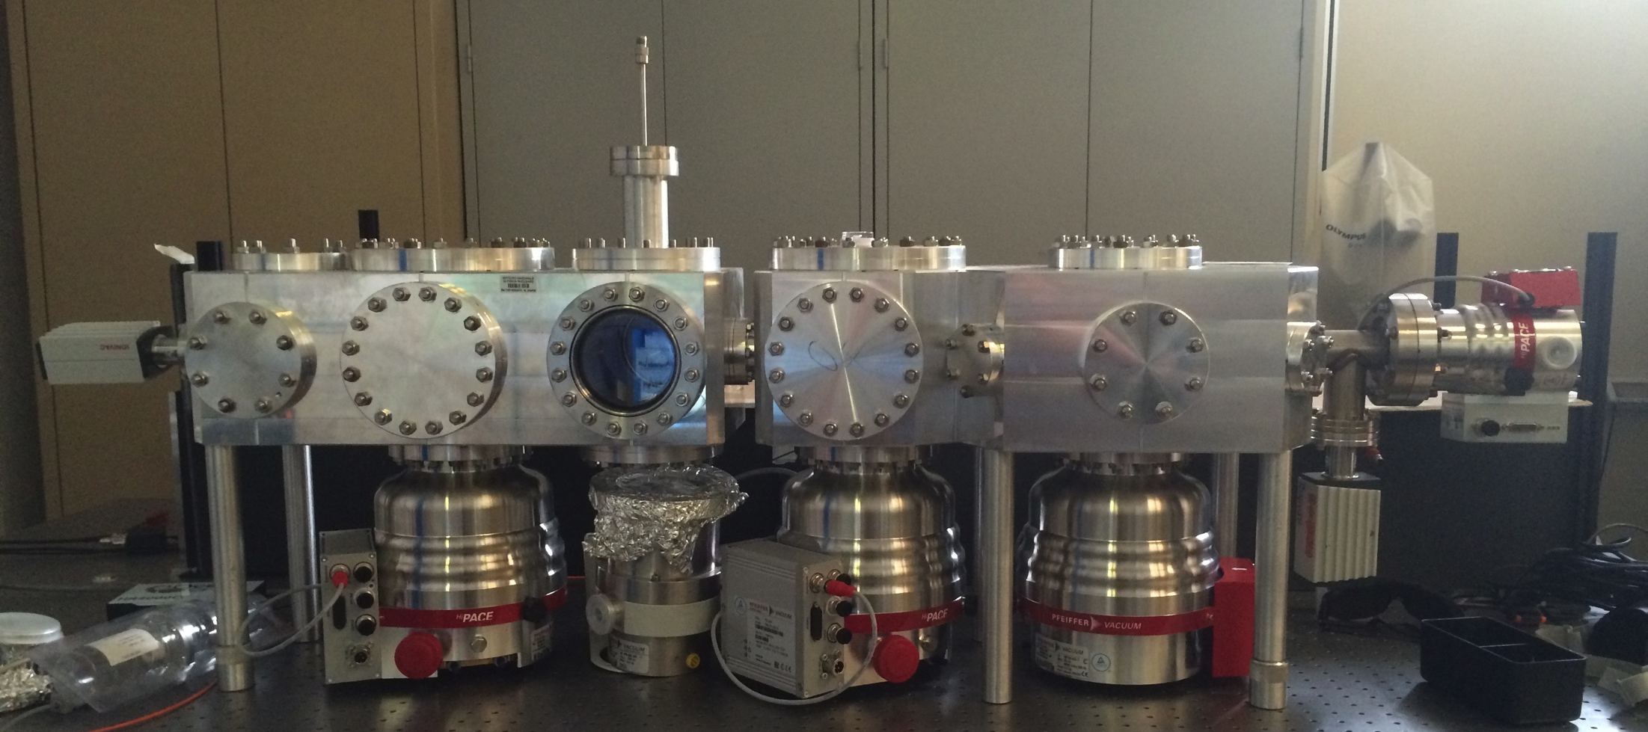
Plasma based acceleration
Diagnostics
PMQs
Plasma
PMQs
EOS
e⁻
The vacuum chamber has been designed to have the best vacuum performances, in order to guarantee the ultra-high vacuum level at the exit of the last accelerating structure (5*10⁻⁸ mbar).
Vacuum tests show that we can run the plasma at 5 Hz without problems (vacuum level 7*10⁻⁸ mbar). 1 Hz operation on the linac has been tested and worked well (no discharges in accelerating structures, no gas reached the electron gun!).

Slide 8
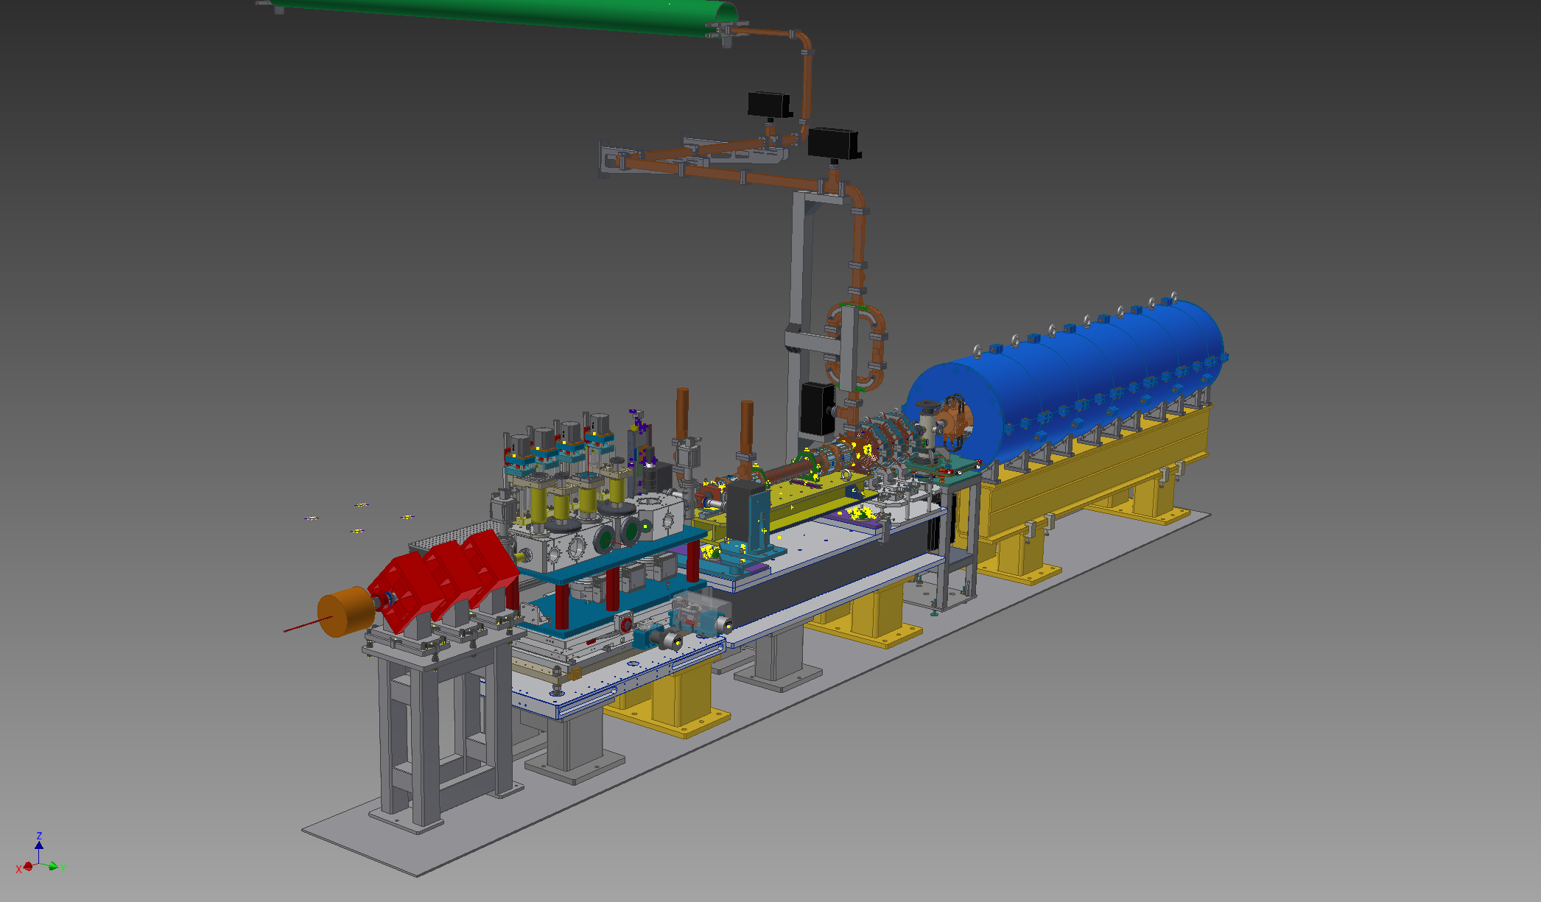
Plasma based acceleration
Final layout: 2 S-band cavities, 1 C-band cavity + 1 plasma stage.

Slide 9
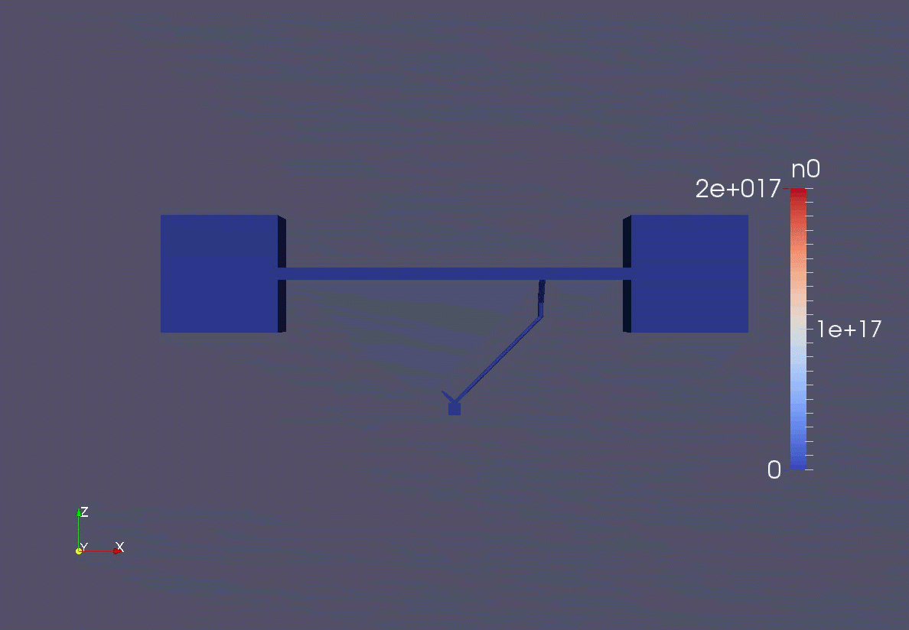
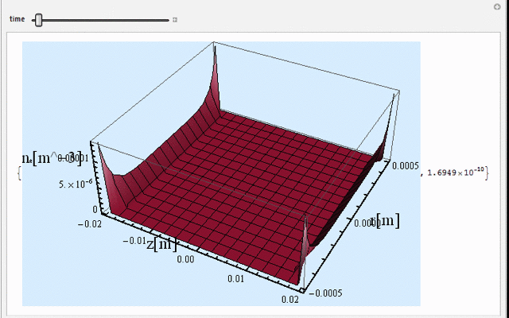
Plasma based acceleration
OpenFoam simulations for the gas (neutral particle) distribution inside the capillary. The 3D gas profile has then been then used to study ionization process.
Gas ionization has been fully studied and simulated using a 3D “home-made” code.
Using simulations, discharge unit has been designed, manufactured and tested, giving expected results.
M.P.Anania et al, NIMA, 740 (2013)

Slide 10
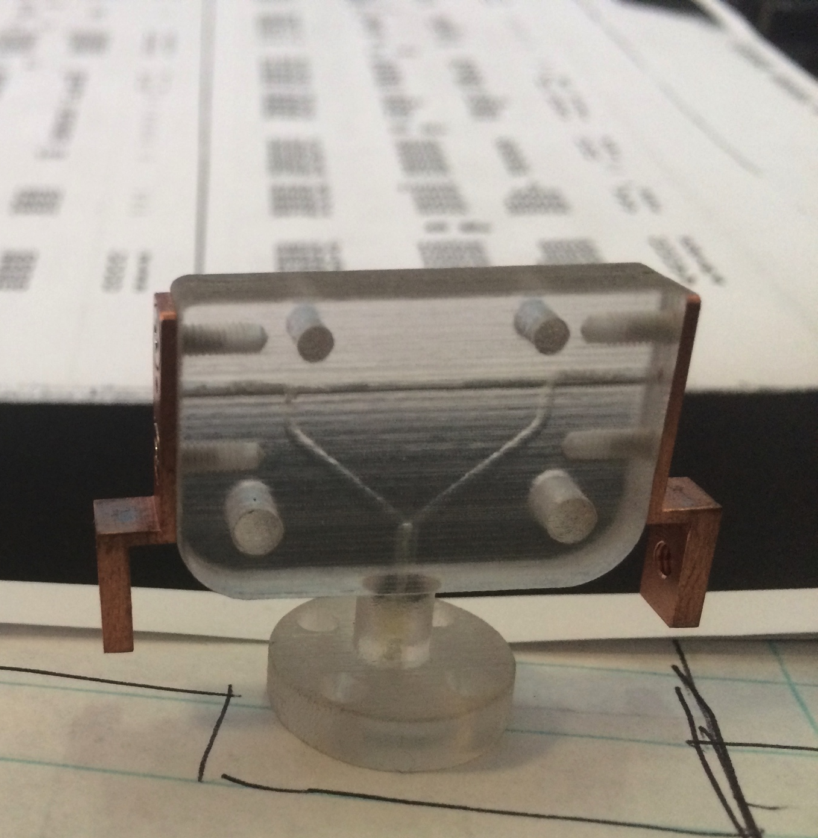
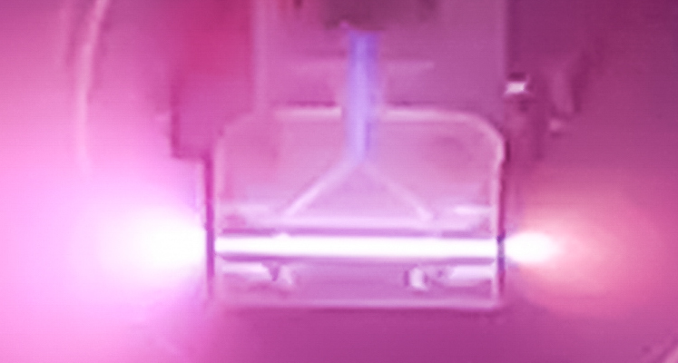
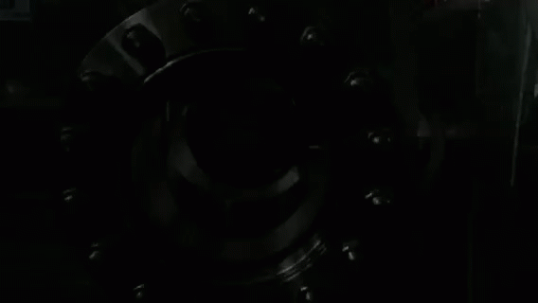
Plasma based acceleration
First plasma discharges.

Slide 11
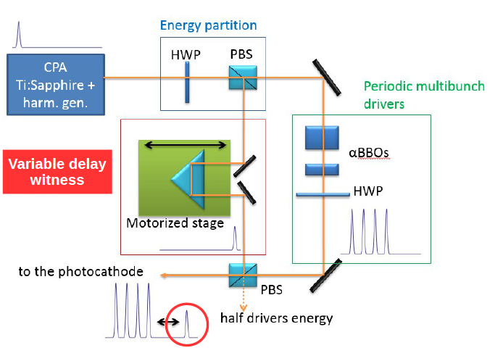
Plasma based acceleration
And from electron point of view…
F. Vialla et al, NIMA, 740 (2014)

Slide 12
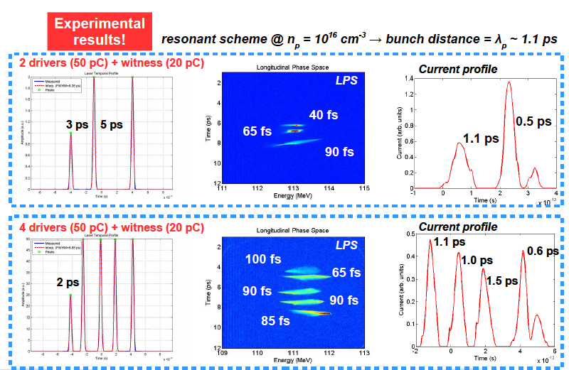
Plasma based acceleration
A. Cianchi et al, PRSTAB, 18, 082804 (2015)

Slide 13

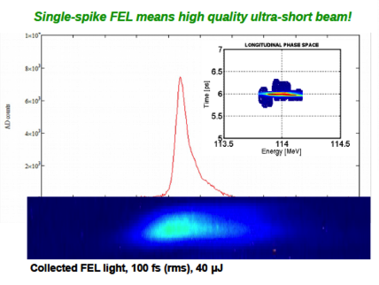
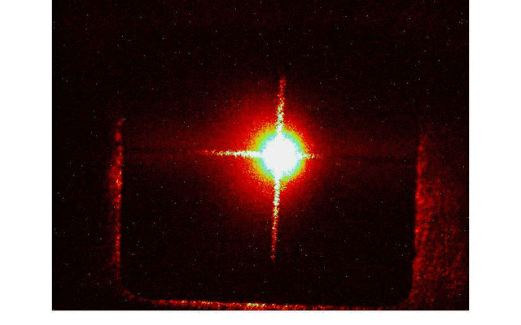
Plasma based acceleration
Electron bunches with properties similar to the one produced by plasma, have been sent into the SPARC FEL in the SASE regime and lasing has been observed.

Slide 14
The FLAME laser

Slide 15
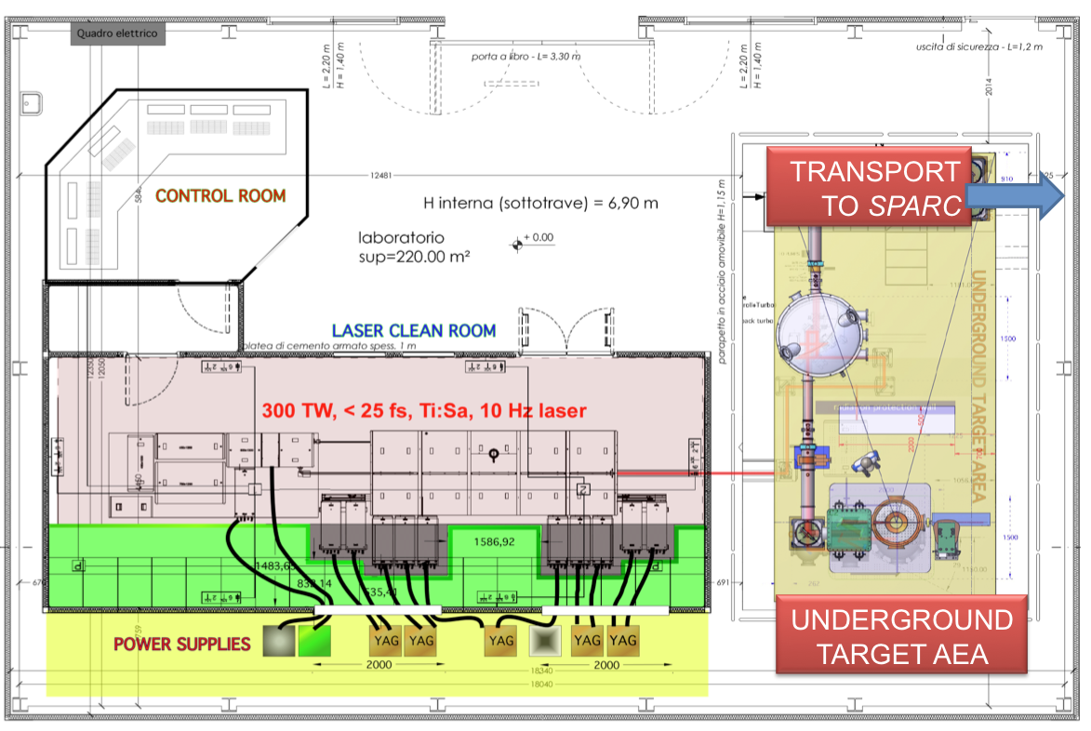
FLAME @ SPARC_LAB
Laser to SPARC
Compressor
Interaction
chamber
Booster
Amplifiers
Oscillator
Stretcher

Slide 16
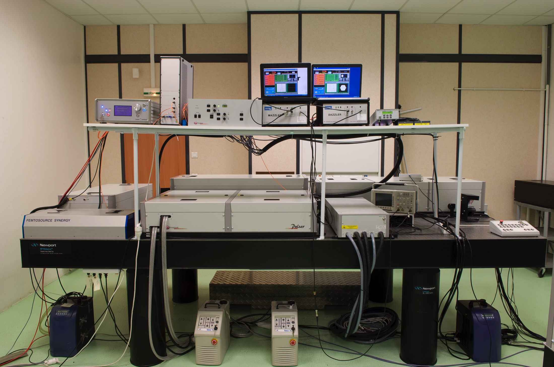
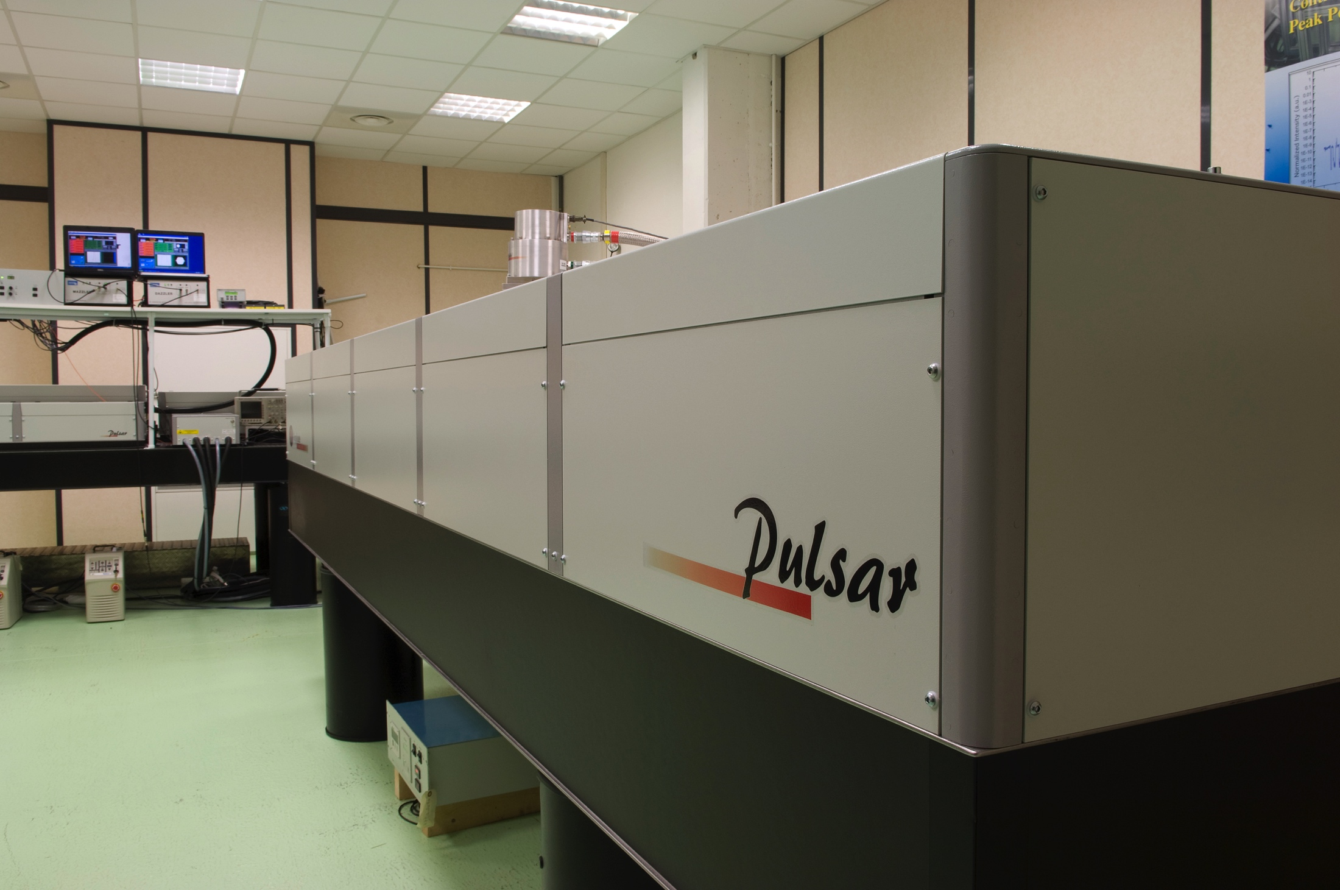
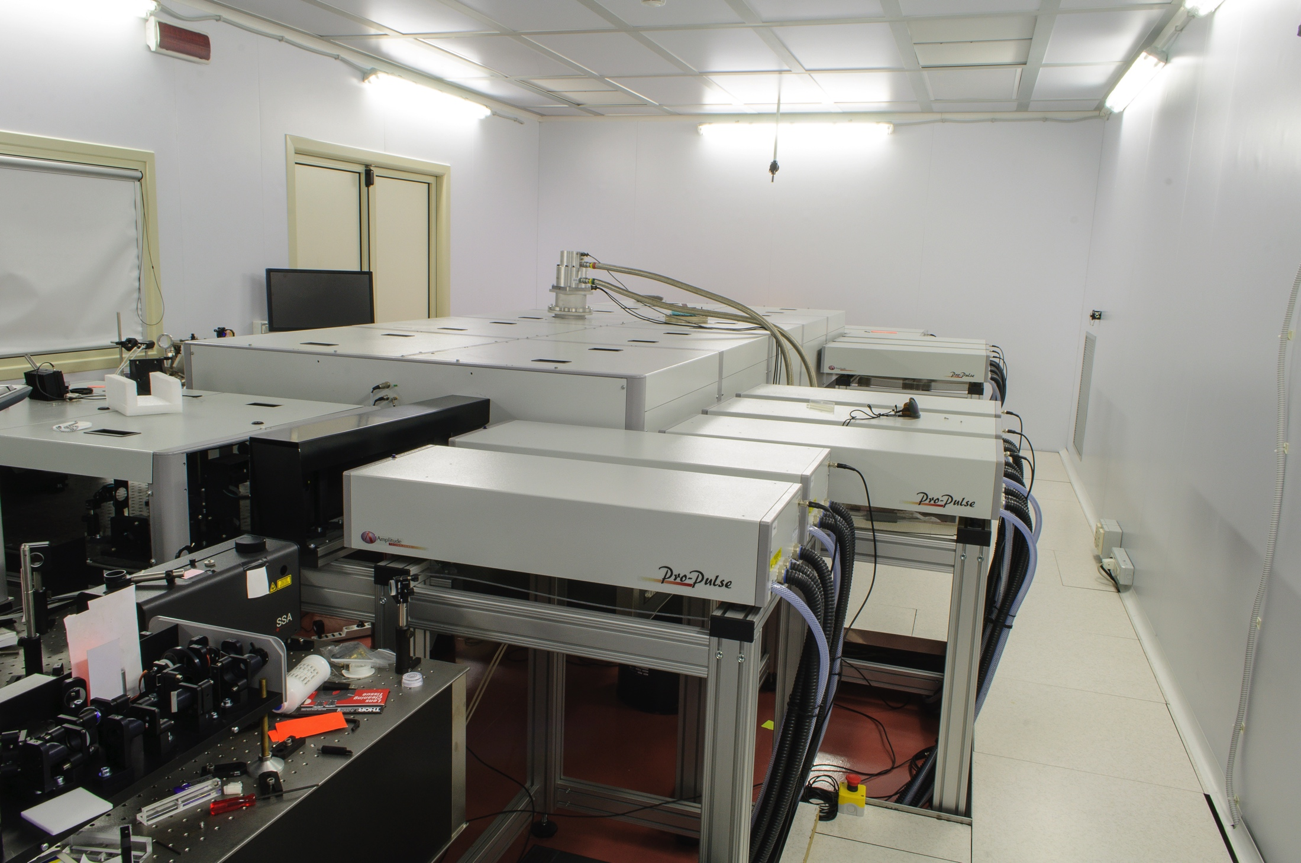
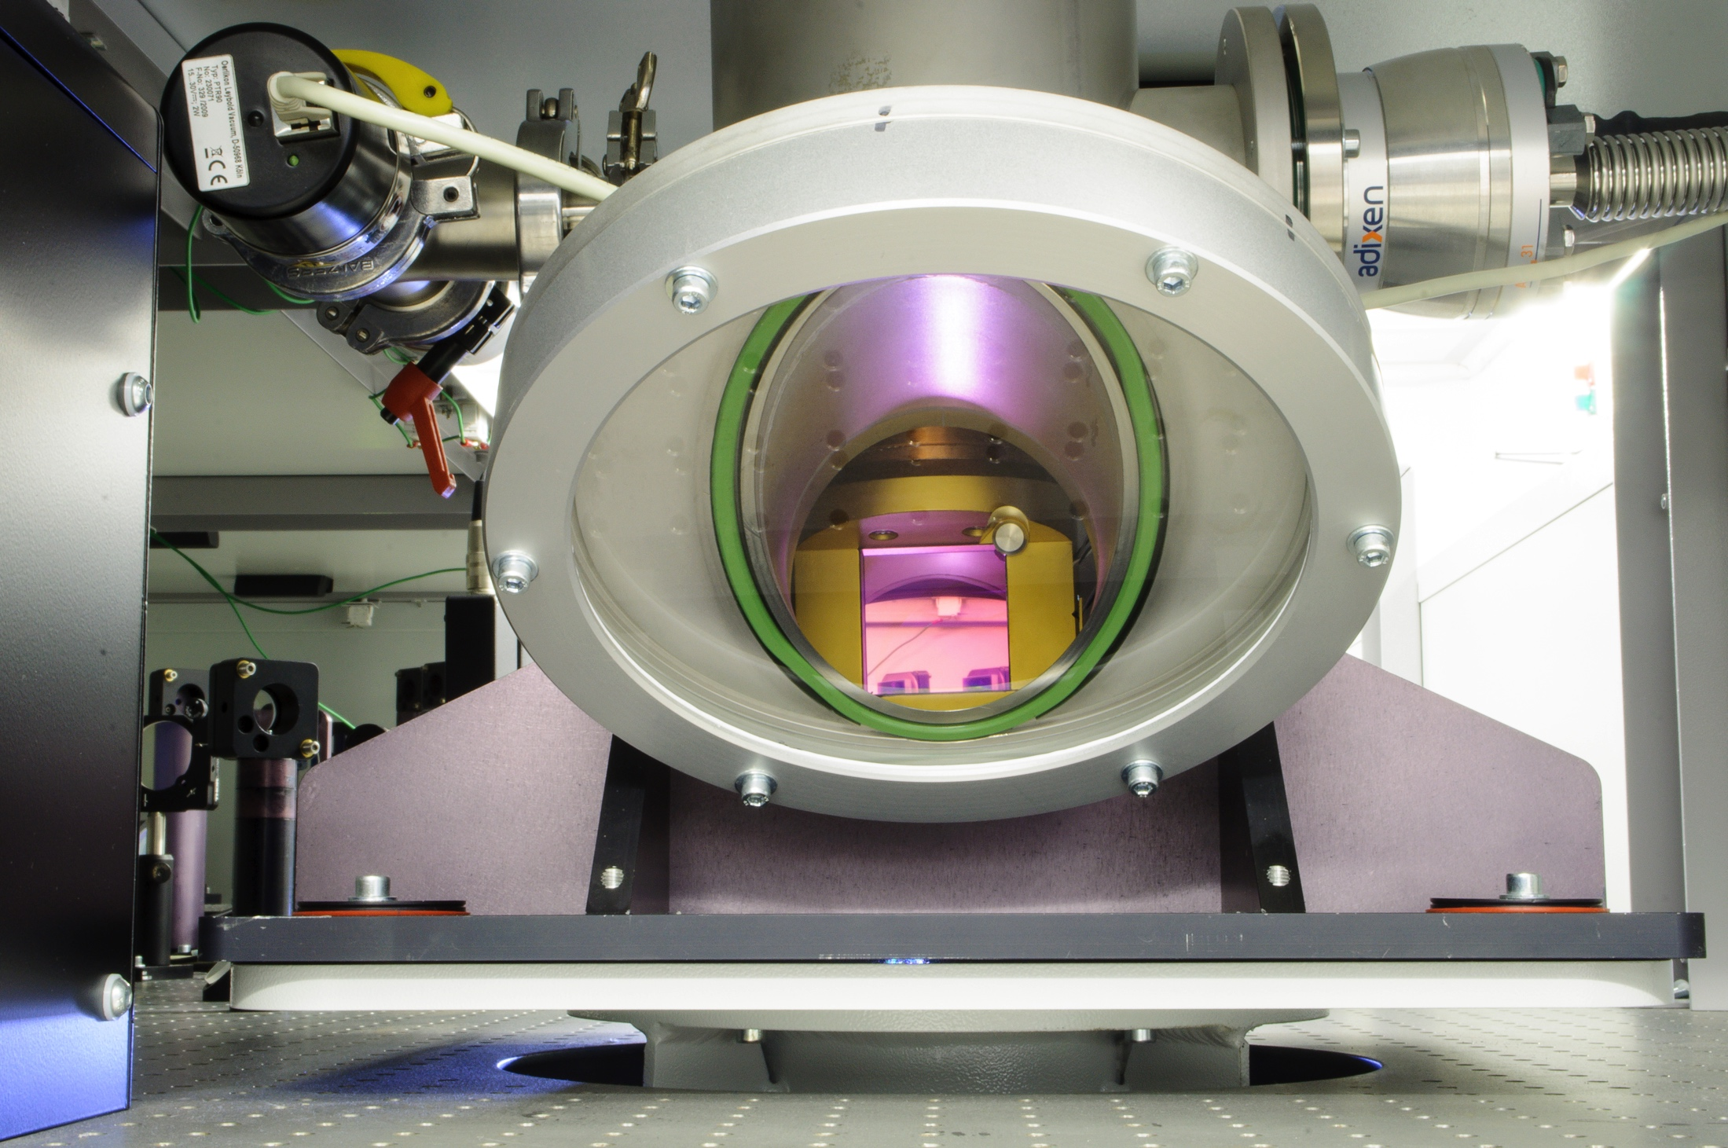
FLAME @ SPARC_LAB

Slide 17
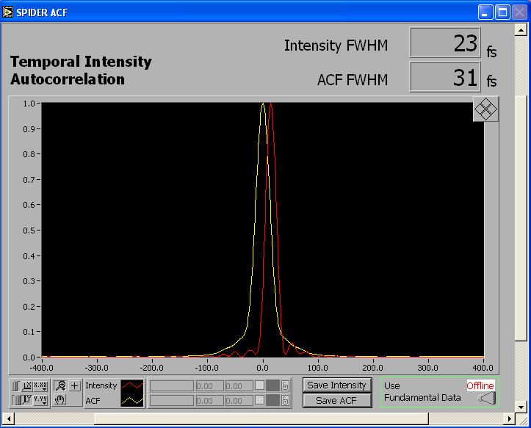
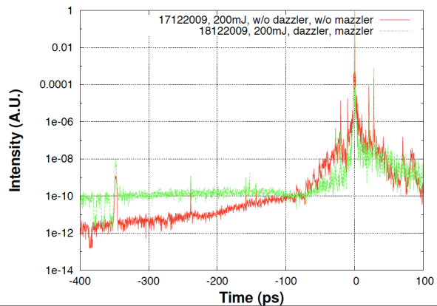
FLAME @ SPARC_LAB
BEST LASER PERFORMANCES:
Max energy before compression: 7J
Max energy on target: ̴ 5J
Min bunch duration: 23 fs
Wavelength: 800 nm
Bandwidth: 60/80 nm
Spot-size @ focus (1/e²): 20 µm
Max power: ̴ 300 TW
Contrast ratio: 10¹⁰

Slide 18
FLAME @ SPARC_LAB
Adaptive optics is placed in the compressor chamber, after compression.
20 μm
20 μm
Also energy in the
1/e2 focal spot energy is enhanced (from 40% up to 65%).

Slide 19
Experiments with only the FLAME laser

Slide 20
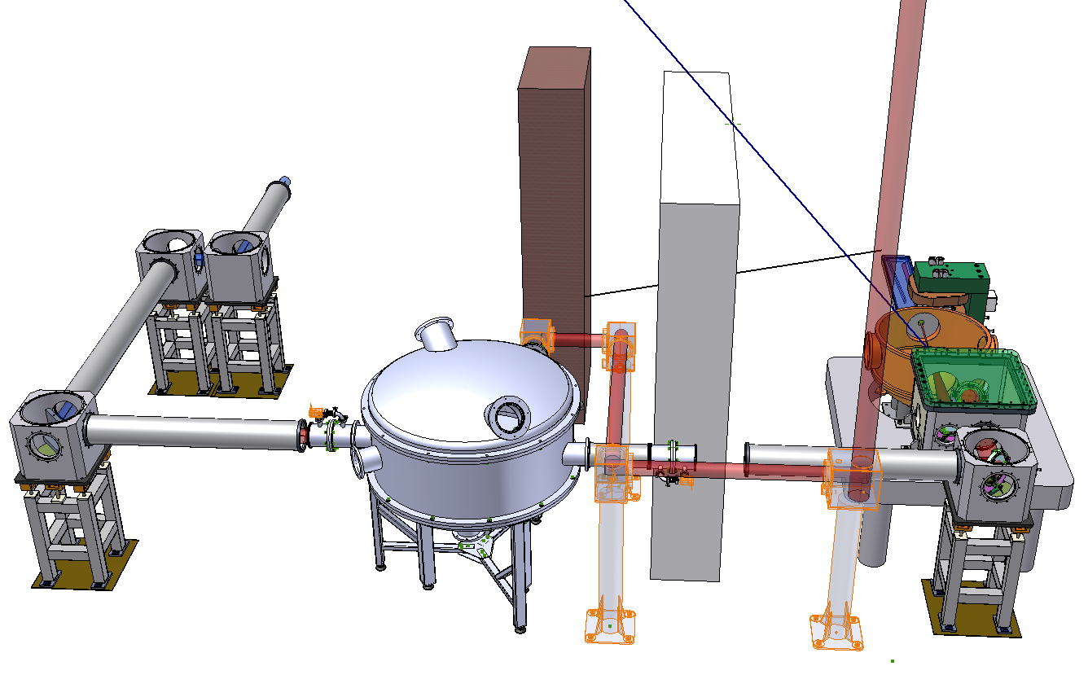
FLAME target area
Radiation protection wall
Beam transport to sparc bunker
Interaction
vacuum
chamber
Compressor
vacuum chamber
Main beam (>300 TW)
Vacuum transport line
Notes:
20

Slide 21
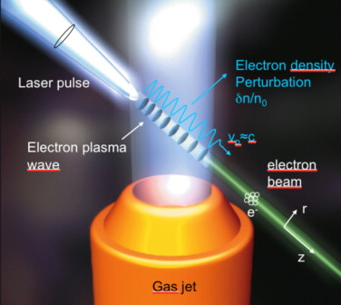
Self-injection
Laser wakefield accelerators (LWFA) are a novel type of accelerators capable to produce accelerating field up to 100 GV/m. This feature gives the possibility to have very compact accelerators able to accelerate electrons to GeV energies in few centimetres.
1 GeV in 1 cm
PROS:
Costs of the facilities;
Compactness: key-word is TABLE TOP!
CONS:
Instability of the electron bunches → necessary to study new accelerating structures to control the beam (PWFA?);
Quality of the electron bunched are not comparable to that of conventional accelerators → research undergoing.

Slide 22
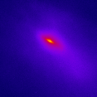
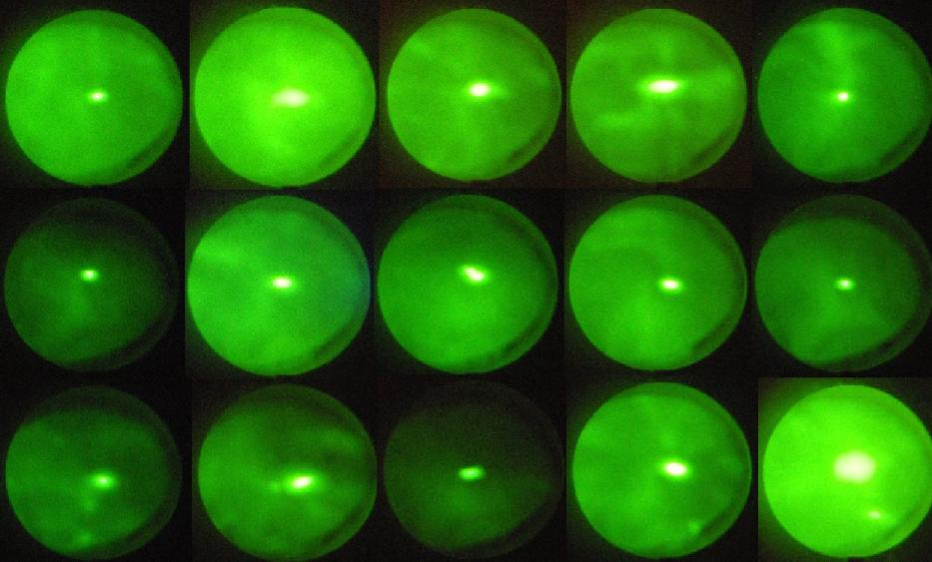
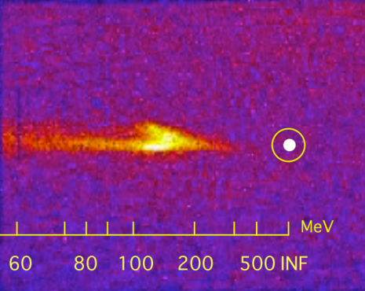
Self-injection experiments
Typical electron bunches accelerated by laser-plasma interaction observed @ SPARC.
40 mrad
Collimated and reprudicible electron bunches have been generated. 200 MeV energy electron bunches have been measured by using only 25% of the nominal laser power.
G. Grittani et al, SPIE proceeding, 740 (2013)

Slide 23
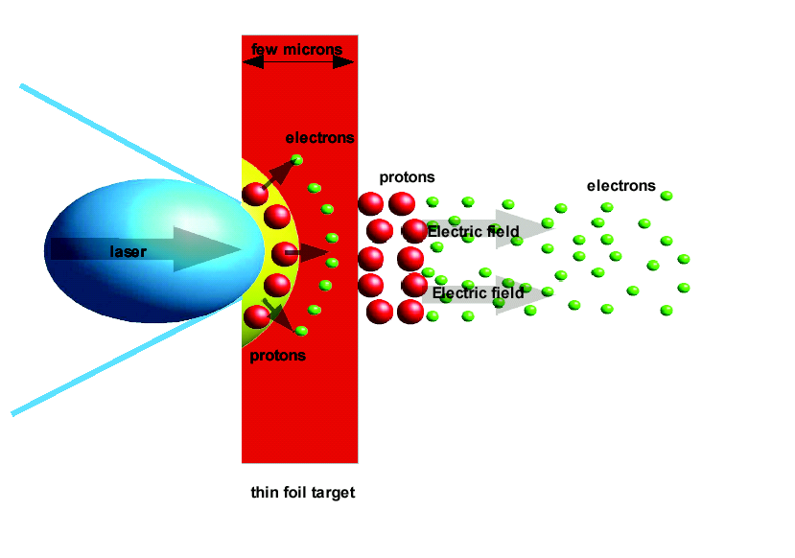
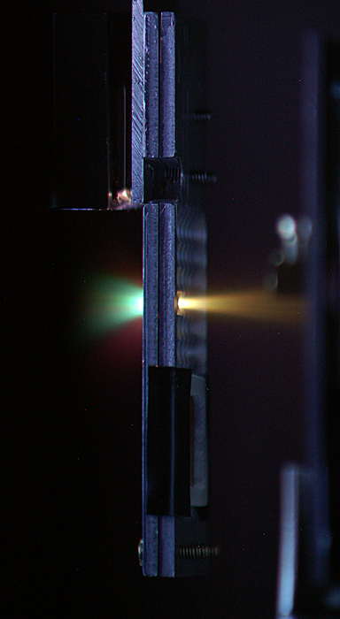
Proton acceleration
The proton acceleration purpose at SPARC is to accelerate light ions trough laser interaction with thin metal targets and obtain a beam suitable for injection in other accelerating structure.
The principle of work of proton acceleration by thin metal target (TNSA) is to focus a high intensity laser on a thin metal target in order to generate a plasma on the surface of the target. This process generates a burst of MeV fast electrons contained in the target (by the very strong electrostatic field generated by charge separation). These some field also act to accelerate protons at the target surface out into the vacuum.

Slide 24
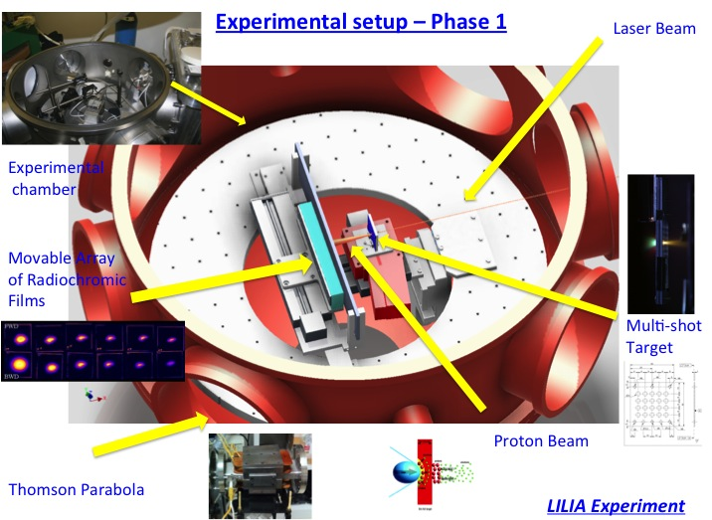
Proton acceleration experiments
Thin metal target
Stuck of CR39
or gafchromic films

Slide 25
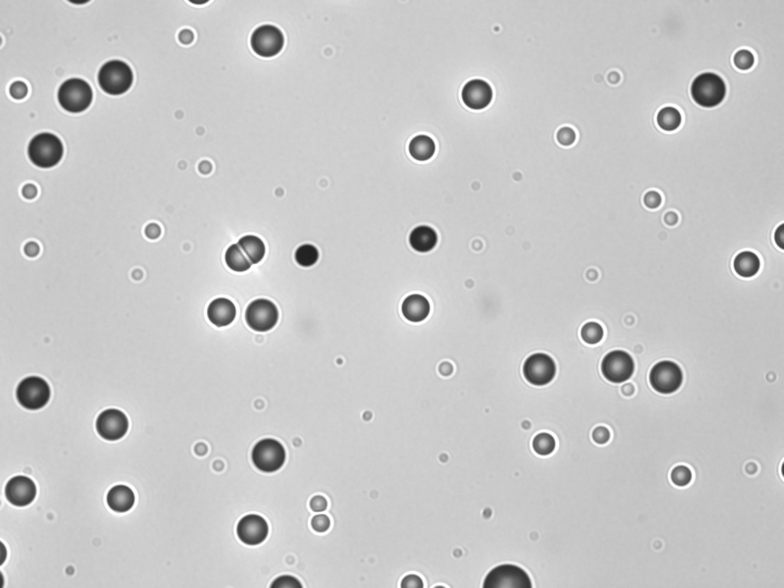
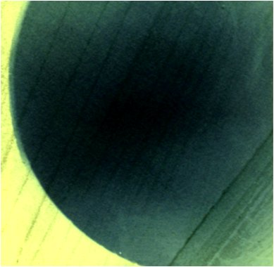
Proton acceleration experiments
CR-39 plastic polymer track detector
EBT3 gafchromic film detector
The estimated maximum energy of the accelerated protons is at least 1.6 MeV (with 1 J on target), measurement that is also confirmed from the analysis of the CR-39 detectors.
S. Agosteo et al, NIMB, Volume 331, 15 July 2014

Slide 26
Experiments coupling FLAME and SPARC

Slide 27
The FLAME laser into the SPARC bunker
Thomson beam-line
Laser FLAME
External injection

Slide 28
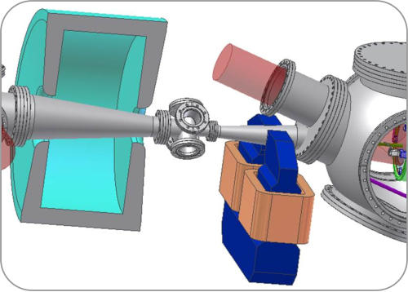
Thomson scattering @ SPARC_LAB
Thomson beam-line
Laser FLAME
Parabola’s chamber
Solenoid
Interaction chamber

Slide 29
Thomson scattering @ SPARC_LAB
Laser pulse
Relativistic electron
The laser acts as an undulator for the relativistic electron bunch.
Head-on collision → Radiation on axis.

Slide 30
Thomson scattering @ SPARC_LAB
Electron beam
Laser beam
Energy: 50.6±0.2 MeV
Energy spread: 0.39±0.025%
Emittance: 4.82 mm mrad
Charge: 200±20 pC
Duration: 3.1 ps
Spot-size: 89.1±2.6 µm in x
88.3±3.2 µm in y
Energy: 2 J on target
Spot-size: 20 µm
Duration: 300 fs / 3 ps
Wavelength: 800 nm
Bandwidth: 60 nm
Contrast: 10⁸

Slide 31
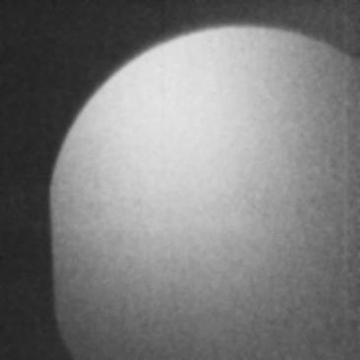
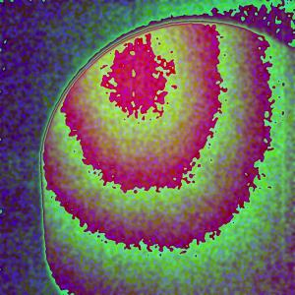
Thomson scattering @ SPARC_LAB
Image of the radiation taken with Hamamatsu imager Flat Panel C9728DK-10.
1s acquisition time.
C. Vaccarezza et al, Proceedings of IPAC (2014)

Slide 32
External injection
Laser FLAME
External injection

Slide 33
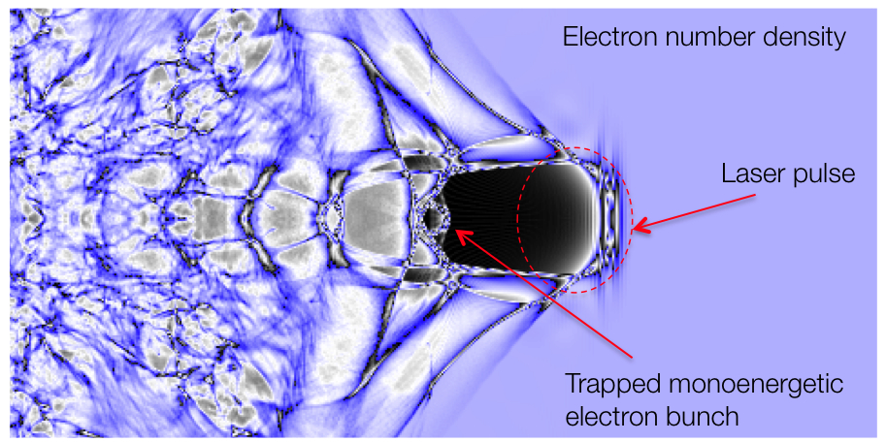
External injection
Electrons accelerated by the linac injected with the right phase on the creast of the wakefield to be further accelerated.
Expected electrons at the plasma exit with a higher energy and a quality comparable to that of incoming electron beam.

Slide 34
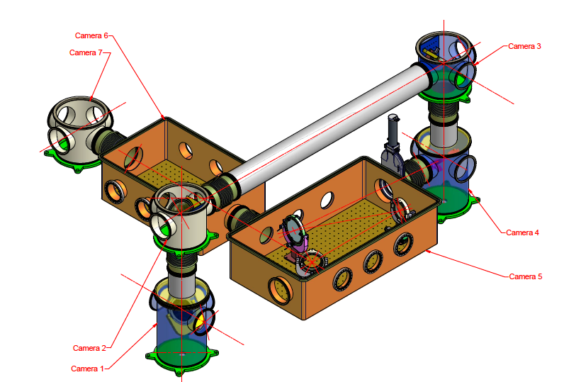
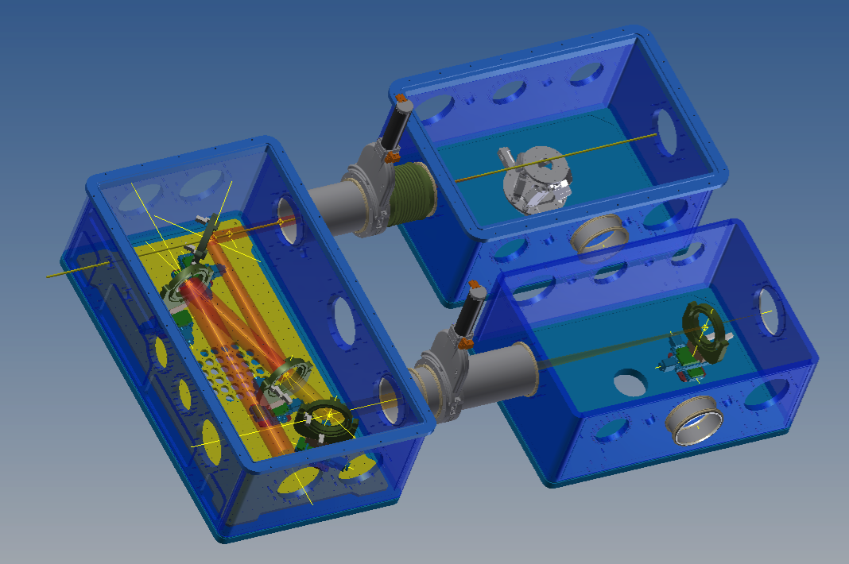
External injection
Design of the vacuum chamber for the laser transport.
1st chamber is for mirrors and 3 m focal length off-axis parabola,
2nd chamber is for interaction and 3rd chamber is for diagnostics.
2
Movements of the capillary (filled with H2) will be made with hexapod.
Synchronization: needs to be at the fs level.
e⁻
1
3

Slide 35
Summary
SPARC_LAB: multi-disciplinary test facility which have the unique possibility to have the combination of a high power laser and a high brightness Linac.
PWFA: the resonant plasma wakefield acceleration scheme will soon be tested at SPARC with the hope to be able to produce a very high quality electron beam, which can then be used as a radiation source.
FLAME: gives the possibility to explore novel type of accelerators, both for electrons and light ions.
FLAME + SPARC: Thomson source is working and is capable to produce stable and high energy X-rays (up to ̴ 1MeV with both FLAME and SPARC at full performances).
FLAME + SPARC: external injection is a promising way to further accelerate electrons to higher energy in a centimetre scale and can, in the future, lead to a new way to accelerate electrons while maintaining the electron beam quality.

Slide 36
Thank you!

Slide 37
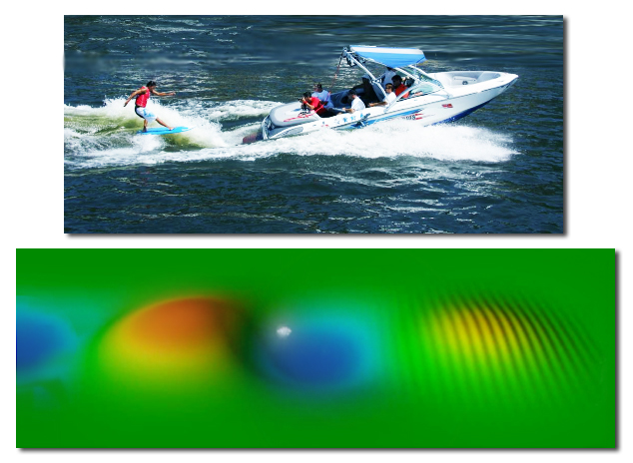
Self-injection
The principle of work is very simple: the transit of the light through the plasma generate a plasma wave like a boat generate a wave passing through the sea.
Electrons can “surf” the plasma wave as a surfer on the sea, gaining energy from the wave and be accelerated.
sea
boat
surfer

Slide 38
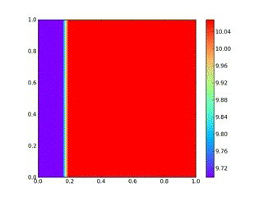
Self-injection
Self-injection technique has been studied and simulated using 3D code with GPUs.
Because electrons are much lighter than ions, they move faster, inducing charge separation.
While the laser moves forward, electrons are pushed backward through the centre of the positively charged bubble created by the ions.
By entering the positively charged region, the electrons gain velocity and therefore they will be accelerated.

Slide 39
Laser propagation in air
High-power systems are commonly used in atmospheric research (LIDAR – Light Detection and Ranging) for measuring many atmospheric parameters: the height, layering and densities of clouds, cloud particle properties, temperature, pressure, wind, humidity, trace gas concentration, etc.
High power lasers propagated in air give rise to multiple plasma lines (filaments which are due to Kerr lens effects) and can propagate in atmosphere up to a few hundreds of meters by controlling the chirp and the duration of the laser beam.
By analyzing the light emitted by the plasma filaments, different species can be detected and analyzed, i.e., industrial incidents, leakages, fires, as well as unknown aerosols, since it does not require any priori knowledge of the species present in air.

Slide 40
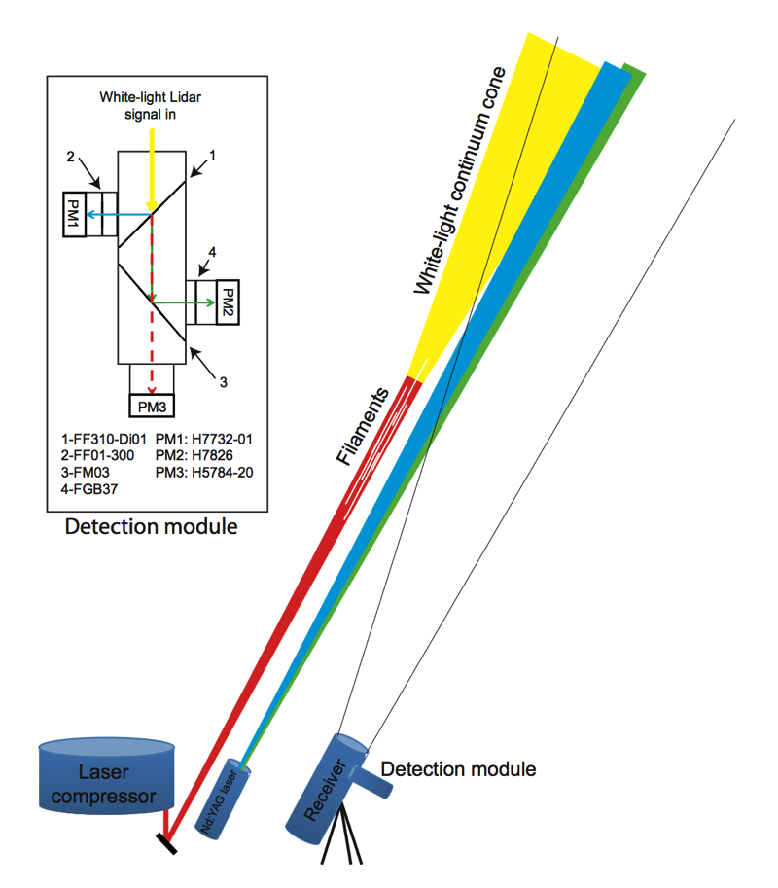
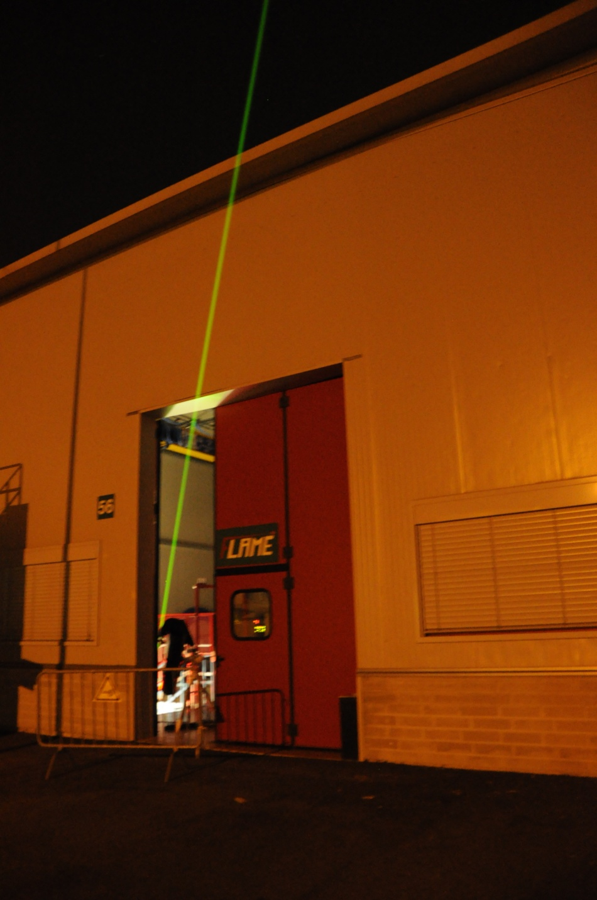
Laser propagation in air

Slide 41
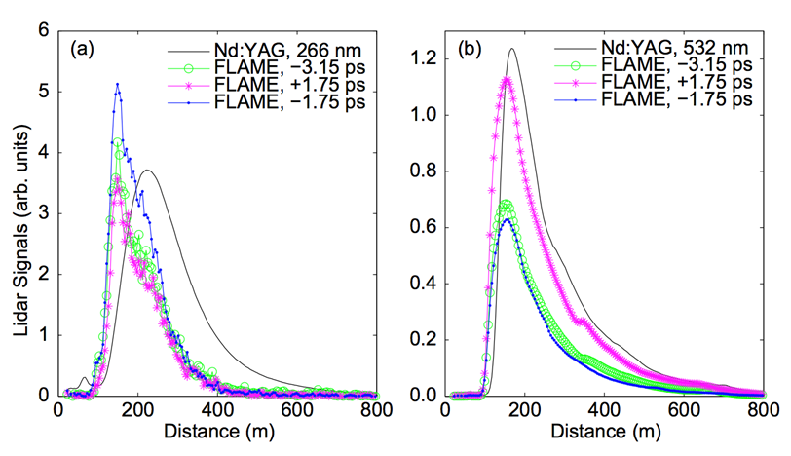
Laser propagation in air
Backscattering light (LIDAR signal) from the plasma filaments.
Backscattered signal from LIDAR has been used to detect the maximum length of propagation of the filaments at different laser parameters.
M. Petrarca et al., Appl. Phys. B, 114, pp 319-325 (2014)

