Slide 1
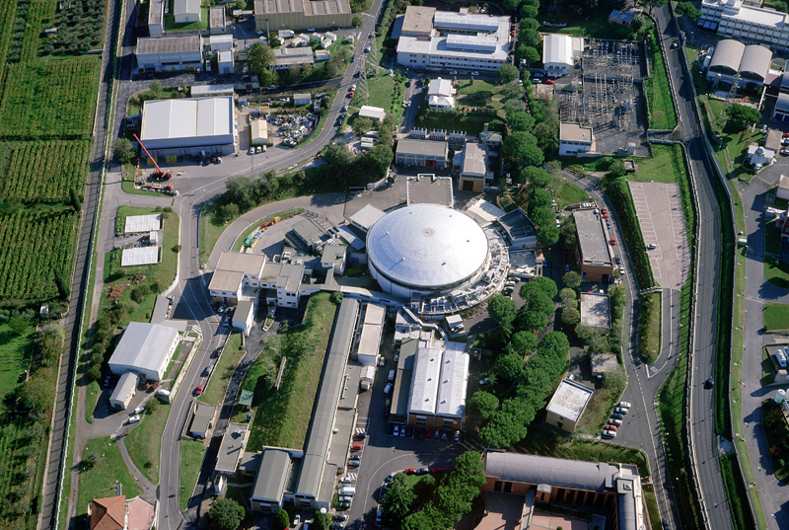
The Laboratori Nazionali di Frascati
of the
Istituto Nazionale di Fisica Nucleare

Slide 2
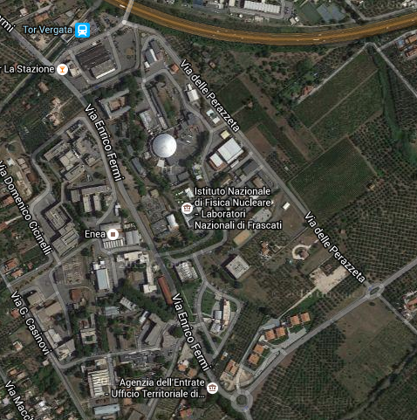
The Laboratori Nazionali di Frascati
of the
Istituto Nazionale di Fisica Nucleare

Slide 3
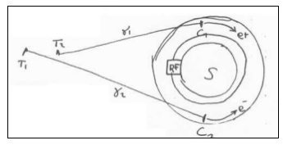
Frascati: a 61 year-long history
Birth of INFN
1954 Construction of Laboratori Nazionali di Frascati
1959 Contruction of Synchrotron
Construction of AdA (first e+e- collider, conceived by B. Touschek)
1969 ADONE (e+e- 3 GeV) starting operations
J/Psi discovery (soon after SLAC and BNL)
ADONE shutdown – Start DAFNE construction (e+e-, 1 GeV)
DAFNE starting operations
2003 SPARC facility project (FEL+gamma source+plasma acceleration)

Slide 4
Frascati Lab is the largest and the oldest of INFN infrastructures
Personnel ~370 people (1/3 scientists) + 500 users
Its main mission: accelerators for High Energy Physics (and not only)
Main competences in e+e-
Capabilities in designing, building and operate relatively large complex
Accelerator Division (~100 people, 1/3 scientists) Technical Division (~30 people)
Current main activities:
Operation 24/24 of DAFNE collider (up to 2018)
Design and installation of ELI-NP facility in Romania (20 MeV gamma source)
R&D on plasma acceleration, 0.2 PW laser facility, FEL, THz sources (SPARC_LAB)
Several other international collaborations:
CERN, Grenoble, KEK (Japan)
Beam Test Facility also available (DAFNE Linac can be used parasythically)
Soft-X, UV, and infrared lines available around DAFNE ring (DAFNE_Light)

Slide 5
Strong activities in Fundamental Research
Large Research Division (~140 people, 1/3 scientists)
Engaged in experiments at DAFNE complex:
KLOE2 (CPT and hadron physics), Siddharta2 (physics of strangeness),
PADME (search for dark matter)
and at outside labs, in particle, nuclear and astro-physics
CERN: LHC (ALICE, ATLAS, CMS, LHCb), SPS (NA62)
Fermilab, Jefferson Lab, China, etc …
A lot of technological R&D activities:
SCF_Lab (space ranging characterization), New Materials Lab,
X-ray Lab, Neutron Lab, Cultural heritage, Radiprotection, etc…
+ 400 m2 clean rooms + mechanical/electronics workshops
+ irradiation facilities + computing (LHC Tier2)
Long standing tradition in the construction of large detectors
Currently, strong engagement in GEM and micro-pattern detectors and in x-stals
Frascati is also hosting a long list of EU-funded projects

Slide 6
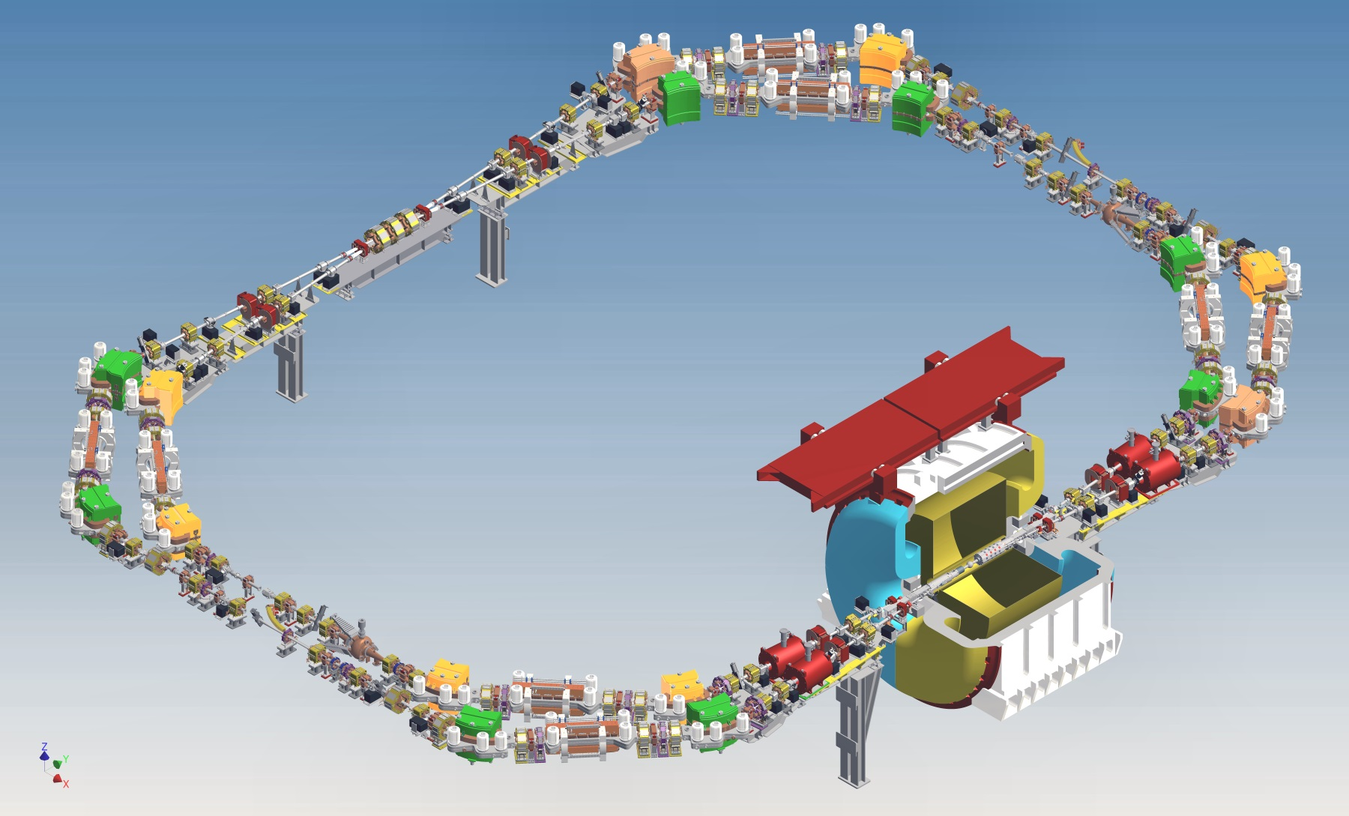
DAFNE and KLOE-2
Colliding beams have:
  low E
  high currents
  long damping time
E_{CM} = 1020 MeV
Crab-Waist collision scheme implemented for the first time with a large detector including a strong solenoidal field
Luminosity achieved at DAFNE is 2 order of magnitude higher than the best measured in colliders working at the same E

Slide 7
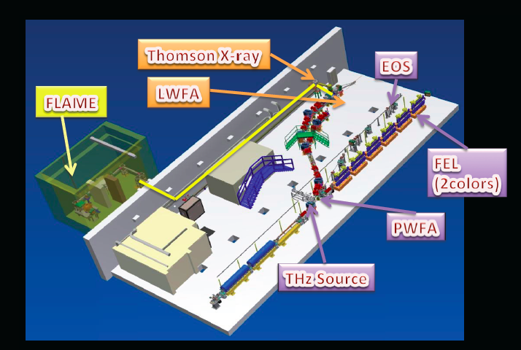
SPARC_LAB facility
0.3 TW laser
Plasma acceleration
studies: LWFA/PWFA

Slide 8
Conclusion
The Frascati Laboratory is a medium size infrastructure with strong capabilities in accelerator science, able to design, build and operate relatively large facilities
Competences cover all aspects of machine problematics (vacuum, RF, feedback, machine physics, cryogenics, controls, electronics, power, cooling, etc…), together with a strong technical support for the running of the machine
We have a variety of facilities for testing purposes, spanning over many wavelengths
Strong imprinting on fundamental research but expanding on interdisciplinary areas
Proximity to the largest research infrastructure area in Italy:
(ASI, ESA, ENEA, CNR, Tor Vergata University) active over a very wide spectrum of lines
Open to collaborations and new ideas

