Slide 1



The Status of
Marcello A. Giorgi
Università di Pisa & INFN Pisa
Perugia General Meeting
June 9, 2009
Notes:
1
1

Slide 2
Outline after Orsay Meeting
TOWARDS END ’09 DOCUMENT and TDR
Physics
Progress in understanding the High Luminosity machine
  Machine Baseline
  MiniMac
  Site discussion
  Parameter optimization
Detector Organization
About the process: a touch of History
  Report from ECFA to CERN Council
  INFN formal start up of TDR Phase
Organizing the TDR effort.
Next steps.

Slide 3
Super Flavour Physics
GOAL:
NEW PHYSICS beyond SM
Measurements in:
beauty , charm, tau
CPV asymmetries, FCNC loops, LFV,
Tau mag.moment, EDM

Slide 4

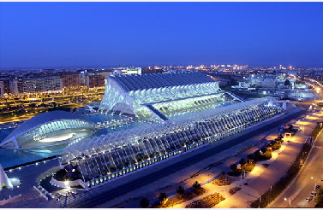



Physics activity
Physics goals have been discussed inside the SuperB community in the CDR published in May 2007 and in the proceedings of the Valencia SuperB Workshop in 2008 .It was reviewed in April 2008 by the IRC appointed by the President of INFN.
Activity in 2009, preliminary document with “realistic” sensitivities ready by the end of 2009
Workshop on New Physics with SuperB
14th-17th April 2009

Slide 5
Requirements to the physics goal
(NOT ONLY LUMINOSITY!)
L_{peak}≥10³⁶ cm⁻²s⁻¹ ( asymmetric 7.0+4.0 GeV E_{cm}= m_{Y(4s)}).
85% Polarization di e⁻ (7.0GeV) for τ :
Asymmetry from T and CP Violation
BKG reduction in LFV, distinguish among LFV models.
B-F asymmetry contribution for τ g-2.
Option to run SuperB still with a luminosity of 10³⁵ cm⁻²s⁻¹ at charm threshold (4 .0 GeV ) . Pure DD_{bar}, no additional fragmentation.
High signal/bkg : optimal for channels with
Quantum Coherence: unique opportunity to measure D⁰-D⁰_{bar}relative phase.
~10⁹ DD /month at 10³⁵ cm⁻²s⁻¹ . (using
σ(e⁺e⁻→D⁰D⁰)~3.6 nb + σ(e⁺e⁻→D⁺D⁻)~2.8 nb ~ 6.4 nb as measured by CLEO-C)
Time dependent measurements at 4 GeV as for B sector at Y(4s) in BABAR and Belle. I will be only possible at SuperB.
In TDR these topics should be better addressed.

Slide 6
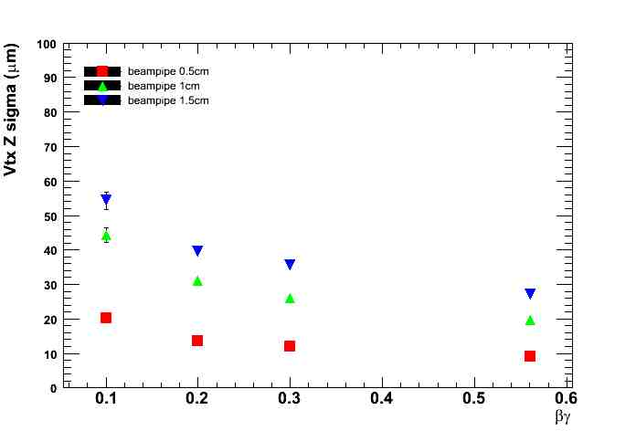

Time dependent measurements at DD threshold:
only possible at SuperB
Proper time resolution dominated by decay vertex resolution.
  Production vertex precisely determined thanks to nm beamspot dimensions
With SuperB lumi at 4 GeV = 10³⁵ cm⁻²s⁻¹
expected ~10⁹ DD per month
SuperB nominal boost
βγct = 0.28 × 120 μm ~ 30μm
Average flight distance similar to vertex resolution → σ_{t}~τ
βγ

Slide 7
Summary of Physics Goals
Increase by O(10) the precision of BaBar &Belle (*)
Challenge CKM at the level of 1% (*)
τ LFV sensitivity improvement by a factor between 10 and 100.
Explore T-violation in τ .
Search for magnetic structure of τ .
Explore CPV in Charm.
Great new Spectroscopy exploration.
Beam Polarization option and possibility to run at charm threshold
It can be allowed with 75 ab⁻¹ in 5 years at Y(4s) and a few months at Charm threshold with peak lumi of 10 ³⁵ cm² s⁻¹.

Slide 8
MACHINE progress and design as reviewed by MiniMac

Slide 9
PARAMETER REQUIREMENTS FROM PHYSICS
Parameter | Requirement | Comment
Luminosity (top-up mode) | 10³⁶ cm⁻²s⁻¹ @ Υ(4S)
Integrated luminosity | 75 ab⁻¹ | Based on a “New Snowmass Year” of 1.5 x 10⁷ seconds (PEP-II experience-based)
CM energy range | t threshold to Υ (5S)
Minimum boost | βγ = 0.28 (4x7 GeV) | 1 cm beampipe radius. First measurement at 1.5 cm
e⁻ Polarization | 60-85% | Enables t CP and T violation studies, measurement of t g-2 and improves sensitivity to lepton flavor-violating decays. Detailed simulation, needed to ascertain a more precise requirement, are in progress.

Slide 10
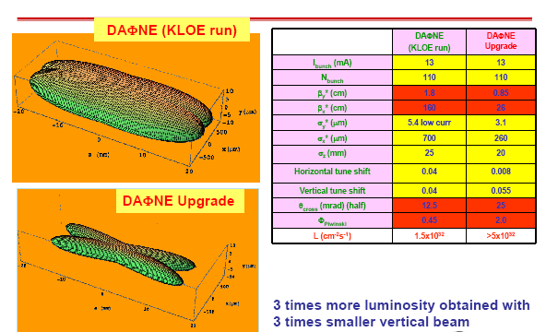
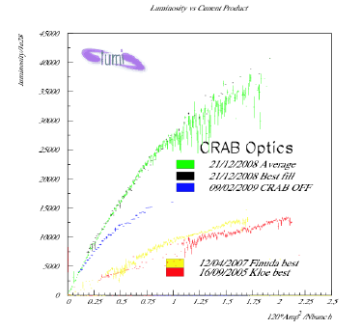
Great success of “CRAB WAIST “ test at LNF.

Slide 11
Crab Waist test was successful
DaΦne test in Frascati very successful, the luminosity has grown by more than a factor 3 as expected from simulations.
All the results agree with beam beam simulations, now also with strong-strong.

Slide 12
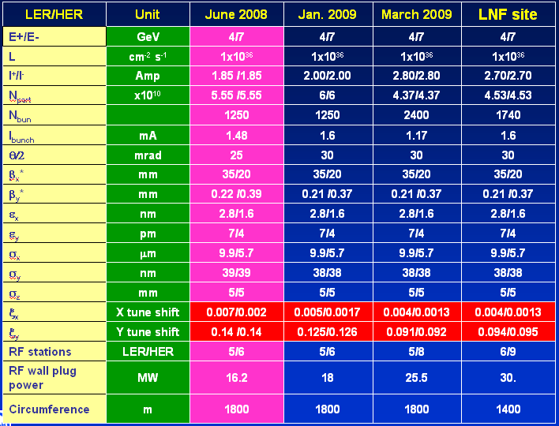
PARAMETERS J.Seeman @MiniMac

Slide 13
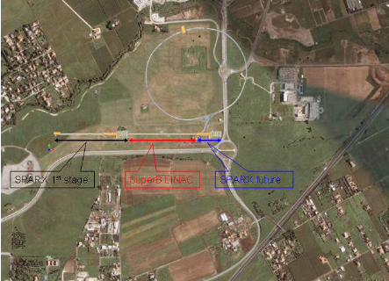
SITES : Tor Vergata……..

Slide 14
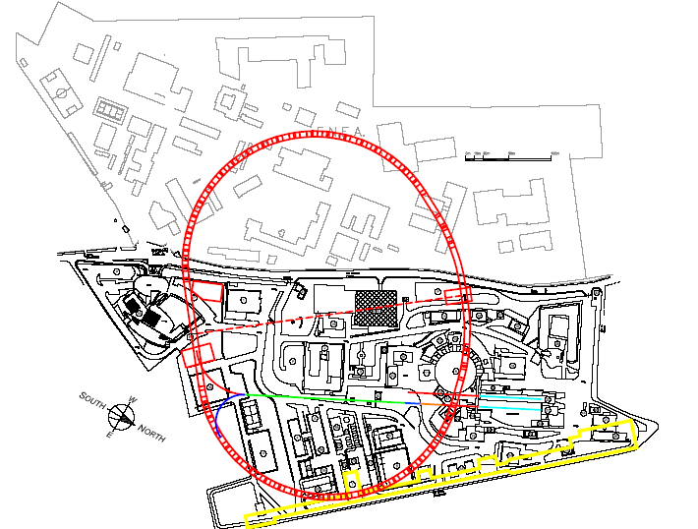
LNF option

Slide 15
From J. Dorfan report of MINI MAC April 24,2009
…. “Mini-MAC now feels secure in enthusiastically encouraging the SuperB design team to proceed to the TDR phase, with confidence that the design parameters are achievable”
Machine is possible!
The 2 rings can be built largely with the components of PEPII:
Magnets and RF stations.

Slide 16
About Detector

Slide 17
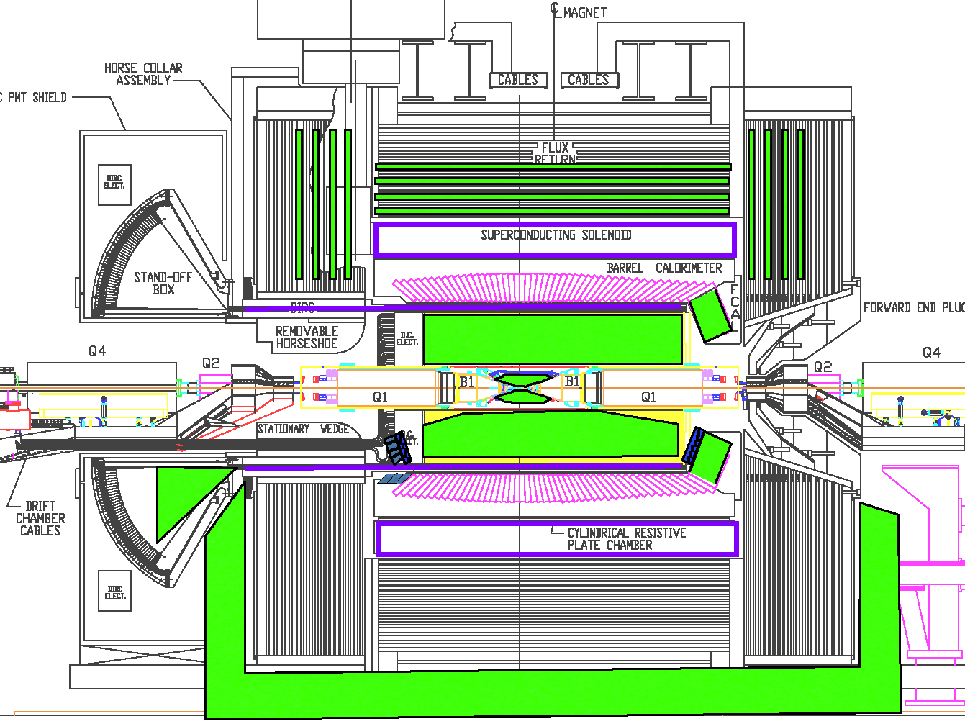
Detector Layout – Reuse parts of Babar
BASELINE
OPTION
28 Nov,2008
Marcello A.Giorgi
17
Notes:
17

Slide 18
Detector Evolution-B Factory(BABAR) to
CDR Baseline based on BaBar. It reuses
  Fused Silica bars of the DIRC
  DIRC & DCH Support
  Barrel EMC CsI(Tl) crystals and mechanical structure
  Superconducting coil & flux return (with some redesign).
Some elements have aged and need replacement. Others require moderate improvements to cope with the high luminosity environment, the smaller boost (4x7 GeV), and the high DAQ rates.
  Small beam pipe technology
  Thin silicon pixel detector for first layer, and a new 5 layer SVT.
  New DCH with CF mechanical structure, modified gas and cell size
  New Photon detection for DIRC fused silica bars
  Possible Forward PID system (TOF in Baseline option)
  New Forward calorimeter crystals (LYSO).Backward veto
  Minos-style extruded scintillator for instrumented flux return
  Electronics and trigger- x100 real event rate
  Computing- to handle massive date volume

Slide 19
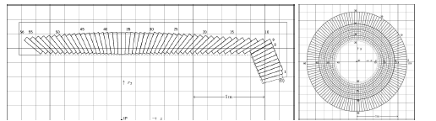
Detector Issues:
SVT
20 cm
Layer0
30 cm
40 cm
Smaller machine asymmetry
➔ Need a new SVT (very similar to that of the 5 layer BaBar SVT) supplemented by a new layer 0 to measure the first hit as close as possible to the production vertex. Goal is coverage to 300 mrad both forward and backward.
Beam pipe radius and thickness are crucial to obtain adequate resolution in vertex separation.
Options:MAPS, Hybrid Pixels, Striplets (the latter is difficult due to the expected Bhabha occupancy)
Forward EMC
Forward Endcap EMC
  Inner BaBar Crystals are radiation damaged. Need replacement.
  At forward angles in SuperB, CsI(Tl) is too slow (occupancy) and radiation soft.
  Propose LYSO.

Slide 20
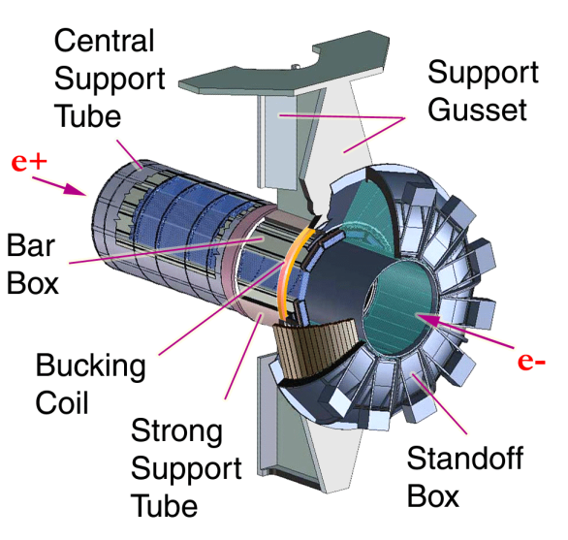
PID
Baseline is to reuse BaBar DIRC barrel-only design.
  Excellent performance to 4 GeV/c.
  Robust operation.
  Elegant mechanical support.
  Photon detectors outside field region.
  Radiation hard fused silica radiators.
  But...PMTs are slow and aging. Need replacement. Large SOB region senstive to backgrounds so volume reduction is desirable.
Photon detector replacement
  Baseline... Use pixelated fast PMTs with a smaller SOB to improve background performance by ~x50-100 with ~ identical PID performance.
  Several other photon detector options are considered in the CDR.
OPTIONS for the Forward PID
Modest solid angle but event acceptance for “veto physics” or decays with multiple particles (e.g., B➔ K_{s}KK) scale much faster than linearly. Physics case needs to be established.
Not just a PID problem. Overall detector optimization required.
  Adds material before EMC.
  Takes space from tracking or EMC.
Aerogel RICH and Very Fast Cherenkov-based TOF seem plausible.
  Space requirements.
  Fast tubes have substantial material. SiPMs are noisy and neutron sensitive.
  R&D underway

Slide 21
Detector Technical Board
Detector Coordinators – B.Ratcliff, F. Forti
Technical Coordinator – W.Wisnieswki
SVT – G. Rizzo
DCH – G. Finocchiaro
PID – N.Arnaud, J.Va’vra
EMC – D.Hitlin → C.Cecchi, F.Porter
IFR – R.Calabrese
Magnet – W.Wisniewski
Electronics, Trigger, DAQ – D. Breton, U. Marconi
Online/DAQ –
Offline SW –
  Simulation coordinator – D.Brown
  Fast simulation – M. Rama
  Full Simulation – F. Bianchi
Rad monitor –
Lumi monitor –
Background simulation & Machine Detector Interface –– M.Boscolo, E.Paoloni +M.Sullivan

Slide 22
Detector R&D
Main parts of Babar to reuse
  Quartz bars of the DIRC
  Barrel EMC CsI(Tl) crystal and mechanical structure
  Superconducting coil and flux return yoke.
Sys | R&D | Engineering
SVT | Layer 0 thin pixels Low mass mechanical support | Silicon strip layers Readout architecture
DCH | High speed waveform digitizing | CF mechanical structure Gas speed, cell size
Barrel PID | Photon detection for quartz bars | Standoff box replacement
Forw PID | Time of flight option Focusing RICH option | Mechanical integration. Electronics
EMC | LYSO characterization Light detection | Readout electronics Forward EMC mechanical support
IFR | Fiber disposition in scintillator | Location of photo-detectors
ETD | High speed data link Radiation hard devices | Trigger strategy Bhabha rejection

Slide 23
project was presented in Sept 09 by R.Petronzio at CERN
Council.
Several meetings with S. Stapnes (secretary of the European Strategy Group) since last summer
March 20, 2009 in LNF meeting with the European Laboratory Directors, in a meeting promoted by the Strategy Group to discuss possibility to help SuperB. (S.Stapnes was attending).
All Directors expressed their support, the two french and Cern directors promised their help with people participating to the
TDR Phase.
Meanwhile…
TDR phase was approved last December 2008 by the Board of Directors of INFN.
The document will be ready before the end of 2010
May 29, 2009 –The INFN Board of Directors has approved the INFN
Special Project inside SuperB TDR to handle Financial Resources
June 18 the President of INFN will update the CERN Council on SuperB.

Slide 24
Approval and funding
INFN has a good relations with Regional Lazio Government and the Italian National government.
The President of INFN is confident that a clear answer about approval of SuperB and will come before the end of this year.
Meanwhile , as announced in Orsay, INFN intends to start MOU’s with labs and agencies to officially support the project and the TDR phase.

Slide 25
THE TDR ORGANIZATION

Slide 26
Project Office
Director
(M.Giorgi)
Oversight
Board
SuperB Organization Chart for TDR Phase
DeputyDirector
(D.Hitlin)
DeputyDirector
(D.Leith)
DeputyDirector
(G.Wormser)
International
Board of
Representatives
Project Board
Machine advisory committee
COMP-Adv Committee
DET-Adv. Committee
Accelerator Consortium
(J.Seeman )
Detector Collaboration
(F.Forti B.Ratcliff)
Local
Infrastructure
(S.Tomassini
Computing
(M.Morandin)
Accelerator
R&D, Engineering
and Construction
Tunnel,
power,
water,
utilities,
………
Detector
R&D, Engineering
and Construction
Site computing system,
offline
Infrastructure,Facilities, Services
Parameters
R&D + Preparatory Studies
Optics
SVT
Offline Computing
Computing Model
Beam Dynamics
Linac
DCH
Polarization
Magnets
PID
Online Computing
RF/Feedback
Mech. Design
EMC
Damping Rings
IR/Final Focus
IFR
Electronics
Control System
Vacuum
Magnet
Trigger
Power Supplies
Transfer Lines
DAQ
Fluid Supplies
Alignment
Rad. Monitor
Rad. Protection
Diagnostics
Lum. Monitor
Accelerator
Technical Board
MDI
Detector
Technical Board

Slide 27
Some of the Functions of SuperB Project office as approved by the International Steering committee .
Functions of Project Office
Funding Agency Interactions
-Interface with funding agencies -External Affairs
-International Coordination -Manage funding
Central Project Management
-Manage overall project budget/schedule -Administrative
-Manage project change control -Quality Assurance
Technical Services
-Facilities Services - Engineering Support
-Material and Logistical Services -Laboratory Fabrication Shop
Administrative Services
- Plannning Personnel
-Education, Outreach
-Technology Transfer

Slide 28
Project Board
Project Board is the new entity inside the Project Office. It is appointed by the Director.
“Charge: Review and propose to the SuperB Project Director the general parameters of the SuperB project that overlap the boundaries between the accelerator, detector, site, computing, and physics analysis. Provide a forum in which all major decision of the management group will be fully discussed with the technical leaders.”
Members:
Maria Enrica Biagini, Francesco Forti, Marcello Giorgi,
David Hitlin, David Leith, Mauro Morandin, Pantaleo Raimondi,
Blair Ratcliff, Claudio Sanelli, John Seeman, Michael Sullivan, Sandro Tomassini, Guy Wormser

Slide 29
Physics activity is coordinated by a group of 4 conveners:
A.Bevan -QMUL
D.Brown -LBNL
M.Ciuchini -INFN Roma3
A.Stocchi -LAL Orsay
This group reports to the Directorate.
After Warwick Workshop they are planning an intermediate meeting in October and another workshop in Frascati Dec 2009 before delivering the update of SuperB Physics Program.

Slide 30
Steering Committee to evolve to the
International
Board of
Representatives
Since 2006 a Steering Committee is in place
M.G. ( INFN Italy-Chair)
W.Gradl (Germany)
P.Harrison (UK) (New appointment soon)
D.Hitlin (USA)
H.Jawahery (USA)
D.Leith (USA)
E.Levichev(Russia)
F. Martinez-Vidal (Spain)
P.Raimondi (INFN Italy)
M.Roney (Canada)
G.Wormser (France)
+ Detector Coordinators +Accelerator Coordinators
This committee is in a restructuring phase and will evolve into the International board of representatives.

Slide 31
Super-B Accelerator Contributors for the TRD (J.Seeman @HEPAP DOE May 2009)
D. Alesini, M. E. Biagini, R. Boni, M. Boscolo, A. Clozza, T. Demma, A. Drago, M. Esposito,
Gallo, S. Guiducci, V. Lollo, G. Mazzitelli, C. Milardi, L. Pellegrino, M. Preger, P. Raimondi,
R. Ricci, C. Sanelli, G. Sensolini, M. Serio, F. Sgamma, A. Stecchi, A. Stella, S. Tomassini,
C. Vaccarezza, M. Zobov (LNF, Italy)
K. Bertsche, A. Brachmann, Y. Cai, A. Chao, A. DeLira, M. Donald, A. Fisher, D. Kharakh,
Krasnykh, N. Li, D. MacFarlane, Y. Nosochkov, A. Novokhatski, M. Pivi, J. Seeman, M. Sullivan,
U. Wienands, J. Weisend, W. Wittmer, G. Yocky (SLAC, US)
A. Bogomiagkov, S.Karnaev, I. Koop, E. Levichev, S. Nikitin, I. Nikolaev, I. Okunev, P. Piminov, S. Siniatkin, D. Shatilov, V. Smaluk, P. Vobly ( BINP, Russia)
G. Bassi, A. Wolski (Cockroft Institute, UK)
S. Bettoni (CERN)
M. Baylac, J. Bonis, R. Chehab, J. DeConto, Gpmez, A. Jaremie, G. Lemeur, B. Mercier, F. Poirier, C. Prevost, C. Rimbault, Tourres, F. Touze, A. Variola (CNRS, France)
Chance, O. Napoly (CEA Saclay, France) F. Bosi, E. Paoloni (Pisa )
At present approximate totals:
– 10 FTEs from LNF
  – 4.5 FTEs from SLAC
  – 3 FTEs from BINP Novosibirsk
  – 2.5 FTEs from France
  – 0.5 FTEs from Pisa
  TDR will be ready by end 2010 with engineering details

Slide 32
Reuse of components
Reuse in SuperB of BABAR and PEPII will be defined soon. About PEPII there was a constructive interactions between INFN management and the SLAC Directorate.
D&D Review last March 23-24 at SLAC.
INFN Board of Director has approved the agreement INFN-DOE concerning the reuse of components.
Before Dec. 31 2009 INFN should confirm the interest about receiving them.

Slide 33
GOALS of this meeting
Move towards a the TDR preparation.
Increase the coordination between the four teams :
accelerator, detector, computing and site.
Assign writing responsibilities and define milestones.

Slide 34
END

Slide 35
NOW ! Today !
The Status of
Marcello A. Giorgi
Università di Pisa & INFN Pisa
Perugia General Meeting
June 9 , 2009
16
Notes:
35
35

