Slide 1
APSEL6D Architecture, simulations and results
SuperB Meeting – Perugia, 6/16/2009
Filippo Giorgi - INFN Bologna

Slide 2
Outline
Expected Target Conditions
Matrix Architecture
Readout architecture
Simulations
Efficiencies
Summary

Slide 3
Target Conditions
100 MHz/cm² hit rate:
25 MHz/cm² track rate (includes x5 security factor)
4 MHz/cm² cluster factor
160 Mhit/s chip bandwidth
0.25 – 2.0 µs BCO clock:
Time Counter clock, represents the time granularity of the events.
60-100 MHz Matrix Read Clock

Slide 4
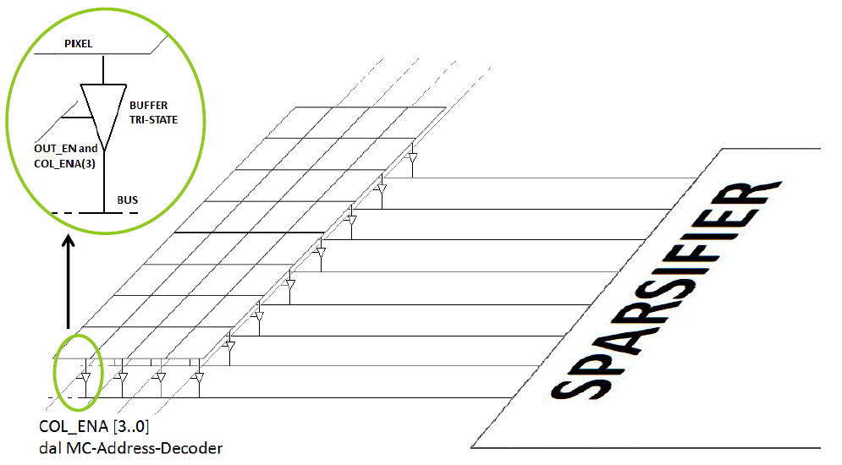
The Matrix Architecture
Pixel Matrix
Active Column
Common Pixel Data Bus – Active 1 column of pixel at a time

Slide 5
The Matrix 320x256 (40µm pitch)
80 x 4 = 320 pxl
AC
AC
AC
AC
80K pixel matrix
Total area ~ 1.3 cm²
130 Mhit/s
4 independent
Submatrix
256 pxl
1 000 pixels analyzed in 1 CLK cycle
4 horizontal parallel scans for the Active Column
80 x 256 pxl, 40 microns pitch

Slide 6
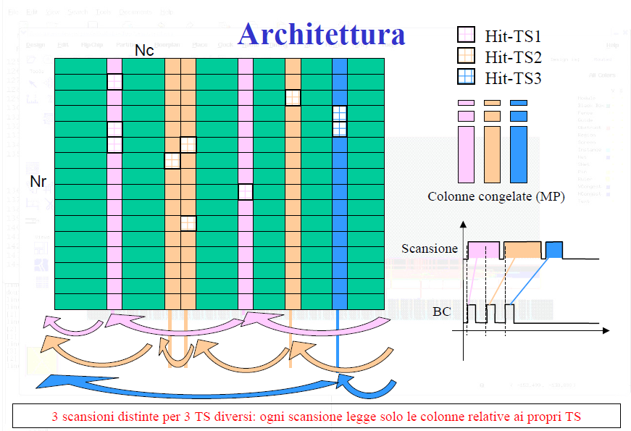
Submatrix Scan Policy
Column scan time oriented: 1 scan for each Time Stamp
→ The hits are time sorted

Slide 7
The Macro Pixels
Matrix divided into MPs: group of pixels (2x8)
MP global lines:
Fast-OR line: (output) inclusive OR of all pixels.
Freeze line: (input) disable the reception of new hits.
On BCO clock edge all MPs with active fast-OR :
Gets frozen
Are associated to the current value of BCO counter (Time Stamp)
Waits to be scanned and reset
BC edge
TIME STAMP
MP reset after read
Active Fast-OR
MP gets frozen
Time

Slide 8
Zone sparsification of the Active Column
Active
Column
The 256 pixels of the Active Column are divided into 32 vertical zones (1x8 pixels each)
Every HIT stored contains the information of a zone, not of a single pixel:
HIT= (Zone address+ Zone pattern)
X zone address = Column address : 80 columns →7 bit
Y zone address : 32 vertical zones → 5 bit
Zone pattern: 8-pixel zone → 8 bit
Time Stamp: since the hits are time sorted, the relative TS word is stored at the beginning of each hit sequence
Zone 0
TS
Zone 1
Active Column

Slide 9
The sparsifiers and barrels
8-hit wide BUS
64 PXL
1 Hit BUS
ACTIVE COLUMN
8 zones
N Hit to write
Barrel: an asymmetric FIFO with variable input width:
from 1 to 8 hits stored per clk cycle.
64 PXL
8 zones
64 PXL
8 zones
64 PXL
8 zones

Slide 10
Sparsification and barrel trees
Each submatrix scan has its own readout – all working in parallel
80
80
80
80
Common output stage

Slide 11
Output stage
FULL resolution Hit + time stamp
8 bit TS (modulo 256 BCO counter)
9 bit X address (320 pixels)
8 bit Y address (256 pixels)
TOT 25 bit
→ expected rate 130 MHit/s per chip = 130MHz x 25bit = 3.2 Gbps
Zone sparsification & time sorting of the hits (TS heading the relative hits) lead to:
2 bit Barrel L2 address (→1/4 of submatrix: 80x64 pxl)
2 bit Barrel L1 address (1 submatrix: 80x256 pxl)
7 bit X address (80 pixels)
3 bit zone Y address (8 vertical zones for each L2 barrel)
8 bit zone pattern
TOT 22 bit
→ expected rate: 130 (+1 TS) * 22 = 2.8 Gbps
→ [(22*2)* 0.875 + (22*4)*0.125 ] *25 Mtrack s⁻¹ cm⁻² * 1.3 cm²
Weighted average ~ 1.6 Gbps
BUT: Considering the cluster factor x4 of the expected rate in the form 2x2:
in 87.5% of cases 2 hits only & in 12.5% are required 4 hits

Slide 12
The components simulated:
2nd layer barrels (B2)
1st layer barrel (B1)
Sub Matrix
NB: Full B1 output bandwidth supposed available (1 hit/clk cycle)
Concentrator
Freezer
Scan Control
Scan Buffer
TS + MP pattern
Sparsifiers
All the models are described using synthesizable VHDL

Slide 13
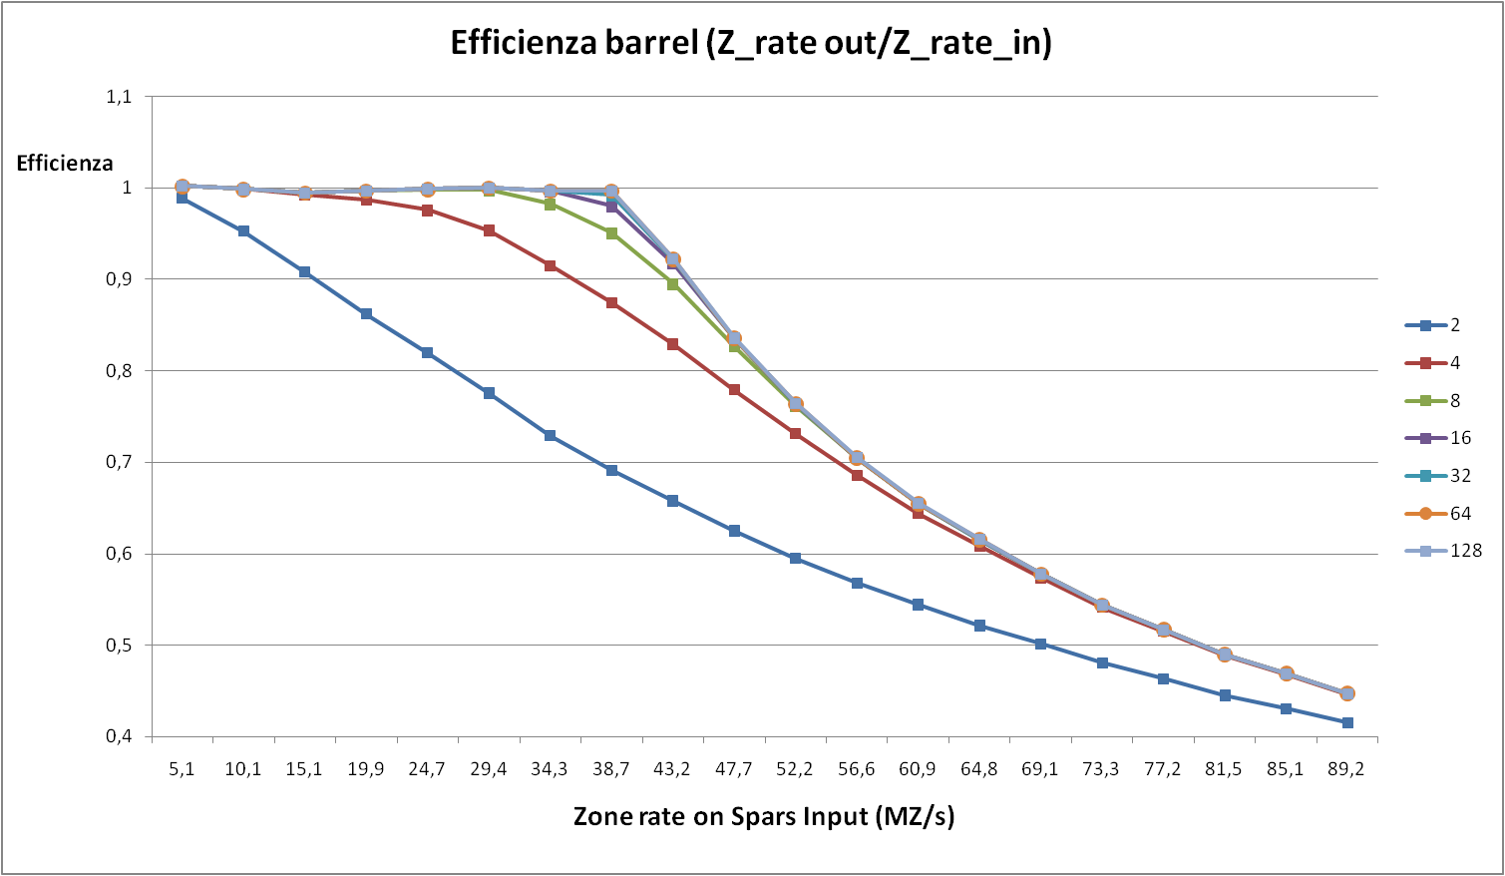
Study on Barrel optimal Depth:
A
B
B2
Forbidden region
Mean input rate > ouput throughput
B counts/
A counts
Barrel depth
Barrel inefficiencies due to fluctuation over the mean rate
Expected rate @B2: 8,2 MPxl/s
Expected rate @B1: 32,8 MPxl/s
Barrel clock 40 MHz

Slide 14
Frozen Efficiency @ 100 MHz/cm²
%
Readout efficiency not
100% :
Scan buffer overflow
BCO period (us)
Barrels efficiency 100%
No barrel overflow
(B2 and B1)
frozen effi.
 |  |  |  | BCO (us)
 |  | 0,25 | 0,5 | 1 | 1,5 | 2
 | 100 | 99.7 | 99,5 | 99,3 | 99,2 | 99,0
Rd_clk (MHz) | 80 | 99,6 | 99,4 | 99,1 | 99,1 | 98,8
 | 60 | 97,5 | 98,9 | 98,8 | 98,8 | 98,4
Fast read clock and narrow BC edges
NB: for 200 MHz/cm² minimum Rdclk 80MHz and efficiency with BC=1 us is 97.6%

Slide 15
Slow Control : I2C-like system
Hard Wired Addresses
½ Modulo:
6 APSEL 6D
001
010
011
100
101
110
slave
slave
slave
slave
slave
slave
VDD
DAQ
BUS master
SDA
SCL
Registers R/W access communication type
I²C : two bidirectional open-drain lines.
Serial Data (SDA)
Serial Clock (SCL), pulled up with resistors.

Slide 16
Conclusions
Study conducted to point out the optimal readout policy and architecture.
A parametrized model has been coded with synthesizable VHDL.
Simulations perfomed allowed a fine adjustment of the free parameters, and showed for a “typical” configuration a global readout efficiency: above 98,4%
Works in progress:
Realization of the final output stage
I2C like interface for slow control
To Do
Service infrastructure (killmask, MP mask, calib facilities…)
Selection of the elements to be implemented in the sett 09 chip

Slide 17
BackUp Slides

Slide 18
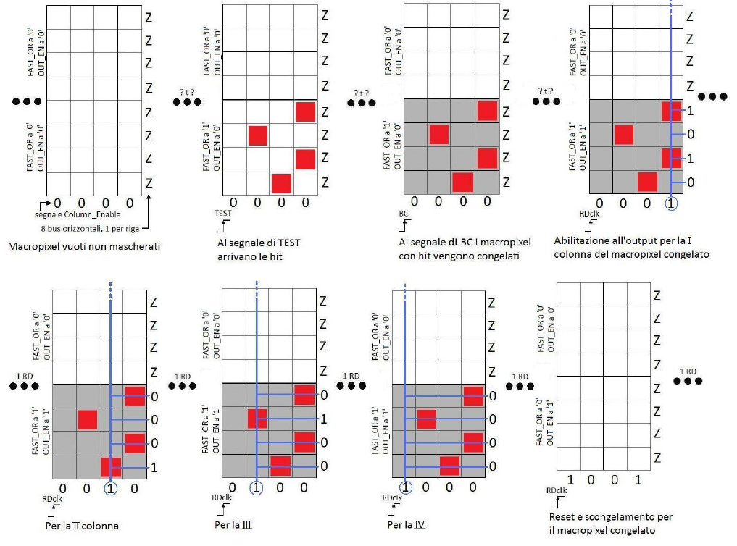
Macro Pixel Cycle

Slide 19
2D scan BCO vs RDclk @ 1MHz/mm2
RN | sim DURATION (us) | RDclk (MHz) | BCO (us) | Mean Sweeping time (us) | global hit rate (MHz) | rate on area (MHz/mm2) | B2 depth | B1 depth | B1 max fill | B1 mean fill | BC lost | Already hit effi (%) | frozen effi (%) | ro effi B2 (%) | ro effi B1 (%)
107 | 1 | 60 | 0,5 | 0,45 | 33,8 | 1.03 | 8 | 32 | 5 | 1 | 0 | 99,96 | 98,90 | 100 | 100
108 | 1 | 80 | 0,5 | 0,34 | 33,8 | 1.03 | 8 | 32 | 5 | 1 | 0 | 99,95 | 99,39 | 100 | 100
109 | 1 | 100 | 0,5 | 0,27 | 33,8 | 1.03 | 8 | 32 | 5 | 0 | 0 | 99,96 | 99,53 | 100 | 100
110 | 1 | 60 | 1 | 0,75 | 33,8 | 1.03 | 8 | 32 | 8 | 1 | 0 | 99,91 | 98,83 | 100 | 100
111 | 1 | 80 | 1 | 0,56 | 33,8 | 1.03 | 8 | 32 | 9 | 1 | 0 | 99,91 | 99,10 | 100 | 100
112 | 1 | 100 | 1 | 0,45 | 33,8 | 1.03 | 8 | 32 | 9 | 1 | 0 | 99,91 | 99,25 | 100 | 100
113 | 1 | 60 | 1,5 | 0,95 | 33,8 | 1.03 | 8 | 32 | 19 | 1 | 0 | 99,86 | 98,78 | 100 | 100
114 | 1 | 80 | 1,5 | 0,71 | 33,8 | 1.03 | 8 | 32 | 18 | 1 | 0 | 99,86 | 99,05 | 100 | 100
115 | 1 | 100 | 1,5 | 0,57 | 33,8 | 1.03 | 8 | 32 | 18 | 1 | 0 | 99,86 | 99,23 | 100 | 100
116 | 1 | 60 | 2 | 1,08 | 33,8 | 1.03 | 8 | 32 | 24 | 3 | 0 | 99,84 | 98,42 | 100 | 100
117 | 1 | 80 | 2 | 0,81 | 33,8 | 1.03 | 8 | 32 | 23 | 2 | 0 | 99,83 | 98,81 | 100 | 100
118 | 1 | 100 | 2 | 0,65 | 33,8 | 1.03 | 8 | 32 | 23 | 2 | 0 | 99,83 | 99,04 | 100 | 100

