Slide 1
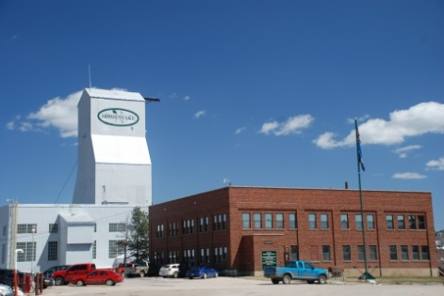
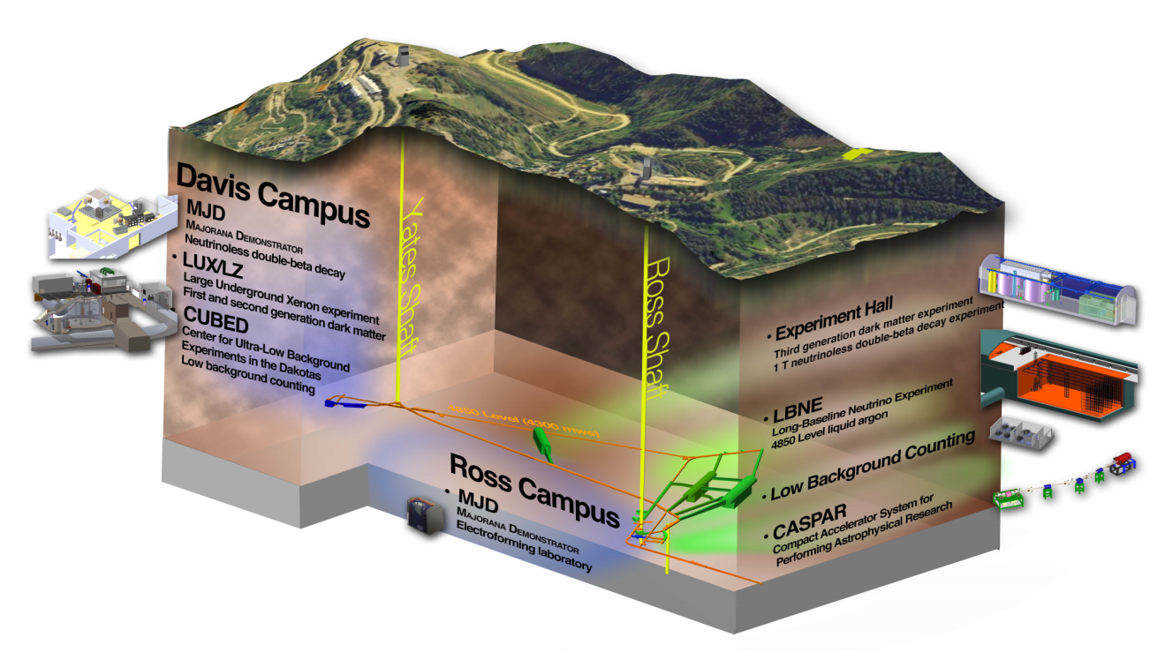
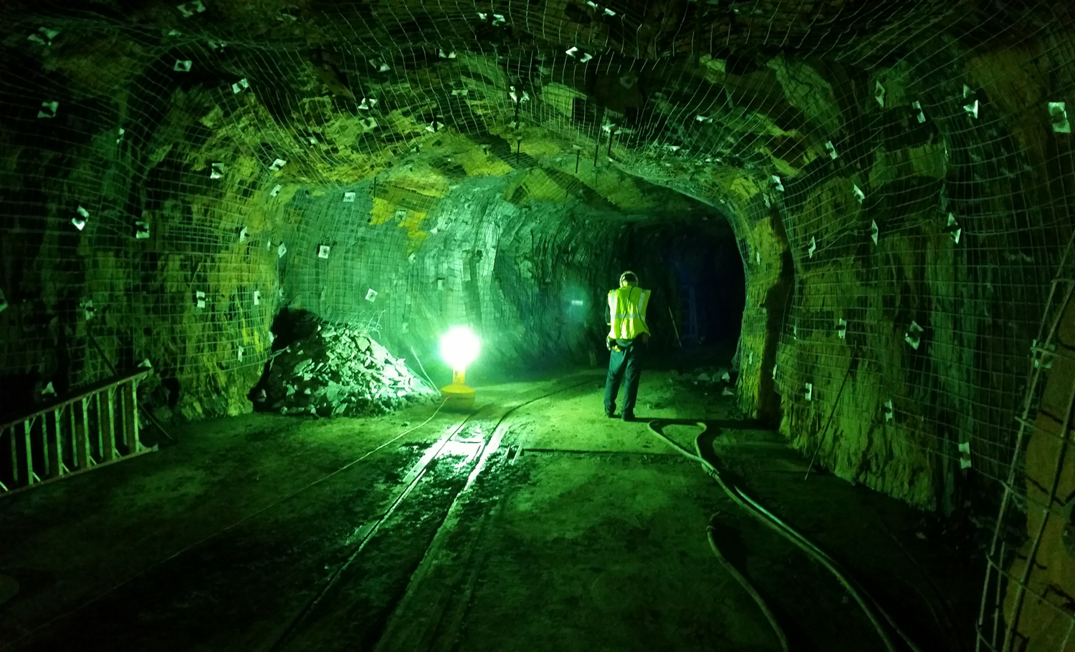
The CASPAR Facility for Underground Nuclear Astrophysics
Sanford Underground Research Facility SURF (4850L)
4300 mwe Shielding

Slide 2
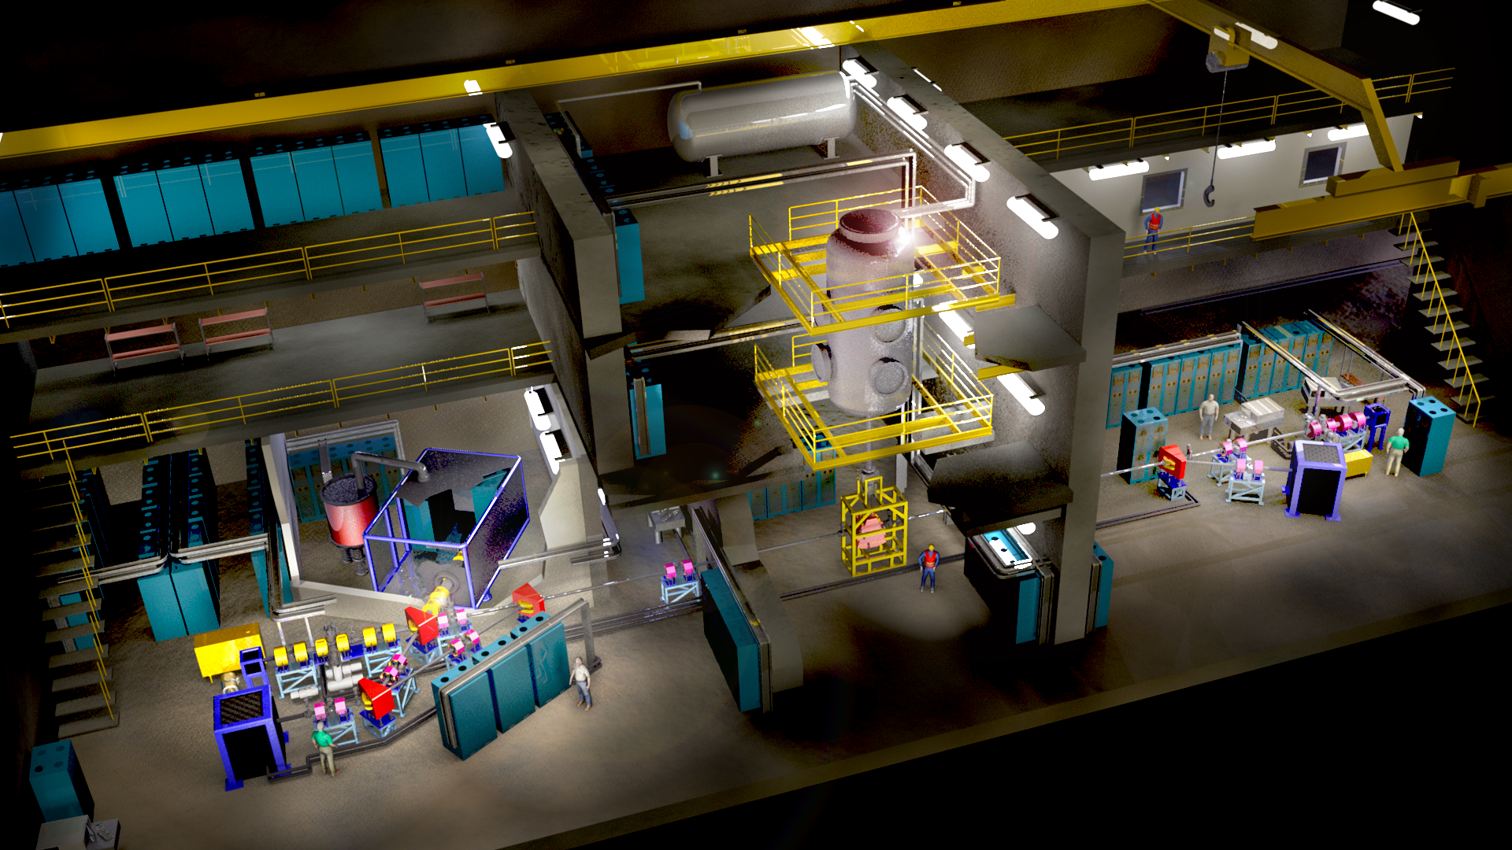
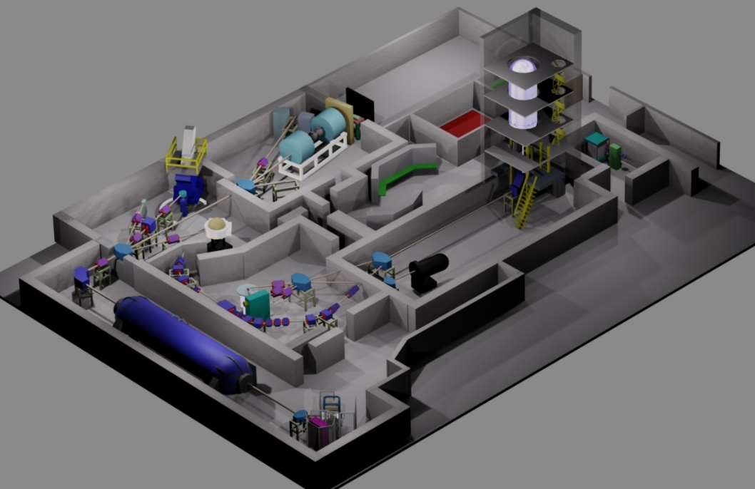
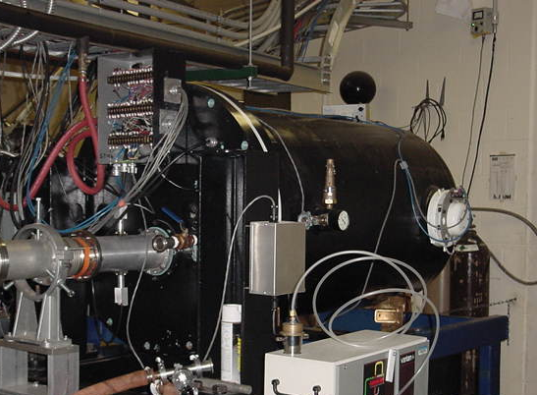
From DIANA to CASPAR a status report
DIANA positively reviewed but postponed due to sequester
Smaller scale facility CASPAR has been developed
Focus on reactions in stellar helium burning.

Slide 3
Projected Reaction Studies
¹³C(α,n)¹⁶O neutron source
²²Ne(α,n)²⁵Mg neutron source
²²Ne(α,γ)²⁶Mg reaction branch
²⁵Mg(α,n)²⁸Si neutron source
²⁶Mg(α,n)²⁹Si neutron source
²⁶Mg(α,γ)³⁰Si reaction branch
Potential beam induced background reactions
¹⁰B(α,n)¹³N beam induced background
¹¹B(α,n)¹⁴N beam induced background
¹⁷O(α,n)²⁰Ne beam induced background
¹⁸O(α,n)²¹Ne beam induced background

Slide 4
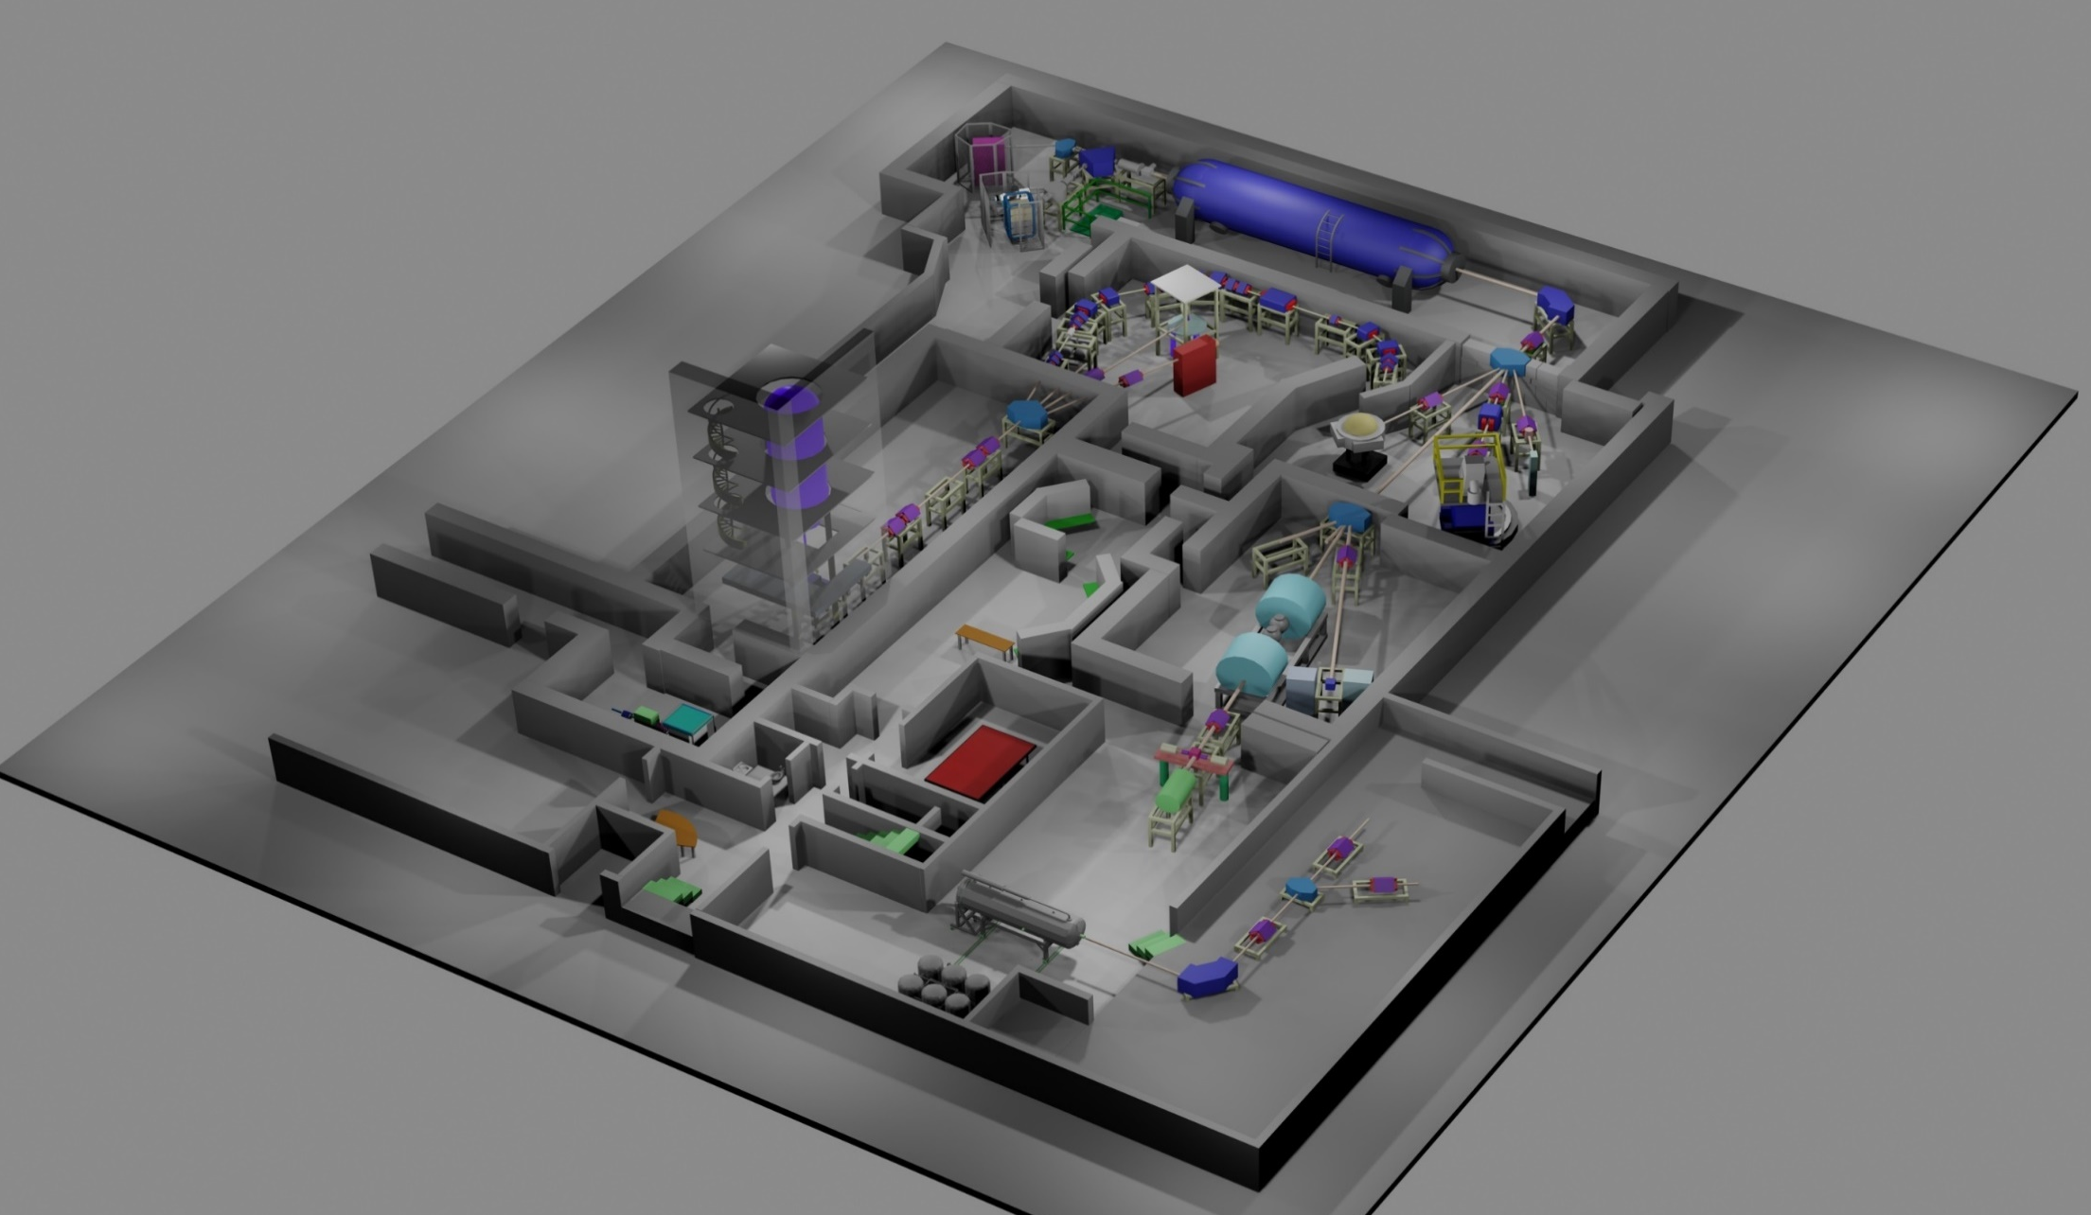
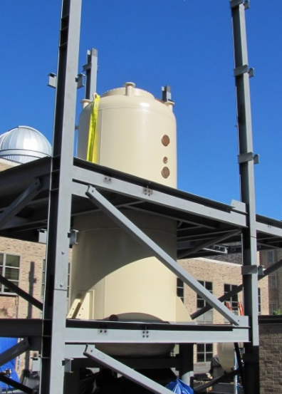
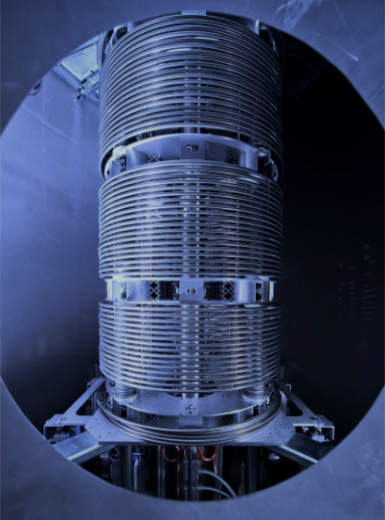
Detector developments and
Measurements at higher energies
10 MV FN Tandem
St. GEORGE Recoil Separator
Reaction tests
5U Pelletron
AMS spectrometer
TwinSol
3MV Tandem Pelletron
¹H, ⁴He, ¹⁴N, ¹⁶O, ²⁰Ne, ⁴⁰Ar

Slide 5
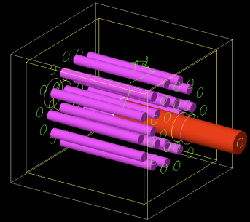
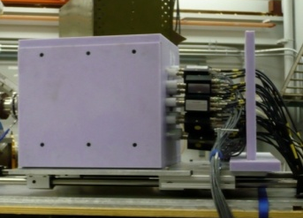
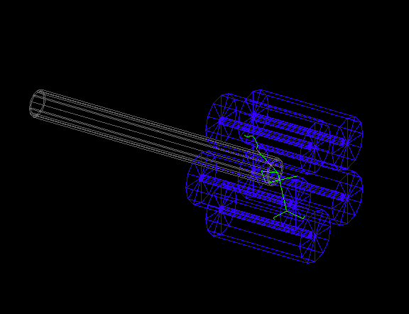
Neutron detector ³He tube array
Jan. 2014
Classical instrument for neutron counting with high efficiency , limited energy resolution capability by double ring design. Efficiency and other calibration measurements with (p,n) reactions at ND 5U pelletron.
Disadvantage is the loss of energy information which prohibits the identification of neutron background contributions.

Slide 6
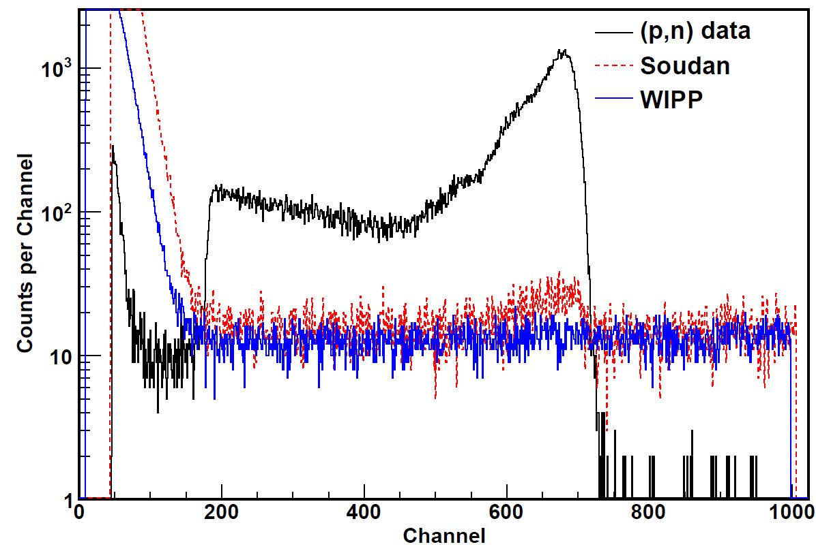
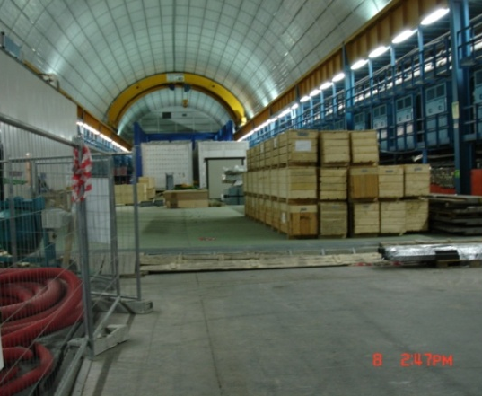
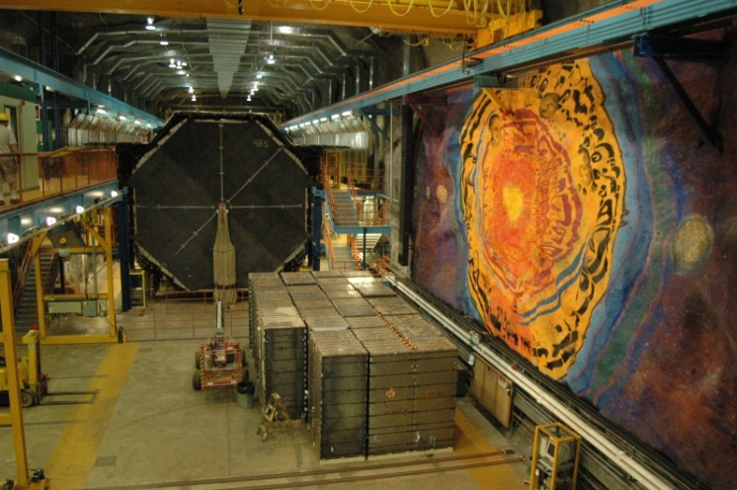
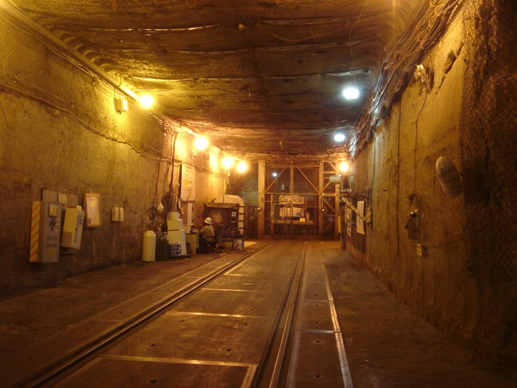
Neutron Background Reduction
Surface
KURF
Five orders of magnitude reduction on cosmogenic background component, remaining issue is the reduction of radiogenic & beam induced background.
Gran Sasso
Soudan
WIPP

Slide 7
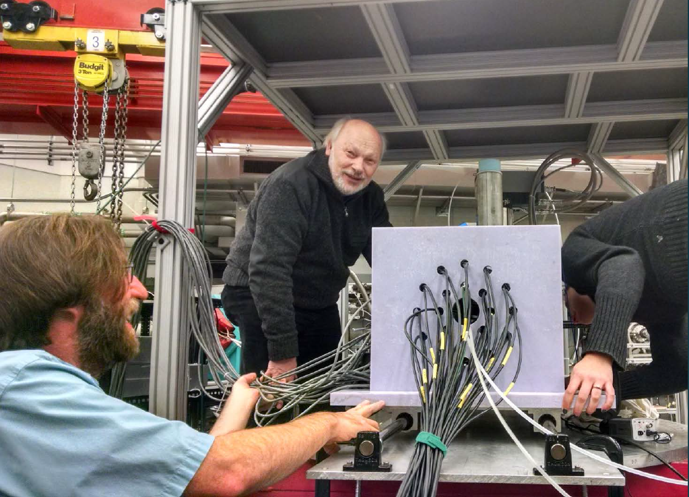
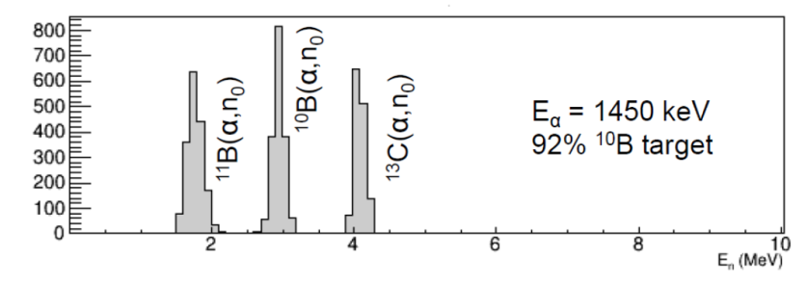
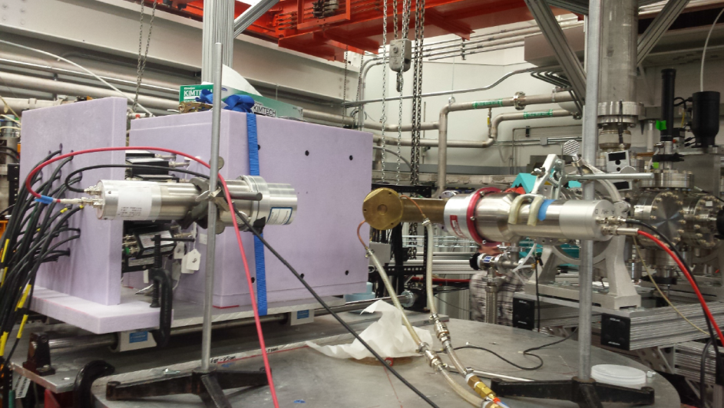
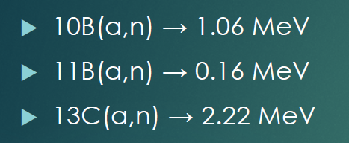
Beam induced neutron background
³He tube Detectors (UND)
With M. Febbraro et al. from U. Tennessee
C8D10, EJ301D
Deuterated Xylene
Deuterated Scintillator Detectors (U.Tenn)

Slide 8
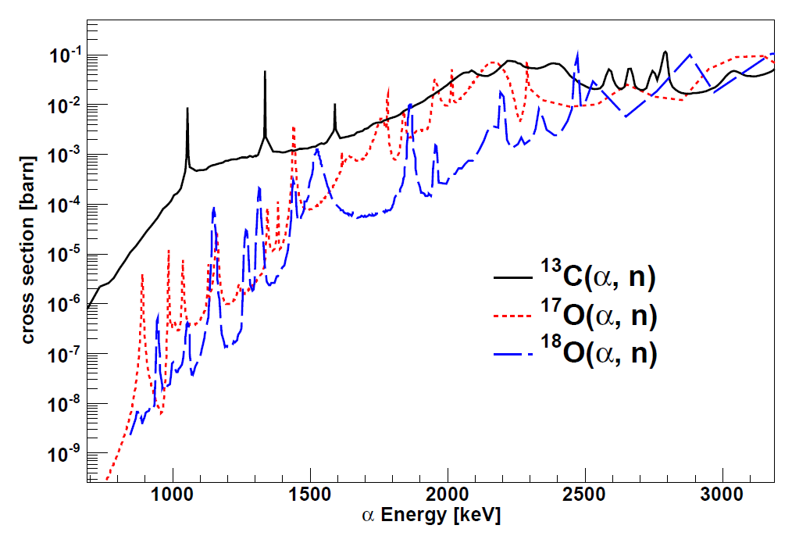
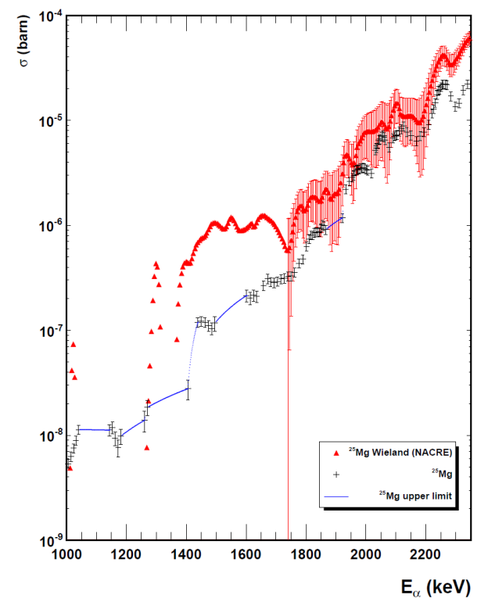
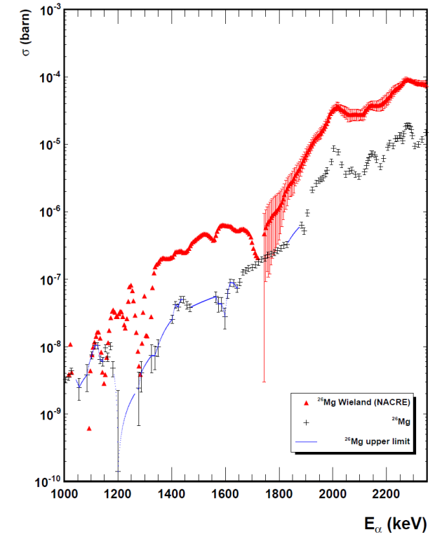
Possible beam induced background
²⁵Mg(α,n)²⁸Si
²⁶Mg(α,n)²⁹Si
NACRE
NACRE
ND data points
ND data points
upper limits
upper limits
The (α,n) reactions on low Z isotope impurities such as Boron, Oxygen represent the main components of beam induced background on Carbon, Neon, Magnesium target and/or aperture materials!

Slide 9
First measurements on oxygen targets
Important for background analysis of Mg target material
Andreas Best et al.
The goal is to measure in all cases an extended excitation curve to establish a multi-channel R-matrix analysis that provides a basis for a reliable extrapolation into the stellar energy range.

Slide 10
First measurements on boron targets
Important for background analysis of carbon target material
¹¹B(α,n)¹⁴N
¹⁰B(α,n)¹³N
With ³He counter system
With liquid scintillator detector
¹⁰B components could not be identified with the ³He counter system because
of the dominant background from ¹¹B impurities in 96% enriched ¹⁰B target.

Slide 11
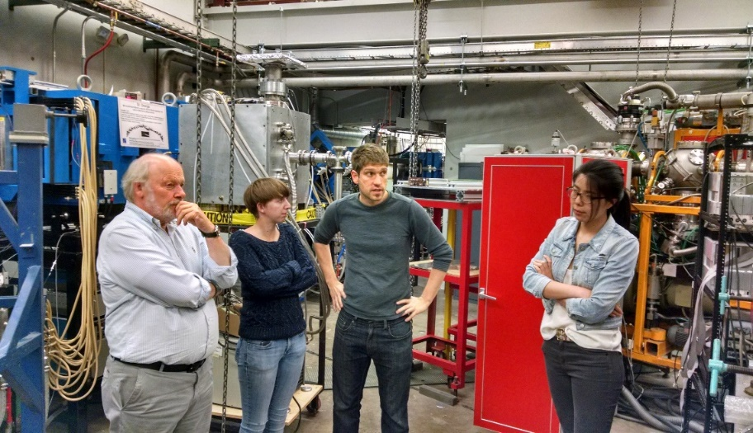
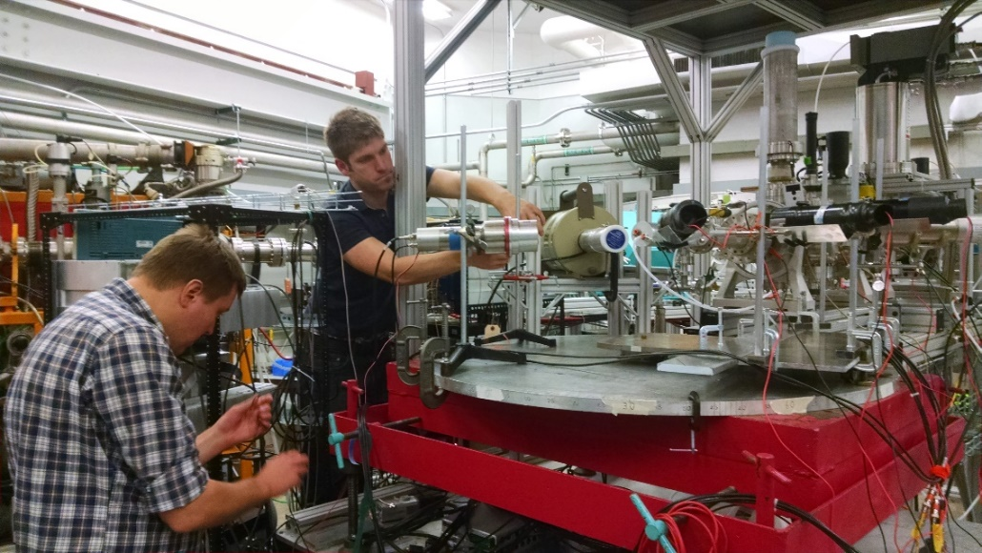
First measurements on ¹³C targets
Becca
Toomey
Mike
Febbraro
Michael
Wiescher
Qian
Liu
EJ315D
HPGe
Mike
Febbraro
Steve
Pain
EJ305D
High energy analysis by Harrissopulos et al., which neglected to identify and include neutron transitions to excited states in ¹⁶O.

Slide 12
Excitation curve for ¹³C(α,n)¹⁶O
Neutron background for KamLAND
neutrino detection experiments.

Slide 13
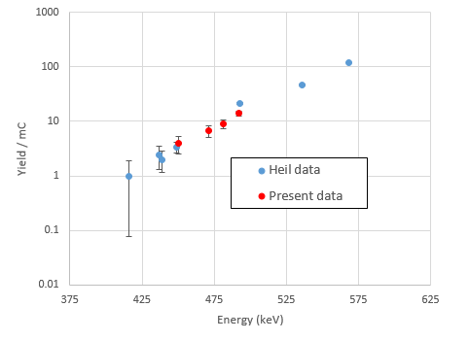
towards lower energies
Measurements at 5MV Pelletron accelerator at Notre Dame
(Febbraro et al. CAARRI 2016)
Measurements at the Oak Ridge 250 kV machine (using ⁴He²⁺)
(Febbraro et al.2016, priv. com.)

Slide 14
Acknowledgement
James DeBoer (UND)
Mike Febbraro (U. Tenn)
Joachim Goerres (UND)
Hye Young Lee (LANL)
Qian Liu (UND)
Kevin Macon (UND)
Steve Pain (ORNL)
Bill Peters (ORNL)
Karl Smith (ORNL)
Becca Toomey (U.Surrey)
James DeBoer (UND)
Gerry Hale (LANL)
Mark Paris (LANL)

Slide 15
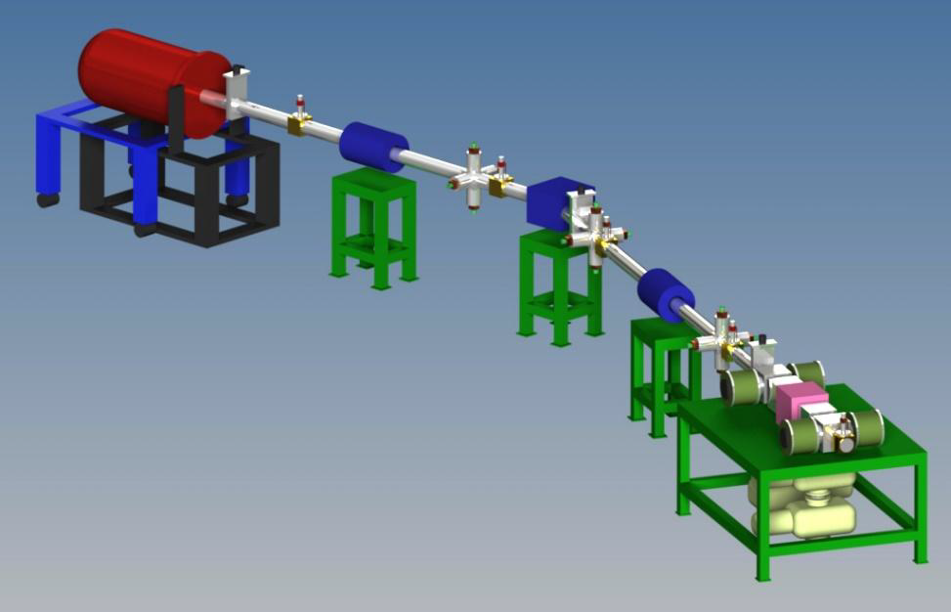
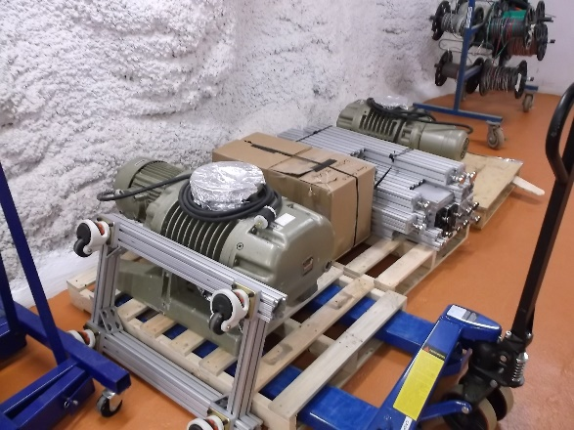
The CASPAR Concept
Jan. 2014
1 MV electrostatic accelerator:
(HVEC JN Model, 10 yrs at Notre Dame)
  Belt driven charging system
  Single stage acceleration of positive ions
  Particle intensity ~ 150µA
Exchangeable solid target and windowless extended gas target
  Roots blowers oil free pumps & turbomolecular pumps

Slide 16
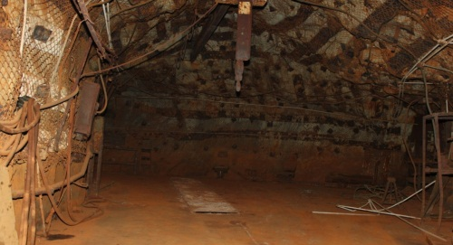
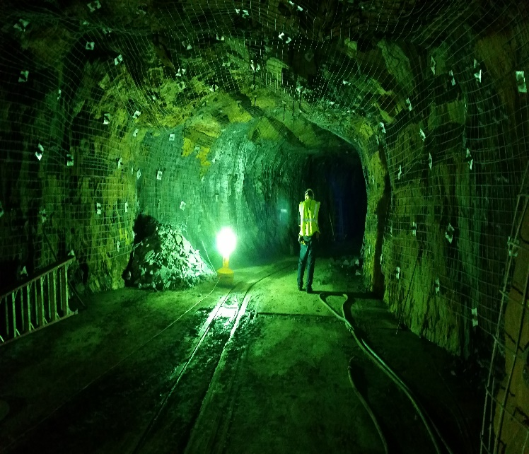
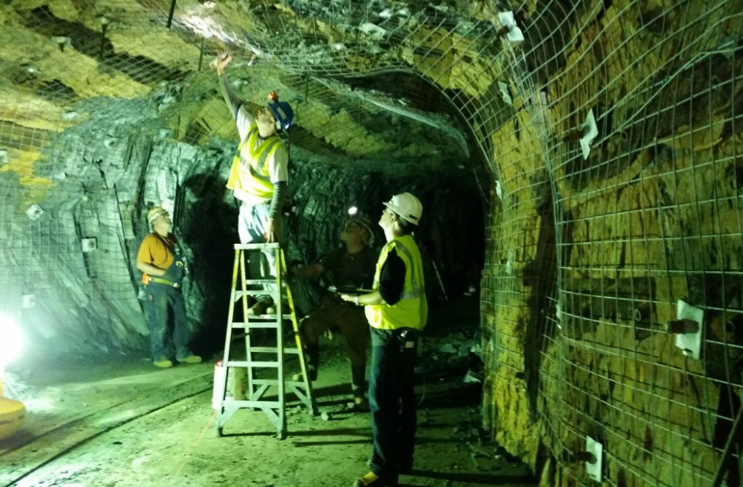
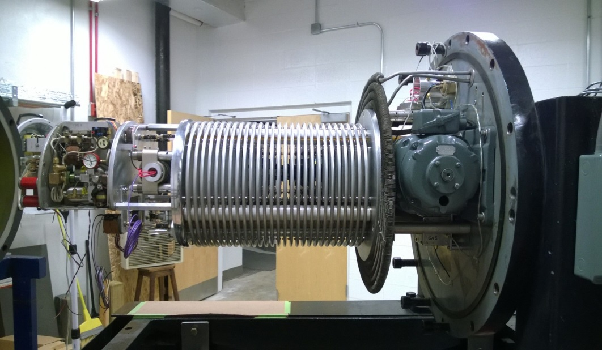
CASPAR development in 2014

Slide 17
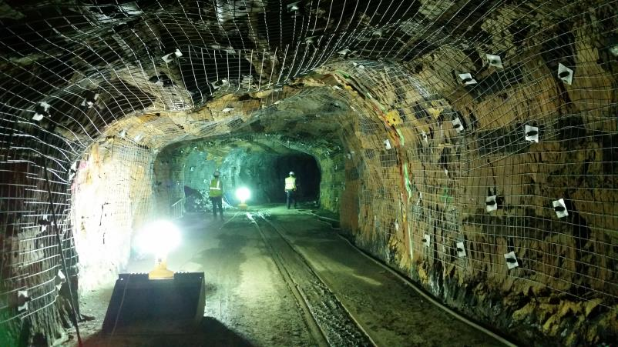
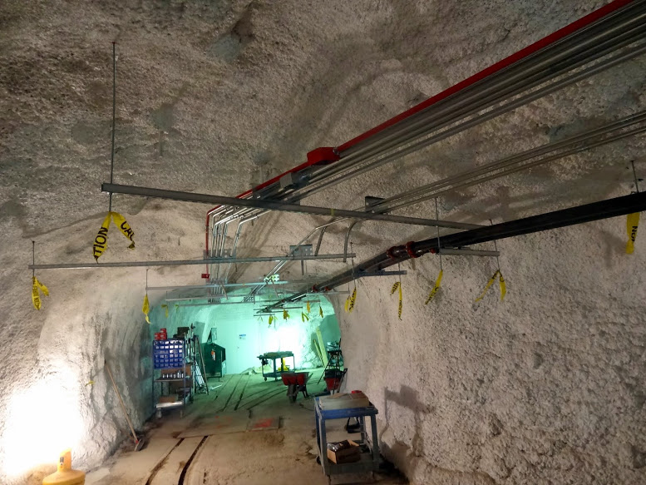
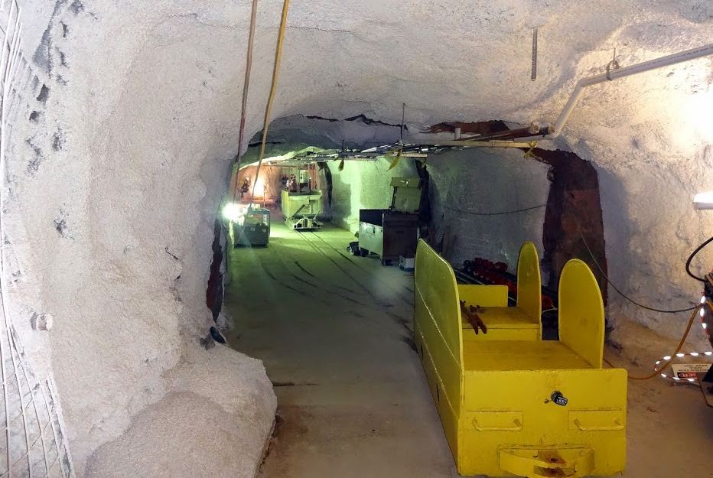
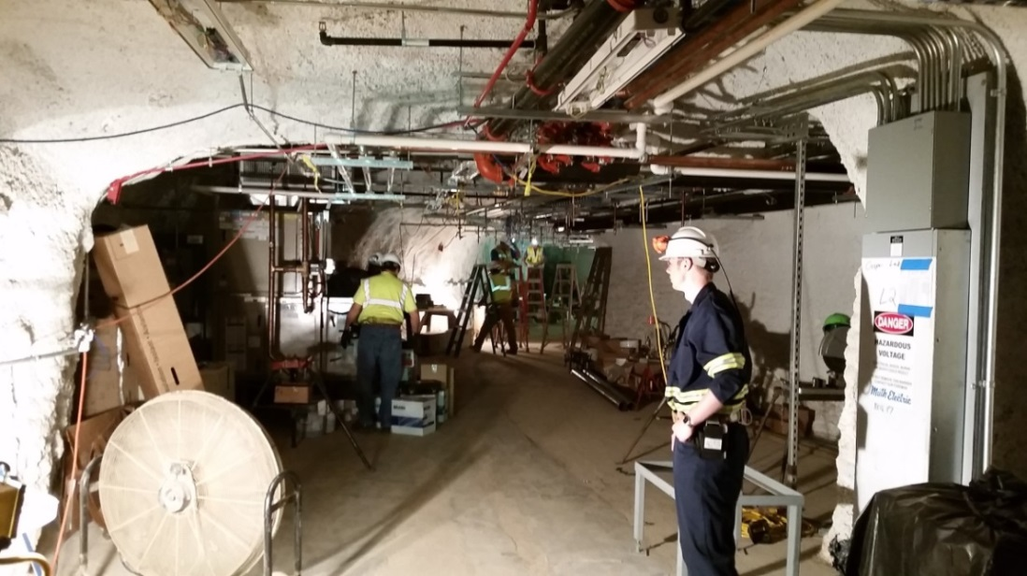
CASPAR development in 2015

Slide 18
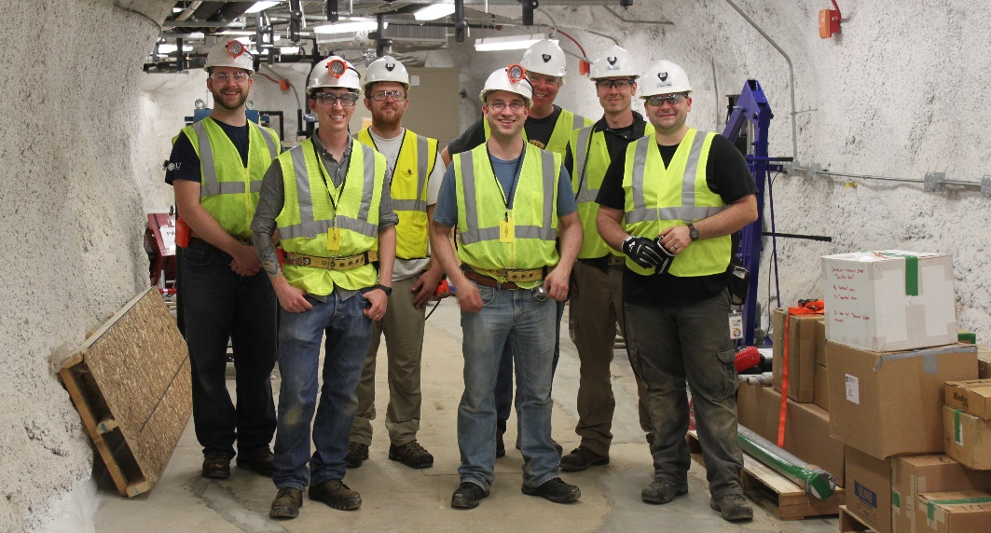
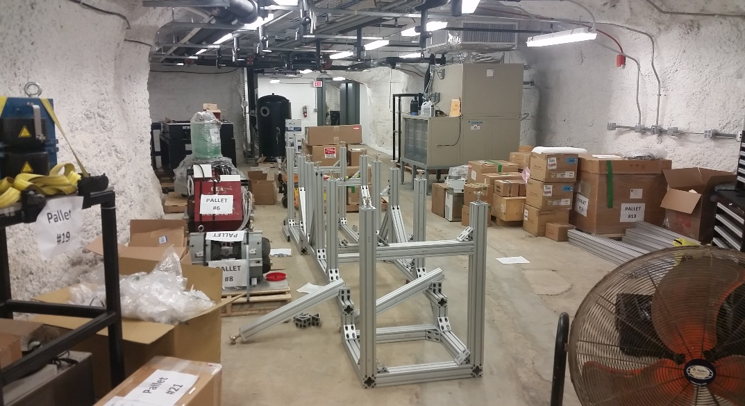
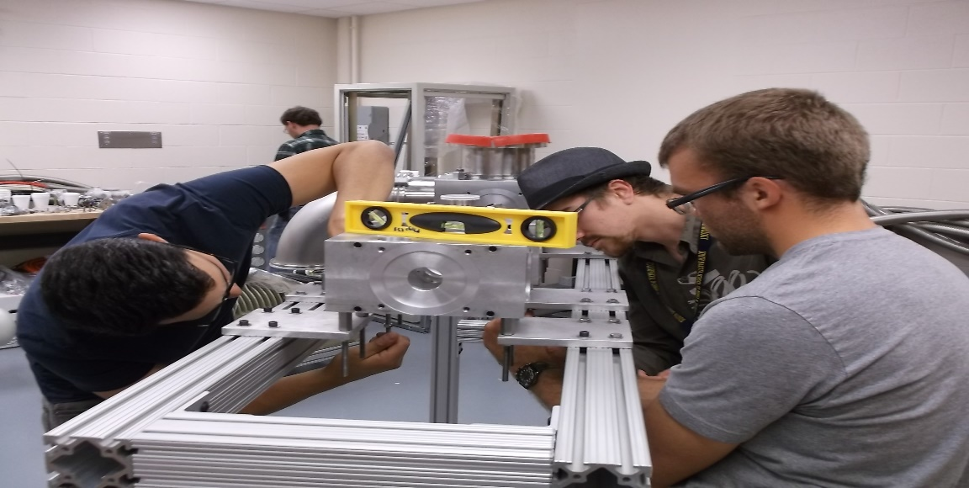
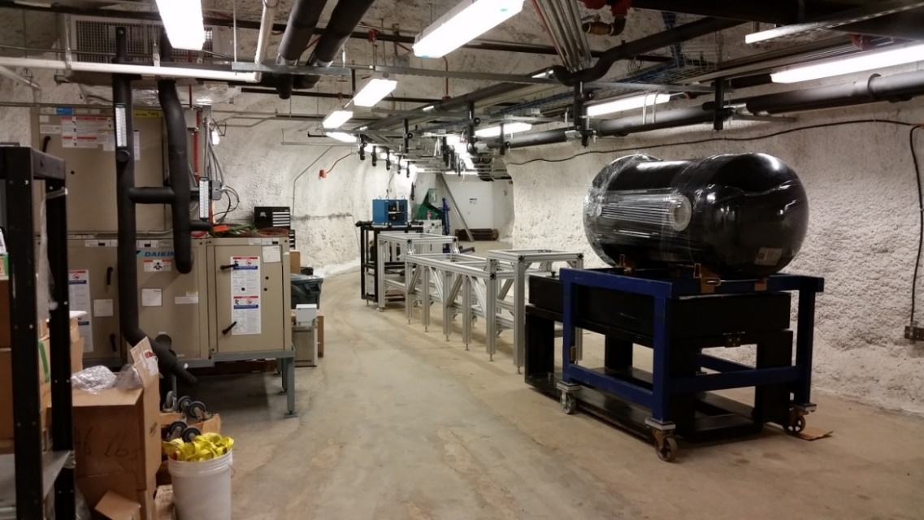
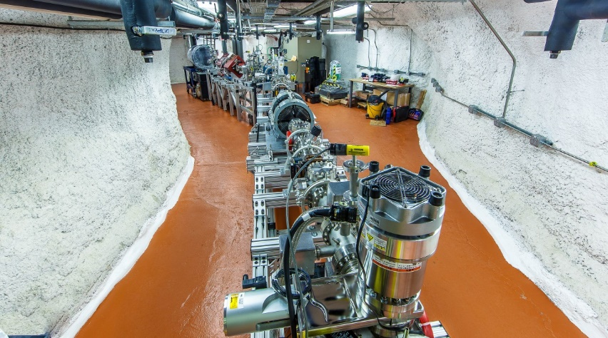
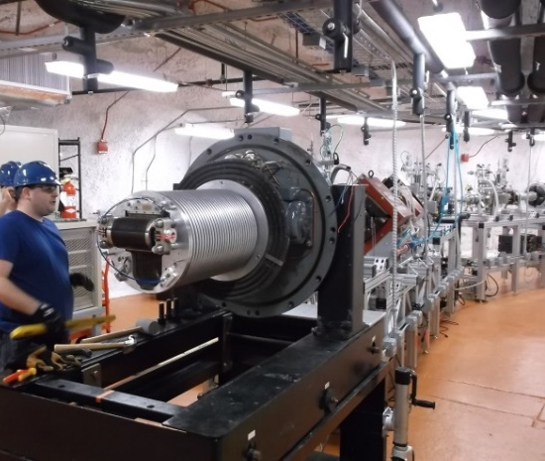
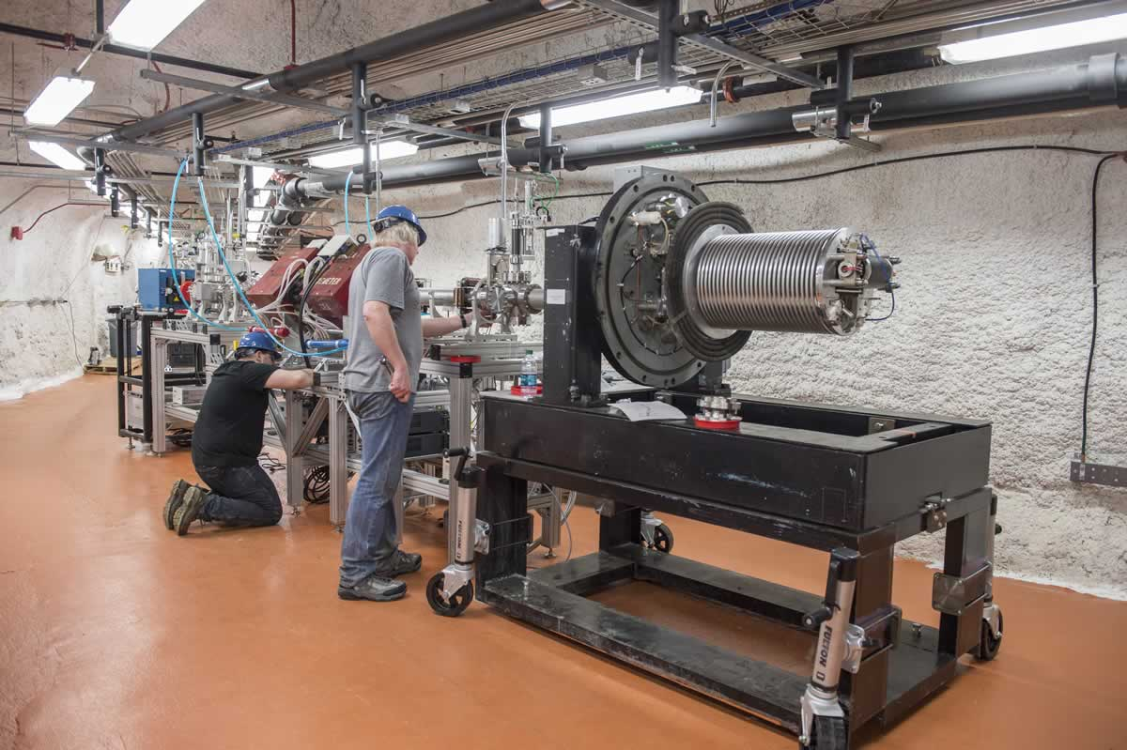
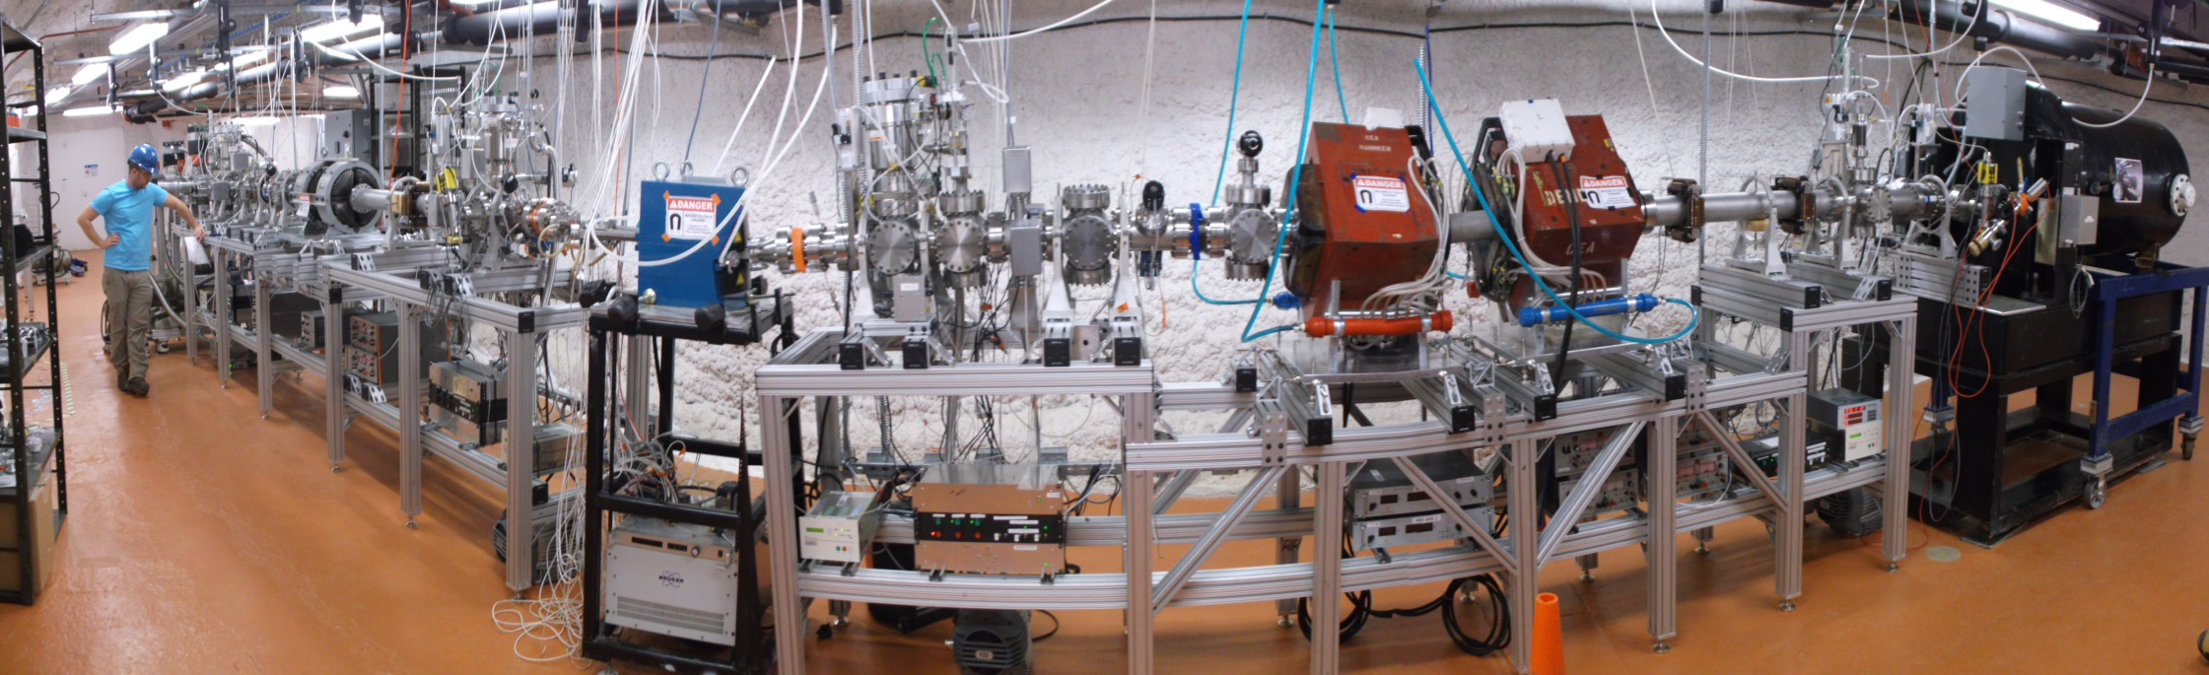
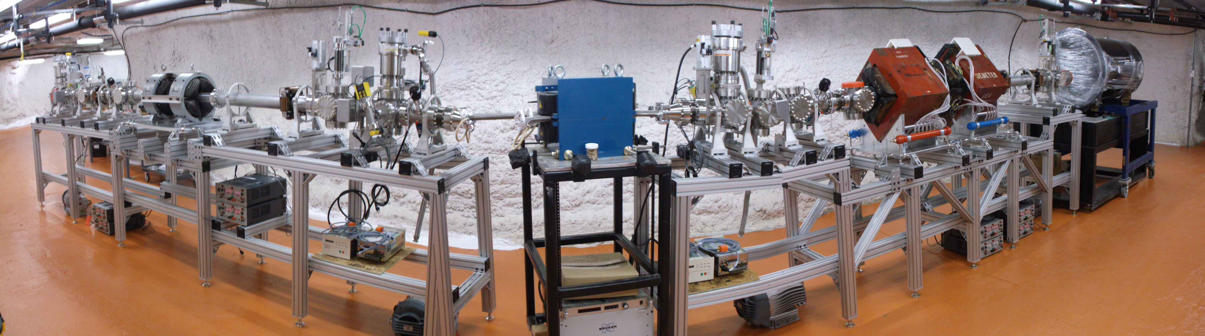
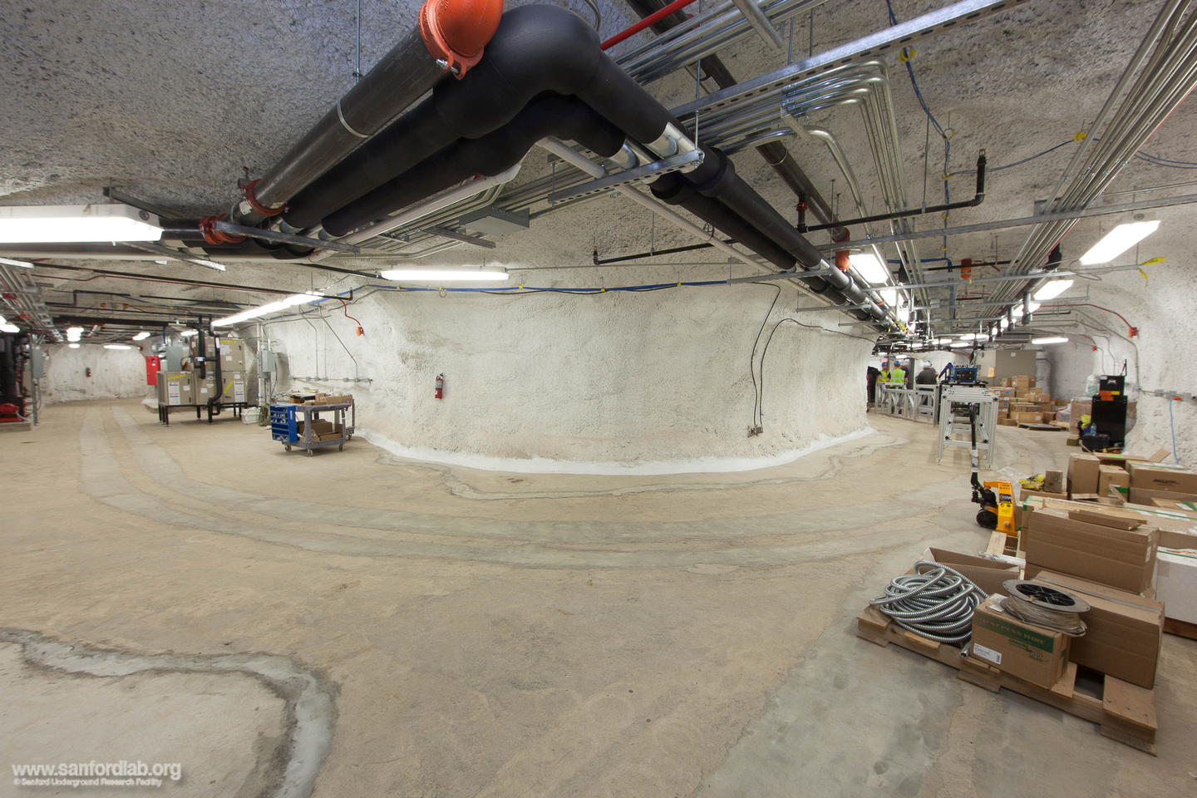
CASPAR development in 2016
Spring 2016
Fall 2016
Fall 2015

Slide 19
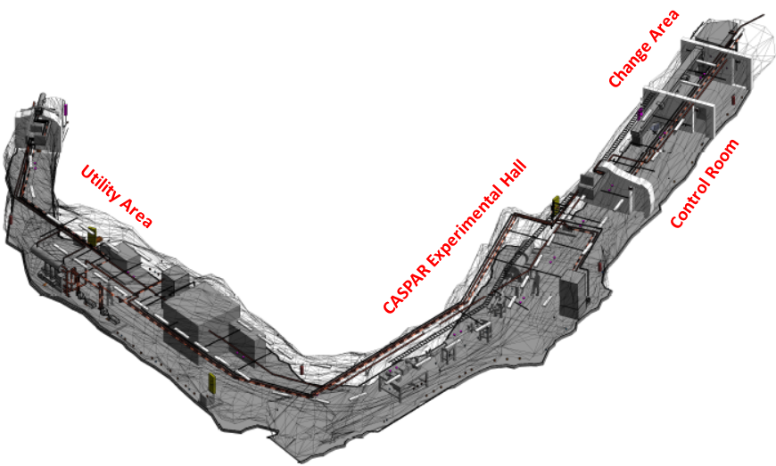




CASPAR status
Cavity rehabilitation and preparation complete
Beneficial occupancy of accelerator vault was August 2015
Accelerator system and target tests by the start of 2017
First beam on target early of 2017
Several delays due to
Administrative hurdles and requirements
Additional safety requirements
Manpower related issues
We hope for continuous
close and collaborative exchange with LUNA and JUNA!

Slide 20
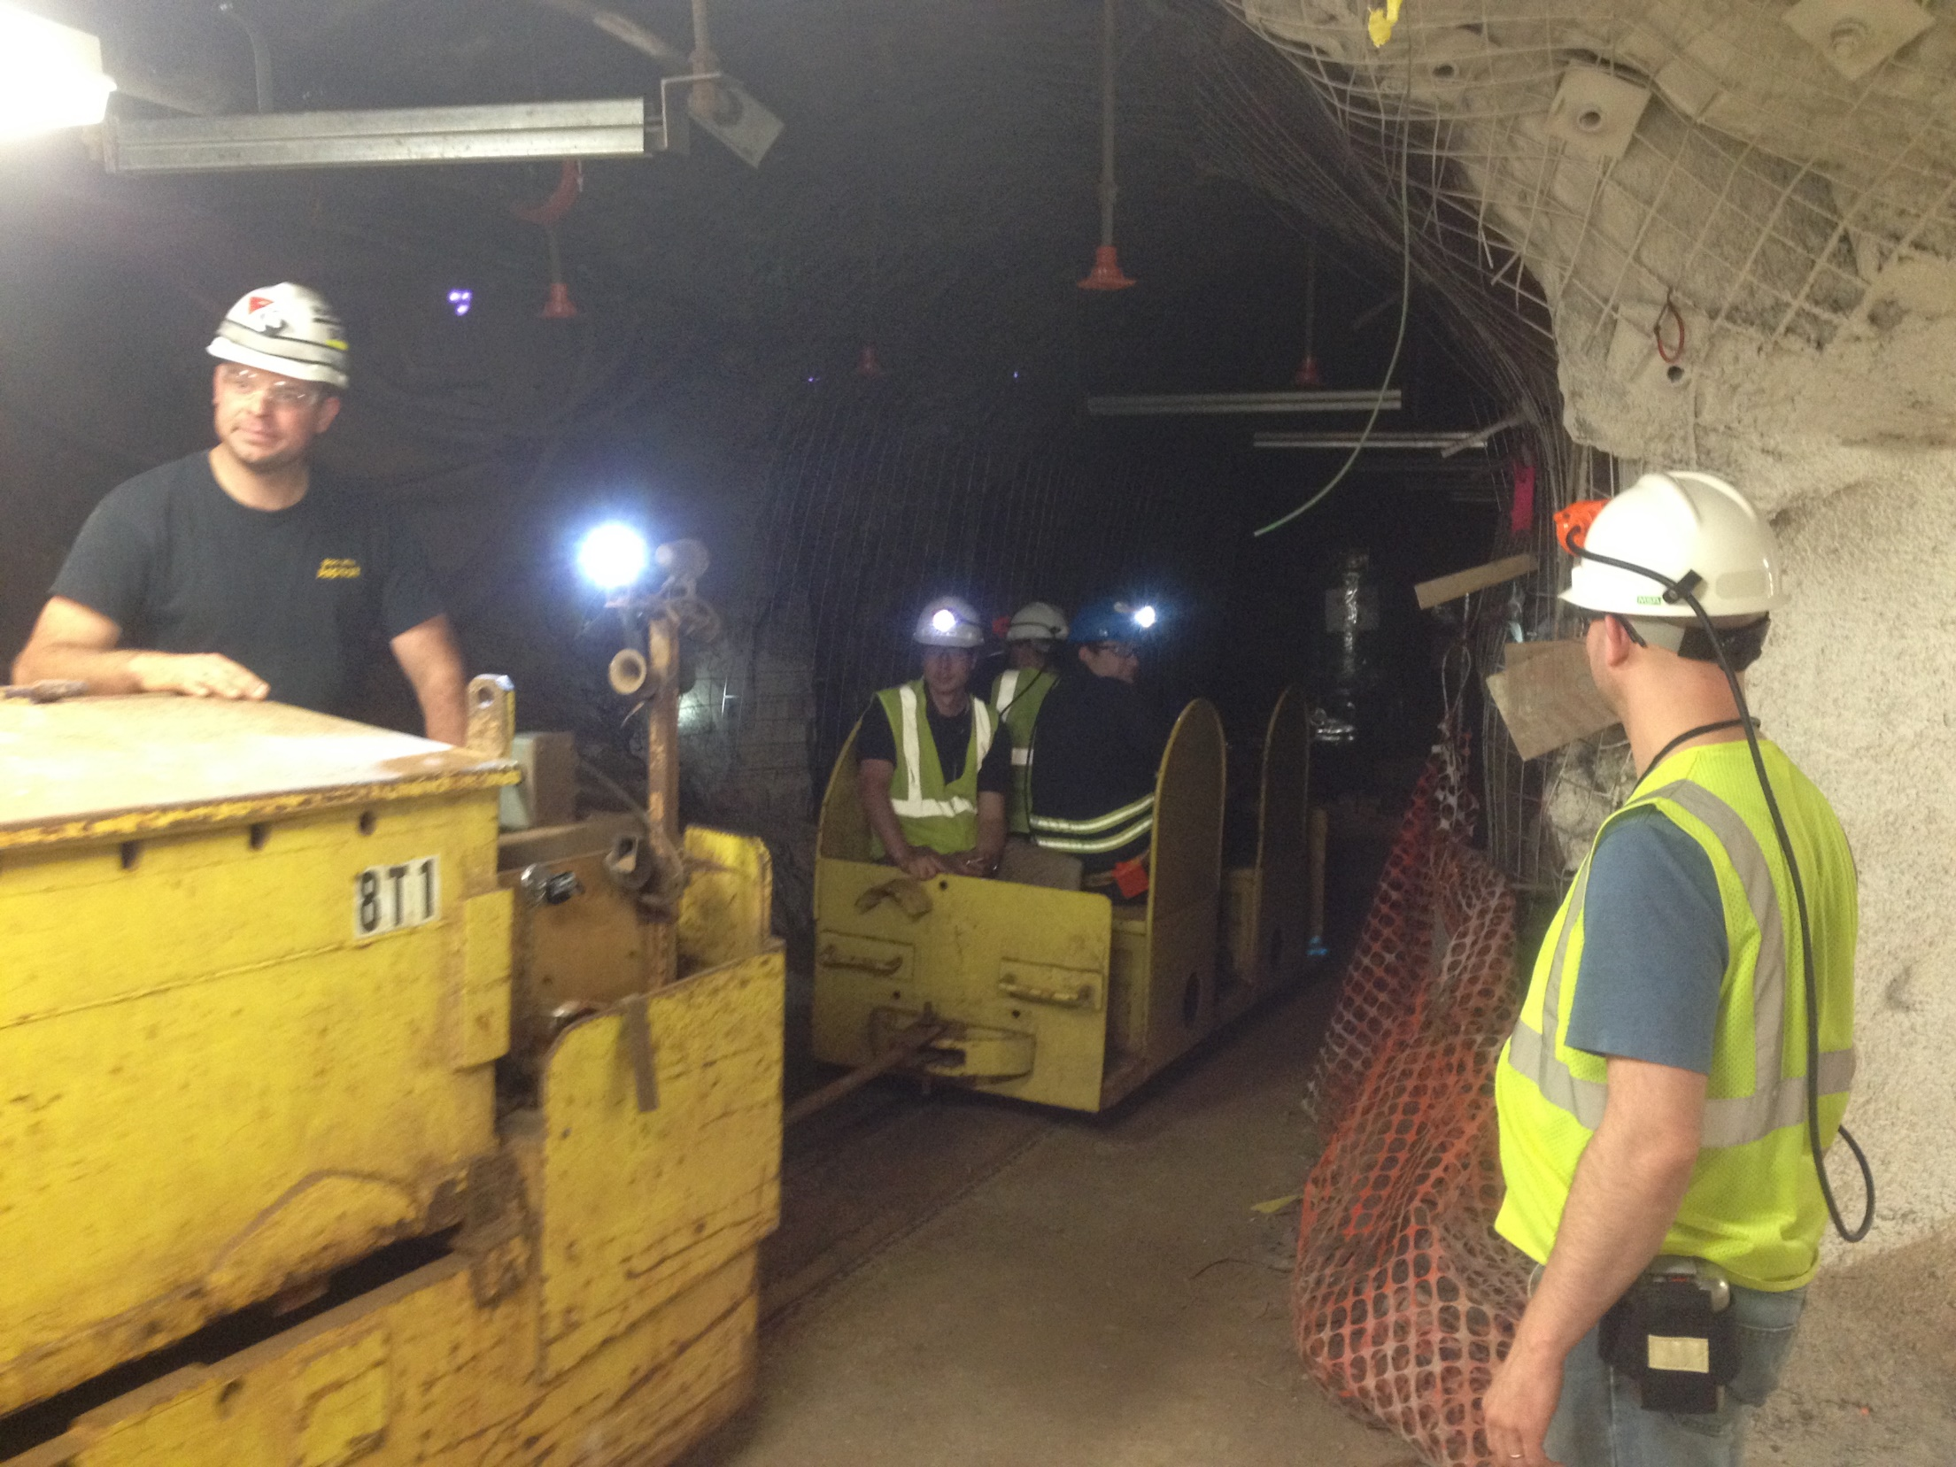
Acknowledgements
Tyler Borgwardt, GS (SDSMT)
Chandler Casey, UG (UND)
Rory Hamilton, GS (UND)
Thomas Kadlecek, GS (SDSMT)
Bryant Vande Kolk, GS (UND)
Joe VanDriel, UG (SDSMT)
Mark Hanhardt (SURF)
Paul Bauer (SURF)
Tim Baumgartner (SURF)
Syd Devries (SURF)
Josh Wilhite (SURF)
Manoel Couder (UND)
Uwe Greife (CSM)
Zach Meisel (OU)
Dan Robertson (UND)
Frank Strieder (SDSMT)

Slide 21
Outlook
CASPAR is well on its way despite regrettable delays, limited funding for SDSM&T has been generated through NSF, additional experimental funding for experiments is being requested. This effort concentrates on questions associated with stellar neutron sources!
But, CASPAR is an old machine, limited in energy range (200 keV-1000 keV) and therefore limited in scope. It was thought as a placeholder for DIANA to be used in combination with NSL experiments at higher energies!
LUNA-MV is a machine for next generation experiments, e.g. for studying fusion processes such as ¹²C+¹²C, ¹⁶O+¹²C, ¹⁶O+¹⁶O using a combination of particle gamma detection techniques.

