Slide 1
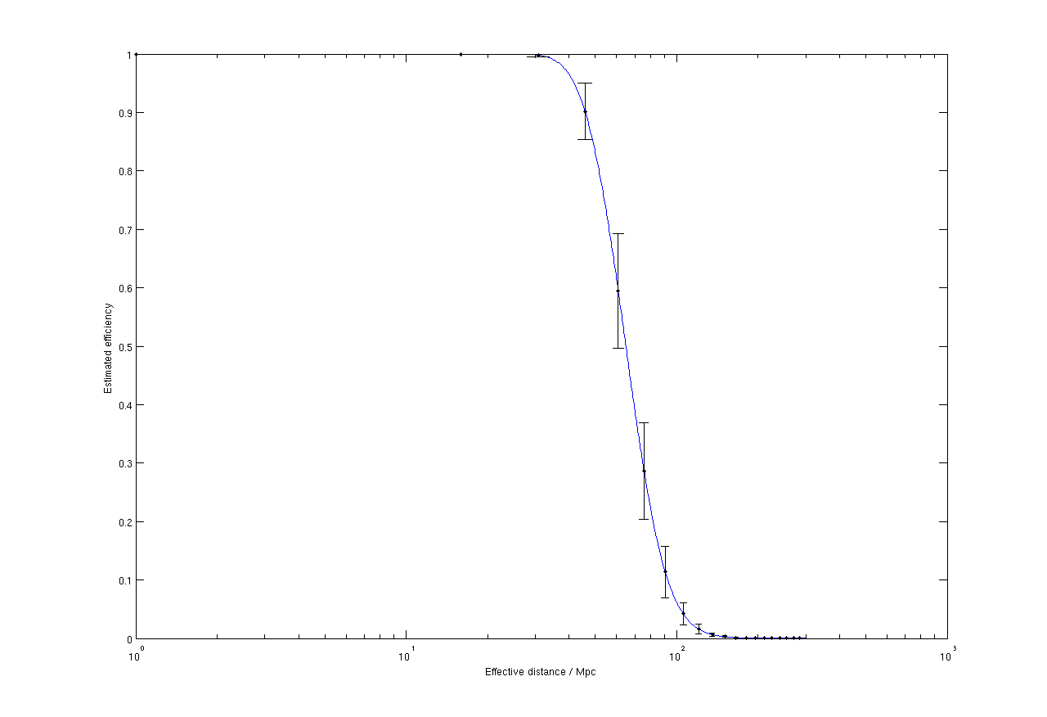
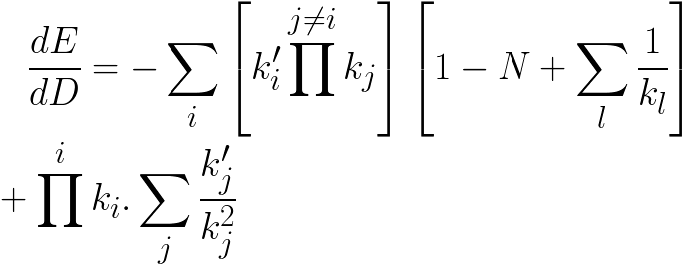
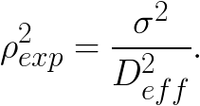
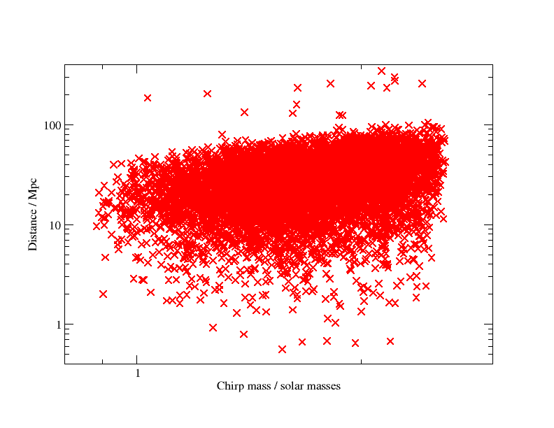
An improved method for estimating the efficiency of GW detectors
Craig Robinson, Cardiff University
Introduction and Motivation
Compact binary coalescences are one of the most promising sources of gravitational waves (GWs) for the current generation of detectors such as LIGO and Virgo. There are a number of searches underway for such sources, namely the low mass search (for systems with total mass in the range 2 − 35M⊙); the high mass search (systems in the range 25 − 100M⊙); and an externally triggered search for signals in coincidence with gamma-ray bursts (GRBs). In the absence of a detection of a signal, the goal of these searches is to set an upper limit on the number of CBC events in the universe, or, in the case of the externally triggered search, to place an exclusion region on the location of the source assuming a CBC progenitor. The detection efficiency of CBC signals as a function of distance plays a crucial role in the calculation of the upper limits and exclusion regions. Thus, it is essential to get a good estimate of the efficiency. This is done by injecting fake signals into the data stream, and determining whether this signal would have been found. To get enough statistics to obtain a reliable estimate of this efficiency, we perform tens of thousands of injections, distributed across the parameter space of masses, distances, orientations, and sky locations. This is a time consuming and computationally expensive process, and can be a significant bottleneck in obtaining final search results. The current preferred method for distributing injections is uniformly in the log of the distance. Although such a distribution is useful for diagnosing potential problems in search pipelines, it is less than optimal for obtaining a measure of the efficiency, due to the placement of too many injections nearby, and too few where efficiency falls off quickly. Similarly, distributing injections uniformly in volume results in too many being placed in regions of no detection efficiency. An optimal approach would concentrate injections in the region where detection efficiency is changing quickly, with fewer injections in the region of 100% or 0% efficiency. We propose a method which attempts to place injections in the region where efficiency is changing quickly. It works by estimating the efficiency as a function of distance for a given set of mass parameters and sky location.
1
0.8
0.6
Efficiency
0.4
0.2
0
10⁰
10¹
10²
10³
Effective distance / Mpc
Fig. 1: Estimated efficiency for binary neutron star injections for a single detector with the initial LIGO PSD. The threshold SNR is chosen to be 5.5.
Distributing the Injections
We wish to place the injections such that they will be concentrated in the area where the efficiency is changing quickly. To calculate this, we need to take the derivative of the efficiency with respect to D. This is given by
where k’_{i} = dk_{i}/dD, which is
where λ = σ²_{i} / D_{eff,i} .
Using this distribution leaves one free parameter in the hands of the user: the SNR threshold in the individual detectors ρ*. This can be chosen to be the actual threshold used in a search to register a trigger in a detector; or it can be tuned to a more appropriate value if desirable.
Estimating the Efficiency
We will first consider how to obtain an estimate of the expected efficiency as a function of distance for a signal with parameters (m₁ , m₂ , ι, θ, φ, ψ). For an injection to be considered found, it must result in a trigger above a given SNR threshold ρ* in at least two interferometers.
In the case of a single detector, it is more convenient to work with effective distance , defined as
We define the quantity σ² as the expected squared SNR at an effective distance of 1 Mpc. The expected squared SNR ρ²_{exp} is therefore
In the absence of a signal, ρ² will be chi-squared distributed with 2 degrees of freedom. In the presence of a signal, ρ² will have a non-central chi-squared distribution with 2 degrees of freedom, and non-centrality parameter ρ²_{exp}.
The cumulative form of the non-central chi-squared distribution is given by:
where k is the number of degrees of freedom, λ is the non-centrality parameter, and P_{χ}2(k,x) is the cumulative distribution function of the standard chi-squared distribution with k degrees of freedom.
The expected detection efficiency for a single detector as a function of effective distance is:
In the multi-detector case, for a given sky location, inclination and polarization, the effective distance in a given detector D_{eff,i} = D_{eff,i}(D), where i is the label for the detector. We will define single-detector terms k_{i} such that
Given this, the efficiency for a multi-detector case is
Where i and j are indices of the detectors, and N is the total number of detectors.
Fig. 2: A set of binary neutron star (BNS) injections with distances chosen based on the expected efficiency to such systems. Calculated for three detectors with the Initial LIGO design noise curve. The threshold SNR ρ* was chosen to be 8.
LIGO DCC No. G0901050

