Slide 1
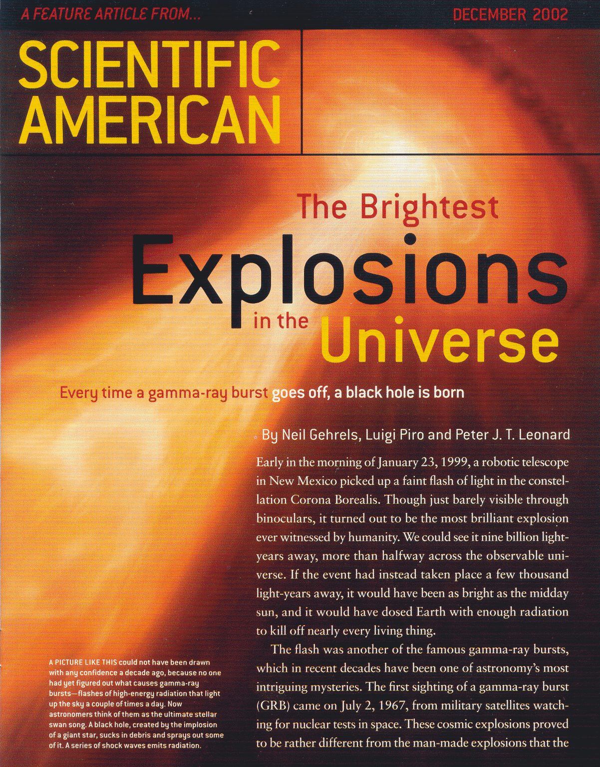
(Long)
Gamma-Ray
Bursts
Luigi Piro
Istituto Astrofisica Spaziale Fisica Cosmica - Roma
INAF

Slide 2
Summary
GRB: the breakthroughs of the last decade
Main theoretical and observational background
Clues to the progenitors
Cosmological Perspectives
GW

Slide 3
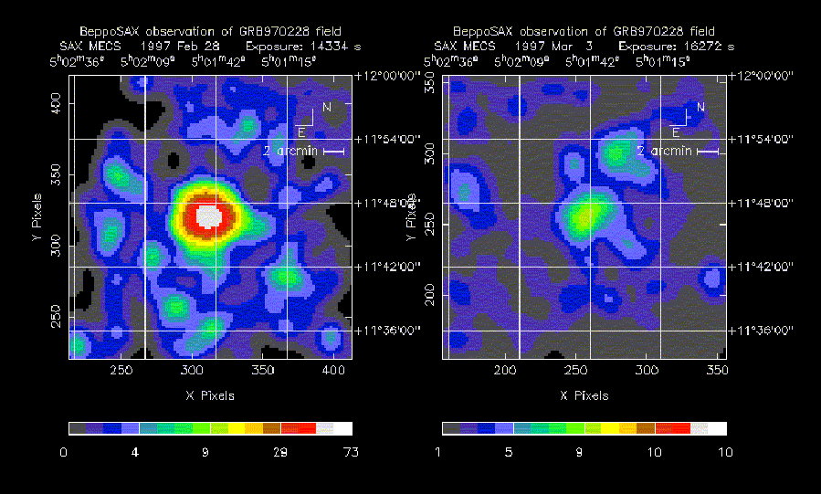
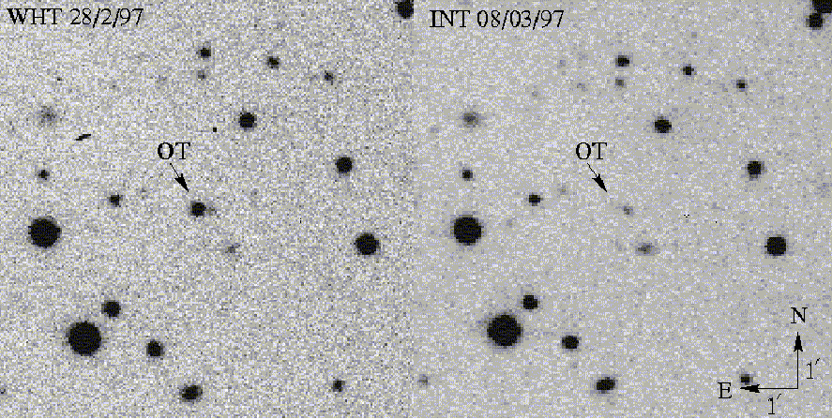
The BeppoSAX era: afterglows
GRB970228: Fast follow up with NFI in 8 hrs: a bright unknown X-ray source
A second pointing 3 days after the GRB: fading X-ray counterpart (Costa et al 1997)
Optical fading source (van Paradijs et al 1997)

Slide 4
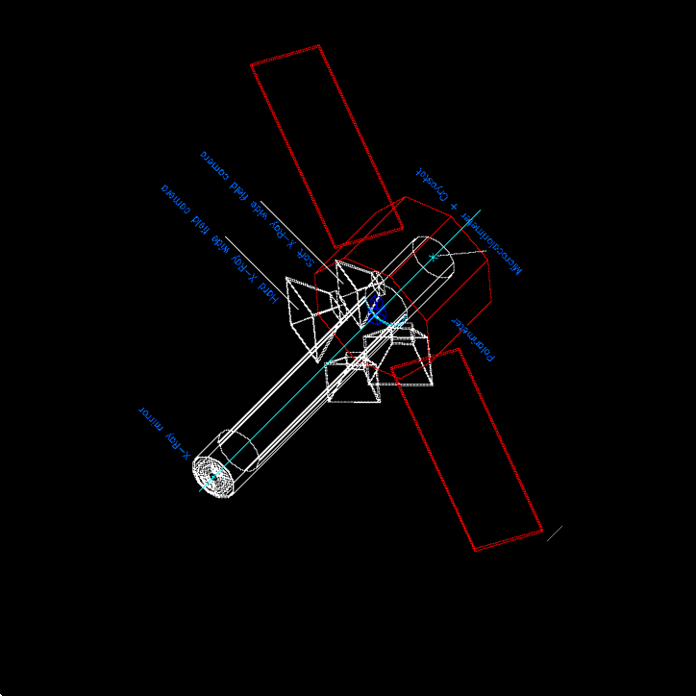
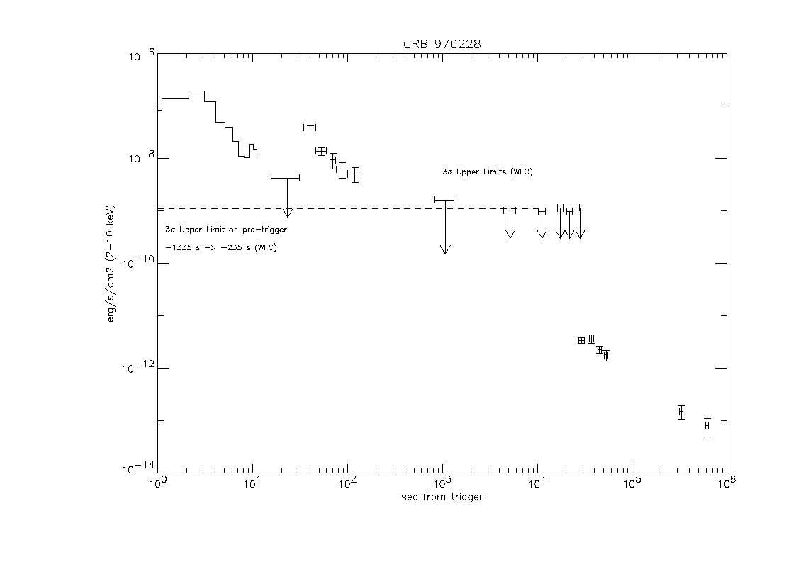
The fireball model
t=R/2cΓ²
10¹⁶ cm
10¹³ cm
10⁶ cm
γ RB
Γ₂
X-ray afterglow
Γ₁
t₋₁
t_{GRB}
t_{aft}

Slide 5
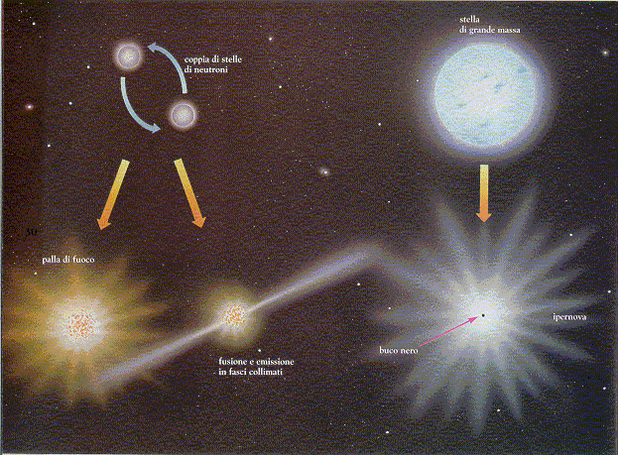
The progenitors of GRB
The nature of the progenitor can be inferred from the environment
NS-NS (BH-NS & BH-WD) travel far from their formation sites before producing GRB’s (Fryer et al 2000) => “clean environment”
Hypernovae/collapsar evolve much faster, going off in their formation site => “mass-rich environment”
NS- NS merging
Collapsar

Slide 6
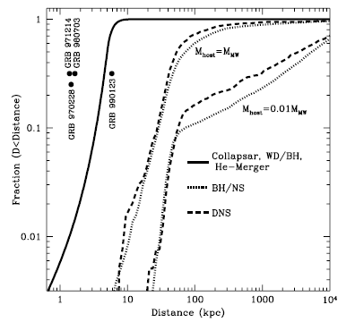
Progenitors and hosts
Collapsar
NS merger
Fryer, Woosley and Hartmann 1999

Slide 7
Host galaxies of long GRBs: Normal (spiral) showing star formation
most GRB within the half-light radius of the galaxy: star-formation sites and massive progenitors

Slide 8
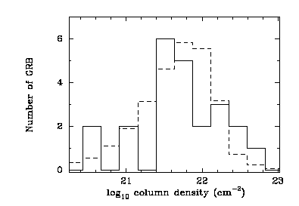
X-ray absorption in the
GRB local environment
  X-ray absorption column densities in the afterglow: NH=10²¹⁻²² cm⁻² (Stratta et al 2000, Campana et al 2006) Consistent with Giant molecular clouds

Slide 9
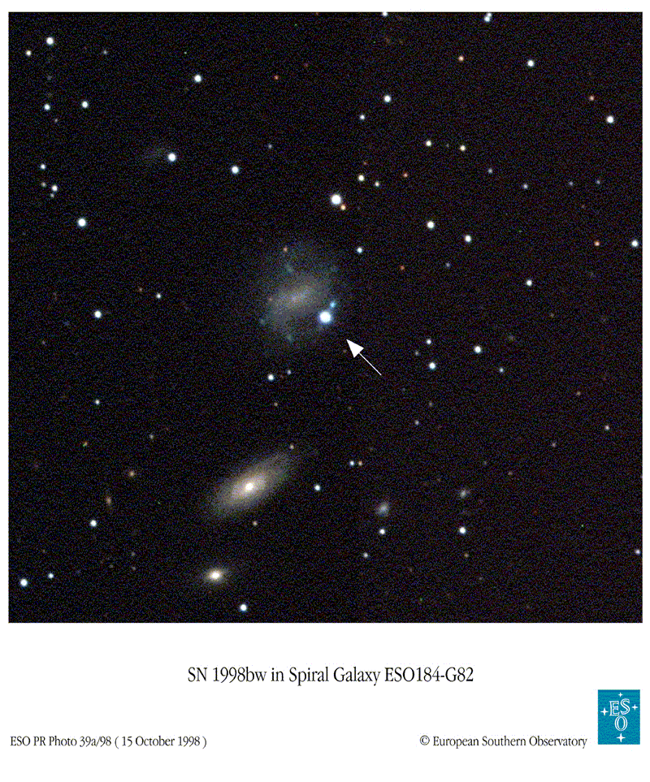
GRB-SN connection
GB980425: in the BeppoSAX error box: SN1998bw (Pian et al. 99,Kulkarni et al, Galama et al al 98). Exploded within 1 day from the GRB. Chance P=1E-4

Slide 10
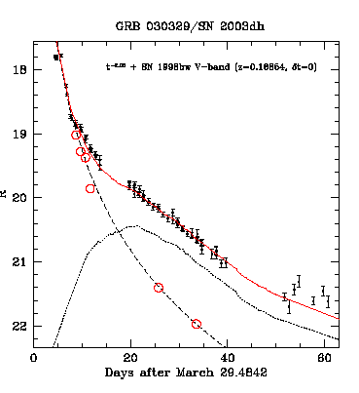
GRB-Sn: 030329
Sn contribution should appear when the power-law GRB afterglow has decreased (Bloom et al 98: GRB980326)
GRB030329: The nearest (and the brightest in HETE2 GRB) z=0.168 (Greiner et al, VLT)
SN spectrum (similar to 1998bw) emerging at about 10 days (Matheson et al 03, Hjorth et al 03).

Slide 11

Collapsar model
Sub energetic X-ray flashes
XRF (low Γ)
GRB (high Γ)
Woosley et al

Slide 12

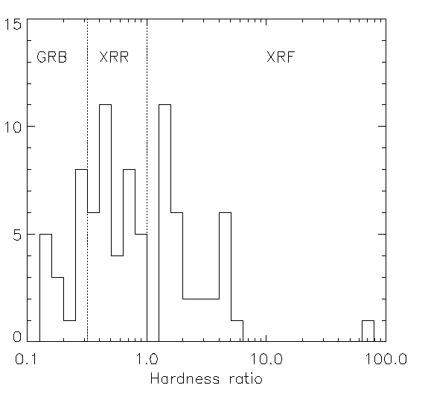
X-ray flashes
A New class discovered by BSAX and confirmed by HETE2: about 70% GRB’s with no or very faint or gamma-ray emission
high redshift GRBs
off-axis events
Subenergetic events, more numerous than normal GRBs
Heise et al 2001
Piro et al, 2009

Slide 13
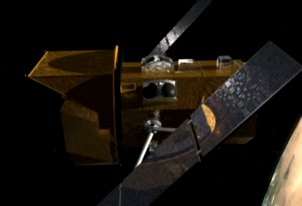
Entering SWIFT

Slide 14
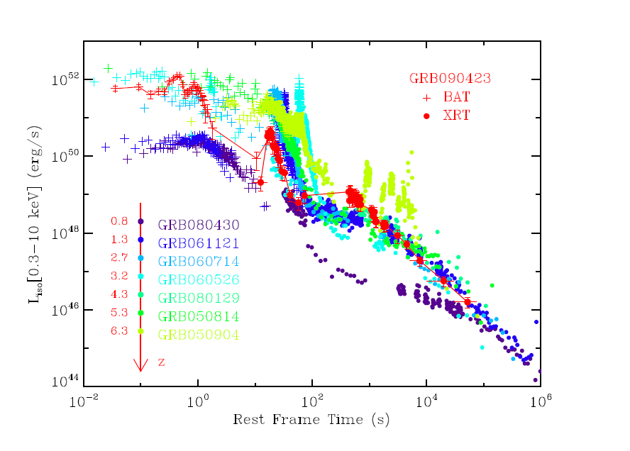
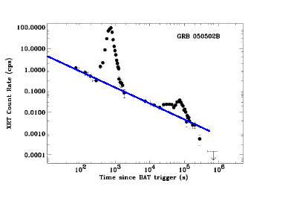
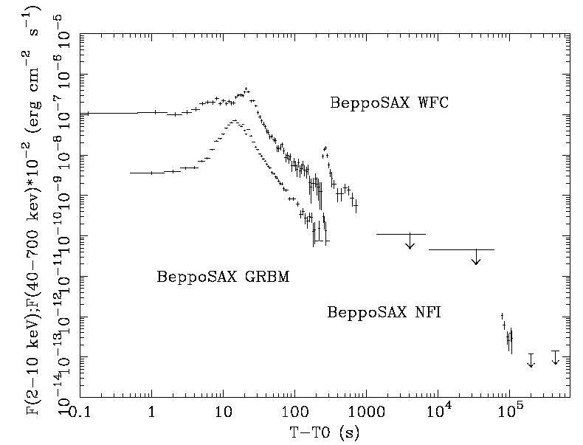
X-ray Flares /canonical light curve
BeppoSAX: Piro et al (2005)
SWIFT: Burrows et al (2005)
Salvaterra et al. 2009
Signature of long duration activity of the central engine
SWIFT: about 40% X-ray afterglows showing X-ray flares on time scales >100 sec (Chincarini et al 2007)

Slide 15
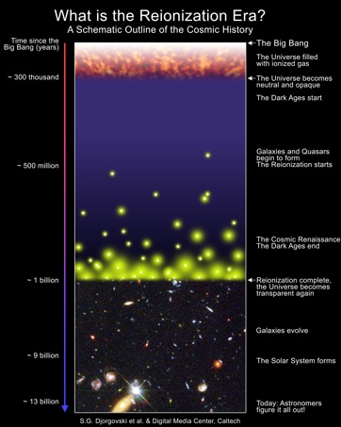
Dark GRBs
BeppoSAX showed that >90% GRB are followed by X-ray afterglows. Confirmed by SWIFT.
However only about 40% have optical afterglows.
Some: High z (z>5) events
Redshift only in X-ray or IR

Slide 16
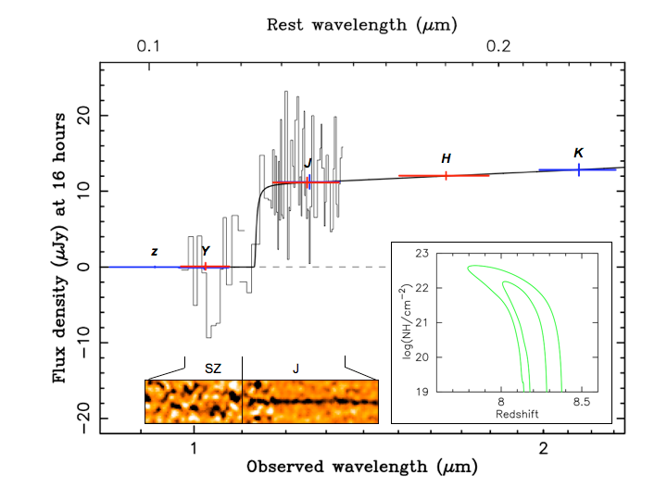
GRB 090423 z=8.3
Tanvir et al 2009
Notes:
GRB090423 z=8.2, the most distant object of the Universe! (vs z=6.96 for galaxies and z=6.43 for quasars)
625 Myrs after the Big Bang: massive star were being produced and ended as GRBs
Forming metals at z>10: 090423 and 050904 have intrinsic X-ray absorption a few 10²² cm⁻²
The only way to measure the redshift: X-ray and IR

Slide 17
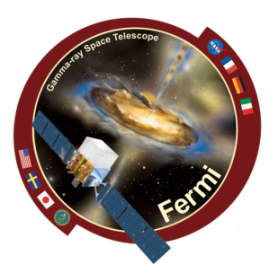
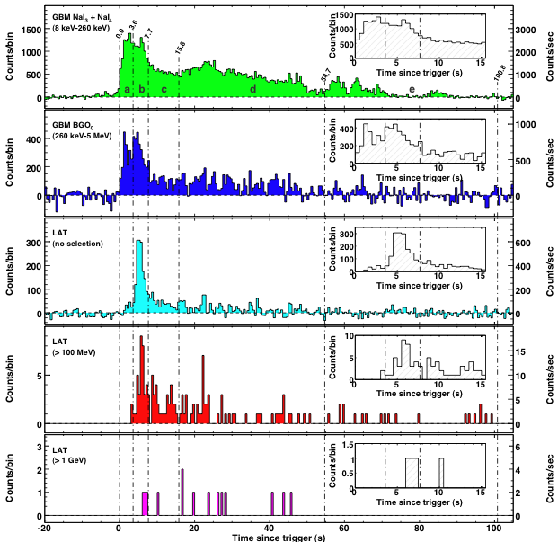
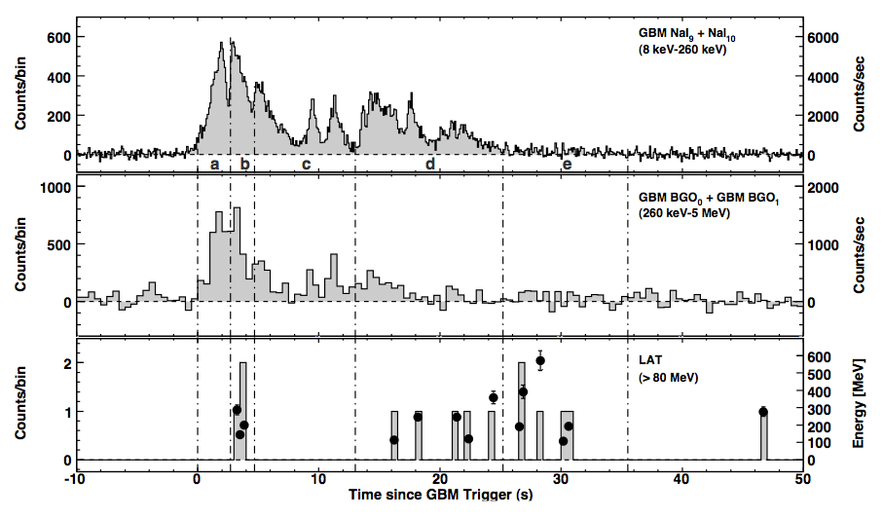
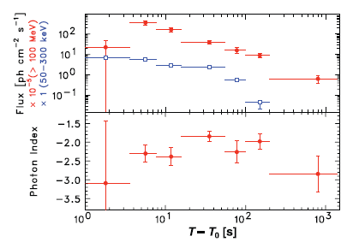
Fermi: Delayed HE
080825C, Abdo et al 2009
080916C, Abdo et al 2009

Slide 18
High energy emission from Fermi
Delayed (time scales of 10s): consistent with external shock
HE counterpart of X-ray flares (so far UL)
Variety of HE: presence/absence of additional (IC?) component: Y ~ ε_{e}/ε_{B}
Optical thickness argument Γ_{min} ~ 1000
And short bursts..

Slide 19

THE GRB PROGENITORS
The tell tale feature from GW
1) Electromagnetic window:
Afterglow: properties of the environment (host galaxy, density,..)
SN features
  Long: Yes (outliers?)
  Short. NO
LONG=COLLAPSAR
2) Gravitational waves by GRBs:
Collapsar:
in-spiral
b) merger,
c) ring down
Long duration central engine
Accretion tails of disk-BH
magnetar

Slide 20
Time delay GW-GRB
Collapsar case (e.g. Waxman and Meszaros 2003):
  the jet inside the star can be subrelativistic
  The jet stream needs to be maintained for several tens of seconds to overcome the pressure inside the star (cork effect)
NS-NS mergers
  Much shorter

Slide 21
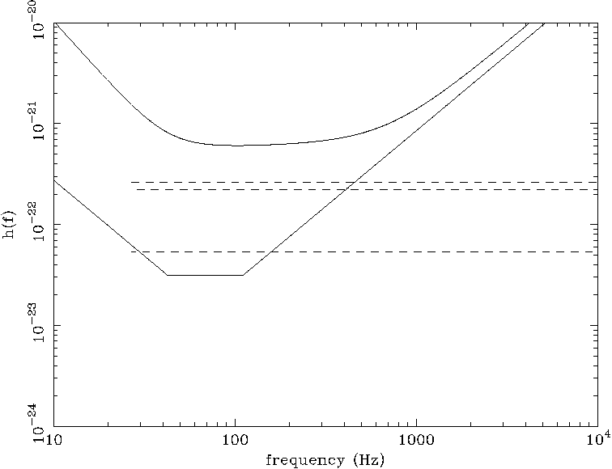
Long GRBs by VIRGO and LIGO
Collapsar m₁= m₂ =1 M
- - - - merger
2300 Mpc
Virgo
Upgraded Virgo
27 Mpc
23 Mpc
GRB 980425 d=40 Mpc
GRB020618 D=130Mpc
110 Mpc
Based on Kobayashi and Meszaros 2003

Slide 22
Prospect for GW
GW provide direct information on the central engine
Good prospect of detections from nearby GRB with advanced LIGO/VIRGO using EM trigger
Rate should be 10-100 times larger than EM burst, due to collimation (EM counterpart: XRF and Orphan afterglows)
Hopefully future GW could provide the trigger and coarse (1 deg position) to carry out fast follow up observations in X-rays with SWIFT or future mission like Xenia to detect the orphan afterglows of GRB jets pointing away from earth

Slide 23
End

