Slide 1
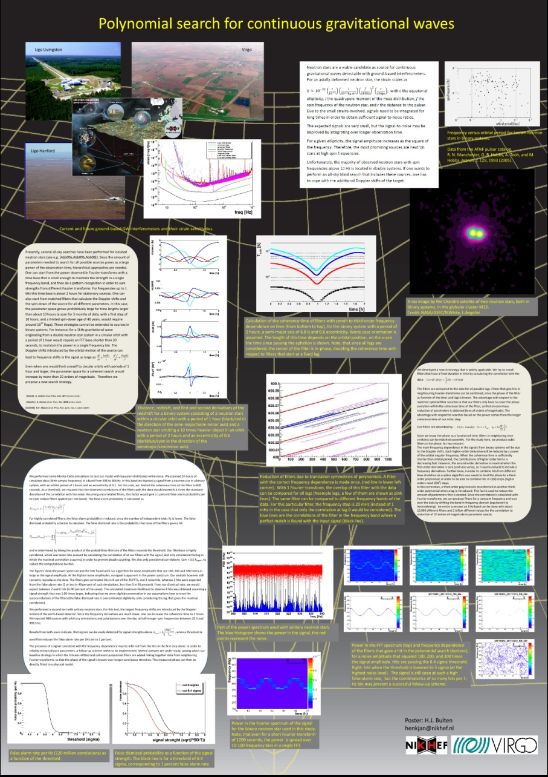
Polynomial search for continuous gravitational waves from neutron stars in binary systems
H.J. Bulten, J.F.J. van den Brand, S. van der Putten
Majority neutron stars at high spin frequencies are in binary systems
Blind all-sky search : not feasible with current techniques:
- power based: coherence time <~ 25 seconds
- optimal filter, F-statistic : parameter space with grow >20 orders of magnitude for searches of a month
New strategy: fit stretches with an empirical (polynomial) phase. Fit for lag in time-domain. Longer coherence times can be obtained, and less computing time is needed.
Widely applicable.

