Slide 1
Toward the Computation
of
Gravitational Wave Signatures
from
Three-Dimensional Multi-Physics Simulations
of
Core Collapse Supernovae
with Konstantin Yakunin (FAU), Pedro Marronetti (FAU), and the ORNL-FAU-NCSU CHIMERA team

Slide 2
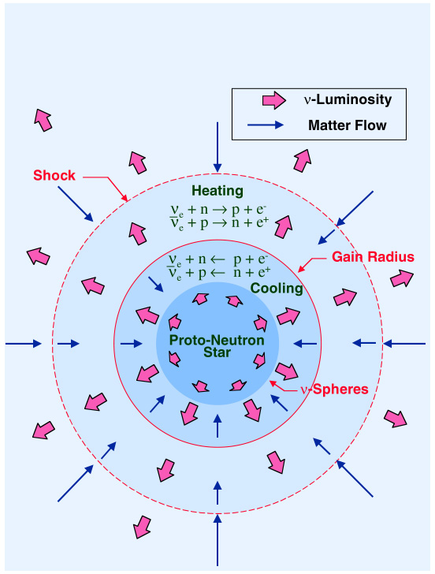
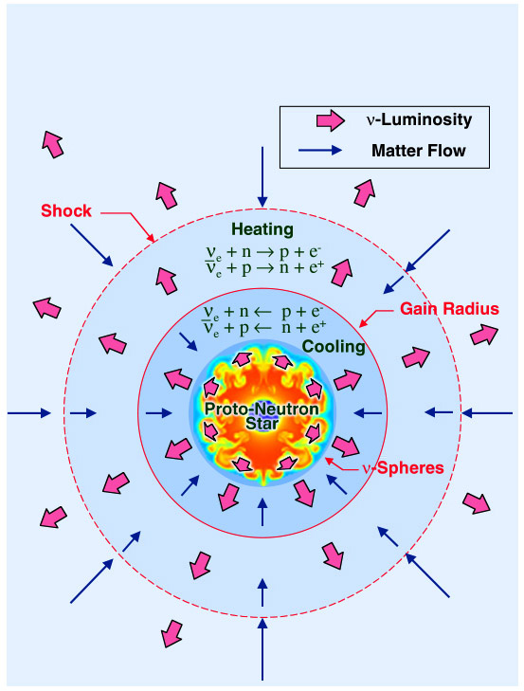
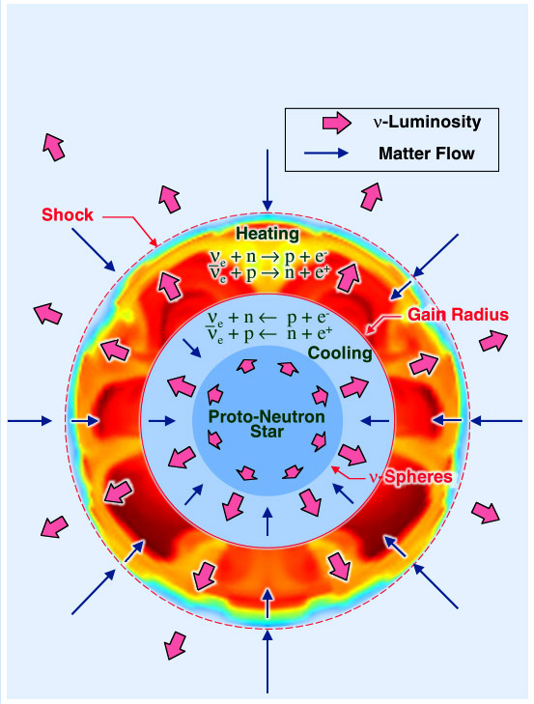
How is the supernova shock wave revived?
Known, Potentially Important Ingredients
Gravity
Neutrino Heating
Convection
Shock Instability
Nuclear Burning
Rotation
Magnetic Fields
Need 3D models with all of the above,
treated with sufficient realism.

Slide 3
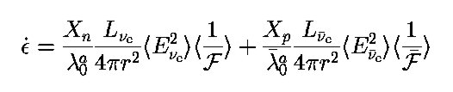
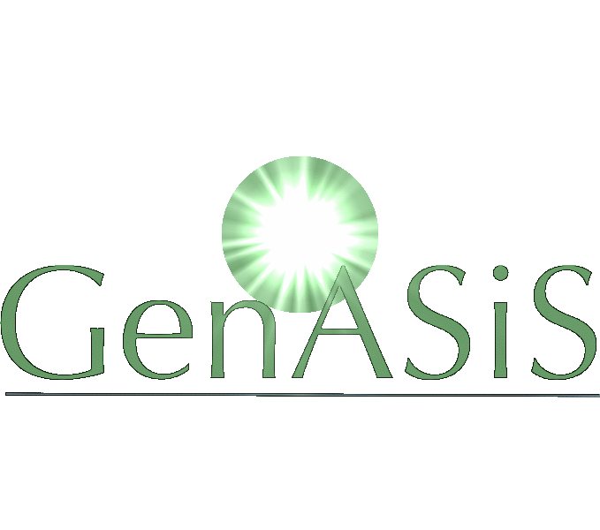

Neutrino Heating
Neutrino heating depends on
neutrino luminosities, spectra,
and angular distributions.
Neutrino heating is sensitive to all three (most
sensitive to neutrino spectra).
  Must compute neutrino distributions.
Multifrequency
Multiangle
CHIMERA
Multifrequency
(Parameterize
Isotropy)
Gray
(Parameterize
Isotropy and
Spectra)

Slide 4
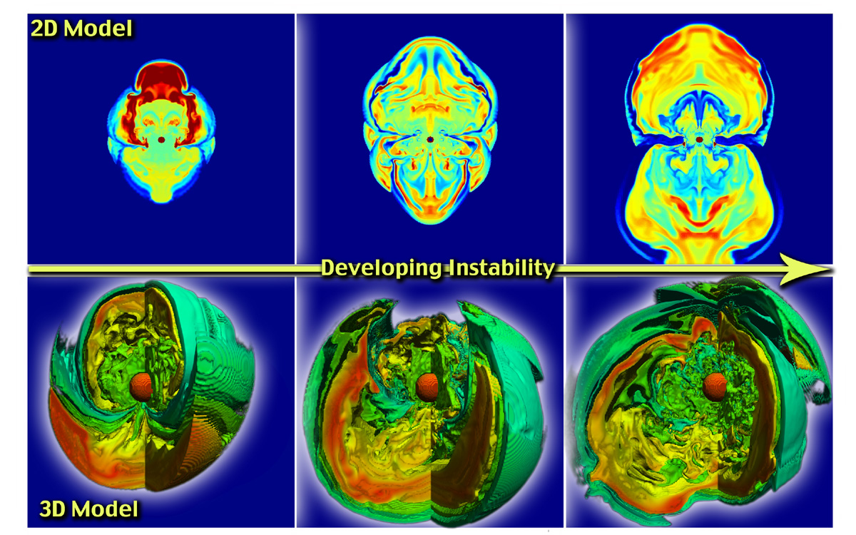
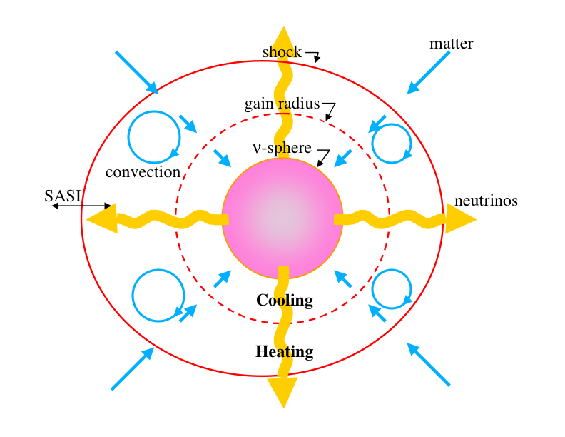
Stationary Accretion Shock Instability (SASI)
Blondin, Mezzacappa, & DeMarino, Ap.J. 584, 971 (2003)
Decreases advection velocity in gain region.
Increases time in the gain region.
Moves shock toward silicon/oxygen layers.
Generates convection.
  Marek and Janka, Ap.J. 694, 664 (2009)
Shock wave unstable to non-radial perturbations.
SASI has axisymmetric and nonaxisymmetric modes
that are both linearly unstable!
  – Blondin and Mezzacappa, Ap.J. 642, 401 (2006)
  – Blondin and Shaw, Ap.J. 656, 366 (2007)
  – Blondin and Mezzacappa, Nature, 445, 58 (2007)

Slide 5
Ongoing 2D Multi-Physics Supernova Models
  Bruenn et al., Journ. Phys. Conf. Ser., 180, 012018 (2009)
Simulation Building Blocks
“RbR-Plus” MGFLD Neutrino Transport
  O(v/c), GR time dilation and redshift, GR aberration (in flux limiter)
2D PPM Hydrodynamics
  GR time dilation, effective gravitational potential,
  adaptive radial grid
Lattimer-Swesty EOS
  180 MeV (nuclear compressibility),
  29.3 MeV (symmetry energy)
Nuclear (Alpha) Network
  14 alpha nuclei between helium and zinc
2D Effective Gravitational Potential
  Marek et al. A&A, 445, 273 (2006)
Neutrino Emissivities/Opacities
  “Standard” + Elastic Scattering on Nucleons
  + Nucleon–Nucleon Bremsstrahlung
“Ray-by-Ray-Plus” Approximation
Radial transport allowed.
Lateral transport suppressed.
  Buras et al. A&A, 447, 1049 (2003)
CHIMERA

Slide 6
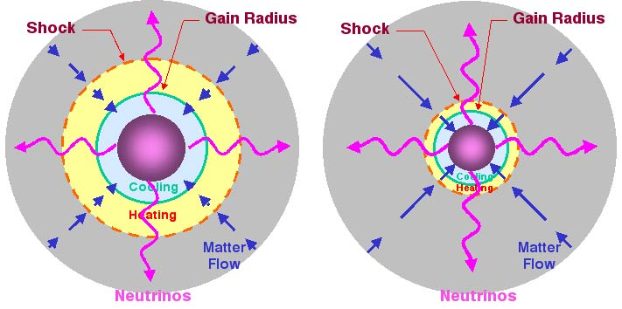
Newtonian versus GR
A comparison of key radii in a Newtonian versus a general relativistic model (25 Solar Masses):
Bruenn, DeNisco, and Mezzacappa, Ap.J. 560, 326 (2001)

Slide 7
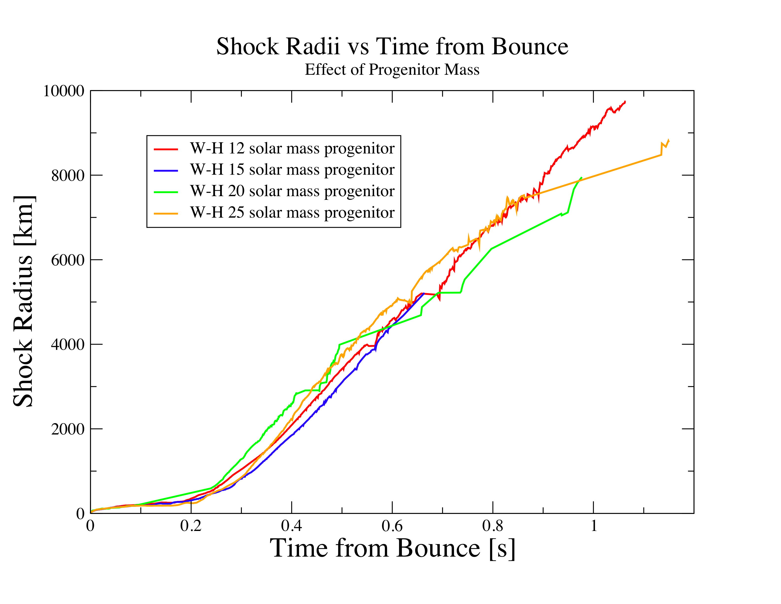
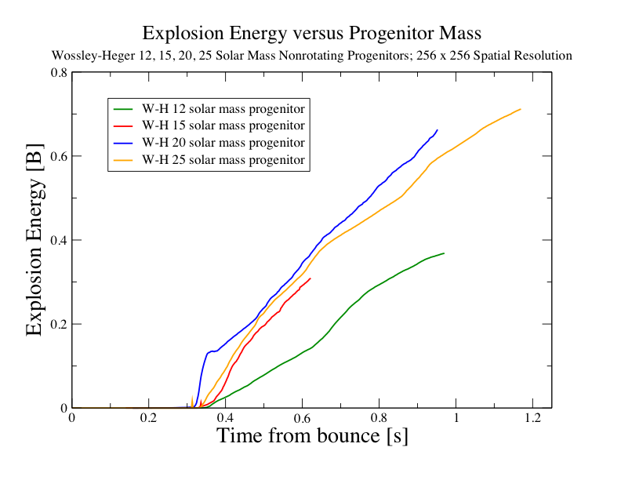
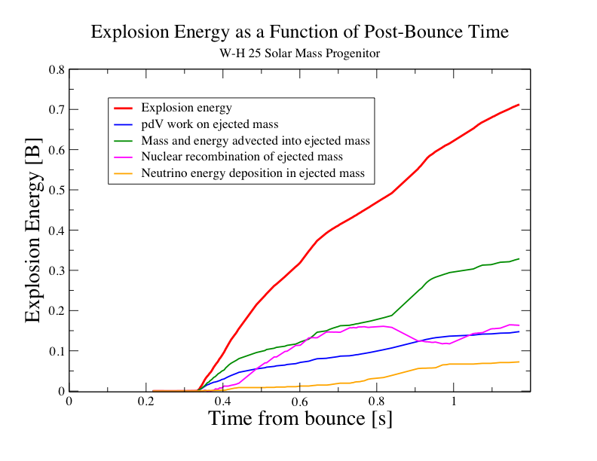
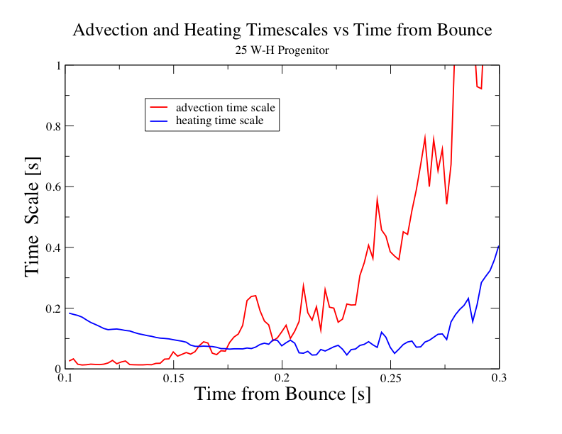

Slide 8
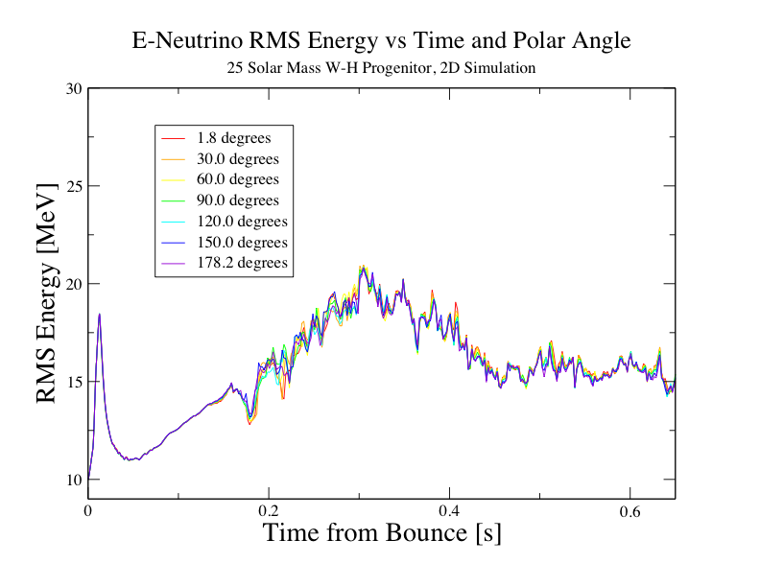
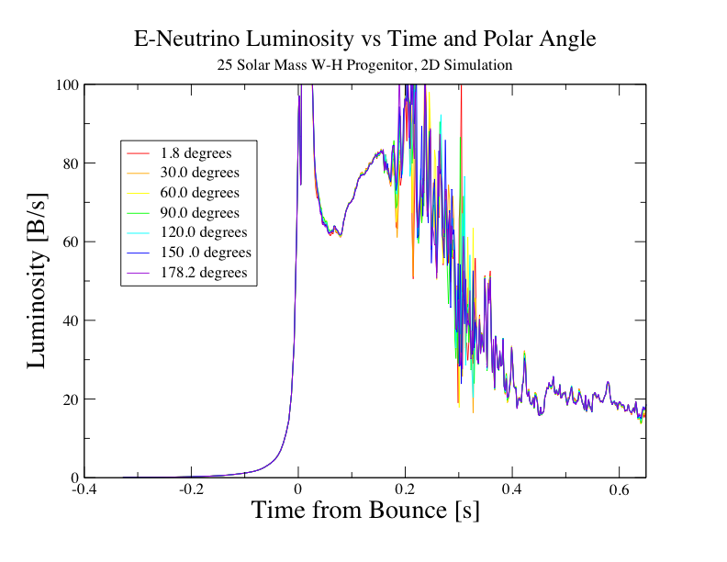
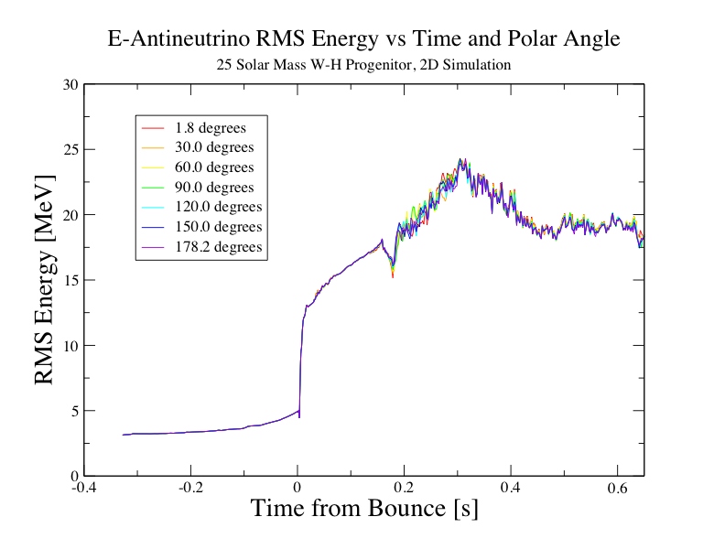
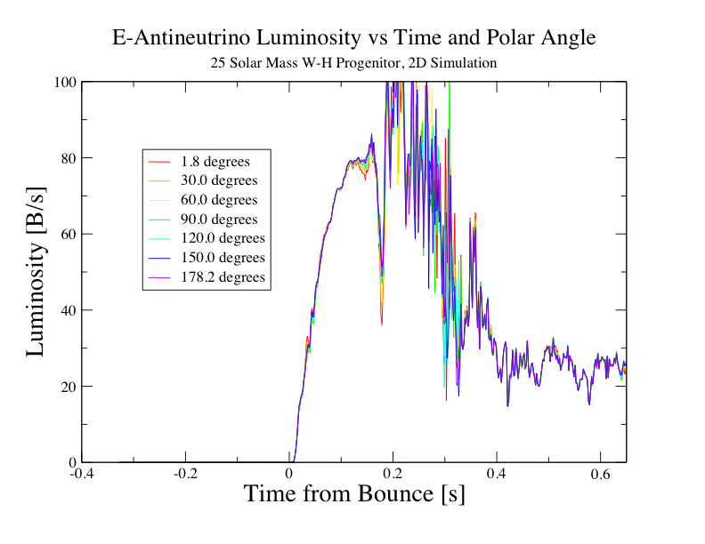

Slide 9


Slide 10
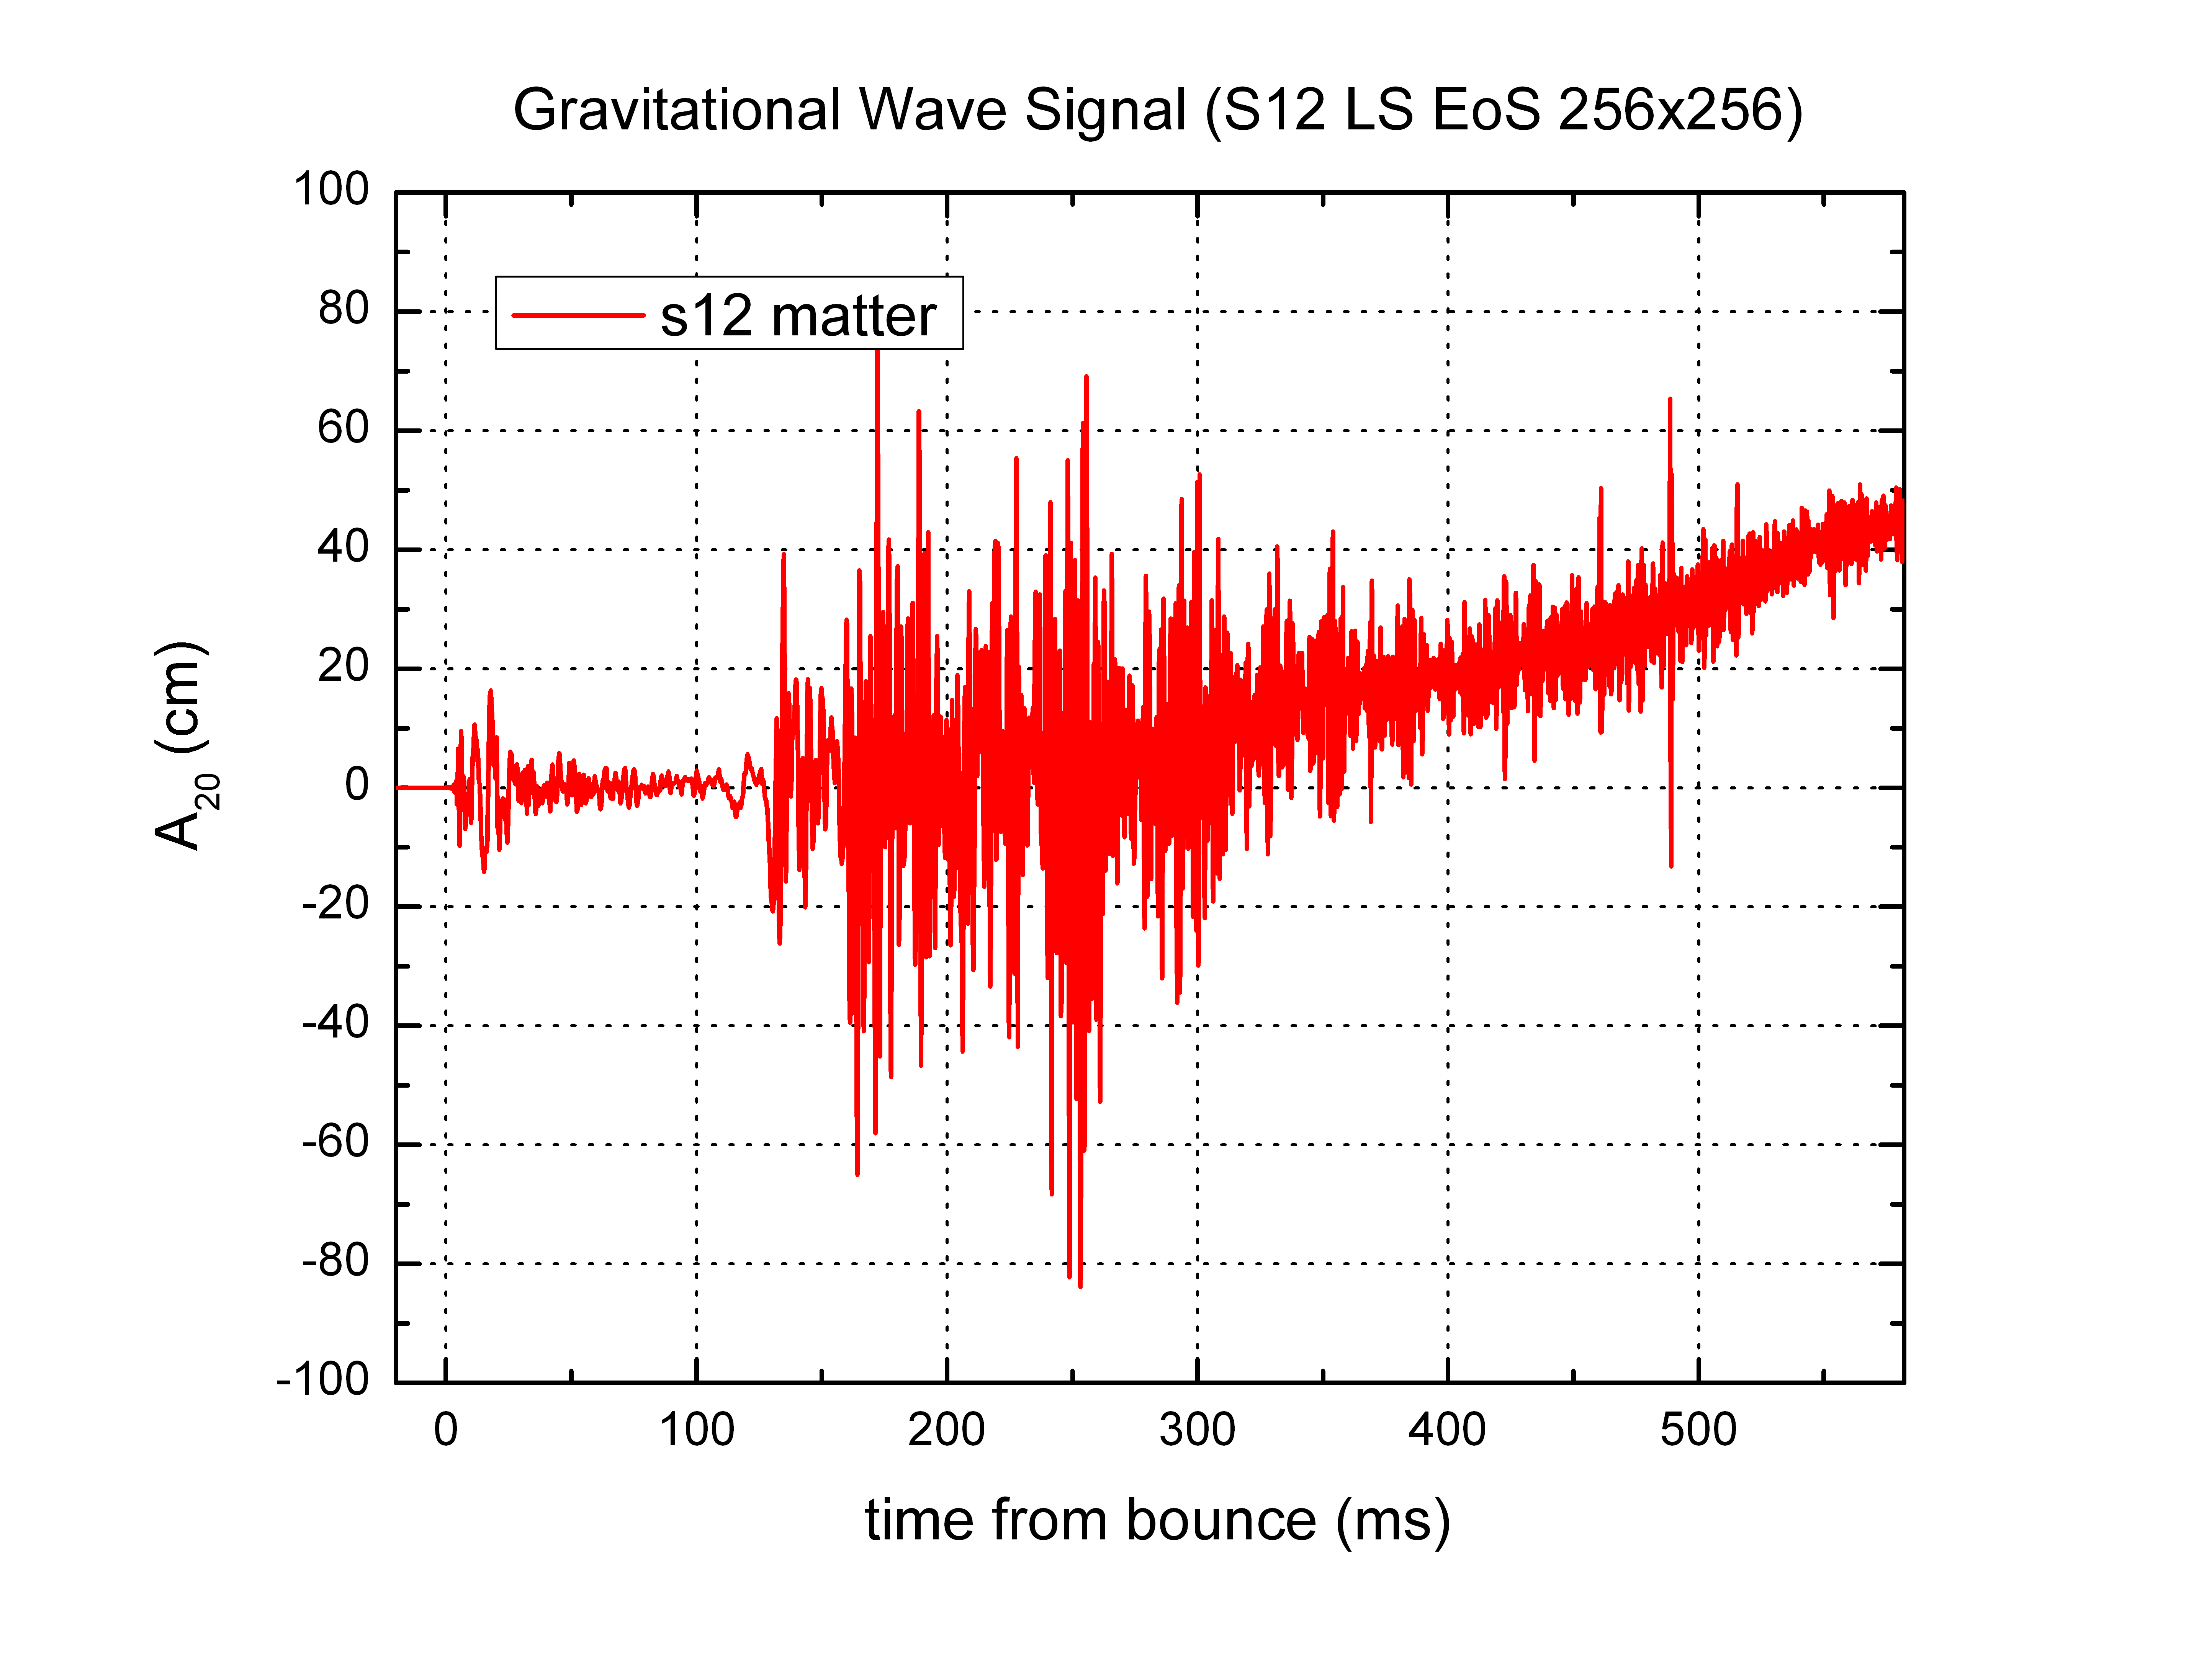
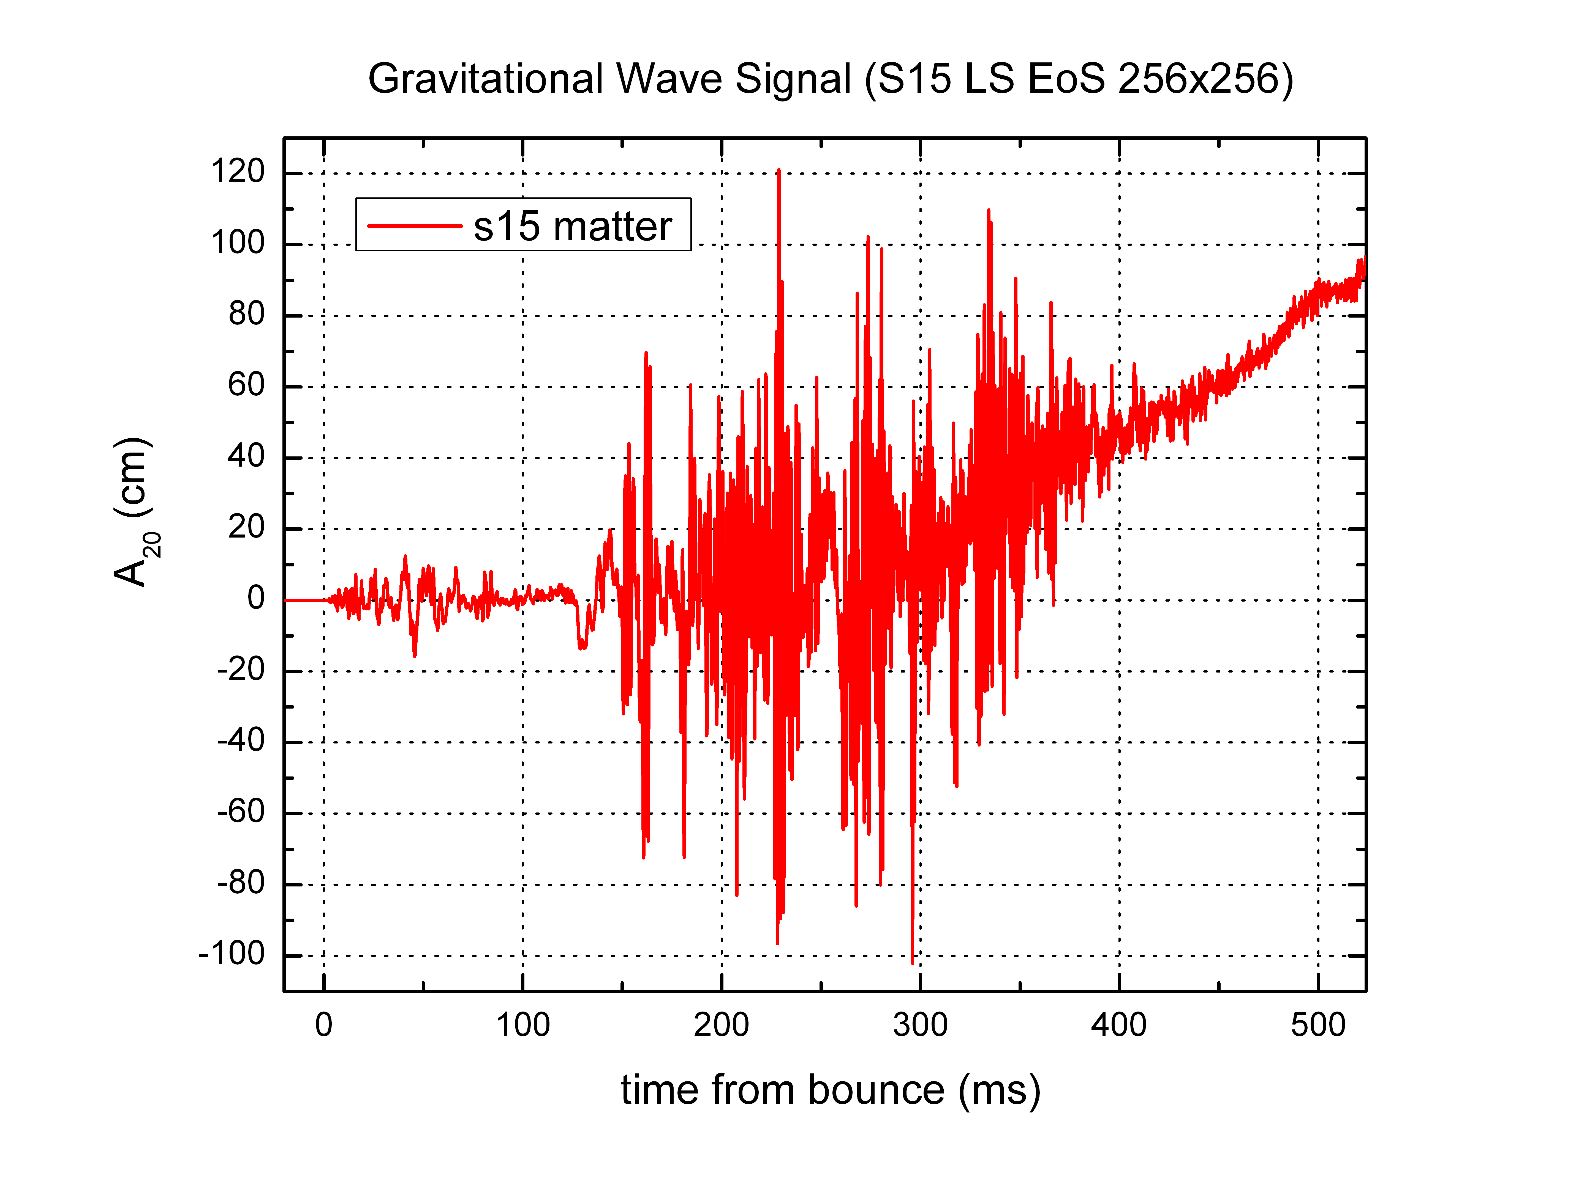
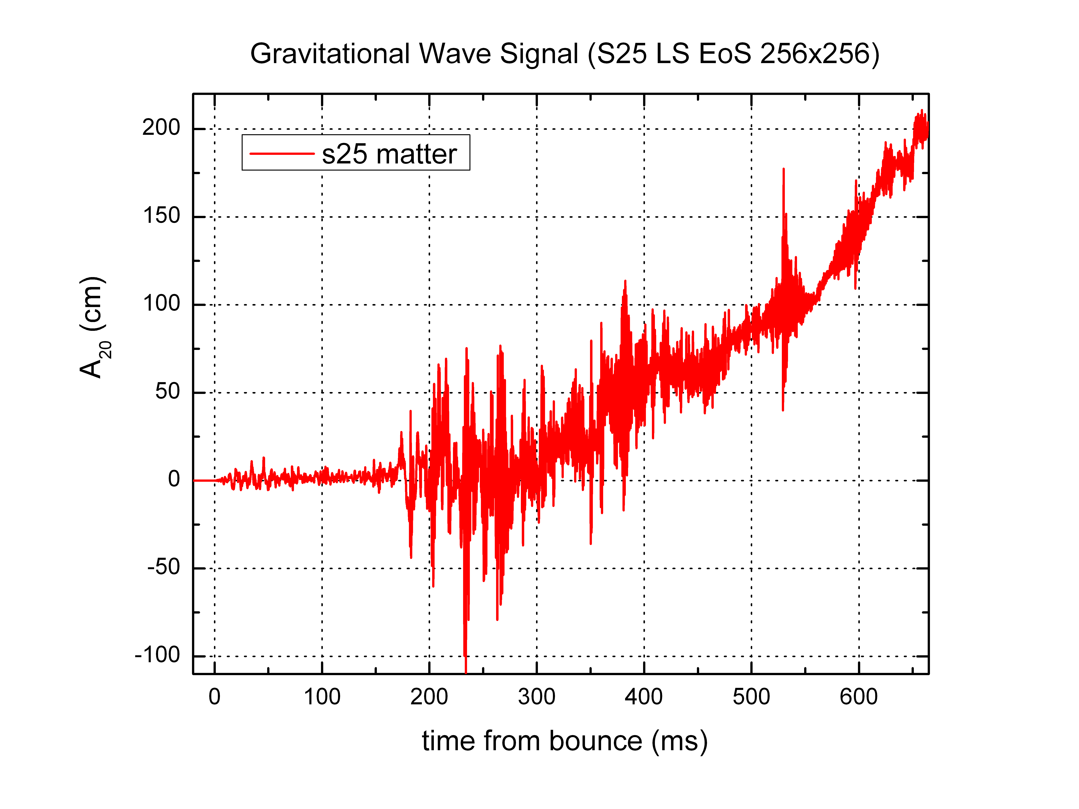
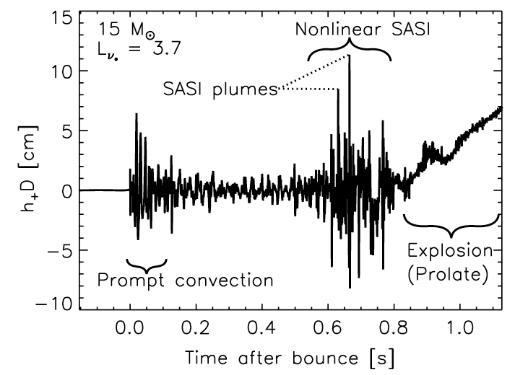
  Prediction from parameterized model.
Murphy, Ott, and Burrows, Ap.J. 707, 1173 (2009)

Slide 11
Anatomy of a Gravitational Wave Signal
Prompt Convection
Early Shock Deceleration
Lower-Frequency Envelope: SASI-Induced Shock Excursions
Higher-Frequency Variations: Impingement of Downflows on
PNS from Neutrino-Driven Convection and SASI
Later Rise: Prolate Explosion/Deceleration at Shock

Slide 12
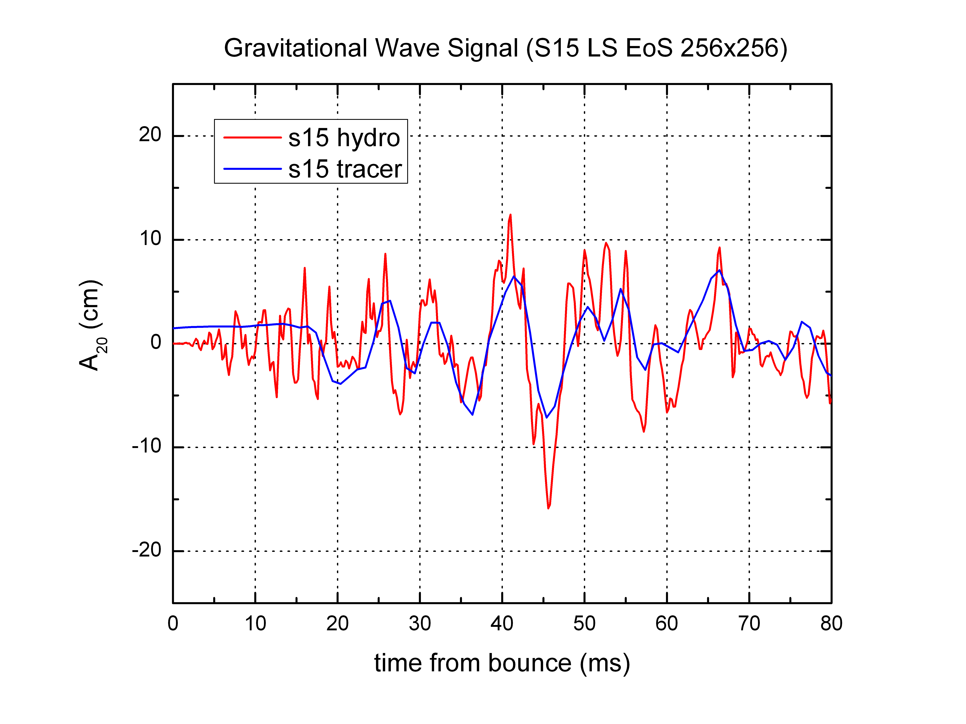
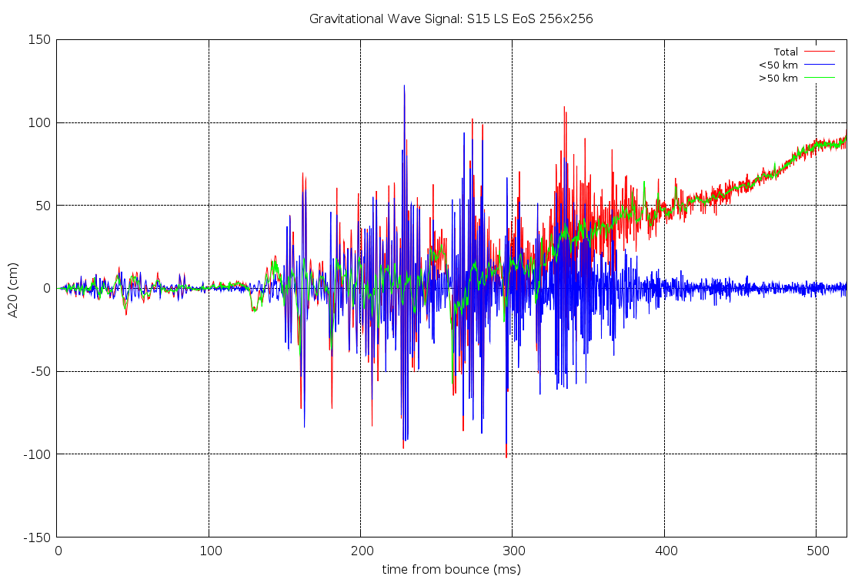
Anatomy of a Gravitational Wave Signal
Shock Deceleration
Shock Deceleration
Prompt Convection
Convection/SASI-induced features emanate from
< 50 km (PNS).

Slide 13
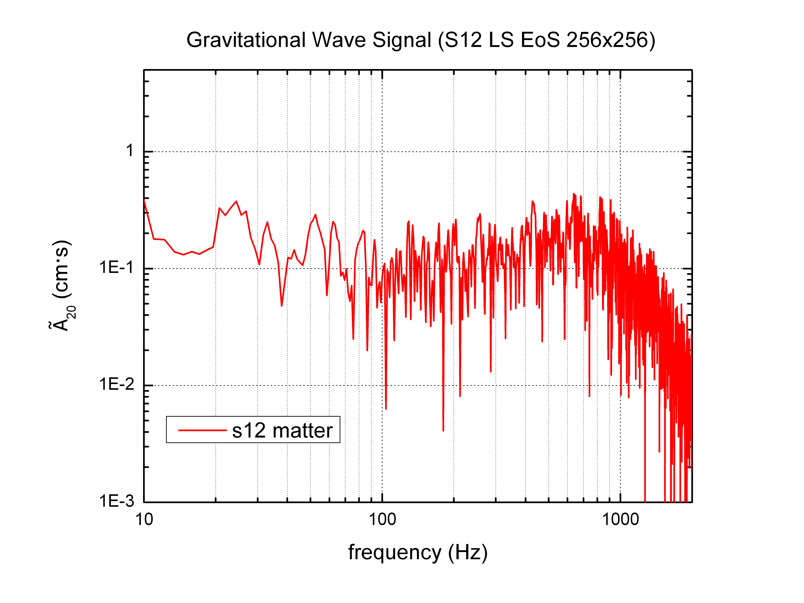
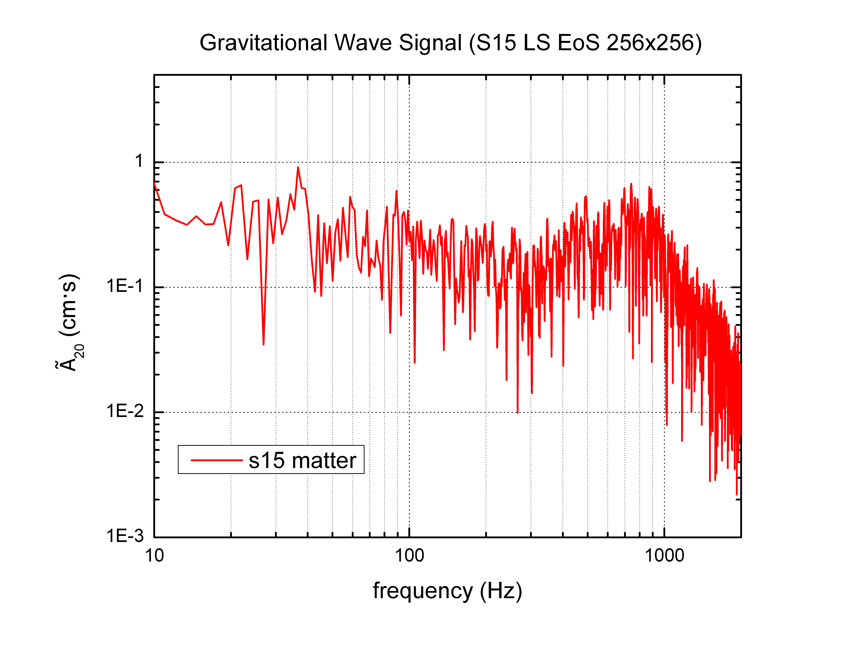
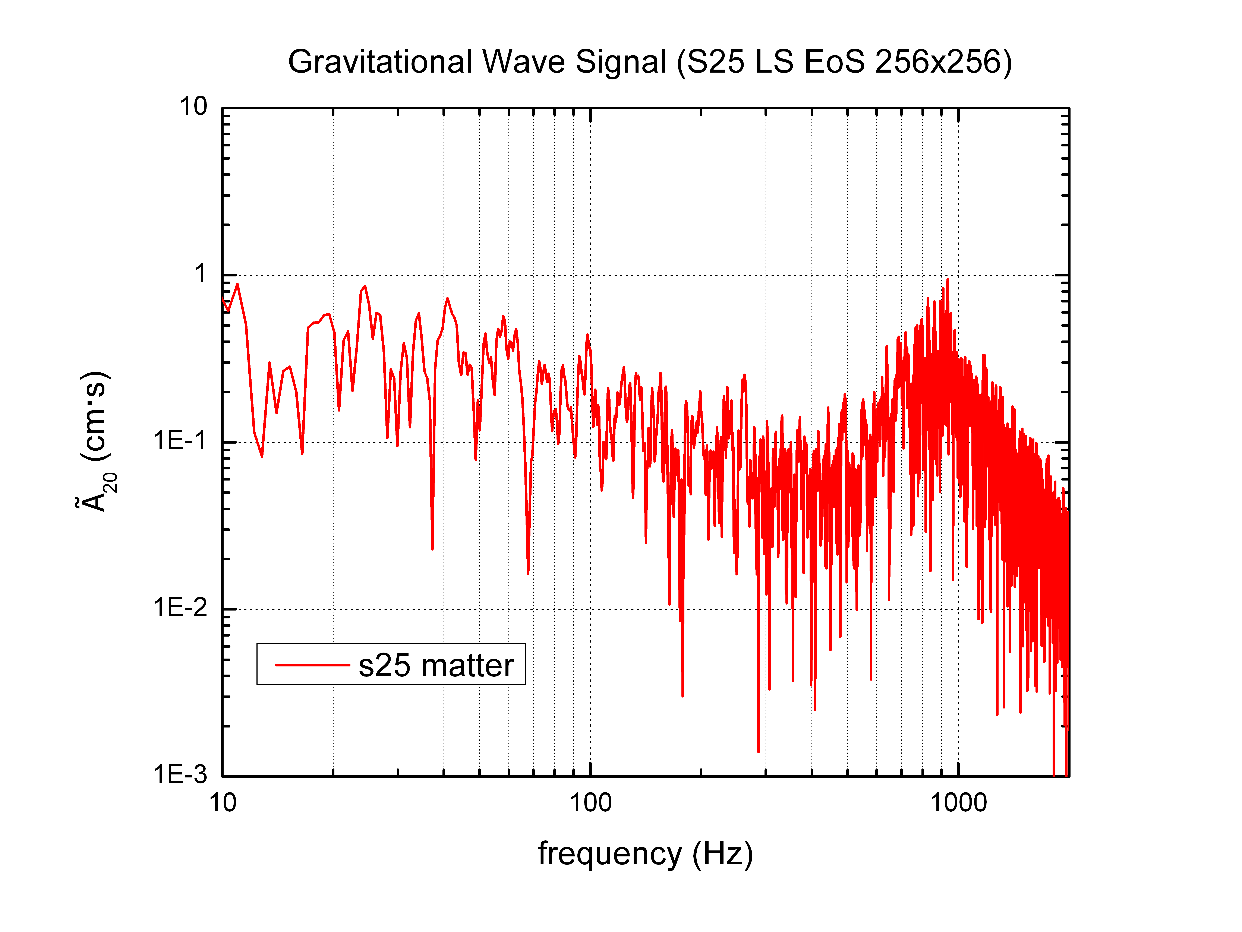
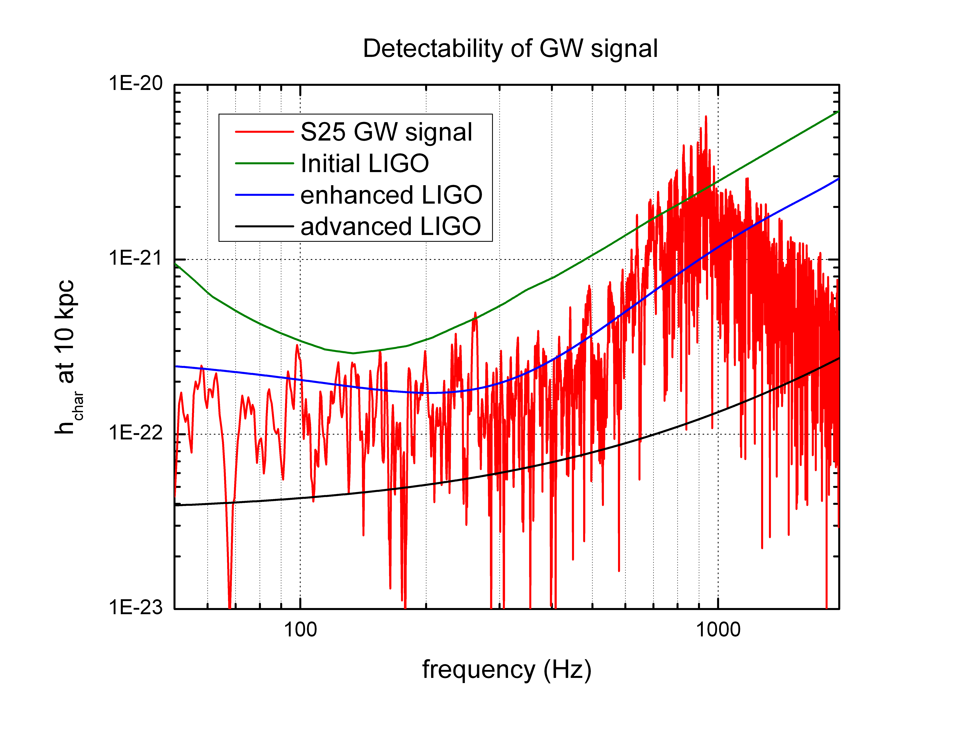

Slide 14
Ongoing 3D Multi-Physics Simulations
  Bruenn et al., Journ. Phys. Conf. Ser., 180, 012018 (2009)
Simulation Building Blocks
“RbR-Plus” MGFLD Neutrino Transport
  O(v/c), GR time dilation and redshift,
  GR aberration (in flux limiter)
3D PPM Hydrodynamics
  GR time dilation, effective gravitational potential,
  adaptive radial grid
Lattimer-Swesty EOS
  180 MeV (nuclear compressibility),
  29.3 MeV (symmetry energy)
Nuclear (Alpha) Network
3D Effective Gravitational Potential
  Marek et al. A&A, 445, 273 (2006)
Neutrino Emissivities/Opacities
  “Standard” + Elastic Scattering on Nucleons
  + Nucleon–Nucleon Bremsstrahlung
Resolution
304 X 76 X 152
  11,552 processors
576 X 96 X 192
  18,432 processors
512 X 256 X 512
  131,072 processors
25 M processor-hours

Slide 15
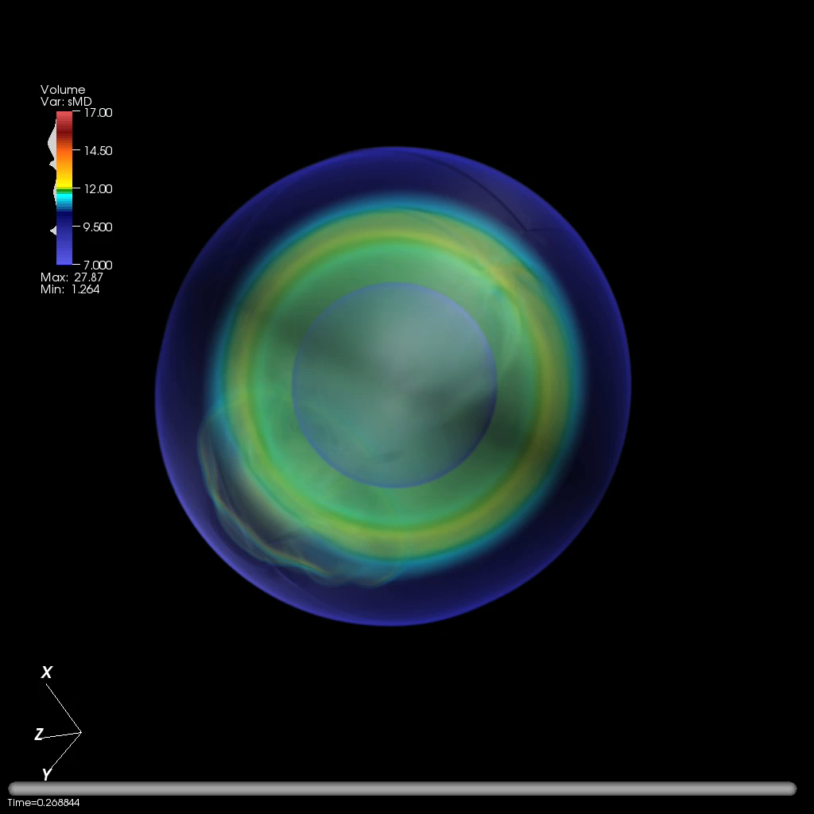

Slide 16
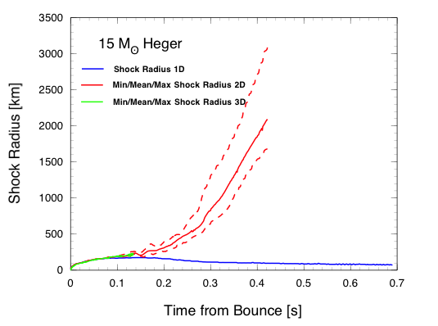

Slide 17
Conclusions
And Outlook
Gravitational wave signatures, including the explosion phase, for a range of
stellar progenitors have been computed in non-parameterized models.
A more complete gravitational wave “template” has emerged from this work.
The models predict signatures that should be detectable by Advanced LIGO for
a Galactic event.
Fundamental limitation of the work reported here: The imposition of axisymmetry – i.e., it’s 2D.
  3D simulations are ongoing.
Other model improvements completed or underway:
  Replacement of GR approximation with BSSN.
  Replacement of RbR approximation with full GR transport.

Slide 18
The Bigger Picture
These are exciting times for core collapse supernova modeling and their GW emission detection:
  We are rapidly approaching the point where realistic and detailed predictions of gravitational
  wave emissions from core collapse supernovae are possible.
  There is significant consistency between the ORNL-FAU-NCSU and MPA 2D simulation
  results: Both teams demonstrate robust neutrino-driven explosions over a range of
  stellar progenitors. (We differ in details that likely result from the use of different
  progenitors. More detailed comparisons are underway.)
    A significant step forward in supernova theory, and one with significant ramifications
    for gravitational wave prediction.
  Our ongoing 3D models will hopefully be completed in time for Advanced LIGO in early 2011
  [Abbott et al., Rep. Prog. Phys. 72, 076901 (2009)].
  Can we move from “transient, unmodeled” to “transient, modeled”?

Slide 19








Collaborators
Blondin
Warren
Bruenn
Marronetti
Yakunin
Dirk
Fuller
Budiardja
Cardall
Endeve
Hix
Lentz
Messer
Mezzacappa
Parete-Koon
Funded by
Collaborators
Solvers: D’Azevedo
Data Management: Barreto, Canon, Klasky, Podhorszki
Networking: Beck, Moore, Rao
Visualization: Ahern, Daniel, Ma, Meredith, Pugmire, Toedte
Cray Center of Excellence: Levesque, Wichmann

