Slide 1
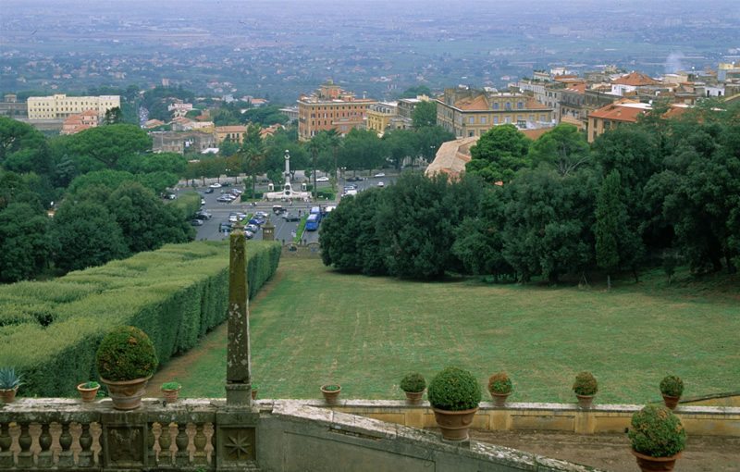
Lambda polarization/Fracture Functions/Spin Directed Momentum Shifts
Gary R. Goldstein
Tufts University
3d parton distributions: path to the LHC
Frascati, Nov.2016
3d-2016 GR.Goldstein

Slide 2
Collaborators
Lambda polarization/Fracture Functions/Spin Directed Momentum Shifts
Work in preparation done in collaboration with Simonetta Liuti, Dennis Sivers
Experimental communications with Pasquale Di Nezza
and Liliet Calero Diaz
3d-2016 G.R.Goldstein

Slide 3

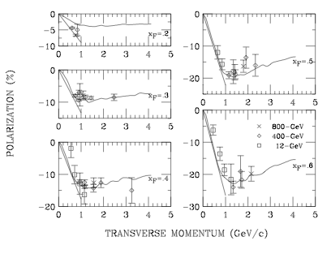
Large polarization in hadron+hadron
p+p→ 𝞚 + X Polzn(x_{F}, p_{T})
compiled by K.Heller (1997)
Curves Dharmaratna & GG
Ramberg, et al.,(FNAL) PLB338, 403 (1994)
3d-2016 GR.Goldstein

Slide 4
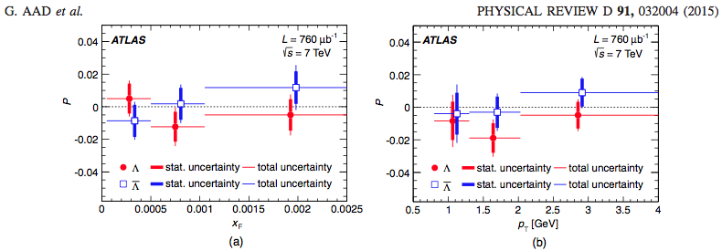
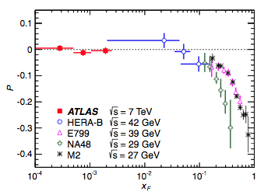
LHC Λ↑ polarization
ATLAS at 7 TeV (Phys.Rev.D91,032004 (2015)) very small x_{F} P(x_{F},p_{T}, s)
<P_{Λ}>=-0.010±0.005±0.004
0.8<p_{T}<1.5 GeV, 5x10⁻⁵<x_{F}<0.01
P(x_{F},p_{T}, s)=-P(-x_{F},p_{T}, s) → P(0,p_{T}, s)=0
3d-2016 GR.Goldstein

Slide 5
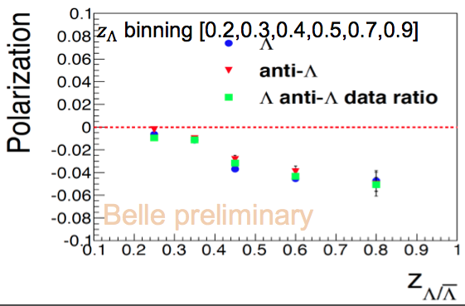
Polarized fragmentation function
Yinghui Guan BELLE e⁺e⁻→Λ antiΛ + X SPIN2016
Indiana University & KEK
3d-2016 GR.Goldstein

Slide 6
(at quark level? m=0 & PQCD - no SSA) Kane, Pumplin, Repko
→P_{Λ} ~
Inclusive A+B->C+X: sum over all X particles
Possibly relate to A+B+anti-C forward elastic. GRG & J.F.Owens (76)
3d-2016 GR.Goldstein

Slide 7
Spin degrees of freedom in pp scattering
Outstanding puzzle!
Set of all data compiled by K. Heller
Collinear Factorization
Non Collinear Factorization?
D. Boer, DIS 2010
Go beyond collinear factorization,
Insert k_{T} and polarization dependent
Fragmentation function
➔ Polarizing Fragmentation Function
3d-2016 GR.Goldstein

Slide 8
Spin: Problem of Polarization of Hyperons and Charmed Baryons in pp collisions
p
Λ
p
What generates polarization?
3d-2016 GR.Goldstein

Slide 9
Evolving Ideas about Source of 𝜦 Polarization in Hadrons
Semi-classical: Lund; Thomas precession; SU(6); Soffer, et al.
Q Field Th: Single polarization requires interference =>Real x Im part & helicity flip
Kane, Pumplin, Repko: PQCD (PRL41,1689(1978)→P_{Λ}~
Complete order α_{s} calculation of quark, antiquark, gluon 2-body scattering →s +sbar imbedded in hadron+hadron pdf’s (but small m_{S}) (Dharmaratna & GG 1990,1996)
How does s get translated to 𝜦 & enhanced?
Acceleration of s to (ud) remnant of N (Thomas precession effect?)
NPQCD must play a significant role in our understanding of orbital angular momentum & hadron formation.
3d-2016 GR.Goldstein

Slide 10
Model of hyperon polarization
Dharmaratna & GRG (1990,96,99)
P_{Λ}
1. p+p →𝞚+X has large negative
P_{𝞚} with flat s dependence &
growth with p_{T} (see Heller . . .)
2. Clues: K⁻ p →𝞚+X at
176 GeV/c or √s=18GeV
Polzn even larger - need s-quark?
3. Simple factorization expectation
Kane, Pumplin, Repko
P_{𝞚} ~
helicity flip ~ m_{q}/hard energy scale
Soft phenomenon?
Dharmaratna & GRG: 1. Gluon fusion
dominant mechanism for producing
polarized
massive quark pair
2. Low p_{T} phenomenon
3. Acceleration mechanism
p_{T} (GeV)
p+p→𝞚+ X Polzn(𝞚)
compiled by K.Heller (1997)
3d-2016 GR.Goldstein

Slide 11
Extending D&G model to LHC for p+p→s(Λ)+X
(Ignore the ups & downs – imprecise MC simulations)
3d-2016 GR.Goldstein

Slide 12
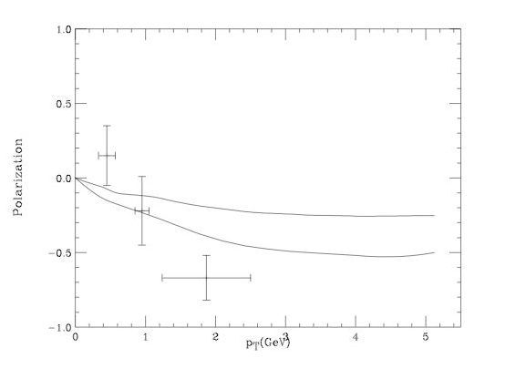
Hyperon and Charmed Hyperon Polarization
P_{Λc}
u
d
Λ_{c}
p_{T} (GeV)
⬇
anti-c
p+p ➔Λ_{C}+X Polzn(Λ_{C}) E791
Large mass scale
_{Λc}
p
11/30/2016
12
3d-2016 GR.Goldstein

Slide 13
Charmed Hyperon Polarization
Polarization 𝞚_{C}
p_{T} (GeV)
P(𝞚_{c}) vs. p_{T} (GeV) for several x_{F} values)
E.M. Aitala, et al. (E791 Collaboration) “Multidimensional Resonance Analysis of Λ_{c}+ → pK− π+” , Fermilab 1999.
Theory Curves: GG, hep-ph/9907573
P(𝞚_{c}) does not fall off with p_{T}
Important Trend to be tested?
3d-2016 GR.Goldstein

Slide 14
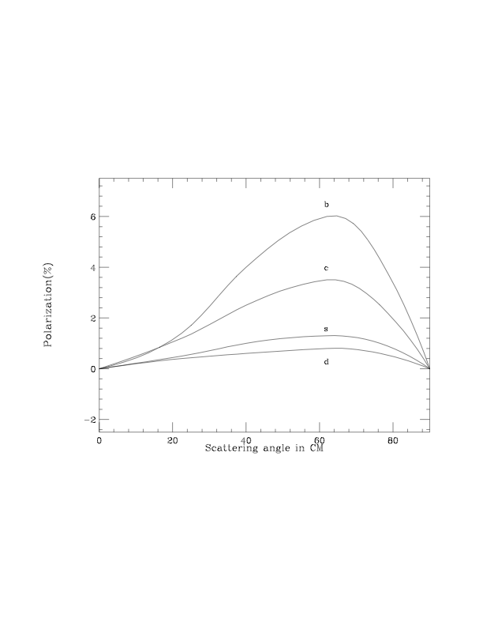
P_{quark} vs. flavor
from gluon fusion
grows with flavor
Does this give
larger P_{hadron} for
heavier flavor?
What sets scales?
quark “mass” or
hyperon mass
P_{quark}
b
c
s
d
g+g→Q+ X
Polzn(Q)~ m_{Q}/√s
(Dharmaratna & GG 1990,1996)
3d-2016 GR.Goldstein

Slide 15
P_{quark} vs. flavor
from gluon fusion
grows with flavor
Does this give
larger P_{hadron} for
heavier flavor?
No Λ_{b} Polzn @
LHC
LHCb:
P(Λ_{b})=0.06±0.07±0.02
all small x_{F}
P_{quark}
b
c
s
d
g+g→Q+ X
Polzn(Q)~ m_{Q}/√s
(Dharmaratna & GG 1990,1996)
3d-2016 GR.Goldstein

Slide 16
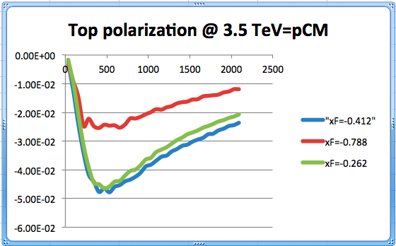
Direct measure of hard process - top polarization
preliminary predictions of D&G PQCD
(GG & S.Liuti, arXiv:1201:0193)
Preliminary!!
Analyze t--> W⁺ b
ATLAS: 𝛼_{ℓ}P_{CPC}=-0.035±0.014±0.037

Slide 17
Hyperon and Charmed Hyperon Polarization
work with S. Liuti, P. Di Nezza, L. Calero Diaz
Interpretation in language of GPDs:
Generalized Fracture Functions
(Trentadue & Veneziano)
P_{Λc}
u
d
Λ_{c}
p_{T} (GeV)
⬇
anti-c
p+p ➔Λ_{C}+X Polzn(Λ_{C}) E791
Large mass scale
_{Λc}
p
11/30/2016
17
3d-2016 GR.Goldstein

Slide 18
How to get to
hyperon Polz’n?
s quark accelerates toward (ud) remnant of proton
u
d
Λ
p
p
Need sea s-quark
⬇
uud-color-8
Λ
u
d
Λ
p
⬇
p
anti-s
Box represents loop
contributions to Im part.
Seen as GPD already
have Im part!
⬇
Need light antiquark
3d-2016 GR.Goldstein

Slide 19
How are quark polarizations measured?
3d-2016 GR.Goldstein

Slide 20
How are quark polarizations measured?
Hadronization of polarized or unpolarized heavy flavor quark
mixes Fragmentation Functions (Anselmino, Boer, et al.)
with small p_{T} production mechanisms – factorization?
Initial or Final state interactions?
3d-2016 GR.Goldstein

Slide 21
How are quark polarizations measured?
Hadronization of polarized or unpolarized heavy flavor quark
mixes Fragmentation Functions (Anselmino, Boer, et al.)
with small p_{T} production mechanisms – factorization?
Initial or Final state interactions?
Unpolarized quark → hadron ⇑ + X for larger p_{T?}
3d-2016 GR.Goldstein

Slide 22
How are quark polarizations measured?
Hadronization of polarized or unpolarized heavy flavor quark
mixes Fragmentation Functions (Anselmino, Boer, et al.)
with small p_{T} production mechanisms – factorization?
Initial or Final state interactions?
Unpolarized quark → hadron ⇑ + X for larger p_{T?}
Top quarks decay before hadronizing ⇒
decays are “self analyzing”
Unique feature of heavy flavors
⇒ provide window into heavy flavor QCD
3d-2016 GR.Goldstein

Slide 23
Evolving Ideas about Source of Λ Polarization in Hadrons
Semi-classical: Lund; Thomas precession; SU(6)
Q Field Th: Single polarization requires interference =>Real x Im part & helicity flip
Kane, Pumplin, Repko: PQCD→P_{Λ}~
Complete order α_{s} calculation of quark, antiquark, gluon 2-body scattering →s +sbar imbedded in hadron+hadron pdf’s (Dharmaratna & GG 1990,1996)
How does s get translated to 𝜦 ?
Consider electroproduction of 𝜦’s. Prelude to hadron production. QCD more under control.
  Soft matrix elements from TMDs & SIDIS or GPDs &/or Fracture Functions
3d-2016 GR.Goldstein

Slide 24
Electroproduction of 𝜦
Extended fracture function (Trentadue & Veneziano, PLB323 1994)
Fracture Functions represent a joint probability
for current quark (or antiquark or gluon) at x_{B} , k_{T}
and target hadron at fraction of target momentum z, p_{T} .
M
X
z=E_{Β} /(1-x)E_{γP CM} for target fragment
P_{Β}⁺=z(1-x)P⁺
P
B=Λ,Σ,Ξ
3d-2016 GR.Goldstein
24

Slide 25
Diquark model for Fracture Functions
GG & S.Liuti, Nuovo Cim.C035N2 (2012) 327; arXiv:hep-ph:1201.0193
δ((k+q)²)→x=x_{Bj}
3d-2016 GR.Goldstein

Slide 26
Spin directed momentum transfers in diquark model
(D. Sivers, hep 2016, and GG, S.Liuti and D. Sivers work in progress)
Hyperon (Λ) polarization is generated from the correlation of the strange quark spin and transverse momentum: s_{T} •(l_{T}x p_{T})
3d-2016 GR.Goldstein

Slide 27



Different nomenclatures for spin dependent fracture functions
(Anselmino, Barone, Kotzinian, PLB 699,108 (2011) see also Ceccopieri & Mancusi)
Fractured Collins Heppelman, Ladinsky Functions FCHLF
Two additional functions introduced in D. Sivers correspond to polarized Λ production (hep…)
Polarizing Fracture Functions PFF
Fractured Boer Mulders Functions FBMF
where Δ^{N} represents asymmetry
( q,q ) scalar & {q,q} axial vector diquark
3d-2016 GR.Goldstein

Slide 28
Every case of SSA requires both transverse momentum &
Spin asymmetry.
e.g. e+p↑→ e +π +X with “𝛾” & p collinear in ±z direction
then asymmetry for S_{p} ∙ k_{T} × p where
k_{T} & p form plane.
k_{T} is “Spin Directed Momentum Transfer”
see D. Sivers
δ k_{TN} for target nucleon
Or e+p→e+ Λ↑ + X asymmetry for S_{Λ} ∙ l_{T} × p
l_{T} is SDM
δ p_{TΛ} for quark or diquark fragmenting into Λ
Spin in each case is transverse – transversity basis
SDM’s carry information from target region to/from current region
Quantum Entanglement
Ongoing collaboration with D. Sivers, S. Liuti, GG
3d-2016 GR.Goldstein

Slide 29
diquark model extended fracture function
quark correlator for Extended Fracture Functions
helicity labels <P, 𝜦_{N}| & |P_{h} ,𝜦_{𝜦} ; X >
For unpolarized dσ, sum over all helicity labels.
Normed by momentum sum rule.
For polarized 𝜦, keep floating
3d-2016 GR.Goldstein

Slide 30
diquark model extended fracture function
GG & S.Liuti, Nuovo Cim. C035N2 (2012) 327;
And GG, S.Liuti, D. Sivers, work in progress
proton diquark process
diquark Lambda process
3d-2016 GR.Goldstein

Slide 31
diquark model extended fracture function
preliminary
3d-2016 GR.Goldstein

Slide 32
Outline
Λ_{s,c,b} polarization Puzzles and Uses
Large polarization in hadron processes
  Very large p+p➔ A_{N} , A_{NN} , π’s
  Very large Pol’zn for inclusive 𝞚 & 𝛴
  Intriguing Systematics
  Explanations? Basic evidence for non-perturbative systematics of hadron structure & formation.
  Charmed & heavy hyperons (Fermilab fixed target)
  Interpret within diquark picture as an instantiation of quantum entanglement.
  Will hyperons maintain large Pol’zn?? Need understanding of NPQCD mechanism
  Future program at LHCe ?
  If we do not understand large SSA’s we do not understand NPQCD !
3d-2016

Slide 33
Backup?

Slide 34
Fractured Collins Heppelman, Ladinsky Functions FCHLF
Polarizing Fracture Functions PFF
Fractured Boer Mulders Functions FBMF
Every case of SSA requires both transverse momentum &
Spin asymmetry. Consider LUND model::
For B↑ visualize via diquark (q) pulling color flux tube
& breaking into q anti-q pair carrying k_{T} & -k_{T} to form Baryon
Positive k_{T} with q_{T} forms baryon with p_{T}⋍k_{T} + q_{T}
L ⋍ 1, ³P₀ so L_{z} =±1, 0 . +1 favored by k_{T}>0.
  Then q (q,q) → baryon system has spin -1/2.
3d-2016 GR.Goldstein

Slide 35
Every case of SSA requires both transverse momentum &
Spin asymmetry. Consider LUND model
(Andersson, et al. PLB85, 417 (1979))
For Λ↑ visualize via diquark (ud) pulling color flux tube
& breaking into s s-bar pair carrying k_{T} & -k_{T} to form Baryon
Positive k_{T} with q_{T} forms baryon with p_{T}⋍k_{T} + q_{T}
L ⋍ 1, ³P₀ so L_{z} =±1, 0 . +1 favored by k_{T}>0.
  Then s (u,d) → baryon system has spin -1/2.
3d-2016 GR.Goldstein

Slide 36
𝜦
X
x,k_{T}
k+q
GG & S.Liuti, Nuovo Cim. C035N2 (2012) 327;
Spin dependence?
a. non-trivial quark or proton-𝞚 spin correlation ➔ axial diquark
b. SSA need phase ➔ beyond tree
Figure shows final state interaction contribution to 𝜦
3d-2016 GR.Goldstein

Slide 37
𝜦
X
x,k_{T}
k+q
Figure shows final state interaction contribution to 𝞚
Im
3d-2016 GR.Goldstein

Slide 38
Final State Interactions or gauge links . . . .
Recall f.s.i. (e.g. Brodsky, Hwang & Schmidt; Gamberg & GG, etc.)
P_{y}=C_{F}α_{s}(μ²)
Im
GG, in progress
3d-2016 GR.Goldstein

