Slide 1

WP13 – JRA 1
Status of the innovative gas detectors work package WP13
Silvia Dalla Torre, Imad Laktineh

Slide 2
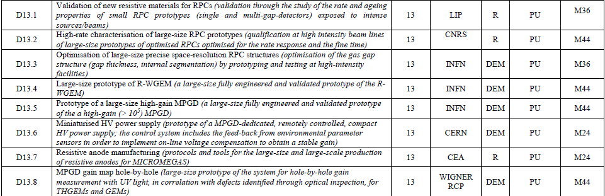
DELIVERABLES

Slide 3
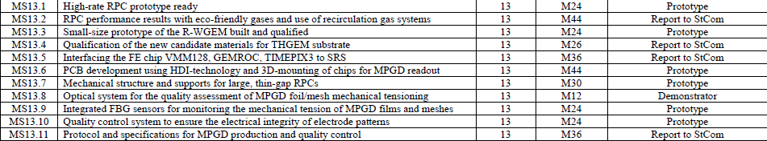
MILESTONES
MS13.8
A report is already ready. It will be soon submitted

Slide 4
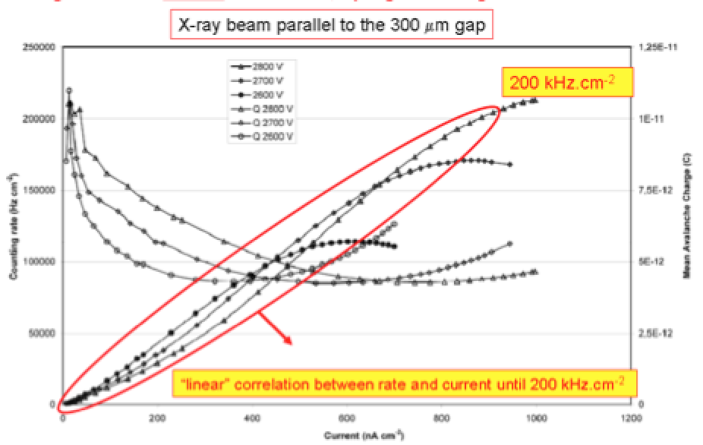
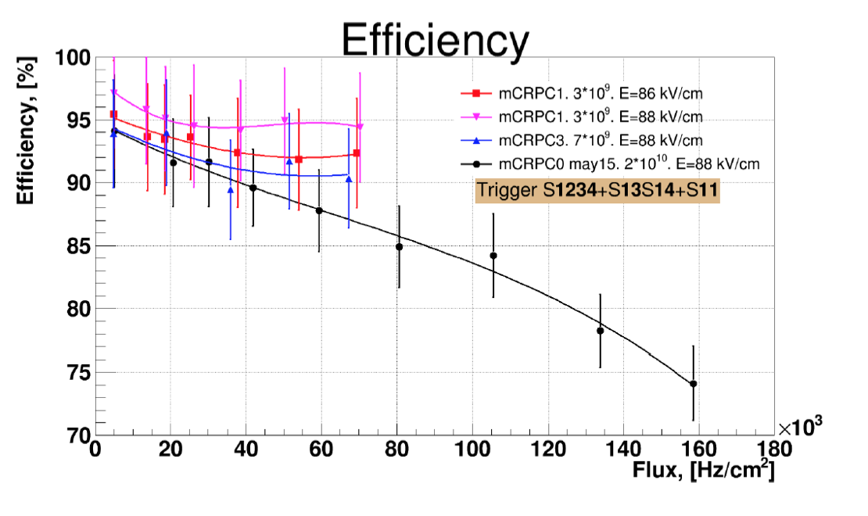
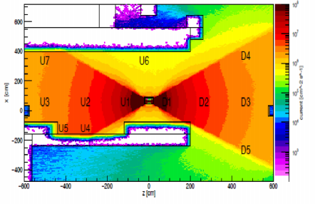
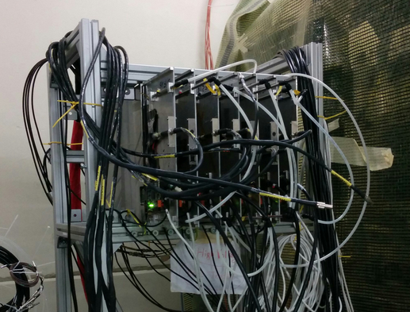
WP13-2-1
Establishing new resistive materials for high rate RPCs
-Low resistivity materials like HPL, Glass, Ceramics are inventoried. New materials are developed.
-Their resistivity (bulk, surface) and homogeneity are studied as well as their ageing properties due to large integrated doses.
^{Si}₃^{N}₄^{/SiC}
Detector with electrodes made of Ceramics
RPC built a new plastic (peek doped with CB)
Detectors made of low-resistivity glass exposed to GIF++ source and SPS beam

Slide 5
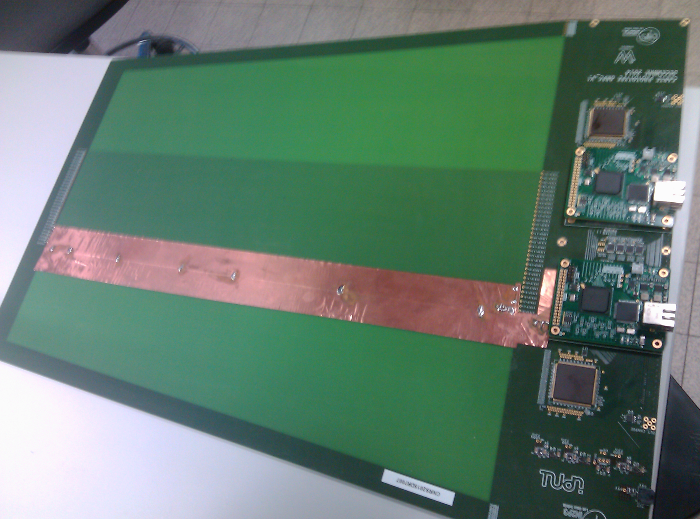
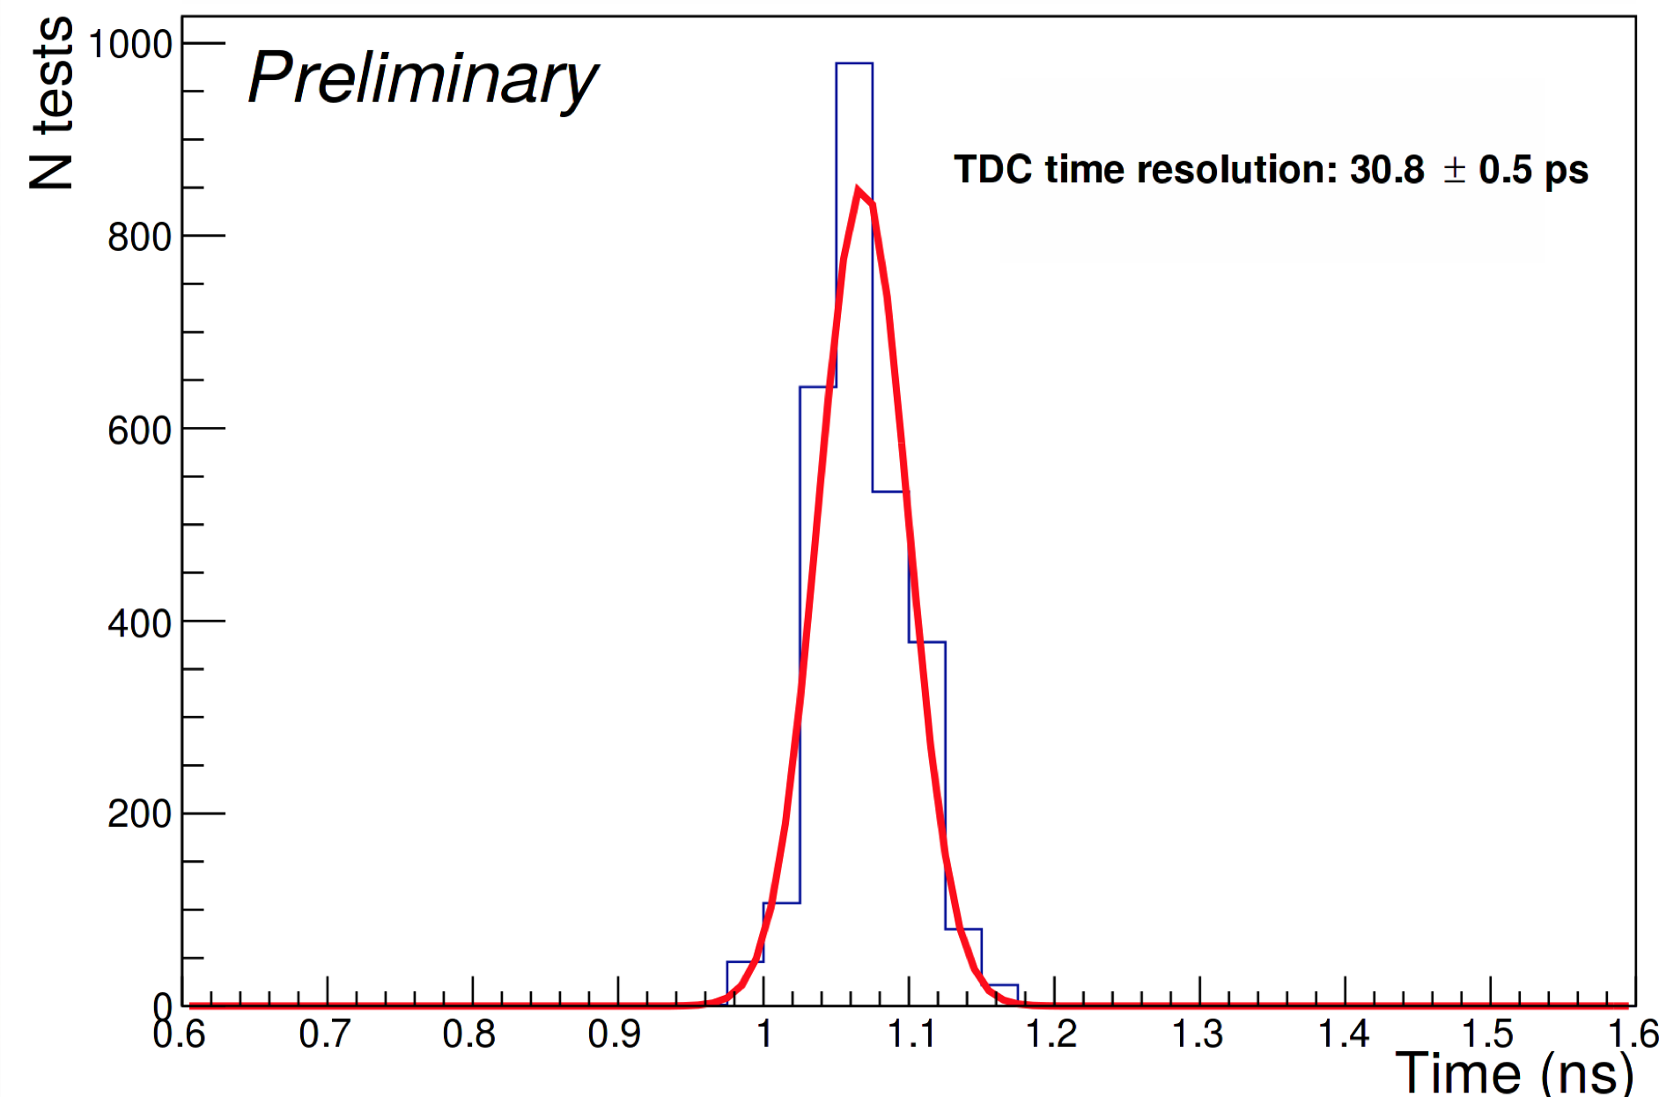
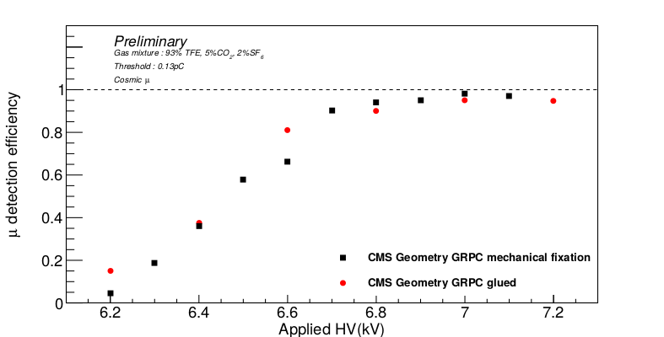
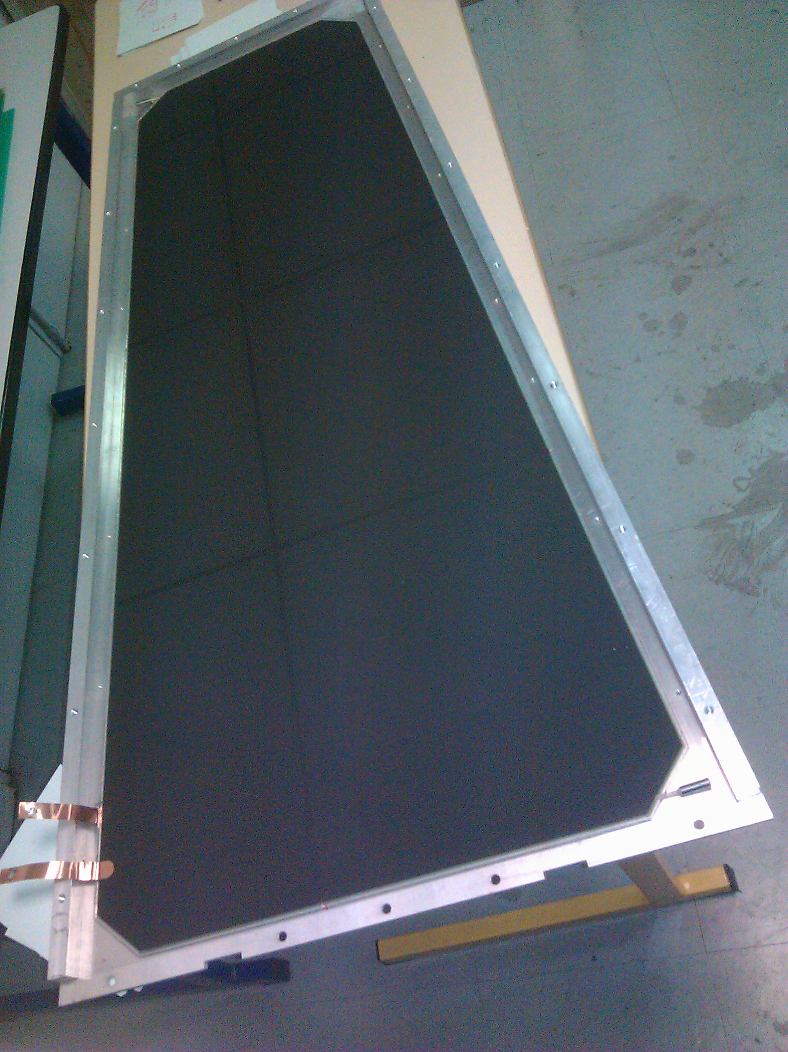
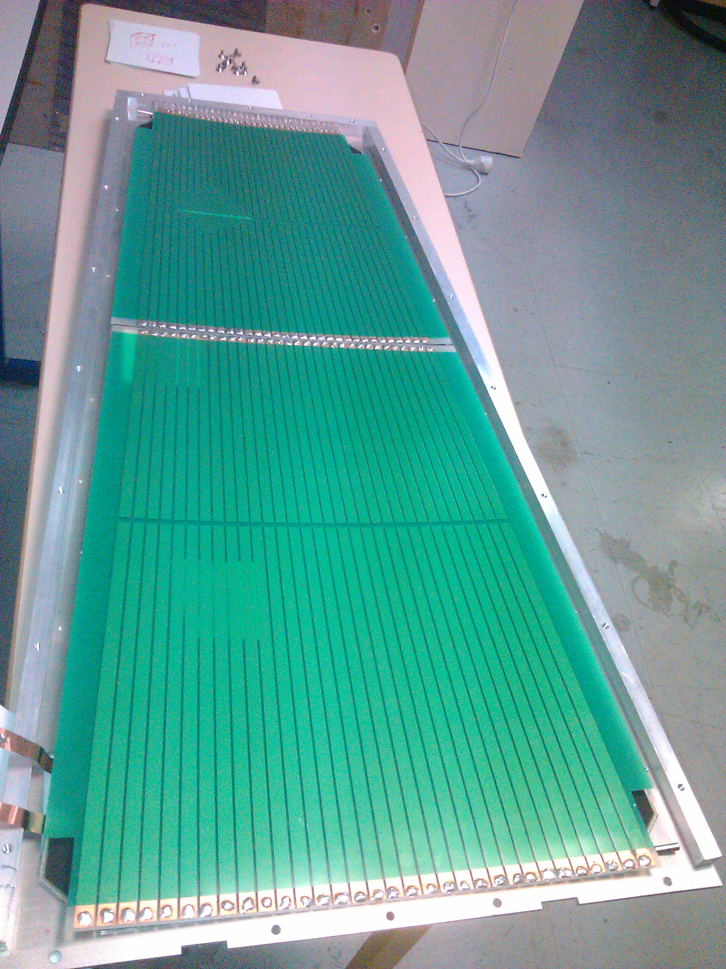
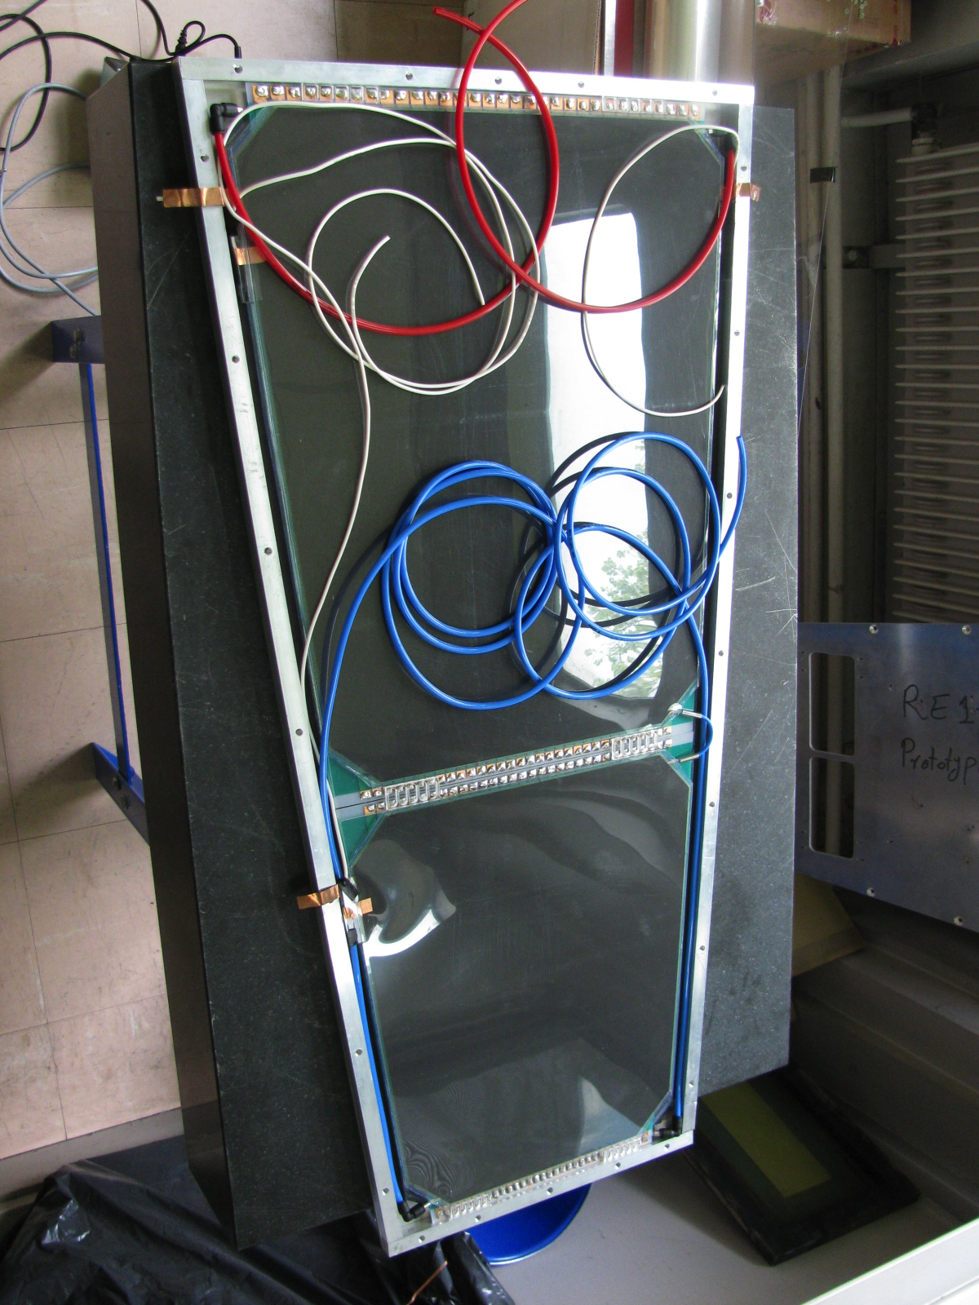
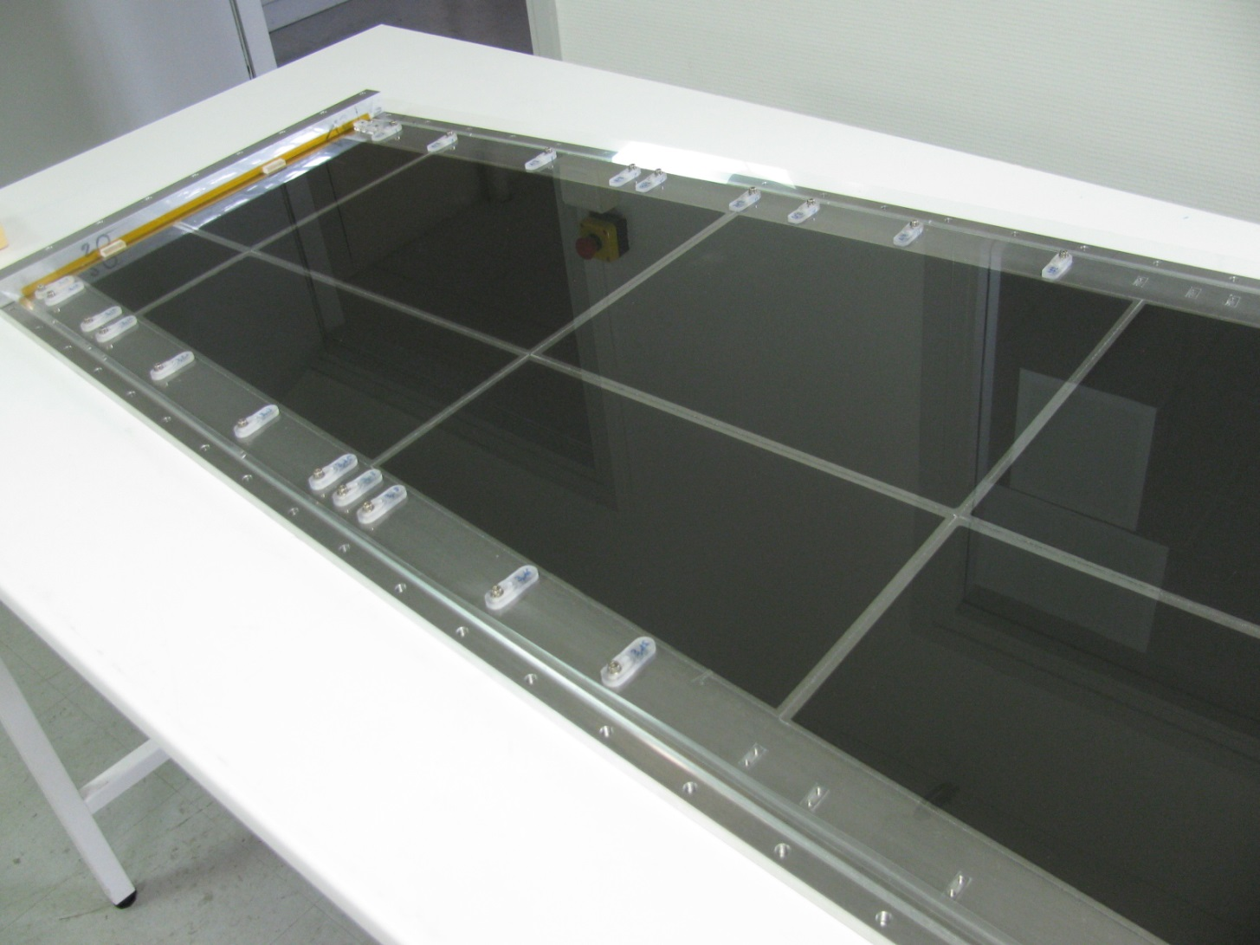
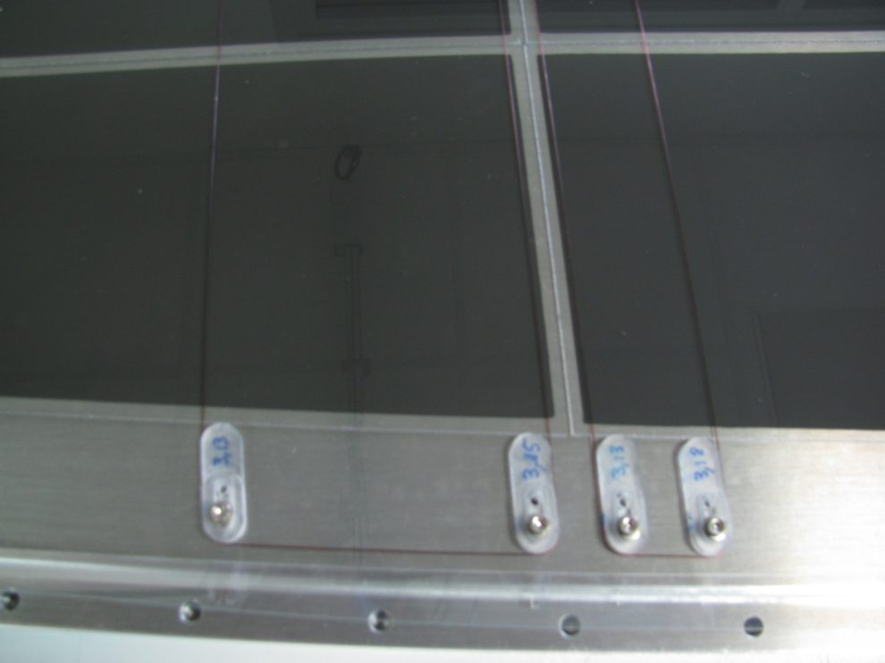
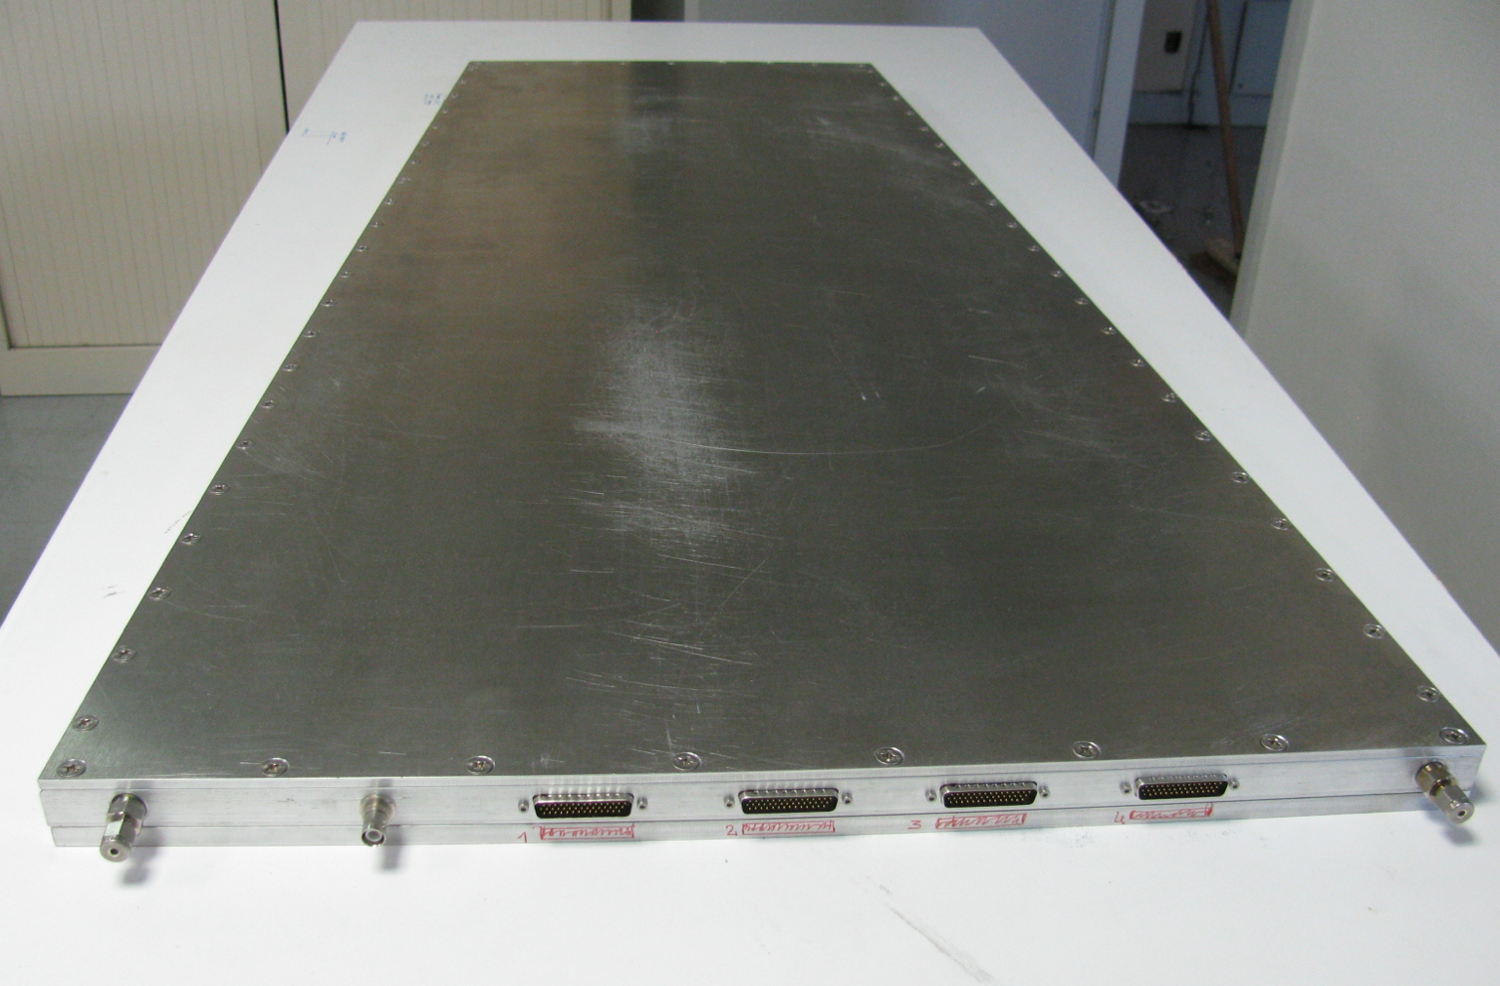
WP13-2-2
Fast timing, high rate large RPC
50 cm
New PCB with pick-up strips read from
both sides. This allows to determine Y:
Y= L/2-v*(t₂-t₁)/2.
resolution can be measured:
(t₁+t₂)- L/v
Excellent time resolution thanks to
the PETIROC ASIC, the Tsinghua TDC and
well matched strips of the PCB: 20-30 ps
The PCB will be inserted in between two gaps
of one large RPC.
20-30 ps
32 strips of 3 mm width
(4 mm pitch)
Return strips outside
the detector
Tsinghua
TDC
Test points
petiroc
Large 2-gap chambers are built using small plates of low-resistivity glass
Gluing method
Fixation method

Slide 6

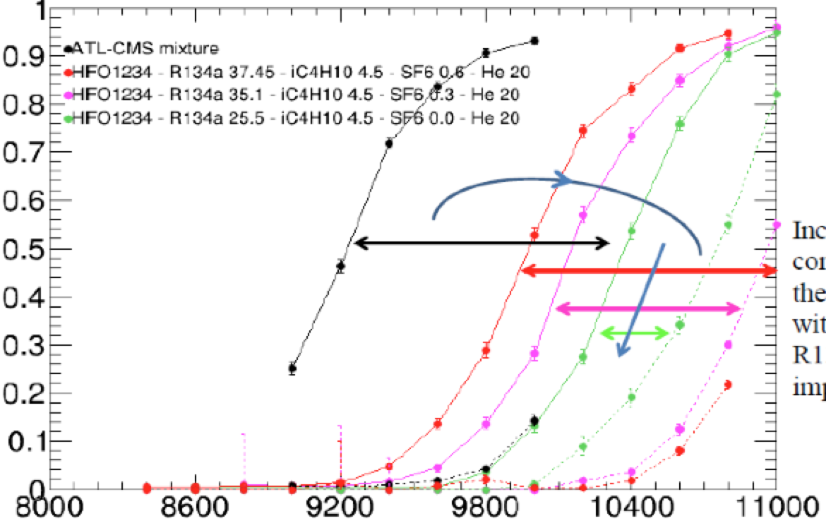
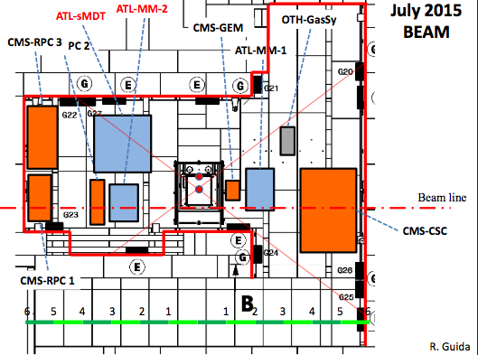
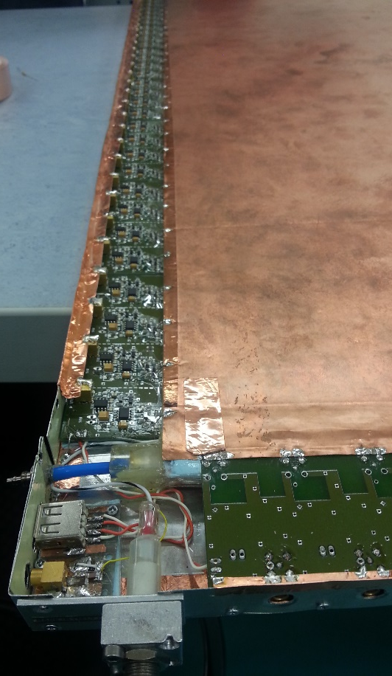
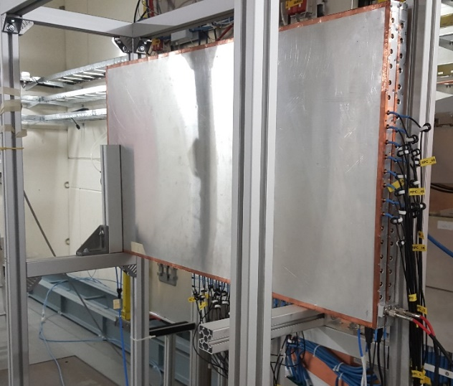
WP13-2-3
High rate and fine space resolution RPCs operated with eco-gases
New “ecological” gases for RPC to replace the high GWP (R134A and SF6) currently used. HFO is a good candidate but could not be used as the only gas, at least for the RPCs currently used. R134A is still needed. Helium could help to reduce the streamer component. Many mixtures are being tested.
Streamer probability
HV
Exposure to GIF++
New gap layout
50 x 100 cm²
1 mm gas gap
1.2 mm electrode
new FE Board
2D readout
Resistive electrode :
10¹¹ Ω . cm
infinite
100
33
10
3

Slide 7
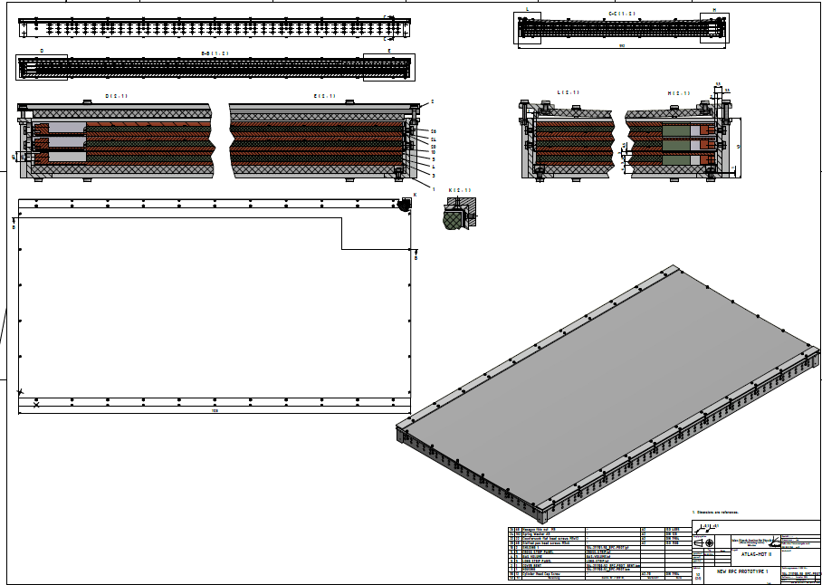
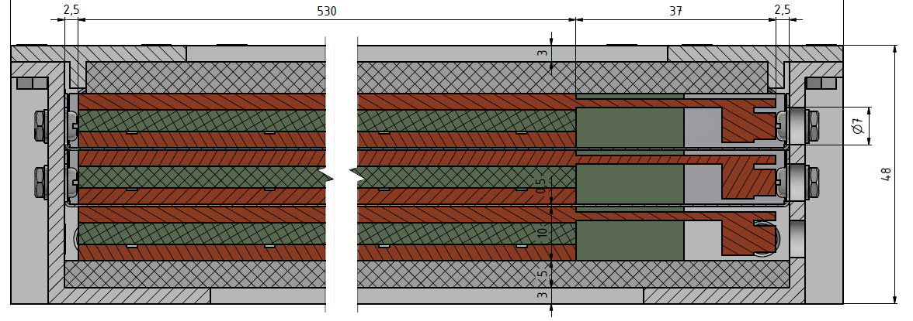
WP13-4-1
Large RPC detector preserving mechanical precision
Development of integrated mechanical support and Faraday cage for large-area thin RPC chambers for future collider detectors and development of mechanical assembly procedures and tools for large-scale production.
INFN activity
Triplet of new RPCs with 1mm gas gap
support frame and Faraday cage with
only 48 mm overall thickness.
First module to be built and tested in 2016
Drawings of the Faraday cage and mechanical support are ready

Slide 8
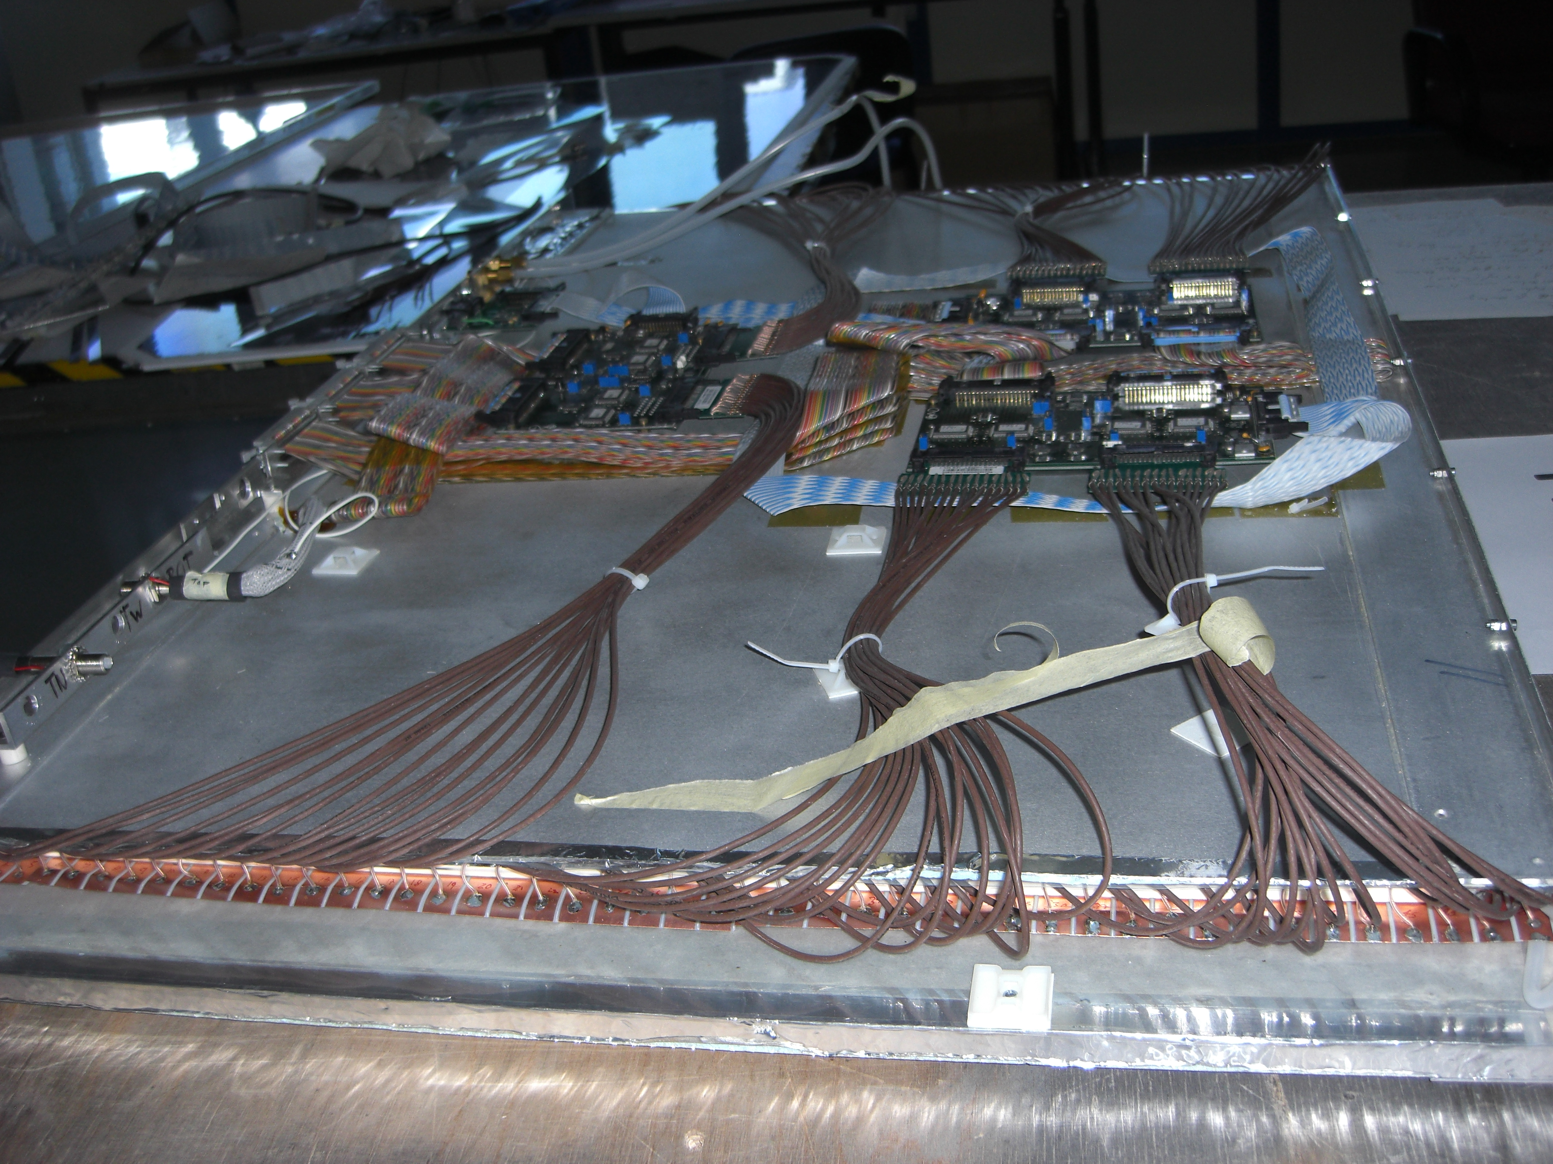
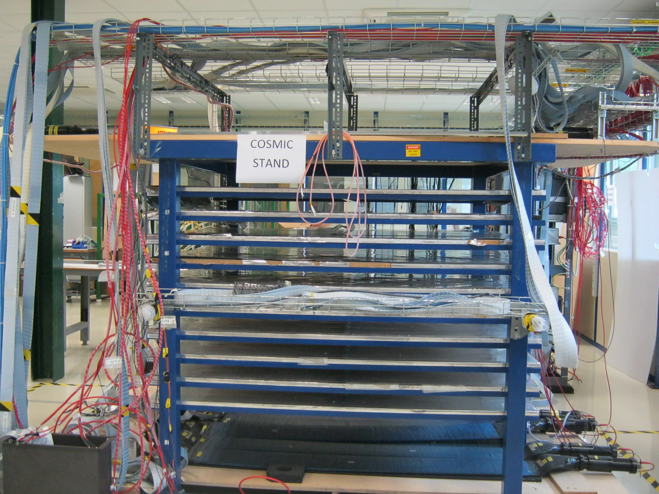
WP13-4-6
Preparation for large RPC series production
INFN activity
Construction of large size RPC using different kind of electrodes : HPL, Glass
Large Bakelite RPC chamber with thinner electrodes and gas gap than those currently used in CMS
Large Glass RPC built from small pieces of low resistivity glass
Definition and developing of common tools for QC & QA procedures are under preparation at CERN. This is crucial to guarantee uniformity on each detectors components

Slide 9
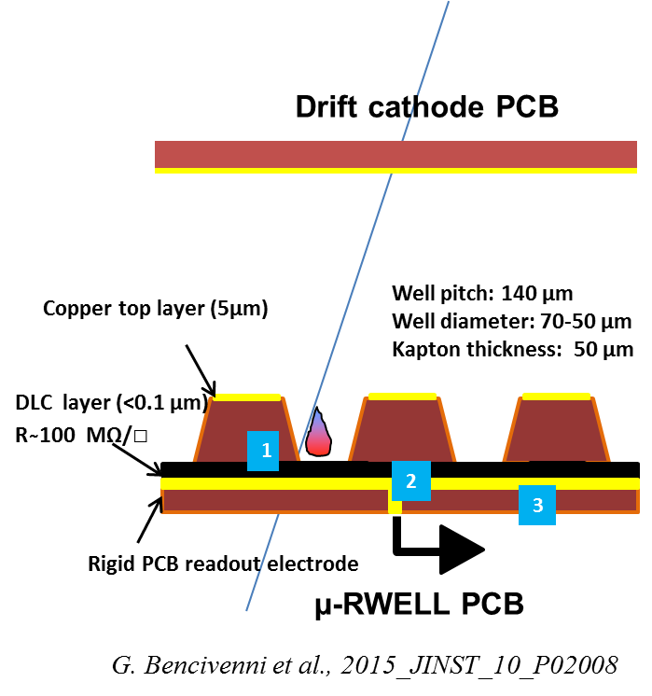
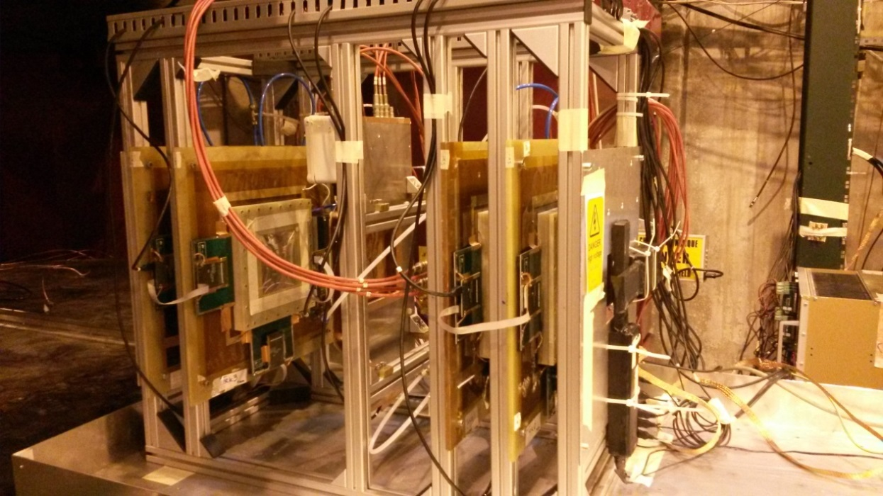
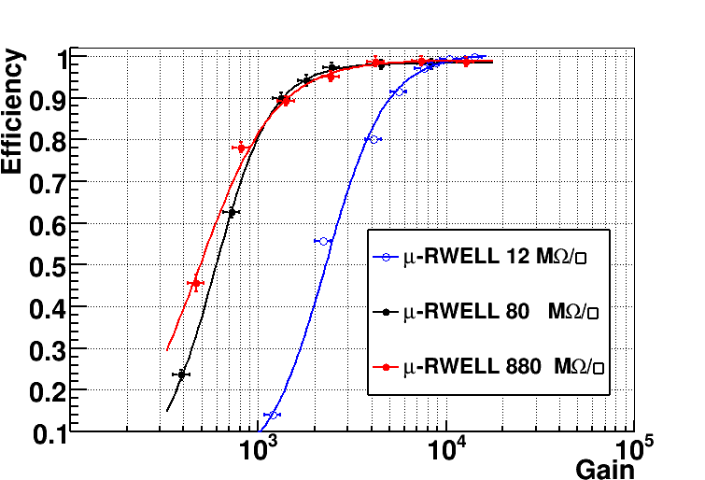
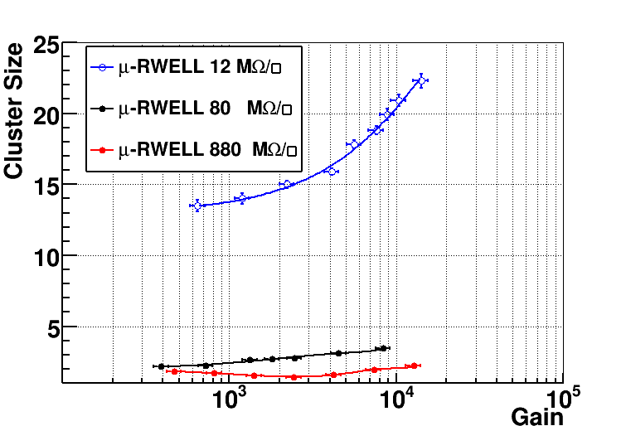
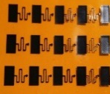
WP13.2.4
the µ-RWELL detector
The µ-RWELL performance: Beam Tests
INFN activity
tracking
efficiency
vs resistivity
Ar/ISO=90/10
Ar/ISO=90/10
Resistive stage
segmentation in
preparation: next step
At low resistivity the spread of the charge (cluster size) on the readout strips increases, thus requiring a higher gain to reach the full detector efficiency.

Slide 10
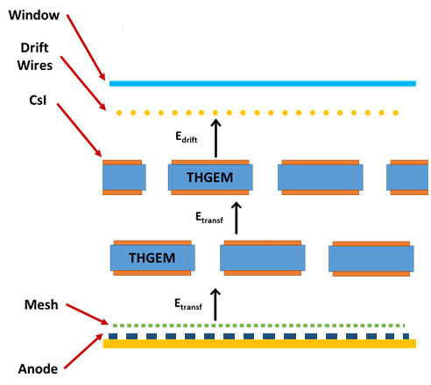
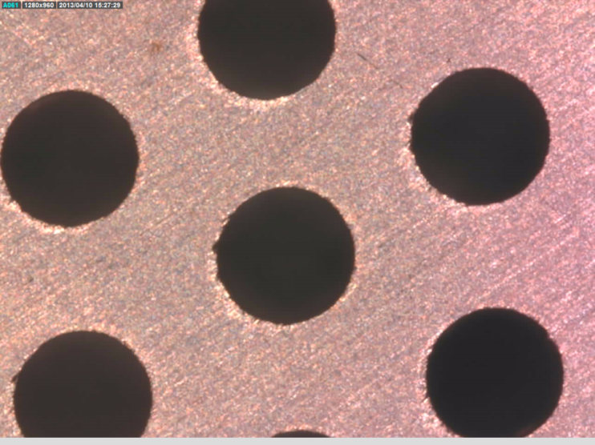
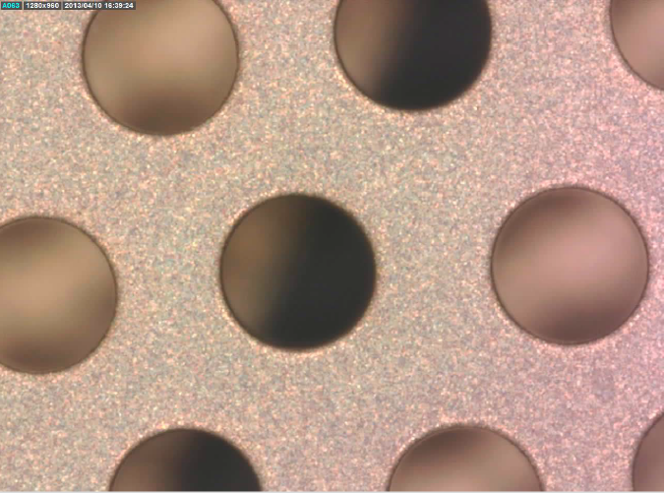
WP13.2.5
Hybrid Detector
(2 THGEMs + Micromesh)
DISCHARGE STUDIES IN THGEMs
TOOL: the phenomenological Paschen curve
The breakdown V vs P, electrode distance and specific gas
INFN activity
In parallel: polishing protocol to increase THGEM production yield
THGEM
Paschen measurements
Before polishing
MAX V: 1390 V
Correlation between the Paschen measurements and the discharge rates
After polishing
MAX V: 2180 V

Slide 11
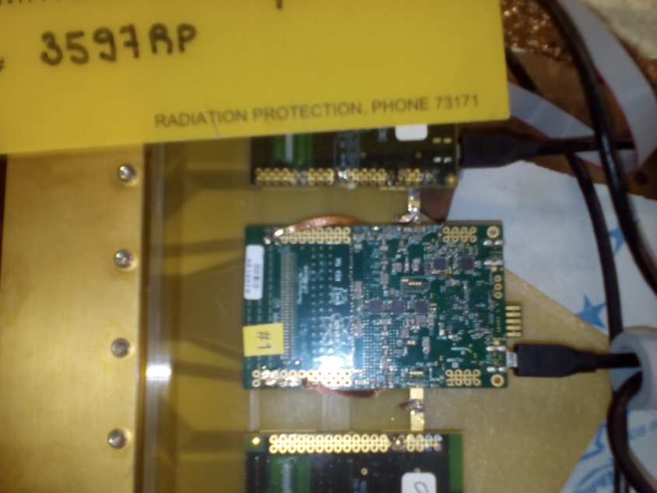
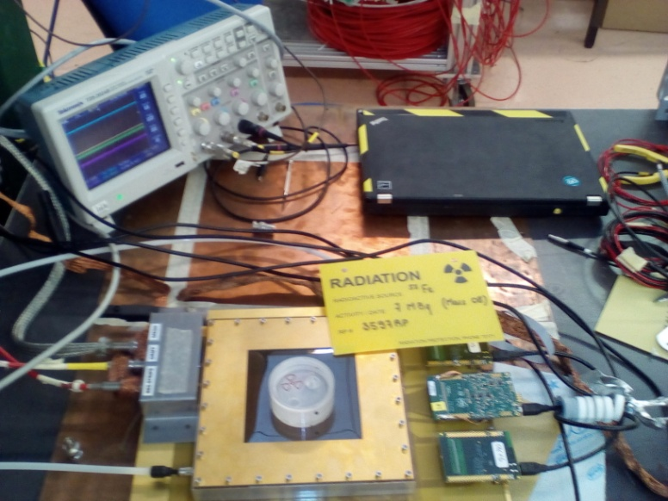
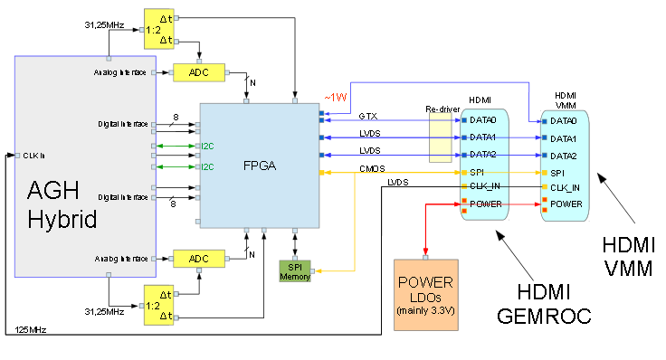
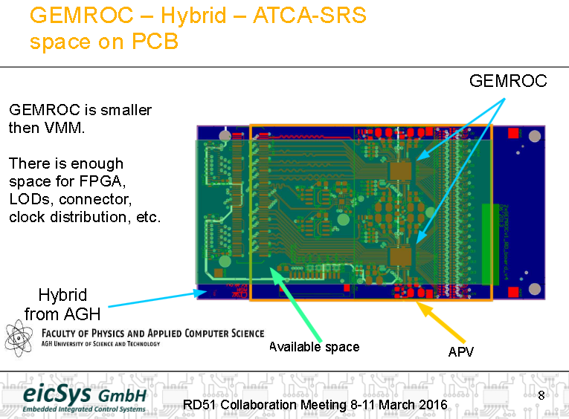
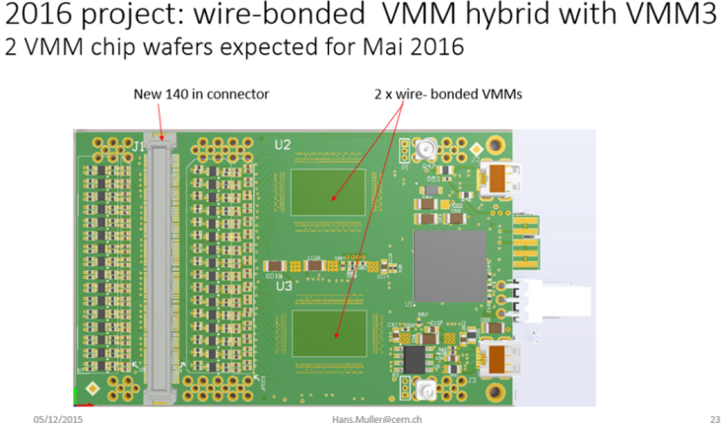
WP13.3.1
Interfacing FE-chips specific to gas detectors to the Scalable Read-out System (SRS)
GEMROC
SRS Readout Electronics for
VMM 128 (laboratory setup)
Intermediate Interface CARD (keeping the AGH hybrid)
First Step
VMM
Interfacing VMM2 /VMM3
Final Hybrid
Design of the new SRS Hybrid with wire bonding finalized.
+
Integration of TIMEPIX3 starting now
New design from A. Rusu

Slide 12
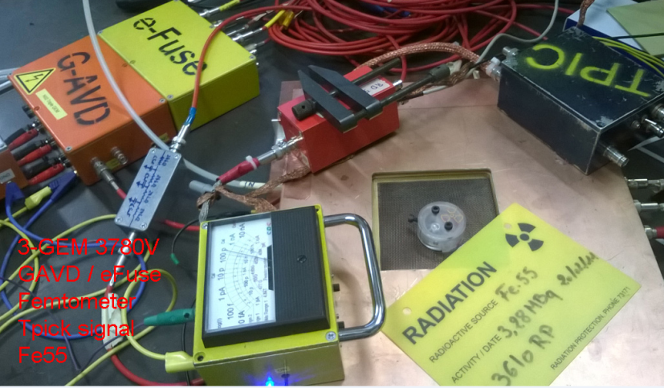
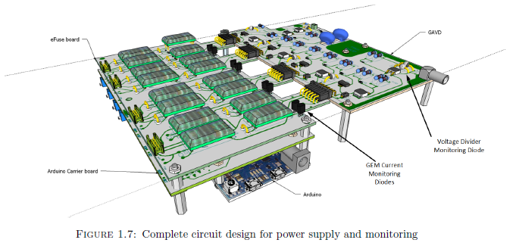
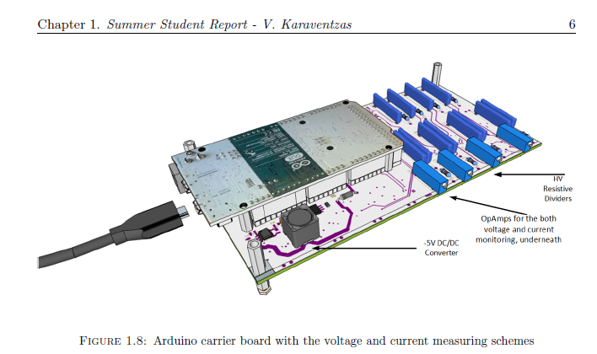
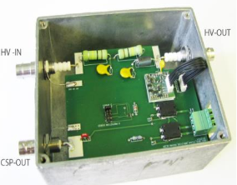
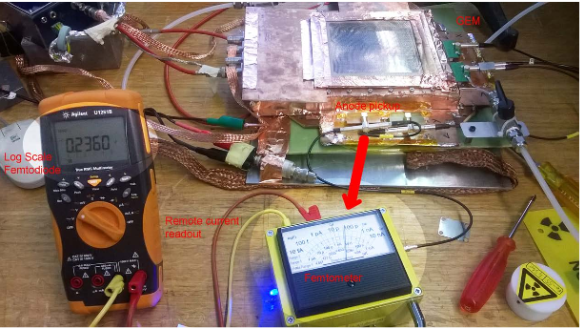
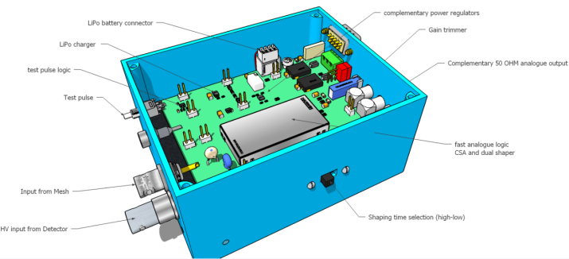
WP13.3.2
Development of cheap, standard MPGD dedicated laboratory instruments
INFN activity
AVD (Active Voltage Divider)
Suitable for multistage MPGDs
 | Task 13.3.2
Deliverable [M24] | High Voltage Power Supply for MPGD
 | (Floating) Pico ammeter
 | Signal Processing
 | Monitoring and Control Unit
 | Regeneration Gas System
APIC: Charge Preamplifier – Shaper Amplifier Chain
FemtoBox: femto-ammeter et al.
CERN
Chips commercially available

Slide 13
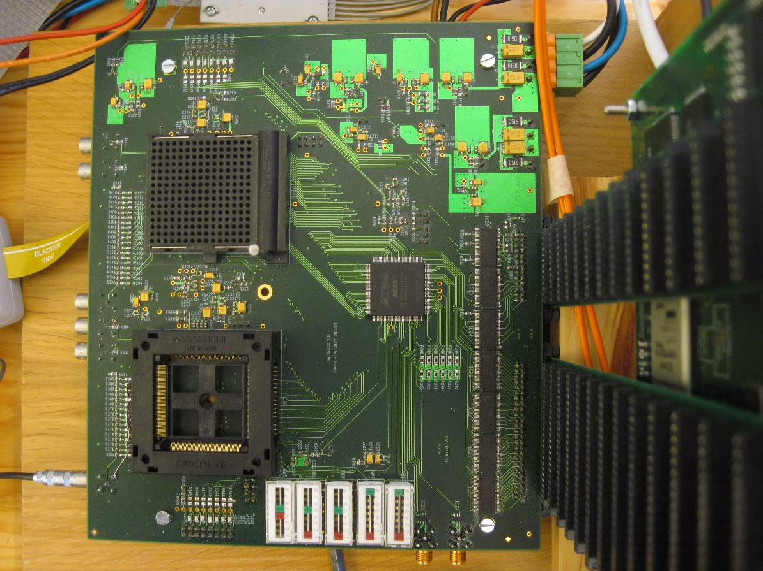
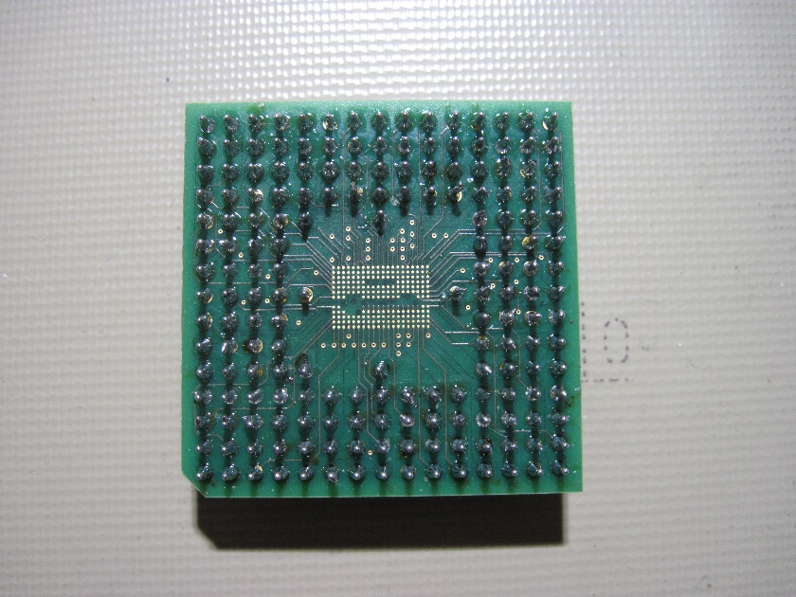
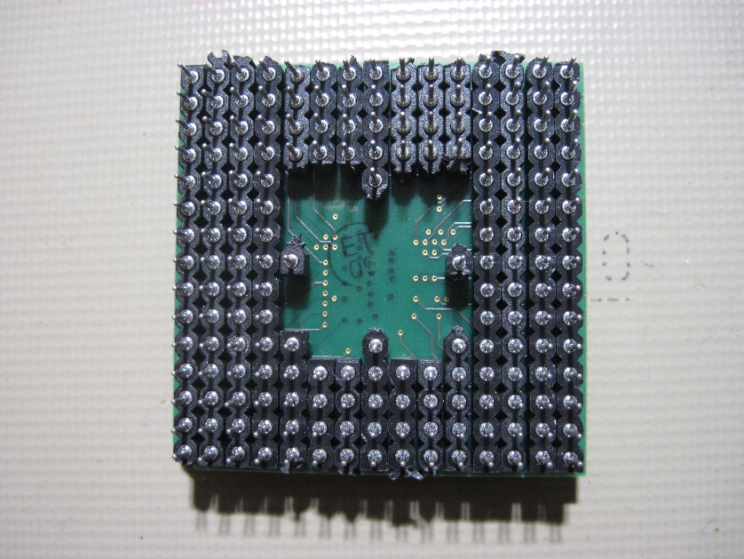
WP13.3.3
Development of a general purpose readout electronics for MPGDs
Test set –up for the
MultiChip Module (MCM)
Upper surface
of adaptor
board with
mounted
SALTRO-chip
(12 x 8.9 mm²)
Adaptor board
Top side
Bottom side
Carrier Board ok but some problems related to soldering.

Slide 14
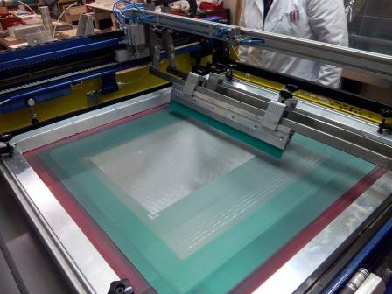
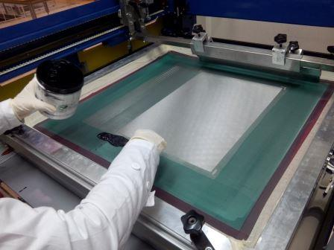
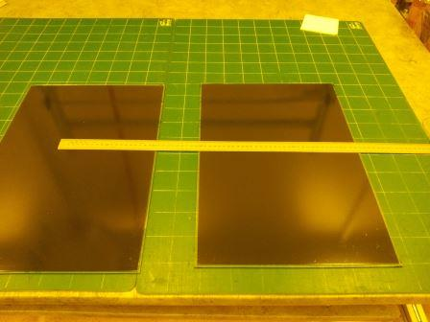
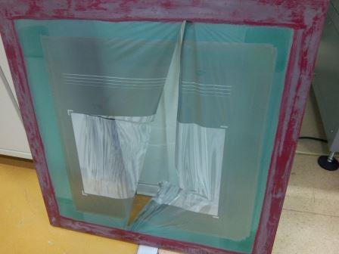
WP13.4.2
Resistive anode Micromegas
Production by silk screen printing
The machine and associated equipment, are also used for other WP13 activities :
Tests on about 30 glass plates, combining
  3 pastes : RS 12115 (100 kΩ/sq) , RS 12116 1 MΩ/sq + bi component from IN2P3
  3 glasses : Leroy-Merlin 2 mm, IN2P3, « chinese » 1 mm thick
  Several baking temperatures around 200 °C during 4 hours
Resistivity meas. on Carbon-Loaded Kapton with a circular probe and with the strip method.

Slide 15
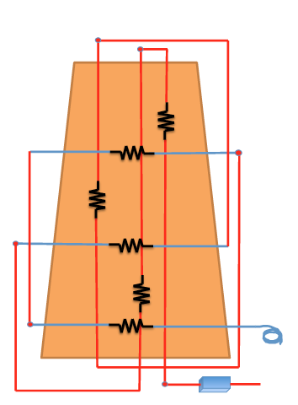
WP13.4.3
Control of foil/micromesh mechanical tensioning by optical inspection
INFN activity
Moire’ interferometry for large area surfaces:
Phase shift algorithm double n. of fringes, lowers noise enhances contrast: fraction of fringe can be appreciated
FBG sensors embedded
in MPGD detectors
MILESTONE 13.8 - M12
Report ready
W/T PHASESHIFT
WITH PHASESHIFT
+-30um RESOLUTION

Slide 16


WP13.4.4
LEOPARD scanning system for THGEMs/GEMs
Small size prototype of optical / gain scanning, high resolution
INFN activity
DAQ with RPi
Position resolution:
FWHM = 60 μm

Slide 17




WP13.4.5
Design of an automatic system to ensure the electrical integrity of electrode patterns by pulse reflection method
INFN activity
A quality assurance test setup
    Time Domain Reflectometer Method
    FPGA implementation
Objectives: cost-effective, flexibility, modular, fast, precise
EXAMPLE:
2D readout geometry
EXAMPLE:
2D readout geometry
ISSUE: Temperature stability:
  The only reliable method is to put one TDC/channel

Slide 18



WP13.4.7
MPGD detectors to industry
2D RESISTIVE MICROMEGAS
Area of 50 x 50 cm2
2D readout with resistive anodes
Bulk technique
Industrial transfert to Elvia
On-going production (Elvia/Cern) of 16 detectors
QA/QC and follow up of the production will be setup
THGEM INDUSTRIAL TRNSFER
THGEM prototypes: (LEMs from WA105)
  10x10 cm2, thickness 1 mm
  Hole pitch 800 µm and diameter 500 µm
  Rim 40 µm (micro-etching)
  Techno transfer to Elvia (4 protos)
THGEM for COMPASS RICH produced by ELTOS
30x60 cm2, thickness 0.4 mm
  Hole pitch 800 µm and diameter 400 µm, no rim

Slide 19
Conclusions
A lot of activities in the different subtasks
Increasing synergy among the different groups
New groups are joining the activities
First milestones and deliverables are expected to be on time

