Slide 1
Task 14.2.1
Test Infrastructure for innovative calorimeters with organic and inorganic scintillator fibers
On behalf of task 14.2.1 group
(part of material from a report by E. Auffray – CERN)
Tommaso Tabarelli deFatis (INFN - UniMIB)
Anna Vedda (UniMIB)
Nadia Pastrone (INFN-TO)

Slide 2
Objectives
Setup test infrastructure for innovative calorimeters with optical readout Subtask 14.2.1:
Test benches for characterization of organic and inorganic scintillator fibers for future calorimetry
Development of test stations for the characterization of scintillation and wavelength-shifting fibres as well as optical and timing properties of organic and inorganic scintillator and fibre elements
Construction of an absorber structure and a readout system to study different fibre types in test beams
Development of devices to evaluate the radiation hardness of fibres and crystals at irradiation facilities

Slide 3
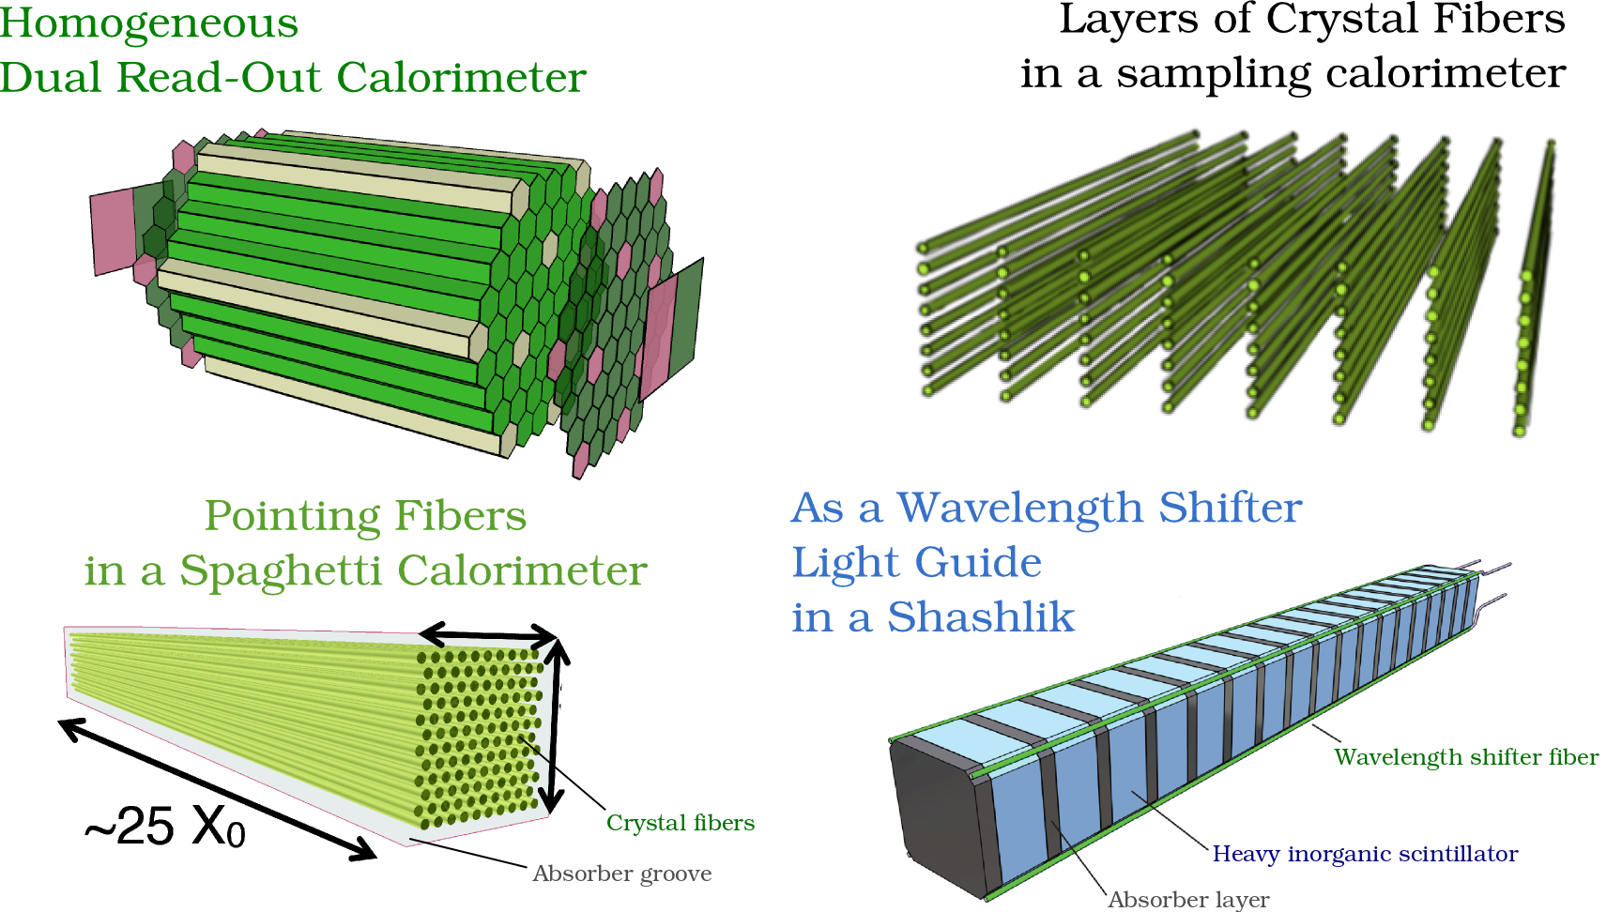
Different concepts to use scintillating fibers
M. Lucchini, PHD Thesis

Slide 4
Task14.2.1 Activities
Characterization benches:
  light attenuation benches:
    CERN & Minsk: development of a multi-wavelength excitation sources for fiber light attenuation bench
    Brunel: Modification of current bench to long fibers (up to 900mm)
  Fiber development:
    CERN & ETHZ: Investigation of luminescence properties of different types of fibers (Ce doped crystal fibers, quartz fibers)
    INFN (Milano, Torino, Roma) development on Cerium-doped quartz fibers for future test beam campaign

Slide 5
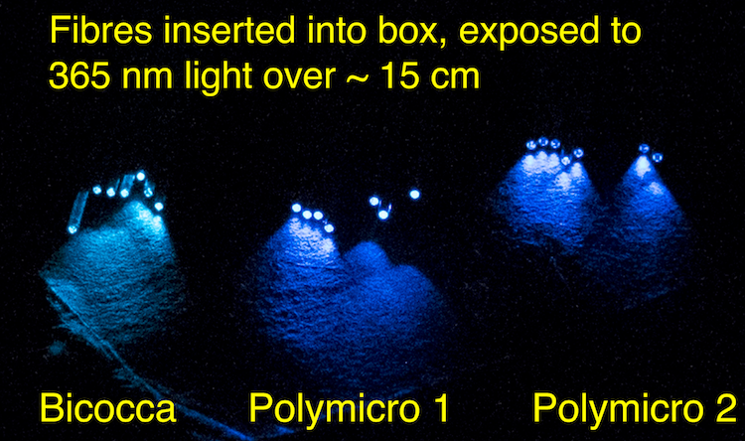
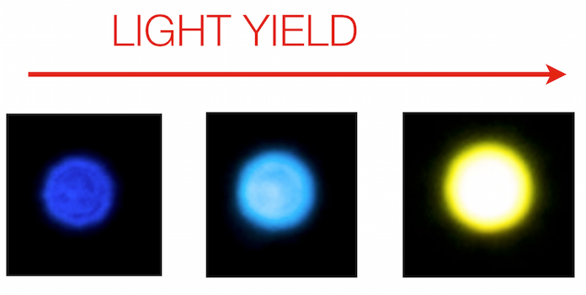
Investigation of new SiO₂:Ce from Milano @ETHZ
Cerium-doped quartz fibers from collaborating institutes have been investigated for photoluminescence, as wavelength-shifters coupled to Cerium Fluoride scintillating crystals.
Cerium-doped quartz fibers have been proven to be photoluminescent, with an excitation wavelength matching the Cerium Fluoride emission spectrum
From early 2015 to late 2015, Ce:SiO₂ fibers from U. Milano Bicocca have become available with increasing core diameter and light yield
spring 2015 fall 2015 Kuraray 3HF
Polymicro Bicocca (plastic)

Slide 6
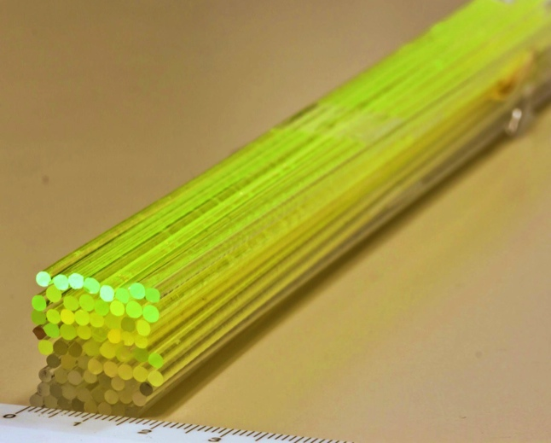
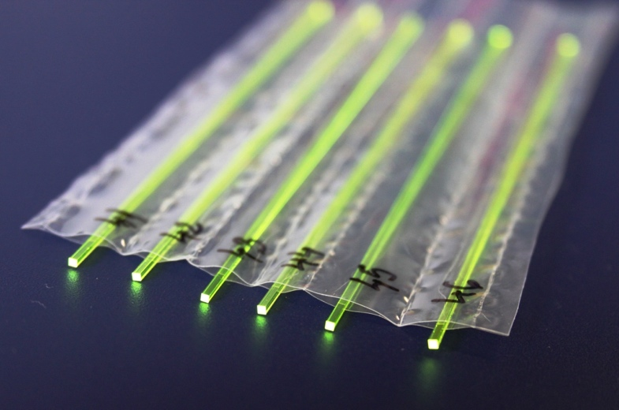
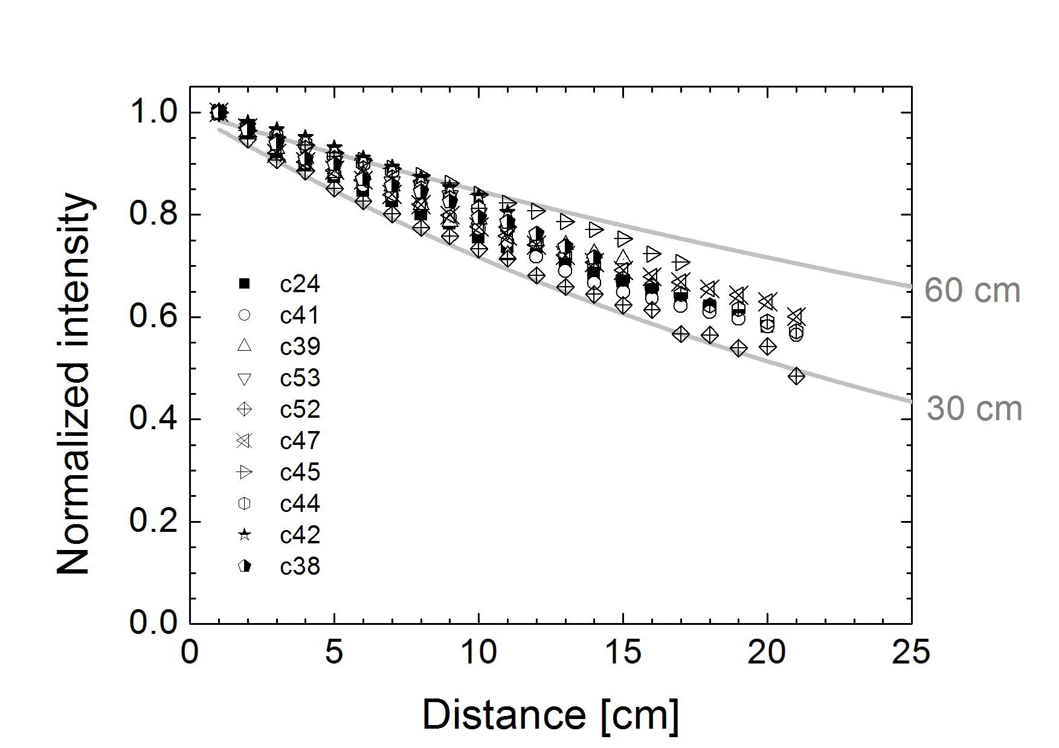
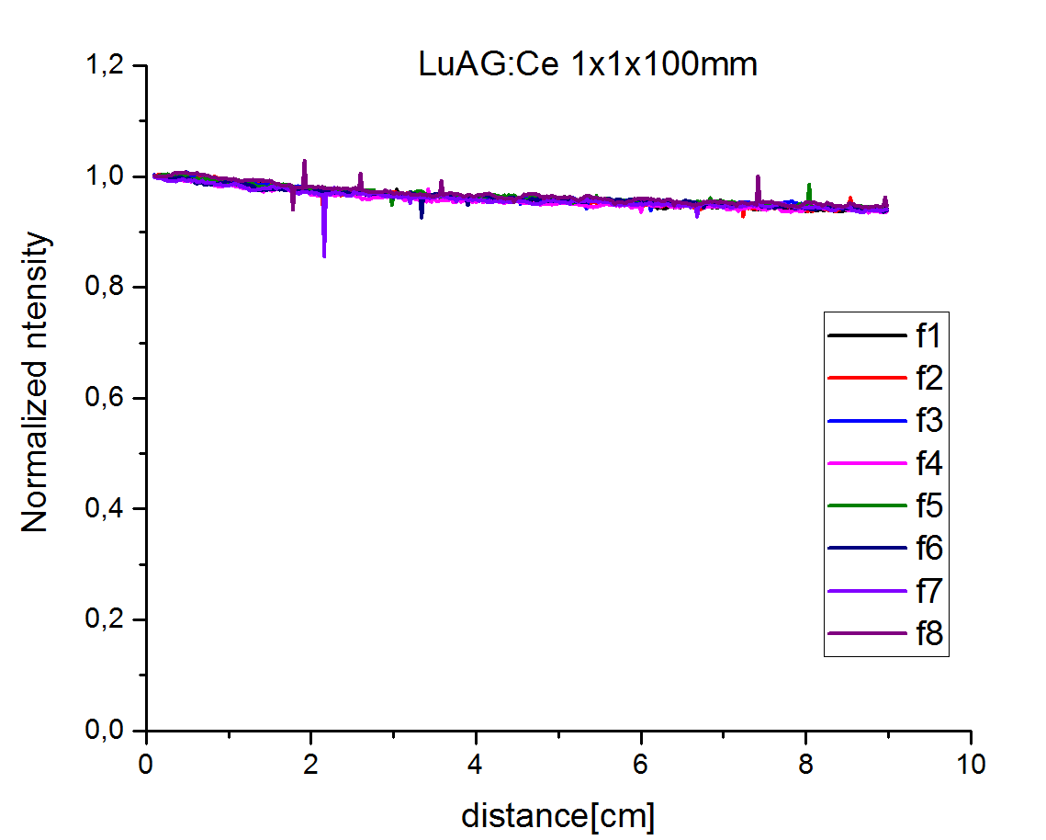
Crystal fiber development
@CERN
Micropulling down technology
Ø ~ 2 mm,L ~ 22 cm
Square Fibers cut from ingot
1x1mm,L ~ 10 cm

Slide 7
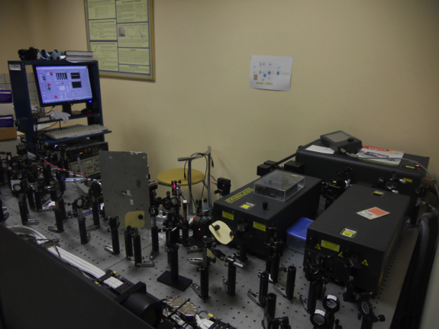
Task14.2.1 Activities
Characterization benches:
  Timing
    Minsk & Vilnius: setup of a “2 photon absorption” bench for timing investigation: some interesting results obtained with new garnet materials
    Brunel: investigation of the modification of the single-photon timing system to measure fiber

Slide 8
Task14.2.1 Activities
Test beam infrastructure
  Decide to first concentrate on a set-up for Electromagnetic calorimeter
    Prototype of ∼3Rm*3Rm*maximum length30cm
  ETHZ & INFN : preparation of sampling calorimeter structure that acts as an absorber: test beam foreseen in October CERN H4 beam
  CERN: development of a W/Cu absorber for crystal fibers (6*6*20cm): test beam foreseen Mid of September (CERN H4beam)
  ETHZ& INFN : Common DAQ

Slide 9
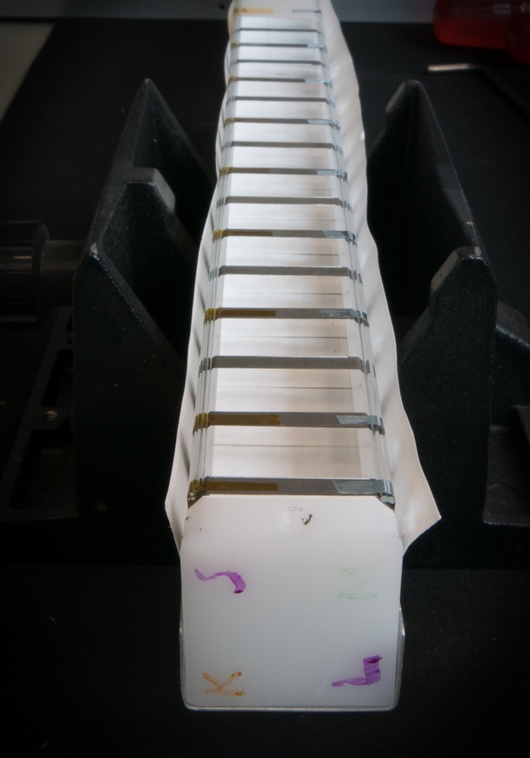
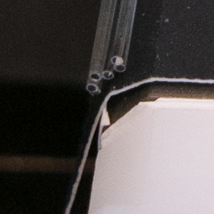
Test of SiO2:Ce fibers as wavelength shifter in H4
ETHZ/INFN
SiO2: Ce Fibers developed in Milano have been studied, inserted into a sampling calorimeter structure that acts as an absorber by ETHZ &INFN. The readout system developed and commissioned earlier in 2015, has been used for that at the CERN SPS accelerator
Bundles of Ce:SiO2 fibers have been tested as WLS coupled to Cerium Fluoride crystals in a sampling calorimeter prototype (left)
The direct Cherenkov light they produce has been tested by blinding one bundle towards the Cerium Fluoride scintillation light (right)
Data analysis is in progress on these tests

Slide 10
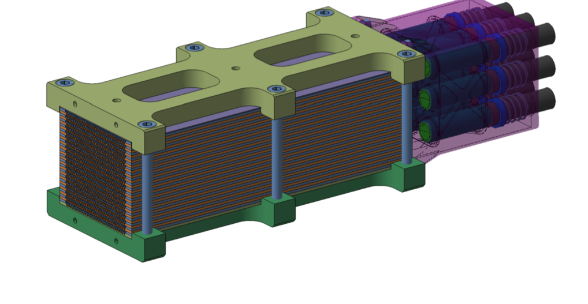
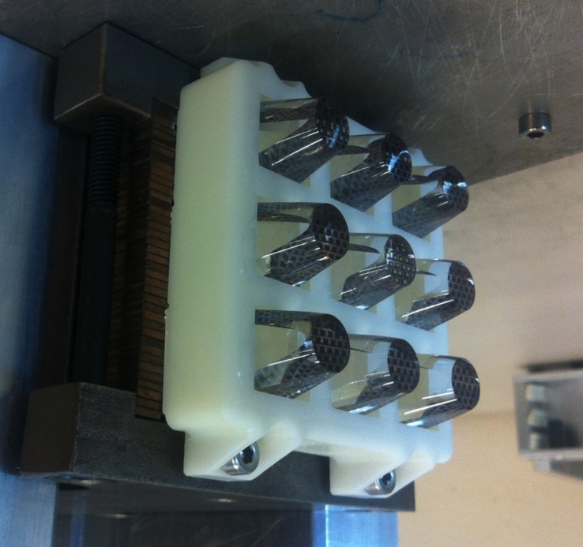
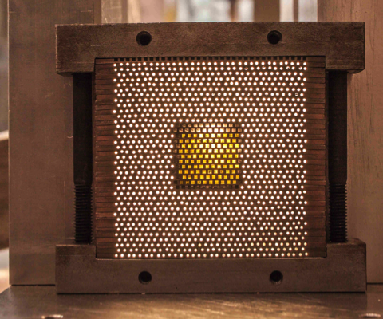
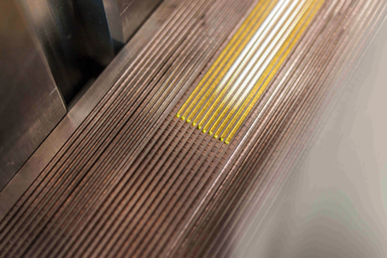
Development of absorber for Spacal Calorimeter (CERN)
Readout with PMT
Coupling fiber to PMT with optical guide
N. Siegrist, H. Gerwig, CERN
Absorber of W/Cu plate
60*60*200mm3, ~ 1200 holes
Equivalent of 3*3 PWO crystals
YAG square fibers
in a 0,75W/0.25Cu Absorber

Slide 11
Common TB DAQ Infrastructure
ETHZ/INFN
A data acquisition for high-energy beam test setups has been developed, commissioned and maintained under the responsibility of one postdoctoral researcher (F. Micheli, ETHZ), who has been hired through Aida for this purpose. It has been used for the tests performed in 2015 in the H4 beam line at the CERN SPS accelerator
A common DAQ for all the setups (H4DAQ with CAEN V1742 up to 5GS): a very detailed waveform sampling for timing studies
The tested configurations included:
Timing resolution measurements of Lead Tungstate scintillators
W/CeF₃ sampling calorimeter with Ce doped quartz fibers as WLS
W/LYSO Shashlik calorimeter with capillaries
SPACAL calorimeter with heavy scintillating fibers

Slide 12
Task14.2.1 Activities
Irradiation facilities:
  CERN & ETHZ: Investigation of how to use PS facilities for fibers irradiation
  Brunel: Modification of Current Co60 irradiation set-up to measure the dynamic induced attenuation of fibers under gamma irradiation with our 60 Co source.
    20 m pair of multi-mode pure-silica core fibres.
    Fibre bench at irradiation point.
    Remote stabilised near-UV to visible light source and spectrophotometer coupled to the fibres.
    Status
    Fibre supplier identified.
    Potential spectrophotometer (StellarNet Black Comet) identified

Slide 13
Task14.2.1 Activities
Update of the Activities:
Brunel: work is continuing on the Co60 irradiation set-up for fibers
CERN with Minsk: Update of the light excitation system for the attenuation bench has been made: investigating the possibility to add excitation in UV. It will be installed in June
CERN with uniMIB: A master student from Anna is currently working at CERN-lab 27. Attenuation measurements are performed on several SiO2:Ce fibers, irradiation of some of these fibers will be soon performed.
Minsk with Vilnius: measurements on free carrier absorption on PWO and garnet samples
ETHZ:
- Measurements of the uniformity of the attenuation length performed on Kuraray fibers with and without reflector on 1 extremity. Seems that the reflector gives better uniformity.
-Preparation of the matrix of "CeF3 sandwich": 4*3 blocs of 17*17*140mm3 readout with APD and Kururaray wavelength shifter fibers . 1APD will be masked in order to study the direct signal in the APD (spikes) the set-up should be ready in June for test beam in June and/or July. Single channel which was tested last year is still available to test new Si02:Ce fibers.
==> INFN RD_FASE2 contributing on CeF3 test (papers published)

Slide 14
Task14.2.1 Activities
Torino: SiPM array Hamamatsu S13361-3050-AE-08 6120 eu RD_FASE2
to be prepared and used in 2016 (August-September)-2017 testbeam
SPACAL test beam
New preforms for SiO2:Ce fibers will be ready end of May, 100 fibers of 20 cm should be ready in June for test beam in July ~ 20 keu RD_FASE2 not yet invoiced
The idea is use the absorber developed last year by CERN (block of alloy 0.75W/0.25Cu) equipped with 100 fibers of Si02:Ce and 100YAG fibers readout with SiPM array to compare the performances of 2 types of fibers.

Slide 15
Task14.2.1 MANPOWER
2 postdocs have been recruited: in Torino and ETHZ,
1 postdoc will be recruited in Milano
1 AdR Torino 75% AIDA2020 ongoing
1 AdR Torino 25% AIDA2020 to be assigned
1 AdR UniMIB to be defined
Nadia Pastrone 0.1 FTE AIDA2020
Nadia Pastrone 0.3 FTE RD_FASE2
Alessio Ghezzi 0.2 FTE RD_FASE2
Pietro Govoni 0.2 FTE RD_FASE2
Tommaso Tabarelli de Fatis 0.2 FTE RD_FASE2
Anna Vedda (PA-UniMIB) 160 h
Federico Moretti (AdR) 126 h
Roma1 (Paolo Meridiani, Riccardo Paramatti et al.) 1 FTE RD_FASE2 (se necessario)

