Slide 1
Non-linear beam dynamics
Yannis PAPAPHILIPPOU
Accelerator and Beam Physics group
Beams Department
CERN
Università di Roma, La Sapienza
Rome, ITALY
20-23 June 2016

Slide 2
Primary purpose
Overview of non-linear effects in accelerators (rings), going from non-linear differential equations, introducing Hamiltonian formalism, using it for advanced concepts and studying the phenomenology of non-linear motion with numerical tools and examples

Slide 3
Primary purpose and outline
Overview of non-linear effects in accelerators (rings), going from non-linear differential equations, introducing Hamiltonian formalism, using it for advanced concepts and studying the phenomenology of non-linear motion with numerical tools and examples
4 lecture sessions (~2h each):
  1st lecture: The dynamics of non-linear differential equations and their application to accelerator dynamics
  2nd lecture: Hamiltonian formalism applied to beam dynamics, perturbation theory, onset of chaos
  3rd lecture: Advanced topics of non-linear beam dynamics, including Lie formalism, symplectic integrators and normal forms
  4th lecture: Modern tools for studying non-linear beam dynamics in simulations and measurements with an emphasis to frequency map analysis

Slide 4
Bibliography
Books on non-linear dynamical systems
  M. Tabor, Chaos and Integrability in Nonlinear Dynamics, An Introduction, Willey, 1989.
  A.J Lichtenberg and M.A. Lieberman, Regular and Chaotic Dynamics, 2nd edition, Springer 1992.
Books on beam dynamics
  E. Forest, Beam Dynamics - A New Attitude and Framework, Harwood Academic Publishers, 1998.
  A. Wolski, Beam Dynamics in High Energy Particle Accelerators, Imperial College Press, 2014.
Lectures on non-linear beam dynamics
  A. Chao, Advanced topics in Accelerator Physics, USPAS, 2000.
  W. Herr, Lectures on Mathematical and Numerical Methods for Non-linear Beam Dynamics in Rings, CAS 2013.
  L. Nadolski, Lectures on Non-linear beam dynamics, Master NPAC, LAL, Orsay 2013.
  Y. Papaphilippou, Lectures on Non-linear dynamics in particles accelerators, Cockroft Institute, October 2013.

Slide 5
Contents of the 1st lecture
Accelerator performance parameters and non-linear effects
Linear and non-linear oscillators
  Integral and frequency of motion
  The pendulum
  Damped harmonic oscillator
Phase space dynamics
  Fixed point analysis
Non-autonomous systems
  Driven (damped) harmonic oscillator, resonance conditions
Linear equations with periodic coefficients – Hill’s equations
  Floquet solutions and normalized coordinates
Perturbation theory
  Non-linear oscillator
  Perturbation by periodic function – single dipole perturbation
  Application to single multipole – resonance conditions
  Examples: single quadrupole, sextupole, octupole perturbation
  General multi-pole perturbation– example: linear coupling
  Resonance conditions and working point choice
Summary
Appendix I: Multipole expansion

Slide 6
Contents of the 1st lecture
Accelerator performance parameters and non-linear effects
Linear and non-linear oscillators
  Integral and frequency of motion
  The pendulum
  Damped harmonic oscillator
Phase space dynamics
  Fixed point analysis
Non-autonomous systems
  Driven (damped) harmonic oscillator, resonance conditions
Linear equations with periodic coefficients – Hill’s equations
  Floquet solutions and normalized coordinates
Perturbation theory
  Non-linear oscillator
  Perturbation by periodic function – single dipole perturbation
  Application to single multipole – resonance conditions
  Examples: single quadrupole, sextupole, octupole perturbation
  General multi-pole perturbation– example: linear coupling
  Resonance conditions and working point choice
Summary
Appendix I: Multipole expansion

Slide 7
Accelerator performance parameters
Colliders
  Luminosity (i.e. rate of particle production)
    Ν_{b} bunch population
    k_{b} number of bunches
    γ relativistic reduced energy
    f_{r} repetition rate
    ε_{n} normalized emittance
    β* “betatron” amplitude function at collision point

Slide 8
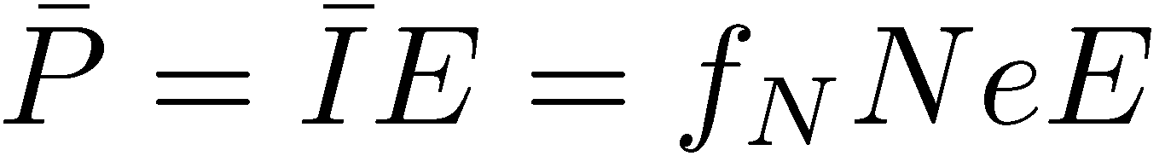
Accelerator performance parameters
Colliders
  Luminosity (i.e. rate of particle production)
    Ν_{b} bunch population
    k_{b} number of bunches
    γ relativistic reduced energy
    f_{r} repetition rate
    ε_{n} normalized emittance
    β* “betatron” amplitude function at collision point
High intensity accelerators
  Average beam power
    mean current intensity
    Ε energy
    f_{N} repetition rate
    Ν number of particles/pulse
I

Slide 9
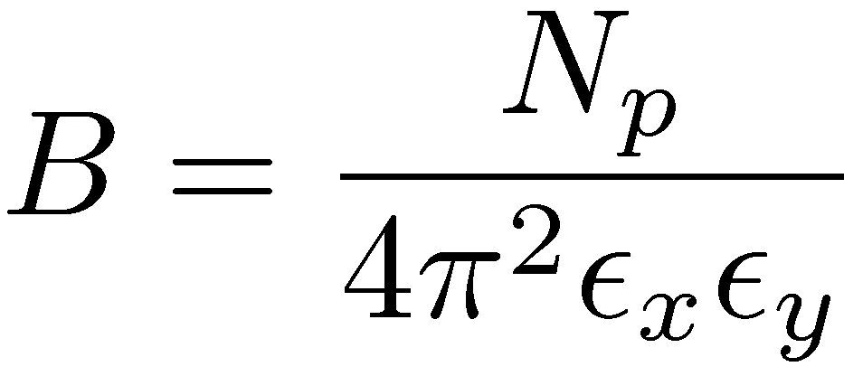
Accelerator performance parameters
Colliders
  Luminosity (i.e. rate of particle production)
    Ν_{b} bunch population
    k_{b} number of bunches
    γ relativistic reduced energy
    f_{r} repetition rate
    ε_{n} normalized emittance
    β* “betatron” amplitude function at collision point
High intensity accelerators
  Average beam power
    mean current intensity
    Ε energy
    f_{N} repetition rate
    Ν number of particles/pulse
Synchrotron light sources (low emittance rings)
  Brightness (photon density in phase space)
    Ν_{p} number of photons
    ε_{x,,y} transverse emittances
I

Slide 10
Accelerator performance parameters
Colliders
  Luminosity (i.e. rate of particle production)
    Ν_{b} bunch population
    k_{b} number of bunches
    γ relativistic reduced energy
    f_{r} repetition rate
    ε_{n} normalized emittance
    β* “betatron” amplitude function at collision point
High intensity accelerators
  Average beam power
    mean current intensity
    Ε energy
    f_{N} repetition rate
    Ν number of particles/pulse
Synchrotron light sources (low emittance rings)
  Brightness (photon density in phase space)
    Ν_{p} number of photons
    ε_{x,,y} transverse emittances
I
Non-linear effects limit performance of particle accelerators but impact also design cost

Slide 11
Non-linear effects in colliders
At injection
  Non-linear magnets (sextupoles, octupoles)
  Magnet imperfections and misalignments
  Power supply ripple
  Ground motion (for e+/e-)
  Electron (Ion) cloud
At collision
  Insertion Quadrupoles
  Magnets in experimental areas (solenoids, dipoles)
  Beam-beam effect (head on and long range)

Slide 12
Non-linear effects in colliders
Limitations affecting (integrated) luminosity
  Particle losses causing
    Reduced lifetime
    Radio-activation (super-conducting magnet quench)
    Reduced machine availability
  Emittance blow-up
  Reduced number of bunches (either due to electron cloud or long-range beam-beam)
  Increased crossing angle
  Reduced intensity
Cost issues
  Number of magnet correctors and families (power convertors)
  Magnetic field and alignment tolerances
At injection
  Non-linear magnets (sextupoles, octupoles)
  Magnet imperfections and misalignments
  Power supply ripple
  Ground motion (for e+/e-)
  Electron (Ion) cloud
At collision
  Insertion Quadrupoles
  Magnets in experimental areas (solenoids, dipoles)
  Beam-beam effect (head on and long range)

Slide 13
Non-linear effects in high-intensity accelerators
Non-linear magnets (sextupoles, octupoles)
Magnet imperfections and misalignments
Injection chicane
Magnet fringe fields
Space-charge effect

Slide 14
Non-linear effects in high-intensity accelerators
Limitations affecting beam power
  Particle losses causing
    Reduced intensity
    Radio-activation (hands-on maintenance)
    Reduced machine availability
  Emittance blow-up which can lead to particle loss
Cost issues
  Number of magnet correctors and families (power convertors)
  Magnetic field and alignment tolerances
  Design of the collimation system
Non-linear magnets (sextupoles, octupoles)
Magnet imperfections and misalignments
Injection chicane
Magnet fringe fields
Space-charge effect

Slide 15
Non-linear effects in low emittance rings
Chromaticity sextupoles
Magnet imperfections and misalignments
Insertion devices (wigglers, undulators)
Injection elements
Ground motion
Magnet fringe fields
Space-charge effect (in the vertical plane for damping rings)
Electron cloud (Ion) effects

Slide 16
Non-linear effects in low emittance rings
Limitations affecting beam brightness
  Reduced injection efficiency
  Particle losses causing
    Reduced lifetime
    Reduced machine availability
  Emittance blow-up which can lead to particle loss
Cost issues
  Number of magnet correctors and families (power convertors)
  Magnetic field and alignment tolerances
Chromaticity sextupoles
Magnet imperfections and misalignments
Insertion devices (wigglers, undulators)
Injection elements
Ground motion
Magnet fringe fields
Space-charge effect (in the vertical plane for damping rings)
Electron cloud (Ion) effects

Slide 17
Contents of the 1st lecture
Accelerator performance parameters and non-linear effects
Linear and non-linear oscillators
  Integral and frequency of motion
  The pendulum
  Damped harmonic oscillator
Phase space dynamics
  Fixed point analysis
Non-autonomous systems
  Driven (damped) harmonic oscillator, resonance conditions
Linear equations with periodic coefficients – Hill’s equations
  Floquet solutions and normalized coordinates
Perturbation theory
  Non-linear oscillator
  Perturbation by periodic function – single dipole perturbation
  Application to single multipole – resonance conditions
  Examples: single quadrupole, sextupole, octupole perturbation
  General multi-pole perturbation– example: linear coupling
  Resonance conditions and working point choice
Summary
Appendix I: Multipole expansion

Slide 18
Reminder: Harmonic oscillator
Described by the differential equation:

Slide 19
Reminder: Harmonic oscillator
Described by the differential equation:
The solution obtained by the substitution
  and the solutions of the characteristic polynomial are which yields the general solution
The amplitude and phase depend on the initial conditions

Slide 20
Reminder: Harmonic oscillator
Described by the differential equation:
The solution obtained by the substitution
  and the solutions of the characteristic polynomial are which yields the general solution
The amplitude and phase depend on the initial conditions
Note that a negative sign in the differential equation provides a solution described by a hyperbolic sine function
Note also that for no restoring force , the motion is unbounded

Slide 21
Integral of motion
Rewrite the differential equation of the harmonic oscillator as a pair of coupled 1st order equations

Slide 22
Integral of motion
Rewrite the differential equation of the harmonic oscillator as a pair of coupled 1st order equations
  which can be combined to provide
  or
  with an integral of motion
  identified as the mechanical energy of the system

Slide 23
Integral of motion
Rewrite the differential equation of the harmonic oscillator as a pair of coupled 1st order equations
  which can be combined to provide
  or
  with an integral of motion
  identified as the mechanical energy of the system
Solving the previous equation for , the system can be reduced to a first order equation

Slide 24
Integration by quadrature
The last equation can be solved as an explicit integral or “quadrature”
  , yielding
  or the well-known solution

Slide 25
Integration by quadrature
The last equation can be solved as an explicit integral or “quadrature”
  , yielding
  or the well-known solution
Note: Although the previous route may seem complicated, it becomes more natural when non-linear terms appear, where a substitution of the type is not applicable

Slide 26
Integration by quadrature
The last equation can be solved as an explicit integral or “quadrature”
  , yielding
  or the well-known solution
Note: Although the previous route may seem complicated, it becomes more natural when non-linear terms appear, where a substitution of the type is not applicable
The ability to integrate a differential equation is not just a nice mathematical feature, but deeply characterizes the dynamical behavior of the system described by the equation

Slide 27
Frequency of motion
The period of the harmonic oscillator is calculated through the previous integral after integration between two extrema (when the velocity vanishes), i.e. :

Slide 28
Frequency of motion
The period of the harmonic oscillator is calculated through the previous integral after integration between two extrema (when the velocity vanishes), i.e. :
The period (or the frequency) of linear systems is independent of the integral of motion (energy)

Slide 29
Frequency of motion
The period of the harmonic oscillator is calculated through the previous integral after integration between two extrema (when the velocity vanishes), i.e. :
The period (or the frequency) of linear systems is independent of the integral of motion (energy)
Note that this is not true for non-linear systems, e.g. for an oscillator with a non-linear restoring force
The integral of motion is and the integration yields
This means that the period (frequency) depends on the integral of motion (energy) i.e. the maximum “amplitude”

Slide 30
The pendulum
An important non-linear equation which can be integrated is the one of the pendulum, for a string of length L and gravitational constant g
For small displacements it reduces to an harmonic oscillator with frequency
The integral of motion (scaled energy) is
and the quadrature is written as
assuming that for

Slide 31
Solution for the pendulum
Using the substitutions with , the integral is
and can be solved using Jacobi elliptic functions:

Slide 32
Solution for the pendulum
Using the substitutions with , the integral is
and can be solved using Jacobi elliptic functions:
For the period, the integration is performed between the two extrema, i.e. and , corresponding to and , for which
,
i.e. the complete elliptic integral (whose argument depends on the integral of motion) multiplied by four times the period of the harmonic oscillator

Slide 33
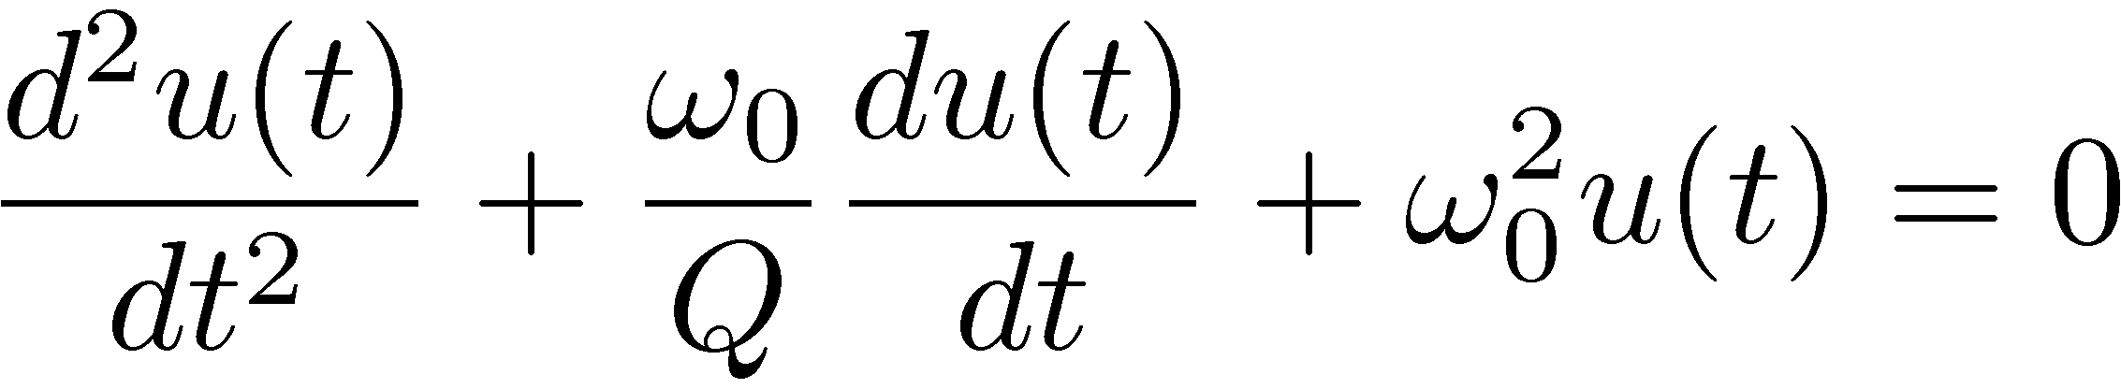
Damped harmonic oscillator I
Damped harmonic oscillator:
  is the ratio between the stored and lost energy per cycle with the damping ratio
  is the eigen-frequency of the harmonic oscillator

Slide 34
Damped harmonic oscillator I
Damped harmonic oscillator:
  is the ratio between the stored and lost energy per cycle with the damping ratio
  is the eigen-frequency of the harmonic oscillator
General solution can be found by the same ansatz
leading to an auxiliary 2nd order equation
with solutions

Slide 35
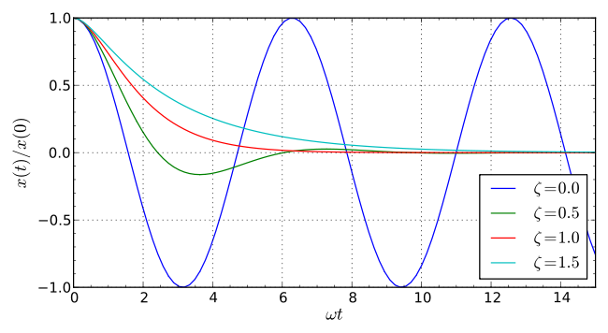
Damped harmonic oscillator II
Three cases can be distinguished
  Overdamping ( real, i.e. or ): The system exponentially decays to equilibrium (slower for larger damping ratio values)
  Critical damping (ζ = 1): The system returns to equilibrium as quickly as possible without oscillating.
  Underdamping ( complex, i.e. or ): The system oscillates with the amplitude gradually to zero, with a slightly different frequency than the harmonic one:
  Note that there is no integral of motion, in that case, as the energy is not conserved (dissipative system)

Slide 36
Contents of the 1st lecture
Accelerator performance parameters and non-linear effects
Linear and non-linear oscillators
  Integral and frequency of motion
  The pendulum
  Damped harmonic oscillator
Phase space dynamics
  Fixed point analysis
Non-autonomous systems
  Driven (damped) harmonic oscillator, resonance conditions
Linear equations with periodic coefficients – Hill’s equations
  Floquet solutions and normalized coordinates
Perturbation theory
  Non-linear oscillator
  Perturbation by periodic function – single dipole perturbation
  Application to single multipole – resonance conditions
  Examples: single quadrupole, sextupole, octupole perturbation
  General multi-pole perturbation– example: linear coupling
  Resonance conditions and working point choice
Summary
Appendix I: Multipole expansion

Slide 37
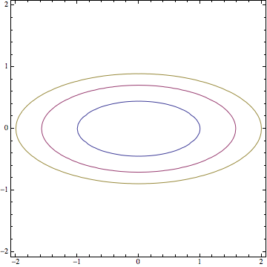
Phase space dynamics
Valuable description when examining trajectories in phase space
Existence of integral of motion imposes geometrical constraints on phase flow
For the simple harmonic oscillator phase space curves are ellipses around the equilibrium point parameterized by the integral of motion Hamiltonian (energy)

Slide 38
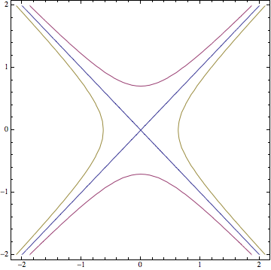
Phase space dynamics
Valuable description when examining trajectories in phase space
Existence of integral of motion imposes geometrical constraints on phase flow
For the simple harmonic oscillator phase space curves are ellipses around the equilibrium point parameterized by the integral of motion Hamiltonian (energy)
By simply changing the sign of the potential in the harmonic oscillator, the phase trajectories become hyperbolas, symmetric around the equilibrium point where two straight lines cross, moving towards and away from it

Slide 39
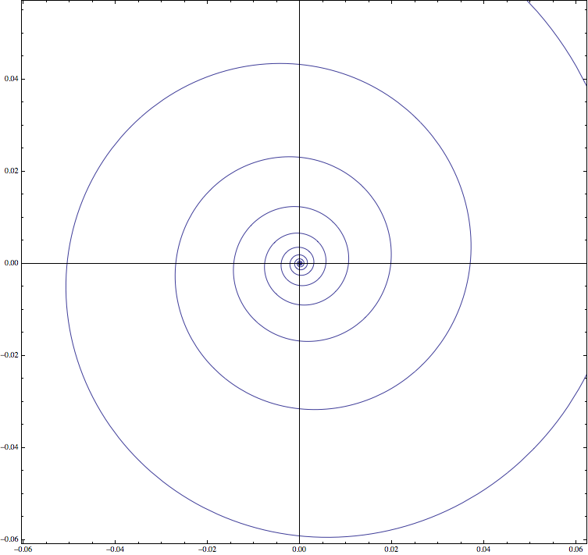
Phase space dynamics
Valuable description when examining trajectories in phase space
Existence of integral of motion imposes geometrical constraints on phase flow
For the simple harmonic oscillator phase space curves are ellipses around the equilibrium point parameterized by the integral of motion Hamiltonian (energy)
For the damped harmonic oscillator (above), the phase space trajectories are spiraling towards equilibrium with a rate depending on the damping coefficient

Slide 40
Non-linear oscillators
Conservative non-linear oscillators have Hamiltonian with the potential being a general (polynomial) function of positions
Equilibrium points are associated with extrema of the potential

Slide 41
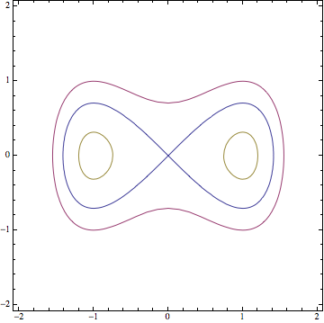
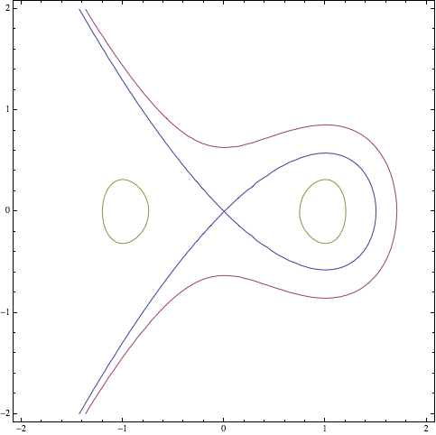
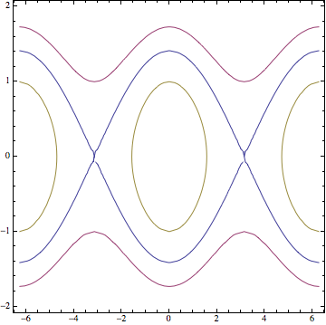
Non-linear oscillators
Conservative non-linear oscillators have Hamiltonian with the potential being a general (polynomial) function of positions
Equilibrium points are associated with extrema of the potential
Considering three non-linear oscillators
  Quartic potential (left): two minima and one maximum
  Cubic potential (center): one minimum and one maximum
  Pendulum (right): periodic minima and maxima

Slide 42
Fixed point analysis
Consider a general second order system
Equilibrium or “fixed” points are determinant for topology of trajectories at their vicinity

Slide 43
Fixed point analysis
Consider a general second order system
Equilibrium or “fixed” points are determinant for topology of trajectories at their vicinity
The linearized equations of motion at their vicinity are
Fixed point nature is revealed by eigenvalues of , i.e. solutions of the characteristic polynomial
Jacobian matrix

Slide 44
Fixed point for conservative systems
For conservative systems of 1 degree of freedom, the second order characteristic polynomial for any fixed point has two possible solutions:
  Two complex eigenvalues with opposite sign, corresponding to elliptic fixed points. Phase space flow is described by ellipses, with particles evolving clockwise or anti-clockwise
elliptic

Slide 45
Fixed point for conservative systems
For conservative systems of 1 degree of freedom, the second order characteristic polynomial for any fixed point has two possible solutions:
  Two complex eigenvalues with opposite sign, corresponding to elliptic fixed points. Phase space flow is described by ellipses, with particles evolving clockwise or anti-clockwise
  Two real eigenvalues with opposite sign, corresponding to hyperbolic (or saddle) fixed points. Flow described by two lines (or manifolds), incoming (stable) and outcoming (unstable)
hyperbolic
elliptic

Slide 46
Pendulum fixed point analysis
The “fixed” points for a pendulum can be found at
The Jacobian matrix is
The eigenvalues are

Slide 47
Pendulum fixed point analysis
The “fixed” points for a pendulum can be found at
The Jacobian matrix is
The eigenvalues are
Two cases can be distinguished:
  , for which corresponding to elliptic fixed points
  , for which corresponding to hyperbolic fixed points
  The separatrix are the stable and unstable manifolds passing through the hyperbolic points, separating bounded librations and unbounded rotations
elliptic
hyperbolic

Slide 48
Contents of the 1st lecture
Accelerator performance parameters and non-linear effects
Linear and non-linear oscillators
  Integral and frequency of motion
  The pendulum
  Damped harmonic oscillator
Phase space dynamics
  Fixed point analysis
Non-autonomous systems
  Driven (damped) harmonic oscillator, resonance conditions
Linear equations with periodic coefficients – Hill’s equations
  Floquet solutions and normalized coordinates
Perturbation theory
  Non-linear oscillator
  Perturbation by periodic function – single dipole perturbation
  Application to single multipole – resonance conditions
  Examples: single quadrupole, sextupole, octupole perturbation
  General multi-pole perturbation– example: linear coupling
  Resonance conditions and working point choice
Summary
Appendix I: Multipole expansion

Slide 49
Non-autonomous systems
Consider a linear system with explicit dependence in time
Time now is not an independent variable but can be considered as an extra dimension leading to a completely new type of behavior
Notes:
Tabor 33-34

Slide 50
Non-autonomous systems
Consider a linear system with explicit dependence in time
Time now is not an independent variable but can be considered as an extra dimension leading to a completely new type of behavior
Consider two independent solutions of the homogeneous equation and
The general solution is a sum of the homogeneous solutions and a particular solution, , where the coefficients are computed as
with the Wronskian of the system
Notes:
Tabor 33-34

Slide 51
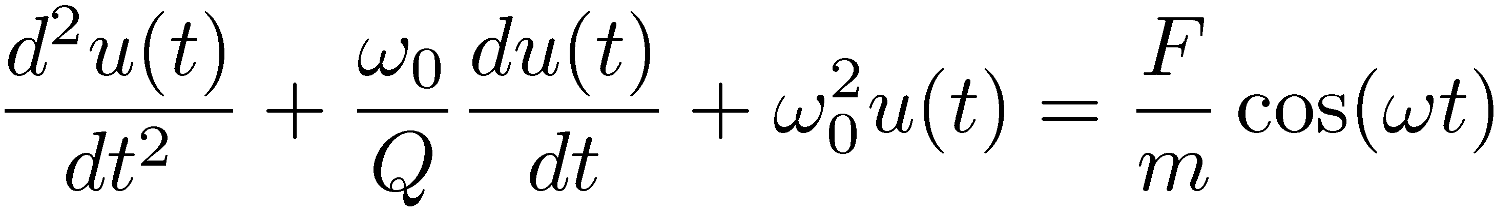
Driven harmonic oscillator
Consider periodic force pumping energy into the system
General solution is a combination of the homogeneous and a particular solution found as
Notes:
Tabor 35

Slide 52
Driven harmonic oscillator
Consider periodic force pumping energy into the system
General solution is a combination of the homogeneous and a particular solution found as
Obviously a resonance condition appears when driving frequency hits the oscillator eigen-frequency.
Notes:
Tabor 35

Slide 53
Driven harmonic oscillator
Consider periodic force pumping energy into the system
General solution is a combination of the homogeneous and a particular solution found as
Obviously a resonance condition appears when driving frequency hits the oscillator eigen-frequency.
In the limit of the solution becomes
The 2nd secular term implies unbounded growth of amplitude at resonance
Notes:
Tabor 35

Slide 54
Damped oscillator with periodic driving
Consider periodic force pumping energy into the system
The solution of the homogeneous system is
Notes:
Tabor 36

Slide 55
Damped oscillator with periodic driving
Consider periodic force pumping energy into the system
The solution of the homogeneous system is
The particular solution is
The homogeneous solution vanishes for , leaving only the particular one, for which there is an amplitude maximum for but no divergence
In that case, the energy pumped into the system compensates the friction, and a steady state is reached representing a limit cycle
Notes:
Tabor 36

Slide 56
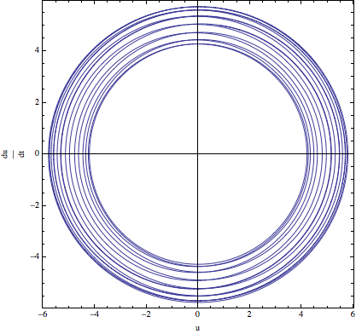
Phase space for time-dependent systems
Consider now a simple harmonic oscillator where the frequency is time-dependent
Plotting the evolution in phase space, provides trajectories that intersect each other
The phase space has time as extra dimension

Slide 57
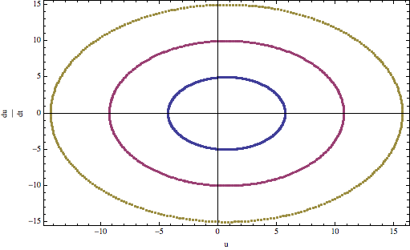
Phase space for time-dependent systems
Consider now a simple harmonic oscillator where the frequency is time-dependent
Plotting the evolution in phase space, provides trajectories that intersect each other
The phase space has time as extra dimension
By rescaling the time to become and considering every integer interval of the new “time” variable, the phase space looks like the one of the harmonic oscillator
This is the simplest version of a Poincaré surface of section, which is useful for studying geometrically phase space of multi-dimensional systems

Slide 58
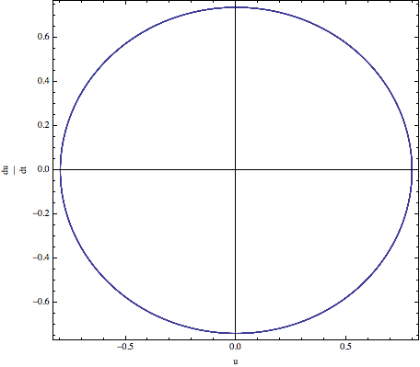
Phase space for time-dependent systems
Consider now a simple harmonic oscillator where the frequency is time-dependent
Plotting the evolution in phase space, provides trajectories that intersect each other
The phase space has time as extra dimension
By rescaling the time to become and considering every integer interval of the new “time” variable, the phase space looks like the one of the harmonic oscillator
This is the simplest version of a Poincaré surface of section, which is useful for studying geometrically phase space of multi-dimensional systems
The fixed point in the surface of section is now a periodic orbit

Slide 59
Contents of the 1st lecture
Accelerator performance parameters and non-linear effects
Linear and non-linear oscillators
  Integral and frequency of motion
  The pendulum
  Damped harmonic oscillator
Phase space dynamics
  Fixed point analysis
Non-autonomous systems
  Driven (damped) harmonic oscillator, resonance conditions
Linear equations with periodic coefficients – Hill’s equations
  Floquet solutions and normalized coordinates
Perturbation theory
  Non-linear oscillator
  Perturbation by periodic function – single dipole perturbation
  Application to single multipole – resonance conditions
  Examples: single quadrupole, sextupole, octupole perturbation
  General multi-pole perturbation– example: linear coupling
  Resonance conditions and working point choice
Summary
Appendix I: Multipole expansion

Slide 60
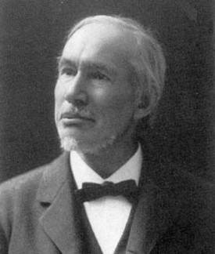
Linear equation with periodic coefficients
A very important class of equations especially for beam dynamics (but also solid state physics) are linear equations with periodic coefficients
with a periodic function of time
George Hill

Slide 61
Linear equation with periodic coefficients
A very important class of equations especially for beam dynamics (but also solid state physics) are linear equations with periodic coefficients
with a periodic function of time
These are called Hill’s equations and can be thought as equations of harmonic oscillator with time dependent (periodic) frequency
There are two solutions that can be written as with periodic but also with a constant which implies that is periodic
The solutions are derived based on Floquet theory
George Hill

Slide 62
Amplitude, phase and invariant
Differentiating the solutions twice and substituting to Hill’s equation, the following two equations are obtained
The 2nd one can be integrated to give , i.e. the relation between the “phase” and the amplitude

Slide 63
Amplitude, phase and invariant
Differentiating the solutions twice and substituting to Hill’s equation, the following two equations are obtained
The 2nd one can be integrated to give , i.e. the relation between the “phase” and the amplitude
Substituting this to the 1st equation, the amplitude equation is derived (or the beta function in accelerator jargon)
By evaluating the quadratic sum of the solution and its derivative an invariant can be constructed, with the form

Slide 64
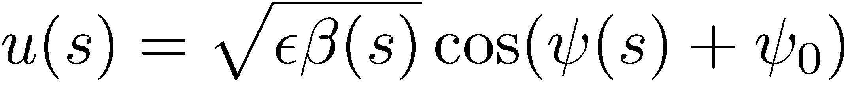
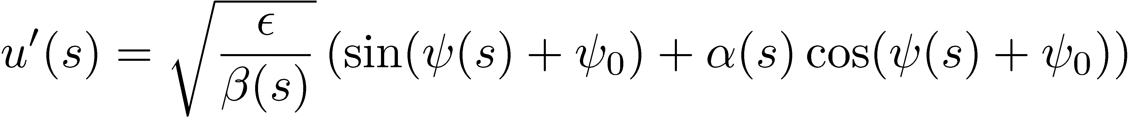
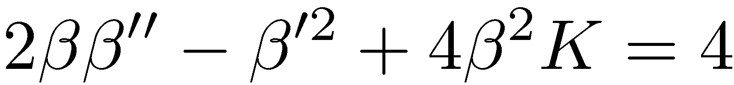
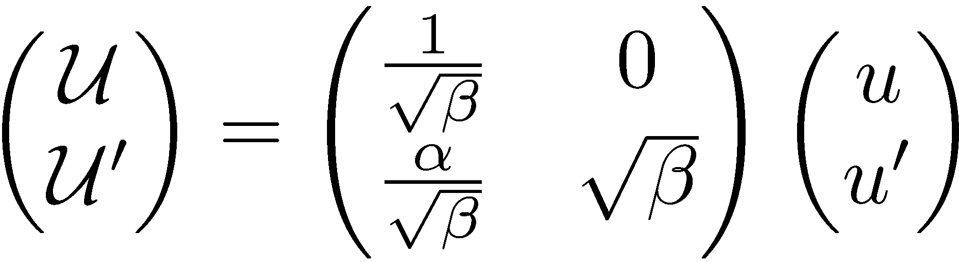
Normalized coordinates
Recall the Floquet solutions for betatron motion
Introduce new variables
In matrix form

Slide 65
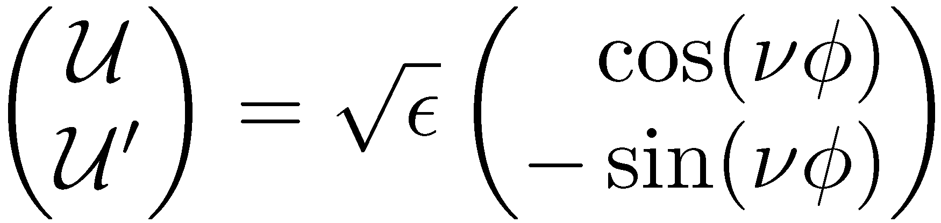
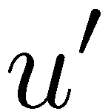


Normalized coordinates
Recall the Floquet solutions for betatron motion
Introduce new variables
In matrix form
Hill’s equation becomes
System becomes harmonic oscillator with frequency or
Floquet transformation transforms phase space in circles

Slide 66
Perturbation of Hill’s equations
Hill’s equations in normalized coordinates with harmonic perturbation, using and
where the F is the Lorentz force from perturbing fields
  Linear magnet imperfections: deviation from the design dipole and quadrupole fields due to powering and alignment errors
  Time varying fields: feedback systems (damper) and wake fields due to collective effects (wall currents)
  Non-linear magnets: sextupole magnets for chromaticity correction and octupole magnets for Landau damping
  Beam-beam interactions: strongly non-linear field
  Space charge effects: very important for high intensity beams
  non-linear magnetic field imperfections: particularly difficult to control for super conducting magnets where the field quality is entirely determined by the coil winding accuracy

Slide 67
Contents of the 1st lecture
Accelerator performance parameters and non-linear effects
Linear and non-linear oscillators
  Integral and frequency of motion
  The pendulum
  Damped harmonic oscillator
Phase space dynamics
  Fixed point analysis
Non-autonomous systems
  Driven (damped) harmonic oscillator, resonance conditions
Linear equations with periodic coefficients – Hill’s equations
  Floquet solutions and normalized coordinates
Perturbation theory
  Non-linear oscillator
  Perturbation by periodic function – single dipole perturbation
  Application to single multipole – resonance conditions
  Examples: single quadrupole, sextupole, octupole perturbation
  General multi-pole perturbation– example: linear coupling
  Resonance conditions and working point choice
Summary
Appendix I: Multipole expansion

Slide 68
Perturbation theory
Completely integrable systems are exceptional
For understanding dynamics of general non-linear systems composed of a part whose solution is known and a part parameterized by a small constant , perturbation theory is employed
The general idea is to expand the solution in a power series
and compute recursively the corrections hoping that a few terms will be sufficient to find an accurate representation of the general solution
This may not be true for all times, i.e. facing series convergence problems
In addition, any series expansion breaks in the vicinity of a resonance
Notes:
Tabor 90-96

Slide 69
Perturbation of non-linear oscillator
Consider a non-linear harmonic oscillator,
This is just the pendulum expanded to 3rd order in
Note that is a dimensionless measure of smallness, which may represent a scaling factor of (e.g. without loss of generality)
Notes:
Tabor 90-96

Slide 70
Perturbation of non-linear oscillator
Consider a non-linear harmonic oscillator,
This is just the pendulum expanded to 3rd order in
Note that is a dimensionless measure of smallness, which may represent a scaling factor of (e.g. without loss of generality)
Expanding and separating the equations with equal power in :
  Order 0:
  Order 1:
Notes:
Tabor 90-96

Slide 71
Perturbation of non-linear oscillator
Consider a non-linear harmonic oscillator,
This is just the pendulum expanded to 3rd order in
Note that is a dimensionless measure of smallness, which may represent a scaling factor of (e.g. without loss of generality)
Expanding and separating the equations with equal power in :
  Order 0:
  Order 1:
The 2nd equation has a particular solution with two terms. A well behaved one and
the first part of which grows linearly with time (secular term)
But this cannot be true, the pendulum does not present such behavior. What did it go wrong?
Notes:
Tabor 90-96

Slide 72
Perturbation of non-linear oscillator
It was already shown that the pendulum has an amplitude dependent frequency, so the frequency has to be developed as well (Poincaré-Linstead method):

Slide 73
Perturbation of non-linear oscillator
It was already shown that the pendulum has an amplitude dependent frequency, so the frequency has to be developed as well (Poincaré-Linstead method):
Assume that the solution is a periodic function of which becomes the new independent variable. The equation at zero order gives the solution and at leading perturbation order becomes

Slide 74
Perturbation of non-linear oscillator
It was already shown that the pendulum has an amplitude dependent frequency, so the frequency has to be developed as well (Poincaré-Linstead method):
Assume that the solution is a periodic function of which becomes the new independent variable. The equation at zero order gives the solution and at leading perturbation order becomes
The last term has to be zero, if not it gives secular terms, thus which reveals the decrease of the frequency with the oscillation amplitude
Finally, the solution is the leading order correction due to the non-linear term

Slide 75
Perturbation by periodic function
In beam dynamics, perturbing fields are periodic functions
The problem to solve is a generalization of the driven harmonic oscillator,
with a general periodic function , with frequency
The right side can be Fourier analyzed:
Notes:
Tabor 35

Slide 76
Perturbation by periodic function
In beam dynamics, perturbing fields are periodic functions
The problem to solve is a generalization of the driven harmonic oscillator,
with a general periodic function , with frequency
The right side can be Fourier analyzed:
The homogeneous solution is
The particular solution can be found by considering that has the same form as :
By substituting the following relation is derived for the Fourier coefficients of the particular solution
Notes:
Tabor 35

Slide 77
Perturbation by periodic function
In beam dynamics, perturbing fields are periodic functions
The problem to solve is a generalization of the driven harmonic oscillator,
with a general periodic function , with frequency
The right side can be Fourier analyzed:
The homogeneous solution is
The particular solution can be found by considering that has the same form as :
By substituting the following relation is derived for the Fourier coefficients of the particular solution
There is a resonance condition for infinite number of frequencies satisfying
Notes:
Tabor 35

Slide 78
Perturbation by single dipole
Hill’s equations in normalized coordinates with single dipole perturbation:
The dipole perturbation is periodic, so it can be expanded in a Fourier series

Slide 79
Perturbation by single dipole
Hill’s equations in normalized coordinates with single dipole perturbation:
The dipole perturbation is periodic, so it can be expanded in a Fourier series
Note, as before that a periodic kick introduces infinite number of integer driving frequencies
The resonance condition occurs when
i.e. integer tunes should be avoided (remember orbit distortion due to single dipole kick)

Slide 80
Perturbation by single multi-pole
For a generalized multi-pole perturbation, Hill’s equation is:
As before, the multipole coefficient can be expanded in Fourier series

Slide 81
Perturbation by single multi-pole
For a generalized multi-pole perturbation, Hill’s equation is:
As before, the multipole coefficient can be expanded in Fourier series
Following the perturbation steps, the zero-order solution is given by the homogeneous equation
Then the position can be expressed as

Slide 82
Perturbation by single multi-pole
For a generalized multi-pole perturbation, Hill’s equation is:
As before, the multipole coefficient can be expanded in Fourier series
Following the perturbation steps, the zero-order solution is given by the homogeneous equation
Then the position can be expressed as
with

Slide 83
Perturbation by single multi-pole
For a generalized multi-pole perturbation, Hill’s equation is:
As before, the multipole coefficient can be expanded in Fourier series
Following the perturbation steps, the zero-order solution is given by the homogeneous equation
Then the position can be expressed as
with
The first order solution is written as

Slide 84
Resonances for single multi-pole
Following the discussion on the periodic perturbation, the solution can be found by setting the leading order solution to be periodic with the same frequency as the right hand side

Slide 85
Resonances for single multi-pole
Following the discussion on the periodic perturbation, the solution can be found by setting the leading order solution to be periodic with the same frequency as the right hand side
Equating terms of equal exponential powers, the Fourier amplitudes are found to satisfy the relationship

Slide 86
Resonances for single multi-pole
Following the discussion on the periodic perturbation, the solution can be found by setting the leading order solution to be periodic with the same frequency as the right hand side
Equating terms of equal exponential powers, the Fourier amplitudes are found to satisfy the relationship
This provides the resonance condition or which means that there are resonant frequencies for and “infinite” number of rationals

Slide 87
Tune-shift for single multi-pole
Note that for even multi-poles and or , there is a Fourier coefficient , which is independent of and represents the average value of the periodic perturbation
The perturbing term in the r.h.s. is
which can be obtained for (it is indeed an integer only for even multi-poles)

Slide 88
Tune-shift for single multi-pole
Note that for even multi-poles and or , there is a Fourier coefficient , which is independent of and represents the average value of the periodic perturbation
The perturbing term in the r.h.s. is
which can be obtained for (it is indeed an integer only for even multi-poles)
Following the approach of the perturbed non-linear harmonic oscillator, this term will be secular unless a perturbation in the frequency is considered, thereby resulting to a tune-shift equal to
with
This tune-shift is amplitude dependent for

Slide 89
Example: single quadrupole perturbation
Consider single quadrupole kick in one normalized plane:
The quadrupole perturbation can be expanded in a Fourier series

Slide 90
Example: single quadrupole perturbation
Consider single quadrupole kick in one normalized plane:
The quadrupole perturbation can be expanded in a Fourier series
Following the perturbation approach, the 1st order equation becomes with
For , the resonance conditions are
i.e. integer and half-integer tunes should be avoided

Slide 91
Example: single quadrupole perturbation
Consider single quadrupole kick in one normalized plane:
The quadrupole perturbation can be expanded in a Fourier series
Following the perturbation approach, the 1st order equation becomes with
For , the resonance conditions are
i.e. integer and half-integer tunes should be avoided
For , the condition corresponds to a non-vanishing average value , which can be absorbed in the left-hand side providing a tune-shift:
or

Slide 92
Single Sextupole Perturbation
Consider a localized sextupole perturbation in the horizontal plane
After replacing the perturbation by its Fourier transform and inserting the unperturbed solution to the right hand side
with
Notes:
Show also octupole…

Slide 93
Single Sextupole Perturbation
Consider a localized sextupole perturbation in the horizontal plane
After replacing the perturbation by its Fourier transform and inserting the unperturbed solution to the right hand side
with
Resonance conditions:
3rd integer
integer
Notes:
Show also octupole…

Slide 94
Single Sextupole Perturbation
Consider a localized sextupole perturbation in the horizontal plane
After replacing the perturbation by its Fourier transform and inserting the unperturbed solution to the right hand side
with
Resonance conditions:
Note that there is not a tune-spread associated. This is only true for small perturbations (first order perturbation treatment)
Although perturbation treatment can provide approximations for evolution of motion, there is no exact solution
3rd integer
integer
Notes:
Show also octupole…

Slide 95
General multi-pole perturbation
Equations of motion including any multi-pole error term, in both planes
Expanding perturbation coefficient in Fourier series and inserting the solution of the unperturbed system on the rhs gives the following series:

Slide 96
General multi-pole perturbation
Equations of motion including any multi-pole error term, in both planes
Expanding perturbation coefficient in Fourier series and inserting the solution of the unperturbed system on the rhs gives the following series:
The equation of motion becomes
In principle, same perturbation steps can be followed for getting an approximate solution in both planes

Slide 97
Example: Linear Coupling
For a localized skew quadrupole we have
Expanding perturbation coefficient in Fourier series and inserting the solution of the unperturbed system gives the following equation:
with

Slide 98
Example: Linear Coupling
For a localized skew quadrupole we have
Expanding perturbation coefficient in Fourier series and inserting the solution of the unperturbed system gives the following equation:
with
The coupling resonance are found for
Linear sum resonance
Linear difference resonance

Slide 99
General resonance conditions
The general resonance conditions is
or , with order
The same condition can be obtained in the vertical plane

Slide 100
General resonance conditions
The general resonance conditions is
or , with order
The same condition can be obtained in the vertical plane
For all the polynomial field terms of a -pole, the main excited resonances satisfy the condition but there are also sub-resonances for which
For normal (erect) multi-poles, the main resonances are whereas for skew multi-poles

Slide 101
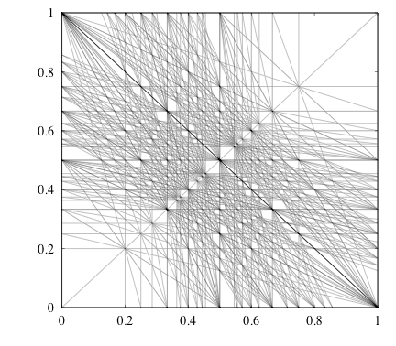
General resonance conditions
The general resonance conditions is
or , with order
The same condition can be obtained in the vertical plane
For all the polynomial field terms of a -pole, the main excited resonances satisfy the condition but there are also sub-resonances for which
For normal (erect) multi-poles, the main resonances are whereas for skew multi-poles
If perturbation is large, all resonances can be potentially excited
The resonance conditions form lines in frequency space and fill it up as the order grows (the rational numbers form a dense set inside the real numbers), but Fourier amplitudes should also decrease

Slide 102
Systematic and random resonances
If lattice is made out of identical cells, and the perturbation follows the same periodicity, resulting in a reduction of the resonance conditions to the ones satisfying
These are called systematic resonances

Slide 103
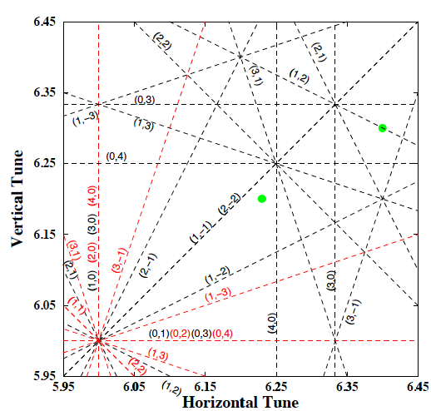
Systematic and random resonances
If lattice is made out of identical cells, and the perturbation follows the same periodicity, resulting in a reduction of the resonance conditions to the ones satisfying
These are called systematic resonances
Practically, any (linear) lattice perturbation breaks super-periodicity and any random resonance can be excited
Careful choice of the working point is necessary

Slide 104
Contents of the 1st lecture
Accelerator performance parameters and non-linear effects
Linear and non-linear oscillators
  Integral and frequency of motion
  The pendulum
  Damped harmonic oscillator
Phase space dynamics
  Fixed point analysis
Non-autonomous systems
  Driven (damped) harmonic oscillator, resonance conditions
Linear equations with periodic coefficients – Hill’s equations
  Floquet solutions and normalized coordinates
Perturbation theory
  Non-linear oscillator
  Perturbation by periodic function – single dipole perturbation
  Application to single multipole – resonance conditions
  Examples: single quadrupole, sextupole, octupole perturbation
  General multi-pole perturbation– example: linear coupling
  Resonance conditions and working point choice
Summary
Appendix I: Multipole expansion

Slide 105
Summary
Accelerator performance depends heavily on the understanding and control of non-linear effects
The ability to integrate differential equations has a deep impact to the dynamics of the system
Phase space is the natural space to study this dynamics
Perturbation theory helps integrate iteratively differential equations and reveals appearance of resonances
Periodic perturbations drive infinite number of resonances
There is an amplitude dependent tune-shift at 1st order for even multi-poles
Periodicity of the lattice very important for reducing number of lines excited at first order

Slide 106
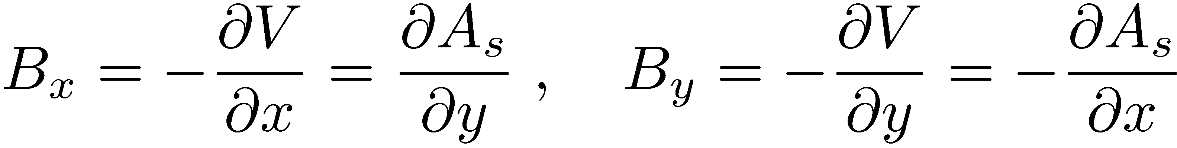
Magnetic multipole expansion
From Gauss law of magnetostatics, a vector potential exist
Assuming transverse 2D field, vector potential has only one component A_{s}. The Ampere’s law in vacuum (inside the beam pipe)
Using the previous equations, the relations between field components and potentials are
y
i.e. Riemann conditions of an analytic function
Exists complex potential of with power series expansion convergent in a circle with radius (distance from iron yoke)
iron
r_{c}
x

Slide 107
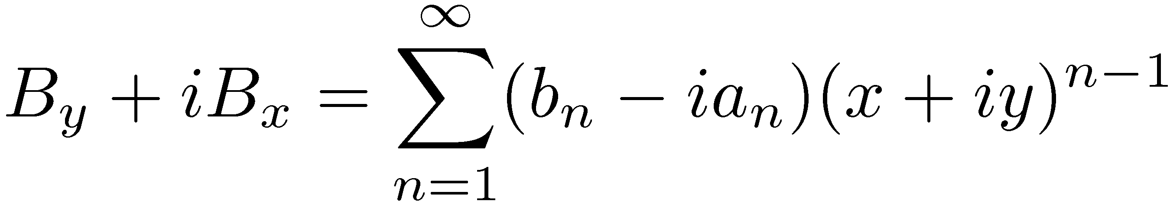
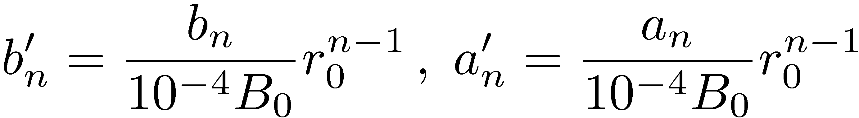
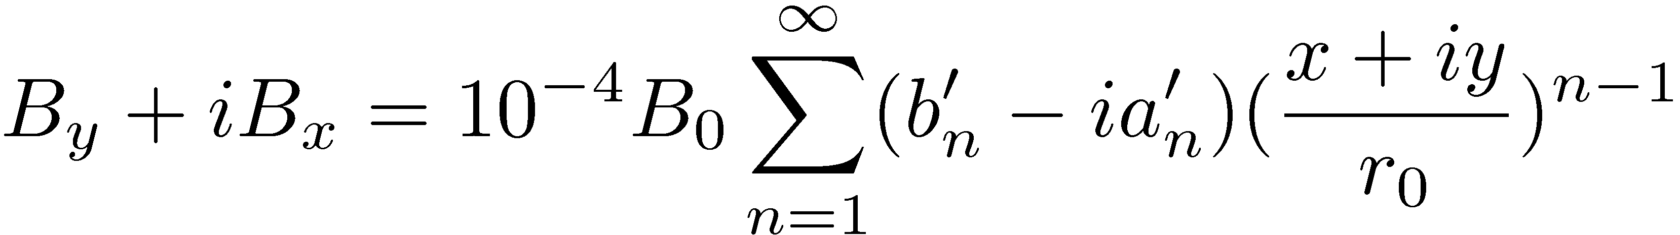
Multipole expansion II
From the complex potential we can derive the fields
Setting
Define normalized coefficients
on a reference radius r₀, 10⁻⁴ of the main field to get
Note: is the US convention

