Slide 1
Università degli Studi di Napoli Federico II
PhD School of Fundamental and Applied Physics
XVIII Cycle
Development of FPGA-based High-Speed serial links for High Energy Physics Experiments
Sabrina Perrella
10/05/2016
Notes:
Good morning. I’m Sabrina Perrella and I was involved in the Development of High-Speed serial links for High Energy Physics Experiments

Slide 2
Outline
Introduction to serial transmission
Adaptive serial link project
Serial links in the ATLAS framework
New MUCTPI Interface Board
Pad Trigger Logic Board
Notes:
In this presentation I’ll start with an introduction on the serial transmission and after I’ll describe the three project I worked on consisting in
The development of an Adaptive serial link
The design of an new Interface board and a high speed serial link on it. The project was intendet as a parto of one of the upgrade of the muon trigger system of the ATLAS experimet.
Still in the framework of the ATLAS experiment I developed the serial interface of a New trigger board for the trigger system of the NSW project

Slide 3
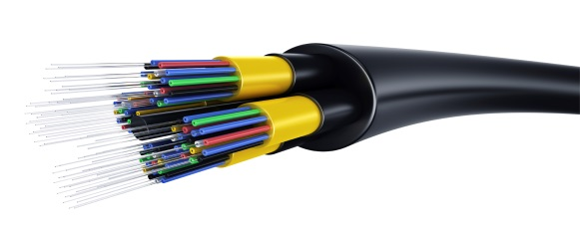
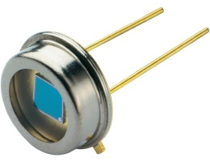
Why serial transmission?
Extreme High Bandwidth
One fibre can carry in the order of tens of Tbs
One line
Small dimension, Low weight, Simple cabling, Reduced costs
Reliability over long-distance
Bi-directionality
Not sensitive to Crosstalk and EMI (Electro Magnetic Interference)
Low transmission loss
Transmitter
Transmission Media
Receiver
Notes:
High Energy Physics experiments generate high volumes of data, that also means a great demand for high bandwidth over long distance.
Then for data read out, but not only, Serial links (especially optical) seem to be the natural solution.
Especially for their Extreme High Bandwidth, but also due to other properties such as
Reliability over Long-distance
Bi-directionality
Low transmission loss
And so on.
Indeed….
(for example, the ATLAS detector produces 18 Pbyte/year).
[decrerased cost of integrated circuit in hard disk communication, the Integrated Drive Electronics (IDE) commonly known as AT Attachment with Packet Interface (ATA/ATAPI) has been completely overcome with Serial AT Attachment (SATA); analogously IEEE-1284 bi-directional parallel communications have been replaced by Universal Serial Bus (USB)]

Slide 4
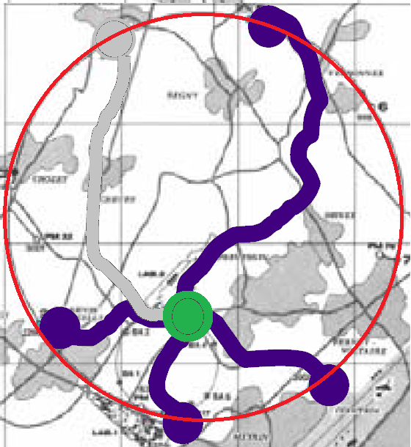
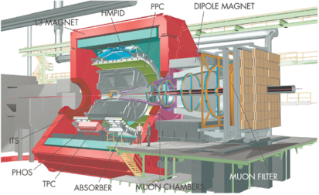
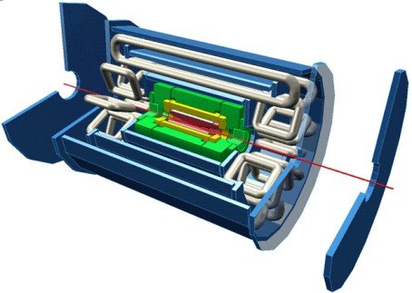
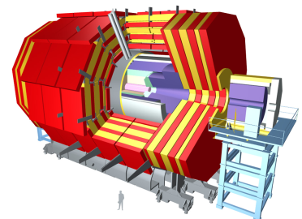
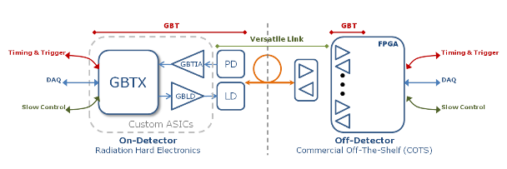
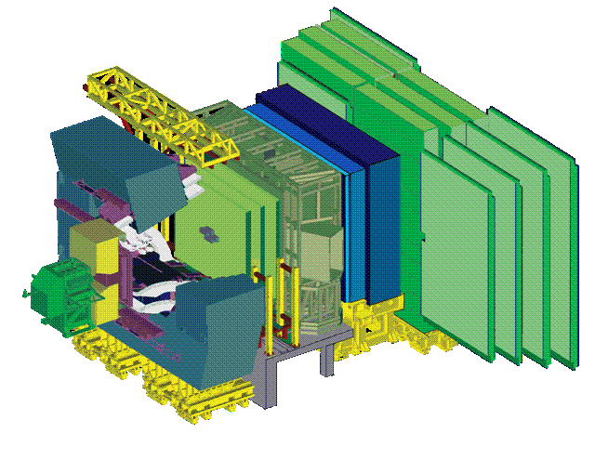
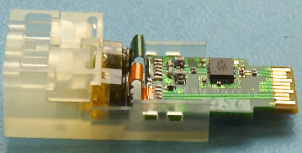
Serial Links @ LHC (Large Hadron Collider)
Alice-DDL | Optical: 200 MB/s ≈ 400 links
ATLAS-SLINK | Optical: 160 MB/s ≈ 1600 Links
CMS-SLIK-64 | LVDS: 200 MB/s (max. 15m) ≈ 500 links
LHCb -GOL | Optical 200 MB/s ≈ 400 links
The Timing, Trigger and Control system (TTC) at CERN
Broadcasts timing signals from LHC machine to the experiments
Readout Links of
LHC Experiments
Links in the LHC future
Notes:
Each of the four big experiments installed on the Large Hadron Collider @ CERN uses a huge amount of serial links in their read out system.
Another example @ LHC is the Timing, Trigger and Control system (TTC) which broadcasts the timing signals from the LHC machine to the experiments, using optical fibers.
So over kilometers of distance (LHC has 27 KM of diameter)
Also for the upgrades of experiments at LHC, physical layer components and protocol chips (ASIC) have been designed and are now under development
the Versatile Link and the GBT protocol (and ASICs) whose pecularity relies in their radiation hardness
Indeed, LHC Upgrade will require links components to be sit inside or in the proximity of the detectors. Then, since they will be subject to harsh radiation levels due to the high number of colliding particles and the high frequency of occurrence of collisions, they have to be radiation hard.
The Timing, Trigger and Control (TTC) ss a system architecture that provides the distribution of synchronous timing, (level-1) trigger, and broadcasts (as well as individually-addressed control signals???)
appropriate phase relative to the LHC bunch structure is guaranteed
account for the different delays due to particle time-of-flight and signal propagation.
within each trigger distribution zone, the signals can be broadcast from a single laser source to several hundred destinations over a passive optical network composed of a hierarchy of optical tree couplers

Slide 5
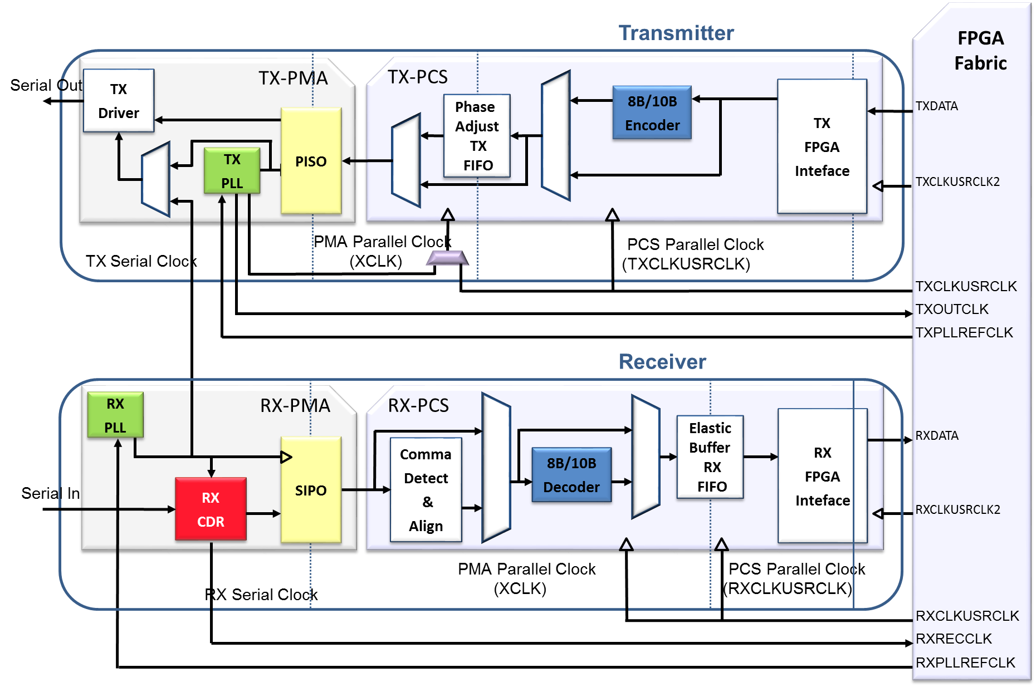
Embedded SERDES in FPGA: GTP & GTX
SerDes functions:
Serialization
Deserialization
Clock and Data Recovery
Encoding/Decoding
Internal Phase-locked Loops (for frequency synthesis)
Notes:
Grazie all’importanza degli FPGA nel mercato dei dispositive elettronici e dei SERDES (I componenti che permettono la serializzazione e deserializzazione dei dati ) nel campo delle trasmissioni…I serdes sono stati man mano integrati all’interno dei dispositive FPGA. In questo modo alle loro cartteristiche si aggiunge la riprogrammabilità tipica degli FPGA. In questa slide è mostrata la struttura interna dei due SerDes utilizzati nei miei progetti Il GTP e il GTX appartenenti alla serie 7 degli FPGA Xilinx
E noi…

Slide 6
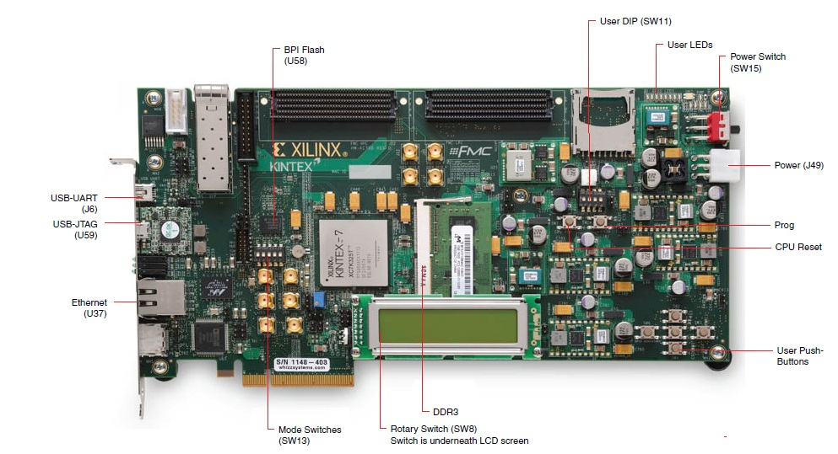
FPGAs and Evaluation Boards
Development and test without custom board
FPGA + peripherals
I/O SMA
LEDs
USB
ETHERNET
LCD
SWITCH
Notes:
Un punto a favore dell’utlizzo di questi dispositivi risiede nella possibilità di testare il circuito senza la necessità di disegnare e una scheda custom , ma semplicemente utilizzando le schede di valutazione fornite dai produttori, caratterizzate dalla presenza di un FPGA e un sistema di periferiche di input ed otput per l’interfaccimaento con l’esterno
Per il mio lavoro di tesi in particolare ho utilizzato due diversi tipi di Schede di valutazione
Una con un dispositivo ARTIX 7 con un SERDES chiamato GTP e
Una con un dispositivo kintex 7 con un SERDES chiamato GTx e

Slide 7
Frequency-agile auto adaptive
serial link*
*
“A Frequency Agile, Self-Adaptive Serial Link on Xilinx FPGAs”
Aloisio, A. ; Giordano, R. ; Izzo, V. ; Perrella, S.
Nuclear Science, IEEE Transactions on (Volume: 62 , Issue: 3)
Notes:
Then I will start to explain one of the three projects based on serial links I develeped
The first I’ll present has been also published by IEEE.
It consists of a system capable of checking the quality of the link, using a methodology called 2D BER Map (which I’ll explain later), and which it is automatically capable to change the line rate in order to work at its highest value
But, before going into the details of the project, I’ll briefly describe some of the testing methods usually used for the evaluation of the quality of a serial link

Slide 8
Quality of a serial link & Bit Error Ratio Test
Bit Error Ratio
(BER)
$$=\frac{\text{Nmber} \text{of} \text{errored}\text{−}\text{bits}\text{ (}\text{E}\text{)}}{\text{T}\text{otal} \text{bits}\text{ (}\text{N}\text{)}}$$
$\lim_{N→∞}{BER}$=$P\left(E\right)$
$CL=P\left(BER<{BER}_{Limit}\right)$, given E and N
Typical links designed for BERs better than 10⁻¹⁰
BER Test Thresholds:
BER < specified ${BER}_{Limit}$
specific CL
specified E
Successful Test
After N transmitted bits
# of Errors ≤ Error Threshold
Fixed N
Notes:
Then, a typical test consists in checking if for the link the BER is less than a specified BER_LIMIT with a specific CL, with a certain number of Errors (E).
Statistical formulas help in finding the number of bits to be transmitted in order to check the link
The link passes the test, that means it is qualified with a BER less the than the BER limit, if after N transmitted bits the number of Errors is less or equal of the Error Threshold initially requested
Typical links are designed in order to have a BER less than 10 ⁻¹⁰

Slide 9
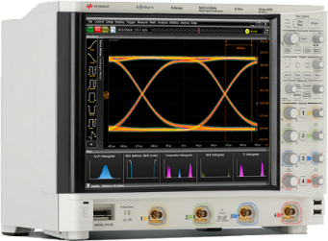
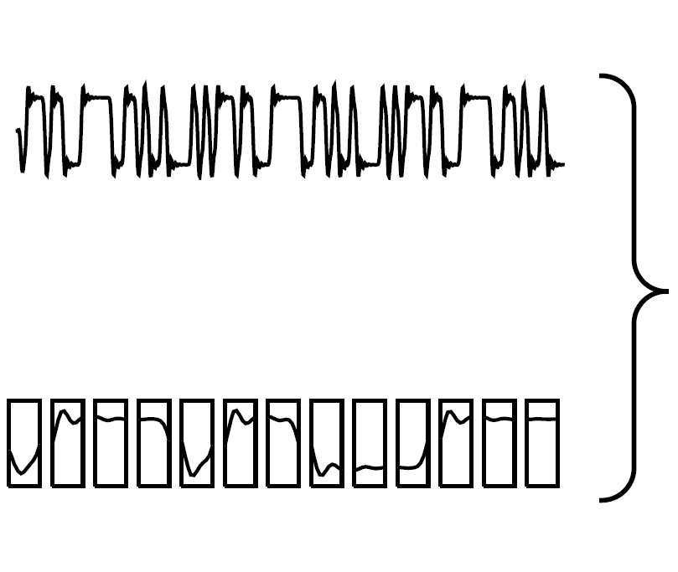
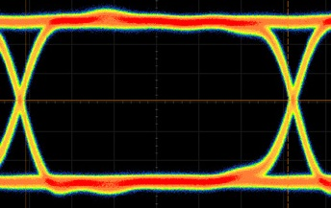
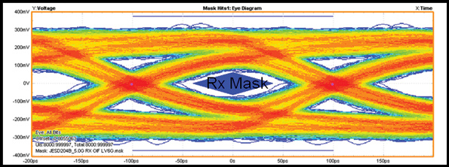
Eye diagram
Random
Data
TX
RX
Synth
Use a precise clock to chop the data
Overlay the parts of the waveform corresponding to each individual bit into a single graph
signal amplitude
Unit Interval
(UI)
time
Notes:
The eye diagram is another methodology to represent and analyze a high speed digital signal.
It is constructed from a digital waveform by superimposing, into a single graph, the parts of the waveform corresponding to individual bits and by repeating this construction over many samples of the waveform.
The vertical axis of the Eye diagram is signal amplitude while there is time on horizontal axis.
The eye opening corresponds to one bit period which is typically called the Unit Interval (UI)
On the slide
ther is an example of good trasnsmission in which all waveform transitions overlap almost perfectly.
And a link of bad quality in which the effects of the imperfections in a real communication can be easly seen
(jitter and noise)
The resultant graph is the same that would be obtained analyzing the serial stream at the oscilloscope and by maintaining the persistence
Jitter: the drift of a signal with the respect ot its ideal position

Slide 10
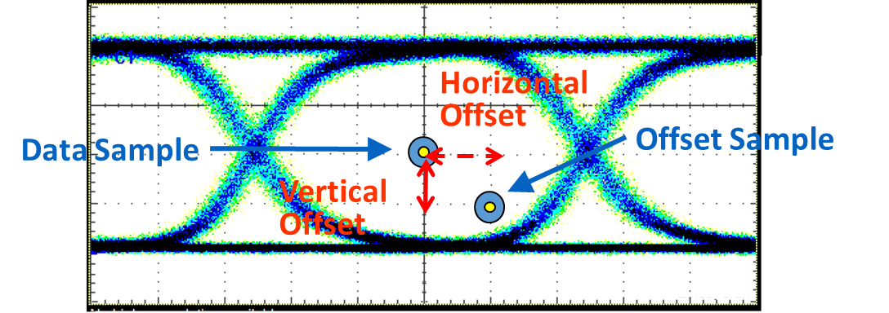
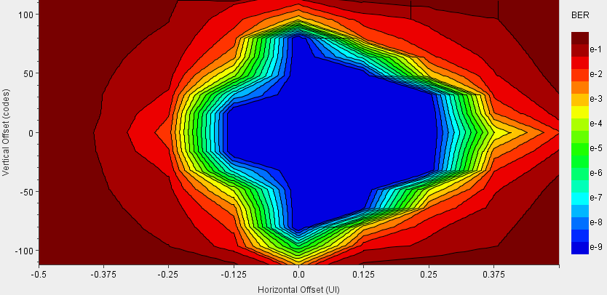
2-D BER Map
Sample Count:
# Total Data Sample acquired
Error Count:
# Offset Sample different from Data Sample
The Bit Error Ratio (BER) @ Offset Sample:
BER $=\frac{\text{Error} \text{Count}}{\text{Sample} \text{Count}}$
Notes:
Un’altra metodologia di test di un link consiste nel costruire la mappa di BER bidimensionale, rappresentata nella slide per la quale viene calcolato il BER per diversi punti all’interno della unit interval chiamati offset point.
Nella mappa bidimensionale sugli assi è rappresentato il valore del’offset point e il valore del BER è rappresentato dall curve di livello colorate.
Using this two samplers we can built the so called 2 dimensional BER Map: that is the last methodology I’ll present you in order to qualify a link and the methodology used in the adaptive serial link
During what it is called an eye scan measurement,
the position of the offset sample is fixed, a large number of Samples are acquired ( in order to obtain a low BER with a High CL)
Then the error count is calculated, that means I count how many times the value in the offset sample is different from the value of the data sample
The bit error ratio (BER) at a specific offset sample is given/CALCULATEd by the ratio between the Error Count and the Sample Count.
By repeating the eye scan measurement for different offsets in the Unit Interval a 2-D BER map (shown here) can be produced
Where on the axis there is the position in the offset sample. The coloured contour plots represent the BER value
This functionality poses no specific requests or constraints on the data pattern to be received
However, the possibility to dynamically (daɪˈnæmɪkəlɪ) vary the position of Sample point is required

Slide 11
Frequency-agile adaptive serial link
The link:
analyzes the incoming data stream by using the eye scan measurement
sets the highest transmission line rate, according to a given tolerated BER
A microprocessor dynamically drives the Serdes (GTX)
To build a 2-D BER Map
To change line rate
No specific requirement on link specification or protocol
FPGA
TX GTX
RX GTX
FPGA & RAM
Application Fields!
Monitoring tool in different HEP experiments
(serial links intensively used)
transmission system can be remotely monitored
and
issues in the physical layer can be detected
Tx
Rx
Rx
Tx
TX Module RX Module
Notes:
Summarizing, using the eye scan technique just now described, the system is capable to:
analyze the incoming data stream, by scanning the Unit Interval,
find the highest transmission line rate, according to a given tolerated BER.
It is designed around an embedded microprocessor which
drives Serdes in order vary the samples point position over the UI, and to built a 2-D BER Map
takes care of the reconfiguration of the SERDES, in order to vary the link linerate and to find its highest value
In such a way we can fully benefit from the available link bandwidth.
This application, since has no specific requirement about link specification or protocol, can be used as a monitoring tool in HEP experiments, in order to remotely monitor a transmission system or detect issues in the serial link physical layer.
The system could also be used whenever it is crucial to have prompt information about the maximum sustainable line rate of a connection, such as on test beam sites, where the user could be forced to adapt dynamically his setup to the cabling resources available on site.

Slide 12
Serial Links for ATLAS
Upgrades
New Interface Board for the Barrel Trigger
Pad Trigger Board for the NSW Trigger
Notes:
The second part of the presentation will be devoted to the description of two projects in the ATLAS framwork,
Projects in which I was also involved for developing serial links.

Slide 13
New Interface Board for the Level 1 Trigger
Development and test of a high speed serial link
Design of a new board
Notes:
consisted in developing a high speed serial link as a part a new board I designed for the upgrade in the barrel level 1 muon trigger system: the MUCTPI Interface board
high-speed serial link for the barrel Level 1 muon trigger
New MUCTPI Interface Board

Slide 14
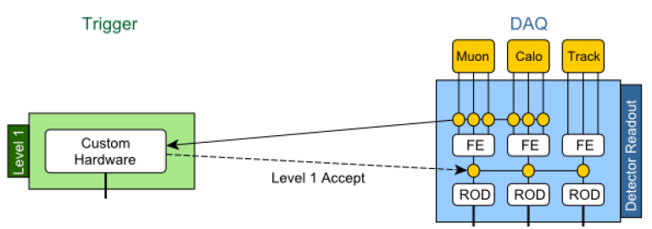
First Level Trigger
The Level 1 trigger is composed of a number of dedicated trigger processors
Central Trigger Processor (CTP) takes Level 1 trigger decision using information from dedicated trigger processors:
L1 Calo
MuCTPI (Muon To CTP Interface)
For RPC detectors,
a further Interface between
Off-Detector Electronics and MUCTPI exists
MuCTPI Interface
L1 Calo
Calorimeter
Level 1 Trigger
CTP
MuCTPI
TGC Muon
MuCTPI Interface
RPC Muon
Level 1 trigger decision
Notes:
The Level 1 trigger is composed of a number of dedicated hardware trigger processors.
The main one is the Central Trigger Processor (CTP) which is in charge of taking the Level one trigger decision.
It receives the information from calorimeter and muon systems through dedicated trigger processors:
Calorimeter
Muon detector (Muon To CTP Interface or MuCTPI)
Actually, the RPC detector has a further Interface between its OFF-Detector Electronics and the MUCTPI.
Since I worked on the development of a new MUCTPI interface board for the RPC muon detector let me quickly describe…
(L1Calo) and the Muon CTP Interface (MUCTPI) receiving data from calorimeter and muon systems at a constant rate of 40 MHz
a number of dedicated trigger processors:
Calorimeter
Muon detector (Muon To CTP Interface
The Level 1 trigger is composed of a number of dedicated trigger processors, (L1Calo) and the Muon CTP Interface (MUCTPI) receiving data from calorimeter and muon systems at a constant rate of 40 MHz .
They provide inputs to the CTP that forms the L1A from a set of logical conditions on the input.
From the calorimeter information L1Calo identifies various trigger objects:
electron, photon and tau/hadron candidates with transverse energy, ET, above programmable thresholds as well as isolation in (; ϕ) if so desired.
L1Calo further identifies generic jet type objects, calculates the total, missing and jet-sum ET.
These quantities (type, thresholds, and multiplicity where applicable) are sent to the CTP every bunch crossing.
The MUCTPI, operating with six programmable pT thresholds, counts the multiplicity of muon candidates above threshold.
Unlike the L1Calo, the MUCTPI doesn’t construct the trigger objects, but gets them directly from the RPC and the TGC. The multiplicity of each threshold is passed on to the CTP corrected for potential double counting.
No geometric information about the various candidates is provided by L1Calo or the MUCTPI.
Between Run I and Run II a topological trigger processor (L1Topo) has been installed. L1Topo uses information from both L1Calo and the MUCTPI to form trigger inputs to the CTP that are based on geometric properties of the event rather than on sole multiplicities. The ability to exploit event geometry and topology can increase the efficiency for physics processes where unstable (intermediate) particles are produced.
The CTP supports up to 512 logical combinations – trigger items, or simply items – to be formed from the received input. The L1A is formed as the logical OR of all defined items.
The conditions are inclusive, and thus e.g., L1_MU20 implies an event with at least one muon over the 20 GeV pT threshold.
It should be stressed that L1Topo as well as the MUCTPI and L1Calo only have partial detector information available, and that the reconstructed candidates at L1 have a much higher uncertainty than the corresponding

Slide 15
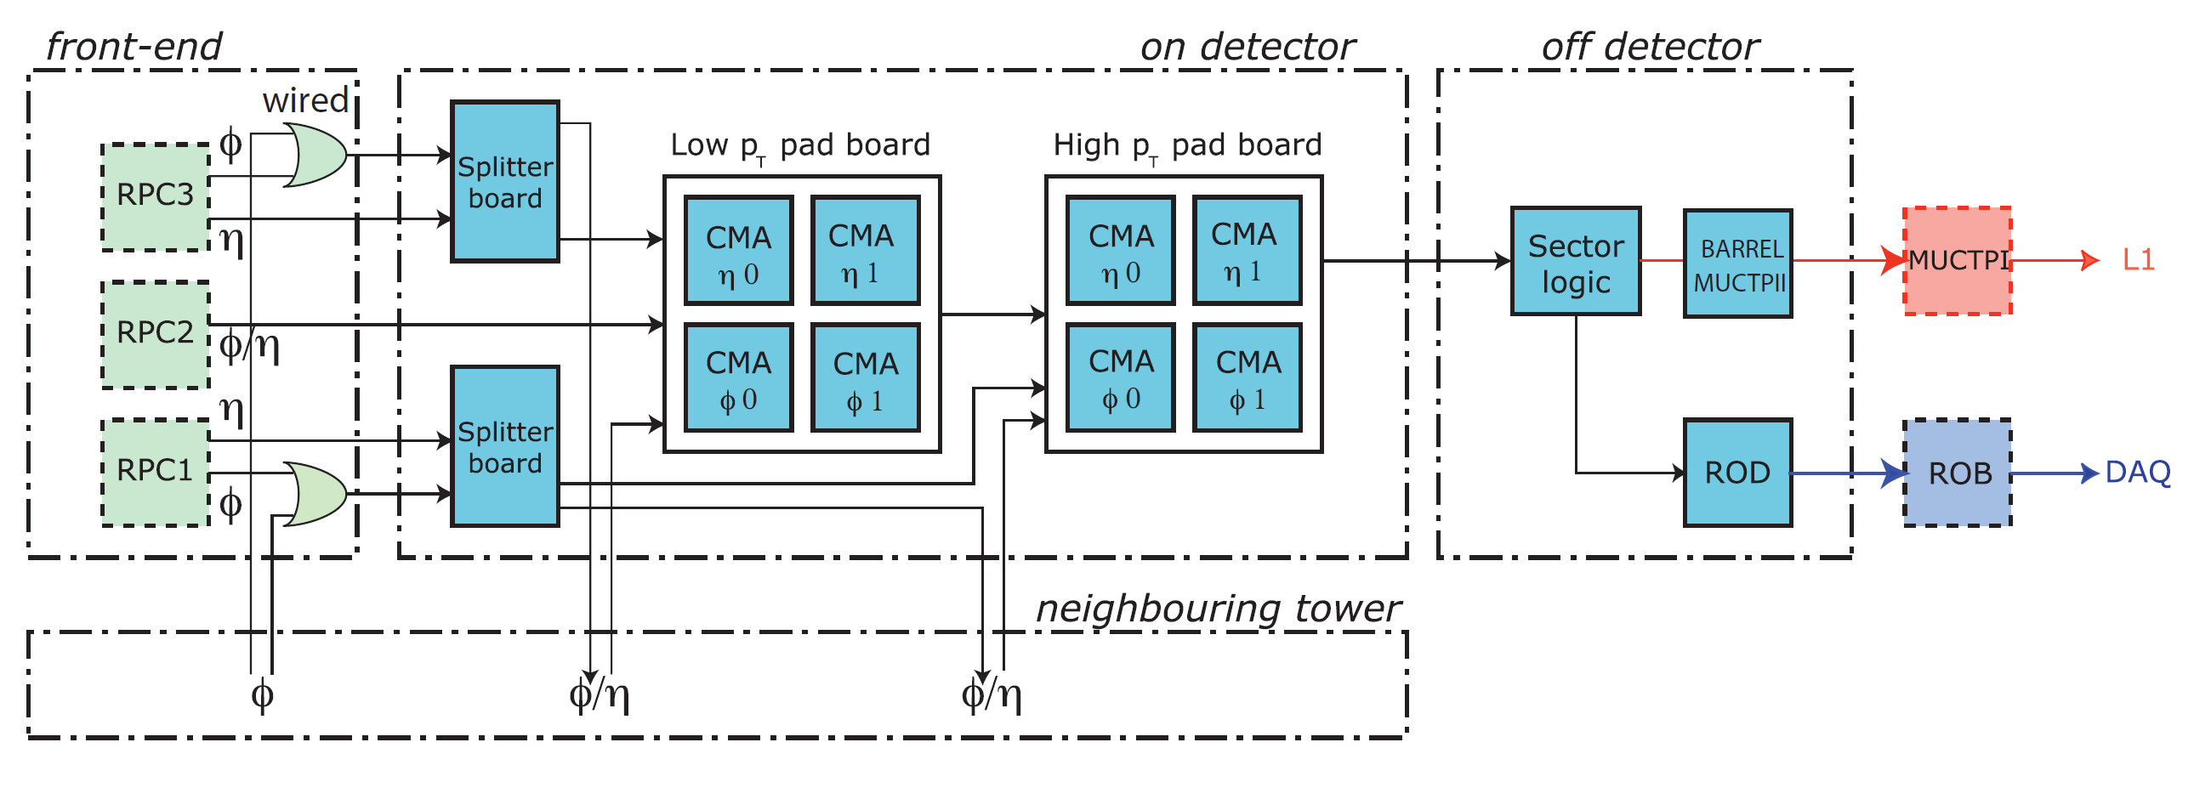
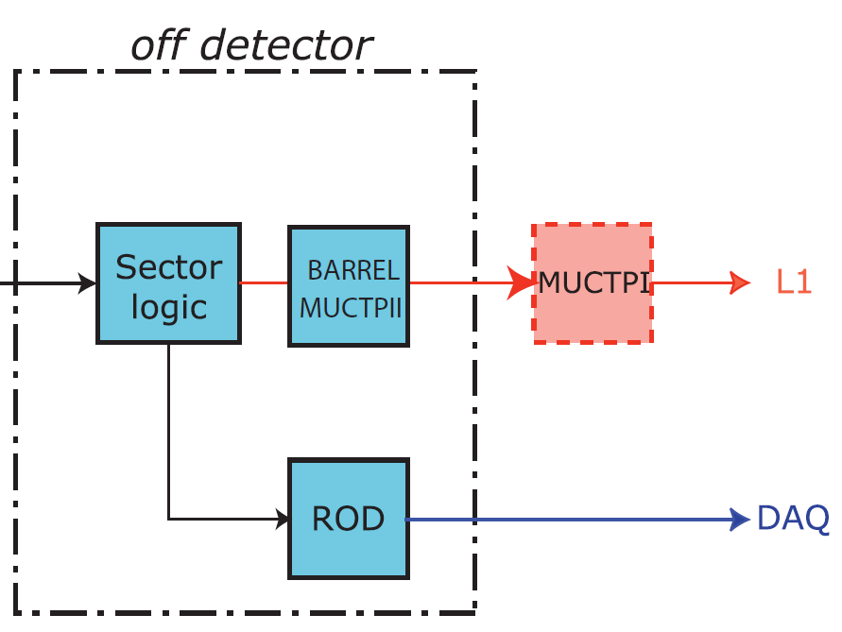
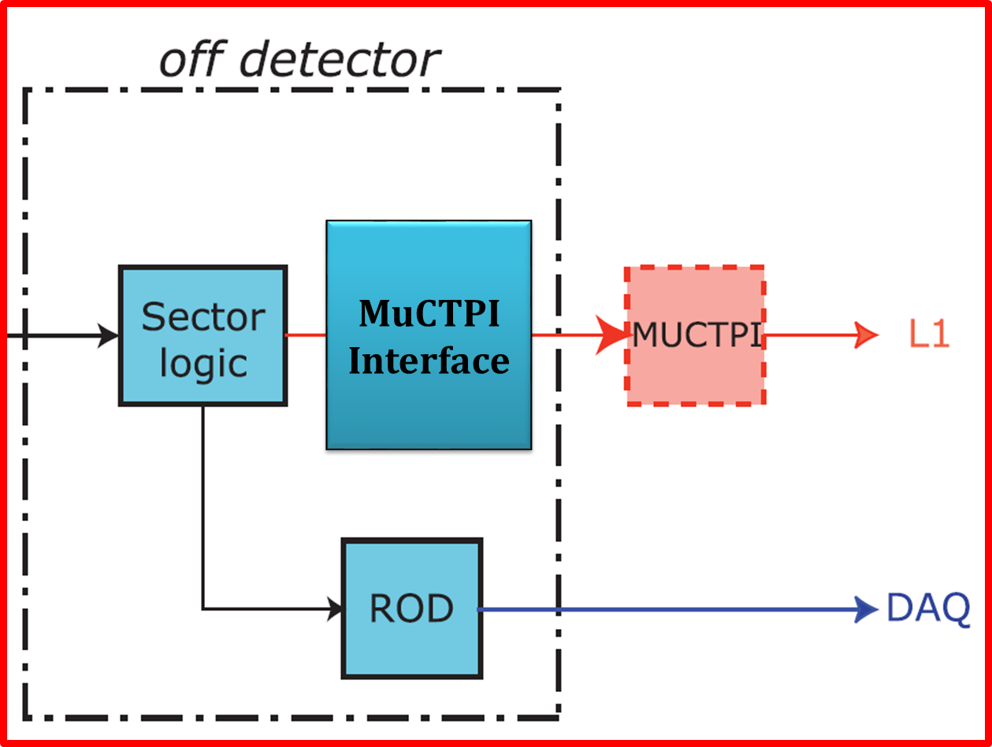
RPC trigger path to MuCTPI
RPC
Front-End
Electronics
RPC
On-Detector
Electronics
VME CRATE
Notes:
The RPC trigger path to MuCTPI
For the RPC, if we skipp the front end and on detector blocks, we can see that
the of-detector electronics consist of three borad inserted in a VME crate far from the detector

Slide 16
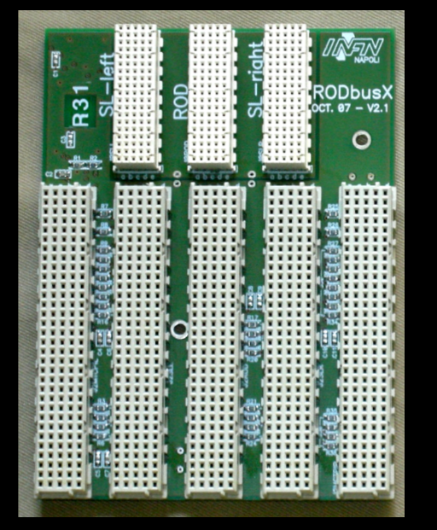
RPC trigger path to MuCTPI
Electrical cables
to MuCTPI trigger data
I
N
T
E
R
F
A
C
E
B
O
A
R
D
S
E
C
T
O
R
L
O
G
I
C
ROD
S
E
C
T
O
R
L
O
G
I
C
I
N
T
E
R
F
A
C
E
B
O
A
R
D
I
N
T
E
R
F
A
C
E
B
O
A
R
D
S
E
C
T
O
R
L
O
G
I
C
ROD
S
E
C
T
O
R
L
O
G
I
C
I
N
T
E
R
F
A
C
E
B
O
A
R
D
VME
CRATE
fibers from cavern
trigger/readout
data from RPC
Notes:
According to this scheme.
The sector logic boad receives trigger and read out data from the cavern over fibers and comunicates with its MUCTPI interface and Readout Driver Board (ROD) board through a custom backplain shown in slide
Besides, the MUCTPI interface sends trigger data to the muon trigger processor on electrical cables (blue arrows in the slide)...

Slide 17
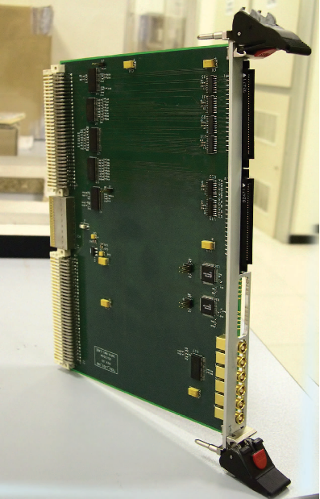
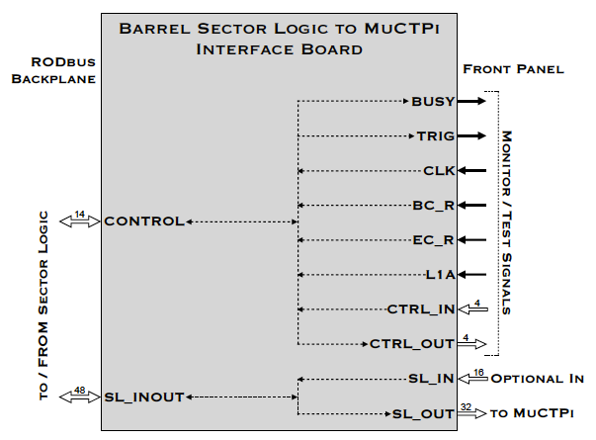
MuCTPI Interface
Current board
Notes:
This is a picture of the actual bord, and of its schematic description.
One of the Phase-I ATLAS upgrade (2019) requires a new board, which I implemtented which had to be compliant with this interface towards the SL.
A new borad will be necessary since

Slide 18
Motivations for a New Board
A new Muon Trigger Processor (MuCTPI) for the barrel region will be designed
A new MuctpI Interface for
barrel muon detectors (RPC muon)
will optically send data
to the MuCTPI
L1 Calo
Calorimeter
CTP
Level 1 Trigger
Higher bandwidth
more information to the trigger processor
New processes could be studied
MuCTPI
TGC Muon
New
MuCTPI
New
MuCTPI Interface
MuCTPI Interface
RPC Muon
Level 1 trigger decision
Notes:
Indeed, for the improvement on the Level-1 muon trigger system in the barrel region a new Muon Trigger processor (the MuCTPI) will be designed and it will accept only optical inputAlso a consequence also the MuctpI Interface for the RPC (barrel muon detector) will be upgraded in order to optically send data to the Muon Trigger processor
The higher bandwidth available will be used to send more information (additional muon trigger candidates)
This will allow the study of particular events with more than two muon candidates produced in the same sector
is (fəʊkəs)

Slide 19
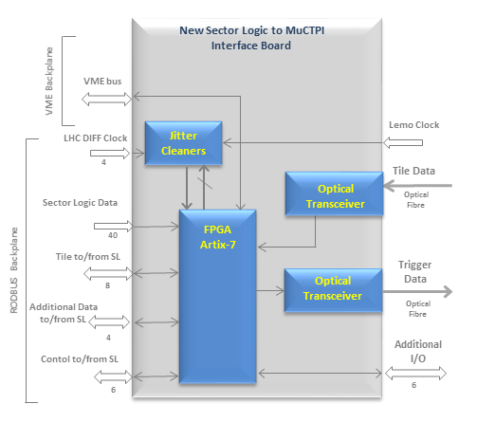
New MuCTPI Interface
Phase-1 board
Trigger data will be sent on a fiber
Optical Transceivers
FPGA to provide serialization and to allow the implementation of additional logic
Challenge of Serial Link
Very high data rate
Fixed Latency
High Quality Reference Clock
(for clock Data Recovery Circuit)
Serial link
@ 6.4 Gbps
Notes:
For this reason I designed a new interface board.
Since the comunication to the muon trigger processor will be optical on the new Muctpi interface board, in addition to an optical transceiver the board is equipped with an FPGA in order to provide the serialization and allow the development of additional logic
The challenging constraints of this project, beyond (bɪˈjɒnd) the design of the board, were the implementation af a serial link with a Fixed Latency at the very high linreate of 6,4Gpsa.
Besides, there will be the necessity of using a reference clock signal for the Embeded serdes (which requires a High Quality Reference Clock ). This signal will be forworded by the Sector Logic via the custom backplane already present in the VME crates
The latter constraint is the reason why a jitter cleaner has been foreseen on the board, indeed

Slide 20
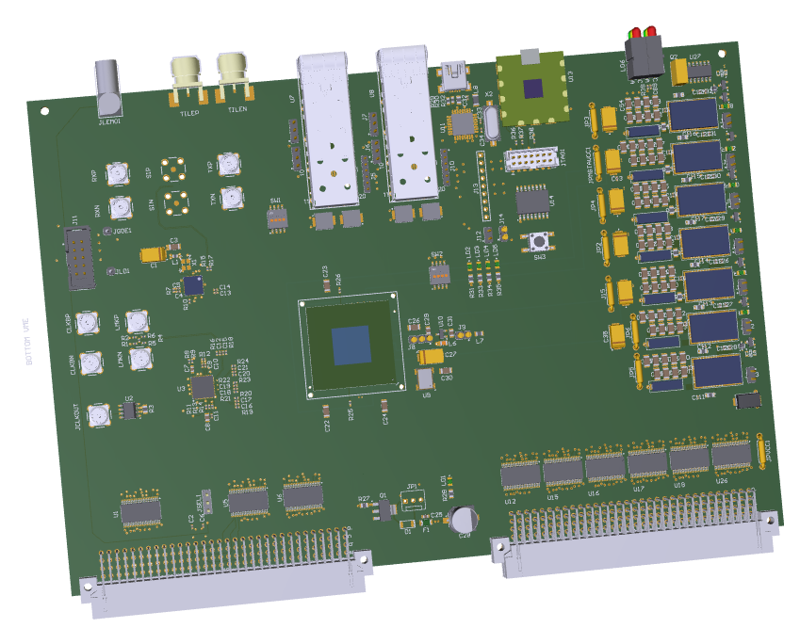
New MuCTPI Interface
Phase-1 board
Board preliminary layout
Notes:
Here there is the preliminary layout of the board I designed and which is now in production

Slide 21
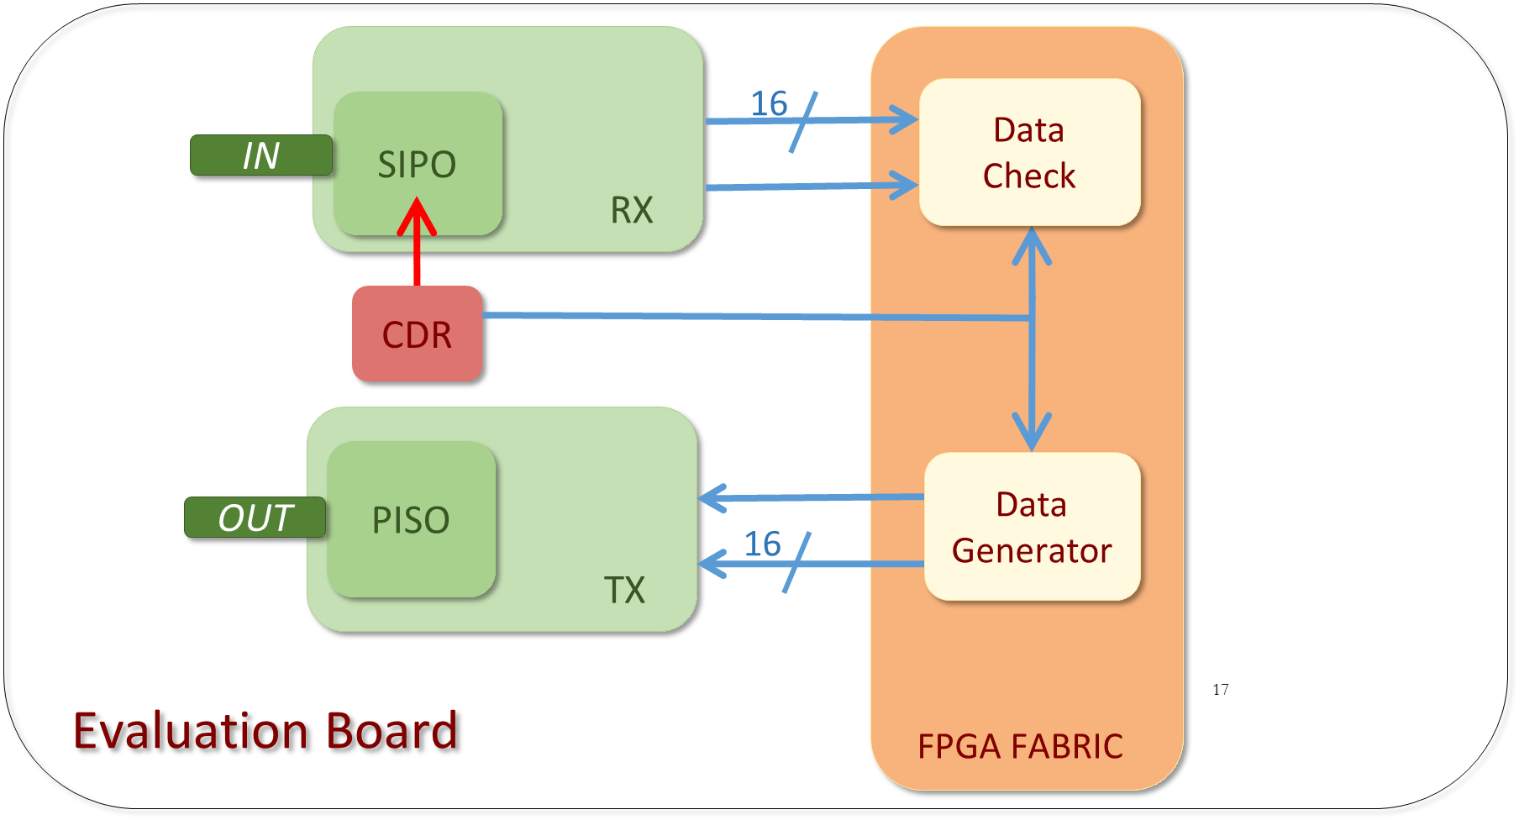
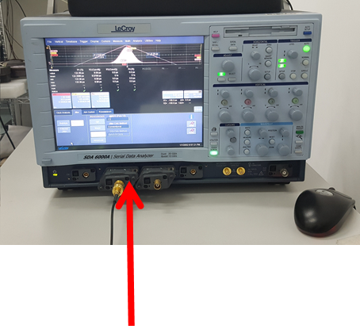
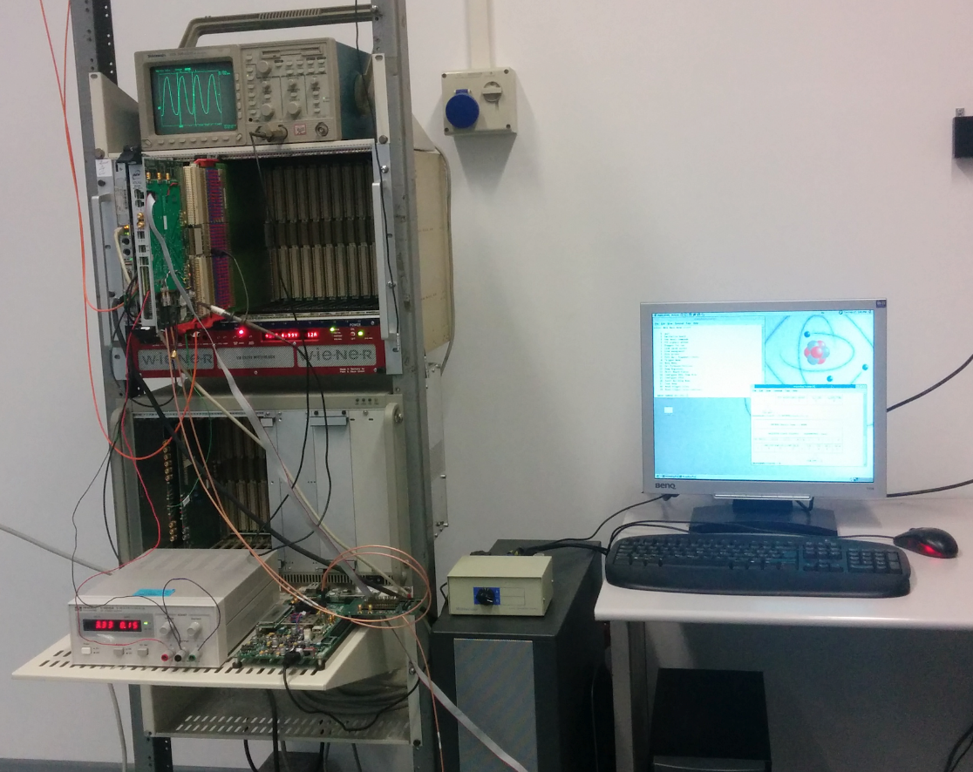
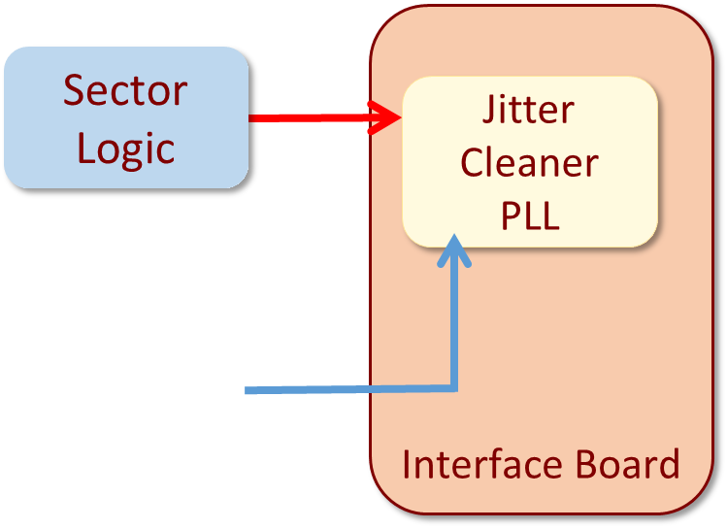
Tests
Jitter cleaner performace:
Period Jitter = 66 ps
Link qualification @ 6,4 Gbps:
BER=10⁻¹²
CL=90%
Errors = 0
Notes:
Waiting for it I did some test in order to check the feasibility of the project
I evaluated the perfomance of the jitter cleaner.
I feed it with the clock farworded by the Sector logic via the VME custom backplane and I measured the jitter of the cleaned clock. I found a perid jitter of 6 ps.
Beside I tested the feasibility of implementing a link at 6,4 Gbps using the cleaned clock signal as reference clock for the clock Data Recovery circuit
The test was succesfull and I was able to quilify the link at 6,4 Gbps

Slide 22
Pad Trigger Board for the NSW Trigger
Development and test of the serial interface
Notes:
In the third part of my presentation I will describe my work in developing and testing the serial interface of a the Pad trigger Board which will be used in the on detector electronics of the new Small wheels and will be developed by INF Roma. In particoular in the L1 trigger system for the STGC

Slide 23
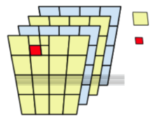
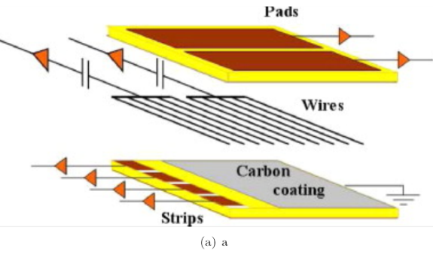
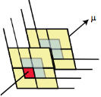
sTGC trigger scheme
Physical PADS are staggered by ½ pad in both directions
Logical pad-tower is defined by projection from 2 x 4 layer of staggered pad boundaries
Pad-tower coincidence =
2 x 3-out-4 overlapping pads
1/16th sector
On Rim of NSW
FPGAs
sTGC
Trigger Processor
Pad Trigger
sTCG
sTCG
sTCG
sTCG
USA 15
sTCG
sTCG
sTCG
Pad
Front-End
sTCG
Strip
Front-End
Pad trigger uses PAD tower coincidence to choose ONLY the relevant strips before reading them out to the Trigger Processor
Reduce bandwidth
Reduce amount of centroid track finding logic sTGC trigger
On-chamber
ASICS
Strip
Front-End
23
Notes:
The Pad trigger board is placed on the rim of the nsw.
It will implement a trigger algoritm with a 3 out of 4 majority in order to chose ONLY the relevant strips to be sent to the trigger processor
The Pad trigger board will receive the information hits from the PAD Front-End (the on detector electronic ASIC which reads the signals from the pads) and will send back the trigger decision to the strip Front-End (the ASIC which reads the strip electrods)
use the information of the Pad Front-End Asic in order to perform a pre
It searchs for a PAD tower coincidence witha 3 out four majority in order to choose on the strip TDS ONLY the relevant strips to be sent to the trigger processor
Find a Pad hit coincidence in a
tower of logical Pads within one
Bunch Crossing.
• 3/4 majority logic is required on
both sTGC quadruplet.
• Candidate geometrical
coordinates and BCID sent to
the front-end strip-TDS chips.
• Strip-TDS sends only selected
strip data to the routers.

Slide 24
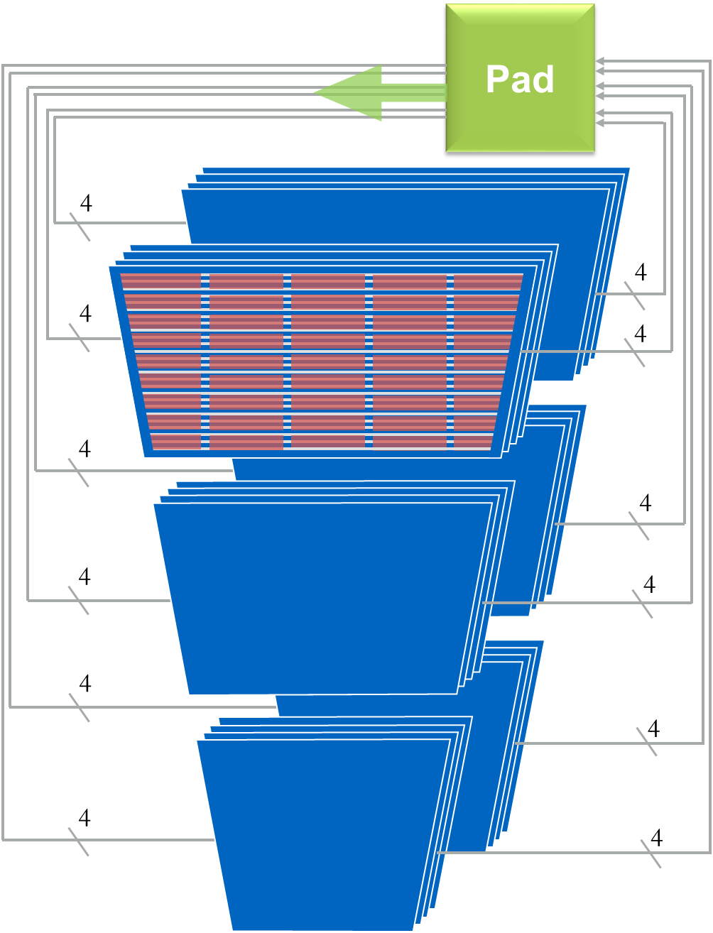
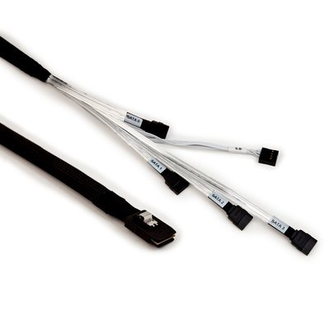
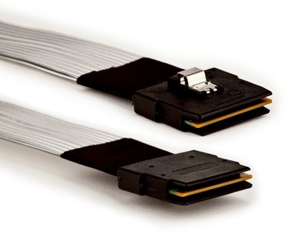
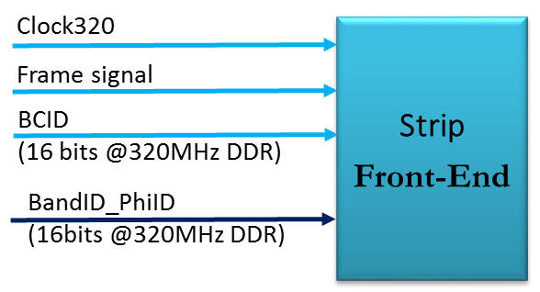
The sTGC Pad trigger
24 Pad-hit serial inputs/links @ 4.8 Gbps
24 outputs to the strip Front-End @ 640Mbps
Pad hit info:
120-bit word each 25 ns
Pad info:
16 bits (BCID)
16 bits (phi ID, road ID)
Notes:
Since I was involved in the deveopment and test of the interface logic of the poardt I’d like to describe the input and output ports of the board with more details
The Pad trigger board will receive data from 24 Pad Front-end board as packet of 120 bits each 25ns. The Pad Front-end board will serialize and send data to the pad trigger board at a line rate of 4.8 Gbps
Besides, the board will send data to 24 strip Front-end board at 640 Mbps. In the specific, the PAD Trigger board will send to the each strip Front-end a clock signal as reference clock, a signal which will define the begininng of the frame, and the timing and the geometrical information
In order to save the number of cables as wel as space (the reason why electrical flat cables are used insead of the optical ons) 2 or 4 serial links could be grouped on the Pad side into one connector of the kind shown in figure
On the output side
The kind of information sent to the Strip TDA is necessary in order to recognize in the pannel the relevant regions with interesting data. Also for the outputalectrica flat cable are chose

Slide 25
FPGA Latency
Sampling and deserialisation of the input 120-bit Pad hit data:
70,1 ns (VHDL simulation).
Trigger algorithm:
8 clock cycles @ 320 MHz = 25 ns (estimate).
Serialisation of the trigger output word:
16-bit @ 640 Mbps = 3,125 ns (VHDL simulation).
TOTAL FPGA LATENCY (first bit in to first bit out): 102,4 ns.
6 x 20-bit words
240 MHz
320 MHz
320 MHz DDR
IN GTX
deserialiser
descrambler
Trigger Algorithm
OUT
serialiser
4.8 Gbps
120-bit serial in
640 Mbps
out
70,1 ns
4,2 ns
25 ns
3,125 ns
RX PMA Latency (for 20-bit words): 110.5 UI = 19,7 ns (4.8 Gbps, 208 ps period);
Alignment block: 8,4 ns;
RX Elastic Buffer : 12,6 ns;
FPGA Interface: 8.4 ns;
Additional latency for 5x20-bit words = 21 ns (5 x 4.2 ns);
Descrambler block: 4.2 ns.
Notes:
I implemented the interface logic for the comunication with the PAD and the strip front end , in paricular the deserializer on a GTX, the descrembler used for deconding data, and the output serializer at a lower line rate.
The trigger alghritm is in its initil state
Since one of the strick constraint was the low and fixed latency I tested the logic in simulation in order to give an estimate of the total lateny in the FPGA
In this slide the results are summarized. The total latency, intened as first bit in to first bit out is of 127 ns according to the L1 timing budget

Slide 26
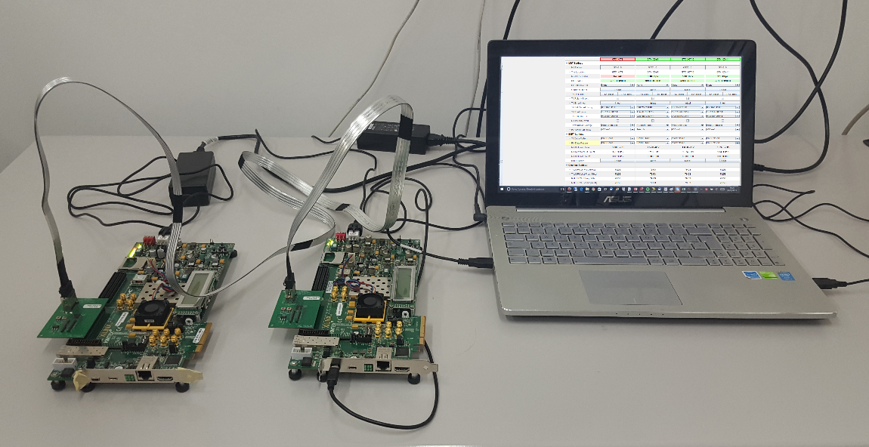
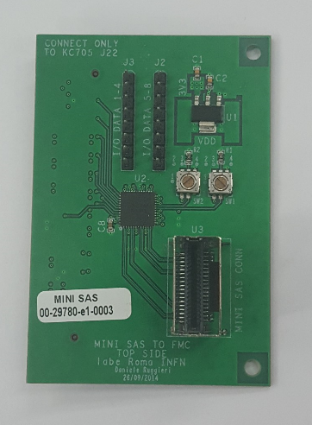
Cabling tests
Test setup was used to prove I/O data transmission and protocol feasibility over the flat electrical cable chosen to be used in the experiment
Xilinx Kintex-7 evaluation board (kc705)
Custom cable adaptor board (INFN Roma) hosting one commercial booster chip (DS100BR410)
BER < 10 ⁻¹²
CL = 90%
Errors = 0
Line rate @ 4,8 Gbps
Firmware (based on Xilinx embedded microprocessor) and software in order to configure the booster chip and to access the FPGA's internal registers via RS232 protocol
Software: LogiCoreIBERT (Integrated Bit Error Ratio Tester)
Bit Error Ratio Measurement and 2-D BER Map
Notes:
I did also some tests in order to check the quality of the transmission on the flat electrical cables chosen to be used in the experiment
For this purpose I used the kintex7 eb and an external mezzanine card with commercial repeater which could be used in case of great problem on the transmission in the real environment, where the reapeater is a a high pass filter and amplifier
I implemented the Firmware (based on Xilinx embedded microprocessor) and the software in order to configure the repeater and to access the FPGA's internal registers via RS232 protocol
For the tests I used a logic core provided by xilinx called IBERT (Integrated Bit Error Ratio Tester) in order to measure the Bit Error Ratio and to build 2-D BER Map
I qualified the link at a line rate of 4,8 Gbps

Slide 27
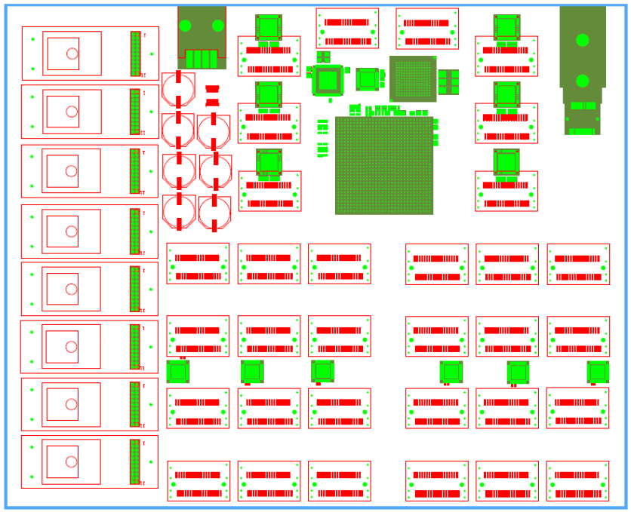
sTGC Pad Trigger Board
Notes:
We don’t have a first prototype yet
Stesso motivo ancorastudi di fattibilià
1. Kintex-7 FPGA
2. TI booster
3. TI fan-out
4. GBT-SCA
5. Si 535 160 MHz quartz
6. Si5345 jitter cleaner
7. Kyocera 48 MHz quartz
8. VTT transmitter link
9. Power connector
10. 8 x FEASTs voltage regulator
11 32 x miniSASconnectors

Slide 28
Conclusion
Study of state of the art of SerDes architectures and design of special features beyond state of art (fixed latency, adaptive links)
Design of an adaptive serial link architecture (published by IEEE)
Design of a new Board for the muon L1 trigger system
Feasibility studies for the implementation of a challenging serial link with fixed latency on the new architecture
Design and test of the serial interface between one of the new on-detector board in the NSW and the corresponding on detector electronics
Feasibility studies and test of cables and integrated devices which could be used
Notes:
Durin my PHd course i did
did
Improvement of the CPP code for the VME acces to the RPC off-detector modules

Slide 29
Back up

