Slide 1
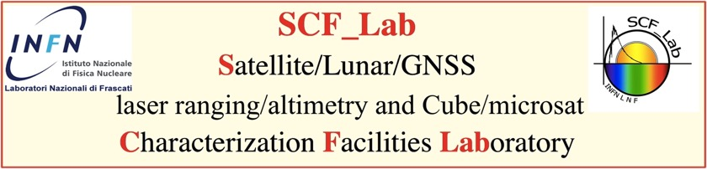
INFN-LNF SCF_Lab
Optical test facility for payloads in Space simulated conditions

Slide 2
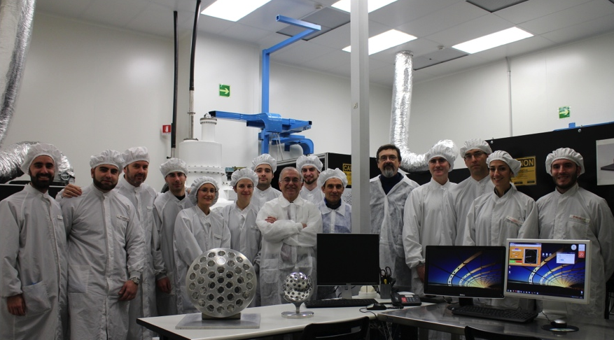
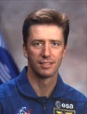
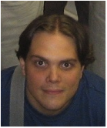



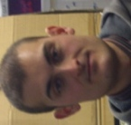
Optical test facility for payloads in Space simulated conditions
The SCF_Lab is a unique space test infrastructure with 2 Optical Ground Support Equipment facilities in a new ISO 7 Clean Room

Slide 3
Optical test facility for payloads in Space simulated conditions
ISO 7 (10.000) class clean room
2 cryostats (∅=900 mm L=1600 mm) + 1 “pocket sized” cryostat on the way (∅=500 mm L=500 mm) with LN2 cooled shields
Thermal control limits: T_{cold}=-180°C T_{hot}=+150°C
Optical, Quartz and Ge windows for IR thermometry
Hi-Fi Sun simulator
Near future option for combined irradiation test (BTF) in Space/Cryogenic conditions of EEE components, cubests and microsats, space optics components and systems with real time visual inspection;

Slide 4
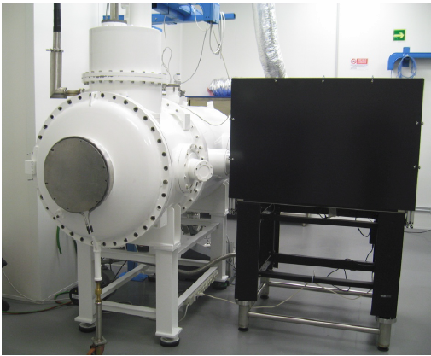
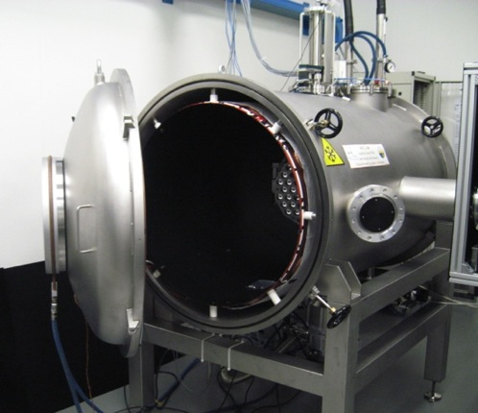
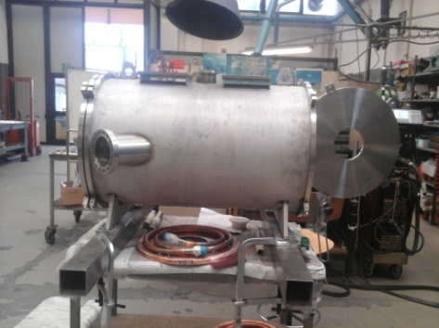
Optical test facility for payloads in Space simulated conditions

Slide 5
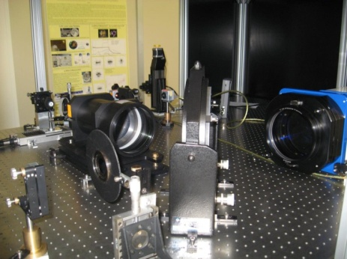
Optical test facility for payloads in Space simulated conditions
Optical benches equipment:
CW Laser: 532nm (Green), 632nm
PW Laser: ~800 nm
1’’ Cube splitter polarizer (c and g)
Beam expanders Custom 40X, λ/10
Beam splitter 9” (SCF-G) and 3 ” (SCF) diameter
AccuFiz-S 6” Fizeau Interferomter (SCF-G), vibration insensitive
2 CCD Spiricon model LBA-FW-SCOR20 for each table
Newport Mirror model 4” diameter, λ/20
Laser windows up to 4” clear optical aperture, λ/20
Lens of various diameters
Plus a other components and continuous refinements ...

Slide 6
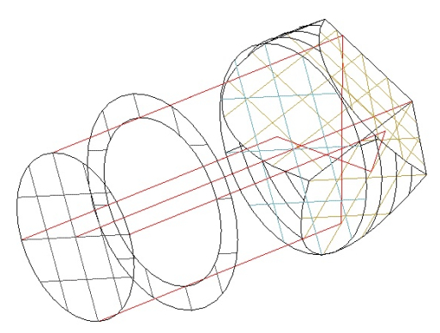
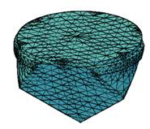
Optical test facility for payloads in Space simulated conditions
Facility includes:
Thermal, optical, orbital and structural sw analysis capability
CAD
Cryogenic, thermal control and vacuum expertise
QM and PA systems

Slide 7
(Some of) Past Present anf Future Projects: GNSS
ETRUSCO ('06-09): R&D to characterize laser reflectors for Satellite Navigation, Space Geodesy and optimize laser ranging to GPS. An International effort of INFN, IAF, ILRS, NASA-GSFC and UMD
ETRUSCO-2 (‘10-15): industry-level R&D for Galileo/GPS. Flight reflectors of GPS, GLONASS, GIOVE, Galileo have been SCF-Tested. Built a Retroreflector Array being proposed for Galileo V1, FOC (Full Orbit Capability) Batch 3 and, soon, for a patent
Galileo IOV (’14-15): ESA contract for construction and SCF-T. of IOV EM
Laser Ranging to Galileo (’16-18, ASI-INFN Project competitively awarded by the Italian Ministry of Research).

Slide 8
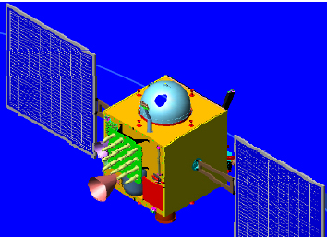
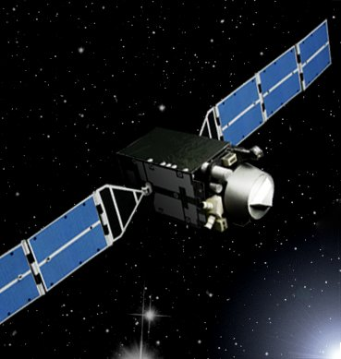
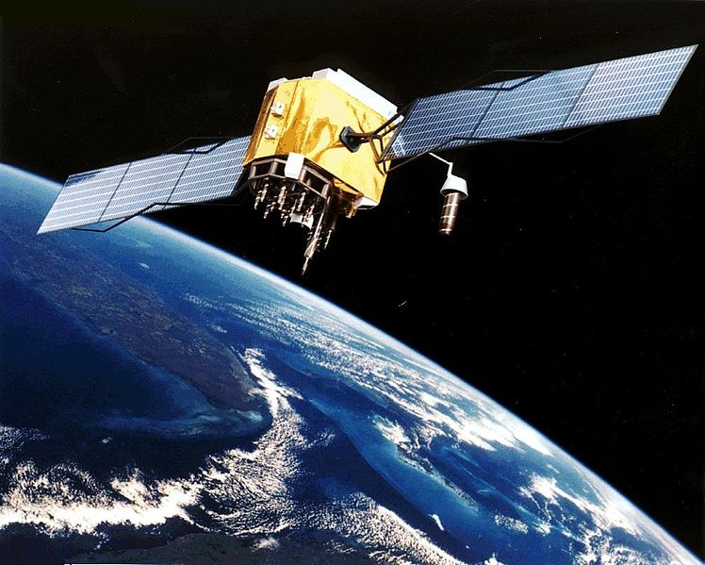
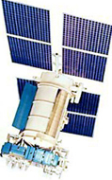
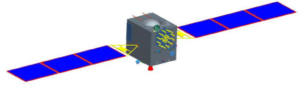
(Some of) Past Present anf Future Projects: GNSS
Indian IRNSS: ~7+4 regional satellites
Japanese QZSS: 3 regional satellites
SCF Tested
US GPS: 24 global satellites
SCF Tested
SCF Tested
Chinese Compass/Beidou: ~20 global, +5 regional satellites
Russian GLONASS: 24 global satellites:

Slide 9
(Some of) Past Present and Future Projects: Earth Observation
ETRUSCO-GMES (’13-15), Global Monitoring for Environment and Security), an INFN R&D experiment for Copernicus, Galileo and COSMO-SkyMed
AUGUSTUS (’14-15), a MAECI-INFN High-Relevance Project for Copernicus and USA
G-CALIMES (’13-15) Galileo-COSMO-SkyMed Absolute Laser Intercalibration with Measurements on Earth and in Space a Ministry of Defence-INFN Contract. Developed and SCF-test a reflector array for EO

Slide 10
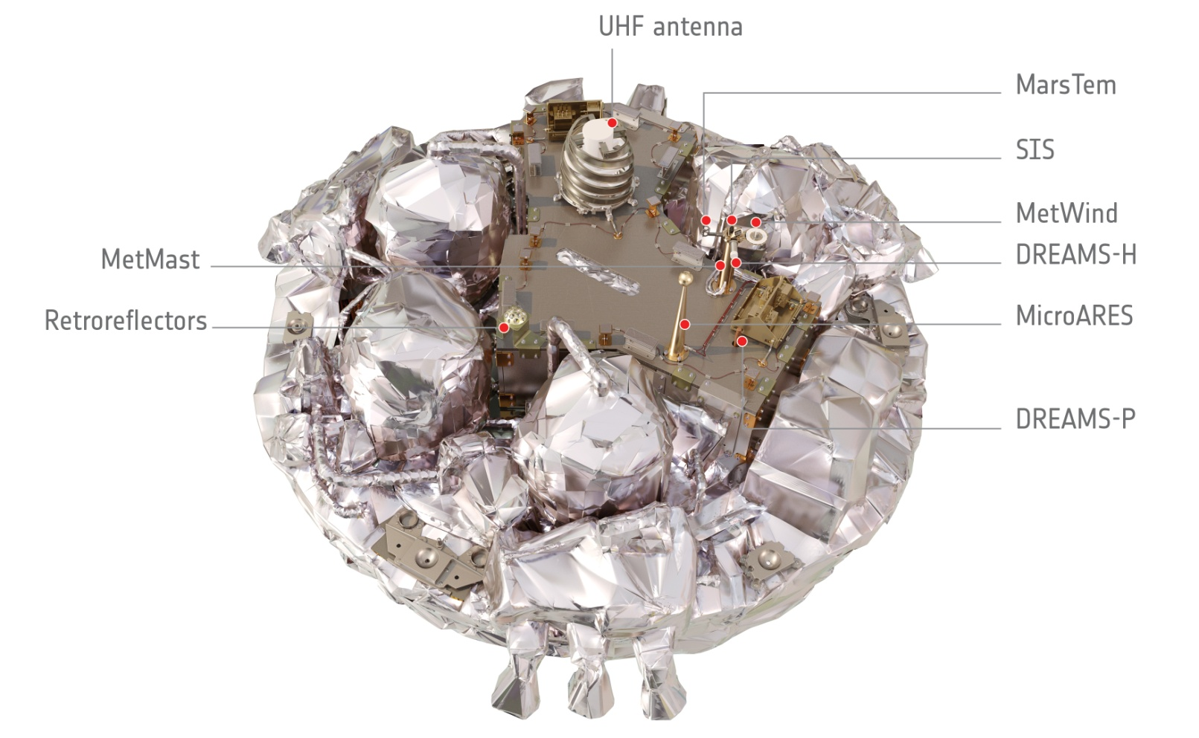
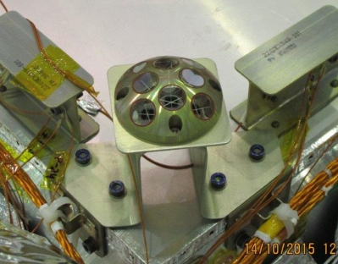
(Some of) Past Present and Future Projects: Mars
Full design construction and full qualification of the INRRI payload, the first LRA to land beyond the Moon, launched the 14°of March with Exomars EDM 16 ESA mission
LAUNCHED!!

Slide 11
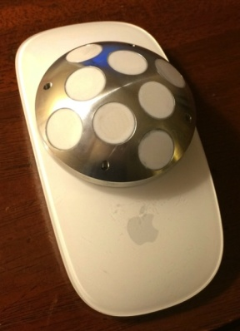

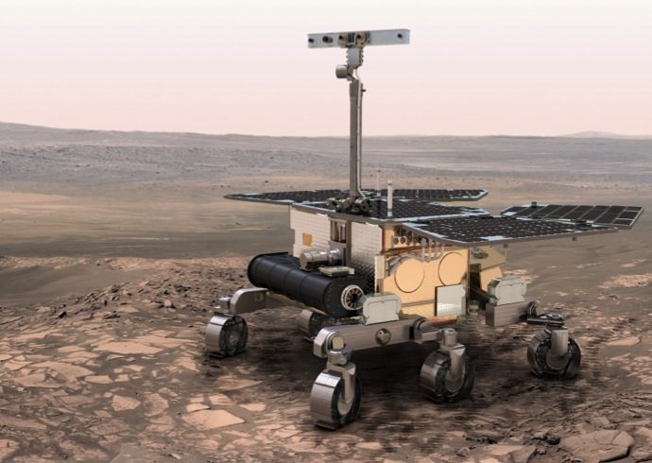



INRRI microreflector for Mars
for NASA Mars 2020
ESA ExoMars 2018

Slide 12
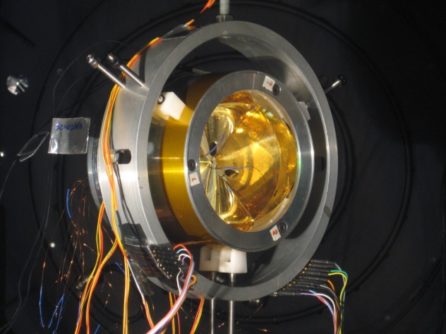
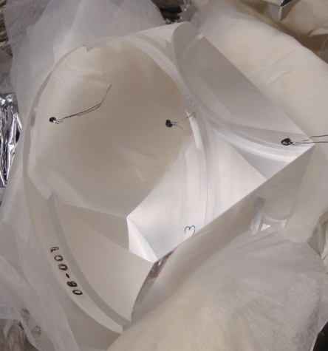
(Some of) Past Present and Future Projects: Moon
Full design construction and full qualification on the way for MoonLIGHT, a next generation array for Moon ranging. Agreement signed with Moon Express team and UMD for 4 launches, the first no ealier than December 2017, also in the framework of the Google X prize competition. INFN Projects:
  R&D MoonLIGHT-ILN (2010-2012)
  science experiment MoonLIGHT-2 (2013-2021)

Slide 13
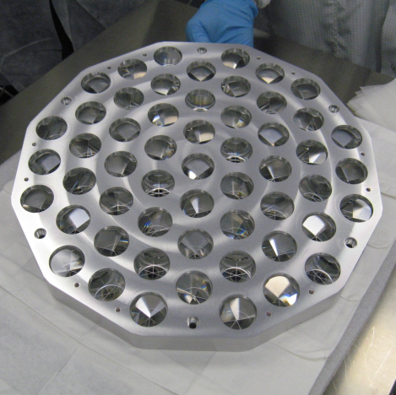
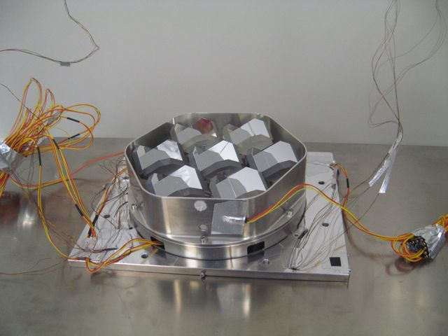
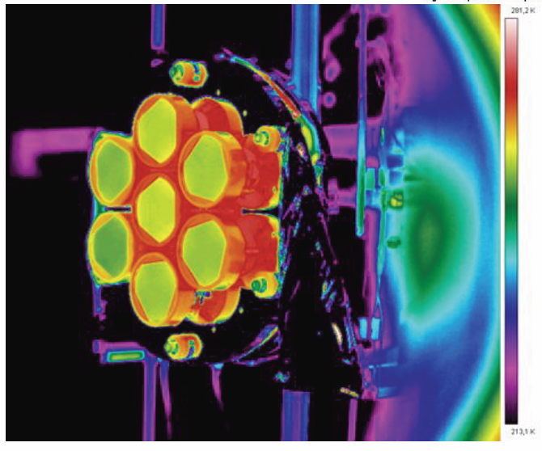
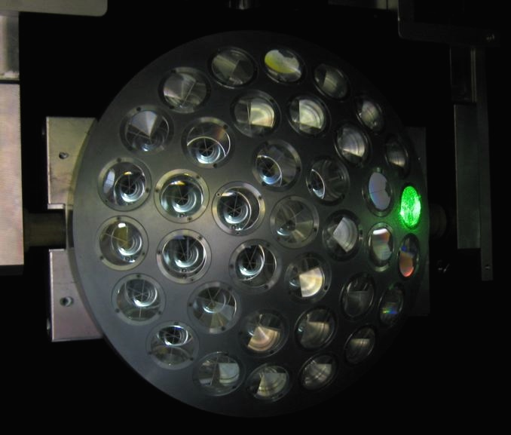
Some Engineering Models

Slide 14
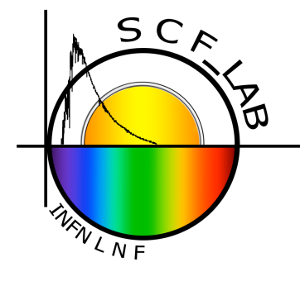

Questions?
Thanks for your attention!
Giovanni O. Delle Monache and SCF_Team
e-mail: dellemon@lnf.infn.it

