Slide 1

Accelerator Division Activities
Andrea Ghigo on behalf of
INFN-LNF Accelerator Division

Slide 2
Accelerator Division Main Projects
  DAFNE Collider
  BTF
DAΦNE
SPARC-LAB
ELI-NP (Romania) / STAR (Cosenza)
Collaborations: LC/CLIC, HL-LHC, FCC, ESRF, KEKB, !CHAOS, CNAO…
  FEL
  Plasma acceleration
  Thomson Scattering
  FLAME
  TeraHertz

Slide 3
40 Researchers
49 Technicians
3 Administrative
4 Fellows
8 PhD students

Slide 4
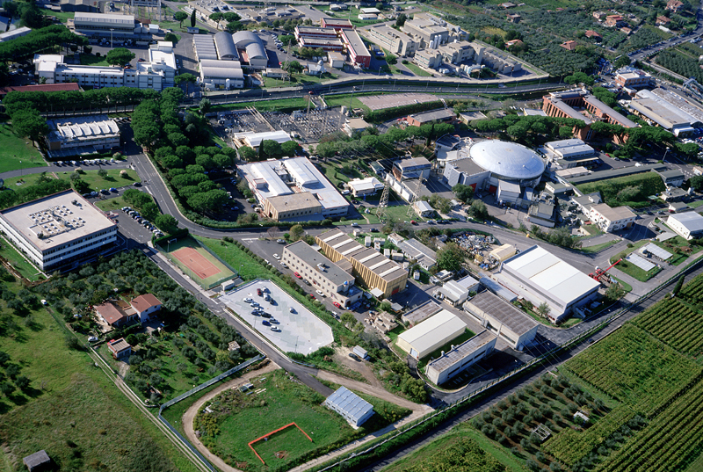
LNF
DAFNE-light
DAFNE
LINAC
BTF
The DAΦNE Φ-Factory complex

Slide 5
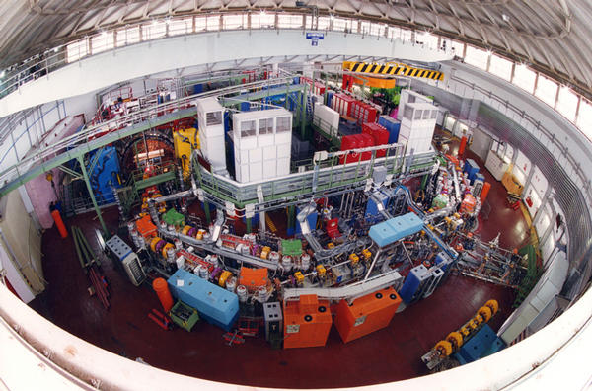
DAΦNE – LNF - FRASCATI
e+ e-
Ecm = 1.02 GeV
L = 2 x 10³² cm⁻² sec⁻¹

Slide 6
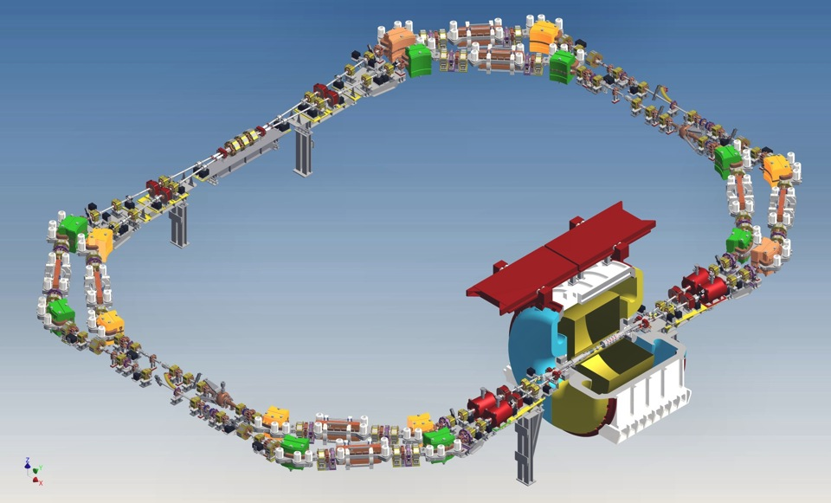
DAΦNE e KLOE2

Slide 7
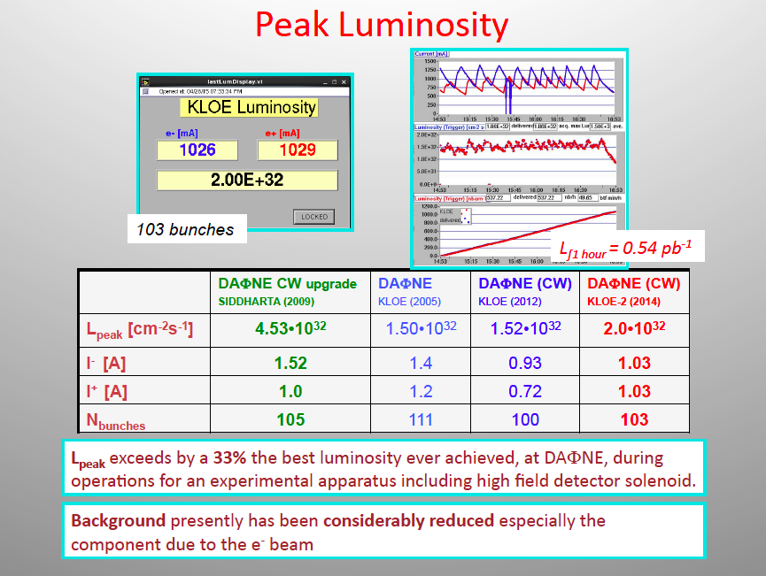

Slide 8
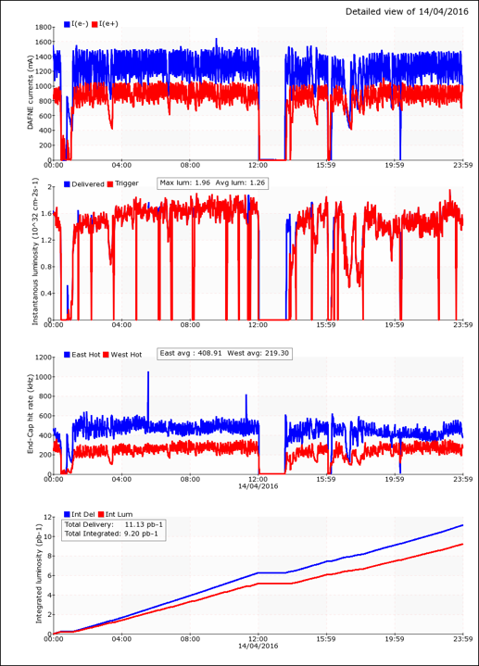
Daily luminosity run
currents
luminosity
integrated
luminosity

Slide 9
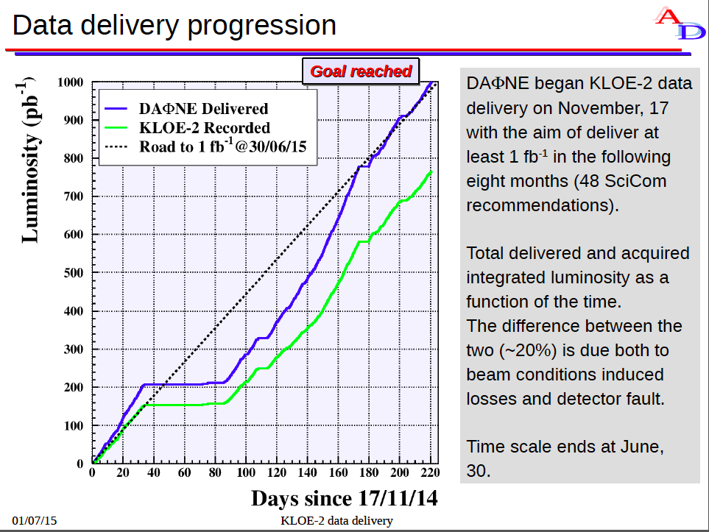
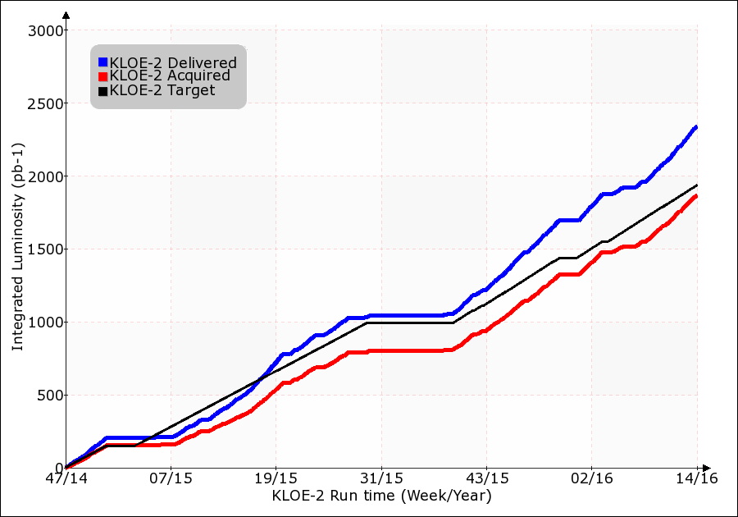

Slide 10
LNF
The SPARC-LAB complex
FLAME
SPARC-LAB

Slide 11
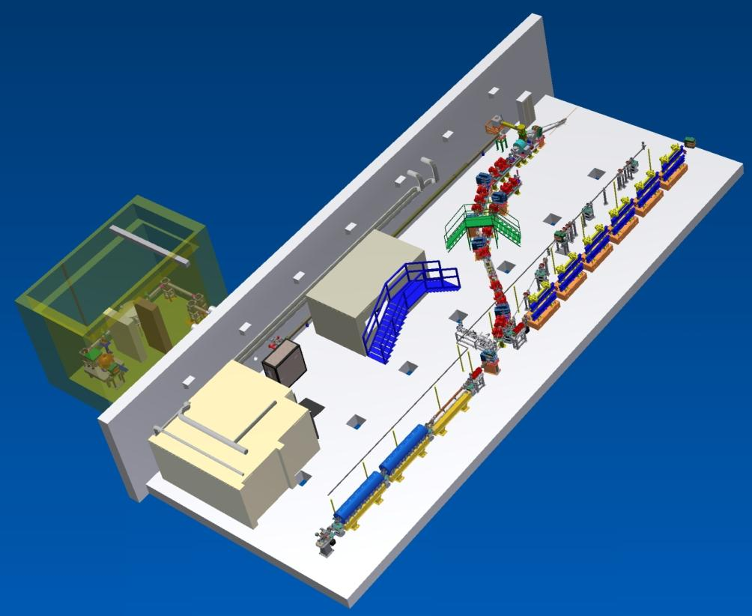
SPARC_LAB
Sources for Plasma Accelerators and Radiation Compton with Lasers And Beams
Thomson X-ray
EOS
EXIN
FLAME
FEL
(2colors)
COMB
THz Source

Slide 12
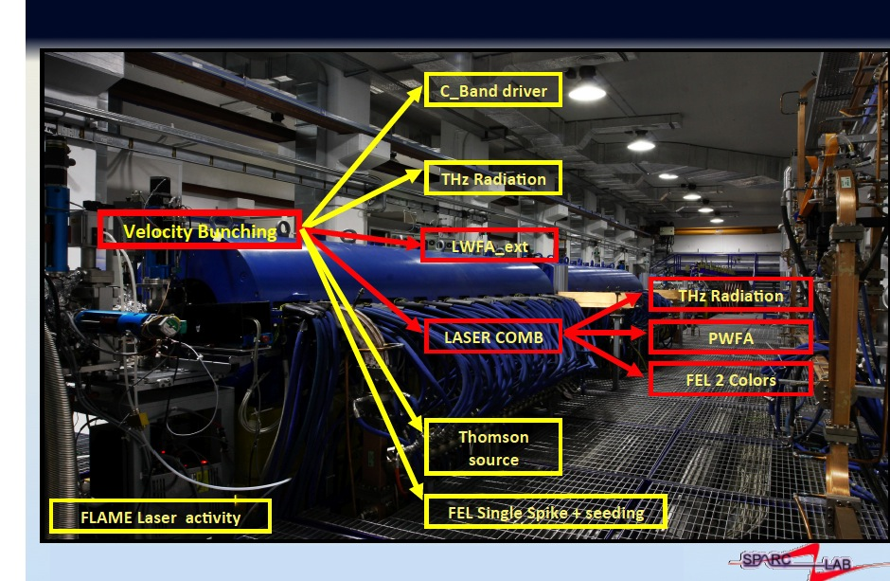
SPARC-LAB and related experiments

Slide 13
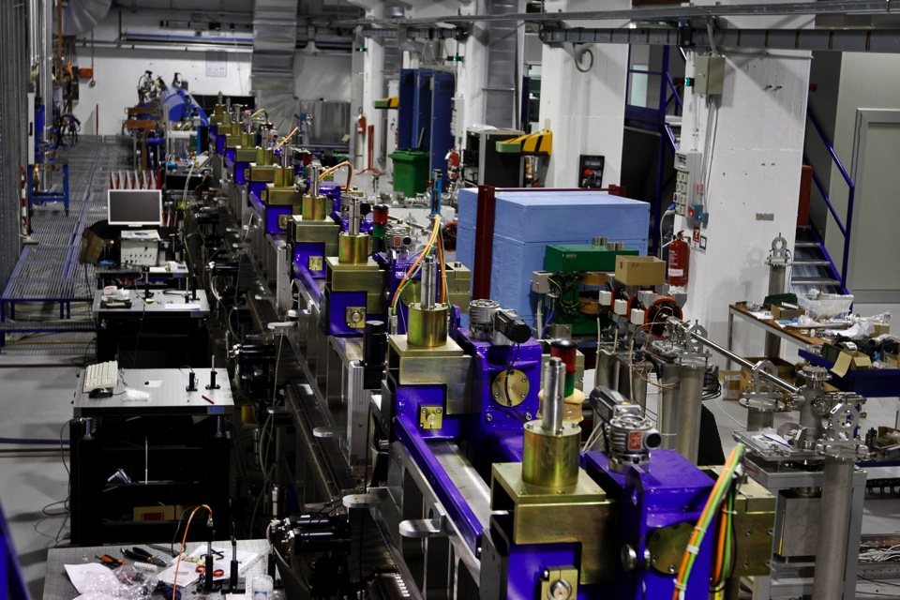
Free Electron Laser

Slide 14
Resonant plasma excitation by a Train of Bunches
Weak blowout regime with resonant amplification of plasma wave by a train of high Brightness electron bunches produced by Laser Comb technique?
Ramped bunch train configuration to enhance tranformer ratio?
High quality bunch preservation during acceleration and transport?

Slide 15
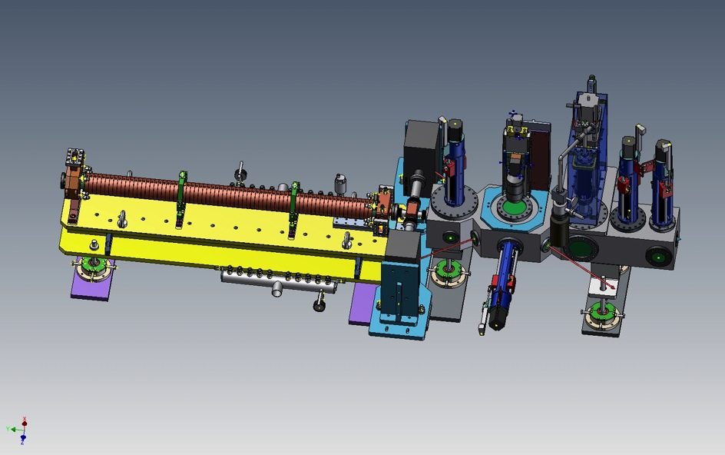
COMB plasma interaction chamber
Camera interazione e
Sistemi ancillari di pompaggio e iniezione gas
Gruppo Pompe Vuoto
Sezione Banda C
YAG/OTR actuator
Permanent magnet actuator
YAG/OTR/EOS crystal actuator

Slide 16
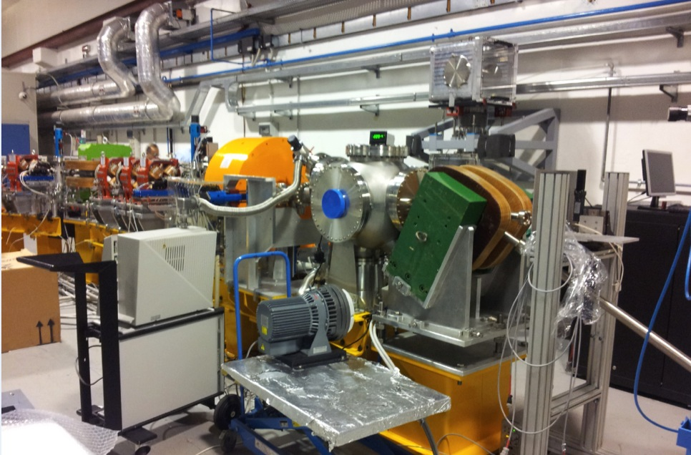
Thomson back-scattering source

Slide 17
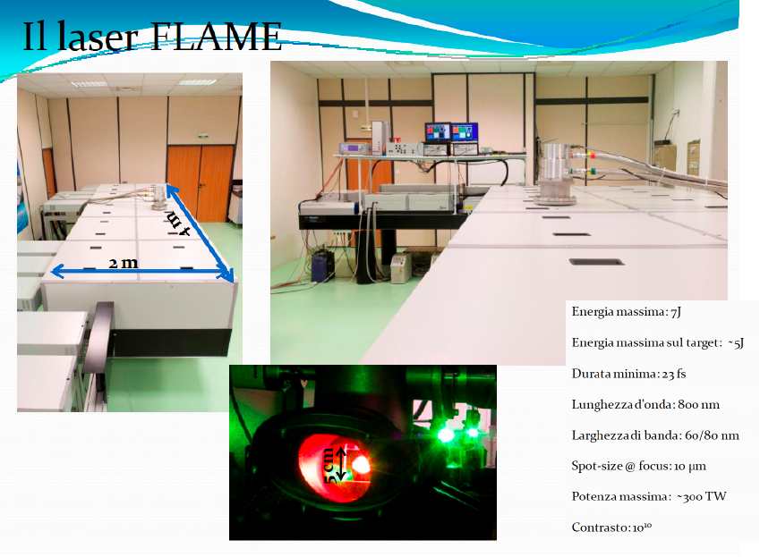

Slide 18
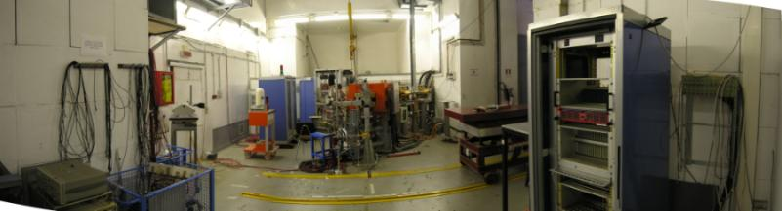
Beam Test Facility (BTF) Infrastructure
@DAFNE Linac
The Frascati Beam Test Facility infrastructure is a beam extraction line optimized to produce electrons, positrons, photons and neutrons mainly for HEP detector calibration purposes. The quality of the beam, energy and intensity is also of interest for experiments (~ 20% of the users) studying the electromagnetic interaction with matter

Slide 19
LNF
The ELI Pre-installation

Slide 20

ELI Nuclear Physics (Romania)
Laser-Induced Photonuclear Physics
nuclear physics methods to study laser-target interactions, new nuclear spectroscopy,
new photonuclear physics

Slide 21

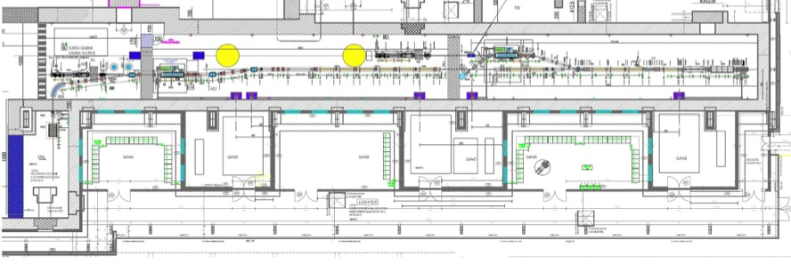


Gamma Beam System – Layout
e– beam
dump
Interaction Point
High Energy
e– beam
dump
Interaction Point
Low Energy
Photogun
multibunch
beam
coll&diag
beam
coll&diag
e– beam
dump
Racks
Room
Control
Room
Racks
Room
Interaction Laser
High Energy
e– RF LINAC
High Energy
720 MeV
Interaction Laser
Low Energy
e– RF LINAC
Low Energy
300 MeV
Photo–drive Laser
e– source

Slide 22
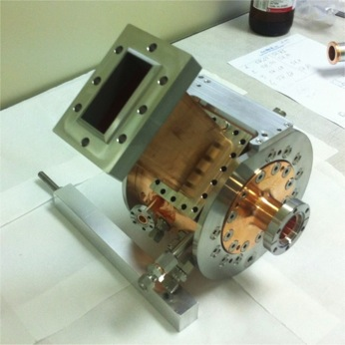
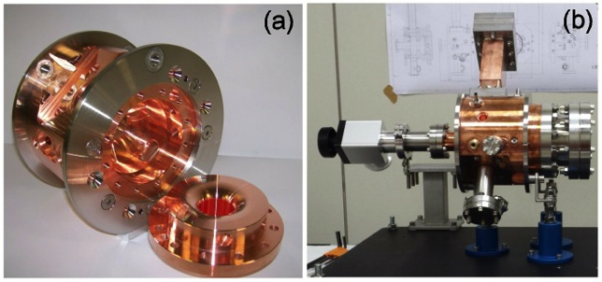
Fabrication process
The device has been fabricated with a precision on the internal dimensions of +/- 10 μm while the surface roughness is maintained smaller than 200 nm.
Before the final clamping, the gun has been cleaned with a detergent (ALMECO-19) and a mixture of organic (citric) acid and distilled water, in a bath with an ultra-sound machine.
After the assembly a bake-out at 150 deg for 24 hours allowed reaching a vacuum pressure below 5⋅10⁻¹⁰ mbar.

Slide 23
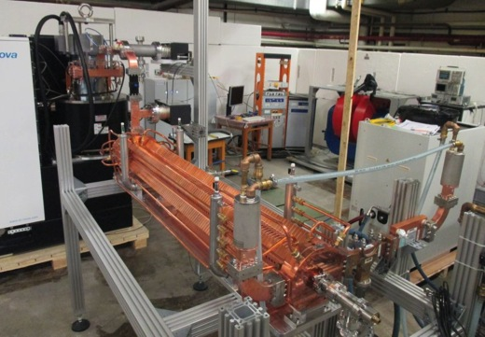
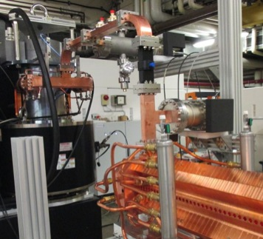
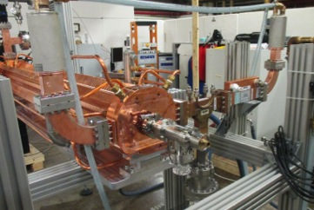
C-BAND STRUCTURES: HIGH POWER TEST SETUP
The structure has been tested at high power at the Bonn University under RI responsibility.
Ceramic window
RF waterloads
Ion pumps
Scandinova RF Unit based on Solid State modulator K2-2 adapted for 50MW C-band Toshiba klystron E37210
C-BAND
DC

Slide 24
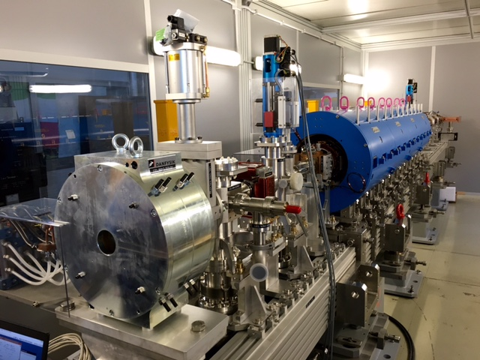
The ELI Pre-installation

Slide 25

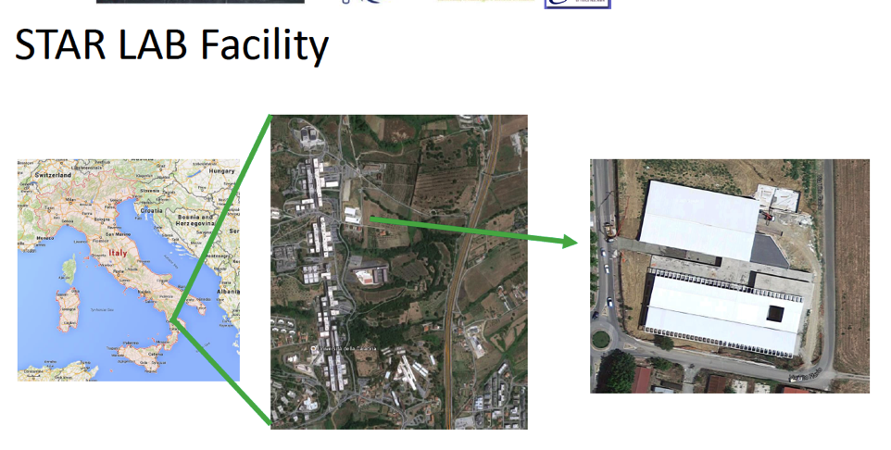
SIF 2015 Roma, 22 Settembre 2015
Valutazione dei Laboratori Frascati 7 October 2015

Slide 26
Thanks for your attention

