Slide 1
Noise studies pre-amp
Breve descrizione del setup
Descrizione misure
Risultati

Slide 2
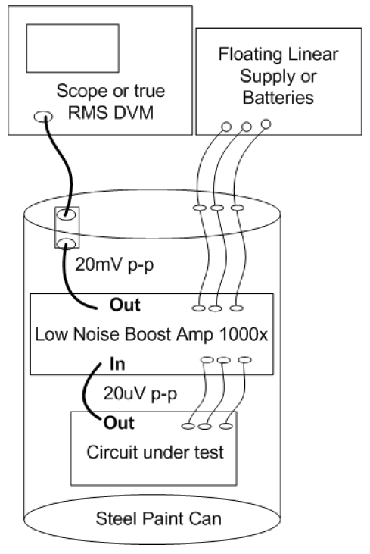
Setup to measure the noise
Bacteries turn out to be the most
silent source of power.
To measure 1/f noise we need to ampl

Slide 3
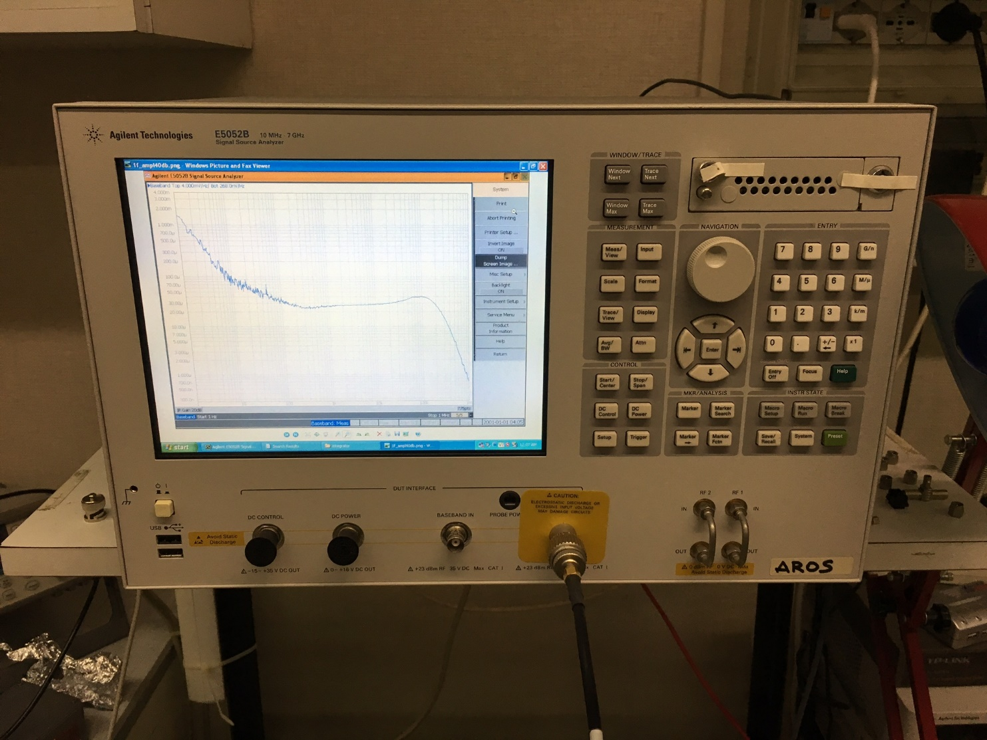
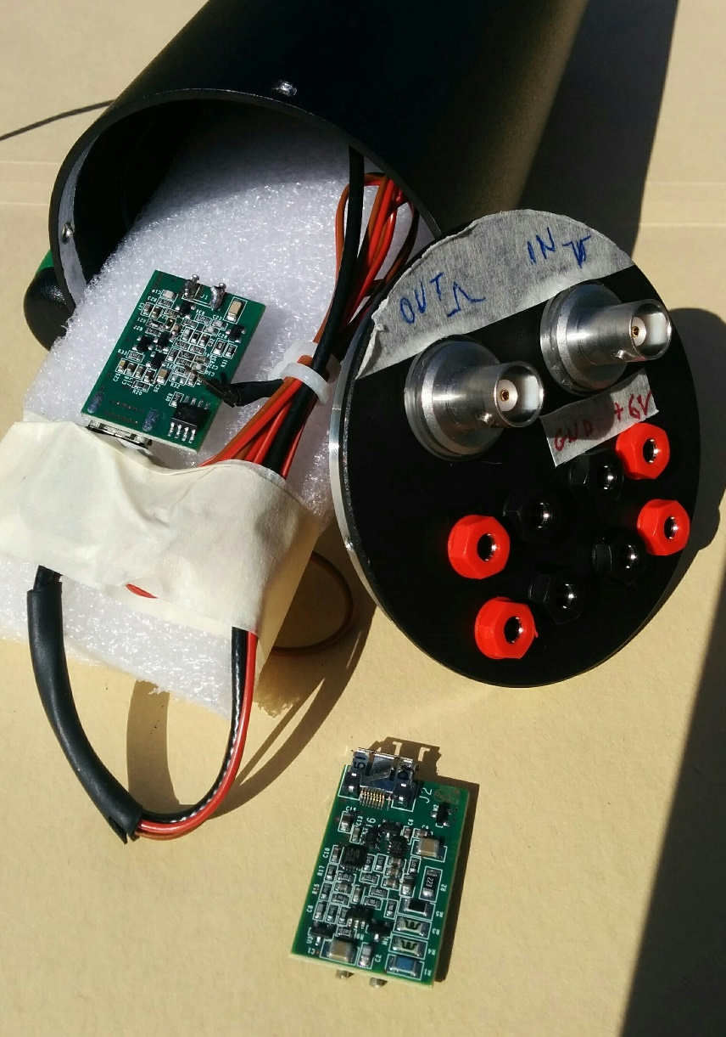
Setup
E5052b
Pre-amp and faraday cage

Slide 4
Pre-amp layout
The pre-amp has to be loaded with different capacitance mimicking the effect of different detectors (APD about 250 pF).

Slide 5
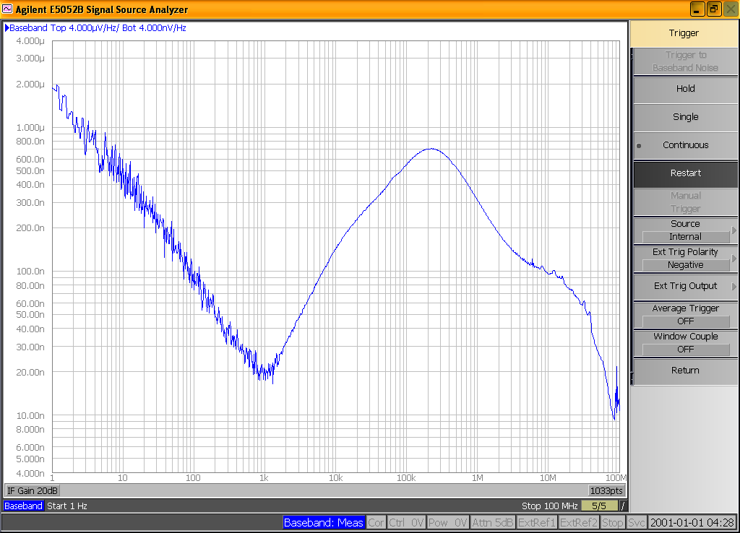
Example output
1/f E5052Bnoise floor
High frequency cut
due to RC in feedback
AC decoupling input filter low
Frequency cut
We need to amplify the signal
To measure 1/f pre-amp noise figure

Slide 6
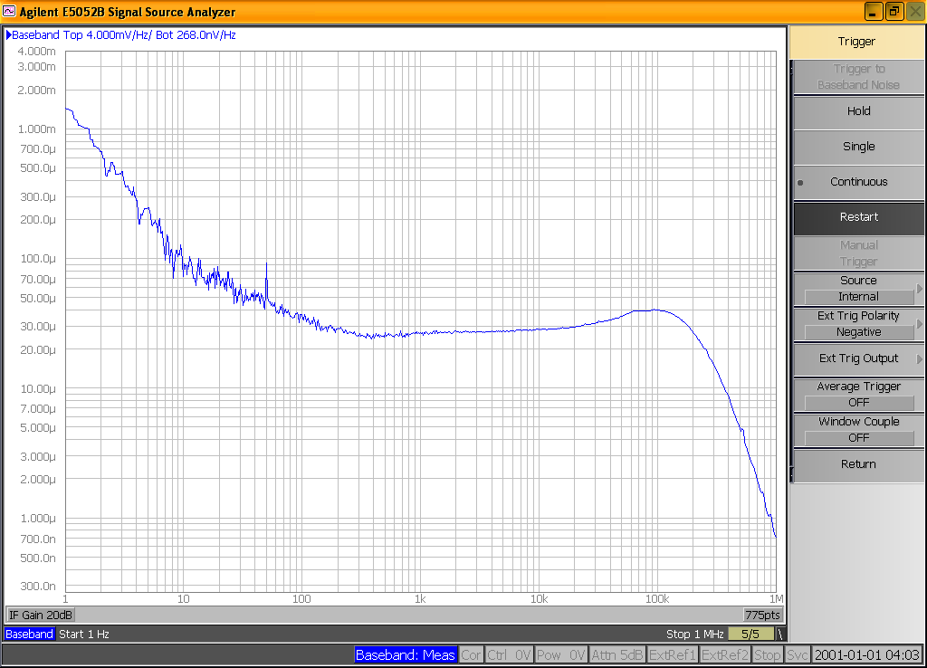
Output (after 40 Db amplification
1/f corner noise at 100 Hz

Slide 7
What do we see on the scope?
RMS about 1.4 mV

Slide 8
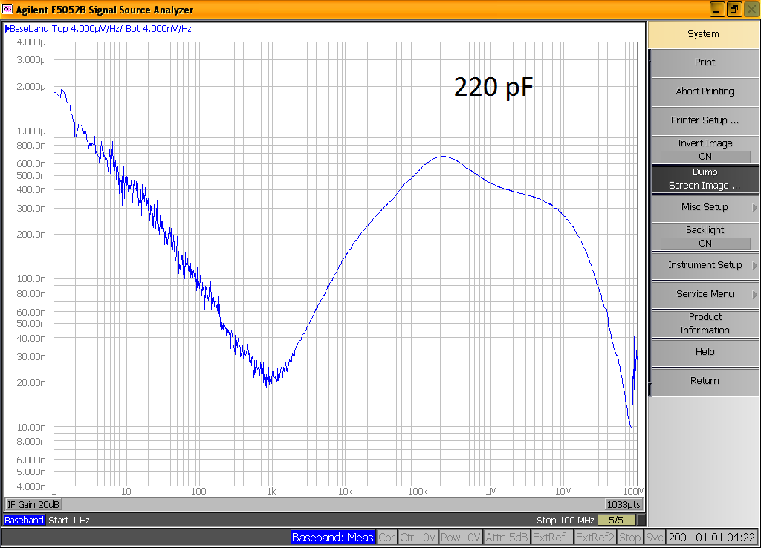
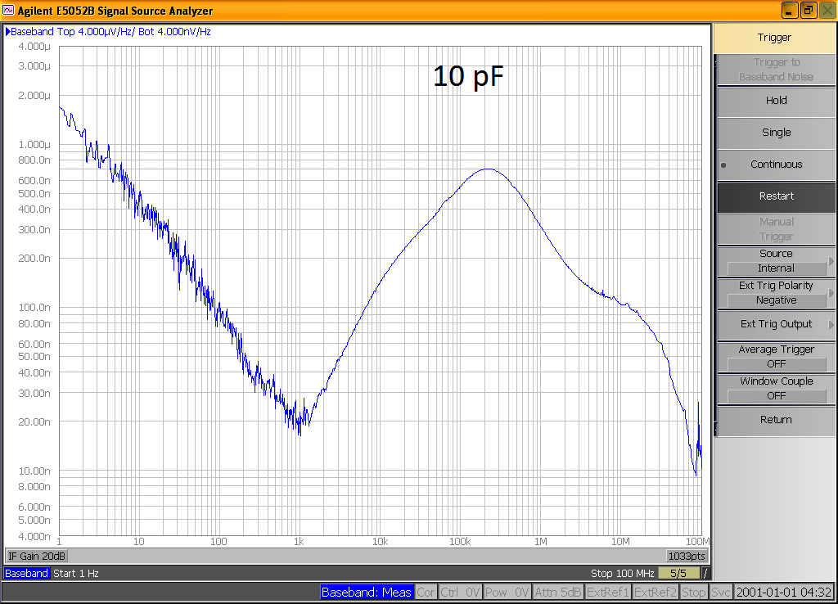
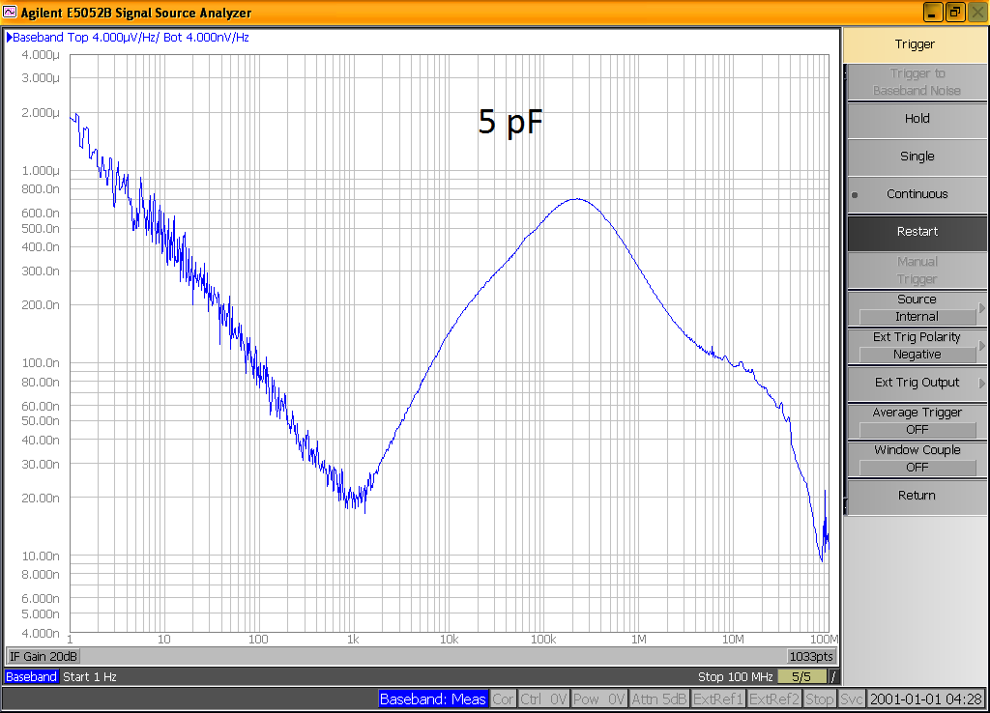
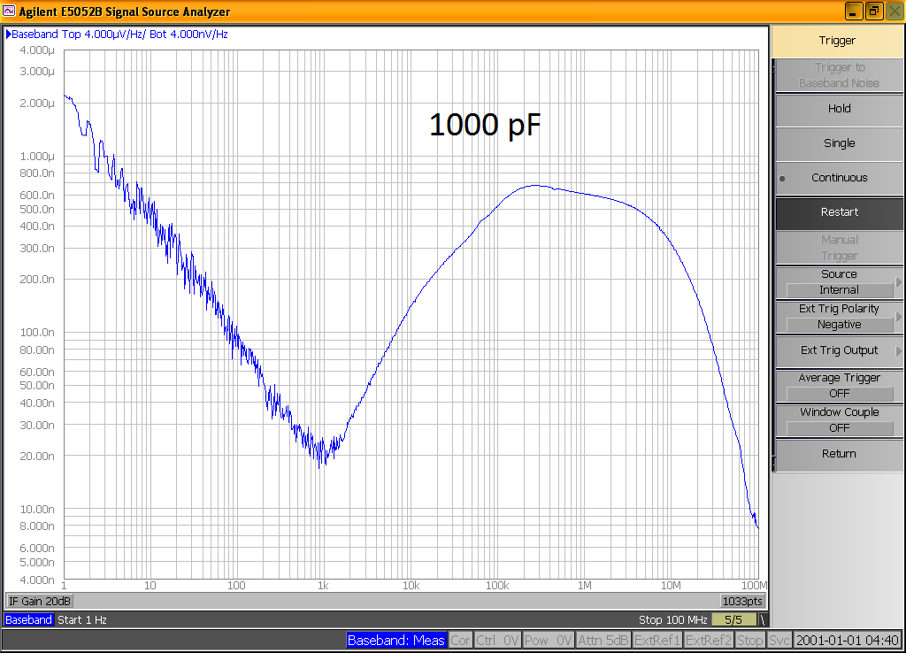
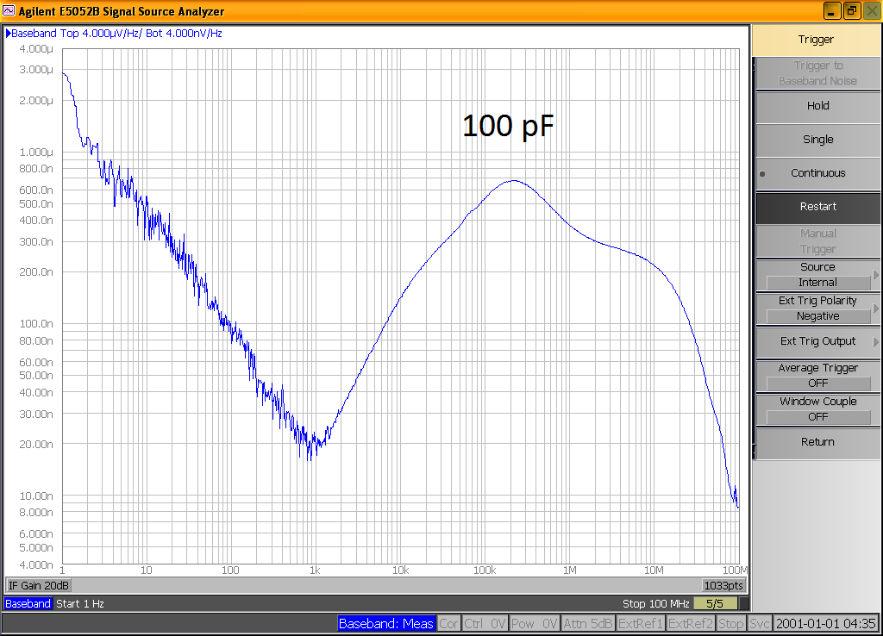
What does it happen when we load the pre-amp input?

Slide 9
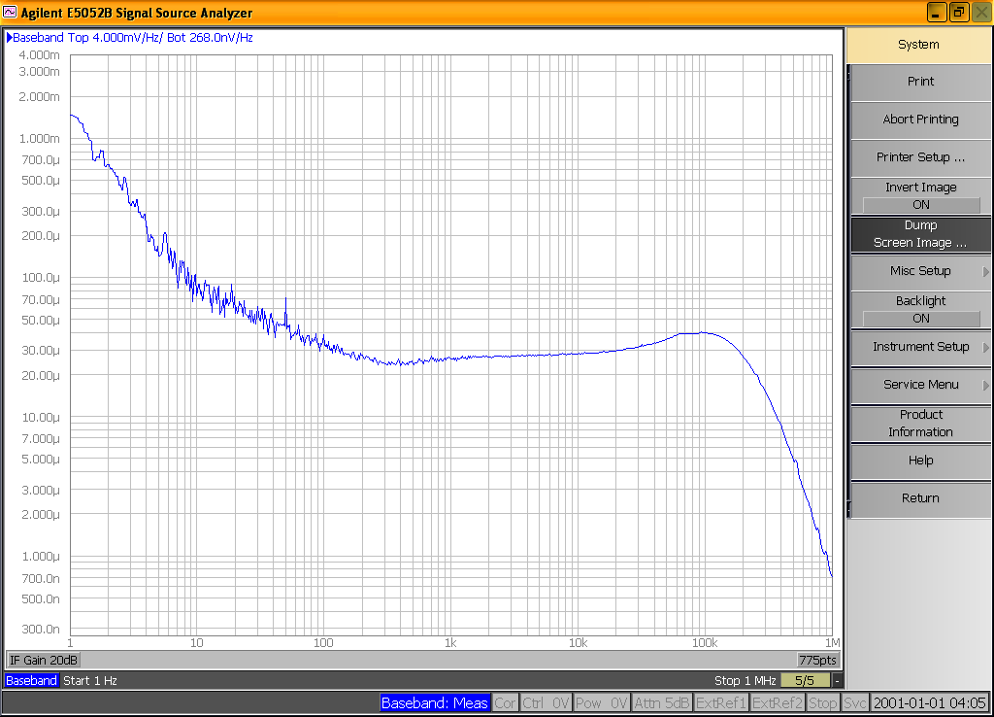
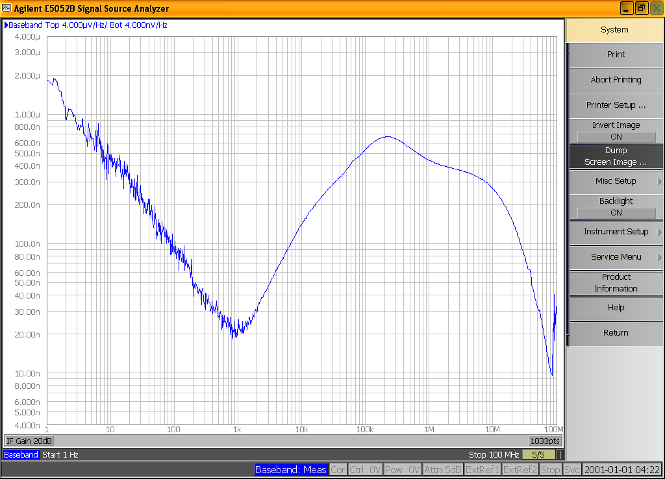
Summary
Digital scope mesurement
1/f noise spectrum after 40 dB amlification

Slide 10
Problem: how to compare scope measurement with spectrum analyser ones?
First of all: scope measurement are «integrated» in the all frequency
range.
Noise power distribution affects a broader frequency range.
Nevertheless if we integrate the noise spectrum in the frequency range the amplifier normaly works we should find similar values.

Slide 11
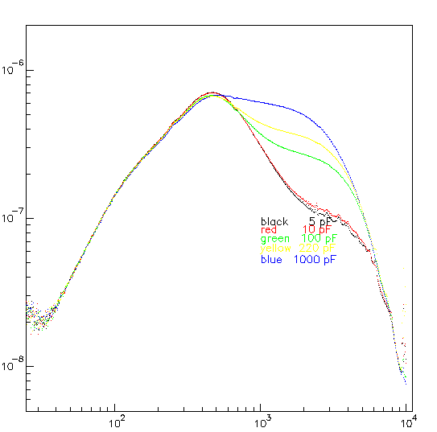


Noise spectra studies
V/$\sqrt{ν}$
Noise distribution
Here we completely drop the 1/f contribution from
data. We’ll integrate every spectrum in different
Range from 1kHz to 1 MHz and compare with the
scope measured RMS.
$$\sqrt{ν}$$

Slide 12
Integral noise R.M.S.

Slide 13
Conclusion
Noise spectra have been measured in all the interesting frequency range.
We now know the noise power distribution of the amplifier and its shape as a function of the «load».
There is agreement between scope meassured integral noise distribution and it’s «integral» as derived from the measured distribution.

