Slide 1


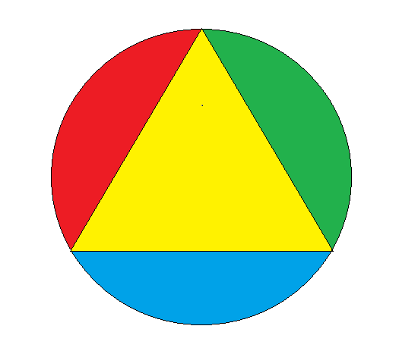


VOXES, a new high resolution X-ray spectrometer for low yield measurements in high background environments
X
O
E
S
Alessandro Scordo
Laboratori Nazionali di Frascati, INFN
Workoshop “Developement of novel detectors at LNF”, Frascati, 14-06-2016

Slide 2
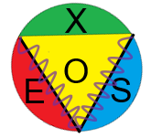
Project’s goal
Ultra high resolution (few eV) measurements of the X rays (2-20 keV) emitted in various processes is strongly demanded in: particle and nuclear physics, fundamental science, astrophysics, biology, medical and industrial applications
Additionally, the realisation of such X-ray detector systems able to work in high background environments is badly needed.
VOXES’s goal: to develop, test and qualify the first prototype
of ultra-high resolution and high efficiency X-ray spectrometer in
the range of energies 2 - 20 keV using HAPG bent crystals in the
von Hamos configuration able to work in high background environments
Grant Giovani CSN-5 (INFN) n. 17367 (2015)

Slide 3
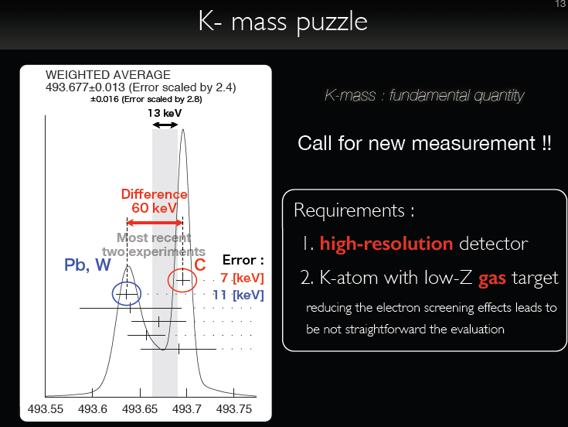
An example: the K⁻ mass puzzle
K⁻ mass is a fundamental quantity in physics
to reduce the electron screening effect
Needs precision below 0.1 eV!

Slide 4

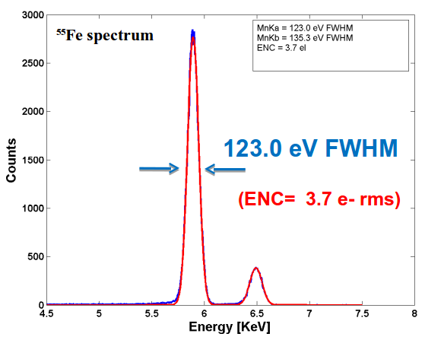
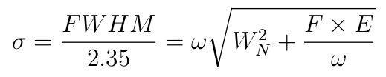
Commonly used detectors for X-rays in the range 1-20 keV are the Solid State Detectors (CCD, SDD, etc…)
However…
The solid state detectors have intrinsic resolution (FWHM ~ 120 eV at 6 keV) given by the electronic noise and the Fano Factor
Presently, to achieve ~ 1 eV resolution, two options are available:
Transition Edge Sensors (TES)
Crystals and CCDs (Bragg spectrometers)

Slide 5

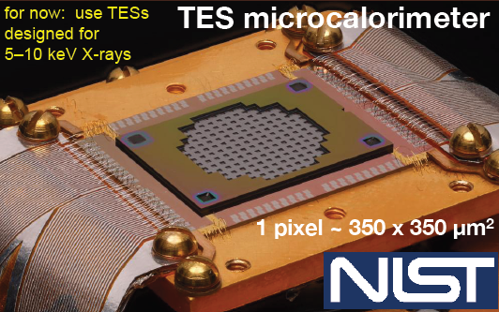
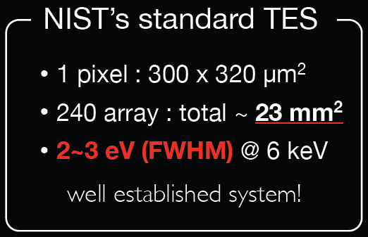
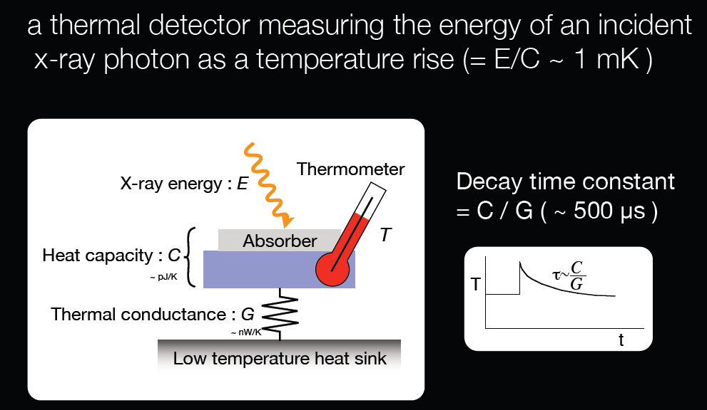
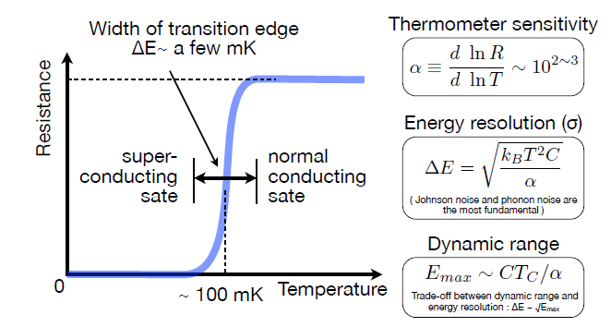
Transition Edge Sensors (TES).
Excellent energy resolution (few eV at 6 keV)
LIMITATIONS:
not optimised for E < 5 keV
very small active area
prohibitively high costs
rather laborious use (complex cryogenic system needed)
T_{C} ~ 50 mK !!!

Slide 6

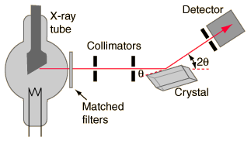
High resolution can be achieved depending on the quality of the crystal and the dimensions of the detectors
Geometry of the detector determines also the energy range of the spectrometer
But….
Crystals response may not be uniform (shape, impurities, ecc.)
Lineshapes are difficult to be measured within few eV precision (surface scan)
In accelerator environments particles may hit the detector
Background reduction capability is mandatory
Limitation in efficiencies

Slide 7
VOXES: the 3 pillars
Integrate :
(1) focusing properties of the von Hamos scheme with the
(2) high efficiency and resolution of HAPG mosaic crystals and
(3) use triggerable detectors to dramatically reduce
background in a new detector system capable to perform

Slide 8

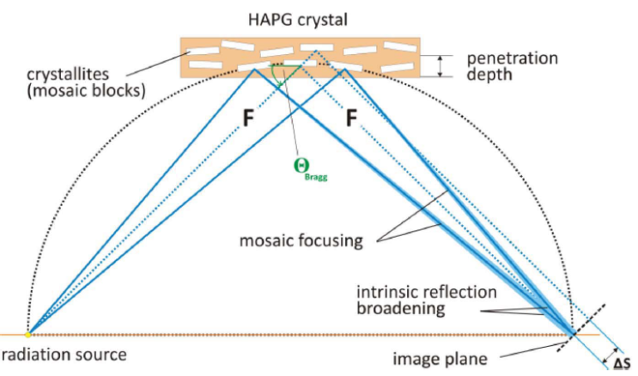
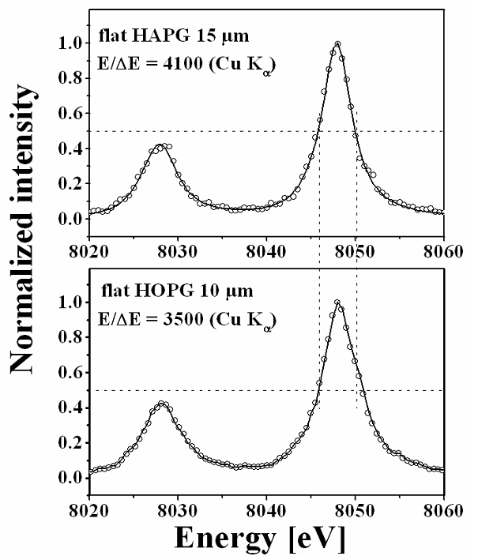
Mosaic crystal consist in a large number of nearly perfect small crystallites.
Mosaicity makes it possible that even for a fixed incidence angle on the crystal surface, an energetic distribution of photons can be reflected
Increase of efficiency
(focusing) ~ 50
Loss in resolution
Pyrolitic Graphite mosaic crystals (d = 3.354 Å):
Highly Oriented Pyroliltic Graphite (HOPG)
Highly Annealed Pyrolitic Graphite (HAPG)
Resolution of E/∆E=7000 for (004) reflection at 15 µm HAPG film @ 8 keV (1,1 eV)
flexible HAPG has twice higher spectral resolution, while flexible HOPG – approximately twice higher reflectivity

Slide 9

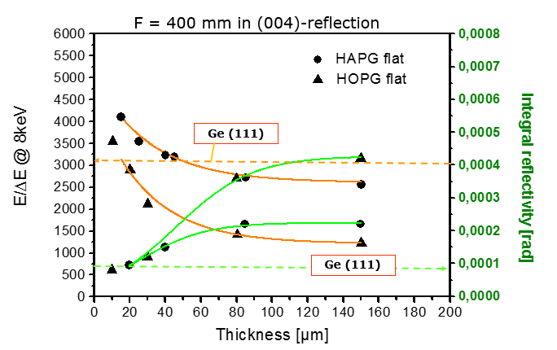
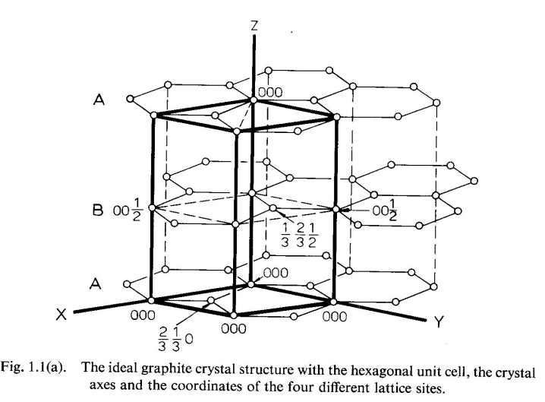
Production
Thermo cracking of CH₄
on heated substrate at T=2100ºC
Pyrocarbon d₀₀₂=3,44Å, mosaicity 30º
Annealing under pressure at T>2800ºC
Pyrographite:
HOPG d₀₀₂=3,356-3,358Å, mosaicity <1º
HAPG d₀₀₂=3,354-3,356Å, mosaicity <0.1º

Slide 10
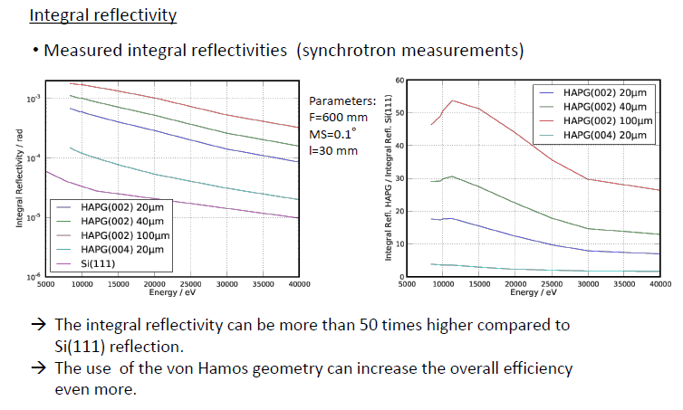

Slide 11
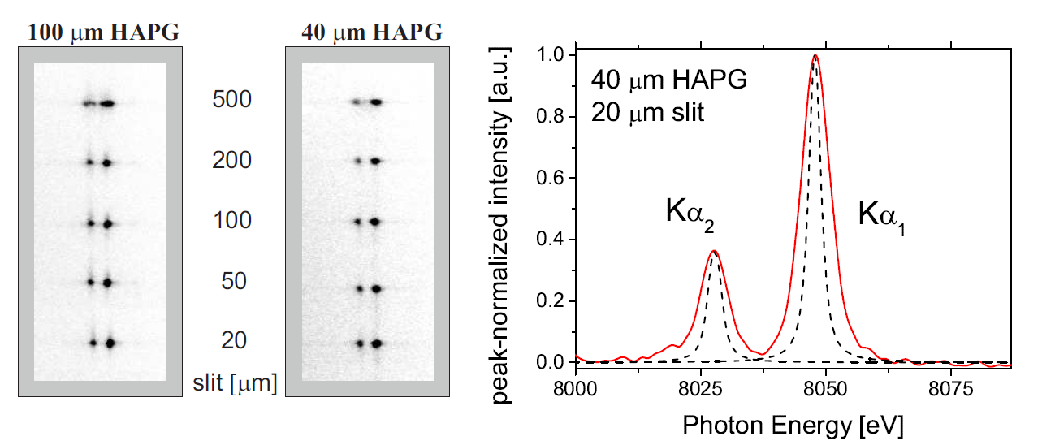
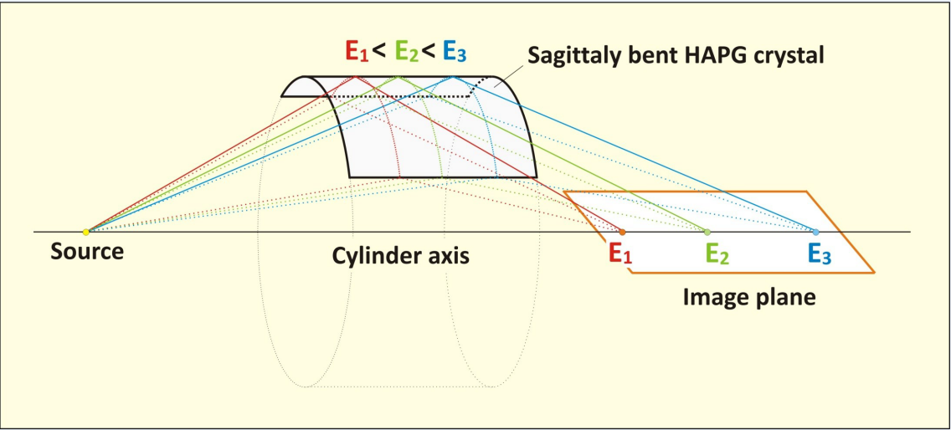
Already tested with 500 μm slits
VOXES wants to go further
Bending does not influence resolution and intensity
Mosaic spread down to 0.05 degree
Integral reflectivity ~ 10² higher than for other crystals
Variable thickness (efficiency)
Excellent thermal and radiation stability
Von Hamos configuration: Cylindrically bent crystal combines mosaic focusing in diffraction plane with sagittal focusing.
E/∆E & efficiency are one order of magnitude better than expected from the crystal mosaicity only

Slide 12

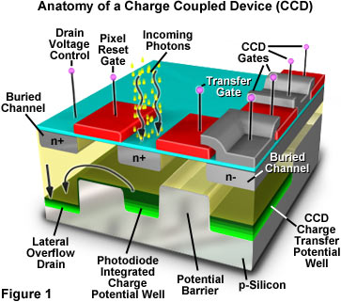
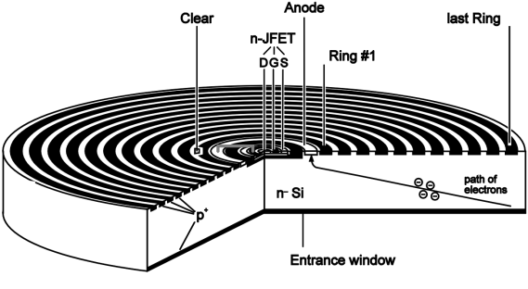
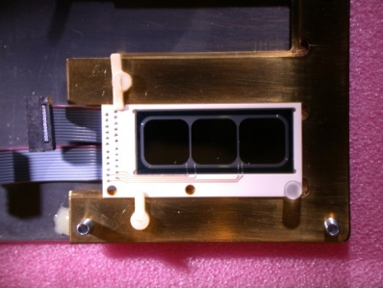
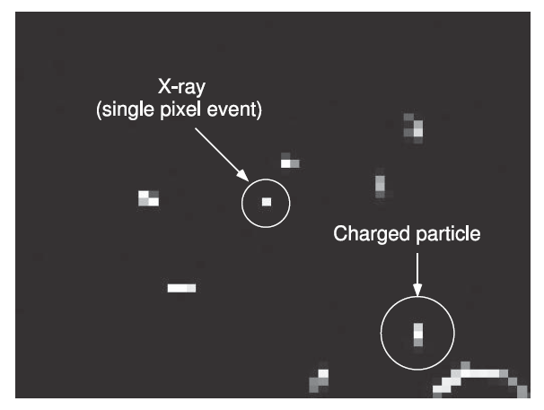
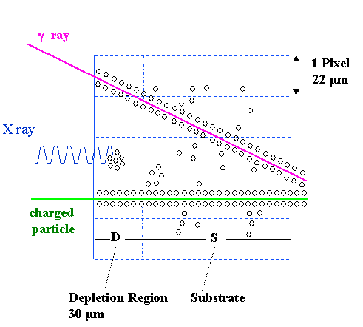
In accelerators (and not only) environment experiments, X-rays have to be discrimated from charged particles on the detector
CCD:
Background reduction with an algorithm based of the number of fired pixels
SDD:
Background reduction thanks to trigger capability
Already used in the SIDDHARTA experiment giving a factor 10⁵ reduction factor
Even better

Slide 13

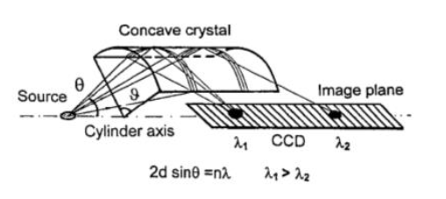
HAPG optics in VH geometry allows:
To reach energy resolution at the level of eV in a broad X rays energy range (2 – 20 keV)
To get efficiencies ~10² than for any other crystal in the flat geometry
To develop a compact spectometer, with moderate cost, which could be easy moved and installed at a new place
The von-Hamos focusing geometry gives high collection efficiency:
e_{vH}/e_{flat} ~ Rθ/a
radius of curvature angular aperture source size
Source size can be increased playing with the R of the crystal allowing high efficiency for larger sources

Slide 14

The research activity aims to the construction of an X-ray spectrometer, consisting in three von Hamos spectrometers (VH units), each optimised for a specific energy range, E1<E<E2 and it will be realised in two phases:
Additionally:
Implement a strategy for the kaonic helium and kaon mass measurements at DAFNE or at JPARC using SDDs.
Organise a dedicated workshop where to invite representatives of the potentially interested companies/industries and other interested users
Second phase:
Mcarlo simul. design, and construction of the final VOXES system prototype: 3 VH units
Use of SDDs
Final Slow Control & DAQ software
Debug, test and calibration @ LNF
Pionic helium measurement at PSI
AIM: VOXES qualification by the measurement of the pionic helium X-ray lines @ PSI with:
FWHM < 5 eV
efficiencies ~10² than for previous
measurements (VH, HAPG, SDD)
First phase:
R&D on HAPG and optimisation
Detailed Monte Carlo simulations
Single VH unit design and construction
System debug and characterisation in the
laboratory, using targets activated by an
X-ray tube
AIM: optimize the acceptance (source size) and energy resolution

Slide 15

The VOXES final prototype will consist in 3 VH units:
10.6 keV -> πHe
4.5 keV -> Ti (calib)
15.8 keV -> Zr (calib)
E ~ 16 keV
θ_{B}~ 7 ° (n=1)
θ_{B}~ 13 ° (n=2)
circular rail to collect the different Bragg angles
HAPG-SDD/CCD unit rotate on its central axis to optimise the X-ray collection and focusing.
E ~ 10.6 keV
θ_{B}~ 10 ° (n=1)
θ_{B}~ 20 ° (n=2)
E ~ 4 keV
θ_{B}~ 27 ° (n=1)
θ_{B}~ 67 ° (n=2)
Target
Target:
Ti, Cu, Br, Zr foils + X-ray
tube (calibration and test)
Cryogenic targets for πHe
HAPG
CCD / SDD
Signal X-Rays
Reflected X-Rays
Rails

Slide 16

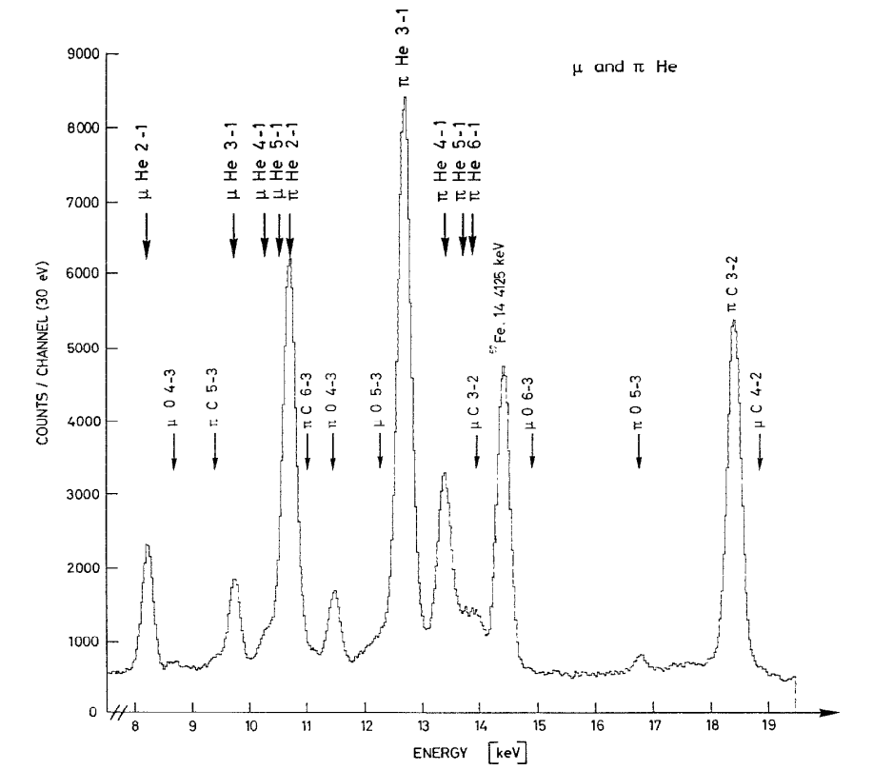
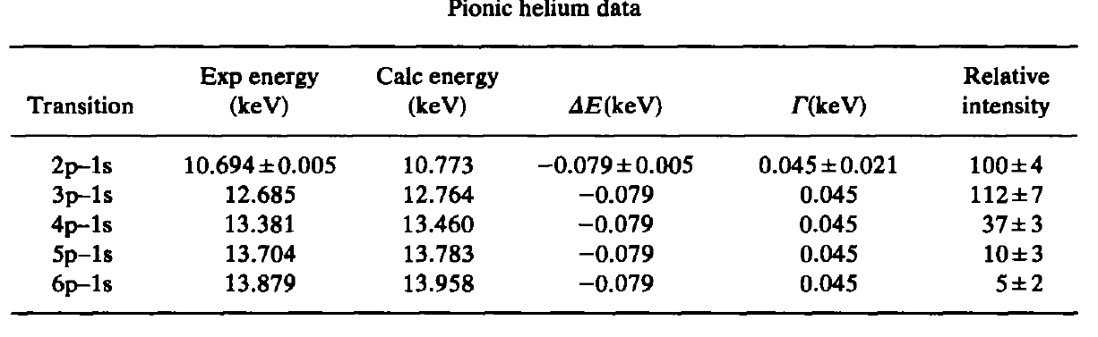
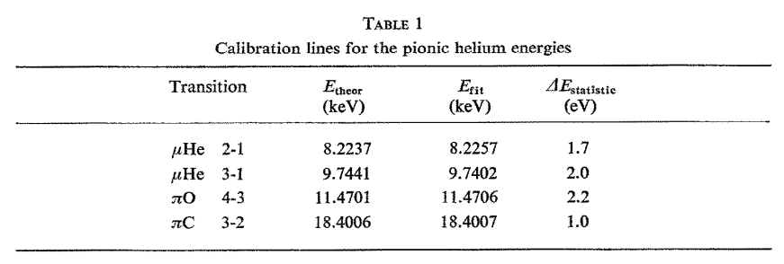
Useful to understand low energy QCD (non-perturbative region)
Few (and old) precision measurements of pionic transitions in light elements showed that the experimentally determined energy shifts and widths of the 1s level due to strong interaction effects do not agree with theoretical models
πHe is particularly interesting because the helium nucleus is small and the nucleons are tightly bound
Old Si(Li) experiment (Batty, 1979)

Slide 17
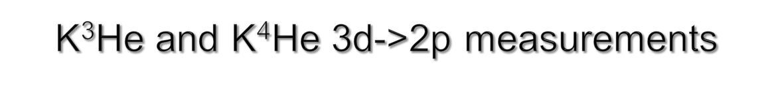
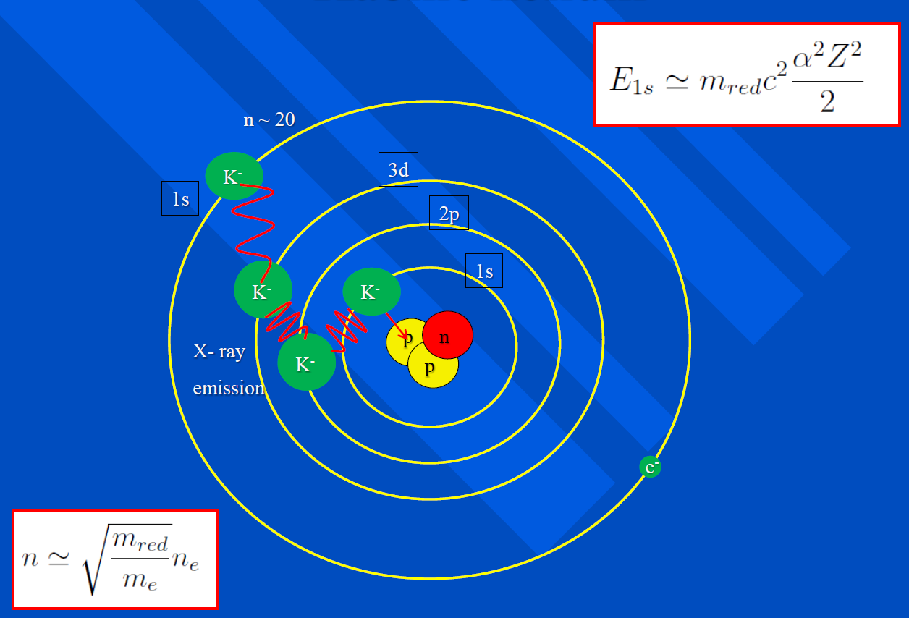
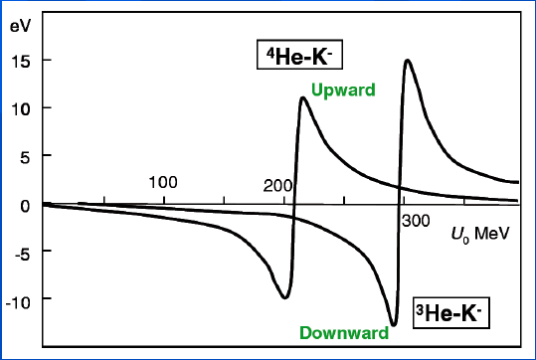
Kaonic helium is formed when a K- is captured in the electron orbit
It down cascades toward the lowes levels emitting X-rays
To test the influence of the strong interaction the energy a precise measurement of the line shift and width of the 3d->2p transition is needed
The discrepancies between different theoretical models and approaches could be eliminated with ~ 1eV precision measurement
Best measurements (SIDDHARTA):
ε Γ
⁴He +5 ±3 (stat.) ±4 (syst.) 14 ±8 (stat.) ± 5 (syst.)
³He −2 ±2 (stat.) ±4 (syst.) 6 ±6 (stat.) ±7 (syst.)
New measurements are needed

Slide 18

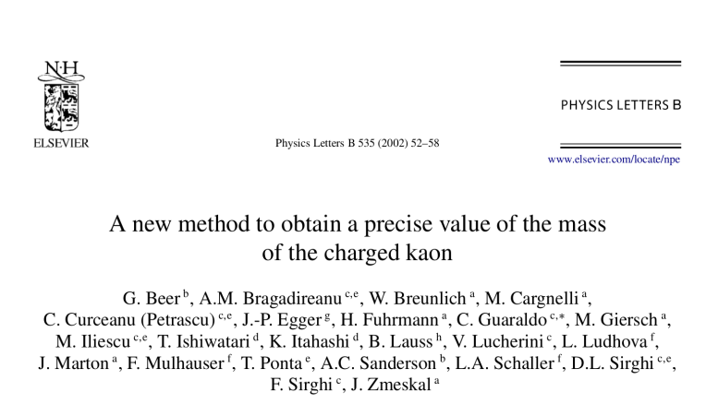
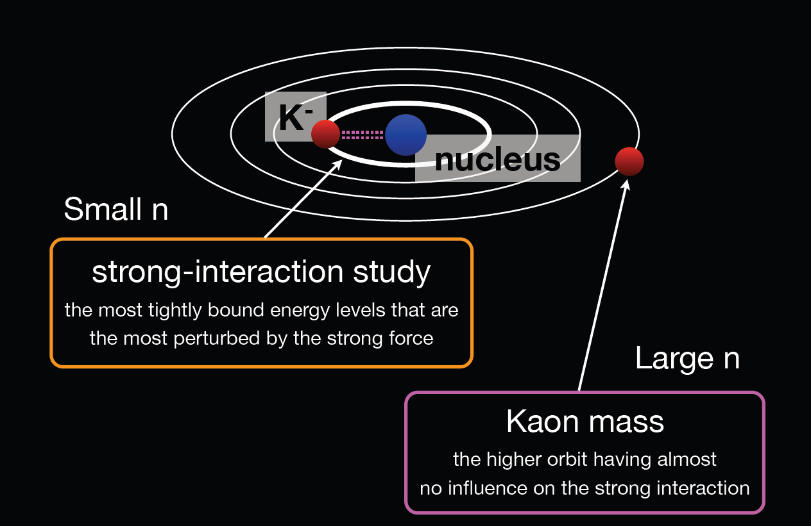
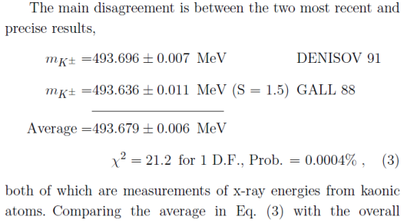
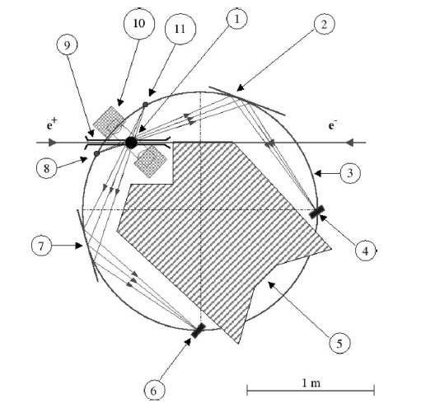
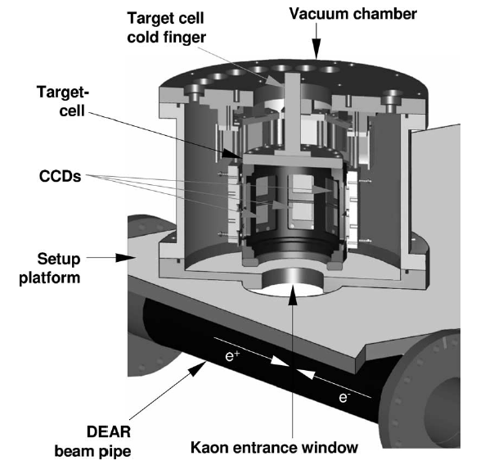
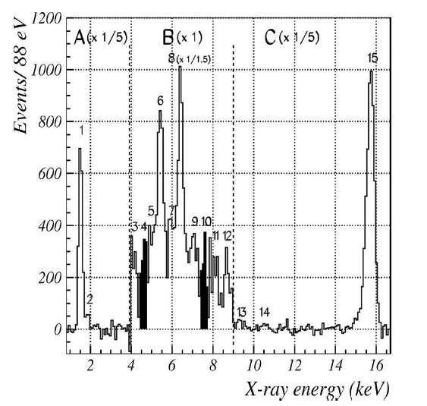
(6→5) kaonic nitrogen transition: 7560± 32 eV,
(7→6) kaonic nitrogen transition: 4589± 37 eV.
http://pdg.lbl.gov/2015/reviews/rpp2014-rev-charged-kaon-mass.pdf
Exploratory test with DEAR @ DAΦNE
Not yet performed
Calculated efficiency ~ 400 times less than @ DAFNE
Un-efficient background reduction (statistics loss)

Slide 19

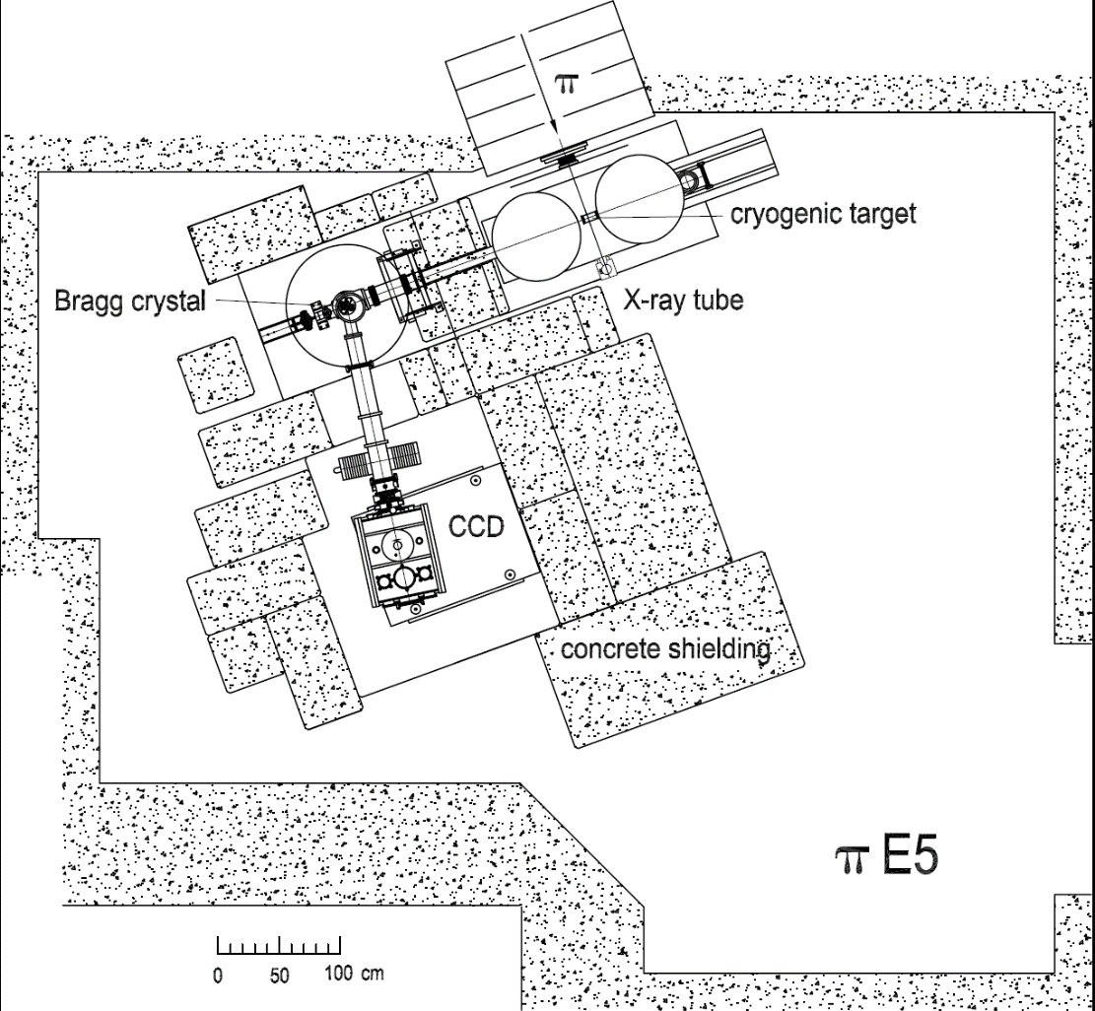
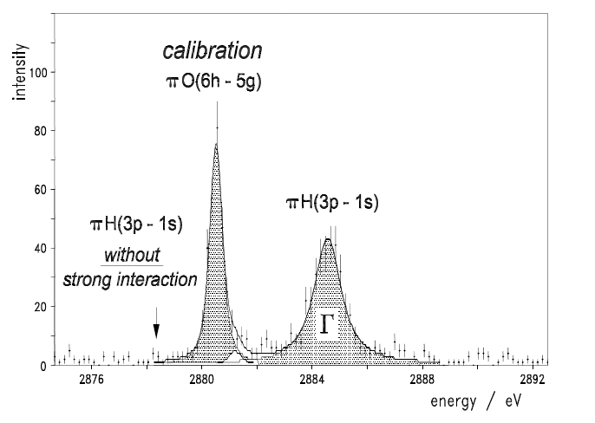
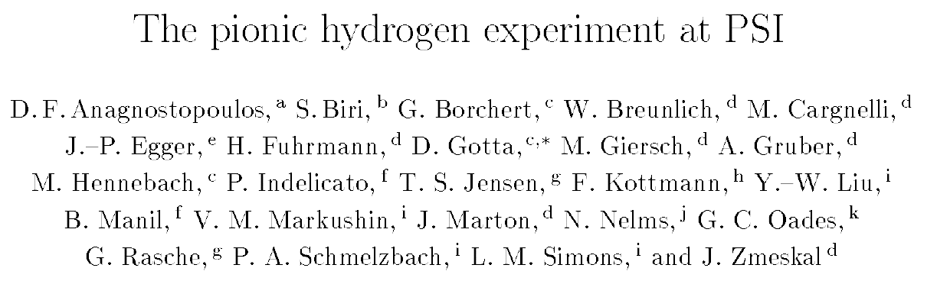
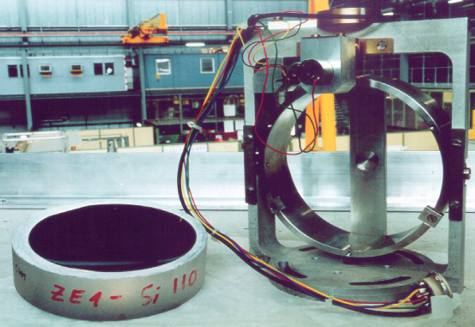
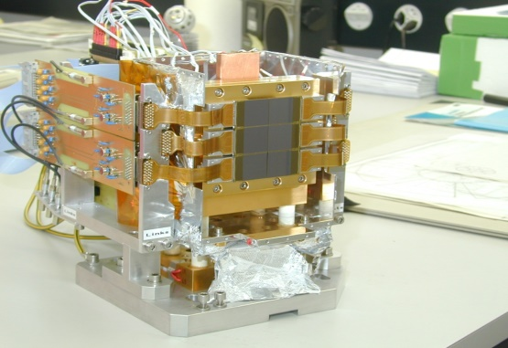
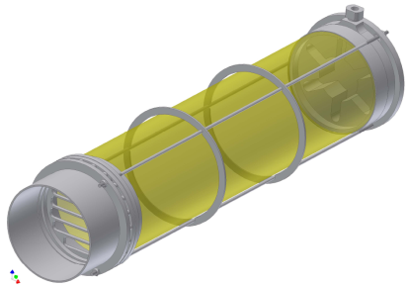
High precision values for the hadronic shift
and width of the 1s ground state of pionic hydrogen
Goal:
ε ~ 7 eV
Γ ~ 1 eV
high pion flux in πE5 at PSI
p_{π}=112 MeV/c, ~ 10⁹ π⁻/s
Light weight cryogenic target
for wide density range
spherically bent Bragg crystals (Silicon)
position sensitive X-ray detection with CCD array:
CCD-22 (600x600 pixel) in 2x3 matrix,
background reduction by shielding and pixel analysis
calibration lines (pionic oxygen) measured in parallel
Problems in the Γ measurement:
Too low rate to obtain results on the response lineshape of the spectrometer !

Slide 20
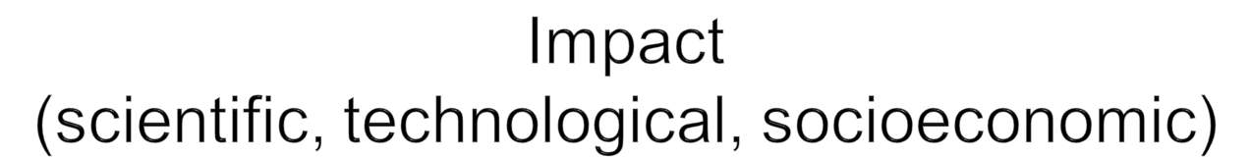
Medical Applications
(Mammography)
FAIR
(exotic atoms)
HAPG technology development
JPARC
(K-atoms)
X
PSI
(π-atoms)
E
O
S
Particle and Nuclear Physics
X-ray spectroscopy (DAΦNE-Luce)
DAΦNE
(K-atoms)
LNGS
(PEP)
Industry, art and Safety: Elemental Mapping
Foundations:Quantum Mechanics

Slide 21
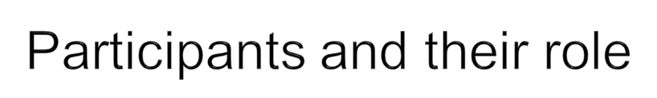
SMI
LNF
LNF
OPTIGRAPH
Mechanical setup &
SlowControl & DAQ
Vacuum and cryogenic for target and detectors
LNF
Crystals optimization and construction
POLIMI&FBK
Detectors & electronics assembly
LNF
Final VOXES prototype
LNF
SMI
Single VH unit
SMI
DATA analysis
DATA analysis and publications
Laboratory tests
Pionic atoms measurement at PSI
Coordinating Unit: LNF-INFN
Duties: DAQ, detector assembly and tests
Optigraph
Duties: HAPG design (MC) & production
SMI-Vienna
Duties: cryogenic and vacuum systems, mechanics design and realisation, detector assembly and tests
Politecnico Milano & FBK
Duties: Detectors & electronics

Slide 22
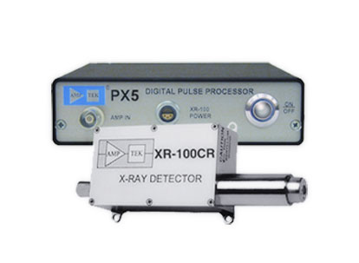
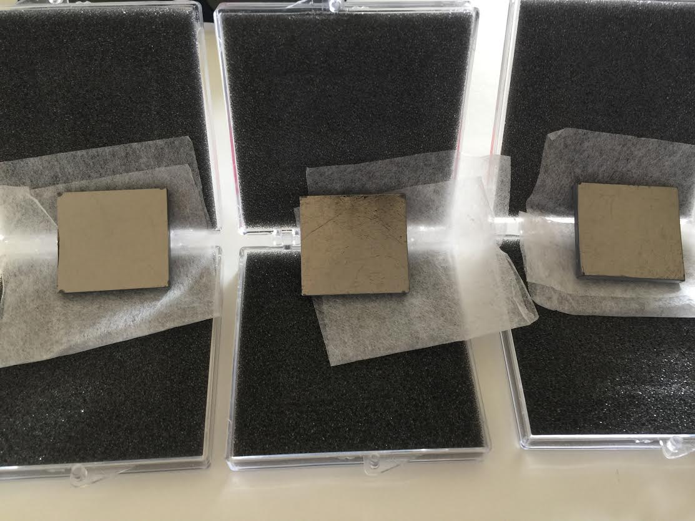
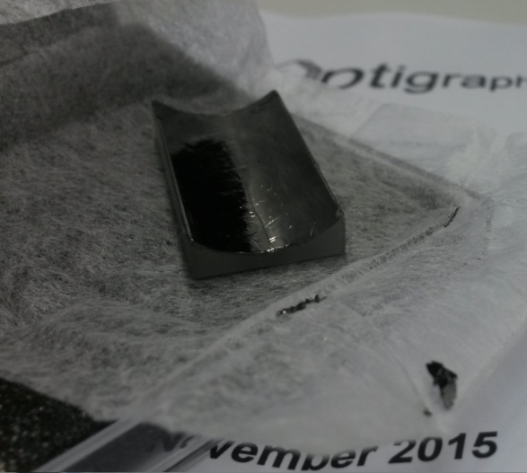
Starting VOXES:
first tests with HAPG crystals
First stage measurements (efficiency):
Ti, Cu, Br, Zr (activated with X-Ray tube)
Direct detection with a XR-100CR Si-PIN X-Ray Detector
Different ρ crystals (10.6 mm & 206.7 mm) → efficiency
Different thickness (20,40,100 μm) → efficiency
ρ = 10.6 mm
100 μm
ρ = 206.7 mm
20 μm
ρ = 206.7 mm
40 μm
ρ = 206.7 mm
100 μm

Slide 23
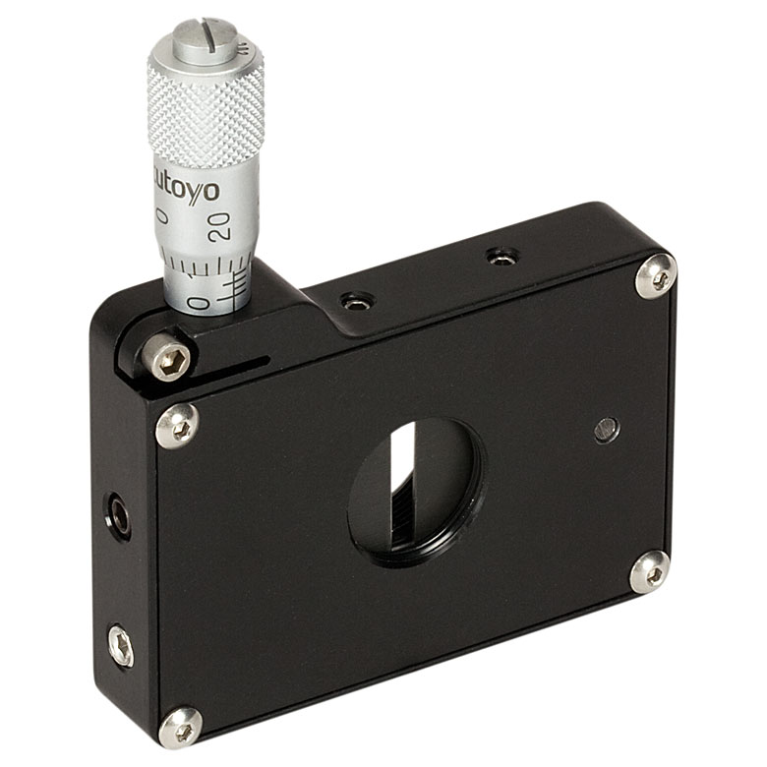
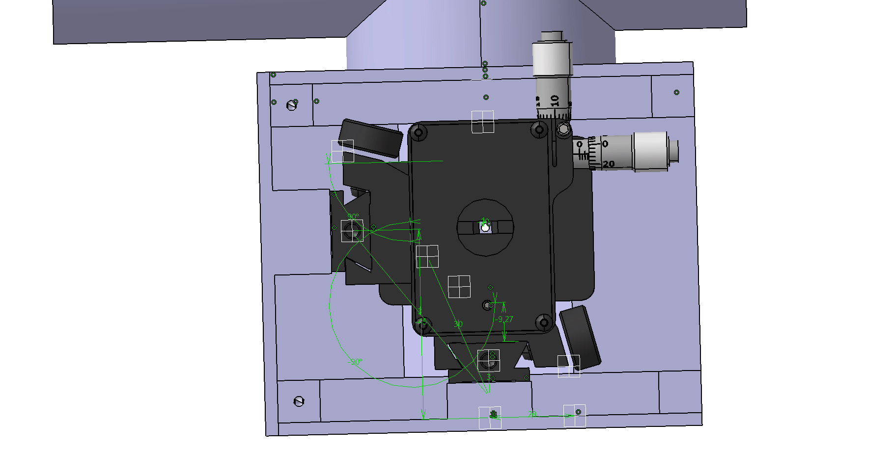

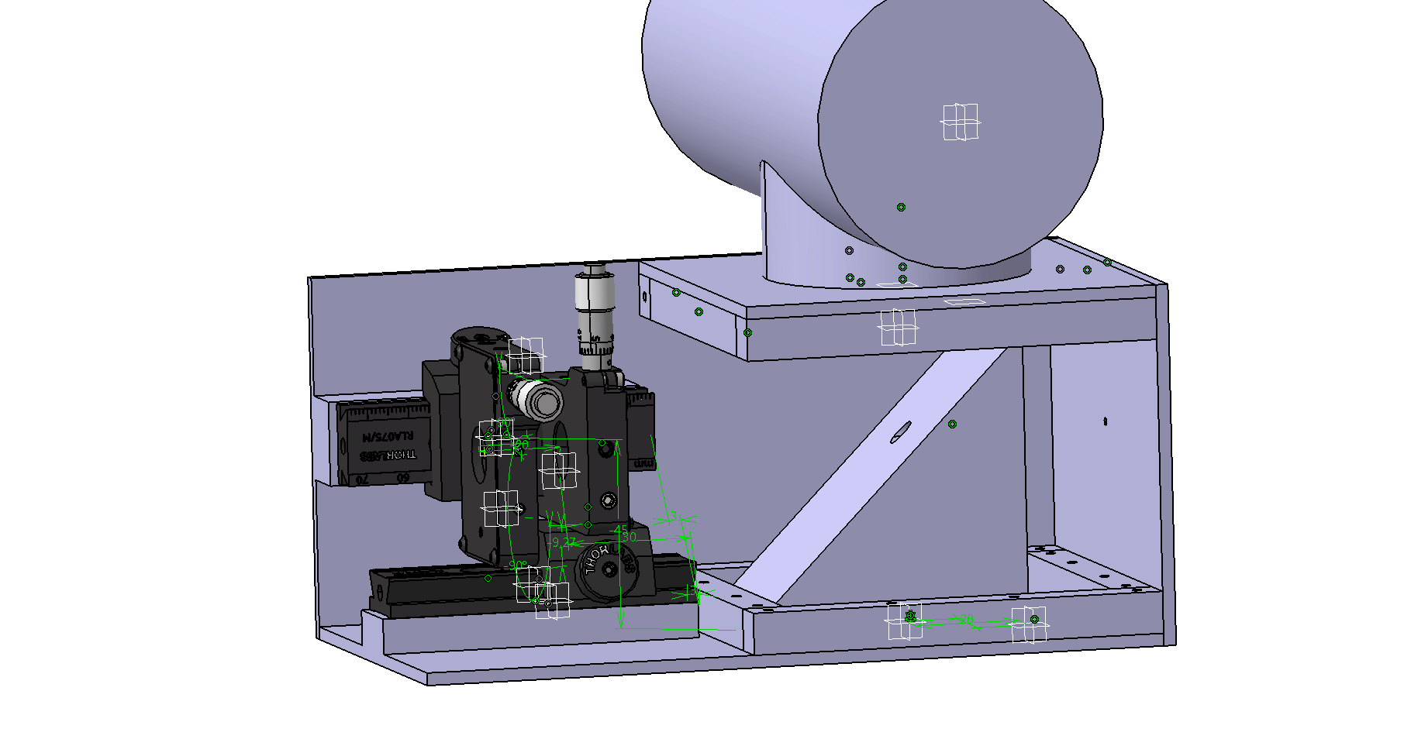
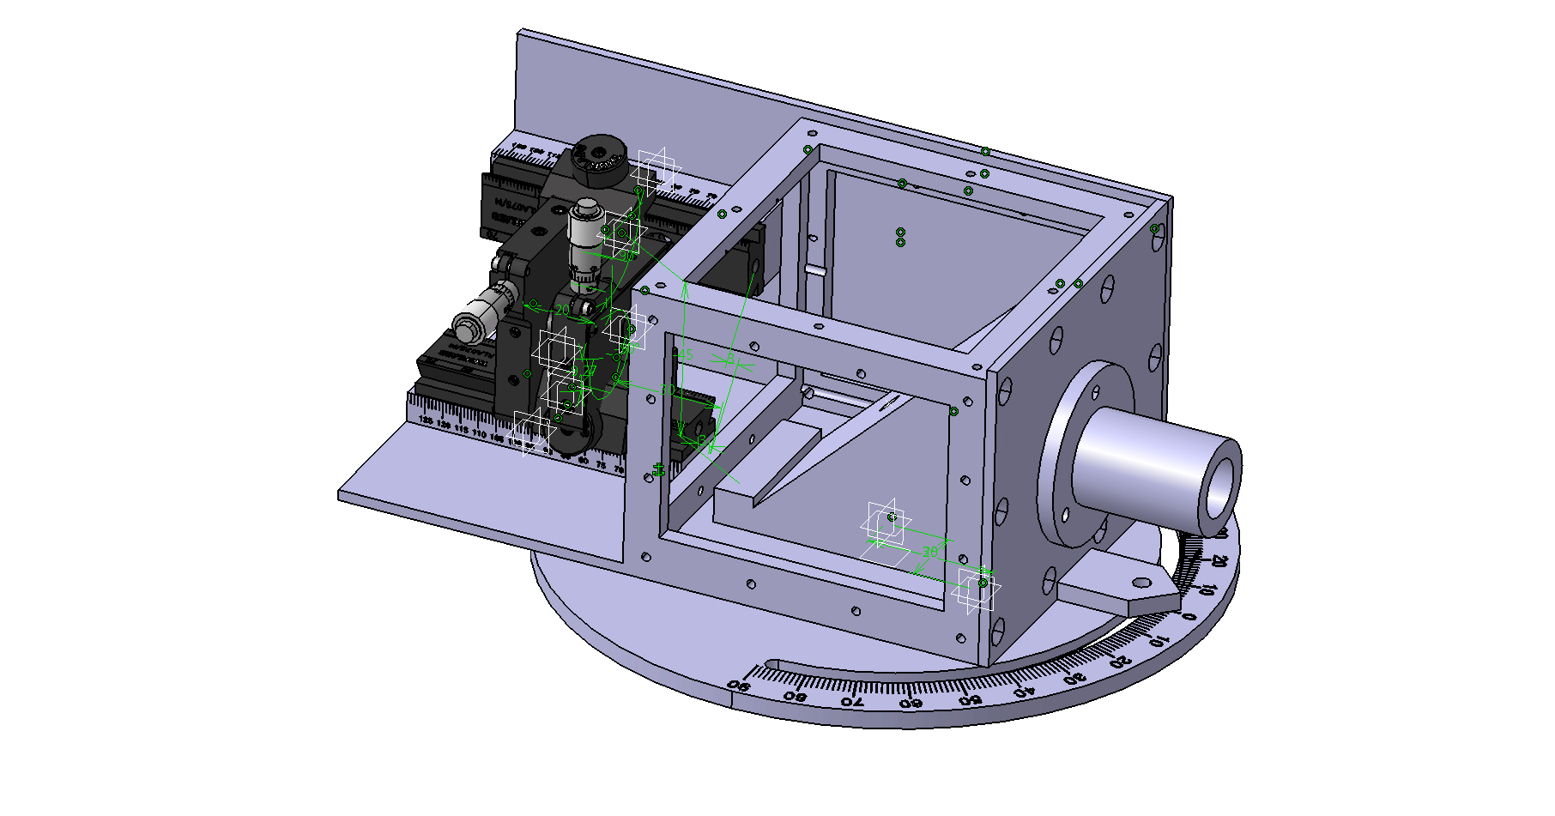


Starting VOXES: test Setup
Designed by Nicola Intaglietta
LNF services

Slide 24




Starting VOXES: test Setup
Printed with the 3D printer @ LNF

Slide 25



Location for VOXES development
Laboratory equipped with optical bank @LNF
Bunker for radioactive sources @LNF
Inside the bunker

Slide 26

VOXES develops an innovative ultra-high resolution X-ray spectrometer
prototype, badly needed in various fields of research and technological
applications
To achieve its goal VOXES sets up a highly qualified multi-disciplinary international network, with contacts with the world-leader producer of HAPG (Optigraph)
VOXES introduces a new technology in INFN, having high potential for
applications inside INFN (DAΦNE-Luce, SIDDHARTA, VIP@LNGS) and in
external facilities (JPARC, PSI, FAIR), in strong contact with world-leader
institutes (PoliMi, SMI, FBK) and crystals producer (Optigraph)
VOXES will realise a feasibility demonstration through a preliminary measurement with high scientific impact (pionic helium at PSI)
Thank you for the attention

